Slide 1
Latest Developments in NGS
PLSC
Survey Summit
March 3, 2012

Slide 2
Agenda
Improvements in the NSRS
MultiYear CORS Solution ->NAD83 (2011)
Geoid12
New Data Sheets
DS-World
OPUS
CDOT CORS/OPUS Team Efforts
GRAV-D
CBLs
LOCUS
RTN
NGS Advisor Program
New Datums (2022)
CHANGE
Improvements

Slide 3
NGS
National Spatial Reference System(NSRS) Improvements
TIME NETWORK LOCAL
NETWORK SPAN ACCURACY ACCURACY
NAD 27 1927-1986 10 meter s (1 part in 100,000)
NAD83(86) 1986-1990 1 meter (1 part in 100,000)
NAD83(199x)* 1990-2007 0.1 meter B-order (1 part in 1 million)
HARN A-order (1 part in 10 million)
NAD83(NSRS2007) 2007 - 0.01 meter 0.01 meter
(CORS)
CHANGE
IMPROVEMENTS
* CO was completed and adjusted in 2007

Slide 4
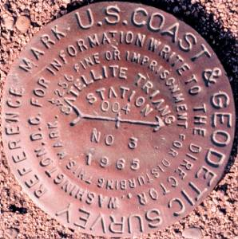
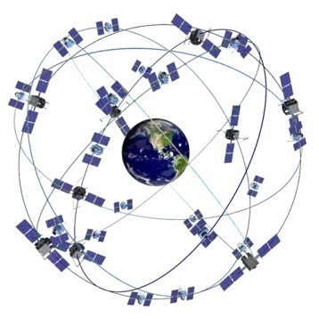
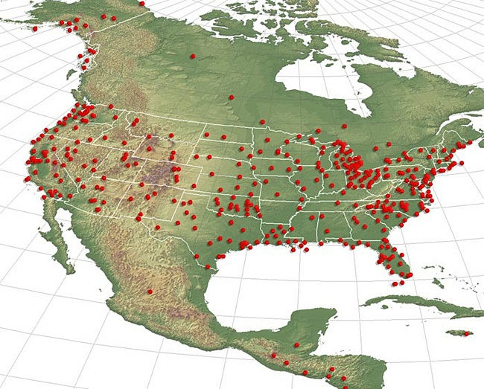

National Spatial Reference System (NSRS)
The NSRS is a consistent coordinate system that defines latitude, longitude, height, scale, gravity, and orientation throughout the United States.
One common datum
Evolving from passive → active →
real-time augmentations
Notes:
NGS provides users with a consistent national coordinate system, which includes:
Latitude
Longitude
Height
Scale
Gravity
Orientation

Slide 5
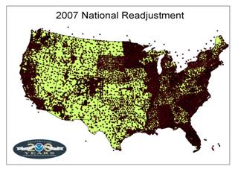

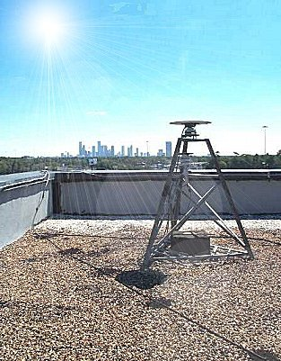
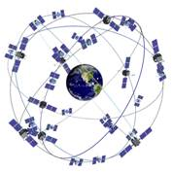
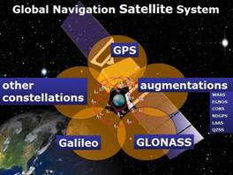
The NSRS has evolved
1 Million Monuments
(Separate Horizontal and Vertical Systems)
70,000
Passive Marks
(3-Dimensional)
→
Passive Marks
(Limited Knowledge of Stability)
1,500 CORS
(Time Dependent System Possible;
4-Dimensional)
→
GPS CORS → GNSS CORS

Slide 6
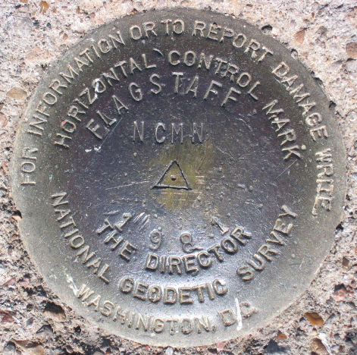
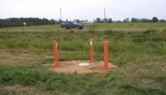
“PASSIVE” NETWORK marks in the ground
1.5 million marks in the
National Geodetic Survey database
NSRS
These marks provide:
Horizontal position, or
Horizontal position and ellipsoid height, or
Orthometric Heights, or
Both Horizontal and Vertical values
Tidal Information

Slide 7
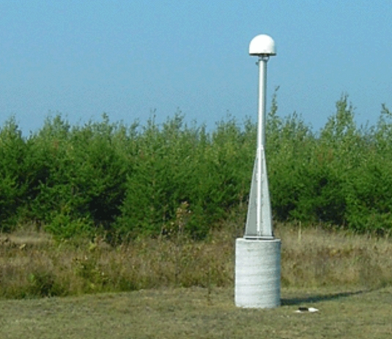
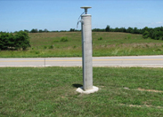
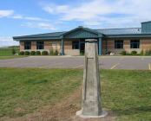
“ACTIVE” Geodetic Network
Continuously Operating Reference Stations
CORS
NSRS

Slide 8
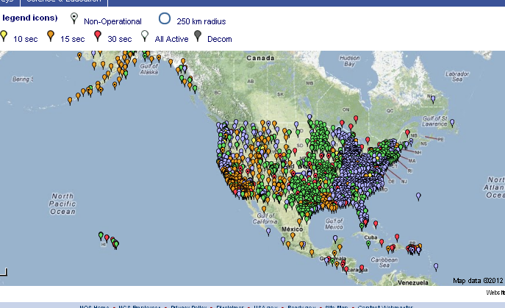
CORS

Slide 9
NAD83 (2011) and the
MultiYear CORS Solution
Previous/Current Reference Frame
NAD 83(CORS96)
Epoch 2002.00
ITRF00
New Reference Frame
NAD 83(2011)
Epoch 2010.00
IGS08
Epoch of Observation

Slide 10
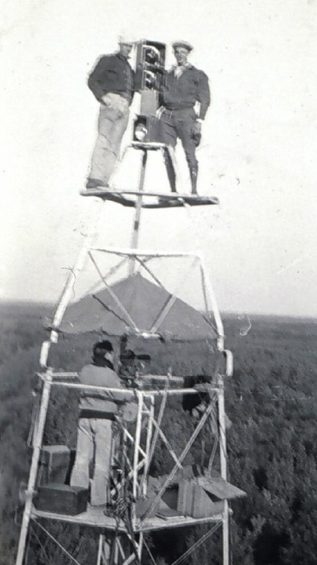
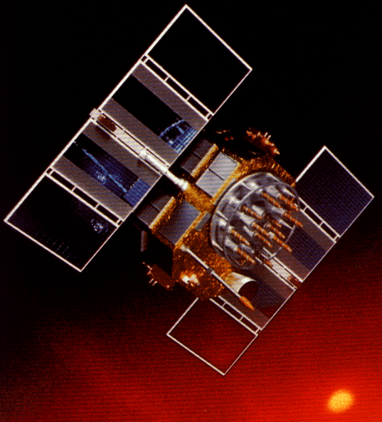
A (very) brief history of NAD 83
Original realization completed in 1986
  Consisted (almost) entirely of classical (optical) observations
“High Precision Geodetic Network” (HPGN) and “High Accuracy Reference Network” (HARN) realizations
  Most done in 1990s, essentially state-by-state
  Based on GNSS but classical stations included in adjustments
National Re-Adjustment of 2007
  NAD 83(CORS96) and (NSRS2007)
  Simultaneous nationwide adjustment (GNSS only)
New realization: NAD 83(2011) epoch 2010.00

Slide 11
Multi-Year CORS Solution
Longer data spans
Absolute antenna calibrations
  satellite transmitting and ground receiving antennas
  most significant change
New network design—added redundancy
  Delaunay triangulation over global sites and CORS backbone
  tie remaining CORS to backbone as stars
IERS 2003 Conventions generally implemented
Updated model for station displacements due to ocean tidal loading
Updated models for troposphere propagation delays
Use current frame; first attempt to obtain a full history of products in a fully consistent framework

Slide 12
Why a Multi-Year CORS Solution?
Consistent coordinates and velocities from combined solution
  Previous a mix of station and velocity sources, few ties to global frame
  Previous vertical velocities of zero for most CORS
Aligned with most recent realization of global frame (IGS08)
  IGS08 epoch 2005.0 (previous aligned at epoch 1997.0)
  NAD 83 epoch 2010.0 (previous epochs of 2002.0 and 2003.0)
Major processing algorithm, modeling, metadata improvements
  Conformance with current international conventions (IERS)
Absolute phase center antenna calibrations
  Both ground (receiving) and satellite (transmitting) antennas
  Previous (CORS96) used relative calibrations (significant change)
Highly accurate and consistent CORS coordinates and velocities determined using Best Available Methods
  Needed because CORS network is foundation of NSRS

Slide 13
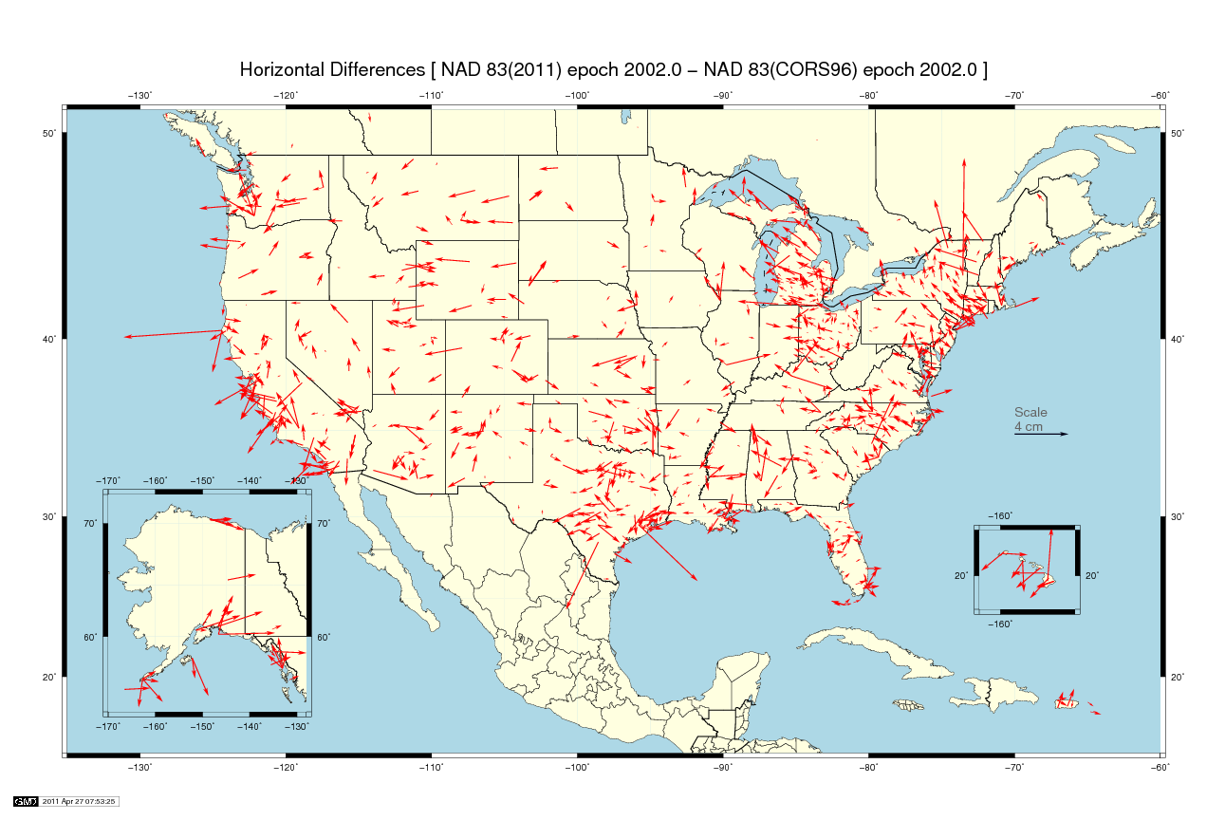
Mean horizontal shift = 0.2 cm (±2 cm) at epoch 2002.0

Slide 14
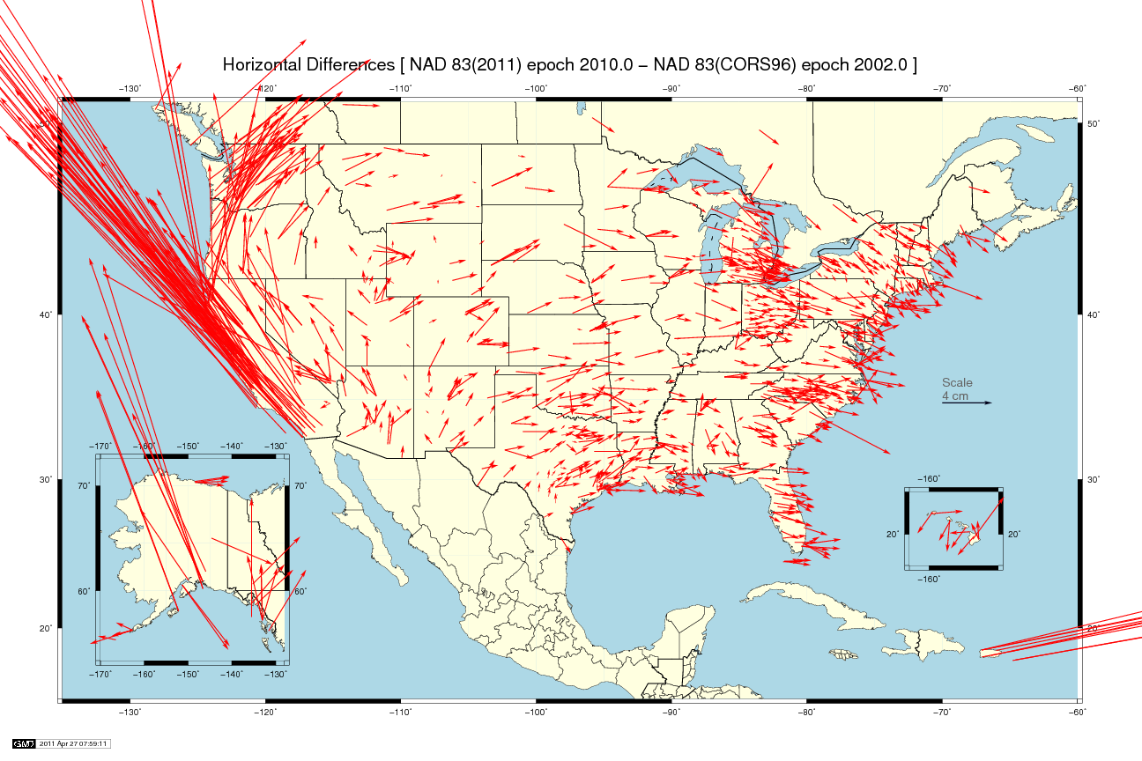
West CONUS
mean shift = 1.1 cm
East CONUS
mean shift = 0.1 cm
Mean horizontal shift = 2.0 cm (±8 cm) from 2002.0→2010.0

Slide 15
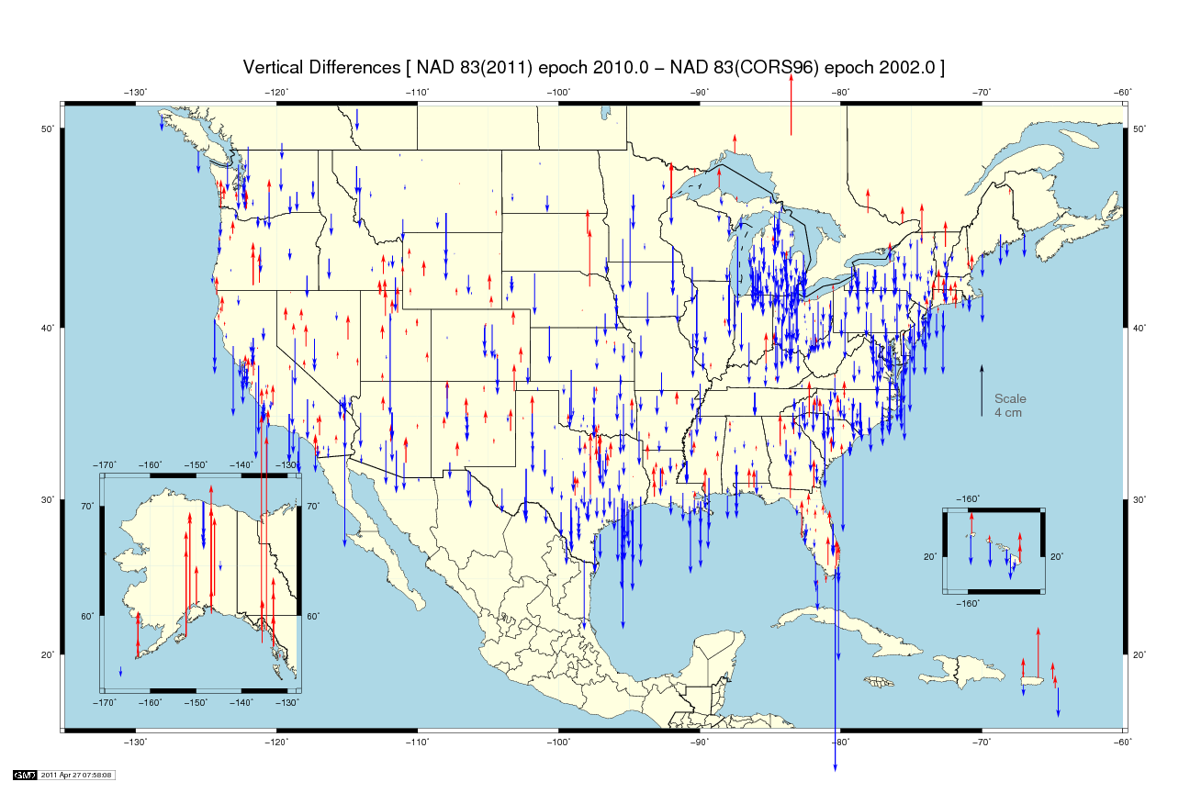
Mean vertical shift = -0.8 cm (±2 cm) from 2002.0→2010.0
Mean vertical shift = +0.7 cm (±2 cm) at epoch 2002.0

Slide 16
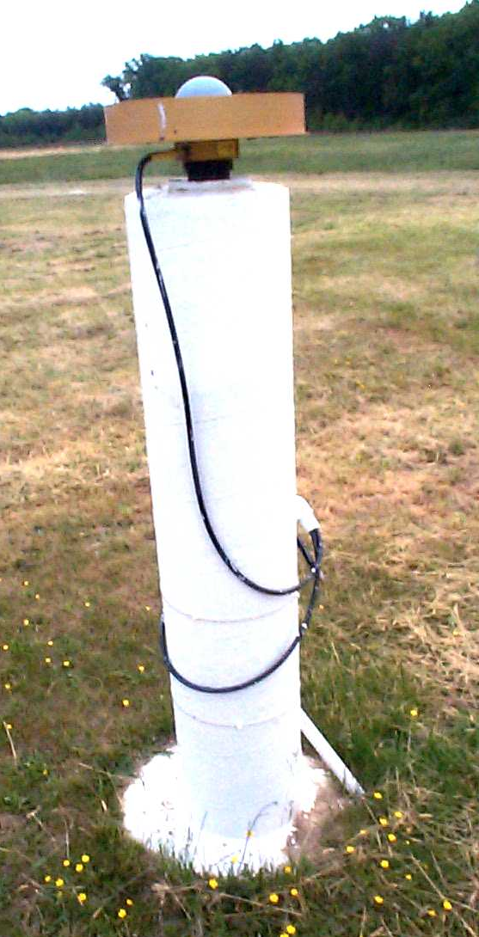
Introducing…
NAD 83(2011) epoch 2010.00
Multi-Year CORS Solution (MYCS)
  Reprocessed all CORS GPS data Jan 1994-Apr 2011
  2264 CORS & global stations
  NAD 83 computed by transformation from IGS08
National Adjustment of 2011 (NA2011)
  New adjustment of GNSS passive control
  GNSS vectors tied (and constrained) to CORS
  NAD 83(2011) epoch 2010.00
  Approximately 80,000 stations and
  more than 400,000 GNSS vectors
Realization SAME for CORS
and passive marks
This is NOT a new datum! (still NAD 83)

Slide 17
Why a New National Adjustment?
Optimally align passive control with new CORS
Add >1000 projects submitted since 2007 project
  Also observations for Hawaii, other Pacific islands
Network and local accuracies on all stations
  Including future submitted projects
More consistent results in tectonically active areas
  More current data, better tectonic modeling
Better computations and analysis techniques
  E.g., improved outlier detection
  Incorporation of lessons learned from previous national adjustment

Slide 18
Transformation & Tectonic Complications
NAD 83(2011) transformation tools?
  NAD 83(2011) ←→ (NSRS2007/CORS96) ←→ (HARN)
  Under study by NGS
When is North America not North America?
  Not all stations on the North American tectonic plate
  Pacific plate: Hawaii and American Samoa
  Mariana plate: Guam and CNMI
  Caribbean plate: Referenced to North American plate
  Can relate frames (and epoch dates) with HTDP

Slide 19
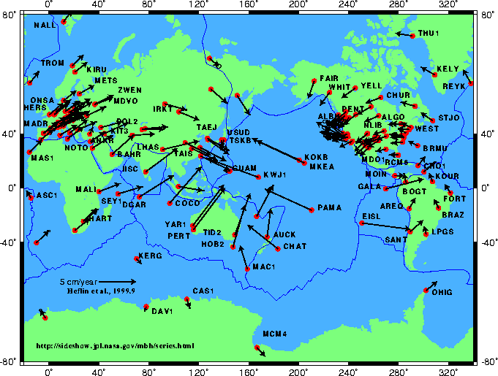
Tectonic Motions

Slide 20
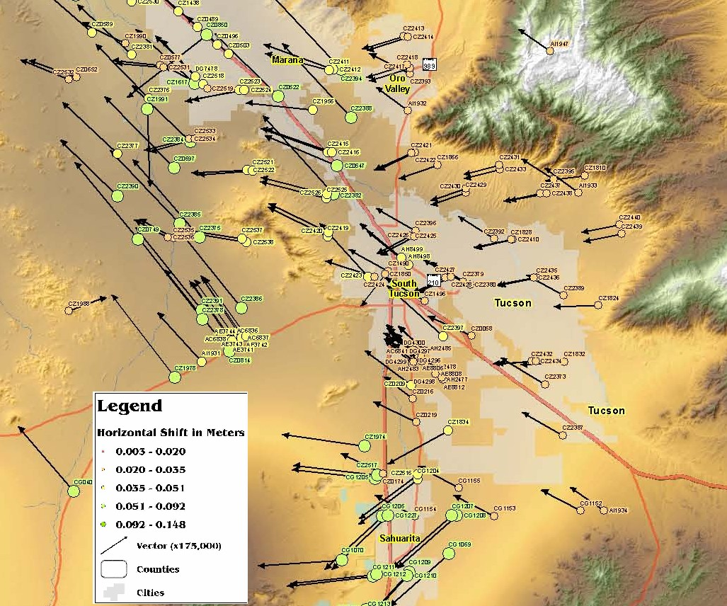
How to get to the New Geometric Datum
“Furthermore, NGS will provide simple transformation tools between historic and current datums and reference frames used by NGS, in four dimensions, wherever practical and possible.”
There is no NGS-sanctioned transformation from NAD 83(HARN) to NAD 83(NSRS2007). Therefore, if your data are on a realization prior to NAD 83(NSRS2007) you will either have to get them on NSRS2007 (or 2011) or ignore the position shift and transform them to the new datum. NGS’s OPUS may be the answer for you.
Shift from HARN to NSRS2007
Tucson, AZ

Slide 21
Future Milestones of the NSRS
Multi-Year CORS solution –
  Completed (for all intents and purposes)
National Adjustment (geometric) of passive control
  2012
Hybrid Geoid Model using new ellipsoid heights
  2012
National Adjustment (vertical) of GPS passive marks
  Under consideration
  This not adjusting the leveling network
Adoption of new datums
  Geometric, could happen any time
  Vertical, requires completion of GRAV-D

Slide 22
How to Plan for the Future
Move to a contemporary realization of NAD 83
  No NAD 83(HARN) <-> NAD 83(NSRS2007) tool
Obtain precise ellipsoid heights on NAVD 88 bench marks (OPUS, contact NGS Geodetic Advisor(s))
  Improves hybrid geoid models and provides “hard points” in new vertical datum
Move off of NGVD 29 to NAVD 88
  Understand the accuracy of VERTCON in your area
Move away from passive marks to GNSS
  Especially move off of classical passive control
Require/provide complete metadata for all survey/mapping contracts
  How did they get the positions/heights?
  Survey Manual/Spatial Data Accuracy and Georeferencing Standards

Slide 23
A Question to Consider:
What is good enough
with respect to the NSRS,
i.e. have we reached a level of precision and accuracy where further realizations (adjustments) are unnecessary?

Slide 24
Near-future plans & possibilities
New hybrid geoid model (GEOID12)
  Use NAD 83(2011) epoch 2010.00 ellipsoid heights on NAVD 88 benchmarks
  Might also use OPUS-Database results on NAVD 88 BMs
May perform national vertical adjustment
  Constrain vertically to NAVD 88 benchmarks
    Perform as simultaneous nationwide adjustment
  GNSS-derived orthometric heights
    NAD 83(2011) ellipsoid heights with GEOID12
    NOT a readjustment of NAVD 88 leveling

Slide 25
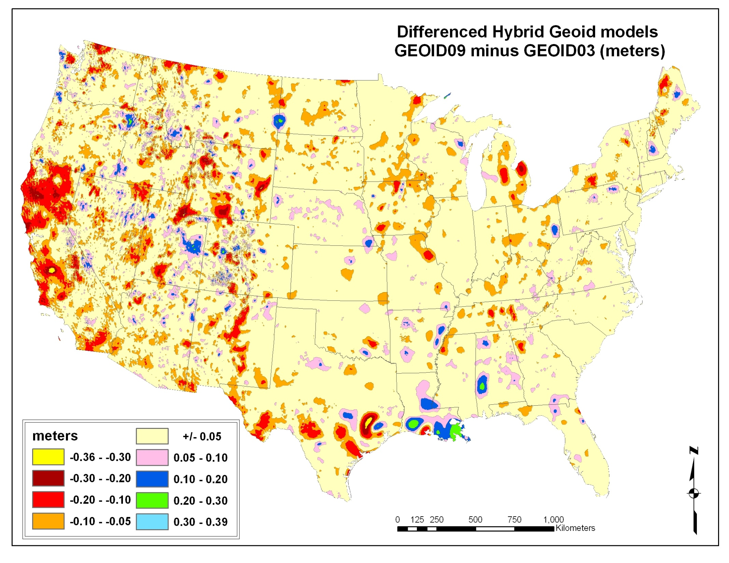
-1.18 ft to +1.28 ft

Slide 26
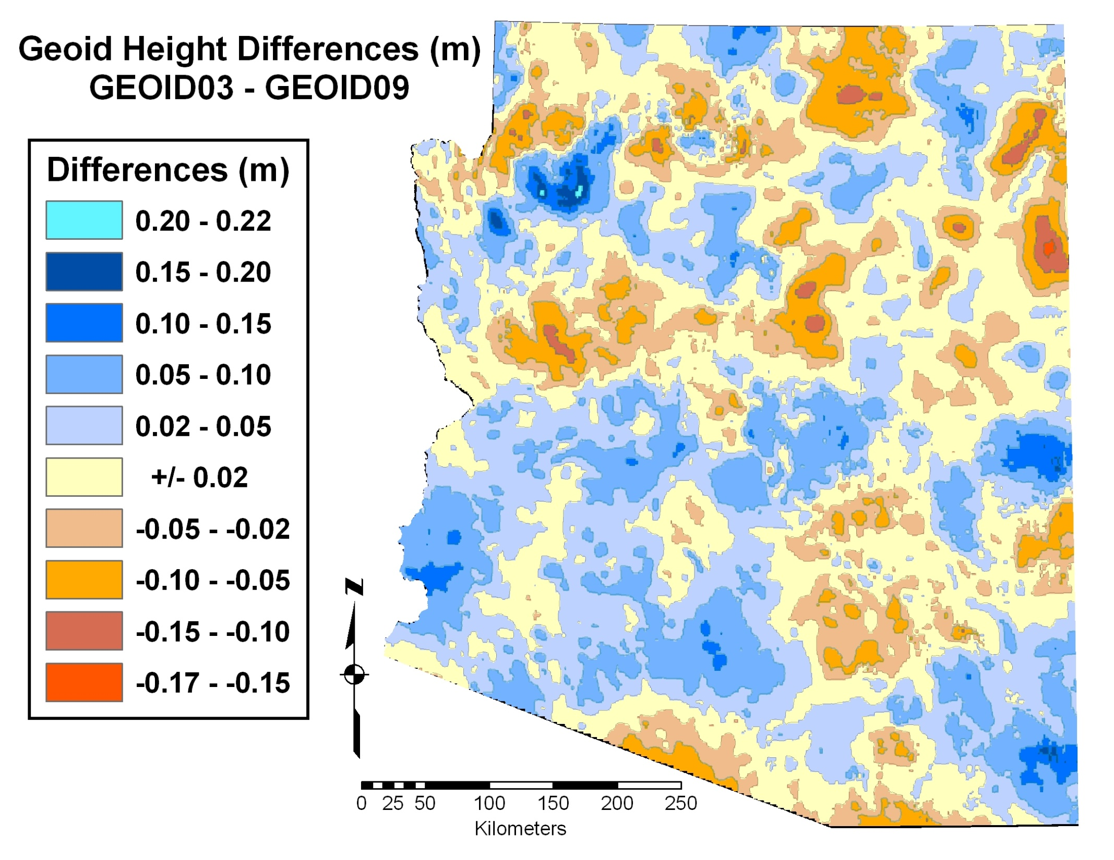
GPS-derived orthometric heights Warning #1
H ≈ h - N
NAVD 88 height ≈ NAD 83 ellipsoid height - GEOID03
NAVD 88 height ≈ NAD 83 ellipsoid height - GEOID09
Provide, to client(s), datum & realization, ellipsoid heights, geoid model used, methodology (e.g. OPUS or adjusted survey), along with orthometric heights.
GPS-derived orthometric heights Warning #2
H ≈ h – N
The Hybrid GEOID model is defined with respect to a particular realization of NAD 83.
GEOID09 should only be used with NAD 83(NSRS 2007)
GEOID03 should only be used with NAD 83(1992 aka HARN)
NAD 83(HARN) – NAD 83(NSRS2007) in Arizona:
Heights -> min = -20.1 cm, max = 11.5 cm, avg = -2.4 cm
-0.49 ft to +0.72 ft

Slide 27
Announcing…
A New NGS Datasheet Format
Update to new Datasheet version (8.00)
  Changed location, length, and text for many fields
  Added new fields, deleted fields, augmented existing fields
  To be Implemented in 2012
  Will add announcement and prototype to NGS web site soon
Summary of content changes
  Added country (e.g., USA) where control station located
  Hyperlinked vertical datum designation to datum web page
  Ortho height epoch date, if applicable (e.g., subsidence areas)
  Note for geoid model used on Ht Mod stations if not current geoid
  Network and (median) local accuracies
    Horizontal and ellipsoid height accuracy at 95% confidence (per FGDC)
    Includes link to detailed accuracy info, list of all local accuracies
  Superseded Ht Mod ortho heights indicate geoid model used

Slide 28
Announcing…
A New NGS Datasheet Format

Slide 29
Announcing…
A New NGS Datasheet Format

Slide 30
Announcing…
A New NGS Datasheet Format

Slide 31
Announcing…
A New NGS Datasheet Format

Slide 32
Announcing…
A New NGS Datasheet Format

Slide 33
“DSWorld” Software Program
Highly rated new NGS software tool
Developed to search the NGS database
Easy to learn/use
Multiple search options available
Displays search results using Google Earth

Slide 34
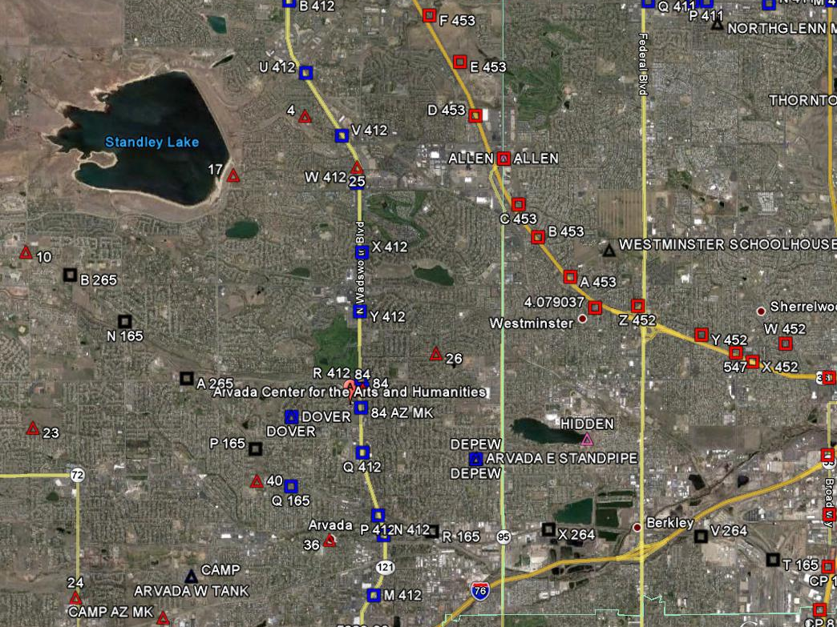
Geodetic Control Near the Arvada Center
Triangles – Horizontal Control
Squares – Vertical Control

Slide 35
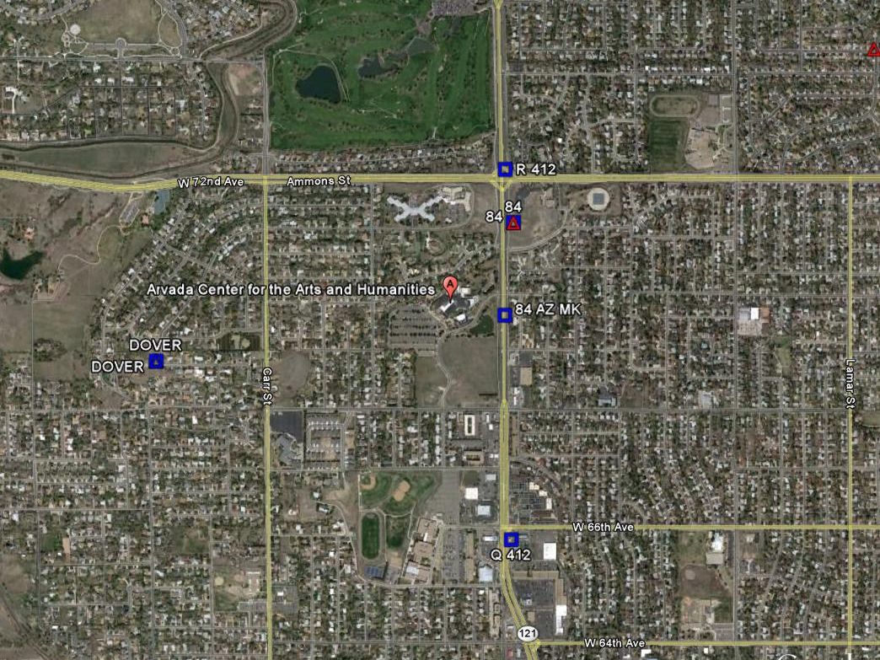
Blue – First Order
Red – Second Order

Slide 36
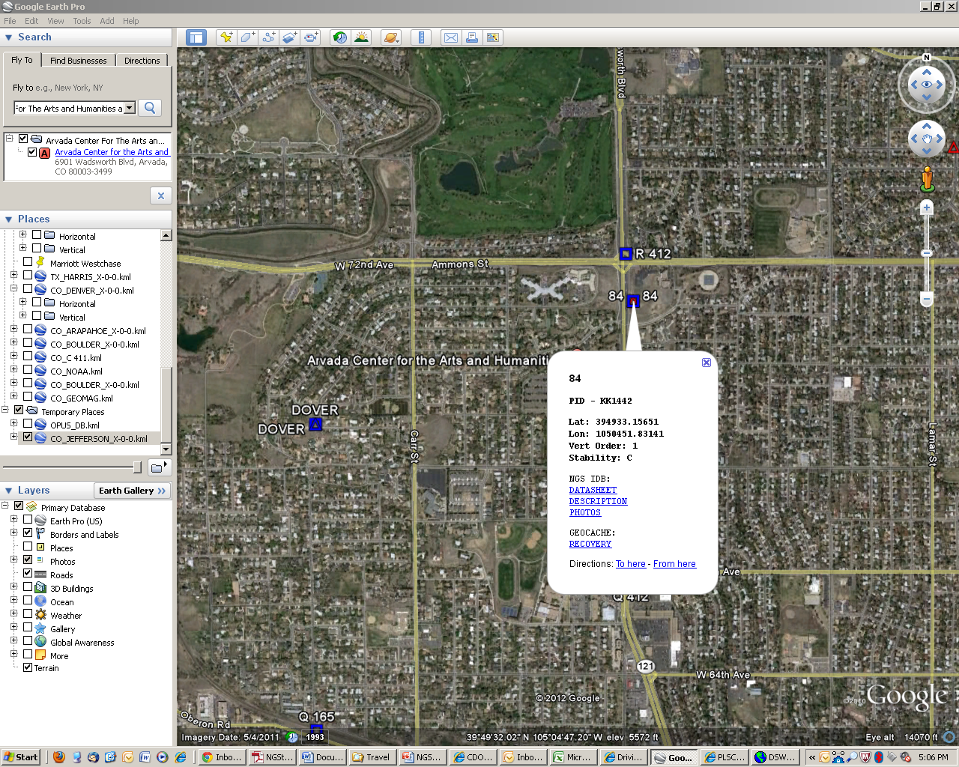
Click to get to Information
Datasheets Recovery
Photos Directions
Descriptions

Slide 37
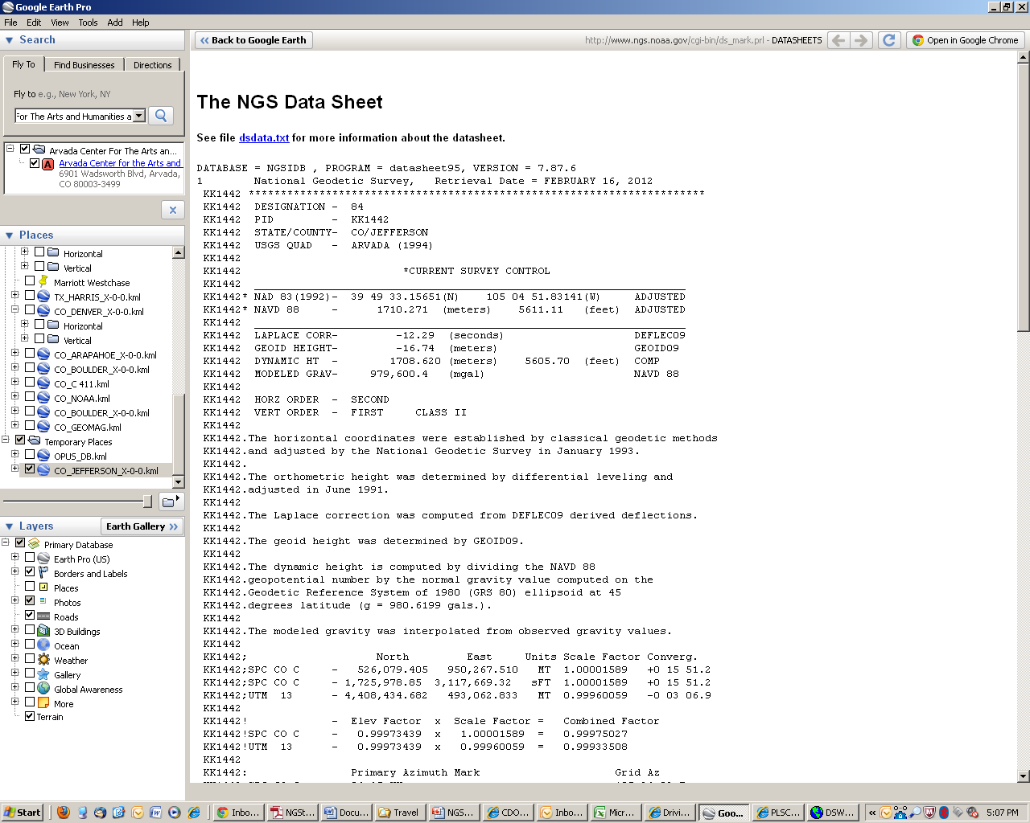
Direct Access to the NGS Datasheet

Slide 38
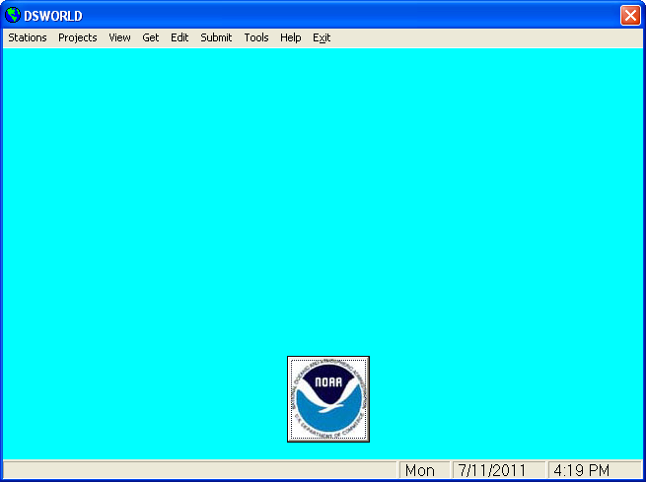
DSWorld opening screen

Slide 39
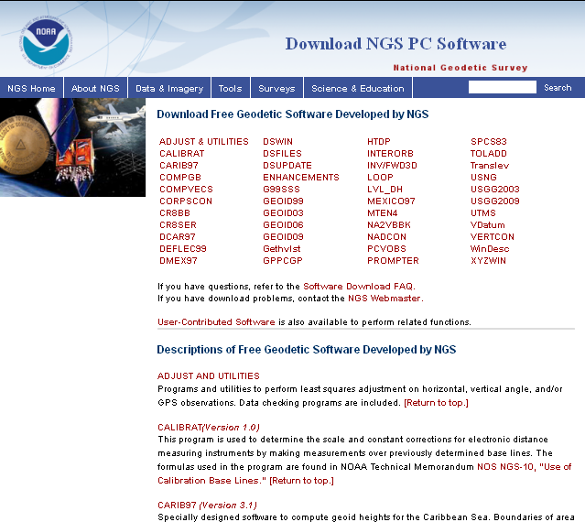
Where do you get DS-World?

Slide 40
OPUS
OPUS – S (2 hrs)
OPUS – RS (15 minutes)
OPUS – DB (Publish)
OPUS – Projects (Network)

Slide 41
CORS

Slide 42
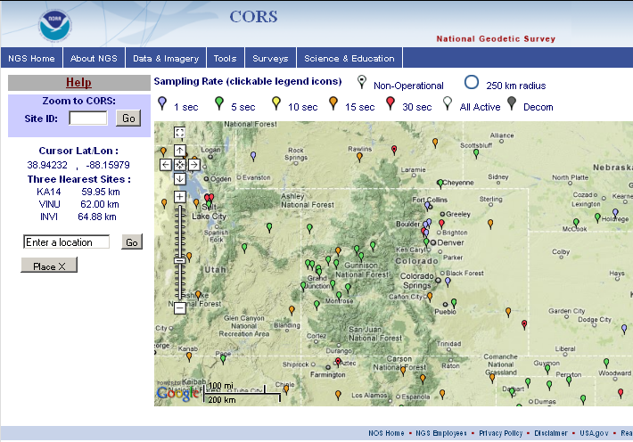
CORS

Slide 43
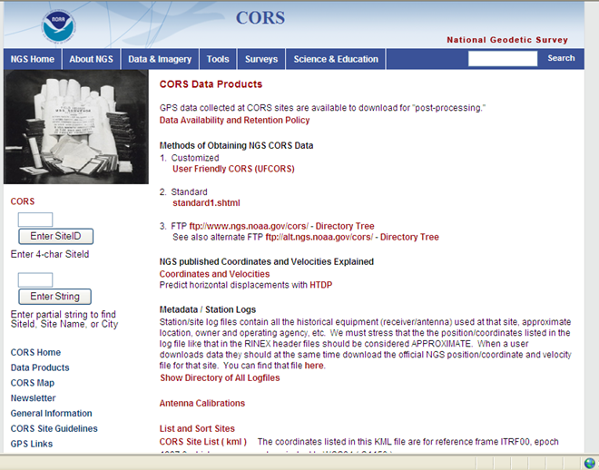
CORS “Data Products” Page
Obtain Static Data Files for CORS Here

Slide 44
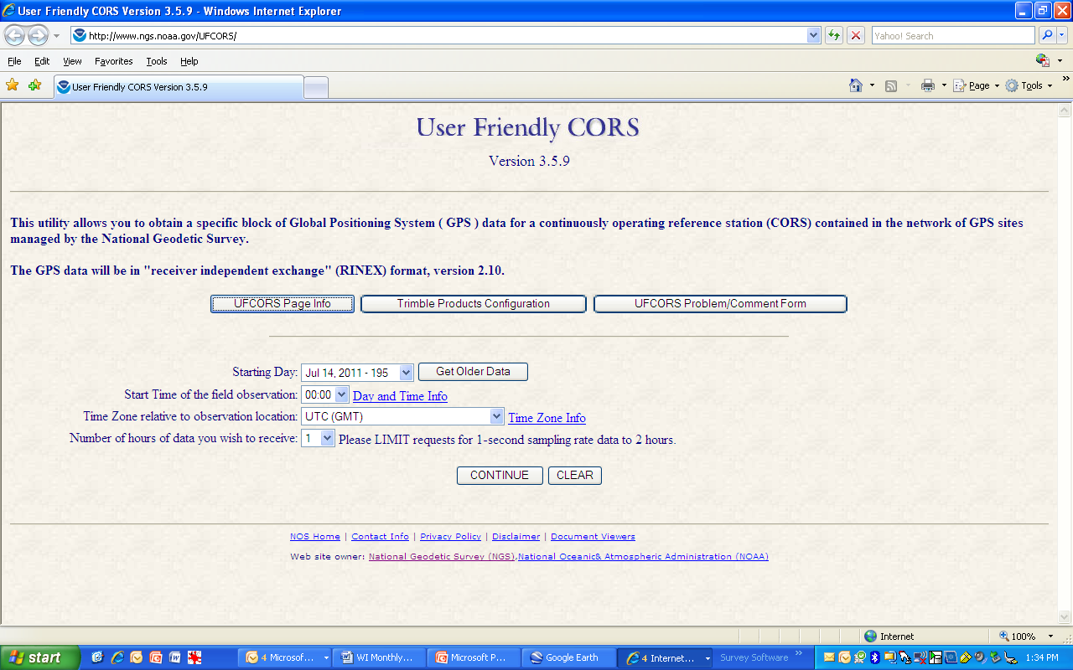
Provide Information about your Project

Slide 45
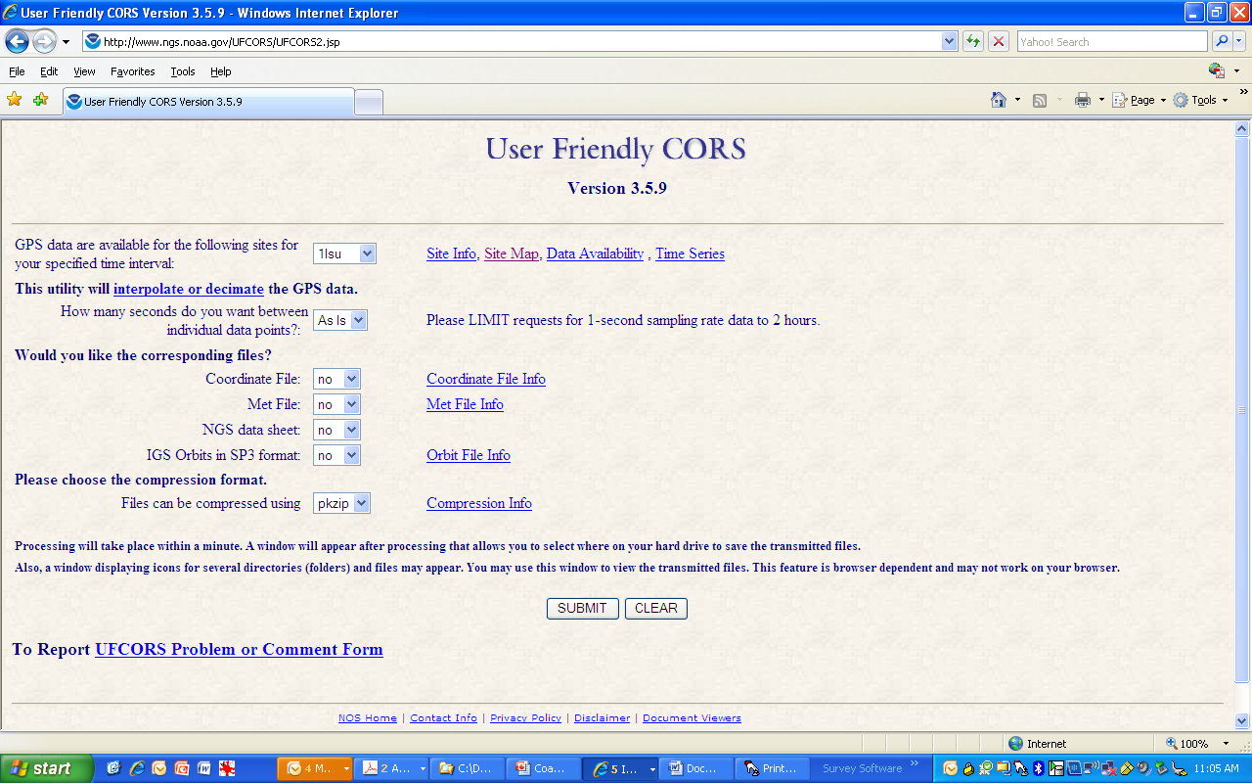
Enter your custom requests

Slide 46
OPUS
OPUS – S (2 hrs)
OPUS – RS (15 minutes)
OPUS – DB (Publish)
OPUS – Projects (Network)

Slide 47
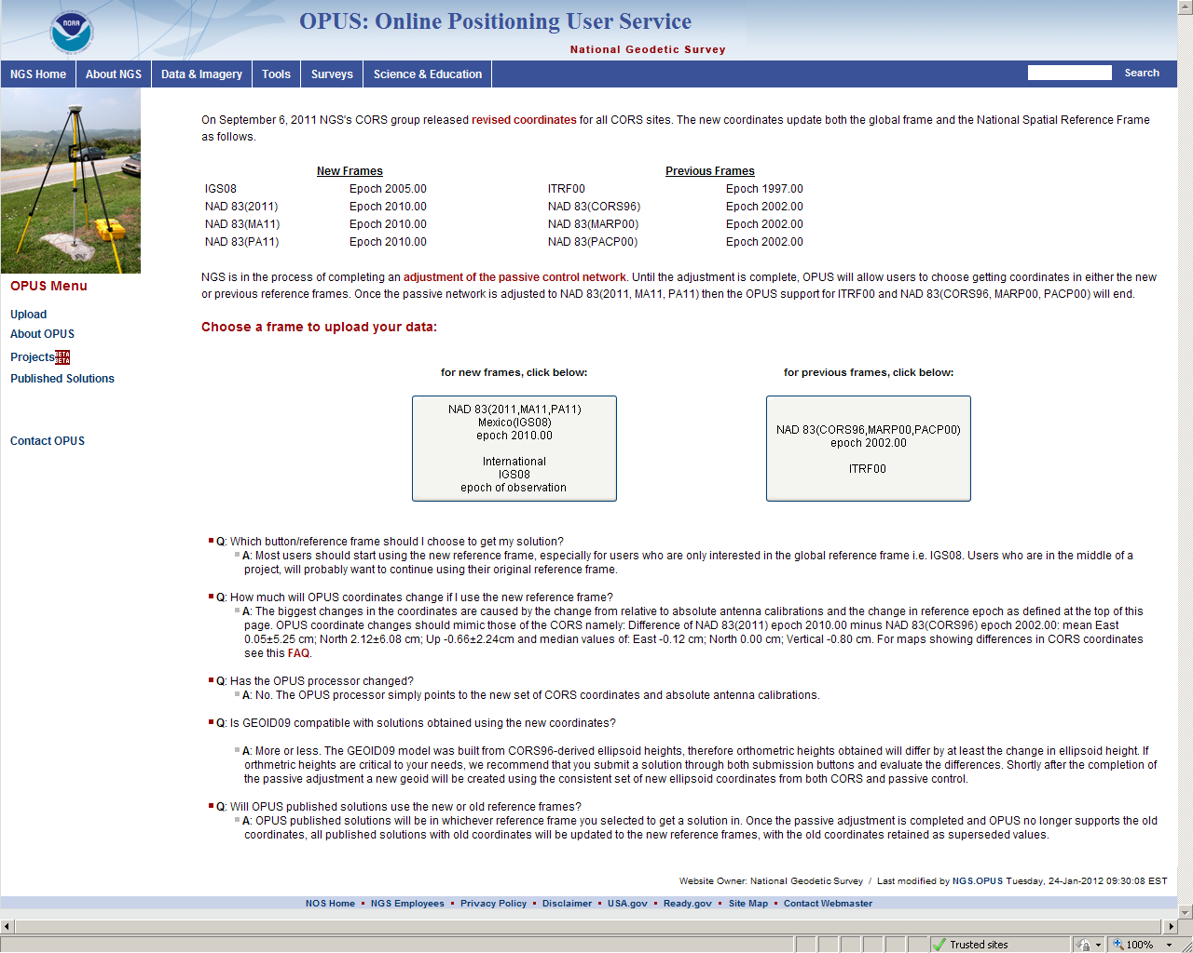

Slide 48
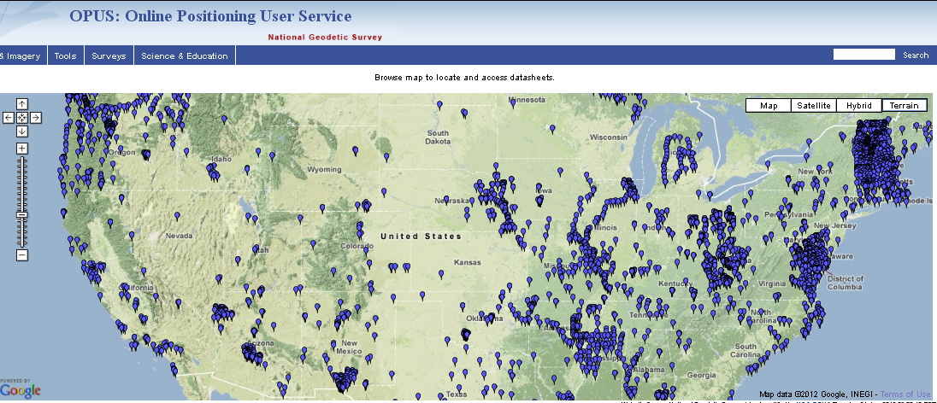
OPUS-DB Published Solutions

Slide 49
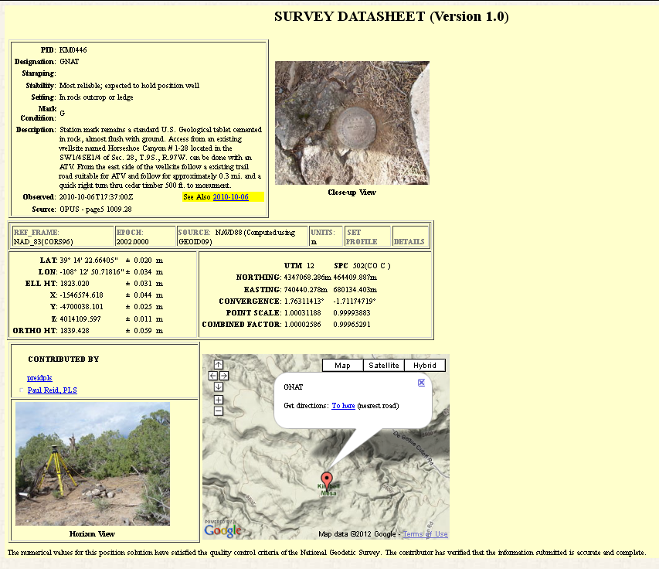
Sample OPUS DataSheet
http://www.ngs.noaa.gov/

Slide 50
OPUS DB Requirements
Field Procedures
GPS data file ≥ 4 hour duration
quality mark setting
experienced observer
fixed height tripod recommended
brace tripod legs with sandbags or chain
verify antenna height and plumb

Slide 51
OPUS DB Requirements
High-Quality OPUS Solution
≥ 70% observations used
≥ 70% ambiguities fixed
≤ 3 cm RMS
≤ 4 cm peak-to-peaks, lat. & lon.
≤ 8 cm peak-to-peak, el. hgt.
properly identify antenna type
precise or rapid orbits (avail. next day)

Slide 52
OPUS DB Requirements
Mark Attributes
photos of mark & equipment
details (name, type, stability, etc.)
description to aid mark recovery
preview mark description form
& help file

Slide 53
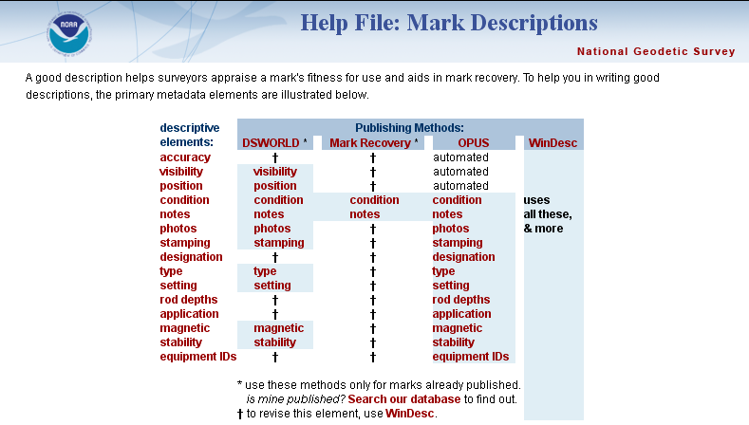
OPUS-DB Requirements

Slide 54
Why OPUS-DB
A new easier way to capture data and have it in an NGS database
Help populate Ellipsoidal Heights on Bench Marks, help with Geoid models and future vertical datums

Slide 55
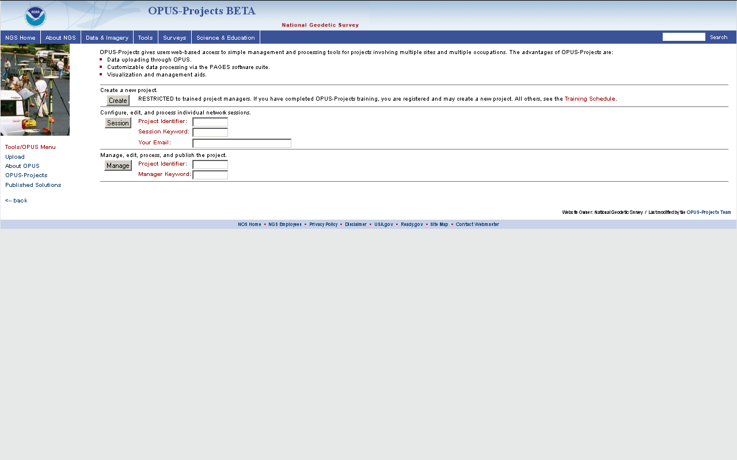
OPUS Projects
Create
Session
Manage

Slide 56
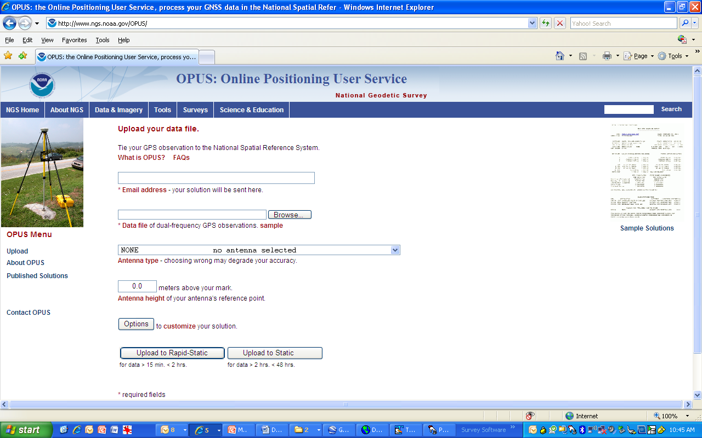
OPUS Submission Webpage
Your email address
Location of your data file
Your antenna type
Antenna height
Customize your solution - details on next slide

Slide 57
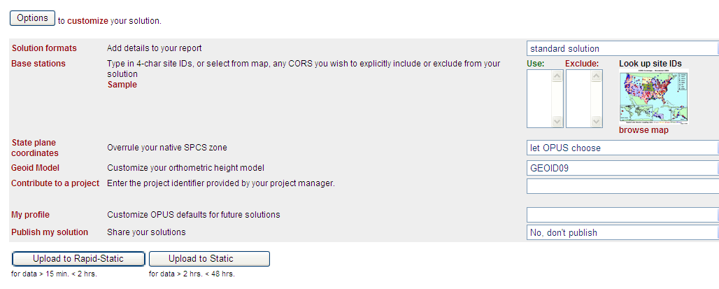
Under the “OPTIONS” tab in OPUS
Include-Exclude CORS here
SPCS overrule
Change Geoid Model
OPUS Projects ID
Publish in OPUS-DB?
Select one to start computation process

Slide 58
CDOT CORS/OPUS Team
To incorporate CORS and OPUS into the CDOT Survey Manual
Presented to SAC on Feb 15, 2012
Proposed Addendum
Recommendations

Slide 59
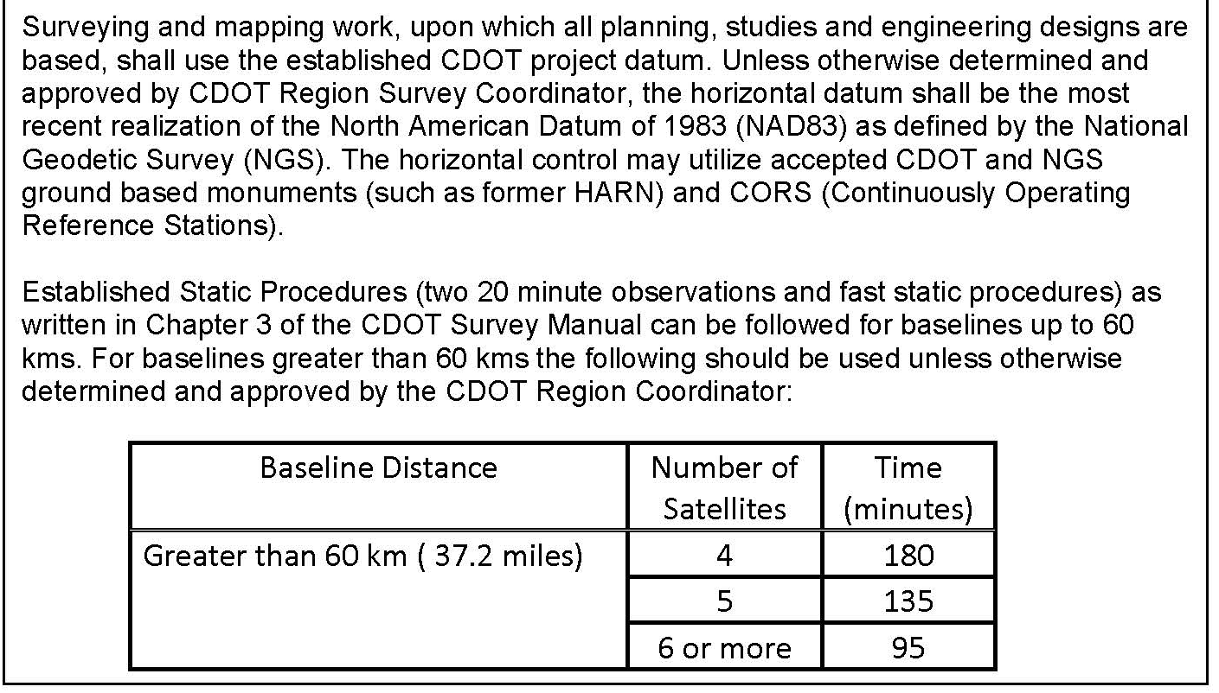
CDOT CORS/OPUS Team
DRAFT
DRAFT
Proposed Addendum

Slide 60
CDOT CORS/OPUS Team
DRAFT
DRAFT
Recommendations
  OPUS tools are valuable and use of them should be further explored and encouraged where appropriate and incorporated into re-write of Chapter 3.
  Encourage publishing of control using OPUS-DB especially on NGS vertical marks to prepare the vertical datums for the future.
  Additional CORS should be added in Colorado
  Microstation control diagrams be edited to reflect the language in the proposed (approved) Addendum
  Training to Support these Changes

Slide 61
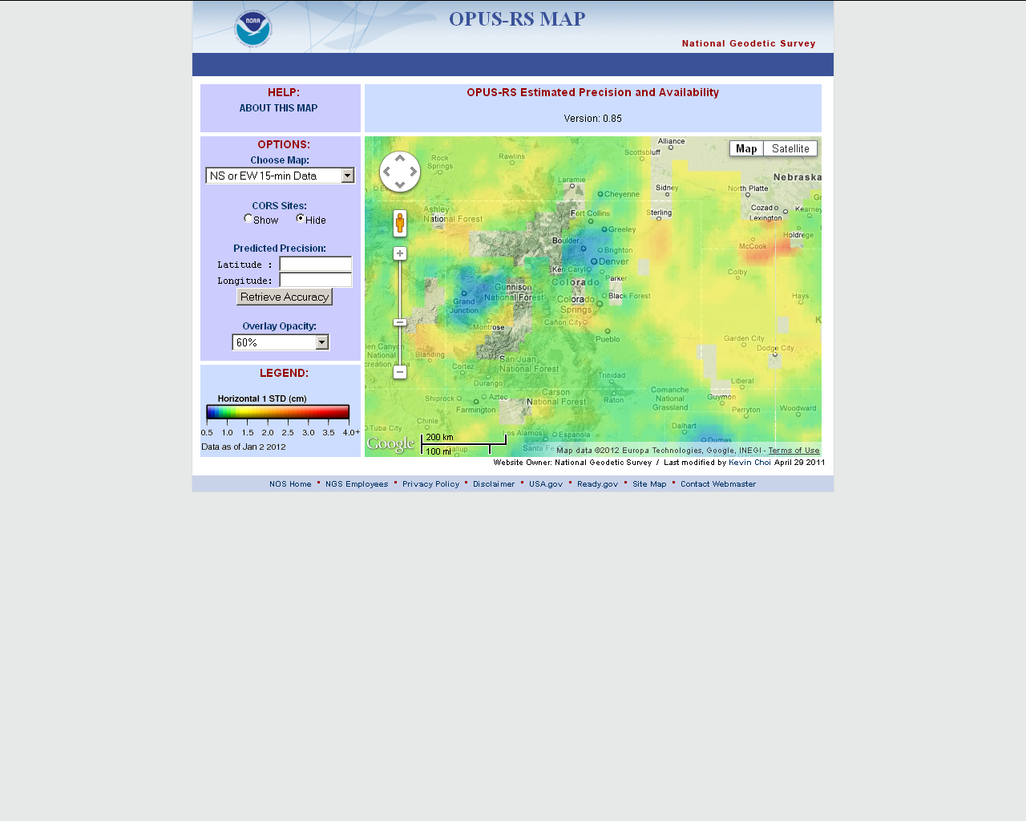
OPUS-RS Coverage in Colorado

Slide 62
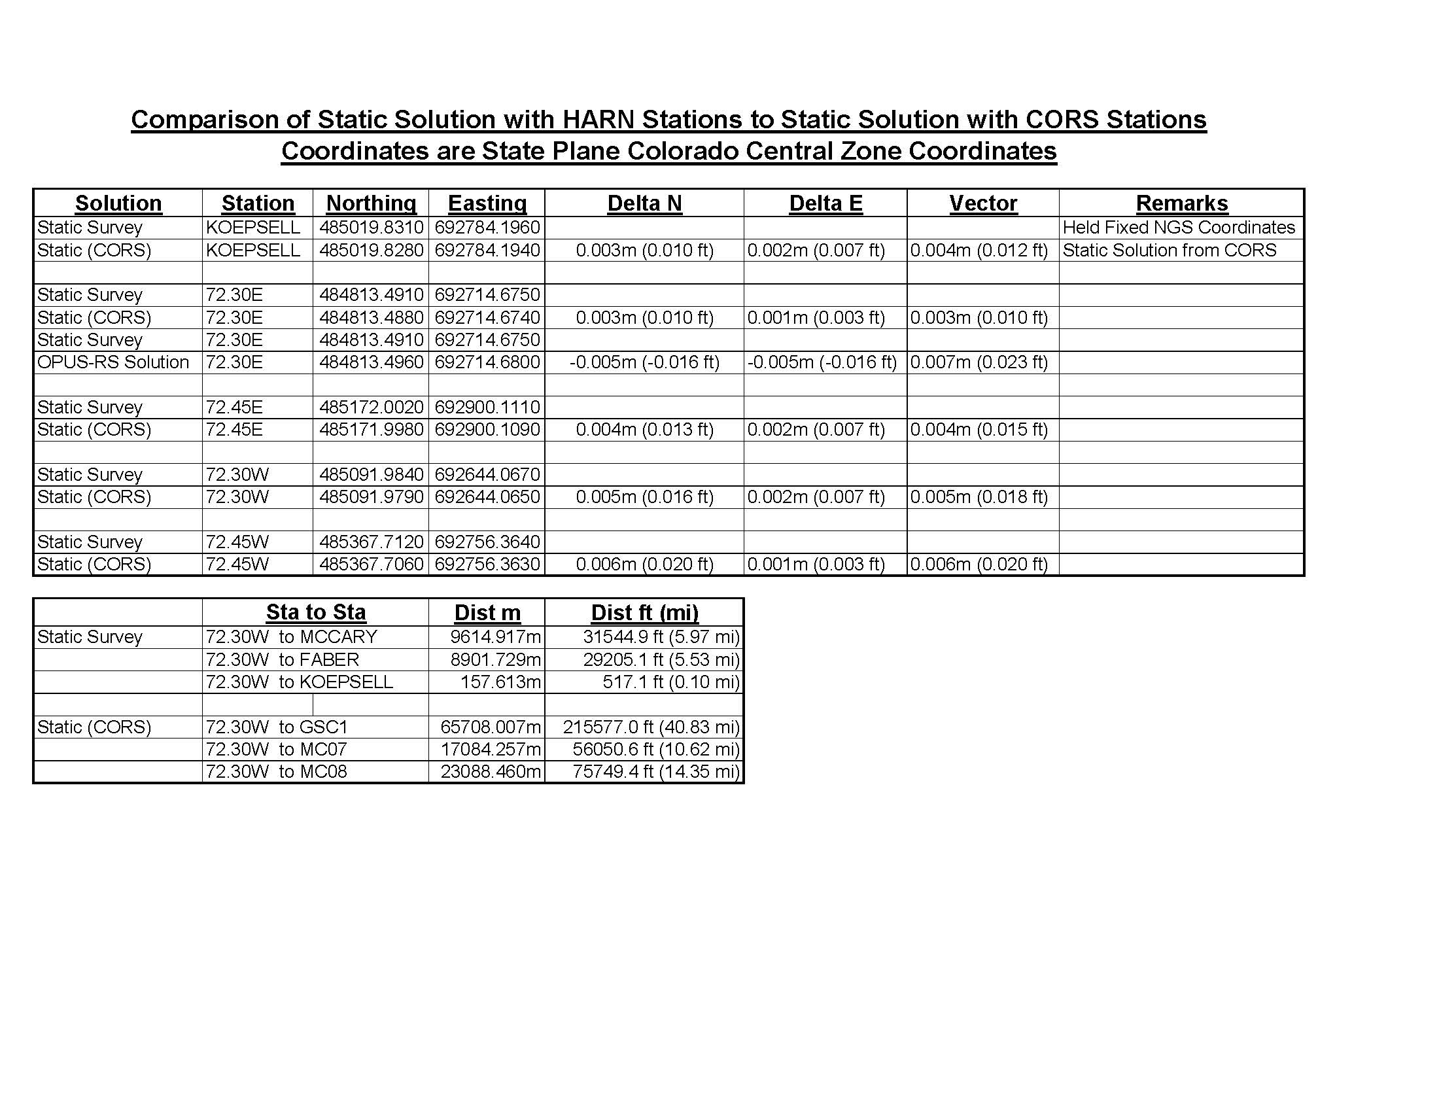
CDOT Comparison Between HARN, CORS and OPUS

Slide 63
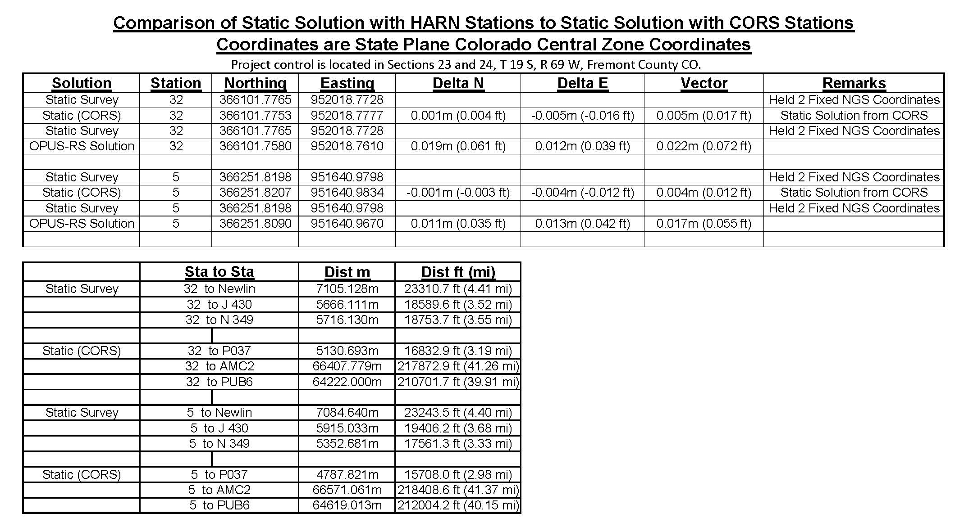
CDOT Comparison Between
HARN, CORS and OPUS

Slide 64
Using GNSS is cheaper, easier than leveling
To use GNSS we need a good geoid model
Heights Bottom Line
GNSS – Global Navigation Satellite System

Slide 65
Ellipsoid, Geoid, and
Orthometric Heights
H = Orthometric Height (leveling)
H = h - N
h = Ellipsoidal Height (GPS)
N = Geoid Height (model)
h (NAD83)
TOPOGRAPHIC
SURFACE
(NAVD88) H
N
Geoid Height
(GEOID09)
Geoid
Ellipsoid
Notes:
Orthometric height is the height on the surface above the geoid. But we can’t measure from the geoid so we have used leveling. The NAVD88 is defined from the control point, B, in Quebec. Because the ortho ht at A is computed from leveling observations, where error is modeled or estimated, it probably isn’t right at the geoid, right at “sea level”.
Our vertical datum is defined. We need a geoid that we can use that is relative to the vertical datum.
Note that in this picture the geoid is shown above the ellipsoid. In the continental United States, the geoid is actually below the ellipsoid, so the value of the geoid height is negative.

Slide 66
Problems in NAVD 88
A North American realization through spirit leveling networks
Pre-satellite era product (625,000 km of leveling added to the NGVD29)
Height information through passive bench marks whose positions change constantly in our changing world (e.g., PGR, subsidence, earthquakes, …)
The geoid differences between NAVD 88 and GRACE are in meter range: compare to ±2-3 cm error in typical GPS ellipsoidal heights

Slide 67
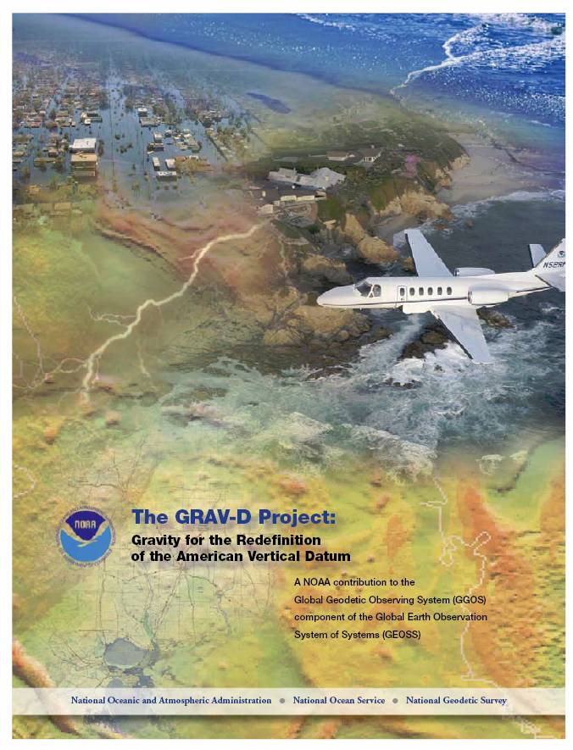
The Future of Height Mod: GRAV-D
Gravity for the Redefinition of the American Vertical Datum
GRAV-D
  Airborne gravity survey (10 years)
  Gravity monitoring into the future
  Coastal areas surveyed first
  All USA states and territories
  www.ngs.noaa.gov/GRAV-D
2018-2022 Targets:
  Orthometric heights (“elevations” on maps) good to 2 cm anywhere, anytime from GNSS technology
  Height changes easily monitored using new vertical datum
Gravity for the Nation’ benefits
  Imagery for the Nation
  Lidar for the Nation
  Elevation for the Nation
Notes:
Sent letters to potential partners to share costs and resources.
NOAA’s National Geodetic Survey (NGS) conducted an airborne survey in western interior Alaska in July, 2009. The National Geospatial-Intelligence Agency (NGA) is a partner in the survey. The operation will be conducted aboard a Naval Research Laboratory (NRL) C-12 King Air aircraft with a Navy aircrew.

Slide 68
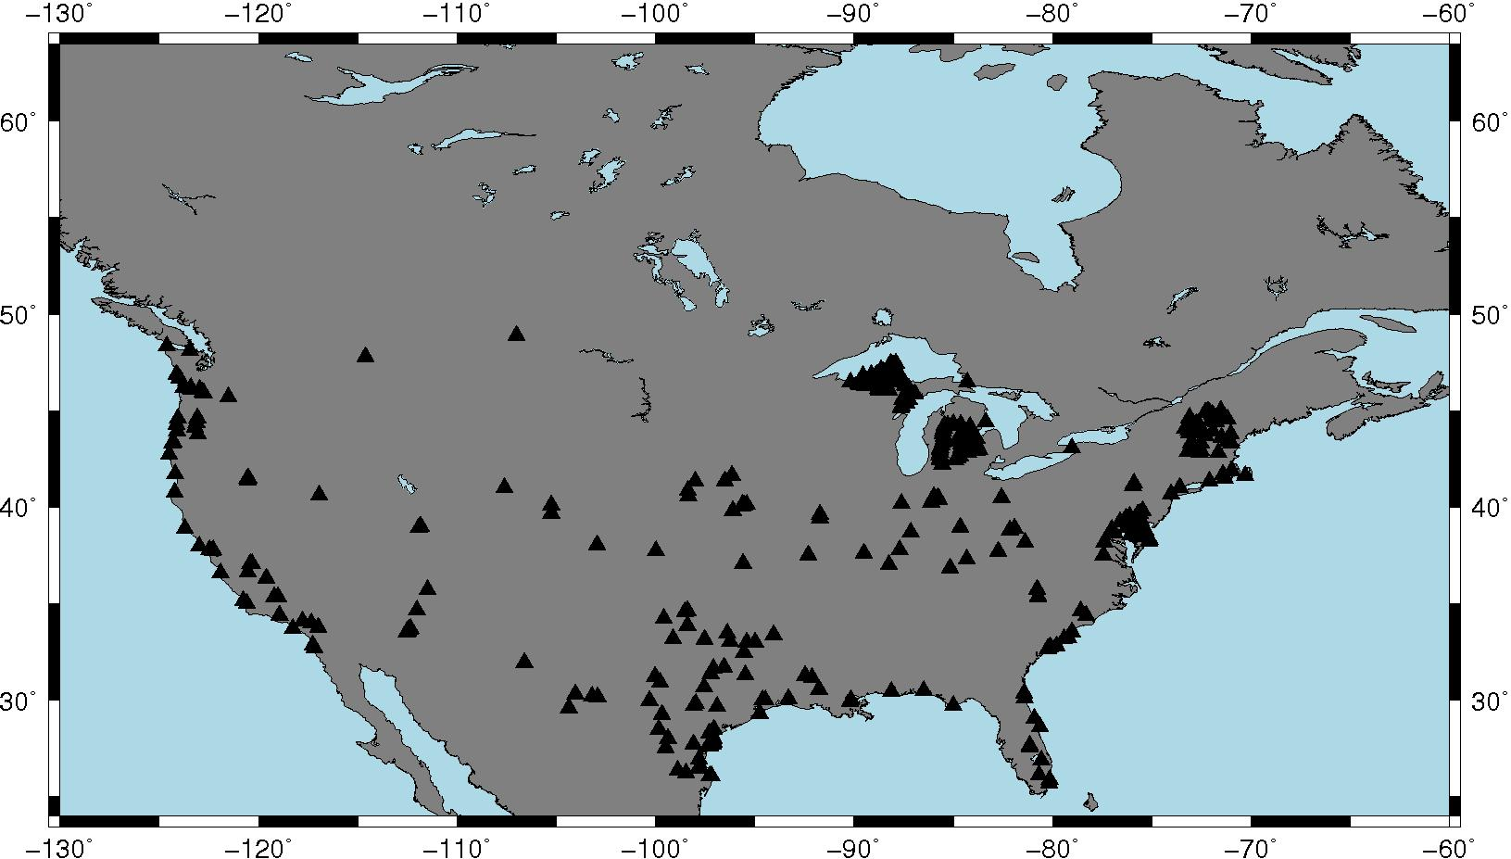
Leveled Bench Marks Occupied by GPS and stored in OPUS-DB
OPUS-DB shows great promise for filling gaps
Notes:
80 are in common with NGSIDB and were used in making GEOID09
57 are in common with NGSIDB and were *NOT* used in making GEOID09
285 are new points never before occupied with GPS
Distribution is fair, but you can see that some states are more active than others

Slide 69
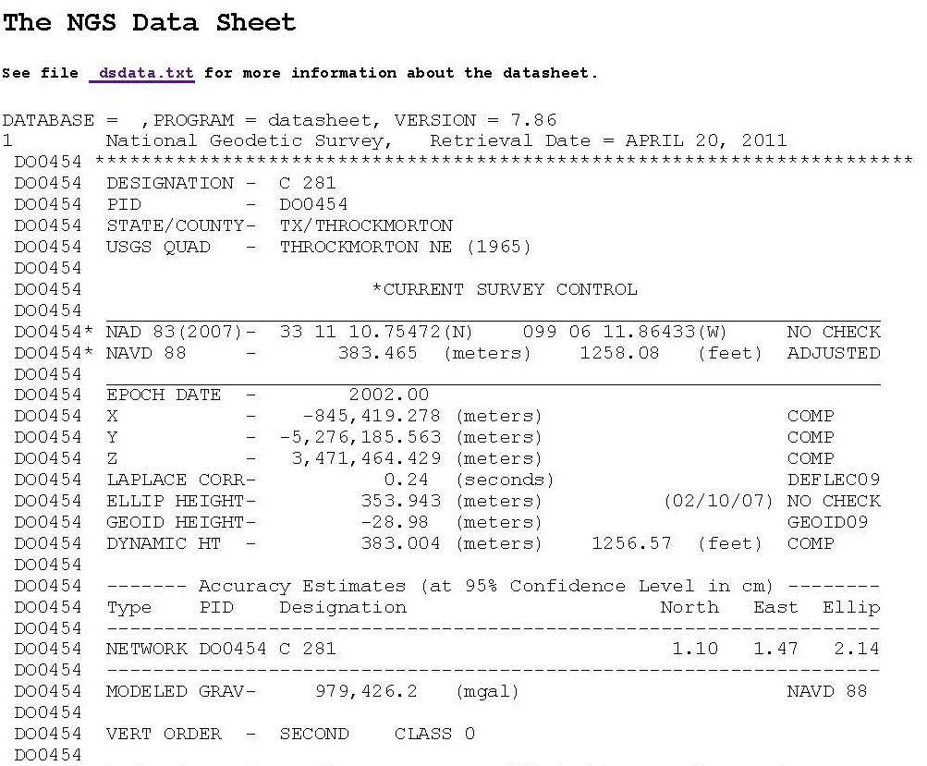
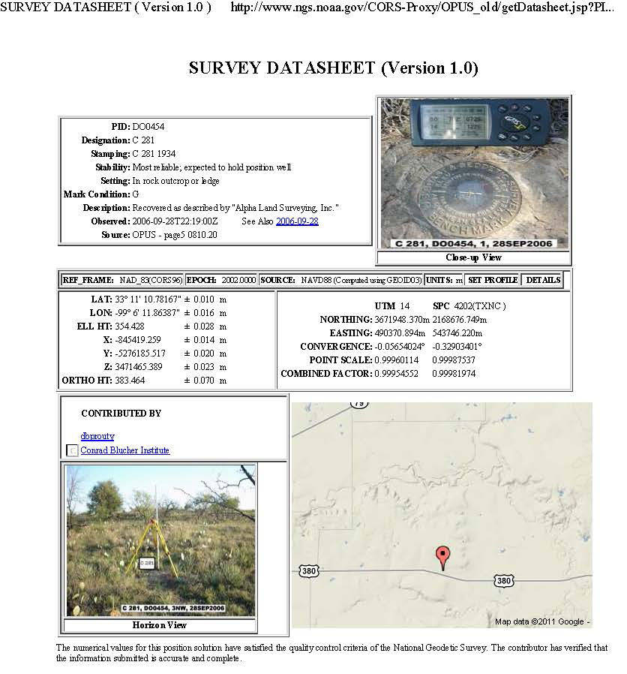
NGSIDB Versus OPUS-DB
NGSIDB
  Passive control
  Episodically refined (NRA2011)
  Traditional surveying
  A lot of (important!) numbers and text
OPUS-DB
  Actively determined from CORS
  Constantly refined
  GPS Surveying
  A lot of numbers/text and some useful graphics/images

Slide 70
Work to be Done
(Ht Modernization)
Big Picture
Assessment of Vertical Issues in CO
Gap Analysis of Where we need better vertical measurements, whether orthometric or ellipsoidal
Collect Data in those Key areas, using OPUS-DB, and determine what other means (leveling)
In the meantime, collect what you can using OPUS-DB
Write a report capturing all of this

Slide 71
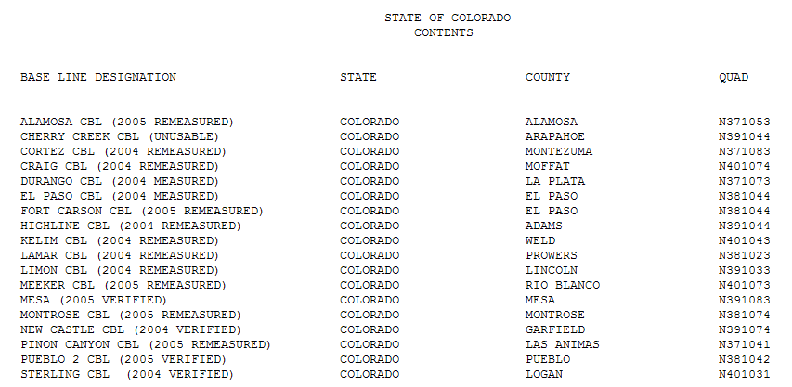
CBLs

Slide 72
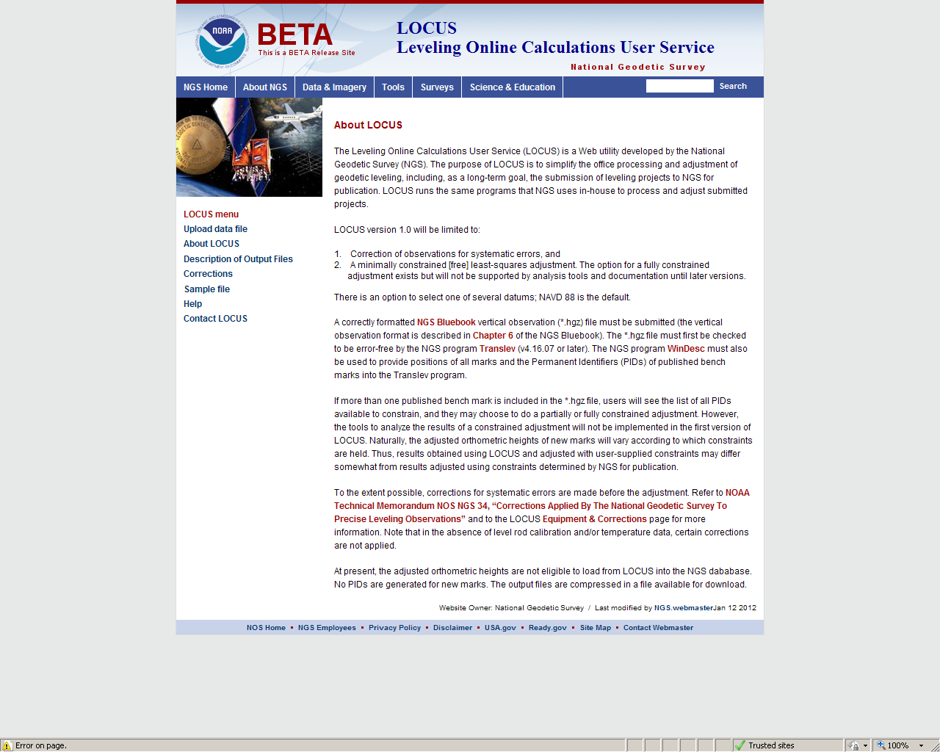

Slide 73
LOCUS
Leveling OnLine Calculations User Service
Provides a means to process and adjust level data
  Has been done at NGS Headquarters
Requires *.hgz file from Translev
  Error free
Requires Description file from WinDesc
You pick stations to constrain
Helps expedite entire process
Beta Version – Needs to be tested
Data is not submitted to NGS (at this time)

Slide 74
NGS
Real Time Positioning Components
GOAL:
To Ensure the Proper Geodetic Basis
for Accurate Real Time Positioning
Aligned To The NSRS

Slide 75
NGS - RT Program Components
NGS Streams Raw Data From The Backbone CORS
Provide Outreach and Education
Develop and Publish Guidelines Describing Best Practices.
Research Scientific Research Affecting Accurate Real-Time Positioning. [satellite orbits, refraction, multipath, antenna calibration, and crustal motion.]

Slide 76


>200 RTN World wide
>80 RTN in USA
35+ State DOT
Many Cooperative Efforts

Slide 77





























Outreach, Cooperative Efforts & Leadership
FGCS
LSRC
TSRC
+ PUBLIC & PRIVATE RTN ADMINISTRATORS SPANNING MORE THAN 35 STATES

Slide 78


DRAFT
http://www.ngs.noaa.gov/

Slide 79

Summary Table
RT Single-Base Guidelines

Slide 80
NGS Guidelines
Real Time GNSS Networks
Site Considerations
Planning and Design
Administration
Obtaining Station Coordinates Consistent with NAD83 and ITRS
User Best Methods

Slide 81
Obtaining Station Coordinates Consistent with NAD83 and ITRS
Include a subnetwork of the RTN into the National CORS network. This would be three stations If RTN has less than 30 stations, 10% of RTN with greater than 30 stations. NGS will not distribute/broadcast RTN reference station data.
Align all RTN reference stations coordinates to the CORS network at 2-cm horizontal and 4-cm vertical
For each reference station in the RTN, use the Online Positioning User Service (OPUS) at http://www.ngs.noaa.gov/OPUS/ to test for the continued consistency of its adopted positional coordinates and velocity on a daily basis, and revise the station’s adopted coordinates and/or velocity if the tests reveal a need to do so.

Slide 82
Best methods from the Guidelines:
The 7 “C’S” of NOAA’s NGS
The Control is at the Pole
Check Equipment
Communication
Conditions
Calibration (or not)
Coordinates
Collection
Confidence

Slide 83
Expediting The Guidelines
The NGS Encourages RTN Users and Administrators to become Cooperative Partners to Provide Input that will Enable Valuable Documents to be Drafted that will Benefit the Public Welfare.
- Establishing Reference Stations
- Adjusting Networks
- Accuracy Expectations Vs. Obtained
- Baseline Distances
- Error Modeling
- Communication Issues

Slide 84
Real Time Networks (RTN)
Considerations
How Are They Established?
How Are Their Coordinates Computed? Are They Consistent?
How Is The Network Adjusted?
How Does The RTN Align To The NSRS?
Can Users Use Any Manufacturers’ Equipment In The RTN?
Do Overlapping Networks Give The Same Coordinates?
What Are The Field Accuracies?
?

Slide 85
Real-Time Considerations
Passive / Active
Datums & Adjustment Epochs
Geoid + Ellipsoid / Calibrate
Single Base / RTN
GNSS / GPS
Grid / Ground

Slide 86
Some RT Field Considerations
- Multipath
- Position Dilution of Precision (PDOP)
- Baseline Root Mean Square (RMS)
- Number of satellites
- Elevation mask (or cut-off angle)
- Base accuracy (datum level, local
level)
- Base security
- Redundancy, redundancy,
redundancy
- Part(s) Per Million Error (ppm) –
iono, tropo models,
orbit errors
- Space weather- sunspot numbers,
solar maximum
- Geoid quality
- Site calibrations (a.k.a. Localizations)
- Bubble adjustment
- Latency, update rate
- Fixed and float solutions
- Accuracy versus Precision
- Signal to Noise Ratio (S/N or C/N0)
- Carrier phase
- Code phase
- VHF/UHF radio communication
- CDMA/SIM/Cellular TCP/IP
communication
- WGS 84 versus NAD 83,
local datums,
- GPS, GLONASS, Galileo, Compass
Constellations

Slide 87
Metadata
The RT Practitioner must record items not recorded in the Field. For instance:
What is the Source of the Data?
What is the Datum/Adjustment Epoch?
What are the Field Conditions?
What Equipment was used, especially what Antenna?
What firmware was in the receiver and collector?
What redundancy, if any, was used?

Slide 88


Slide 89

Mesa County, Colorado RTN

Slide 90


Slide 91


Slide 92






Slide 93
CSRN GPS DAY
CSRN- Colorado Spatial Reference Network (Chapter of the PLSC)
MAY 12, 2012 Saturday
Free Food, Vendors, Boy and Girl Scouts

Slide 94

Advisor Status In Your State

Slide 95
NGS 10-Year Plan (excerpts)
Vision 1# Summary:
By 2020?, NGS has defined a new geometric datum (classically called “horizontal”) to replace NAD 83 with its many systematic errors. The primary means of accessing this new datum is GNSS technology.
Vision #2 Summary:
By 2020?, a new geopotential datum (for orthometric and dynamic heights) is defined and realized through the combination of GNSS technology and gravity field modeling.
Note: Vision #2 can not happen without Vision #1.

Slide 96
NGS 10-Year Plan (more excerpts)
“NGS redefines the national horizontal datum to remove gross disagreements with the ITRF.”
“The primary means of accessing this new datum is GNSS technology. While passive control continues to be used as a secondary method to access the NSRS, such control will be “tied to”, not a “part of”, the NSRS.”
“Furthermore, NGS will provide simple transformation tools between historic and current datums and reference frames used by NGS, in four dimensions, wherever practical and possible.”
“In order to support users of NAVD 88, NGS will provide transformation tools between the new datum and NAVD 88 based predominantly on the few thousand measurements of GPS derived ellipsoid heights on NAVD 88 benchmarks.”
Underlining added for emphasis

Slide 97
Why a New Datum(s)?
NAD 83
  non-geocentric, i.e. inconsistent with GNSS positioning
  NAD 83 coordinates of the Continuously Operating Reference Station (CORS) network inconsistent with passive marks
  Lack of velocities, i.e. NAD 83 does not report station motion for passive marks

Slide 98
Why a New Datum(s)?
NAVD 88
  cross-country build up of errors (“tilt” or “slope”) from geodetic leveling
  Passive marks inconveniently located and vulnerable to disturbance and destruction
  A 0.5 m bias in the NAVD 88 reference surface from the geoid surface best approximating global mean sea level
  Subsidence, uplift, freeze/thaw, and other crustal motions invalidate heights of passive marks, and can make it difficult to detect such motions.
  Passive marks without adequate geophysical models make it difficult to reliably detect sea level change
  Changes to Earth’s gravity field cause changes in orthometric heights, but NAVD 88 does not allow/account for those changes (because it is based on a static gravity model)
  The gravity model and modeling techniques used to determine NAVD 88 are not consistent with those currently used for geoid modeling

Slide 99


Slide 100
New Datums
“NGS redefines the national horizontal datum to remove gross disagreements with the ITRF.”
  In other words, ellipsoid heights will change.
“By 2020(?), a new geopotential datum (for orthometric and dynamic heights) is defined and realized through the combination of GNSS technology and gravity field modeling.”
In other words, orthometric heights will NOT be based on leveling data and they too will change.

Slide 101


Slide 102

http://www.ngs.noaa.gov/
www.geodesy.noaa.gov

Slide 103



NGS Training Center
Webinars!
http://www.ngs.noaa.gov/corbin/
Notes:
What I have provided is a quick overview. We have much more in depth classes and workshops offered by our state advisor, association meetings and at our training facility outside of Washington, DC in Corbin, VA as well as webinars.

Slide 104
More information…
NGS Home Page: http://www.geodesy.noaa.gov
geodesy.noaa.gov
CORS Webpage: http://www.ngs.noaa.gov/CORS/
CORS newsletter
OPUS Webpage: http://www.ngs.noaa.gov/OPUS/
Find Your Advisor:
www.ngs.noaa.gov/ADVISORS/AdvisorsIndex.shtml
This presentation will be uploaded to:
http://www.ngs.noaa.gov/web/science_edu/presentations_archive/
FAQs on the various webpages

Slide 105
Thank You
pamela.fromhertz@noaa.gov
240-988-6363

Slide 106
Questions? Comments? Jokes?
Multi-Year CORS Solution
National Adjustment of 2011
New NGS Datasheet Format

