Slide 1



Datums, OPUS, and NCAT, Oh My
What’s new at NGS
Maine Society of Land Surveyors
February 02, 2024
Dan Martin
Northeast Regional Geodetic Advisor
Dan.martin@noaa.gov
240-676-4762

Slide 2

Happy Groundhog Day

Slide 3
Today’s Topics
New Datum
  GRAV-D
  GPSonBM
  Laser
  Sproccet
  Alpha Page
OPUS
  OPUS 5 (M-Pages) Beta
OPUS Projects 5.2 (Production)
  GVX
  Publish
  Online Videos and Tutorials
NCAT Version 2.1
Beta Time Series Tool
NGS Map
Passive Marks Page

Slide 4
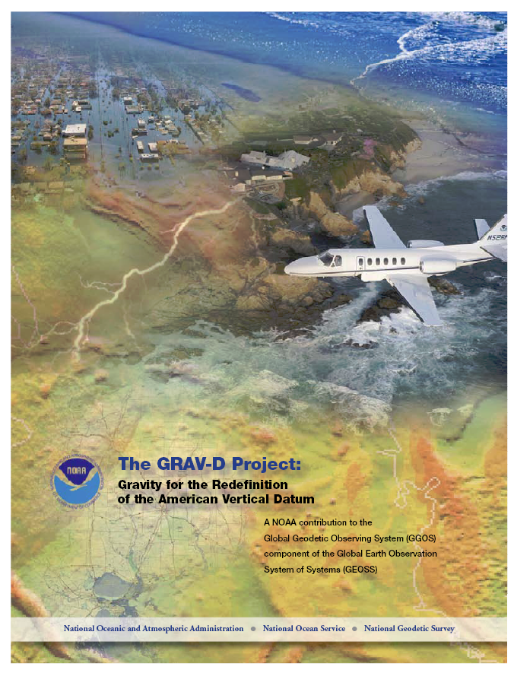
GRAV-D Project Overview
Overall Target: 2 cm accuracy orthometric heights from GNSS and a geoid model
GRAV-D Goal: Create gravimetric geoid accurate to 1 cm where possible using airborne gravity data
GRAV-D: Two thrusts of the project
  Airborne gravity survey of entire country and its holdings
  Long-term monitoring of geoid change
Leveraging partnerships to improve and validate gravity data
Notes:
Target is to be able to achieve 2 cm accuracy orthometric heights (where possible) using a GNSS receiver and a geoid model
Roughly 1 cm uncertainty from GNSS and 1 cm from the geoid model
GRAV-D
Phase 1: snapshot of the entire country to provide a consistent data set
Phase 2: long term monitoring of geoid change – in development
Work with partners to incorporate additional gravity data, particularly surface gravity data, validate existing data, and monitor change

Slide 5
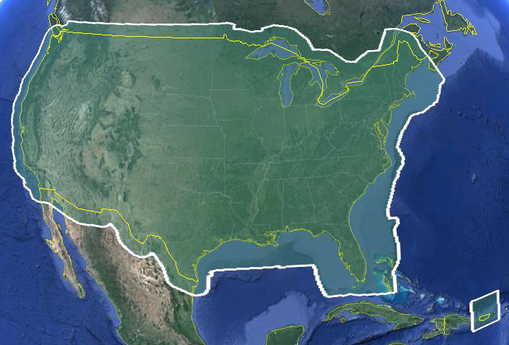
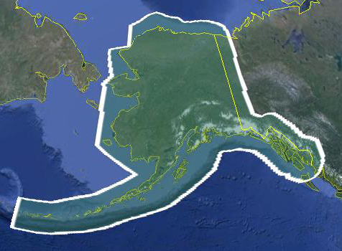
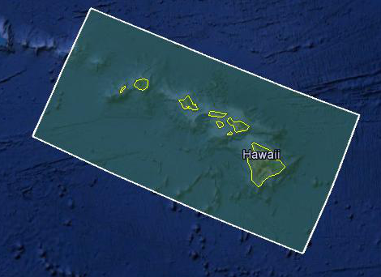
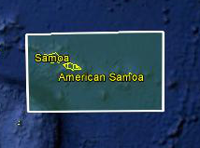
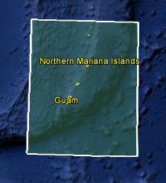
Data Collection Scope
Entire U.S. and territories
  Total Square Kilometers: 15.6 million
  Initial target area for 2022 deadline
  ~200 km buffer around territory or shelf break if possible
Notes:
Project Scope:
Scope of the project: cover roughly 15.6 million square kilometers – contiguous united states, Alaska, Hawaii, Guam, and American Samoa
In order to blend with satellite altimetry data the airborne survey is done to the continental shelf where possible or ~ 200 km beyond the shoreline or border, whichever is further
Deadline of 2022 for datum rollout, which means a target of 2021 to finish the airborne survey
Priority areas were defined as Alaska and coastal areas
Challenges:
Fixed annual budget and time → design of surveys had to fit within an annual budget of $3.5 million and meet the deadline
This was a major factor in setting altitude and line spacing

Slide 6
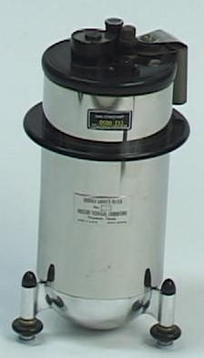
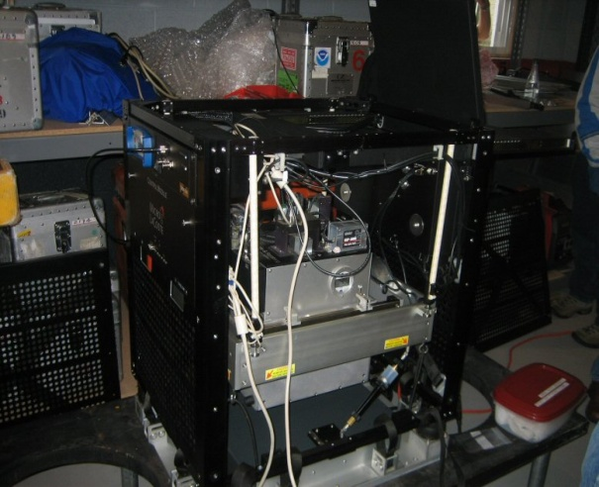
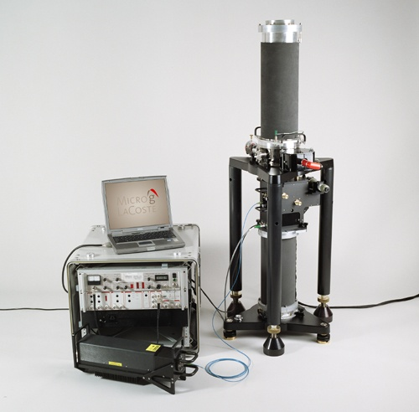
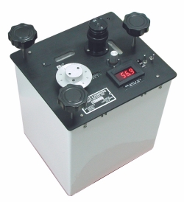
Gravity Survey Plan
National Scale Part 1
  Predominantly through airborne gravity
  With Absolute Gravity for ties and checks
  Relative Gravity for expanding local regions where airborne shows significant mismatch with existing terrestrial

Slide 7
Priority- Greatest Datum Need
Alaska
Puerto Rico/US Virgin Islands (PRVI)
Coastal US and Great Lakes
  Great Lakes
  Gulf of Mexico & FL
  Eastern Seaboard
  Western Seaboard
Hawaii and Pacific Islands
Aleutian Islands
Interior CONUS
  Mountainous areas first

Slide 8
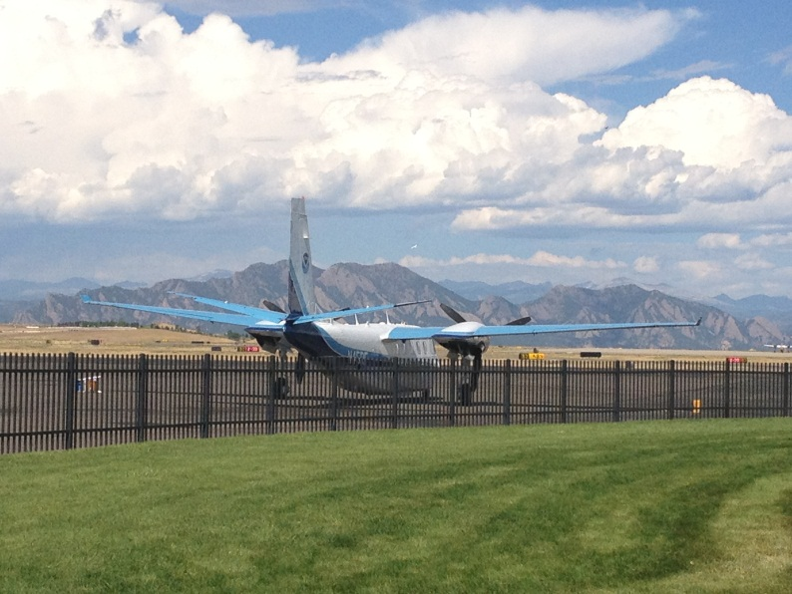
Other Variables to Consider
Time of Year, Need Smooth Air
  Likelihood of Turbulence: Hurricanes, Tornados
  Prevailing winds and weather patterns, especially wintery conditions and
  thunderstorms
Aircraft Available
  Differing Capabilities
Funding
Areas already completed
GPRA
NOAA TurboCommander at
Denver Rocky Mountain Airport
September 2012
*GPRA = Government Performance and Results Act of 1993

Slide 9
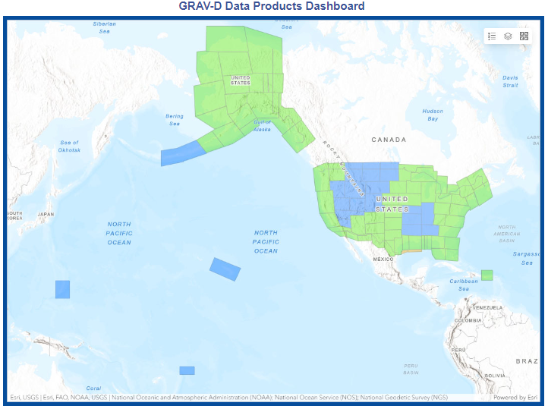

Airborne Gravity Current Coverage
http://www.ngs.noaa.gov/GRAV-D/data_products.shtml

Slide 10
GRAV-D Progress
100% of target area flown!
Currently re-flying older, lower quality lines
Will continue to improve data holdings as schedule permits
Beginning to plan some Terrestrial Gravity to densify relative gravity in areas with interesting gravity signals.
Planning absolute gravity 10-15 sites in the NW to support GeMS (Geoid Monitoring Service)

Slide 11
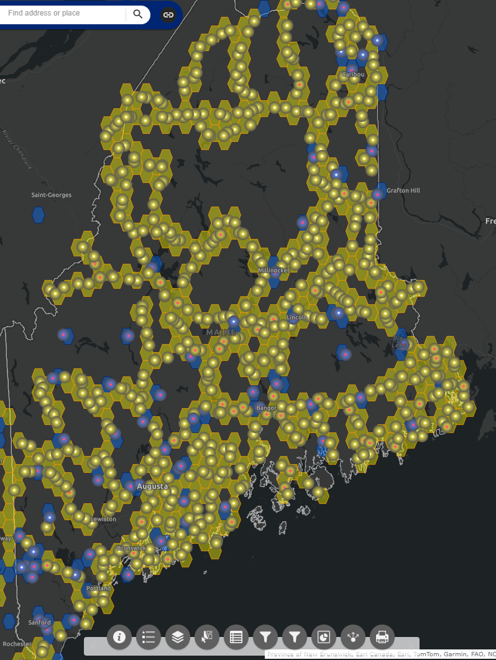
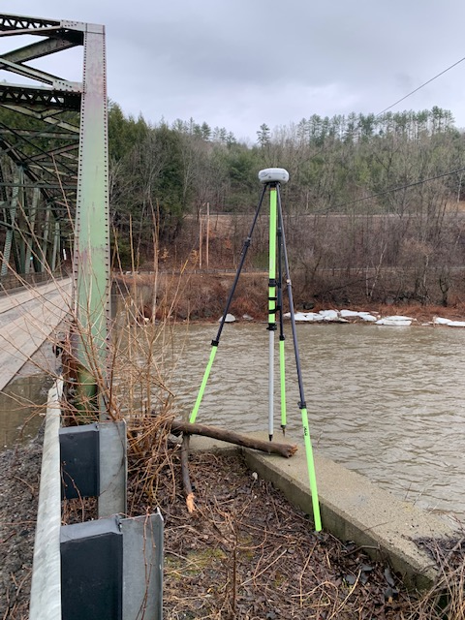
GPSonBM for Transformation Tool
Deadline was extended until Feb. 29, 2024
This will be the LAST extension.

Slide 12
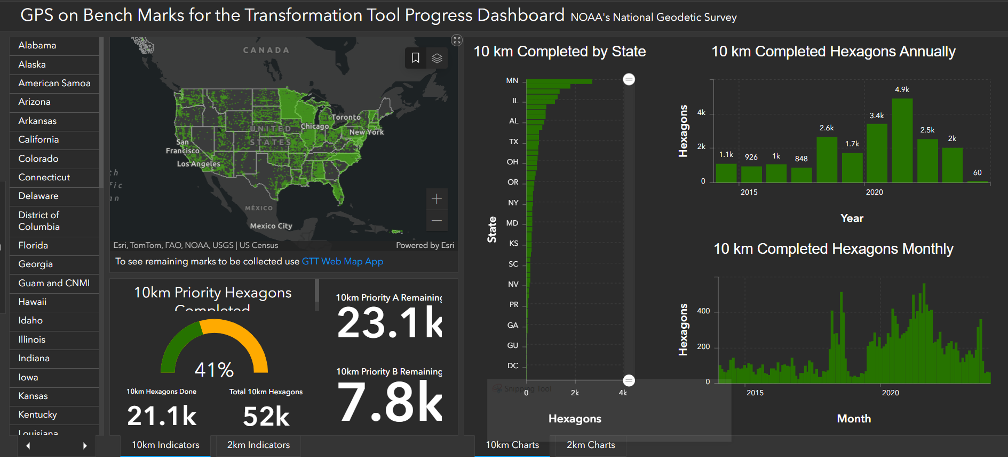
All in all, an amazing effort

Slide 13
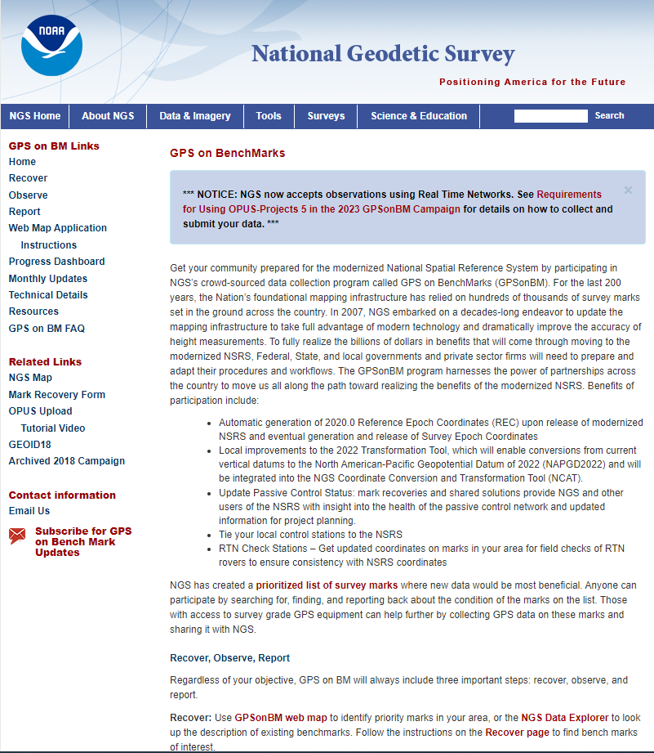
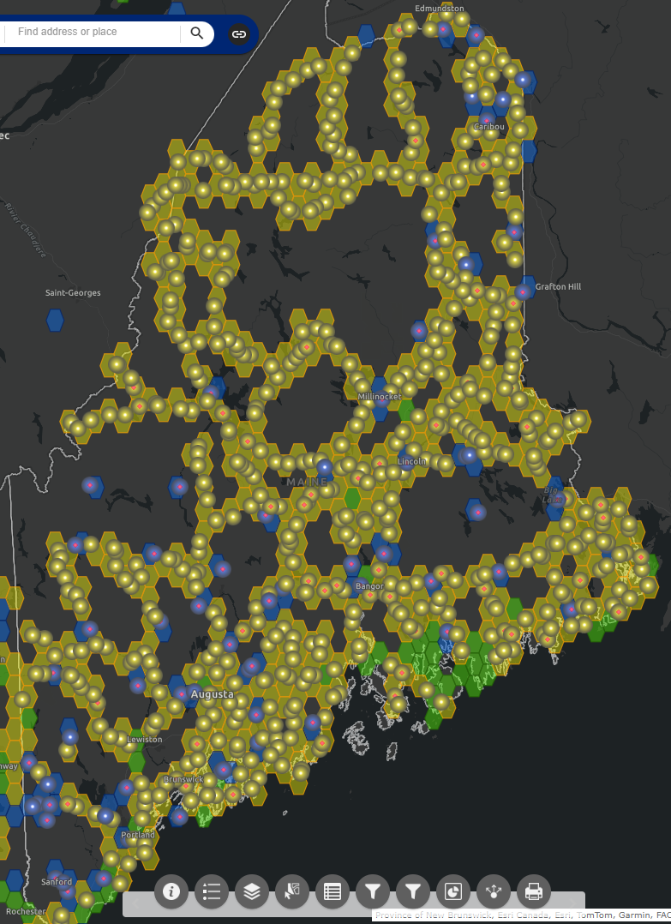
Observe and Share one in your area…there is still time!

Slide 14
LASER
Least squares Adjustments: Statistics, Estimates and Residuals
Contract began in August 2020
Solves many LSA problems
    Has been tested on historic NGS archives
  Uses the pre-existing Eigen library of linear algebra routines

Slide 15
A (probably incomplete) history of LSA software at NGS
INERT1 (1982) …….. Inertial
HOACOS (1979)…… Precursor to Adjust
HAVAGO (1979)……. Precursor to Adjust for 3D djustments
ADJUST ……………. Horizontal, modified for GPS, used by OP
GPSCOM/LLSOLV...Used to compute CORS network, early OP
ASTA………………...Geodetic leveling
NETSTAT …………...Built for 2007 adjustment, used again in 2011
APOGEE…………….Relative Gravity
CALIBRATE……….. Calibration Baselines
Additionally, LSAs are encompassed within this NGS software tool:
PAGES
Also, there is the following stand-alone set of matrix manipulation subroutines:
Heart Of Gold (1984)

Slide 16
Concerns: General
Inconsistency
  Different languages, different variable names, and different times lead to inconsistency in code
    Some programs might be perfectly compatible, but it’s difficult to know with such a vast number of authors and code over the years.
Lack of generality
  Code written to adjust only one type of geodetic observation has limited usefulness to other applications
Languages: FORTRAN, C++, MATLAB are all in use today
Scalability

Slide 17
Software for PRojecting Observations, Constraints and Cofactor matrices/Errors through Time (SPROCCET)
Replaces HTDP
Support for orthometric data
Use of Geodetic Data eXchange (GDX) format
Use of IFDM2022
Error propagation through time
Distinct modules for 14-parameter Helmert transformations and deformation models

Slide 18
NSRS Modernization Alpha Site
Provides examples of the content, format, and structure of select data and products that NGS plans to release as a part of the Modernized NSRS
Products found on this page are for testing purposes only and do not contain any authoritative NGS data or tools

Slide 19
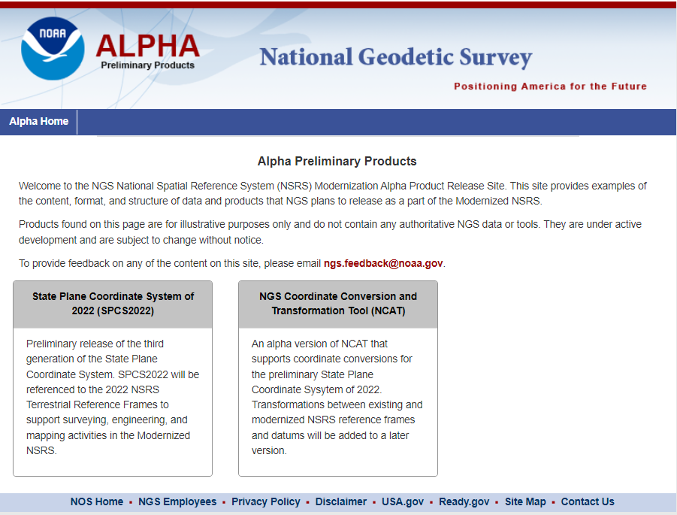

Slide 20
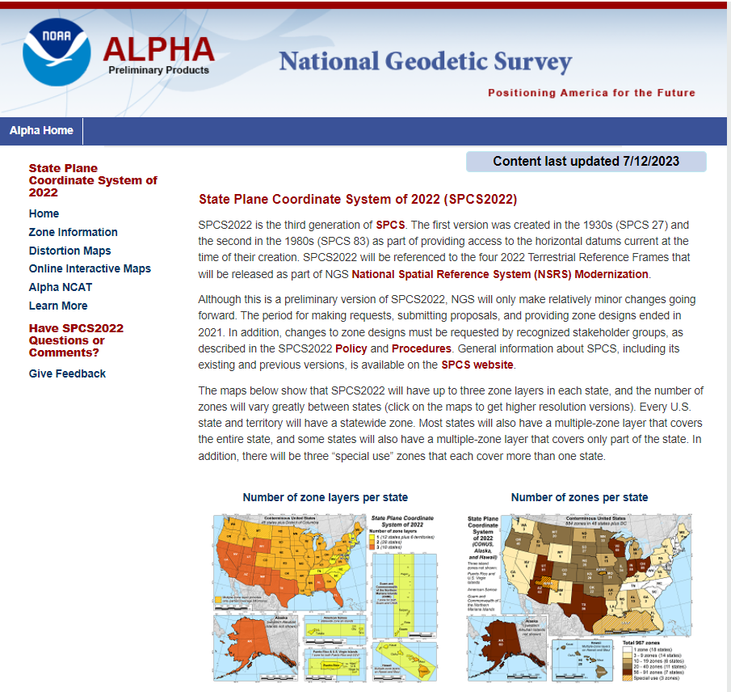

Slide 21
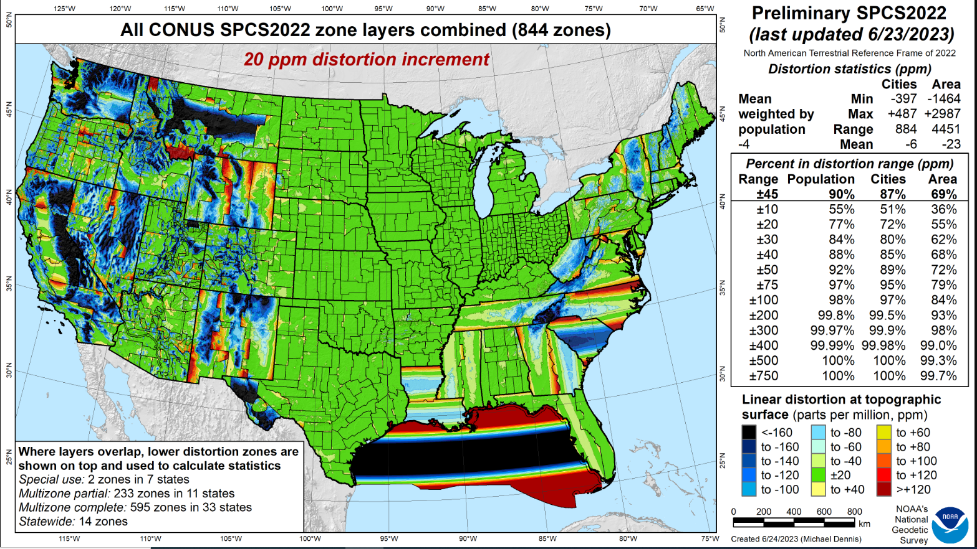
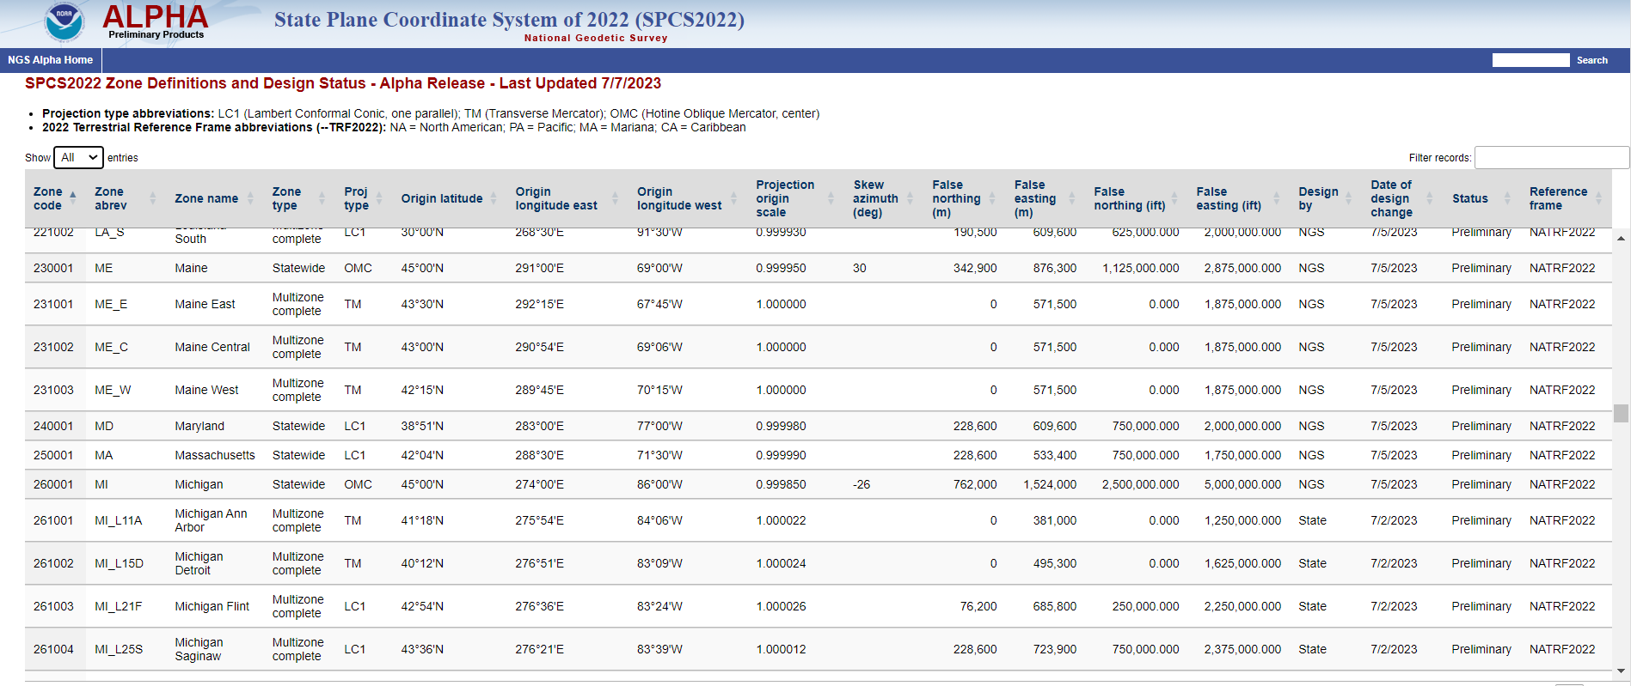

Slide 22
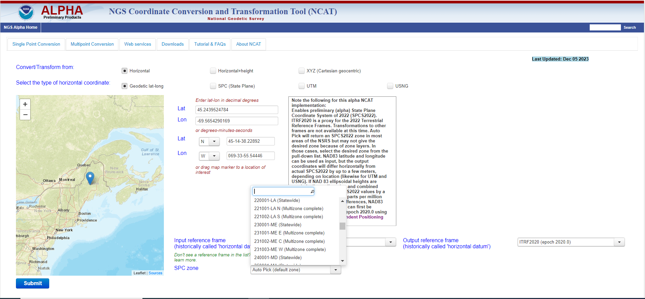
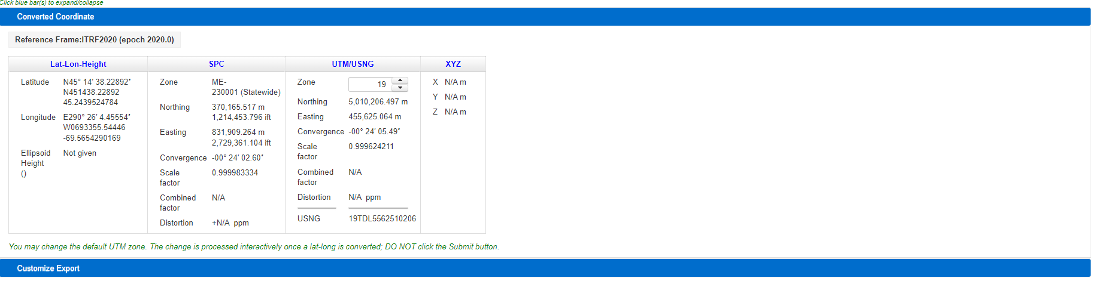

Slide 23
What’s New in OPUS World?
OPUS Projects 5.1 moved to Production
  Current version 5.2
  Full support for Bluebooking
  Supports the uploading, QA/QC, adjustment, and submission for publication of real-time kinematic (RTK) vectors in the GVX file format.
  Working to replace mandatory, instructor-led Managers training with self-paced, online videos and tutorials.
  OPUS 5.0 in Beta (includes M-PAGES)
    Multi-constellation

Slide 24
GNSS Vector EXchange Format (GVX)
Website: https://www.ngs.noaa.gov/data/formats/GVX/index.shtml
Detailed documentation
Schema (XSD)
Example vector files
GVX is written in Extensible Markup Language (XML)
Designed to store and carry data in plain text format
Flexible representation of arbitrary data structures
Extensible – new elements can be added later without breaking applications
Both machine-readable and human-readable
Schemas can be used to define “must haves” and “should haves”

Slide 25
GVX Do’s and Don’t’s
Make sure your manufacturer supports GVX
Collect RTK/RTN observations
  Recommend between 3 and 6, 5-min observations, some should be on a different day
  Make sure that you are storing the vector in addition to coordinates
  If RTN, make sure the vector is from a Physical Reference Station, not from a Virtual Reference Station
  If Base is not a NCN station, collect static data on it to be processed in OP

Slide 26
GVX Do’s and Don’t’s Cont…
Load observations to your office software
  some manufactures allow the creation of GVX in the data collector.
  Convert your vector(s) to GVX Format
Upload to an OPUS Project

Slide 27
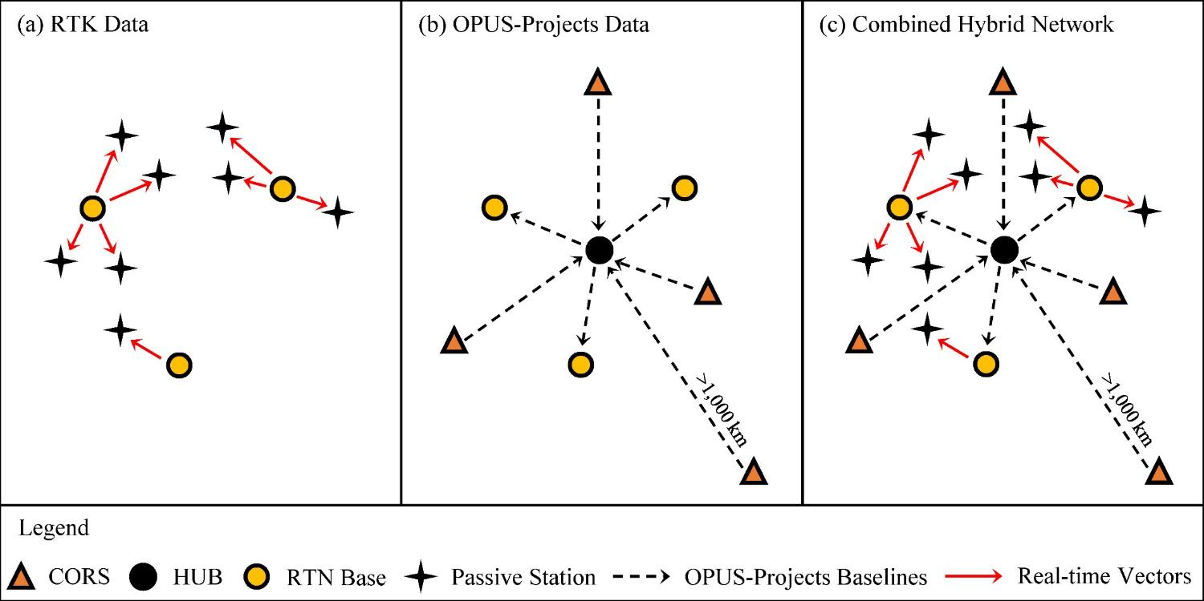
Design for OPUS-Projects and GVX
GVX file (from RTK survey or baseline processing in other software)
OPUS-Projects (from static GNSS session processing)
500-800 km
500-800 km
RTK Base or “From” Mark
RTK Rover or “To” Mark
Vector
Vector in GVX File
[Adapted from Weaver et al. 2018]

Slide 28
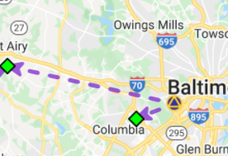
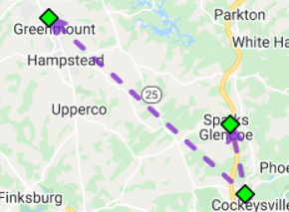
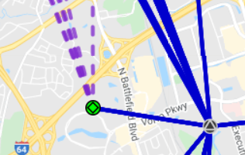
Three Cases for RTK/RTN Bases
RTN Base = CORS
Automatically attaches GVX vectors to official coordinates for CORS
Constrain CORSs
RTK/RTN Base = Not a CORS and new to NGS
Upload static GPS data logged at the base during the days of the RTK survey
Perform session baseline processing to connect to CORSs
Constrain CORSs
3. RTK/RTN Base = Not a CORS but has a datasheet
Could constrain coordinates on datasheet
Or, upload static data at the RTN base, logged during the days of the RTK survey; perform session baseline processing; constrain CORSs

Slide 29
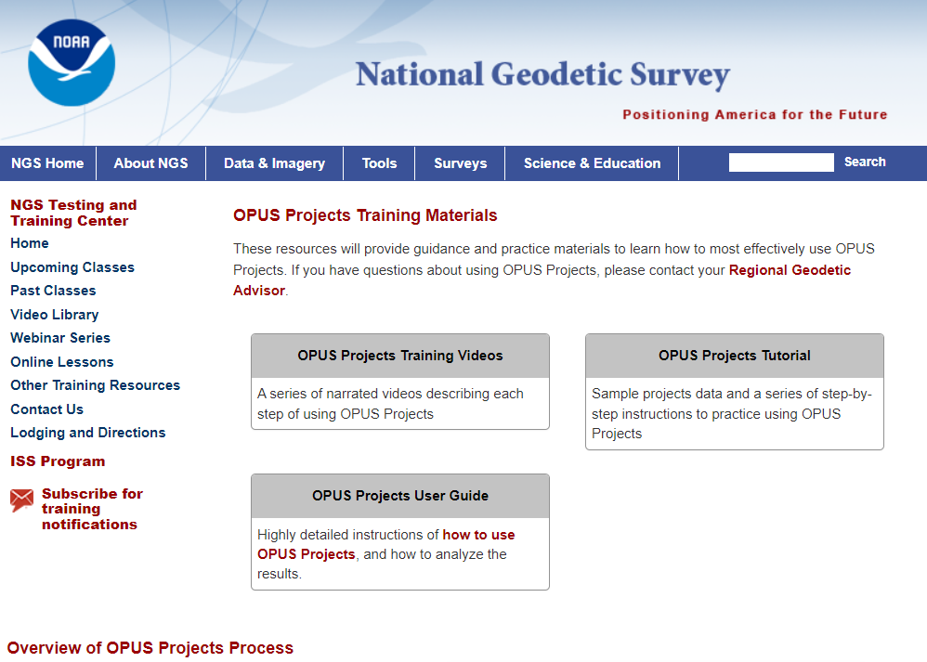

Slide 30
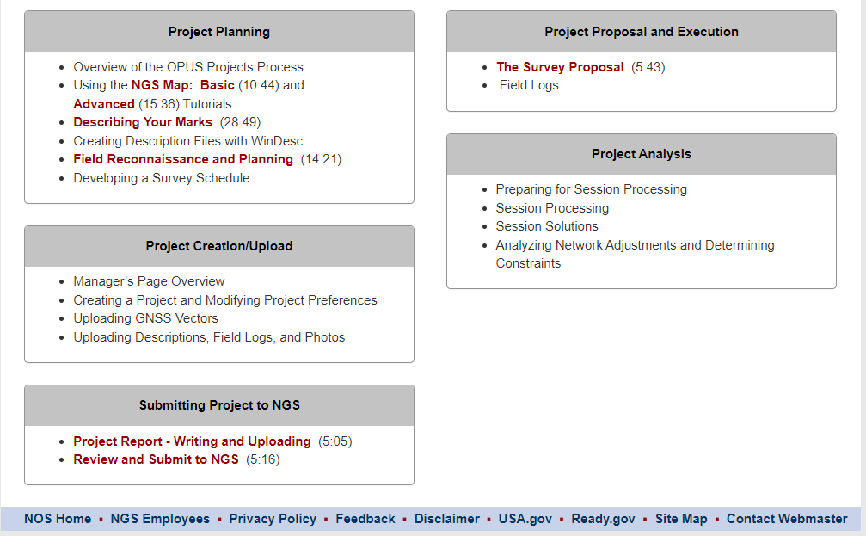

Slide 31
M-PAGES = Multi-GNSS PAGES
Currently in BETA!!
Capable of ingesting all GNSS observables currently supported by the global infrastructure
Capable of using more than two frequencies.
Capable of ingesting RINEX 2 or 3
  Version 2 only supports GPS and GLONASS, Galileo (to a limited extent)
  Submission of proprietary data will result in RINEX 2.11 (limitation of TEQC). NGS will ONLY accept RINEX submission in the near future.
Capable of using pseudorange and phase.
Uses a single-difference processing strategy.
M-PAGES can support NGS strategic objectives.
January 26, 2021
Multi-GNSS OPUS : First Call for Internal Testing

Slide 32
M-PAGES
GPS : Global Positioning System
GLONASS: Globalnaya Navigatsionnaya Sputnikovaya Sistema
Galileo :
BeiDou : BeiDou Navigation Satellite System
BDS, BeiDou-2, COMPASS
IRNSS : Indian Regional Navigation Satellite System
NavIC
QZSS : Quasi-Zenith Satellite System
Michibiki
SBAS : Satellite-based Augmentation Systems
https://en.wikipedia.org/
January 26, 2021
Multi-GNSS OPUS : First Call for Internal Testing

Slide 33
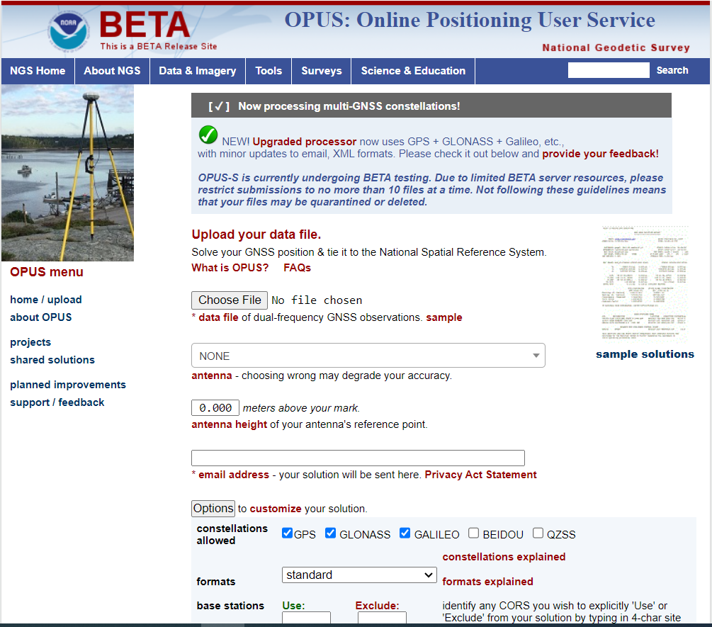

Slide 34
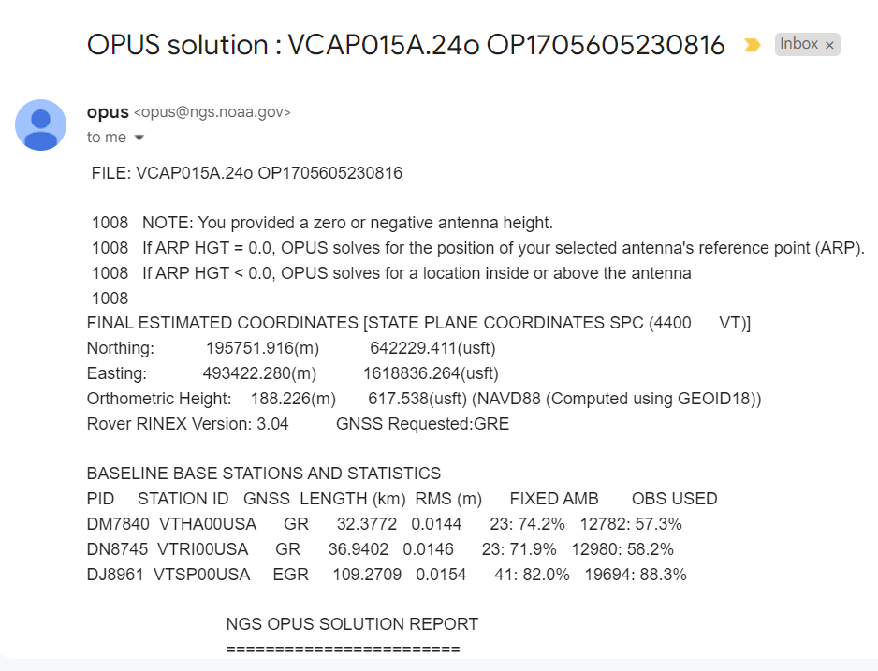

Slide 35
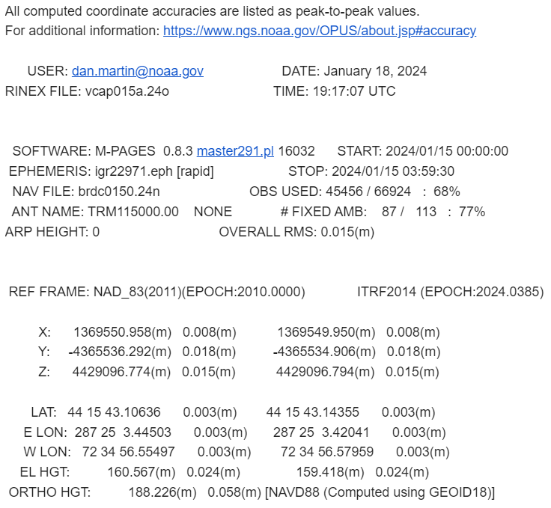

Slide 36
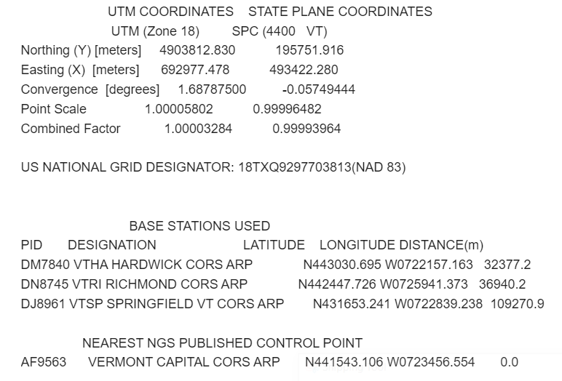

Slide 37
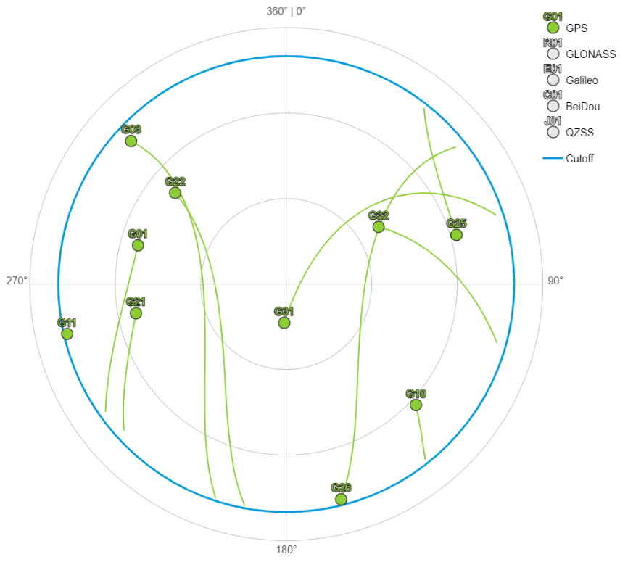
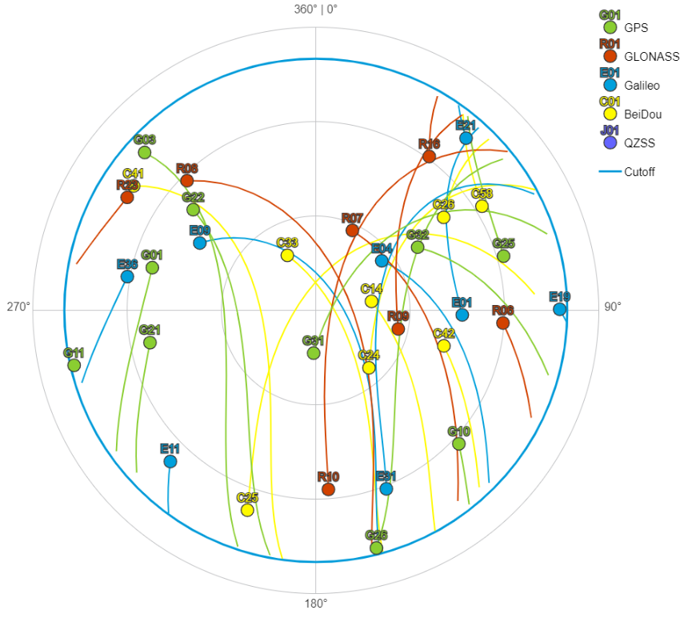
Why All the Fuss?
The distribution of and changes in the relative positions of the satellites with respect to the receiving antenna are the most important data characteristics for high accuracy positioning.
GPS (left) is good. Multi-GNSS (right) is better.
https://www.gnssplanning.com/#/settings
January 26, 2021
Multi-GNSS OPUS : First Call for Internal Testing
Notes:
Geographic center of CONUS, 2021-1-12 12:00 PM - 6:00 PM CST

Slide 38
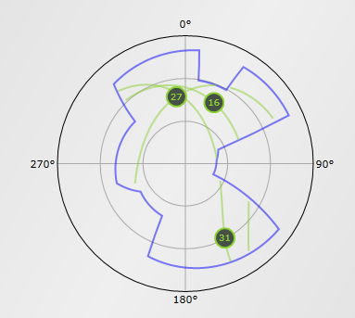
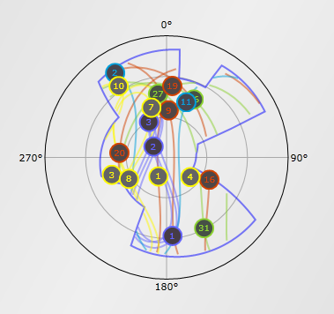
Obstructed View
Simulated sky coverage in urban or natural canyon.
GPS-only (left) isn’t viable. Multi-GNSS (right) is.
http://www.gnssplanningonline.com
January 26, 2021
Multi-GNSS OPUS : First Call for Internal Testing

Slide 39
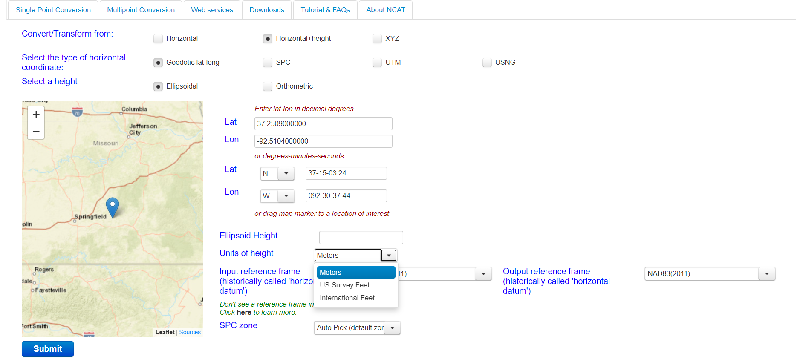
NCAT v2.1
Added selection of units on heights
Added option to customize data exported

Slide 40
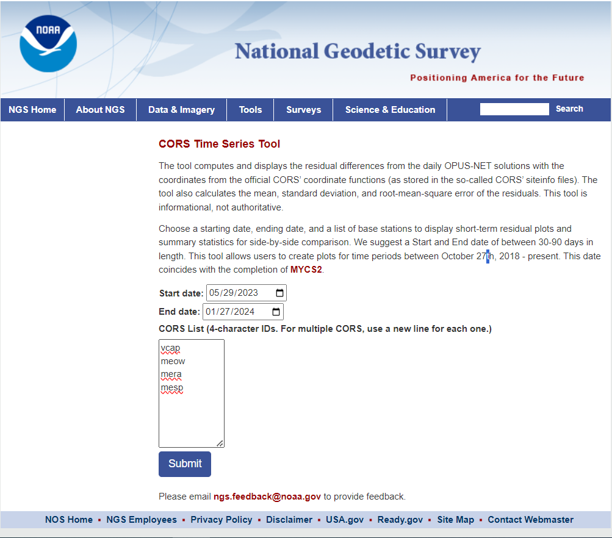
CORS Page short-term series only shows last 90 days

Slide 41
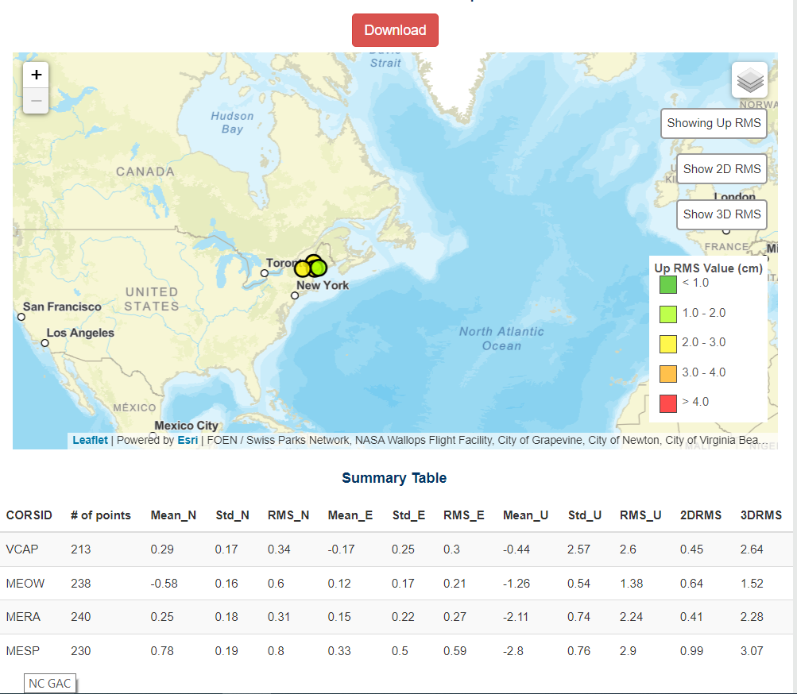

Slide 42
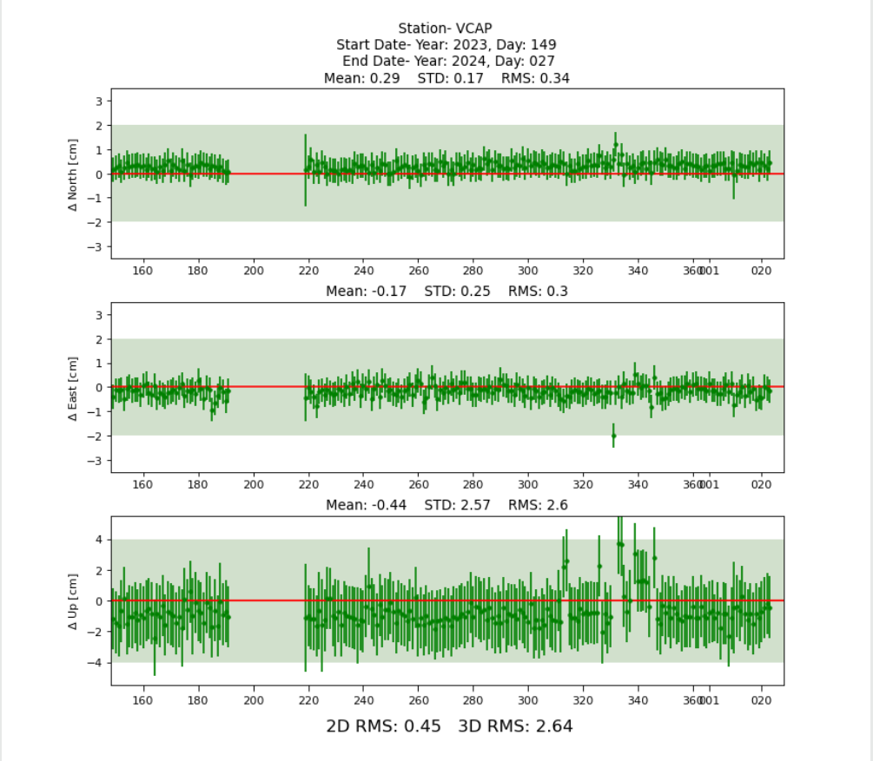

Slide 43
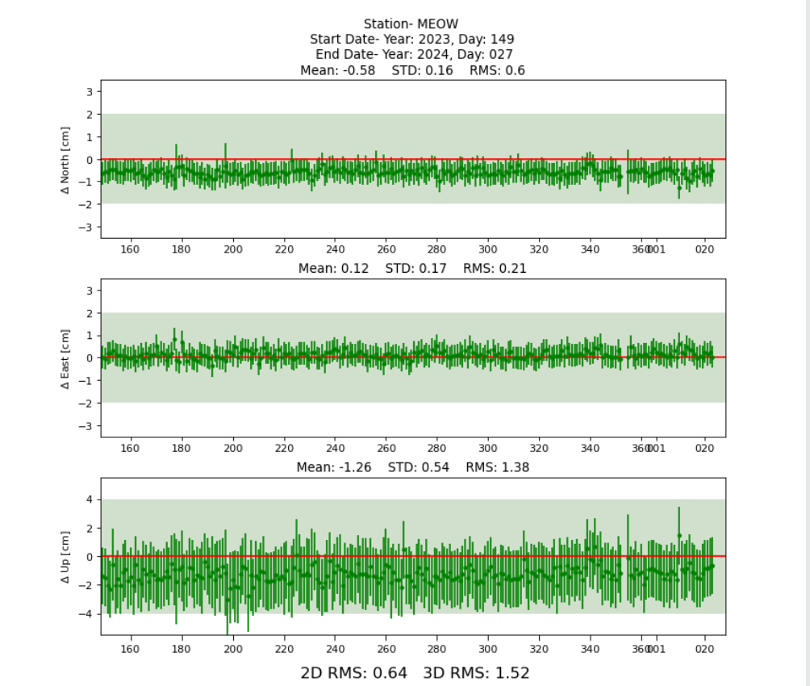

Slide 44
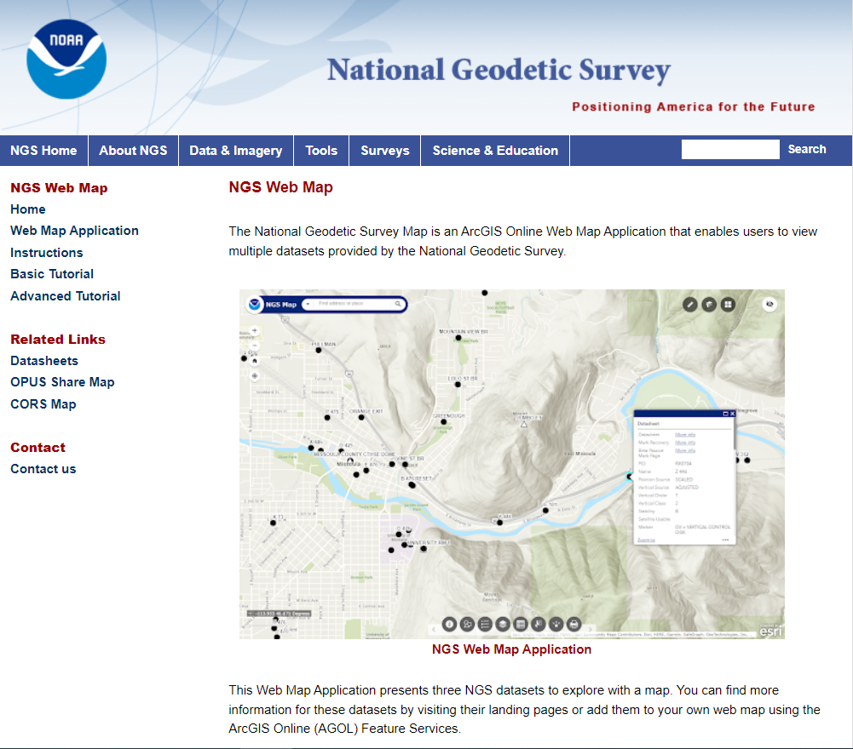
Replaces NGS Data Explorer

Slide 45
Lets go Live
NGS Web Map

Slide 46
Thank You!
Questions?
Presentation will be available at:
https://www.ngs.noaa.gov/web/science_edu/presentations_library/
Dan Martin
Northeast Regional Geodetic Advisor
ME, NH, VT, MA, CT, RI, NY, NJ
Dan.martin@noaa.gov
240-676-4762

