Slide 1



“Datums and State Plane Coordinate Changes for 2022”
Alabama Association of Floodplain Managers
2019 Fall Conference
Orange Beach, AL
October 28, 2019
Denis Riordan, PSM
NOAA, National Geodetic Survey
denis.riordan@noaa.gov

Slide 2
U.S. Department of Commerce National Oceanic & Atmospheric Administration National Geodetic Survey
Mission: To define, maintain & provide access to the
National Spatial Reference System (NSRS)
to meet our Nation’s economic, social & environmental needs
National Spatial Reference System
* Latitude * Scale
* Longitude * Gravity
* Height * Orientation
& their variations in time
Notes:
- NSRS benefit to the nation = $2.5B/year
est. 300K precision GPS users worldwide (2008); ¼ in US
- Very exciting to us at NGS to see how it has evolved over the years – now cm-accuracy capability / tracking with time

Slide 3
New U.S. Geometric Datums in 2022

Slide 4
National Spatial Reference System(NSRS) Improvements in the Horizontal Datums
TIME NETWORK METHOD
NETWORK SPAN ACCURACY OF REFERENCE
NAD 27 1927-1986 10 meter
NAD83(86) 1986-1990 1 meter
NAD83(199x)* 1990-2007 0.1 meter
HARN
NAD83(2007) 2007 - 2011 0.01 meter
(CORS)
NAD83(2011) 2011 - 2022 0.01 meter
(CORS)
TRAVERSE & TRIANGULATION -
GROUND MARKS USED FOR REFERENCING THE NSRS.
TERRESTRIAL BASED
REFERENCE SYSTEM
FOR NSRS
GPS BECOMES MEANS OF POSITIONING – STILL GRND MARKS.
TERRESTRIAL BASED REFERENCED
SYSTEM FOR NSRS
GPS – CORS STATIONS ARE MEANS OF REFERENCE FOR THE NSRS.
SPACE BASED
REFERENCE SYSTEM
FOR NSRS

Slide 5
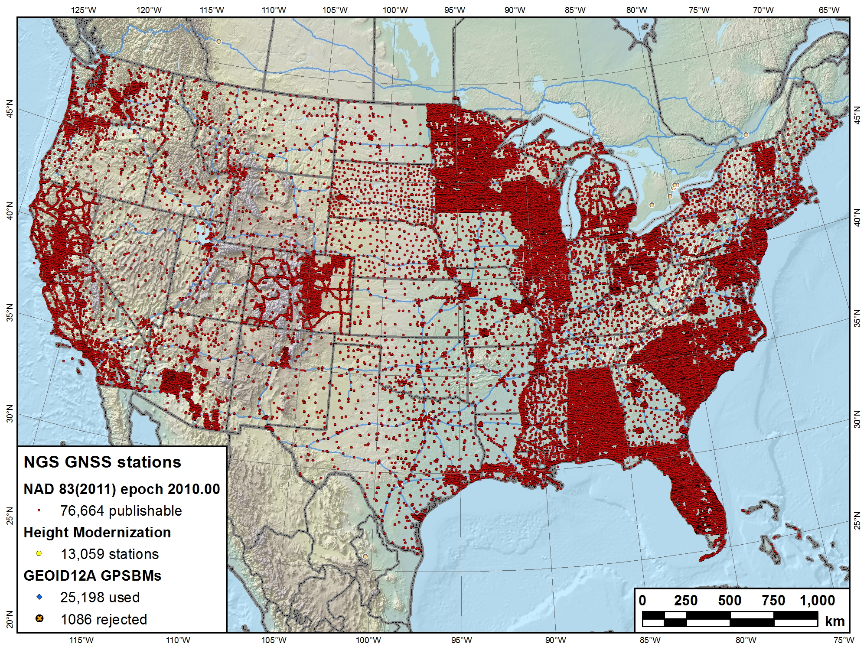
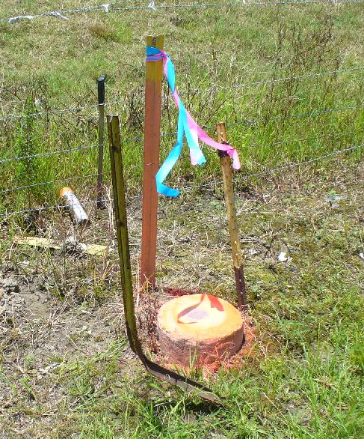
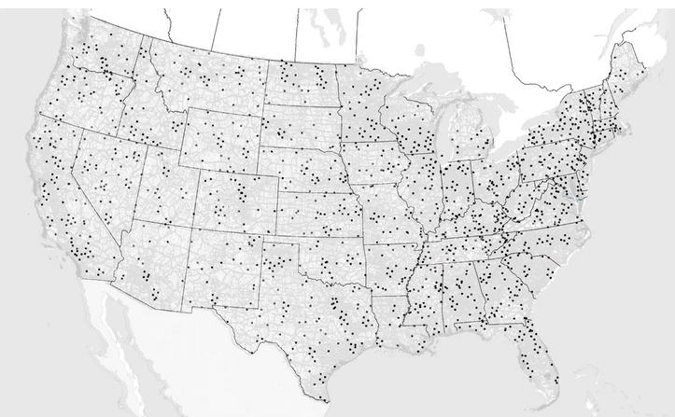
NSRS Reference Basis
Old Method - Ground
Marks (Terrestrial)

Slide 6
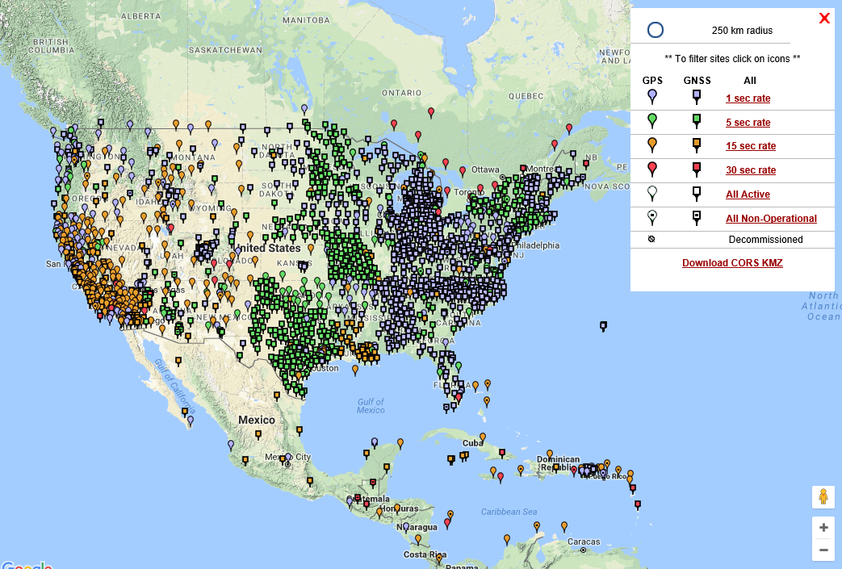
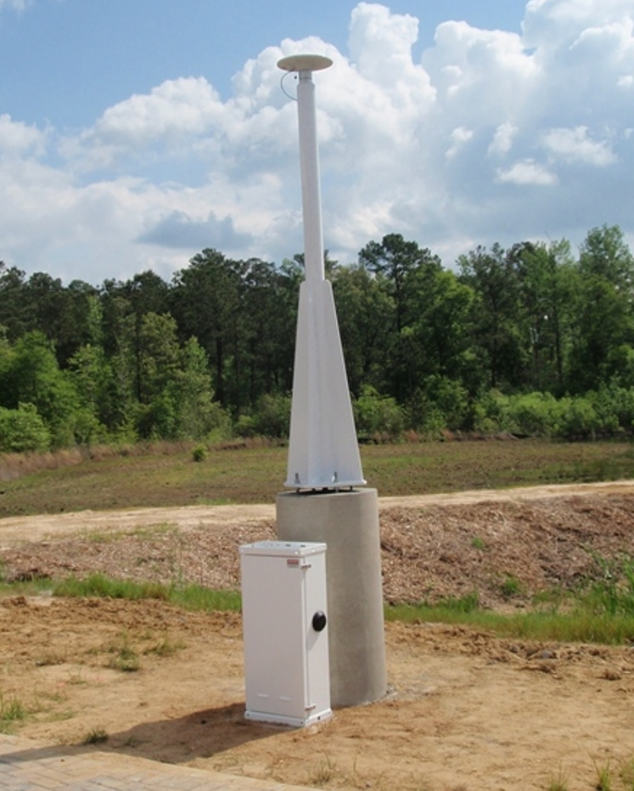
NSRS Reference Basis
New Method - GNSS Stations
(CORS)

Slide 7
Why Replace NAD83?
Datum based on best known information about the earth’s size and shape from the early 1980’s (≈35 years old), and the terrestrial survey data of the time.
NAD83 is NON-geocentric & hence inconsistent w/GNSS .
Necessary for agreement with future ubiquitous positioning of GNSS capability.

Slide 8
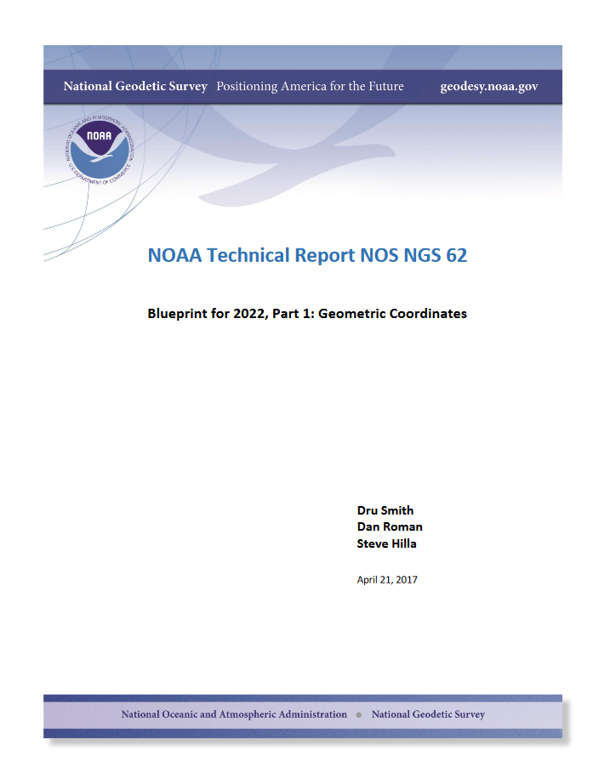
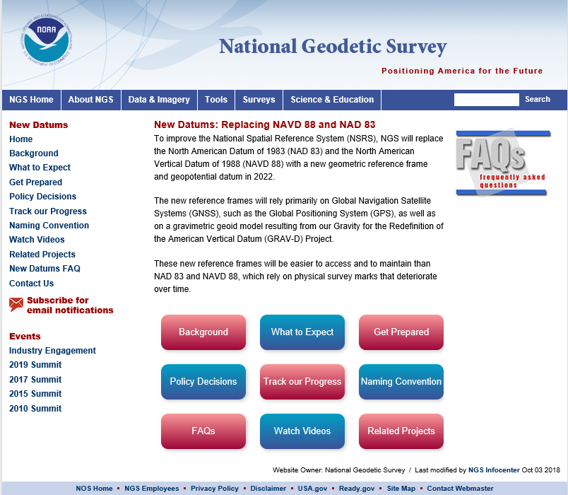

Slide 9
Future Geometric (3-D) Reference Frame
Blueprint for 2022: Part 1 – Geometric Datum
Replace NAD83 with new geometric reference frame – by 2022.
CORS-based, accessed via GNSS observations.
Coordinates & velocities in ITRF (IGS) & new US reference frame.
(coordinates in time) (stable coordinates)
Transformation tools will relate NAD83 to new US reference frame (NCAT with 2022 transformation).

Slide 10
Datum Names
The Old:
NAD 83(2011)
NAD 83(PA11)
NAD 83(MA11)
The New:
The North American Terrestrial Reference Frame of 2022
(NATRF2022)
The Caribbean Terrestrial Reference Frame of 2022
(CATRF2022)
The Pacific Terrestrial Reference Frame of 2022
(PATRF2022)
The Mariana Terrestrial Reference Frame of 2022
(MATRF2022)

Slide 11
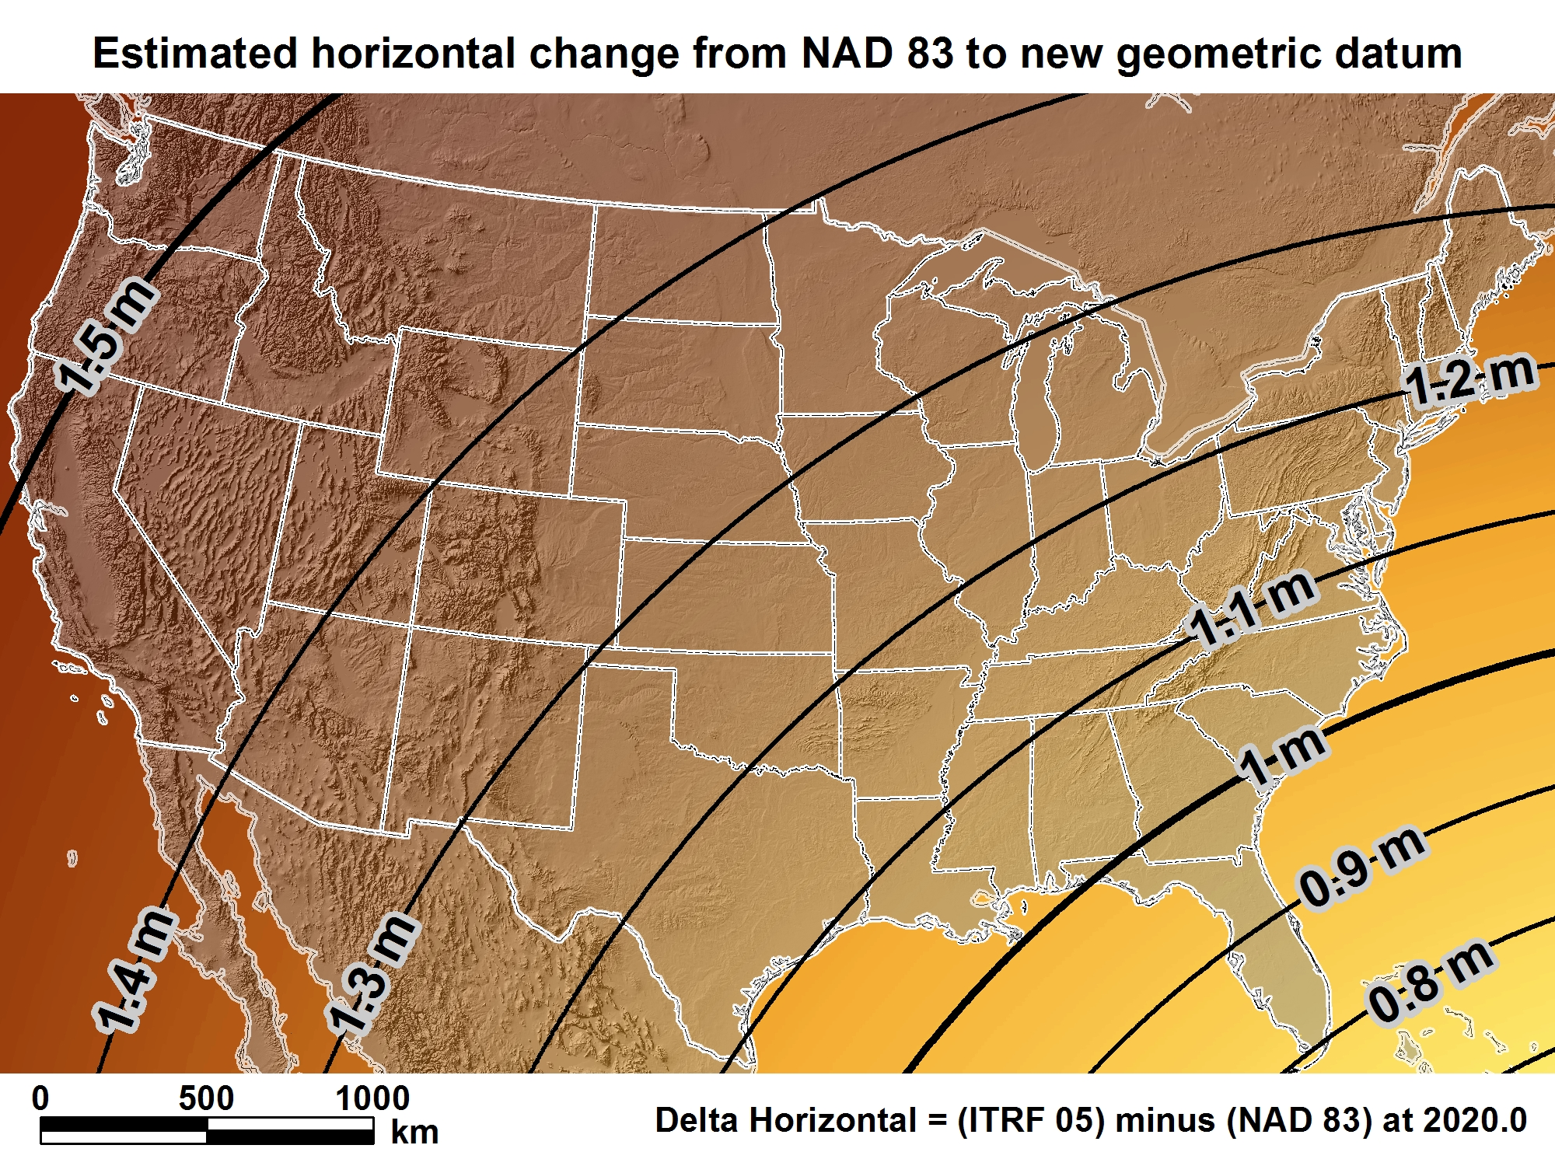
New geometric datum minus NAD 83 (horizontal)
For Alabama = 0.9 > 1.1 m (2.9 > 3.6 ft.)

Slide 12
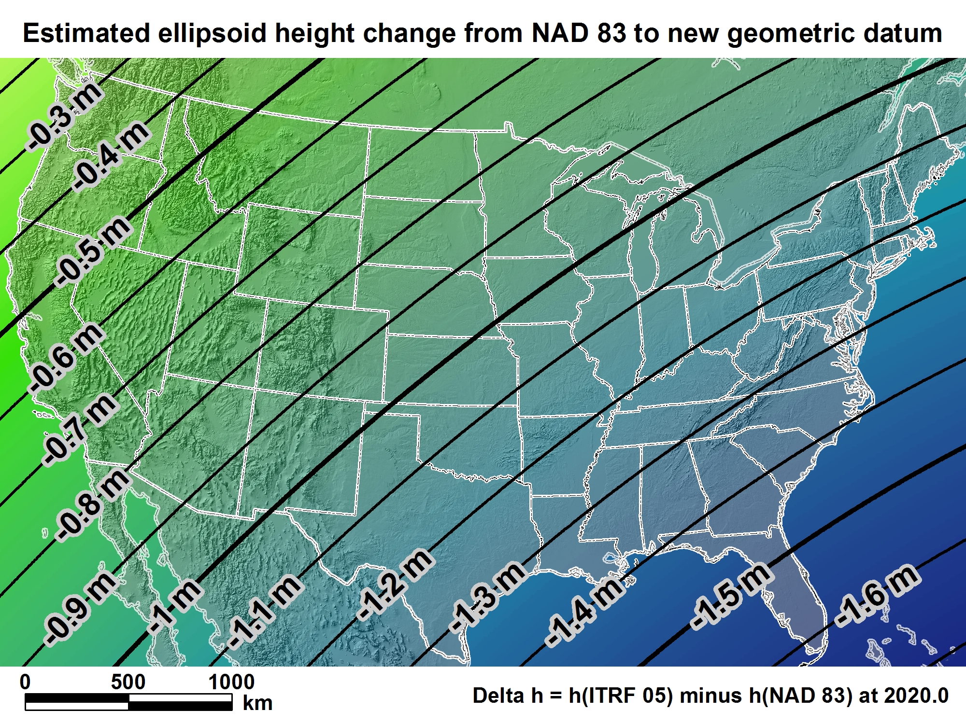
New geometric datum minus NAD 83 (ellipsoid height)
For Alabama = -1.27 > -1.39 m (-4.2 > -4.5 ft.)

Slide 13
New U.S. Vertical Datum in 2022

Slide 14

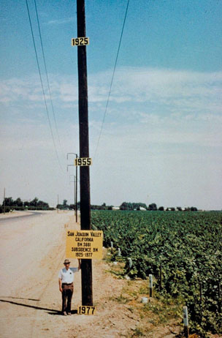
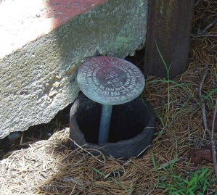
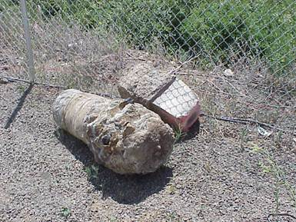
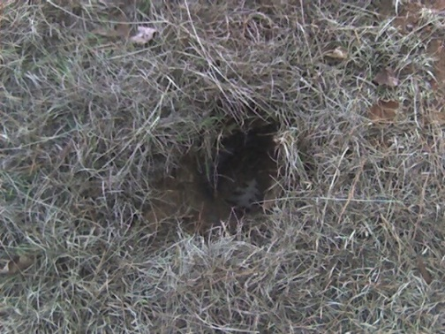
Why isn’t NAVD 88 good enough anymore?
* NAVD 88 is a terrestrial based vertical datum that changes as the land changes.
NAVD 88 suffers from use of bench marks that:
Are almost never re-checked for movement
Disappear by the thousands every year
Are not funded for replacement
Are not necessarily in convenient places
Don’t exist in most of Alaska
Were determined by leveling from a single point, allowing cross-country error build up

Slide 15
Can NAVD 88 be fixed?
Long term fix: Re-level some/all of NAVD 88
81,500 km of 1st order leveling at least
625,000 km of mixed 1st and 2nd order leveling
Re-leveling NAVD 88 estimated to cost between
$200 Million and $2 Billion
Time factor in that amount of leveling
Still would have problems related to passive control
Notes:
Re-leveling NAVD 88 won’t fix:
Sparseness of the bench marks
Continued subsidence or uplift of bench marks
Destruction of bench marks
Canada’s decision not to adopt NAVD 88
Whatever errors caused a continent-wide 1 meter build up in the leveling the first time around

Slide 16
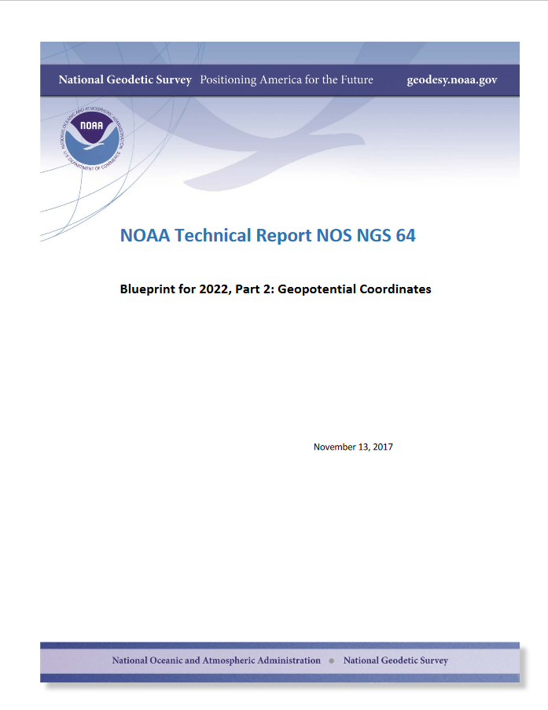

Slide 17
NEW VERTICAL DATUM (Rationale)
A move away from differentially leveled passive control as the defining mechanism of the reference surface
To be consistent with the shift in the geometric reference frame/ellipsoid (2022)
Improvement in our technical abilities in reference surface realization (geopotential gravimetric reference surface - 1cm accuracy of the geoid (GNSS/GRAV-D))
Goal - ability to establish 2cm orthometric height anywhere in U.S. using a minimum of 15 min. of GNSS data.
The new geopotential reference surface will be aligned with the geometric reference frame/ellipsoid (i.e., no hybrid geoid)

Slide 18
Names
The Old:
NAVD 88
PRVD 02
VIVD09
ASVD02
NMVD03
GUVD04
IGLD 85
IGSN71
GEOID12B
DEFLEC12B
Orthometric
Heights
The New:
The North American-Pacific
Geopotential Datum of 2022
(NAPGD2022)
Normal
Orthometric
Heights
Dynamic
Heights
Gravity
Geoid
Undulations
Deflections of
the Vertical

Slide 19
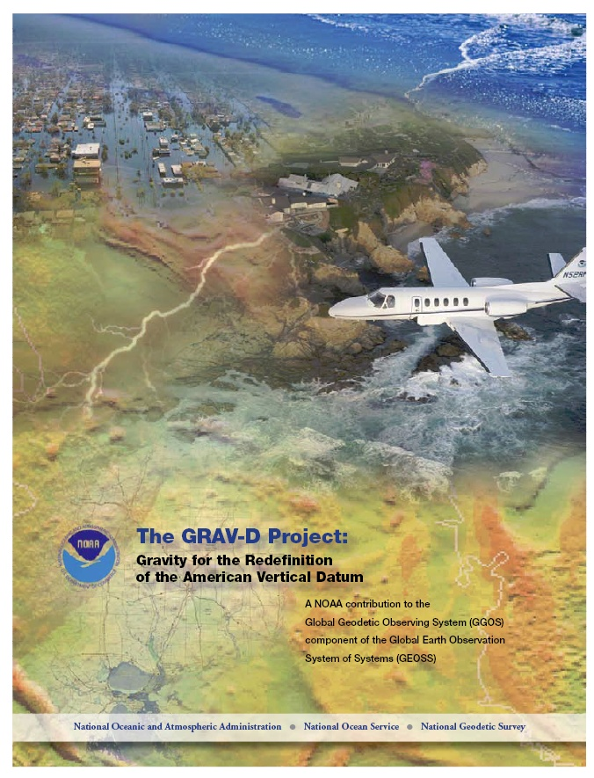
Gravity for the Redefinition of the American Vertical Datum (GRAV-D)
Replace the Vertical Datum of the USA by 2022 (at today’s funding)
GRAV-D is:
An airborne gravity survey of the entire country and its holdings
A 2022 gravimetric geoid accurate to 1 cm
Long-term monitoring of geoid change over time
Partnership surveys
Working to launch a collaborative effort with the USGS for simultaneous magnetic measurement
Acting Manager: Jeffery Johnson
Gravity and Heights are
inseparably connected

Slide 20
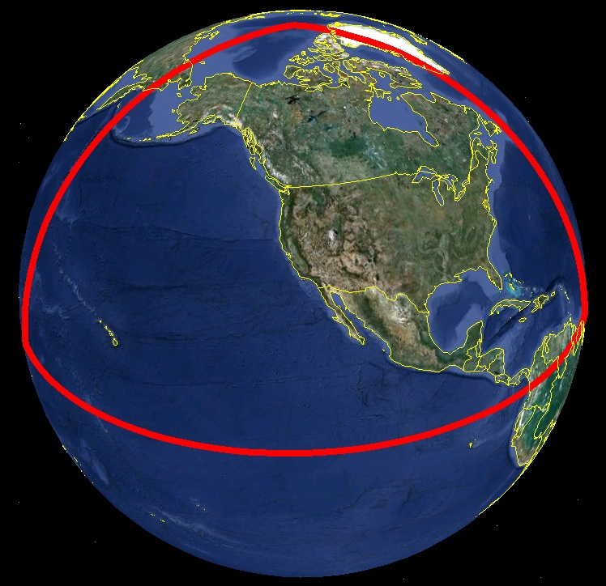
Extent of 2022 gravimetric geoid model used for NAPGD2022

Slide 21
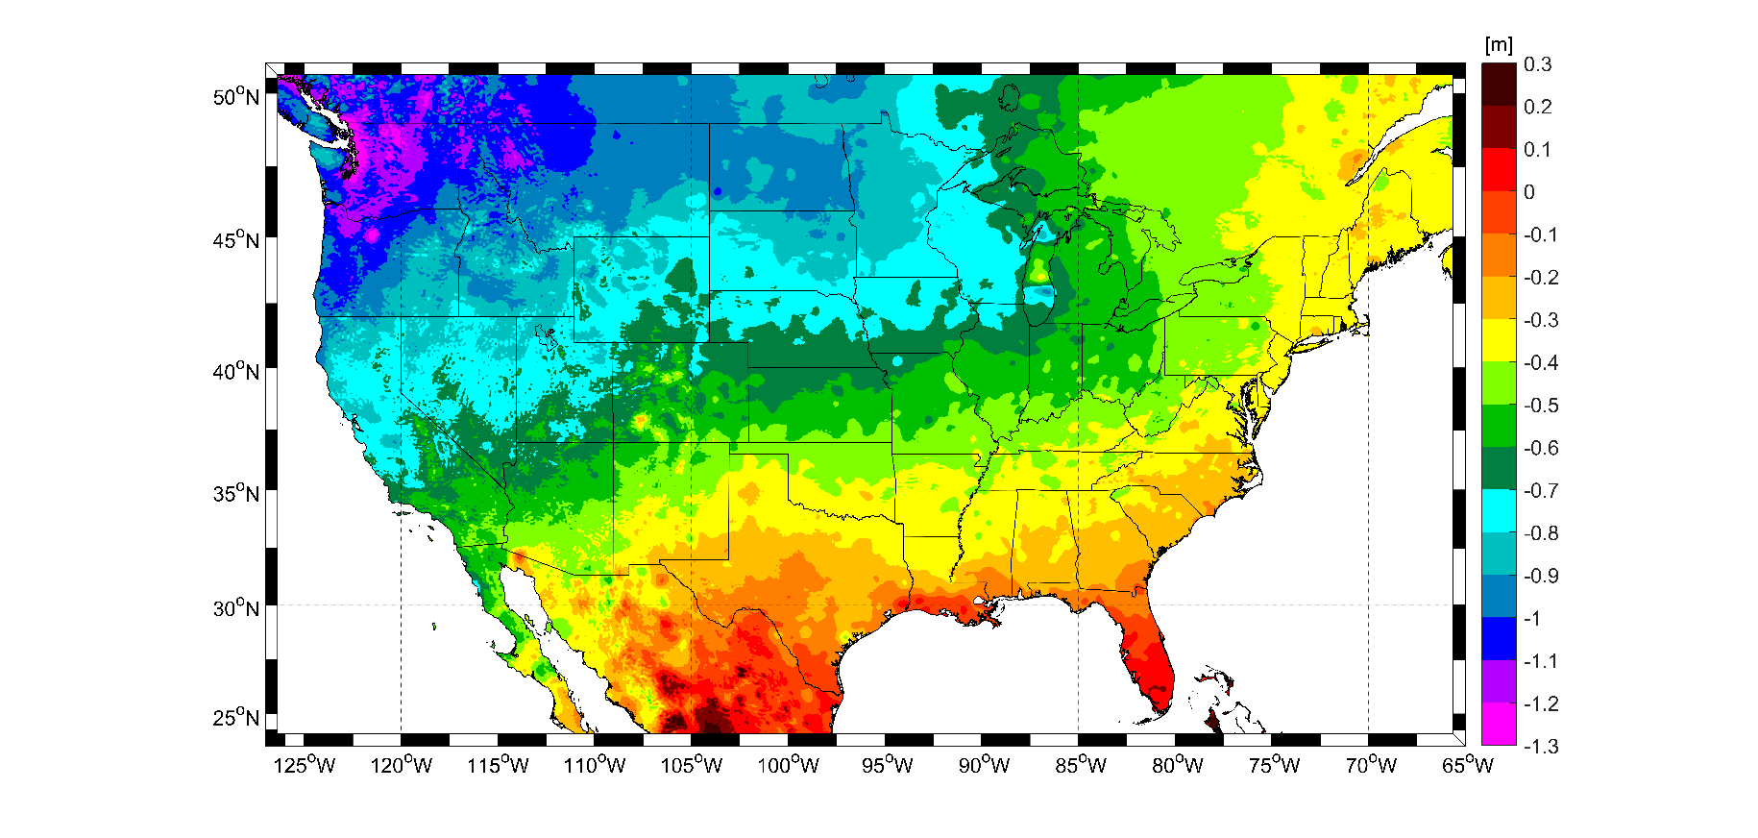
Expected Orthometric height Changes – NAVD88 – NAPGD2022
For Alabama = -0.2 > -0.4 m (-7 > -16 in.)

Slide 22
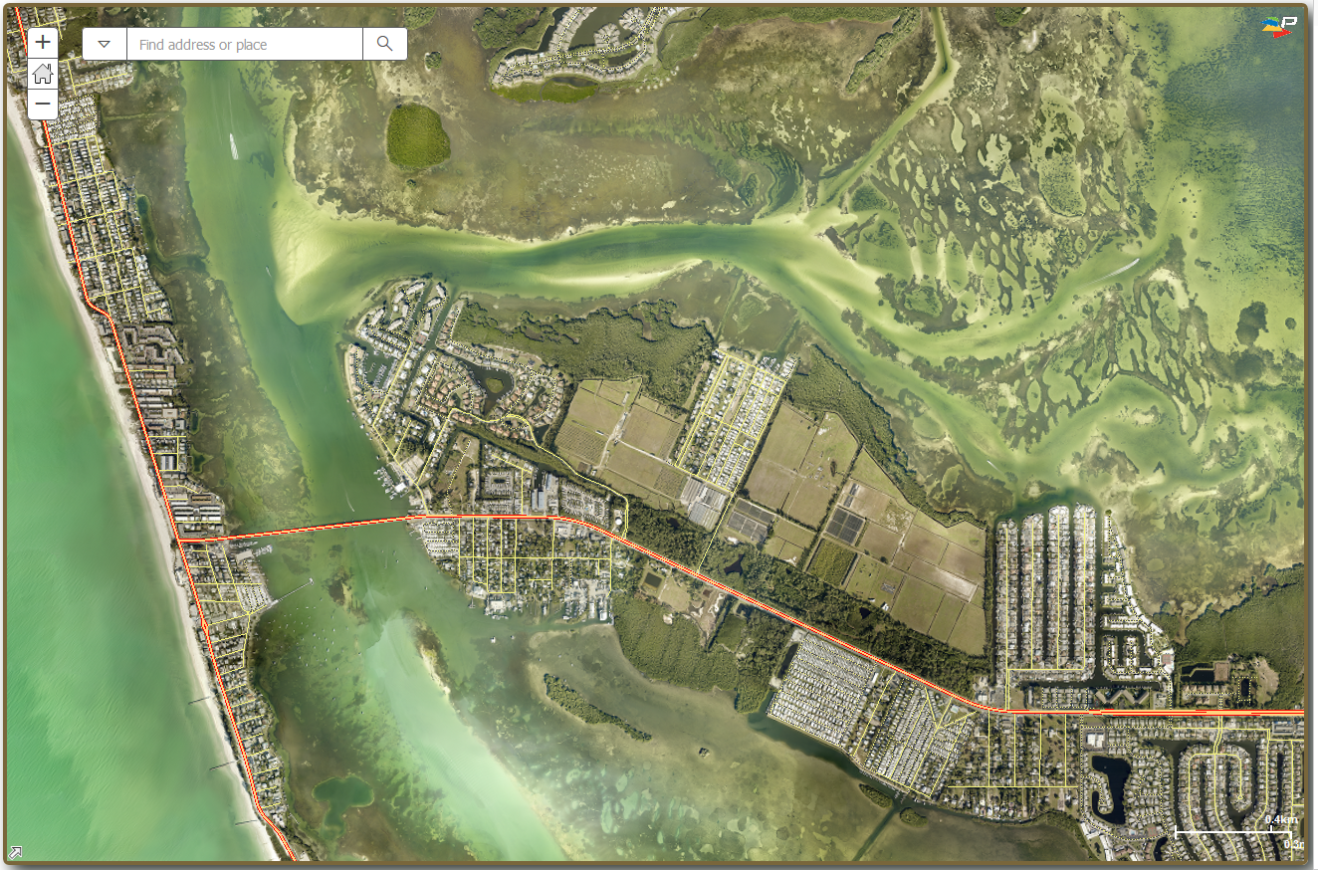
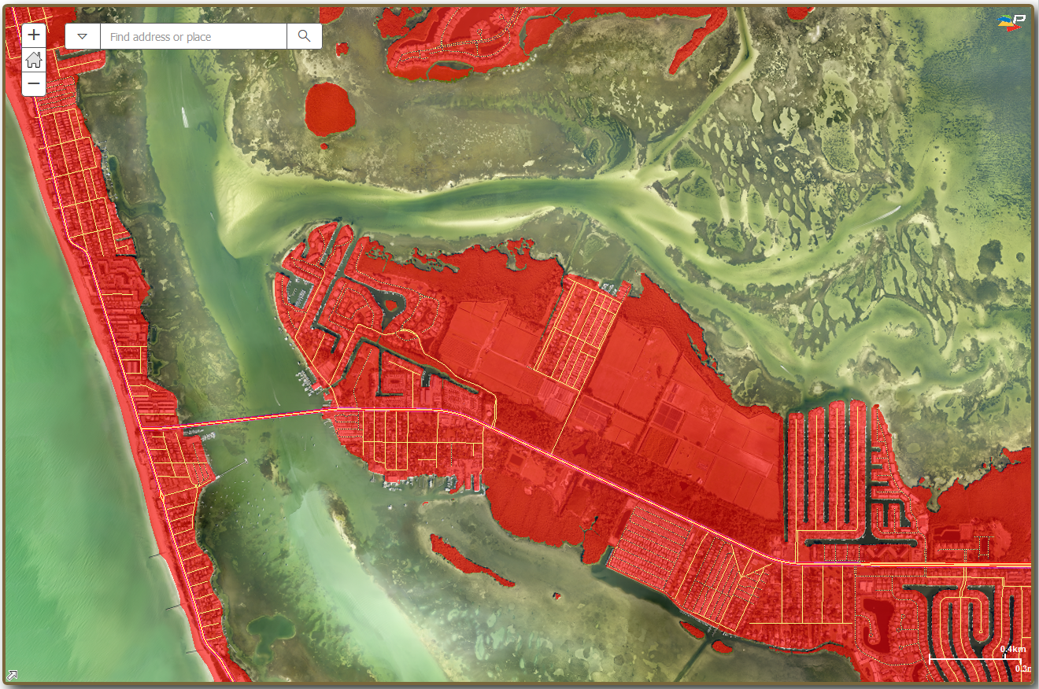
Importance of Correct Positioning
Notes:
NGS Regional Geodetic Advisors
https://geodesy.noaa.gov/ADVISORS/
State Geodetic Coordinators
https://geodesy.noaa.gov/ADVISORS/state-geodetic-coordinators.shtml

Slide 23
How to Plan for 2022
Move to newest realizations
NAD 83(2011) epoch 2010.00
GEOID 18 (hybrid geoid)
Utilize passive marks that are up to date
Stay aware of what marks are included in datum updates
Use OPUS & Hgt. Mod procedures to update mark positions
Metadata
Document positions in current datums to know what you have in the future.
NGS Outreach Efforts
Participate in NGS webinars, Geospatial summits, contact NGS Regional Advisor, etc.
NEW

Slide 24
State Plane Coordinates System - SPCS 2022 Project

Slide 25
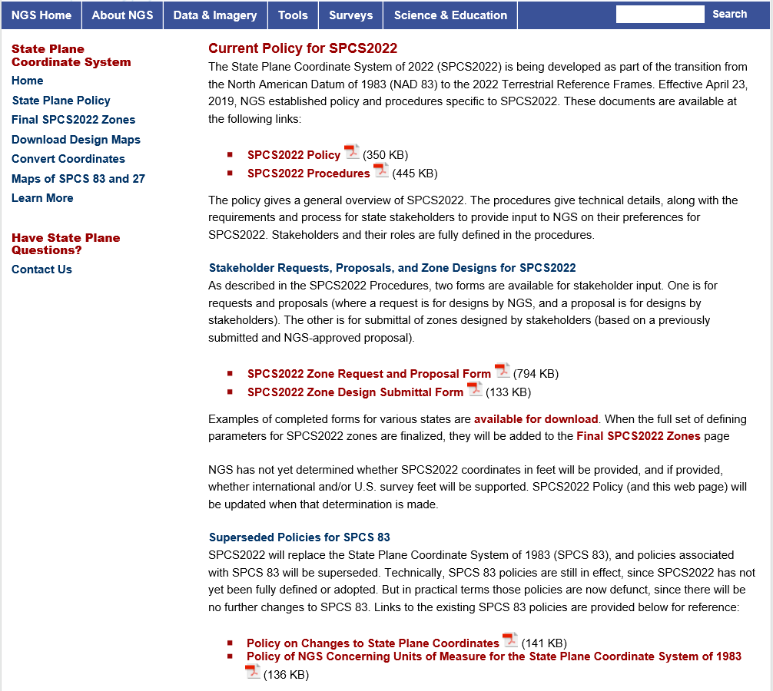
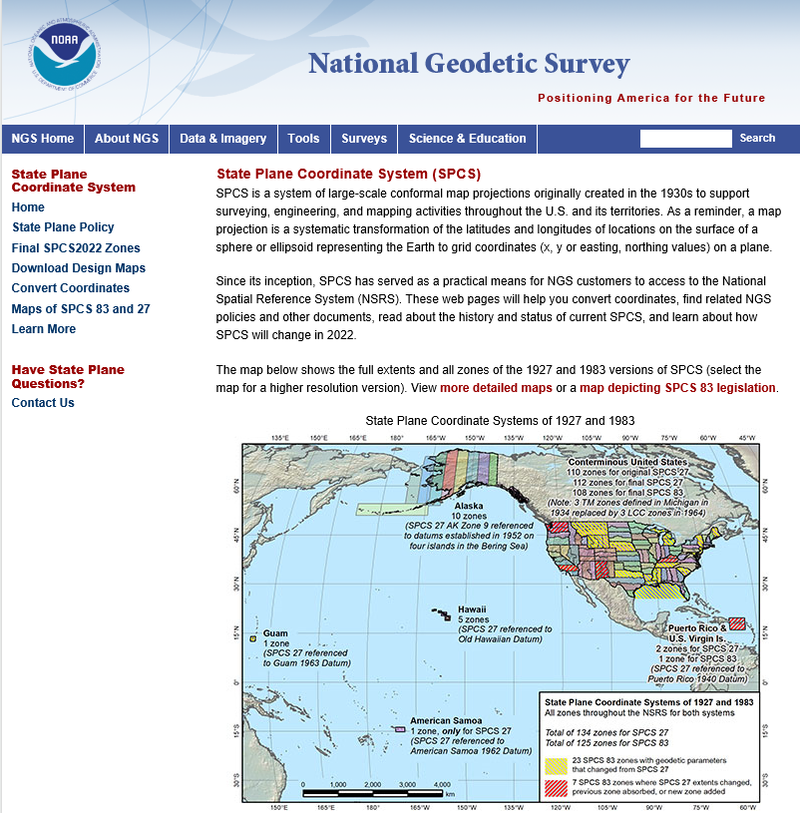
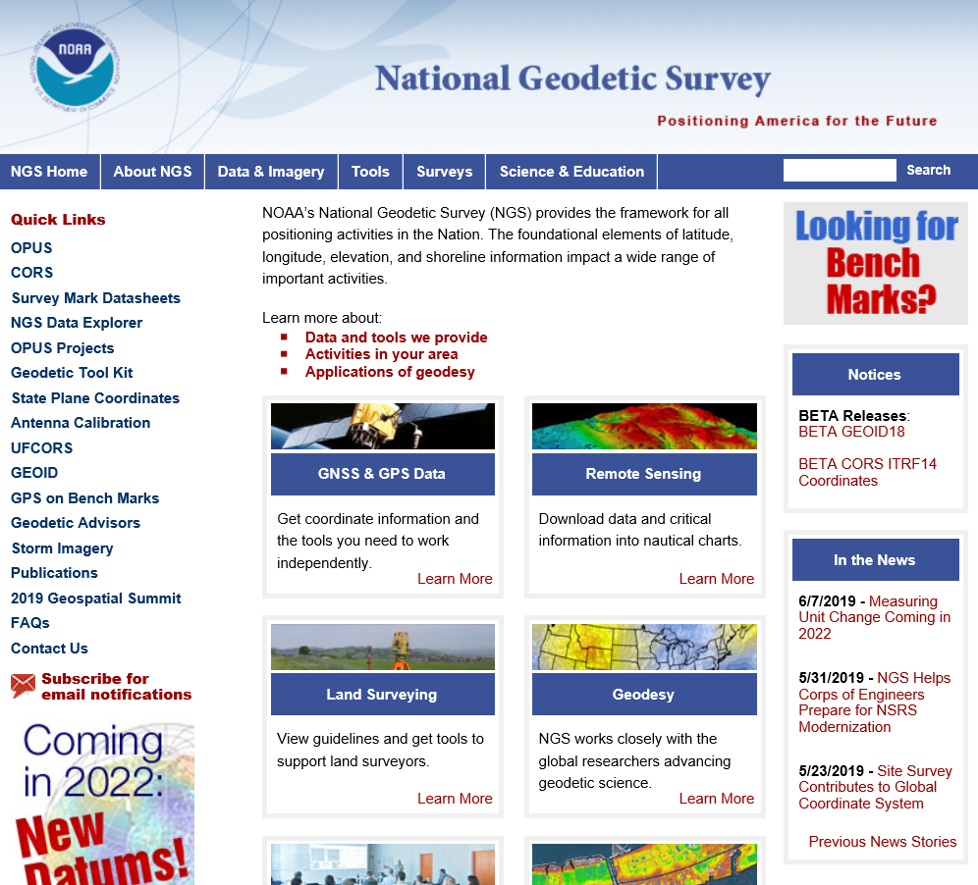

Slide 26
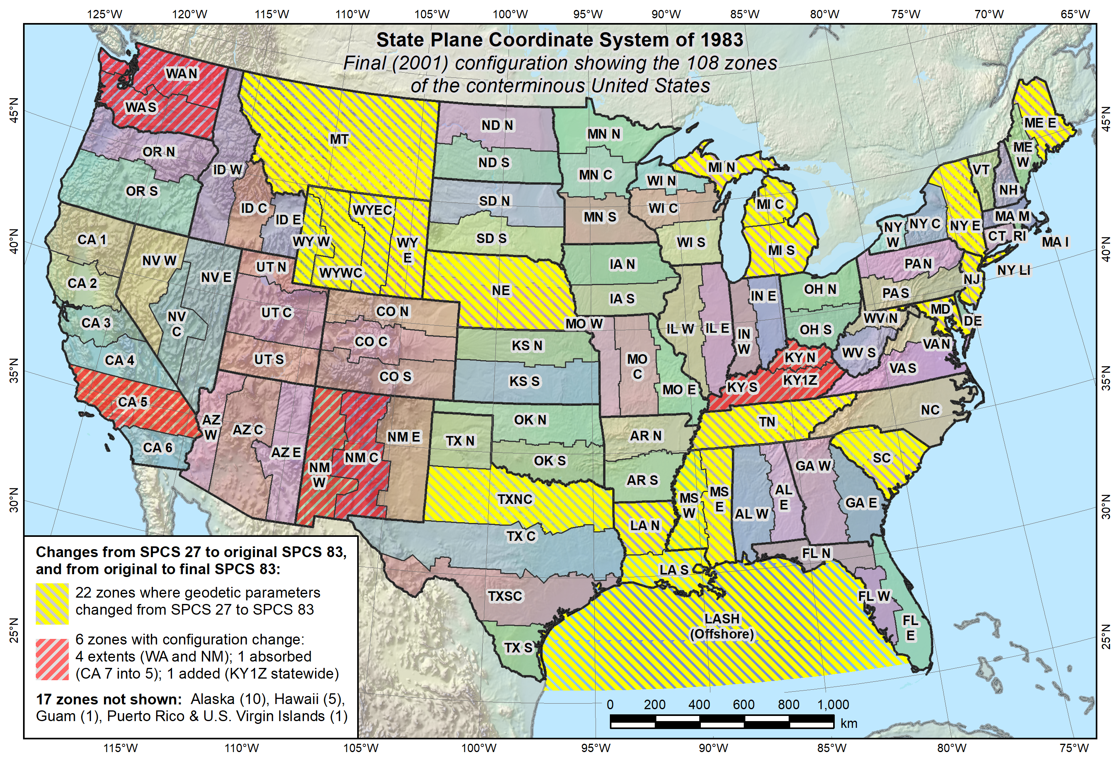
Final SPC 83 State Systems - 2001

Slide 27
SPCS2022 Stakeholders
State groups that form the “Stakeholder Group”
Departments transportation, Cartographer/GIS office
Professional surveying, engineering, GIS societies
Colleges/universities with geospatial curriculum
Federal agencies can “sign on” with states
NGS is looking for a “consensus” response from the Stakeholders of each state

Slide 28
New State Plane Coordinate System
SPCS2022 characteristics different from SPCS 83:
NGS will design statewide and default zones
Up to 3 zone “layers” allowed (including an LDP layer)
Coordinate changes of at least 10,000 m everywhere
Longitudes will be positive east (0° to 360°)
(Orange Beach = 360° - 87° = 273° E)
Notes:
SPCS2022 is referenced to 2022 TRFs and thus part of new “datums”, and will replace existing SPCS 83 (referenced to NAD 83)
Similar to SPCS 83 in some ways:
Designed by state, using same reference ellipsoid and same projection types
Differs from SPCS 83 in other ways:
Designs minimize distortion at topographic surface rather than ellipsoid surface (reduces distortion where system is actual used)
NGS will design default zones for every state, and default zones corresponding to existing SPCS 83 zones for states that do not request or propose something different
Can have up to 3 zone layers (where one layer must be a statewide zone). The other layers can be default zones and/or LDP zones (but not designed by NGS). Only one layer can be discontinuous (i.e., zones do not completely cover a state); it is expected that discontinuous layers will always be LDP zones.
“Special use” zones are for major urban areas, American Indian reservations, or federal jurisdictions/applications that fall in more than one state. These must eb approved by the NGS Director on a case-by-case basis.
The stakeholder role is vitally important for states that want something other than default zones. But all requests and proposals from stakeholders must be unanimous to become part of SPCS2022.

Slide 29
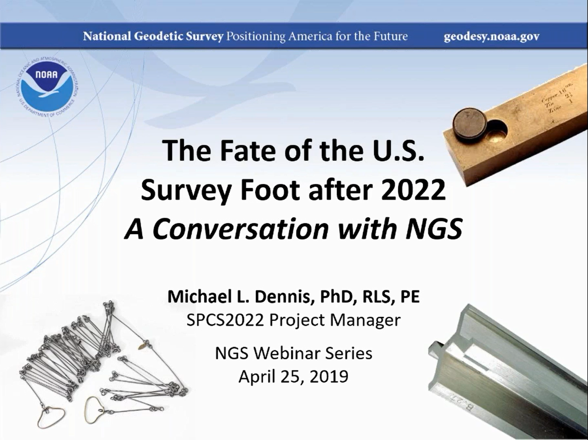

Slide 30
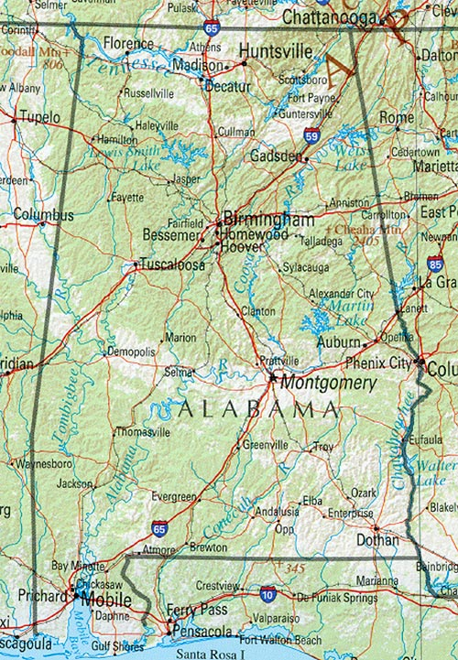
Huntsville
467,764 meters
= 1,534,658.8 iFt.
= 1,534,655.7 sFt.
Diff. = 3.1 ft.
≈ 467.764 Km
≈ 2 ± ppm
Mobile

Slide 31
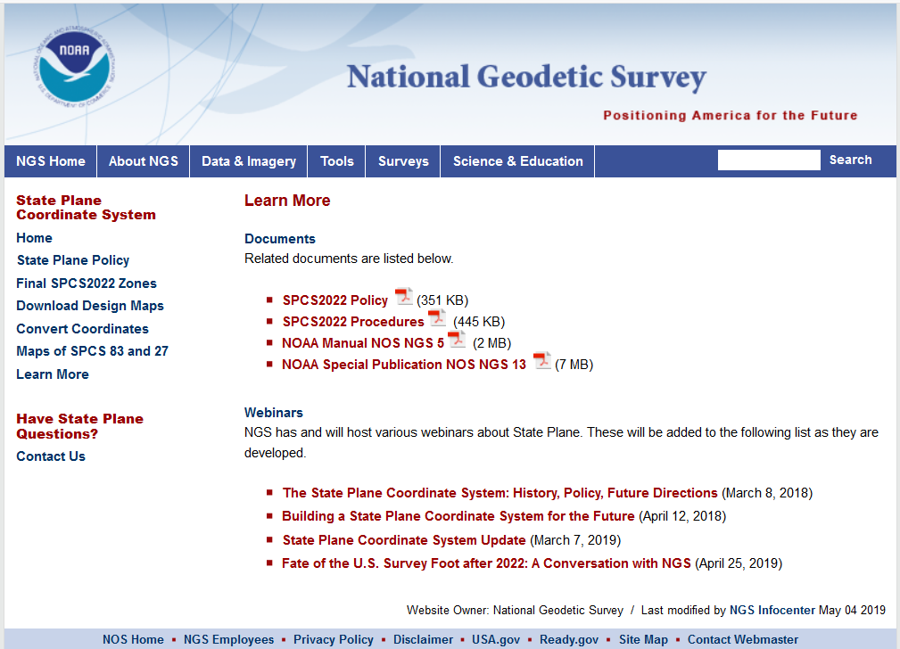

Slide 32
SPCS2022 Policy & Procedures
August 31, 2018 for Federal Register Notice comments
On policy and procedures
Includes “special purpose” zones
Deadlines for consensus input
Mar. 31, 2020 for requests and proposals
Requests are for designs by NGS
Proposals are for designs by stakeholders
Mar. 31, 2021 for submittal of approved designs
Proposal must first be approved by NGS
Designs submitted by stakeholders
Designs must be complete before NGS review
Dec. 31, 2022 for NGS to confirm zone computations
After deadlines, will be a change request for SPCS2022
NGS.SPCS@noaa.gov

Slide 33

? ? QUESTIONS ? ?
Denis.Riordan@noaa.gov

