Slide 1

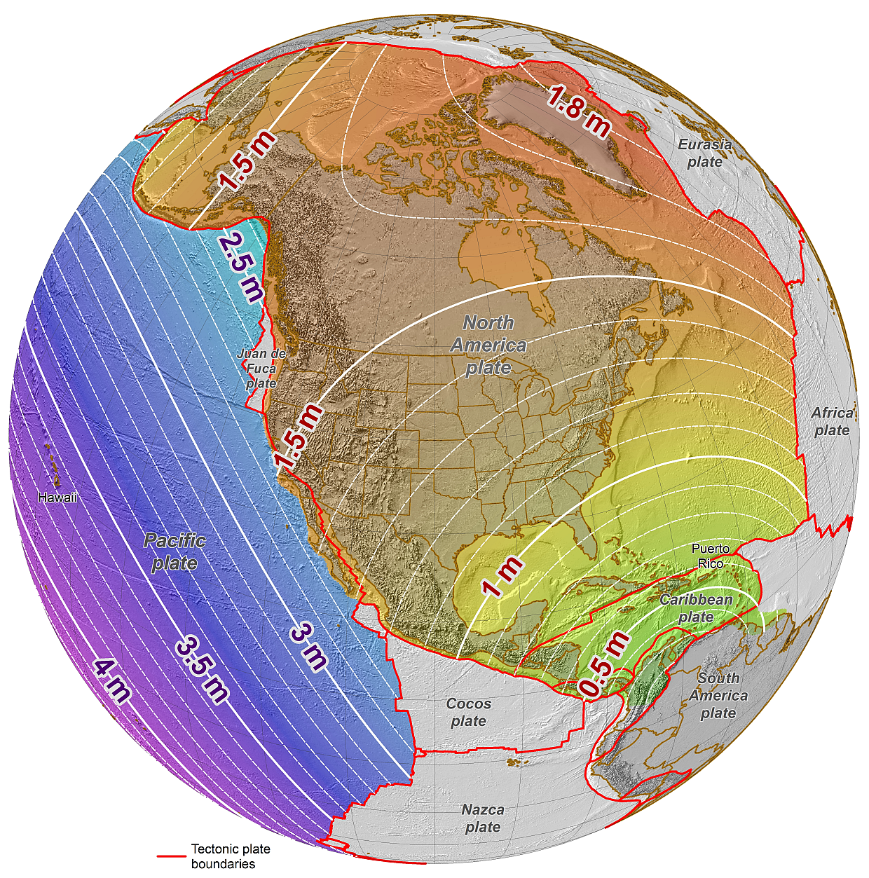
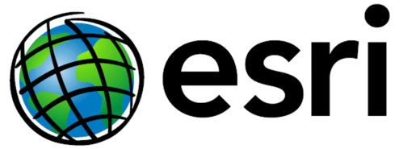
An NGS Illustrated Guide to Geodesy for GIS Professionals
Michael Dennis, RLS, PE
michael.dennis@noaa.gov
Esri User Conference
San Diego Convention Center
July 14-18, 2014 • San Diego, CA
®

Slide 2

Why should we care about geodesy?

Slide 3
The Plan
GIS and the National Spatial Reference System (NSRS)
  NOAA’s National Geodetic Survey (NGS) defines, maintains, and provides access to the NSRS
Geodetic concepts – illustrated!
Focus today is on geometric (“horizontal”) datums
  Connecting data to the Earth: Datums
  A complicated topic: Datum transformations
  Nothing is constant except change: Time dependence
  Specific example: “WGS 84” ←→ “NAD 83”
Other topics of Great Interest but not enough time to pursue
  How data are displayed and analyzed: Map projections
  How high? How deep? Where will water go? Gravity and heights
  How good is it? How do you know? Accuracy vs. Precision

Slide 4
NGS: Who we are is where you are
Been around a long time (since 1807)
  Became National Geodetic Survey in 1970 (when NOAA created)
Keepers of the National Spatial Reference System (NSRS)
  Define, maintain, provide access for US and territories
  Position, height, scale, gravity, orientation
  …and how they change with time
Products & Services
  Geodetic control (active and passive)
  Data, models, and imagery (gravity, geoid, aerial imagery)
  Tools and services (online and desktop software and services)
  Standards, specifications, guidelines, and education

Slide 5
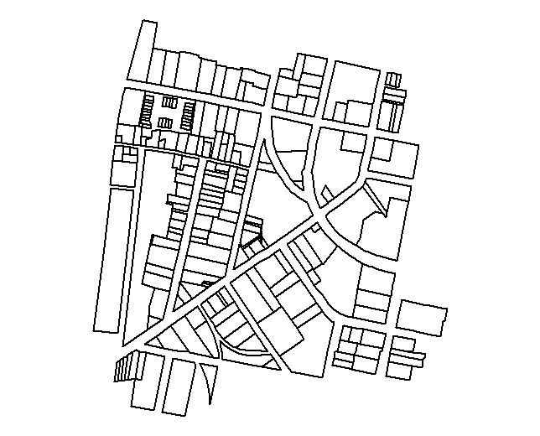
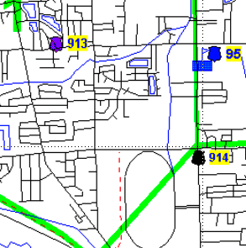
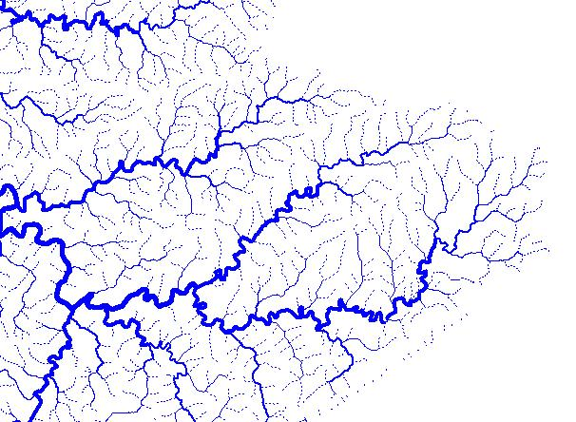
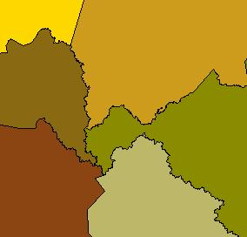
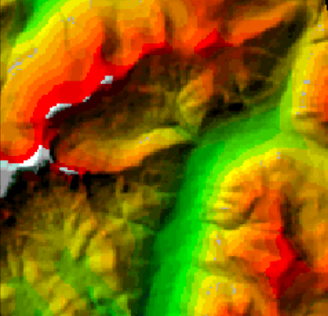
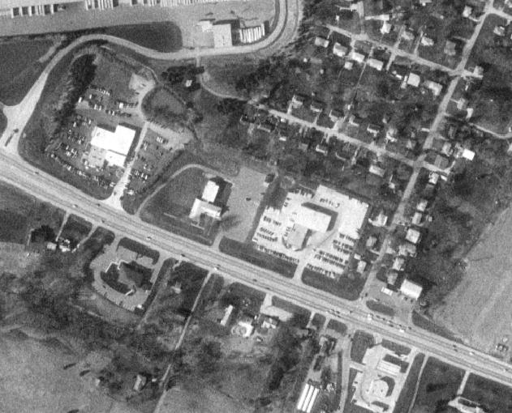
The NSRS is the foundation for GIS
Land Ownership
Transportation
Surface Waters
Boundaries
Elevation
Aerial Imagery
NSRS
Geodetic Control

Slide 6
What is a (geometric) “datum”?
Geometric (“horizontal”) datums
  a.k.a. “geographic coordinate systems”
  Basis for determining positions on the Earth
  Modern ones are 4-D (time is 4th dimension)
    Lat, lon, height (or Earth-Centered, Earth-Fixed XYZ), velocities
  Ellipsoid (“spheroid”) by itself is NOT a datum
    ~Same ellipsoid for NAD 83 and WGS 84, but differ by ~2 m
Includes “local” and “global” datums
  “Local” (regional) datums (e.g., NAD 83)
  “Global” datums (e.g., WGS 84)
Vertical datums another topic for another time…

Slide 7
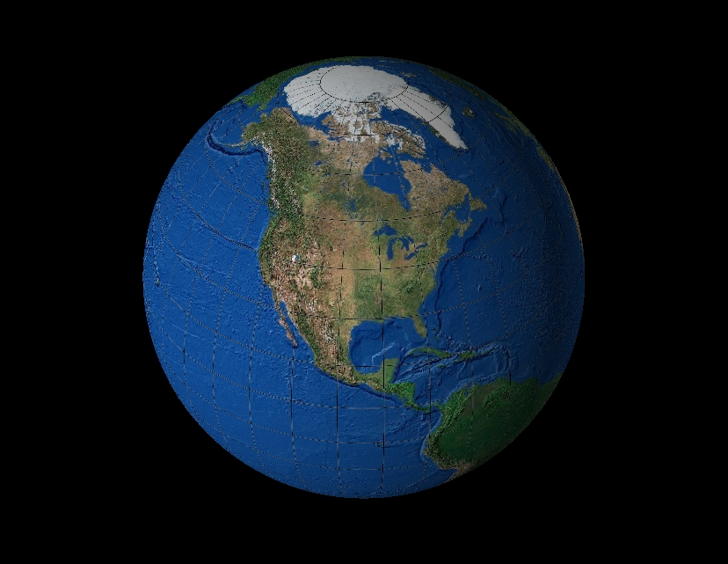
“The Figure of the Earth”
“The Figure of the Earth”
Best-fit spherical
Earth model
Too big by 9 miles at the poles
Point #1
San Diego
Point #1
San Diego
Too small by 4 miles at the equator
Earth mass center
Too small by 4 miles at the equator
Mean
Earth radius,
R ≈ 3959 miles
Equatorial plane
Geoid
(“mean sea level”)
Too big by 9 miles at the poles

Slide 8
Earth model: Ellipsoid of revolution
Best-fit ellipsoid
(e.g., GRS-80, WGS-84)
a = 6,372,137.000 m ≈ 3963 mi
b = 6,356,752.314 m ≈ 3950 mi
Ellipsoid flattening
f = (a – b)/a ≈ 0.335%
1/f ≈ 298.25722
b = semi-minor axis
(polar radius)
Point #1
San Diego
Earth mass center
a = semi-major axis
(radius of equatorial plane)
Equatorial plane
Ellipsoid fits geoid to
within about ±100 m worldwide
Geoid
(“mean sea level”)

Slide 9
Geospatial Codependence the first step is admitting you have a problem
Datums must be “realized”
  Connected to Earth by observations (e.g., GNSS)
  New realizations improve accuracy of coordinates
  A single datum can have multiple realizations
Interrelationships given by “datum transformations”
  Mathematical methods for converting between datums
  Needed if combining data based on different datums
  There are many different kinds and they can vary greatly
Modern datum definitions are accurate but complex
  Will focus on two here: NAD 83 and WGS 84.

Slide 10
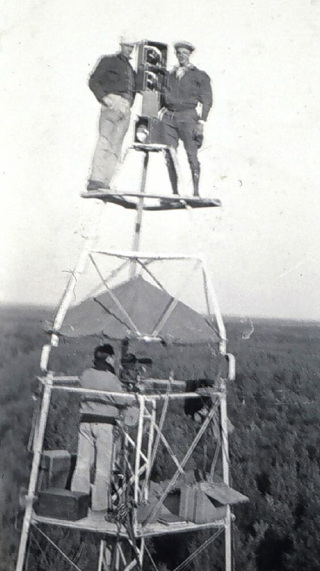
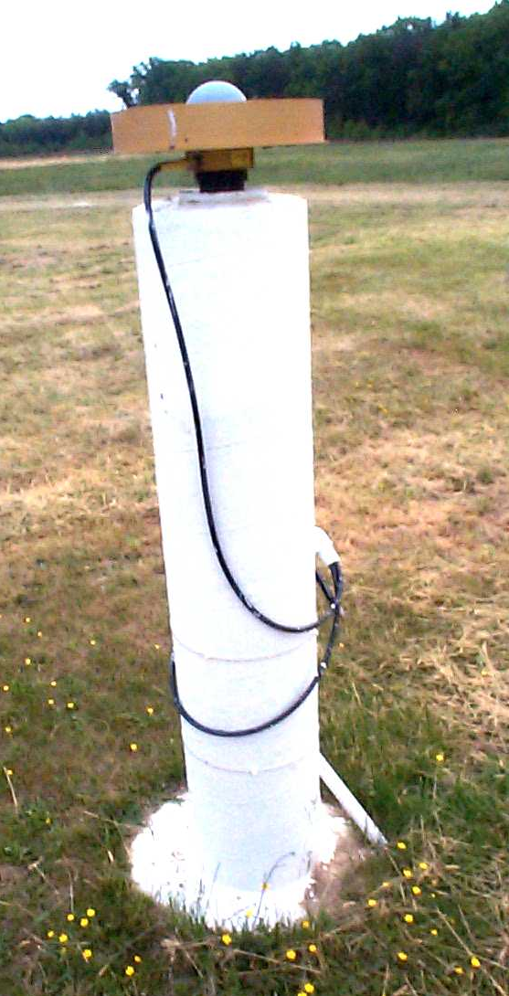
A (very) brief history of NAD 83 datum
Original realization completed in 1986
  Almost entirely classical (optical) observations
“High Accuracy Reference Network” (HARN) realizations (1990s)
  Done essentially state-by-state
  Based on GNSS but classical stations included
National Re-Adjustment of 2007
  NAD 83(NSRS2007/CORS96) epoch 2002.00
  Nationwide adjustment (GNSS only)
NAD 83 (2011/PA11/MA11) epoch 2010.00
  Also nationwide GNSS-only adjustment
  This is NOT a new datum! (still NAD 83)

Slide 11
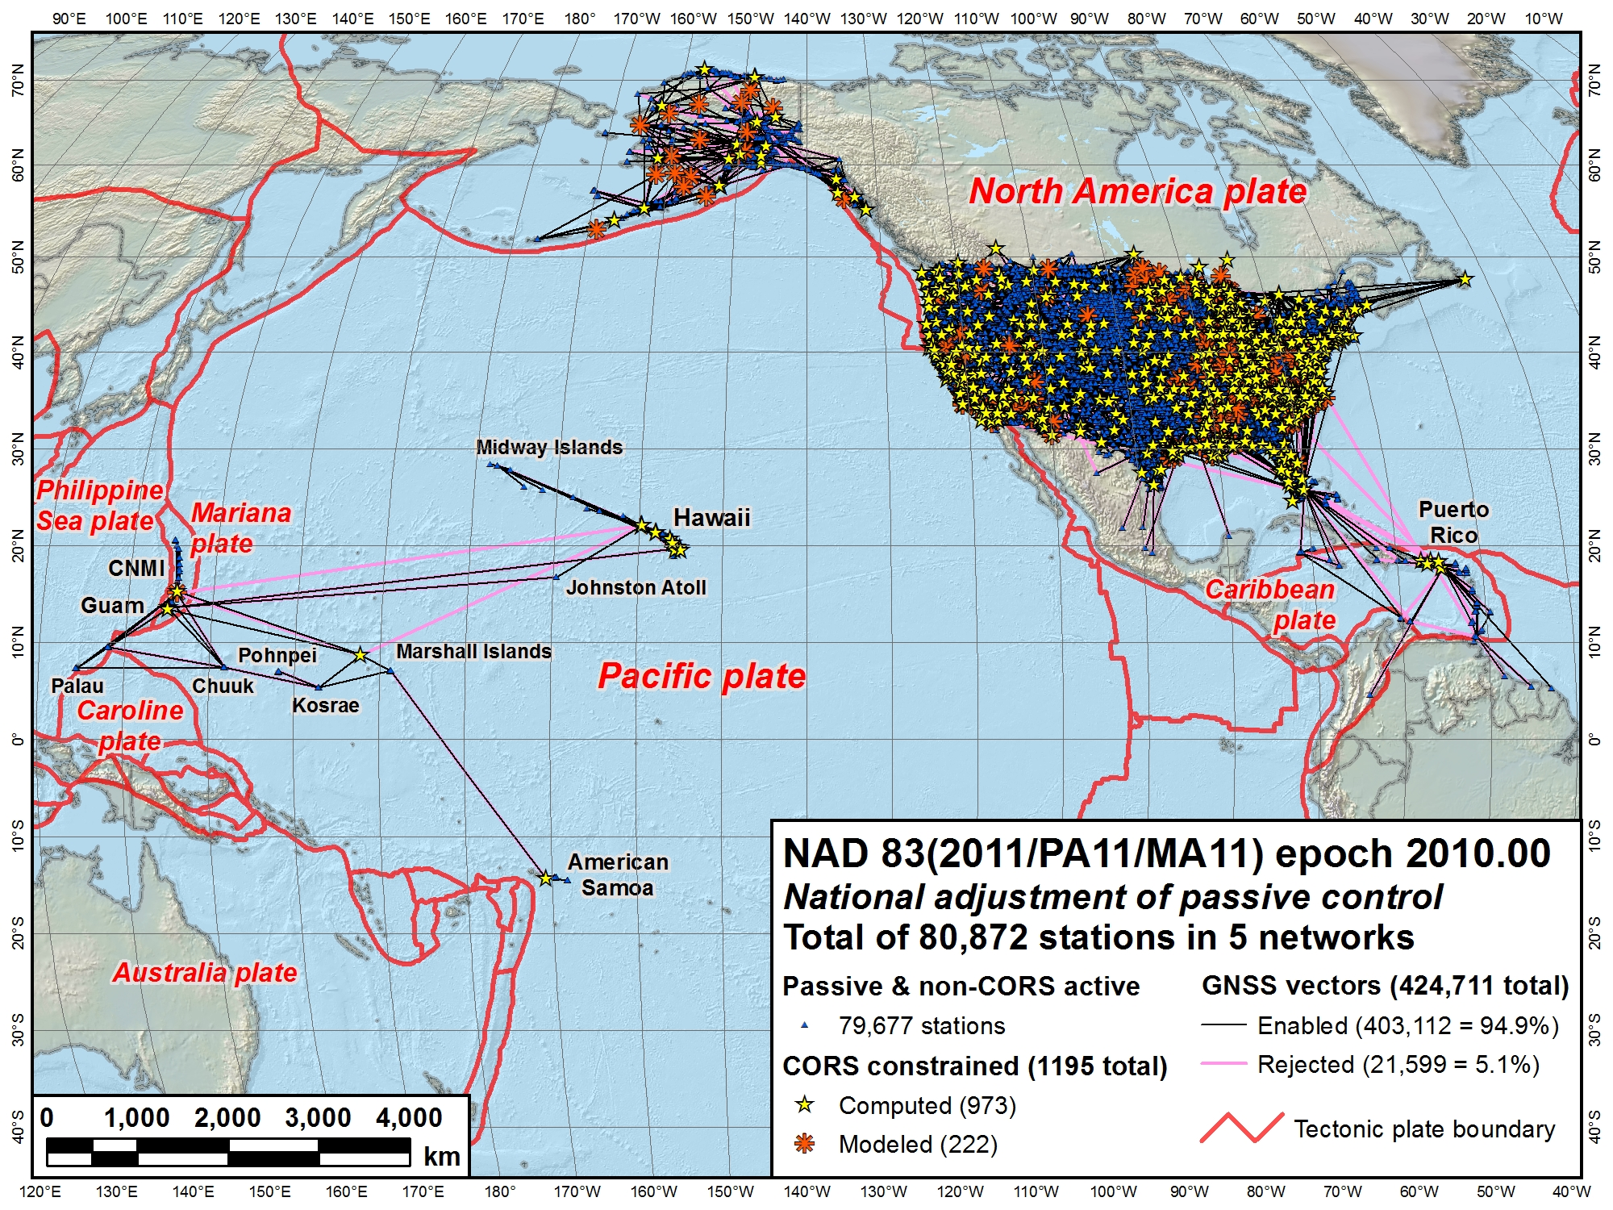
Alaska
CONUS
Pacific
(MA11)
Pacific (PA11)
GIS is only for low spatial accuracy?
Median accuracy (95% conf.):
0.9 cm horiz, 1.5 cm height

Slide 12

A (very) brief history of WGS 84 datum
Original realization completed in 1987
  “Same” as original NAD 83 (to within ±1-2 m)
WGS 84 (G730) — adopted Jan 1994
  Aligned with ITRF91
WGS 84 (G873) — adopted Sep 1996
  Aligned with ITRF94
WGS 84 (G1150) — adopted Jan 2002
  Aligned with ITRF2000 (at epoch 2001.00)
WGS 84 (G1674) — adopted Feb 2012
  Aligned with ITRF2008 (at epoch 2005.00)
WGS 84 (G1762) — adopted Oct 2013
  Also aligned with ITRF2008 (at epoch 2005.00)
  Note that current NAD 83 is epoch 2010.00

Slide 13
Understanding geodetic coordinates
Positions for entire Earth (or large part of Earth)
  For modern datums these are 3-D
    With velocities they are 4-D
  Here concerned with geometric coordinates
Two main types:
  Latitude, longitude, and ellipsoid height: φ, λ, h
  Earth-Centered, Earth Fixed (ECEF) Cartesian: X, Y, Z
    Used for many types of geodetic computations
  Can covert between both types without error

Slide 14
Earth-Centered Earth-Fixed (ECEF) coordinates
Ellipsoid
(e.g., GRS-80, WGS-84)
+Z axis (parallel to axis of rotation)
Point #1, San Diego
+Y axis (90°E)
+Z₁
Coordinates:
(–X₁, –Y₁, +Z₁)
(φ₁, λ₁, h₁)
h₁
Earth mass center
+X axis
(Prime meridian)
–X axis (180°W)
–X₁
φ₁
λ₁
–Y₁
Equatorial plane
Geoid
(“mean sea level”)
–Y axis (90°W)
–Z axis

Slide 15
Earth-Centered Earth-Fixed (ECEF) coordinates
Ellipsoid
(e.g., GRS-80, WGS-84)
+Z axis (parallel to axis of rotation)
Point #1, San Diego
+Y axis (90°E)
+Z₁
Coordinates:
(–X₁, –Y₁, +Z₁)
(φ₁, λ₁, h₁)
h₁
Earth mass center
+X axis
(Prime meridian)
–X axis (180°W)
–X₁
Where is San Diego Conference Center?
X = -2,451,510 m
Y = -4,780,100 m
Z = +3,426,640 m
…is the same as:
Latitude, φ = 32°42’ 25” N
Longitude, λ = 117°09’ 05” W
Ellipsoid height, h = -30 m
φ₁
λ₁
–Y₁
Equatorial plane
Geoid
(“mean sea level”)
–Y axis (90°W)
–Z axis

Slide 16
Datum transformations
Typical datum transformations
  3-parameter: 3-dimensional translation of origin as ΔX, ΔY, ΔZ
  7-parameter: 3 translations plus 3 rotations (one about each of the axes) plus a scale
  14-parameter: A 7-parameter where each parameter changes with time (each has a velocity)
  Transformations that model tectonic displacement and other distortion (e.g., NGS models in NADCON, GEOCON, and HTDP)
Vertical datum transformations
  Can be simple shift or complex operation that models distortion (e.g., GEOCON, VERTCON)

Slide 17
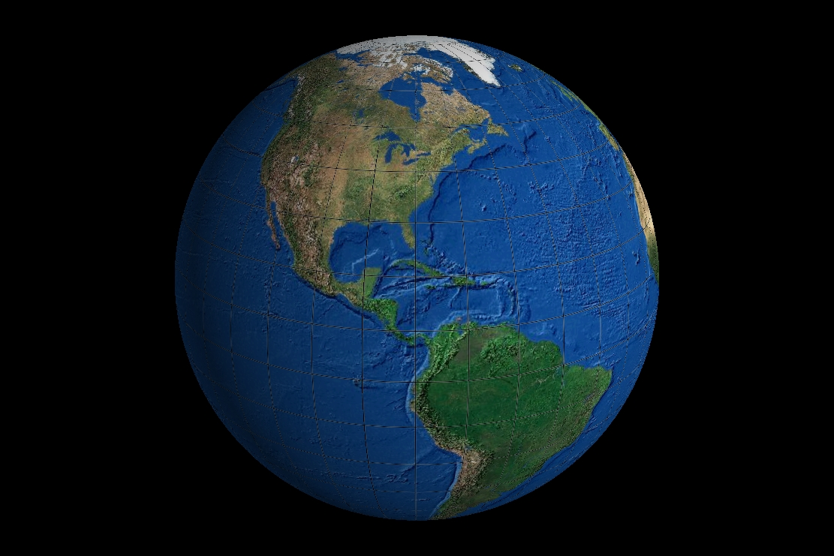
Datum transformations
b₂
b₁
a₁
a₂
ΔX, ΔY, ΔZ
3-parameter
datum transformation

Slide 18
Datum transformations
If datum changes with time, each component has a velocity…
rot_{Z}
b₁
a₁
b₂
ΔX, ΔY, ΔZ
rot_{X}
a₂
3-parameter
datum transformation
7-parameter
datum transformation
rot_{Y}
14-parameter
datum transformation
scale

Slide 19
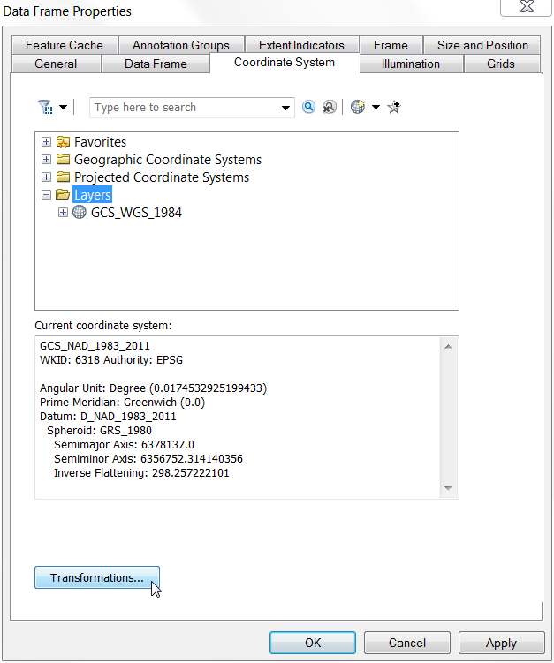
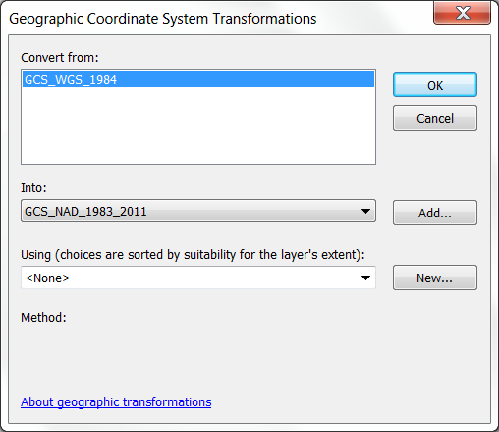
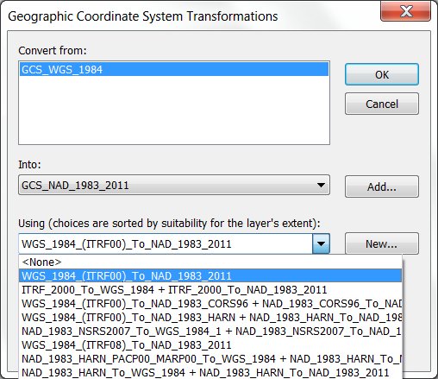
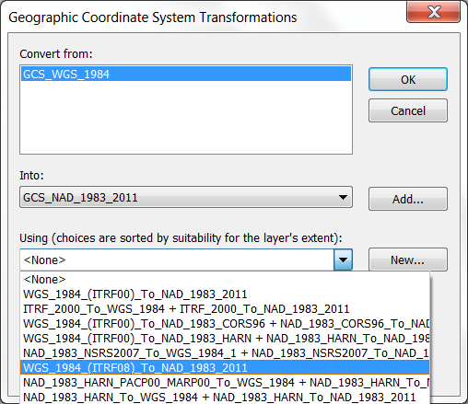
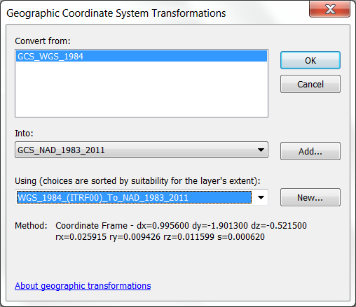
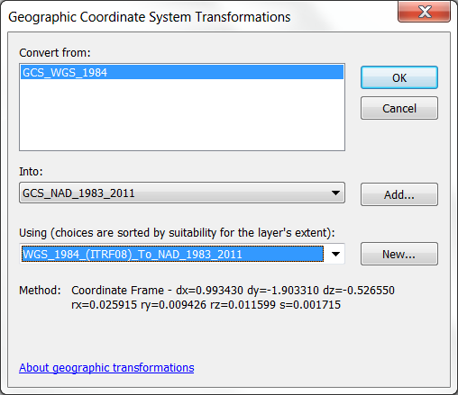
What to do…?

Slide 20
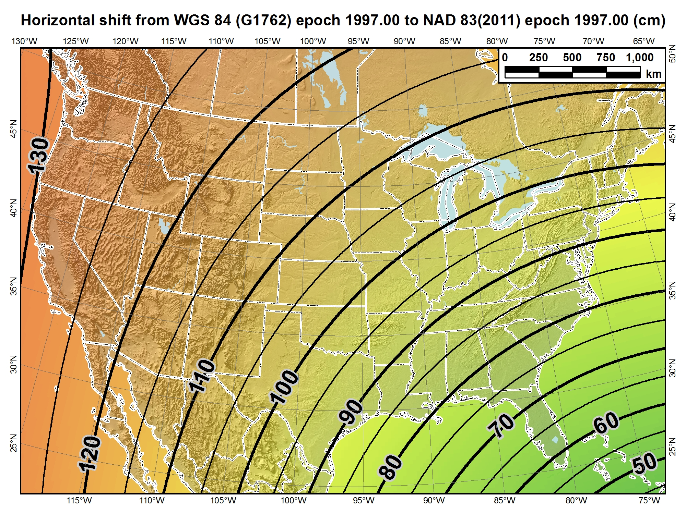
Based on 7 constant transformation parameters published by NGS (7 time-dependent parameters ignored), at input time = output time of 1997.0 (so tectonic velocities irrelevant).
This is how the transformation is implemented in most commercial geospatial software.

Slide 21
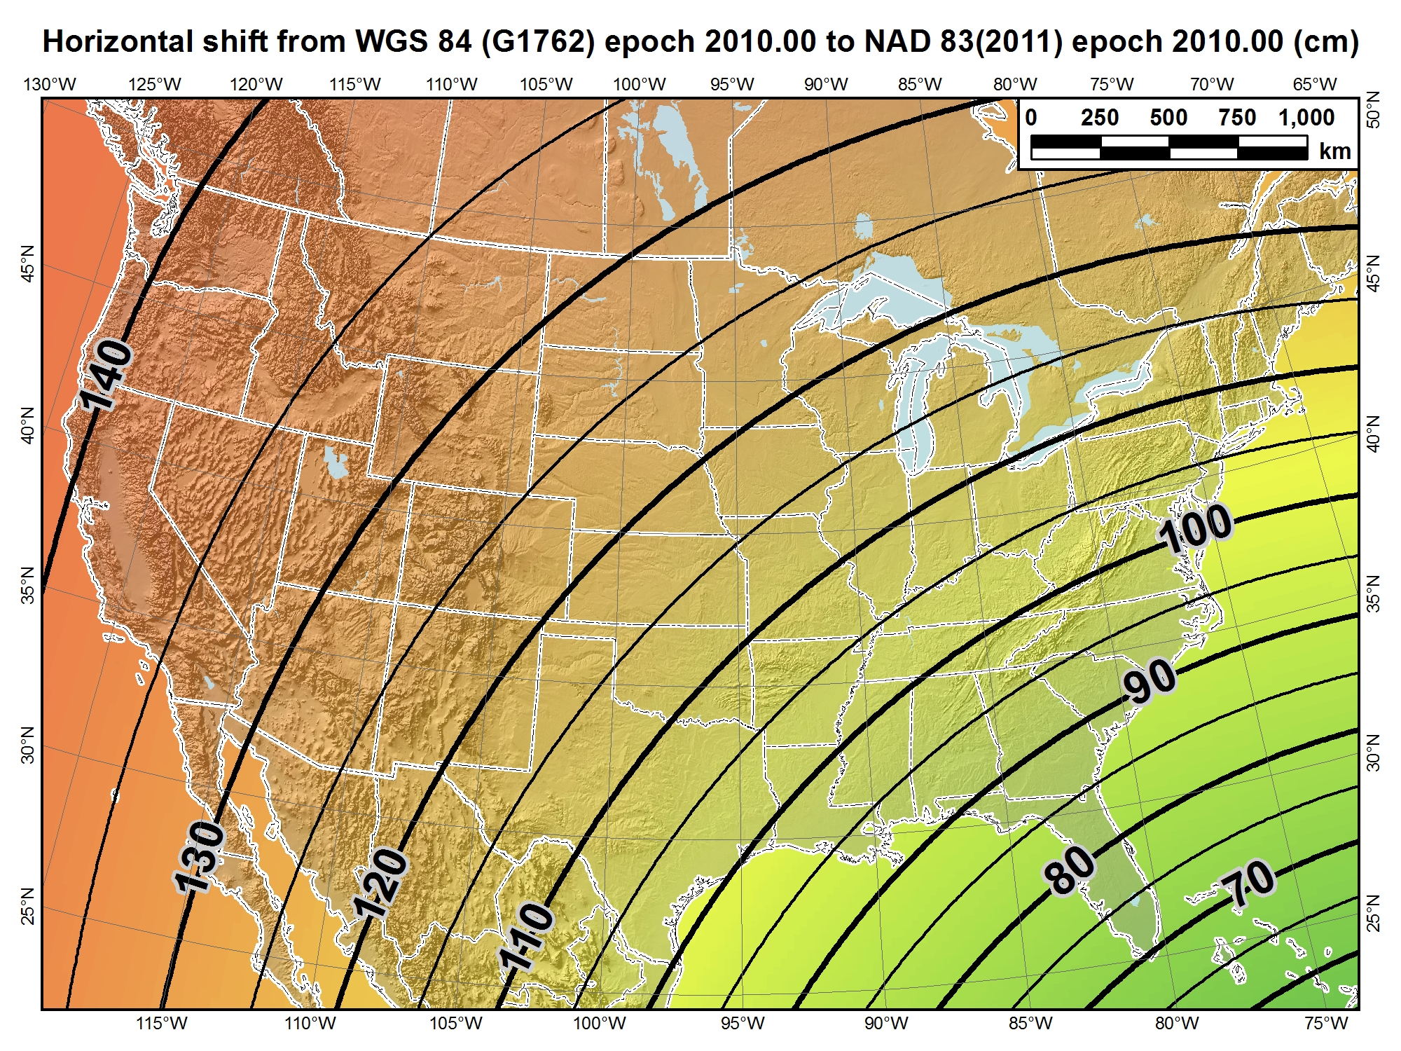
Based on 14 transformation parameters published by NGS at input time = output time of 2010.0 (so tectonic velocities irrelevant)

Slide 22
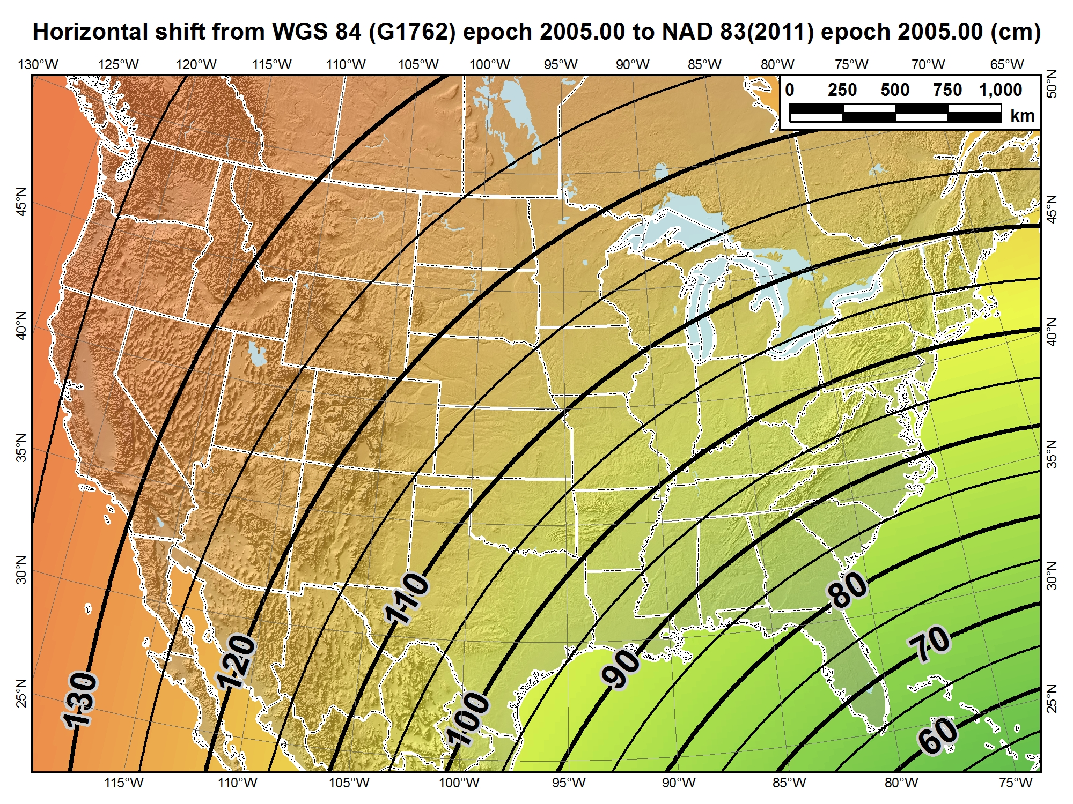
Based on 14 transformation parameters published by NGS at input time = output time of 2005.0 (so tectonic velocities irrelevant)

Slide 23
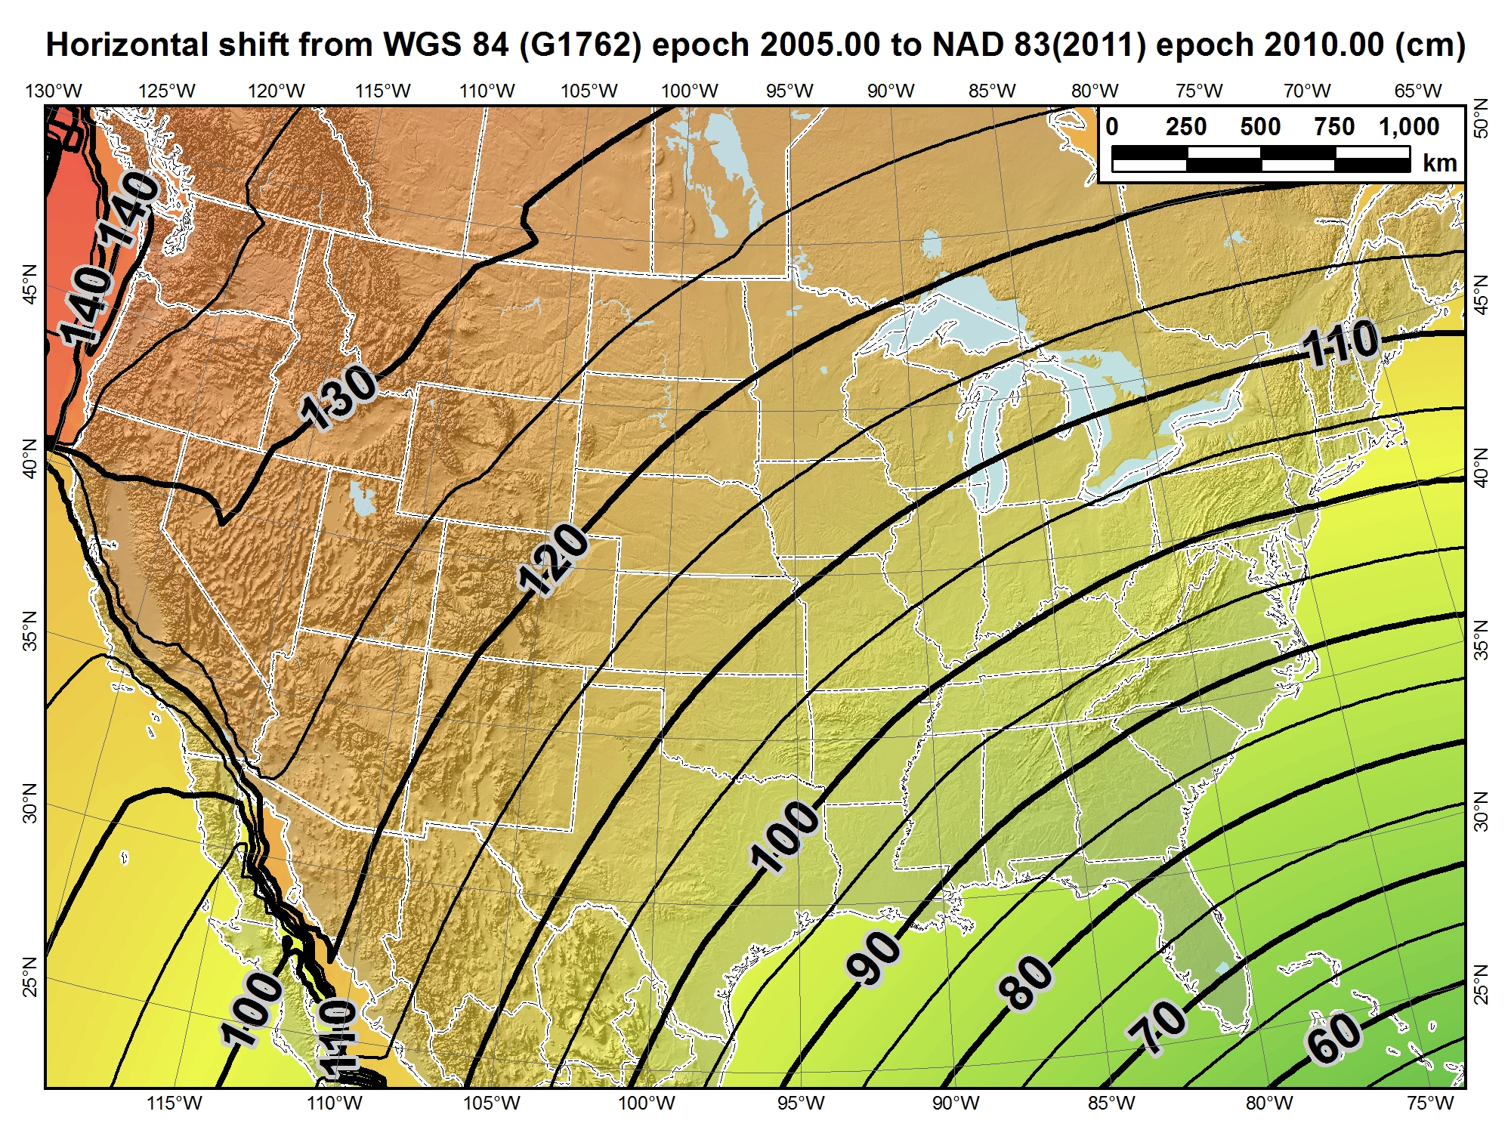
Based on 14 transformation parameters published by NGS at input time of 2005.0 ≠ output time of 2010.0 (5 years of tectonic movement).
This much more complex case is the “correct” transformation.

Slide 25
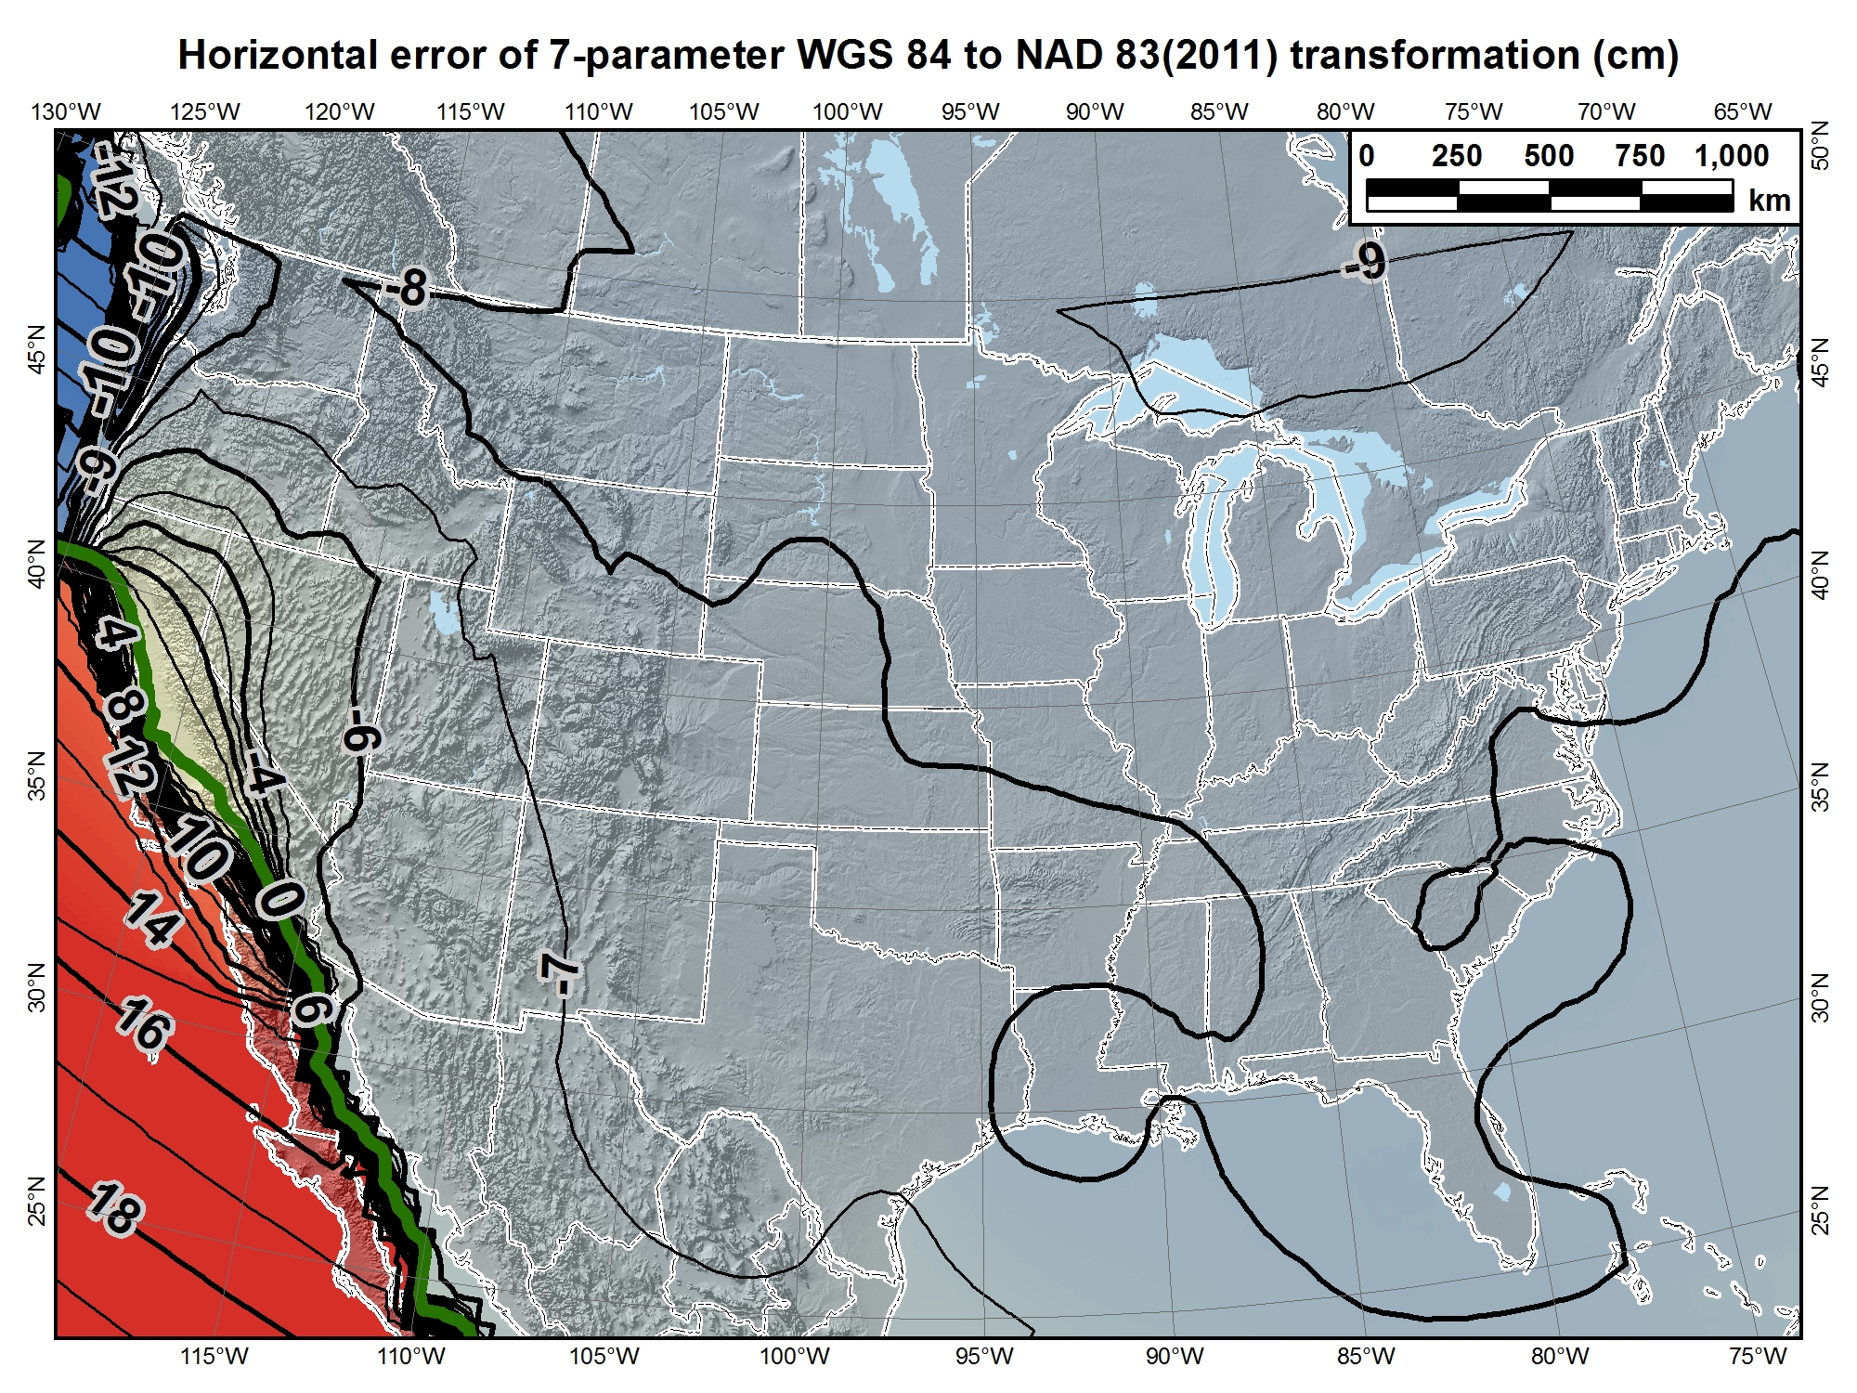

Slide 26
This 7-parameter transformation is equivalent to the following commercial vendor transformations:
ESRI: “WGS_1984_(ITRF08)_To_NAD_1983_2011” (108363)
  NOT “WGS_1984_(ITRF00)_To_NAD_1983_2011”, or the ~25+ other NAD 83←→WGS 84 transformations in ArcGIS 10.x
Trimble: “ITRF to NAD 1983 (2011)”
  NOT “NAD 1983 (Conus)”, a “zero” transformation (used automatically with State Plane)
Topcon: “NAD83”
  NOT “NAD83_NO_TRANS”, another “zero” transformation
WGS 84

Slide 27
Does this stuff really matter?
Significant for accuracies better than ~1-2 m
  Can be problem for combining accurate datasets
  Requires understanding of modern datums
  Be careful when using “WGS 84”
    Which realization? At what epoch? At what level of accuracy?
    Just because it comes from GPS does NOT mean it is “WGS 84”
Things are moving, and it can make a difference
  e.g., San Diego moving 4.0 cm/yr NW w.r.t. Phoenix, AZ
Modern GNSS becoming more precise
  Autonomous positions soon better than 1-2 m
  But accuracy another issue…
  With respect to what? And at what point in time?

Slide 28
New Datums for the U.S.
Planned release in 2022
  Geometric datum: Aligned with ITRF/WGS 84
  Vertical datum: Based on gravimetric geoid
How much will NSRS coordinates change?
  North America plate (CONUS and AK): Approx 0.8 to 1.6 m
  Pacific plate: Approx 3.4 (Midway) to 4.3 m (American Samoa)
  Mariana plate: Approx 1.1 to 1.4 m
How much will NSRS ellipsoid height change?
  Approx -1.9 m (Puerto Rico) to +2.0 m (Guam)
How much will NSRS CONUS orthometric height change?
  Approx +0.1 m (Florida) to -1.3 m (Washington)

Slide 29
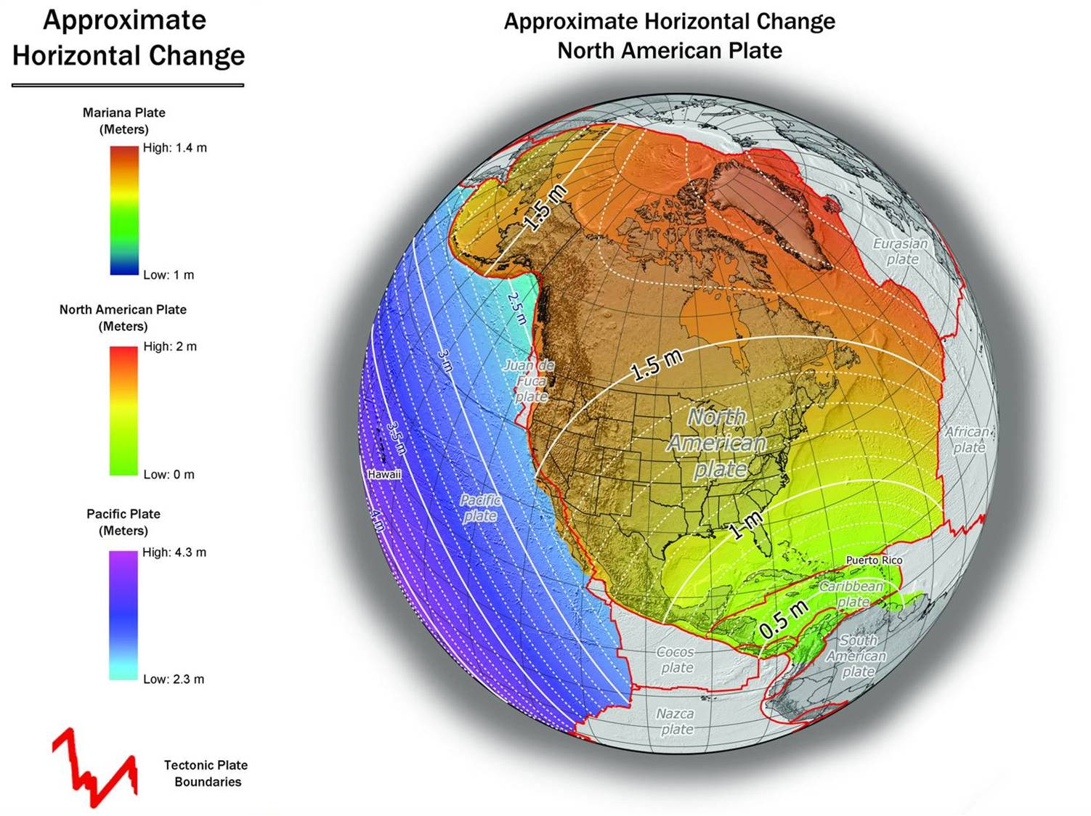
NAD 83(2011) to IGS08 at epoch 2022.0

Slide 30
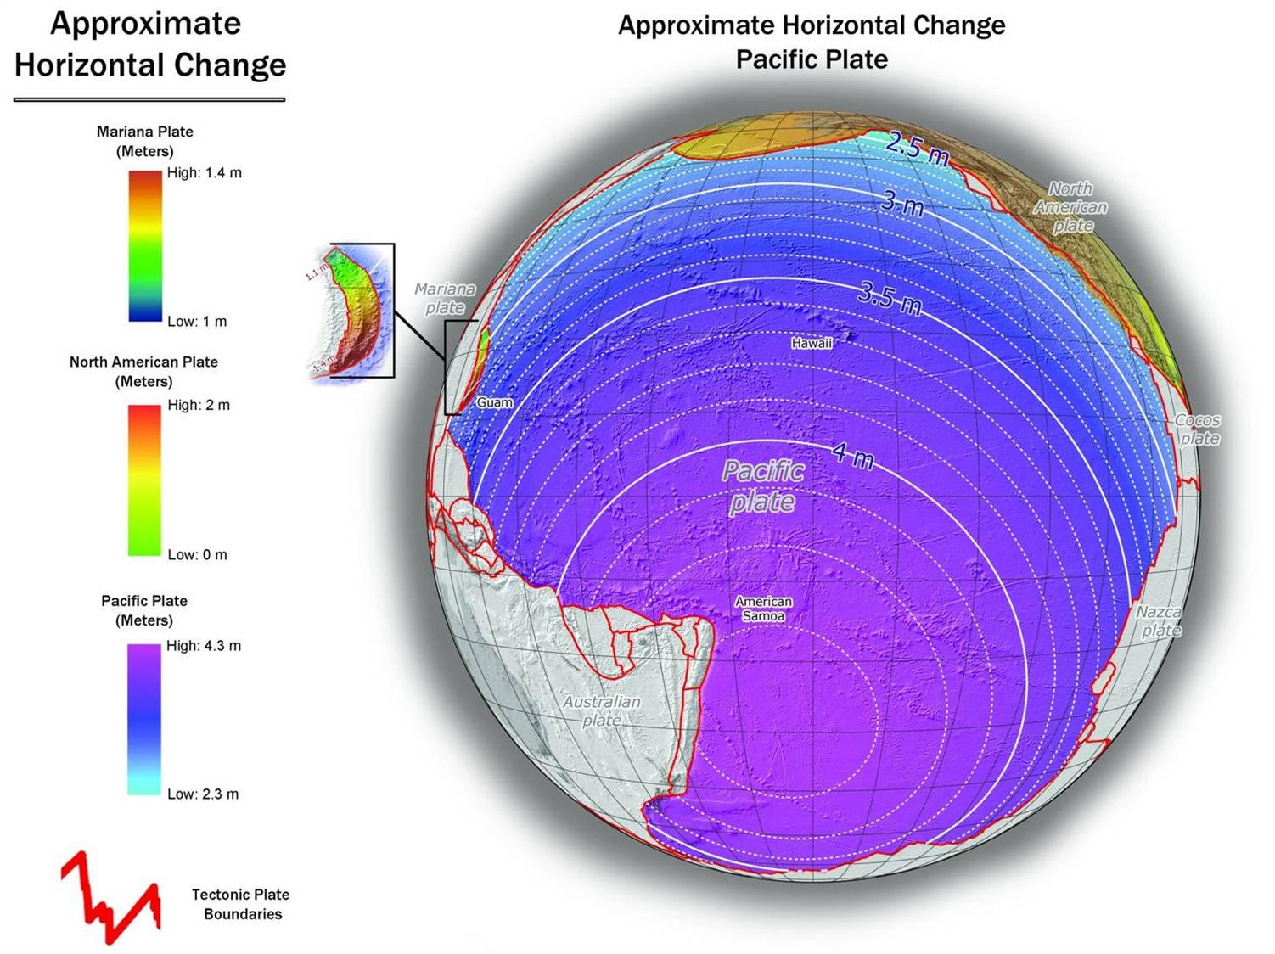
NAD 83(PA11) to IGS08 at epoch 2022.0

Slide 31
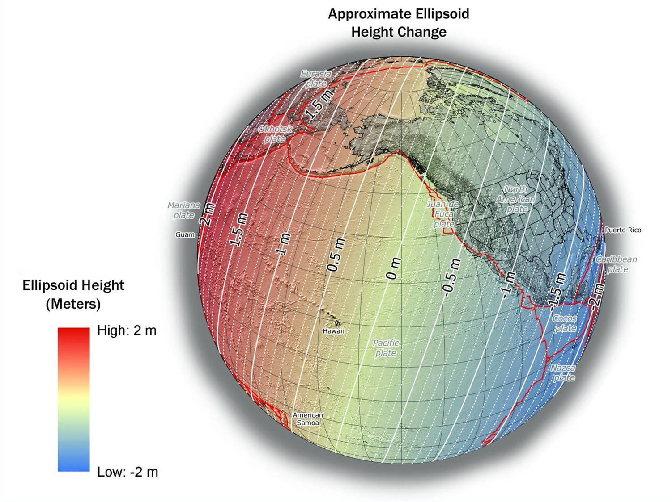
NAD 83(2011) to IGS08 at epoch 2022.0

Slide 32
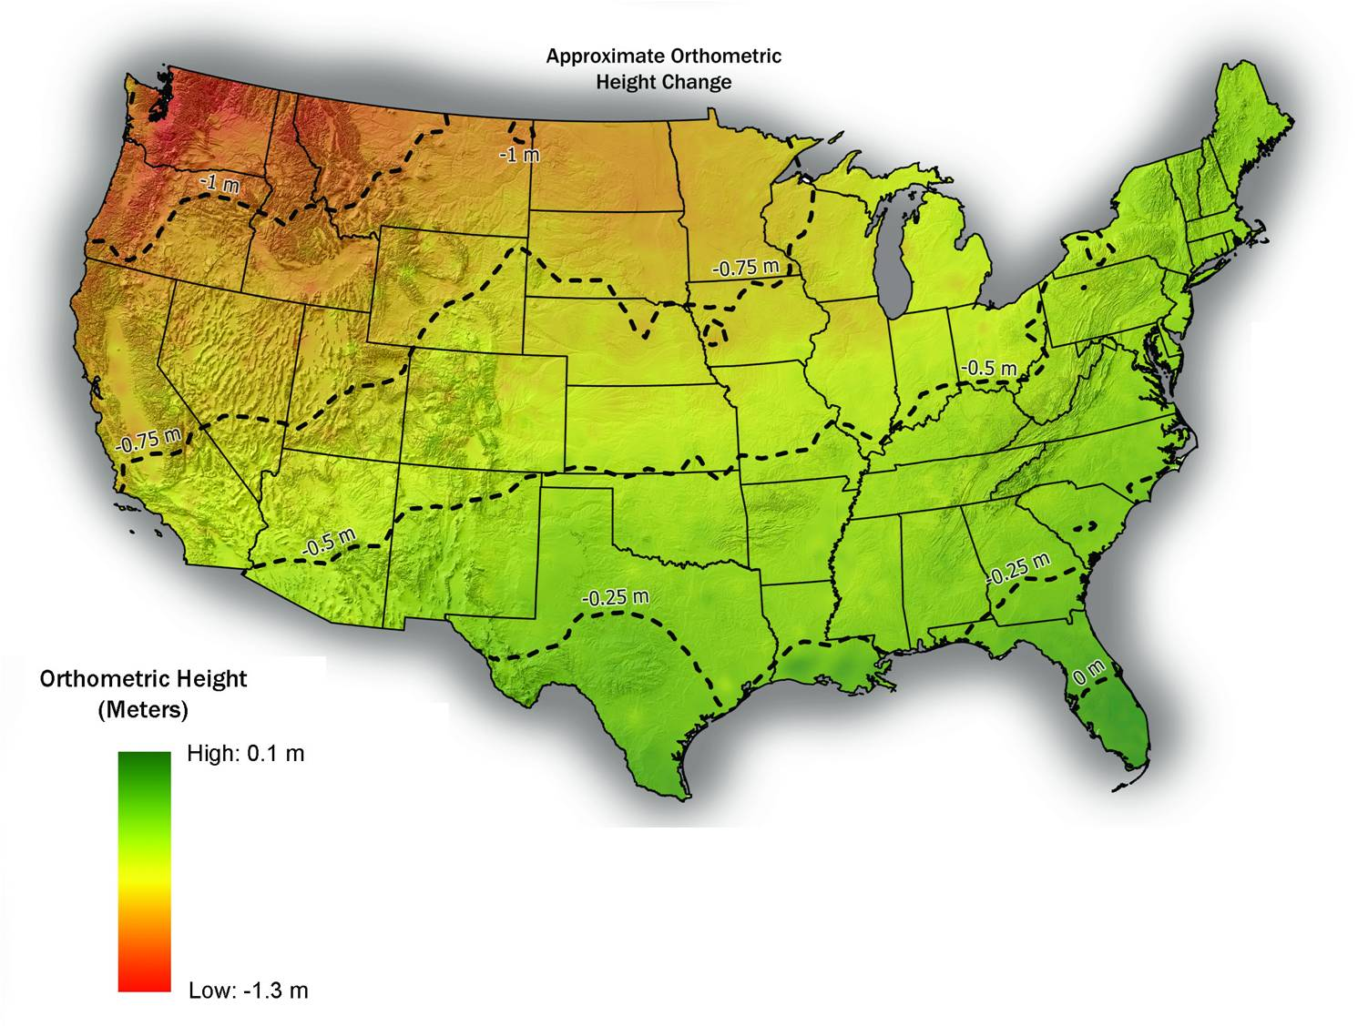
Orthometric height change (meters)
NAVD 88 to new vertical datum
Estimated as NAVD 88 "zero" (datum) surface minus NGS gravimetric geoid

Slide 33
Conclusions
Geodesy knowledge needed for correct georeferencing
  Becomes more important as spatial accuracy increases
  Driven by high precision and low cost of GNSS (a geodetic tool)
High-accuracy geodetic transformations are complicated
  Time-dependence especially complex for differential tectonic motion
  Datasets representing different times difficult to spatially align
Metadata (documentation) is essential
  Improves reliability and accuracy of data
  Increases value and usefulness of spatial data
  Needed all geospatial data (GIS, surveying, engineering, etc.)

Slide 34
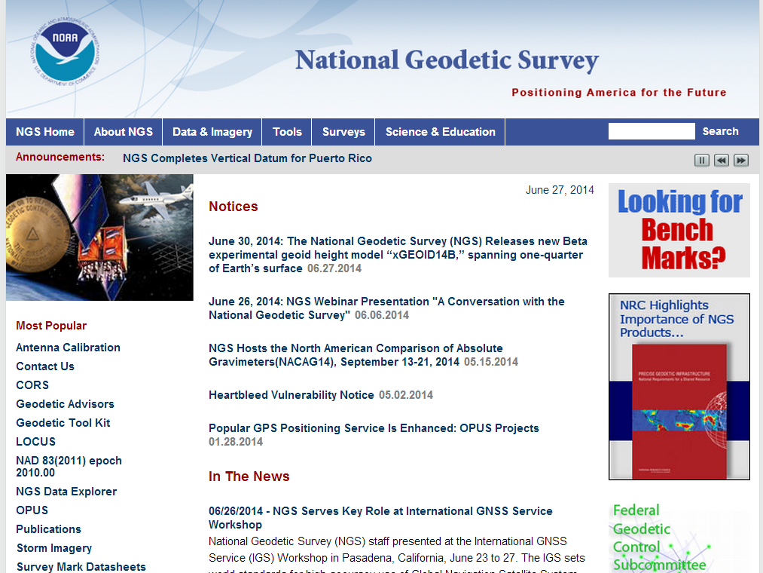
More information…
geodesy.noaa.gov

Slide 35

Questions?
An NGS Illustrated Guide to Geodesy for GIS Professionals

