Slide 1
Online Positioning User Service (OPUS) Part 2
NGS Geospatial Summit
May 5, 2021
Phillip McFarland
Spatial Reference Systems phillip.mcfarland@noaa.gov
Dru Smith
Modernization Manager
dru.smith@noaa.gov
Dan Gillins
Observation and Analysis
daniel.gillins@noaa.gov

Slide 2
Poll Question
For those familiar with OPUS, how useful would you find a tool that auto selects the best CORSs to use as geodetic control?
Extremely useful
Probably useful
Neutral
Probably not useful
Definitely not useful
Notes:
- this is the modernized NSRS
- OPUS 6.0

Slide 3
Motivation
Use OPUS to process data the way you want
“We will build significant flexibility into OPUS for you to process your data your way.”
-NGS Blueprint for 2022 Part 3 p. 63
Notes:
- this is the modernized NSRS
- OPUS 6.0

Slide 4
Motivation
Use OPUS to process data the way you want
“We will build significant flexibility into OPUS for you to process your data your way.”
-NGS Blueprint for 2022 Part 3 p. 63
…but if you want your solution “tied to the NSRS” you must follow OPUS Recommendations.
Notes:
- this is the modernized NSRS
- OPUS 6.0

Slide 5
Motivation
Use OPUS to process data the way you want
“We will build significant flexibility into OPUS for you to process your data your way.”
-NGS Blueprint for 2022 Part 3 p. 63
…but if you want your solution “tied to the NSRS” you must follow OPUS Recommendations.
Notes:
- this is the modernized NSRS
- OPUS 6.0

Slide 6
Survey data
OPUS
Notes:
- this is the modernized NSRS
- OPUS 6.0

Slide 7
Survey data
OPUS
data processing
Notes:
- this is the modernized NSRS
- OPUS 6.0

Slide 8
Survey data
OPUS
data processing
Did you follow OPUS recommendations?
Notes:
- this is the modernized NSRS
- OPUS 6.0

Slide 9
Survey data
OPUS
data processing
Did you follow OPUS recommendations?
yes
OPUS Coordinates that are
“tied to the NSRS”
Notes:
- this is the modernized NSRS
- OPUS 6.0

Slide 10
Survey data
OPUS
data processing
Did you follow OPUS recommendations?
yes
no
OPUS Coordinates that are
“tied to the NSRS”
OPUS Coordinates that are
“not tied to the NSRS”
Notes:
- this is the modernized NSRS
- OPUS 6.0

Slide 11
Survey data
OPUS
data processing
Did you follow OPUS recommendations?
yes
no
If you choose to deviate from the OPUS recommendations:
OPUS will warn you when you do so
You will receive an explanation why your coordinates are not tied to the NSRS
OPUS Coordinates that are
“tied to the NSRS”
OPUS Coordinates that are
“not tied to the NSRS”
Notes:
- this is the modernized NSRS
- OPUS 6.0

Slide 12
Survey data
OPUS
data processing
Did you follow OPUS recommendations?
yes
no
If you choose to deviate from the OPUS recommendations:
OPUS will warn you when you do so
You will receive an explanation why your coordinates are not tied to the NSRS
OPUS Coordinates that are
“tied to the NSRS”
OPUS Coordinates that are
“not tied to the NSRS”
Do you want to “share” your results with the world?
Notes:
- this is the modernized NSRS
- OPUS 6.0

Slide 13
Survey data
OPUS
data processing
Did you follow OPUS recommendations?
yes
no
If you choose to deviate from the OPUS recommendations:
OPUS will warn you when you do so
You will receive an explanation why your coordinates are not tied to the NSRS
OPUS Coordinates that are
“tied to the NSRS”
OPUS Coordinates that are
“not tied to the NSRS”
Do you want to “share” your results with the world?
yes
Unique, public URL for this survey which you can share with anyone
Notes:
- this is the modernized NSRS
- OPUS 6.0

Slide 14
Survey data
OPUS
data processing
Did you follow OPUS recommendations?
yes
no
If you choose to deviate from the OPUS recommendations:
OPUS will warn you when you do so
You will receive an explanation why your coordinates are not tied to the NSRS
OPUS Coordinates that are
“tied to the NSRS”
OPUS Coordinates that are
“not tied to the NSRS”
Do you want to “share” your results with the world?
yes
no
Unique, public URL for this survey which you can share with anyone
Your results are shown to you on screen or via email only
Notes:
- this is the modernized NSRS
- OPUS 6.0

Slide 15
So what are the OPUS Recommendations going to be?
Notes:
- you are welcome to do whatever you like – you just won’t be tied to the NSRS

Slide 16
So what are the OPUS Recommendations going to be?
DISCLAIMER – many OPUS Recommendations are still TBD
Notes:
- you are welcome to do whatever you like – you just won’t be tied to the NSRS

Slide 17
So what are the OPUS Recommendations going to be?
DISCLAIMER – many OPUS Recommendations are still TBD
General
Classical surveying techniques
Leveling
GNSS
Notes:
- you are welcome to do whatever you like – you just won’t be tied to the NSRS

Slide 18
So what are the OPUS Recommendations going to be?
DISCLAIMER – many OPUS Recommendations are still TBD
General
Classical surveying techniques
Leveling
GNSS
✓ = “tied to the NSRS” ✘ = “not tied to the NSRS”
Notes:
- you are welcome to do whatever you like – you just won’t be tied to the NSRS

Slide 19
OPUS Recommendations – general
Coordinate epochs
Representative epoch – at or very near collection time of observations ✓
Most recently passed reference epoch - ( see “Two Types of Coordinates”, Kanazir, NGS GSS, 2021) ✓
Some other epoch of your choosing ✘
Notes:
- you are welcome to do whatever you like – you just won’t be tied to the NSRS

Slide 20
OPUS Recommendations – classical surveys
One set of redundant GNSS occupations on at least three control points ✓
Required to transform from
local horizon to global
Earth-centered-Earth-fixed frame
No (or not enough) GNSS data ✘
Z
y
z
A
x
Y
X
Notes:
- river crossings during a levelling project are classical data

Slide 21
OPUS Recommendations - leveling
Absolute heights – 3 options
Collect GNSS to obtain orthometric heights on selected points ✓
Projects 4 weeks or shorter – one set of redundant GNSS observations on primary control marks
Projects between 4 weeks and 6 months – two separate sets of redundant GNSS observations at beginning and end of survey
Projects between 6 and 12 months – additional intermediary set of GNSS observations
Projects longer than 12 months – should be broken up into multiple projects

Slide 22
OPUS Recommendations - leveling
Absolute heights – 3 options
Collect GNSS to obtain orthometric heights on selected points ✓
Projects 4 weeks or shorter – one set of redundant GNSS observations on primary control marks
Projects between 4 weeks and 6 months – two separate sets of redundant GNSS observations at beginning and end of survey
Projects between 6 and 12 months – additional intermediary set of GNSS observations
Projects longer than 12 months – should be broken up into multiple projects
Use heights from NSRS database for selected points ✓
NSRS heights must have been obtained within X number of years from time of survey - X is a TBD quantity

Slide 23
OPUS Recommendations - leveling
Absolute heights – 3 options
Collect GNSS to obtain orthometric heights on selected points ✓
Projects 4 weeks or shorter – one set of redundant GNSS observations on primary control marks
Projects between 4 weeks and 6 months – two separate sets of redundant GNSS observations at beginning and end of survey
Projects between 6 and 12 months – additional intermediary set of GNSS observations
Projects longer than 12 months – should be broken up into multiple projects
Use heights from NSRS database for selected points ✓
NSRS heights must have been obtained within X number of years from time of survey - X is a TBD quantity
Provide no absolute heights – yields only differential heights ✘

Slide 24
OPUS Recommendations - GNSS
NOAA CORS Network (NCN) station selection – 3 options
Automated ✓
OPUS will automatically select the best stations for your survey

Slide 25
OPUS Recommendations - GNSS
NOAA CORS Network (NCN) station selection – 3 options
Automated ✓
OPUS will automatically select the best stations for your survey
Manual selection from OPUS recommendations ✓
The user will be able to select stations from a list of OPUS recommended stations that fall above a TBD quality threshold

Slide 26
OPUS Recommendations - GNSS
NOAA CORS Network (NCN) station selection – 3 options
Automated ✓
OPUS will automatically select the best stations for your survey
Manual selection from OPUS recommendations ✓
The user will be able to select stations from a list of OPUS recommended stations that fall above a TBD quality threshold
Manual selection ignoring OPUS recommendations
The station can be used – but not as control – and coordinates may still be labelled “tied to the NSRS” ✓
If the station is used as control – the resulting coordinates will not be tied to the NSRS ✘

Slide 27
OPUS Recommendations – GNSS cont’d
Station selection criteria
Geographic criteria
Quantitative criteria
Qualitative criteria

Slide 28
OPUS Recommendations – GNSS cont’d
Station selection criteria
Geographic criteria
Quantitative criteria
Qualitative criteria

Slide 29
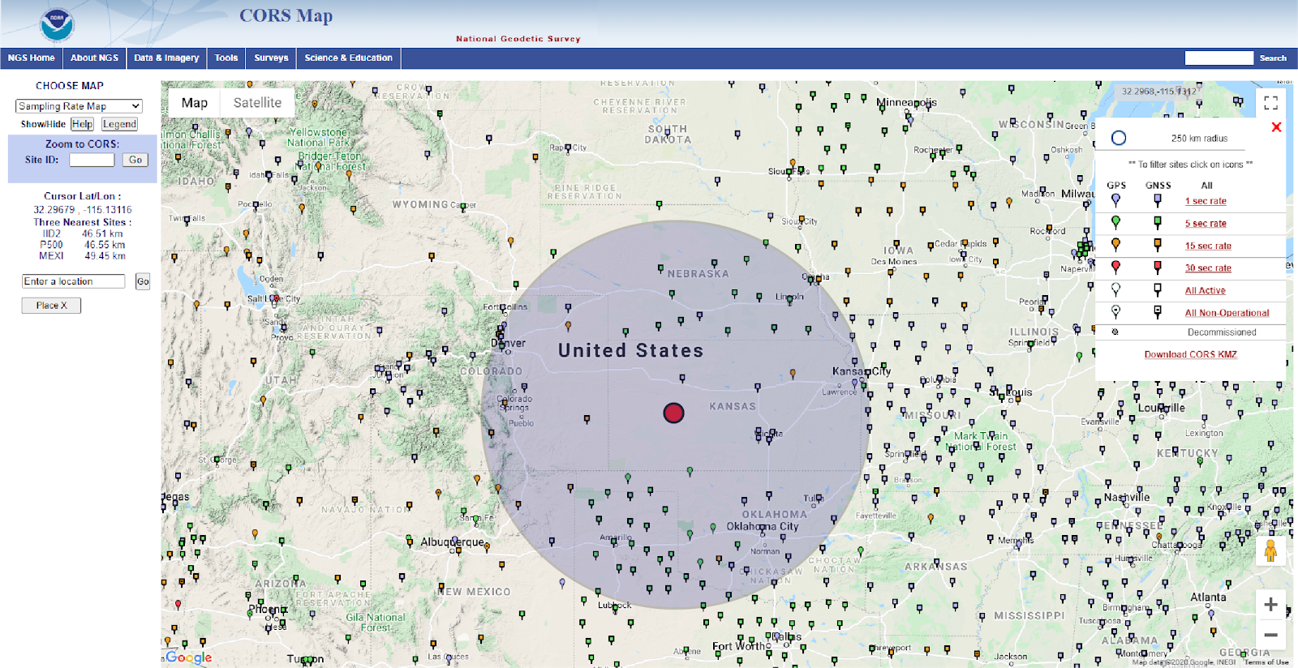
OPUS Recommendations – GNSS cont’d
Station selection criteria
Geographic criteria
0 < r < d_{max}

Slide 30
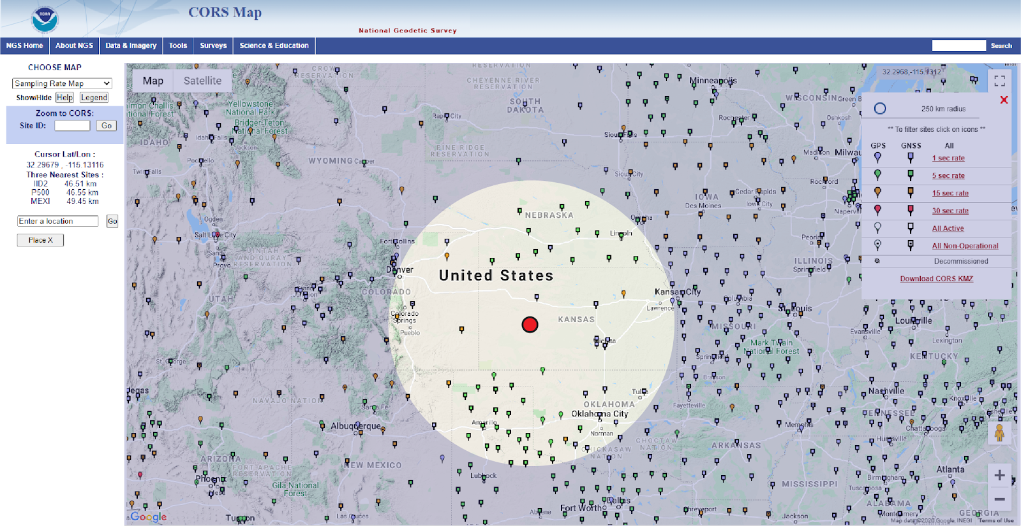
OPUS Recommendations – GNSS cont’d
Station selection criteria
Geographic criteria
d_{min} < r < inf

Slide 31
OPUS Recommendations – GNSS cont’d
Station selection criteria
Geographic criteria
Quantitative criteria
Qualitative criteria

Slide 32
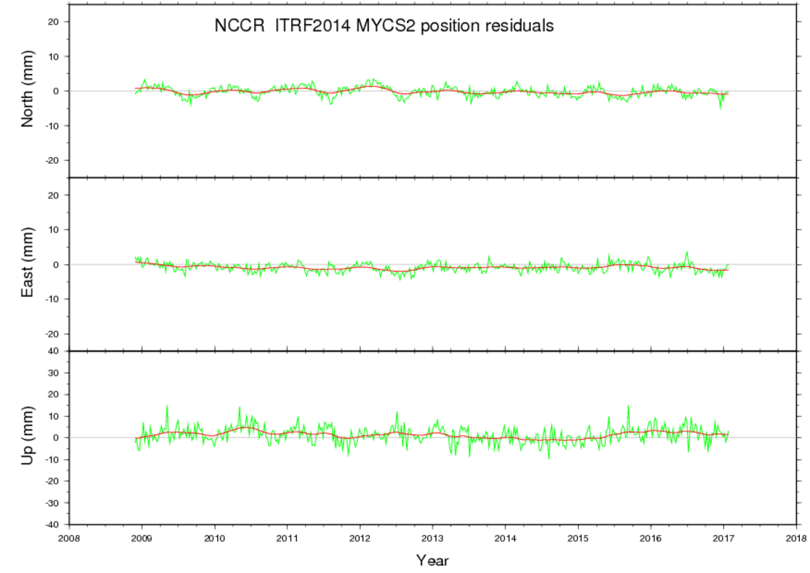
OPUS Recommendations – GNSS cont’d
Station selection criteria
Quantitative criteria
Historical temporal stability –
Goodness of fit of the coordinate function to the data that went into the most recent multi-year CORS solution (MYCS)

Slide 33
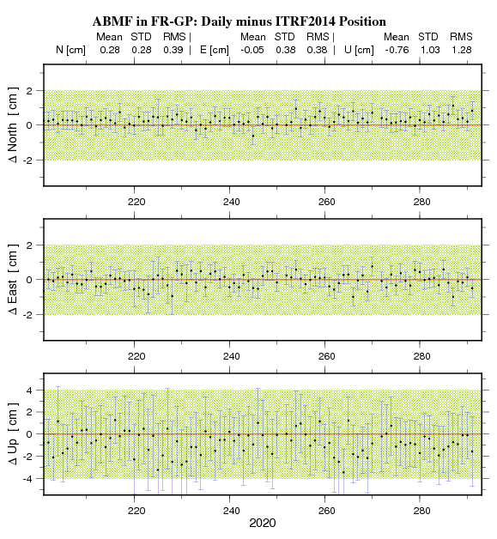
OPUS Recommendations – GNSS cont’d
Station selection criteria
Quantitative criteria
Recent temporal stability –
Goodness of fit of the coordinate function to data that has been collected since the end of the most recent multi-year CORS solution (MYCS)

Slide 34
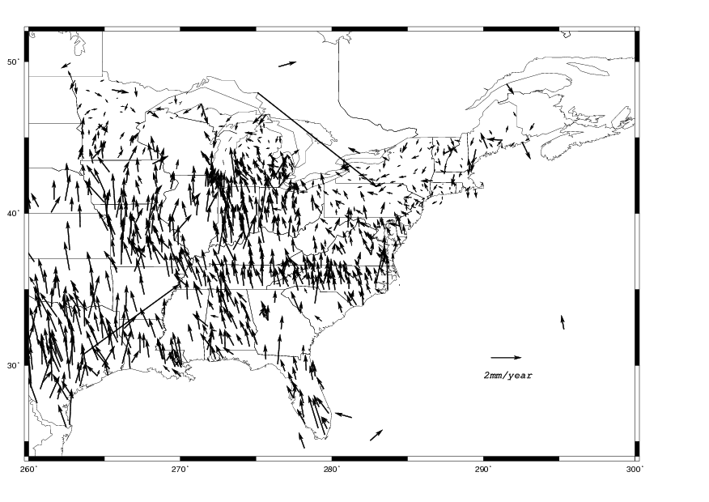
OPUS Recommendations – GNSS cont’d
Station selection criteria
Quantitative criteria
Spatial stability –
How well does the estimated velocity at a CORS agree with the velocities of its neighbors?
Notes:
- baseline length; distance from rover – geographic criteria

Slide 35
OPUS Recommendations – GNSS cont’d
Station selection criteria
Geographic criteria
Quantitative criteria
Qualitative criteria

Slide 36
OPUS Recommendations – GNSS cont’d
Station selection criteria
Qualitative criteria
Data availability
Uptime of station
Well-defined GRP?
Monumentation quality
Observing multi-GNSS
Recency of photos
Estimated vs modeled velocities

Slide 37
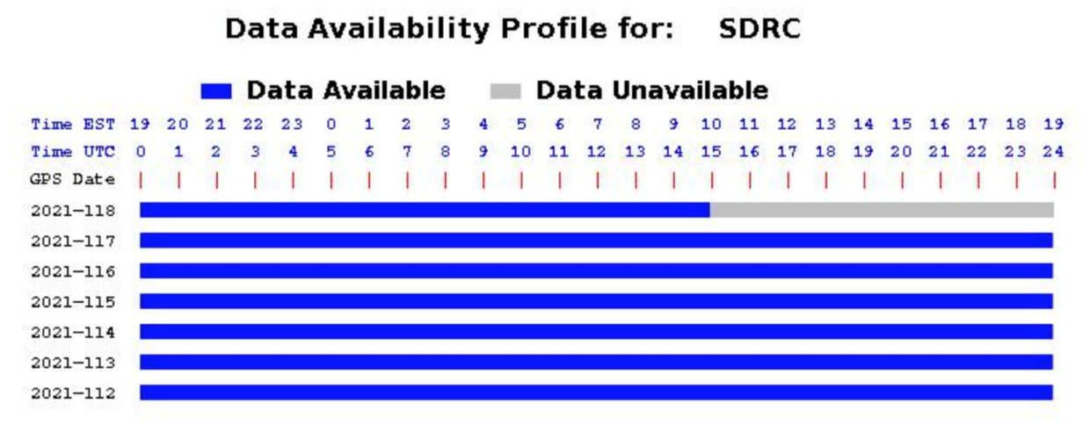
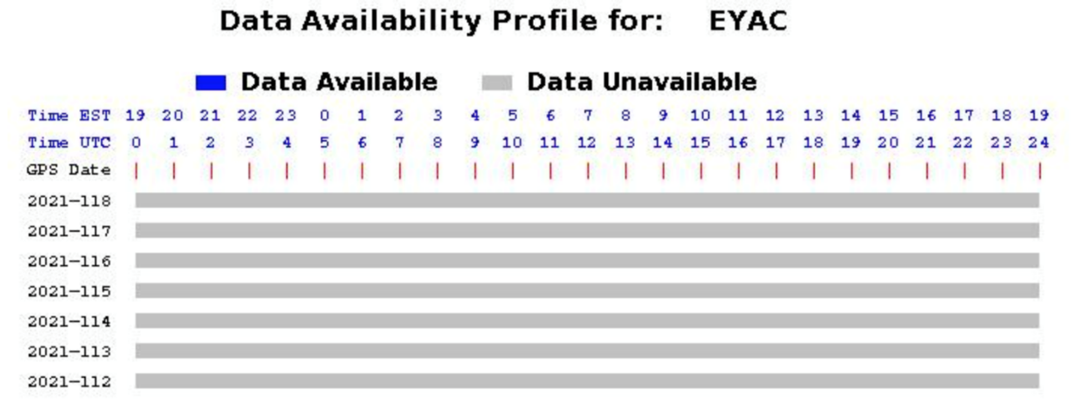
OPUS Recommendations – GNSS cont’d
Station selection criteria
Qualitative criteria
Data availability
Uptime of station
Well-defined GRP?
Monumentation quality
Observing multi-GNSS
Recency of photos
Estimated vs modeled velocities

Slide 38
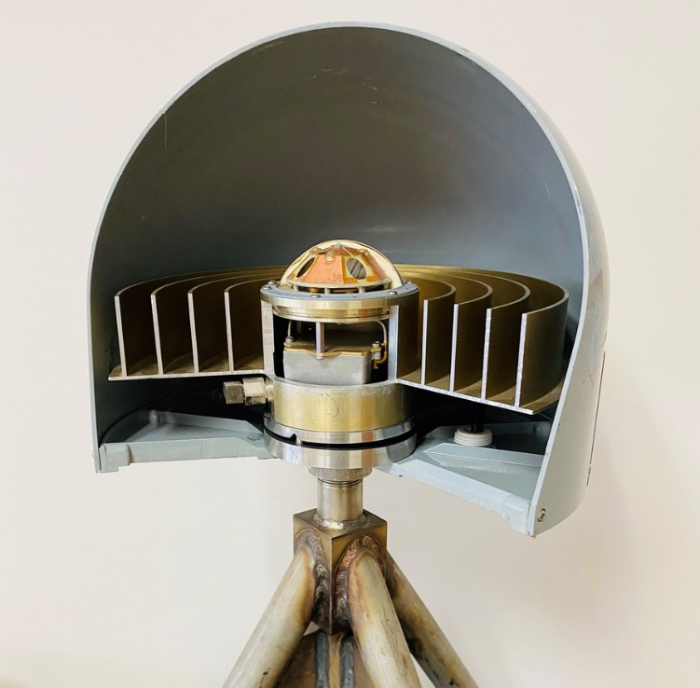
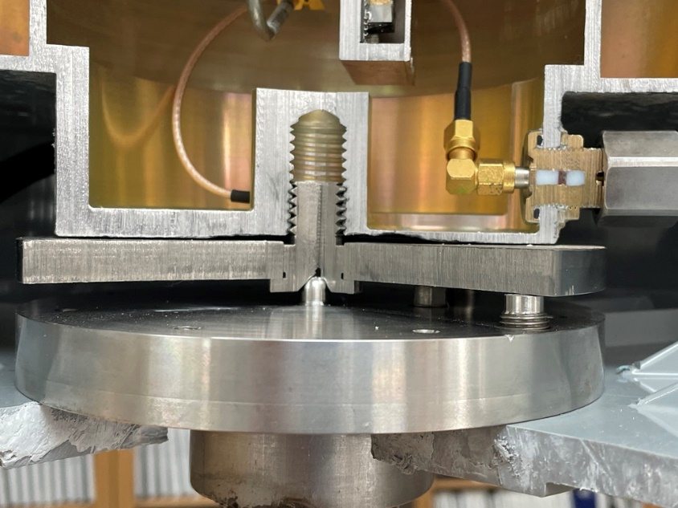
OPUS Recommendations – GNSS cont’d
Station selection criteria
Qualitative criteria
Data availability
Uptime of station
Well-defined GRP?
Monumentation quality
Observing multi-GNSS
Recency of photos
Estimated vs modeled velocities
Geometric
Reference
Point
(GRP)

Slide 39
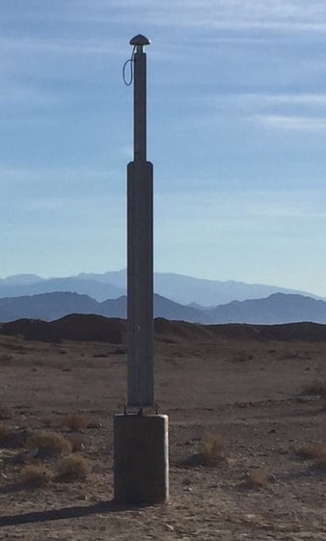
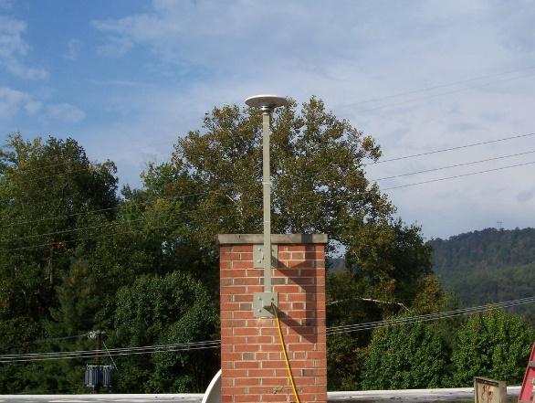
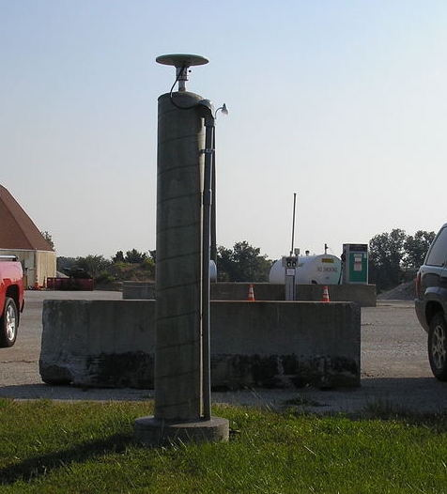
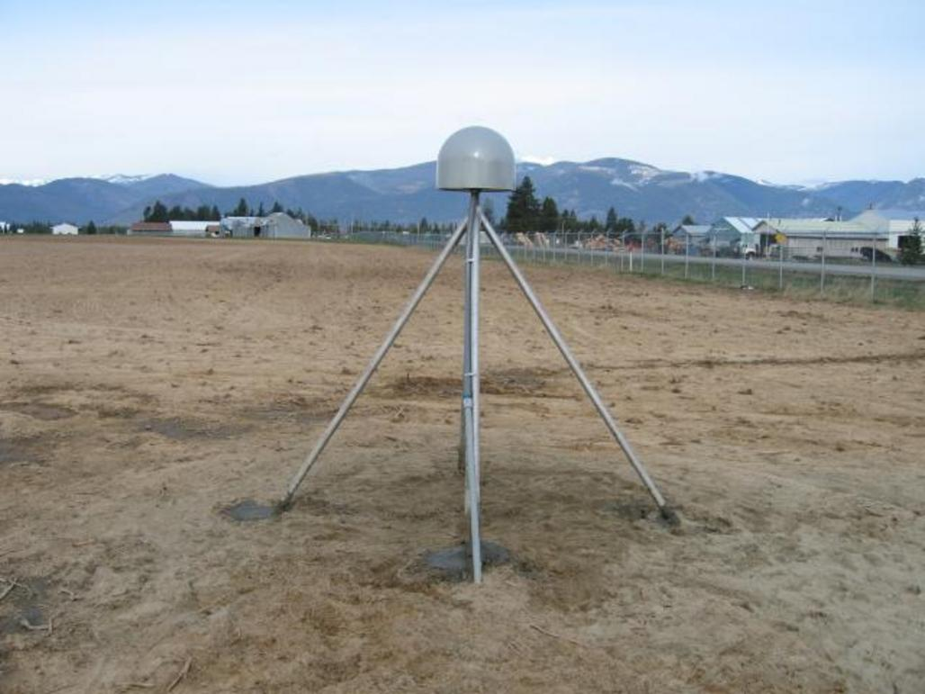
OPUS Recommendations – GNSS cont’d
Station selection criteria
Qualitative criteria
Data availability
Uptime of station
Well-defined GRP?
Monumentation quality
Observing multi-GNSS
Recency of photos
Estimated vs modeled velocities
KYTL
NVAG
P025
MOCN

Slide 40
OPUS Recommendations – GNSS cont’d
Station selection criteria
Qualitative criteria
Data availability
Uptime of station
Well-defined GRP?
Monumentation quality
Observing multi-GNSS
Recency of photos
Estimated vs modeled velocities
GPS
Galileo
GLONASS
Beidou
QZSS
IRNSS

Slide 41
OPUS Recommendations – GNSS cont’d
Station selection criteria
Qualitative criteria
Data availability
Uptime of station
Well-defined GRP?
Monumentation quality
Observing multi-GNSS
Recency of photos
Estimated vs modeled velocities
INVI

Slide 42
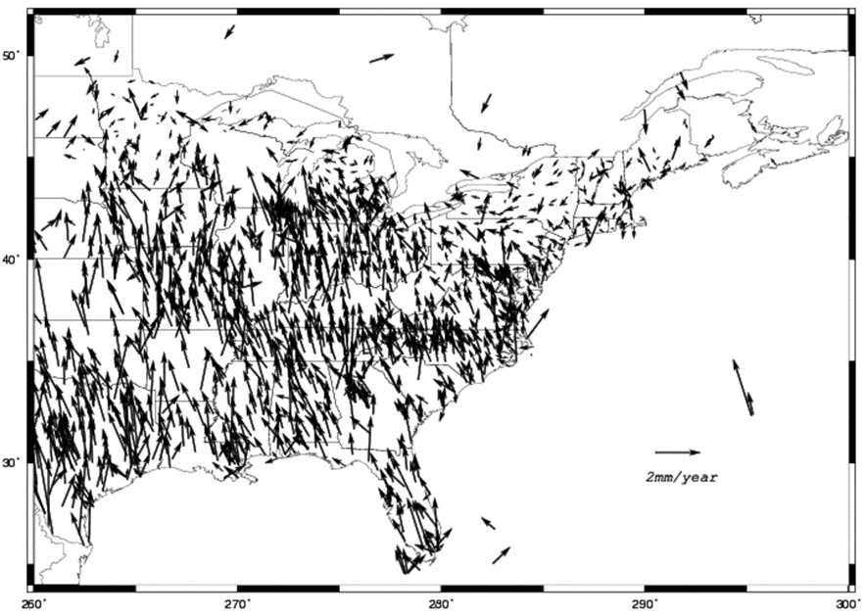
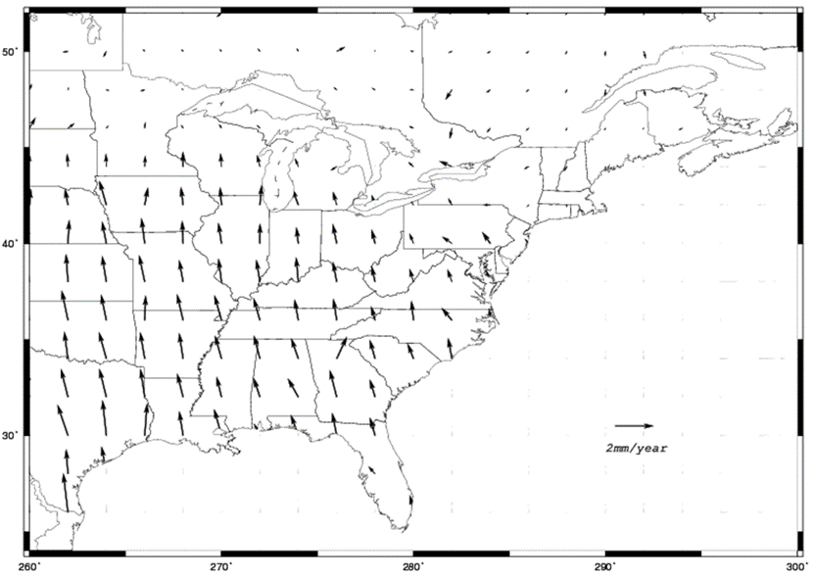
OPUS Recommendations – GNSS cont’d
Station selection criteria
Qualitative criteria
Data availability
Uptime of station
Well-defined GRP?
Monumentation quality
Observing multi-GNSS
Recency of photos
Estimated vs modeled velocities

Slide 43
The Big Takeaway
OPUS 6.0 will be built so that you can process your data the way you want…
…but if you want your coordinates to be “tied to the NSRS” you will need to follow NGS-prescribed best practice – i.e. OPUS Recommendations.

Slide 44
Thank You!

