Slide 1


U.S. Datums and Changes for 2022
Florida Floodplain Managers Association -
Annual Conference
Daytona Beach, FL
March 27, 2019
Denis Riordan, PSM
NOAA, National Geodetic Survey
denis.riordan@noaa.gov

Slide 2
Took 40 min with presentation was practiced on 03/22/2010.

Slide 3
Presentation Outline
1. - Introductions.
- National Geodetic Survey.
- Horizontal Datums / New Reference Frames.
- Vertical Datums / New Geopotential Datum.
- Update on NGS Products.
- Questions.

Slide 4
U.S. Department of Commerce
National Oceanic & Atmospheric Administration
National Geodetic Survey
Mission: To define, maintain & provide access to the
National Spatial Reference System (NSRS)
to meet our Nation’s economic, social & environmental needs
National Spatial Reference System
* Latitude * Scale
* Longitude * Gravity
* Height * Orientation
& their variations in time
Notes:
- NSRS benefit to the nation = $2.5B/year
est. 300K precision GPS users worldwide (2008); ¼ in US
- Very exciting to us at NGS to see how it has evolved over the years – now cm-accuracy capability / tracking with time

Slide 5
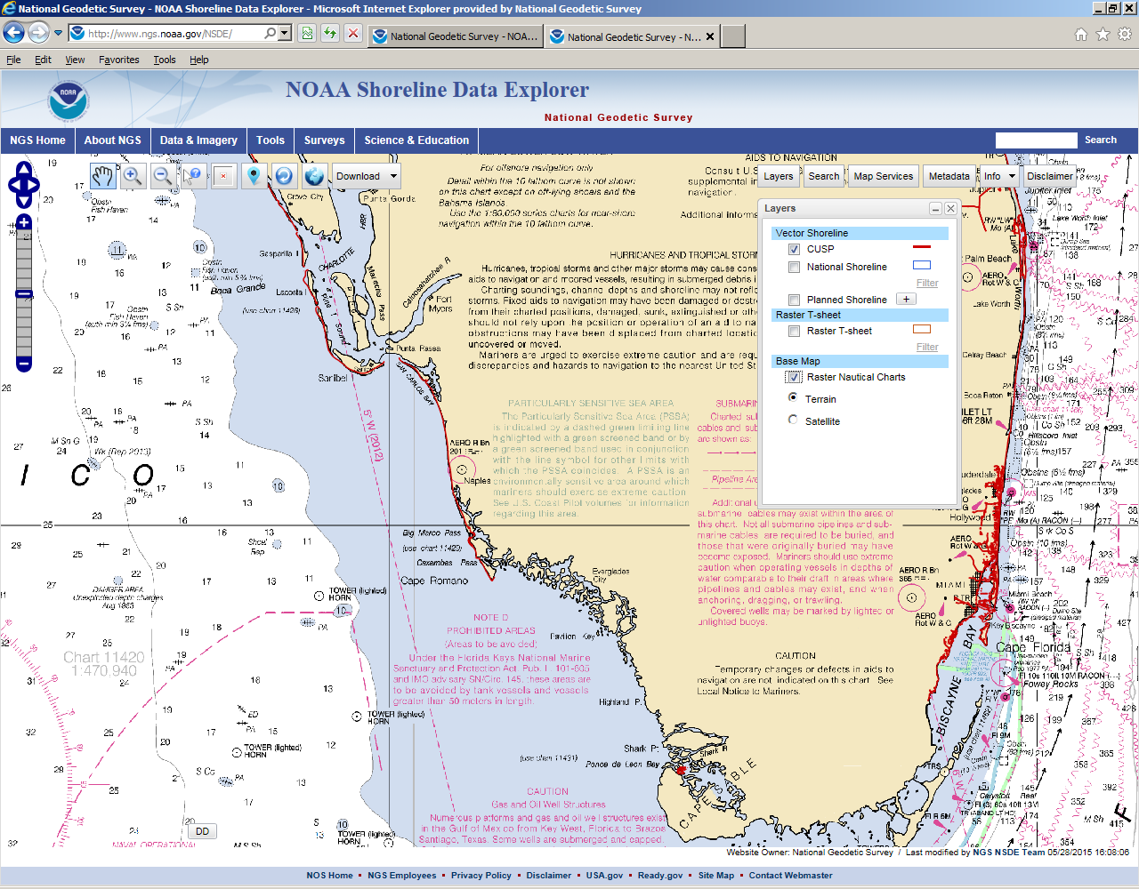
Additional NGS Mission and Products
Notes:
NGS is also mandated to define the National Shoreline.
Product & Services Outreach: Presentation library, publications, videos, webinars, Corbin Training Center, participate in production of GNSS orbits, aeronautical surveys, emergency response imagery, etc.

Slide 6
U.S. Geometric Datums in 2022

Slide 7
National Spatial Reference System(NSRS)
Improvements in the Horizontal Datums
TIME NETWORK METHOD
NETWORK SPAN ACCURACY OF REFERENCE
NAD 27 1927-1986 10 meter
NAD83(86) 1986-1990 1 meter
NAD83(199x)* 1990-2007 0.1 meter
HARN
NAD83(2007) 2007 - 2011 0.01 meter
(CORS)
NAD83(2011) 2011 - 2022 0.01 meter
(CORS)
TRAVERSE & TRIANGULATION -
GROUND MARKS USED FOR REFERENCING THE NSRS.
GPS BECOMES MEANS OF POSITIONING – STILL GRND MARKS.
GPS – CORS STATIONS ARE MEANS OF REFERENCE FOR THE NSRS.

Slide 8
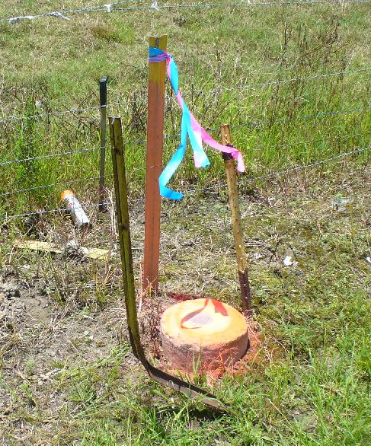
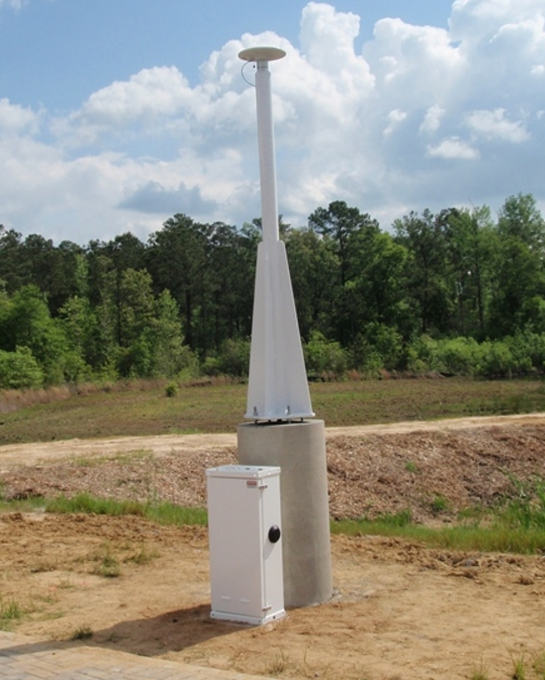
NSRS Reference Basis
Old Method - Ground
Marks (Terrestrial)
New Method - GNSS Stations
(CORS)

Slide 9
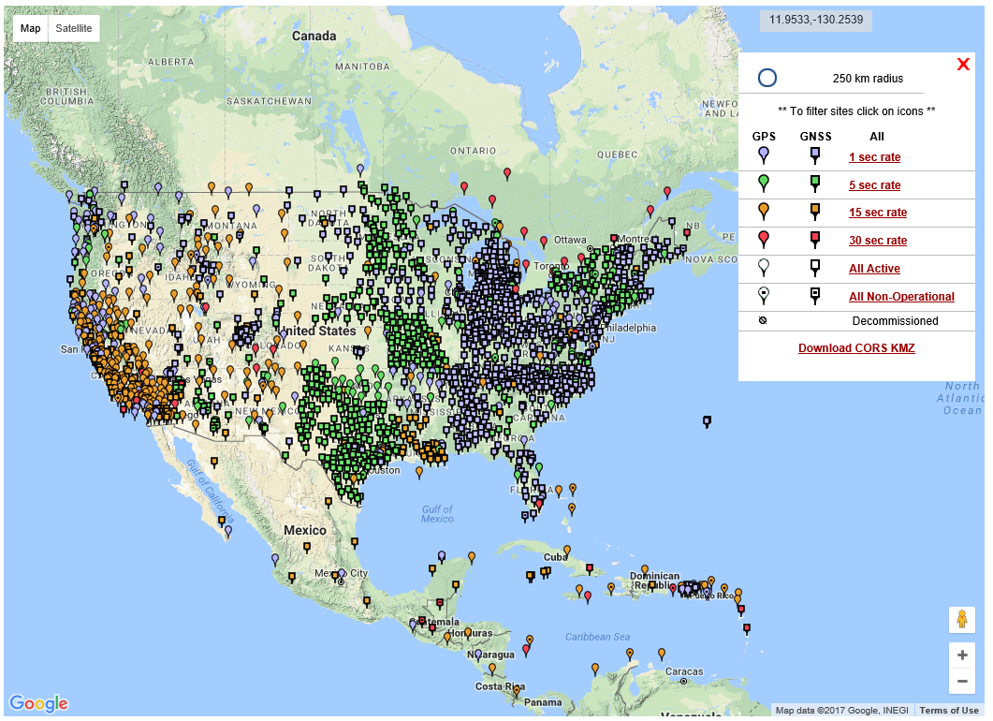
NGS Published CORS

Slide 10
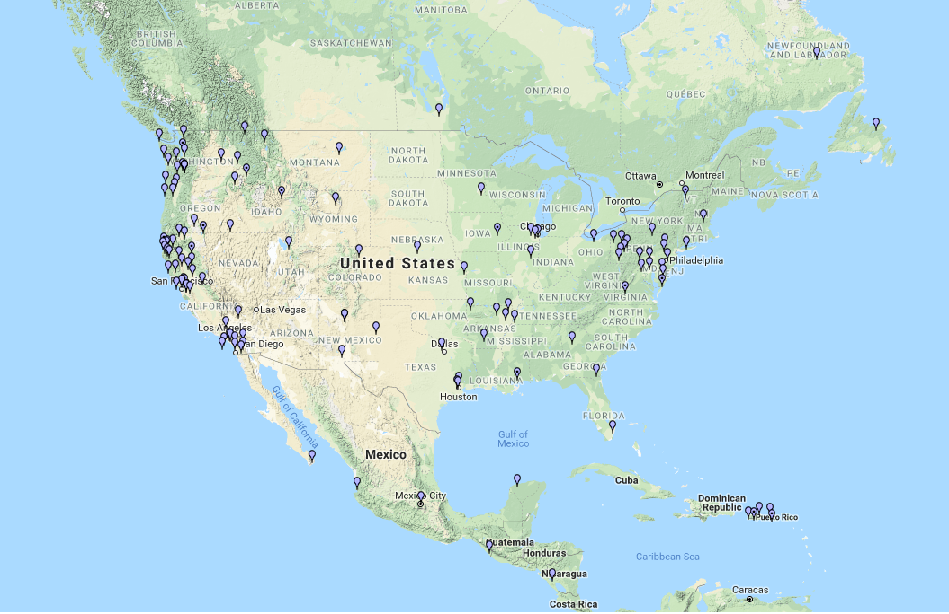
NSRS “Constrained” CORS
* Stations shown for
concept purposes only.

Slide 11
Why Replace NAD83?
Datum based on best known information about the earth’s size and shape from the early 1980’s (45 years old), and the terrestrial survey data of the time.
NAD83 is NON-geocentric & hence inconsistent w/GNSS .
Necessary for agreement with future ubiquitous positioning of GNSS capability.

Slide 12
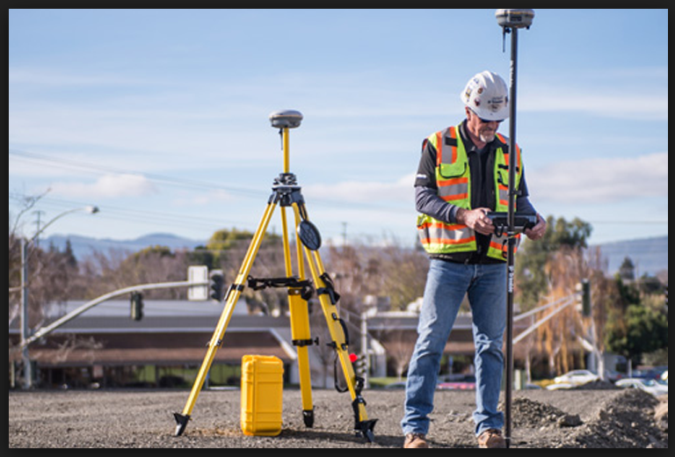
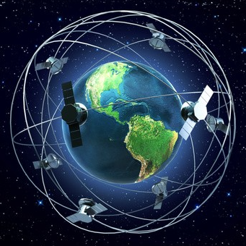
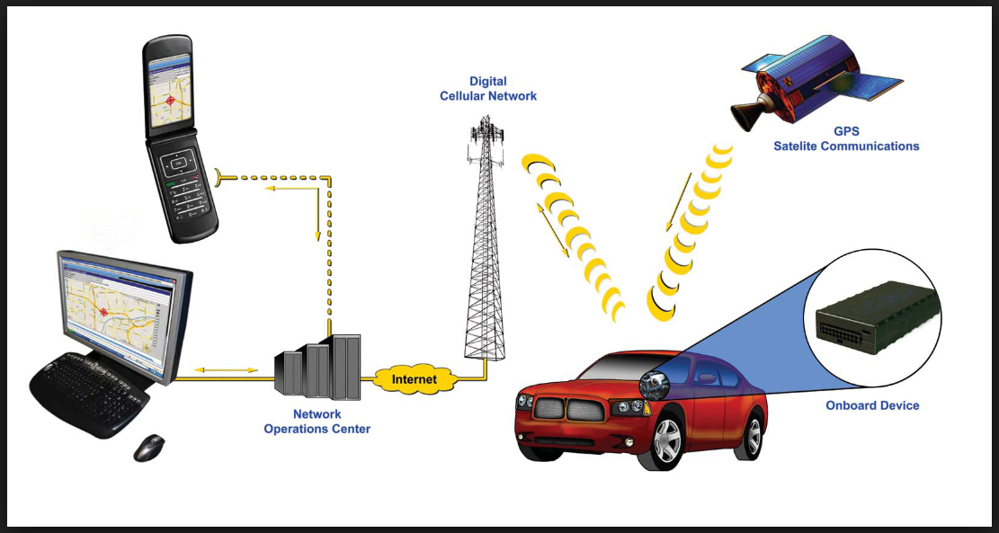
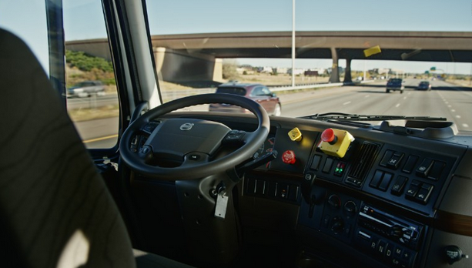
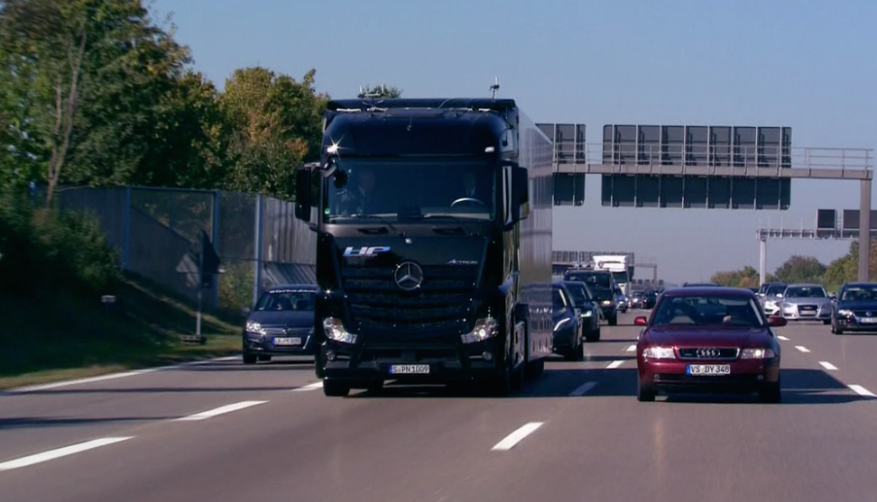
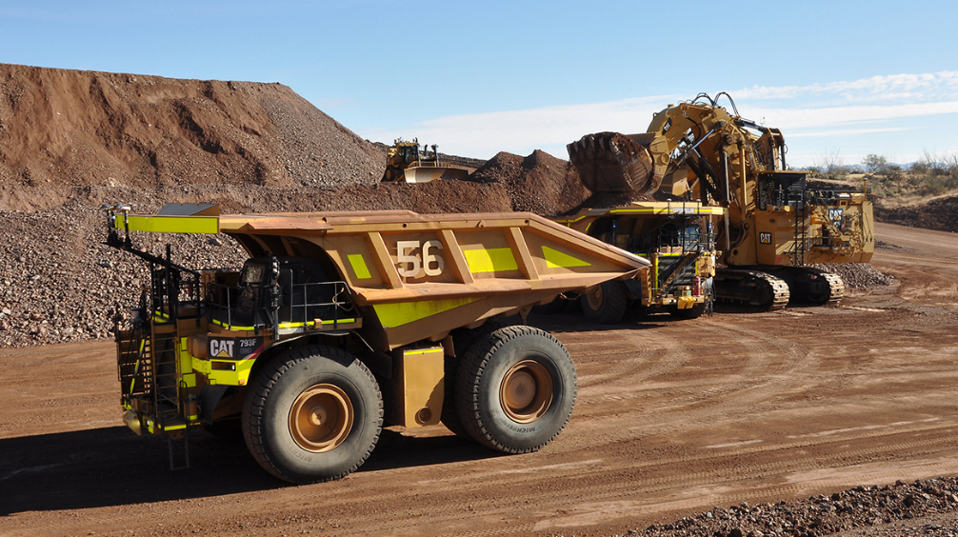
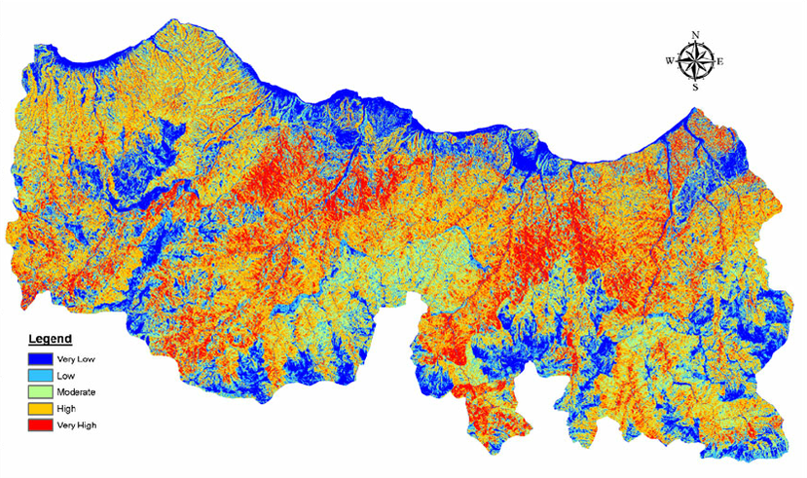
Why Replace NAD83? – Future Uses of the NSRS
Notes:
Use of GNSS technology is widely used today in surveying, mapping, navigation will cell. Phones, auto on-board navigation, and autonomous driving is fine in open pit mines, but do we really want autonomously driven trucks operating with maps that may be in error because of the difference between NAD83 and GNSS positioning?

Slide 13
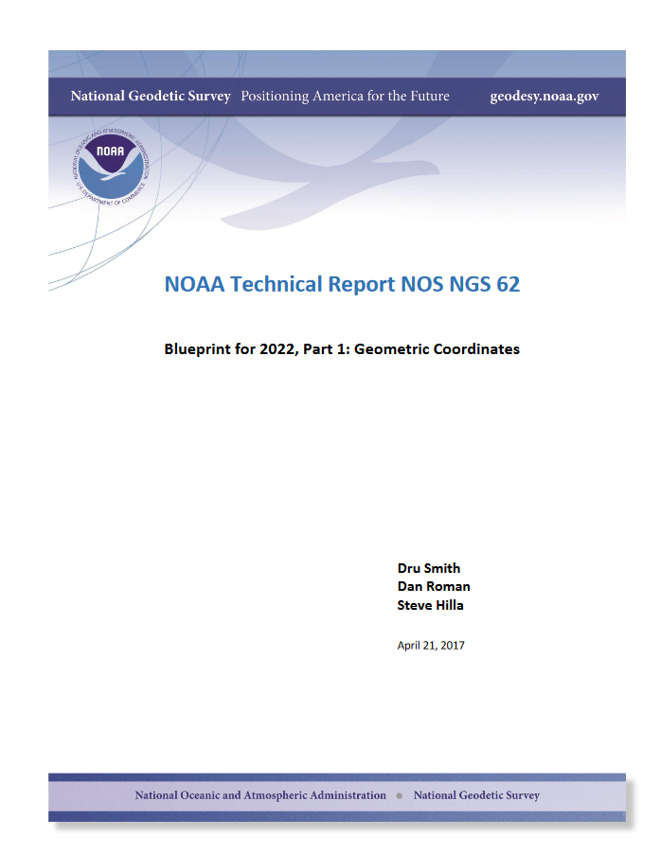

Slide 14
Future Geometric (3-D) Reference Frame
Blueprint for 2022: Part 1 – Geometric Datum
Replace NAD83 with new geometric reference frame – by 2022.
CORS-based, accessed via GNSS observations.
Coordinates & velocities in ITRF (IGS) & new US reference frame.
Passive control tied to new reference frame (not a component).
Transformation tools will relate NAD83 to new US reference
frame (NCAT with 2022 transformation).

Slide 15
Datum Names
The Old:
NAD 83(2011)
NAD 83(PA11)
NAD 83(MA11)
The New:
The North American Terrestrial Reference Frame of 2022
(NATRF2022)
The Caribbean Terrestrial Reference Frame of 2022
(CATRF2022)
The Pacific Terrestrial Reference Frame of 2022
(PATRF2022)
The Mariana Terrestrial Reference Frame of 2022
(MATRF2022)

Slide 16
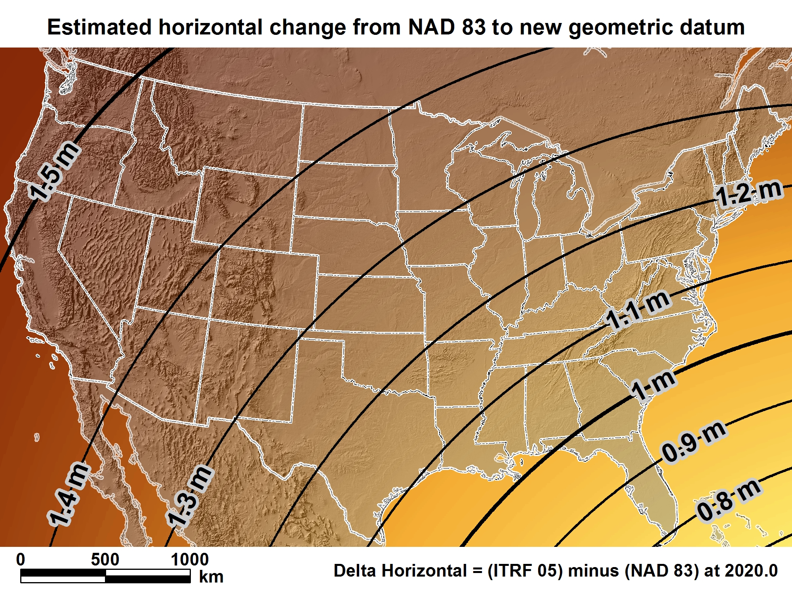
New geometric datum minus NAD 83 (horizontal)
For Florida = 0.8 > 1.02 m (2.6 > 3.3 ft.)

Slide 17
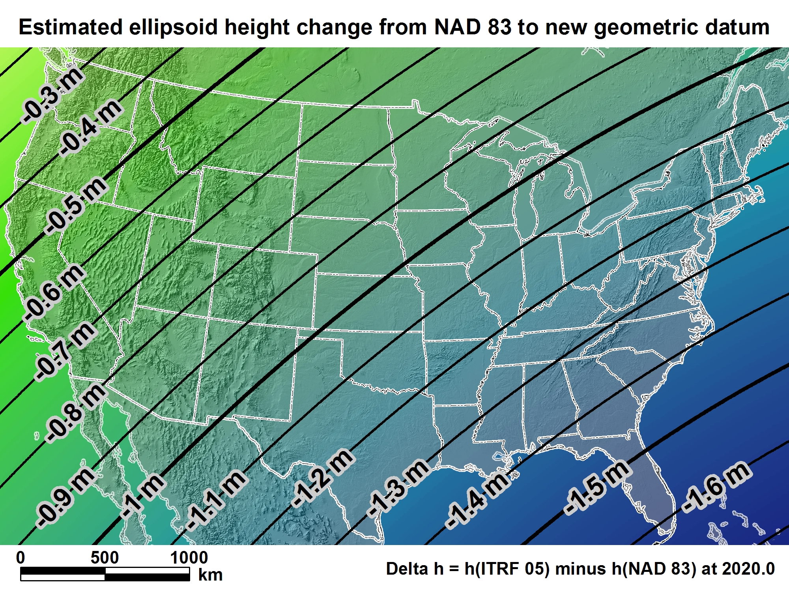
New geometric datum minus NAD 83
(ellipsoid height)
For Florida = -1.39 > -1.62 m (-4.5 > -5.3 ft.)

Slide 18
U.S. Vertical Datums in 2022

Slide 19

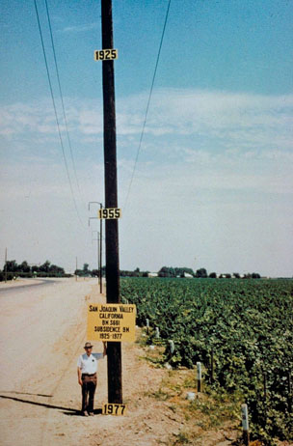
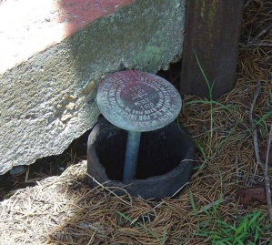
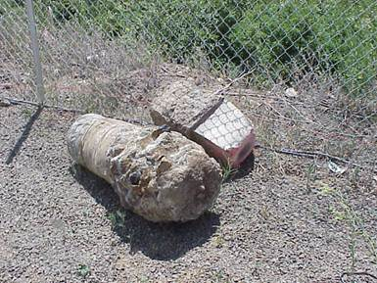
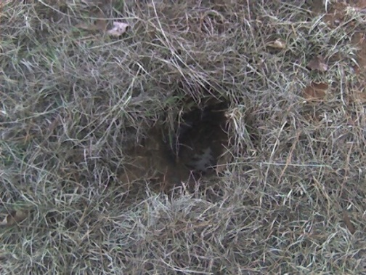
Why isn’t NAVD 88 good enough anymore?
* NAVD 88 is a terrestrial based vertical datum that changes as the land changes.
NAVD 88 suffers from use of bench marks that:
  Are almost never re-checked for movement
  Disappear by the thousands every year
  Are not funded for replacement
  Are not necessarily in convenient places
  Don’t exist in most of Alaska
  Were determined by leveling from a single point, allowing cross-country error build up

Slide 20
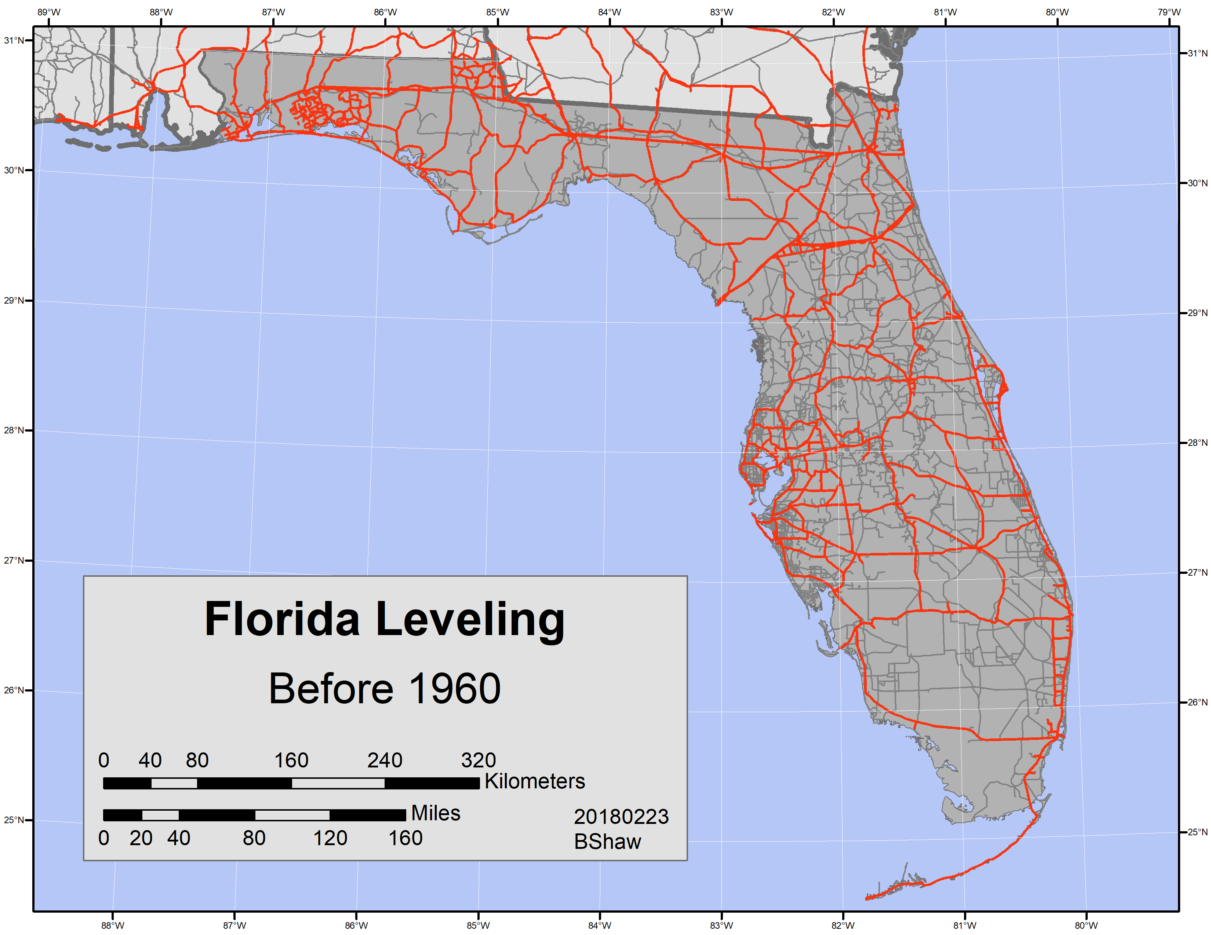




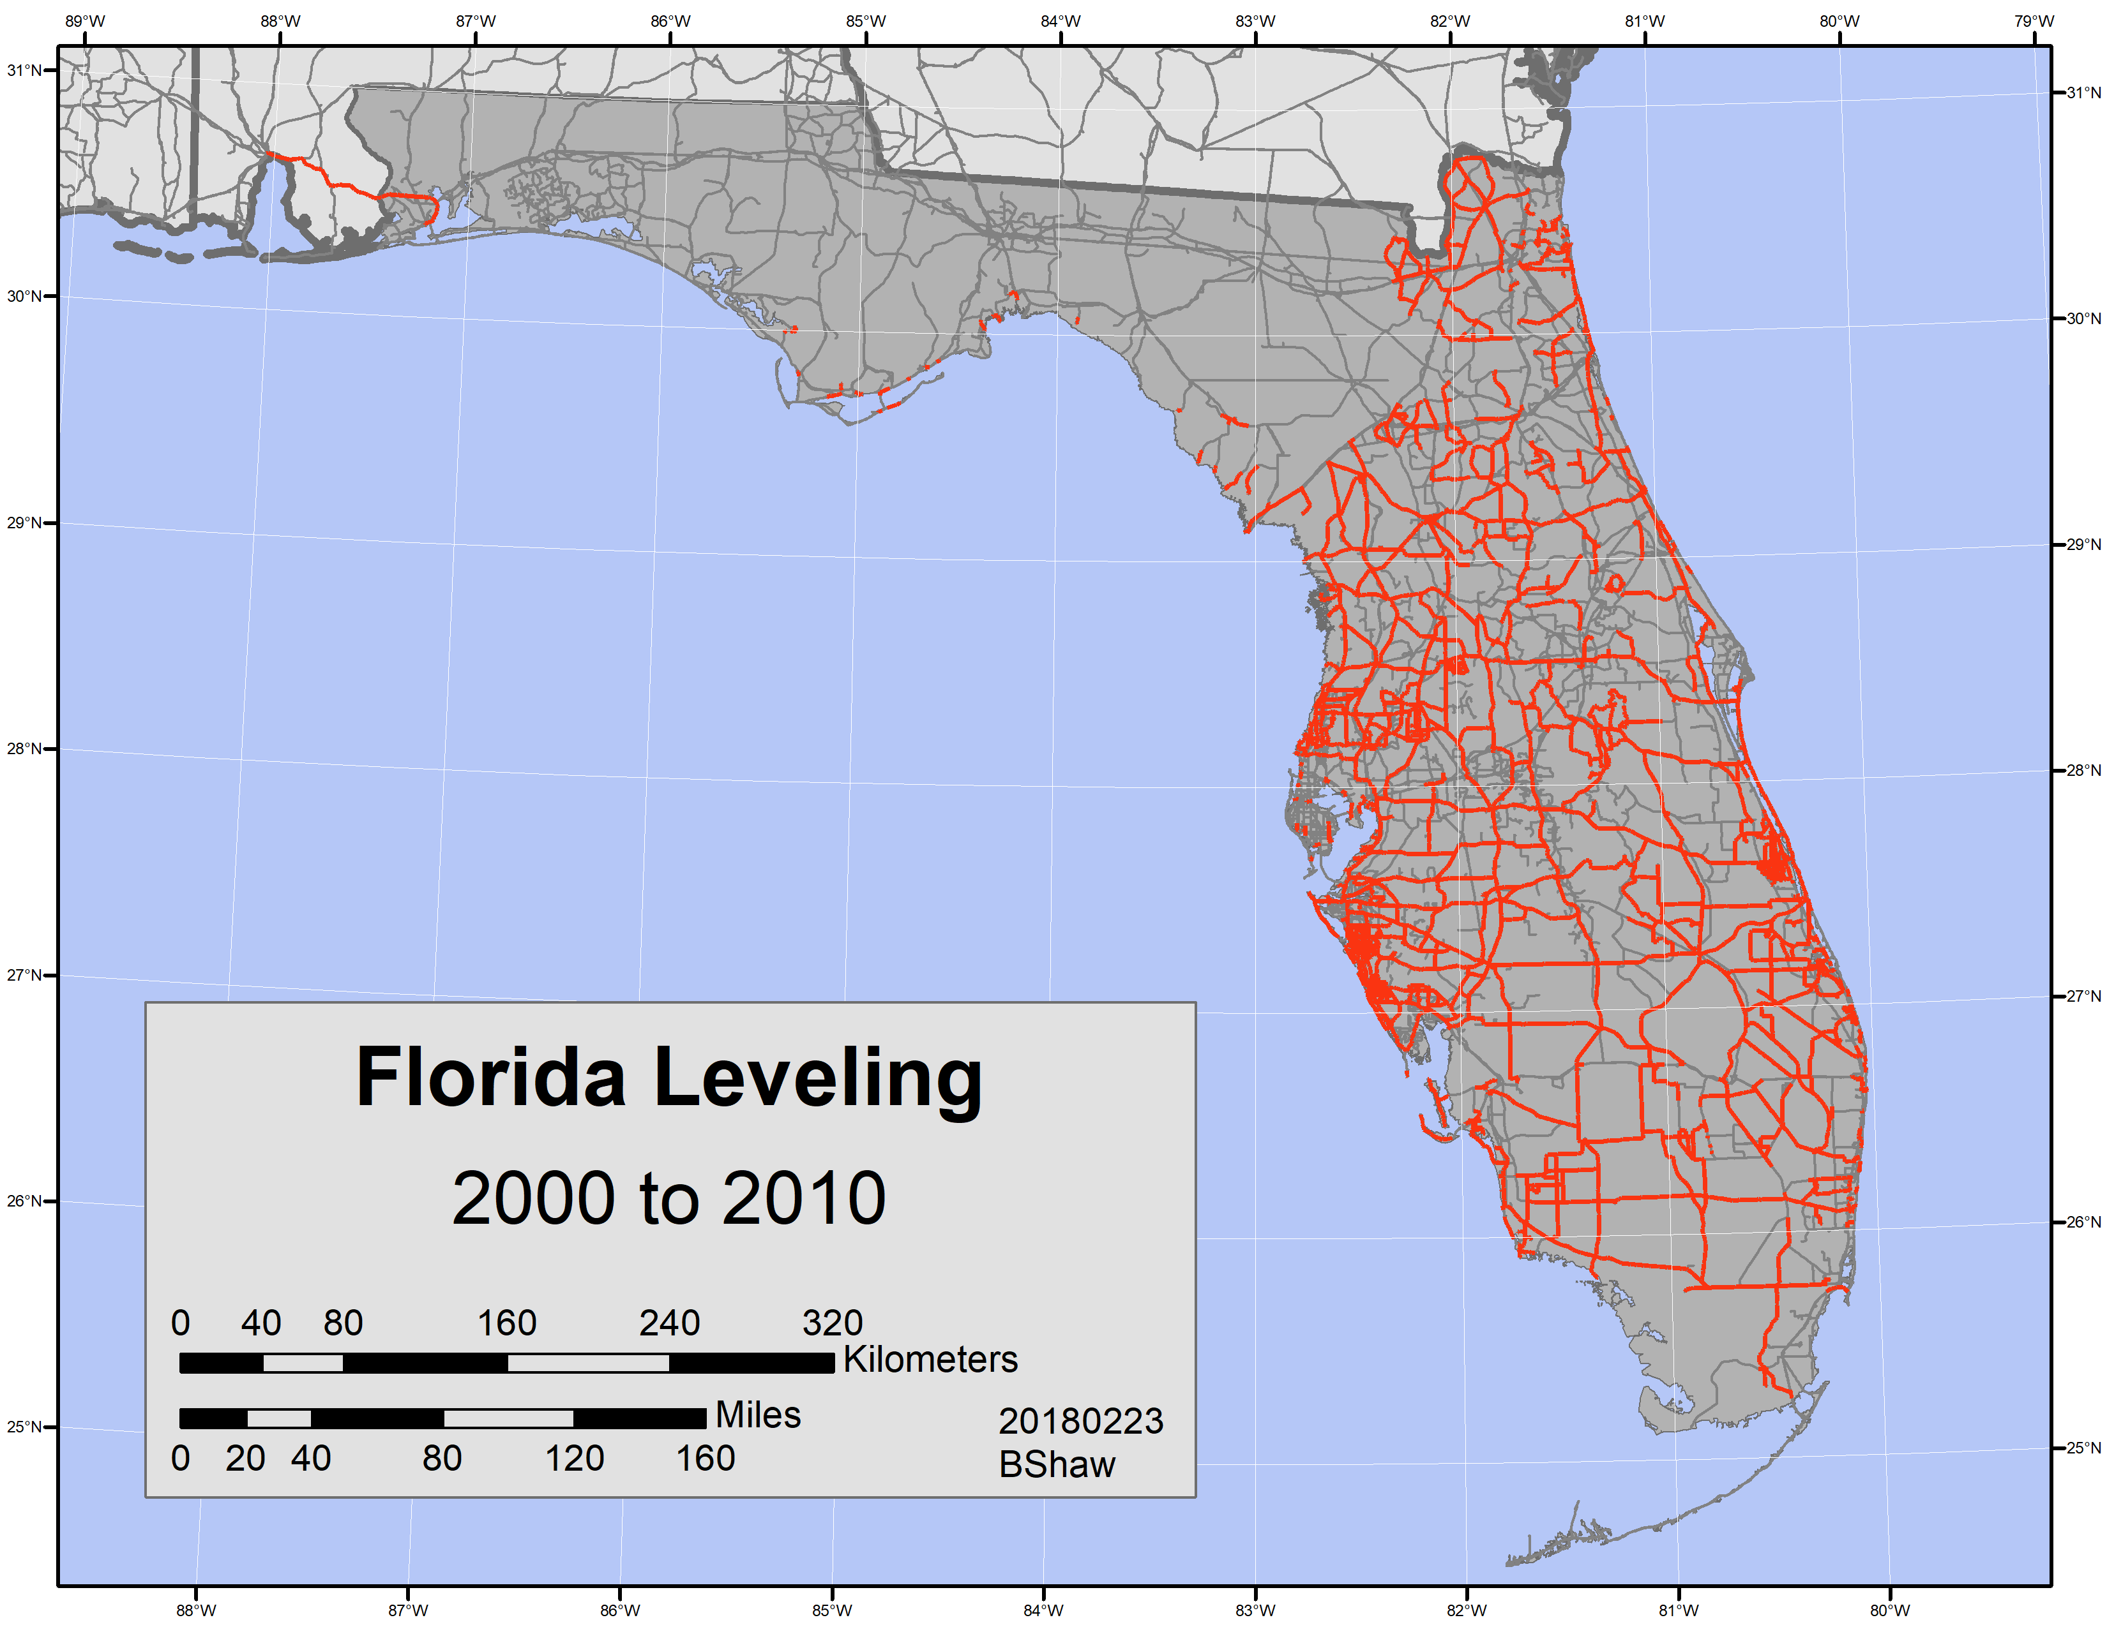


Slide 21
NEW VERTICAL DATUM (Rationale)
  A move away from differentially leveled passive control as the defining mechanism of the reference surface
  To be consistent with the shift in the geometric reference frame/ellipsoid (2022)
  Improvement in our technical abilities in reference surface realization (geopotential gravimetric reference surface - 1cm accuracy of the geoid (GNSS/GRAV-D))
  Goal - ability to establish 2cm orthometric height anywhere in U.S. using a minimum of 15 min. of GNSS data.
  The new geopotential reference surface will be aligned with the geometric reference frame/ellipsoid (i.e., no hybrid geoid)

Slide 22
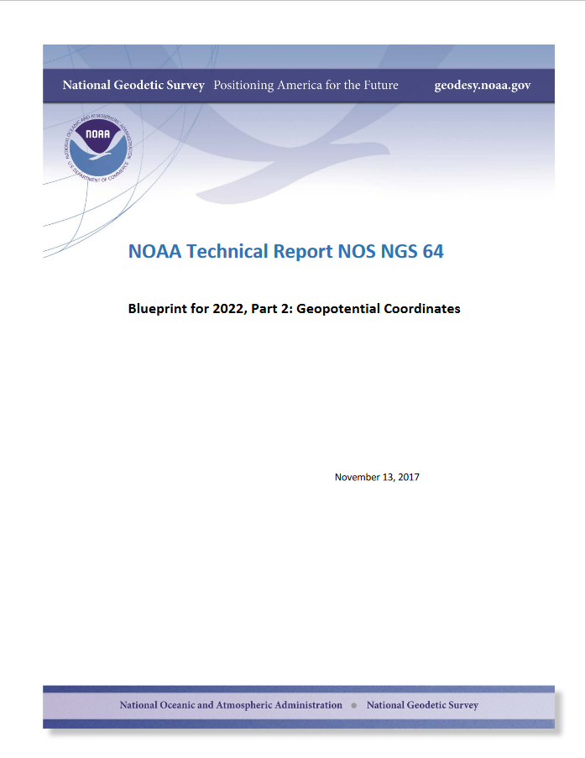

Slide 23
Names
  The Old:
  NAVD 88
  PRVD 02
  VIVD09
  ASVD02
  NMVD03
  GUVD04
  IGLD 85
  IGSN71
  GEOID12B
  DEFLEC12B
Orthometric
Heights
  The New:
  The North American-Pacific Geopotential Datum of 2022 (NAPGD2022)
Normal
Orthometric
Heights
Dynamic
Heights
Gravity
Geoid
Undulations
Deflections of
the Vertical

Slide 24
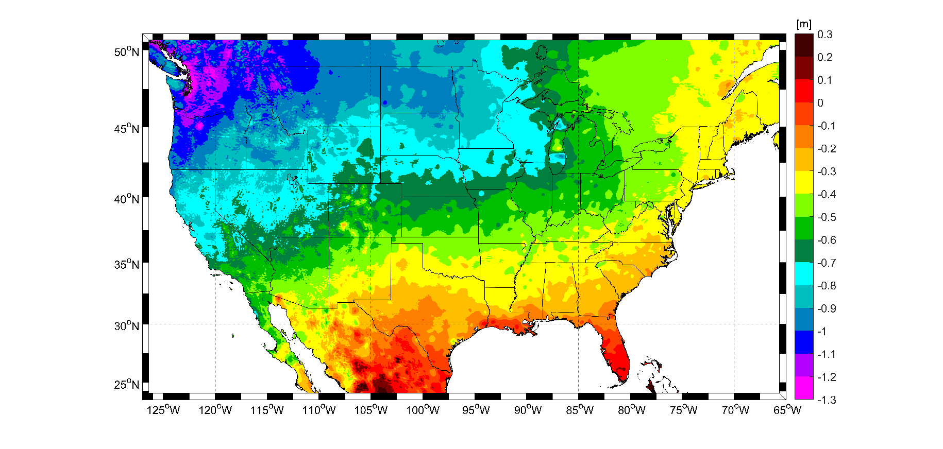
Expected changes to orthometric heights
For Florida = 0.1 > -0.3 m (4 > -11 in.)

Slide 25
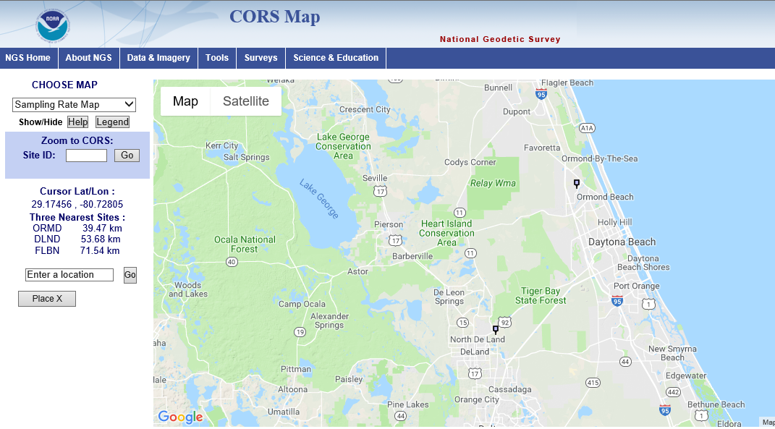
Vertical Shifts (BETA)
-3.38 IN.
ORMD
-2.32 IN.
DLND

Slide 26
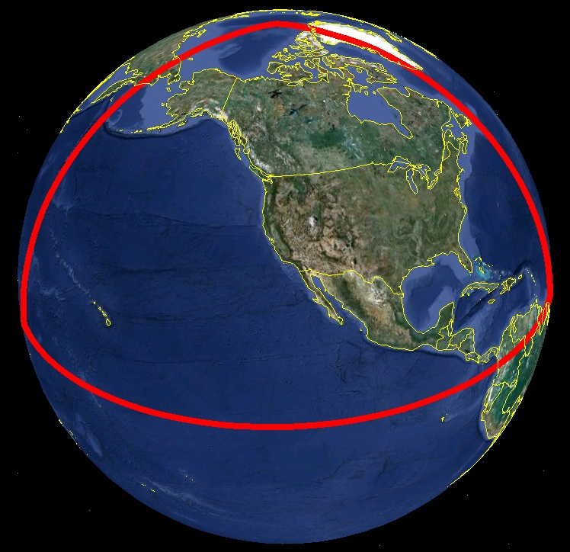
Extent of 2022 gravimetric geoid model used for NAPGD2022

Slide 27
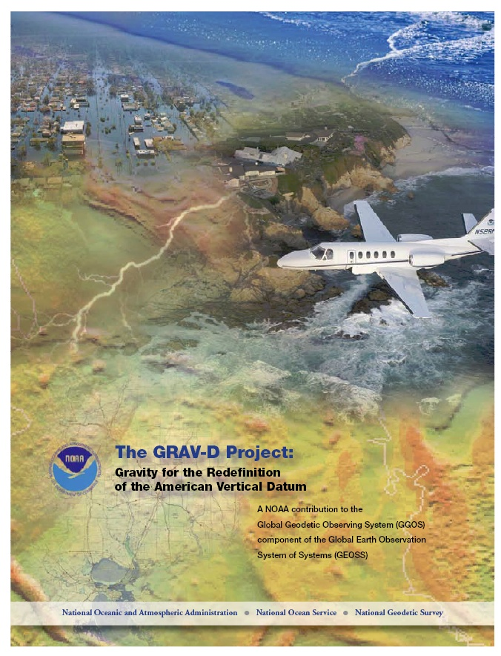
Gravity for the Redefinition of the American Vertical Datum (GRAV-D)
Replace the Vertical Datum of the USA by 2022 (at today’s funding)
GRAV-D is:
  An airborne gravity survey of the entire country and its holdings
  A 2022 gravimetric geoid accurate to 1 cm
  Long-term monitoring of geoid change over time
  Partnership surveys
Working to launch a collaborative effort with the USGS for simultaneous magnetic measurement
Acting Manager: Monica Youngman
Monica.Youngman@noaa.gov
Gravity and Heights are
inseparably connected
Notes:
GRAV-D is the NGS project designed to replace NAVD88 with a vertical datum based upon a gravimetric geoid accurate to 1 cm. Heights above this datum will be accessed via GNSS measurements. Three thrusts of project. Launch USGS collaboration for simultaneous mag measurement.

Slide 28
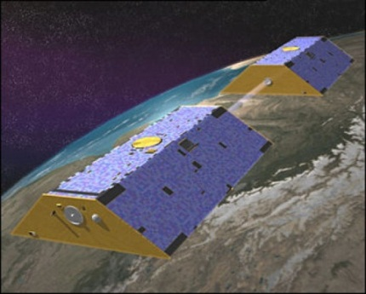
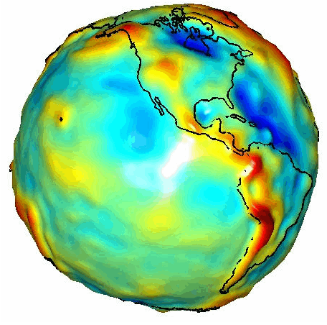
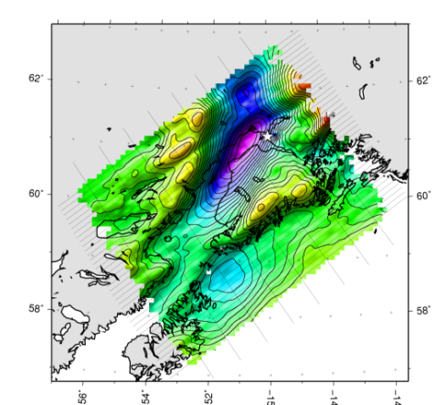

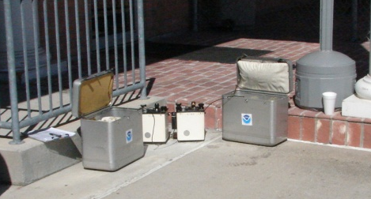
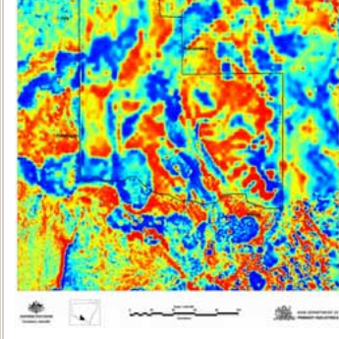
Building a Gravity Field
Long Wavelengths
(≥ 250 km)
GRACE/GOCE/Satellite Altimetry
+
Intermediate Wavelengths
(500 km to 20 km)
Airborne Measurement
+
Short Wavelengths
(< 100 km)
Surface Measurement and
Predicted Gravity from Topography
Notes:
Give example of how short wavelength information is like low altitude aerial photos (1/2” pixel accuracy) in that it provides very accurate and detailed information. The long wavelength gravity can be likened to the old LANDSAT imagery (3 meter pixel accuracy) in that it was good over large areas, but didn’t give much detail for local areas. The intermediate wavelength gravity data gives us a connection between the two (the short and long), allowing the NGS gravity team to use all available gravity information in working toward the production of a 1 cm accurate gravitational surface.

Slide 29
Geoid Monitoring Service (GeMS)
Goal: Track all changes to the geoid which would prevent 1 cm accuracy
Aspects included:
  Shape, Secular: e.g. Hudson Bay
  Shape, Episodic: e.g. Massive Earthquakes
  W0, Secular: Global Sea Level Change (see next slides)
Examples of things excluded:
  Size, Secular: Mass quantity of Earth is effectively static
  Shape, Periodic: Seasonal glacier cycle

Slide 30
Preparing for New Reference Frames

Slide 31
How to Plan for 2022
Move to newest realizations
  NAD 83(2011) epoch 2010.00
  GEOID12B (hybrid geoid)
Move to NAVD 88
  understand the accuracy of VERTCON in your area
Utilize passive marks that are up to date
  Stay aware of what marks are included in datum updates
  Use OPUS & Hgt. Mod procedures to update mark positions
Use OPUS for GPSBMs
  Help improve future geoid models & relationship with new datum
NGS Outreach Efforts
  Participate in NGS webinars, Geospatial summits, contact NGS Regional Advisor, etc.

Slide 32
Metadata is Critical
Your positional metadata should include:
  datum
  epoch
  source / methods
These will facilitate transforming from current to new datum
Maintaining your original survey data will provide more accurate results
Notes:
Metadata related to how someone establishes control is important. Important for today’s positions, but especially as we moving toward and into the coming new datums in 2022.

Slide 33
State Plane Coordinates System 2022

Slide 34
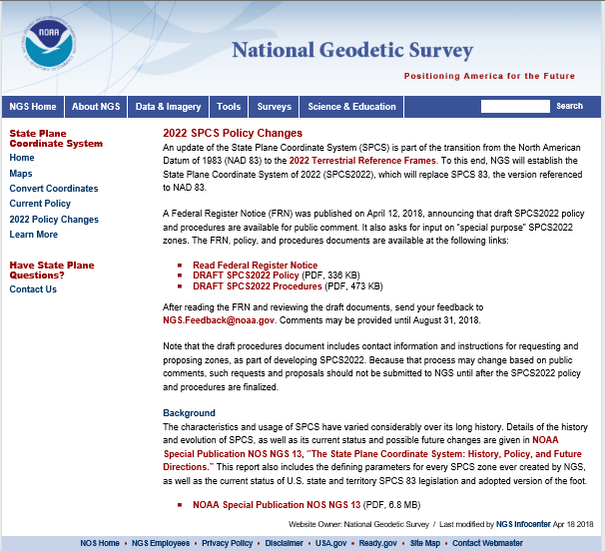

Slide 35
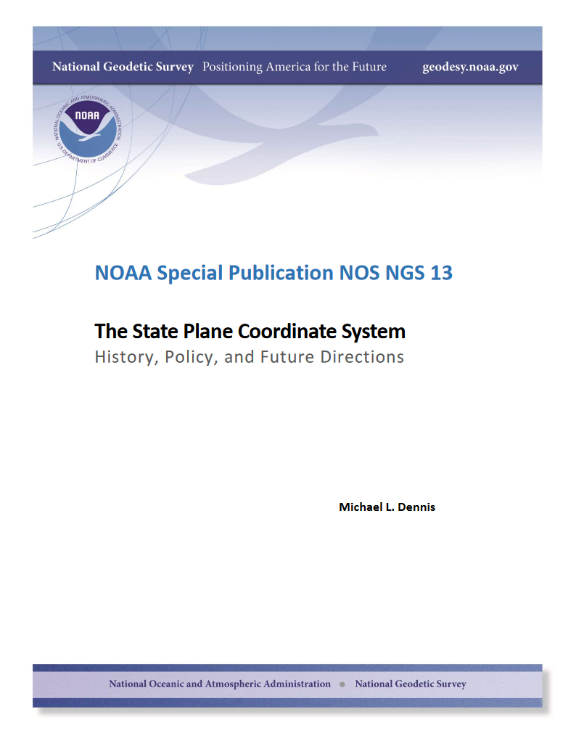
SPCS Special Publication
History of NGS projections (1853 to present)
SPCS policies and legislation
Departures from policy and convention
Recent developments in projected coordinate systems
Appendices
  Defining parameters for ALL zones of ALL versions of SPCS, plus additional information
  Status of SPCS 83 legislation and foot conversions

Slide 36
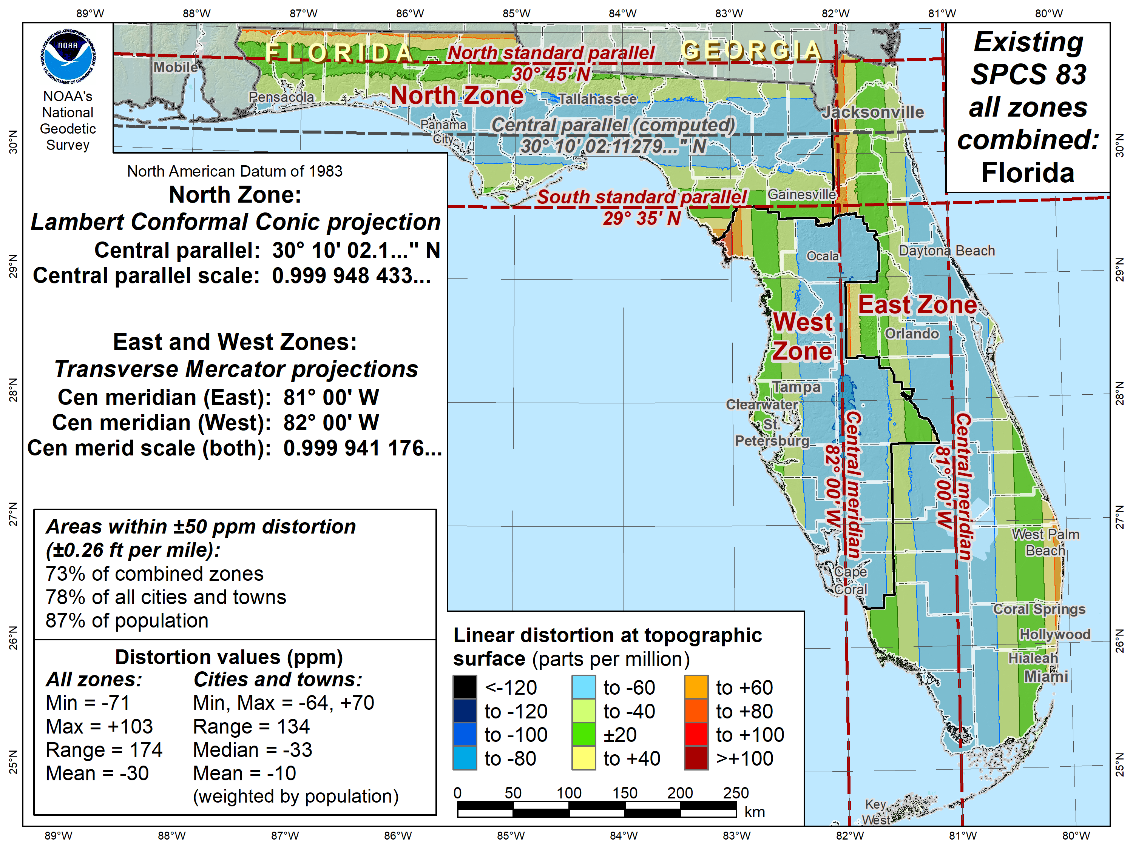

Slide 37
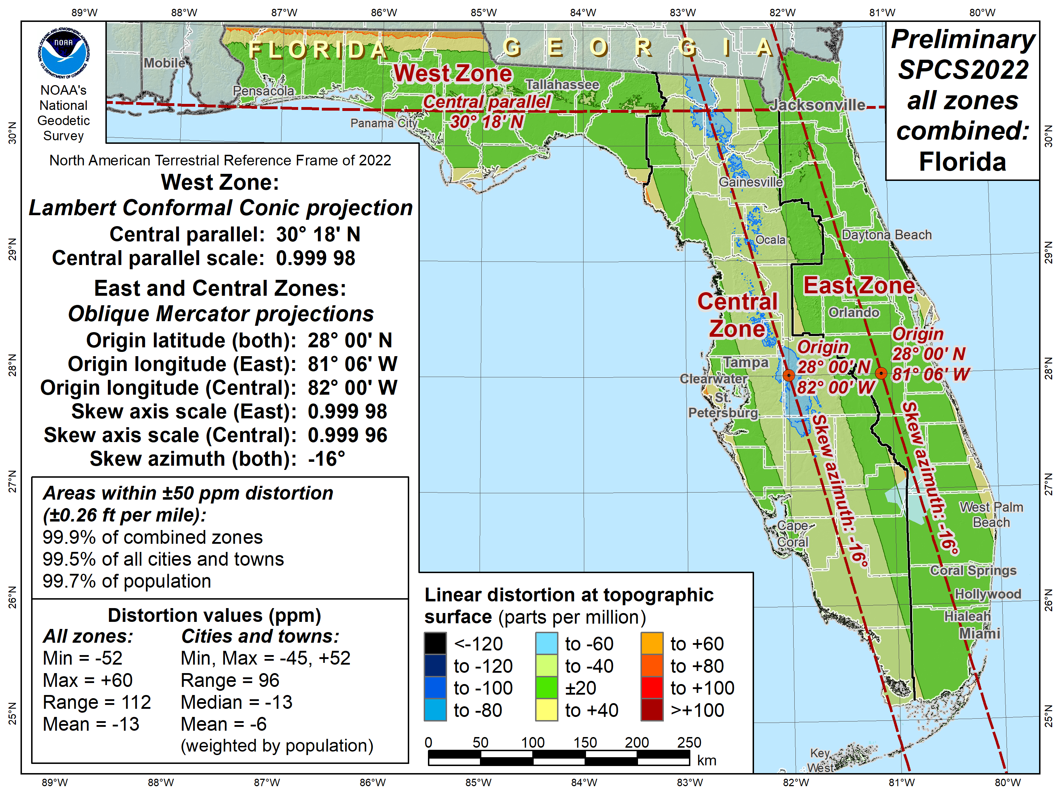

Slide 38
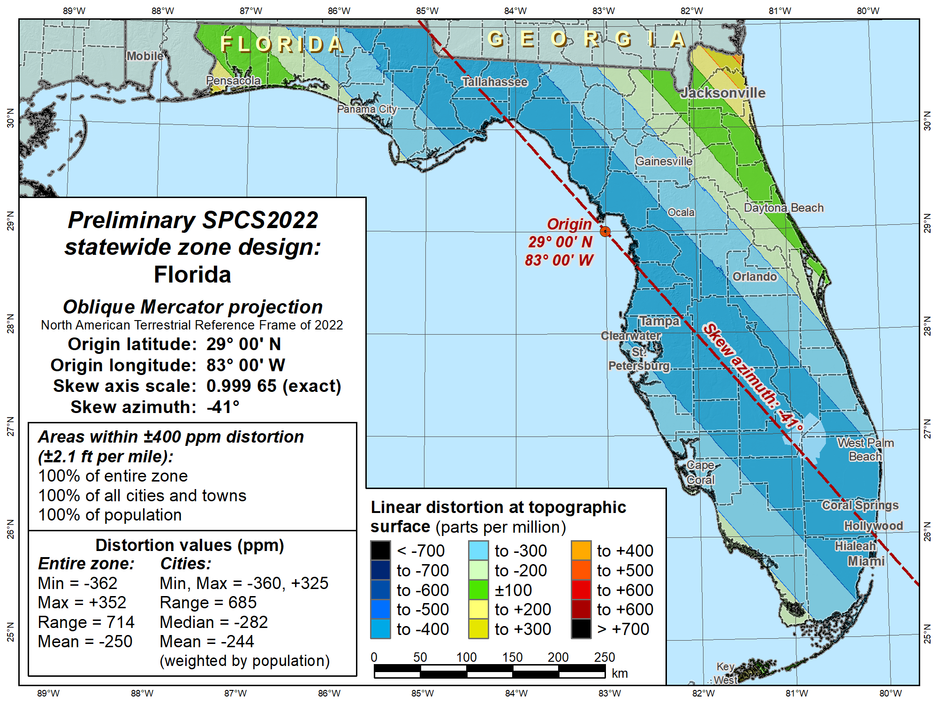

Slide 39
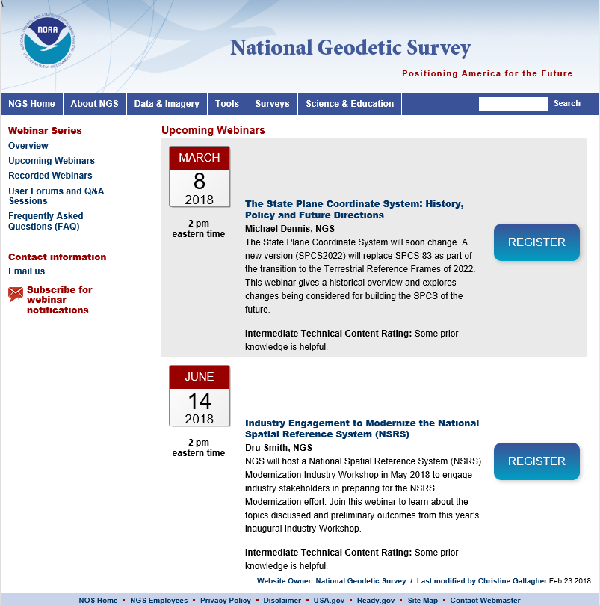

Slide 40
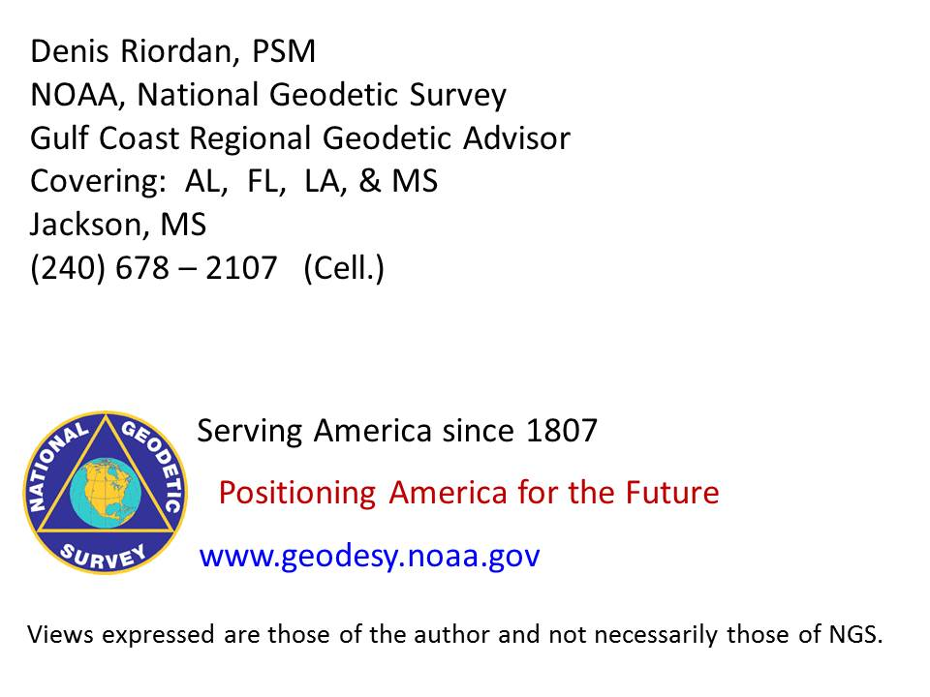
? ? QUESTIONS ? ?

