Slide 1

New Datums for the Nation
A Change for Better
Positioning in the US
Esri User Conference
San Diego, CA
July 12, 2017
Michael Dennis, RLS, PE
Geodesist
michael.dennis@noaa.gov

Slide 2
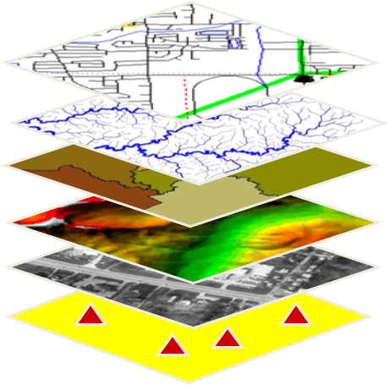
U.S. Department of Commerce
National Oceanic & Atmospheric Administration
National Geodetic Survey
Mission: To define, maintain & provide access to the
National Spatial Reference System (NSRS)
to meet our Nation’s economic, social & environmental needs
& their time variations
(plus National Shoreline, etc.)
Latitude
Longitude
Height
Gravity
Orientation
Scale
Notes:
- NSRS benefit to the nation = $2.5B/year
est. 300K precision GPS users worldwide (2008); ¼ in US
- Very exciting to us at NGS to see how it has evolved over the years – now cm-accuracy capability / tracking with time

Slide 3

Why bother with datums at all?
Geospatial data are everywhere
But not useful if can’t line data up
Datums make it possible to align data

Slide 4
Projections are easy
Datums are hard
WARNING: This stuff is complicated.
But if you want to align data to better than 3 m,
it matters
Datum definitions and transformation are not for sissies!

Slide 5
What is a “datum”, anyway?
“Datum” is a reference for measurements
  Can think of it as defining “zero”
“Terrestrial reference frame” more specific
  “Terrestrial” means frame rotates with the Earth
  “Frame” specifies a 4D geometric “framework”
    4D is 3D position plus time
For vertical, we use term “geopotential datum”
  “Geopotential” because “vertical” only part of system
  “Datum” used here to specify zero “surface”
    Actually a field of gravity potential energy (geopotential)
    “Surface” implied by choosing specific geopotential value
    Geopotential is not geometric, so “frame” not appropriate
    The datum is built on the geometric reference frame

Slide 6
Current situation with datums in the US
“Horizontal”: North American Datum of 1983 (NAD 83)
  Actually 4D: latitude, longitude, ellipsoid height, and time
  3 current realizations referenced to different tectonic plates
    NAD 83 (2011): North America plate (but includes Caribbean)
    NAD 83 (PA11): Pacific plate (e.g., Hawaii, American Samoa)
    NAD 83 (MA11): Mariana plate (e.g., Guam, Northern Mariana Islands)
“Vertical”: North American Vertical Datum of 1988 (NAVD 88)
  But there are six other current vertical datums in the NSRS:
    Puerto Rico Vertical Datum of 2002 (PRVD02)
    Virgin Islands Vertical Datum of 2009 (VIVD09)
    Guam Vertical Datum of 2004 (GUVD04)
    Northern Marianas Vertical Datum of 2003 (NMVD03)
    American Samoa Vertical Datum of 2002 (ASVD02)
    International Great Lakes Datum of 1985 (IGLD 85)

Slide 7
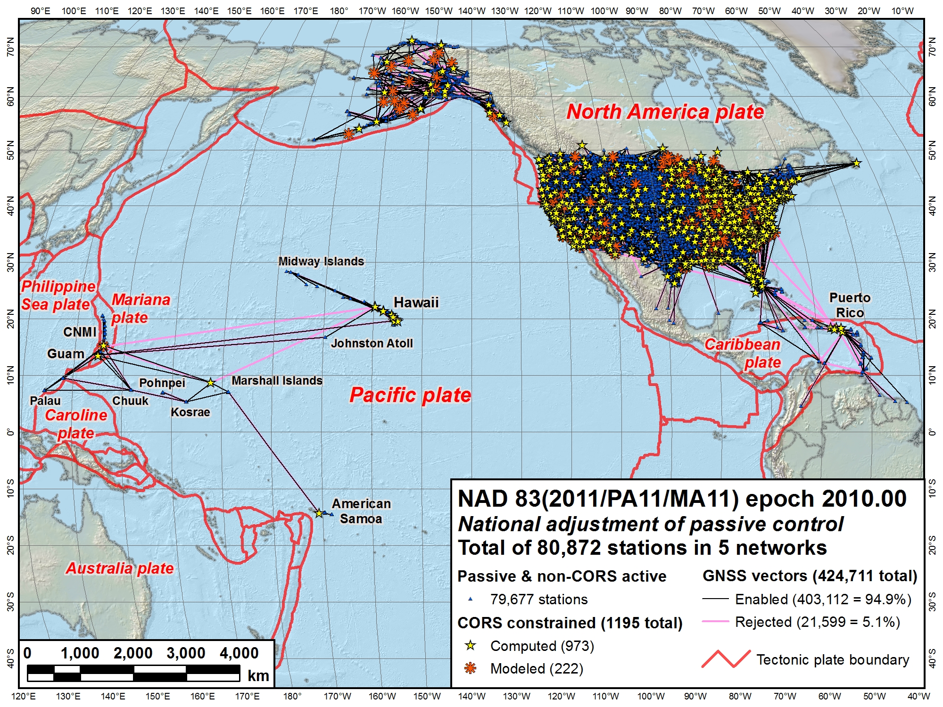
NAD 83 (2011)
NAD 83
(MA11)
NAD 83 (PA11)
North American Datum of 1983
Three frames:
NAD 83 (2011): North America and Caribbean plates
NAD 83 (PA11): Pacific plate
NAD 83 (MA11): Mariana plate

Slide 8
NAVD 88
IGLD 85
VIVD02
NMVD03
PRVD02
GUVD04
Current vertical datums of the NSRS
ASVD02
NA and Caribbean
NAVD 88
IGLD 85
PRVD02
VIVD09
Pacific
GUVD04
NMVD03
ASVD02

Slide 9
Why replace NAVD 88 and NAD 83?
Main driver: Global Navigation Satellite System (GNSS)
ACCESS!
  GNSS equipment is fast, inexpensive, reliable (and improving)
  Reduces reliance on finding survey control (“bench marks”)
ACCURACY!
  Insensitive to distance-dependent errors; reliable
  Immune to bench mark instability (referenced to CORS)
CONSISTENCY!
  Eliminates systematic errors in current datums
  Aligned with global reference frames
  Integrated system for both positions and heights (“elevations”)

Slide 10
NAD 83 is not aligned with the global frame
“Global frame” is International Terrestrial Reference System (ITRS)
  Realized as International Terrestrial Reference Frame (ITRFxxxx)
    “xxxx” is the year tag for the realization (e.g., 2014)
    Latest is ITRF2014 (defined at epoch 2010.00)
    WGS 84 and IGSxx are aligned with specific ITRFxxxx at specific epoch
  GPS & WAAS navigation uses WGS84, aligned to ITRF
  Satellite orbits and other geospatial datasets use global frames
NAD 83 offset, rotated, and scaled with respect to global frame
  New TRFs will agree with ITRF (specifically, IGSxx) at initial epoch
  New TRFs will diverge from ITRF by a few cm each year to stay “plate-fixed”
    Due mainly to simple plate rotation (about an Euler pole)
    Many areas will diverge further, as no plate is perfectly rigid
Choice is plate-fixed OR ITRF-fixed; can’t have it both ways

Slide 11
NAD 83 is not quite geocentric…
h₈₃
h_{yy}
Earth’s
Surface
same
GRS-80
ellipsoid
IGSyy
Origin
~2.2 meters
NAD 83
Origin

Slide 12
Replacing NAD 83
Four new plate-fixed Terrestrial Reference Frames (TRFs)
  For North America, Pacific, Mariana, and Caribbean (new!)
  Replaces three (quasi) plate-fixed frames
Removes non-geocentricity of NAD 83 frames
All four: identical to global frame at some initial epoch
  Will use latest available realization of the ITRS
  2020.00 (i.e., Jan 1, 2020)?
All four: will differ from global frame over time
  Due mainly to plate rotation (horizontal only)
  Also due to “intra-frame velocities” (horizontal and vertical)

Slide 13
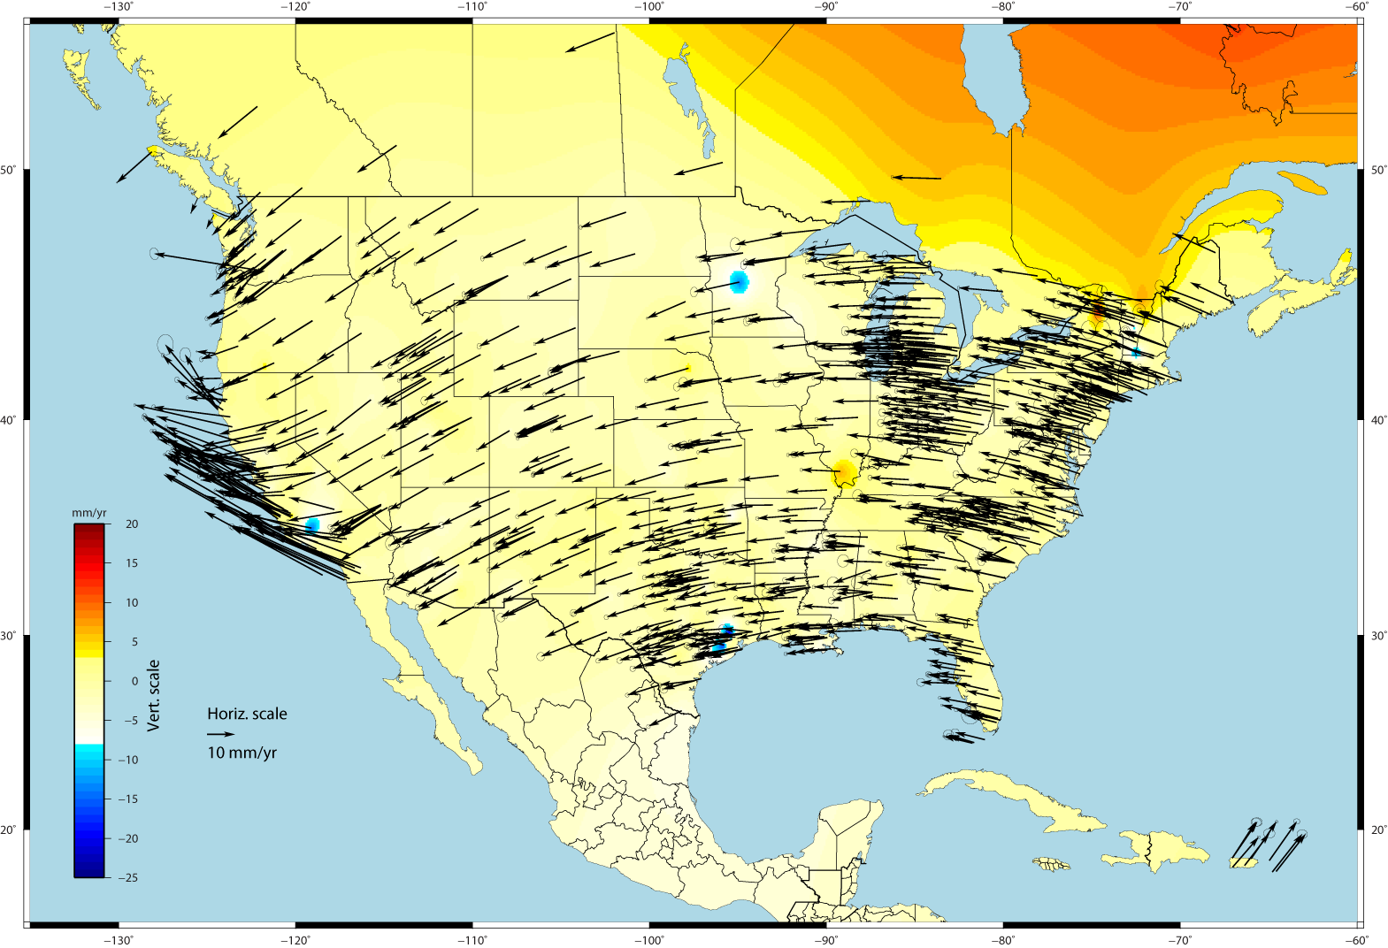
U.S. CORS Velocity Field – ITRF2008 (IGS08 epoch 2005.0)

Slide 14
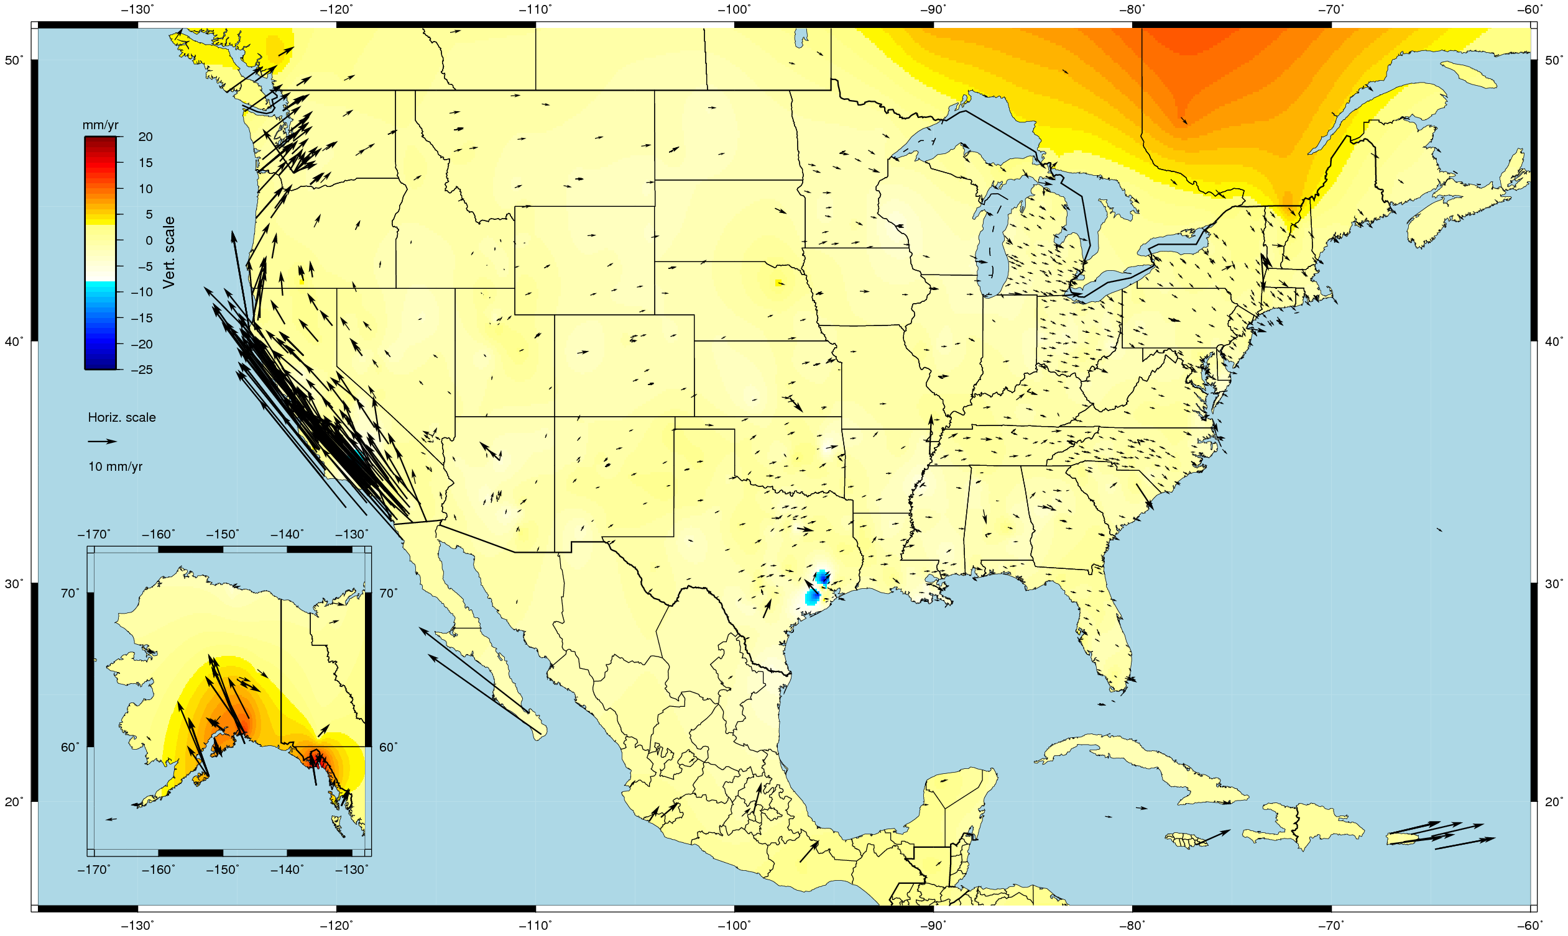
U.S. CORS Velocity Field - NAD83(2011) epoch 2010.00

Slide 15
Geometric: Out with the old, in with the new
The Old:
NAD 83(2011)
NAD 83(PA11)
NAD 83(MA11)
The New:
North American Terrestrial Reference Frame of 2022
(NATRF2022)
Caribbean Terrestrial Reference Frame of 2022
(CATRF2022)
Pacific Terrestrial Reference Frame of 2022
(PATRF2022)
Mariana Terrestrial Reference Frame of 2022
(MATRF2022)
4 plate-fixed frames
North America, Caribbean, Pacific, Mariana

Slide 16
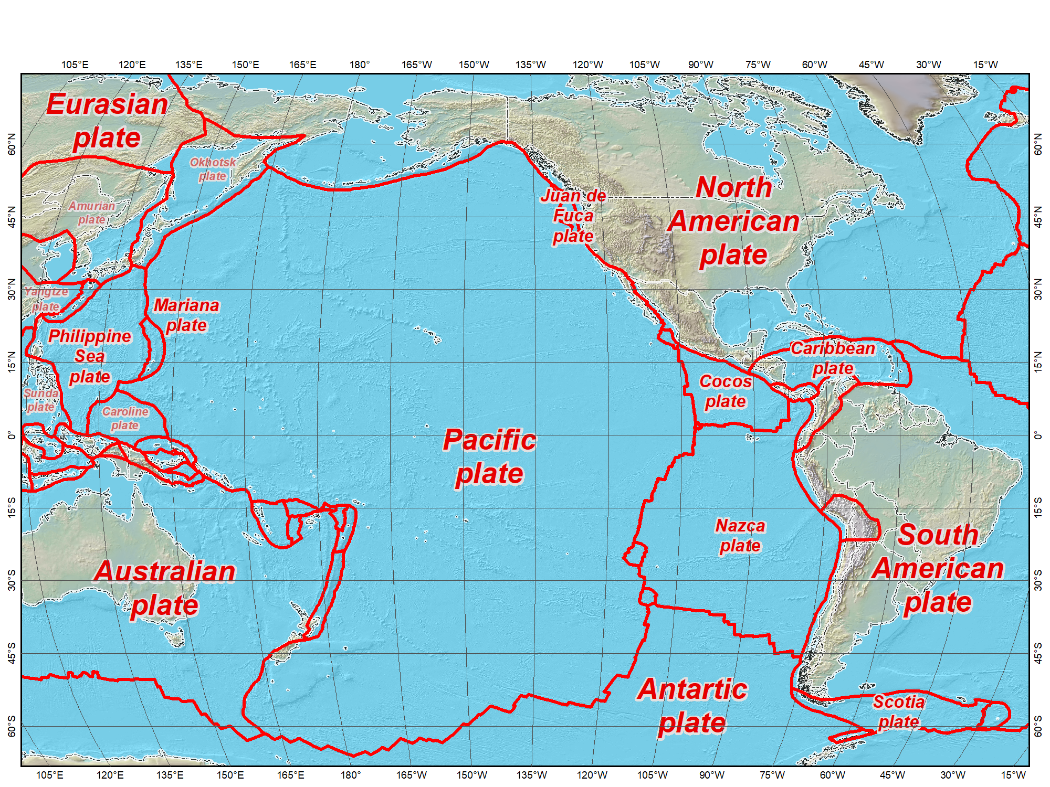
Tectonic plates modeled by NGS
Tectonic plates

Slide 17
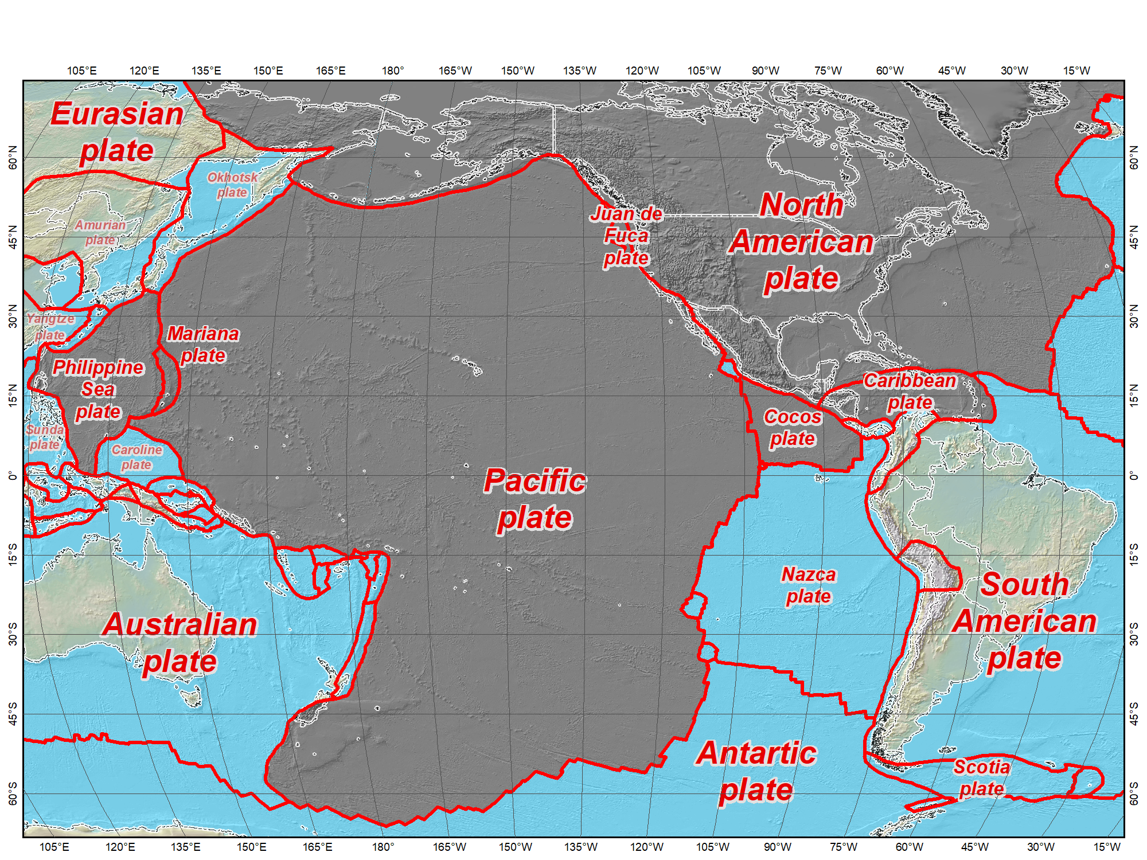
Tectonic plates modeled by NGS
Tectonic plates currently modeled in NGS software

Slide 18
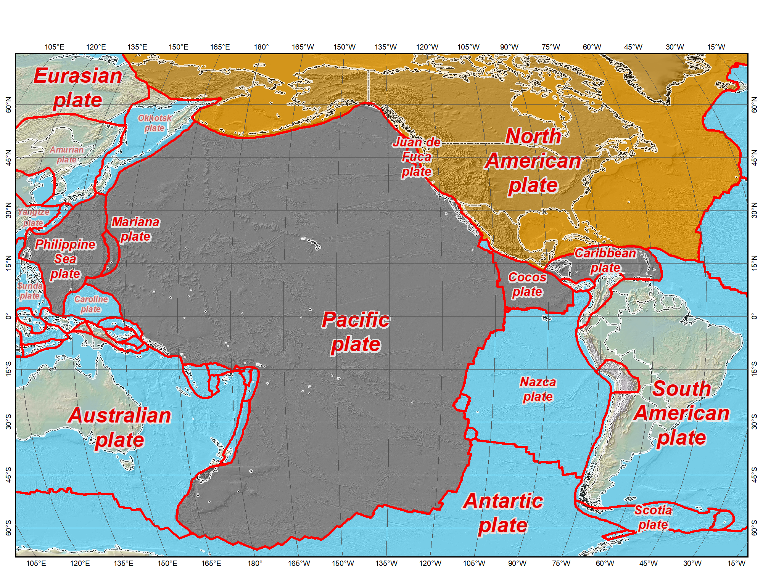
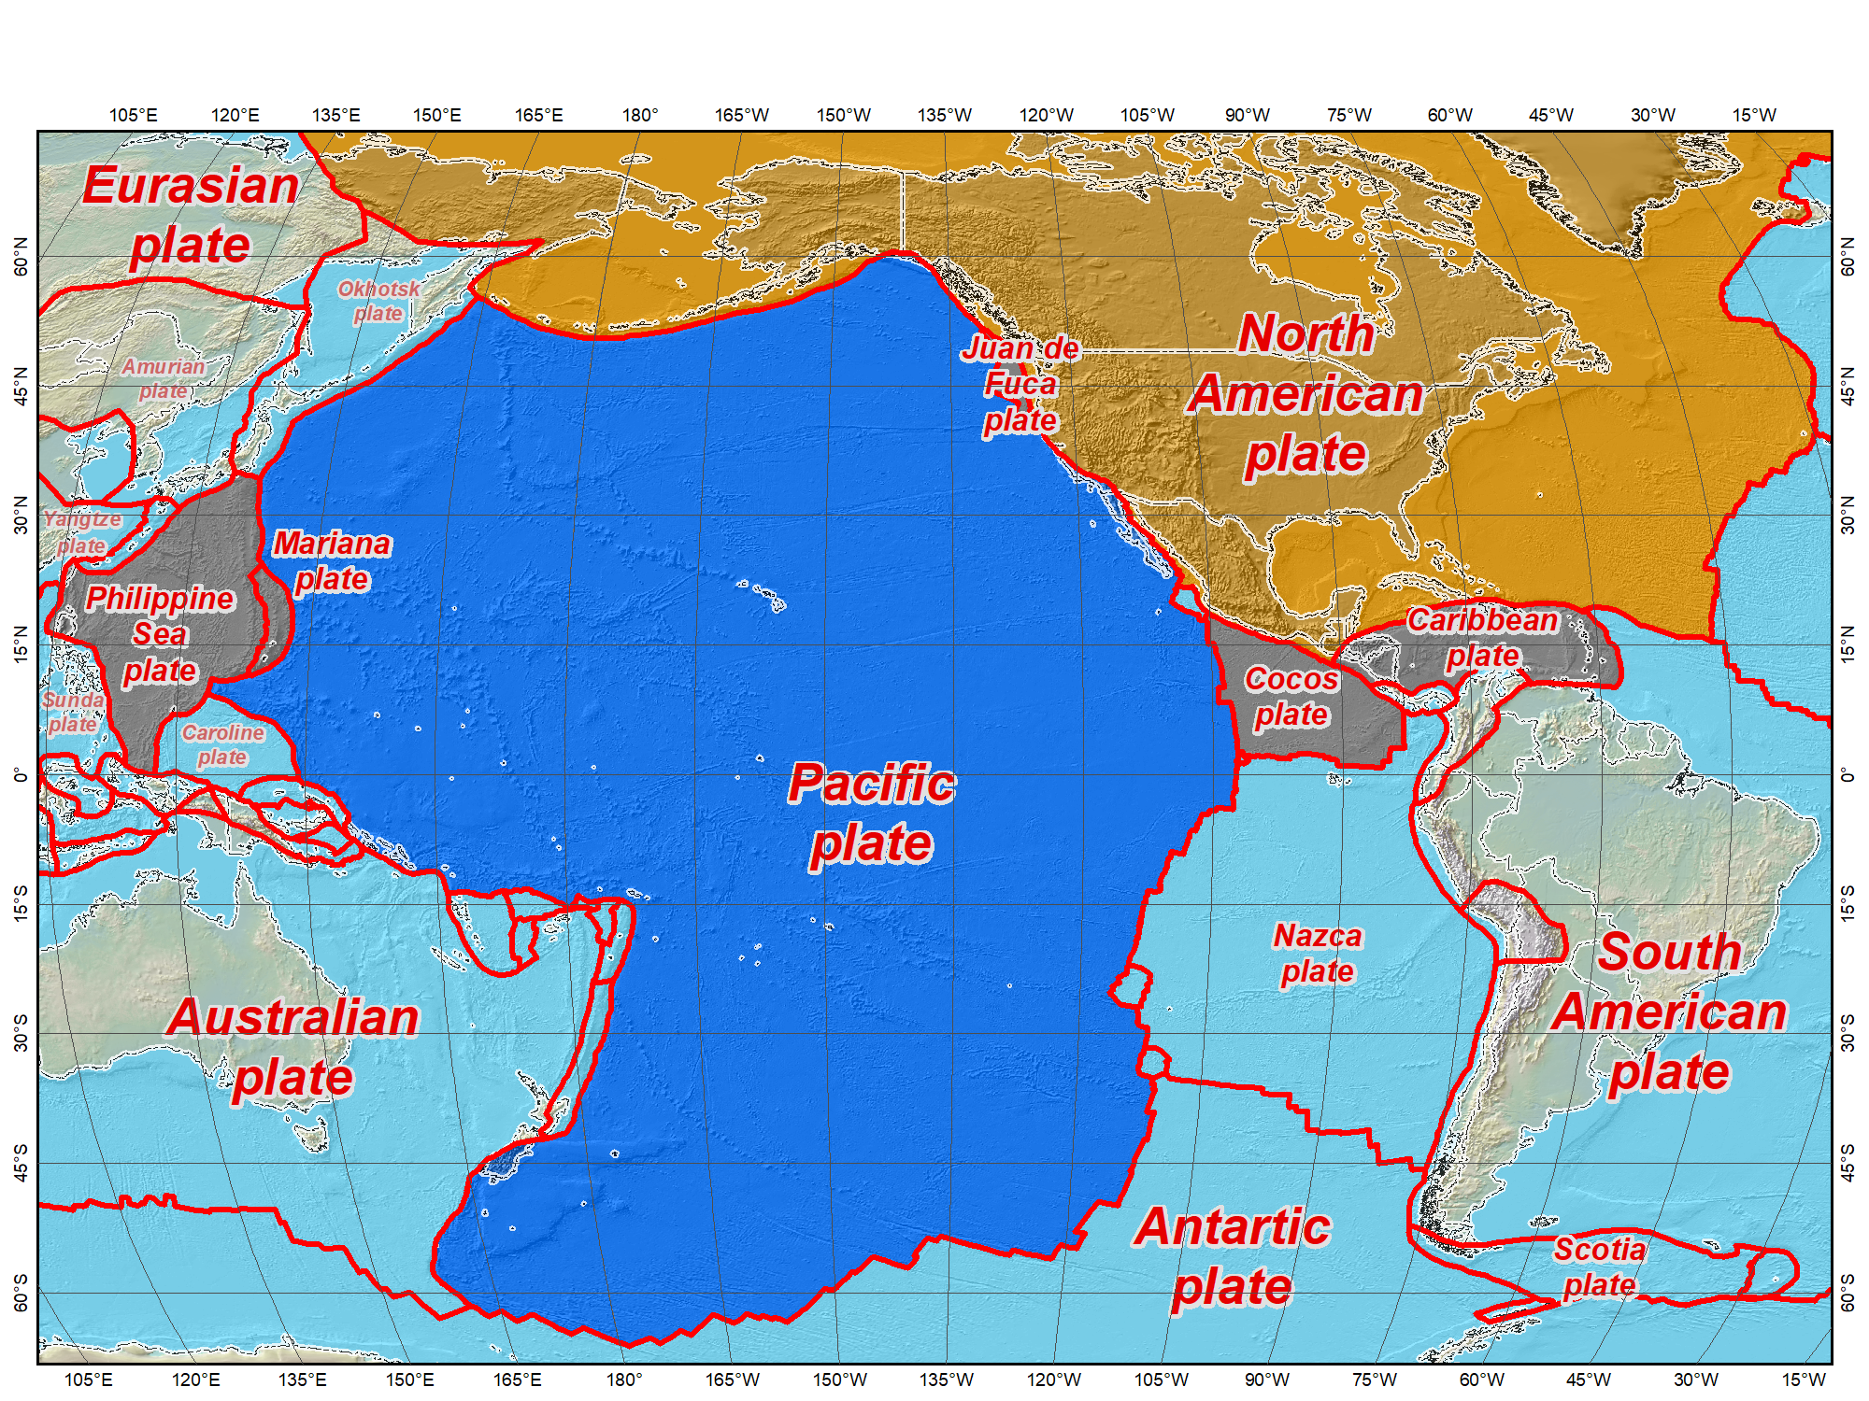


Tectonic plates modeled by NGS
The four tectonic plates “fixed” for the 2022 terrestrial reference frames

Slide 19
How much change will there be for the new TRFs?
Four new geometric terrestrial reference frames
  North American Terrestrial Reference Frame of 2022 (NATRF2022)
  Pacific Terrestrial Reference Frame of 2022 (PATRF2022)
  Mariana Terrestrial Reference Frame of 2022 (MATRF2022)
  Caribbean Terrestrial Reference Frame of 2022 (CATRF2022)
Aligned with ITRF / IGS / WGS84 at initial epoch
Coordinate changes at initial epoch (2020.00…?)
  Horizontal: Up to ~1.5 m in North America, ~4.3 m in Pacific
  Ellipsoid height change approximately ±2 m
Later horizontal change nearly zero in stable part of plates.
Initial change depends on initial epoch used for alignment…

Slide 20
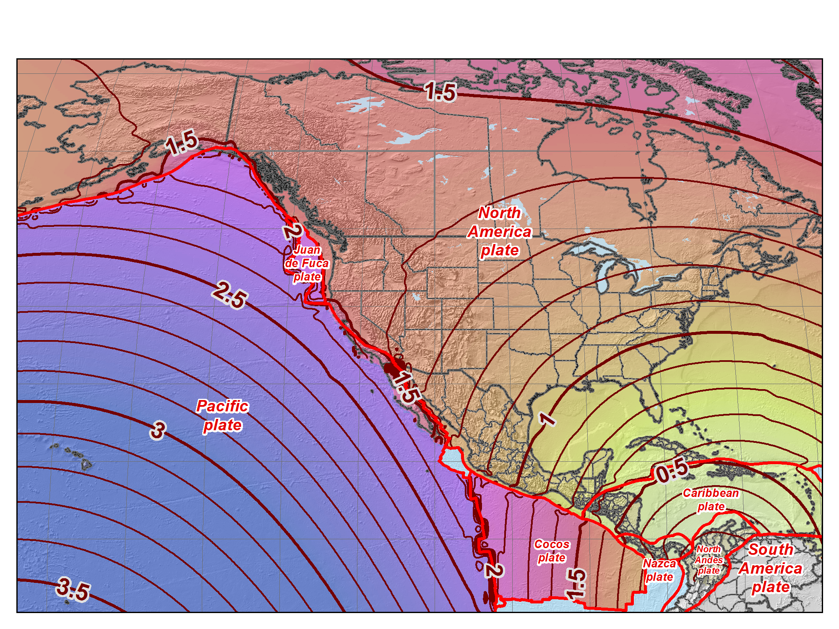
Horizontal shift (m) NAD83 epoch 2010.00 to ITRF2008 epoch 2015.00

Slide 21
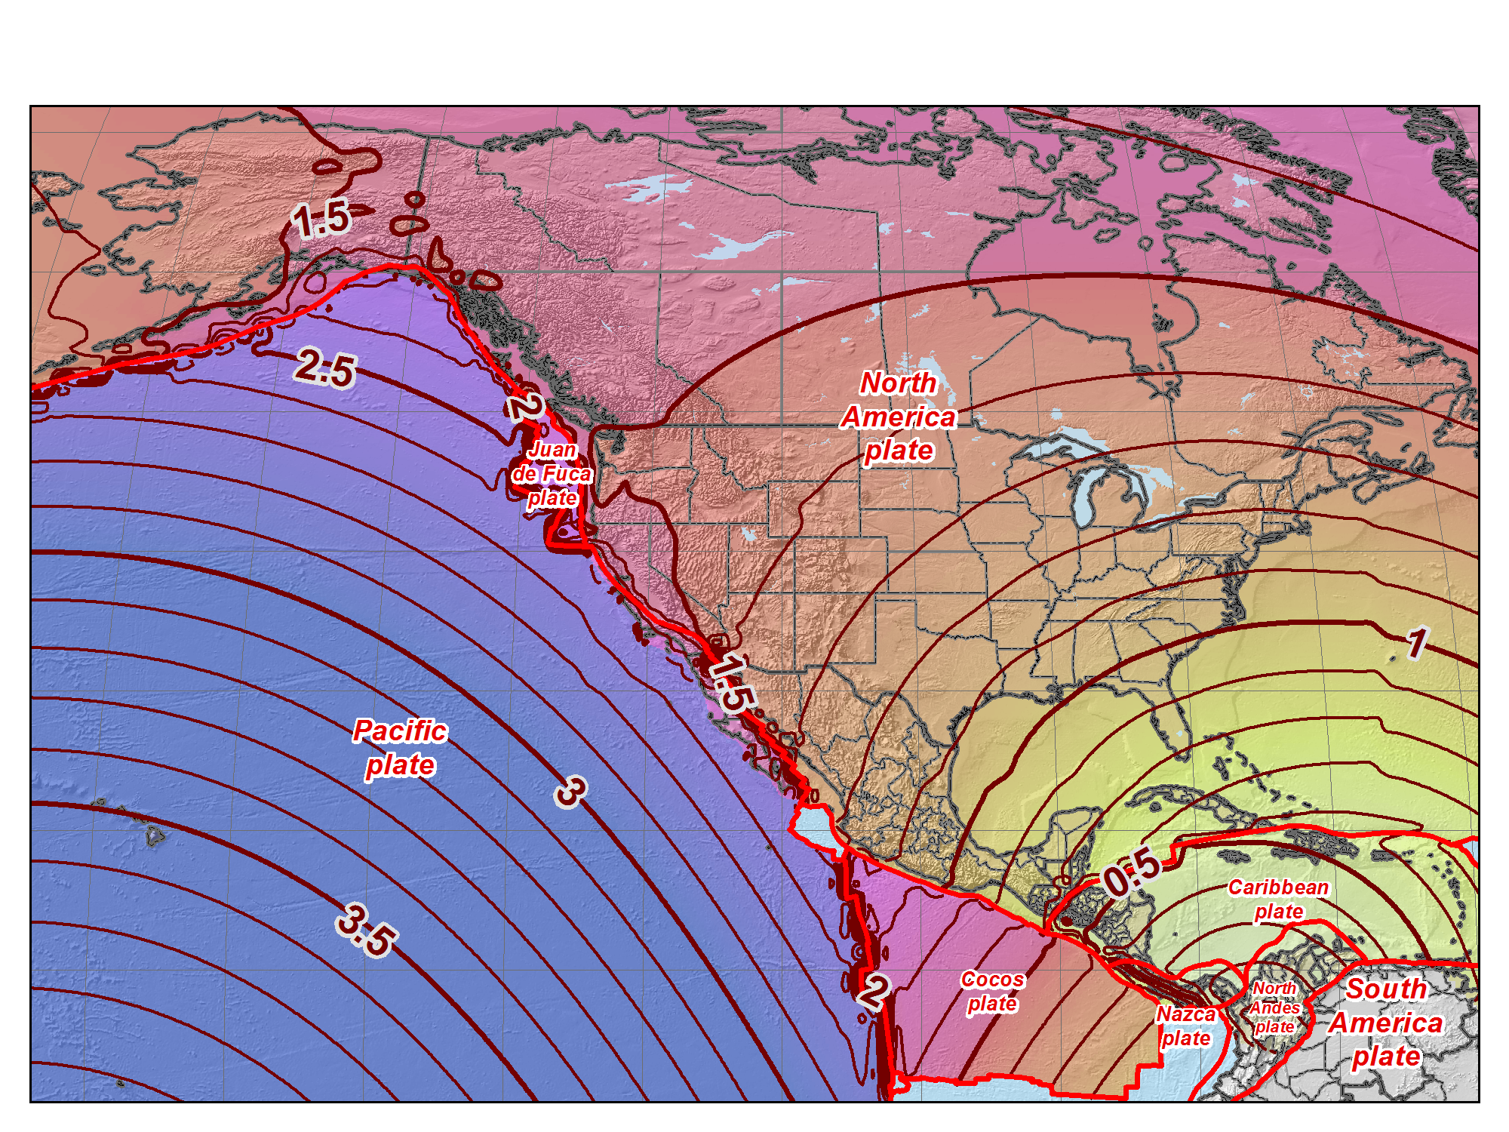
Horizontal shift (m) NAD83 epoch 2010.00 to ITRF2008 epoch 2020.00

Slide 22
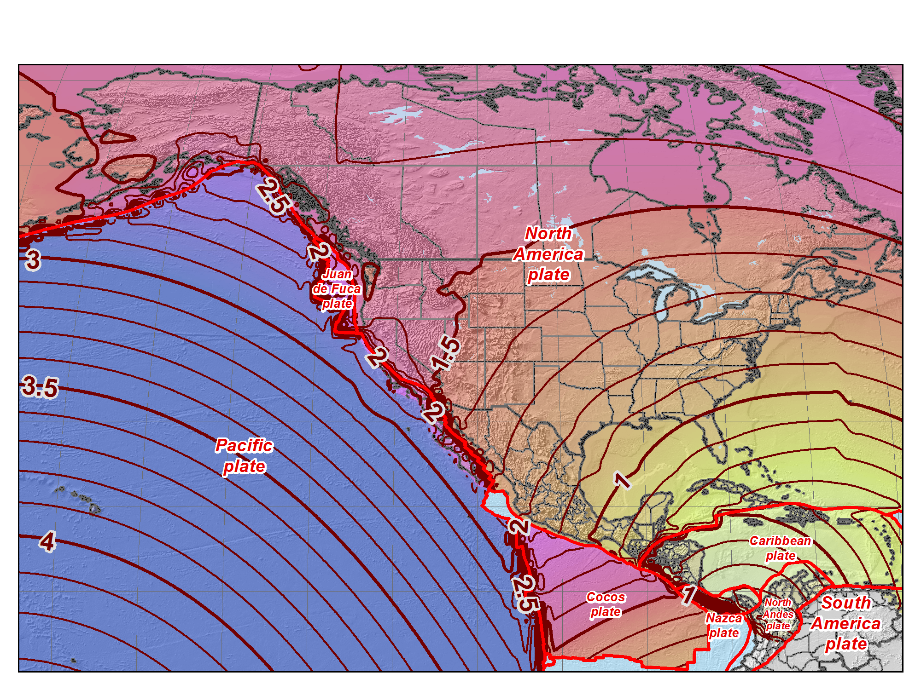
Horizontal shift (m) NAD83 epoch 2010.00 to ITRF2008 epoch 2025.00

Slide 23
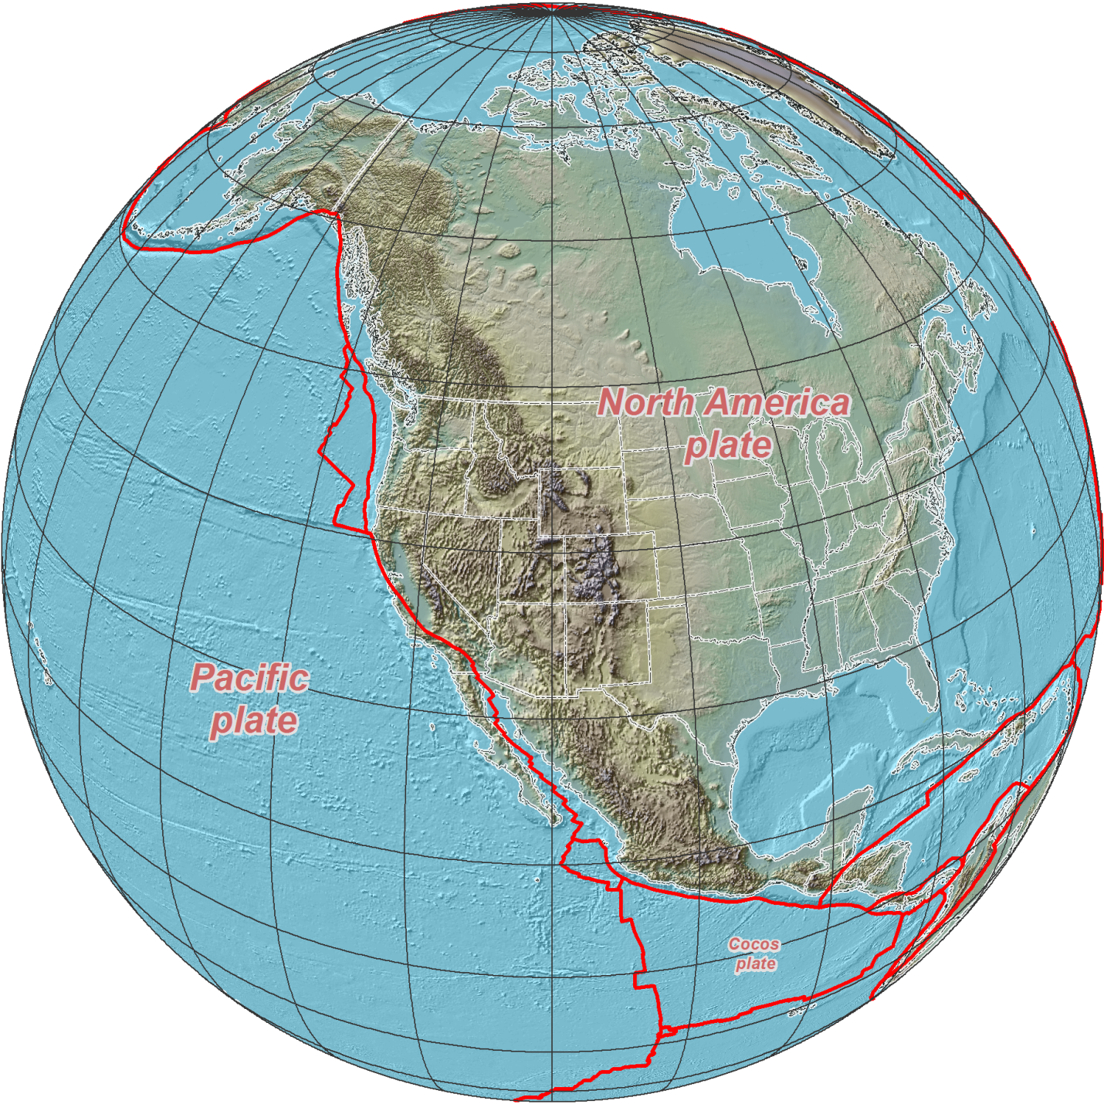
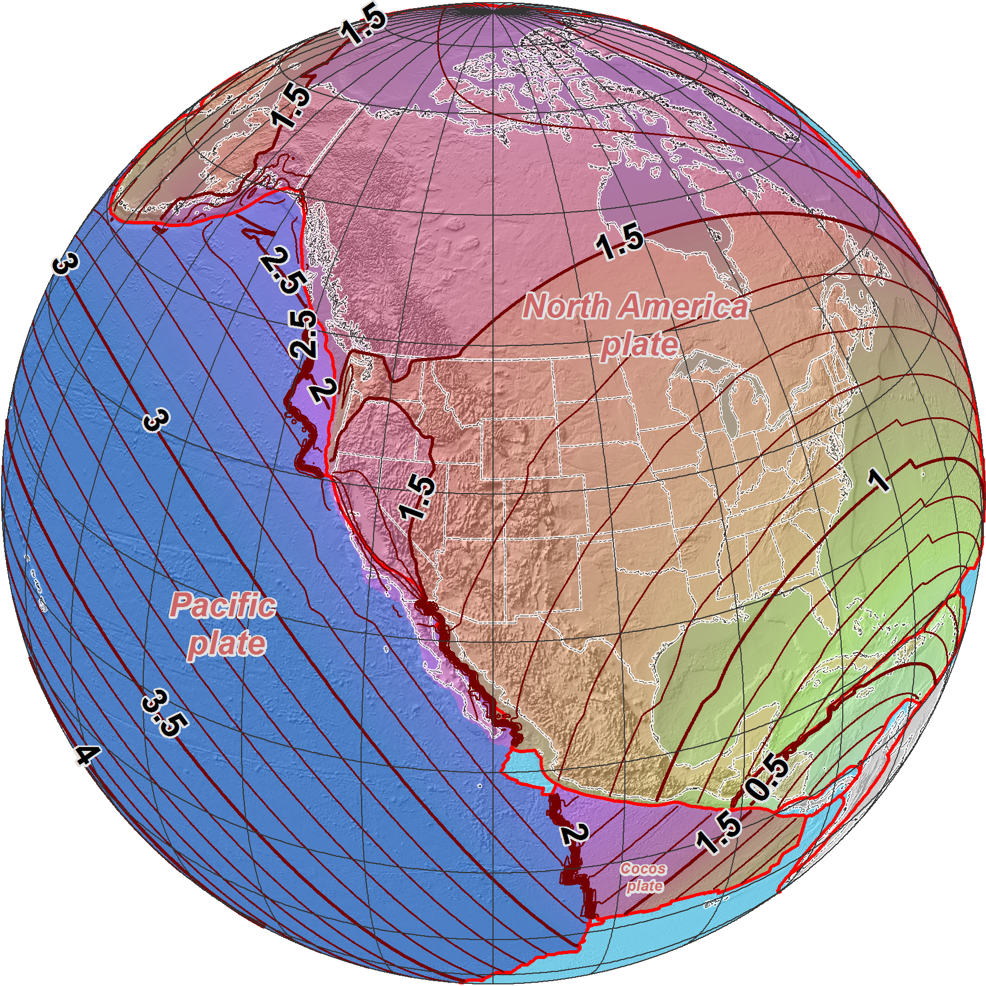
NAD 83 (2011/PA11/MA11) epoch 2010.00 →
2022 Terrestrial
Reference Frames
Horizontal change at epoch 2022.00
(contours in meters)
NATRF2022
PATRF2022
CATRF2022

Slide 24
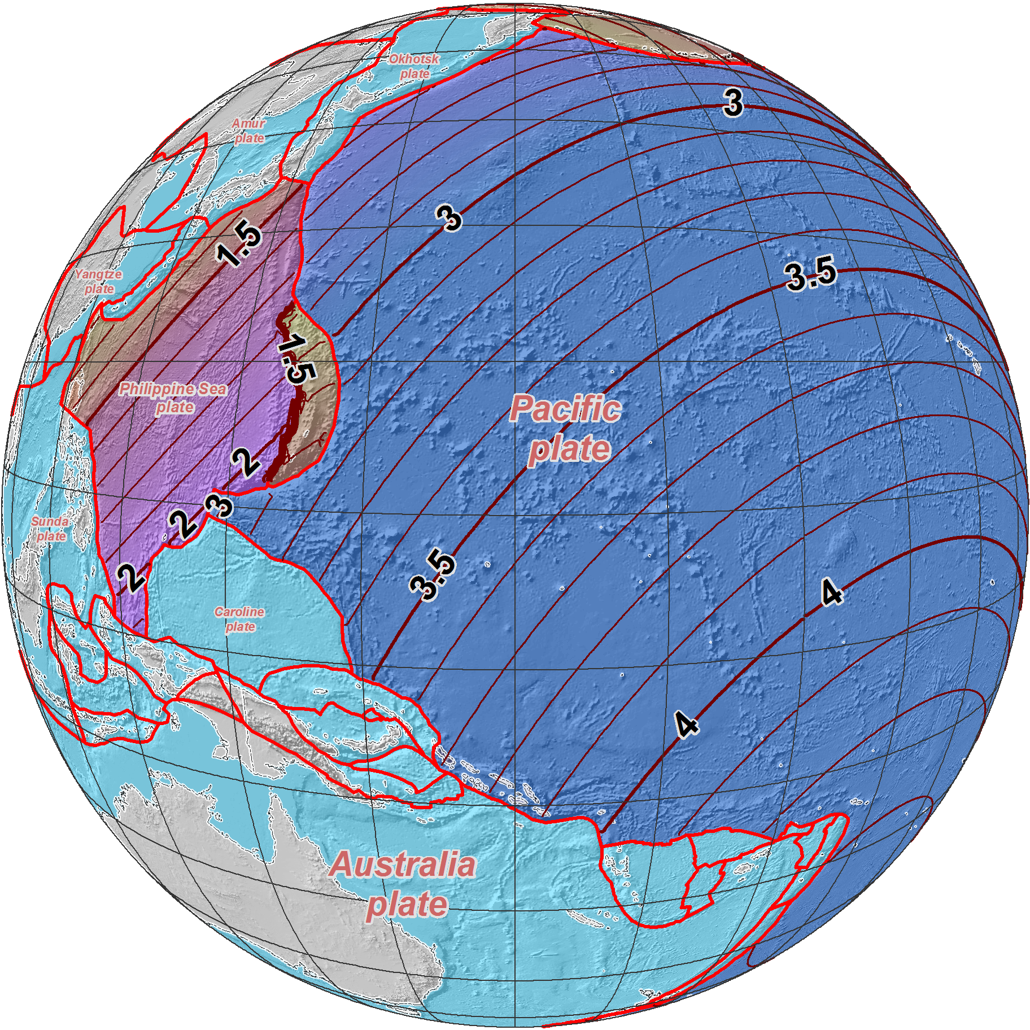
NAD 83 (2011/PA11/MA11) epoch 2010.00 →
2022 Terrestrial
Reference Frames
Horizontal change at epoch 2022.00
(contours in meters)
MATRF2022
PATRF2022

Slide 25
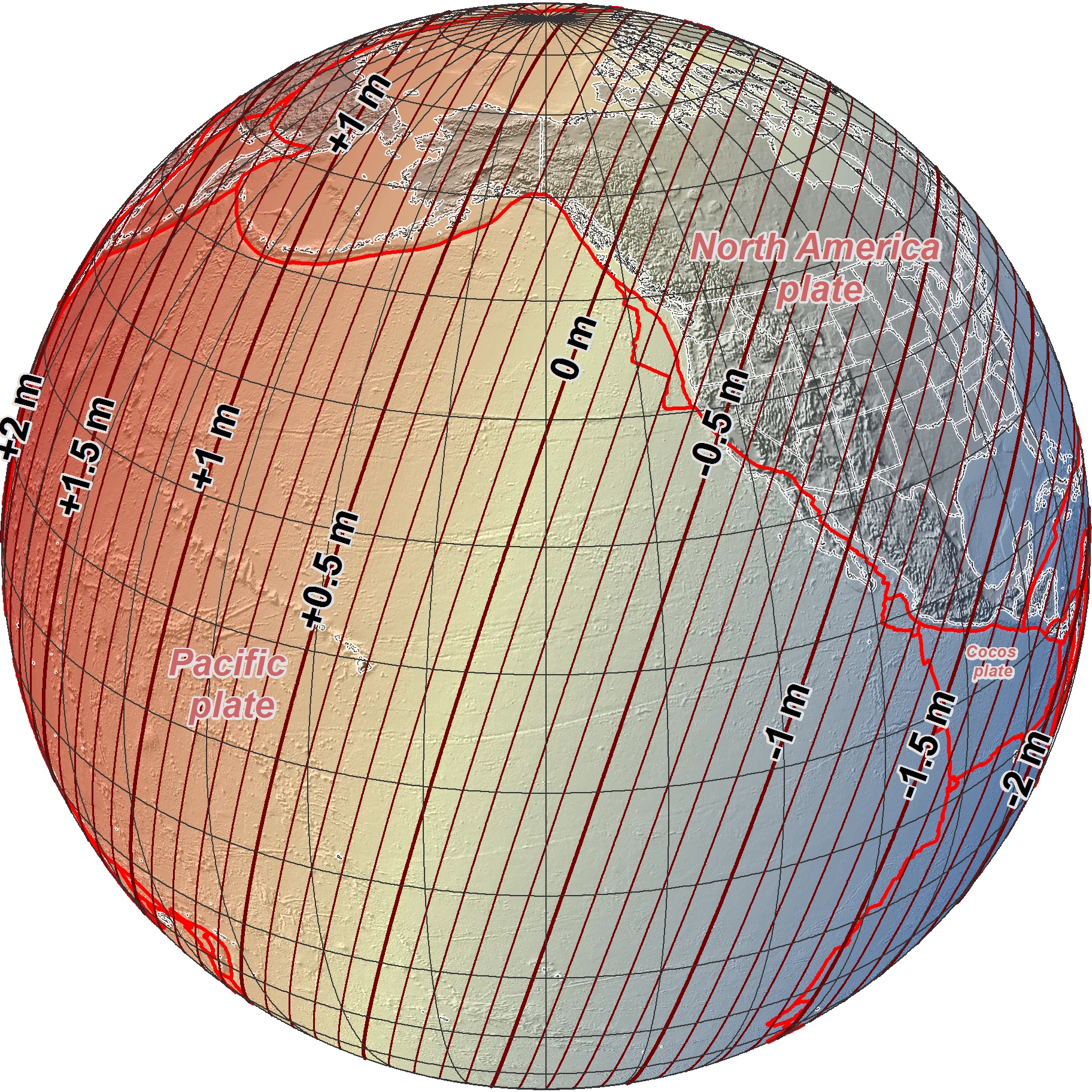
NAD 83 (2011/PA11/MA11) epoch 2010.00 →
2022 Terrestrial
Reference Frames
Change in ellipsoid heights at epoch 2022.00
(contours in meters)
NATRF2022
MATRF2022
PATRF2022

Slide 26
Replacing NAVD 88 (and the others…)
One gravity geopotential datum will replace:
  Seven vertical datums
  One gravity datum
  Several gravimetric and hybrid geoid and vertical deflection models
Aligned and consistent with the TRFs
Main access to “elevations” via GNSS
  Orthometric heights using geoid model (GEOID2022)
  Dynamic heights will also be available (e.g., for Great Lakes)
  Replaces leveling as primary access
GEOID2022 coordinated with Canada and Mexico
  Set to mean sea level at a specific epoch
  Will update epoch as needed, based on sea level change
Geopotential datum will include time-dependent component

Slide 27
“Vertical”: Out with the old, in with the new
  The Old:
  NAVD 88
  PRVD 02
  VIVD09
  ASVD02
  NMVD03
  GUVD04
  IGLD 85
  IGSN71
  GEOID12B
  DEFLEC12B
Orthometric
Heights
  The New:
  The North American-Pacific Geopotential Datum of 2022 (NAPGD2022)
  Will include GEOID2022
one vertical datum
pole-to-equator
Normal
Orthometric
Heights
Dynamic
Heights
Gravity
Geoid Heights
Deflections of
the Vertical

Slide 28
The ellipsoid, the geoid, and you
Deflection of the vertical
You are here
Earth surface
Ellipsoid height, h
Orthometric height, H
Mean
sea level
Geoid height, N_{G}
Ellipsoid
Geoid
h = H + N_{G}
Note: Geoid height is negative everywhere in the coterminous US
(but it is positive in most of Alaska)

Slide 29
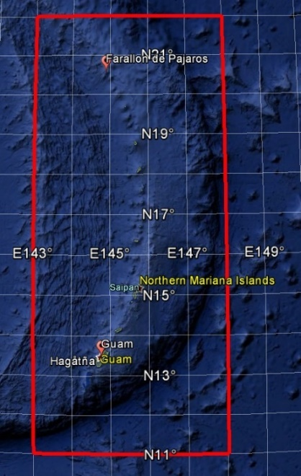
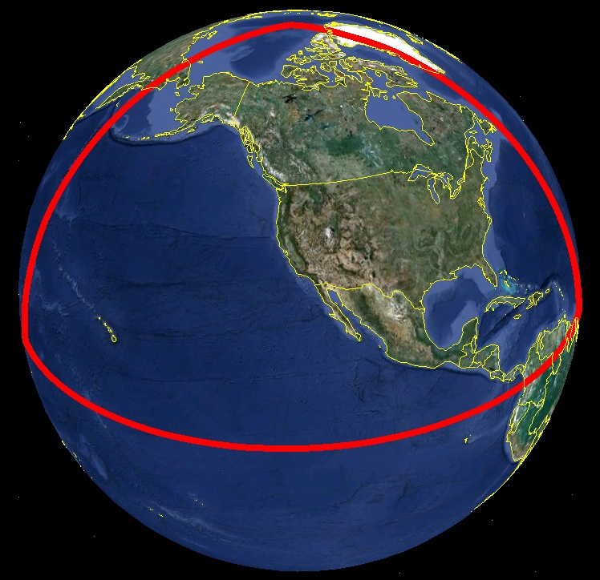
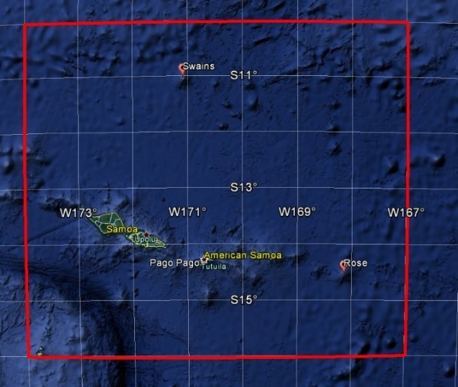
Extent of NAPGD2022 gravimetric geoid model
Guam and Northern Marianas Islands
American Samoa

Slide 30
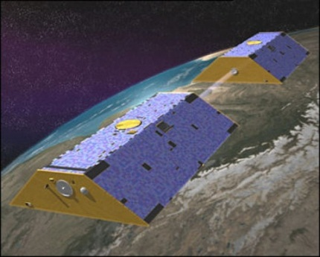
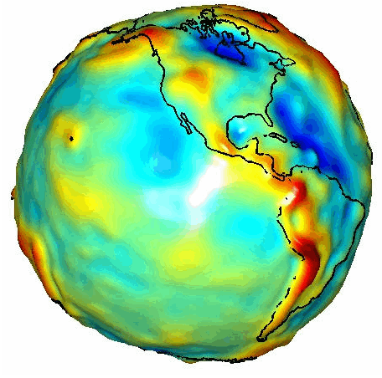


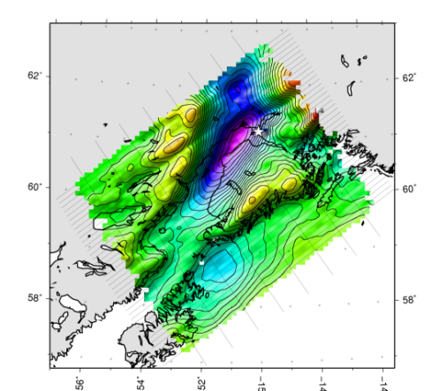


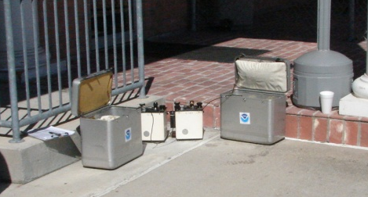
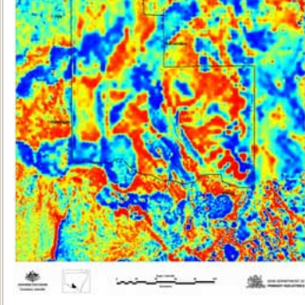

Building a Gravity Field
Long Wavelengths
(≥ 250 km)
GRACE/GOCE/Satellite Altimetry
+
Intermediate Wavelengths
(300 km to 20 km)
Airborne Measurement
+
Short Wavelengths
(< 100 km)
Surface Measurement and
Predicted Gravity from Topography

Slide 31
How much change will there be?
New geopotential (“vertical”) datum
  North American-Pacific Geopotential Datum of 2022 (NAPGD2022)
  Based on gravimetric geoid model
  Vertical change approximately -1.2 to +0.1 m in CONUS
  Vertical change approximately 0 to -2 m in Alaska
NAPGD2022 based on global geopotential model (GM2022)
Regional higher-resolution products derived from GM2022:
  Gravimetric geoid model (GEOID2022)
  Deflection of the vertical model (DEFLEC2022)
  Surface gravity model (GRAV2022)
Includes products and services to account for time dependence

Slide 32
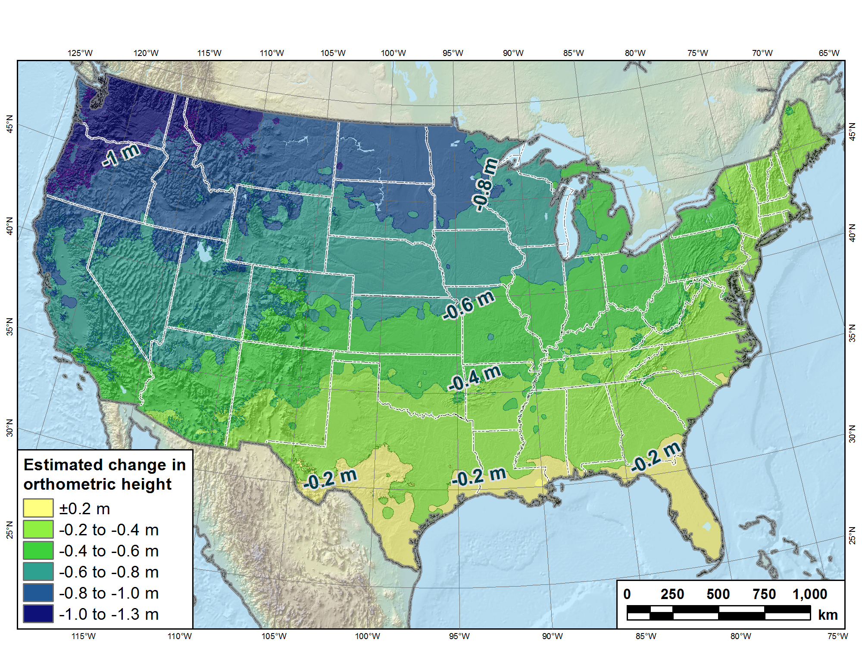
Estimated change in orthometric heights from NAVD 88 to NAPGD2022
NAPGD2022 approximated using xGEOID16B

Slide 33
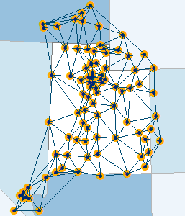
How to Plan for 2022
Move to NAD 83(2011) epoch 2010.00
  via surveys (or possibly via NADCON)
Move to NAVD 88
  via surveys (or possibly via VERTCON)
Move from reliance on passive marks to GNSS infrastructure
  utilize CORS, OPUS, real-time networks, etc.
Use OPUS-Share/Database for GPSBMs & NAD83(2011) ties
  improve next geoid model & relationship with new datum
METADATA!!!!

Slide 34
X, Y, Z
NADCON 5
Tool for transforming between geometric (“horizontal” datums)
φ, λ, h
φ, λ, h
2022
X, Y, Z
SPC
UTM
USSD
USNG
UTM
φ, λ, h
φ, λ, h
NAD 27
NAD 83 (2011)
X, Y, Z
SPC
X, Y, Z
SPC
USNG
UTM
USNG
UTM
NAD 83 (NSRS2007)
φ, λ, h
φ, λ, h
NAD 83 (1986)
NAD 83 (FBN)
NAD 83 (HARN)
φ, λ, h
X, Y, Z
SPC
X, Y, Z
SPC
φ, λ, h
USNG
UTM
USNG
UTM
X, Y, Z
SPC
X, Y, Z
SPC
USNG
UTM
USNG
UTM

Slide 35
Legislation
Federal NSRS users required to switch from NAD 27 to NAD 83
1980s and 1990s NGS worked with states to update their laws
  To encourage use of NAD 83 beyond Feds
48 states now have laws that refer to NAD 83
  NAD 83 name will be retired in 2022
NSPS, AAGS, and NGS formed committee to address this issue
  The NSPS/AAGS/NGS Advisory Committee on National Spatial Reference System Legislation
New Legislative Template completed June 2016
  Generic terminology: “NSRS or its successor,” etc.
  NSPS will work with states to adopt new template (2017 – 2022)

Slide 36
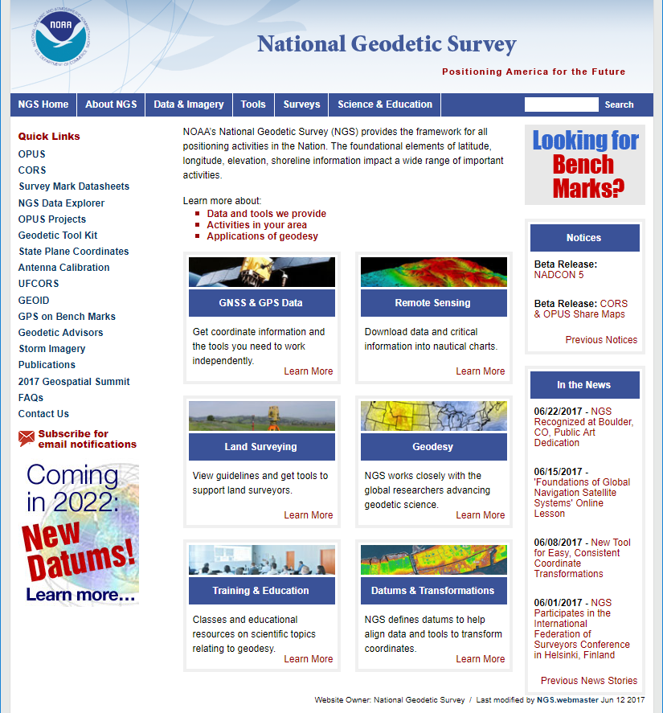
geodesy.noaa.gov

Slide 37
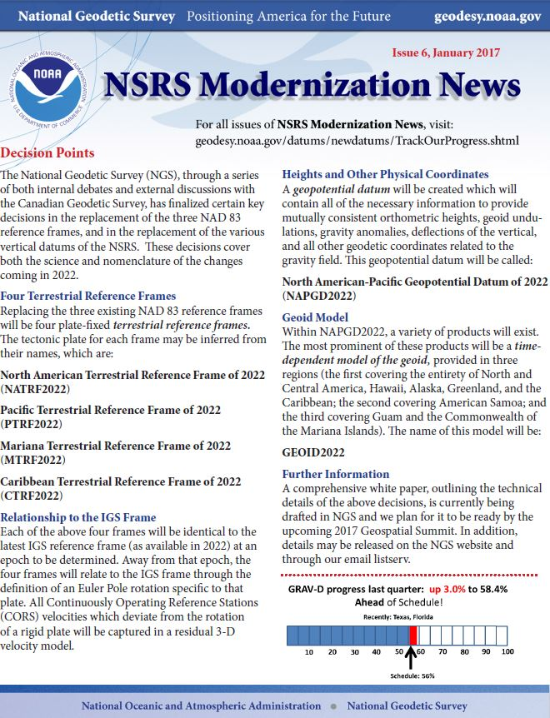
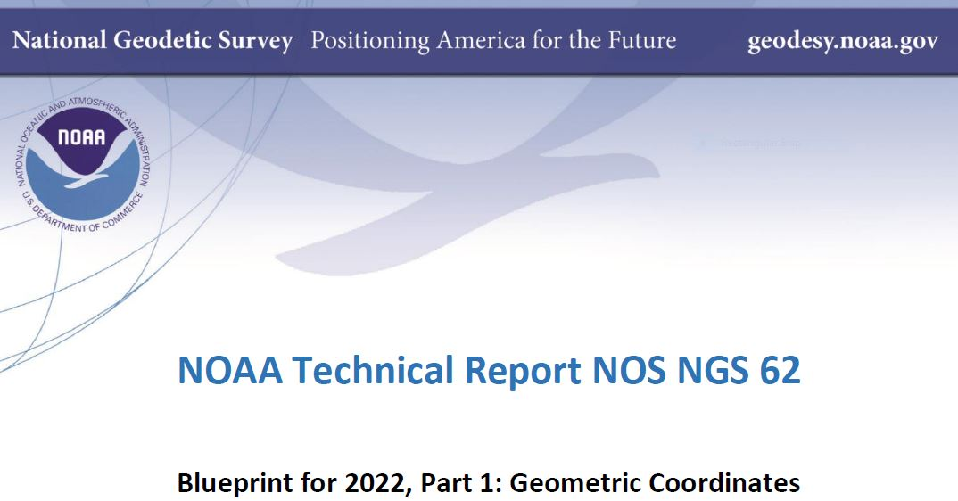
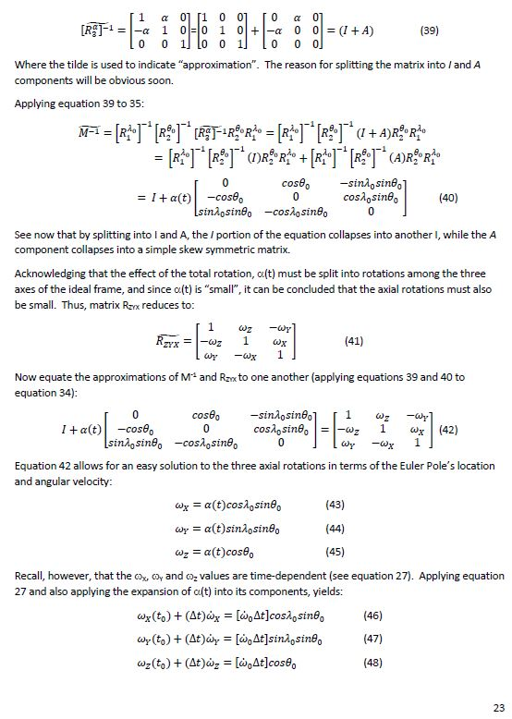

Slide 38
But wait, there’s more!
State Plane Coordinate System of 2022 (SPCS2022)
New State Plane system to replace SPCS 83
  Referenced to new TRFs
  Based on same reference ellipsoid (GRS-80)
  Same conformal projection types
NGS seeking stakeholder feedback
  All states and US territories, possibly large Indian reservations
  Find out what users want for SPCS2022
    Keep (nearly) same as SPCS 1983?
    Or make major changes to zones?

Slide 39
Summary
Primary access: GNSS
  Based on CORS and gravimetric geoid model (not passive bench marks)
  But also compatible with terrestrial methods
Geometric (TRFs)
  Fixed to 4 tectonic plates and aligned with global frame (ITRF/IGS/WGS 84)
  Intraframe velocity models allow georeferencing to specific epochs
  Includes new State Plane system
Geopotential
  Elevations derived from geopotential models using GNSS
  Referenced to best estimates of mean sea level, updated as necessary
Includes time-dependency
Benefits:
  Integrated
  Consistent
  Accurate

