Slide 1

New Datums coming in 2022:
Replacing NAVD 88 and NAD 83
Consortium of Ohio Universities on Navigation & Timekeeping
Thirteenth Annual Information Meeting
Steve Hilla
National Geodetic Survey, NOAA
April 2, 2019
Columbus, Ohio

Slide 2
Outline
What is the National Geodetic Survey (NGS)?
Why replace NAD 83?
The four new Terrestrial Reference Frames
Why replace NAVD 88?
The one new Geopotential Datum
What life will be like in the future
Links to webpages and the 2019 Geospatial Summit

Slide 3



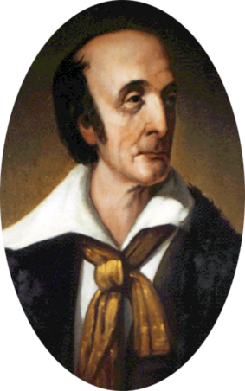
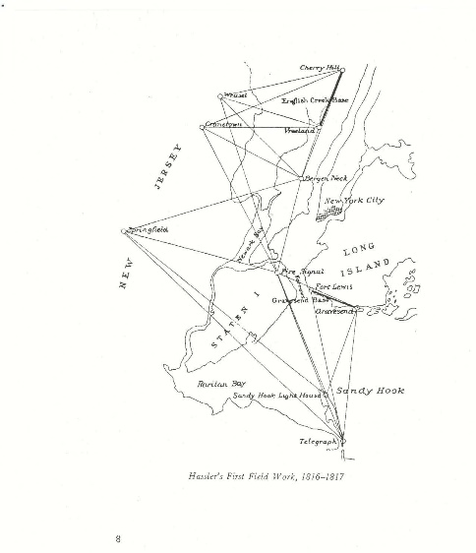
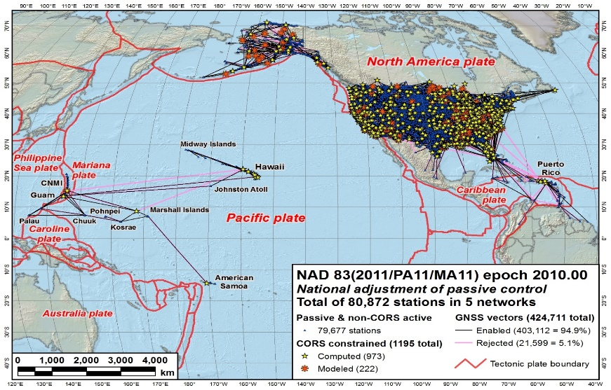
The National Geodetic Survey (NGS)
Our Nation’s first science agency
  1807
  Thomas Jefferson
  Survey of the Coast
  1807
Ferdinand R. Hassler
First Superintendent
  1878
  U.S. Coast and
  Geodetic Survey
  1970
  NOAA is
  established
Notes:
NGS has been around a long time. For more than 212 years (now 2019), NGS and its predecessor agencies have collaborated with public and private organizations to establish reference stations at precisely determined locations.
In Fact I would say it was conceived from a thought experiment from the American Philosophical society. Today, it is an eminent scholarly organization of international reputation, originally made up from doctors, lawyers, clergymen, and merchants interested in science, and also many learned artisans and tradesmen like Franklin. This country's first learned society, the APS has played an important role in American cultural and intellectual life for over 250 years. Washington, Jefferson and Yes, Hassler were members.
I would argue that most of the members were surveyors, and that the country was founded on the shoulders of geodesy. Anyhow one of the first “survey and mapping projects were the “Lewis and Clark Exposition”. After L&C made it back alive, The country was 30 years young and Thomas Jefferson was president. And there were a lot of problems, one such problem was shipwrecks. Shipping was the major source of commerce and transportation. Since we ran away from home so to speak our mother country “Mother”, no longer felt obliged to provide us with infrastructure items such as maps. The APS studied this issue and the mission began.
We began on a mission established by Thomas Jefferson in 1807 to conduct a “Survey of the Coast” (as the United States Coast Survey).
(Pictured are Thomas Jefferson and Ferdinand Hassler, the first Superintendent of the Coast Survey). We were renamed the U.S. Coast and Geodetic Survey in 1878. NOAA was established in 1970.

Slide 4
U.S. Department of Commerce
National Oceanic & Atmospheric Administration
National Geodetic Survey
Mission: To define, maintain & provide access to the
National Spatial Reference System (NSRS)
to meet our Nation’s economic, social & environmental needs
& their time variations
(& National Shoreline, etc.)
Latitude
Longitude
Height
Gravity
Orientation
Scale
North American
Datum of 1983
(NAD83)
North American
Vertical Datum of 1988
(NAVD88)
Notes:
- NSRS benefit to the nation = $2.5B/year
est. 300K precision GPS users worldwide (2008); ¼ in US
- Very exciting to us at NGS to see how it has evolved over the years – now cm-accuracy capability / tracking with time

Slide 5
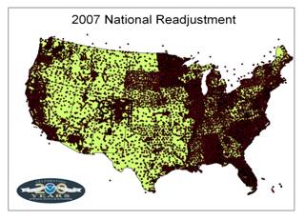
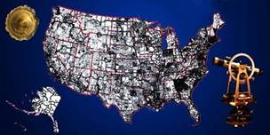
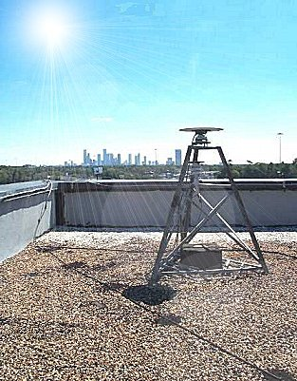
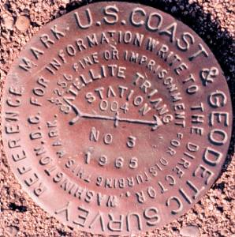
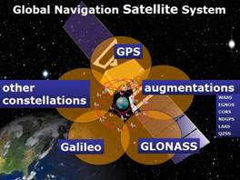
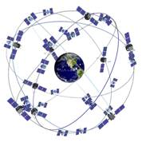
The NSRS has evolved
1 Million Monuments
(Separate Horizontal and Vertical Systems)
70,000
Passive Marks
(3-Dimensional)
→
Passive Marks
(Limited Knowledge of Stability)
≈ 2,000 GPS CORS
(Time Dependent System Possible;
4-Dimensional)
→
GPS CORS → GNSS CORS

Slide 6
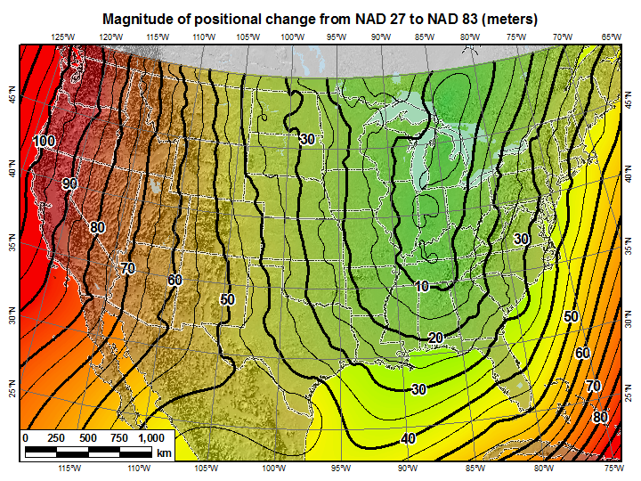
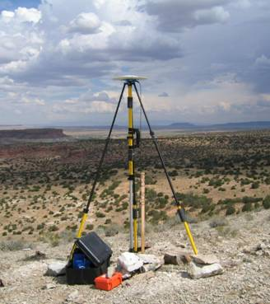
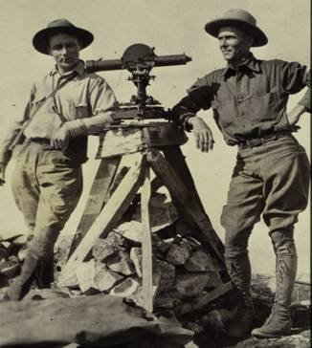
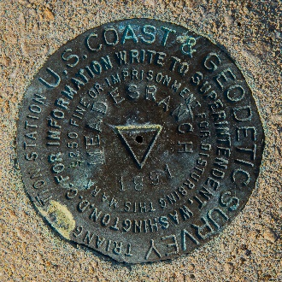
NSRS - Evolved Over Time
U.S. Standard Datum
NAD27
  NAD83 (1986)
    NAD83 (HARN /199X)
      NAD83 (2007)
        NAD83 (2011)
+
+
+
+
+
+
time
< 10m ~ 10m 1m 0.1m 0.01m 0.01m
Network Accuracy

Slide 7
NAD 83 is non-geocentric
h₈₃
h_{yy}
Earth’s
Surface
This shift will cause changes in Lat, Lon, and EllHt
same
GRS-80
ellipsoid
IGS yy
Origin
~2.2 meters
NAD 83
Origin
Notes:
ITRF (International Terrestrial Reference Frame) just has an origin; take NAD83 shaped ellipsoid centered at the ITRF origin to derive ITRF97 ellipsoid heights.
Ellipsoid heights NAD83 vs. ITRF97 - Defined origins are best estimate of the center of mass; NAD83 is not geocentric. Move origin; move ellipsoid surface as illustrated.
Ellipsoid height differences reflect the non-geocentricity of NAD83.

Slide 8
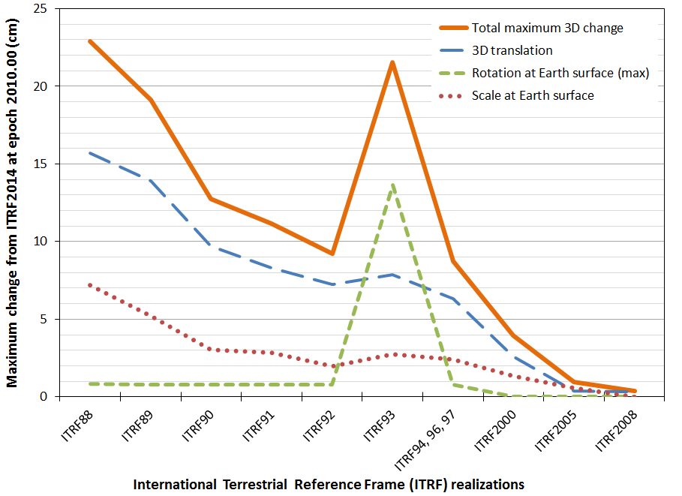
ITRF is now mature – smaller changes each epoch
ITRF2014

Slide 9
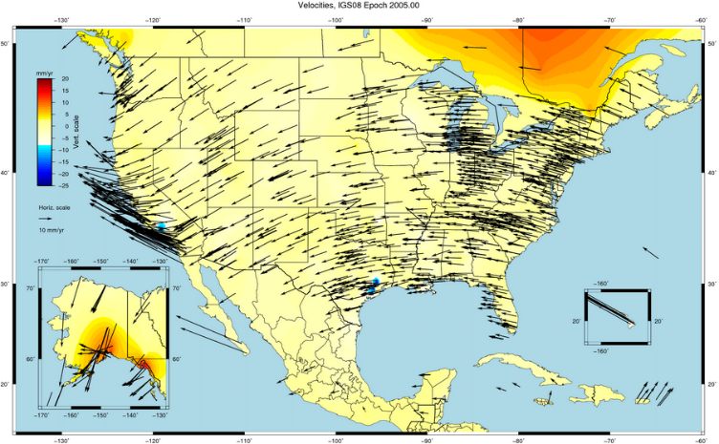
NAD 83 is not ITRF
GPS & WAAS navigation uses WGS84, aligned to ITRF
satellite orbits and other geospatial datasets use global frames
our TRFs will agree with ITRF (specifically, IGSyy) at the initial epoch
our TRFs will diverge from ITRF by a few cm each year to stay “plate-fixed”
  difference is a simple Euler plate rotation
  many areas will diverge further, as no plate is perfectly rigid
plate-fixed or ITRF-fixed; can’t have both

Slide 10
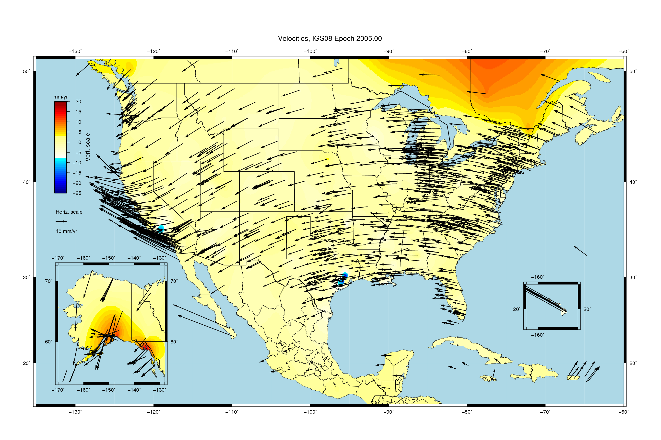
Velocities, relative to IGS08 epoch 2005.00

Slide 11
Each frame will get 3 parameters
Euler Pole Latitude
Euler Pole Longitude
Rotation rate (radians / year)
This will be used to compute
time-dependent NATRF2022
coordinates from time-dependent
IGS coordinates.
North American Plate rotates CCW around its Euler Pole
EULER Pole

Slide 12
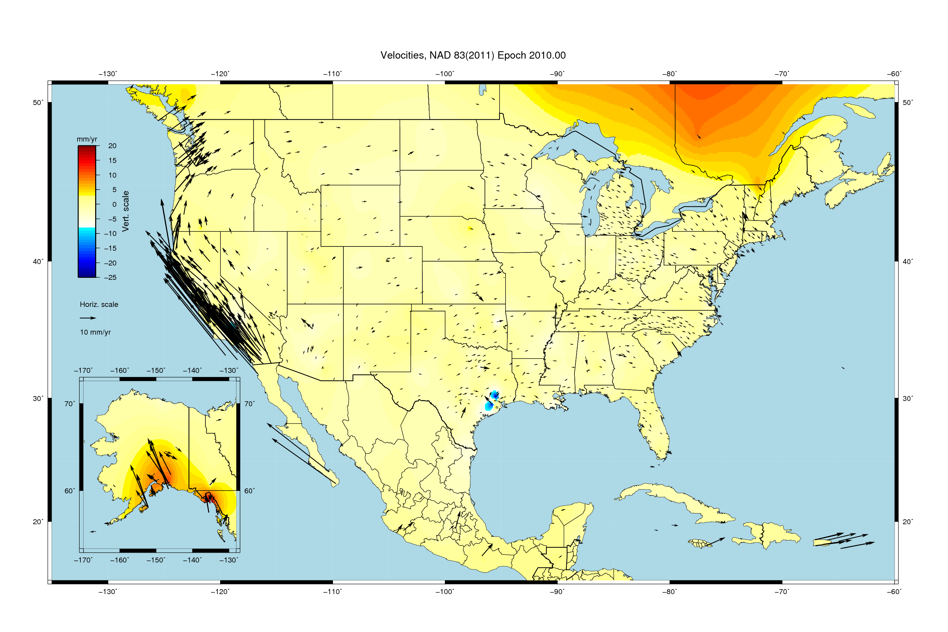
Velocities, relative to NAD83(2011) epoch 2010.00

Slide 13
Replacing NAD83
NAD83 replaced in 2022 by 4 “plate-fixed” reference frames
defined by CORS (GNSS data, coordinates, velocities, antennas)
removes non-geocentricity of NAD 83 by aligning w/ global International Terrestrial Reference Frame of 2014 (IGS14)
identical to IGS14 at 2020.00, then diverges
removes most of tectonic plate rotation from IGS14 using updated Euler Poles (hold that thought…)
CORS velocities deviating from rigid-plate rotation captured in 3-D velocity model (to transform to fixed epoch)

Slide 14
New Names
The Old:
NAD 83(2011)
NAD 83(PA11)
NAD 83(MA11)
The New:
The North American Terrestrial Reference Frame of 2022
(NATRF2022)
The Caribbean Terrestrial Reference Frame of 2022
(CATRF2022)
The Pacific Terrestrial Reference Frame of 2022
(PATRF2022)
The Mariana Terrestrial Reference Frame of 2022
(MATRF2022)

Slide 15
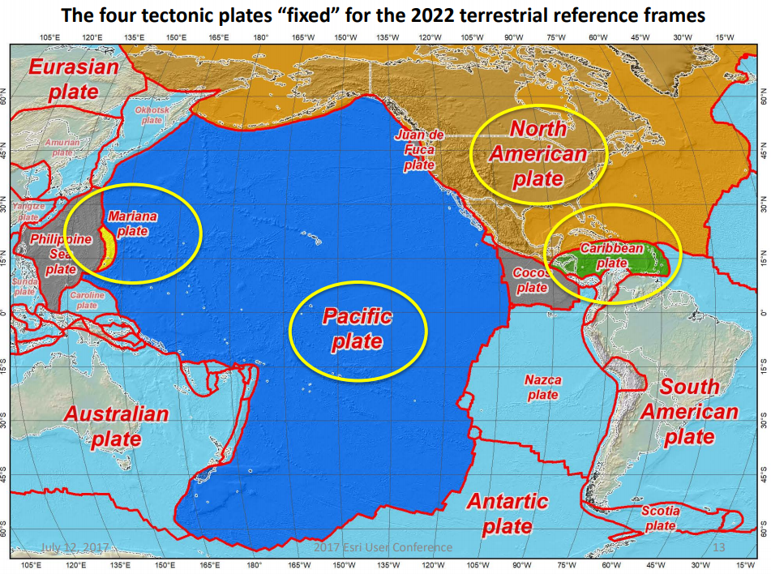
Four Tectonic Plates NGS Monitors
In 2022, the entire National Spatial Reference System (NSRS) will be modernized and will contain four new reference frames:
  North American Terrestrial Reference Frame of 2022 (NATRF2022)
  Pacific Terrestrial Reference Frame of 2022 (PATRF2022)
  Caribbean Terrestrial Reference Frame of 2022 (CATRF2022)
  Mariana Terrestrial Reference Frame of (MATRF2022)

Slide 16
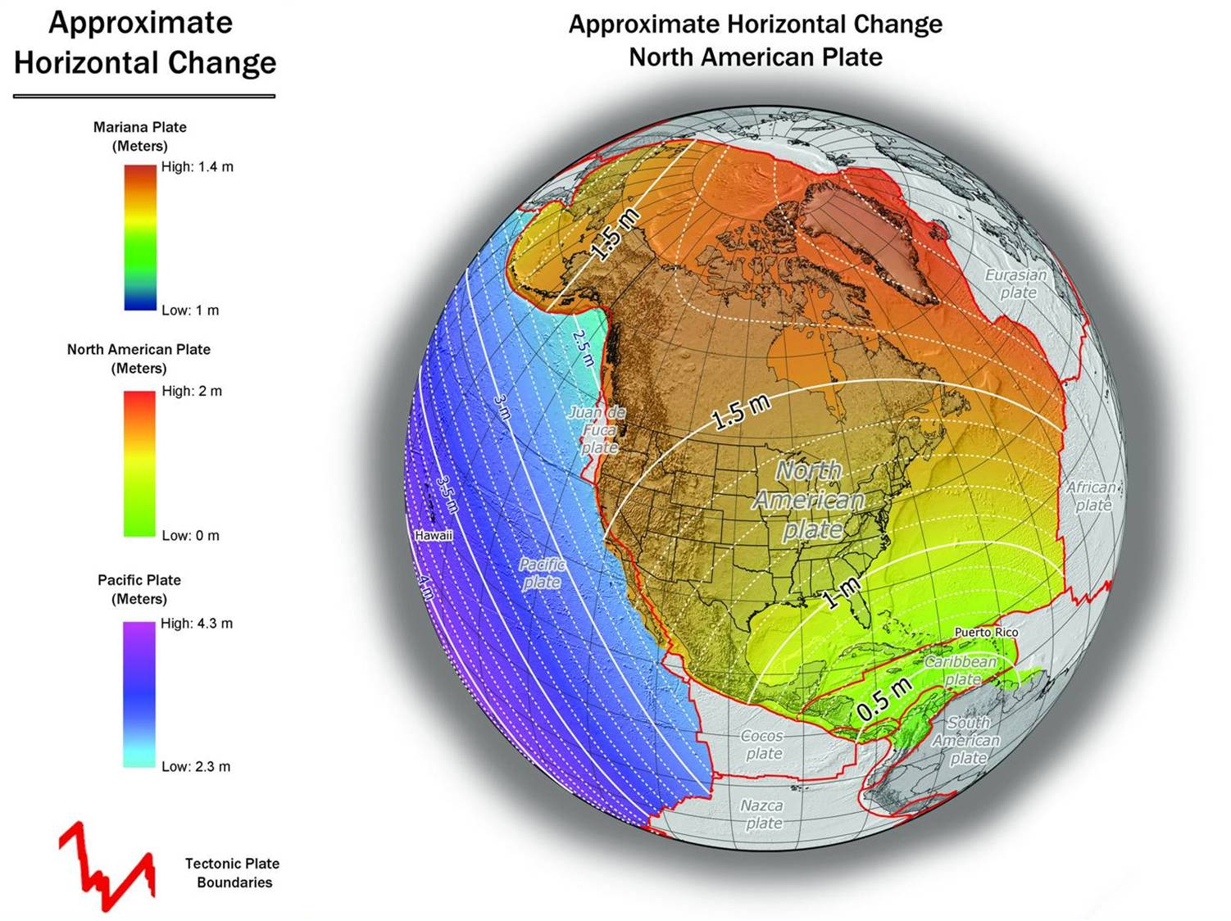
NAD 83(2011) to IGS08 at epoch 2022.0

Slide 17
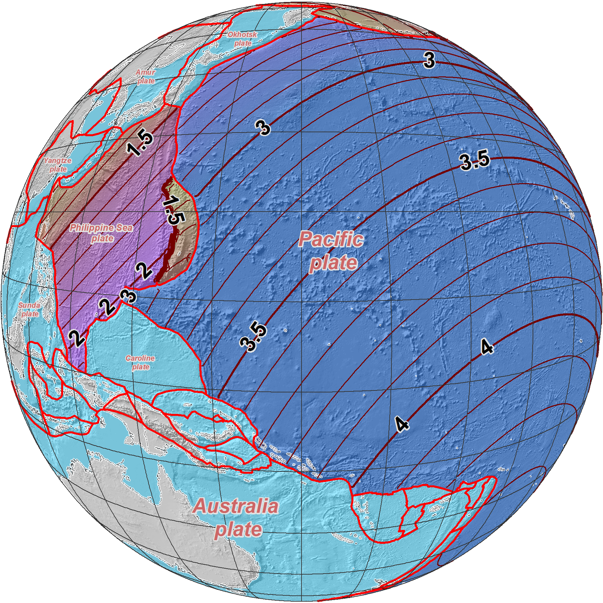
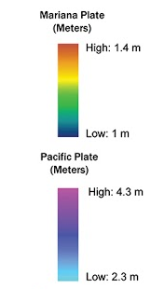
Approximate Horizontal Change
NAD 83 (2011/PA11/MA11) epoch 2010.00 →
2022 Terrestrial
Reference Frames
Horizontal change at epoch 2022.00
(contours in meters)
MATRF2022
PATRF2022

Slide 18
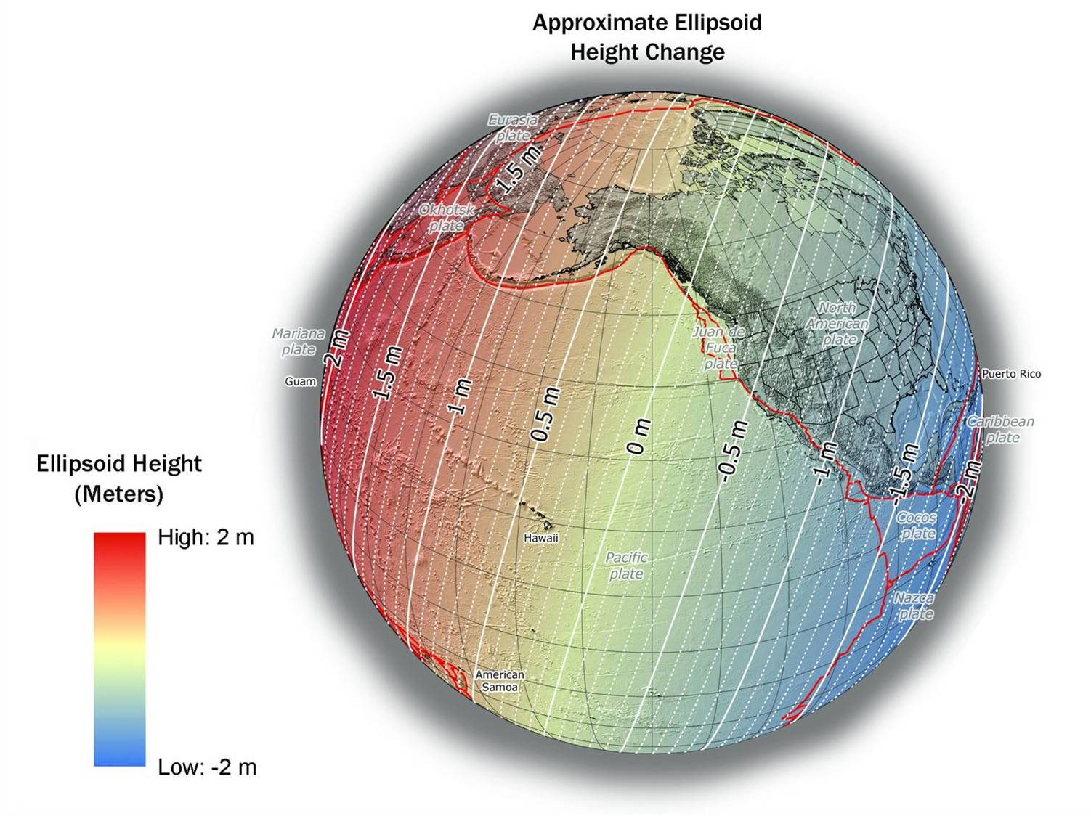
NAD 83(2011) to IGS08 at epoch 2022.0
Notes:
NGS has not yet determined the co-definitional epoch between IGSxx and the four TRFs. The epoch 2022.0 is for reference purposes only, and does not constitute a policy choice at this time

Slide 19
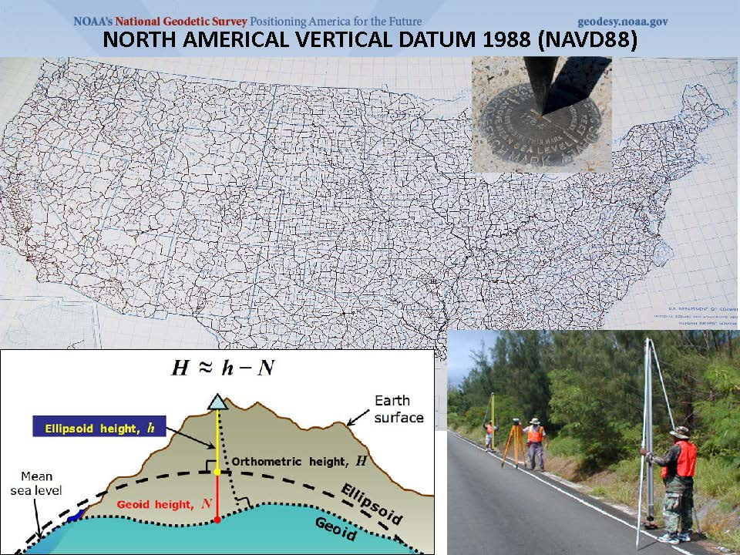
Dense as it is, it’s not everywhere!

Slide 20
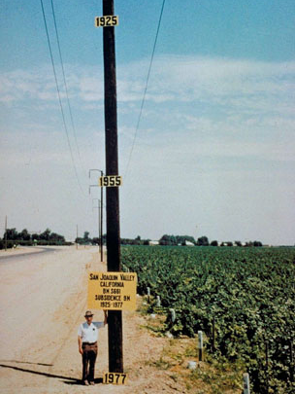
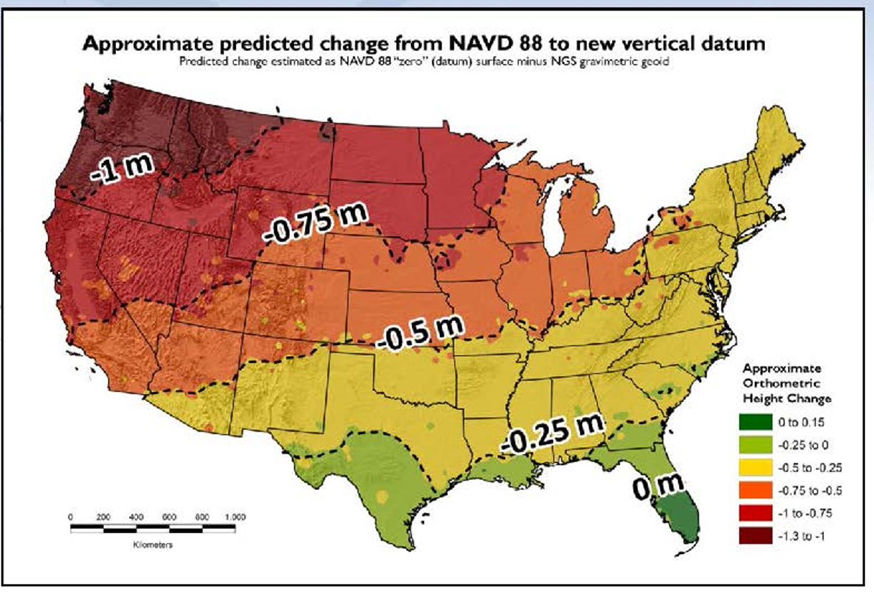
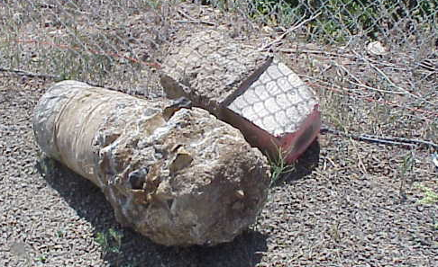
North American Vertical Datum 1988 (NAVD88) Shortcomings
  Cross-country errors (1-m tilt)
  0.5 m bias in reference surface vs. global mean sea level
  Subsidence, uplift, freeze/thaw invalidate BM elevations
  LIMITED AVAILABILITY / ACCESS

Slide 21
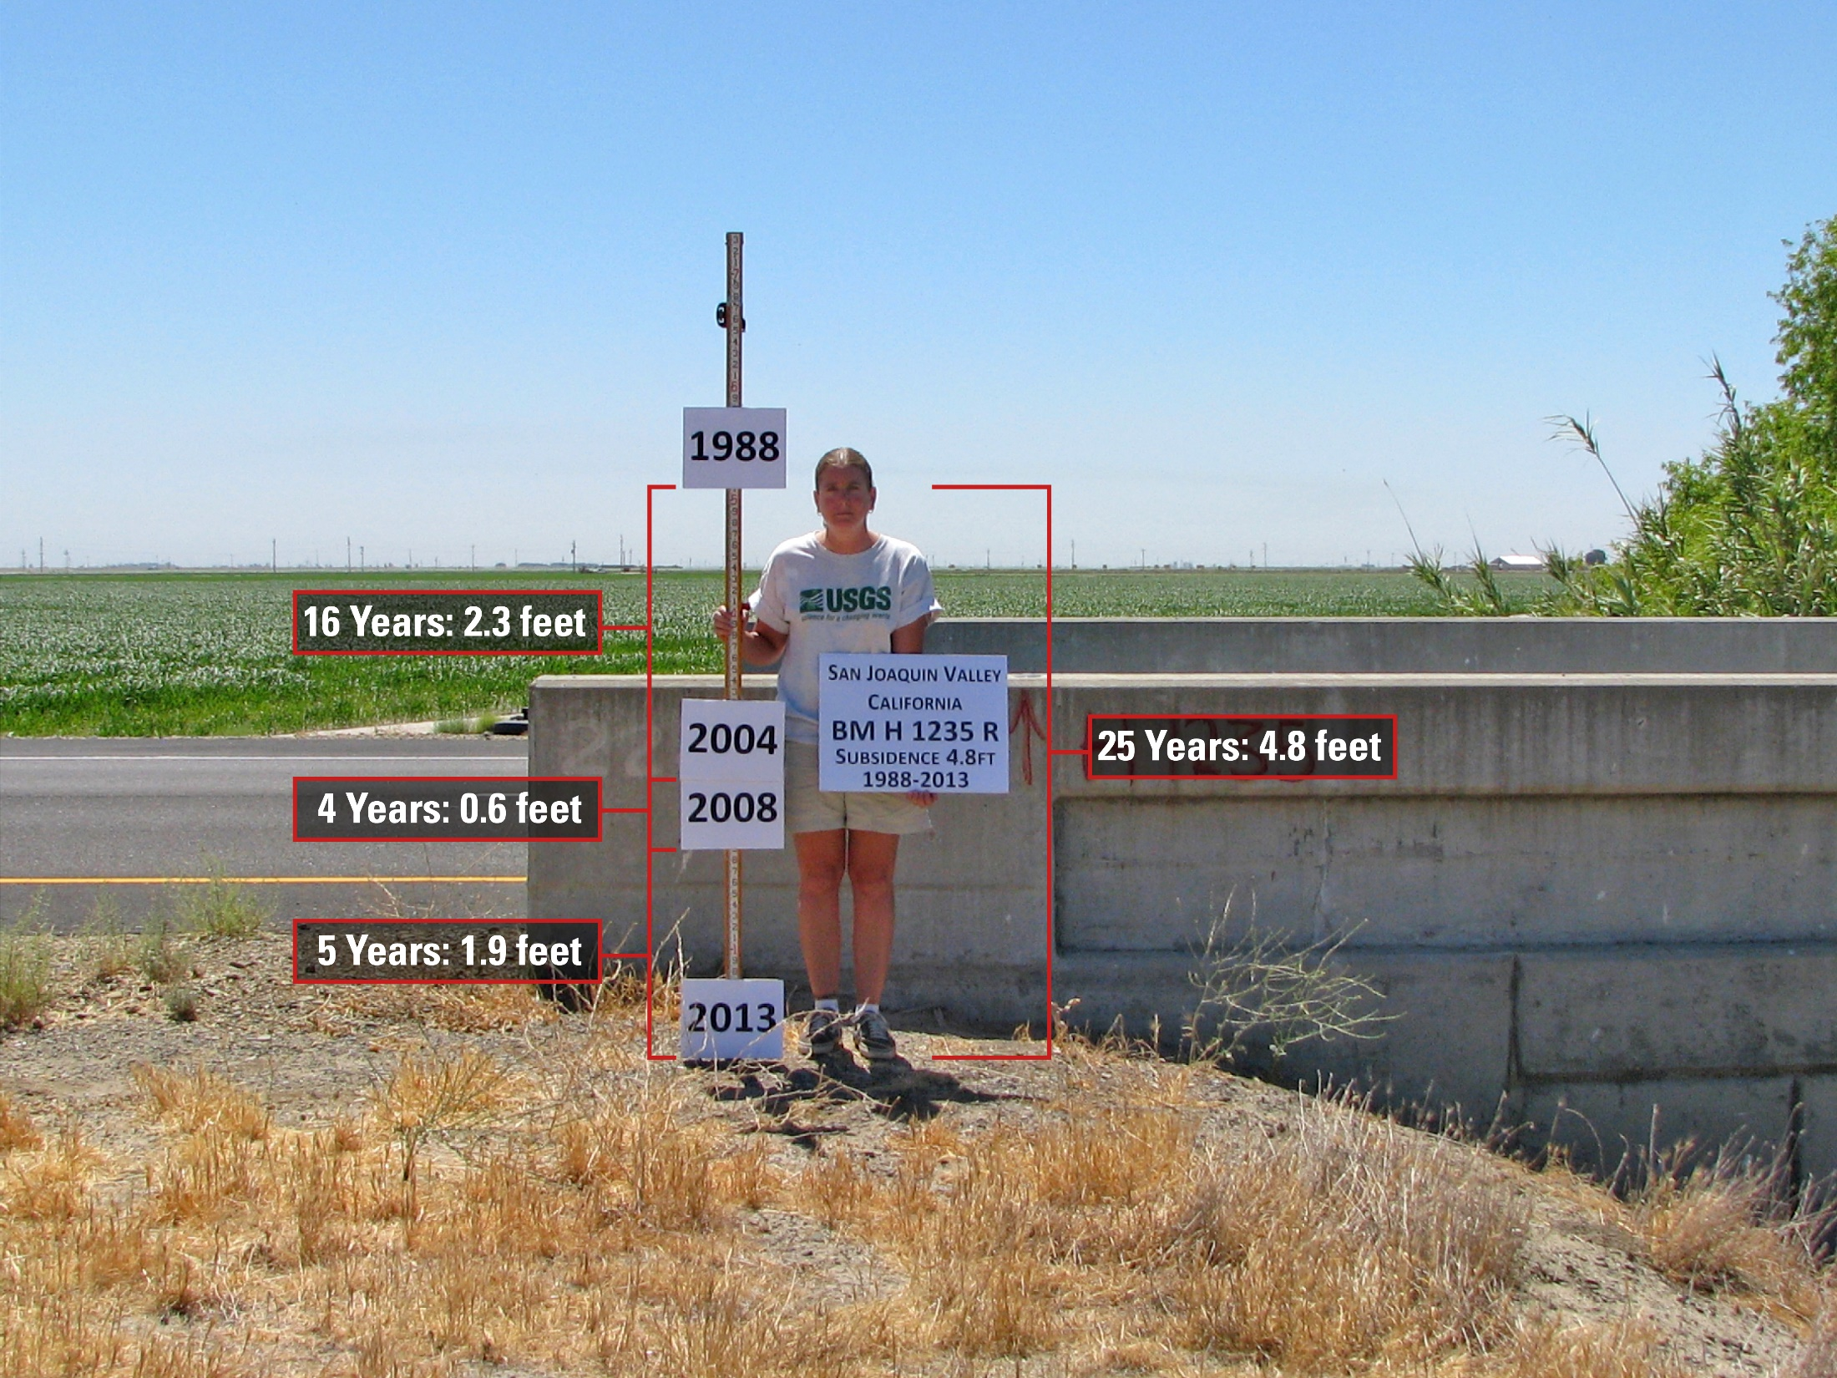
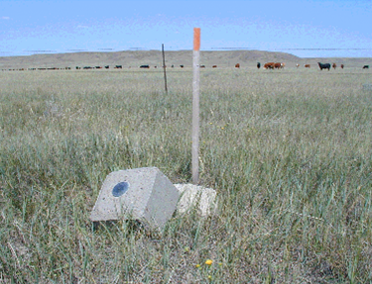
passive marks may lie still, but they still lie
small instability x long time = inaccuracy
Subsidence
Destruction

Slide 22
The Relationship of Heights

Slide 23
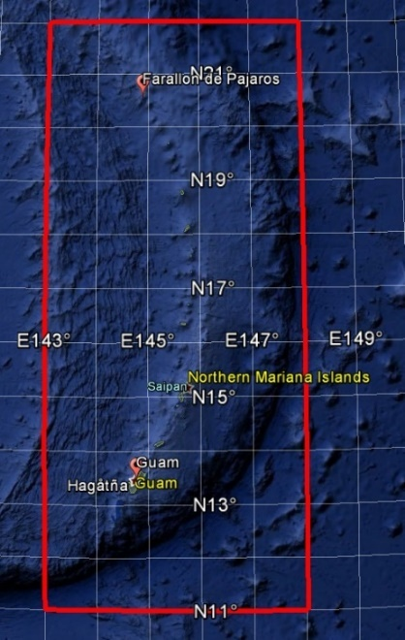
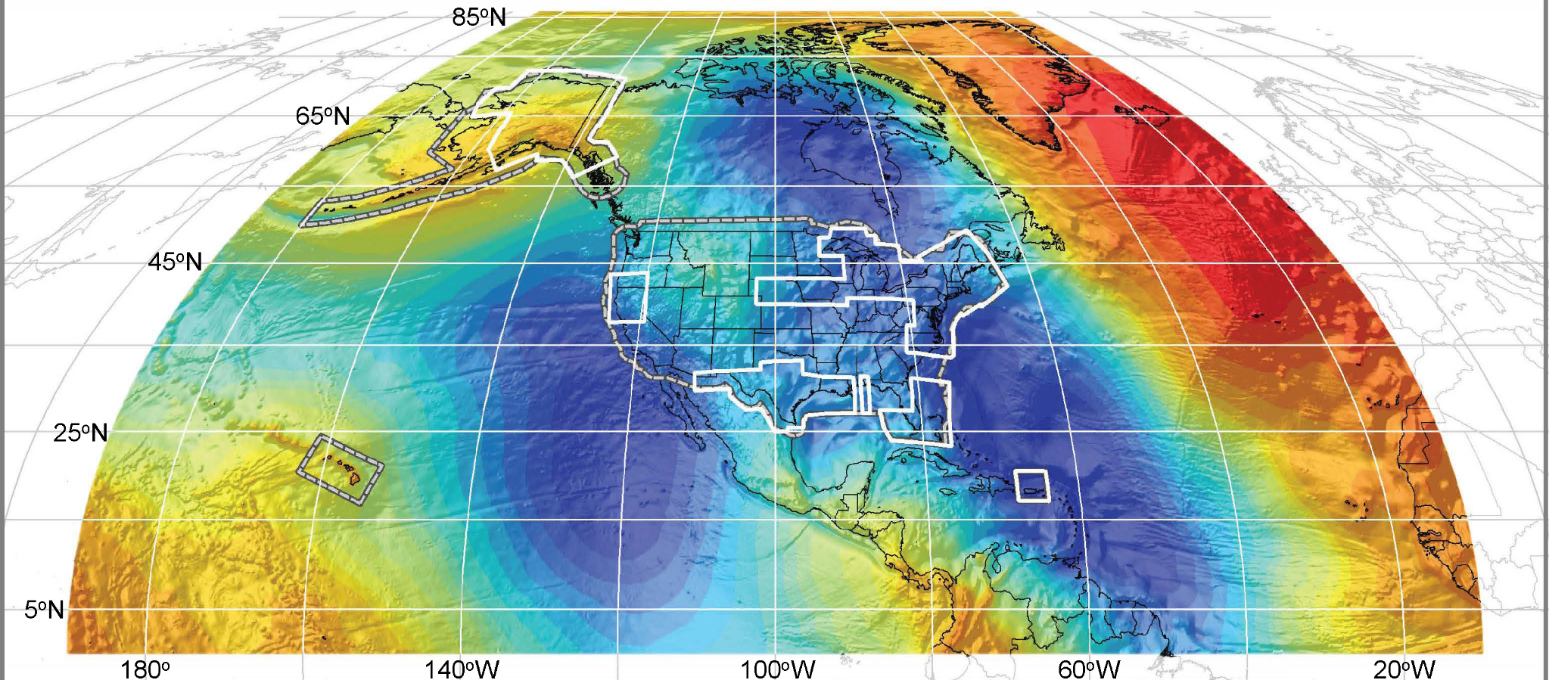
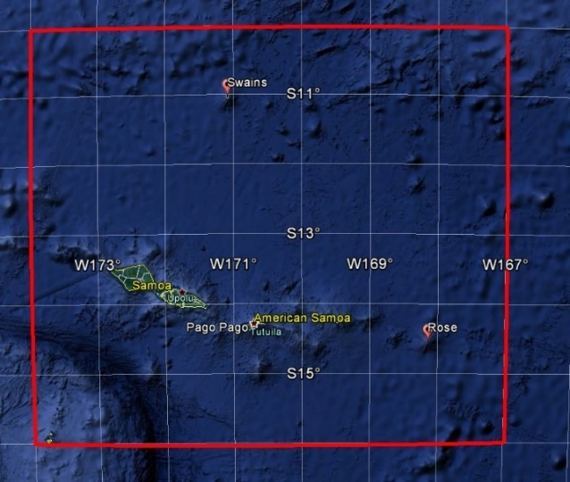
Extent of NAPGD2022 Gravimetric Geoid Model (GEOID2022)
Guam and Northern Marianas Islands
American Samoa

Slide 24

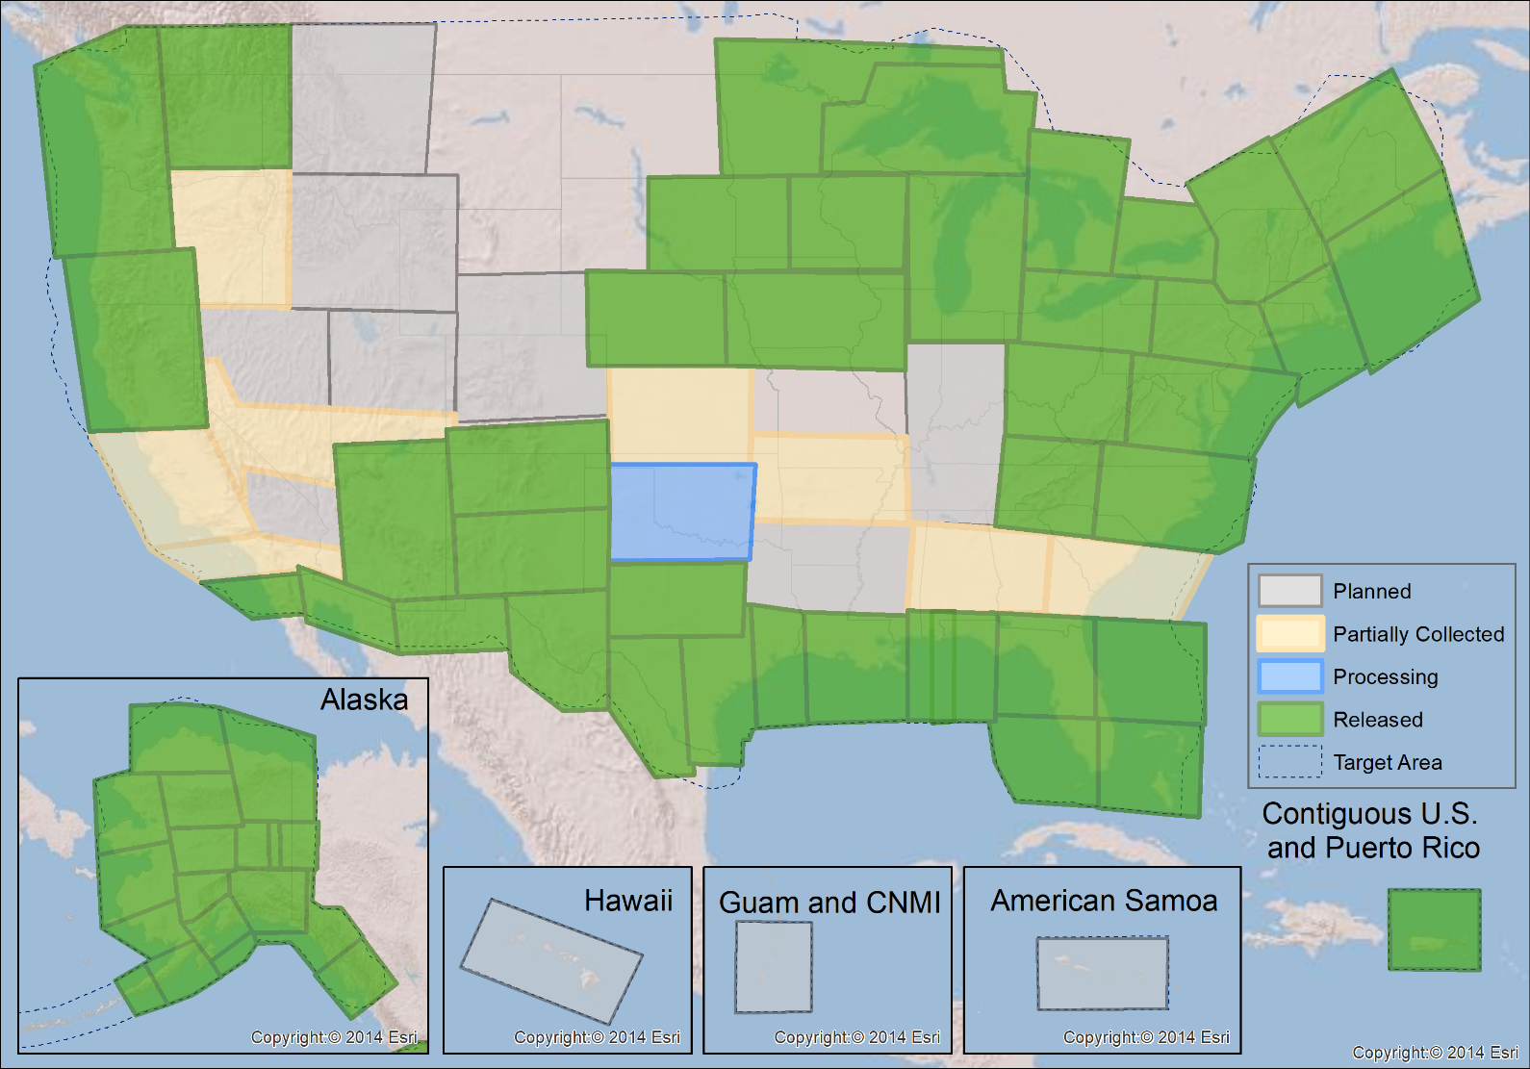
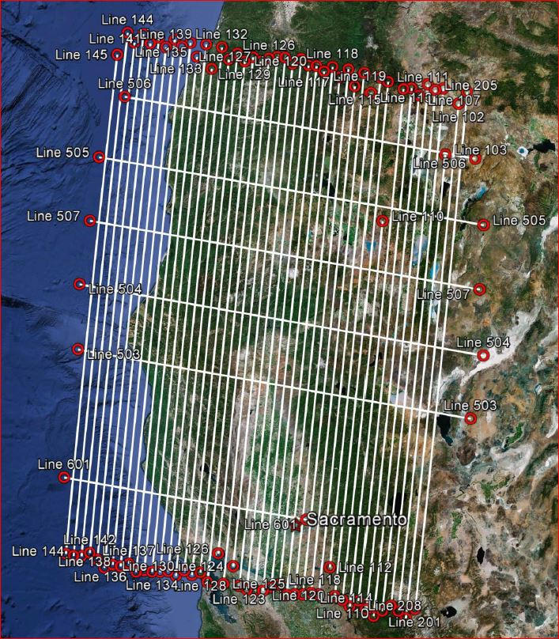
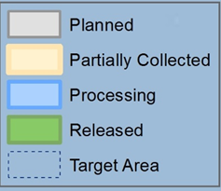
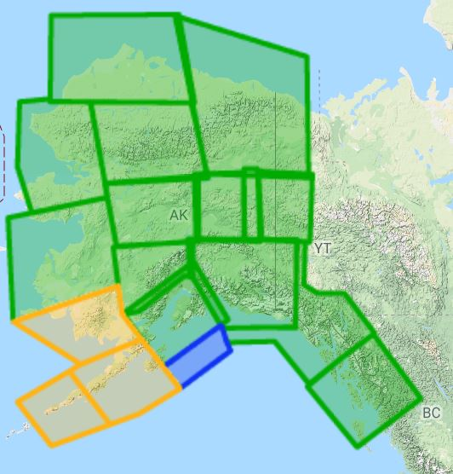
Gravity for the Redefinition of the American Vertical Datum (GRAV-D)
10 km data lines
70 km cross lines
20,000 ft altitude
230 kt flight speed
2019-Q1:
75% complete

Slide 25
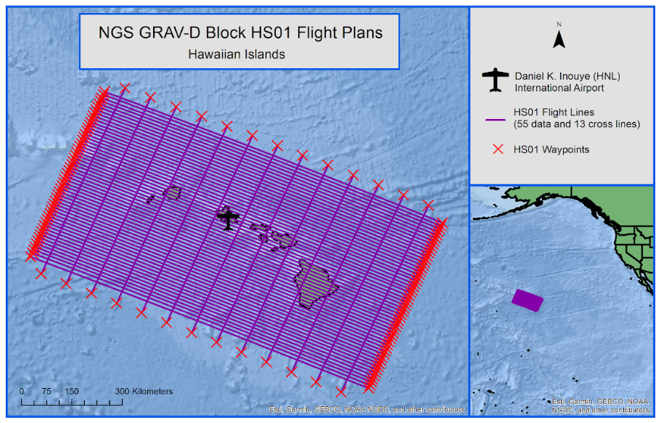
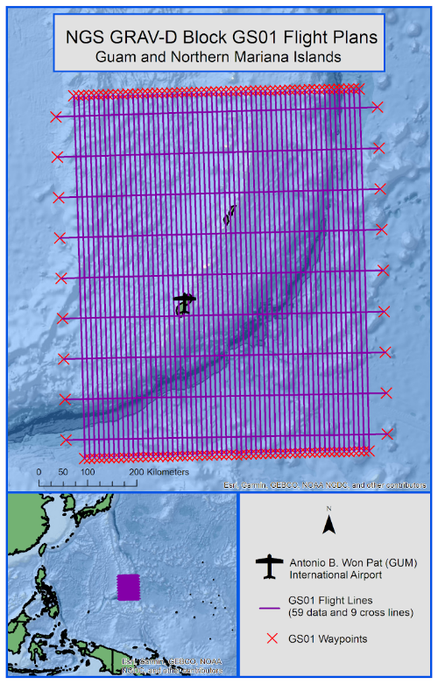
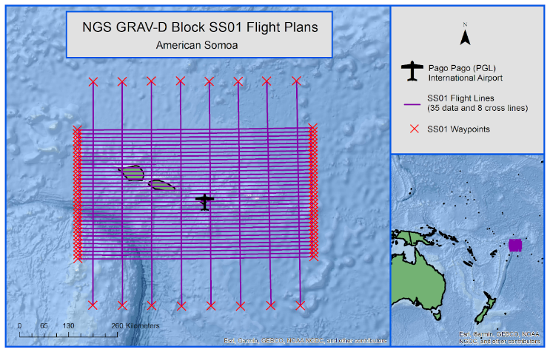
GRAV-D work in Pacific
Early February to late March 2019
HS01- 55 data lines
13 cross lines
22 flights
SS01 - 35 data lines
8 cross lines
9 flights
Not being done
this year - furlough

Slide 26
Old Vertical Datums replaced by NAPGD2022
  The Old:
  NAVD 88
  PRVD 02
  VIVD09
  ASVD02
  NMVD03
  GUVD04
  IGLD 85
  IGSN71
  GEOID12B
  DEFLEC12B
Orthometric
Heights
  The New:
  The North American-Pacific Geopotential Datum of 2022 (NAPGD2022)
  - Will include GEOID2022
Normal
Orthometric
Heights
Dynamic
Heights
Gravity
Geoid
Undulations
Deflections of
the Vertical

Slide 27
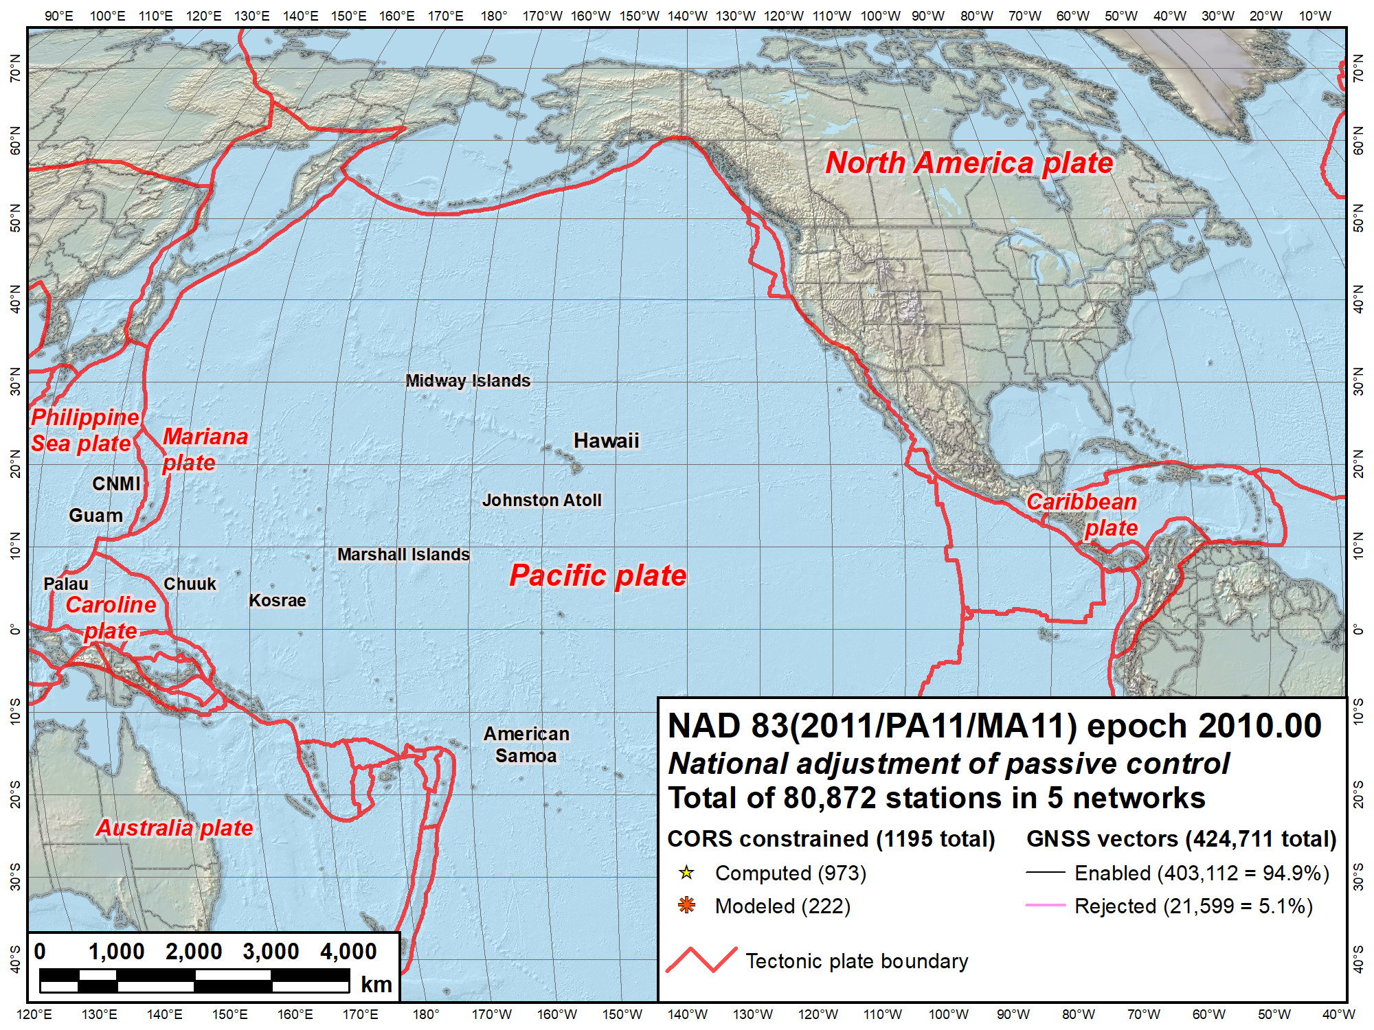
NAVD 88
IGLD 85
NAVD 88
PRVD02
NMVD03
VIVD02
GUVD04
Current vertical datums of the NSRS
ASVD02
NA and Caribbean
NAVD 88
IGLD 85
PRVD02
VIVD09
Pacific
GUVD04
NMVD03
ASVD02

Slide 28
Q: When should I care?
A: When your accuracy needs are smaller than about 4 meters
Expected latitude/longitude changes:
  1-2 meters CONUS
  2+ meters Alaska
  4+ meters Hawaii
Expected (“MSL”) height changes:
  1-2 meters CONUS
  2+ meters Alaska
  +0.5 to 1 meter in Hawaii ? (flying GRAV-D now)
Plus, time-dependent changes to all of these at ~few cm/year

Slide 29
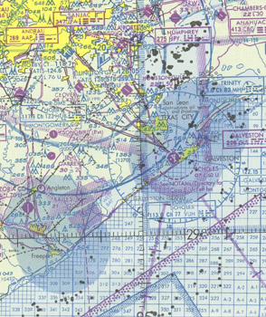
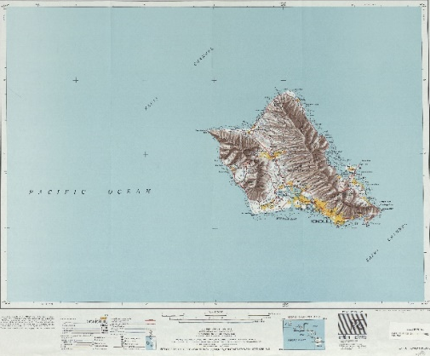
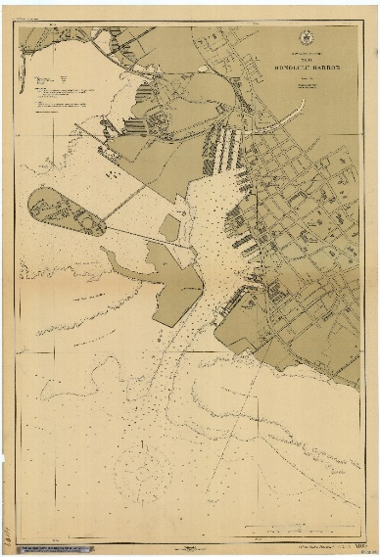
What to do with historic maps/charts?
Is the accuracy expected to be better than a few meters?
Yes
No
Stop. You won’t likely gain much by transforming
Do you have trusted metadata which puts the map/chart in the NSRS?
Yes
No
Use NCAT to update the datums in 2022
Stop. Transformation tools only work in the NSRS and only if you trust the metadata
NGS Coordinate Conversion
&
Transformation Tool
(NCAT)

Slide 30
Benefits of the 2022 Datum
USGS
Improved 3DEP and other topographical products
More accurate representation of the physical world in our elevation (and other georeferenced) products
FEMA
More accurate horizontal and vertical coordinates for NFIP
NFIP requires thousands of precise horizontal and vertical measurements of buildings to know where water will flow during floods
USACE
Consistency of vertical datums across the country Improved accuracy of GPS derived elevations and a better relationship between geodetic and hydrologic datums to manage levies and waterways
NGA
New NSRS will be more closely aligned with WGS 84 and ITRF

Slide 31
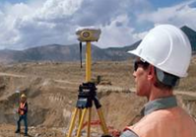
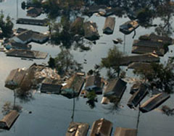
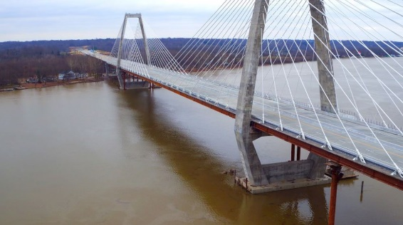

What life will be like in the future
Revolutionize professional surveying
No more need for installing and locating bench marks
Absolute, consistent positioning autonomously, anywhere
Vastly improved flood plain mapping
Water flows due to differences in gravity
Critically important in low-lying, flat communities
Impacts on infrastructure
Any application requiring precise positioning -- bridges, tunnels, railways, agriculture, navigation -- will be easier and more accurate
Fundamental support for new technologies
“Smart Highways” for autonomous vehicles

Slide 32
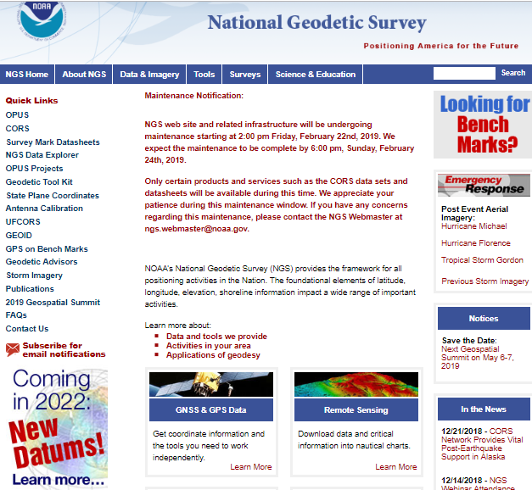
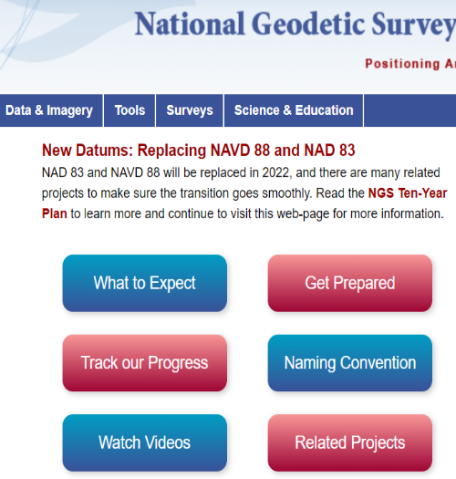
geodesy.noaa.gov

Slide 33
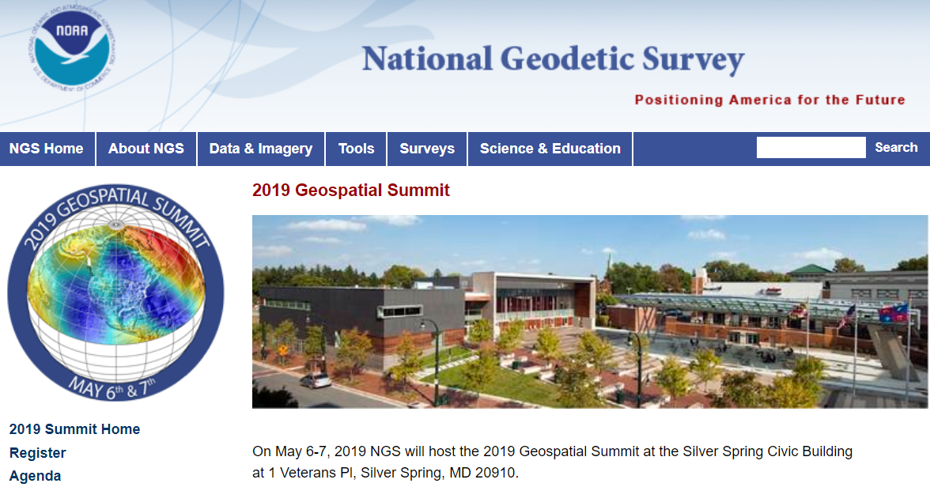
NGS 2019 Geospatial Summit
May 6-7, 2019 in Silver Spring, MD
To attend in person, you must Register by April 5th
https://www.ngs.noaa.gov/geospatial-summit/index.shtml

Slide 34
Questions?
Jeff Jalbrzikowski, P.S., GISP
Appalachian Regional Advisor (KY, OH, PA, WV)
National Geodetic Survey
https://www.ngs.noaa.gov/ADVISORS/
ph: 240-988-5486
Mendenhall Lab 318
125 Oval Drive S.
The Ohio State University
Columbus, OH 43210
Stephen Hilla N/NGS6
Chief, Geosciences Research Division
National Geodetic Survey, NOS, NOAA
1315 East-West Highway
Silver Spring, Maryland 20910
Steve.Hilla@noaa.gov
(office) 240-533-9562

Slide 36
EXTRA SLIDES
Note: the above presentation was designed for a 30-minute time slot

Slide 37
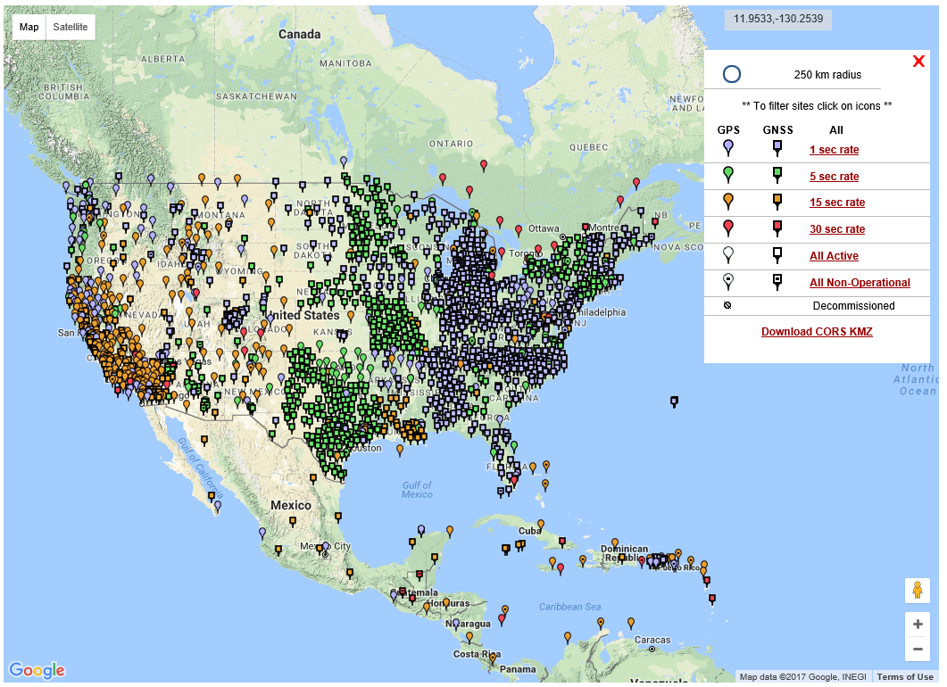
NGS Published CORS

Slide 38
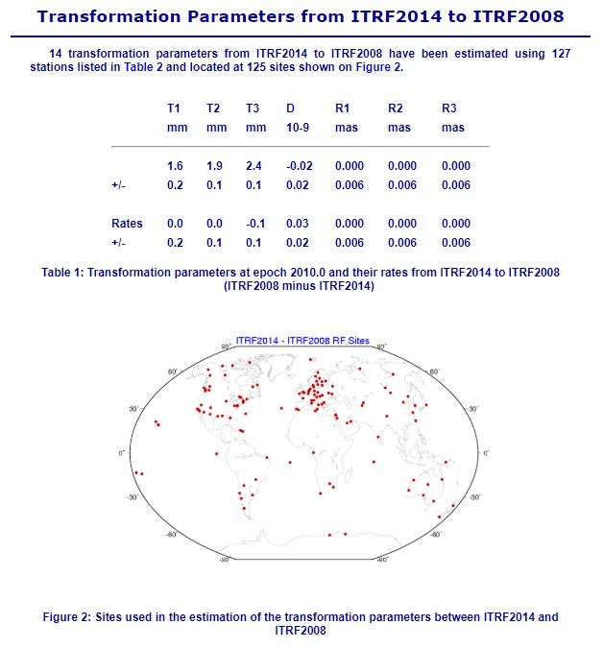

Slide 39
Why replace
NAD 83 & Vertical Datums?
Main driver: Global Navigation Satellite System (GNSS)
ACCESS!
  GNSS equipment is fast, inexpensive, reliable (and improving)
  Reduces reliance on finding survey control (“bench marks”)
ACCURACY!
  Insensitive to distance-dependent errors; reliable
  Immune to bench mark instability (referenced to CORS)
CONSISTENCY!
  Eliminates systematic errors in current datums
  Aligned with global reference frames
  Integrated system for both positions and heights (“elevations”)

Slide 40
Geoid Monitoring Service (GeMS)
Goal: Track all changes to the geoid which would prevent 1 cm accuracy
Aspects included:
  Shape, Secular: e.g. Hudson Bay
  Shape, Episodic: e.g. Massive Earthquakes
  W0, Secular: Global Sea Level Change (see next slides)
Examples of things excluded:
  Size, Secular: Mass quantity of Earth is effectively static
  Shape, Periodic: Seasonal glacier cycle

Slide 41












NGS Programs
Modernizing the NSRS
CORS
Height Modernization
GRAV-D
Ecosystem and Climate Operation
NGS Products and Services
Airport Surveys
OPUS
VDatum
GPS Satellite Orbits
Coastal Mapping
Regional
Advisor Program
Emergency Response Imagery

Slide 42

Client and Employee Education
Many clients and employees may not understand what datums are.
NGS has resources available to help explain the concepts.
Prepare handouts.
Teach up the organization.
see Educational Videos
https://www.ngs.noaa.gov/corbin/class_description/NGS_Video_Library.shtml

Slide 43



NSRS Modernization: the “Blueprints”
Blueprint for 2022, Part 3: Working in the Modernized NSRS
#1 Geometric:
Sep. 2017
#2 Geopotential:
Nov. 2017
#3 Working in the
Modernized NSRS:
Coming Soon
https://www.ngs.noaa.gov/datums/newdatums/policy.shtml

Slide 44
How do you get WGS 84 coordinates?
Credit Michael Dennis (NGS)
Only true access: Broadcast orbits
  Accuracy ~3 to 5 m (10 to 15 ft) horizontal
  Epoch at midpoint of year (e.g., now 2018.5)
Can assume equal to civilian global frames
  International Terrestrial Reference Frame (ITRF)
  International GNSS Service (IGS) frame
Sources for ITRF/IGS coordinates:
  Satellite Based Augmentation Systems (SBAS)
    E.g., WAAS, OmniSTAR HP
  Various post-processed positioning services
    E.g., OPUS, AUSPOS, CSRS-PPP, GAPS, APPS, SCOUT, etc.

Slide 45

A (very) brief history of WGS 84
Credit Michael Dennis (NGS)
Original realization completed in Jan 1987
  “Same” as original NAD 83 (to within ±2 m)
WGS 84 (G730) — adopted Jun 1994
  Aligned to ITRF91
WGS 84 (G873) — adopted Jun 1997
  Aligned to ITRF94
WGS 84 (G1150) — adopted Jan 2002
  Aligned to ITRF2000 (at epoch 2001.00)
WGS 84 (G1674) — adopted Feb 2012
  Aligned to ITRF2008 (at epoch 2005.00)
Latest: WGS 84 (G1762) — adopted Oct 2013
  Also aligned to ITRF2008 (at epoch 2005.00)
A new one: WGS 84 (Gxxxx) — adopted late 2018…?
  Aligned to ITRF2014 (at epoch 2010.00)

Slide 46


Slide 47

A New State Plane Coordinate System
State Plane Coordinate System of 2022 (SPCS2022)
  Referenced to 2022 Terrestrial Reference Frames (TRFs)
  Based on same reference ellipsoid as SPCS 83 (GRS 80)
  Same 3 conformal projection types as SPCS 83 and 27:
Lambert Conformal Conic (LCC)
Transverse Mercator (TM)
Oblique Mercator (OM)
Notes:
State Plane Coordinate System of 2022 (SPCS2022) is also part of modernizing the NSRS
Referenced to the new 2022 TRFs (not to NAD 83)
But still uses same reference ellipsoid (GRS 80) and same 3 conformal projections

Slide 48
SPCS2022 overview
SPCS2022 characteristics different from SPCS 83:
  Minimize distortion at topo surface, not ellipsoid
  NGS will design statewide and default zones
  Up to 3 zone “layers” allowed (including an LDP layer)
  Allow “special use” zones (if in multiple states)
  Coordinate changes of at least 10,000 m everywhere
  Longitudes defined as positive east (0° to 360°)
  Stakeholders can request and propose preferences
Consensus state stakeholder input required for SPCS2022 zone requests, proposals, and designs
Can still change/add/remove zones after 2022

Slide 49
Options for Ohio zone “layers”
Can have maximum of THREE zone layers
  One must be statewide layer (designed by NGS)
  0, 1, or 2 multiple-zone layers can exist. However:
    Only ONE layer can have complete state coverage
    Only ONE layer can have partial state coverage
  Likely result: ONE multiple-zone layer in Ohio
    E.g., existing two zones OR multiple small zones, but NOT both
Minimum zone width is 50 km (31 miles)
  Proposed 88 county zones does not meet this limit
  Can request exception (although not guaranteed)
Notes:
Layered zones are allowed for SPCS2022 (for a max of 3 layers)
One state in SPCS 83 has 2 layers, Kentucky (statewide plus a pre-existing 2-zone layer)
States can have 1, 2, or 3 layers
One layer MUST be a statewide zone (so a state with 1 layer has only a statewide zone)
The other 1 or 2 layers will almost always have multiple zones (unless a state has, say, a single LDP in SPCS2022 that covers only part of the state)
Only 1 layer can be “discontinuous”, that is, consist of layers that do not collectively cover the entire state (will show an example of this)
Decision to go with 3 layers based on FRN responses, especially those from mountainous western states
The multi-zone layer(s) can consist of LDPs
Almost always means distortion criterion < ±50 ppm, so must be designed by others (i.e., “contributing partners”), not by NGS

Slide 50
SPCS2022 deadlines
Consensus input per SPCS2022 procedures
  Requests for designs done by NGS
  Proposals for designs by contributing partners
Submittal of approved designs
  Proposal must first be approved by NGS
  Designs must be complete for NGS to review
Later requests will be for changes to SPCS2022
NGS.SPCS@noaa.gov
by March 31, 2020 for requests and proposals
by March 31, 2021 for submittal of approved designs
Notes:
Deadlines for requests, proposals, and submittal of approved designs
Designs by “contributing partners” must first be approved as proposals by NGS
Contributing partners can be the stakeholders, or an individuals or organizations designing the zones for the stakeholders
It is expected that most (all?) proposed designs will be for LDP systems (with design criterion < ±50 ppm), since NGS will not design those
Any requests, proposals, or submittals that are not received by the deadlines will not be included in the initial release of SPCS2022 (in 2022)
However, these could still become part of SPCS2022 at a later time
Policy & procedures provide mechanism for changing SPCS2022, so there will still be an opportunity to change/add SPCS2022 layers even after 2022

Slide 51
NGS Coordinate Conversion
&
Transformation Tool
(NCAT)
X, Y, Z
φ, λ, h
φ, λ, h
2022
X, Y, Z
SPC
UTM
USSD
USNG
UTM
φ, λ, h
φ, λ, h
Old Hawaiian, Guam
NAD 83 (2011,PA11,MA11)
X, Y, Z
SPC
X, Y, Z
SPC
USNG
UTM
USNG
UTM
NAD 83 (NSRS2007)
φ, λ, h
φ, λ, h
NAD 83 (1986)
NAD 83 (FBN)
SPC
NAD 83 (HARN)
φ, λ, h
X, Y, Z
SPC
X, Y, Z
φ, λ, h
USNG
UTM
SPC
USNG
UTM
X, Y, Z
SPC
X, Y, Z
USNG
UTM
USNG
UTM

Slide 52
How to Plan for the Future
Move to newest realizations
  NAD 83(2011) epoch 2010.00
  USGG12 (gravimetric geoid) / GEOID12B (hybrid geoid)
Obtain precise ellipsoid heights on NAVD 88 bench marks (GPS on BM via OPUS-SHARE, contact NGS Geodetic Advisor)
  Improves hybrid geoid models and provides “hard points” in new vertical datum
  Follow new NGS Guidelines when released
Move off of NGVD 29 to NAVD 88
  Understand the accuracy of VERTCON in your area
Move away from passive marks to GNSS
  Especially move off of classical passive control
Require/provide complete metadata for all mapping contracts
  How did they get the positions/heights? Document it!!

