Slide 1

New Datums:
Replacing NAVD 88 and NAD 83
National States Geographic Information Council
NSGIC 2018 Annual Conference
Dave Zenk
NGS Northern Plains Regional Advisor
October 1, 2018
Duluth MN

Slide 2
Outline
Need to replace NAD 83 and NAVD 88
Customer Concerns
Recent Decisions: Naming conventions and white papers
Anticipated effects of datum change and how to prepare

Slide 3
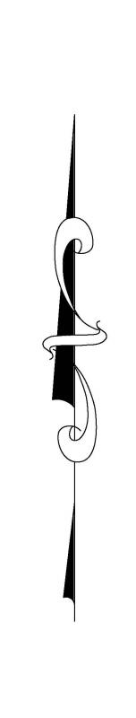
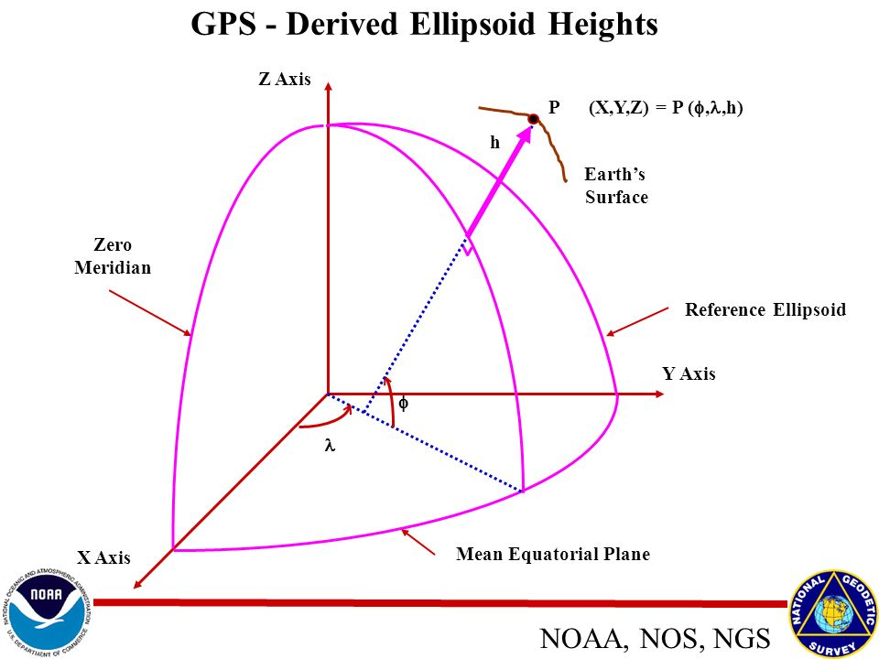
Why replace NAVD 88 and NAD 83?
It’s the next logical step in a century old progression.
  Migration from assumed coordinates, height, and direction to worldwide need to share unified datasets.
US Standard Datum -> NAD27 -> NAD83 -> NATRF2022
Assumed NORTH
N=5,000
E=10,000
Ht=100

Slide 4
Why replace NAVD 88 and NAD 83?
EXPANDS ACCESS!
  easier to find the sky than to find a 60-year-old bench mark
  GNSS equipment is cheap and fast
ENSURES ACCURACY!
  easier to trust the sky than to trust a 60-year old bench mark
  immune to passive mark instability
GLOBAL STANDARDS!
  systematic errors of many meters across the US
  aligns with GPS, international efforts
  aligns with Canada, Mexico
GEOPHYSICS!
  Gravity defines level surfaces
  Satellite orbits based on gravitational center of mass
Notes:
Things are looking up! GNSS technologies simplify and improve access to and accuracy of our spatial reference system.
While we can continue to leverage this technology to maintain the old datums, it makes sense to adopt GRAV-D results in an unpolluted form, and align it to modern global standards.

Slide 5
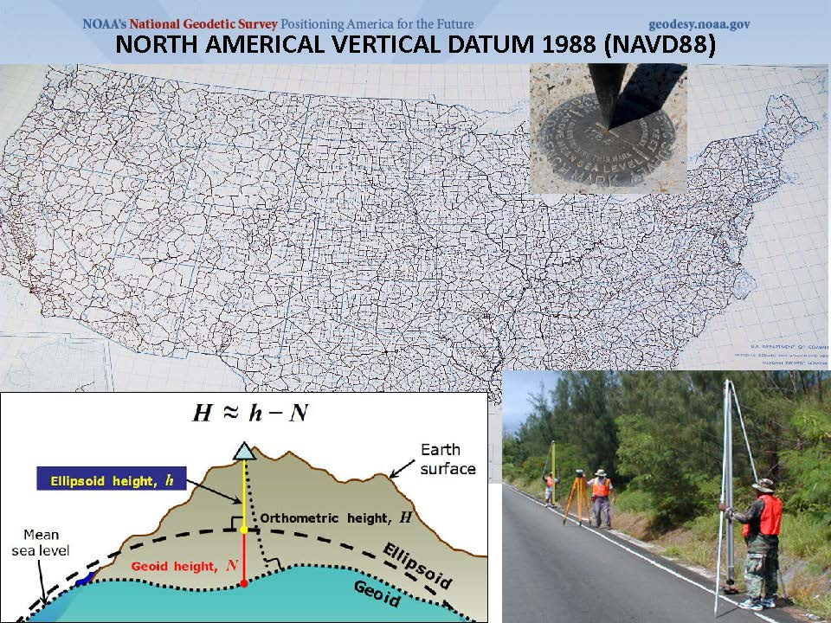
Dense as it is, it’s not everywhere!

Slide 6
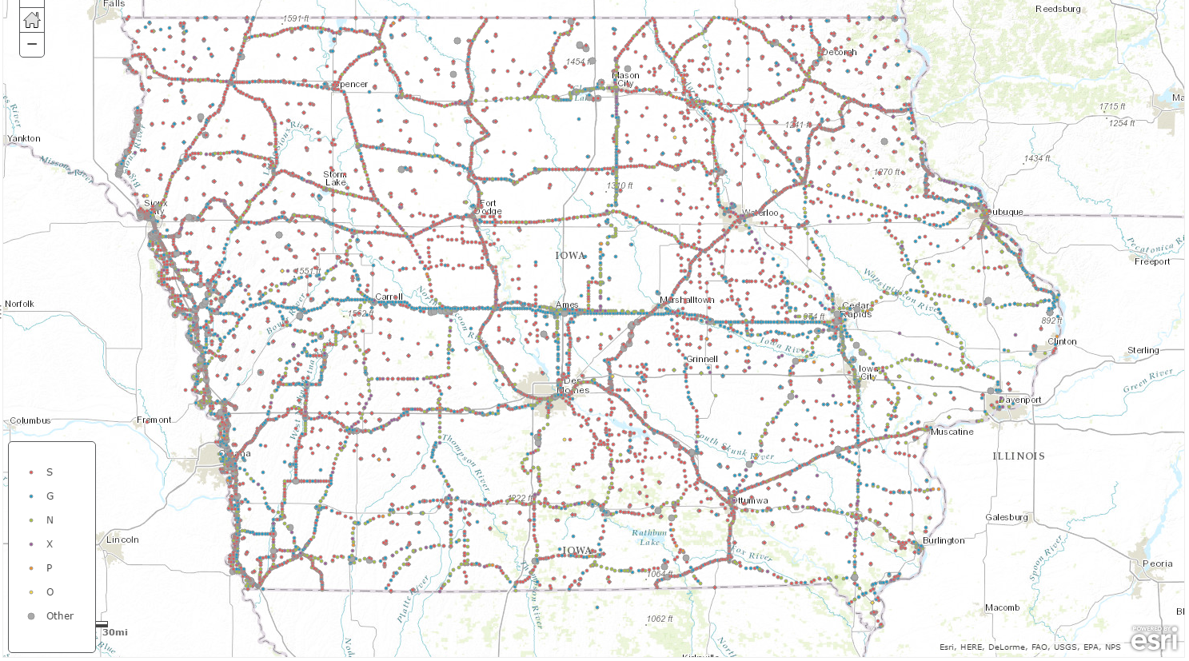
Where are IA’s Benchmarks?
Everywhere, but with gaps

Slide 7
Access to New Datum – Now and Future
In the future vertical datum (NAPGD2022), access will be via GPS, OPUS, and a GEOID model. Here’s a sample of current OPUS output with highlighted items:
REF FRAME: NAD_83(2011)(EPOCH:2010.0000) IGS08 (EPOCH:2016.5642)
LAT: 44 59 16.25809 0.006(m) 44 59 16.28558 0.006(m)
E LON: 266 30 48.71589 0.002(m) 266 30 48.67220 0.002(m)
W LON: 93 29 11.28411 0.002(m) 93 29 11.32780 0.002(m)
EL HGT: 272.794(m) 0.013(m) 271.868(m) 0.013(m)
ORTHO HGT: 299.770(m) 0.024(m) [NAVD88 (Computed using GEOID12B)]
And at bottom of the OPUS report:
APPROX ORTHO HGT: 298.971 (m) [PROTOTYPE (Computed using xGeoid16B,GRS80,IGS08)]
Location west of Minneapolis, MN
Lat = + 0.846 m
Lon = + 0.932 m
Ell Ht = - 0.926 m
Ortho Ht = - 0.799 m
Black = current datums
Red = future datums

Slide 8
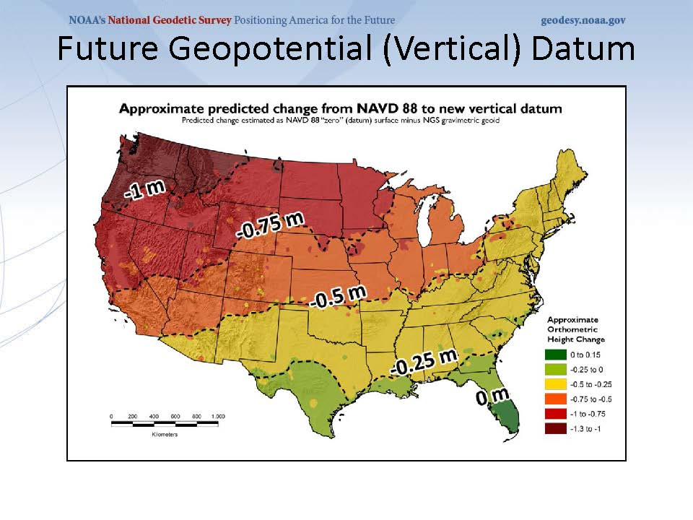
NAVD 88 is tilted and biased compared to gravitational potential

Slide 9
passive marks are old

Slide 10
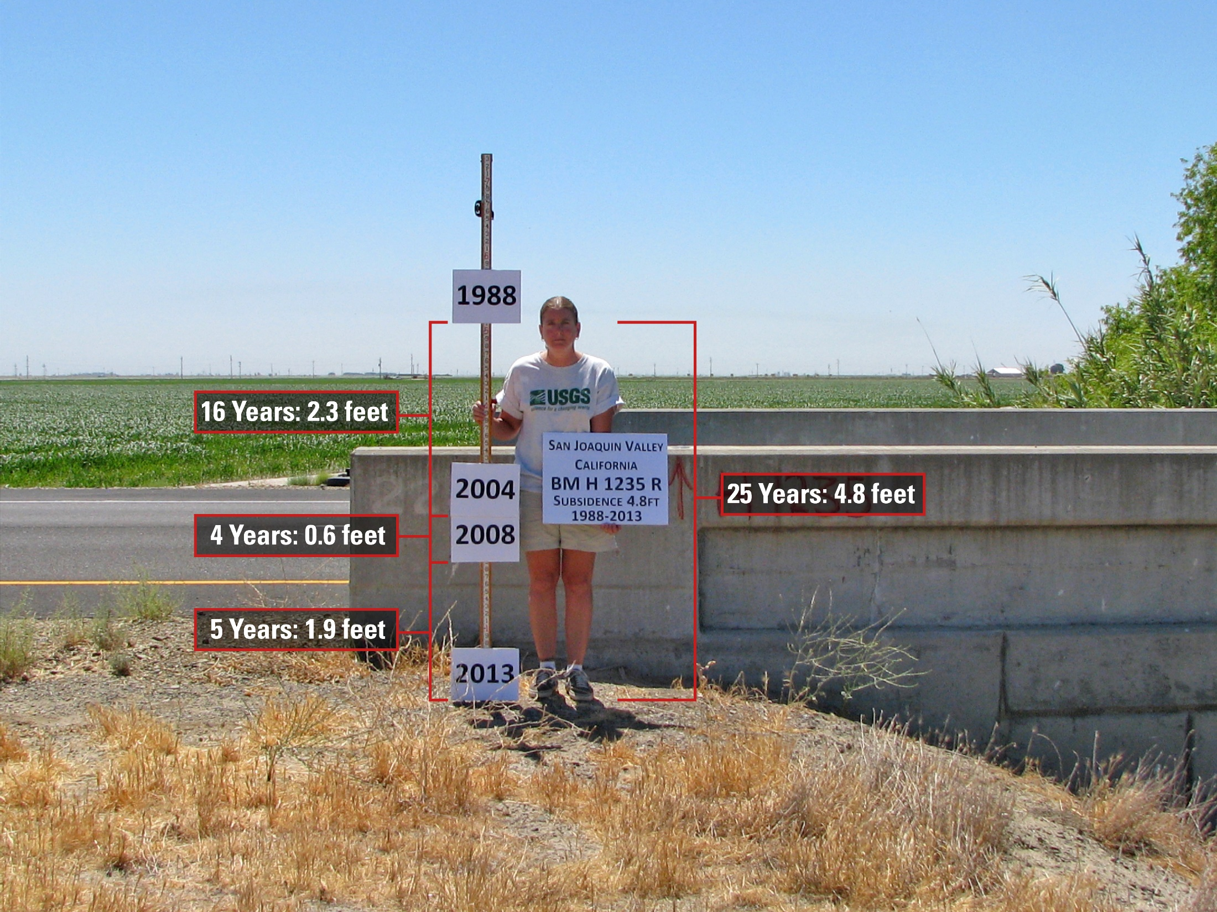
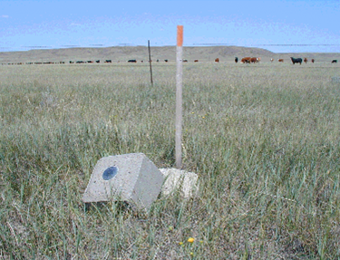
passive marks may lie still, but they still lie
small instability x long time = inaccuracy
Subsidence
Destruction

Slide 11
NAVD 88 is not America’s only datum
NAVD 88 North American Vertical Datum of 1988
PRVD02 Puerto Rico Vertical Datum of 2002
ASVD02 American Samoa Vertical Datum of 2002
NMVD03 Northern Marianas Vertical Datum of 2003, 3 each
GUVD04 Guam Vertical Datum of 2004
VIVD09 Virgin Islands Vertical Datum of 2009, 3 each
Hawaii … Hawaiian Islands Vertical Datum (coming soon)
various local datums, as national datum is inaccessible
IGLD 85 International Great Lakes Datum of 1985
IGSN71 gravity dataset
GEOID12B geoid undulations
DEFLEC12B deflection of the vertical
Will be replaced with one vertical datum - pole-to-equator

Slide 12
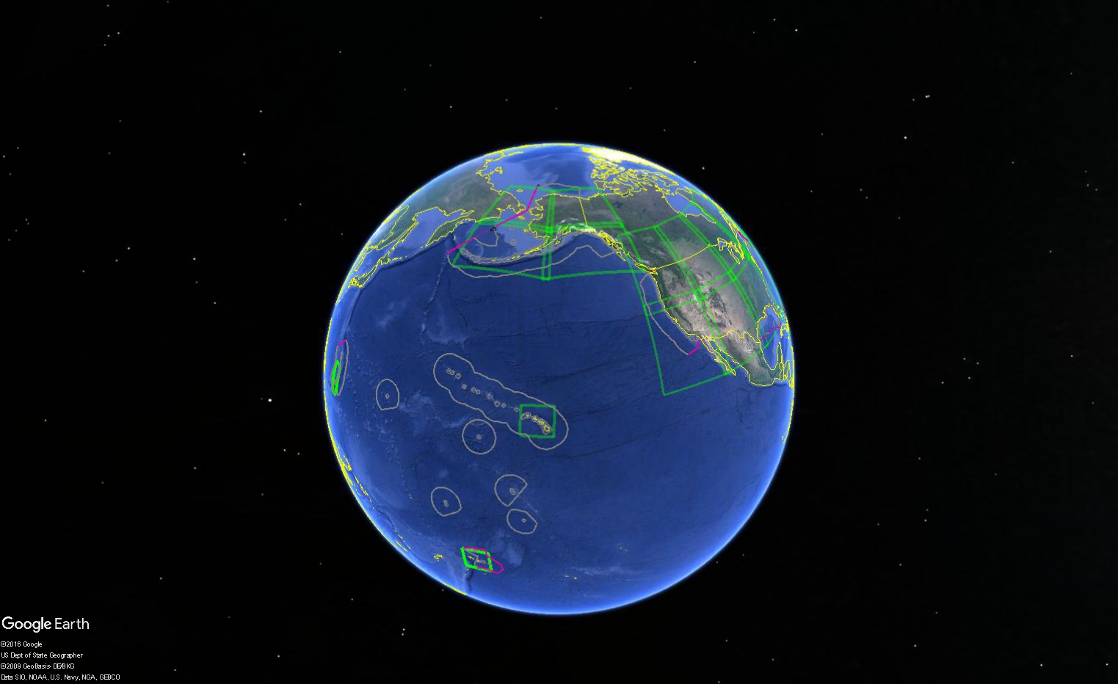
Multiple regional datums

Slide 13
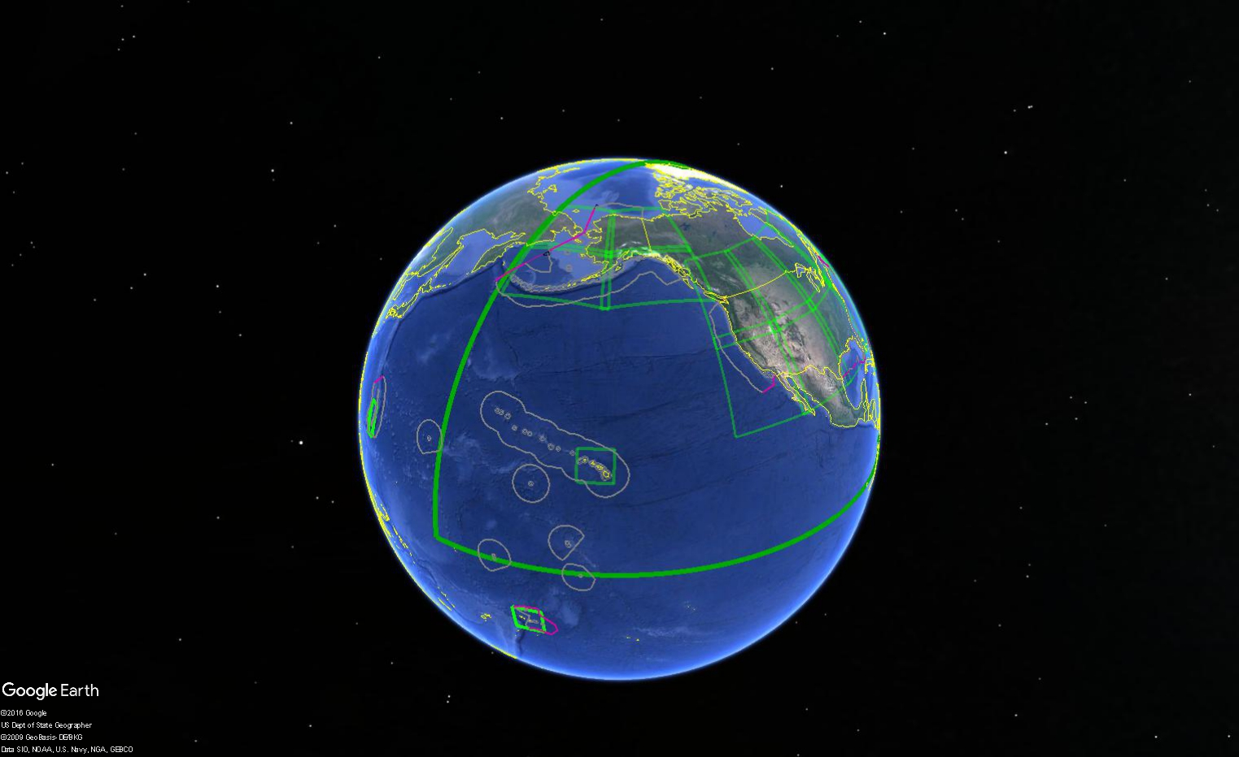
Multiple regional datums replaced with one datum.

Slide 14
NAD 83 is non-geocentric
h₈₃
h_{yy}
Earth’s
Surface
This shift will cause changes in Lat, Lon, and EllHt
same
GRS-80
ellipsoid
IGS yy
Origin
~2.2 meters
NAD 83
Origin
Notes:
ITRF (International Terrestrial Reference Frame) just has an origin; take NAD83 shaped ellipsoid centered at the ITRF origin to derive ITRF97 ellipsoid heights.
Ellipsoid heights NAD83 vs. ITRF97 - Defined origins are best estimate of the center of mass; NAD83 is not geocentric. Move origin; move ellipsoid surface as illustrated.
Ellipsoid height differences reflect the non-geocentricity of NAD83.

Slide 15
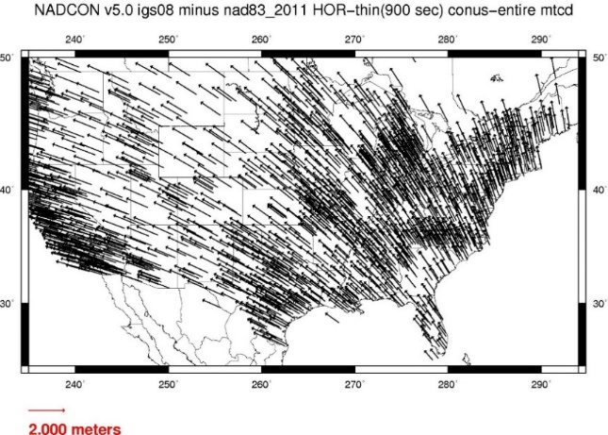
Comparison of IGS08 and NAD83
These arrows are ~ 1.5 meters long
These arrows are ~ 1.1 meters long

Slide 16
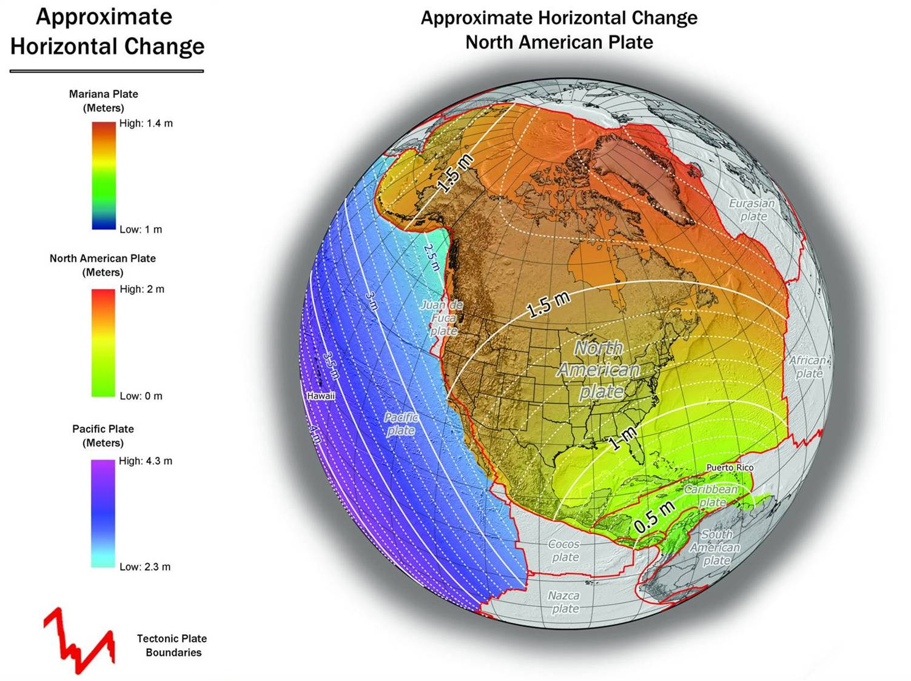
~ 1.3 meters (NW) in IA
NAD 83(2011) to IGS08 at epoch 2022.0

Slide 17
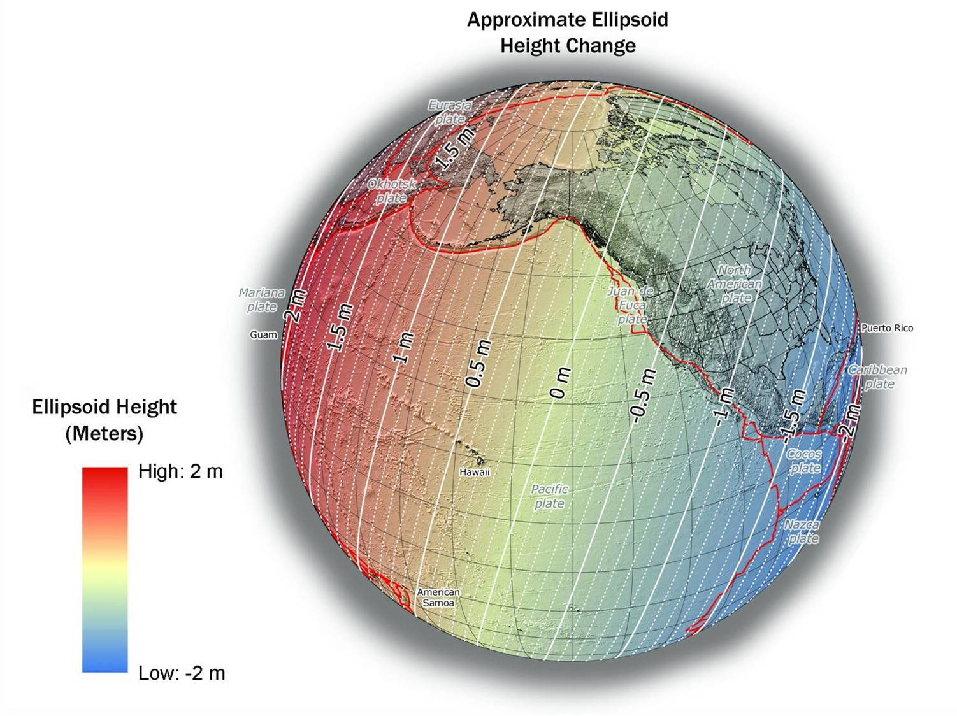
~ -0.9 meters in IA
NAD 83(2011) to IGS08 at epoch 2022.0
Notes:
NGS has not yet determined the co-definitional epoch between IGSxx and the four TRFs. The epoch 2022.0 is for reference purposes only, and does not constitute a policy choice at this time

Slide 18
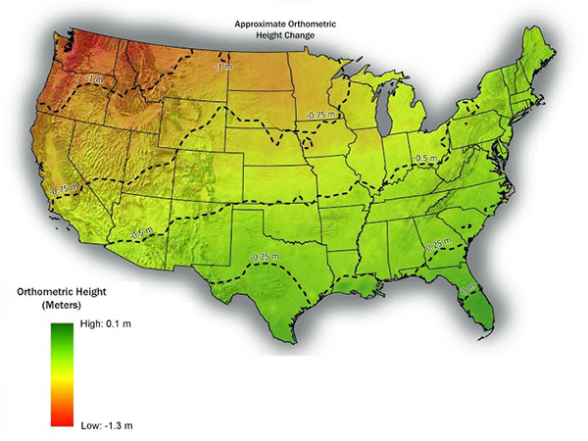
~ -0.75 meters in IA
NAVD88 to NAPGD2022

Slide 19
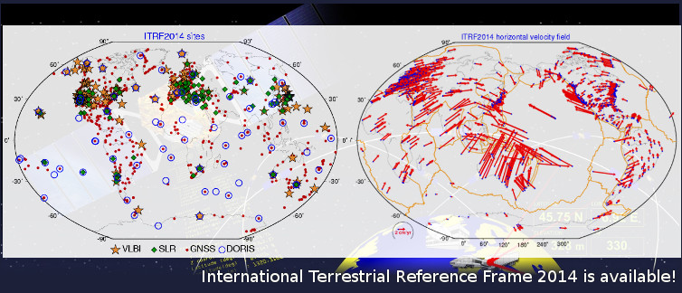
ITRF is now mature – worldwide research sites

Slide 20
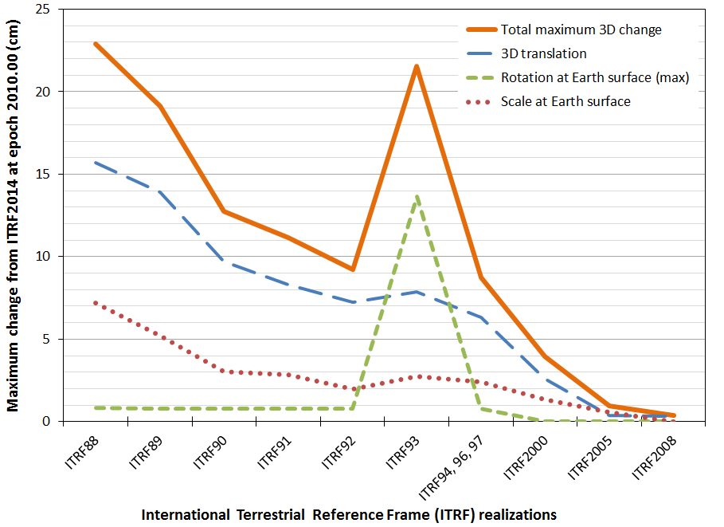
ITRF is now mature – smaller changes each epoch
ITRF2014

Slide 21
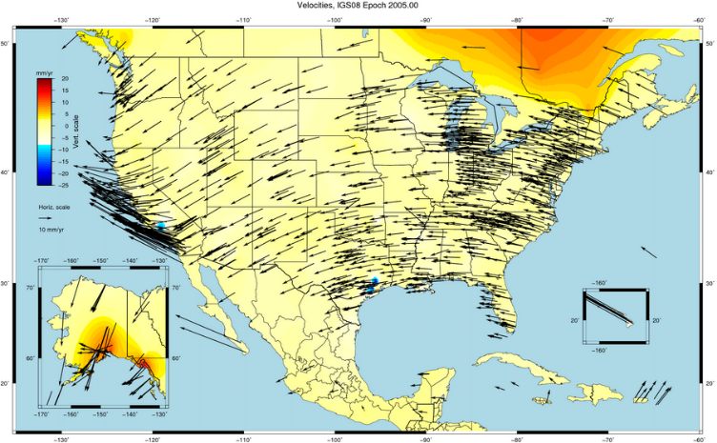
NAD 83 is not ITRF
GPS & WAAS navigation uses WGS84, aligned to ITRF
satellite orbits and other geospatial datasets use global frames
our TRFs will agree with ITRF (specifically, IGSyy) at the initial epoch
our TRFs will diverge from ITRF by a few cm each year to stay “plate-fixed”
  difference is a simple Euler plate rotation
  many areas will diverge further, as no plate is perfectly rigid
plate-fixed or ITRF-fixed; can’t have both

Slide 22
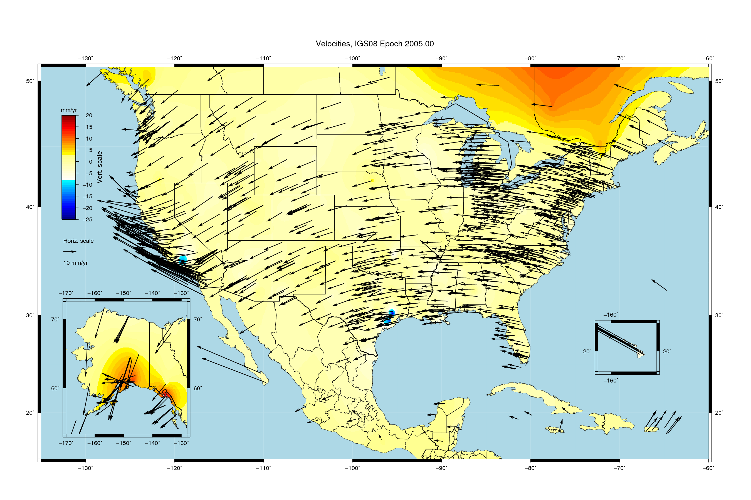
Velocities, relative to IGS08 epoch 2005.00

Slide 23
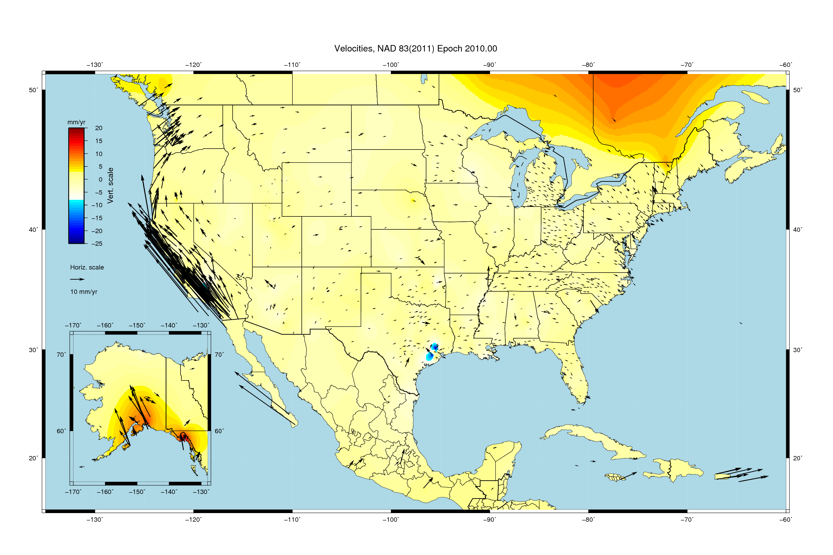
Velocities, relative to NAD83(2011) epoch 2010.00

Slide 24
NAD 83 “versions”
NAD 83 (1986)
NAD 83 (HARNs)
NAD 83 (FBNs)
NAD 83 (NSRS)
NAD 83 (2011)
NAD 83 (PA11)
NAD 83 (MA11)
Replace with 4 plate-fixed frames
  North America
  Caribbean
  Pacific
  Marianas

Slide 25
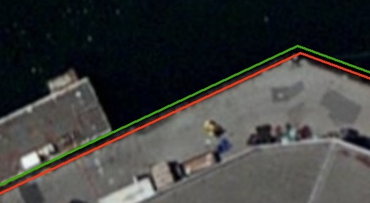
Everything must shift
RED: NAD 83 coastline against NAD 83 imagery
GREEN: Coastline shifted into NATRF2022 but
the imagery remains on NAD 83

Slide 26
Summary: The NSRS in 2022…
Four semi-dynamic reference frames
Geoid/GPS based vertical datum
All data will be time tagged
All coordinates will come from GNSS surveys

Slide 27
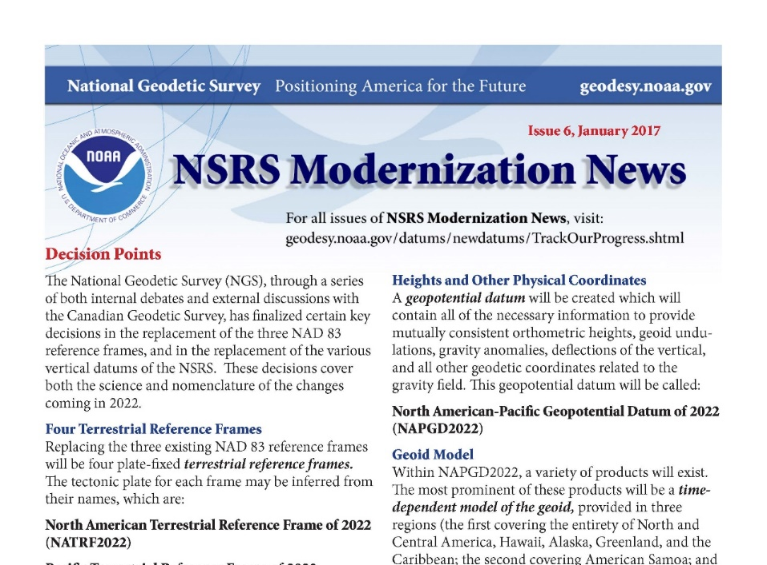
Customer Concerns
https://geodesy.noaa.gov/datums/newdatums/
✓
✓
control shouldn’t move!
a national terrestrial reference frame should minimize velocities, even if that means drifting away from ITRF/WGS84 over time.
don’t make us think!
provide vendor- and user-friendly transformation tools with modern programming
modernize datasheets and bluebooking
tell us more!
more updates, training, & tutorials
a formal publication describing the differences between NAD 83 / NAVD 88 and the new reference frames
help with legislation
NSPS distribute sample language to update state legislation that references NAD 83
✓
✓
Subscribe for email notifications
Notes:
These high-level issues were all brought up in multiple presentations from our stakeholders at the Summit.
They are consistent with what is included in the Summit Report.
There were many other items that each stakeholder brought up that were more unique to his or her particular organization.

Slide 28
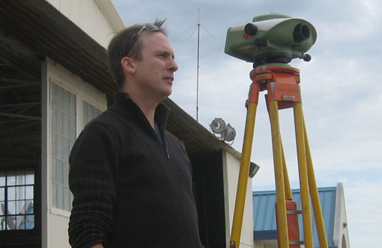
Some recent decisions:
Names and Blueprints
by
Dru Smith
NSRS Modernization Manager
NOAA’s National Geodetic Survey

Slide 29
New Names
The Old:
NAD 83(2011)
NAD 83(PA11)
NAD 83(MA11)
The New:
The North American Terrestrial Reference Frame of 2022
(NATRF2022)
The Caribbean Terrestrial Reference Frame of 2022
(CATRF2022)
The Pacific Terrestrial Reference Frame of 2022
(PATRF2022)
The Mariana Terrestrial Reference Frame of 2022
(MATRF2022)

Slide 30
New Names
  The Old:
  NAVD 88
  PRVD 02
  VIVD09
  ASVD02
  NMVD03
  GUVD04
  IGLD 85
  IGSN71
  GEOID12B
  DEFLEC12B
Orthometric
Heights
  The New:
  The North American-Pacific Geopotential Datum of 2022 (NAPGD2022)
  - Will include GEOID2022
Normal
Orthometric
Heights
Dynamic
Heights
Gravity
Geoid
Undulations
Deflections of
the Vertical

Slide 31
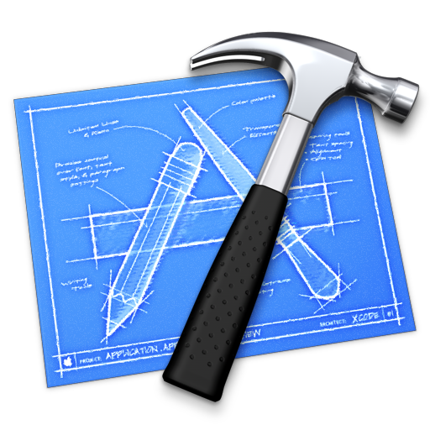
Scientific Decisions
Blueprint for 2022, Part 1: Geometric
  Four plate-fixed Terrestrial Reference Frames
    And what “plate fixed” means
  Mathematical equation between IGS and TRFs
    Plate Rotation Model for each plate
    Coordinates at survey epoch
  Intra-frame velocity model
    To compare coordinates surveyed at different epochs
Other Blueprints:
We are finalizing NOAA Technical Report NOS NGS 64, “Blueprint for 2022, Part 2: Geopotential Coordinates,” for an August 2017 release. The document describes the year 2022 replacement of all vertical datums and other NSRS geopotential quantities. It will serve as a companion document to NOAA Technical Report NOS NGS 62, “Blueprint for 2022, Part 1: Geometric Coordinates,” released in March of this year. Work has begun on Part 3 to address the re-invention of Bluebooking

Slide 32
Replacing the NAD 83’s
Three plate-(pseudo)fixed frames will be replaced with four plate-fixed reference frames
  N. Amer., Pacific, Mariana, Caribbean(new!)
Remove long-standing non-geocentricity of NAD 83 frames
All four : identical to IGSxx at a TBD epoch
  2020.00?
All four : differ from IGSxx by plate rotation only
  Updated Euler Pole determination for rigid plate only

Slide 33
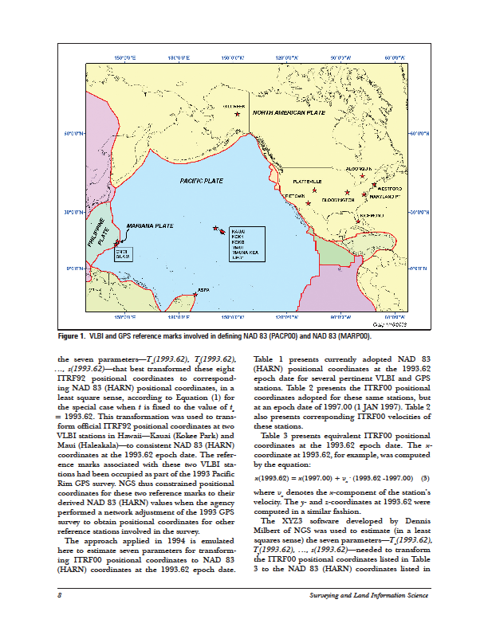
Four Frames/Plates in 2022
NATRF2022
MATRF2022
CATRF2022
PATRF2022
Image from Snay 2003

Slide 34
Each frame will get 3 parameters
Euler Pole Latitude
Euler Pole Longitude
Rotation rate (radians / year)
This will be used to compute
time-dependent NATRF2022
coordinates from time-dependent
IGS coordinates.
North American Plate rotates CCW around its Euler Pole
EULER Pole

Slide 35
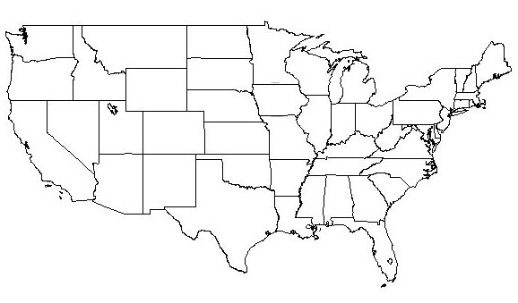
NATRF2022 frame is rigid and fixed to rigid part of the N.A. plate
Non-rigid part of the N.A. plate
(deformation area)
Rigid part of the N.A. plate

Slide 36
NATRF2022 coordinates over time
(Remember: The NATRF2022 frame is rigid)
Point on deforming part of plate
Point on rigid part of plate
λ
λ
EAST LONGITUDE
EAST LONGITUDE
t
TIME
t
TIME

Slide 37
NATRF2022 coordinates over time
(Remember: The NATRF2022 frame is rigid)
Point on deforming part of plate
Point on rigid part of plate
λ
λ
EAST LONGITUDE
EAST LONGITUDE
t
t

Slide 38
NATRF2022 coordinates over time
(Remember: The NATRF2022 frame is rigid)
Point on deforming part of plate
Point on rigid part of plate
λ
λ
EAST LONGITUDE
EAST LONGITUDE
t
t

Slide 39
NATRF2022 coordinates over time
(Remember: The NATRF2022 frame is rigid)
Point on deforming part of plate
Point on rigid part of plate
λ
λ
EAST LONGITUDE
EAST LONGITUDE
t
t

Slide 40
Intra-frame velocities
This is the velocity of the
point in NATRF2022.
Rotation of plate removed.
It is not constant because
the point still suffers small
“intra-frame” velocities.
Such IFVs will be captured
in a model by NGS.
This is the velocity of the
point in ITRF. Includes all
movements, but the
dominant one is the
rotation of the N.A. Plate.

Slide 41
Scientific Decisions!!
Blueprint for 2022, Part 2: Geopotential
  Global 3-D Geopotential Model (GGM)
    Will contain all GRAV-D data
    Able to yield any physical value on/above surface
  Special high-resolution geoid, DoV and surface gravity products consistent with GGM
    Not global: NA/Pacific, American Samoa, Guam/CNMI
  Time-Dependencies
    Geoid monitoring service
      Impacts of deglaciation, sea level rise, earthquakes, etc

Slide 42
Blueprint for 2022
Part 1: Geometric – now available April 2017
Part 2: Geopotential – coming soon, Summer 2017
Part 3: Bluebooking
NOAA Technical Report NOS NGS 62 Blueprint for 2022, Part 1: Geometric Coordinates
https://geodesy.noaa.gov/PUBS_LIB/NOAA_TR_NOS_NGS_0062.pdf

Slide 43
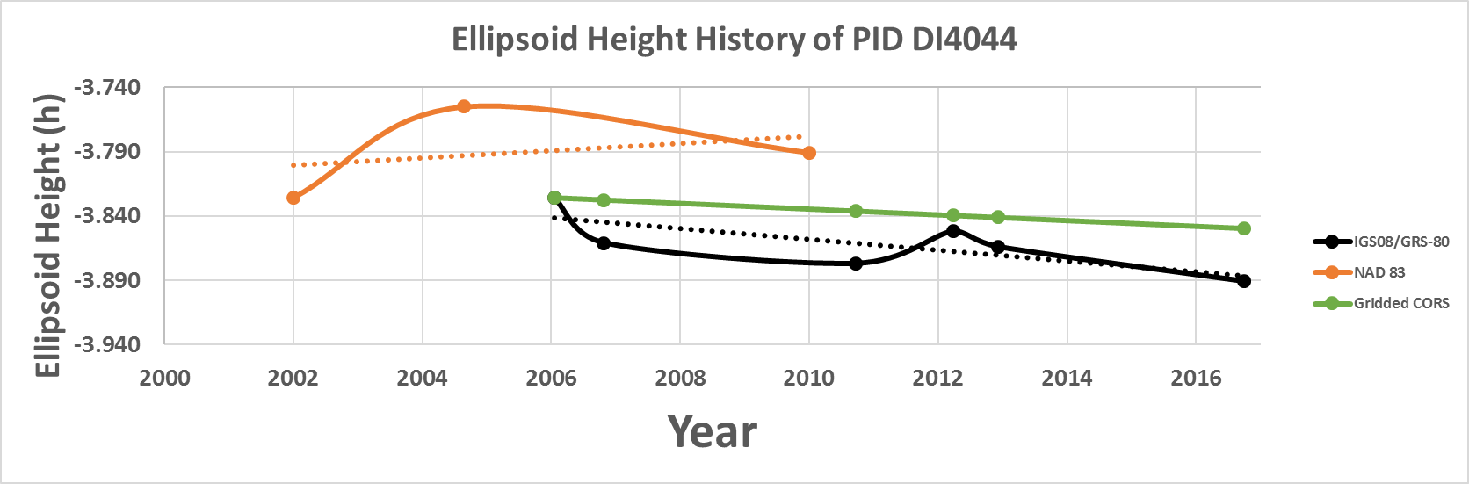
Time-Dependencies as a service:
NATRF2022 and actual survey epochs
NAD 83 forcibly combined data spanning many years (using HTDP with no vertical modeling) to compute and find one height at one epoch.
NATRF2022 will compute coordinates at survey epoch to show actual motion.
Even gridding surrounding CORS yields better subsidence rates than you have today.
NAD 83 best estimate of dh/dt: +2.8 mm / year
NATRF2022 best estimate of dh/dt: -4.2 mm / year
CORS best estimate of dh/dt: -2.2 mm / year
Notes:
Potential outline and speaker assignments; can be adjusted as needed.

Slide 44
Change and Preparedness

Slide 45
SHIFTS: 1.25 meters N&W x 0.75 meters VERT
Changes in Lat/Lon/EllHT and OrthoHt not negligible
Systematic shift over local areas
Paper maps – at scale of 1”=100 feet, change = 0.04” (1 mm)
  So, overlays of old and new data may be a concern.

Slide 46
Databases and Software
Many databases were designed with coordinate conversions in mind, but not all.
Some cannot handle datum conversions, even if they handle coordinate conversions.
NGS will release NCAT to assist in managing datum and coordinate conversions.
  How big are your datasets?
Will your software be ready to handle a new datum?

Slide 47

Client and Employee Education
Many clients and employees may not understand what datums are.
NGS has resources available to help explain the concepts.
Prepare handouts.
Teach up the organization.
see Educational Videos

Slide 48
Correct and Current Metadata
There are many existing data sets that lack correct and current metadata.
Now would be a good time to inventory and update/correct any such records in your possession.
A clever practitioner could search the metadata record in Section 4:
  FGDC section 4.1.4.1 Horizontal Coordinate System Definition
If metadata are correct, then some softwares can convert on-the-fly to desired coordinate system.

Slide 49
Laws and Rules
Many states embody requirements for datums in state law or agency rules.
These requirements will need changing in order for transition to new datums.
Work with Legislative Committee and others, refer to NSPS Model Legislation
State | NAD83 | NAD27 | NAVD88 | NGVD29 | SPCS27 | SPCS83
Iowa | x |  |  |  |  | x
Minnesota | x | x |  |  | x | x
North Dakota | x | x |  |  | x | x
Nebraska | x |  |  |  |  | x
South Dakota | x | x |  |  | x | x
50 State TOTALS | 45 | 33 | 2 | 5 | 30 | 43

Slide 50
Plan for the Future
National Geodetic Survey has created a working group specifically for this task.
Working with partners from
  National Society of Professional Surveyors
  American Association of Geodetic Surveying
The NSPS/AAGS/NGS Advisory Committee on NSPS Legislation has produced this flyer - - >
https://www.ngs.noaa.gov/datums/newdatums/nad-83_state-plane-leg-coord_flyer.pdf

Slide 51


Slide 52
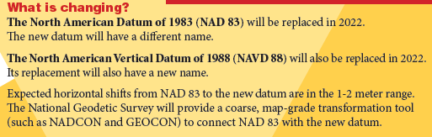
Plan for the Future
The flyer states the following major points:
  NAD83 and NAVD88 will be replaced.
  the new datums will have different names.

Slide 53

Plan for the Future
The flyer states the following major points:
  State laws will not reflect the new names – unless the laws are changed!

Slide 54
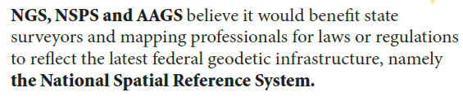
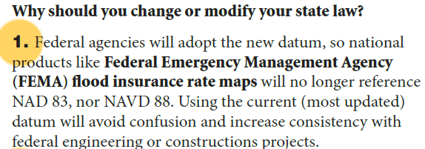
Plan for the Future
The flyer recommends that the laws be changed because 3 important reasons:

Slide 55
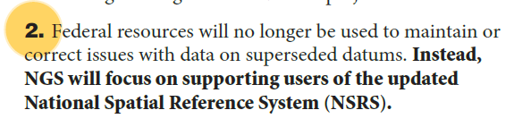
Plan for the Future
The flyer recommends that the laws be changed because 3 important reasons:

Slide 56
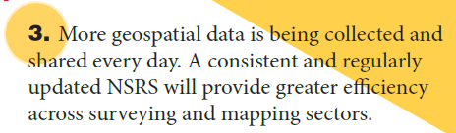
Plan for the Future
The flyer recommends that the laws be changed because 3 important reasons:

Slide 57
How to Plan for the Future
Move to newest realizations
  NAD 83(2011) epoch 2010.00
  USGG12 (gravimetric geoid) / GEOID12B (hybrid geoid)
Obtain precise ellipsoid heights on NAVD 88 bench marks (GPS on BM via OPUS-SHARE, contact NGS Geodetic Advisor)
  Improves hybrid geoid models and provides “hard points” in new vertical datum
  Follow new NGS Guidelines when released
Move off of NGVD 29 to NAVD 88
  Understand the accuracy of VERTCON in your area
Move away from passive marks to GNSS
  Especially move off of classical passive control
Require/provide complete metadata for all mapping contracts
  How did they get the positions/heights? Document it!!

Slide 58
Recommendations
Horizontal/Geometric and Vertical/Geopotential datums should be defined the same way in the Federal Register Notice and in State Legislation
    New wording “National Spatial Reference System”
NSPS will take the lead in disseminating model language.
    Model language is now available
The "Advisory Committee on National Spatial Reference System Legislation" has been working on a template, with the intent that such a template will serve as a consistent foundation for each state and territory to modify their existing legislation. Further, the intent is that the language so adopted will be general enough to specify the use of the NSRS while not relying on the name of one specific datum, thus (hopefully) eliminating the need to update state or territory laws in the foreseeable future.

Slide 59
Future of Coordinate Systems
When NGS releases NAD2022, there will be impacts on what to do with State Plane Coordinate Systems.
As in the NAD27 to NAD83 changeover, states told NGS what they wanted to see happen.
Nebraska, Montana, South Carolina wanted single zone.
Most wanted to retain defining parameters
But, most wanted a shift in Nb and Eb to avoid confusion.
Most wanted to retain county-by-county zonal assignments.
LDP discussions

Slide 60
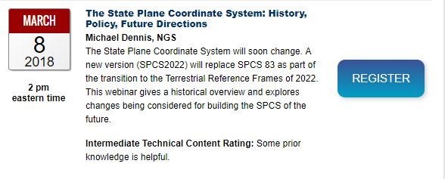
SPCS2022 Webinar
Webinar on State Plane Coordinates on March 8, 2018 by Michael Dennis
https://geodesy.noaa.gov/web/science_edu/webinar_series/Webinars.shtml

Slide 61
Homework Assignment
I strongly urge survey leaders to carefully read:
  NOS 2 NAD83 Report, by Charles R. Schwartz, 1989. Chapter 21 – User Participation and Impact on pages 237-247
  NOAA Manual NOS NGS 5, State Plane Coordinate System of 1983, by James E. Stem, 1989, pages 1-12
Discuss impacts of new datum on mapping activities, legislation to enable, desired changes to SPCS, and action plan to implement.
Work with local surveying and mapping leaders (NSPS, NDSPLS, NDDOT) and NGS Advisor.

Slide 62
Questions
David Zenk PE LS
Geodesist, National Geodetic Survey
Northern Plains Regional Advisor
MN, ND, SD, NE, IA
University of Minnesota, Geography Department
414A Social Sciences Building
267 19th Ave S
Minneapolis, MN 55455
763-600-6912 office
612-414-9522 mobile
dave.zenk@noaa.gov (federal business)

