Slide 1



New Datums Update
What you need to know…..With only FOUR Years to go
Maryland Society of Surveyors
October 21, 2022
Dan Martin
Northeast Regional Geodetic Advisor
ME, NH, VT, MA, CT, RI, NY, NJ
Dan.martin@noaa.gov
240-676-4762

Slide 2
What I am Covering Today
Delay / Updated Timeline
Refresher
Shift and Drift
EPP2022 and IFDM2022
Reference epoch coordinates (RECs) and survey epoch coordinates (SECs)
Other New Types of Coordinates
Use Cases: Using the modernized GNSS

Slide 3
What I am not Covering
What is…
NGS and its mission
The NSRS
Bluebooking
GRAV-D
ITRF
Why we are modernizing
All of these topics have been covered extensively in multiple forums in the last few years

Slide 4
Bottom Line, Up Front
If you do geospatial work in the USA…
and you work in the National Spatial Reference System..
every product you’ve ever made…
every survey…
every map…
every lidar point cloud…
every image…
every DEM…
WILL have outdated coordinates on it in the next few years.
Let’s talk about what this means, why it is happening, and how it will affect things going forward

Slide 5
What is BP3?
BP3 is a companion to BP1 (geometric) and BP2 (geopotential), both released in 2017 and updated in 2021
It is about “re-inventing bluebooking”
It’s about how NGS will provide the frames/datum in the future
It’s about how YOU will use the frames/datum in BP1 and BP2

Slide 6
Timeline
In 2007, NGS assumed we would be done by 2018
By 2013, a finish of 2022 seemed correct
By 2020 four issues derailed that date:
Government shutdowns
Final clarity on the complexity of the task
Loss of personnel without backfill
“2020”
In June 2020, NGS issued a “delay” message that the modernized NSRS would not be released in 2022
Actual date? Estimated to be mid-2025

Slide 7
Modernizing the NSRS means…
Replacing NAD 83 Blueprint for the Modernized NSRS, Part 1
Replacing NAVD 88 Blueprint for the Modernized NSRS, Part 2
Re-inventing Bluebooking
Improving the Geodetic Toolkit Blueprint Part 3
Better Surveying Methodologies

Slide 8
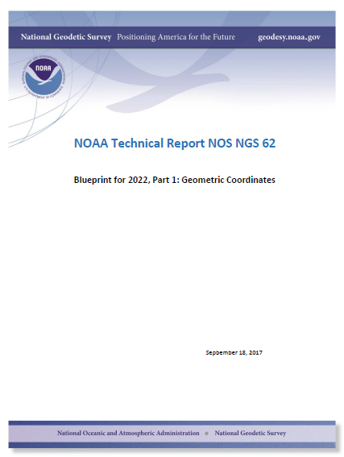
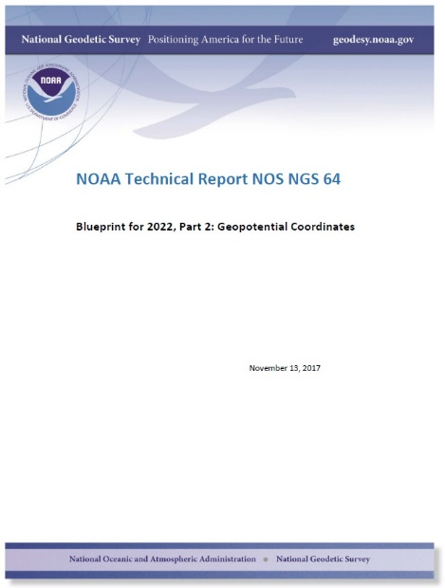
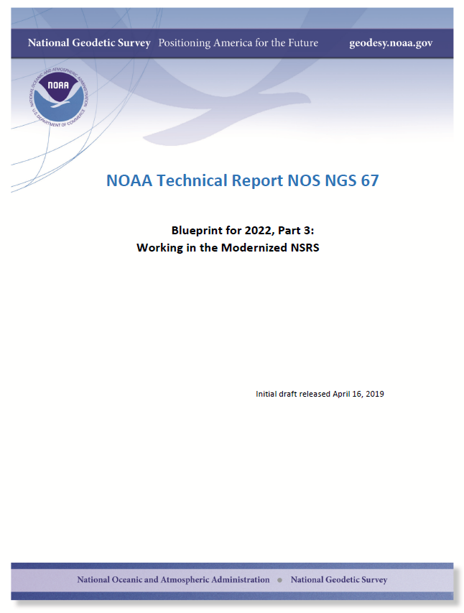
Modernizing the NSRS
The “blueprint” documents: Your best source for information
Geometric:
Sep 2017
Updated Apr 2021
Geopotential:
Nov 2017
Updated Feb 2021
Working in the
modernized NSRS:
Apr 2019
Updated Feb 2021

Slide 9
Names
The Old:
NAD 83(2011)
NAD 83(PA11)
NAD 83(MA11)
The New:
The North American Terrestrial Reference Frame of 2022
(NATRF2022)
The Caribbean Terrestrial Reference Frame of 2022
(CTRF2022)
The Pacific Terrestrial Reference Frame of 2022
(PTRF2022)
The Mariana Terrestrial Reference Frame of 2022
(MTRF2022)

Slide 10
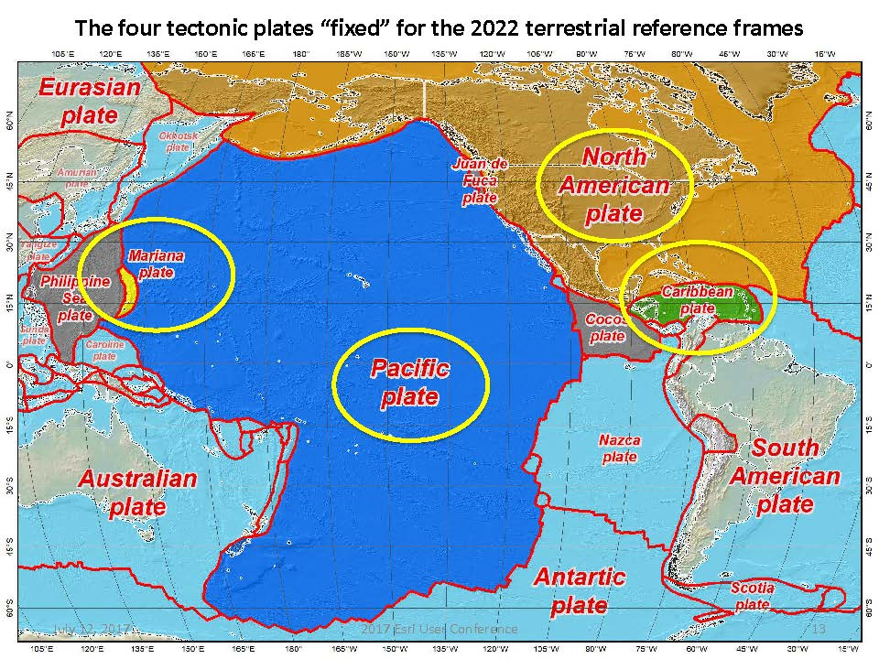
Notes:
-there’s four reference frames because there are four major tectonic plates within the NGS Area of Responsibility.
-As the National Geodetic Survey, we’re part of the DoC so we must cater to all US States and Territories
-thus we’ve got four tectonic plates in our Area of Operations, so four Ref Frames
-But…

Slide 11
Shift
One of the two major changes you’ll see in the modernized NSRS is a shift in coordinates
Latitude, Longitude, Ellipsoid Height: -2 to +4 m
Non-egocentricity of NAD 83
Orthometric Height: -0.5 to +2 m
Bias and tilt in NAVD 88
Other shifts will occur in non-CONUS, non-Alaska regions of the USA

Slide 12
Two types of drift
Tectonic Plate Rotation
horizontal
Everything Else
residual motions left after rotation
regional linear motions
localized subsidence or uplift
simple to model
complex
Notes:
-there’s two types of drift you’ll see

Slide 13
Tectonic Plate Rotation
Horizontal
simple to model
Euler Pole Parameters
of 2022
EPP2022
Notes:
-there’s two types of drift you’ll see

Slide 14
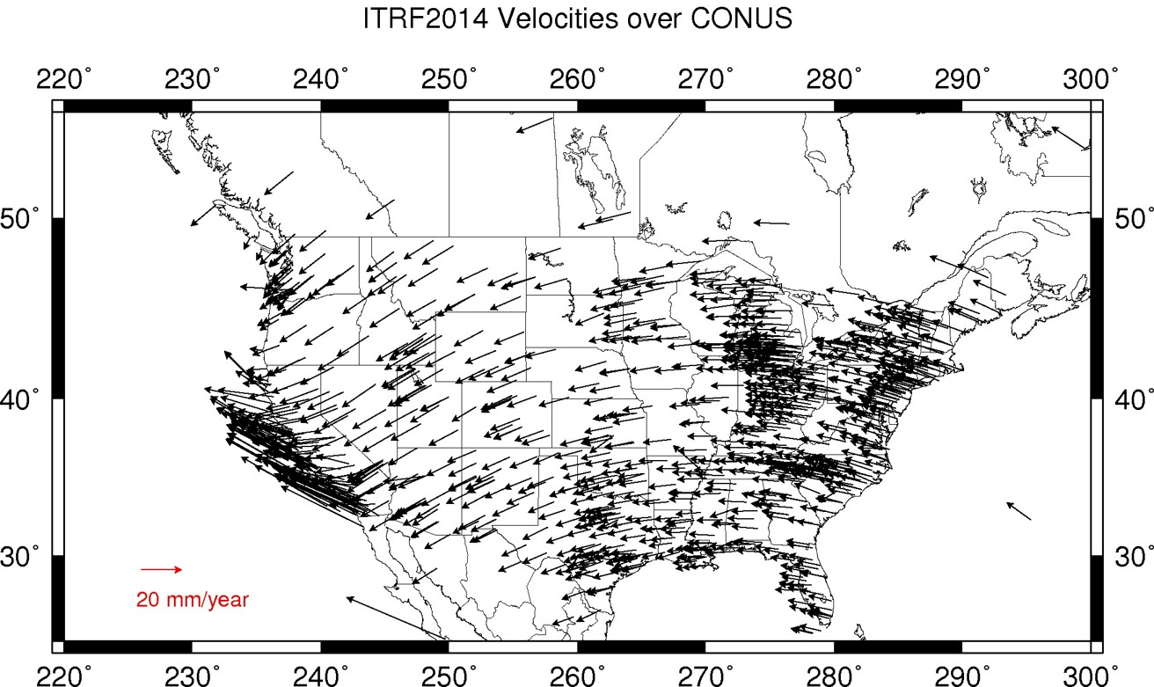
Plate Rotation visualized
Drift…
Notes:
-these are ground-level horizontal velocities
-the arrows illustrate the positions and velocities of CORS plotted in ITRF2014
-our scale is on the left there, with that arrow representing 20mm of motion per year
-so right thru Ohio it’s a little cluttered but we’re seeing arrows about that length so about 2cm/20mm per yr
-what do we notice about the direction of these arrows?
-they look rotational, don’t they?
CLICK HERE
-Note the arrows in California do not conform to the rotation… those are CORS on a different PLATE which is moving in a different direction
CLICK HERE
-so when you look at those arrows you can see the rotation, but the point of rotation is obviously off the map, way down below the screen right?
-that point is what’s known as an Euler Pole

Slide 15
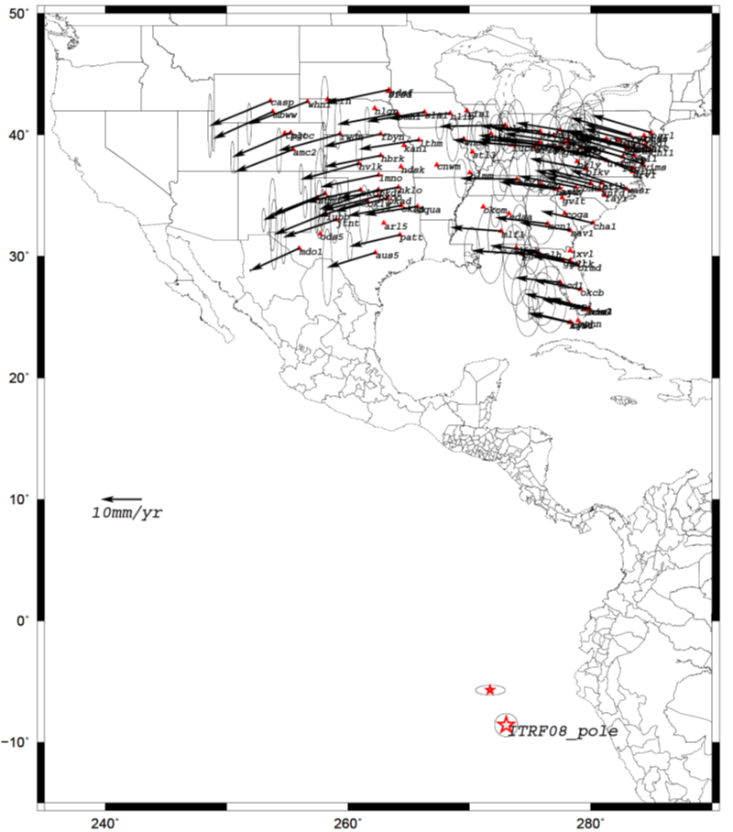
Euler Poles and “Plate-Fixed”
In the ITRF, many tectonic plates have a dominant motion: rotation
Euler Pole - point about which a plate rotates (yellow star)
Euler Pole Parameters
Lat
Lon
Rotation Rate
NATRF2022 Euler Pole
Notes:
We say “NATRF2022” is “fixed” to the N.A. Plate, making it a “plate fixed” frame
-the frame is constant to itself, but rotating within ITRF, and moving in a different direction than the other 3 frames

Slide 16
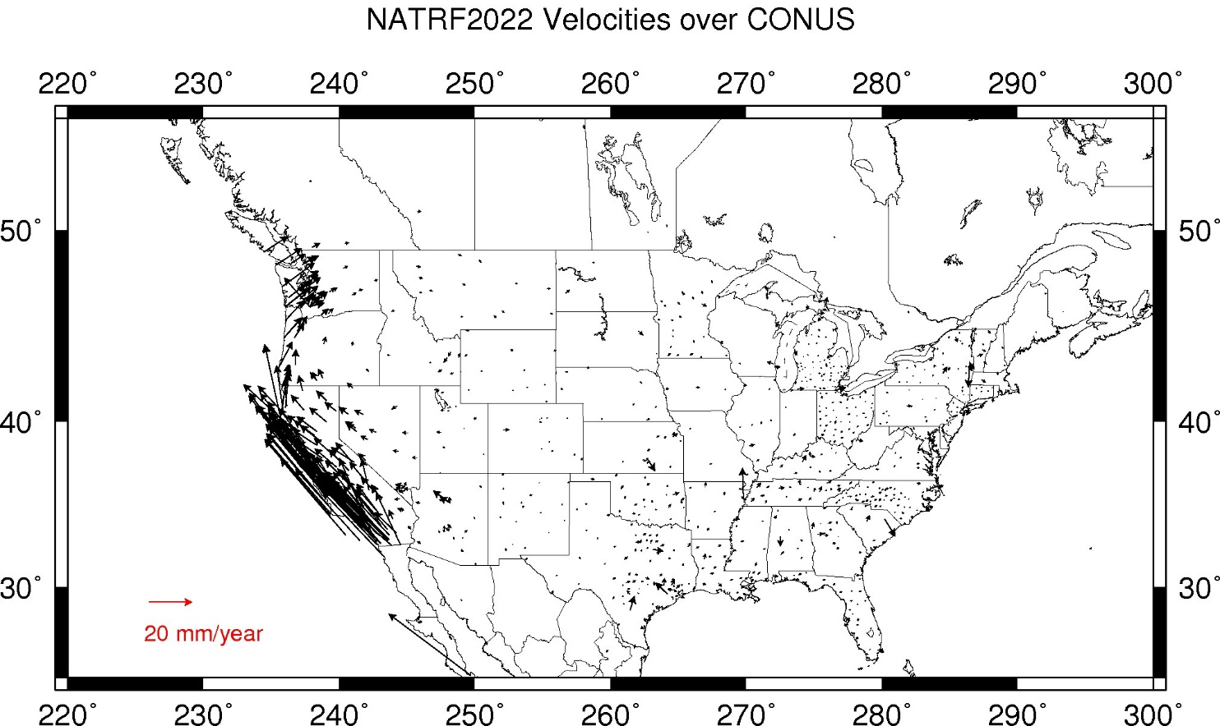
CORS Velocities in NATRF2022
Think of this map as ITRF2020 + EPP2022
Still SomeDrift…
Notes:
These velocities the motion that is left after removing Euler Pole rotation via it’s defining parameters, known simply as Euler Pole Parameters or EPP
These small bare visible arrows in our region are residual velocities leftover after modeling that Euler pole, which will then be modeled into the IFVM for NATRF2022.

Slide 17
ITRF2020 + EPP2022 = --TRF2022
Rotation of the
North American Plate
The North American Terrestrial Reference Frame of 2022
(NATRF2022)
The Caribbean Terrestrial Reference Frame of 2022
(CATRF2022)
The Pacific Terrestrial Reference Frame of 2022
(PATRF2022)
The Mariana Terrestrial Reference Frame of 2022
(MATRF2022)
Rotation of the
Caribbean Plate
ITRF2020
Rotation of the
Pacific Plate
Rotation of the
Mariana Plate
EPP2022
Notes:
-So it all starts with ITRF
-OPUS is already running all your processing in ITRF, take a look at one of your recent solution reports and you’ll see ITRF2014 coordinates on the right hand side (or IGS/IGb08)
-Not just North America, Each plate gets a set of EPP associated with it, as each plate is rotating around a different Euler Pole

Slide 18
The wrong question, circa 2025:
“What’s the position of that point?”
The right question, circa 2025:
“What’s the position of that point, on some specific date?”
Drift…
Notes:
-why??
-because of that word down there: drift

Slide 19

What are we trying to say??

Slide 20
Euler Poles and “Plate-Fixed”
ITRF
Frame = constant
NA Plate = rotating
NATRF
Frame = rotating
(relative to ITRF)
NA Plate = constant
(relative to NATRF2022)
Notes:
We say “NATRF2022” is “fixed” to the N.A. Plate, making it a “plate fixed” frame
-the frame is constant to itself, but rotating within ITRF, and moving in a different direction than the other 3 frames

Slide 21
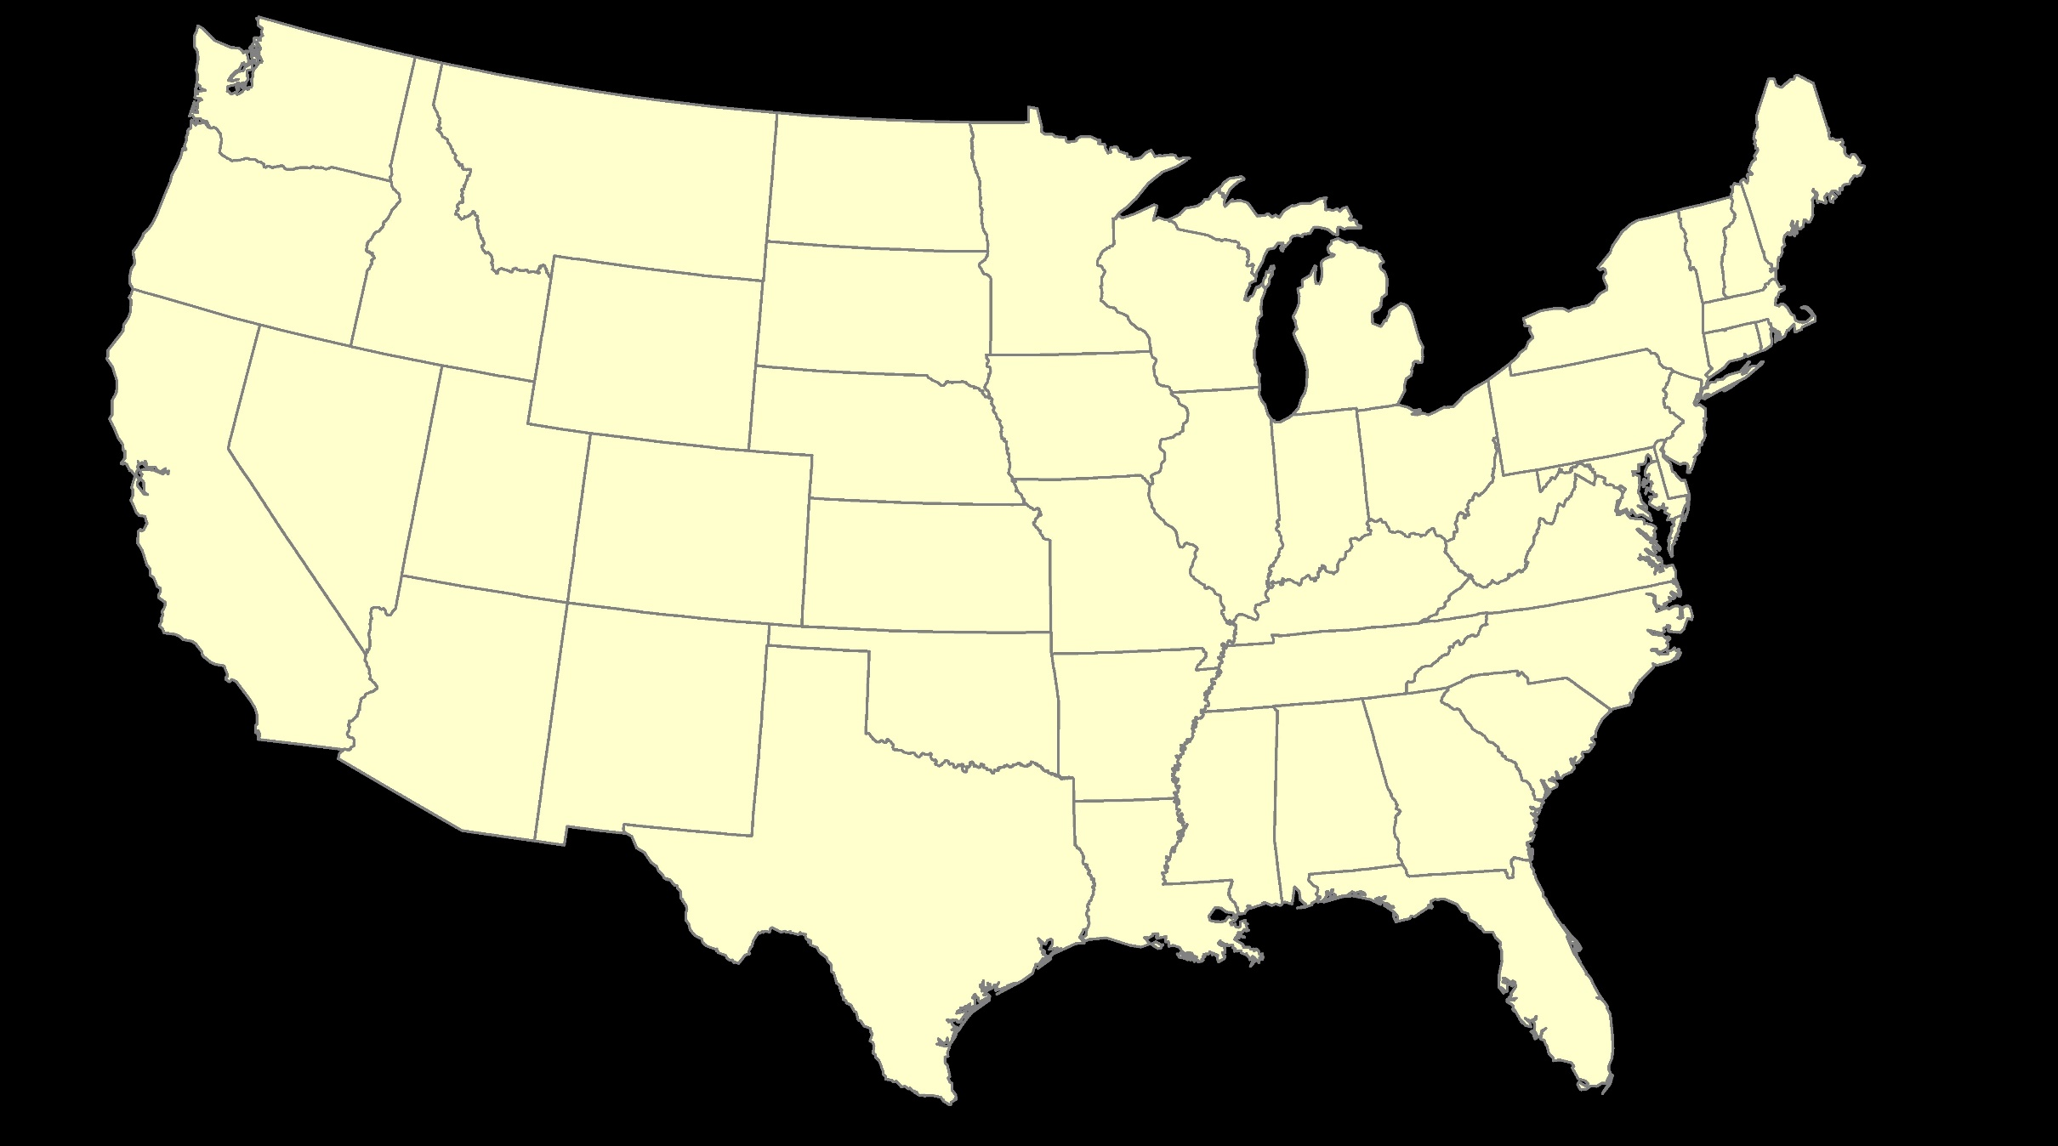
ITRF – constant frame, rotating plate

Slide 22
“Plate-Fixed”
NATRF – rotating frame, constant with plate

Slide 23
ITRF or NATRF – your choice, just use EPP

Slide 24
CORS Velocities in NATRF2022
Think of this map as ITRF2020 + EPP2022
Still SomeDrift…
Notes:
These velocities the motion that is left after removing Euler Pole rotation via it’s defining parameters, known simply as Euler Pole Parameters or EPP
These small bare visible arrows in our region are residual velocities leftover after modeling that Euler pole, which will then be modeled into the IFVM for NATRF2022.

Slide 25
Two types of drift
Tectonic Plate Rotation
horizontal
Everything Else
residual motions left after rotation
regional linear motions
localized subsidence or uplift
simple to model
complex
Notes:
-there’s two types of drift you’ll see

Slide 26
Everything Else
residual motions left after rotation
regional linear motions
localized subsidence or uplift
Still SomeDrift…
complex
Notes:
-there’s two types of drift you’ll see

Slide 27
Intra-Frame Deformation Model of 2022
IFDM2022
Formerly known as Intra-Frame Velocity Model
IFVM2022

Slide 28
Concept of goal of IFDM
Longitude (Easting) History of DI4044
Trend: -1.7 mm / year
RED IS NATRF2022
COORDINATE
Still Some Drift…
Trend: -14.3 mm / year
BLUE IS ITRF COORDINATE
2004 2006 2008 2010 2012 2014 2016 2018
Notes:
First look at that blue line, that is the velocity of DI4044 if we graph it’s easting coordinate in ITRF over 10+ years.
So look at the reddish line, that’s the longitude/easting of PID DI4044 after the EPP (rotation) is modeled and factored in, but before the IFVM is applied.
This is the velocity of the point in NATRF2022
Rotation of plate removed. It is not constant because the point still suffers small “intra-frame” velocities.
Such IFVs will be captured in a model by NGS.
The intent of the IFVM is to remove even that movement to better support coordinate comparisons, etc.

Slide 29
Shift and Drift: Summary
Shift
Drift
When?
Why?
How much?
Who?
Once, at rollout
Correcting systematic errors in the current datums
Decimeters-to-meters of one-time immediate coordinate changes
Will affect everyone
Impact will grow as time goes on
Embracing the dynamic planet upon which we live
Centimeters of persistent annual coordinate changes (plus potential meter-level jumps from earthquakes)
Can mostly be ignored or mitigated through NGS’s creation of plate-fixed frames and reference epoch coordinates

Slide 30
EPP2022 – Euler Pole Parameters – Simple Rotation
Three parameters: lat, lon, rotation speed
Horizontal only: just latitude and longitude
Changes the frame: ITRF2020 + EPP2022 = NATRF2022
Does not change the epoch
IFDM2022 – Intra-Frame Deformation Model - Complex
Complex set of parameters
Residual horizontal motion: all the motion leftover after Euler Pole rotation plus any local/regional motions
All vertical motion: localized subsidence or uplift
Changes the epoch
Does not change the frame: “intra” = on the inside; within

Slide 31
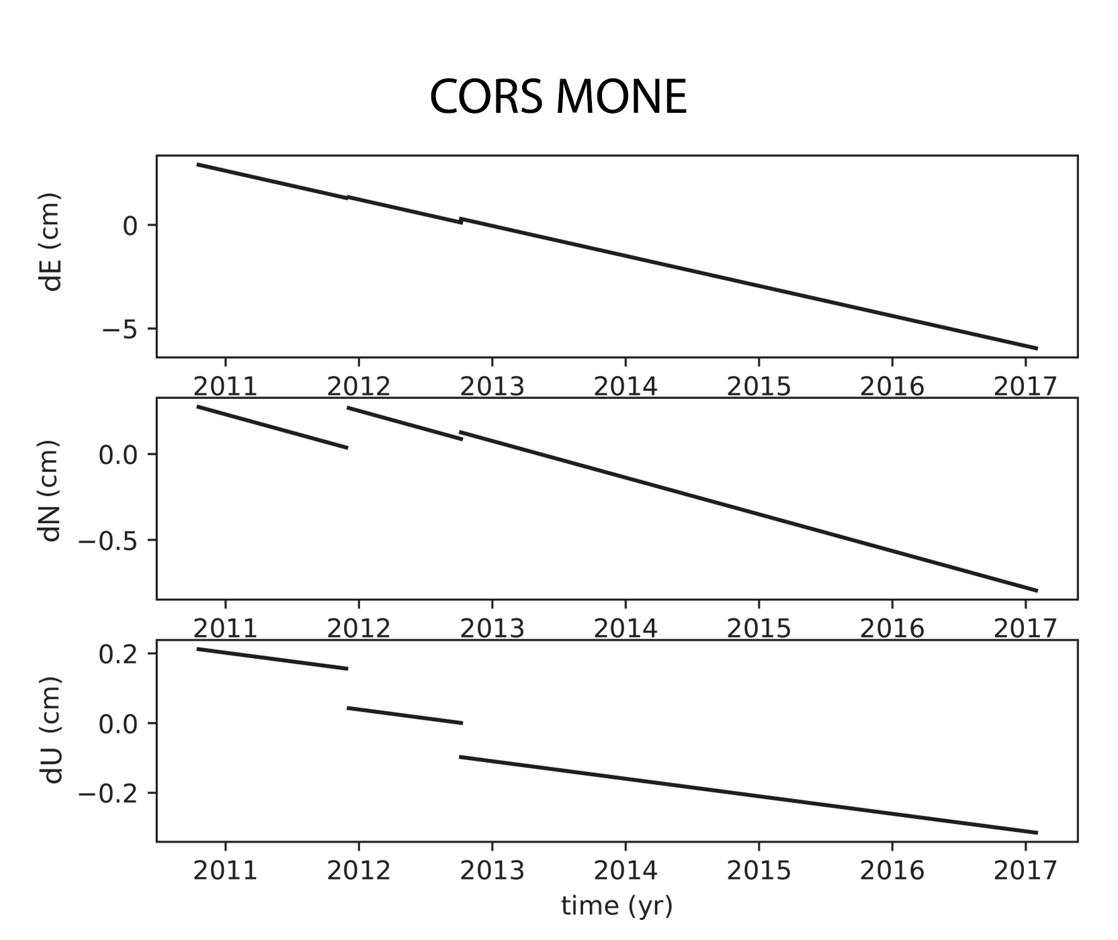
New Types of Coordinates
Active
Coordinate functions in time, generated by NGS, and not associated with a specific epoch. As these coordinates are computed by NGS (or adopted by NGS) they are considered “part of the NSRS”.
Generally will only be available at each CORS
Also being called the coordinate function
Which will be generated by a “fit” to daily processed data

Slide 32
New Types of Coordinates - A two-track approach to coordinates
Reference Epoch Coordinates
Survey Epoch Coordinates
An estimated “snapshot” of the entire network
Every 5 or 10 years
Similar to NAD 83(2011) epoch 2010.00
Answers: what were a mark’s coordinates when it was last surveyed?
Multiple SECs can show changes over time

Slide 33
Other New Types of Coordinates
Reported
“Coordinates directly reported to NGS without the data necessary for NGS to replicate or evaluate them. These coordinates are neither ‘part of the NSRS’ nor ‘tied to the NSRS.’”
Scaled from a map
Transformed using NCAT or VDatum
Smartphone
Reported directly from an RTK rover without data files
Notes:
These are coordinates directly reported to NGS without the data necessary for us to replicate or evaluate them.

Slide 34
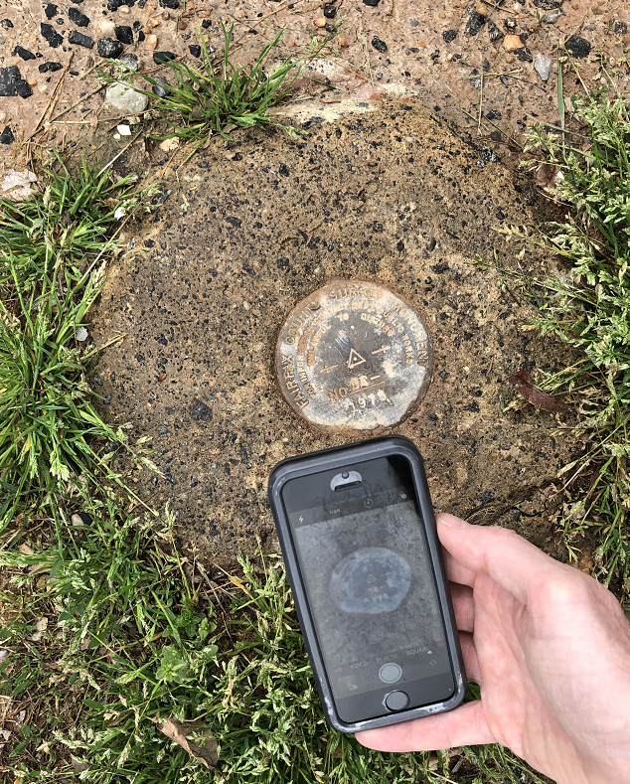
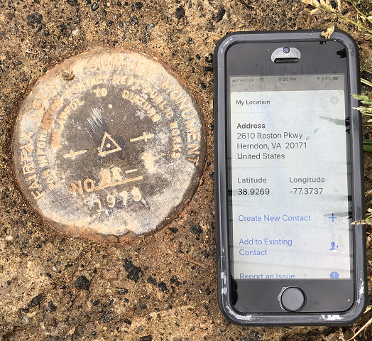
Reported Coordinates

Slide 35
New Types of Coordinates
OPUS
“Coordinates computed by OPUS that have not been evaluated by anyone at NGS. As these coordinates are not computed by NGS they are not considered “part of the NSRS.” However, if NGS-provided OPUS recommendations are followed, they may be ‘tied to the NSRS.’ ”
User-computed values, such as they might get today from either OPUS-S or OPUS Projects
“OPUS” coordinates are the only coordinates a user will get directly from OPUS
NGS will not evaluate your OPUS coordinates!

Slide 36
New Types of Coordinates
OPUS coordinates may also come with the label “tied to the NSRS”
Only if a user restricts their computations to OPUS-recommended constraints
Users who deviate from OPUS-recommended constraints can still perform computations and will get OPUS coordinates, but they will not be “tied to the NSRS”, nor have any NSRS label at all.
In neither case will OPUS coordinates be considered “part of the NSRS” however.

Slide 37
Coordinates
Five types:
Active: Continuous functions at a CORS
Survey Epoch: “Time dependent coordinates”
Reference Epoch: “Estimated at 2020, 2025, 2030, …”
OPUS: Computed by you, and as accurate or inaccurate as the choices you make
Tied to the NSRS if you follow OPUS recommendations
Reported: Good for finding a point somewhere on Earth.
Not to be used as geodetic control

Slide 38
North American-Pacific Geopotential Datum of 2022
NAPGD2022
(pronounced: nap-jee-dee)

Slide 39
Overview NAPGD2022
primary access via GNSS and geoid (think OPUS)
accurate continental gravimetric geoid
aligned with:
--TRF2022
global mean sea level (GMSL)
monitor time-varying nature of gravity
via the Geoid Monitoring Service (GeMS)
Notes:
The goal stated in the NGS strategic plan is to achieve 2cm accuracy vertically with a 15 minutes GPS session.
Note the datum will be aligned to global mean sea level, not continental as with previous datums
Like I”d said, the community wants an easier to access, no need to go recover a BM, nationwide datum. GNSS is the most efficient way to accomplish that, which mean geoid-based ortho heights, which means gravity observations.
So let’s talk about that.

Slide 40
Names
The Old:
NAVD 88
PRVD 02
VIVD09
ASVD02
NMVD03
GUVD04
IGLD 85
IGSN71
GEOID12B
DEFLEC12B
Orthometric
Heights
The New:
The North American-Pacific Geopotential Datum of 2022 (NAPGD2022)
- Will include GEOID2022
one vertical datum
pole-to-equator
Normal
Orthometric
Heights
Dynamic
Heights
Gravity
Geoid
Undulations
Deflections of
the Vertical

Slide 41
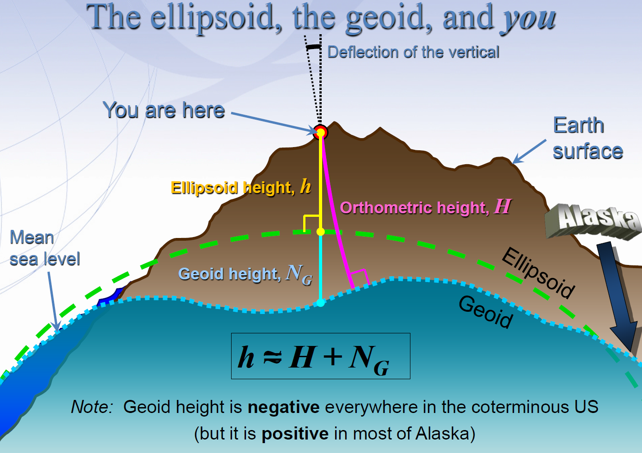
Notes:
GNSS Users get an ellipsoid height calculated from GNSS satellite data.
Ultimately we need an orthometric height (height in relationship to the geoid) to know where water will flow
Problem: we need to know the difference between the ellipsoid height and geoid (aka geoid height or undulation)
In the past this geoid height was calculated by NGS using large scale leveling and GNSS campaigns. Then provided to users through a realization of NAVD-88
The new NGS vertical datum North American-Pacific Geopotential Datum of 2022 will be based on gravimetric calculations rather than traditional leveling surveys

Slide 42
Types of Geoid Height Models
Gravimetric (or Gravity) Geoid Height Models
Defined by gravity data crossing the geoid
Refined by terrain models (DEM’s)
Scientific and engineering applications
Composite (or Hybrid) Geoid Height Models
Gravimetric geoid defines most regions
Warped to fit available GPSBM control data
Defined by legislated ellipsoid (NAD 83) and local vertical datum (NAVD 88, PRVD02, etc.)
May be statutory for some surveying & mapping applications

Slide 43
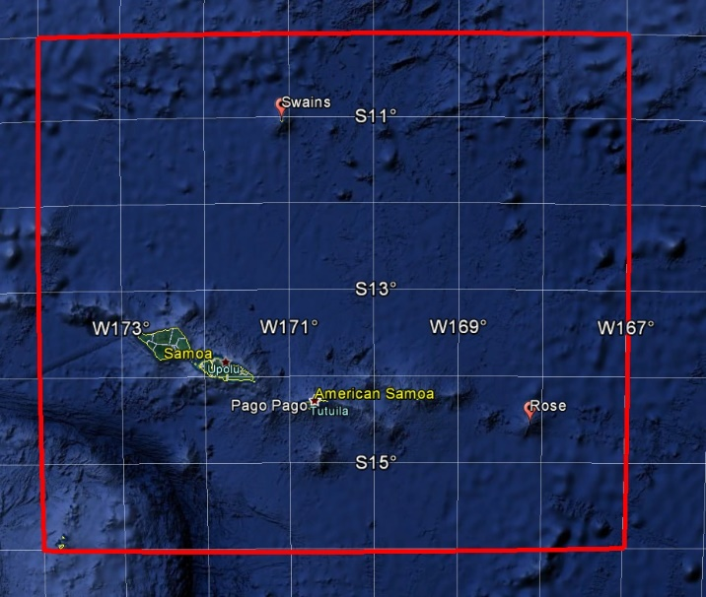
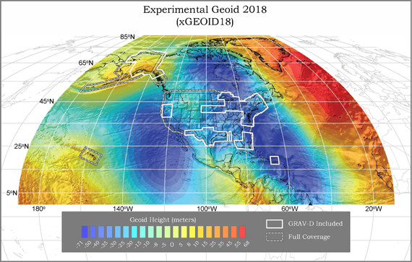
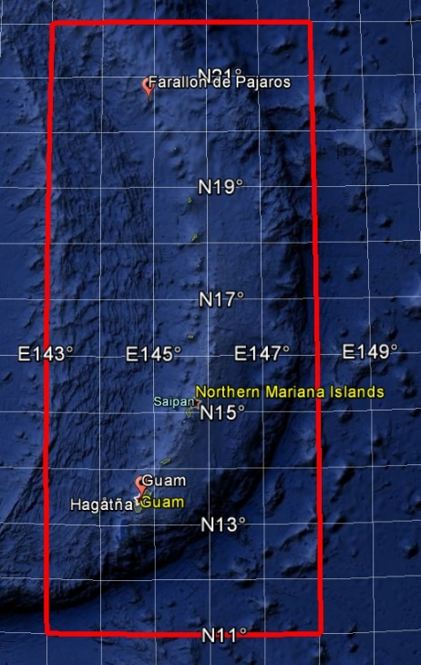
GEOID2022 (et al) over American Samoa:
-16 to -10, 186-193
GEOID2022 (et al) over Guam/CNMI:
11-22, 143-148
GEOID2022 (et al) over the North America/Pacific/Caribbean/Central America/Greenland region will range from
0 to 90 latitude and from 170 to 350 longitude.

Slide 44
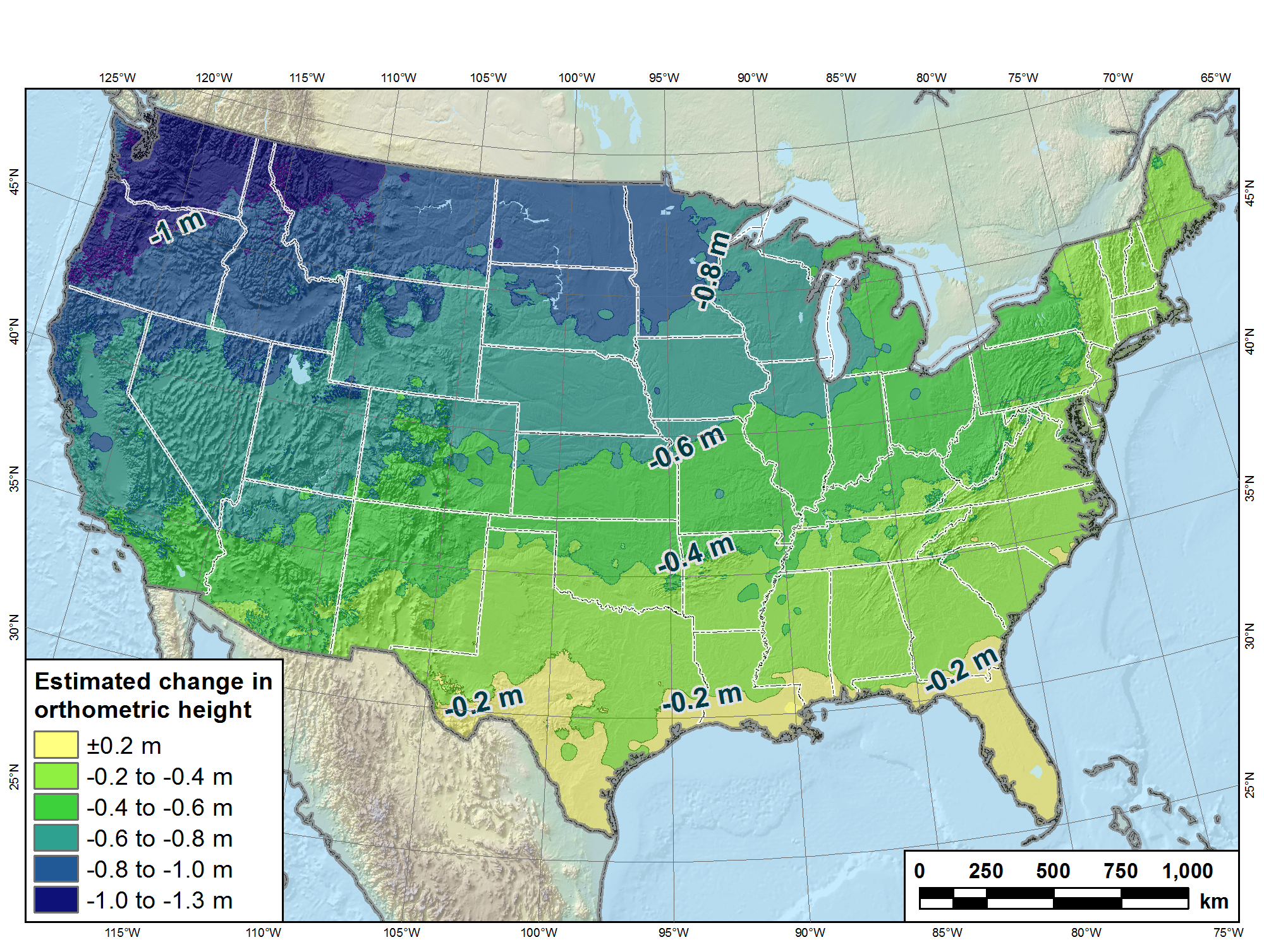
Estimated change in orthometric heights from NAVD88 to NAPGD2022
(NAPGD2022 approximated using xGEOID16B)

Slide 45
New Types of Coordinates - A two-track approach to coordinates
Reference Epoch Coordinates
Survey Epoch Coordinates
An estimated “snapshot” of the entire network
Every 5 or 10 years
Similar to NAD 83(2011) epoch 2010.00
Answers: what were a mark’s coordinates when it was last surveyed?
Multiple SECs can show changes over time

Slide 46
Assume “h” was determined four different times:
1995: 2.210
1999: 2.200
2007: 2.140
2014: 2.145
2.250
2.200
h
2.150
2.100
2.050
2.000
‘95
‘00
‘05
‘10
‘15
‘20
‘25
‘30
time

Slide 47
All measurements have error. Shown here are the same
Values of “h”, but with their error estimates.
1995: 2.210 +/- 0.0375 (3.75 cm)
1999: 2.200 +/- 0.0250 (2.50 cm)
2007: 2.140 +/- 0.0200 (2.00 cm)
2014: 2.145 +/- 0.0250 (2.50 cm)
2.250
2.200
h
2.150
2.100
In the modernized NSRS these time-dependent
coordinates, estimated at (or very near) the actual date when
the surveys took place, will be called
survey epoch coordinates (SECs)
2.050
2.000
‘95
‘00
‘05
‘10
‘15
‘20
‘25
‘30
time

Slide 48
In today’s NSRS, a height is held fixed until replaced.
So plotting the height as seen on a datasheet over time might look like this:
2.250
2.200
h
2.150
2.100
2.050
2.000
‘95
‘00
‘05
‘10
‘15
‘20
‘25
‘30
time

Slide 49
In the modernized NSRS we will also have an estimate of
3-D mark motion (estimated from crustal motion) called IFDM2022
IFDM2022 (intra-frame deformation model) will be fairly coarse, showing broad regional estimates of mark motion through time
2.250
In general, IFDM2022 will not fit perfectly through SECs
2.200
h
2.150
2.100
2.050
2.000
‘95
‘00
‘05
‘10
‘15
‘20
‘25
‘30
time

Slide 50
Combining the same observations that were used to create SECs with IFDM2022 allows NGS to estimate reference epoch coordinates (RECs)
2.250
2.200
h
2.150
2.100
2.050
2.000
‘95
‘00
‘05
‘10
‘15
‘20
‘25
‘30
time

Slide 51
In the absence of new survey data, error estimates will
grow through time.
2.250
2.200
h
2.150
2.100
2.050
2.000
‘95
‘00
‘05
‘10
‘15
‘20
‘25
‘30
time

Slide 52
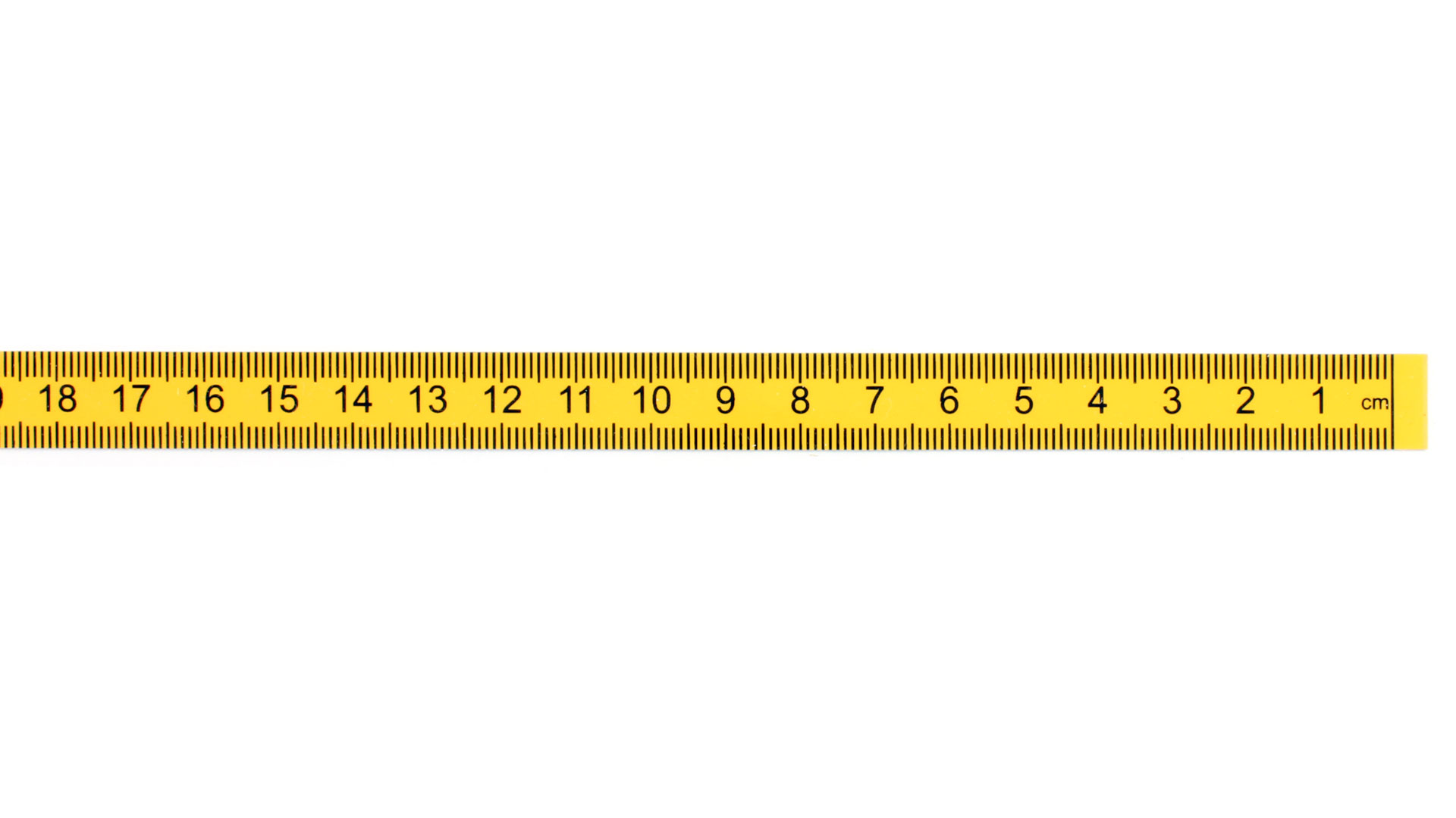


A survey done Jan 1, 2020
New Survey (same point) done Jan 1, 2030
Position of point in NATRF2022(2030)
Position of point in NATRF2022(2020)
If IFDM = 0, then NATRF2022 (2030) = NATRF2022 (2020)
Position from 2020 survey NATRF2022 (2020)
ITRF2020 (2020)
ITRF2020 (2030)
IFDM 2030-2020
NATRF2022
(2020.0)
Epp2022
fframe
NATRF2022 (2030)
fEpoch
(V)
(H)
Notes:
At 2020, ITRF and NATRF are identical. As time goes on the North American plate moves, resulting in new ITRF coordinates at epoch (say 2030) for the same point. If I remove 10 years of plate motion (ITRF velocity) it puts me back where NATRF used to be....EXCEPT, there has been local motion. That is why we call the it NATRF epoch 2030, because it is where NATRF IS in 2030. We now have to apply IFVM to get back to 2020, or any other date relative to NATRF.

Slide 53
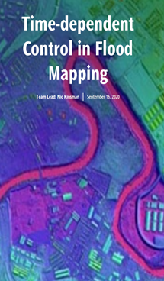
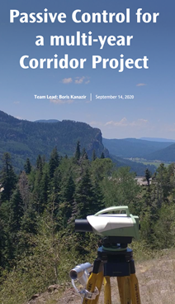

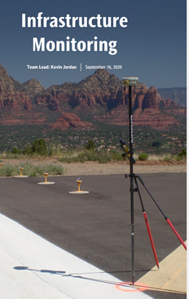
Modernized NSRS Use Cases

Slide 54
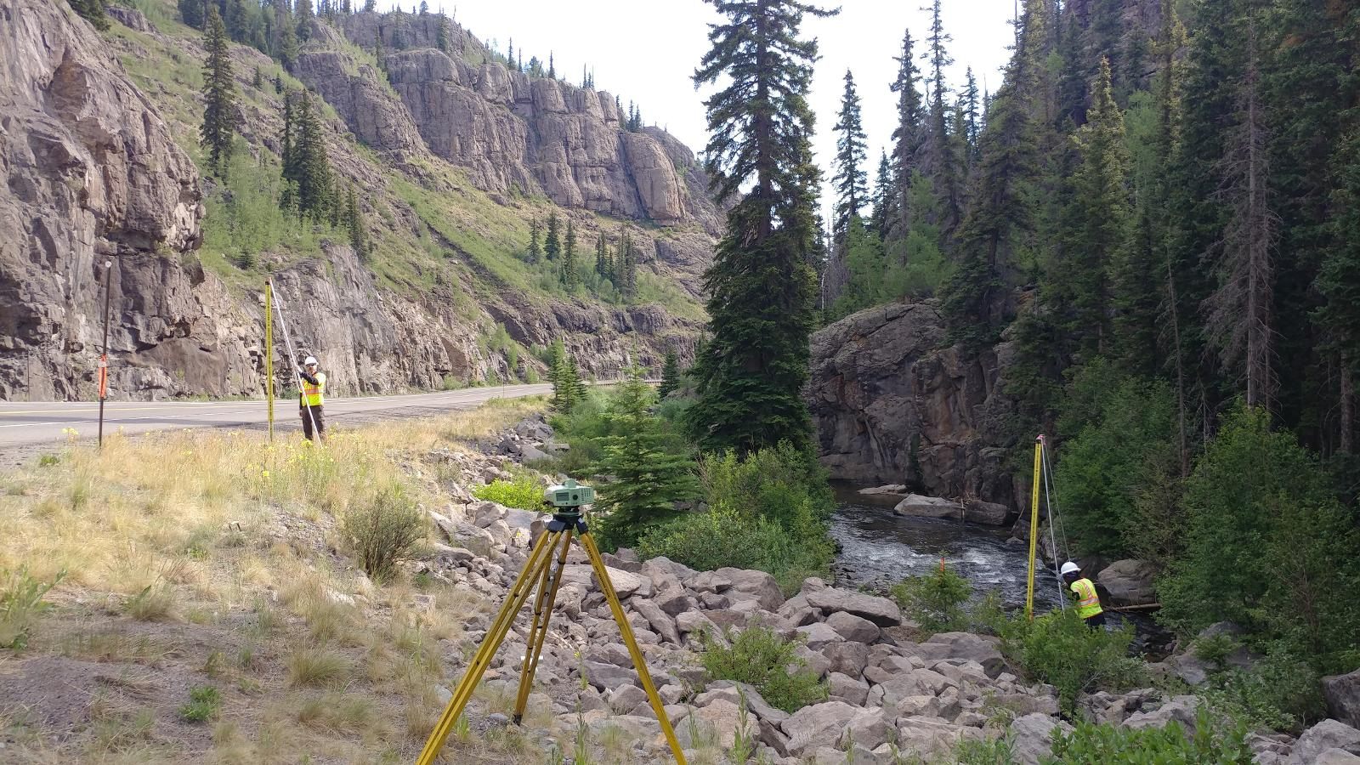
Why is Modernized NSRS Important to Passive Control?
World is dynamic place
Everything (including geodetic control) around us is moving
Modernized NSRS will connect time-dependent positioning and passive control
This becomes critical when passive control is used to build new infrastructure

Slide 55
Passive Control Benefits in Modernized NSRS
Time series analysis
Epoch definitions
Trusted control marks
Project location selection
Infrastructure monitoring
More reliable and accurate data

Slide 56
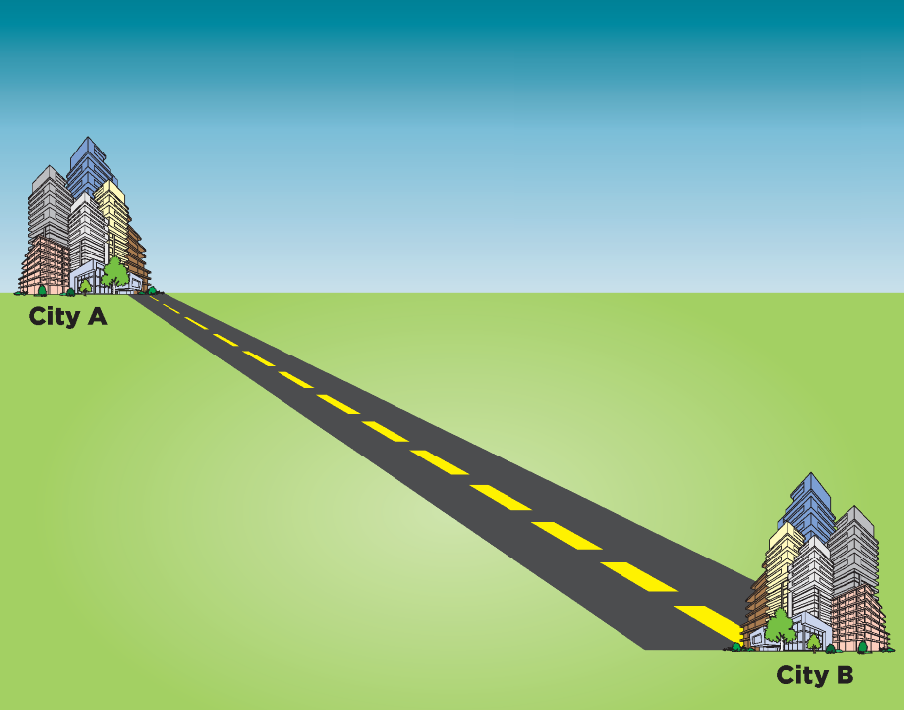
Multi-year Corridor Project
Imagine your job is to build something in a long corridor (a highway or pipeline, for example) over the course of ten years or more.
How will that change in the modernized NSRS?

Slide 57
Survey Data
CONTROL
GNSS
CONVENTIONAL
LEVELING
OTHER
Total Station
Static
RTK
Differential Leveling
Mobile LiDAR
Aerial LiDAR/Photogrammetry
Terrestrial Laser Scanning
RTN

Slide 58
Control Surveys and Coordinate Types
Control Surveys
Survey Epoch Coordinates
Survey Epoch Coordinates
RTN Alignment
Reference Epoch Coordinates
Leveling Control
Reference Epoch Coordinates
Reference Epoch Coordinates
GNSS Control

Slide 59
Common Reference Epoch
Construction Survey
Construction staking
Control checks
Reference Epoch Coordinates
Reference Epoch Coordinates
Survey Epoch Coordinates
Preliminary, construction, and as-built surveys can be tied to a common reference epoch!
This allows for a proper QA/QC (ensuring that projects are being built as designed) throughout all of the phases of the project

Slide 60
Transitioning Data to the Modernized NSRS

Slide 61
Best ways to determine coordinates in the Modernized NSRS
Listed in decreasing order of Accuracy, Cost, and Complexity
Resurvey: Return to the field and collect new observations, relying on geodetic control that has coordinates in the new datum. Useful for municipalities looking to migrate a local datum into the NSRS or for ongoing project control in areas experiencing lots of vertical motion
Readjust: Using existing observations, re-compute new coordinates based on geodetic control that has been defined in the new datum. Most appropriate for updating existing project control in stable regions
Transform: Take finished products that have coordinates in the old datum and use transformation software to estimate coordinates in the new datum. Best for for updates to legacy mapping data. Note - Not all data will need to be transformed as soon as the Modernized NSRS is released
OPUS
NCAT

Slide 62
How NGS will support transition of data
NGS will provide:
The source code, defining datasets, and robust documentation for NCAT and VDATUM so they can be incorporated into non-NGS software
Downloadable versions of NCAT & VDatum so they can be run locally
Sample input and output datasets so that users may test other transformation software against NGS’ definitive transformations
Uncertainty estimates for transformations
Note: Superseded historic transformation software will continue to be available on the NGS website, however they will not be updated.

Slide 63
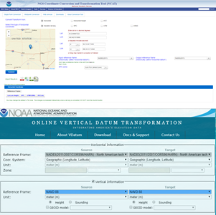
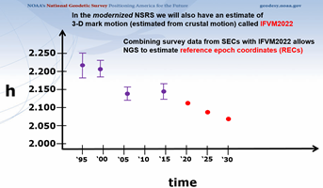
GPS on Bench Marks for the Modernized NSRS
GPS on Bench Marks is not only about building the Transformation Tool to connect the past and future Datums. It is about preparing the country and our communities to take full advantage of the benefits of the Modernized NSRS
GPSonBM Campaign Goals:
Data for NAVD 88 – NAPGD2022 Transformation Tools
2020.0 Reference Epoch Coordinates (REC’s)
Build time series of observations in areas of motion

Slide 64
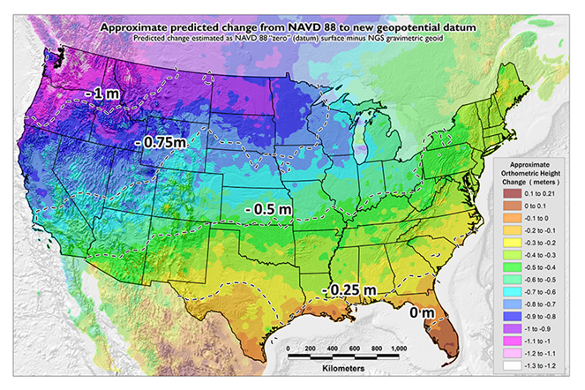
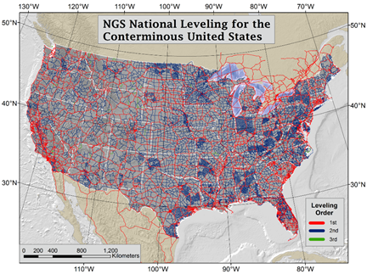
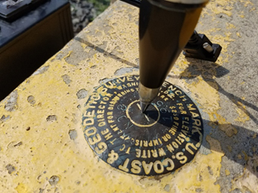
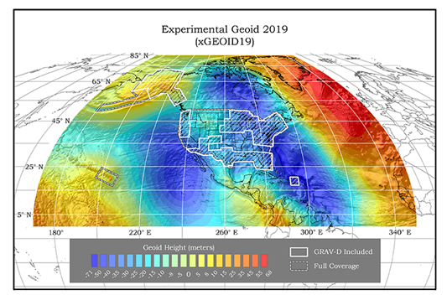
GPSonBM Measurements Connect
Old & New Datums
Because the relationships between the old and new datums vary by location, the accuracy of the transformations in any particular place is directly related to the density of GPSonBM data available in that area.

Slide 65
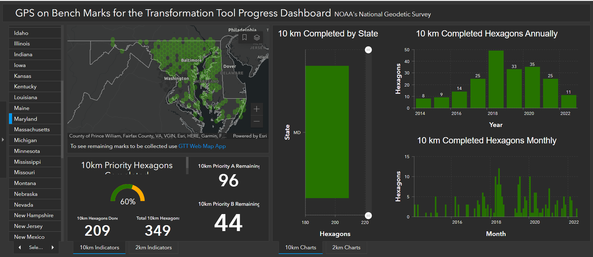
GPSonBM in Maryland

Slide 66
Flood Mapping

Slide 67
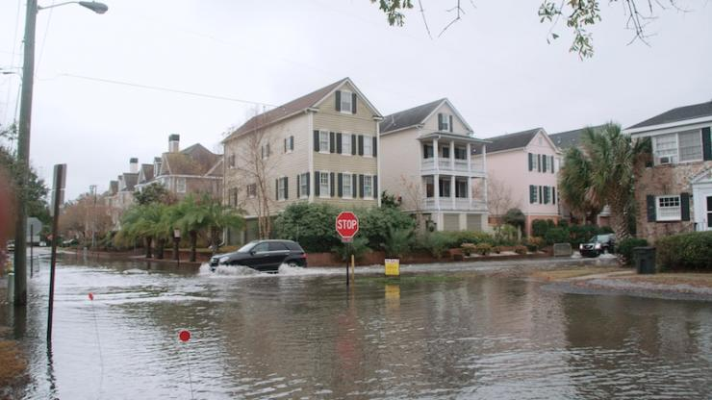
Water in the streets during a high-tide event on a sunny day in Charleston, South Carolina (toolkit.climate.gov)

Slide 68

NSRS Modernization benefits to Flood Mapping
A 2009 socio-economic study conducted on behalf of NOAA estimated that the GRAV-D project will save $2.2 billion over 15 years in avoidance costs from improved floodplain management alone.
2006 USACE U.S. Army Corps of Engineers Report on Hurricane Katrina:
“The floodwalls along the outfall canals were constructed to elevations nearly 2 feet below the original intent because of errors in relating the local geodetic datum to the water level datum.”
floodsmart.gov

Slide 69
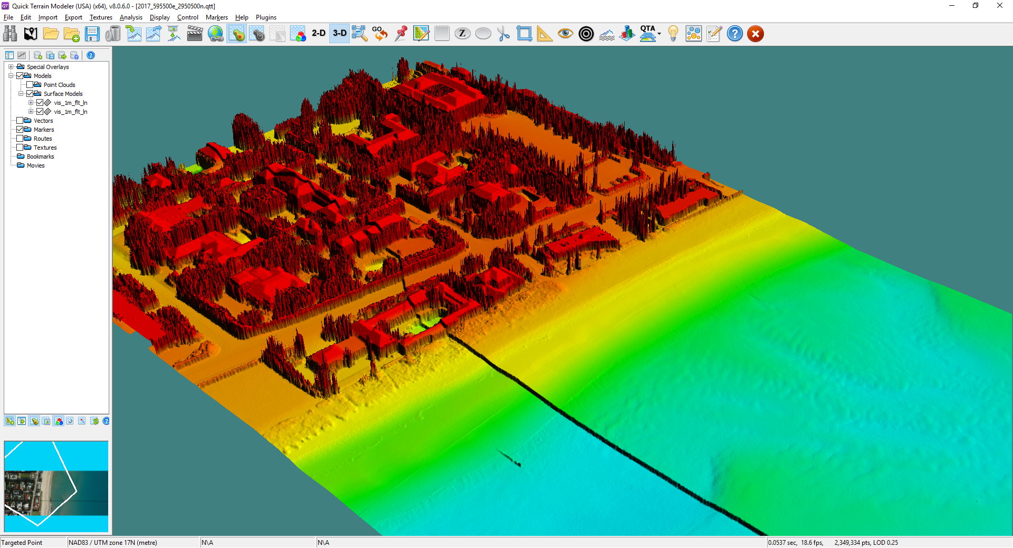
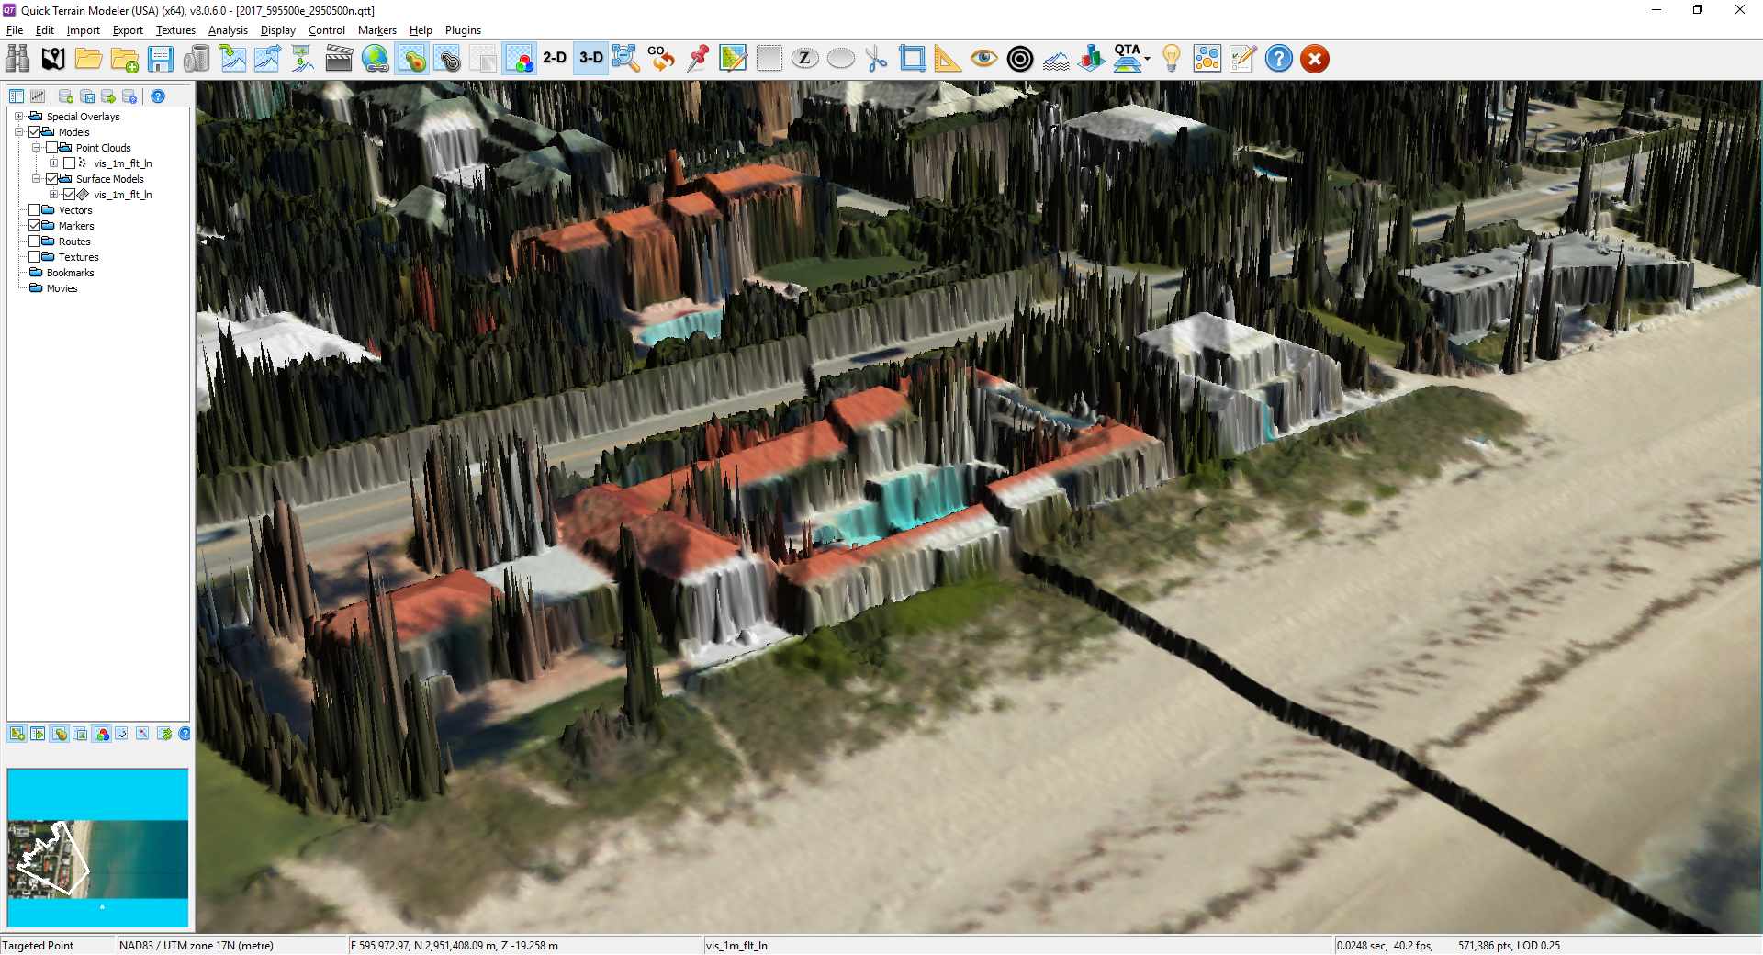
Minimizing negative impact of the SHIFT
FEMA requires use of the NSRS in the NFIP wherever practicable
Local Datum/NGVD 29 → NAVD 88
inhibited by non-digital data and limited transformation tools;
incomplete due to NAVD 88 extent/access exceptions
As NFIP operates today, rolling nature of FIS restudies allows for the gradual adoption of modernized NSRS
Projected vertical offset of >1 meter (Pacific NW)

Slide 70


Leveraging time-dependency to track the DRIFT
Susan
Fred
Base Flood Elevation
Not accounting for ground or mark motion can cause rate-setting to depart from true risk.
Notes:
Average age of flood insurance map is 11 years

Slide 71
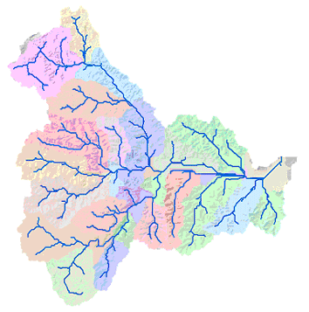
Layers of Benefits in Flood Insurance Study Updates
Digital elevation models
Hydraulic obstruction heights (toe, crest or deck on structures)
Stream cross section surveys for hydrograph calculations
FIRM production:
Discovery phase leverages best available existing data
Flood hydraulic modeling
Hazard zone mapping
GIS Flow Accumulation Analysis

Slide 72
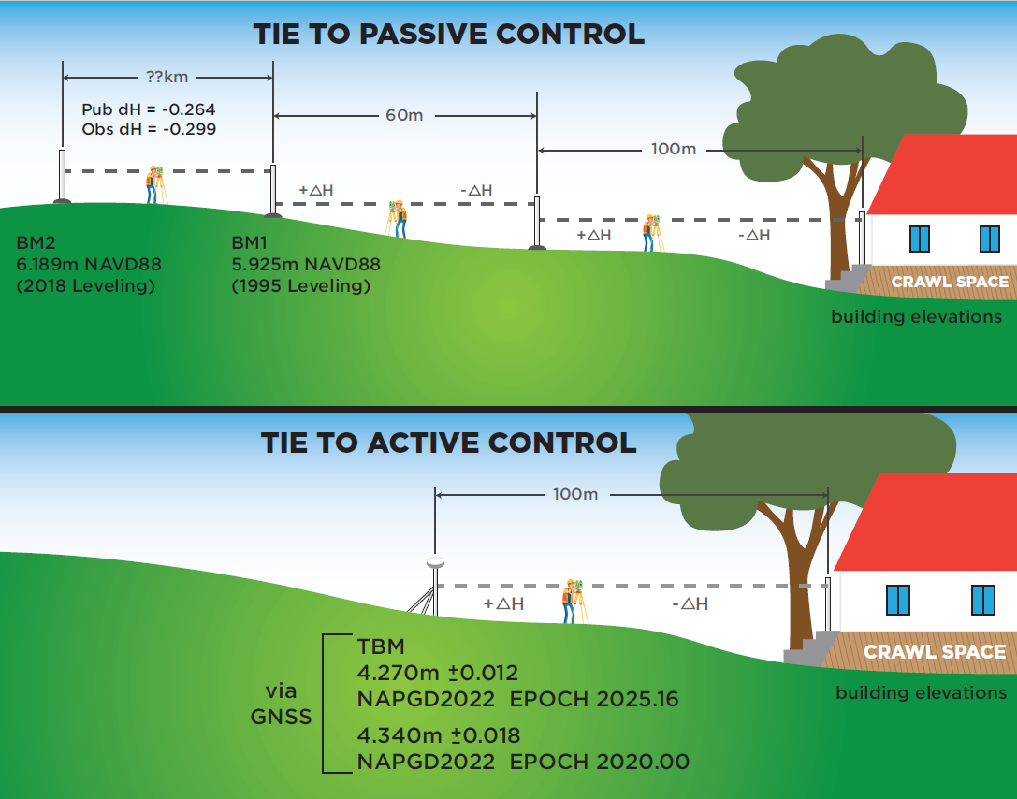
Added Convenience in NFIP Workflows

Slide 73
Added Convenience in NFIP Workflows

Slide 74
How to Prepare
Does your work currently require referencing NAD 83?
Do you collect the necessary metadata needed to move existing data into the new frames?
When was it surveyed?
How was it surveyed?
What was the source of control?
Full datum description? (datum, tag, epoch)

Slide 75
How to Prepare
Do you currently have GNSS equipment?
Remember that the primary method of establishing NAPGD2022 heights will be through GNSS and Geoid2022.
USFT vs IFT
Store Data…not just coordinates!
If you have your original data, it can always be reprocessed later
Maintains the integrity of your survey
Better than a transformation

Slide 76
How to Prepare
Do you have documents, manuals, contracts, etc…that include language re: datums?
Do you have clients, subcontractors, in-house staff other than survey that need to be educated about the new datums?
Are you going to have to support projects in old datums for a while? What is the plan for that?

Slide 77
Questions?
Dan Martin
Northeast Regional Geodetic Advisor
ME, NH, VT, MA, CT, RI, NY, NJ
Dan.martin@noaa.gov
240-676-4762

