Slide 1

Geodetic Control in Texas
Boris Kanazir, Geodesist, RPLS
boris.kanazir@noaa.gov
Daniel Prouty, Ph.D.
Southern Plains Regional Advisor (TX, OK)
daniel.prouty@nooa.gov
New 2022 Datums & SPCS Workshop
New Braunfels, Texas
January 24, 2020

Slide 2




National Geodetic Survey (NGS)
Department of Commerce (DOC)
National Oceanic & Atmospheric Administration (NOAA)
National Geodetic Survey (NGS) - the oldest scientific agency in the U.S. Federal Government!

Slide 3
NGS Mission
To define, maintain, and provide access to the National Spatial Reference System (NSRS) to meet our Nation’s economic, social, and environmental needs

Slide 4
National Spatial Reference System (NSRS)
Latitude
Longitude
Height
Scale
Gravity
Orientation
How these values change over time

Slide 5
What is Geodesy
The science of accurately measuring and understanding the Earth's geometric shape, orientation in space, and gravity field
It is a foundational science that defines positions and heights for geodetic control

Slide 6
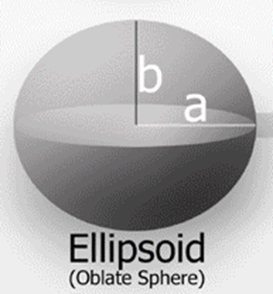
What is Ellipsoid
Ellipsoid is a mathematical figure that approximates Earth’s surface
It is created by rotating an ellipse around its shorter axis
It is used by GPS to measure ellipsoid height relative to the reference ellipsoid surface

Slide 7
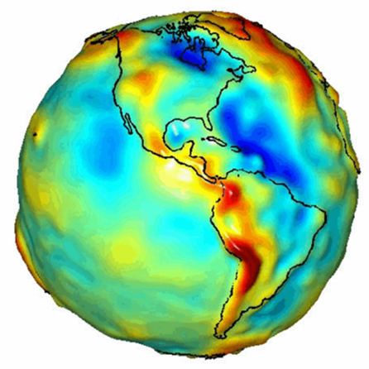
What is Geoid
The equipotential surface of the Earth’s gravity field which best fits, in a least square sense, global mean sea level
Geoid models are used to transform between ellipsoidal and vertical datums

Slide 8
Relationship of Heights

Slide 9
Geodetic Datums
A geodetic datum or reference frame is an abstract coordinate system with a reference surface (such as sea level) that serves to provide known locations to begin surveys and create maps.

Slide 10
Current Datums of the U.S. and Territories
Current official datum | Description
North American Datum of 1983 (2011/PA11/MA11) epoch 2010.00 | This geometric datum allows measurement of positions relative to an ellipsoid model of the Earth (latitude, longitude and ellipsoid height).
North American Vertical Datum of 1988 (NAVD 88) | This vertical datum allows measurement of land elevations and water depths.

Slide 11
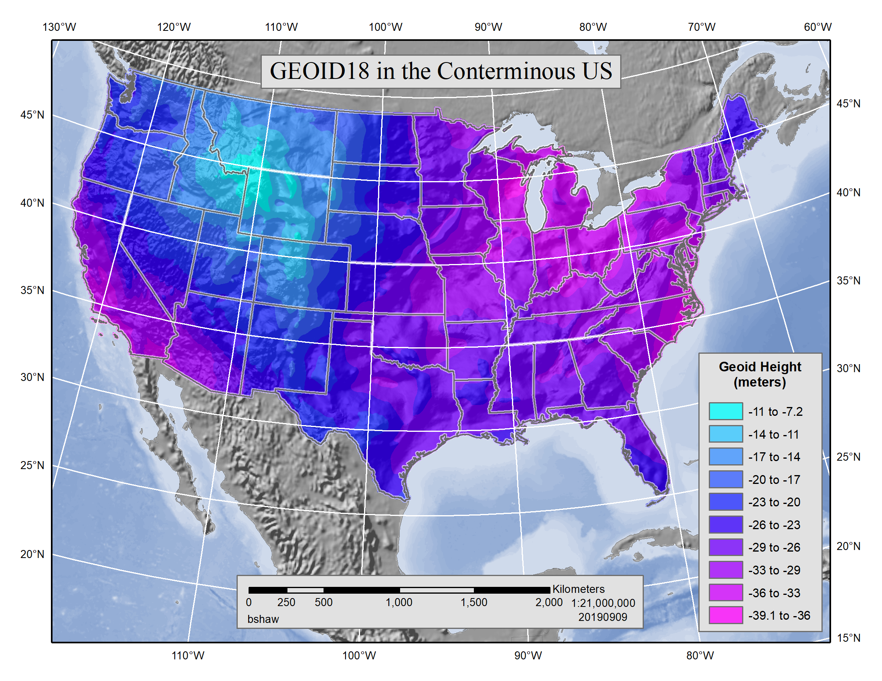
GEOID18 in the Conterminous US

Slide 12
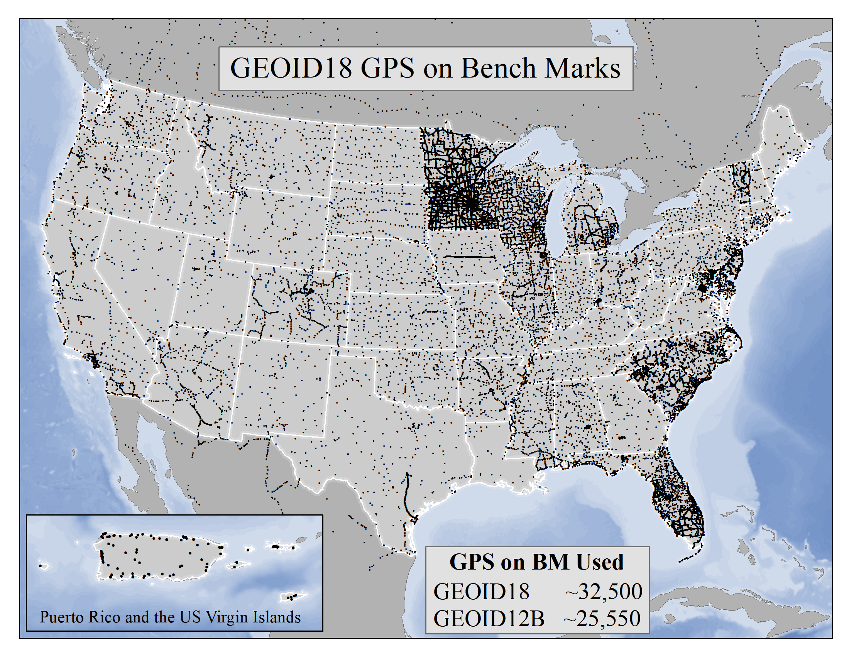
GEOID18 GPS on Benchmarks

Slide 13
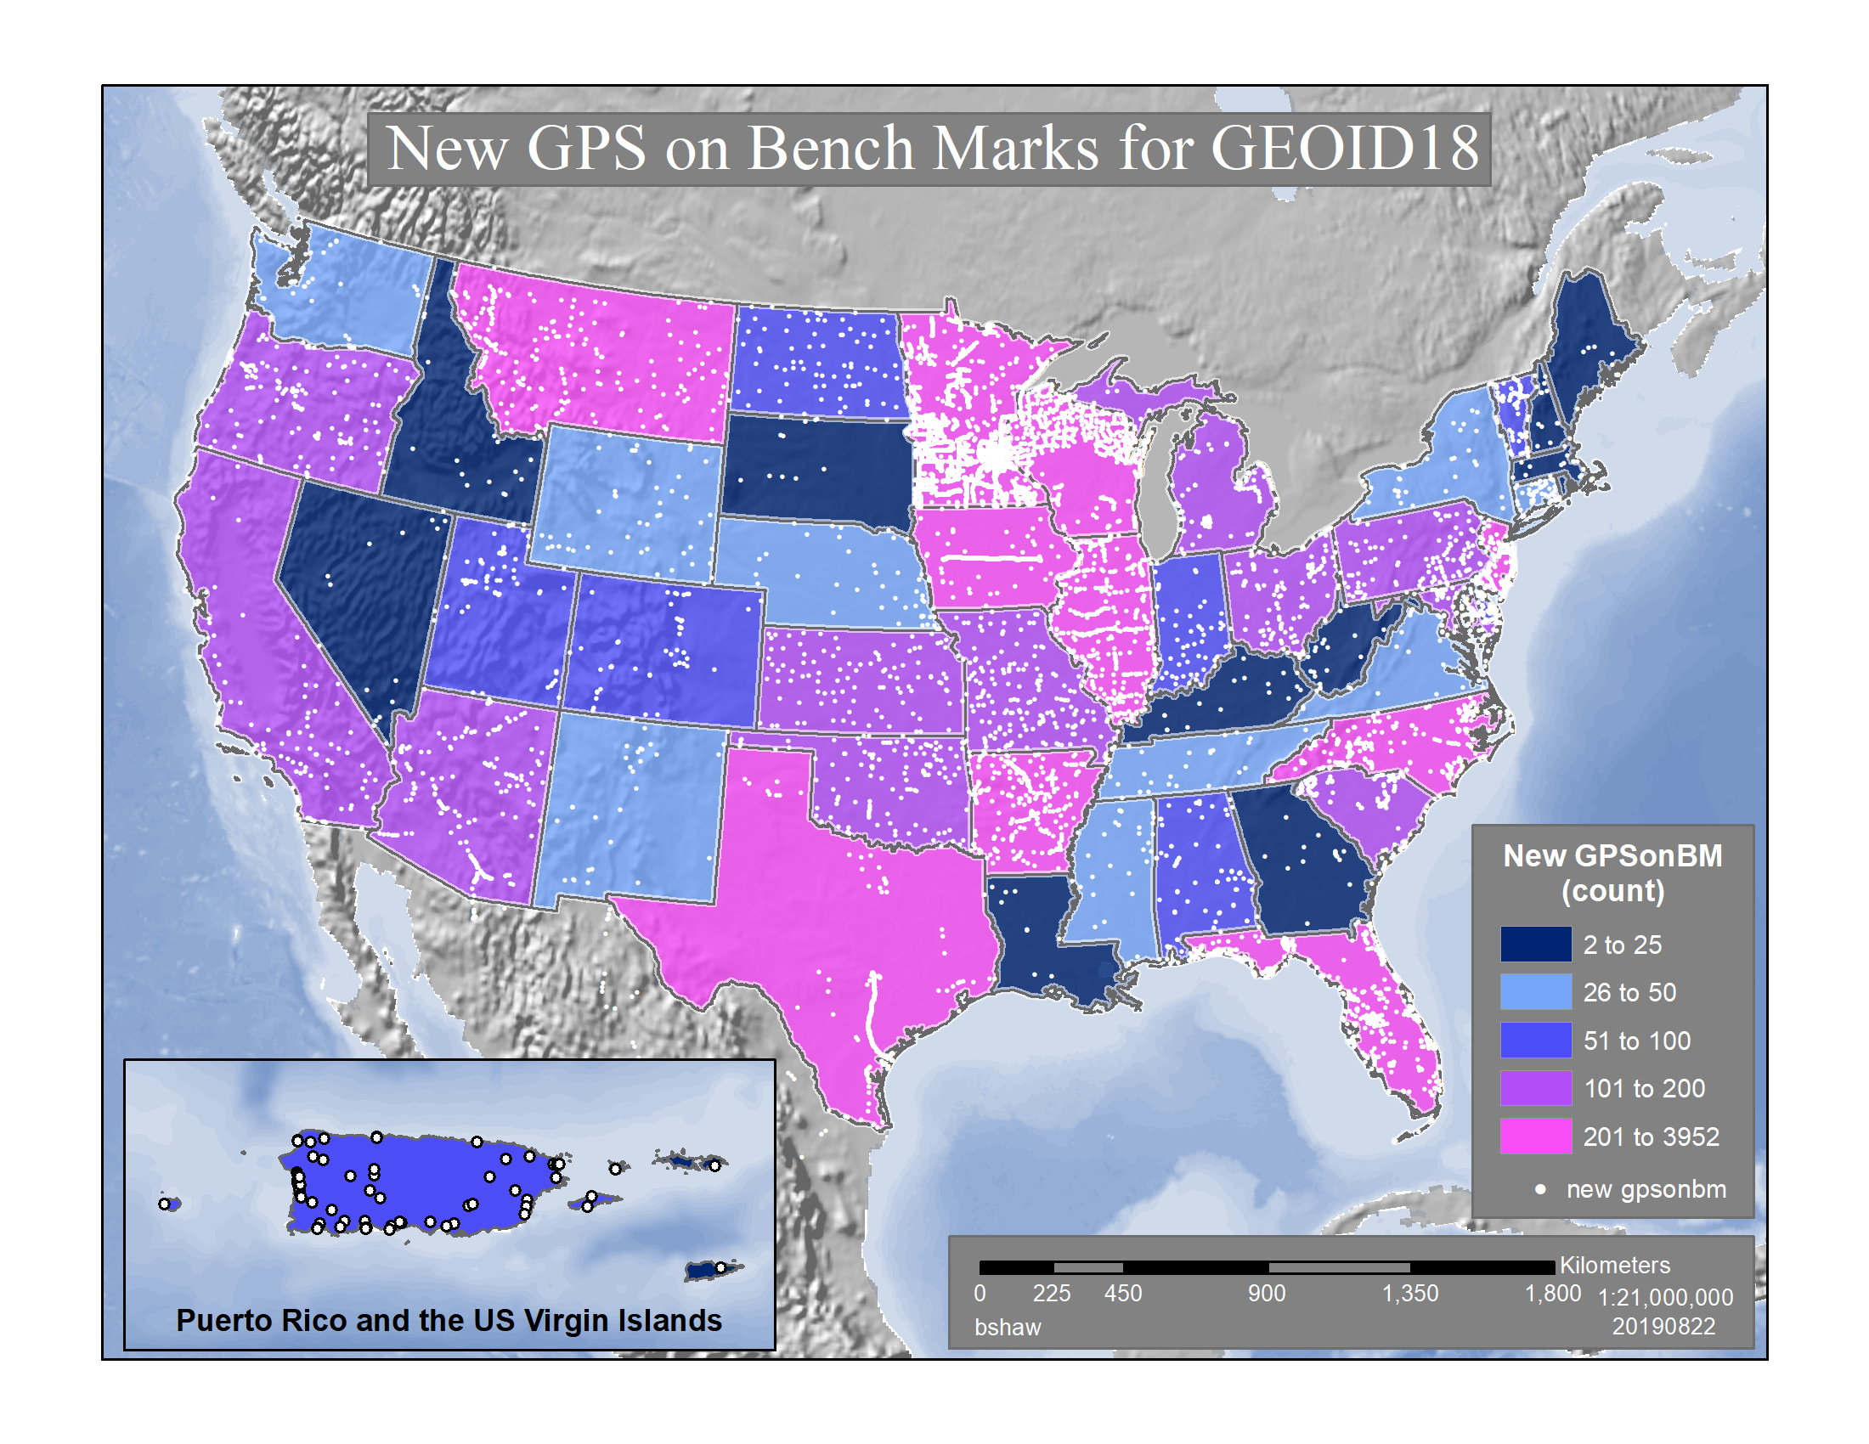
New GPS on BM for GEOID18

Slide 14
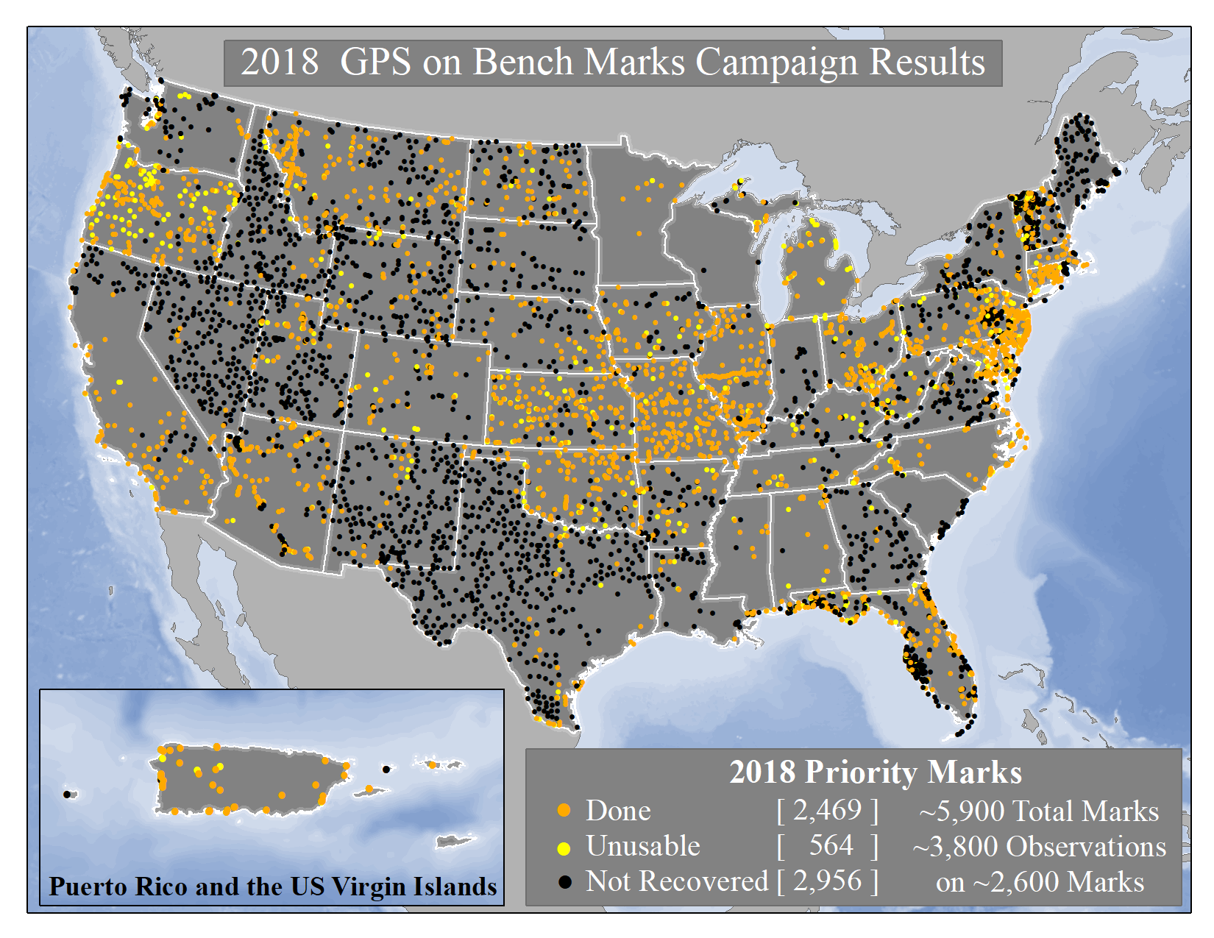
2018 GPS on BM Campaign Results

Slide 15
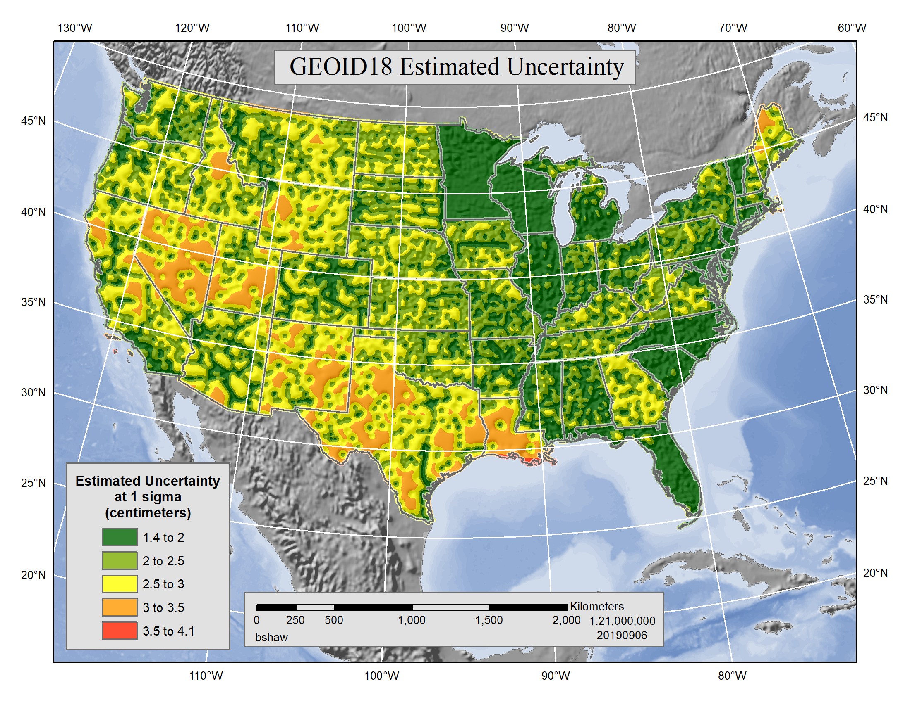
GEOID18 Estimated Uncertainty

Slide 16
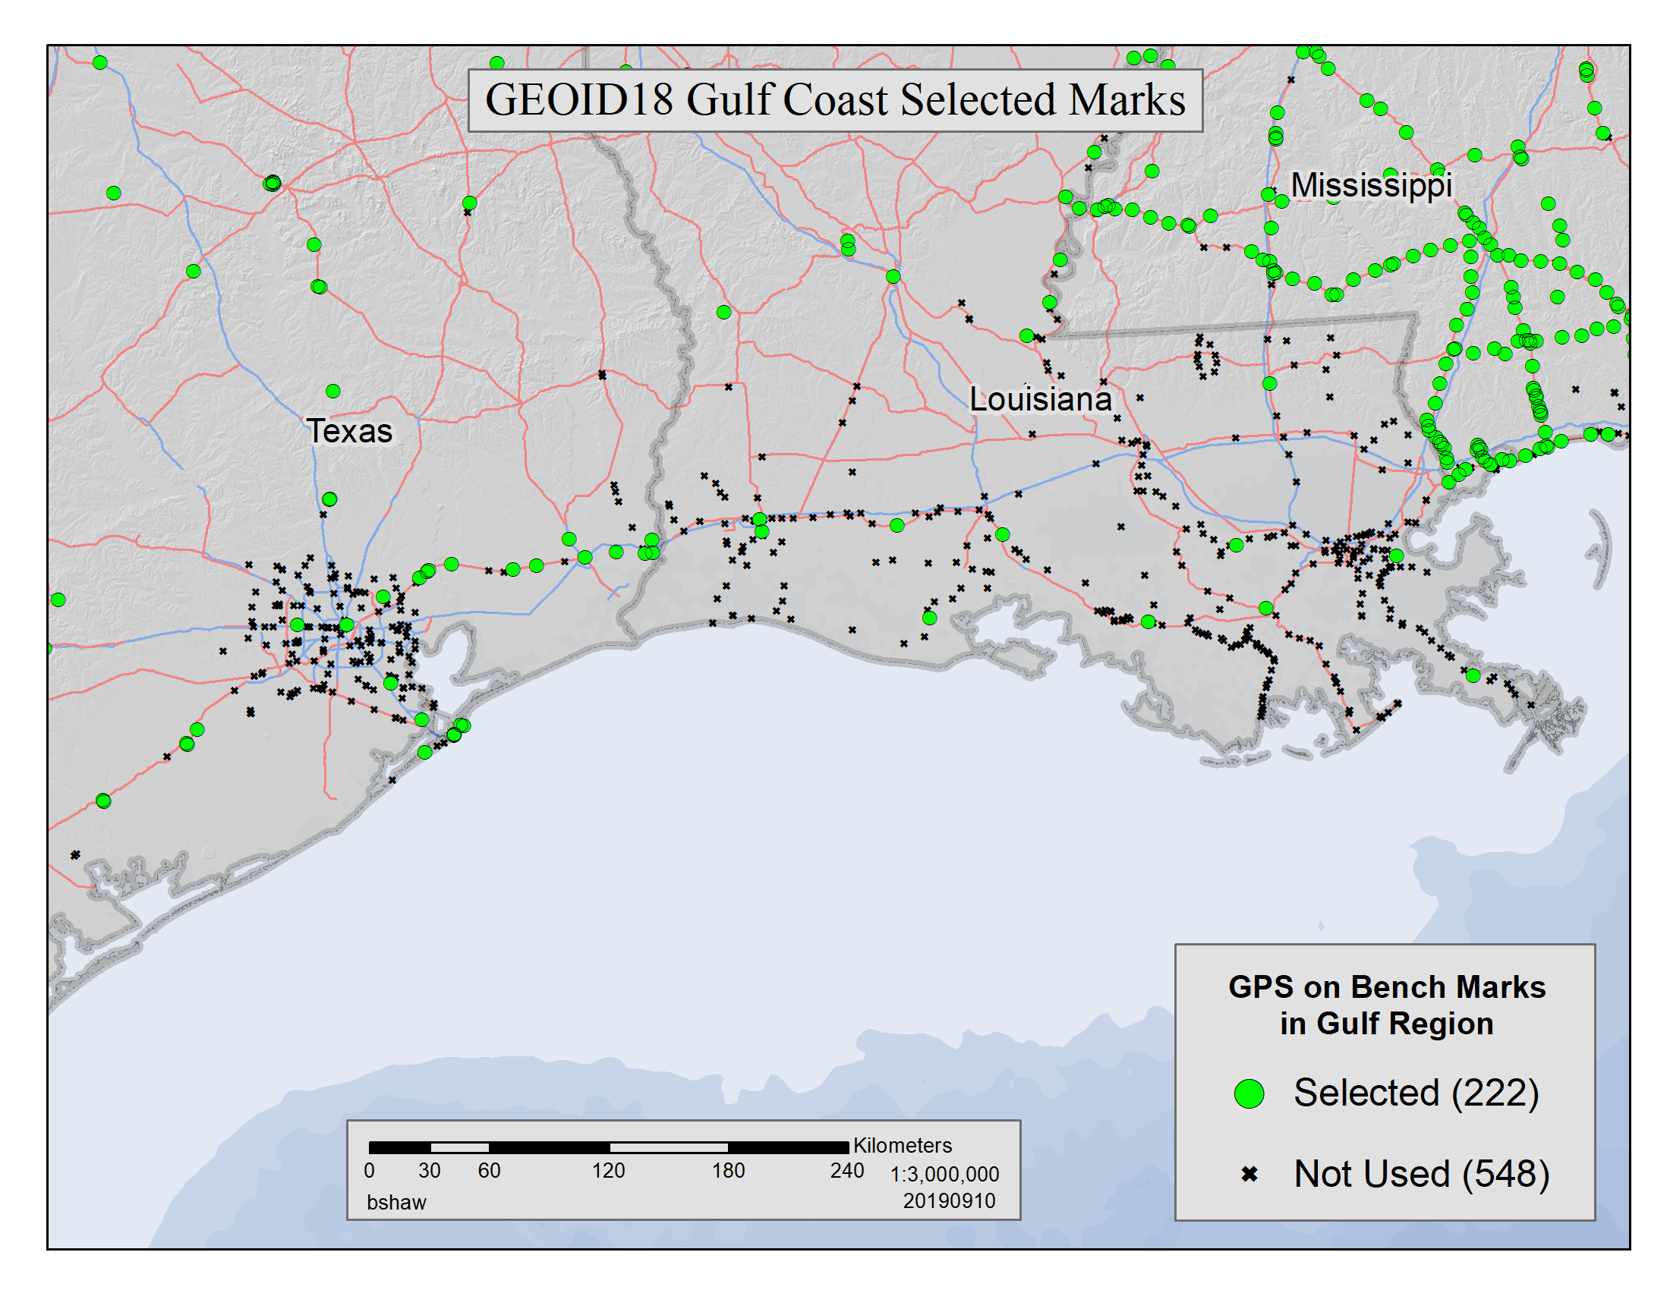
GEOID18 Gulf Coast Selected Marks

Slide 17
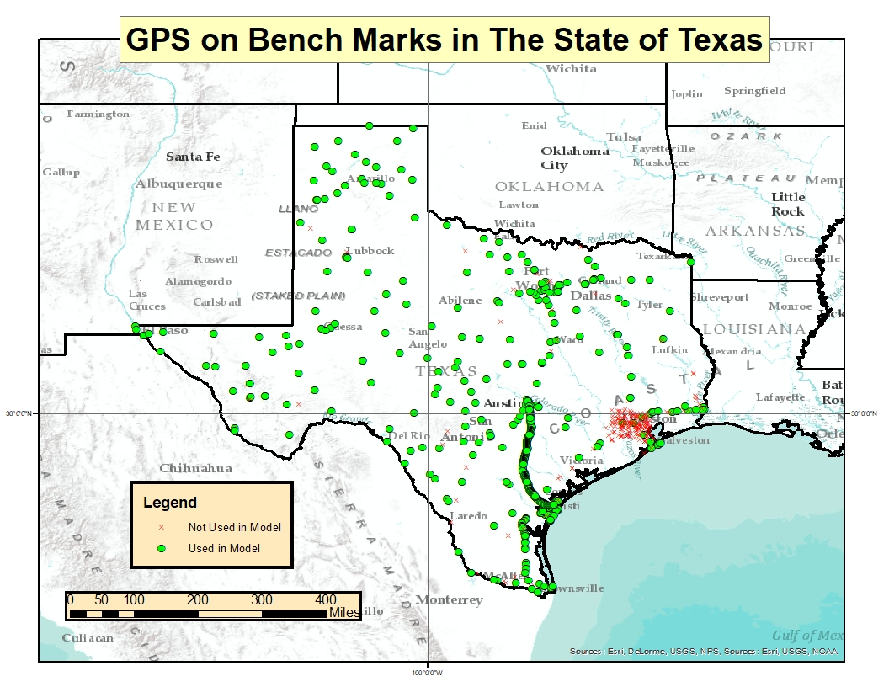
GPS on BM in Texas

Slide 18
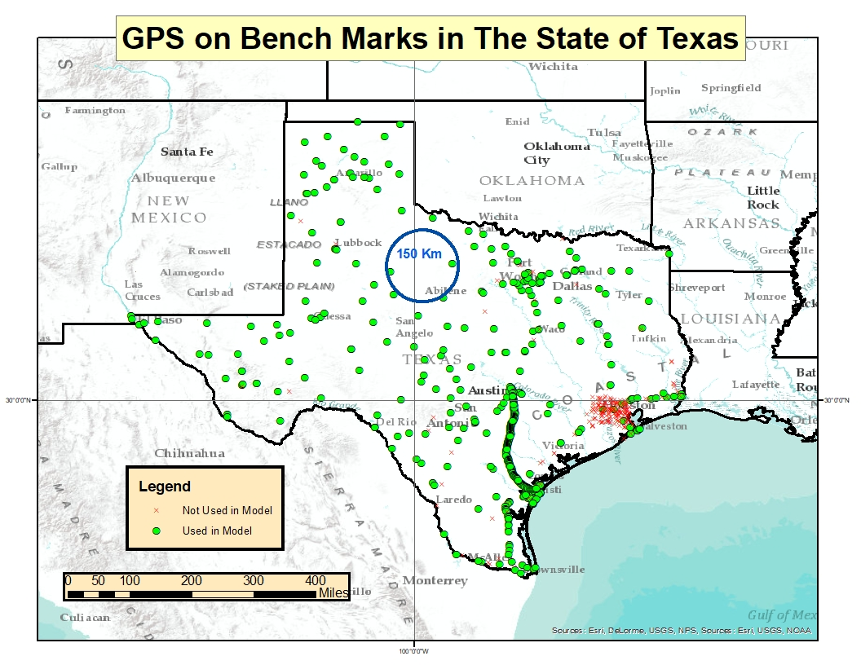
GPS on BM in Texas

Slide 19
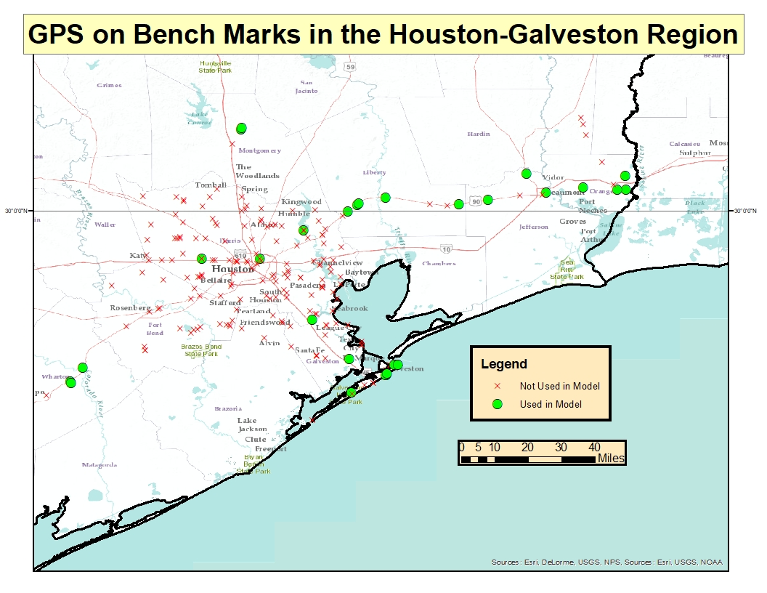
GPS on BM in Houston-Galveston

Slide 20
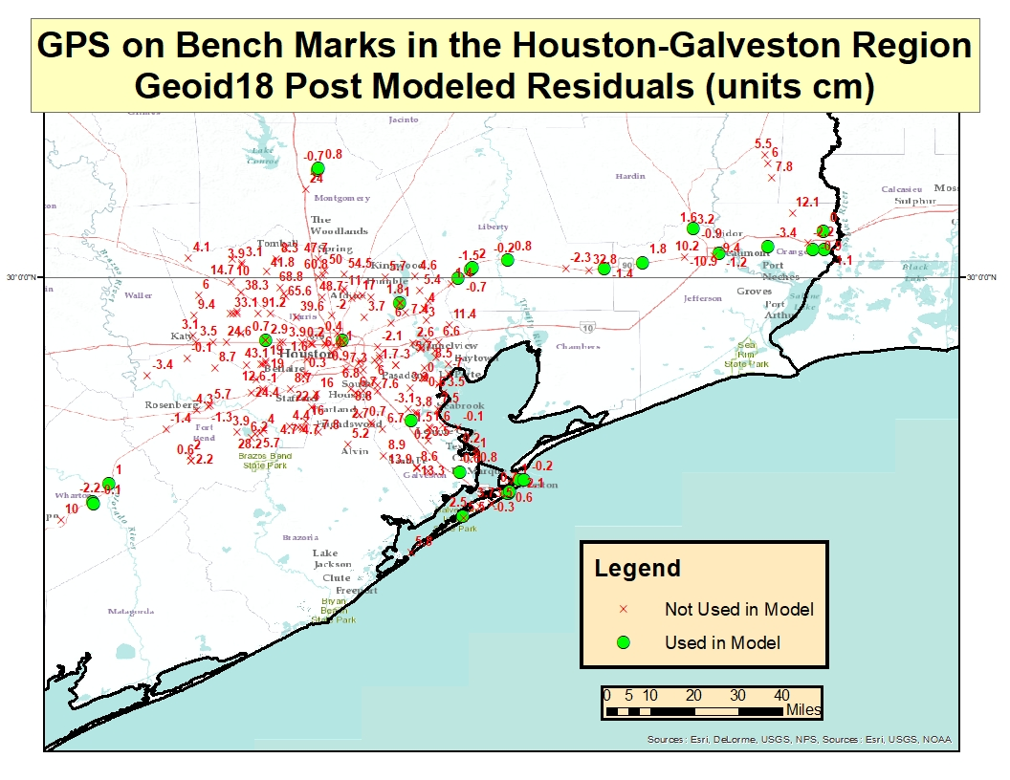
GEOID18 Post Modeled Residuals

Slide 21
Houston Case
Harris County Floodplain Reference Marks and Flood Insurance Rate Maps (FIRMs) are referenced to locally defined NAVD88 2001 elevations (not published by NGS)
Elevation errors and outdated maps could have a major effect on flood zones determination and flood risk assessment
This highlights the reasons for and the importance of NGS’ shift to time-dependent positioning in the NSRS Modernization in 2022

Slide 22
New 2022 Horizontal Datums
NGS will replace NAD83 (non-geocentric) with new geometric reference frame
Defined relationship to global frame
National Spatial Reference System (NSRS) will be accessed via GNSS
Active geodetic control = CORS
Coordinates in new US reference frames
  NATRF2022 - North American Terrestrial Reference Frame of 2022
  PATRF2022 - Pacific Terrestrial Reference Frame of 2022
  MATRF2022 - Mariana Terrestrial Reference Frame of 2022
  CATRF2022 - Caribbean Terrestrial Reference Frame of 2022
Transformation tools (NAD83 to new reference frame)

Slide 23
Existing NAVD88
Relies on local benchmarks – the goal is to fit a new survey to good local control
Limited availability
  Destroyed benchmarks
  Suspect heights – hard to identify good benchmarks
No good mechanism to track vertical motion – this will change in 2022 with the future Geopotential Datum

Slide 24
New 2022 Vertical Datum
NAPGD2022 (dynamic) will replace NAVD88 (static)
GNSS and gravimetric geoid
Orthometric height = ellipsoid height – geoid height
Time dependent heights

Slide 25
How good is GEOID18
As good as the data that was available to NGS when the model was created
NGS wants to get consistency between GEOID18 and published marks
More data = better models, better transformation tools

Slide 26
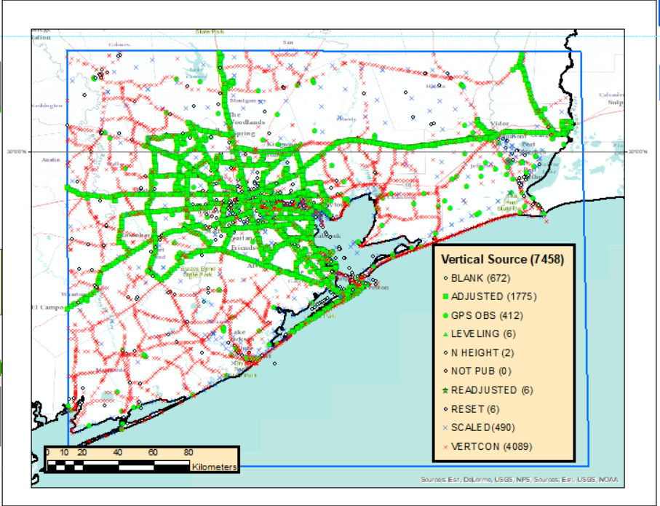
Good published heights in the SE Texas
The box includes approximately 7,500 marks in the NGS database
More than 4,000 heights created by VERTCON (Vertical Datum Conversion) = suspect heights!
Only 28 marks out of 7,500 in this box are considered to have good heights!

Slide 27
GPS-derived Orthometric Heights
They rely on the following three elements:
  Ellipsoid Height – from GPS survey
  Geoid Height – from current GEOID18 model
  NAVD 88 existing control (if available)

Slide 28
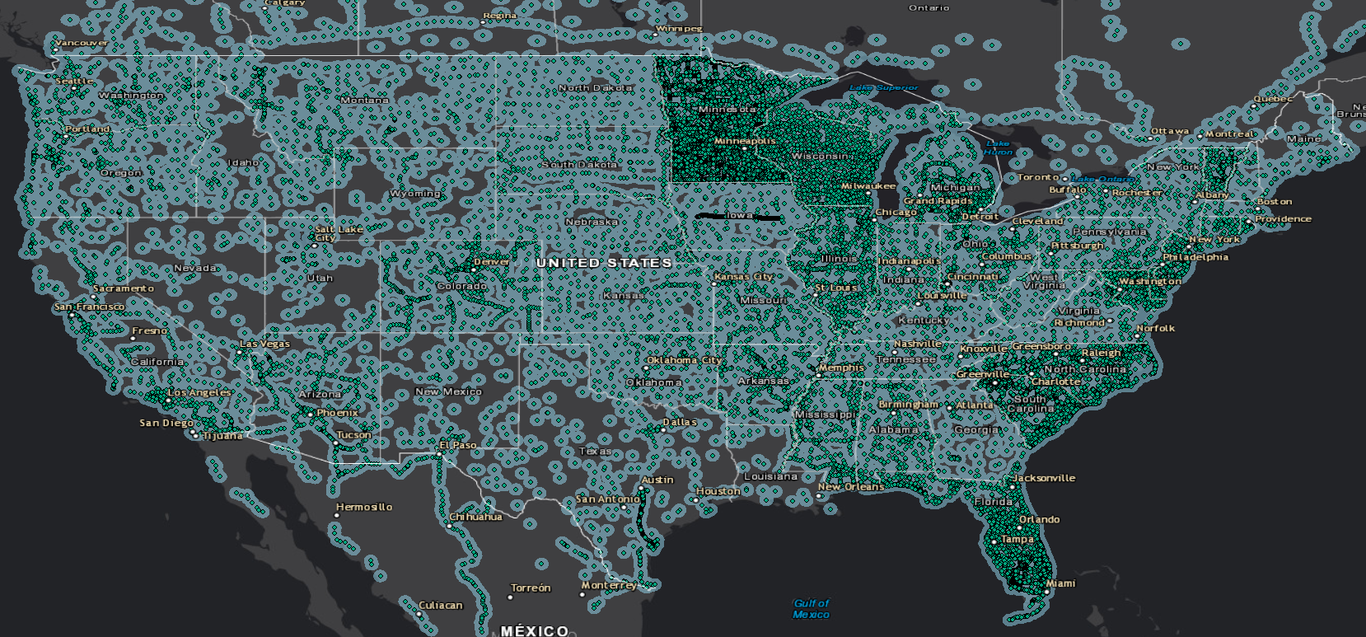
Good heights in the US - 30 km buffer

Slide 29
Can I just use LiDAR and OPUS?
It really depends. Assume scenario where you are working on a project in the southeast Texas outside of 30 km buffer:
  Relative accuracy of your LiDAR dataset (95% confidence) ≈ 10 cm
  GEOID18 accuracy in that area (95 % confidence) ≈ 7 cm (AT BEST!)
  OPUS-derived ellipsoid height for 2 hr occupation (95% confidence) ≈ 5 cm
    NOTE: peak-to-peak errors provided by OPUS can be used to estimate standard deviation (1 sigma) - peak-to-peak range is a approximately 70% larger than 1 sigma
Combined error is around 15 cm or 6 inches!

Slide 30
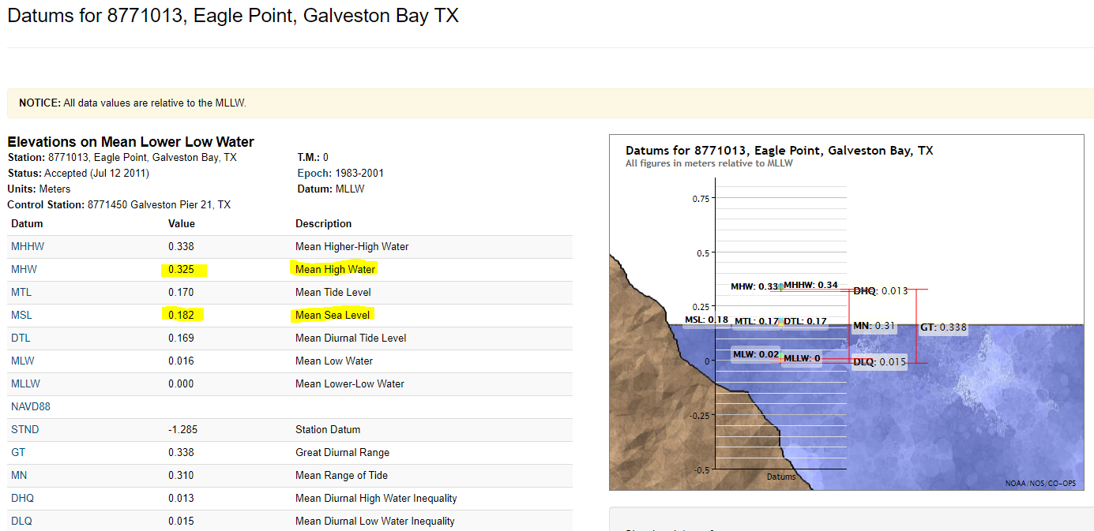
15 cm is difference between MSL & MHW!

Slide 31
You can use different resources, but…
You need good heights!

Slide 32
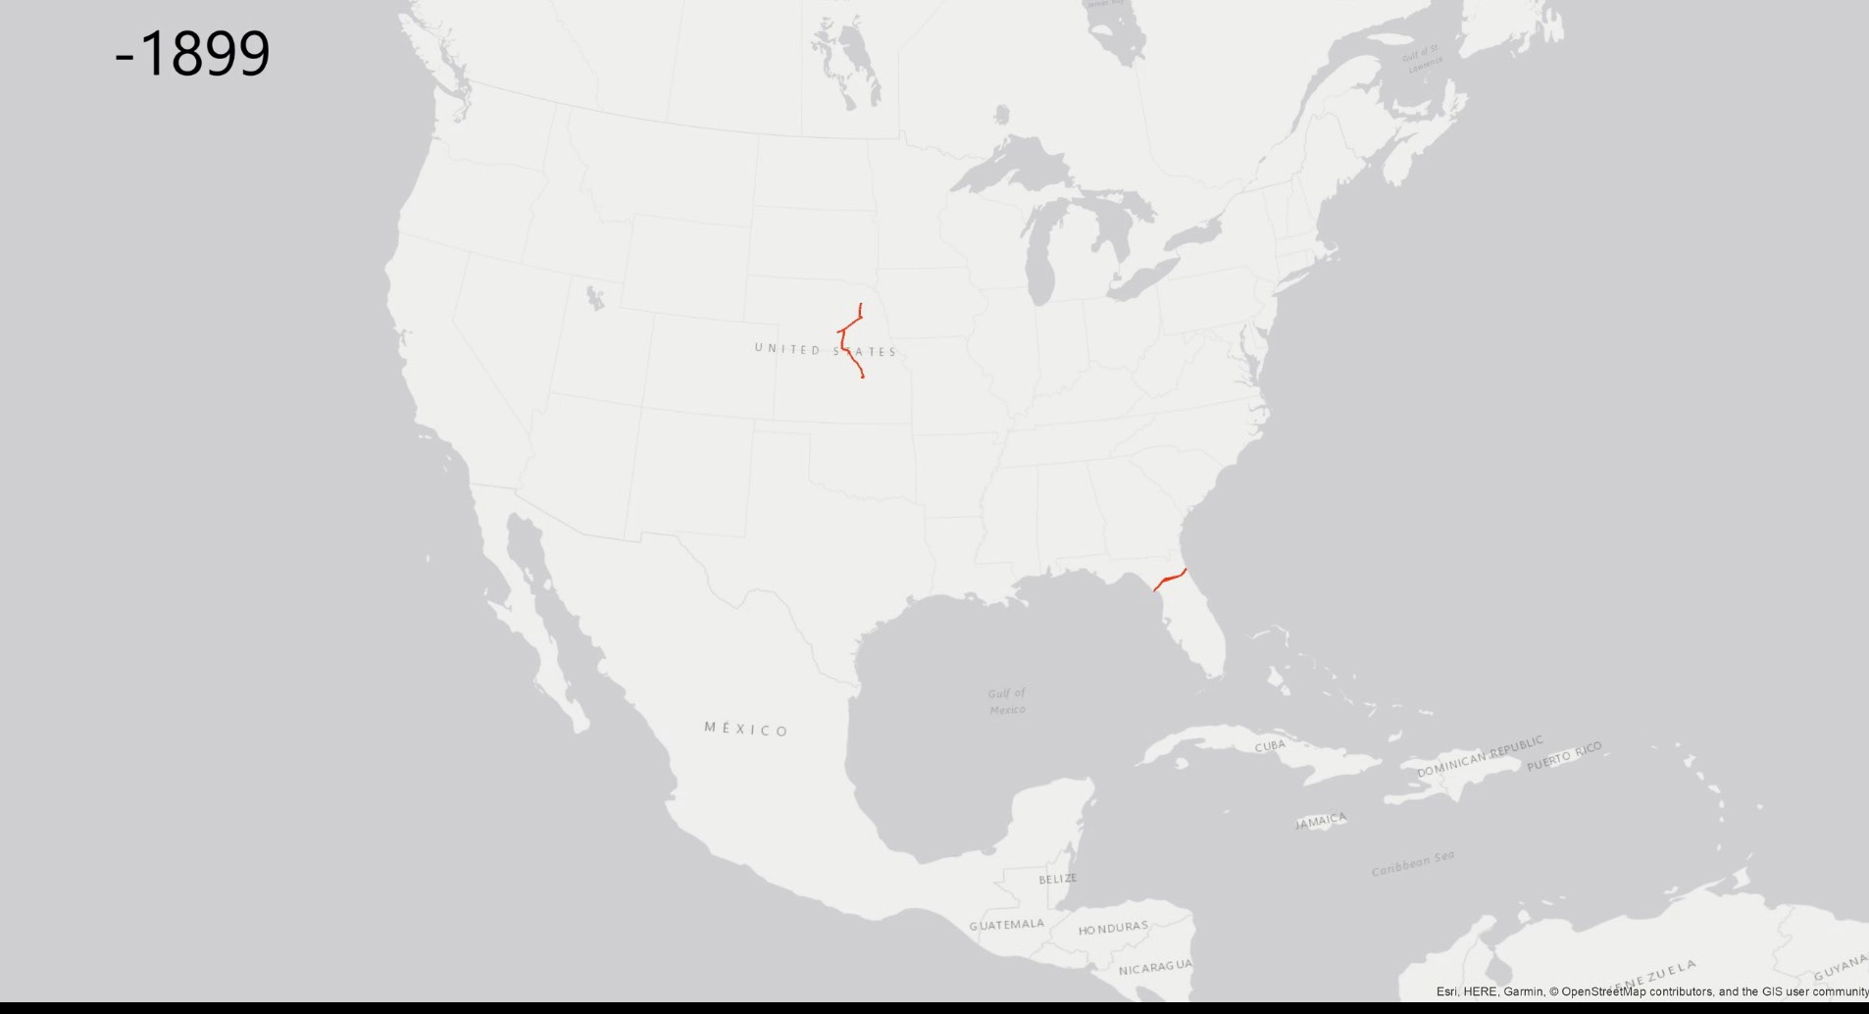
History of Leveling in the U.S.

Slide 33
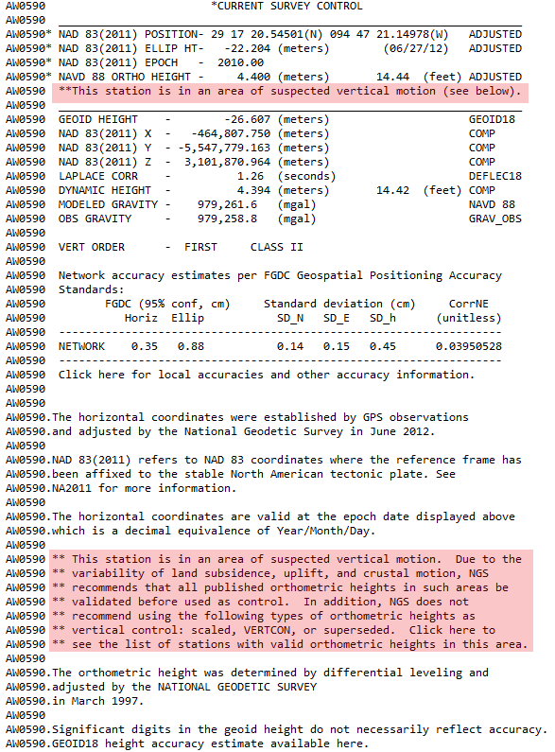
What is NGS doing about it now?

Slide 34
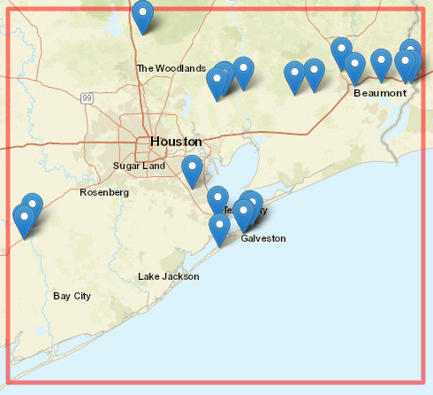
What is NGS doing about it now?

Slide 35
What can Texas do about it?
Densify geodetic control (with good heights) by conducting new Leveling & GPS projects
  Submit data for inclusion into the NSRS (FCGS Bluebook)
  Update elevations on a select set of marks (where good heights don’t exist)
  Improved survey network will provide enhancements for rebuilding and improvement of infrastructure in the area
  It will help with flood plain management, flood hazard identification and risk assessment, elevation certificates…

Slide 36
How can NGS support these efforts?
NGS can provide:
  Trainings
  Technical support
  Projects QA/QC
  Analyzing, ingesting and storing new data
  Online tools to access the NSRS
NGS cannot conduct field work for you!

Slide 37
What tools can Texas use?
BETA OPUS Projects - New way of Bluebooking!
  Makes bluebooking process easier and less intimidating
  Provides an interactive visual interface
  Automates the processing and creation of complex files
  Provides improved QA/QC process and better display & visualization of statistics

Slide 38
What tools can Texas use?
BETA OPUS Projects
  It requires minimum of two 2-hours sessions for your stations
  It is used for submitting static, campaign-style GNSS surveys resulting in network survey solution intended for inclusion in the NGS database
  New stations will have published adjusted position on a datasheet

Slide 39
What tools can Texas use?
OPUS Shared Solutions
  Your GPS data file must be 4 hours or longer
  This is not network survey solution intended for inclusion in the NGS database and it will not result in adjusted position on a datasheet
  This solution will be in OPUS database and new station will have OPUS shared solution

Slide 40
What tools can Texas use?
GPS on Bench Marks
  2022 Transformation Tool campaign
  To provide a mapping-grade transformation between the current and new datums
  Users are encouraged to submit GPS data on existing bench marks to improve the quality of the transformation in their local areas

Slide 41
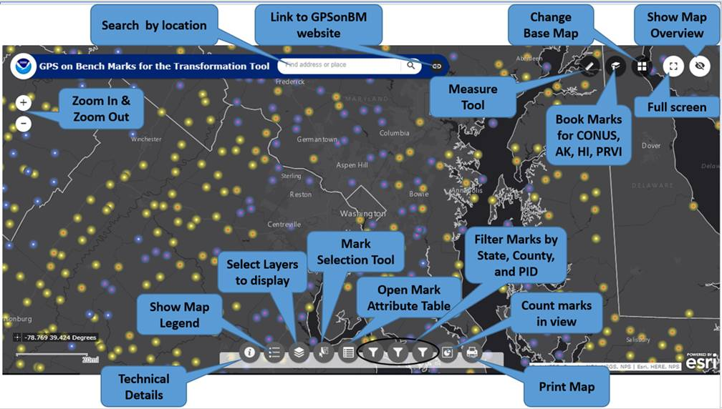
GPS on Bench Marks Web Map

Slide 42


Which Marks First? How Many Observations?
Marks are classified as Priority A or B
  Priority A marks meet quality standards for use in the transformation tool
  Priority B marks are lower quality marks, less likely to be used to make the tool, but may be used to test the tool
NGS needs 2 consistent GPS observations on a mark to use it in the tool. At least on observation within last 5 years (since 2014)
List and map indicate whether 1 or 2 observations are requested

Slide 43
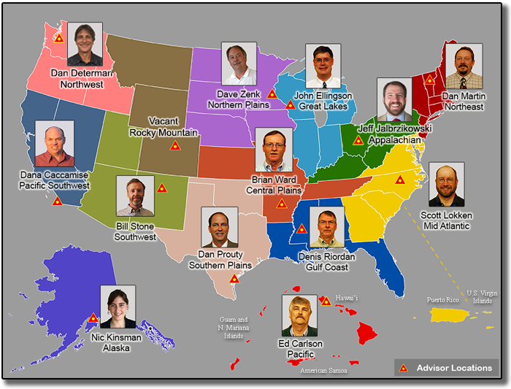
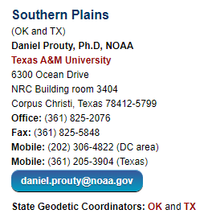
Contact your NGS Regional Geodetic Advisor

