Slide 1

Public Sector Networks- Vermont
New England Real Time Network Summit
Friday August 6, 2010
Dan Martin
National Geodetic Survey
VT State Advisor

Slide 2
What is VECTOR??
Vermont Enhanced CORS & Transmission Of Real-time data
Network of Continuously Operating GNSS Reference Stations.
Provides access to the National Spatial Reference System (NSRS)
Access available for post processing (Static) and Real-time (single base RTK).

Slide 3
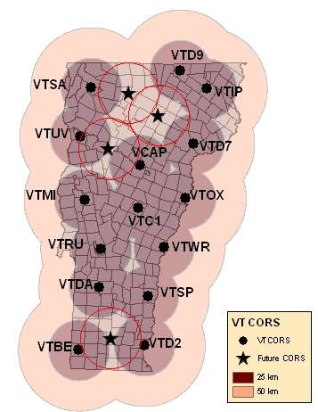
VECTOR Expansion
1996 - VCAP
2004 - VTUV
2006 – VTD2, VTSP, VTWR, VTOX, VTD7, VTD9, VTC1, VTSA, VTRU, (VCAP Upgrade)
2008 – VTBE, VTDA, VTMI, VTIP
Four Stations will be added in 2010 to complete the network - Dover, Bolton, Hardwick, and Eden

Slide 4
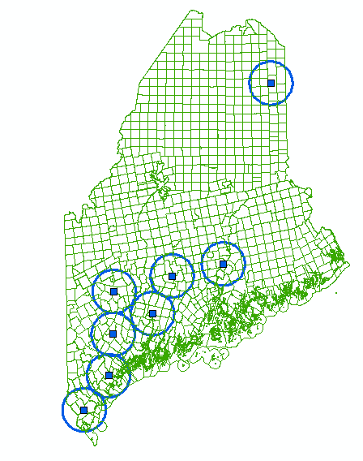
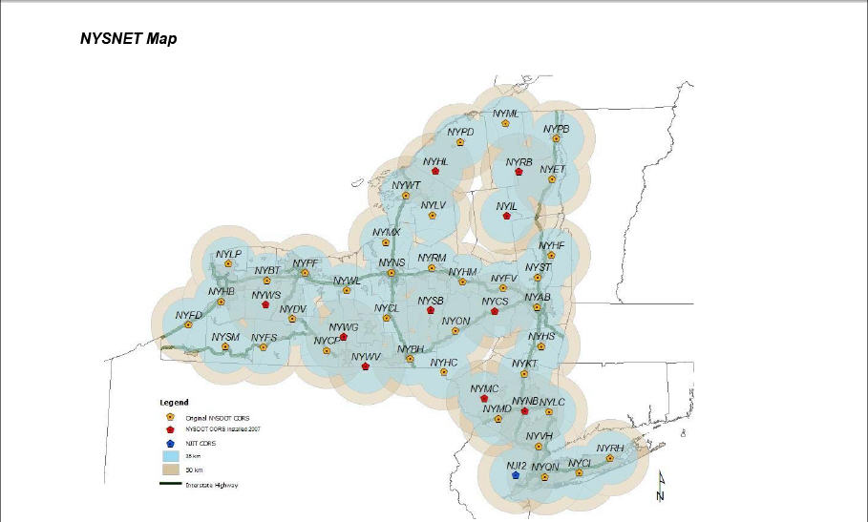
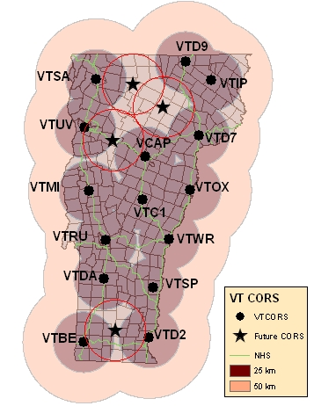
Real Time Networks

Slide 5
So What??
What is the benefit to having these station out there?
  Are they being used?
  How are they being used?
  Who is using them?
  How are they being accessed?
  How much are they being accessed?

Slide 6
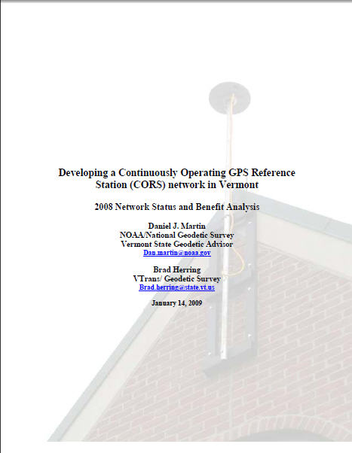

Slide 7
How are they being used?
Highway Surveys
Collection of inventory and resource data
  Culvert inventory, Rest Area re-design, and ITS elements such as RWIS, PCMS/VMS, and WIMS location and planning
Control surveys for photography and LiDAR
Topo
Boundary
Flood Plane mapping
Wetland Surveys
Construction stakeout
Geodetic and Geophysical applications
  Ionospheric modeling
  Plate tectonics
  Precipitable Water Vapor modeling (weather forecasting)

Slide 8
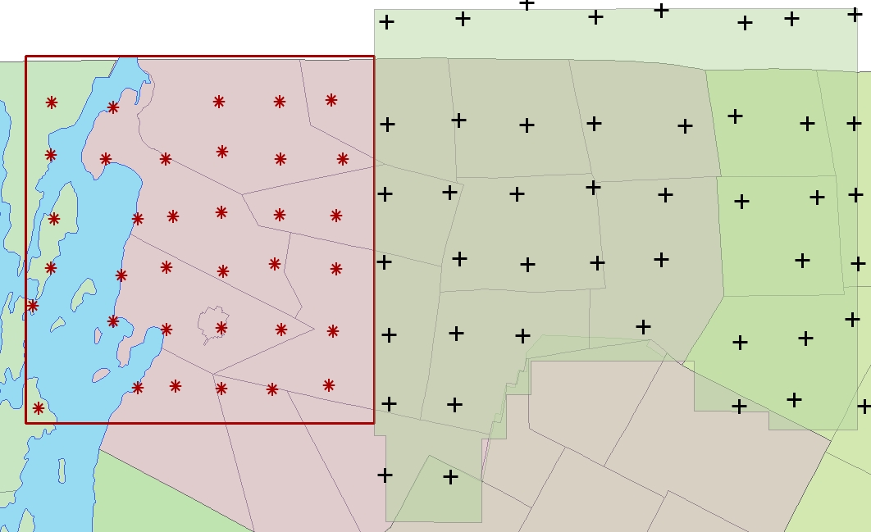
2009-2010 LiDAR QA

Slide 9
Interstate Small
Culvert Inventory
2007-2008
I89
  ≈4000 Culverts
  ≈2800 DI’s
  ≈10,800 Total Shots
I91 (first 95 miles)
  ≈2700 Culverts
  ???? DI’s
  ≈5400 Total Shots+DI’s
59 crew weeks
  ≈ $60k savings

Slide 10
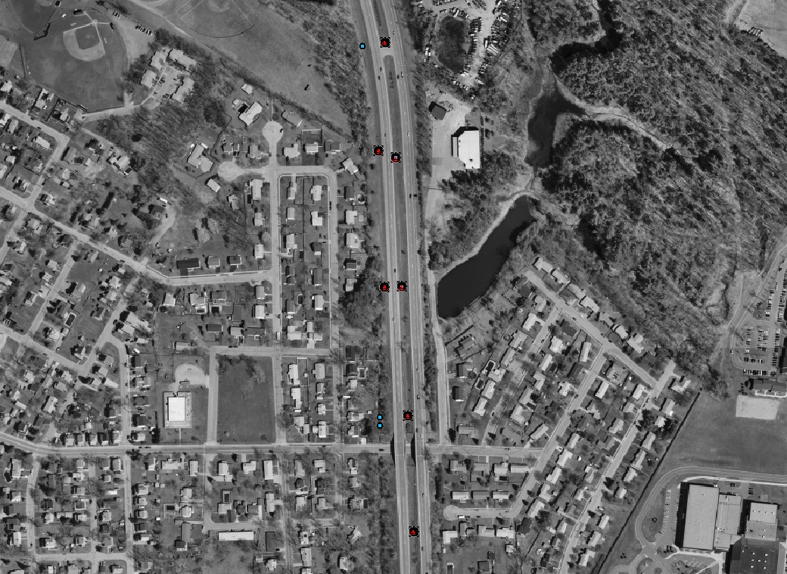
I89 Small Culvert Inventory

Slide 11
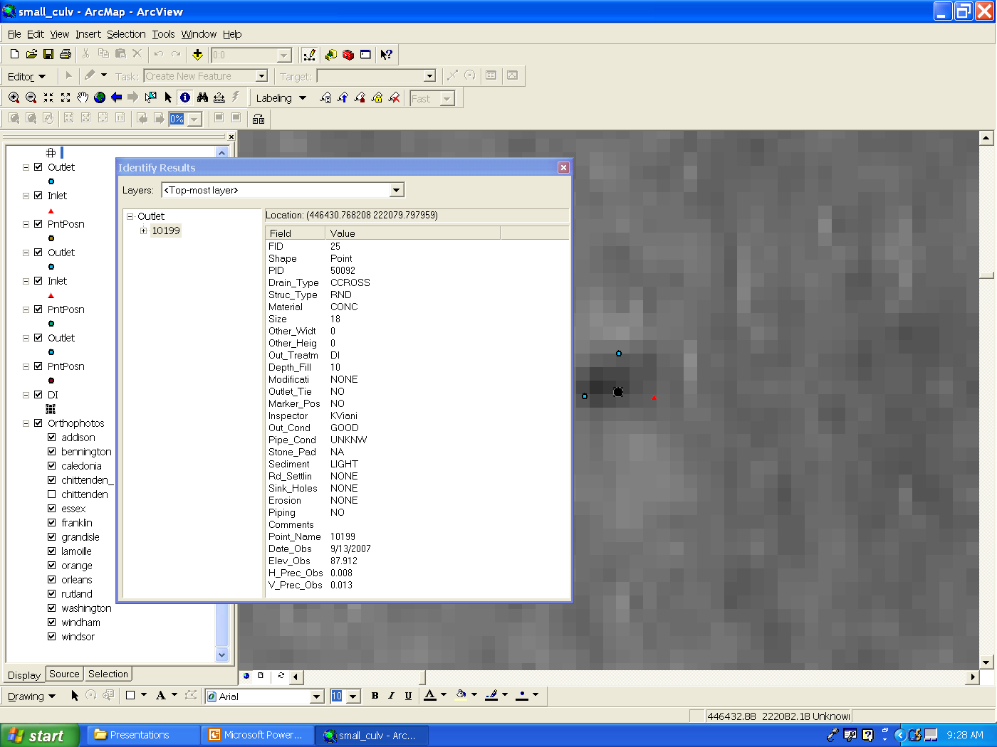

Slide 12
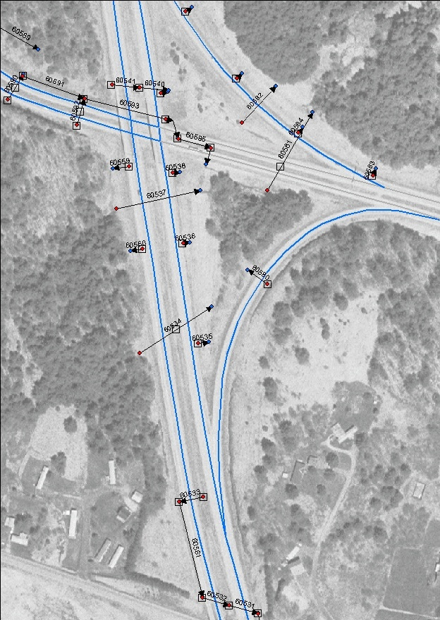

Slide 13
Who is using them
VTrans
Land Surveyors
Engineering firms
GIS Professionals
Foresters
Other State Agencies Such as Agency of Natural Resources and Department of Agriculture
Other non-VT State Agencies
Federal and International Agencies and educational institutions
  National Weather Service
  National Geodetic Survey
  US Geological Survey
  Geodetic Survey Canada
  International GNSS Service
  UVM, UNH, UMaine, Lyndon and Johnson State, Norwich University

Slide 14
How are the VT CORS being Accessed?
Raw Data (post processing)
  VTGS Web
  VTGS FTP
  NGS Web (UFCORS)
Derived Products
  OPUS_S
  OPUS_RS
  OPUS_DB
  RTK Corrections
Incorporated into other networks (NY, Keynet, MTS)

Slide 15
2009 Statistics
Product | 2009 Usage
UFCORS Downloads | 2364 2-hr files (ave)
VT Web Download (VTDL) | 5880 1-hr files
VT FTP Download | 8098 1-hr files
OPUS_S | 816 Solutions
OPUS_RS | 564 Solutions
OPUS_DB | 97 Submissions
RTK | 1614 Hours

Slide 16
COST/Benefit of VT CORS (Initial Investment)
Initial system investment into the VT CORS Network which was made to support the fiber optic project on the VT Interstates ≈ $340,000
  9 receivers and antennas
  system software,
  Installation
  required field equipment needed to make use of the system (4 rovers)

Slide 17
Benefit
Easy to quantify (included in report)
  Reduction in person hours to accomplish a task
  Reduction in purchased equipment to accomplish a task
  Reduction in purchased software
Difficult to quantify (not included in report)
  Reduced training (multiple types of equipment)
  Reduced maintenance (multiple types of equipment)
  Consistency and reliability of a system

Slide 18
Some generalities need to be made
One CORS replaces one receiver and operator
Without CORS network, one receiver and observer would need to spend an average of 2 hours to collect and download one hour of data (including travel)
Average UFCORS download consists of 2 hours of data
Cost of one observer and receiver is $50/hour
Most VT FTP users are “Resource Grade” users who require less accuracy. Could operate without VT CORS but would be subjected to even lower accuracy. FTP data has half the $$ benefit of data retrieved from the web page

Slide 19
Benefit for VT CORS Products
Product | User Benefit
UFCORS | $200/download
VT Web Download (VTDL) | $100/1-hour file
VT FTP Download | $50/1-hour file
OPUS_S | $600/solution
OPUS_RS | $600/solution
OPUS_DB | $400/submission
RTK | $100/hour

Slide 20
Direct Benefit to VTrans (work on Interstate)
RTK
  2007 use = 576 hours
  2008 use = 970 hours
  2009 use = 812 hours
OPUS_S
  2008 solutions = 60
  2009 solutions = 97
OPUS-DB
  2008 submissions = 60
  2009 submissions = 97

Slide 21
Direct Benefit to VTRANS

Slide 22
Direct Benefit to VTrans
3 year benefit (2007-2009) ≈ 112% of initial system investment

Slide 24
Cost/Benefit (Current level of investment)
Current level of investment ≈ $567,668 which includes the initial investment ($340,000) plus
  8new CORS ($195,528)
  Extended Warranty on firmware and software since implementation ($32,140)
Benefit/Cost ratio of 11.3 to 1 in 2.5 years

Slide 25
Summary
The VT CORS Network has provided significant benefit to VTrans and the taxpayers of VT
It supports a wide variety of different applications from a diverse user community
Three-year cost recovery based on VTrans usage only

Slide 26
Recommendations
Continue with expansion of network to provide state-wide coverage
Work to get as many stations into the National Network as possible
Work to increase the use of the network inside VTrans
Continue to promote the network outside of VTrans

