Slide 1
Towards the unification of the vertical datums over the North American continent
D Smith¹, M Véronneau², D Roman¹,
J L Huang², YM Wang¹, M Sideris³ ¹National Geodetic Survey
²Natural Resources Canada
³University of Calgary d
Notes:
Does “Toward” takes an “s” in this case???

Slide 2
Overview
Status of the North America Vertical Datums
NAVD88, IGLD85 and CGVD28
Plans and suggested procedures for the unification
Fundamental constants/parameters/models
Relationship between North America VD and the WHS, existing VDs and ITRFs
Summary

Slide 3
Current VDs used by N.A. countries
United States | Canada | Mexico | Puerto Rico
NAVD88 IGLD85 | CGVD28 IGLD85 | NAVD88 | PRVD 02
GEOID09 | HTv2.0 | GGM05 | GEOID03
Notes:
I think it should be mentioned that Canada and USA provides hybrid geoid models to go directly from ellipsoidal heights to national vertical datum, but the problem is that the hybrid models includes the errors of the official datum. Hybrid models allows users to combine modern technologies (e.g., GNSS) with traditional realized datum (levelling). Unfortunately, this mixture is sometime more problematic than useful.

Slide 4
Problems in NAVD88
A North American Datum realization through spirit leveling networks
Pre-satellite era product (625,000 km of leveling added to the NGVD29)
Height information through passive benchmarks whose positions change constantly in our changing world (e.g., PGR, earthquakes, subsidences …)
The geoid differences between NAVD88 and GRACE are in meter range: compare to ±2-3 cm error in typical GPS ellipsoidal heights

Slide 5
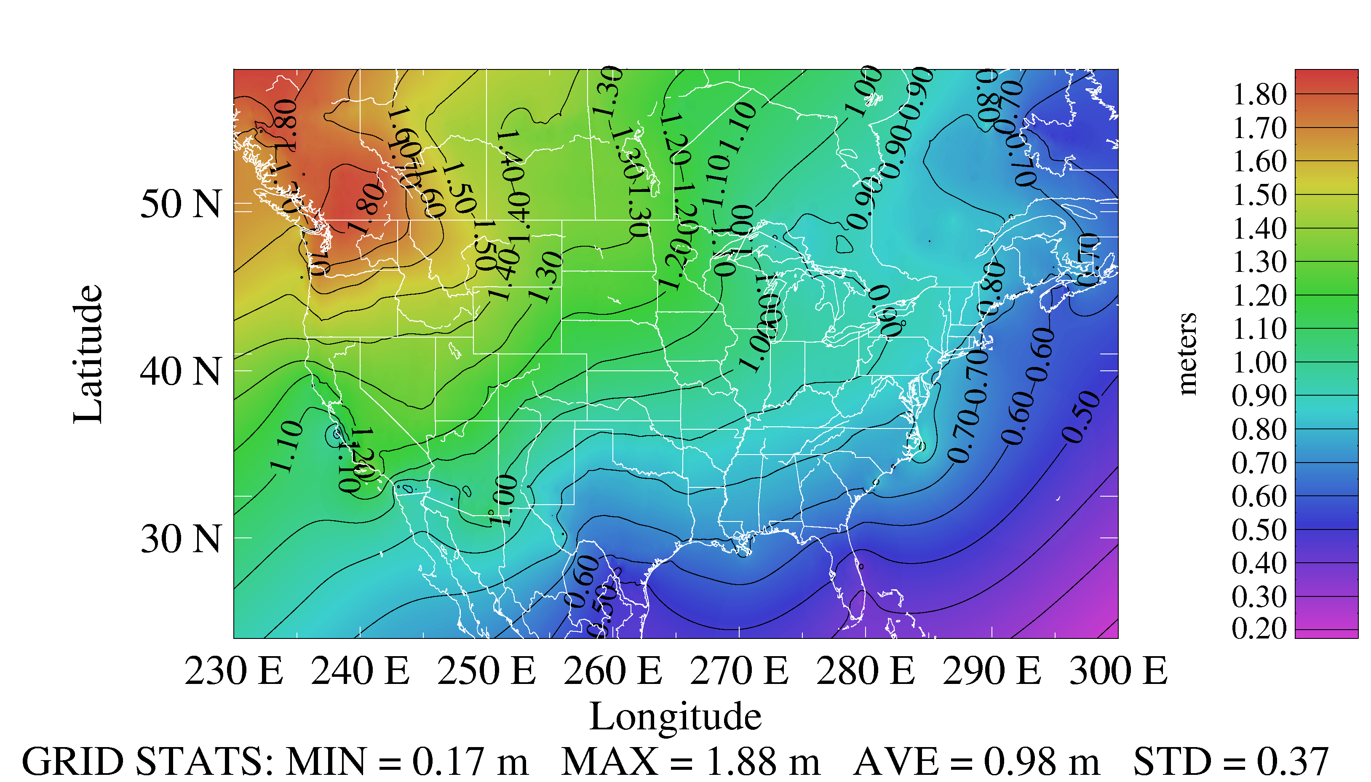
Geoid difference (GGM02S-NAVD88)

Slide 6
Problems in CGVD28
Pre-satellite era product: Still based on the initial adjustment from 82 years ago
Several local piecemeal adjustments since 1928
Does not make use of any actual gravity (normal gravity only)
Still neglects several systematic errors (Sea level rise, post-glacial rebound, systematic corrections to leveling measurements)
Analysis indicates that the national distortion ranges from -35 cm (Halifax, NS) to 75 cm (Banff, AB), representing about a one-meter distortion in Canada.

Slide 7
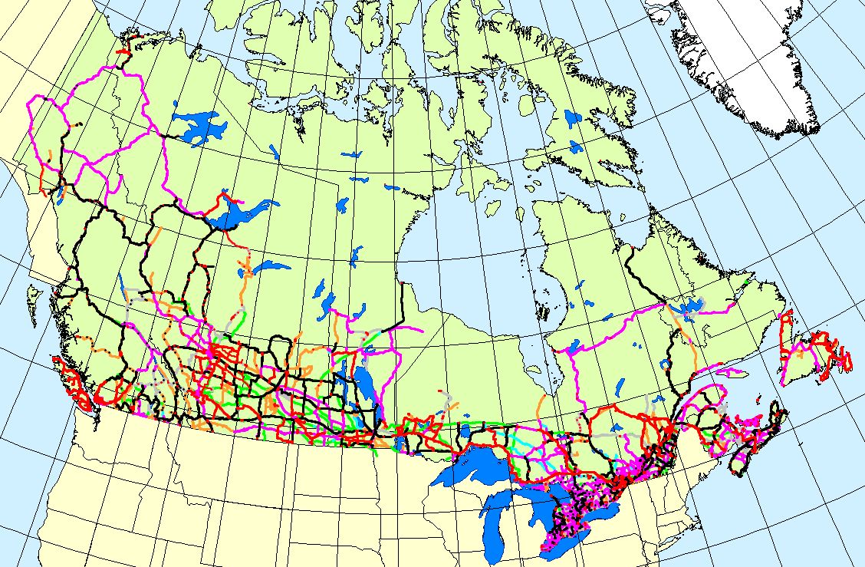
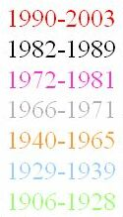
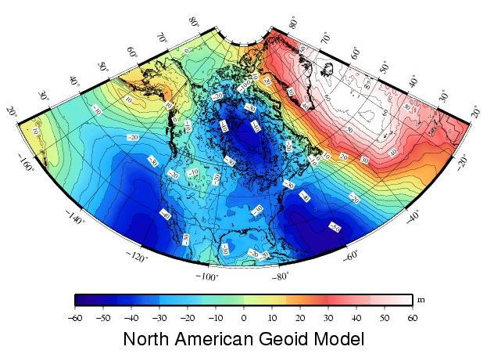
Canada Height Modernization - 2013
The geoid model:
1. Entire coverage of the
Canadian territory
(land, lakes and oceans)
2. Compatible with space-
based positioning
(e.g., GNSS, altimetry)
3. Less expensive for
maintenance
4. Fairly stable reference
surface
Levelling Networks:
1. Established over the
last 100 years
2. 120,000 km of levelling
lines
3. Some 80,000
benchmarks
1. Time consuming
2. Expensive
3. Limited coverage
4. BMs are unstable
5. BMs disappear
6. Local networks
H = h_{GNSS} – N_{Model}

Slide 8
The GRAV-D Project
A US NGS lead gravity project for improving American geoid model
Redefinition of the vertical datum of the US by 2021
Gravity
for the Redefinition of
the American vertical Datum
A NOAA contribution to the Global Geodetic Observing System (GGOS) component of the Global Earth Observation System of Systems (GEOSS)

Slide 9
Differences in Canada and US plans
The main difference between the two plans is the date of implementation of a new vertical datum
Canada is to replace CGVD28 in 2013
US is to redefine its vertical datum by 2021
Possible danger: Datum discontinuity at countries’ borders
Canada and USA need to agree on a common equipotential surface, which will still be suitble for US by 2021
Difference in the realization of geoid models in Canada and USA
The US plan includes modernization of the 3D reference frames (lat, lon and h); Canada has currently no plan to replace NAD83(CSRS)
Geoid heights will not be in the same reference frame
It will require a transformation

Slide 10
Solution:
The unification of the vertical datums over the North American continent (NAVRS)

Slide 11
NAVRS: Fundamental concepts
An equipotential surface (W₀, Unit: m² s⁻²)
To be realized by a geoid model (N, Unit: m)
A dynamic surface (N^{dot}, Unit: mm/yr)
Maintained according to adopted national, continental and international standards

Slide 12
NAVRS: Requirements
One geoid model for North America: Canada, United States (including Alaska and Hawaii), Mexico and Caribbean Islands (possible expansion to include Greenland and Central America … South America?)
Accuracy
±1 - 2 cm absolute accuracy in coastal and flat areas;
±3 - 5 cm in mountainous regions
A dynamic surface
Will be updated at certain time interval (time-tagged model)
Will realize a velocity model of the geoid
Notes:
It is required to produce both: velocity model and updated version. The updated version is required to represent the geoid variation for a new epoch AND the improvement due to better theory and data sets since the last realization. The velocity models are required to show users how the geoid change in time and inform them if they should be worry or not about the dynamic aspect of the geoid

Slide 13
Required parameters for a geoid model
Geoid model parameters
Boundaries (North/South/West/East)
Grid Interval (ΔLat , ΔLon)
Potential (e.g., W₀ = 62636855.69 m²/s²)
Reference ellipsoid (e.g., GRS80)
Geometric frame (e.g. NAD83(CSRS), ITRF2008)
Geocentric gravitational constant (GM)
Epoch
Tidal System (Tide free or mean tide)
Node: Point or mean values / Center or Corner
Supplemental files
Error estimates for geoid heights (σ_{N})
Geoid vertical velocity (N^{dot})
Error estimates of velocities (σ_{N-dot})

Slide 14
Challenges in the 1-cm geoid computation
Theories (more terms = more accurate?)
All computation methods are equivalent, but not equal – models computed from the same data sets using different methods may differ from cm to dm
How to judge a geoid computation method is superior over others?
How to quantify and verify geoid accuracy (relative and absolute)?

Slide 15
NAVRS: Realization
Definition of the vertical reference system
Adoption of a W₀ value from an internationally agreed upon value
No fundamental stations in realizing the vertical reference system
Realization of the vertical reference system
A gravimetric geoid
Data
Satellite gravity models (GRACE , GOCE…), airborne and surface gravity, DEM , density of the topography
Validation
Geoid test lines
Deflections of the vertical
Ocean dynamic topography models

Slide 16
Options to define a time varying geoid
Three options
Define to a W₀ value that fits the global mean sea level
Advantage: Datum always represent GMLS
Disadvantage: no consistency for heights as W₀ changes
Define to a fixed W₀ value
Advantage: Possible height consistency if model is at correct surface
Disadvantage: Not consistent with MSL
Define by the same initial equipotential surface
Advantage: Height consistency; even correct for computational error
Disadvantage: Not consistent with MSL
Geoid model parameters allow advanced users to convert data to any datums
Canadian favourite option

Slide 17
Geoid change monitoring
Long wavelength changes can be monitored by satellite gravity missions
as long as a GRACE follow-on or equivalent mission is available
If not, national GNSS network (e.g, CORS, ACS, CBN) with absolute gravity measurements (a challenging approach)
Medium to short wavelength (e.g., 5-100km) changes may be monitored by combination of GNSS measurements, surface gravity measurements and DOVs for regions with high interest
Provide a velocity model of geoid variation
Notes:
NGS and GSD should provide a velocity model of the geoid to indicate to users how the geoid behave in time. This is in addition to provide a time-tag geoid model on a regular basis (e.g., 5 years, 10 years, …) or whenever it warrants an update due to new information (data, theory) that provides a more accurate model. With ground technologies, it will not be feasible to monitor short to medium wavelengths across North America; it has to be target areas.

Slide 18
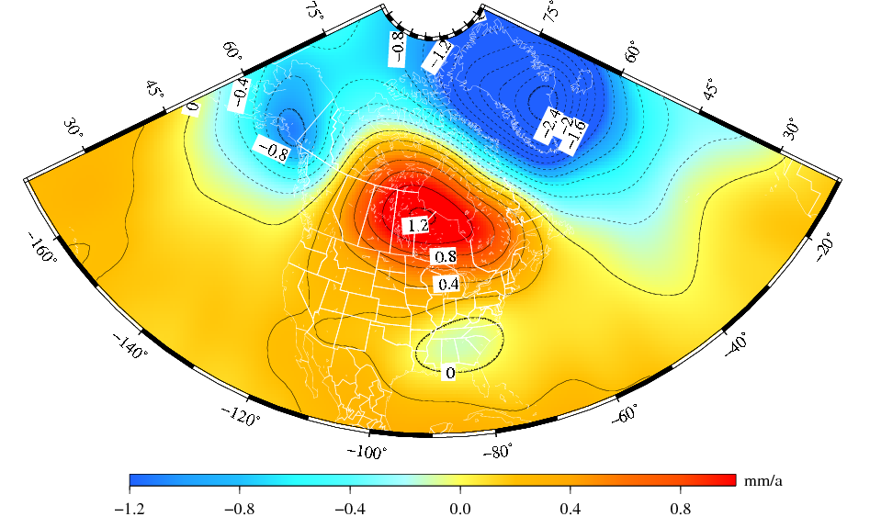
The “secular” geoid change from the monthly GRACE models (2002-2008).
Deglaciation
The solution represents the effect due to total mass changes.
The solution uses a 400-km Gaussian filter.
Glacial Isostatic
Adjustment
Drought
Notes:
Secular is between quotation marks because only GIA is secular, the deglaciation and drought are currently more recent multi-year systematic variations of the geoid. I used the term “secular” not to confuse with seasonal variations of the geoid.

Slide 19
Relationship between WHS and existing VDs
The relationship is through conversion surfaces:
NAVD ↔ WHS
Should be zero or a potential constant if WHS and NAVD does not adopt the same equipotential surface
No WHS is established by IAG yet
NAVD ↔ Levelling datums (NAVD88, CGVD28 and NGVD29)
Use of a hybrid geoid model to convert between geoid and levelling datum
NAVD ↔ IGLD
Software to convert from orthometric heights to dynamic heights for proper water management of the Great Lakes and St-Lawrence Seaway
Note: IAG should adopt Wo = 62636855.69 and EGM08 as its best realization. All research and development related to height system should be in reference to this adopted constant.
Notes:
The big question is: What will be the WHS?

Slide 20
Summary
North America needs a unified vertical datum
NAVD is to be realized through a geoid model with well established parameters
The geoid model is required to have an absolute accuracy of ±1-2 cm in coastal and flat areas and ±3-5 cm in mountainous regions
Challenges
Canada and USA do not have the same implementation date
Technical aspects
Data accuracy and coverage
Computation methods
Validation and verification
Long-term maintenance of the NAVD
No definition of a WHS yet
Notes:
Regarding the long term-maintenance of the geoid model; should the presentation discuss if we want to use a NAVRS that is GMSL-driven, specific-Wo driven or consistant-equipotential surface driven? Do you understand well the difference between the three options from my presentation that I sent to you in a previous e-mail.

