Slide 1



A New & Improved National Spatial Reference System
Refinements of the North American Datum of 1983 through the Multi-Year CORS Solution
and the National Adjustment of 2011
Michael L. Dennis, RLS, PE
michael.dennis@noaa.gov
SURVEY SUMMIT
The ACSM Annual Conference
July 7-12, 2011 ● San Diego, CA
San Diego Convention Center
®
ACSM

Slide 2
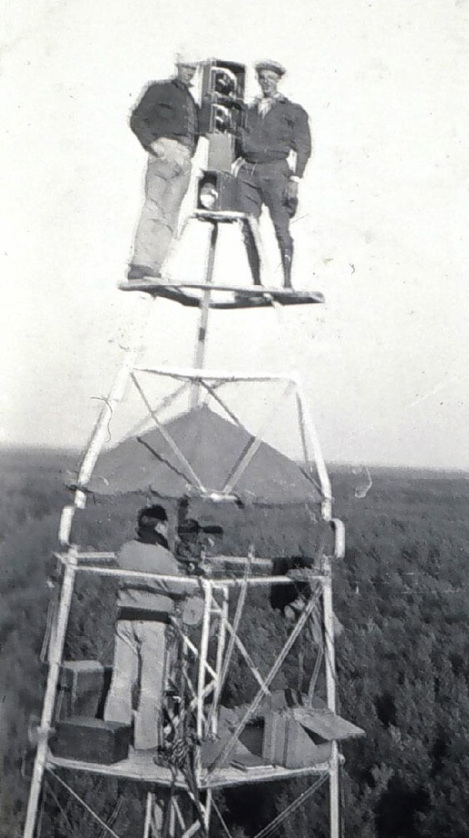
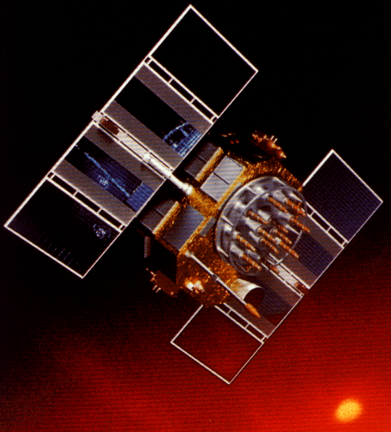
A (very) brief history of NAD 83
Original realization completed in 1986
  Consisted (almost) entirely of classical (optical) observations
“High Precision Geodetic Network” (HPGN) and “High Accuracy Reference Network” (HARN) realizations
  Most done in 1990s, essentially state-by-state
  Based on GNSS but classical stations included in adjustments
National Re-Adjustment of 2007
  NAD 83(CORS96) and (NSRS2007)
  Simultaneous nationwide adjustment (GNSS only)
New realization: NAD 83(2011) epoch 2010.00

Slide 3
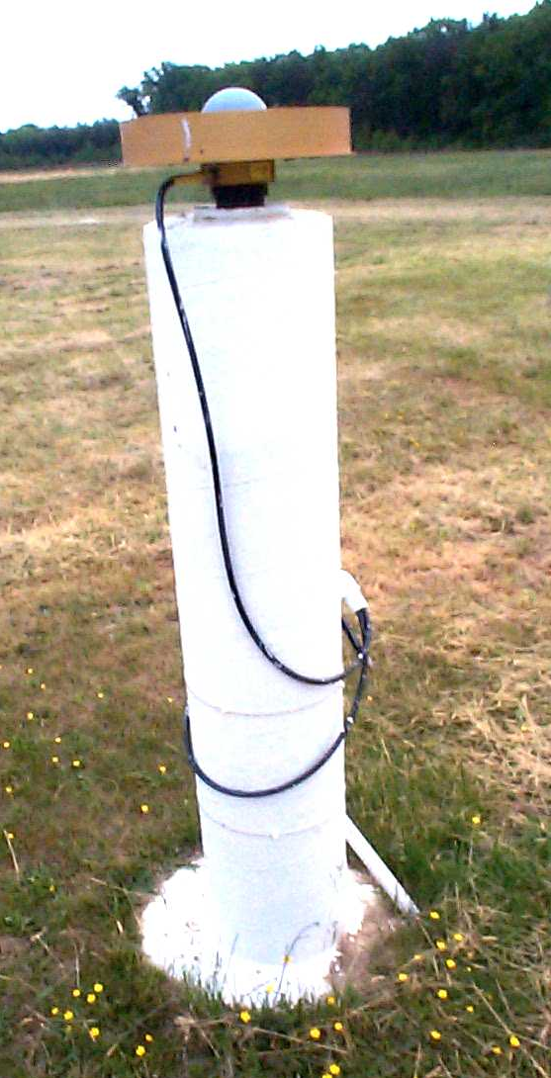
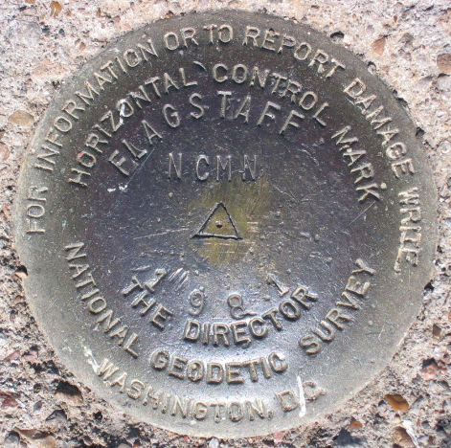
Introducing…
NAD 83(2011) epoch 2010.00
Multi-Year CORS Solution (MYCS)
  Reprocessing of all CORS GPS data 1994-present
  2264 CORS & global stations
  NAD 83 computed by transformation from IGS08
National Adjustment of 2011 (NA2011)
  New adjustment of GNSS passive control
  GNSS vectors tied (and constrained) to CORS
  NAD 83(2011) epoch 2010.00
  Approximately 80,000 stations and
  400,000 GNSS vectors
Realization SAME for CORS
and passive marks
This is NOT a new datum! (still NAD 83)

Slide 4
Why a Multi-Year CORS Solution?
Consistent coordinates and velocities from combined solution
  Previous a mix of station and velocity sources, few ties to global frame
  Previous vertical velocities of zero for most CORS
Aligned with most recent realization of global frame (IGS08)
  IGS08 epoch 2005.0 (previous aligned at epoch 1997.0)
  NAD 83 epoch 2010.0 (previous epochs of 2002.0 and 2003.0)
Major processing algorithm, modeling, metadata improvements
  Conformance with current international conventions (IERS)
Absolute phase center antenna calibrations
  Both ground (receiving) and satellite (transmitting) antennas
  Previous (CORS96) used relative calibrations (significant change)
Highly accurate and consistent CORS coordinates and velocities determined using best available methods
  Needed because CORS network is foundation of NSRS

Slide 5
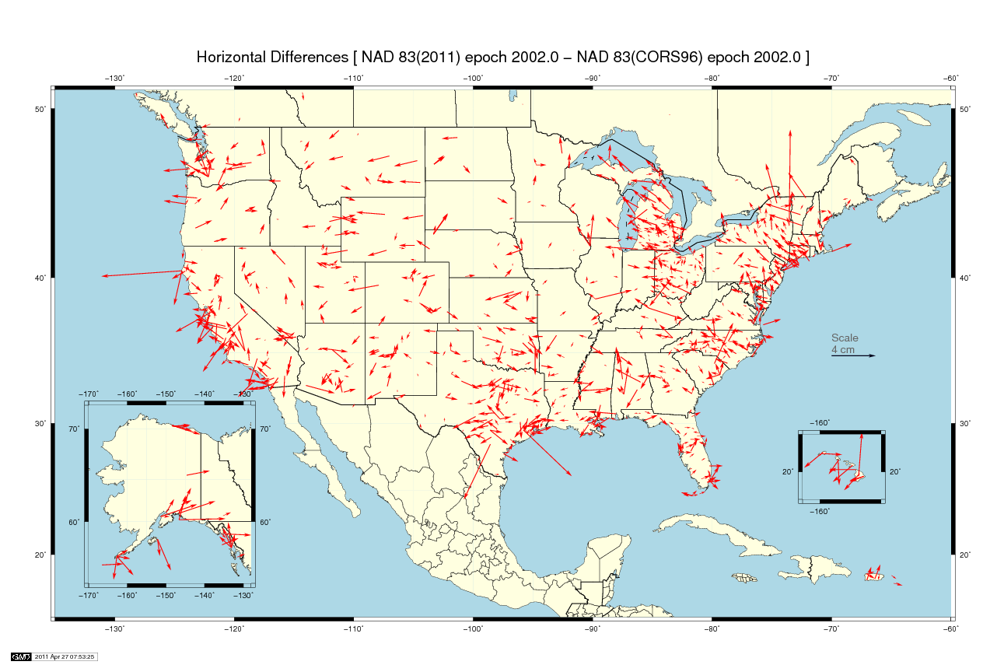
Mean horizontal shift = 0.2 cm (±2 cm) at epoch 2002.0

Slide 6
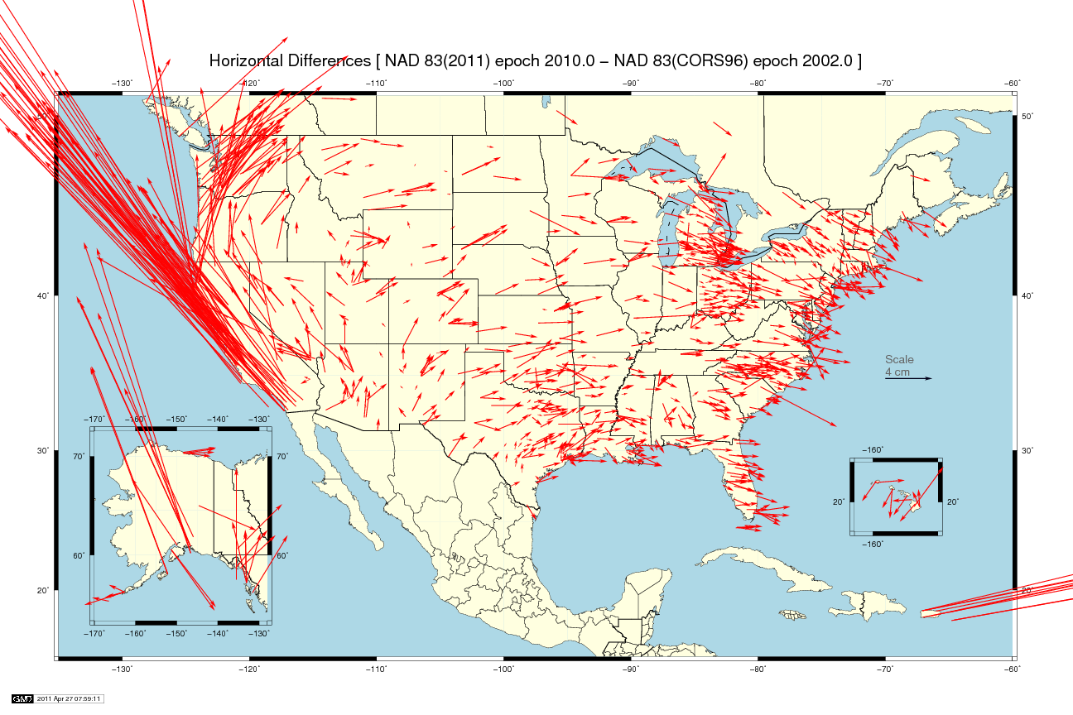
West CONUS
mean shift = 1.1 cm
East CONUS
mean shift = 0.1 cm
Mean horizontal shift = 2.0 cm (±8 cm) from 2002.0→2010.0

Slide 7
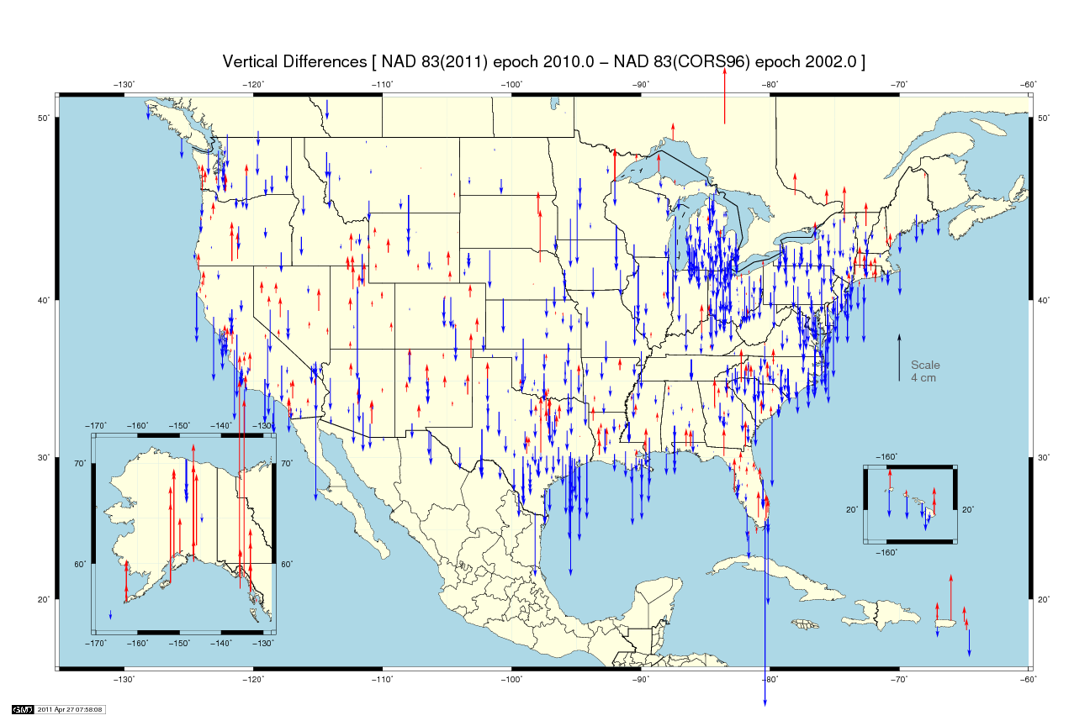
Mean vertical shift = -0.8 cm (±2 cm) from 2002.0→2010.0
Mean vertical shift = +0.7 cm (±2 cm) at epoch 2002.0

Slide 8
Why a new national adjustment?
Optimally align passive control with new CORS
Add >1000 projects submitted since 2007 project
  Also observations for Hawaii, other Pacific islands
Network and local accuracies on all stations
  Including future submitted projects
More consistent results in tectonically active areas
  More current data, better tectonic modeling
Better computations and analysis techniques
  E.g., improved outlier detection
  Incorporation of lessons learned from previous national adjustment

Slide 9
Transformation & Tectonic Complications
NAD 83(2011) transformation tools?
  NAD 83(2011) ←→ (NSRS2007/CORS96) ←→ (HARN)
  Under study by NGS
When is North America not North America?
  Not all stations on the North American tectonic plate
  Pacific plate: Hawaii and American Samoa
  Mariana plate: Guam and CNMI
  Caribbean plate: Referenced to North American plate
  Can relate frames (and epoch dates) with HTDP

Slide 10
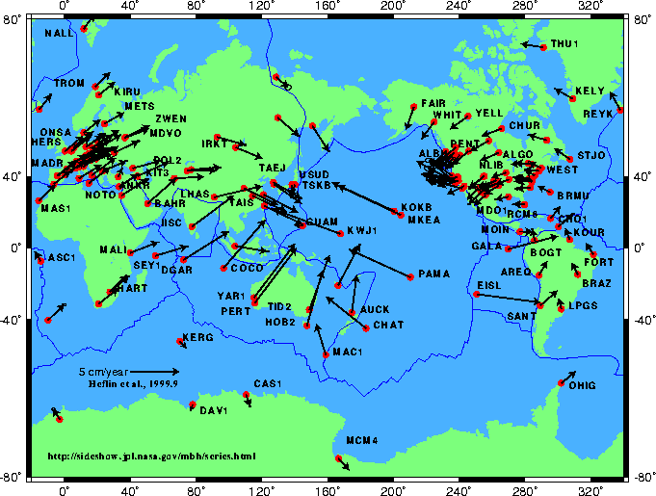
Tectonic Motions

Slide 11
What’s in a name?
That which we call a datum
By any other name would smell as sweet…
NAD 83(2011) epoch 2010.00
  “2011” is datum tag → year adjustment complete
  “2010.00” is “epoch date” (January 1, 2010)
    Date associated with coordinates of control station
  Frame fixed to North American tectonic plate
    Includes California, Puerto Rico, and US Virgin Islands
NAD 83(PA11) epoch 2010.00
  Frame fixed to Pacific tectonic plate
NAD 83(MA11) epoch 2010.00
  Frame fixed to Mariana tectonic plate

Slide 12
When will it all be done?
Multi-Year CORS Solution
  Beta results released in May 2011
  Official release of coordinates August 2011
  OPUS (Online Positioning User Service)
    Will provide solutions referenced both to previous (CORS96) and new (MYCS) coordinates
    Dual solutions will be available until NA2011 complete
National Adjustment of 2011
  Goal: Complete by end of 2011 calendar year
  Deadline for submitted projects: Aug 31, 2011

Slide 13
Near-future plans & possibilities
New hybrid geoid model (likely “GEOID12”)
  Use NAD 83(2011) epoch 2010.00 ellipsoid heights on NAVD 88 benchmarks
  Might also use OPUS-Database results on NAVD 88 BMs
May perform national vertical adjustment
  Constrain vertically to NAVD 88 benchmarks
    Perform as simultaneous nationwide adjustment
  GNSS-derived orthometric heights
    NAD 83(2011) ellipsoid heights with GEOID12
    NOT a readjustment of NAVD 88 leveling

Slide 14


More information…
geodesy.noaa.gov

Slide 15
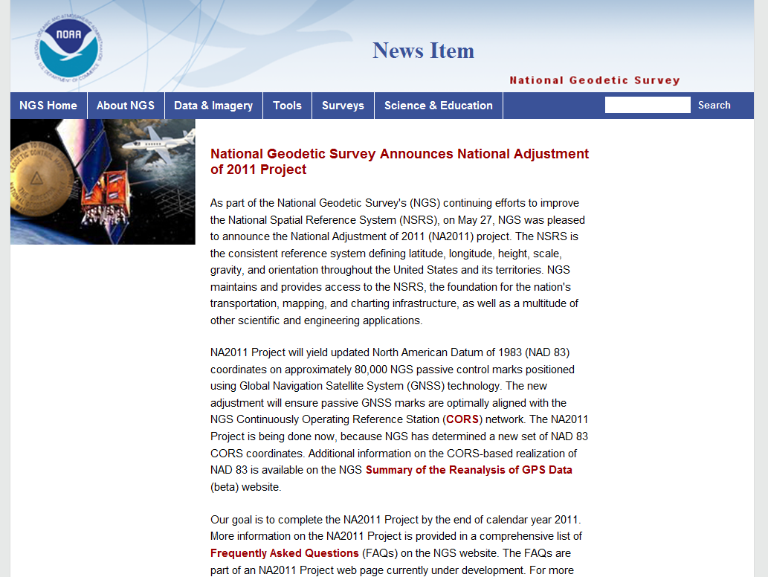
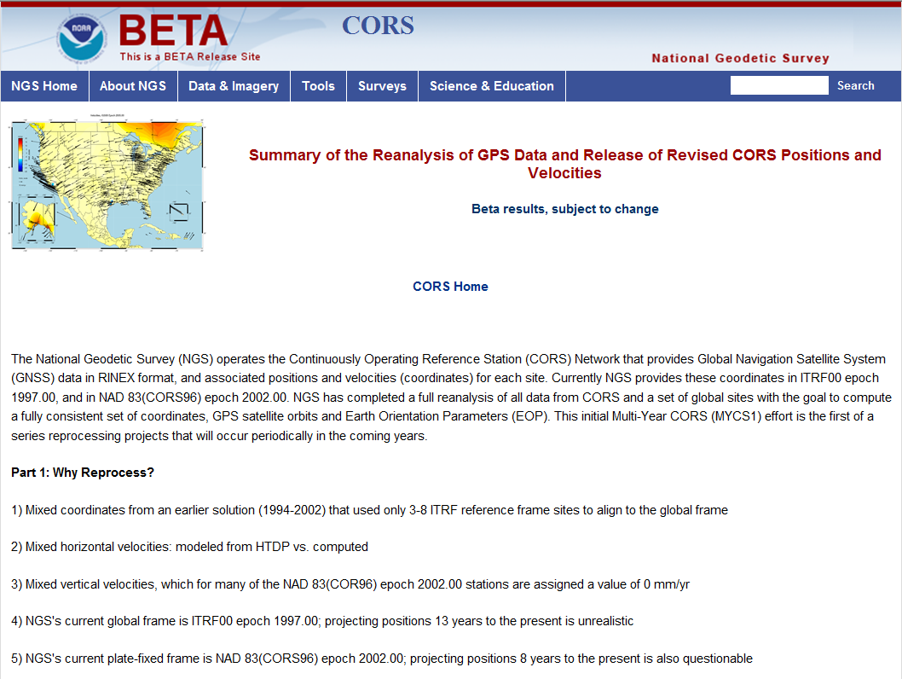
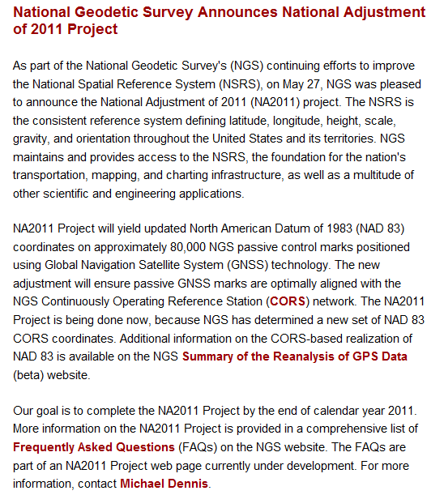
geodesy.noaa.gov

Slide 16


Slide 17
Points of Contact
Multi-Year CORS Solution
  Giovanni Sella: giovanni.sella@noaa.gov
  Jake Griffiths: jake.griffiths@noaa.gov
National Adjustment of 2011
  Michael Dennis: michael.dennis@noaa.gov

