Slide 1
Positioning in a multi-Global Navigation Satellite Systems (GNSS) World
Jacob Heck
December 14, 2017
NGS Webinar Series

Slide 2
About me
Geodesist at NOAA’s National Geodetic Survey since 2016.
Previously a graduate research associate at The Ohio State University as well as a surveyor in private industry and for county and state governments.
Ph.D. Candidate in Geodetic Science at Ohio State.
M.S. in Geodetic Science from Ohio State.
B.S. in Surveying Engineering from Michigan Technological University in Houghton, Michigan.

Slide 3
Outline
Overview of the history of GNSS
Describe the different constellations
Advantages/challenges of a multi-constellation solution
Show some examples of improvements when using extra satellites

Slide 4
GNSS Timeline
1960
1970
1980
1990
2000
2010
2020
1960: First Transit satellite launched
1982: First GLONASS satellite launched
1994: International GPS Service (IGS) forms
2001: GLONASS only has 6 satellites
1978: First GPS satellite launched
1983: First Network GPS project, Summit County, Ohio
1995: GPS, GLONASS fully operational

Slide 5
GNSS Timeline
2000
2010
2020
2016: Galileo declared initially operational
2020: Galileo and BeiDou constellations expected to be complete
2003: First GLONASS-M satellite launched
2011: GLONASS fully operational (again)
2007: First BeiDou satellite launched
2005: First Galileo satellite launched
2011: BeiDou initially operational over the Asia-Pacific Region
2017: 113 GNSS satellites in the sky, multi-GNSS smartphones fit in your pocket
Notes:
Google Pixel 2 has GPS+GLO+GAL+BDS+QZSS

Slide 6
GNSS Timeline
1960
1970
1980
1990
2000
2010
2020
GPS
31
GLONASS
24
GALILEO
27
BEIDOU
35
QZSS
4
NAVIC
7

Slide 7
The Constellations
Name | Country | Began | #now | FOC | Type
GPS | USA | 1978 | 31 | 30 | MEO
GLONASS | Russia | 1982 | 24 | 24 | MEO
Galileo | European Union | 2005 | 22 | 30 | MEO
BeiDou | China | 2007 | 25 | 35 | MEO (27),GEO (5), IGSO (8)
QZSS | Japan | 2010 | 4 | 4 | IGSO
NavIC | India | 2013 | 7 | 7 | 3 GEO,4 GSO
TOTAL |  |  | 113 | 130
Notes:
4 Galileo satellites were just launched on Tuesday. MEO – Medium Earth Orbit; GEO – Geostationary Earth Orbit; IGSO – Inclined Geo-Synchronous Orbit

Slide 8
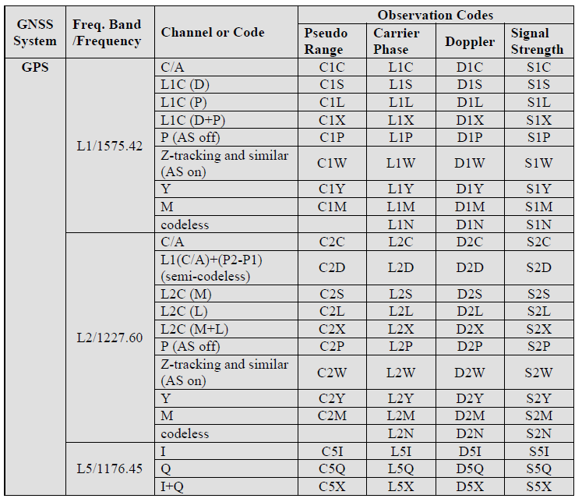
GPS Signals
https://www.labsat.co.uk/

Slide 9
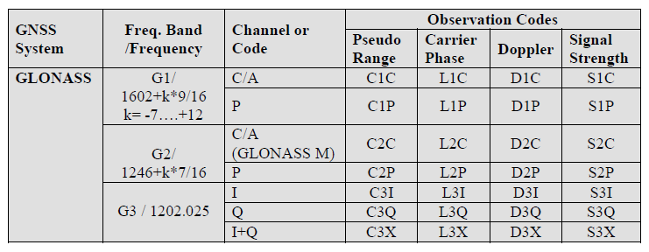
GLONASS Signals
https://www.labsat.co.uk/

Slide 10
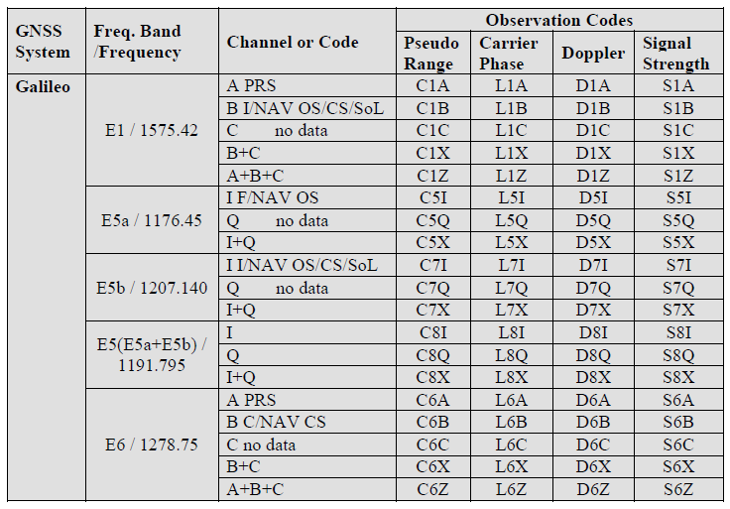
Galileo Signals
https://www.labsat.co.uk/

Slide 11
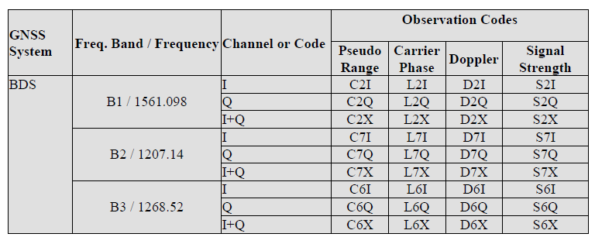
BeiDou Signals
https://www.labsat.co.uk/

Slide 12
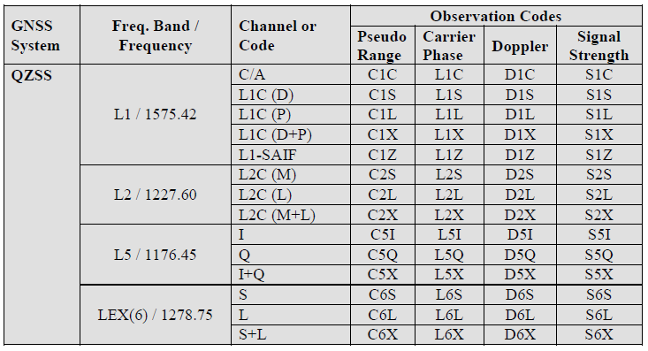
QZSS Signals
https://www.labsat.co.uk/

Slide 13
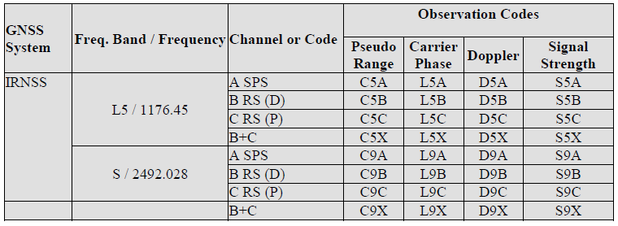
NavIC Signals
https://www.labsat.co.uk/
Notes:
NAVigation with Indian Constellation
Formerly called IRNSS (Indian Regional Navigation Satellite System)

Slide 14
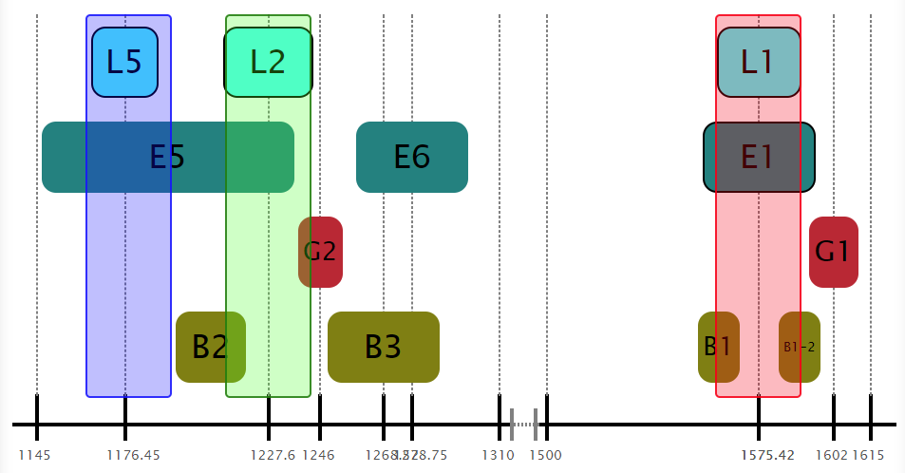
GNSS Signals
https://www.labsat.co.uk/
Notes:
NAVigation with Indian Constellation
Formerly called IRNSS (Indian Regional Navigation Satellite System)

Slide 15
Now we have
7 constellations each with 2-5 available wavelengths
Over 200 observables!
Currently: 113 satellites
Planned: 130 satellites

Slide 16
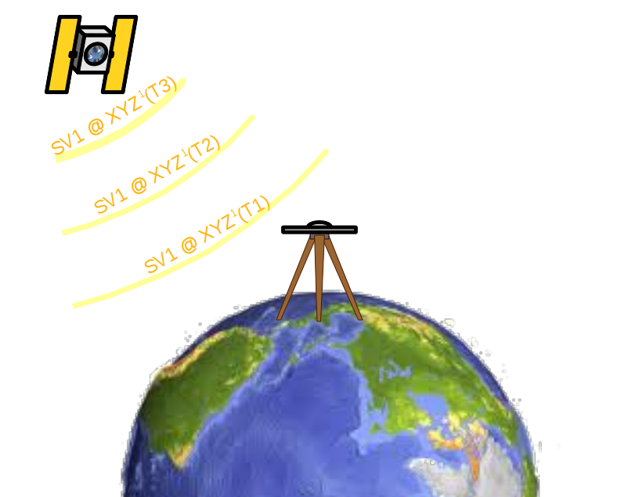
How GNSS works in 5 slides. (1/5)
A GNSS satellite passes overhead broadcasting a signal:
I’m SV 1 at XYZ¹ (1) at Time¹(1).
I’m SV 1 at XYZ¹ (2) at Time¹(2).
I’m SV 1 at XYZ¹ (3) at Time¹(3).
•
•
•
Notes:
Note that we’re introducing some symbols. Superscript numbers will represent satellites.

Slide 17
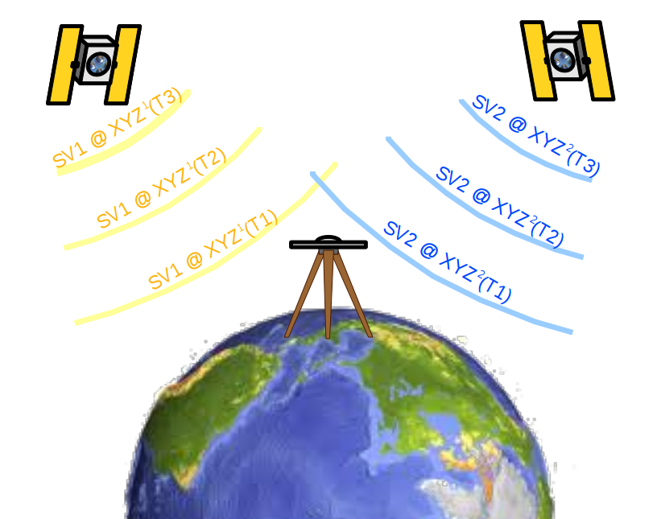
How GNSS works in 5 slides. (2/5)
At the same time, other satellites are saying:
I’m SV 2 at XYZ² (1) at Time²(1). I’m SV 3 at XYZ³ (1) at Time³(1).
I’m SV 2 at XYZ² (2) at Time²(2). I’m SV 3 at XYZ³ (1) at Time³(2).
I’m SV 2 at XYZ² (3) at Time²(3). I’m SV 3 at XYZ³ (1) at Time³(3).
• •
• •
• •

Slide 18
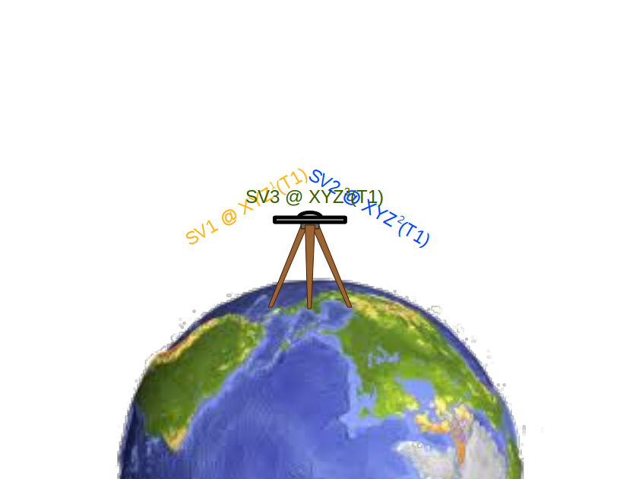
How GNSS works in 5 slides. (3/5)
Your receiver hears all this just a fraction of a second later:
SV 1 said its at XYZ¹ (1) at Time¹(1), but I think it is Time_{A}(1).
SV 2 said its at XYZ² (1) at Time²(1), but I think it is Time_{A}(1).
SV 3 said its at XYZ³ (1) at Time³(1), but I think it is Time_{A}(1).
•
•
•
Notes:
More symbols. Subscript letters represent receivers.

Slide 19
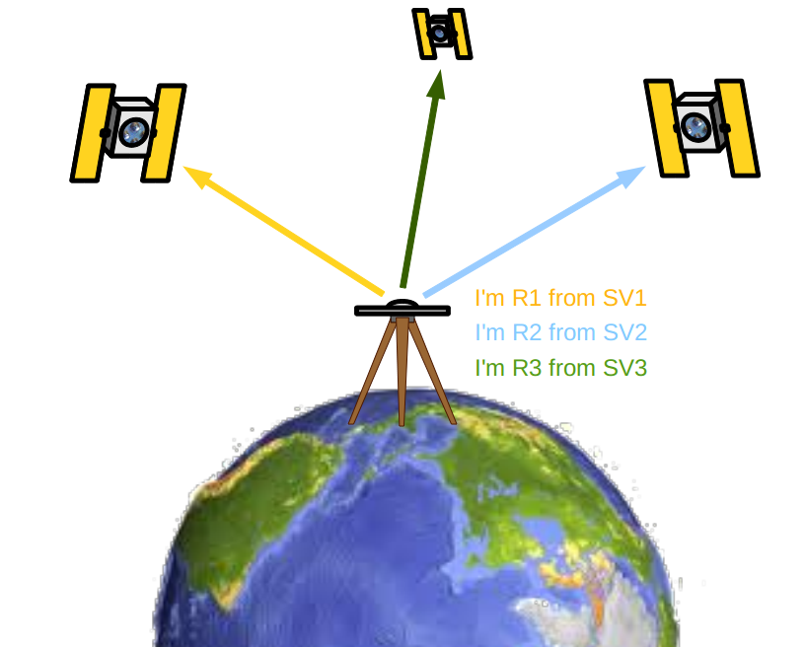
How GNSS works in 5 slides. (4/5)
Your receiver knows that these signals are travelling at the speed of light, c, so it starts doing a some math:
c × (Time_{A}(1) – Time¹(1)) means I’m Range_{A}¹(1) from XYZ¹(1).
c × (Time_{A} (1) – Time²(1)) means I’m Range_{A}²(1) from XYZ²(1).
c × (Time_{A} (1) – Time³(1)) means I’m Range_{A}³(1) from XYZ³(1).
•
•
•

Slide 20
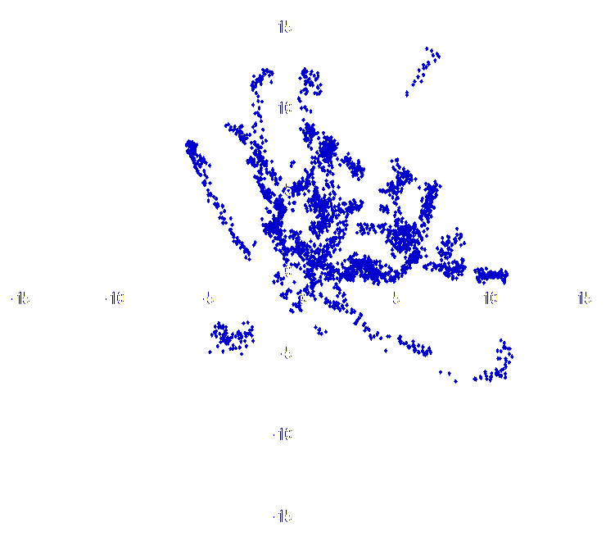
How GNSS works in 5 slides. (5/5)
If your receiver has enough ranges, then it can compute its position: XYZ_{A}(1) at time Time_{A}(1). Repeat ad nauseum.

Slide 21
How is this going to improve my positioning?

Slide 22
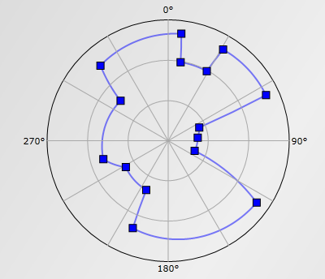
Dilution of Precision (DOP)
HDOP: Horzontal DOP
VDOP: Vertical DOP
PDOP: Position DOP = $\sqrt{{HDOP}^{2}+{VDOP}^{2}}$
TDOP: Time DOP
GDOP:Geometric DOP=$\sqrt{{PDOP}^{2}+{TDOP}^{2}}$
Obstruction diagram
Notes:
DOP is a factor that multiplies the uncertainty associated with User Equivalent Range Error. For example, a DOP of about 2 doubles the uncertainty associated with UERE. Therefore, low DOP is good and high DOP is bad. DOP values greater than 6 are really bad and should not be used for surveying. PDOP values of 1-2 are really good for a solution
On the obstruction diagram, areas between the outer gray circle and the blue segments represent obstructions of the sky. To properly read the diagram, imagine you are lying on your back looking up at the sky. 0 degrees is north, 90 degrees is east, etc. The concentric circles represent 0 degrees above the horizon, then 30 degrees and 60 degrees as one moves from the outside in. The center of the plot is at 90 degrees elevation.

Slide 23
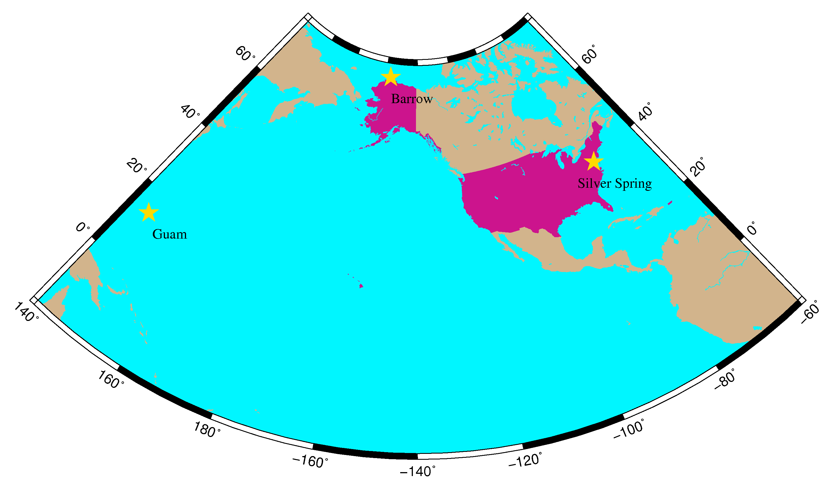
Notes:
Study will first show a 10-deg cut-off, 24 hours beginning at UTC midnight Dec. 13, 2017, at a location in Silver Spring, MD (mid-latitude), Barrow, AK (high-latitude), and Guam (low-latitude) and then show a sky full of obstructions at Low-latitude
Silver Spring -77.03 38.99
Barrow -156.47 71.39
Guam 144.80 13.48

Slide 24
Mid-latitude, no obstructions 10 degree mask

Slide 25
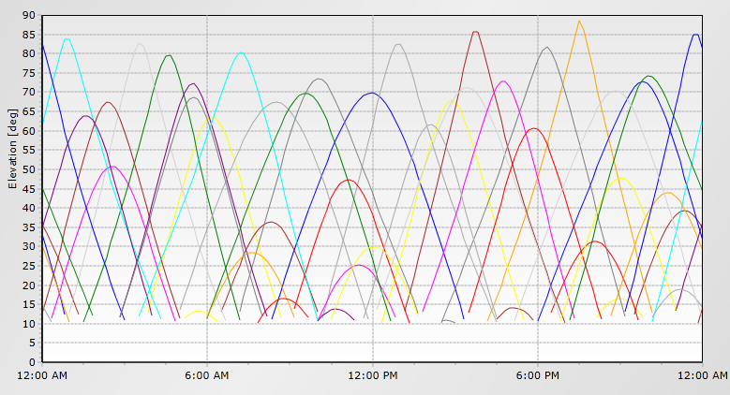
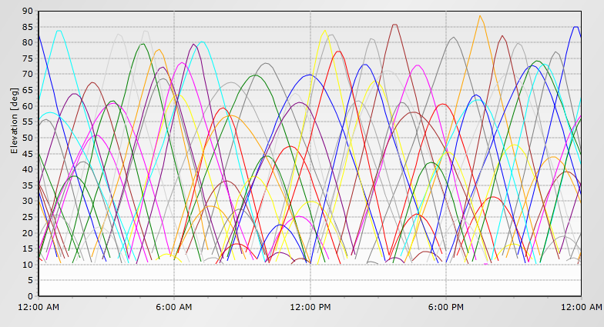
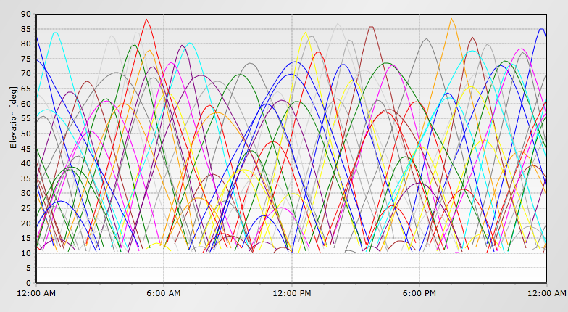
Satellite Elevation
GPS only
GPS+GLO
GPS+GLO+GAL+BDS+QZSS
http://www.gnssplanningonline.com/

Slide 26
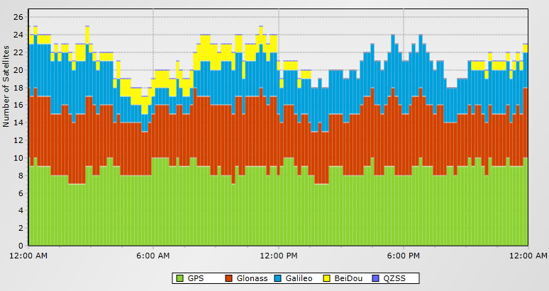
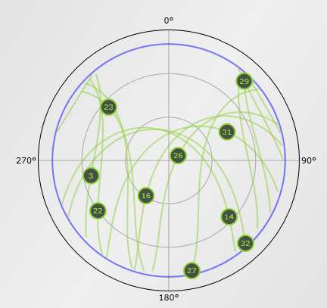
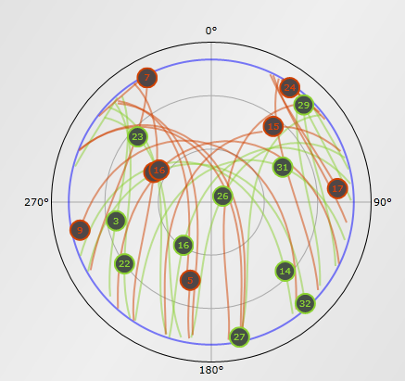
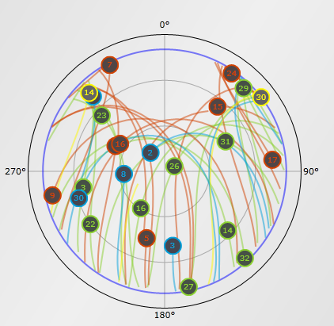
Satellite Visibility
GPS only
GPS+GLO+GAL+BDS+QZSS
GPS+GLO
http://www.gnssplanningonline.com/
Notes:
_{Mid-latitude,, 10 degree mask}

Slide 27
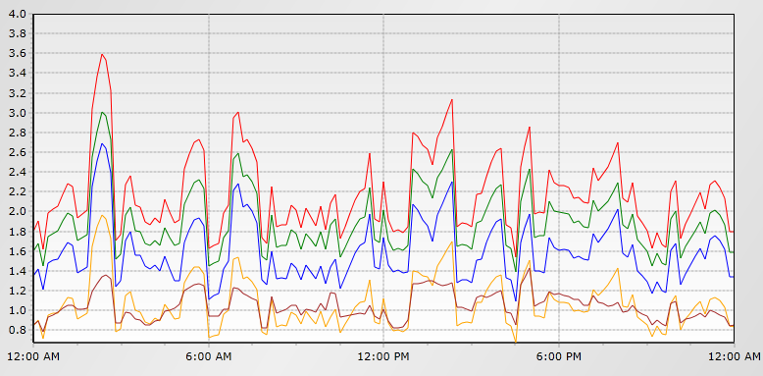
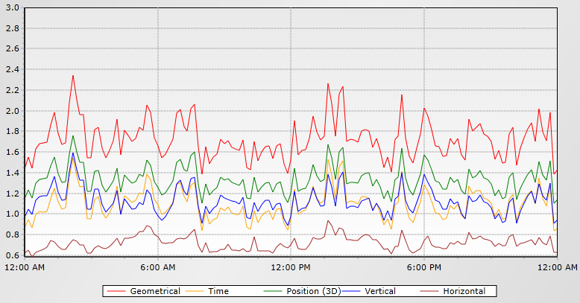
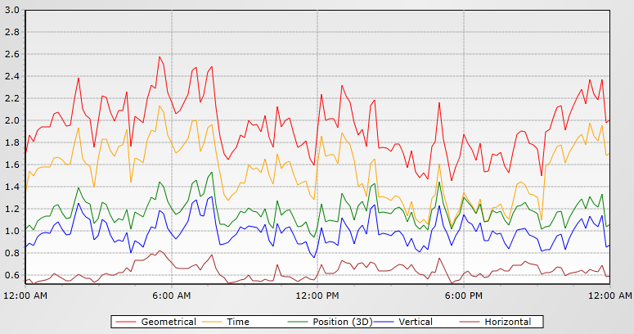
DOP
GPS only
GPS+GLO
GPS+GLO+GAL+BDS+QZSS
http://www.gnssplanningonline.com/
Notes:
_{Mid-latitude,, 10 degree mask}

Slide 28
High-latitude, no obstructions 10 degree mask

Slide 29
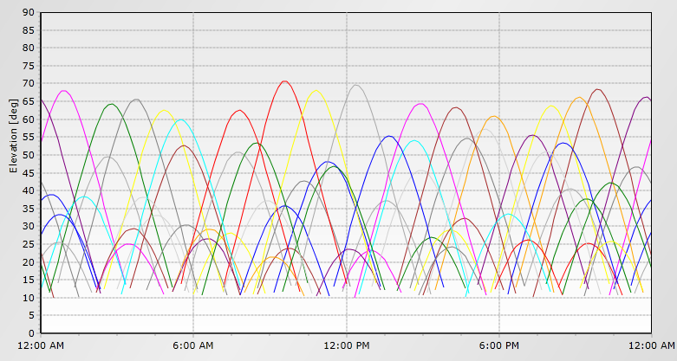
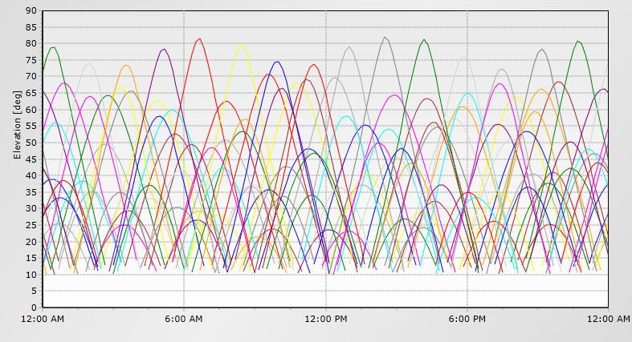
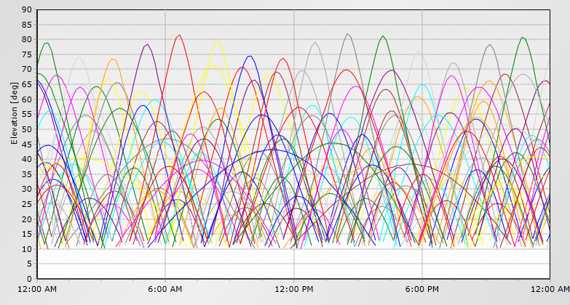
Satellite Elevation
GPS only
GPS+GLO
GPS+GLO+GAL+BDS+QZSS
http://www.gnssplanningonline.com/
Notes:
High latitude, 10 degree mask

Slide 30
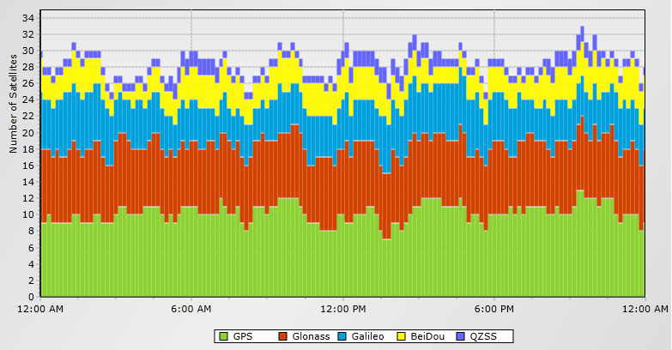
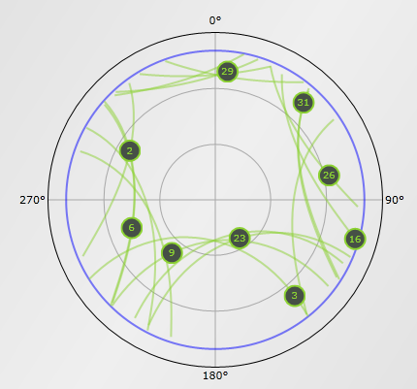
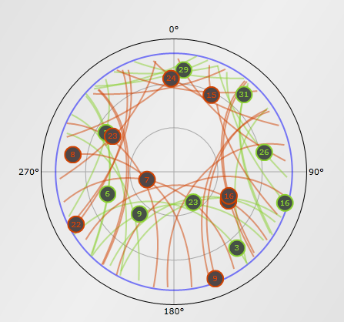
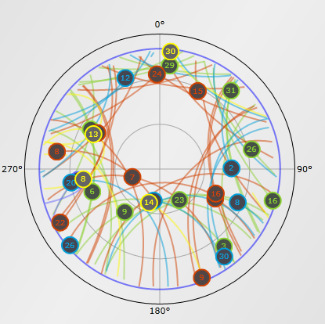
Satellite Visibility
GPS+GLO+GAL+BDS+QZSS
GPS only
GPS+GLO
http://www.gnssplanningonline.com/
Notes:
High latitude, 10 degree mask

Slide 31
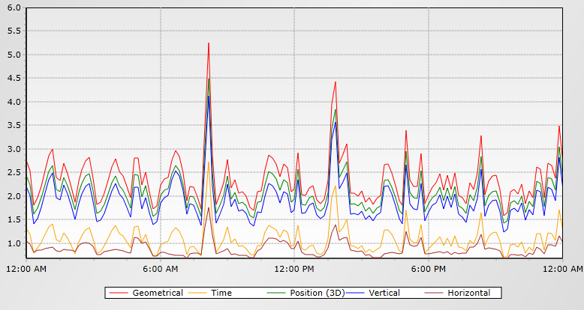
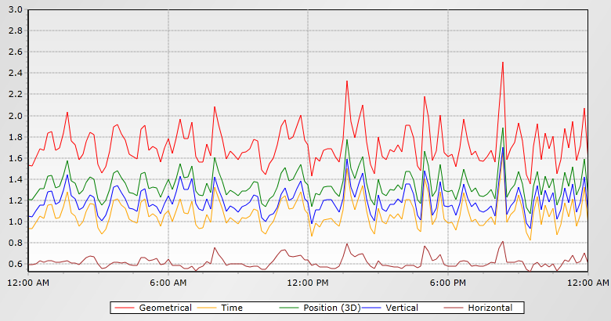
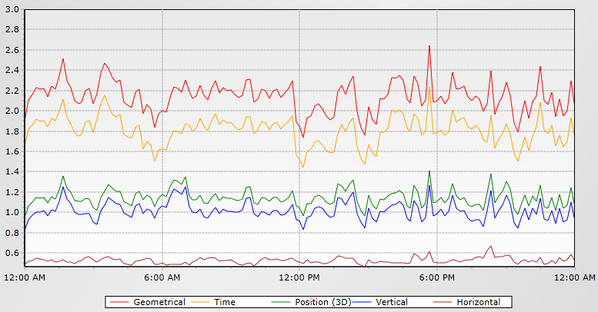
DOP
GPS only
GPS+GLO
GPS+GLO+GAL+BDS+QZSS
http://www.gnssplanningonline.com/
Notes:
High latitude, 10 degree mask

Slide 32
Low-latitude, no obstructions 10 degree mask

Slide 33
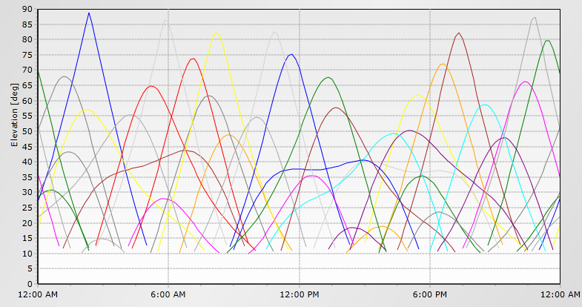
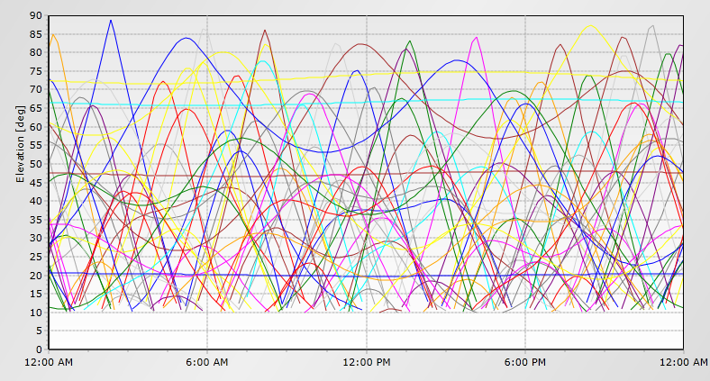
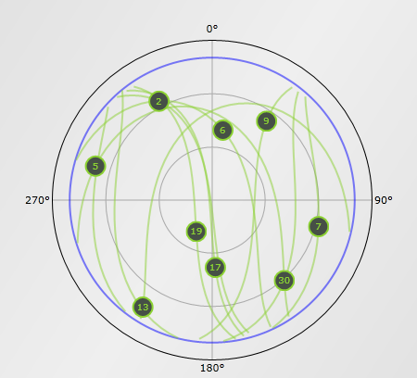
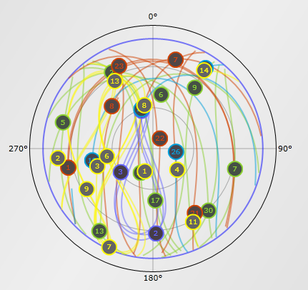
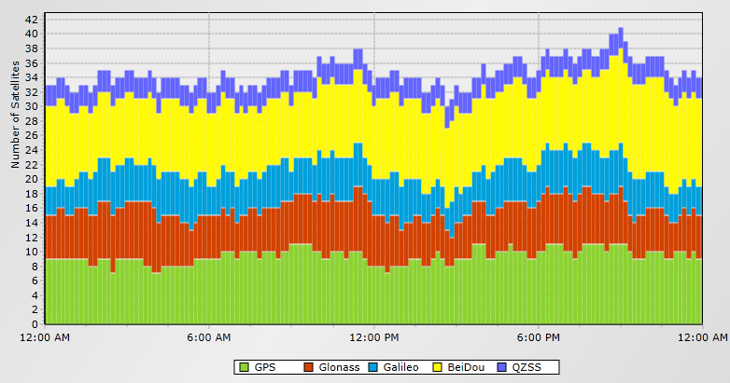
Satellite Position
GPS+GLO+GAL+BDS+QZSS
GPS only
http://www.gnssplanningonline.com/
Notes:
Low latitude, 10 degree mask

Slide 34
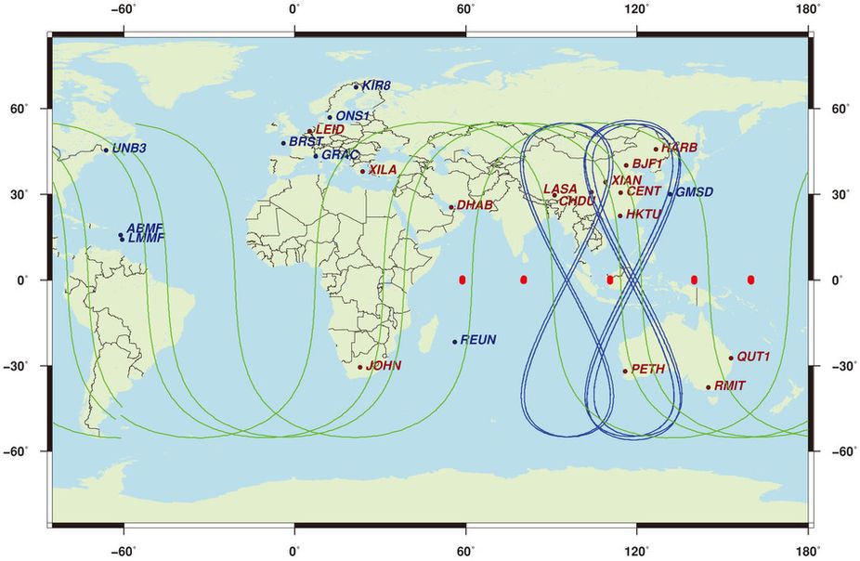
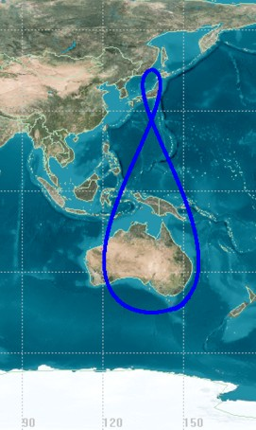
Why does Guam see so many satellites?
BeiDou
QZSS
http://www.navipedia.net/index.php/QZSS
Lou et al 2014
Notes:
Low latitude, 10 degree mask

Slide 35
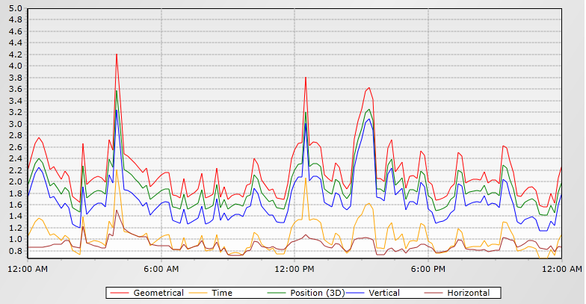
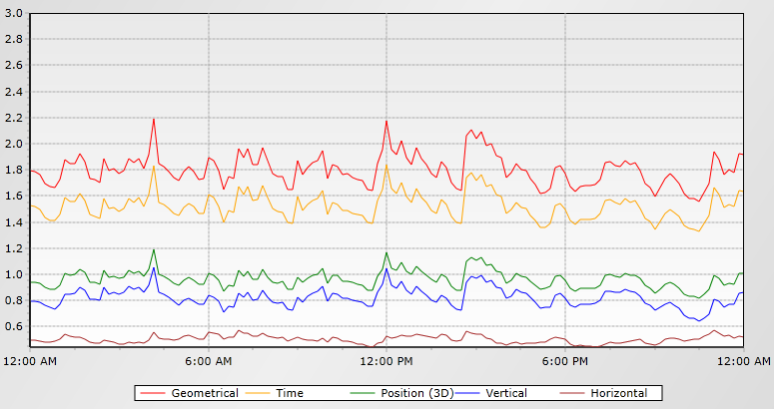
DOP
GPS only
GPS+GLO+GAL+BDS+QZSS
http://www.gnssplanningonline.com/
Notes:
Low latitude, 10 degree mask

Slide 36
Low-latitude, with obstructions

Slide 37
Obstruction Diagram
http://www.gnssplanningonline.com/

Slide 38
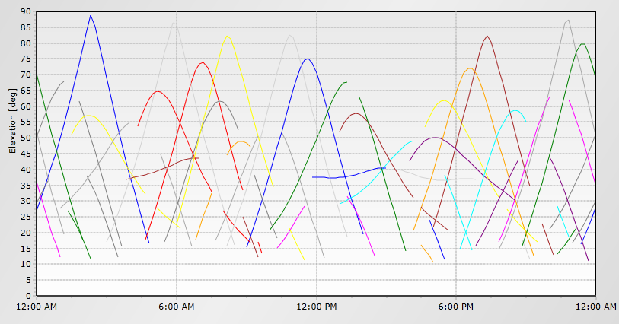
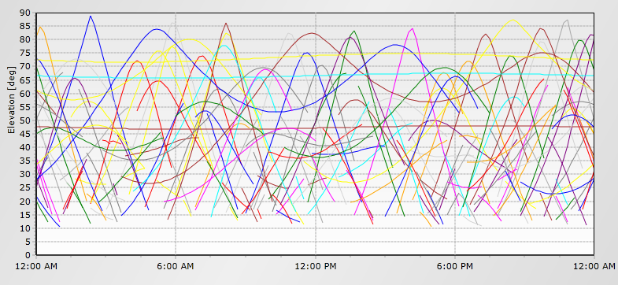
Satellite Elevation
GPS only
GPS+GLO+GAL+BDS+QZSS
http://www.gnssplanningonline.com/
Notes:
Low latitude with obstructions (Guam, N13.48 E144.80)

Slide 39
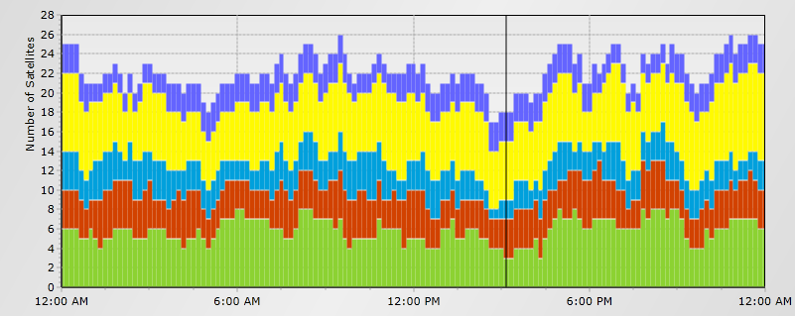
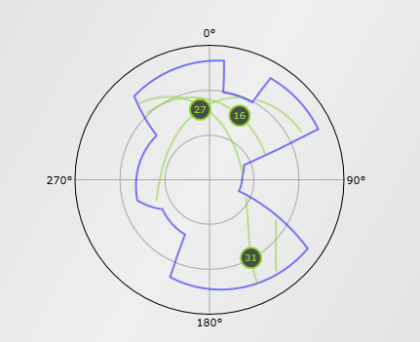
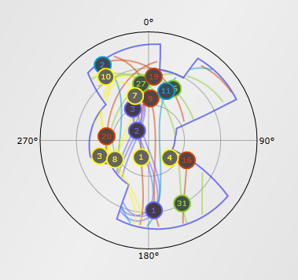
Satellite Visibility
GPS only
GPS+GLO+GAL+BDS+QZSS
http://www.gnssplanningonline.com/
Notes:
Low latitude with obstructions (Guam, N13.48 E144.80)

Slide 40
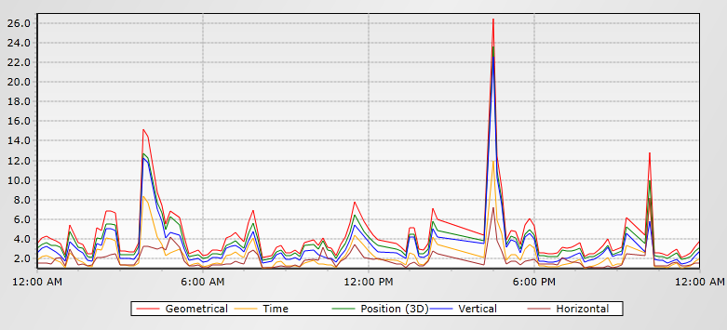
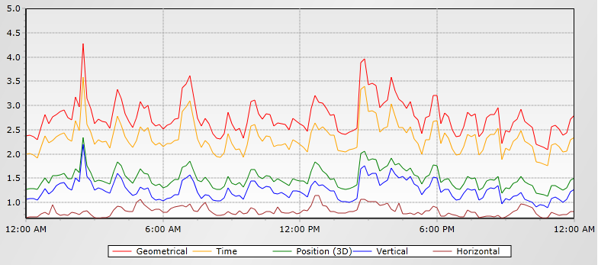
DOP
GPS only
GPS+GLO+GAL+BDS+QZSS
Maximum PDOP: 2.4
http://www.gnssplanningonline.com/
Notes:
Low latitude with obstructions (Guam, N13.48 E144.80)

Slide 41
GPS+GLONASS RMSE results
From Gillins 2017
Notes:
This is from Dan Gillins’ presentation from November 9, 2017.

Slide 42
Convergence Times
From Cai et al 2017
Notes:
FTNA is an IGS station in the French Polynesia, SEYG is an IGS station in the Seychelles in the Indian Ocean

Slide 43
DOP
From Cai et al 2017

Slide 44
Software Development Challenges
Inter-system biases
Inter-frequency biases
Availability of precise data products
Reference system differences, scale factors
Time system differences (Leap seconds)
Data formats
Orbit modeling
Antenna phase models
Notes:
Every satellite system is designed differently so orbits and forces that affect those orbits need to be modeled independently.
GLONASS is FDMA (frequency division multiple access) whereas the other GNSSs are CDMA (code division multiple access). The next generation of GLONASS, GLONASS-K, will be CDMA as well as FDMA

Slide 45
Challenges for the user
Bigger files
Software, hardware must be up to date
Resources to keep this online

Slide 46
Summary
By 2020, the sky will be very full
NGS currently only has GPS capability
Using more satellites, convergence times, sky coverage, and DOP will improve

Slide 47
Acknowledgements
Thanks to Andria Bilich, Steve Hilla, Mark Schenewerk, Xiaopeng Li for your help with this presentation

Slide 48
References
http://www.gnssplanningonline.com
https://www.labsat.co.uk/index.php/en/applications/labsat-frequency-guide
Cai, C.; Gong, Y.; Gao, Y.; Kuang, C. An Approach to Speed up Single-Frequency PPP Convergence with Quad-Constellation GNSS and GIM. Sensors 2017, 17, 1302.
Gillins, D (2017) Deriving High-accuracy Ellipsoid Heights Using OPUS-Projects. NGS Webinar Series
Lou YD, Liu Y, Shi C, Yao XG, Zheng F (2014) Precise orbit determination of BeiDou constellation based on BETS and MGEX network. Sci Rep 4:4692.

Slide 49
QUEstions

