Slide 1

Updates from the National Geodetic Survey
MSPS Annual Convention
February 19, 2021
Jacob M. Heck, Ph.D.
Great Lakes Regional Geodetic Advisor

Slide 2
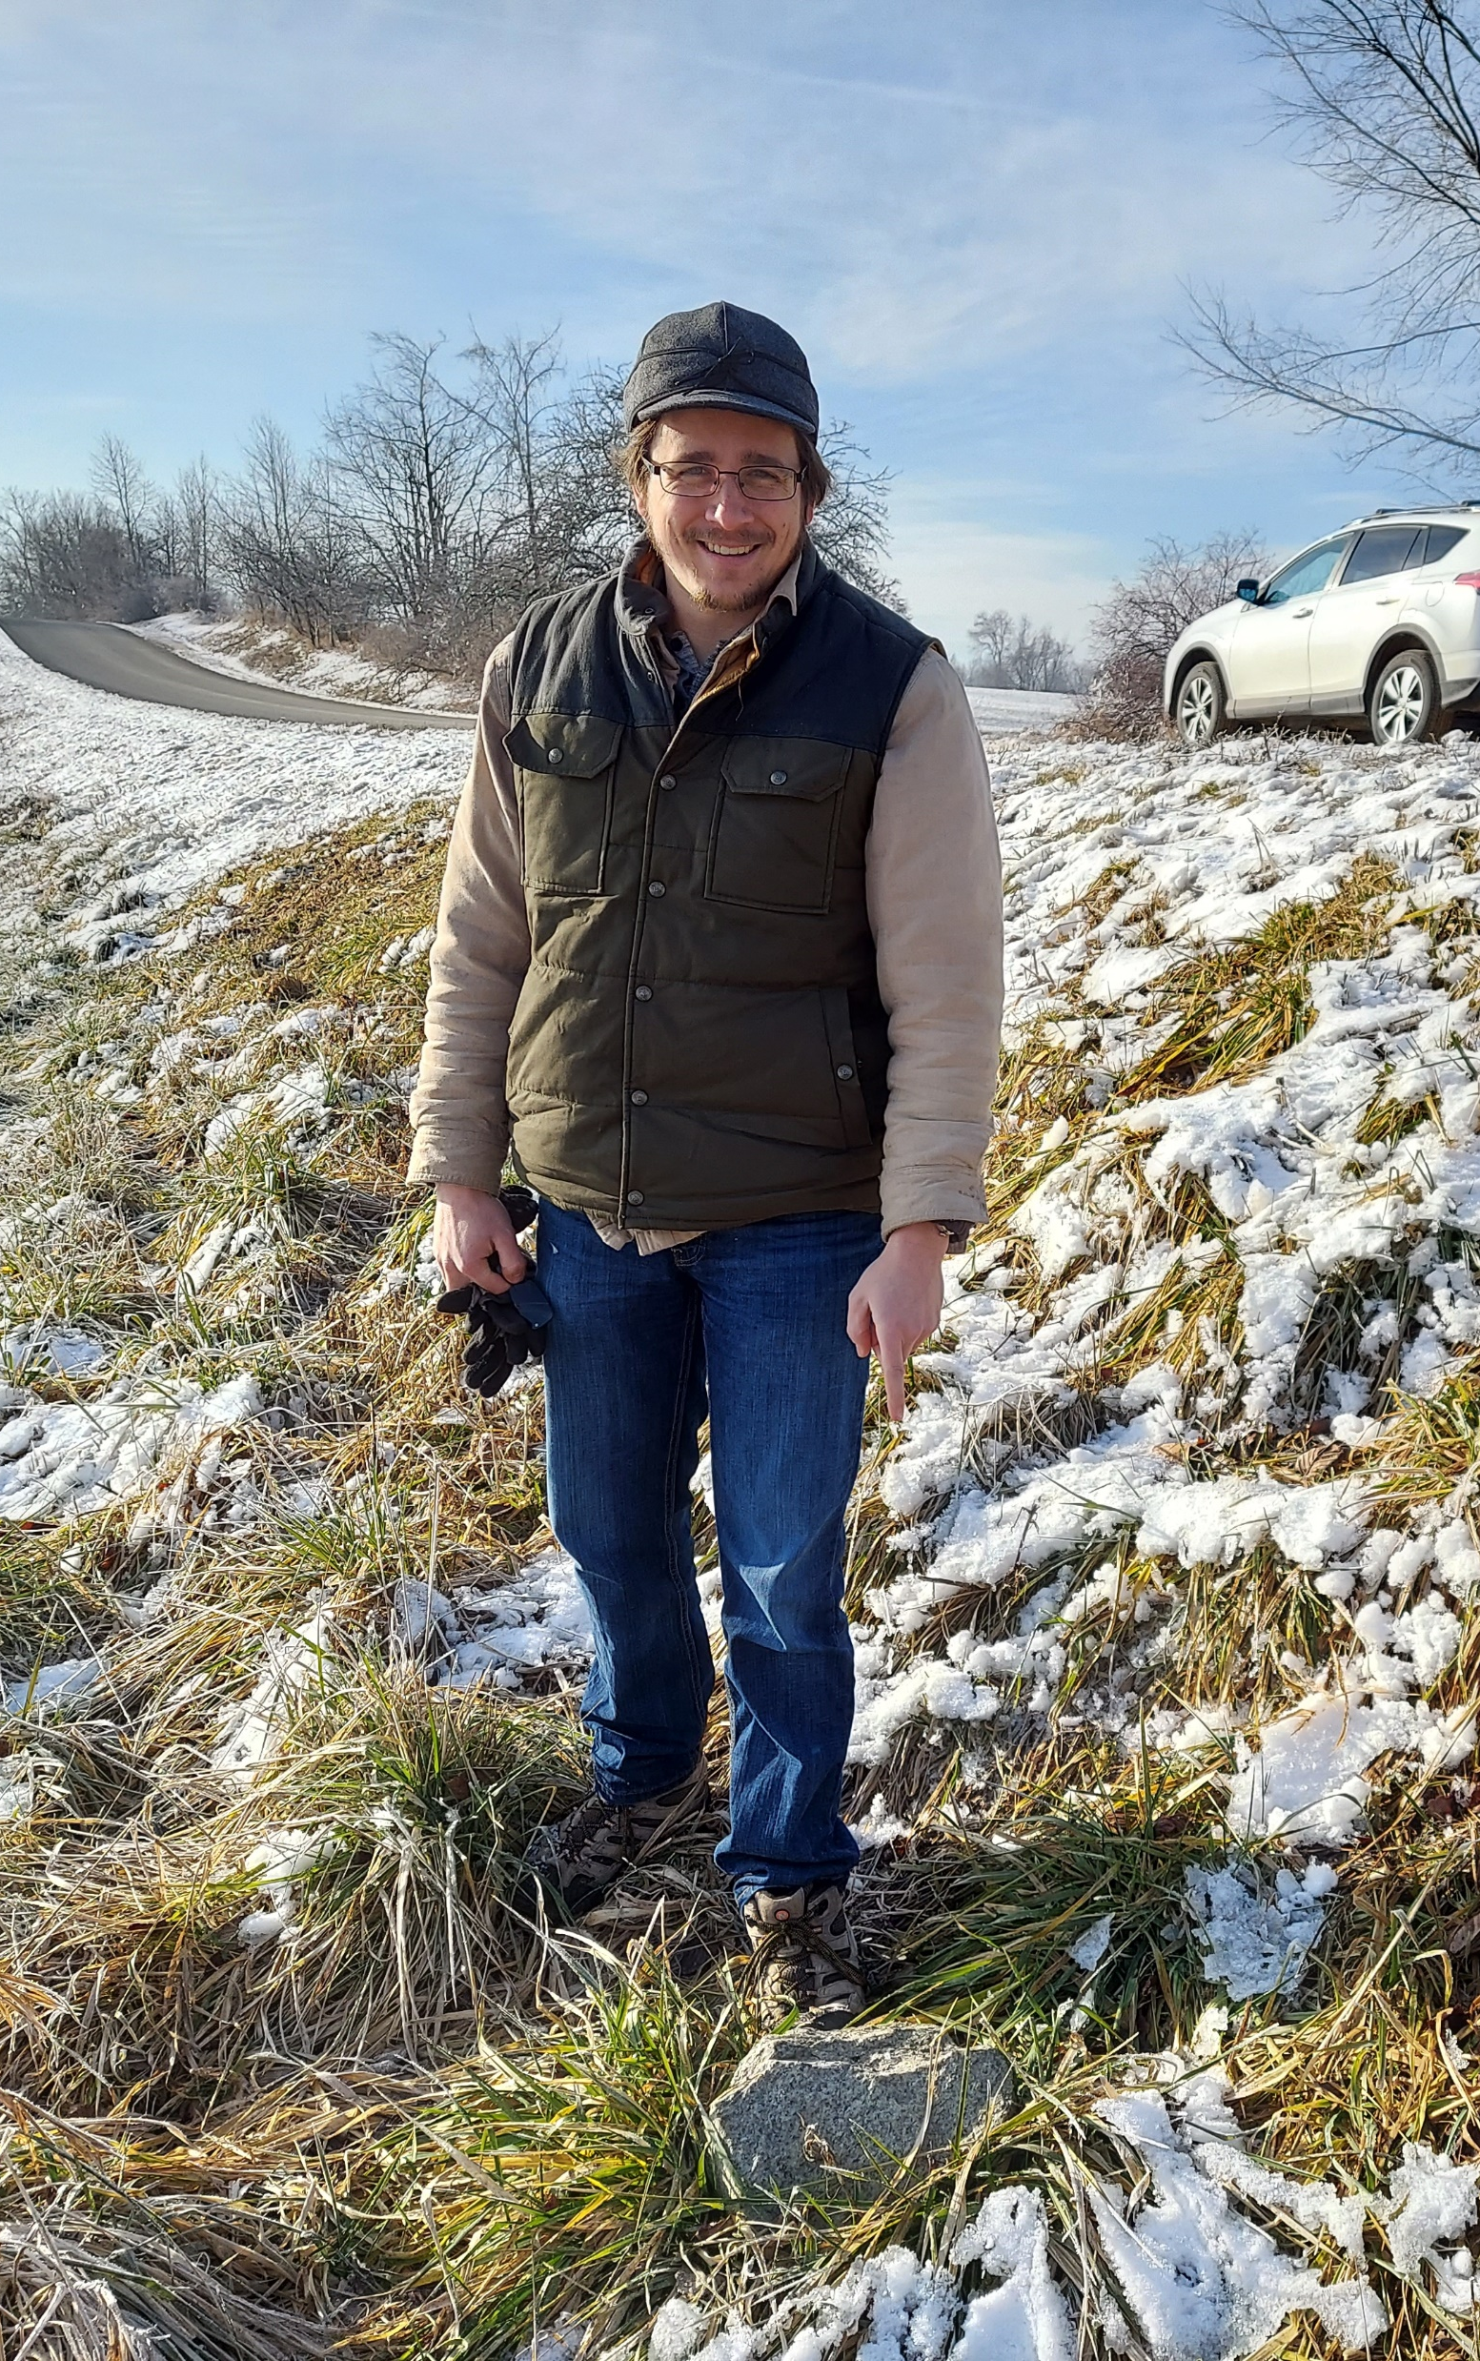
My Background
B.S. Surveying Engineering at Michigan Tech.
Ph.D. in Geodetic Science at The Ohio State University.
NGS Headquarters (Geosciences Research Division) 2016-20.
Now the Great Lakes Regional Geodetic Advisor.

Slide 3
What is NGS?
The National Geodetic Survey (1970–present)
  U.S. Coast and Geodetic Survey (1878–1970)
  U.S. Coast Survey (1836–1878)
  U.S. Survey of the Coast (1807–1836)
Nation’s Oldest Scientific Agency
Currently:
  U.S. Government Executive Branch
    Department of Commerce
      National Oceanic and Atmospheric Administration (NOAA)
        National Ocean Service (NOS)
          National Geodetic Survey (NGS)

Slide 4
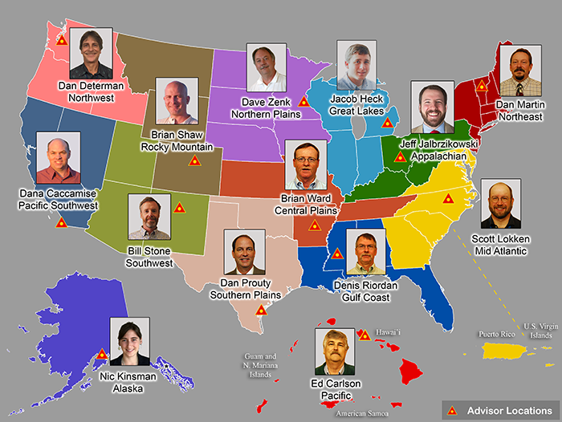
Regional Geodetic Advisor Program
www.ngs.noaa.gov/ADVISORS/

Slide 5
National Spatial Reference System (NSRS)
Geometric Geodesy
Physical Geodesy
Horizontal Datums/Geometric Reference Frames
Latitude
Longitude
Ellipsoid Height
State Plane Coordinates
Geopotential Datums
Orthometric Height
Dynamic Height
Surface Gravity
Leveling
Main Components: latitude, longitude, height, origin, scale, gravity, and orientation

Slide 6
Outline
Geometric Reference Frames
Vertical Datums and the Geopotential Datum
New coordinate types in the modernized NSRS
How you can contribute

Slide 7
Geometric reference frames

Slide 8
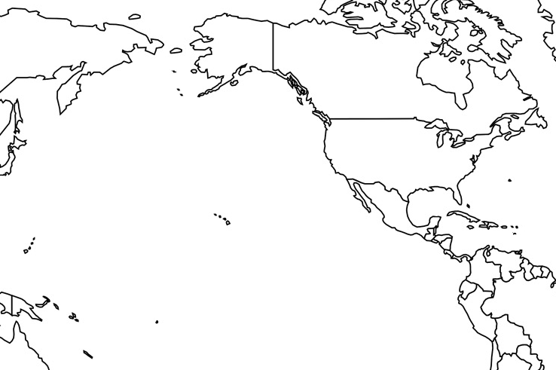
Horizontal Datums of the NSRS
St. Paul I.
St. Paul 1897
St. Paul 1952
NAD 83(1986)
NAD 83(2002:AK)
NAD 83(NSRS2007)
NAD 83(2011) epoch 2010.00
St. Lawrence I.
St. Lawrence 1952
NAD 83(1986)
NAD 83(2002:AK)
NAD 83(NSRS2007)
NAD 83(2011) epoch 2010.00
St. Matthew I.
St. Matthew 1952
Alaska
NAD 27
NAD 83(1986)
NAD 83(2002:AK)
NAD 83(NSRS2007)
NAD 83(2011) epoch 2010.00
St. George I.
St. George 1897
St. George 1952
NAD 83(1986)
NAD 83(2002:AK)
NAD 83(NSRS2007)
NAD 83(2011) epoch 2010.00
CONUS
U.S. Standard Datum
NAD 27
NAD 83(1986)
NAD 83(“HARN”)
NAD 83(“FBN”)
NAD 83(NSRS2007)
NAD 83(2011) epoch 2010.00
Hawaii
Old Hawaiian Datum
NAD 83(1986)
NAD 83(1993:HI)
NAD 83(PA11) epoch 2010.00
CNMI
Guam 1963
NAD 83(1993:GU)
NAD 83(2002:GU)
NAD 83(MA11) epoch 2010.00
Puerto Rico
Puerto Rico 1940
NAD 83(1986)
NAD 83(1993:PR)
NAD 83(1997:PR)
NAD 83(2002:PR)
NAD 83(NSRS2007)
NAD 83(2011) epoch 2010.00
U.S. Virgin Islands
Puerto Rico 1940
NAD 83(1986)
NAD 83(1993:PR)
NAD 83(1997:PR)
NAD 83(2002:PR)
NAD 83(NSRS2007)
NAD 83(2011) epoch 2010.00
Guam
Guam 1963
NAD 83(1993:GU)
NAD 83(2002:GU)
NAD 83(MA11) epoch 2010.00
American Samoa
American Samoa 1962
NAD 83(1993:AS)
NAD 83(2002:AS)
NAD 83(PA11) epoch 2010.00

Slide 9
Replacing the NAD 83s
The Old | The New
NAD 83 (2011) | NATRF2022 - The North American Terrestrial Reference Frame of 2022
NAD 83 (2011) | CATRF2022 - The Caribbean Terrestrial Reference Frame of 2022
NAD 83 (PA11) | PATRF2022 - The Pacific Terrestrial Reference Frame of 2022
NAD 83 (MA11) | MATRF2022 - The Mariana Terrestrial Reference Frame of 2022

Slide 10
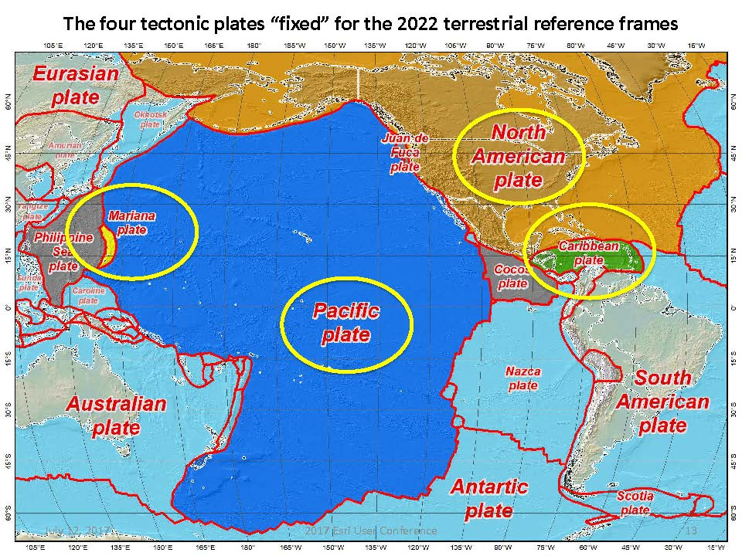
Four Tectonic Plates

Slide 11
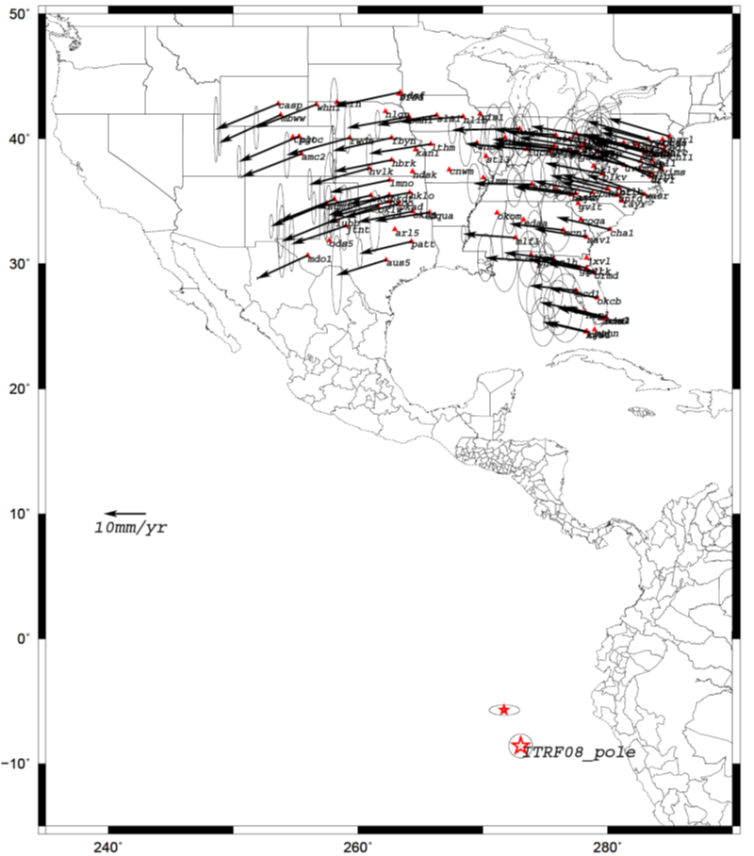
Euler Poles and “Plate-Fixed”
  In the ITRF, many tectonic plates have a dominant motion: rotation
  Euler Pole - point about which a plate rotates (yellow star)
NATRF2022 Euler Pole

Slide 12
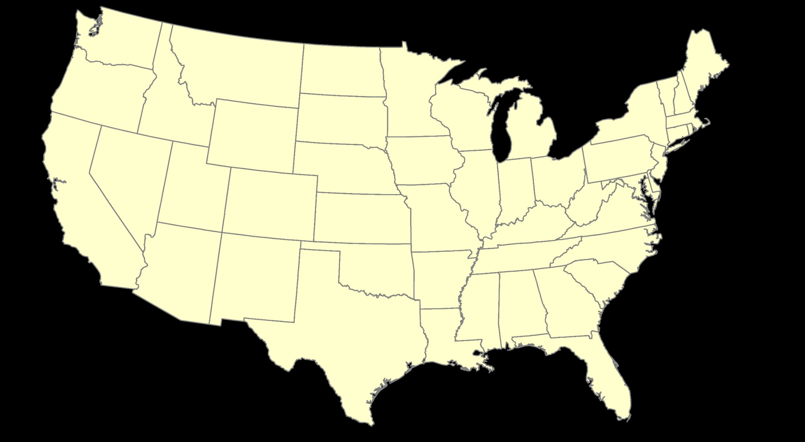
ITRF2020: Constant Frame, Rotating Plate

Slide 13


“Plate-Fixed”
NATRF2022: Constant Frame, Rotating Plate

Slide 14

ITRF2020 or NATRF2022 — Your choice, just use EPP2022

Slide 15
The Relation of 5 Global Reference
Frames through Time
MATRF2022
NATRF2022
Rotation of North American Plate
Rotations are not to scale
PATRF2022
CATRF2022
Rotation of Pacific Plate
ITRF2020 frame
ITRF2020 frame through time
ITRF2020 frame
Rotation of Caribbean Plate
PATRF2022
Rotation of Mariana Plate
CATRF2022
NATRF2022
2020.00 : The time when
all four TRFs and
ITRF2020 are identical by definition.
MATRF2022
t = 2020.00 - Dt
(“the past”)
t = 2020.00 + Dt
(“the future”)

Slide 16
Shift and Drift
When transitioning off of NAD 83, your coordinates will experience shift and drift
  Shift: A one-time jump somewhere in the 0 to 4 meter range (latitude, longitude, ellipsoid height)
    From fixing NAD 83’s non-geocentricity
  Drift: Coordinates are now time-dependent. The shift will take you to 2020.00. Working at any other epoch means you must account for the drift (velocity) of your coordinates
    As well as any other motions over time

Slide 17
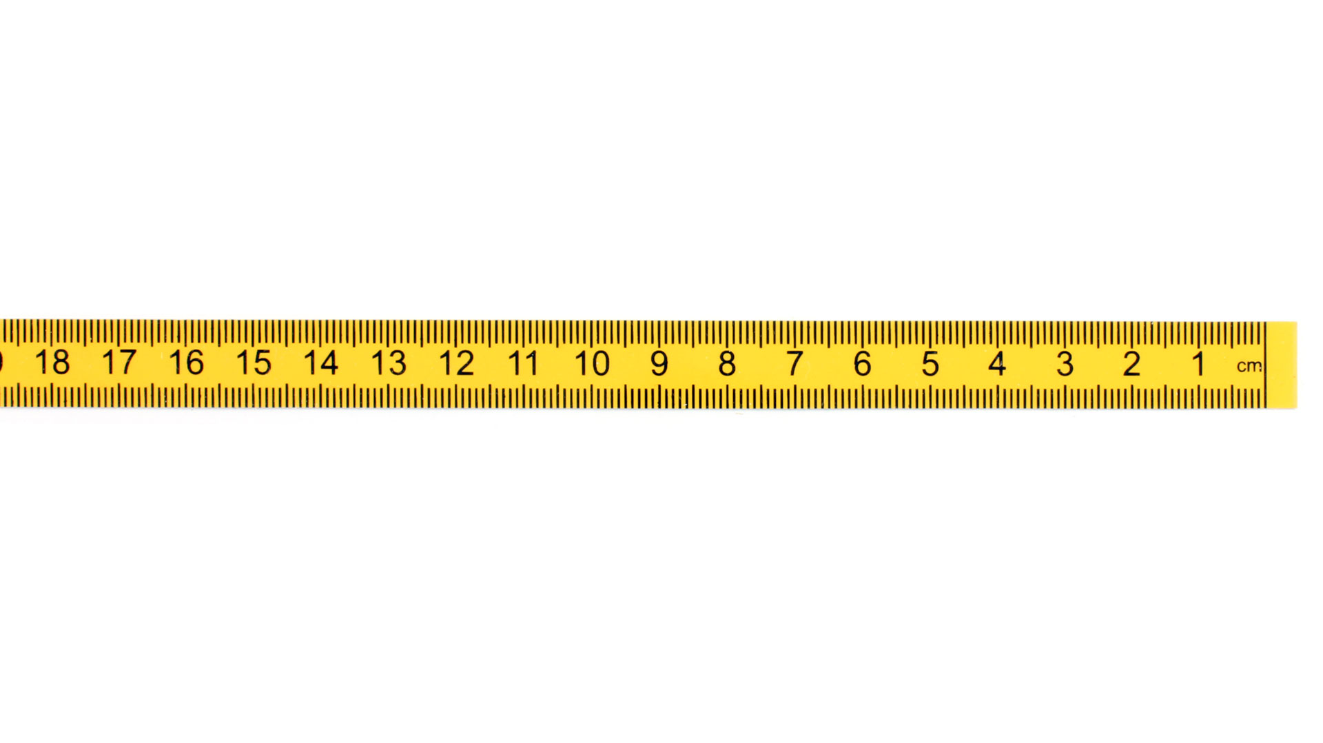

Coordinates, Frames, Epochs, EPP2022 and IFVM2022
A survey done Jan 1, 2023 and reported at epoch 2020.0
New Survey (same point) done Jan 1, 2030
Position of point in NATRF2022(2030)
Position of point in NATRF2022(2020)
If IFVM = 0, then NATRF2022 (2030) = NATRF2022 (2020)
(V)
Position from 2023 survey NATRF2022 (2020.0)
ITRF2020 (2020.0)
ITRF2020 (2030.0)
IFVM 2030-2020
NATRF2022
(2020.0)
Epp2022
fframe
NATRF2022 (2030)
fEpoch
(H)

Slide 18
Vertical Datums and the Geopotential Datum

Slide 19
Vertical Datums of the NSRS
St. Paul I.
- None -
St. Lawrence I.
- None -
St. Matthew I.
- None -
Alaska
NGVD 29
NAVD 88
St. George I.
- None -
CONUS
NGVD 29
NAVD 88
Hawaii
- None -
CNMI
NMVD 03
Puerto Rico
PRVD 09
U.S. Virgin Islands
VIVD 09
American Samoa
ASVD 02
Guam
GVD 63
GUVD 04

Slide 20
Replacing NAVD 88
  The New:
  The North American-Pacific
  Geopotential Datum of 2022
  (NAPGD2022)
  - Will include GEOID2022
  The Old:
  NAVD 88
  PRVD 02
  VIVD09
  ASVD02
  NMVD03
  GUVD04
  IGLD 85
  IGSN71
  GEOID18
  DEFLEC18
Orthometric
Heights
Normal
Orthometric
Heights
Dynamic
Heights
Gravity
Geoid
Undulations
Deflections of
the Vertical

Slide 21
NAPGD2022
Is a global datum (no “boundary”), sort of…
  Foundation is GM2022, a global geopotential model with 5’ x 5’ resolution, at, and above, the surface
    Thus missing some high resolution information
Will have regional, enhanced capabilities
  GEOID2022, DEFLEC2022, etc.
  At 1’ x 1’ resolution, at the surface only
    Three regions:
      North America (nearly 1/4 of the earth)
      American Samoa
      Guam/CNMI

Slide 22
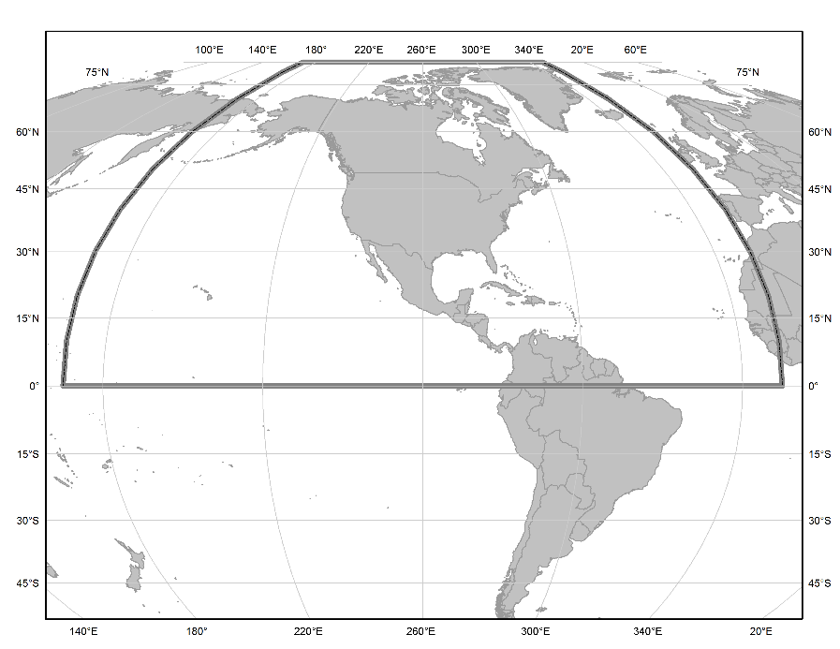
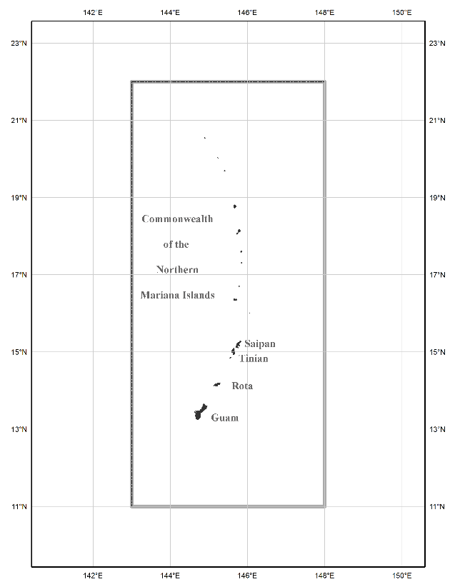
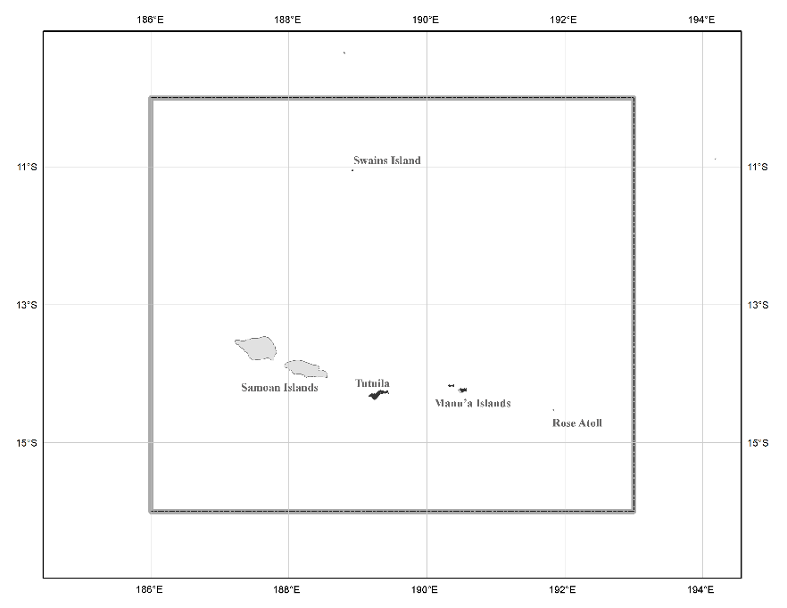
Three Gridded Regions
“North American region”
¼ of the Earth
“American Samoa region”
“Guam/CNMI region”

Slide 23

Definitional Relationship
$${H(t)}_{NAPGD2022}≡{h(t)}_{ITRF2020}−{N\left(t\right)}_{GEOID2022 }$$
We end with orthometric height in NAPGD2022 at the same epoch as the survey.
All work is done in ITRF2020 XYZ coordinates first.
They are associated with the epoch of the data collection (survey) “t”, then converted to φ, λ and (especially relevant here) h.
Conversion to orthometric heights is definitional through GEOID2022.
Contrast with NGS hybrid geoids where the equation H=h-N did not close.

Slide 24
New types of Coordinates

Slide 25
Embrace Time-Dependencies
Coordinates Change
  Even in so-called “plate fixed” frames
Associate Coordinates with their Survey Epoch
  Active control: daily computed coordinates
    Fit a simple function to them through time
      Currently linear. Non-linear in the future.
  Passive Control: Coordinates only when the point was surveyed

Slide 26
New Types of Coordinates
NGS anticipates that 5 types of coordinates will be used in the NSRS. They are:
Reported
OPUS
Reference Epoch
Survey Epoch
Active

Slide 27
New Types of Coordinates
Reported
  “These are coordinates directly reported to NGS without the data necessary for NGS to replicate or evaluate them.”
    Scaled from a map
    Transformed using NCAT or VDatum
    Smartphone
    Reported directly from an RTK rover without data files

Slide 28
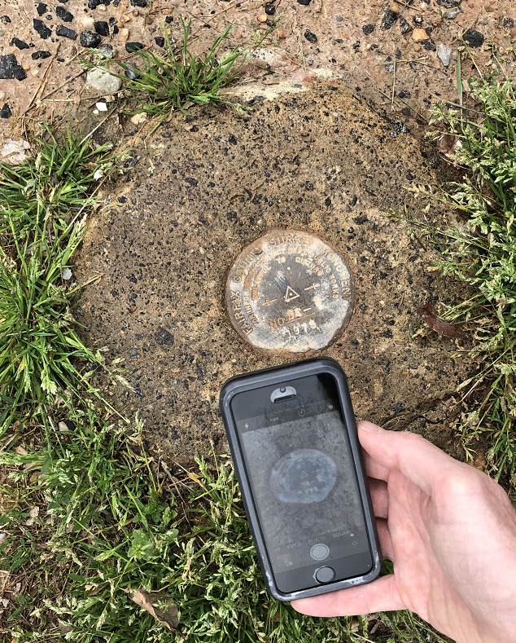
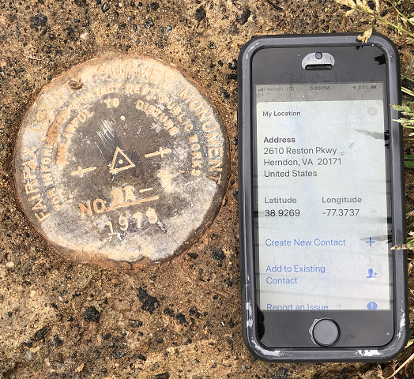
Reported Coordinates

Slide 29
Buyer Beware!
Reported coordinates might be very wrong!
  Reported in NAD 27 or NAD 83 or WGS 84
    Systematic Error: 2–100 meters
  Scaled off of a USGS topographic map
    Random Error: ± 600 meters
  Smartphone
    Random Error: ± 10–50 meters
NGS will show you reported coordinates
  But their function is to get you “in the neighborhood” of a mark, not to use as geodetic control!

Slide 30
New Types of Coordinates
OPUS
  “These are coordinates at any epoch the user wishes to use that have been computed by that user in OPUS”
    User-computed values, such as they might get today from either OPUS-S or OPUS-Projects
    “OPUS” coordinates are the only coordinates a user will get directly from OPUS
    NGS will not evaluate your OPUS coordinates!

Slide 31
New Types of Coordinates
OPUS coordinates may also come with the label “tied to the NSRS”
  Only if a user restricts their computations to OPUS-recommended constraints
  Users who deviate from OPUS-recommended constraints can still perform computations and will get OPUS coordinates, but they will not be “tied to the NSRS”, nor have any NSRS label at all.
  In neither case will OPUS coordinates be considered “part of the NSRS” however.
    That moniker is restricted to NGS-computed coordinates available from the NSRS database, such as survey epoch coordinates (SECs), reference epoch coordinates (RECs) and active coordinates (ACs). See next slides.

Slide 32
New Types of Coordinates
Reference epoch coordinates (RECs)
  “Coordinates estimated by NGS for one of the official reference epochs. As these coordinates are computed by NGS they are considered ‘part of the NSRS’”
  NAD 83(2011) epoch 2010.00 (sort of) would’ve fallen under this category
    These will be computed by NGS every 5 years
      On a schedule 2–3 years past the reference epoch
        2020.00 coordinates are computed in CY 2022, etc

Slide 33
New Types of Coordinates
Survey epoch coordinates (SECs)
  “Coordinates computed by NGS for one survey epoch. As these coordinates are computed by NGS they are considered ‘part of the NSRS’.”
    These represent the best estimates NGS has of the time-dependent coordinates at any mark
    Adjusting multiple surveys in timespans called “adjustment windows”, to a single epoch within that window.
      Initial plan: 4 weeks for GNSS; 1 year for leveling

Slide 34
More on SECs and RECs
At passive control
SECs: adjusted to a midpoint epoch near the survey
  (4 weeks for GNSS; 1 year for leveling; etc)
RECs: adjusted to a ref. epoch (2020.00, etc.)
REC adjustments will include:
  Some age-limited span of data
    If that age-limit were 10 years prior and 2 years post R.E….
      Then 2020.00 RECs come from data spanning 2010.00 to 2021.99999
    Exact age-limit won’t be known until we start experimenting in 2022 with the 2020.00 REC adjustments

Slide 35
New Types of Coordinates
Active coordinates (ACs)
  Not discrete, but rather a function through time assigned to some point
    At a CORS GRP*, they will be the coordinate function
      Which will be generated by a “fit” to regularly computed coordinates on a TBD basis, perhaps daily, perhaps weekly
        These daily or weekly coordinates will not generally be used as geodetic control by themselves
* Recall this is the physical point to which coordinates refer at a station like a CORS

Slide 36
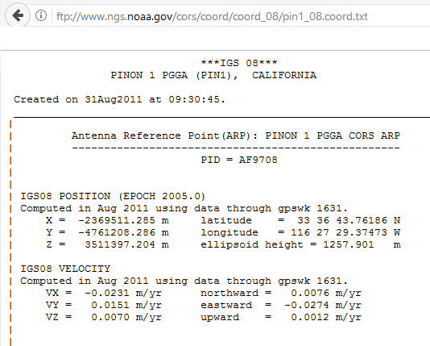
CORS Coordinate Functions…
(AKA “Active coordinates”)
A typical “CORS coordinate
file” available from NGS
Just one set of coordinates
and just one set of
velocities are given…
…while this is good and useful information, it hides the true nature of the coordinate function.

Slide 37
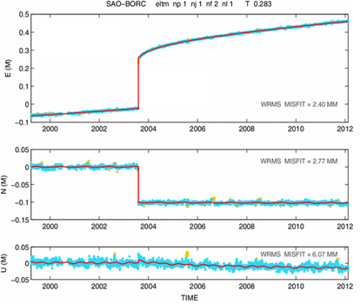
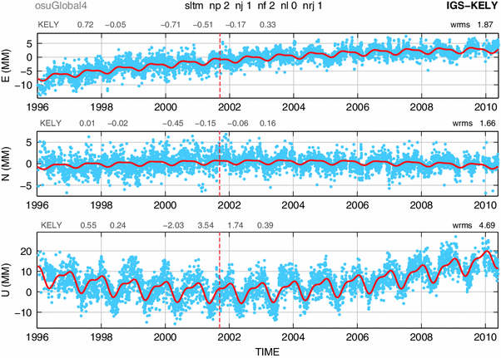
Examples of How Non-Linear CORS Coordinate Functions Might Look

Slide 38
Coordinates
Five types:
  Active: Continuous functions at a CORS
  Survey Epoch: “Time dependent coordinates”
  Reference Epoch: “Estimated at 2020, 2025, 2030, …”
  OPUS: Computed by you, and as accurate or inaccurate as the choices you make
    Tied to the NSRS if you follow OPUS recommendations
  Reported: Good for finding a point somewhere on Earth.
    Not to be used as geodetic control

Slide 39
How You Can Contribute

Slide 40
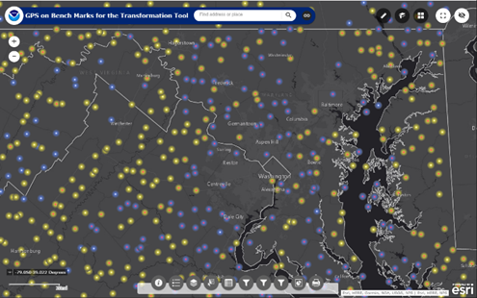
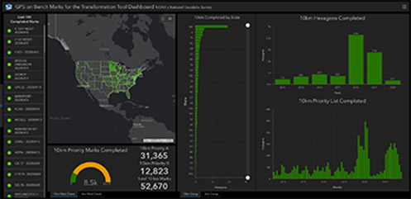
GPS on Bench Marks:
Crowdsourcing Data for Better Models and Tools
NGS provides a prioritized list of marks where new data will most benefit the local accuracy of national scale models and tools such as GEOID18 and the 2022 Transformation Tool
Who: Federal and State government agencies, universities, and private sector firms
What: Mark Recovery Reports & Sharing GPS Observations
2022 Transformation Tool Campaign
National Coverage @ 10km spacing – ideal resolution for data to develop a national scale transformation tool
Local Densification @ 2km spacing – Allows partners to collect higher density data and increase local accuracy in areas they work
Priority Marks Web Map
Transformation Tool Campaign Progress Dashboard

Slide 41
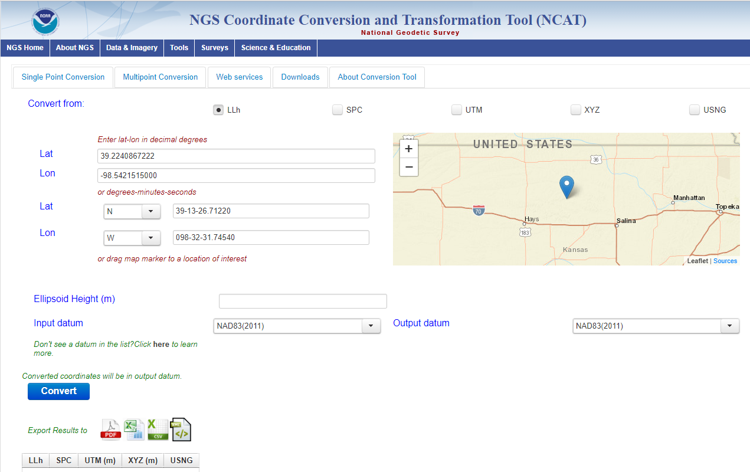
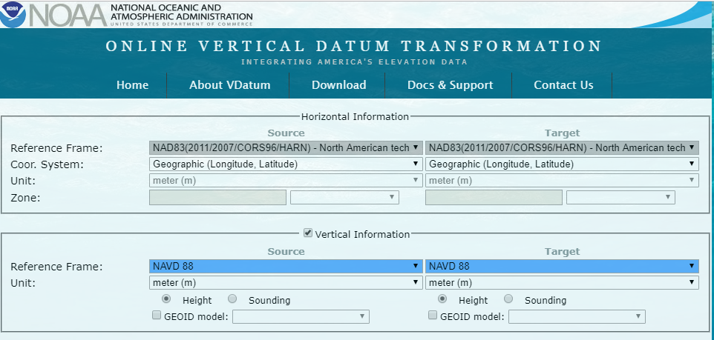
GPSonBM: 2022 Transformation Tool Campaign
NGS’ GPSonBM program is now requesting data to build the models that NCAT and VDatum will use to transform geospatial data from existing datums to the Modernized National Spatial Reference System

Slide 42
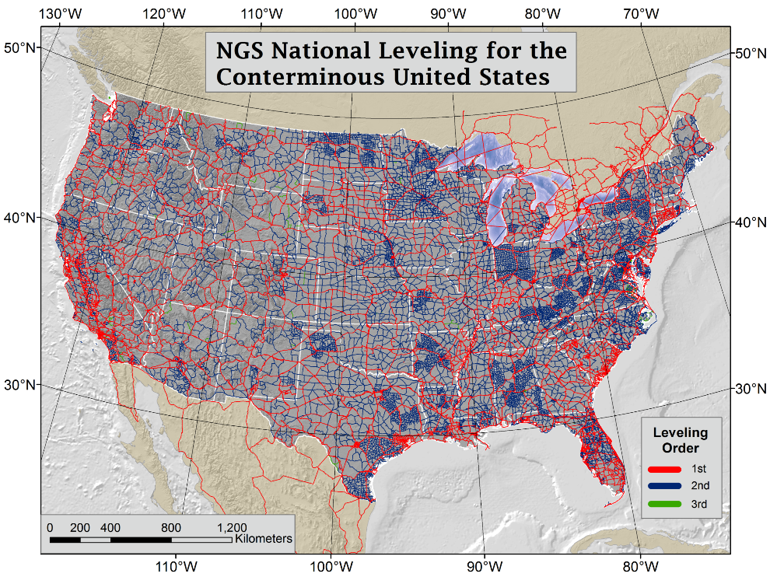
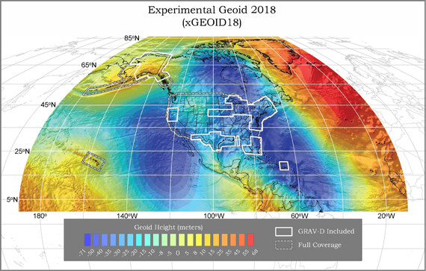
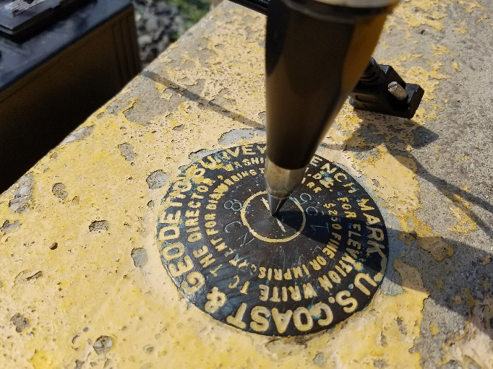
GPSonBM Connects Old & New Datums
Because the relationships between the old and new datums vary by location, the accuracy of the transformations in any particular place is directly related to the density of GPSonBM data available in that area.

Slide 43
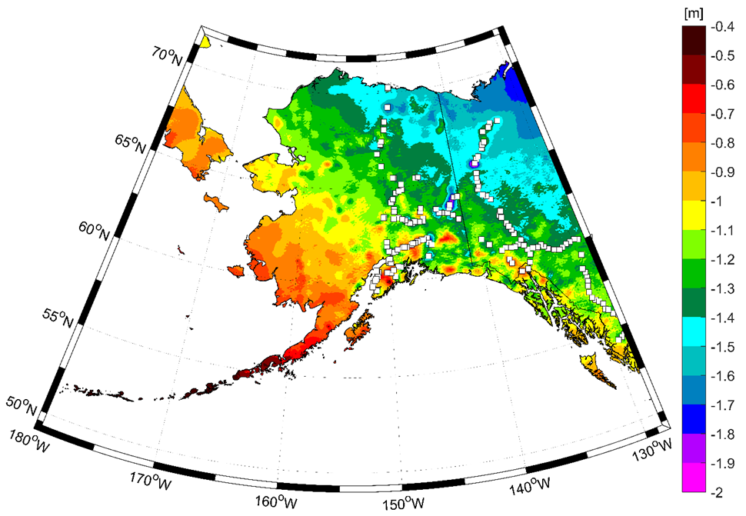
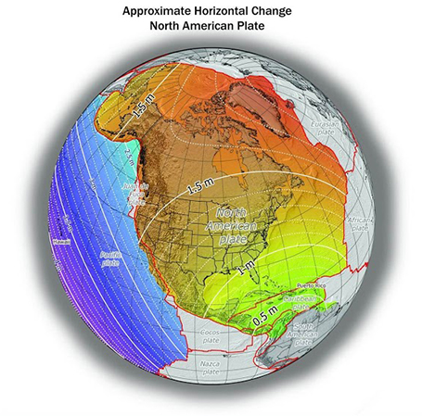
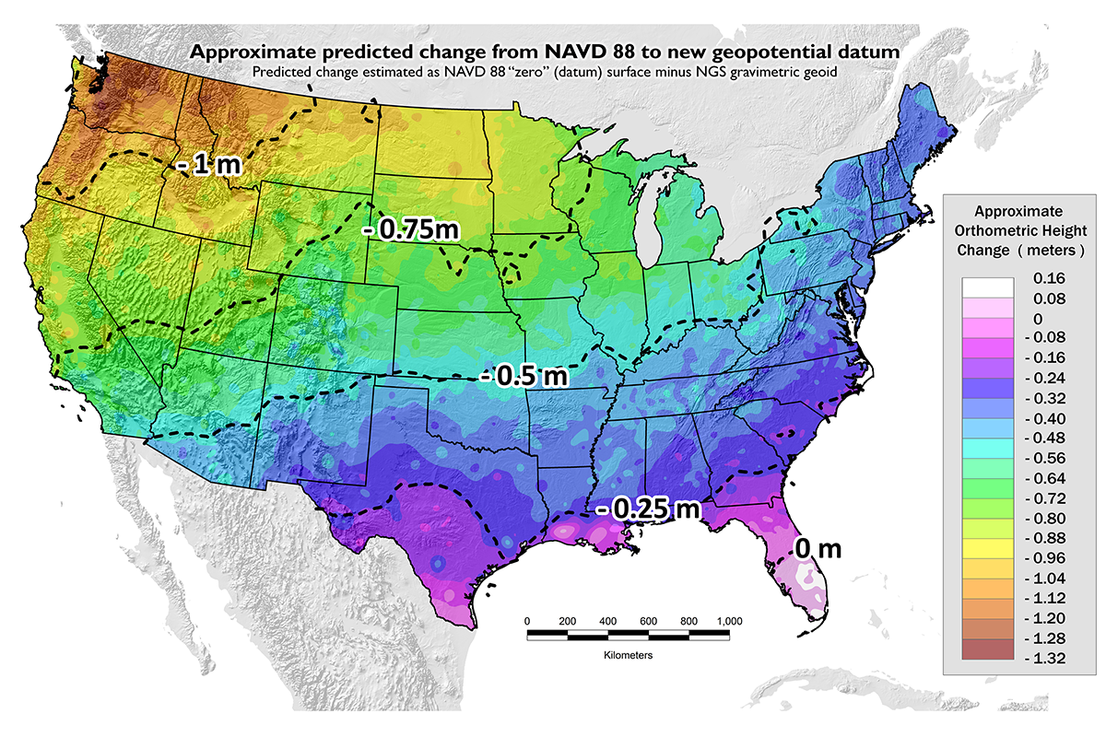
Approximate Predicted differences between Old & New:
NAVD 88 minus NAPGD2022
~0.4 to 2 meters in Alaska
~0 to 1.3 meters CONUS
GPSonBM data collection efforts are focused on the vertical datum transformations to resolve the irregular relationship between the surfaces.
Horizontal transformations are smooth and will be done primary with CORS data.

Slide 44
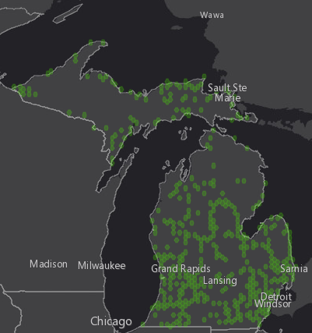
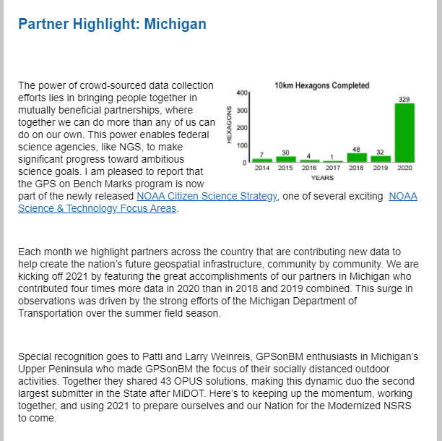
Michigan: Keep Up the Good Work!
From the January 2021 issue of the NGS GPS on Bench Marks Update:

Slide 45
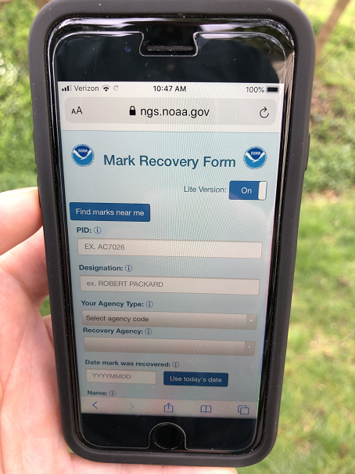
Recover
NGS has a new mobile-friendly mark recovery webpage. Please try it out!
https://www.ngs.noaa.gov/cgi-bin/mark_recovery_form.prl

Slide 46
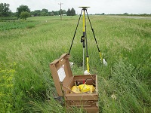
Observe
4+ hour static occupation
Take photos of the mark (close up and eye level), take one horizon photo (preferably facing south) and note any changes to the existing mark description.
Fixed height tripod recommended

Slide 47
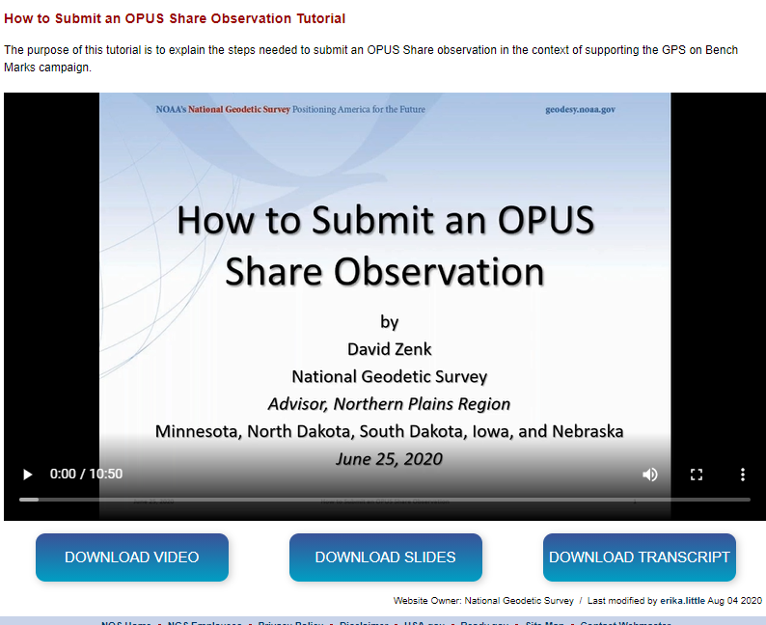
Report using OPUS Share
https://www.ngs.noaa.gov/OPUS/
https://geodesy.noaa.gov/corbin/class_description/opus-share-tutorial/

Slide 48
GPS on Bench Marks Deadlines
DECEMBER 31, 2021
Deadline for inclusion in Reference Epoch Coordinate (REC) adjustment
Deadline for inclusion in the Transformation Tool

Slide 49
NSRS Modernization: DELAY
It’s official: we are delayed beyond 2022
The announcement was made public June 23, 2020
  How long is the delay?
    Unknown. Years.
  Will names change?
    No, “GEOID2022”, “NATRF2022”, etc. will remain the same
  No deadlines slip.
    GPS on BM , SPCS , etc.

Slide 50

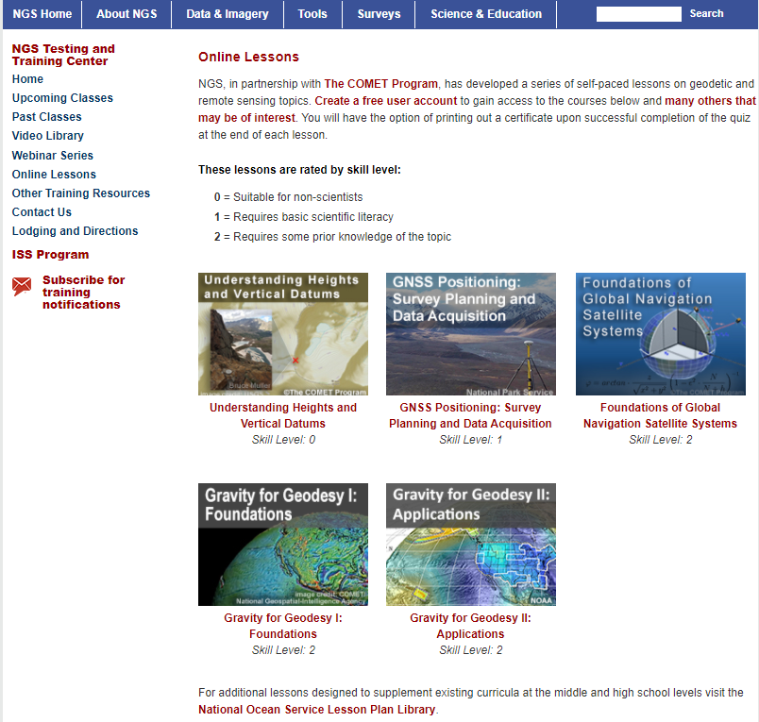

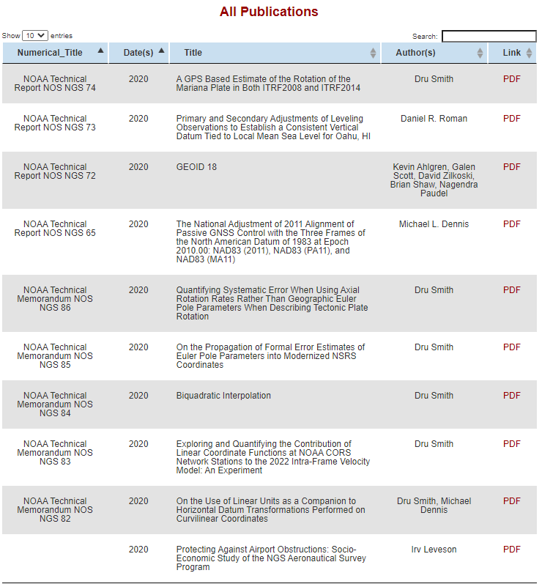
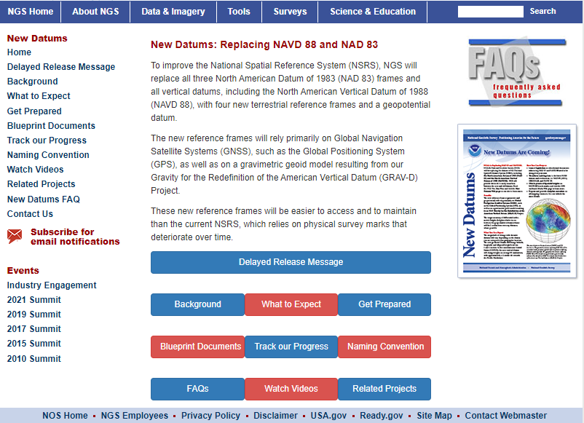
Online Resources
Monthly webinar series
  All webinars are recorded and available online
Online lessons
Video library
Publication library
NSRS Modernization News
https://geodesy.noaa.gov/

Slide 51
Thank You!
Dr. Jacob Heck
U.S. National Geodetic Survey, NOAA
jacob.heck@noaa.gov
c/o NOAA Great Lakes Environmental Research Lab
4840 S. State Road
Ann Arbor, MI 48108
For more information, visit https://geodesy.noaa.gov

