Slide 1
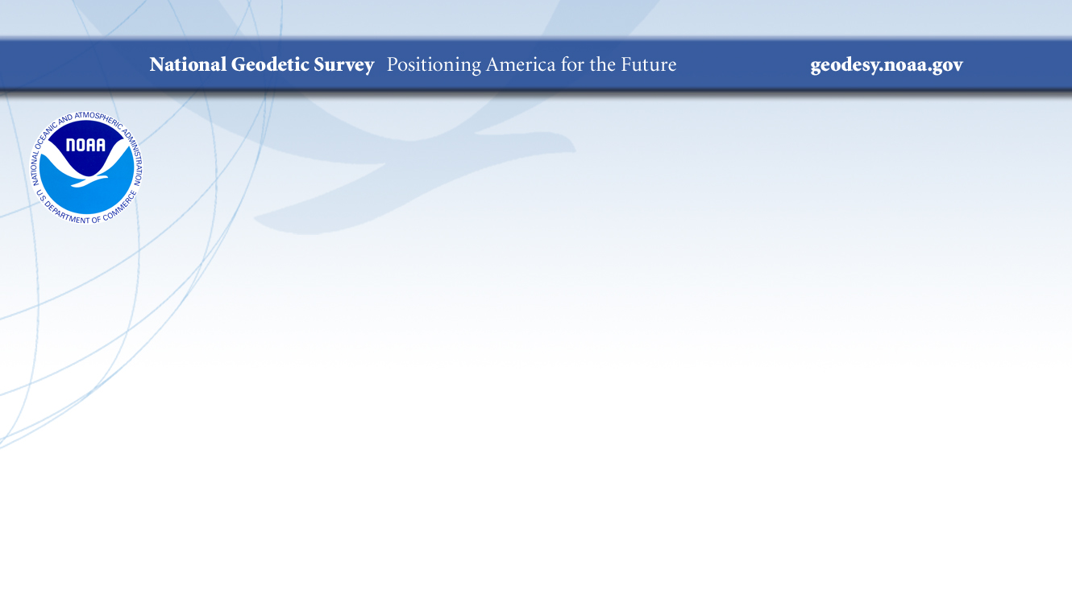
Datums: More Important Than You May Think
Jacob Heck, Ph.D., P.S.
NGS Regional Geodetic Advisor
Notes:
20 minutes + questions
Data is pretty useless if it isn't tied to a common reference. A datum is this common reference for datasets of height information. Think of it as a zero line on graph paper. Without it, the numbers you see can mean anything. The National Geodetic Survey (NGS), within the National Oceanic and Atmospheric Administration (NOAA), defines, maintains, and provides access to the National Spatial Reference System (NSRS), the coordinate system for the United States civilian federal agencies. The current vertical datum is NAVD 88, which has been in place since 1991. A complementary vertical datum, the International Great Lakes Datum (IGLD), provides reference for water levels across the Great Lakes. IGLD is jointly developed and maintained by the United States and Canada and ties to NAVD 88. In a few years. NAVD 88 is being replaced by the North American-Pacific Geopotential Datum of 2022 (NAPGD2022) while the current IGLD (1985) will be updated to IGLD (2020). I'll explain what goes into the determination of these datums, why datums get updated, and why it is critical to know what datum a dataset is tied to, regardless of the time stamp on the dataset.

Slide 2
Datum Fundamentals
Find the coordinate of point A
A

Slide 3
Datum Fundamentals
Find the coordinate of point A
4
A
3
2
1
Datum = 0

Slide 4
Datum Fundamentals
4
Find the coordinate of point A
3
A
2
1
Datum = 0

Slide 5
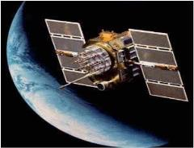
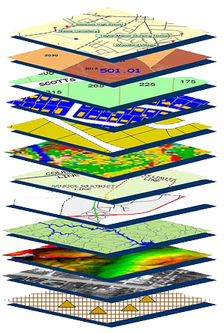
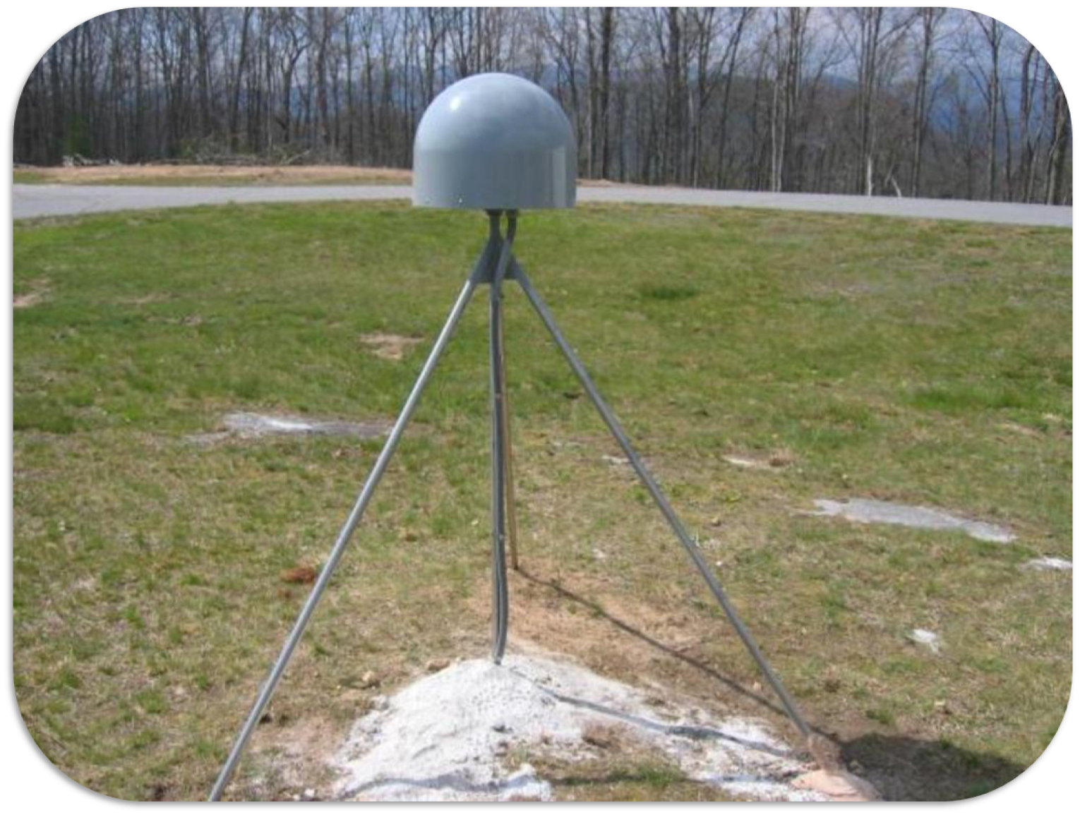
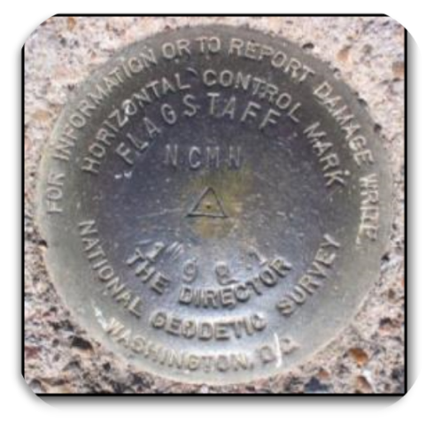

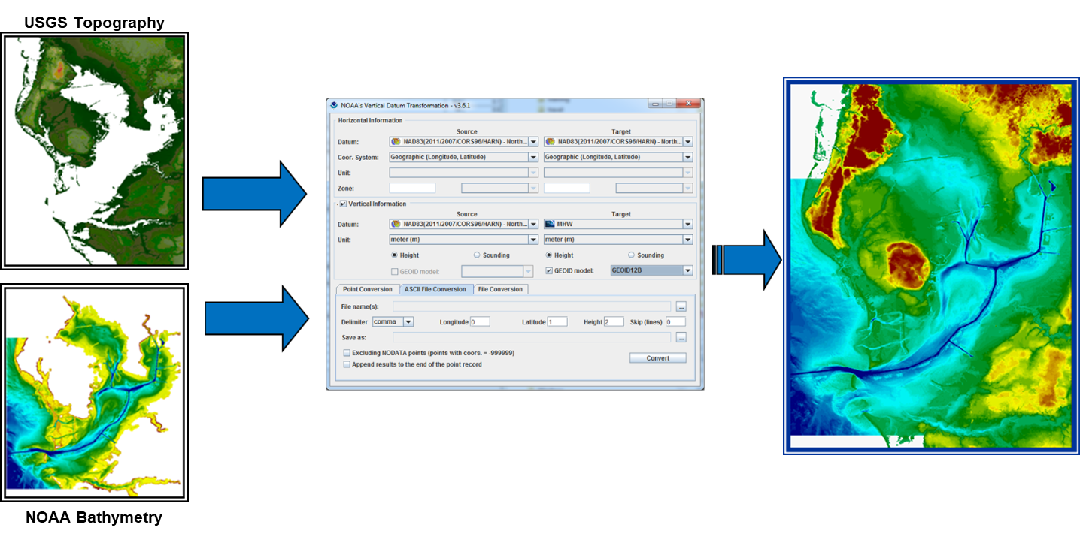
Modernized National Spatial Reference System
Satellite Observations
National Geodetic Survey (NGS) defines, maintains, and provides access to the National Spatial Reference System (NSRS) — a consistent coordinate system that defines latitude, longitude, height, scale, gravity, orientation, and shoreline throughout the United States
As accuracy, precision, and quantity of geospatial data increases, the use of consistent reference frames is critical to maintaining interoperability
NGS supports users in referencing geospatial data to the NSRS, and provides transformation tools to help align data and to transform coordinates between various datums and projections
Environmental Modeling
Obstructions in Air & Sea
Water Levels and Flow
Sea Surface Topography
Habitat Mapping
Bathymetry
Shoreline
Land Elevations
Aerial Imagery
*Geodetic Control*
VDatum
Notes:
Geodesy ties this all together - NOS’s horizontal and vertical reference systems are the framework on which everything hangs
Platforms and observations on left
Data in middle - in this case, a model of the geoid
Products on right

Slide 6
Horizontal Datums/Reference Frames
The Old | The New
NAD 83 (2011) | NATRF2022 - The North American Terrestrial Reference Frame of 2022
NAD 83 (2011) | CATRF2022 - The Caribbean Terrestrial Reference Frame of 2022
NAD 83 (PA11) | PATRF2022 - The Pacific Terrestrial Reference Frame of 2022
NAD 83 (MA11) | MATRF2022 - The Mariana Terrestrial Reference Frame of 2022

Slide 7
Vertical Datums
The Old:
NAVD 88
PRVD 02
VIVD09
ASVD02
NMVD03
GUVD04
IGLD 85
IGSN71
GEOID18
DEFLEC18
The New:
The North American-Pacific Geopotential Datum of 2022 (NAPGD2022)
Will include:
GEOID2022
DEFLEC2022
GRAV2022
DEM2022
More
Orthometric
Heights
Normal
Orthometric
Heights
Dynamic
Heights
Gravity
Geoid
Undulations
Deflections of
the Vertical
Notes:
Is there a way to know when a new datum has been accepted by a community? I run into this all the time looking at plans…say the as-built plans are dated 1990…but design started in 1985…what is the datum? Even if design of something was in 1988, was it on NAVD88 or still NGVD29? - Some communities are slow to adapt. I recommend getting on board with NAPGD2022 once it is ready. Much more consistent.

Slide 8
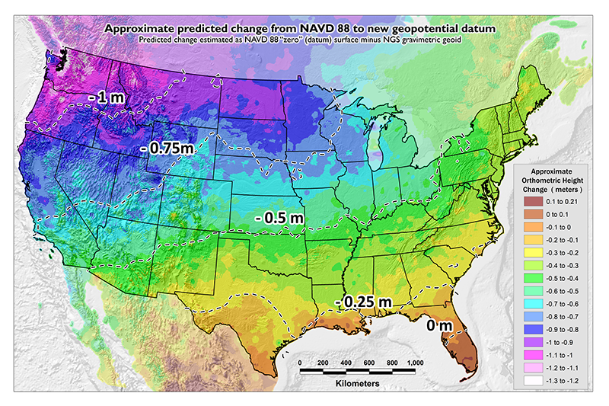
NAVD 88 (epoch ?) to NAPGD2022 Epoch 2020.00 (estimate)

Slide 9
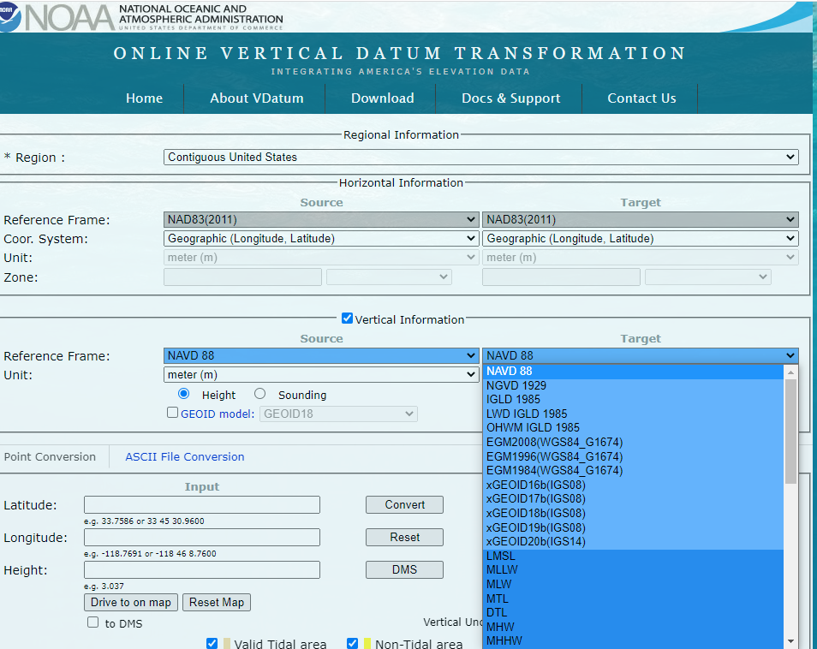
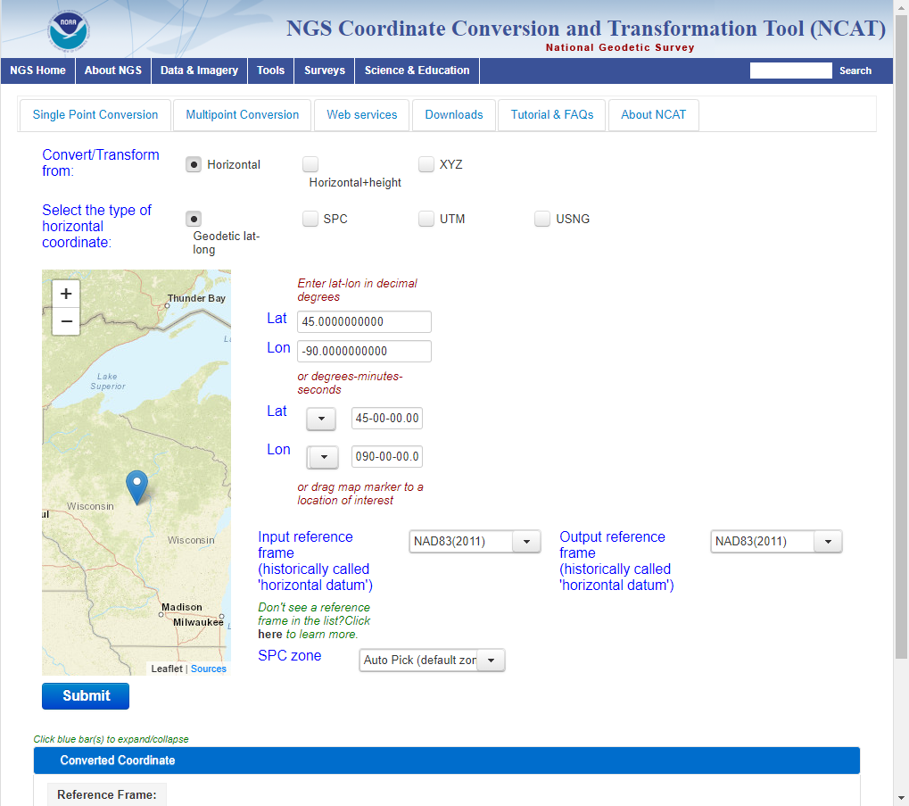
Can we convert data?
Yes, NGS provides tools for transformation between datums:
NCAT: The NGS Coordinate Conversion and Transformation Tool
VDATUM: A tool for vertical datum transformations that include IGLD and tidal datums as well
https://vdatum.noaa.gov/
https://www.ngs.noaa.gov/NCAT/

Slide 10


Slide 11
NSRS Modernization: Delay
Will names change?
No, “GEOID2022”, “NATRF2022”, etc. will remain the same
NGS anticipates the release of all data, and limited tools, by the middle of 2025.
Some of this may depend on things outside of NGS control (we have already delayed beyond 2022!)
Work on additional tools will continue in the out-years
Notes:
Is NAPGD2022 in effect now? No, not yet
How does a new datum become new? An agency like NGS creates it, then Federal agencies formally adopt it through the Federal Geodetic Control Subcommittee (FGCS) of the Federal Geographic Data Committee (FGDC). See omb circular A-16, among other documents.
How does the new datum get enforced? For Federal projects and contracts, you may be required to use it. Otherwise, it’s a good idea to use the latest datum, but either way, specify the datum you are using.

Slide 12
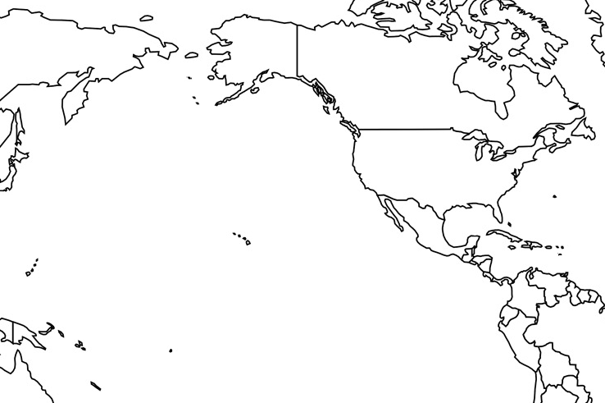
Vertical Datums of the NSRS
St. Paul I.
- None -
St. Lawrence I.
- None -
St. Matthew I.
- None -
Alaska
NGVD 29
NAVD 88
St. George I.
- None -
CONUS
NGVD 29
NAVD 88
Hawaii
- None -
CNMI
NMVD 03
Puerto Rico
PRVD 02
U.S. Virgin Islands
VIVD 09
American Samoa
ASVD 02
Guam
GVD 63
GUVD 04

Slide 13
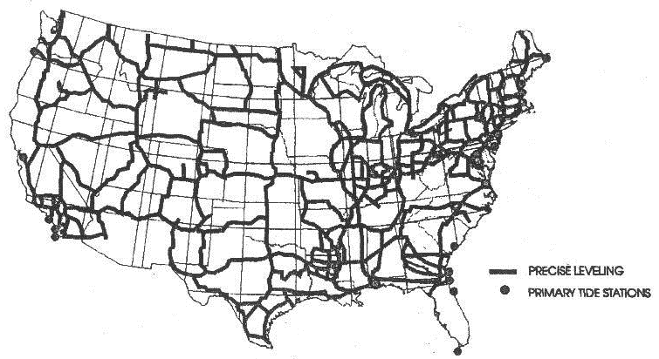
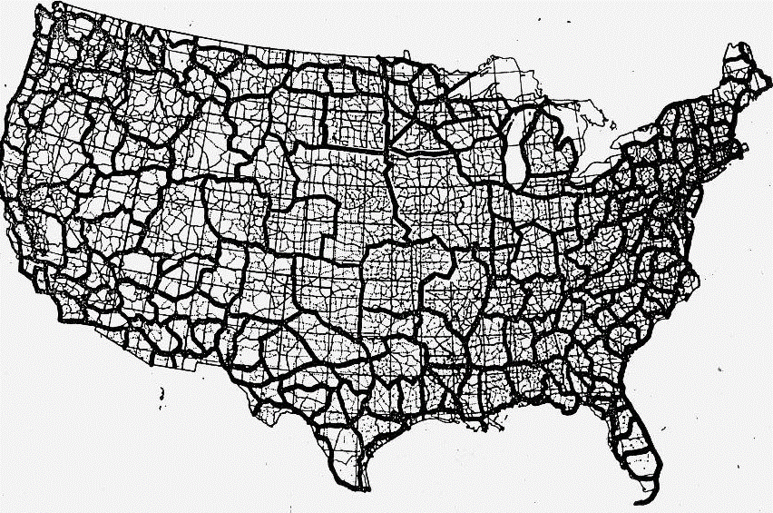
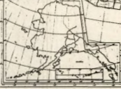
Developing the previous vertical datums
NGVD 29
NAVD 88

Slide 14
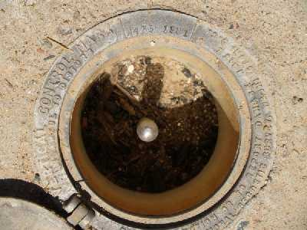
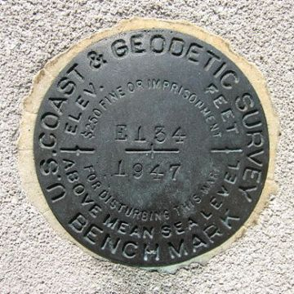
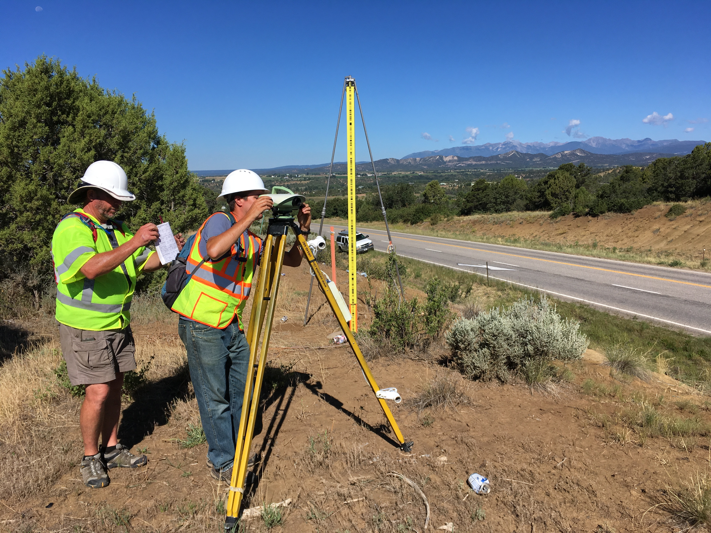
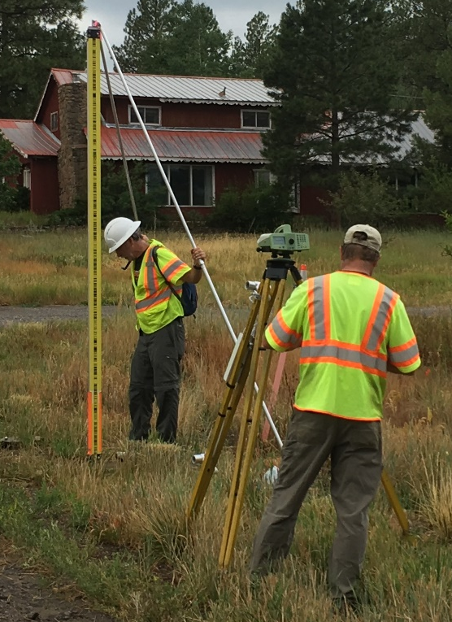
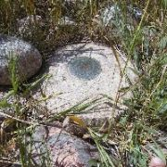
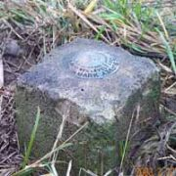
Leveling
Notes:
NAVD 88 is accessed through leveling off of marks with NAVD 88 heights on them.
Those heights were determined by leveling crews.

Slide 15
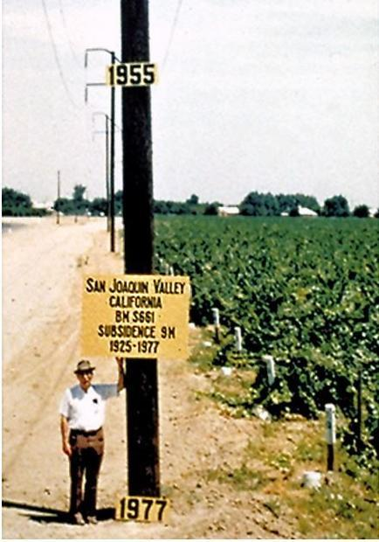
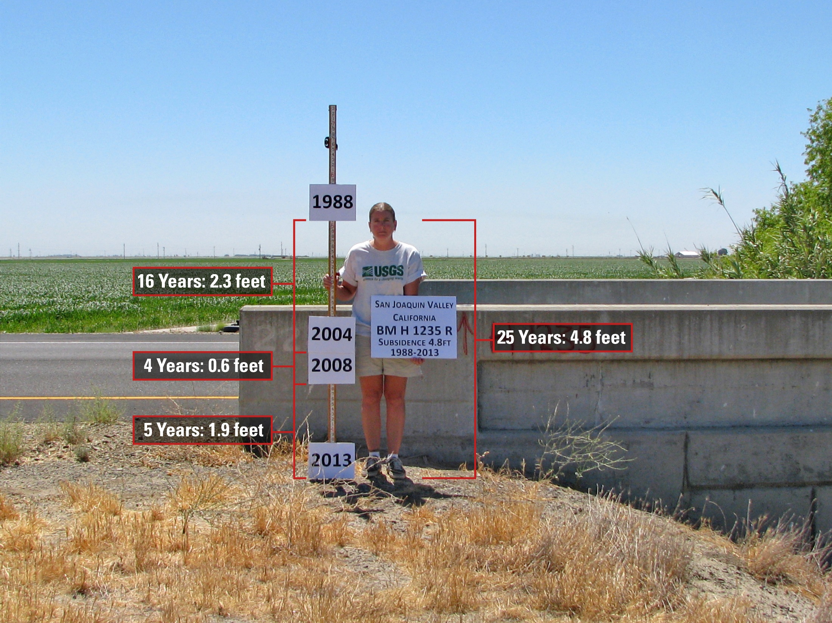
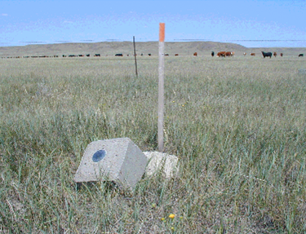
Subsidence
Destruction
Notes:
NAVD 88 has limitations, including that it assumes that the heights stay the same over time, which in reality they don’t. This photo shows subsidence in California’s Central Valley.
Marks are susceptible to destruction and damage as well

Slide 16
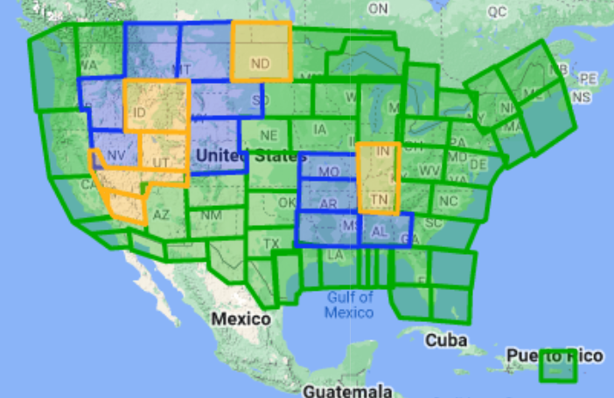

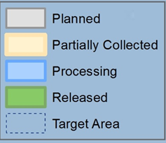
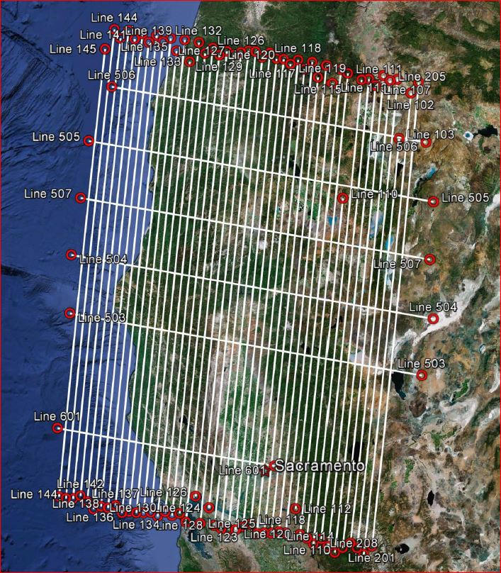
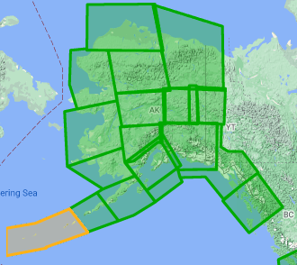
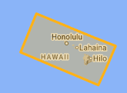
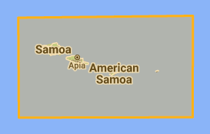

Gravity for the Redefinition of the American Vertical Datum (GRAV-D)
10 km data lines
70 km cross lines
20,000 ft altitude
230 kt flight speed
Over 96% complete
Alaska
Hawaii
American Samoa
Guam & CNMI
Notes:
96.78% complete as of 1/11/2023

Slide 17
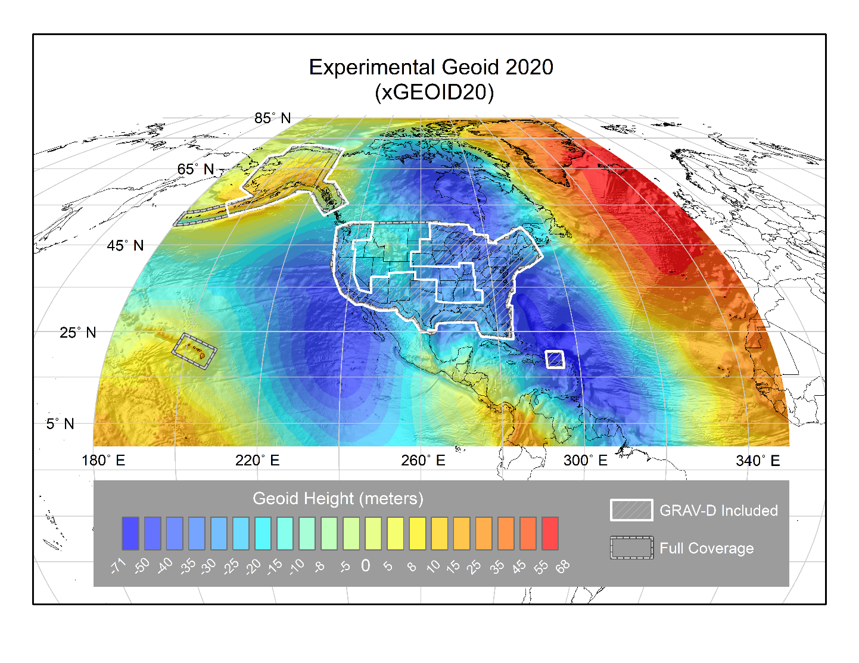
Notes:
The geoid model looks something like this.

Slide 18
Understanding “Geo-Potential”
h
The resting water has “potential” energy just by being high up on this cliff.
Energy = mgh
That potential energy can turn into real (kinetic) energy by falling.
Energy = ½ mv² (= mgh)
Think of the Earth as creating a “gravity field” that masses experience. I’ve drawn potential “field lines”
Potential = gh
Gravity x Height is “Geopotential”. This is what water “feels”.

Slide 19
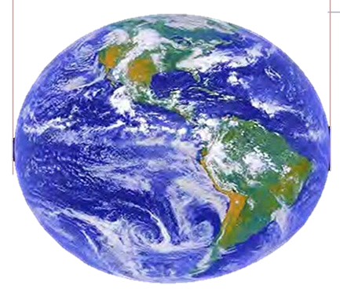
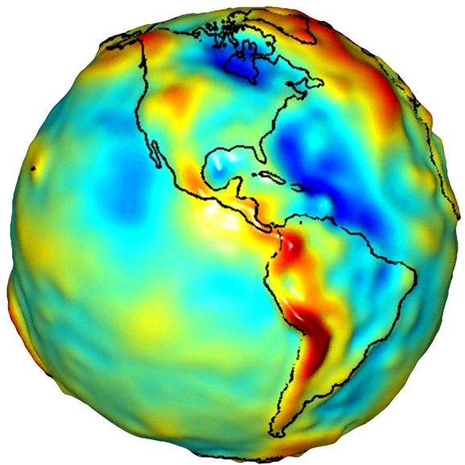
Ellipsoids and Geoids
GRS80 ellipsoid
Geoid
Notes:
NAPGD2022 will be accessed differently than NAVD 88 is. First, let me explain what is what.
Start with the Earth. The Earth isn’t flat, but it’s more than just a sphere.
We first approximate it as an ellipsoid, which is a sphere that’s been squashed a little bit. The ellipsoid that we use is called GRS 80. With GPS we can measure a height above the ellipsoid.
A better approximation is a geoid, a surface that closely matches sea level. A geoid is what’s called an equipotential surface. As you move through the The height above the geoid is called an orthometric height. Leveling gives orthometric height differences. These are more significant than ellipsoidal heights since ellipsoidal heights don’t tell anything about which way water flows.

Slide 20
The Geoid, and Heights
h
= H
+ N
h: ellipsoidal height (from GNSS)
H: orthometric height
N: geoid undulation
Topography
h
H
The geoid
N
A chosen
ellipsoid
Notes:
Fundamental changes to how we access the vertical datum

Slide 21
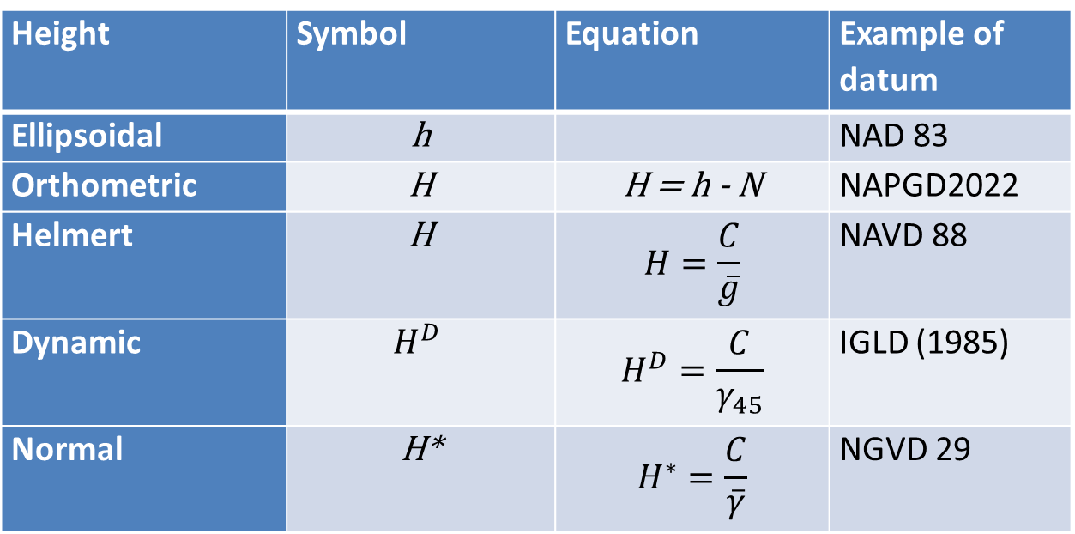
Types of heights summary
Height | Symbol | Equation | Example of datum
Ellipsoidal | h |  | NAD 83
Orthometric | H | H = h - N | NAPGD2022
Helmert | H | $$H=\frac{C}{\overline{g}}$$ | NAVD 88
Dynamic | $$H^{D}$$ | $$H^{D}=\frac{C}{γ_{45}}$$ | IGLD (1985)
Normal | H* | $$H^{∗}=\frac{C}{\overline{γ}}$$ | NGVD 29

Slide 22
Other vertical datums
International Great Lakes Datum (1955, 1985, 2020)
Pre-1929 General Adjustments (1900, 1903, 1907, 1912)
River datums (Mean Gulf Level, Memphis, others)
Tidal Datums (NTDE)
Notes:
See Pearson and Mick: Legacy height datums on the Mississippi and Illinois river systems https://www.ngs.noaa.gov/PUBS_LIB/Miss_ht%20datums_ACSM_v3.pdf

Slide 23
Draw a DATUM PROFILE
St. Paul, MN
(PBM 67)
Dresbach, MN
(PBM 182)
Elevation above datum = Depth to datum
NGVD29
NAVD88
0.046 m
0.013 m
NAVD88
NGVD29
0.098 m
0.071 m
Mean Gulf
Mean Gulf
1912
0.003 m
0.078 m
2.222 m
2.148 m
1912
Memphis
Memphis
Notes:
We note that the Datums are not parallel
They do not converge/diverge uniformly
underlying undetected errors in the leveling
underlying undetected errors in the adjustment
by the choice of constraints used in the adjustments.
There is NO single “Correct” conversion between datums!
These towns are only 127 miles apart

Slide 24
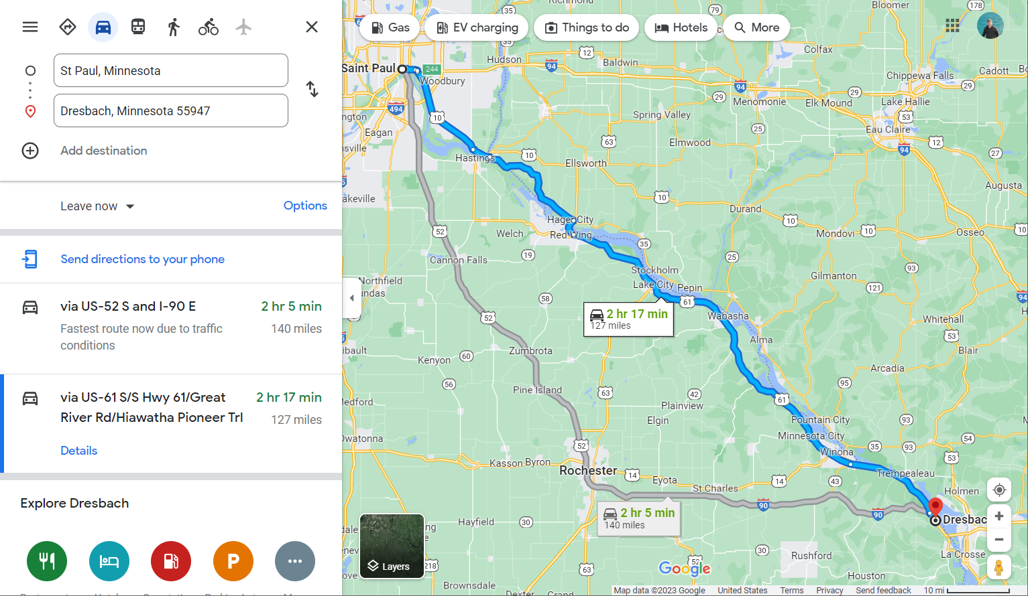
St. Paul to Dresbach: 127 miles

Slide 25
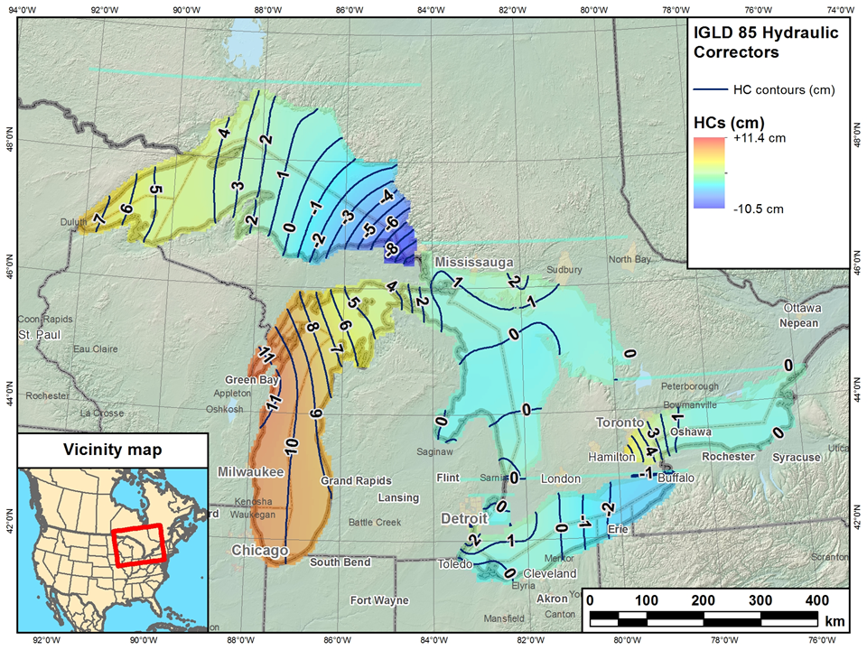
Current IGLD
IGLD (1985) replaced IGLD (1955) in 1992
Same reference zero as NAVD 88 (at Pointe au Père, Québec)
Surface determined by leveling
Dynamic heights
Hydraulic correctors

Slide 26
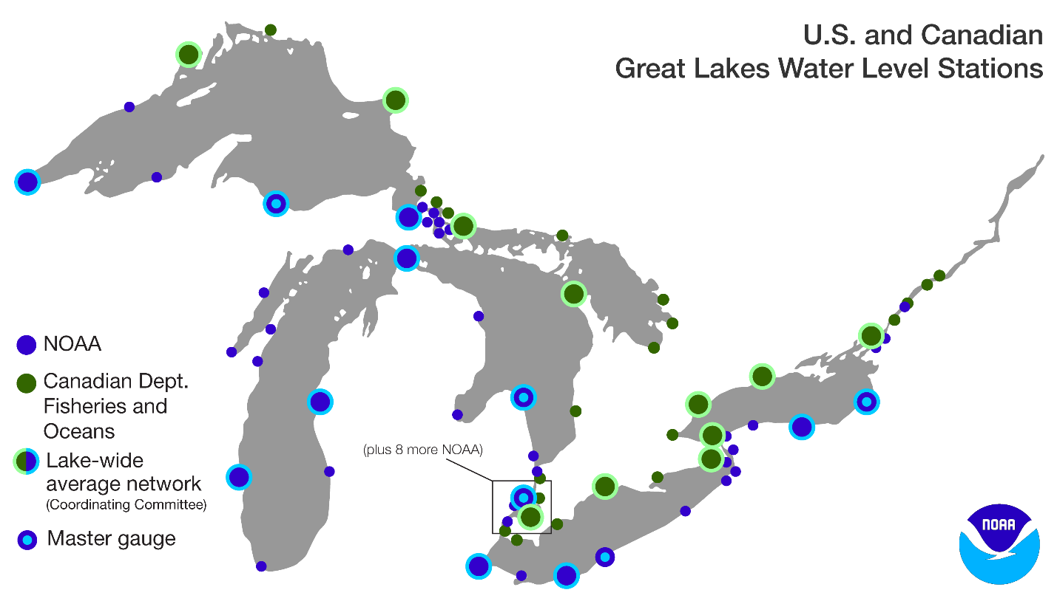
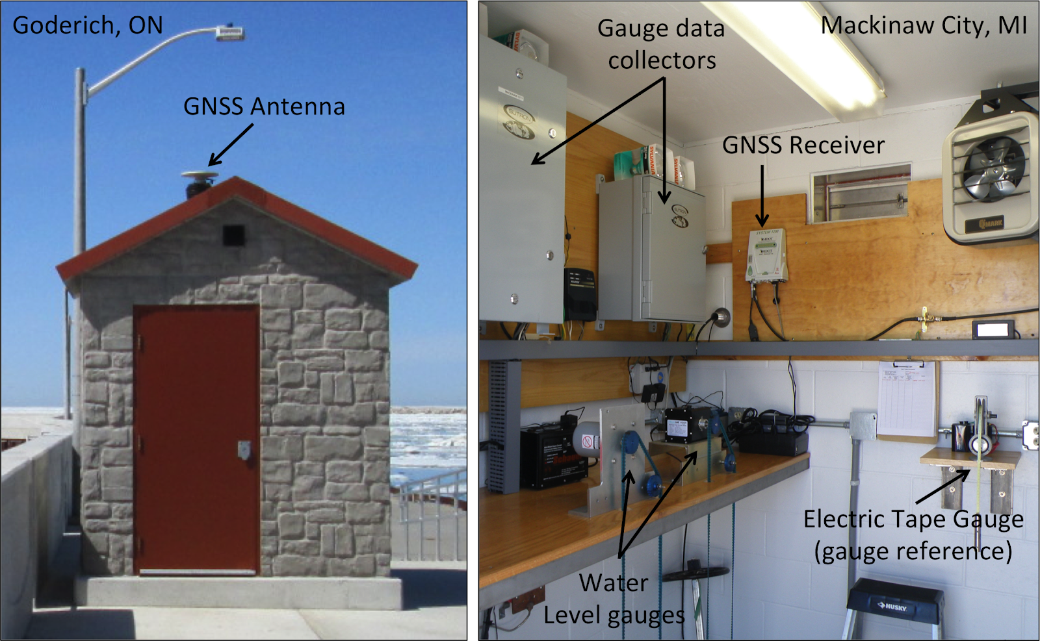
Water Level Stations

Slide 27
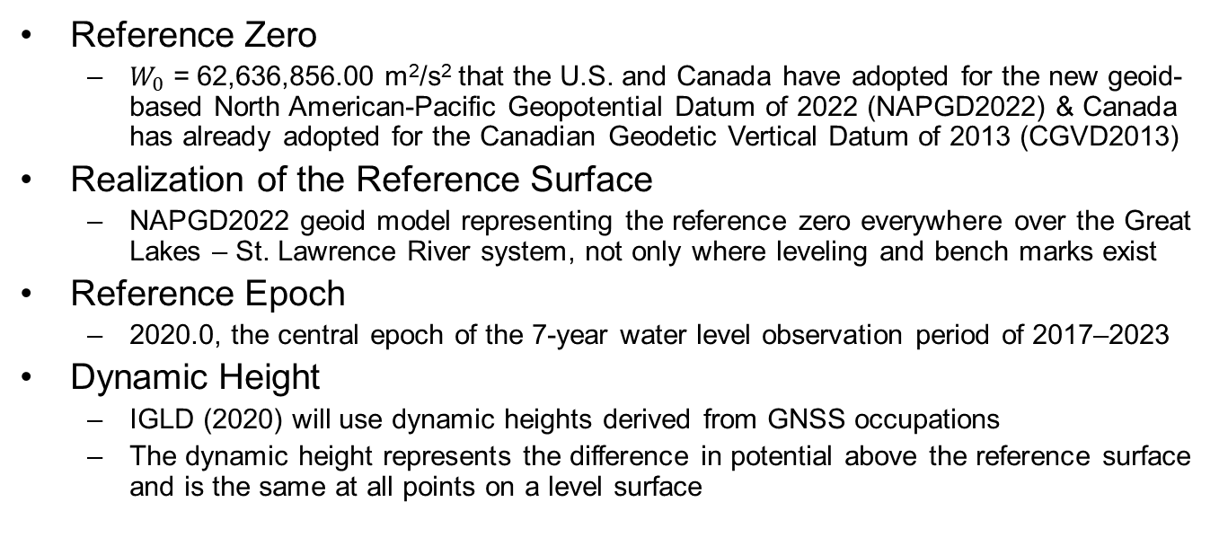
Definition of IGLD (2020)
Reference Zero
$W_{0}$ = 62,636,856.00 m²/s² that the U.S. and Canada have adopted for the new geoid-based North American-Pacific Geopotential Datum of 2022 (NAPGD2022) & Canada has already adopted for the Canadian Geodetic Vertical Datum of 2013 (CGVD2013)
Realization of the Reference Surface
NAPGD2022 geoid model representing the reference zero everywhere over the Great Lakes – St. Lawrence River system, not only where leveling and bench marks exist
Reference Epoch
2020.0, the central epoch of the 7-year water level observation period of 2017–2023
Dynamic Height
IGLD (2020) will use dynamic heights derived from GNSS occupations
The dynamic height represents the difference in potential above the reference surface and is the same at all points on a level surface
Notes:
IGLD (2020) will be completely compatible with dynamic heights in CGVD2013

Slide 28
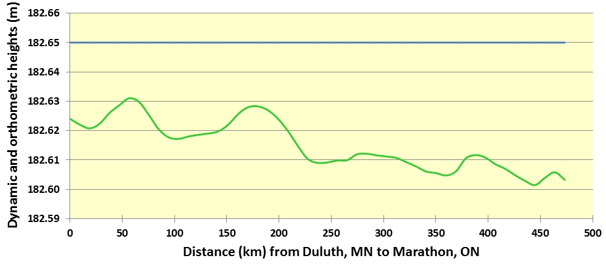
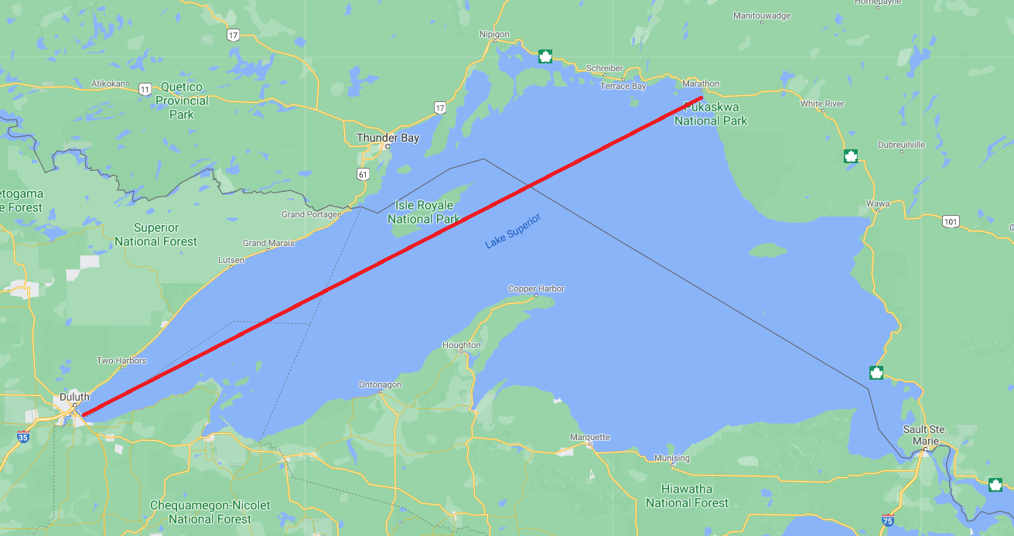
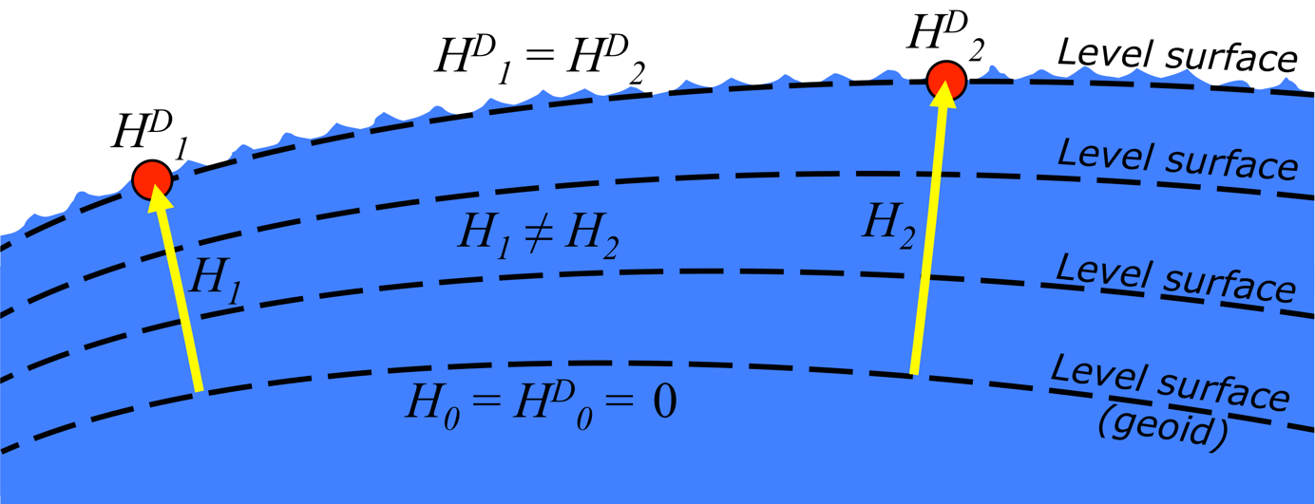
Dynamic vs. Orthometric Heights
South
Dynamic Height
North
Orthometric Height

Slide 29
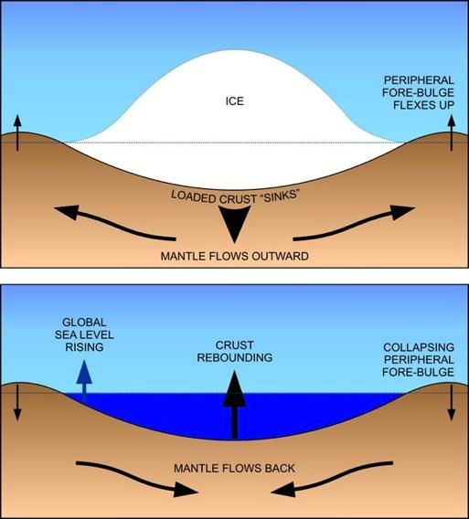
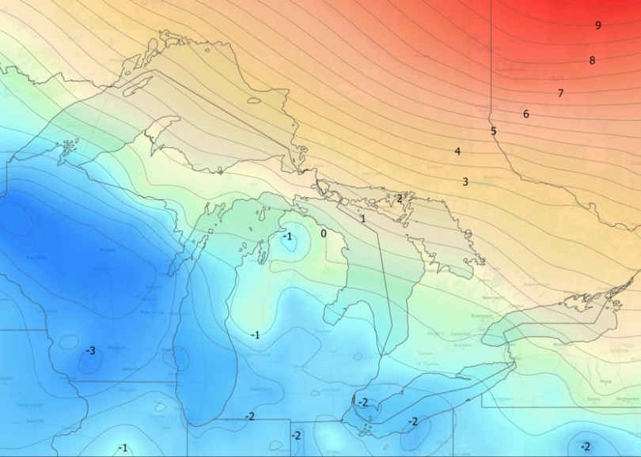
Why a new IGLD?: Glacial Isostatic Adjustment – (GIA)
Process of Glacial Isostatic Adjustment (left) and the resulting tilting of the entire Great Lakes region (right) as determined by high accuracy GPS measurements in units of mm/year. M. Craymer and C. Wisotzkey, 2021.
Entire basin is:
Uplifting in north
Subsiding in south
Overall tilting ~7 mm/year
(21cm or 0.7’ over 30 year)
Need to update IGLD
every 25-30 years
Notes:
The IGLD has to be updated every 25-30 years to keep it accurate because the land in Great Lakes region is shifting, which leads to changes in the water levels.
During the last ice age, the area was covered by glaciers, and the weight of the glaciers caused the land to sink. Though the glaciers are long gone, the earth’s crust is still bouncing back from this extra weight, particularly in the northern part of the Great Lakes region. This motion is known as Glacial Isostatic Adjustment (GIA).
GIA tilting is not uniform across the Great Lakes region; the north is experiencing uplift and the south is experiencing subsidence. This averages out to about 7 millimeters a year or 21 centimeters over a 30 year period.
Because the last update was conducted in 1985, the IGLD is overdue for an update to account for GIA in the region.

Slide 30




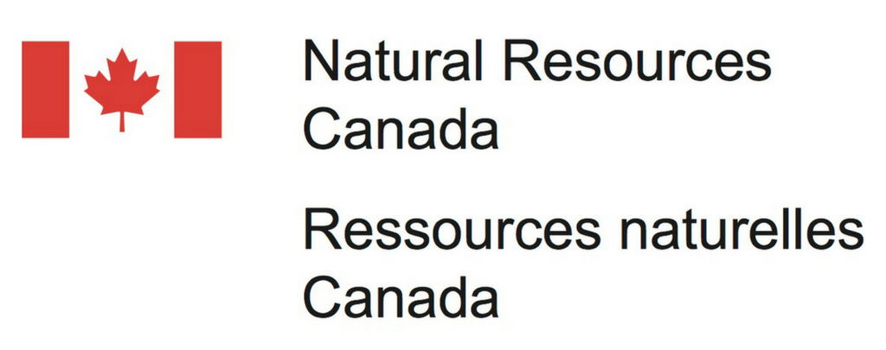

Coordinating Committee on Great Lakes Basic Hydraulic and Hydrologic Data
Formed in 1953
Ad hoc group of federal experts
Four subcommittees
Hydraulics
Hydrology
Coordinated Regulation and Routing Model
Vertical Control - Water Levels
Update and revise IGLD
Standardize water level data processing

Slide 31
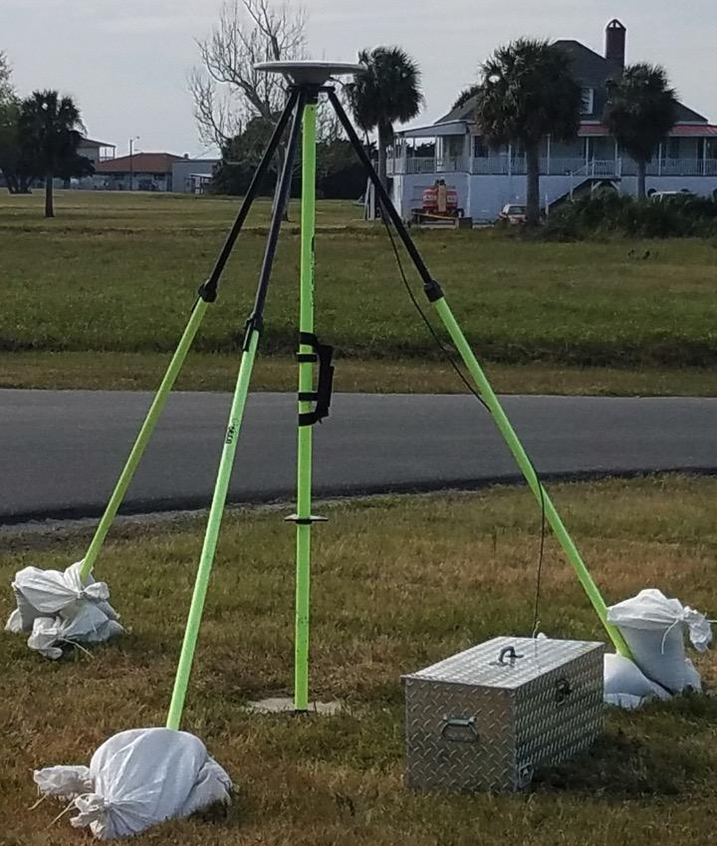
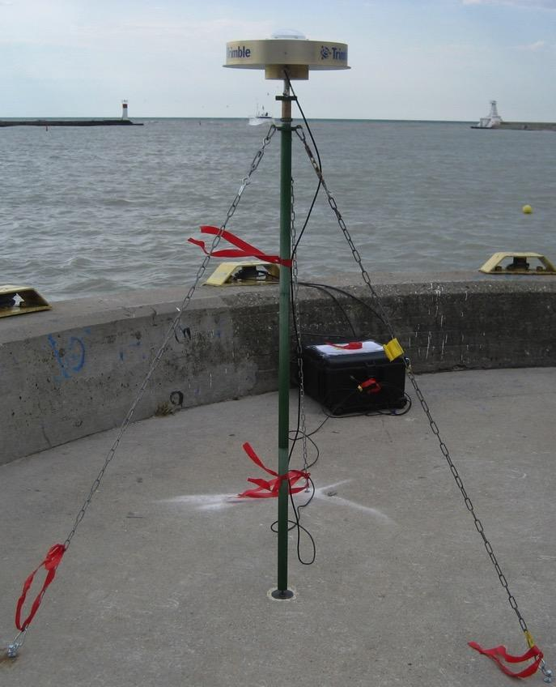
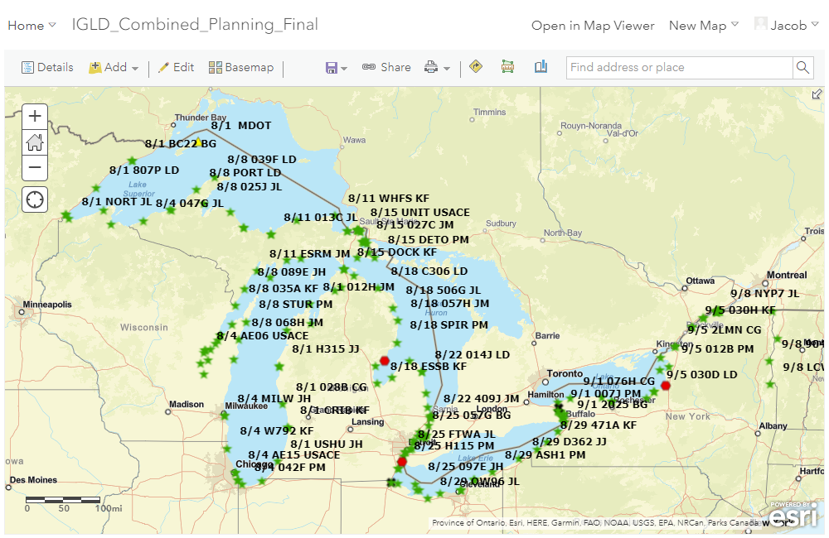
IGLD GNSS Survey
Need to determine heights of water level stations in the new geoid-based IGLD (2020)
GNSS at all water level stations ~300 sites
GNSS equipment & training from CGS & NGS
CGS & NGS will process all data using long-term CORS/CACS
Campaigns at permanent gauges
1997, 2005, 2010, 2015, 2022, 2027 (TBD)
Will be used to improve vertical velocity model
Typical GNSS Setup

Slide 32
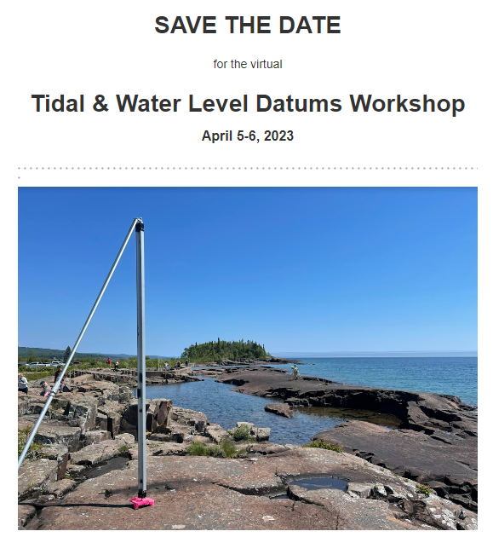


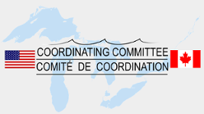
Save the Date! Water Level Datum Workshop
NOAA, the Canadian Hydrographic Service (CHS), and the Coordinating Committee on Great Lakes Basic Hydraulic and Hydrologic Data would like to invite you to a virtual workshop on Tidal and Water Level Datums. Participants will have the opportunity to learn more about the datums and impacts on the coastal, navigation and shipping communities and industries.
April 5: National Tidal Datum Epoch (NTDE)
April 6: International Great Lakes Datum (IGLD) and the Low Water Datum (LWD)
The workshop will feature presentations and discussions from NOAA’s Center for Operational Oceanographic Products and Services, the National Geodetic Survey, and the Office of Coast Survey, as well as U.S. Army Corps of Engineers, CHS, Natural Resources Canada, Environment and Climate Change Canada, and others.

Slide 33
Thank You!
Jacob M. Heck, Ph.D., P.S.
Great Lakes Regional Geodetic Advisor (MI, IN, IL, WI)
U.S. National Geodetic Survey, NOAA
jacob.heck@noaa.gov
c/o NOAA Great Lakes Environmental Research Laboratory
4840 S. State Road
Ann Arbor, MI 48108
For more information, visit https://geodesy.noaa.gov

