Slide 1

Creating
Modernizing the
Geopotential Datum
AKA “Replacing NAVD 88”
Dru Smith
NSRS Modernization Manager
NOAA’s National Geodetic Survey

Slide 2
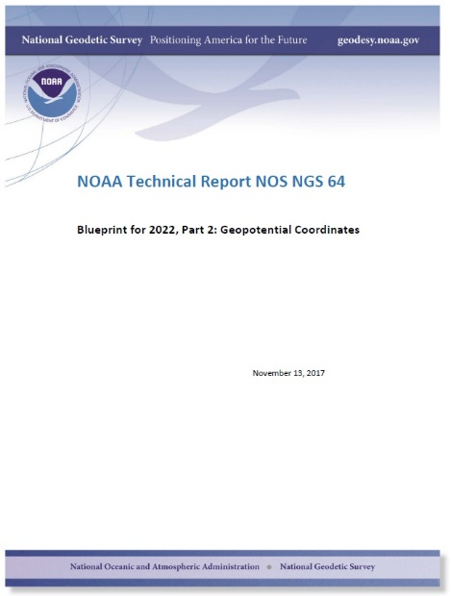

Slide 3
NSRS Modernization
  The Old:
  NAVD 88
  PRVD 02
  VIVD09
  ASVD02
  NMVD03
  GUVD04
  IGLD 85
  IGSN71
  GEOID12B
  DEFLEC12B
  The New:
  The North American-Pacific Geopotential Datum of 2022 (NAPGD2022)
  Primary component is a global harmonic model of geopotential which includes all GRAV-D data:
    GM2022
  Related regional gridded products:
    GEOID2022
    DEFLEC2022
    GRAV2022
Orthometric
Heights
Normal
Orthometric
Heights
Dynamic
Heights
Gravity
Geoid
Undulations
Deflections of
the Vertical

Slide 4
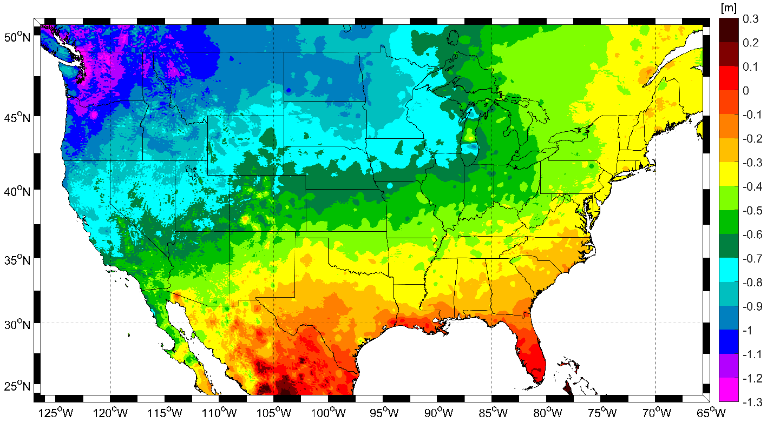
Expected changes to orthometric heights

Slide 5
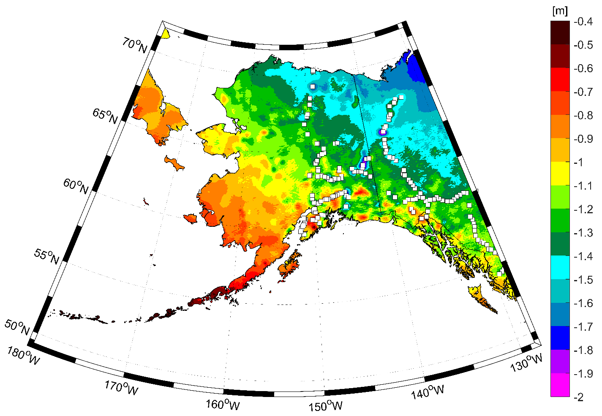
Expected changes to orthometric heights

Slide 6
NAPGD2022
“North American-Pacific…”
  Because the gridded components (geoid, DoV, gravity, DEM) will cover all major USA populated territories, and these happen to fall in the general regions of “North America” and “The Pacific Ocean”
    However, the foundation of the gridded components will be a global geopotential model

Slide 7
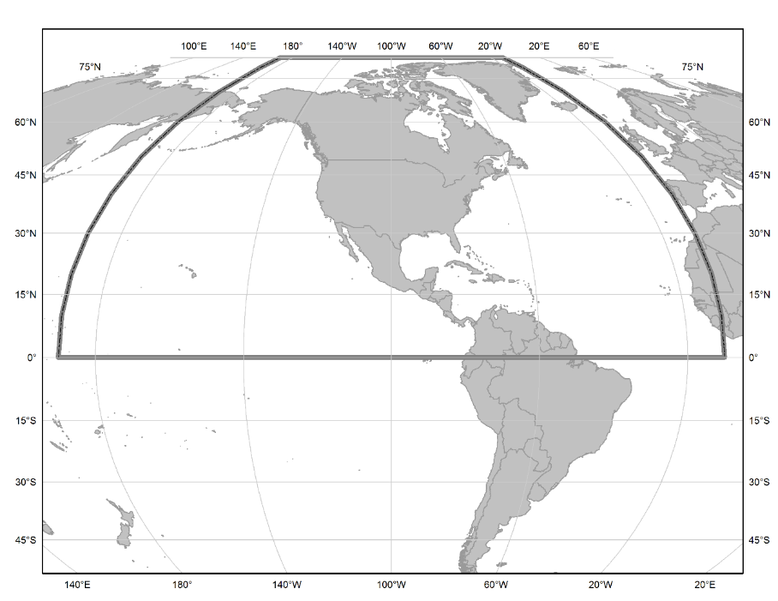
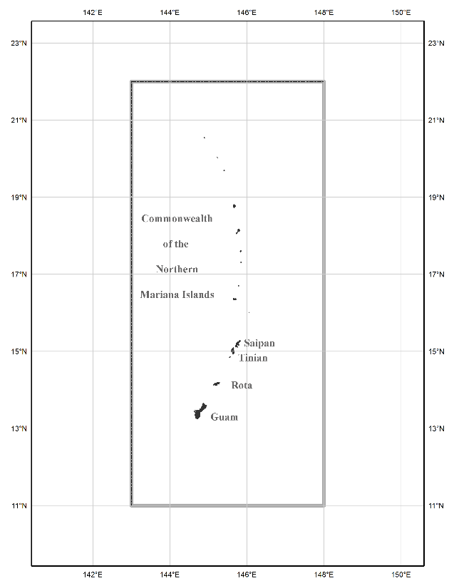
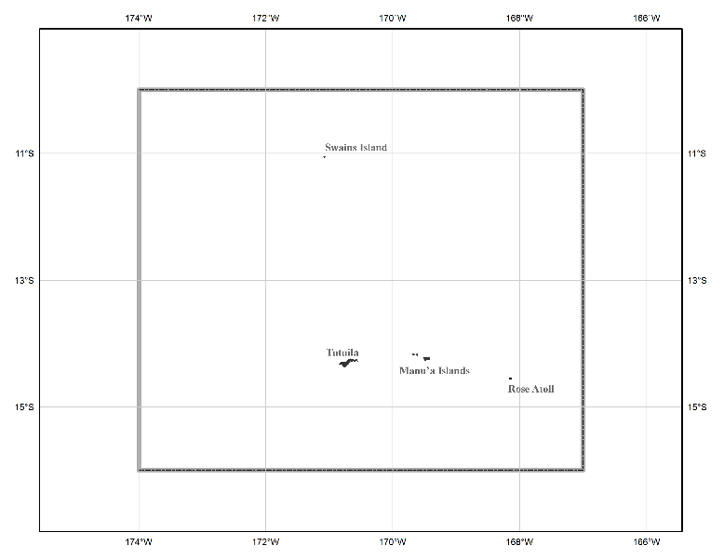
The three gridded regions
“North American region”
¼ of the Earth
“American Samoa region”
“Guam/CNMI region”

Slide 8
NAPGD2022
“…Geopotential…”
  Because it isn’t just about heights, but rather about all geodetic coordinates related to Earth’s geopotential field (geoid, deflections, etc)

Slide 9
NAPGD2022
“…Datum…”
  Because a “geopotential reference frame” was, frankly, an unwieldy term that had no precedence in geodetic literature.
    “Reference Frame” only carries a geometric connotation in geodesy
  It is replacing, and expanding upon, the idea of a “vertical datum”

Slide 10
NAPGD2022
“…2022”
  Because that is our target release date

Slide 11
Static and Dynamic Components
Product | Area | Format | Static | Dynamic
GM2022 | Global | Geopotential Coefficients | SGM2022 | DGM2022
GEOID2022 | Regional (3) | Grid | SGEOID2022 | DGEOID2022
DEFLEC2022 | Regional (3) | Grid | SDEFLEC2022 | DDEFLEC2022
GRAV2022 | Regional (3) | Grid | SGRAV2022 | DGRAV2022*
DEM2022 | Regional (3) | Grid | SDEM2022 | DDEM2022*
* Not scheduled for release by 2022

Slide 12
Static Components
Will model reality circa 2020.00
  SGEOID2022 is NGS’s best attempt to model the geoid as it truly is on date 2020.00, etc

Slide 13
Dynamic Components
Will model reality relative to 2020.00
  DGEOID2022 is NGS’s best attempt to model the geoid changes since 2020.00
    Both forward and backward in time, with limits
May be in a variety of formats
  DGEOID2022 might include
    Regional grid of dN/dt values
    Local grids of event-based changes (massive earthquakes)

Slide 14
The next few slides are found in Blueprint for 2022, Part 2
Represent a flow-chart for:
  Begin with a GNSS receiver
  End with NAPGD2022 values
    Orthometric heights, Gravity, Etc…

Slide 15
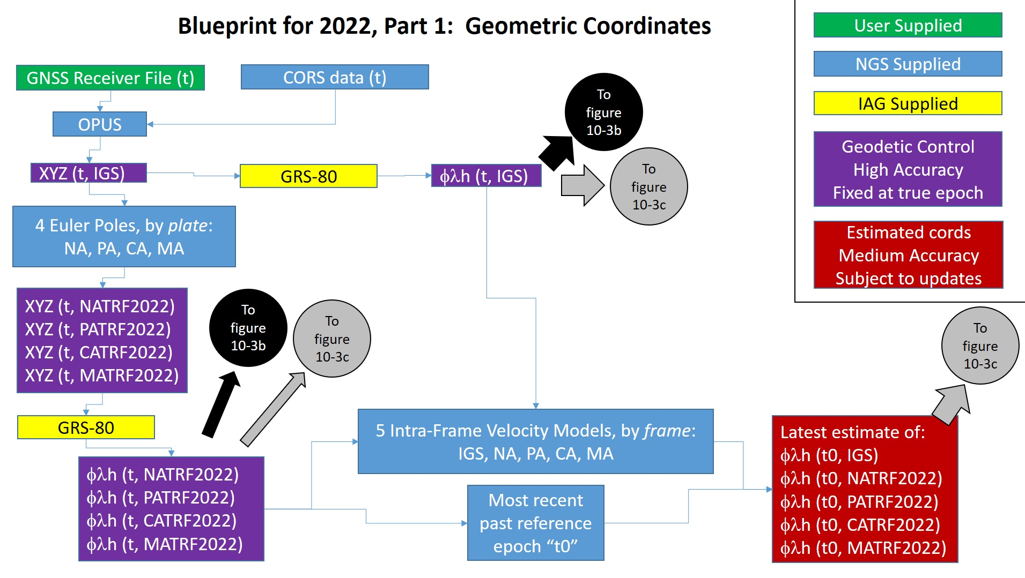

Slide 16
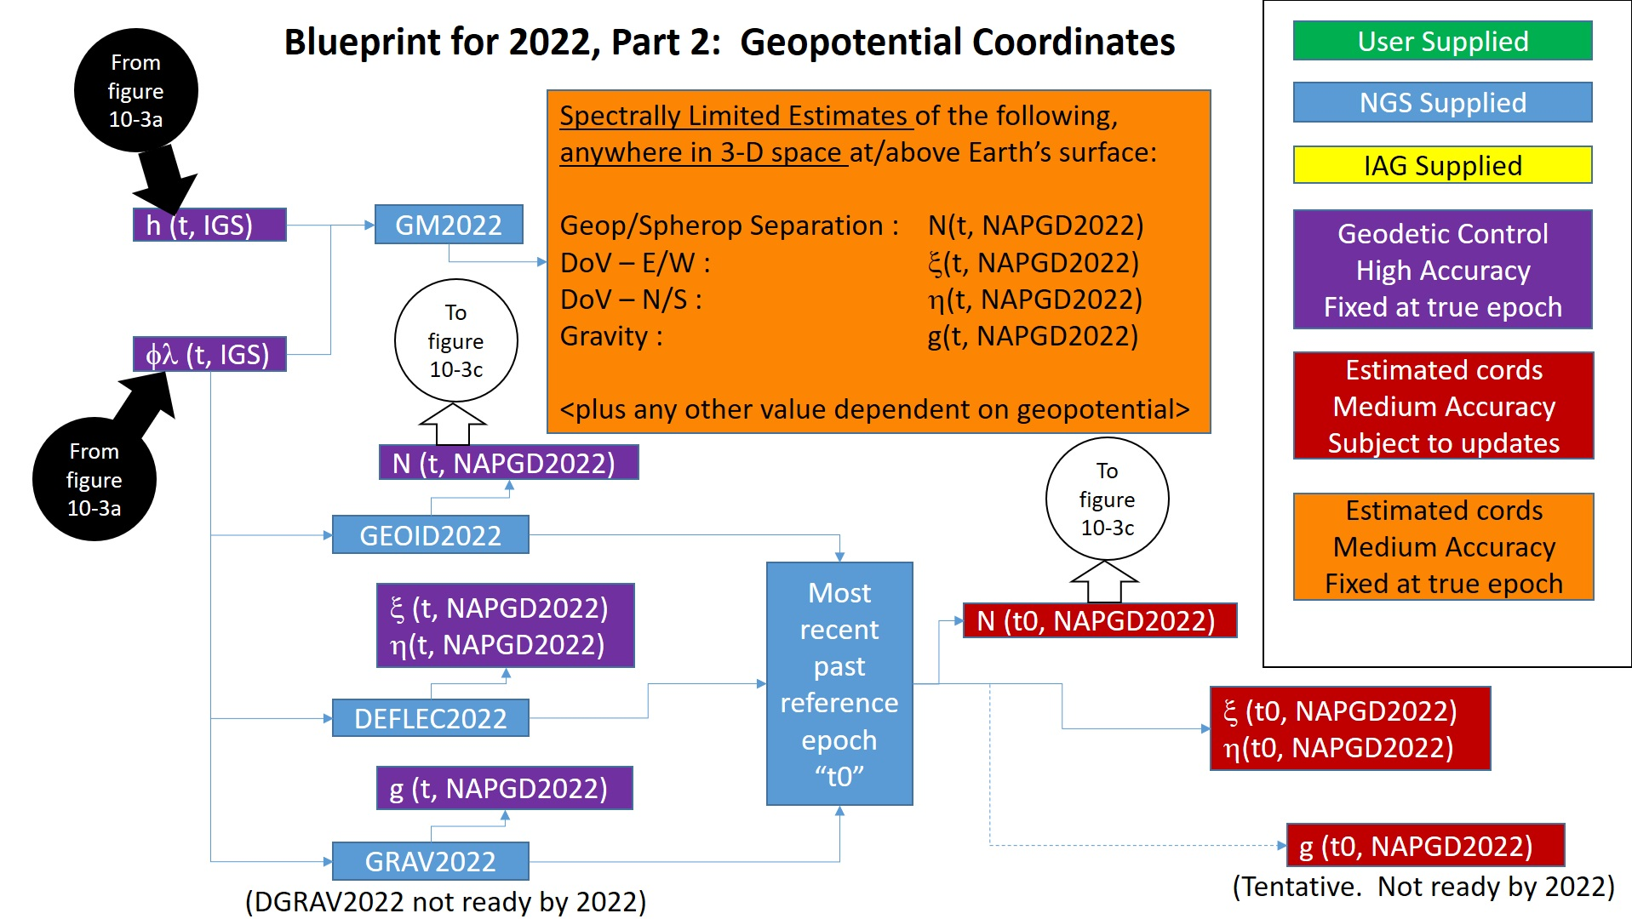

Slide 17
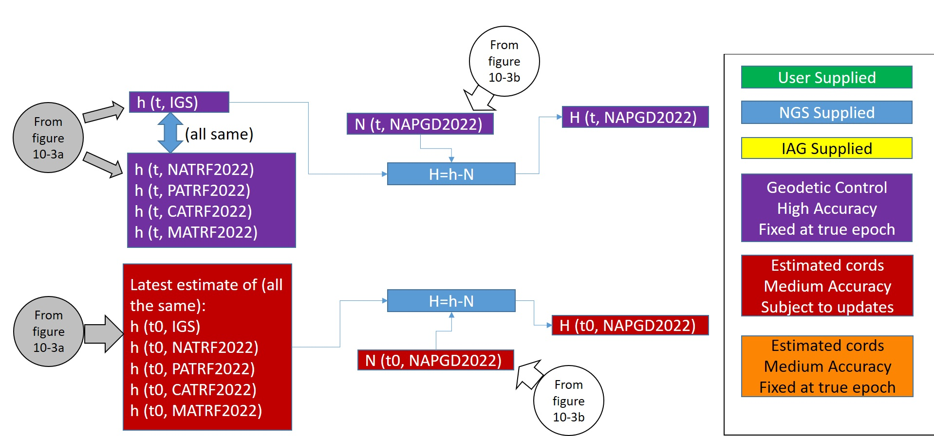

Slide 18
Summary
NAPGD2022 is a self-consistent set of values connected to Earth’s geopotential field
  Replaces all vertical datums of the NSRS
  Time dependent
GNSS/CORS/OPUS is the way to access all of these values
  Passive control as well, but as a secondary source

Slide 19
Thank you

Slide 20
Questions

Slide 21
Extra Slides

Slide 22
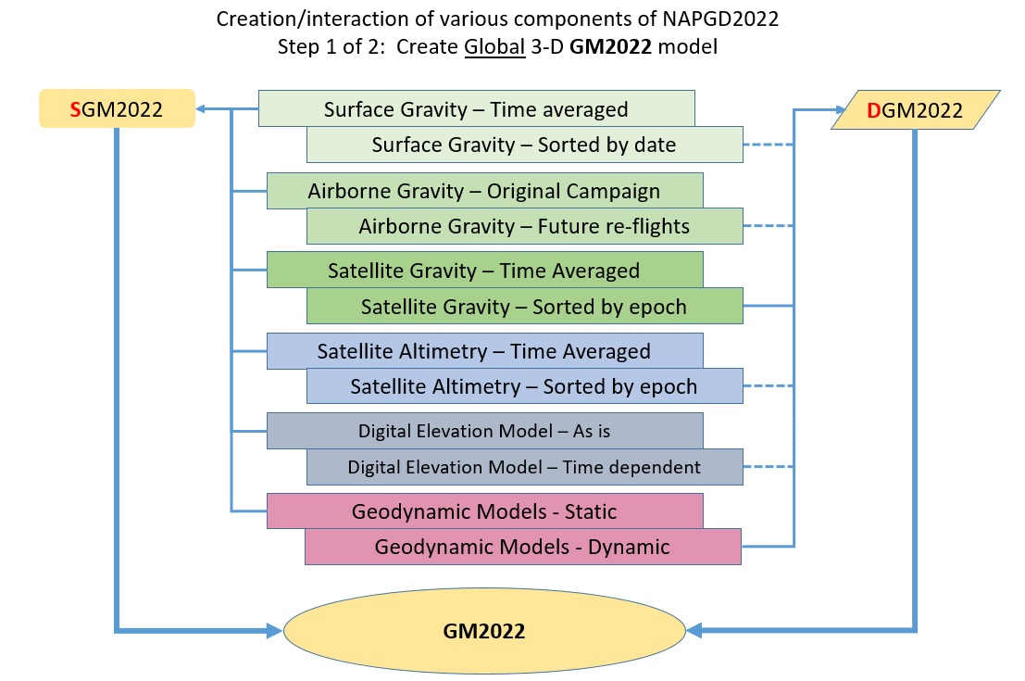

Slide 23
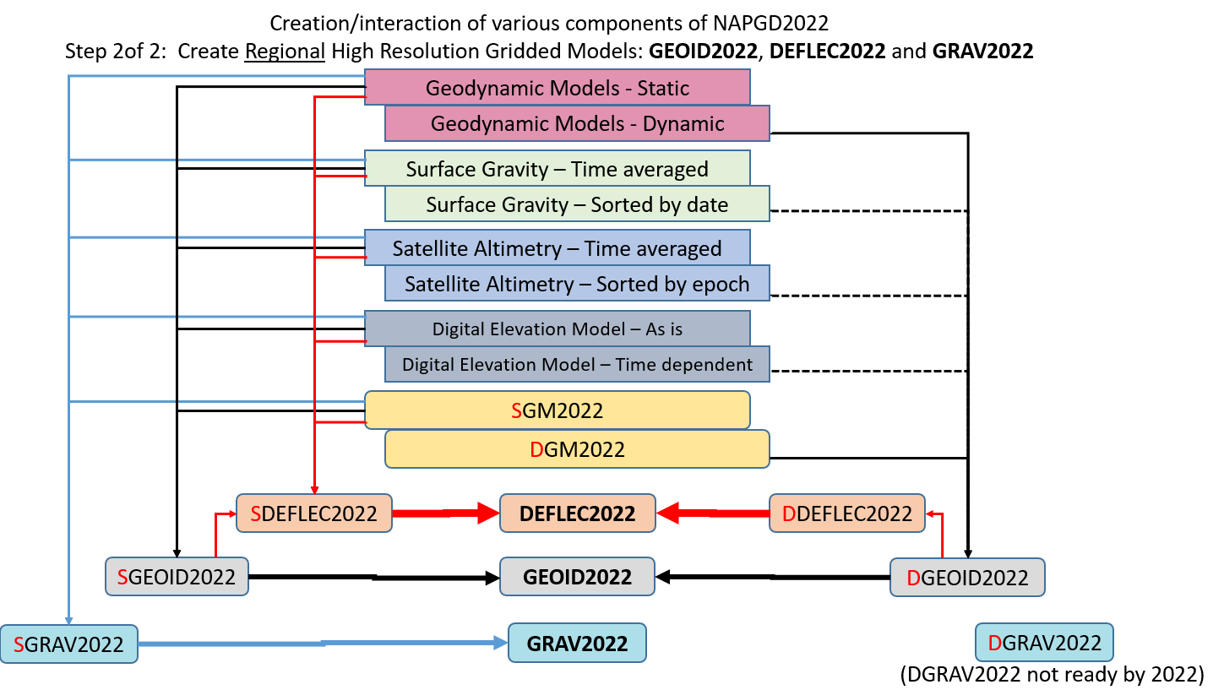

Slide 24
Time Dependency

Slide 25
Time and Mass
Mass quantity in the Earth system is effectively constant
Mass distributions in the Earth system are time dependent and some are large enough to be measurable
  Secular
    Shape change to every equipotential surface (like the geoid)
    Size change to global mean sea level
  Episodic
  Periodic

Slide 26
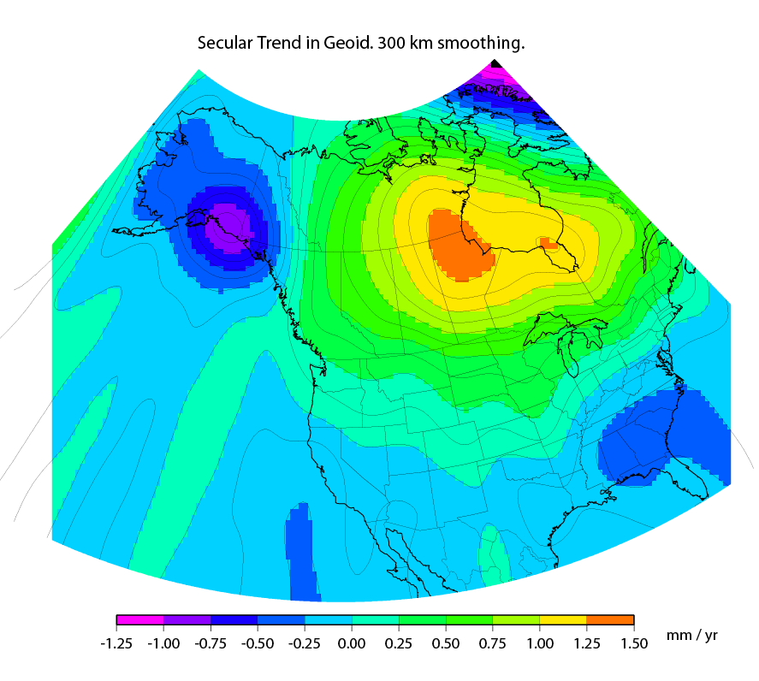
Secular Mass Movement
Mass is flowing in the mantle
to coalesce under Hudson
Bay, pushing the crust up.
GPS on the crust sees this
as one effect:
An increase in ellipsoid height
A gravimeter on the crust
sees two effects:
(small) decrease in gravity as the
gravimeter location gets
farther from the geocenter
(larger) increase in gravity as the
amount of mass below the
gravimeter pulls harder
This gravity change causes the
geoid to “swell” in the area
Notes:
There are two manifestations of the growing mass in the deep mantle under Hudson Bay:
Geometric – a GPS receiver will see the crust uplifting as the increase in mantle mass pushes the crust up in a displacement.
Geopotential – a gravimeter on the surface will sense the growing mass as an increase in the acceleration of gravity, BUT this will be slightly tempered by a reduction in gravity as well (because the gravimeter on the surface is getting farther from the Earth’s center). Still, the gain (from mass increase) is larger than the loss (from geometric movement) for a net gain. Because the net gain in gravity is not caused purely by being at a new crustal height, this translates into an increase in geoid undulations, or a “swelling” of the geoid in this region.
This is different than a purely geometric change caused by a compression of the crust. In that case, no significant mass is entering or leaving the region so, while GPS might sense a subsidence and a surface gravimeter might sense a slight increase as it moves closer to the Earth’s center, the geoid would not actually change.

Slide 27
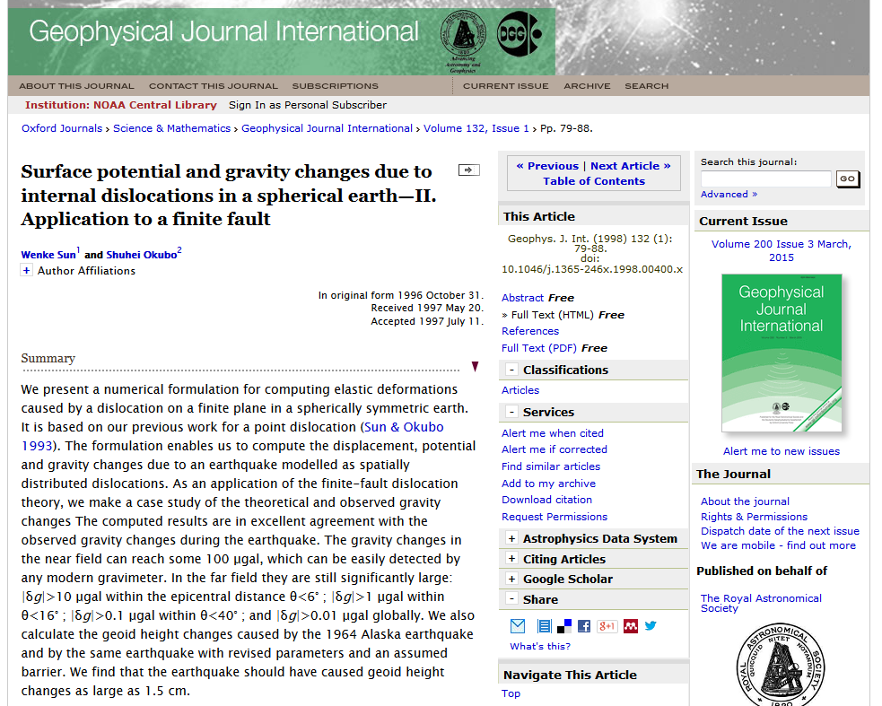
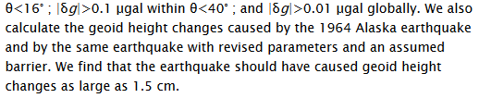
Episodic Mass Movement
Notes:
Rare, but worth monitoring, large earthquakes or volcanic eruptions can move enough mass locally to cause the geoid to make a permanent local shift.

Slide 28
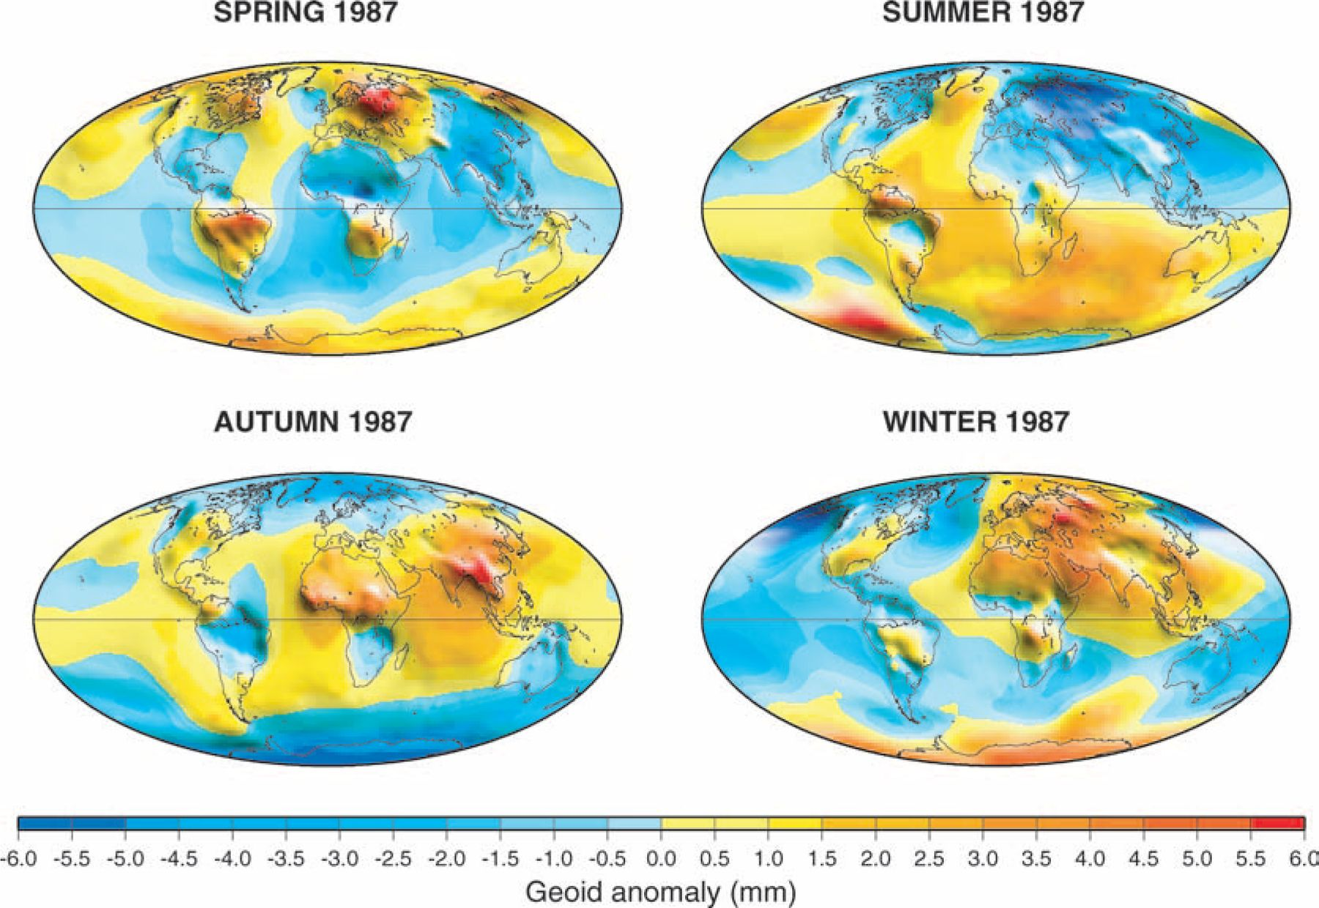

Periodic Mass Movement
Ramillien G et al. Geophys. J. Int. 2004;158:813-826
© 2004 RAS
Notes:
Seasonal variations of the synthetic geoids for 1987 computed using global model forecasts for the same period: atmosphere from ECMWF; oceans from POCM; total land water plus snow from LaD.
NGS sees this as a signal to be modelled and removed so users are not worried about “seasonal heights”.

Slide 29
Geoid Monitoring Service (GeMS)
Goal: Track all changes to the geoid which would prevent 1 cm accuracy
Aspects included:
  Shape, Secular: e.g. Hudson Bay
  Shape, Episodic: e.g. Massive Earthquakes
  W0, Secular: Global Sea Level Change (see next slides)
Examples of things excluded:
  Size, Secular: Mass quantity of Earth is effectively static
  Shape, Periodic: Seasonal glacier cycle

Slide 30
Sea Level and The Geoid

Slide 31
Secular Sea Level Change
Special geoid-definition problem…
Consider only the mechanics of sea-level change:
  Mass is moving about (geopotential change)
    Land ice melts and joins the ocean, re-distributing mass around the globe
  Global mean sea level is rising (geometric change)
    By long standing tradition, the geoid is the one equipotential surface that fits global mean sea level

Slide 32
Scenario 1: Geoid Definition remains tied to GMSL
Time Passes
H
2
H
Sea Level Rises
1
Geoid
GMSL
Geoid
GMSL
As Global Mean Sea Level rises, orthometric height gets smaller

Slide 33
Scenario 2: Geoid Definition decoupled from GMSL
Time Passes
H
Sea Level Rises
H
1
2
GMSL
Geoid
GMSL
Geoid
As Global Mean Sea Level rises, orthometric height remains constant

Slide 34
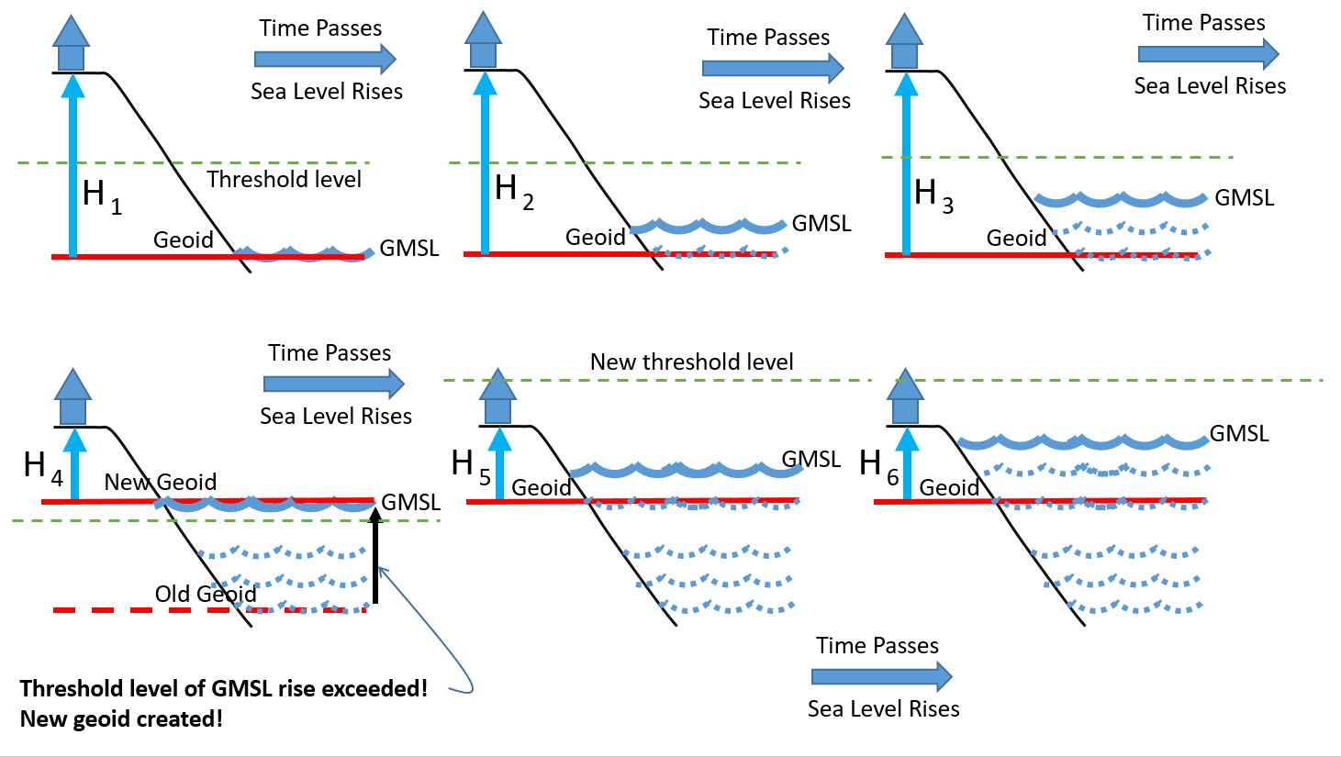
Choosing a new geoid as GMSL changes

Slide 35
NAPGD2022

Slide 36
Definitional Relationship
$H_{NAPGD2022}(t)≡h_{∗TRF2022}(t)−N_{GEOID2022}(t)$
Time-dependencies of ellipsoid heights
come from OPUS, where time-dependent
CORS coordinates serve as control for
your time-dependent GNSS survey.
Time-dependencies of geoid undulations
are captured in the dynamic component
of GEOID2022 (“DGEOID2022”), which
will come from the geoid monitoring
service, or GeMS.

Slide 37
High resolution products
All will be 1 x 1 arcminute grids
All will cover three finite regions of the globe
All will have a static and dynamic component
  Dynamic surface gravity not expected to be ready by 2022
GEOID2022
  Official converter of *TRF2022 ellipsoid heights into NAPGD2022 orthometric heights
DEFLEC2022
  Surface deflections of the vertical in N/S and E/W
GRAV2022
  Surface acceleration of gravity

Slide 38
The three gridded regions
“North American region”
¼ of the Earth
“American Samoa region”
“Guam/CNMI region”

Slide 39
Leveling? Yes!

Slide 40
Leveling? Yes!
Leveling yields differential heights
If you want absolute heights, you need one or more known heights
Previously this was about finding a benchmark with a published NAVD 88 height
  Does published mean “known”?
  Does it mean “trusted”?
  Does it mean “current”?

Slide 41
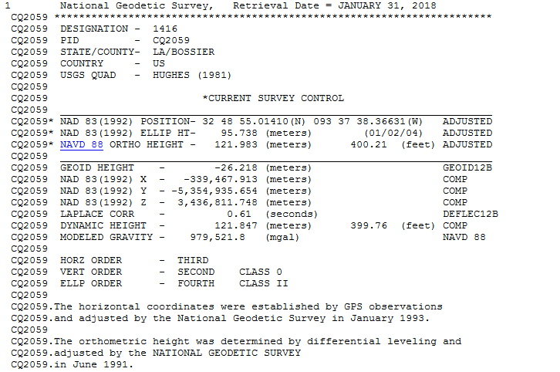
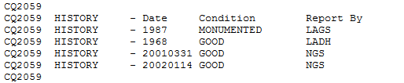
When was this point last leveled?
It’s in Louisiana where
accurate heights are
very important…
Has an “adjusted”
NAVD 88 height to
a millimeter…
It was monumented in
1968 (ignore the glitch),
and was last known to be
in good condition in 2002…
Savvy datasheet snoopers
may recognize this text as
meaning “it was adjusted
as part of the original roll-
out of NAVD 88…
It’s a trick question.
You can’t figure it out
from anything on here.
But the answer is:
Just once: 1968.

Slide 42
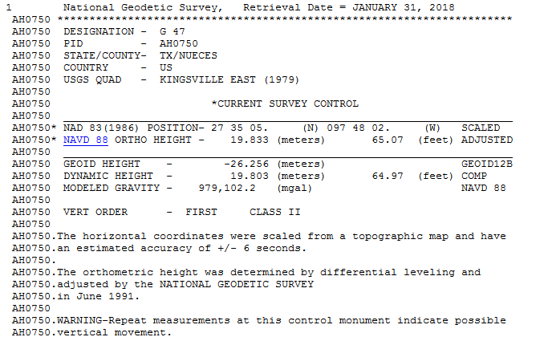
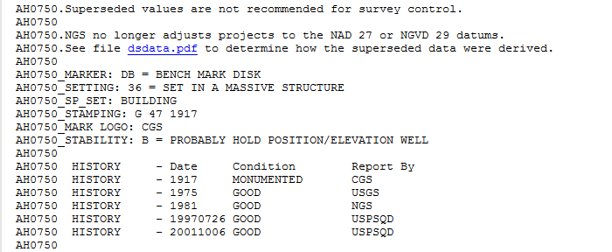
When was this point leveled?
You wouldn’t know it, but it was
leveled in:
1917, 1942, 1942 (again), 1945,
1951, 1981
The 1981 data went into
the NAVD 88 height
Q: But what about 64
years and 6 occupations?
A: You get a “warning” about vertical
movement, but no estimate of the rate.
Less than ¼ mile away is AH1055,
leveled once in 1981, with NO
warnings.

Slide 43
Leveling - Control
In NAPGD2022, “known” heights for a leveling survey:
  Primary: Perform your own GPS survey
    Yields starting orthometric heights using GEOID2022
    RTK may be perfectly acceptable!
  Secondary: Find a “not stale” passive mark
    “Staleness” depends on the mark
  Tertiary: Use VERTCON 3 on an NAVD 88 height
    Please don’t do this

Slide 44
Updates and Replacements
NAPGD2022 will come with a version number
Updates will change the version
  Bug fixes, new data, new theories, minor improvements
Replacements will change the name
  When GMSL has changed by some threshold (20 cm)
    About 50-70 years

Slide 45
Content: Geoid Modeling History
Provides context as to why “sea level” has been a perpetual human choice for “surface of zero height”
  Attempts to model the sea level go back to the 1800s
  Knowledge of currents and global sea level change have complicated the matter in the last 30 years or so
    “Height above sea level” is too vague.
      Which “sea level” and on what date?

Slide 46
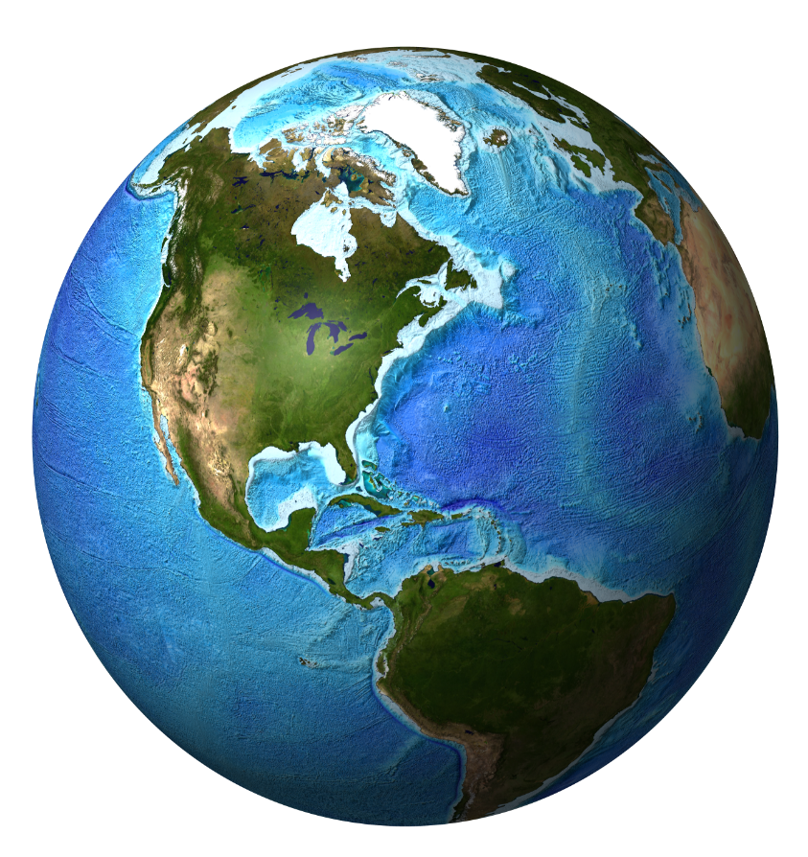

Earth’s Geopotential Field
Surface of equal gravity potential energy
(W=62,636,856 m^2 / s^2 = W )
The “Holy Grail”…
“THE” geoid…
0
Surface of equal gravity potential energy
(W=62,610,000 m^2 / s^2)
Surface of equal gravity potential energy
(W=62,620,000 m^2 / s^2)
Surface of equal gravity potential energy
(W=62,630,000 m^2 / s^2)
Surface of equal gravity potential energy
(W=62,640,000 m^2 / s^2)
Surface of equal gravity potential energy
(W=62,650,000 m^2 / s^2)
Surface of equal gravity potential energy
(W=62,660,000 m^2 / s^2)
Notes:
The derivative of potential relative to radial distance from the Earth (dW/dr) is being treated as negative here. The sense of the sign is convention, and differs based on which textbook and in which field (geodesy or physics) is being consulted.

Slide 47
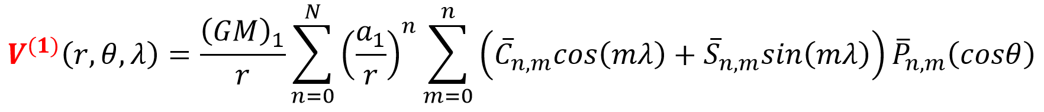
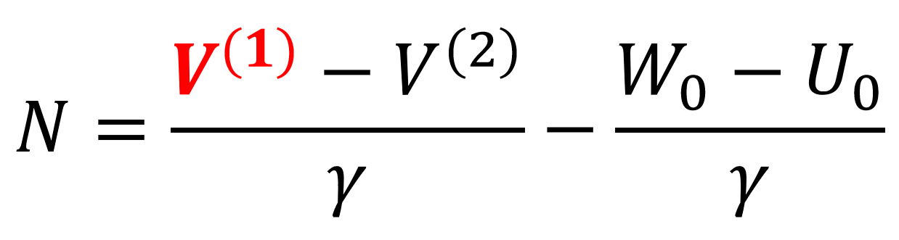
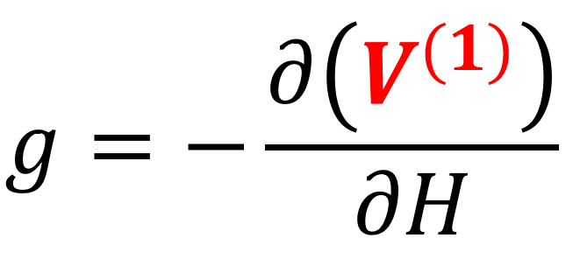
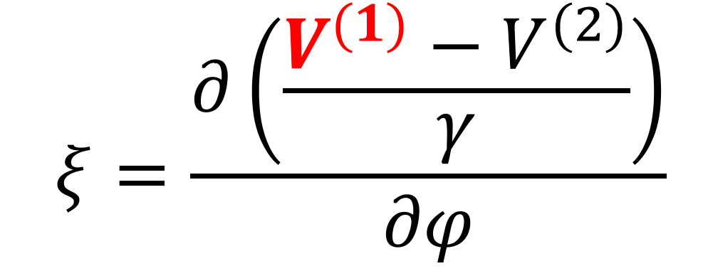
Geopotential Field
…as a function of
geocentric co-latitude,
geocentric longitude
radial distance from the center of the Earth…
Gravity
Potential
Energy…
…can become…
Geoid Undulations…
Acceleration of Gravity…
Deflection of the Vertical…
Etc., ad nauseum.

