Slide 1
Modernizing the geometric reference frame
Kevin Choi (CORS Branch Chief)
Daniel R. Roman (Chief Geodesist)
NOAA’s National Geodetic Survey

Slide 2
Outline
Key Elements
New Frames
NADCON 5.0

Slide 3
Key Elements
Drawn from Blueprint Part 1 (forthcoming)
Will be tied to most recent ITRF (2020)
Epoch date TBD – likely 2020.0
North America, Pacific, Caribbean, and Mariana
At epoch date, all frames identical to ITRF
Then each local frame rotates on own angular rates from the Euler pole rotation
Velocity models describe motion in frame
Access via OPUS tool

Slide 4
Each frame will
get 3 parameters
Euler Pole Latitude
Euler Pole Longitude
Rotation rate (rad/yr)
Used to compute
time-dependent TRF2022
coordinates from time-dependent ITRF coordinates.

Slide 5
NSRS Modernization: Four New Frames
Current:
NAD 83(2011)
NAD 83(PA11)
NAD 83(MA11)
The New:
The North American Terrestrial Reference Frame of 2022
(NATRF2022)
The Caribbean Terrestrial Reference Frame of 2022
(CATRF2022)
The Pacific Terrestrial Reference Frame of 2022
(PATRF2022)
The Mariana Terrestrial Reference Frame of 2022
(MATRF2022)

Slide 6
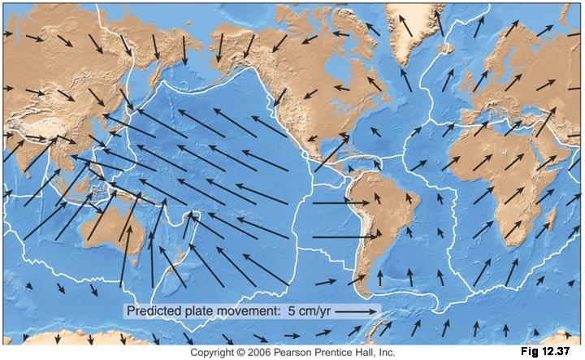
Four Frames/Plates in 2022
NATRF2022
MTRF2022
CTRF2022
PTRF2022
Image from UNAVCO

Slide 7
Replacing the NAD 83’s
Three plate-(pseudo)fixed frames will be replaced with four plate-fixed reference frames
N. Amer., Pacific, Mariana, Caribbean(new!)
Remove long-standing non-geocentricity of NAD 83 frames by aligning to ITRF frame
All four : identical to ITRFxx at a TBD epoch
2020.00?
All four : removes plate rotation from ITRFxx
Updated Euler Pole determination for rigid plate only

Slide 8
NAD 83’s non-geocentricity
Earth’s Surface
h_{NAD83}
φ_{NAD83} – φ_{ITRFxx}
λ_{NAD83} – λ_{ITRFxx}
h_{NAD83} – h_{ITRFxx}
all vary
smoothly by latitude
and longitude
h_{IGSxx}
ITRFxx origin
same
GRS-80
ellipsoid
~2.2 m
NAD 83 origin

Slide 9
Velocity Models or DYI
We will investigate sufficiency of gridded CORS
Concern is dynamic areas: horizontal & vertical
Will gridded CORS work in Alaska?
What if this isn’t enough?
Will look at other models to evaluate
Cost – benefit
What we can easily do in-house and support
increased complexity from outside models
Alternatively, users can model their own …

Slide 10
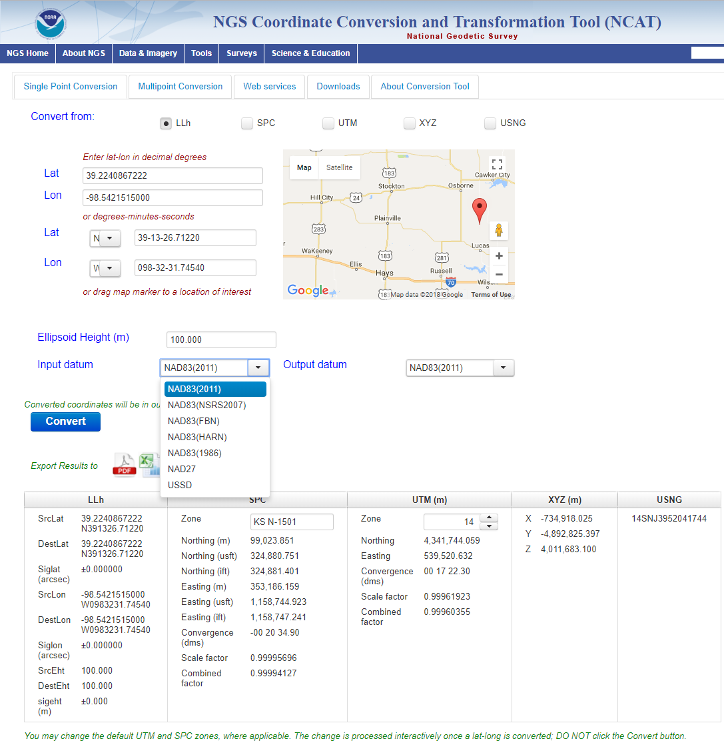
The new Geodetic Toolkit with NADCON 5.0
https://www.ngs.noaa.gov/NCAT/

Slide 11
The new Geodetic Toolkit with NADCON 5.0
https://www.ngs.noaa.gov/NCAT/

Slide 12
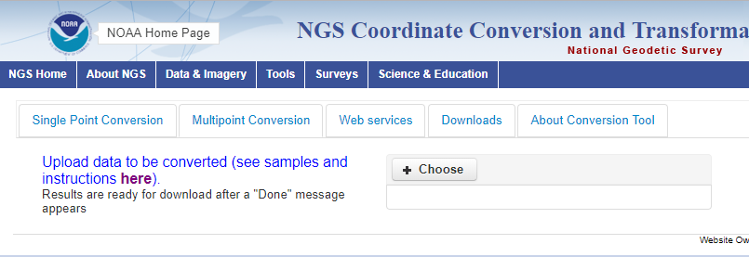
Multiple Conversion
ID,lat,lon,eht,inDatum,outDatum,spcZone,utmZone
BB0002,19.5000000000,-155.0000000000,N/A,NAD83(PA11),OHD,auto,auto
TU2083,19.4758241333,-154.82342208,18.473,NAD83(PA11),NAD83(1993),auto,auto

Slide 13
Multiple Conversion
8 parameters in → 37 params out
ID
nadconVersion
srcDatum destDatum
srcLat srcLatDms
destLat destLatDms
Siglat
srcLon srcLonDms
destLon destLonDms
Siglon
srcEht destEht Sigeht
spcZone spcNorthing_m spcEasting_m
spcNorthing_usft spcEasting_usft
spcNorthing_ift spcEasting_ift
spcConvergence spcScaleFactor spcCombinedFactor
utmZone utmNorthing utmEasting
utmConvergence utmScaleFactor utmCombinedFactor
X Y Z
usng

Slide 14
Multiple Conversion
Region | LOCAL | NAD27 | NAD83 (1986) | NAD83 (HARN/FBN) | NAD83 (1992/1993) | NAD83 (2002) | NAD83 (NSRS2007) | NAD83 (2011)
ST. GEORGE | SG1897 SG1952 |  | J |  | J |  | J | J
ST. PAUL | SP1897 SP1952 |  | J |  | J |  | J | J
ST. LAWRENCE | SL1952 |  | J |  | J |  | J | J
AK |  | J | J |  | J |  | J | J
CONUS | USSD | J | J | J | J |  | J | J
HI | OHD |  | J |  | J |  |  | J (PA11)
PRVI | PR40 |  | J |  | J | J | J | J
AS | AS62 |  |  |  | J | J |  | J (PA11)
GUAM/ CNMI | GU63 |  |  |  | J | J |  | J (MA11)
Datum list

Slide 15
φ, λ, h
xyz2plh
plh2xyz
SPC83
a,f (GRS 80)
NAD 83
X, Y, Z
SPC
USNG
NAD 83
UTMS
a,f (GRS 80)
USNG
UTM
USNG
NAD 83

Slide 16
X, Y, Z
φ, λ, h
φ, λ, h
Region: CONUS
NADCON 5 connections in RED
2022
X, Y, Z
SPC
UTM
USSD
USNG
UTM
φ, λ, h
φ, λ, h
NAD 27
NAD 83 (2011)
X, Y, Z
SPC
X, Y, Z
SPC
USNG
UTM
USNG
UTM
NAD 83 (NSRS2007)
φ, λ, h
NAD 83 (1986)
φ, λ, h
NAD 83 (FBN)
NAD 83 (HARN)
φ, λ, h
X, Y, Z
SPC
X, Y, Z
SPC
φ, λ, h
USNG
UTM
USNG
UTM
X, Y, Z
SPC
X, Y, Z
SPC
USNG
UTM
USNG
UTM

Slide 17
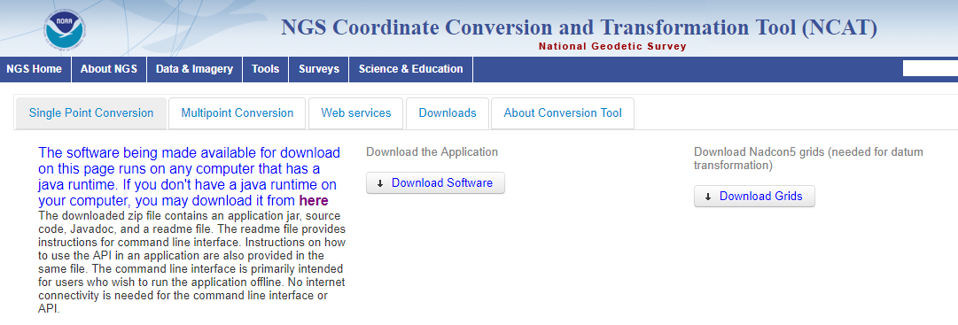
Multiple Conversion
grids.zip → total 148 *.b files
ncat.zip
Java class manual
Java driver example
Java executable
Text instruction
$ java -Dparms=llh,<lat>,<lon>,<eht>,<inDatum>,<outDatum><spcZone><utmZone> -jar jtransform_thin.jar

Slide 18
Summary
New plate fixed frames will replace NAD83
4 tectonic plates
Aligned to the recent ITRF to a common geocenter
NADCON 5.0
Converts coordinates between historic realizations of NAD.
On-line and Off-line tools
Developers can refer to the ISO19111 for the transformation parameters

Slide 19
Thank you!
Kevin Choi, Chief CORS Branch Kevin.Choi@noaa.gov
Daniel R. Roman, acting Chief Geodesist Dan.Roman@noaa.gov

Slide 20
Backup slides

Slide 21
Plate-(pseudo)fixed frames
NAD 83(2011) minus NAD 83(NSRS2007)
NAD 83(NSRS2007)
Epoch 2002.0
NAD 83(2011)
Epoch 2010.0
If NAD 83 were truly “plate
fixed” then an 8 year
epoch change would not
yield the systematic
plate rotation seen here.
(*)TRF2022 will determine
a new Euler Pole rotation
for each of 4 plates.
(*)=NA, C, T or P

Slide 22
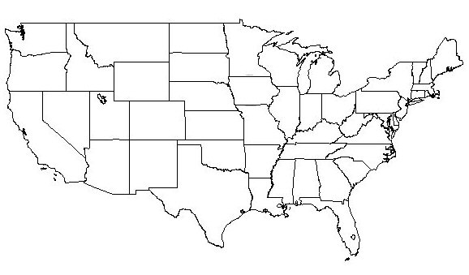
NATRF2022 frame is rigid and fixed to rigid part of the N.A. plate
Non-rigid part of the N.A. plate
(deformation)
area

Slide 23
Time-Dependencies as a service: NATRF2022 and actual survey epochs
NAD 83 forcibly combined data spanning many years (using HTDP with no vertical modeling) to compute and find one height at one epoch.
NATRF2022 will compute coordinates at survey epoch to show actual motion.
Even gridding surrounding CORS yields better subsidence rates than you have today.
NAD 83 best estimate of dh/dt: +2.8 mm / year
NATRF2022 best estimate of dh/dt: -4.2 mm / year
CORS best estimate of dh/dt: -2.2 mm / year
Notes:
Potential outline and speaker assignments; can be adjusted as needed.

Slide 24
Time Dependencies as a service: Intra-plate motions

Slide 25
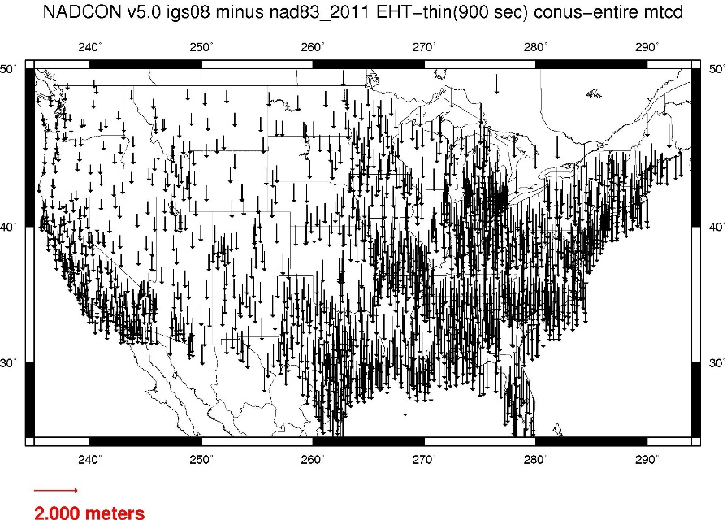
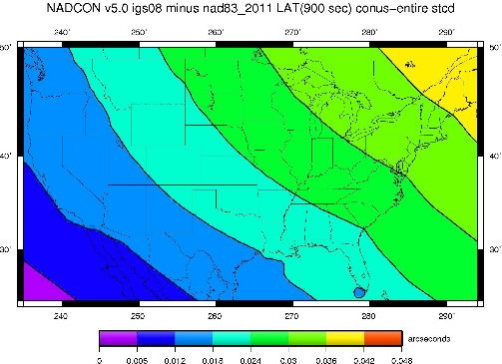
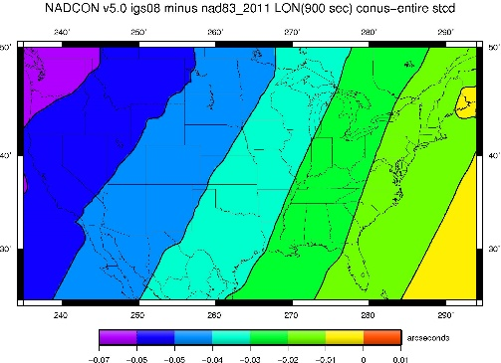
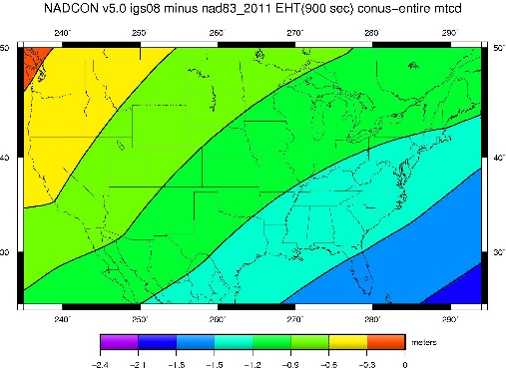
Fixed-Epoch Transformation NAD 83 to “2022”

Slide 26
NEV or IPV or IFV
Euler poles account for most of horizontal vel.
Remaining signal currently modeled by HTDP
HTDP complicated to maintain and only horizontal
So if not HTDP, then what?
A TBD velocity model needed for horizontal and vertical motions
Non-Eulerian Velocity (NEV) or Intra-Plate Velocity (IPV) or Intra-Frame Velocity (IFV)
Simplest solution is to grid CORS velocities

Slide 27
Horizontal velocities after Repro1
Note scale difference between West (10 mm/yr) and east (2 mm/yr)

Slide 28
Residual Horizontal Velocities CONUS – gridded CORS
Eastern CONUS will largely be resolved
Western CONUS has some anomalies

