Slide 1
Exploring how the Modernized National Spatial Reference System will affect Coastal Restoration Practitioners
Philippe Hensel, Galen Scott, Nina Garfield
NOAA National Geodetic Survey
David Wolcott, Paul Fanelli
NOAA Center for Operational Oceanographic Products & Services
2024 Coastal & Estuarine Summit, Hyatt Regency, Crystal City VA

Slide 2
What are Vertical Datums and why should I care?
Heights have to be expressed with respect to a reference zero
Floor = reference zero
Notes:
Vertical datums are simply a common way to express heights
When we say how tall we are, we really mean our height with respect to the floor upon which we stand

Slide 3
What are Vertical Datums and why should I care?
Heights have to be expressed with respect to a reference zero
Table = reference zero
Notes:
Of course, we could conceive of other ways of measuring height
If we were stuck with a shorter ruler, we could express height with respect to the surface of the coffee table
As long as all heights were measured consistently with respect to that reference surface, then all heights would be correct relative to each other

Slide 4
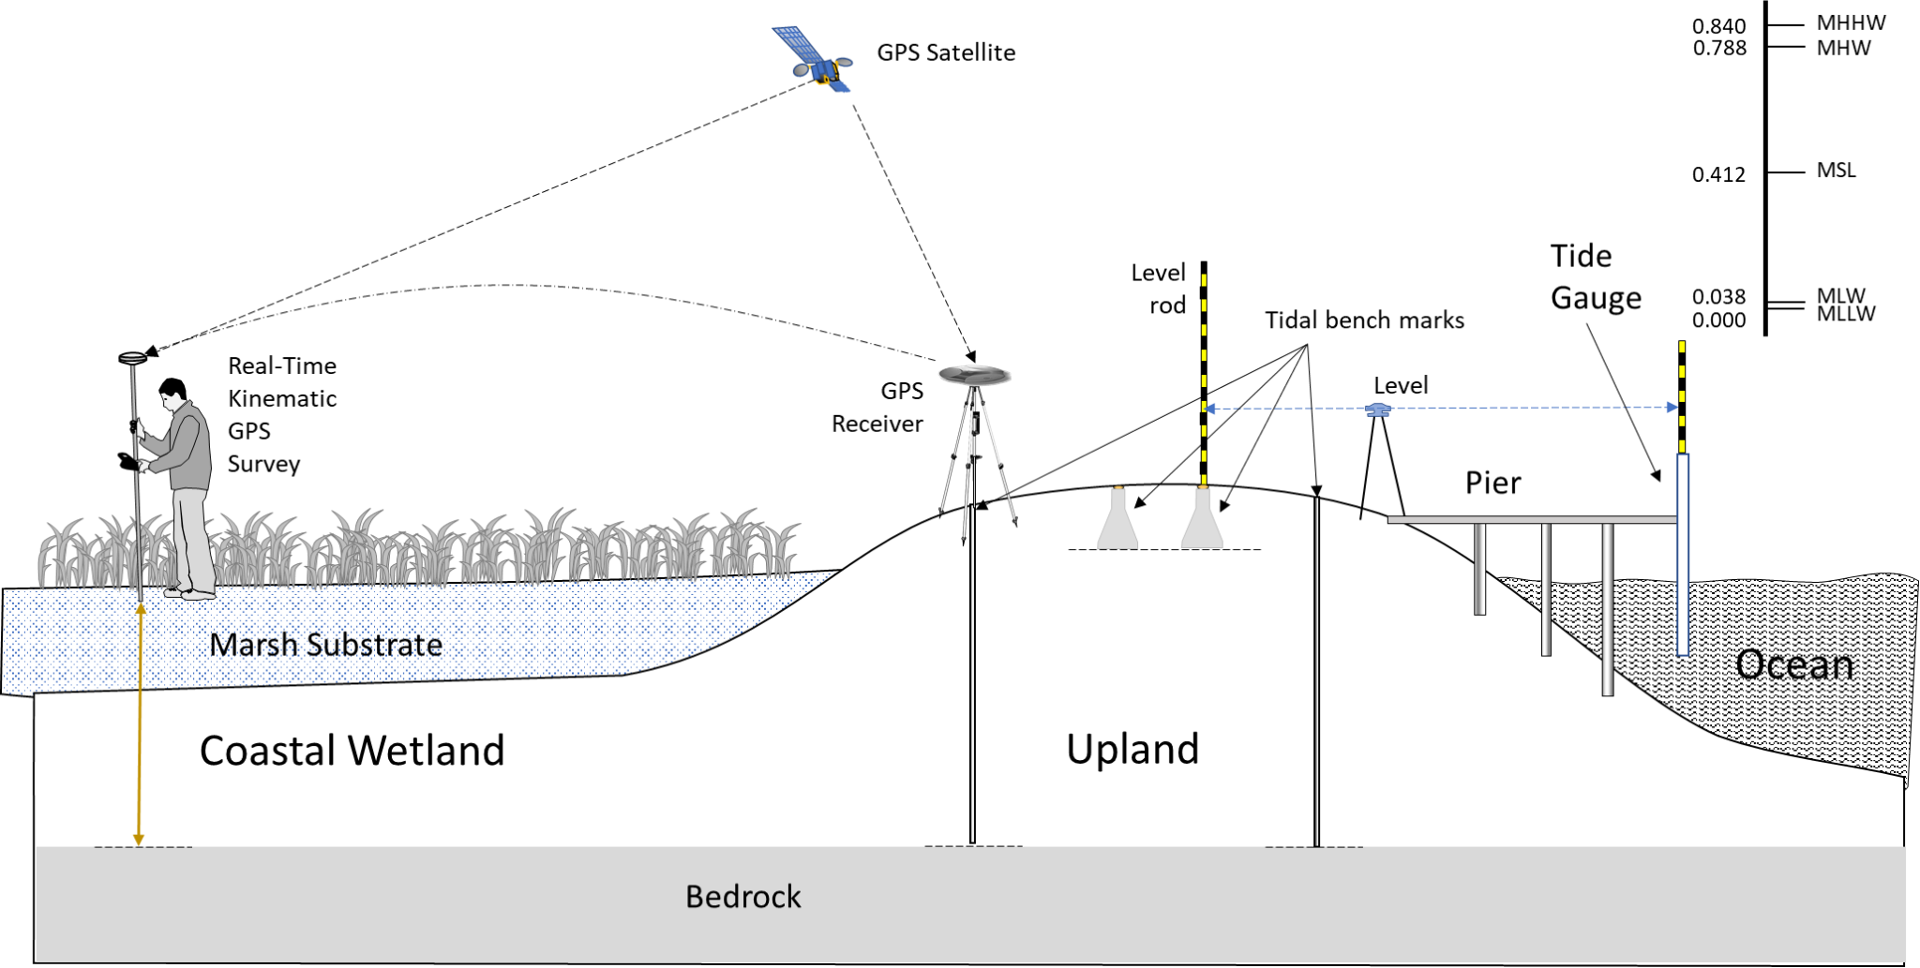
Notes:
Jumping to the coastal practitioner: we need to make sure that our coastal elevations are accurate and precise with respect to local water levels
Water levels are expressed as vertical datums: mean sea level, mean high water, mean low water - these are all tidal datums
Best practices would involve installing tidal bench marks and a local tide gauge, and then leveling from the water level sensor to the bench marks, ensuring sensor stability
Tidal datums would be computed from our local water level data (corrected and adjusted by comparing to the nearest long-term tide station)
The elevation of the tidal bench marks could be expressed with respect to the local tidal datums, so the coastal practitioner could simply survey off these bench marks and off they go. No need for any geodetic (vertical) datums at all.

Slide 5
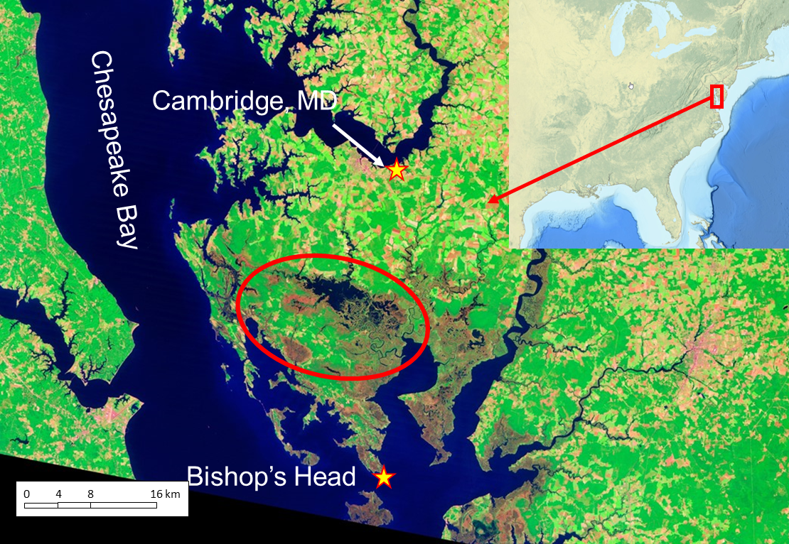
Notes:
Of course, this idealized scenario is not always available
If there are no local water level data, tidal datums have to be obtained from the nearest long-term tide station
In many cases, this could be tens of kilometers away
At the Blackwater National Wildlife Refuge on Maryland’s Eastern Shore, the nearest NOAA tide stations are over 20 km’s away from the central Blackwater lake

Slide 6
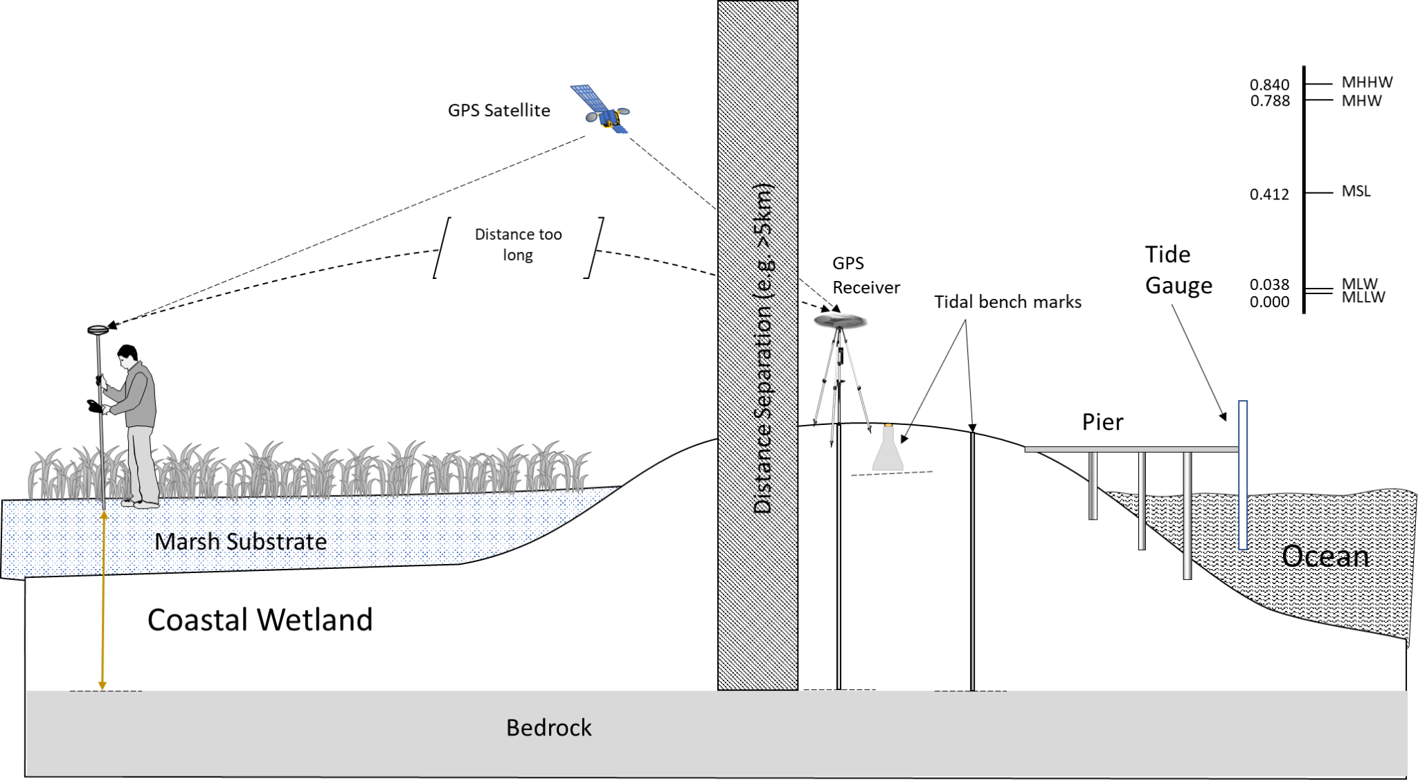
Notes:
When the nearest available tidal datums are too far away, typical survey techniques such as RTK GPS won’t allow you to measure heights with respect to those datums directly

Slide 7
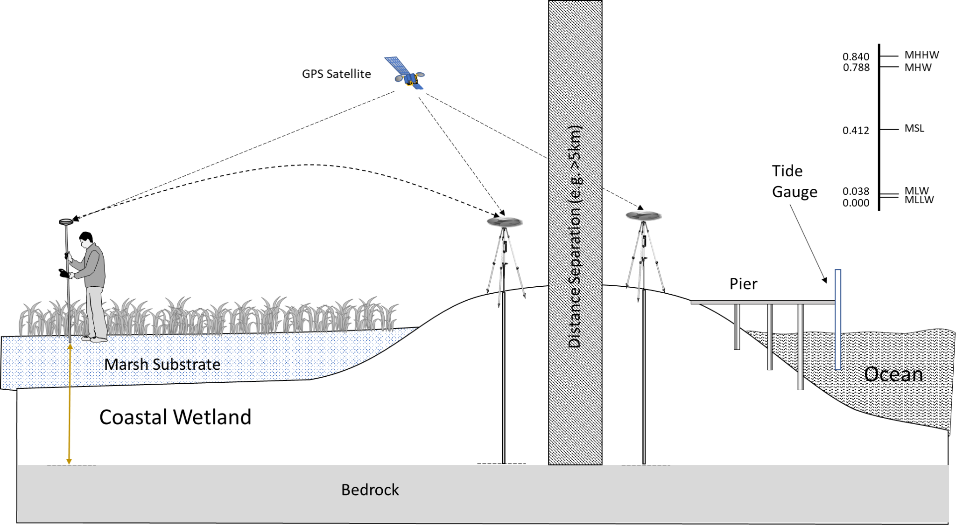
Notes:
In that situation, you’d want to bring the tidal datums in by surveying both the tidal bench marks and your local control mark
However, for the highest accuracy and precision, you’d need to observe the tidal bench marks for quite a number of hours, and on separate days

Slide 8
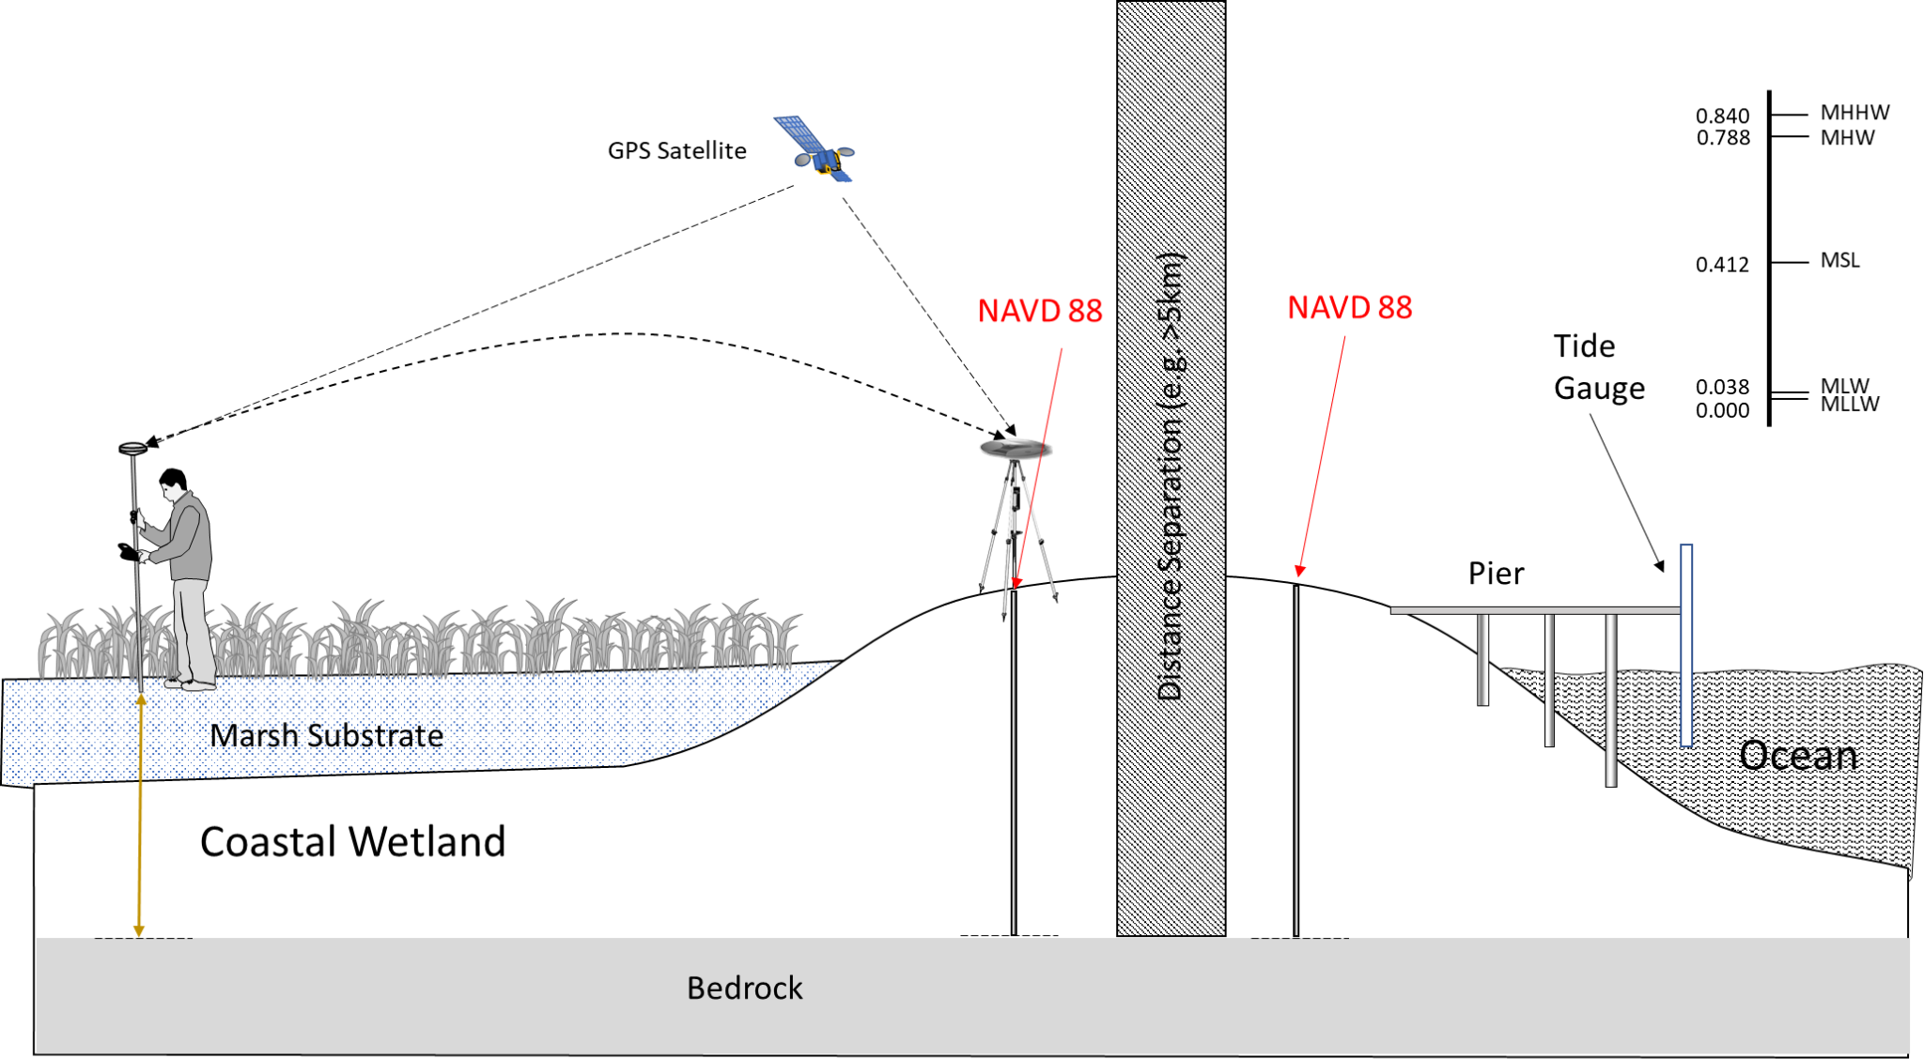
NAVD 88
Notes:
Another possibility would be to use survey marks which have already been surveyed and have an official, published orthometric height on NGS datasheets

Slide 9
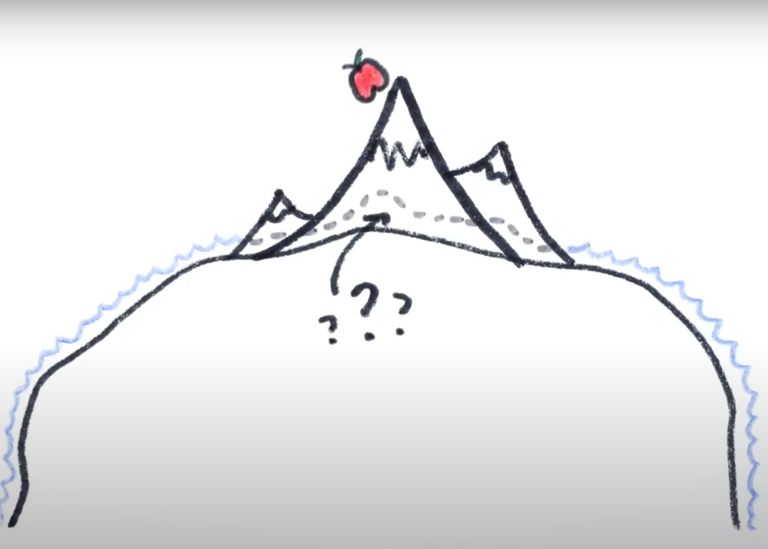
What are Vertical Datums and why should I care?
Heights have to be expressed with respect to a reference zero
“Mean Sea Level” as a vertical datum
What is Sea Level? audible.com/minutephysics
Notes:
So let’s consider tidal datums for a moment
The concept of “mean sea level” resonates with everyone, since we know that water reaches an equilibrium surface very quickly (anyone who has spilled anything can attest to that!)
But what do we really mean when we say “mean sea level?”
First of all, we have to realize that “mean sea level” is not a constant distance from the center of Earth. Earth’s non-uniform gravity field, the rotation of the planet, and ocean circulation patterns cause significant deviations from the idealized scenario

Slide 10
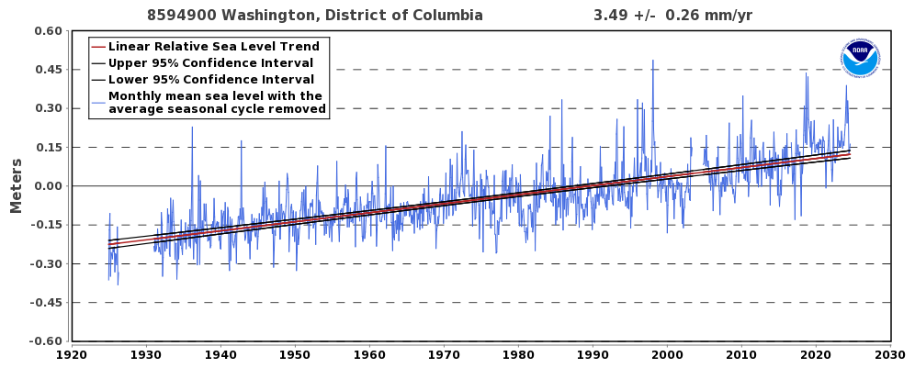
What are Vertical Datums and why should I care?
Heights have to be expressed with respect to a reference zero
“Mean Sea Level” as a vertical datum
Notes:
And then, of course, sea levels are always changing: hourly, according to the tides, but also daily, monthly, seasonally, decadally.

Slide 11
What are Vertical Datums and why should I care?
Heights have to be expressed with respect to a reference zero
“Mean Sea Level” as a vertical datum
NTDE: National Tidal Datum Epoch
1983-2001 Epoch
Notes:
For this reason, when NOAA published the official tidal datums at their long-term tide stations, they refer to what’s called the “National Tidal Datum Epoch.”
The NTDE is an approximately 18-year period that averages out the largest of the known cyclic phenomena acting on water levels.
So the current NTDE is from 1983-2001
With global sea levels rising, it’s clear that tidal datums from about 30 years ago are too low compared to water levels today

Slide 12
What are Vertical Datums and why should I care?
Heights have to be expressed with respect to a reference zero
“Mean Sea Level” as a vertical datum
NTDE: National Tidal Datum Epoch
2002-2020 Epoch
Notes:
New tidal datums will be published soon, that will be based on a more updated NTDE (2001-2020).

Slide 13
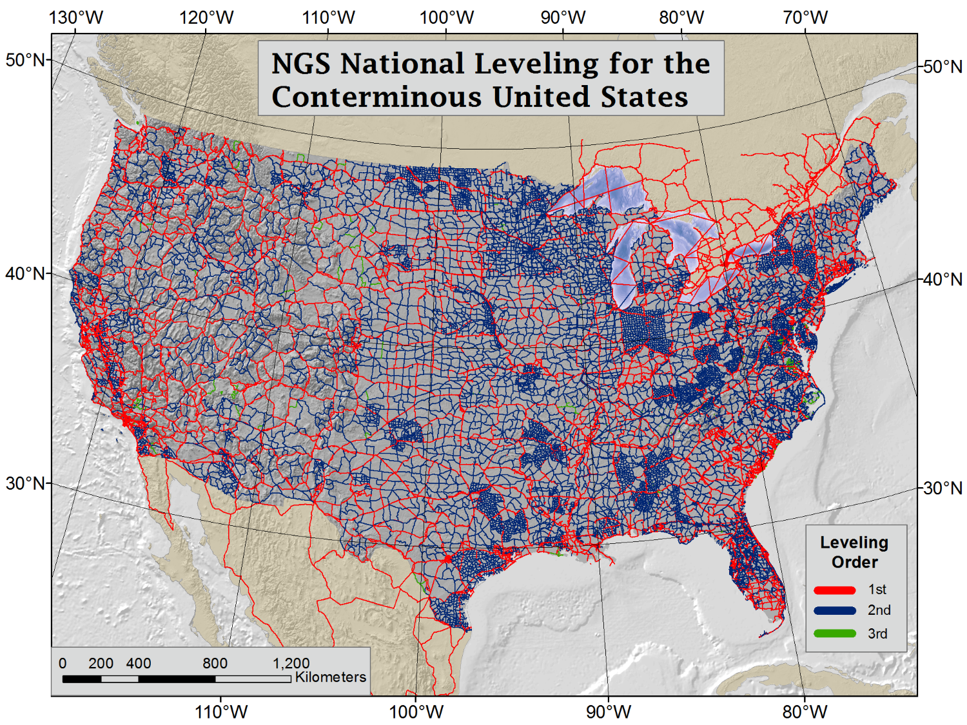
Point-au-Père, Quebec
NAVD 88: defined by IGLD 1985, local mean sea level at Point-au-Père
Notes:
The official orthometric (vertical) datum of the United States, The North American Vertical Datum of 1988 (NAVD 88), is related to mean sea level. When it was established, it held fixed the height of the Primary Tidal bench mark referenced to the International Great Lakes vertical Datum (IGLD) of 1985 local mean sea level at Point-au-Pere, Quebec.
The national leveling adjustment that created NAVD 88 was based on high precision geodetic leveling spanning many decades. Som of the oldest level lines came from the end of the 19th century and the beginning of the 20th century. Most of the long level lines that stretched across the nation were conducted in the post-Great Depression years in the 1930’s. More modern leveling is simply densification of the existing network.
That means that most of our NAVD 88 network is based on a backbone of very old leveling.

Slide 14
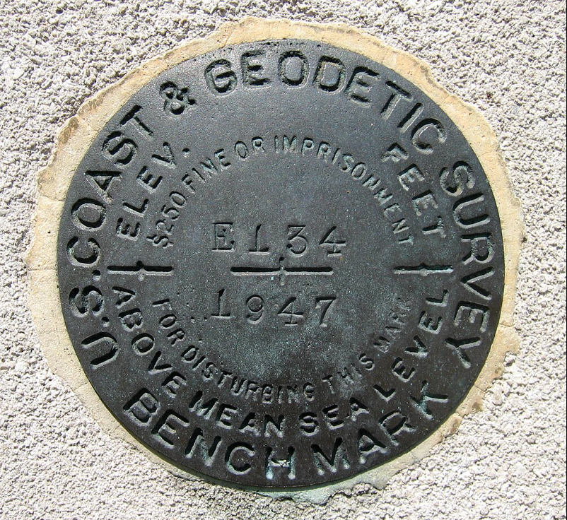
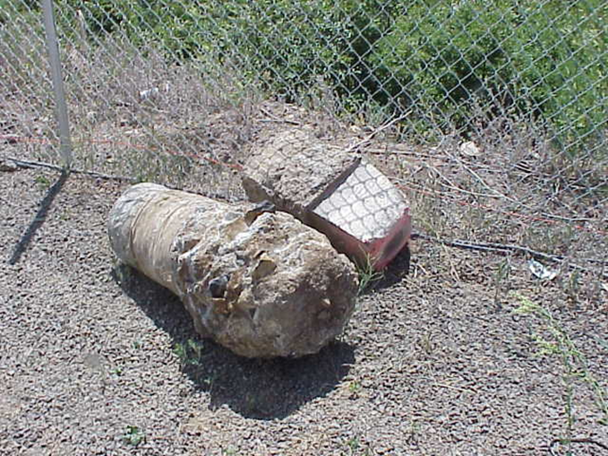
Problems with leveled heights
Leveling is very time consuming/expen$$$ive
Leveling requires the recovery of existing bench marks
Short level lines will not reveal Vertical Land Motion
Most long level lines were established during the Great Depression (1930’s)
Notes:
The problem with leveling is that it is very expensive.
It also requires the recovery of existing bench marks with published NAVD 88 heights on them.
Bench marks often get damaged and destroyed over time, so tying in to an existing level line can be problematic.
And as stated earlier, much of our leveling network is old.

Slide 15
Problems with leveled heights
Leveling is very time consuming/expen$$$ive
Leveling requires the recovery of existing bench marks
Short level lines will not reveal Vertical Land Motion
Most long level lines were established during the Great Depression (1930’s)
Land moves over time (including subsidence and uplift)
Heights are not like fine wine
Notes:
Land, like water, is constantly moving, both horizontally and vertically. Subsidence and uplift are two expressions of Vertical Land Motion, or VLM.
We actually know better how global sea levels are rising than we know how local land moves vertically!
So heights are not like fine wine, they don’t age well at all.

Slide 16
Modernization of the National Spatial Reference System (NSRS)
New reference frames defined by Global Navigation Satellite Systems (GNSS) and updated models of plate rotation
Plate-fixed coordinate system (& updated connection to Earth’s center of mass)
Notes:
Given that our existing vertical datum has aged quite a lot, NGS is in the process of developing a whole new suite of datums.
We are modernizing the entire National Spatial Reference System

Slide 17
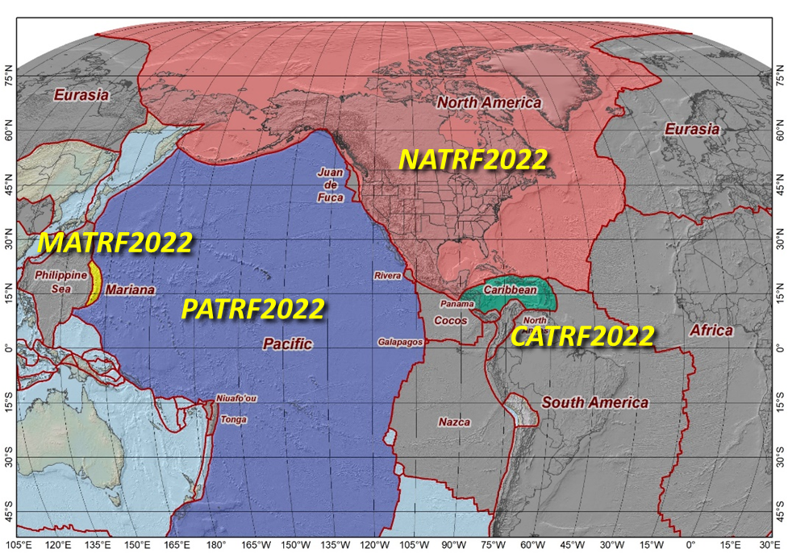
Modernization of the National Spatial Reference System (NSRS)
4 Fixed-Plate Terrestrial Reference Frames:
North American
Pacific
Caribbean
Mariana
Notes:
We are developing four new terrestrial reference frames.
The frames themselves will move, but the coordinates with respect to the frames will be fixed to the plates, so they will be unaffected by plate rotation
The new terrestrial reference frames will also have a mathematically defined relationship to the International Terrestrial Reference Frame (ITRF).

Slide 18
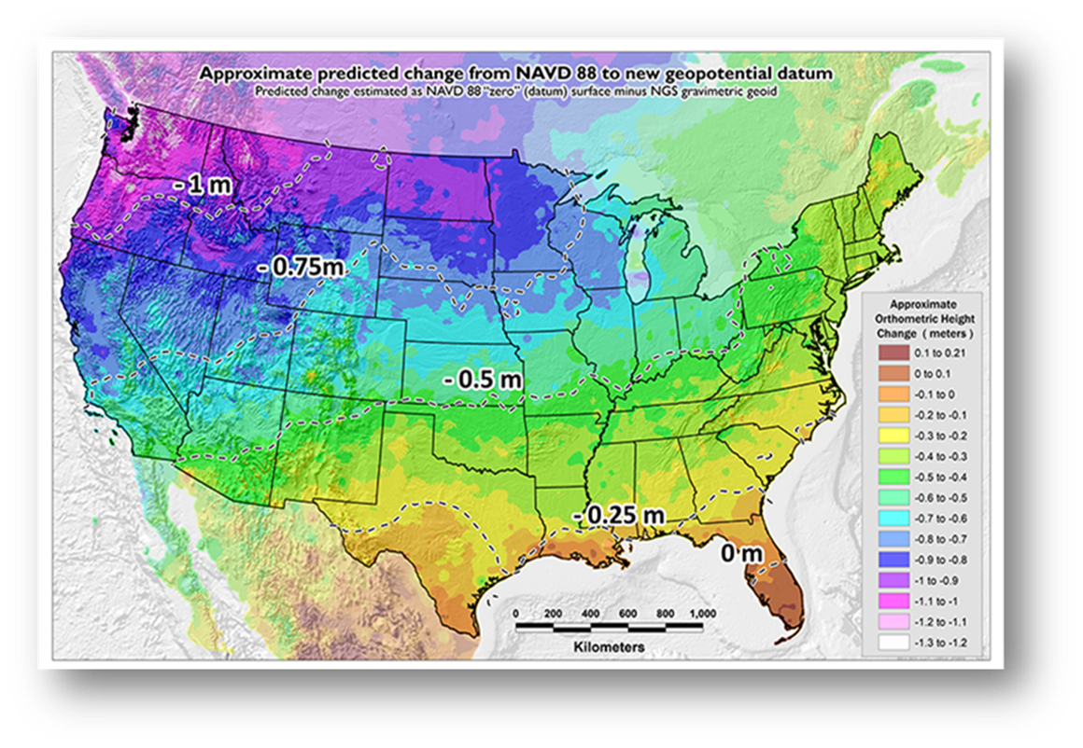
North American-Pacific Geopotential Datum of 2022
Based on GRAV-D
Gravimetric GEOID2022 (2cm 95% CI)
NAPGD2022 absolute accuracy of 4cm 95%CI
Notes:
The new geopotential datum is based on the completed Gravity for the Redefinition of the American Vertical Datum, which relied on airborne gravimetry flown above the entire US continent and territories
This new, geographically extensive data collection, in conjunction with ground-based absolute and relative gravity data, is the foundation of a new purely gravimetric geoid, that is, a model of Earth’s gravity field
The new geoid is slated to have a 1-cm (1 Std) accuracy
NGS aims to provide orthometric heights with an absolute accuracy of 4 cm at 95% CI
The target accuracy is 2 cm anywhere GNSS signals can be received.

Slide 19
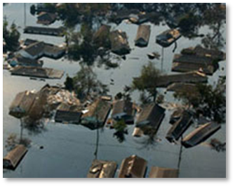
North American-Pacific Geopotential Datum of 2022
Geoid2022 is unrelated to accumulated errors seen in NAVD 88
Will allow seamless transition of water flow models across entire watersheds, from the Piedmont to the Coastal Plain
NAPGD2022 will support higher accuracy floodplain modeling

Slide 20
Implications of Modernized NSRS for Coastal Practitioners
Tie to the reference frame and heights is principally via GNSS
Importance of creating a new connection to the NSRS
Notes:
No requirement to recover previously established geodetic level lines

Slide 21
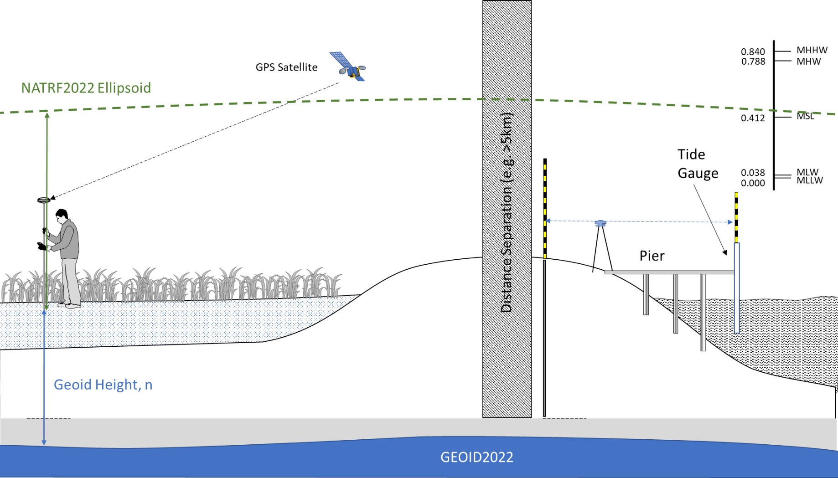
Geoid Height
Orthometric Height
Notes:
This slide shows that a user will be able to derive an orthometric height simple by using GNSS (which will give them an ellipsoid height) and applying the geoid which will give

Slide 22
Geoid Height
Orthometric Height
Notes:
However, best practices remain to establish a local control network through long static GNSS observations
That way, you can check your local work via RTK or Real-Time Networks (RTN)

Slide 23
Geoid Height
Orthometric Height
Notes:
Additionally, observing the tidal bench marks (simultaneously if possible) will create the tightest connection between your site and the tidal datums at the long-term station (en lieu of actually computing tidal datums at your site!)

Slide 24
Implications of Modernized NSRS for Coastal Practitioners
When the new datums are ready to be released, the Federal Geodetic Control Subcommittee of the Federal Geographic Data Committee will vote to accept the new datums as official policy of the USA
All NOAA geographic data products will be converted
Everyone is urged to adopt the new datums, meaning convert existing GIS data

Slide 25
National Tidal Datum Epoch (NTDE) Update
The NTDE is a common water level reference system used by NOAA to collect water level observations and calculate tidal datums.
Epoch - 19-year period
Changing - Updated every 20-25 years
Instrumental - ensures safe navigation
Update - NTDE release date expected after 2026
For more information, please contact Tide.Predictions@noaa.gov
Notes:
The National Tidal Datum Epoch (NTDE) is a common water level reference frame. A common water level reference is needed for safe maritime navigation, coastal management, and understanding sea level rise. As shown in the graphic, these tidal datums serve as a baseline elevation to which sounding depths or topographic heights are referenced. They hold legal implications for property lines, shoreline boundaries, authorized dredging depths, and more.
The NTDE is a specific 19-year period used for data collection that corresponds to a full rotation of the longest lunar cycle. The need to update the NTDE is entirely driven by changes in mean sea level and vertical land motion. Once mean sea level changes by .1 feet or .03 meters across the country, NOAA receives a signal that it’s time to update the NTDE. Mean sea level is anticipated to change by 2-3 inches on average across the U.S.
The National Water Level Observation Network (NWLON), a network of 210 long-term, continuously operating water level stations throughout the US and its territories, provides the data required to maintain the epoch and make primary and secondary determinations of tidal datums.
And that finds us here today. The current NTDE uses tidal datums generated from observations collected between 1983-2001. NOAA is currently updating this NTDE and will replace it with a new NTDE, which will use tidal and water level observations collected between 2002-2020. The expected release date for this new NTDE is currently after 2026.
A few anticipated impacts include impacts to products and services, such as the NOAA Physical Oceanographic Real-Time System (PORTS), CO-OPS tides and currents webpages, NOAA sea level rise viewer, and NOAA forecast systems. Additionally, new bench mark sheets and tidal datums will be available.
Please email tide.predictions@noaa.gov to learn more.

Slide 26
Implications of updated NTDE
Flooding thresholds in existing coastal models are based on water levels above a tidal datum (typically MHHW -on the current NTDE)
If the value of MHHW was increased in the upcoming epoch, observed water levels relative to that datum will decrease
If the threshold used to compute flooding risk does not take the NTDE update into account, the threshold will be too high, and will under-predict flooding risk

Slide 27
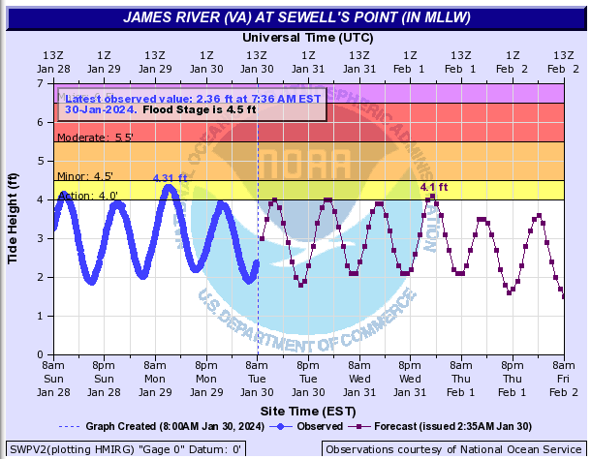
Case Study: Impact to NWS Coastal Flood Thresholds
NWS displays data for Sewells Point relative to MLLW
Thresholds above MLLW are:
Action - 4.0 ft
Minor - 4.5 ft
Moderate -5.5 ft
Major - 6.5 ft
For this example, assume a +0.3 ft change in MLLW

Slide 28
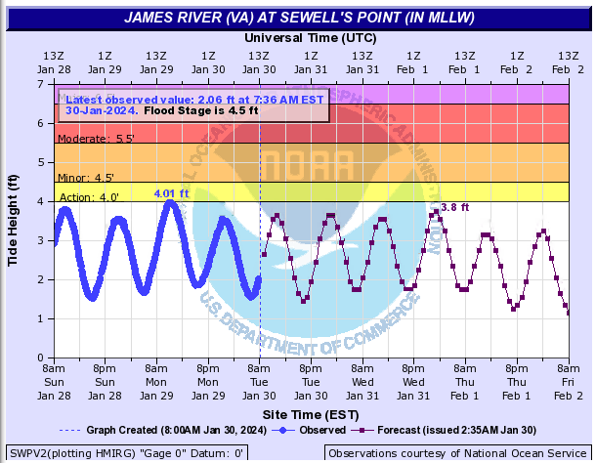
Case Study: Impact to NWS Coastal Flood Thresholds
After NTDE update, water levels will shift to the new MLLW datum (now +0.3 ft)
As a result, water levels relative to new MLLW will decrease by 0.3 ft.
Failing to adjust the flood thresholds downward will result in flooding criteria which are too high

Slide 29
Case Study: Impact to NWS Coastal Flood Thresholds
Adjust flood thresholds downward by 0.3 ft
Note downward change in scale

Slide 30
Thank you very much!
Address your questions to: ngs.infocenter@noaa.gov

