Slide 1

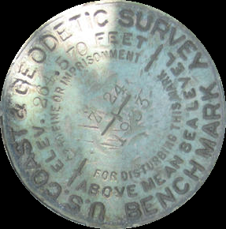
Vertical Datum Changes for Floodplain Mapping
A Modernized Vertical Datum for the Future
MN Association of Floodplain Managers
NGS Presentation
November 14, 2019
Marshall MN
Dave Zenk
Northern Plains Regional Advisor
and
Nicole Kinsman
Alaska Regional Advisor
Notes:
Hello everyone, and welcome.
Thank you all for your time to attend this presentation.
*Special thanks to Celinda Adair, Mike Magyar, Lisa Phipps, and Gail Henrikson for planning and putting together this event, and to everyone else who helped us spread the word. I know that you are very interested in today’s presentation topic.
Two ways I’d like to set the stage:
Me… My name is Dan Determan. I am your NGS Regional Geodetic Advisor for the Northwest. The Northwest includes WA, OR, and ID.
My background is in surveying, mapping and geodesy. I’ve been a Cartographer and/or Geodesist with the Federal Government for over 25 years
*cartography (~4yrs), geodetic surveying (>10yrs), GPS MSNCC (~3yrs) ; [>16yrs DOD (DMA/NIMA/NGA)] : Real-Time GPS Network Operation (RTN’s) ; [~8yrs DOI (USGS/ESC)] : and ~15 months as NGS Regional Geodetic Advisor for the Northwest (WA, OR, ID) [DOC - NOAA/NOS/NGS]
What does geodesy have to do with flood mapping?
Geodesy is the science of determining where the heck things are in space and time
During a flood you need to know where the water is relative to the land and relative to critical infrastructure ➔ all of this requires a sound positional framework, if you are going to set insurance rates or make critical evacuation calls that could save human lives.
NGS is responsible for and provides this positional framework through the National Spatial Reference System (NSRS).
On the title slide I have shown a bench mark to highlight how our understanding and ability to provide accurate and consistent heights has evolved. While this mark is still a useful tool, it reveals itself to be an artifact of the past in three ways:
First of all, it says “above mean sea level” -> but local MSL is not the same everywhere
Second, the stamped height assumes fixed position -> but we know the earth is in motion and the land moves up and down on human and engineering scales
Third, the establishing agency has changed names
Because of these things, we now recognize this bench mark to be an unreliable narrator when it comes to elevation.

Slide 2
Bottom Line
There will be a new vertical datum called
  North American Pacific Geopotential Datum 2022 (NAPGD2022)
Will you be ready?

Slide 3
Perfect World – Myth Busting
Busted
Datums are parallel and smooth
Measuring Errors don’t exist
Adjustments always agree
Nothing moves
Busted
Busted
Busted

Slide 4
Today’s Topic:
When Vertical Datums let us Down
Insufficient Metadata
Inconsistent Access/Heights
‘Stale’ Elevations
Trust Access Motion
… and what NGS is doing about it.
OUTLINE
Vertical Datums
Outline of Changes
Case Studies
Practical Guidance
Extra Resources
Notes:
This presentation will describe what NGS is doing to remedy the situation in our ongoing mission to maintain the very best possible height system for the nation.
I’ll start with a basic intro to the National Geodetic Survey, vertical datums in general, and explain why NAVD 88 heights matter to the floodplain management community.
Then, I’ll explain the upcoming changes to the National Spatial Reference System, with emphasis on the vertical component and what will replace NAVD 88
Beyond just telling you that these changes will enhance floodplain mapping, I will walk you through a few case studies from Alaska that will show the direct benefits of the coming changes
I will present you with some practical guidance, specific to things like BFEs, which will be increasingly useful as we approach NAVD 88 replacement.
Finally, I’ll show you where you can find extra resources to learn about how coordination, education and preparation will help make the transition away from NAVD 88 as smooth as possible.

Slide 5
Current Practice

Slide 6
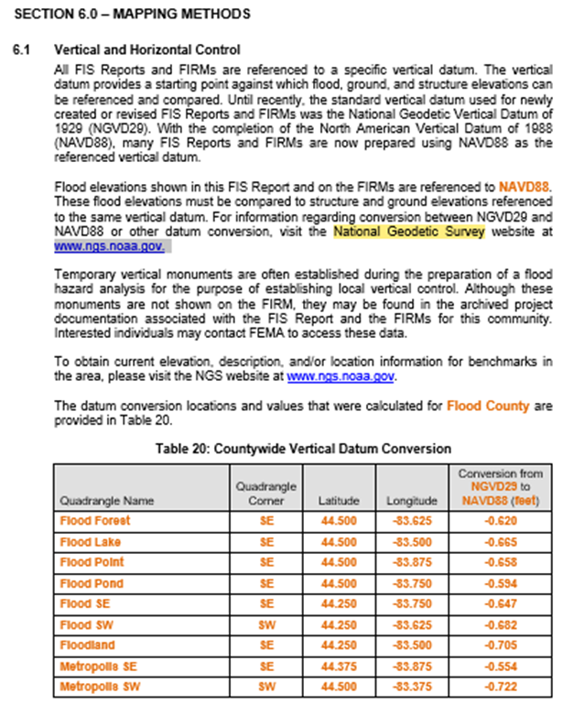
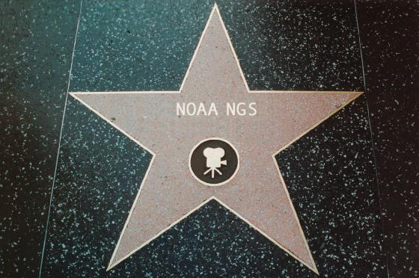
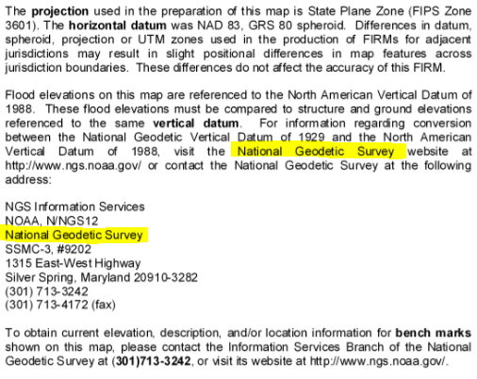
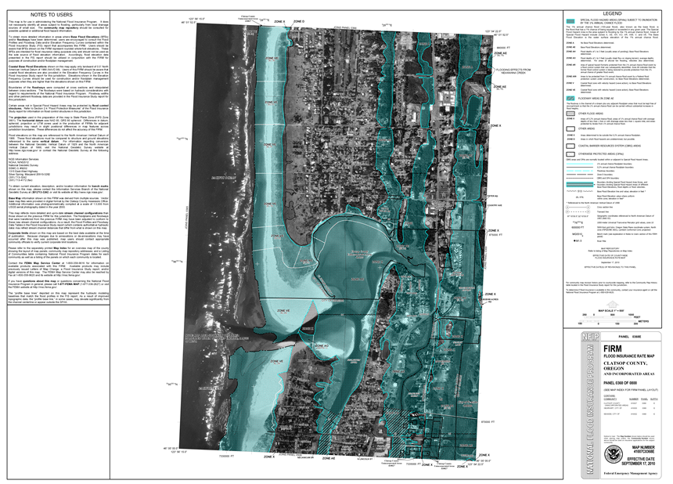
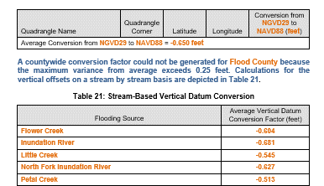
Section 6.1 of Template: Flood Insurance Study (FIS) Report (Nov 2016)
National Geodetic Survey
FIS Report (Sec 6.1) states the need to know the datum for the FIRM and to consult NGS for datum conversion if needed.
Notes:
You may recognize NGS from such prestigious appearances like section 6.1 of Template: Flood Insurance Study (FIS) Report (Nov 2016)
or the “NOTE THE USERS” section of your favorite FIRM

Slide 7
Section 6.1 of Template: Flood Insurance Study (FIS) Report (Nov 2016)
Do you trust Table 20 or should you “Verify, Then Trust” ?
November 14, 2019
MN Assoc of Floodplain Managers
7

Slide 8
VERTCON
Use mark C 300 (OR0485) as example near Chamberlain SD
1 National Geodetic Survey, Retrieval Date = DECEMBER 19, 2017
OR0485 ***********************************************************************
OR0485 DESIGNATION - C 300
OR0485 *CURRENT SURVEY CONTROL
OR0485 ______________________________________________________________________
OR0485* NAD 83(1986) POSITION- 43 46 26. (N) 099 18 46. (W) SCALED
OR0485* NAVD 88 ORTHO HEIGHT - 517.279 (meters) 1697.11 (feet) ADJUSTED
OR0485 ______________________________________________________________________
OR0485 GEOID HEIGHT - -25.673 (meters) GEOID12B
OR0485 DYNAMIC HEIGHT - 517.137 (meters) 1696.64 (feet) COMP
OR0485 MODELED GRAVITY - 980,328.6 (mgal) NAVD 88
OR0485
OR0485 VERT ORDER - SECOND CLASS 0
OR0485
OR0485 SUPERSEDED SURVEY CONTROL
OR0485
OR0485 NGVD 29 (??/??/92) 516.937 (m) 1695.98 (f) ADJ UNCH 2 0
INPUT to VERTCON
Expected OUTPUT from VERTCON

Slide 9
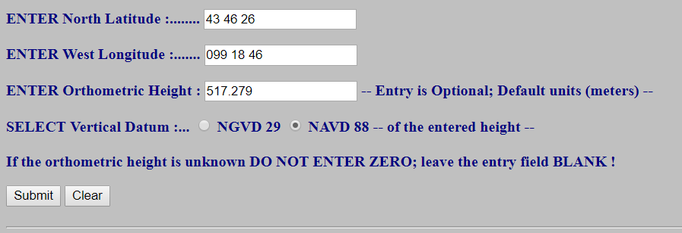
VERTCON
https://www.ngs.noaa.gov/cgi-bin/VERTCON/vert_con.prl
INPUT to VERTCON

Slide 10
VERTCON
Questions concerning the VERTCON process may be mailed to NGS
  Latitude: 43 46 26
  Longitude: 099 18 46
  NAVD 88 height: 517.279
  Datum shift(NAVD 88 minus NGVD 29): 0.343 meter
  Converted to NGVD 29 height: 516.936 meters
Actual OUTPUT from VERTCON
Note: lack of uncertainty statement (std error)
Compare Results
Expected NGVD29 Height (Datasheet) | Output NGVD29 Height (VERTCON) | Difference
516.937 meters | 516.936 meters | 0.001 meters

Slide 11
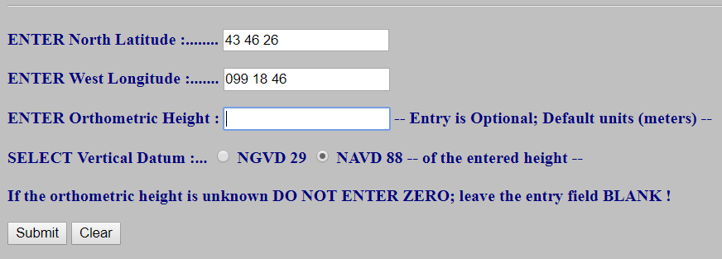
VERTCON
If the ORTHOMETRIC height is not known, VERTCON will compute just the SHIFT at that location.
INPUT to VERTCON
Questions concerning the VERTCON process may be mailed to NGS
Latitude: 43 46 26
Longitude: 099 18 46
NAVD 88 height:
Datum shift(NAVD 88 minus NGVD 29): 0.343 meter
Actual OUTPUT from VERTCON

Slide 12
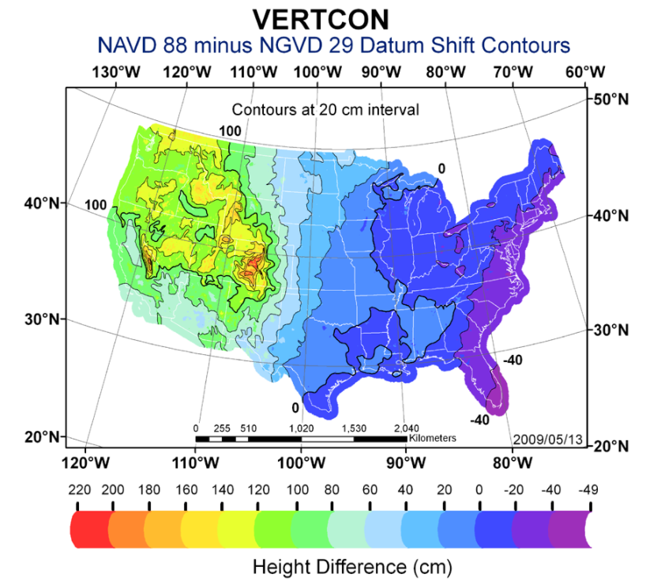
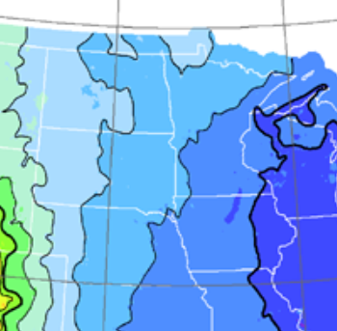
VERTCON
~ 0 to 30 cm in MN
60
ND
40
MN
SD
20
0
IA
NE
Upper Midwest Area

Slide 13
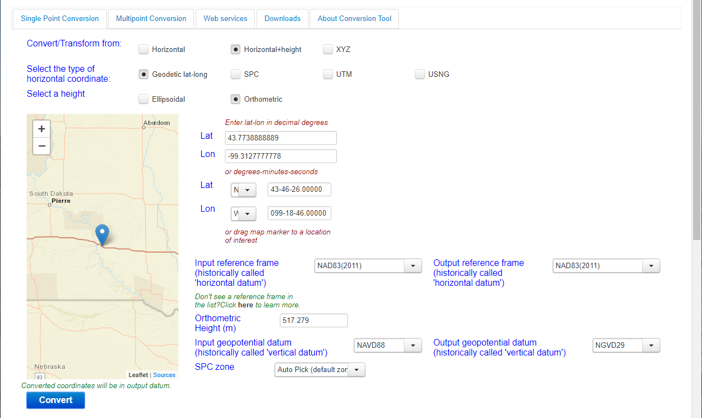
NCAT (beta)

Slide 14
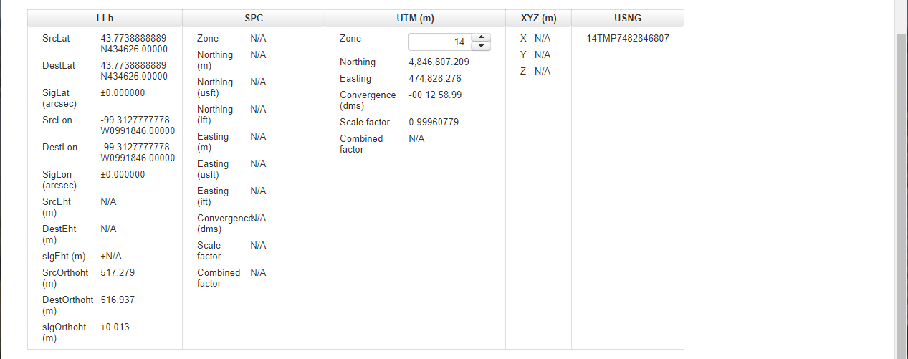
NCAT (beta)
Note: explicit uncertainty statement (std error)
Compare Results
Expected NGVD29 Height (Datasheet) | Output NGVD29 Height (NCAT beta) | Difference
516.937 meters | 516.937 meters | 0.000 meters

Slide 15
Good News
NCAT will incorporate the functionality of VERTCON to convert heights.
NGVD29
NAVD88
NAPGD2022

Slide 16
The Future

Slide 17
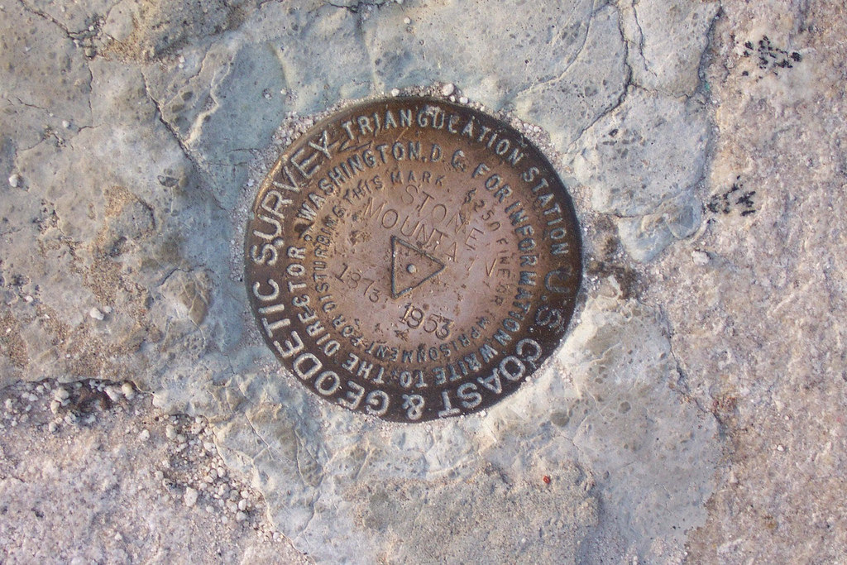
The NSRS of Today (simplified)
System based on connections to published passive control
Primary elements:
Horizontal: North American Datum of 1983 - NAD 83 (2011) epoch 2010.00 coordinates
Vertical: North American Vertical Datum of 1988 - NAVD88 (GRS80, Geoid 18) orthometric heights
These elements are geodetic datums that define the shape and size of the earth to enable precise positioning
Notes:
Here, we simplify the NSRS down to its primary elements:
The horizontal component is the North American Datum of 1983 → NAD 83(2011) epoch 2010.00 → Horizontal Datum; Realization/Adjustment; Reference Epoch
The vertical component is the North American Vertical Datum of 1988, from which we get NAVD88 orthometric heights.
→ NAVD88 (GRS80, Geoid12B) → Vertical Datum; Reference Ellipsoid; Geoid Model
*This system was defined on and based on connections to published passive control or physical survey markers you can find in the ground.

Slide 18
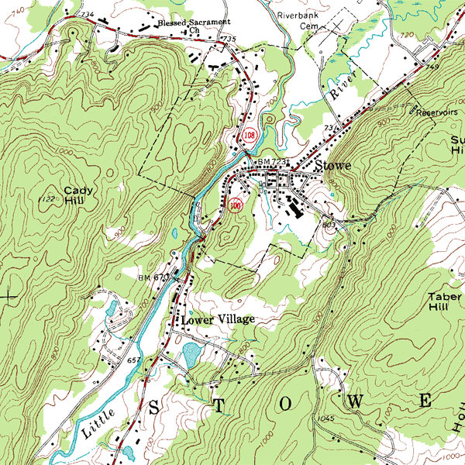
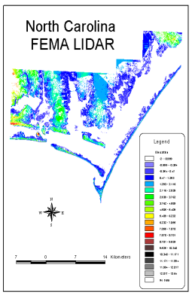
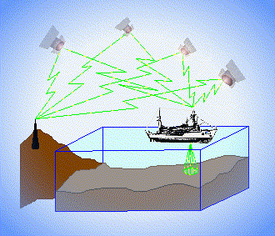
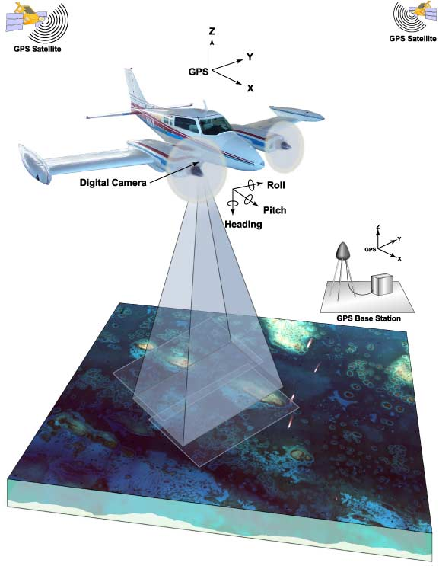
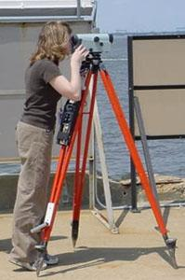
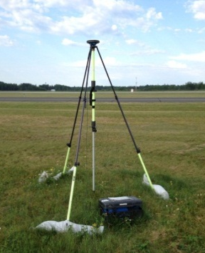
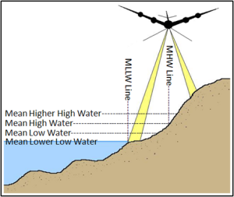
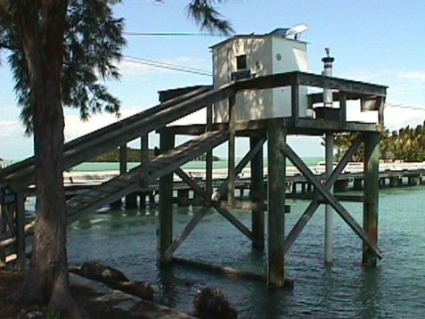
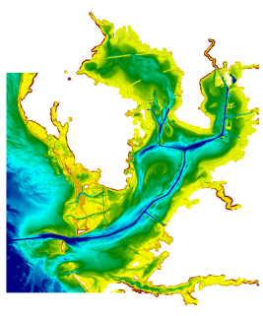
3 Categories of Vertical Datums
Orthometric
Ellipsoidal
Raw Hydrographic Surveys vertically referenced with RTK-GPS
USGS
Topography
FEMA Flood Insurance Rate Maps
Engineering and Development Site Surveys
Tidal
Native GPS measurements
Raw Lidar
NOAA Bathymetry (MLLW)
Shoreline Mapping (MHW) and Regulatory Boundaries at the Coast
Daily and Extreme Water Levels
Notes:
This slide illustrates the 3 categories of vertical datums and examples of where each is directly used They are project and application dependent.
First, we have ellipsoidal datums. Examples include WGS84 and NAD83 (North American Datum of 1983). You will encounter these datums frequently in hydrographic surveys that are vertically referenced with RTK-GPS; any native GPS measurements; and even raw lidar datasets.
Next, we have orthometric datums. These datums are very important because height differences referenced to orthometric datums will allow us to know the direction water will flow, because they have been “gravity-corrected”. The North American Vertical Datum of 1988 (or NAVD 88) is an orthometric datum, which you will see on USGS topographic maps, engineering and development site surveys, and FEMA Flood Insurance Rate Maps.
Finally, we have Tidal Datums, which are derived from water level measurements. They have extremely important applications including daily and extreme water levels; NOAA nautical charts, and shoreline mapping or boundaries along the coast.
*NOAA provides tools (like NCAT and Vdatum) to transform between these different height systems.

Slide 19
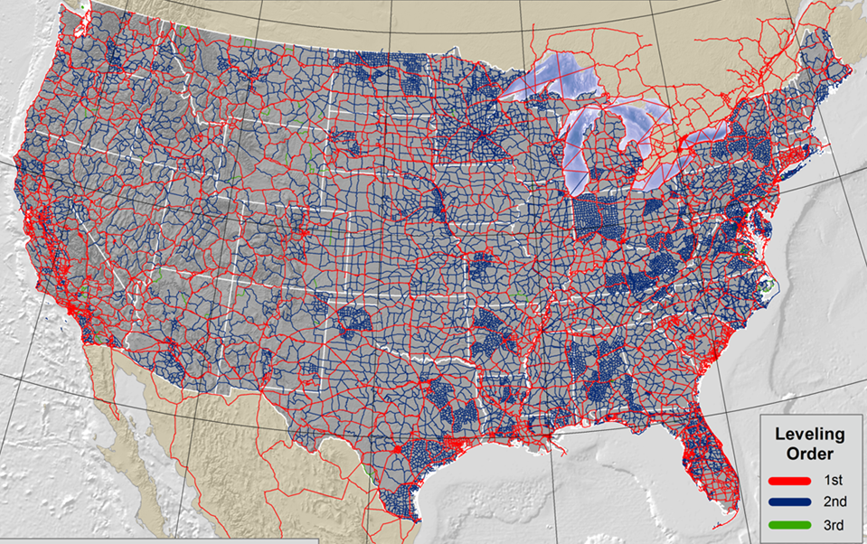
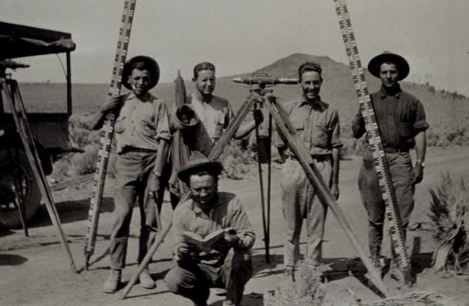
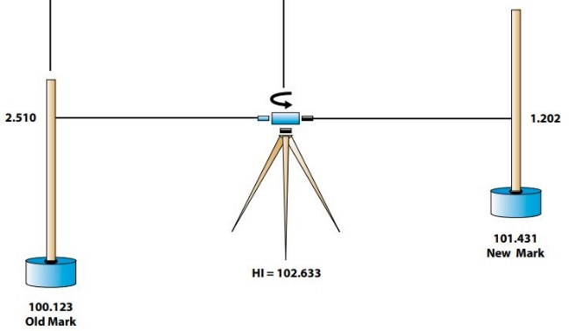
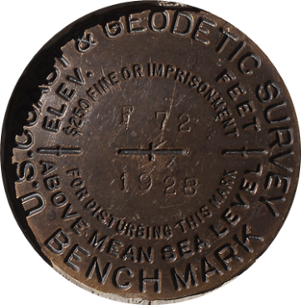
North American Vertical Datum of 1988 (NAVD88)
Notes:
NAVD88 is based on Millions of Miles of Leveling
This is a lot of work and is too costly to maintain.
It is simply no longer practical!

Slide 20
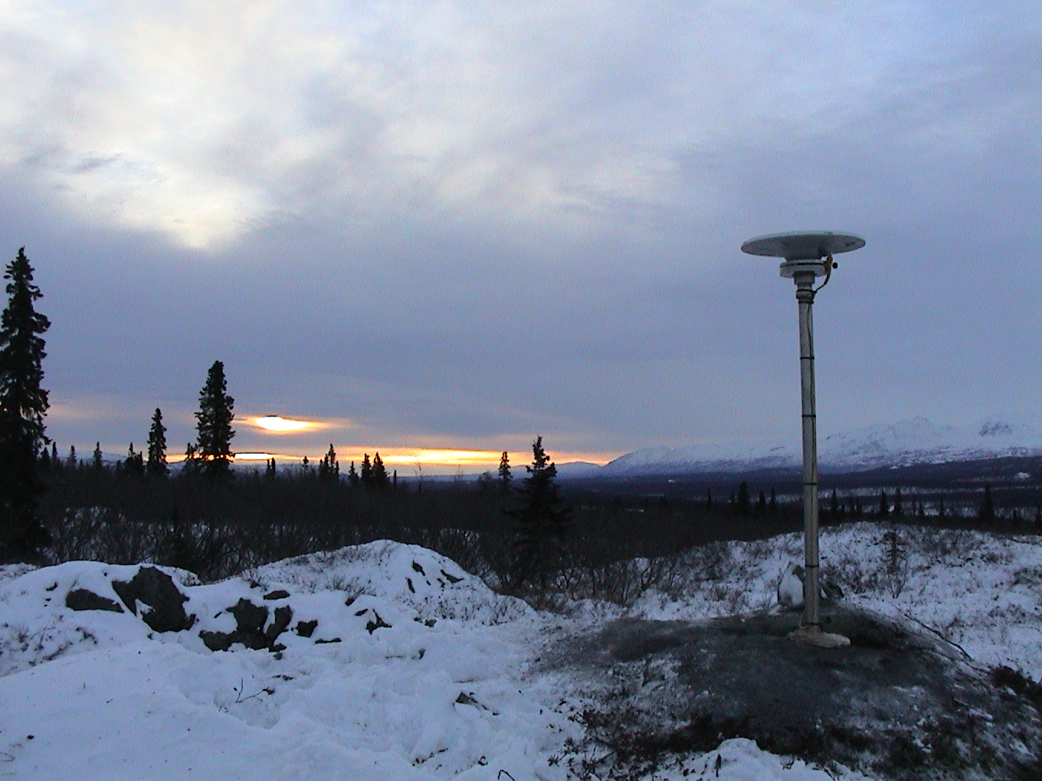
From NAVD 88 to NAPGD 2022
Modernization of the National Spatial Reference System
Notes:
Going from NAVD88 to NAPGD2022…

Slide 21

The NSRS of Tomorrow (2022)
The New reference system is:
Time-dependent and geocentric
Defined by relationships to a global/international ideal frame
Primarily accessed via GPS technology and a newly refined gravimetric geoid model
Primary elements are:
The Horizontal Component is The North American Terrestrial Reference Frame of 2022 (NATRF2022) BPI – Geometric Coordinates
*plus the Caribbean, Pacific, and Mariana plates
The Vertical Component is The North American-Pacific Geopotential Datum of 2022 (NAPGD2022) BPII – Geopotential Coordinates
Notes:
The primary element are:
Horizontal Component: NATRF2022 (BPI – Geometric Coordinates) +Carribean, Pacific, & Mariana plates.
Vertical Component: NAPGD2022 (BPII – Geopotential Coordinates)
The new reference sustem is:
Time Dependant and Geocentric
Defined by relationships to a global/international ideal frame
Primarily accessed via GPS/GNSS technology and a newly refined gravimetric geoid model.

Slide 22
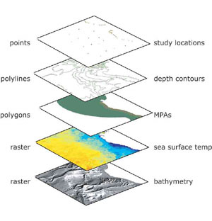
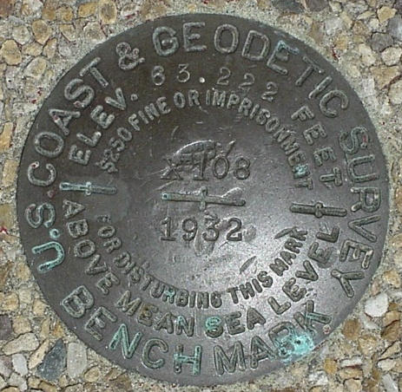
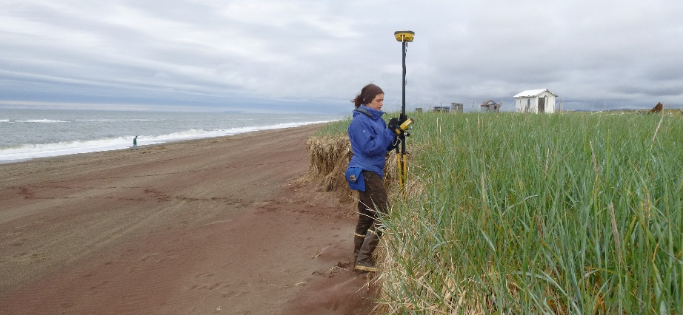
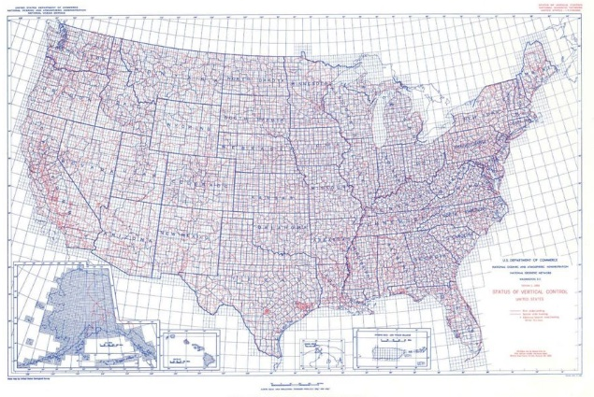
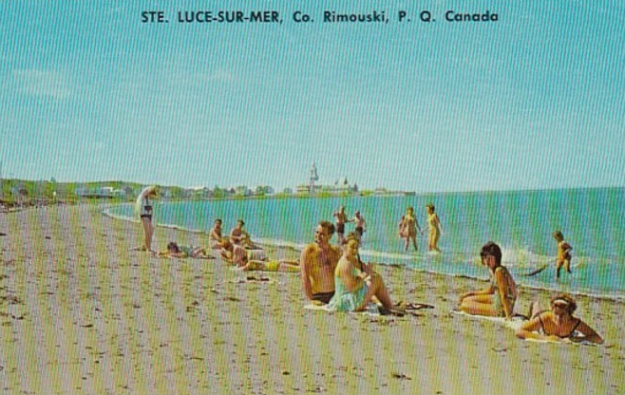
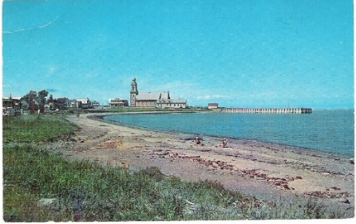
NSRS Considerations – The 4 C’s
Requirements
Expectations
CONSISTENCY
CONVENIENCE
Semi-CONSTANT Coordinates
COHERENCE with Sea Level
stamped with elevation
Notes:
For a reference system to be useful to the public it must be CONSISTENT, meaning it possess spaciotemporal reliability and repeatability, and CONVENIENT, meaning it is readily accessible by users.
Additionally, as a society we have also adopted an expectation that our spatial reference system is defined in a manner that provides some level of CONSTANCY, that objects considered to be stationary have fixed coordinates and/or heights. We have also come to expect that heights and depths are relative to some definition of sea level, and this COHERENCE with a natural equipotential surface also ensures that water will flow from higher to lower height values.
As NGS continues to fulfil our primary mission of defining, maintaining, and providing access to the NSRS, we have recognized the need to modernize the current NSRS in tandem with advances in geodesy, geophysics, and technology (especially GPS/GNSS); to meet evolving requirements and expectations of the NSRS. Decisions about how to best modernize the NSRS must achieve improved consistency (especially between passive and active control), and convenience - while not fully departing from expected characteristics that are part of the fabric of how our Nation uses precise positions.

Slide 23

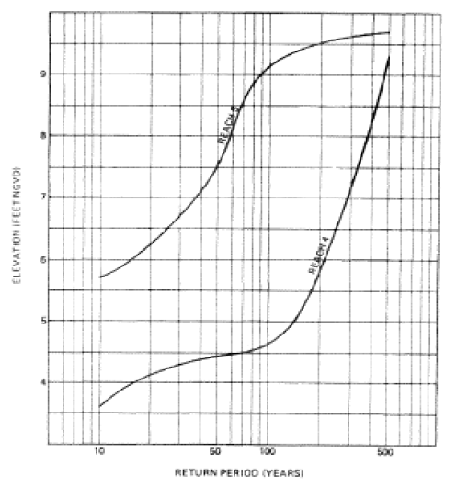
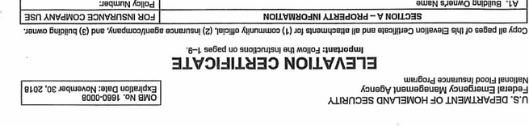
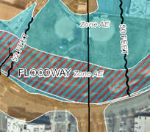
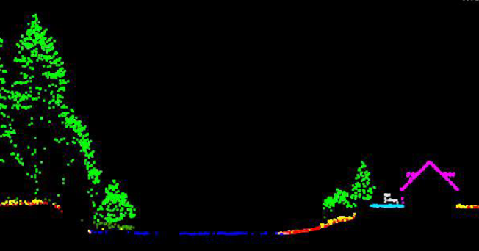
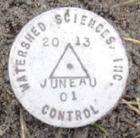
National Spatial Reference System (NSRS)
A common and consistent geospatial framework to meet the economic, social, and environmental positioning needs of our Nation.
Foundational elements include:
Latitude • Longitude • Elevation • Gravity • Shoreline Position
+ changes over time
+
+
=
Reliable FIRMs require data from disparate sources and that dates be consistently aligned
Notes:
The primary mission of NGS is, “to define, maintain, and provide access to the NSRS to meet our nations economic, social, and environmental needs”.
NSRS is a consistent geospatial framework, common to all Federal agencies and other users
NSRS supports informed decision-making for mapping and charting, navigation, flood risk determination, transportation, land management, and more
Elements of NSRS include (but are not limited to): latitude, longitude, elevation, gravity, shoreline position + their changes over time …other elements include scale, earth orientation parameters and others
The vertical component of the NSRS currently utilizes the North American Vertical Datum of 1988 (NAVD88)
Example of why we need consistent coordinates (illustrated):
Just in the making of a single FIRM, data collected at different points in time using different methods (aerial lidar, stream hydrograph, and elevation certificate). All of these must be reliably aligned and combined with historical data, in both the horizontal and vertical components, to produce a final product in which all of this information is available in one place, to assist the planner in appropriate flood mitigation.
→Therefore, Reliable Flood Rate Insurance products rely on the NSRS

Slide 24

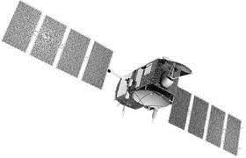
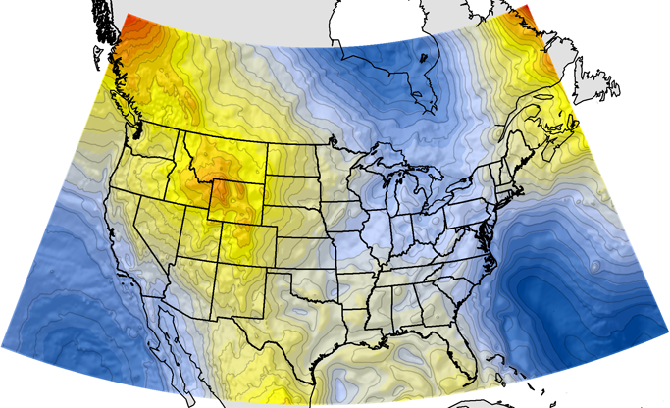
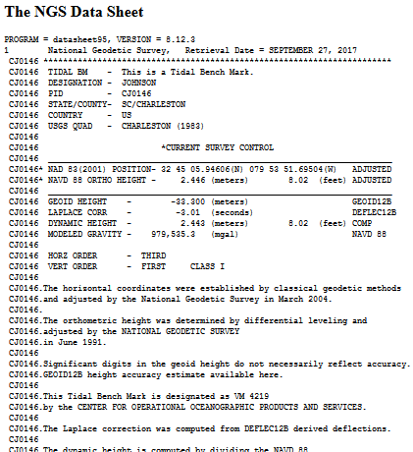
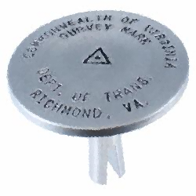
NGS Supports Access to NAVD88 Heights
Passive Marks, Datasheets, and Leveling
GEOID12B,
now use
GEOID18
official path
Notes:
As I mentioned before, an important part of the NGS mission is to provides access to the NSRS.
- Accessing NSRS today - Over time, and with advances in technology, there are now two paths to access NSRS or NAVD 88 heights.
Path (1) Since the NSRS is presently defined by a network of passive control, NGS provides primary access to the NSRS at published passive control that is in the IDB – Integrated Data Base. At present, this remains the ‘official’ gateway to NSRS positions.
Path (2) NGS also supports GPS/GNSS-enabled access to the NSRS via OPUS. For GPS/GNSS-enabled access to NSRS heights, NGS maintains geoid models, which are necessary to convert GPS measurements, which are ellipsoid-based, into real-world elevations. The current geoid model (GEOID12B) that is used to access NSRS orthometric heights (NAVD88) is a hybrid geoid. This means it’s a surface of constant gravity potential that has been warped to align with published values on bench marks.
→ Because of this warping, in an ideal/static world, these two pathways lead you to the same coordinates. Unfortunately, our world is not static, which leads to discrepancies due to plate tektonics, earthquakes, uplift from iso-static rebound, aquifer recharge and mountain building processes, subsidence from petroleum and water pumping, etc…

Slide 25
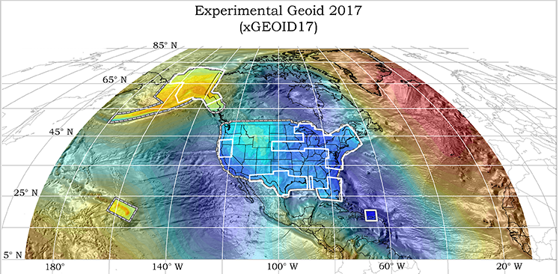
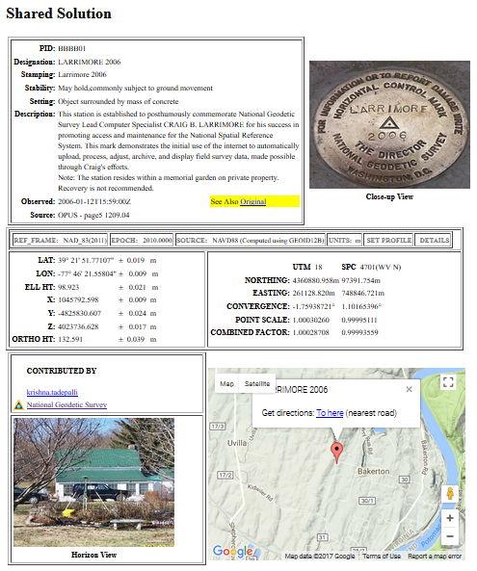
NGS Will Support Access to
NAPGD 2022 Heights
Passive Marks, Datasheets, and Leveling become secondary due to motion
GEOID 2022
official path
Notes:
In 2022 we are switching the official access path to NSRS coordinates.
Active geodetic control (CORS) and a ‘pure’ or un-warped geoid model will replace passive geodetic control, or bench marks.
GPS/GNSS will be the official gateway to the NSRS
The GRAV-D project, for a refined gravimetric geoid for the US, will enable access to orthometric heights w/in 2 cm accuracy using GPS/GNSS. There is no warping to published benchmark heights.
*While the prevalence of active control will reduce our reliance on passive control, it will still have its place.

Slide 26
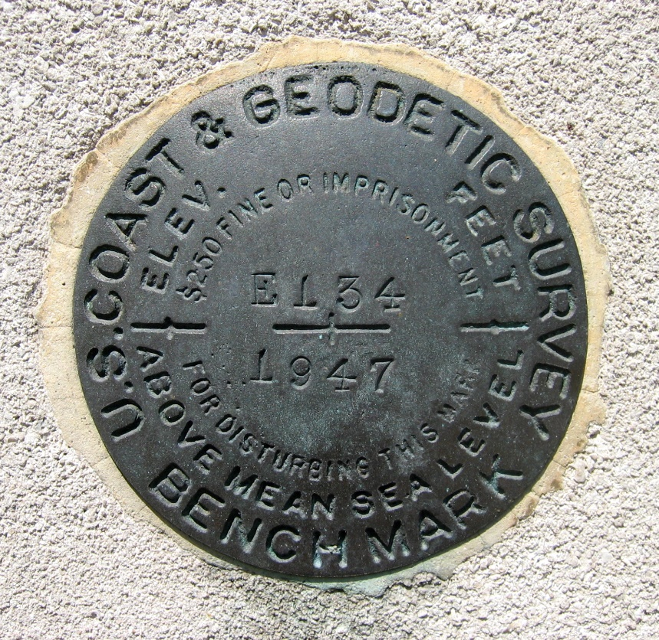
Continued Role of Passive Control
Calibration sites for GNSS technology, Real Time Network validation, and verification of datum transformation tool results.
Monitoring Sites for to enhance velocity models (via repeat/campaign GNSS occupations)
Convenience for local project control, in areas with limited GNSS coverage (e.g. cities, forests), or in the event of GNSS failure (e.g. geomagnetic storms)
Notes:
So, GPS/GNSS technologies simplify and improve access to, and the accuracy of, our spatial reference system.
→ By adding a 4th dimension to all coordinates (time), marks can serve as more faithful access points.

Slide 27
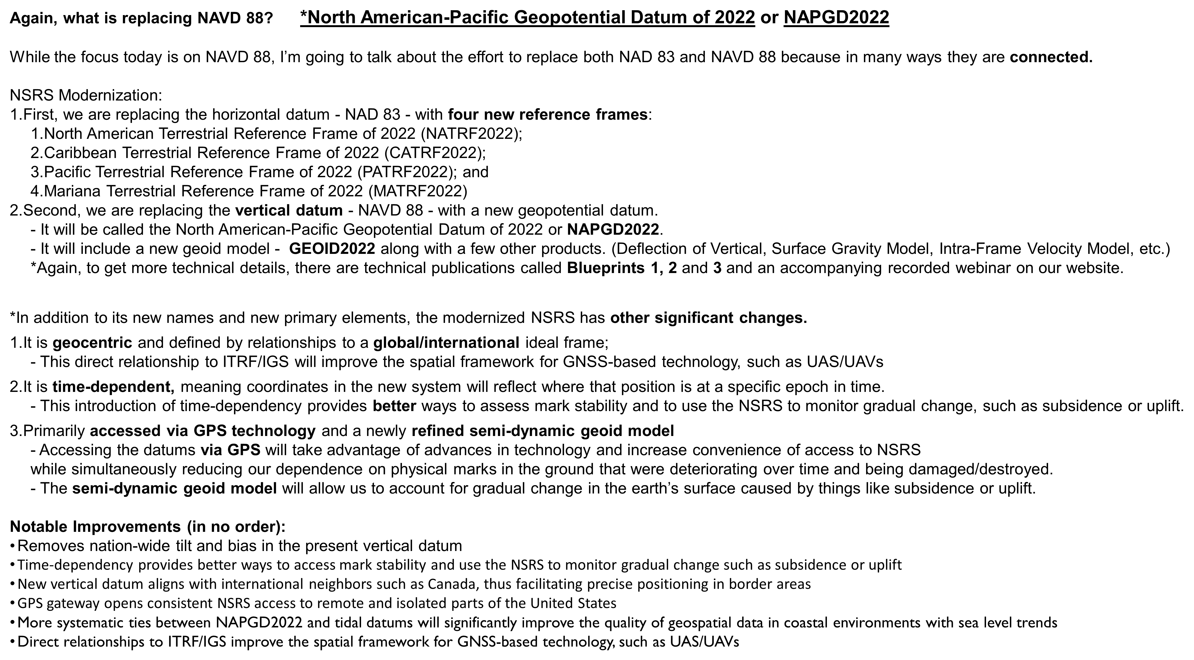

Slide 28
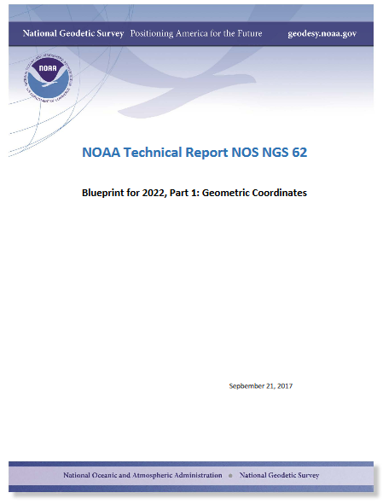
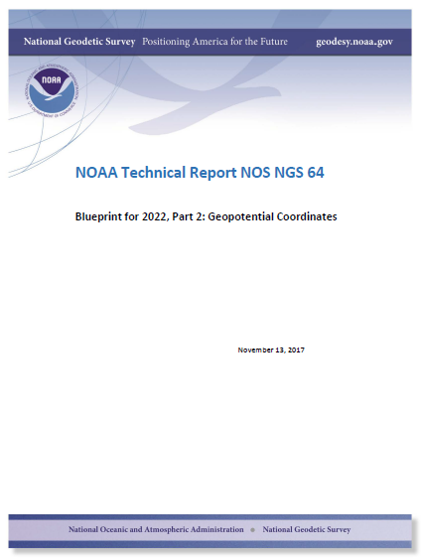
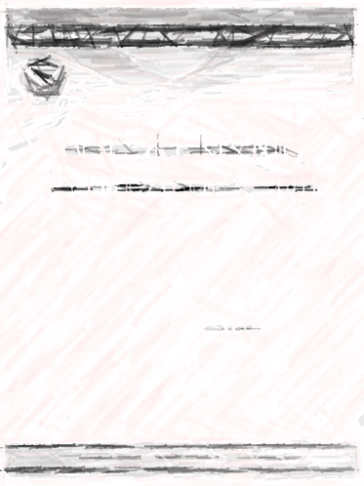
Details Available in Blueprints for 2022
Part 1:
Geometric Coordinates
Part 2:
Geopotential Coordinates
Part 3:
Working in the Modernized NSRS
… or check out related past webinars.
Notes:
Changes are still 3 years away, but users can get a sneak peak at the future in the Blueprints for 2022 Technical Report Series.
BP Part 1 = Geometric Coordinates (NATRF2022); Part 2 = Geopotential Coordinates (NAPGD2022); Part 3 = Working in the Modernized NSRS.
An informal summary of the contents is provided here to pique further interest.
Crack them open! Let NGS know what you think.

Slide 29
NAD 83’s non-geocentricity
Earth’s Surface
h_{NAD83}
h_{IGSxx}
φ_{NAD83} – φ_{ITRFxx}
λ_{NAD83} – λ_{ITRFxx}
h_{NAD83} – h_{ITRFxx}
Coordinates Smoothly varying by
latitude and longitude
ITRFxx origin
same
GRS-80
ellipsoid
~2.2 m
NAD 83 origin
Notes:
NAD83 is offset from the center of the earths mass by ~2.2 meters.
Correcting this will cause a “shift” in coordinates.

Slide 30
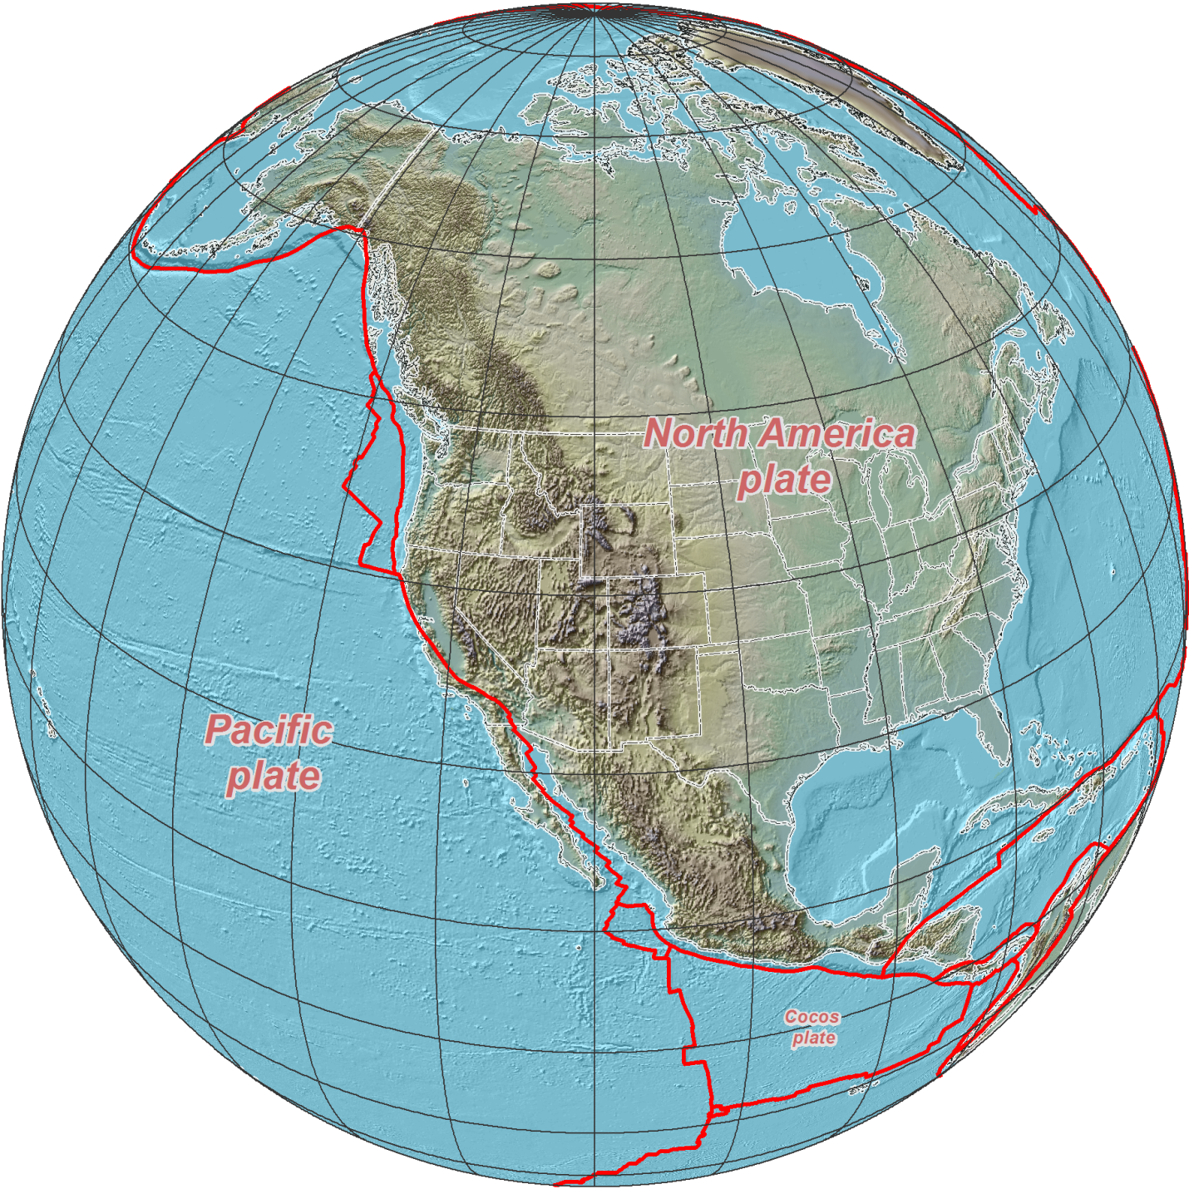

NAD 83 (2011/PA11/MA11) epoch 2010.00
→ 2022 Terrestrial Reference Frames
Horizontal change at
epoch 2022.00
(contours in meters)
NATRF2022
PATRF2022
CATRF2022
About 1.3 meters in MN
Notes:
The change to horizontal coordinates are indicated by this graphic and varies by your location.
The horizontal shift varies from ~.7m on SE tip of Florida to ~1.5m in the NW.

Slide 31

NAD 83 (2011/PA11/MA11) epoch 2010.00
→ 2022 Terrestrial Reference Frames
Change in ellipsoid heights at epoch 2022.00
(contours in meters)
NATRF2022
MATRF2022
PATRF2022
About -0.80 meters in MN
Notes:
The change to ellipsoid heights are indicated by this graphic, and also varies by your location.
The change to ellipsoid heights varies from over -1.5m in Southern Florida to + 0.7m in NW Washington.

Slide 32



NSRS Modernization: Vertical Change
About -0.80 meters in MN
GEOID12B (NAVD88)
Updates available online from the New Datums website and Modernization News
xGEOID17
Vertical offset of more than 1 meter
https://geodesy.noaa.gov/datums/newdatums/index.shtml
Notes:
Obviously, Coordinates will change
There will be a 0 to 1.5 meter shift in your vertical coordinates depending on where you are in the country. This corrects a tilt and bias present in NAVD 88.
This offset could have implications if you try and mix data from sources in the old and new vertical datums
See the offset with the DEM
See the offset in the orthophotography
Do you want to see what the offset is for your area?
Maps and materials are online
You can also use our experimental geoid tool. Every year, we come out with our latest experimental geoid that incorporates new gravity data that is improving our geoid model from the one we use today. Geoid18 will be out soon!

Slide 33



Extent of NAPGD2022 gravimetric geoid model
Guam and Northern Marianas Islands
American Samoa
Notes:
These are maps showing the extent of the high-resolution part of the geopotential model, which includes the new geoid, deflection of the vertical, and surface gravity models, among other things (ie. EPP’s, IFVM, etc.).
Most of the model is equator-to-pole and includes all of North and Central America and Hawaii
There are two smaller grids for Guam/CNMI and American Samoa

Slide 34
Comparing Heights

Slide 35

A vertical datum is a reference surface that can be used to measure heights in a uniform way.
Sally
Jane
X= ?
How much taller is Sally than Jane?
We could measure directly from top of head to top of head.
Or, from floor up to tops of heads and then subtract!
That’s a relative height or height difference
That’s a difference in heights above a datum
Notes:
A vertical reference system is a reference surface that can be used to measure heights in a uniform way.
So, how much taller is Sally?

Slide 36
A vertical datum is a reference surface that can be used to measure heights in a uniform way.
Sally
Jane
X = (H_Sally) – (H_Jane) ?
X= ?
How much taller is Sally than Jane?
Need to know what they’re standing on!
… you cannot compare heights that are measured from different planes of reference (datums)
And what if Sally and Jane are growing?
H_Sally
H_Jane
NAVD88
NGVD29
Notes:
-Well, we need to know how tall, or the slope of the hill.
-You cannot compare heights that are measured from different panes of reference.
*If we replace Sally and Jane with an example more related to floodplains:
What if we want to compare a BFE height in 1990 and a BFE height 2010
what if the land has subsided under that base flood elevation over time?
…hold that thought.

Slide 37
“Height Differences” vs “Heights”
Height Differences and Heights must always refer to consistent datums, determinations, and dates (= metadata records)
Elevation = 900.25 feet
Elevation = 901.25 feet
Elevation = 900.00 feet
Elevation = 901.00 feet
What if Sally and Jane are growing?
Sally
Jane
Sally
Jane
NGVD29
NAVD88

Slide 38
What if Things Move?

Slide 39

ALASKA Case Studies
Illustrative
Notes:
*** I just explained to you how we are modernizing NSRS and told you that it is a good thing for floodplain mapping, but now I am going to show you why with some case studies***
Alaska is a great illustrative end-member.
The issues posed by datums with limited time-dependency shown in the following examples are measurable and apparent, but they are relevant to areas nationwide because these changes are happening everywhere (at slower and less-apparent rates) and they reinforce why NSRS modernization is critical for improved flood mapping, particularly in areas experiencing changes in local relative sea level.

Slide 40




CaSe File: Juneau, AK
2015 Population:
32,756
1940
Looks like sea level is falling 13 mm/yr, but what if…
2014
Notes:
Juneau:
The bottom plot is the Negative Relative Sea Level (RSL) trend in Juneau. The sea is falling relative to the land, because, even though the sea is rising globally the land is rising even faster, and outpacing the ocean.
*The largest component is due to isostatic rebound of the crust as terrestrial glaciers melt.

Slide 41

CaSe File: Juneau, AK
what if…the land is rising 15 mm/yr, and…
Notes:
-In the photo, rapid uplift is monitored with a continuous GNSS site at Mendenhall Glacier. It is a Continuously Operating Reference Station or CORS. -The young lady you see is NGS’s Regional Geodetic Advisor for Alaska and the US Arctic, Nicole (Nic) Kinsman, who might normally have been giving this presentation, if it weren’t for her special rotational assignment within NGS.

Slide 42


CaSe File: Juneau, AK
*** When and how you access or transform to NAVD88 matters ***
Is the flood risk changing in Juneau AK ?
…sea level is also rising by 2 mm/yr
Notes:
**Juneau rates have been generalized for illustrative purposes in this figure**
Local sea level is rising (in blue)
Land is rising faster (in red)
Vertical relationship between tidal and ‘terrestrial’ datums changes (increasing here as shown in green) through time such that if you applied the 2004 relationship 10 years later, the expected position of local MLLW would be significantly off (shown with the red x)
Thought experiment in the creation of a new FIRM:
The mark shown has an official NAVD88 height published in IDB in 2004.
→ Just 10 years later, a surveyor uses this published height value to complete a NAVD88 elevation certificate.
A lidar contractor delivers a new 2014 DEM for Juneau and uses the same mark for control with a NAVD88 height value based on a GPS occupation of the mark (processed with OPUS).
?? Are the surveyor and the lidar contractor working in a consistent vertical datum? NO. *One (the surveyor) is using a NAVD88 height published in 2004, the other (the lidar contractor) is using a current (2014) NAVD88 height, from OPUS.

Slide 43


CaSe File: Cordova, AK
2010 Population: 2,239
Prior FIS: 1979-2015
New FIS Effective: 12/16/2015
Land is falling and sea level is rising
1964
1979
Notes:
Cordova, AK:
Complex RSL trend, positive to steady… why?
Note: record starts in 1964 (see next slide for answer).

Slide 44

CaSe File: Cordova, AK
USGS Professional Paper 531-I
Notes:
Alaska Earthquake happened March 27, 1964. The barnacle line clearly marked by the upper limit of light-gray barnacles and desiccated rockweed in dark patches, and by the lower growth limit of dark-gray encrusting lichens of the splash zone. There was uplift of 3.2 feet in Whale Bay in western Prince William Sound (not far from Cordova).
This photo was taken at 3-foot tide stage. June 22, 1964. Figure 6, U.S. Geological Survey Professional paper 543-I.
= Cordova experienced post-seismic adjustment following the 1964 quake = accelerated RSL rise (unfortunately coinciding with a period of major development in Cordova).

Slide 45


CaSe File: Cordova, AK
BFE in 1979 FIS/FIRM: “18 feet relative to MLLW”
(illustration not to scale)
Fred
Local MLLW in 1994 (1960-78 NTDE)
Fred obtains an Elevation Certificate in Cordova in 1994:
18.1’ MLLW (1960-78 tidal epoch) ← Above BFE
Notes:
Here is an Experiment:
*******NOTE: BFE in Cordova is relative to local MLLW, not NAVD88***********
BFE in 1979 FIS/FIRM = 18 feet relative to MLLW
And Fred obtains an Elevation Certificate (EC) in Cardova in 1994 that determines he is 18.1 ft above MLLW.

Slide 46
CaSe File: Cordova, AK
BFE in 1979 FIS/FIRM: “18 feet relative to MLLW”
(illustration not to scale)
Susan
Fred
Local MLLW in 2004 (1983-2001 NTDE)
Fred obtains an Elevation Certificate in Cordova in 1994:
18.1’ MLLW (1960-78 tidal epoch) ← Above BFE
A decade later (2004), his next door neighbor Susan hires a surveyor to get an Elevation Certificate:
17.9’ MLLW (1983-2001 tidal epoch) ← Below BFE?
Notes:
Talk about Susan, 10 years later (water is up and land down in this time → risk of flood is increasing for both houses)
Note: Susan’s house is actually up small hill from Fred’s, but in 2004 her EC determines she’s at 17.9 feet above MLLW.
*Is her EC correct?

Slide 47
CaSe File: Cordova, AK
BFE in 1979 FIS/FIRM: “18 feet relative to MLLW”
(illustration not to scale)
Susan
Fred
Local MLLW in 2004 (1983-2001 NTDE)
Is the flood risk changing in Cordova AK ?
Fred obtains an Elevation Certificate in Cordova in 1994:
18.1’ MLLW (1960-78 tidal epoch) ← Above BFE
A decade later (2004), his next door neighbor Susan hires a surveyor to get an Elevation Certificate:
17.9’ MLLW (1983-2001 tidal epoch) ← Below BFE?
Notes:
So, Fred is “out” of flood zone due to his grandfathered elevation, but Susan in “in” (she is not really, because these elevations are not relative to the same FIS datum)
→ No one in this scenario paid attention to the tidal epoch of the MLLW datum
*FEMA guidance says that “BFE stays fixed even if there is subsidence.” (a bit ambiguous if BFE is relative to a non-fixed datum)
Susan’s EC is NOT to the same datum as the BFE, but perhaps Susan’s EC reflects her true risk, and Fred just got lucky with timing?
→ This is not how we want to be calculating elevations for the purposes of informed flood preparedness.

Slide 48

CaSe File: Cordova, AK
2015 FIS
Based on NOAA tidal BM records; this conversion value is for NAVD88 to Local MLLW (1983-2001)
Can this equation be used to update all Cordova MLLW Elevation Certificates to NAVD88?
Notes:
The Cordova 1979 FIS was updated in 2015.
The FIS was updated for BFEs relative to NAVD88, and a conversion value was provided that does not specify tidal epoch.
If this equation is used on Susan’s EC, her elevation is now ‘correct’?
*Without a NTDE defined, can we know for sure? -NO
If this equation is applied to Fred’s EC, does he now have a NAVD88 EC compliant with the new FIS? NO
How would the local Flood Plain Manager know the difference when going through the process of Elevation Certificate updates?
*This example is one of many that REINFORCES THE IMPORTANCE OF METADATA!!!!!

Slide 49
Datum Differences

Slide 50
Minnesota Vertical datums
Minnesota has had 3 major vertical datums
  GA1912 (4th General Adjustment)
  NGVD29
  NAVD88
It will soon have a 4th vertical datum
  NAPGD2022

Slide 51


Vertical Datums and Shifts
GA1912 to NGVD29
Meters

Slide 52


Vertical Datums and Shifts
NGVD29 to NAVD88
Meters

Slide 53


Slide 54


MnDOT Datasheet
Lake City MN (PID: PP0082)
Note that all 3 vertical datums were published for this mark

Slide 55

NGS Datasheet
NGVD29 to NAVD88 Offset
689.22 to 689.33 = +0.11 feet
689.22 to 689.34 = +0.12 feet
Which is correct?
PP0082 *CURRENT SURVEY CONTROL
PP0082 ______________________________________________________________________
PP0082* NAD 83(1986) POSITION- 44 26 57.0 (N) 092 15 54.0 (W) HD_HELD2
PP0082* NAVD 88 ORTHO HEIGHT - 210.111 (meters) 689.34 (feet) ADJUSTED
PP0082 ______________________________________________________________________
PP0082 SUPERSEDED SURVEY CONTROL
PP0082
PP0082 NAVD 88 (06/15/91) 210.109 (m) 689.33 (f) SUPERSEDED 1 1
PP0082 NGVD 29 (??/??/92) 210.076 (m) 689.22 (f) ADJ UNCH 1 1
Note that only 2 of 3 vertical datums were published for this mark

Slide 56
Offset from NGVD29 to NAVD88
At Lake City MN (PP0082)
  NGVD29 to NAVD88 Offset
  689.22 to 689.33 = +0.11 feet
  689.22 to 689.34 = +0.12 feet
Note that measurement and adjustment uncertainty influences the computed offset.
Could movement be occurring?

Slide 57
Watch for Measuring Errors and Analysis Differences

Slide 58

NW Minnesota Example
0.272 feet
0.046 feet

Slide 59
NGS adjustment of MNDOT data (regional)
NGS adjustment of MNDOT data (local)
MNDOT measurement and adjustment
NGS adjustment of MNDOT data (local)
MNDOT measurement and adjustment

Slide 60
Dig Deeper
Recent MNDOT surveys showed historic leveling (NAVD88) did not agree with new leveling.
NGS readjusted NW Minnesota (00000941).
Not all marks were included and the adjustment did not extend far into North Dakota.
So, heights pre-date August 2019 (00000941) and some post-date August 2019.
  Pay attention to dates and adjustment references

Slide 61


NW Minnesota (00000941)
Marks included in 00000941
Height changes in 00000941
4699 marks
3450 miles of leveling
(red = constrained)
Fargo Inset
0.05 to 0.10 meter height change around Fargo ND & Thief River Falls MN

Slide 62
Recommendations
Recommendations
Users should conform their surveys and computations to be consistent with the heights used in crafting the many existing data products and maps that were based on the published heights prior to this August 2019 adjustment.
Users should not mix heights from the August 2019 adjustment (00000941) with heights from other references, especially if height differences are large.

Slide 63

DOCUMENTATION OF DATUMS (metadata)
Practical Guidance on

Slide 64
Use Complete Nomenclature
NAD83 (2011) epoch 2010.00
Horizontal Datum
Realization/Adjustment
Reference Epoch
USSD
NAD27
NAD83
NATRF2022
1986
1996
2007
2011
Epoch 1991.0
Epoch 2010.0
Epoch 2025.0
Your report should have a paragraph describing the sources and methods used to determine the horizontal coordinate system used
Notes:
Note: The exact content and format may vary, but these general recommendations are specific to projects with a vertical emphasis.
Also, whenever possible, even before 2022:
Document equipment used, source/date of survey, any software used for conversions and/or transformations, and record their parameters and the name and version numbers.
Retain your raw GPS/GNSS files and all other raw data files and information collected.
Document any additional potentially relative information.

Slide 65
Use Complete Nomenclature
NAVD88 (ell ht source, Geoid Model)
Vertical Datum
For GPS-derived Heights:
NAD83(2011), 2010.0, GEOID12B
GA1912 ?
NGVD29
NAVD88
NAPGD2022
For NGS-published leveling-derived Heights:
PID PP0082, dated 06/15/91
For non-published leveling-derived Heights:
PID PP0082, dated 06/15/91
For other situations:
Specify source and method of height determination
Your report should have a paragraph describing the sources and methods used to determine the vertical height system used

Slide 66
Use Complete Nomenclature
MLLW (9452210; 1960-78 #2128)
Tidal Datum
NOAA Tide Station
National Tidal Datum Epoch & Published Sheet Number (if available)
Your report should have a paragraph describing the sources and methods used to determine the Tidal Height System and Epoch system used

Slide 67



CaSe File: METADATA
1995 EC Form
Weak datum metadata
1981 FIRM - JUNEAU
Notes:
We have made improvements over time, as seen in the old Elevation Certificate Forms (this one is from Juneau)
The old form has issues. Not enough metadata
This is a very common issue in Alaska
The insurer takes the datum label on the EC at face value
A conversion value may not exist OR may demonstrate that datum is mis-labeled by resulting in an unreasonable elevation
In these cases, you must defer to a licensed surveyor for interpretation, or the property will require a re-survey

Slide 68


Section B & C – FIRM Information
Better datum metadata
Better datum metadata
Notes:
On the new elevation certificate documents:
There is extra space to add information about the source.
If you look in the instructions, licensed professionals completing this form are not restricted to just this space, and they may provide attachments if extra explanation is necessary.

Slide 69
Keep Complete Records
If local passive control are used in the FIS, retain a record of:
  Monument stampings/locations
  PIDs or other unique IDs
  Position at time of FIS survey (with complete metadata)
If you do any transformations, keep a record of the parameters and the name and version number if a tool was used (like Vdatum, VERTCON, NCAT, etc)
In areas of uplift/subsidence, inquire about source and ”vintage” of heights
  For NAVD88, which realization, reference epoch?
  For Tidal Datums, what tide station, tidal epoch, published sheet number?
FEMA EC guidance provides for the use of OPUS reports; OPUS solutions of 4+ hours in duration on marks of significance can be archived w/ NGS as an ‘OPUS Shared Solution’ with minimal extra effort.
Copies of NGS and MNDOT Datasheets
Notes:
Read Slide

Slide 70

Training and Resources
Additional
Notes:
This presentation is intended to raise awareness about the upcoming changes and what they mean for floodplain mapping, but you probably have lots of remaining questions and we have a lot of resources online at our website
Please spread the word, and
make an effort to keep yourself and your colleagues informed.
Tell us what content is missing or how we can make it better!

Slide 71


Resources from geodesy.noaa.gov
Click icon on home-page
Notes:
I’m going to highlight a few online resources, beginning with our new datums web site.
Visit our site. It has information today, and we’ll continue to update it.

Slide 72

Online Resources from ngs.noaa.gov
Notes:
You can also access our science and education resources from the drop down menu on our main page

Slide 73


Educational Videos & Online Tutorials
Videos are ~3-5 minutes
Vertical Datums Tutorial is ~1 hour
Notes:
Educational videos and online tutorials –
Our library of lessons and videos are great resources, and will reinforce a lot of information we covered today.
The videos are just 3-5 minutes long.
the lesson is a deeper dive but still only takes an hour.

Slide 74

NGS Regional Advisor Program
Notes:
Please consult with your local NGS life-line.
NGS Regional geodetic advisors are located around the country for questions and/or support.
We also have State Coordinators.

Slide 75


Email Subscriptions
Stay informed!
NGS News
  Includes quarterly NSRS Modernization newsletter
NGS Webinar
NGS Training
Only 1-2 messages / month
Click icon
on home-page
Notes:
Email Subscription –
Sign up for notifications about News, webinars, and training opportunities with NGS.
We also use our News subscription list to send out our quarterly NSRS Modernization Newsletter.

Slide 76
What can everyone do?
Be aware and help spread the word about upcoming NSRS modernization:
  Proactively ask agencies, surveyors, and engineers about what preparations they are taking to learn about and prepare for the upcoming changes
Reach out to NGS for support as needed
Lead by example and exercise best metadata practices
Notes:
Coordinate
-Spread the word and tell others about NSRS Modernization
Educate
-Review materials and ask for support from NGS
Prepare
-Lead by example and use the best metadata practices

Slide 77

Get Prepared
More active NSRS users
Metadata, metadata, metadata..
Use current datums / realizations
Keep original (“raw”) GNSS observation files
Notes:
For more active NSRS users, a few points:
Metadata, metadata, metadata..
Please require and/or provide complete metadata for all mapping contracts.
How did they get the positions/heights? Document it!
Lead by example and use best metadata practices
Use current datums / realizations.
NAD 83(2011) epoch 2010.00
USGG12 (gravimetric geoid) / GEOID12B(hybrid geoid)
NAVD 88 (get off of NGVD 29)
Keep original (“raw”) GNSS observation files. This will improve the quality of future transformations.

Slide 78



Ongoing NOAA/FEMA Coordination
Feedback on the New Datums
Kimberly Pettit, FEMA GIS Coordinator
Prepared with Paul Rooney
2017 Geospatial Summit
April 24 to 25, 2017
https://www.ngs.noaa.gov/geospatial-summit/presentations/fema.shtml
Assessment
Preparations to-date
Advantages and challenges
Concerns
Necessary transition tools, products, and services
Outreach priorities
watch online
Notes:
We are coordinating with other Federal Agencies - since Federal mapping agencies must use the NSRS, we’ve made a particular effort to engage federal agencies
Our director chairs the Federal Geodetic Control subcommittee (FGCS), and they will adopt the new datums in 2022
We hosted Geospatial summits in 2010, 2015, 2017 and most recently in 2019.
We asked federal agencies to share their requirements and concerns.
Check out what FEMA shared and their copperative agreement with North Carolina by visiting our website.

Slide 79

NOAA/FEMA Coordination
Cooperative Pilot Study (2011):
  National Geodetic Survey,
  North Carolina Floodplain Mapping Program,
  North Carolina Geodetic Survey, and
  Federal Emergency Management Agency
Key Outcomes:
Recommendation of FEMA implementation plan to account for coordinate and height shifts.
Improved relative positional accuracies and greater understanding of height uncertainties will enhance quality of flood mapping.
Notes:
NOAA/FEMA – NOAA working with FEMA to implement the new datums is incredibly important.
In 2011 we commissioned a socio-economic benefit study that found improved floodplain maps are of tremendous value to the nation.
This study was a huge driver in getting funding for our GRAVD project.
*We completed a pilot study in 2010 in North Carolina
NGS made a recommendation that FEMA create an implementation plan to account for coordinate and height shifts.
NGS and FEMA found that improved relative positional accuracies and greater understanding of height uncertainties will enhance the quality of flood mapping.
**We recognize there will be challenges, but we really are looking forward to working with FEMA and all of you, to make the transition work as well as possible.

Slide 80

Floodplain Mapping Webinar
NGS Webinar Series
  https://www.ngs.noaa.gov/web/science_edu/webinar_series/2018-webinars.shtml
Follow up FAQ posted:
  https://www.ngs.noaa.gov/web/science_edu/webinar_series/Responses_webinar_2018-11-15.pdf

Slide 81
Please consider inviting a National Geodetic Survey (NGS) Speaker to upcoming meetings or conferences.
Notes:
No way that I can cover everything in today’s presentation, therefore I like to highlight the opportunity to invite speakers for future events.
I also want to point out that Blueprints I, II, and III are now published and available on the NGS website shown.
*BPI,BPII and BPIII are the technical documents that describe the modernized National Spatial Reference System of 2022 (NSRS2022) and explain how to access and use it.

Slide 82

Thank You
Notes:
NGS is not pulling the rug out from under you, we are re-leveling and bracing the subfloor for longevity.
Geodesy and the NSRS are critical to floodplain mapping
Ellipsoidal, orthometric, and tidal vertical datums each have a role…
NAVD 88 is going to be replaced in 2022
By NAPGD 2022, part of larger NSRS Modernization effort (2022).
Replacement is in 2022, but the time to prepare is now.
The tools you use today will be expanded for 2022
Tools for accessing NSRS (OPUS, CORS, Data Explorer)
Tools for transformations (NCAT and VDATUM)
This ALL requires good metadata, so lead by example!
THANK YOU!!

