Slide 1

NGS Updates
MARTI IKEHARA, Geodetic Advisor
CLSA Marin Chapter
June 2011

Slide 2
Reference frame changing for CORS
Adjustment/Datum tag changing for passive
CORS – what’s different?
Want to keep up?
HTDP – what’s different?
RTN Guidelines
GC Mapping tools
Learning Resources

Slide 3
CORS Reference Frame Changing
Current
Upcoming
ITRF2000 1997.00
NAD83(CORS96) 2002.00
Relative antenna calibration
ITRF2000, defined by only 8 global stations
IGS08 (2011) 2005.00
NAD83(2011) 2010.00
Absolute
ITRF2008 uses ~230 stations
What does this all mean?
Average differences of NAD 83(2011) epoch 2002.00 minus NAD 83(CORS96) epoch 2002.00:
East -0.18±1.86 cm; North 0.14±1.07 cm;
Vertical 0.17±2.11 cm
< 2 mm +/- 1-2 cm
(nationally)

Slide 4
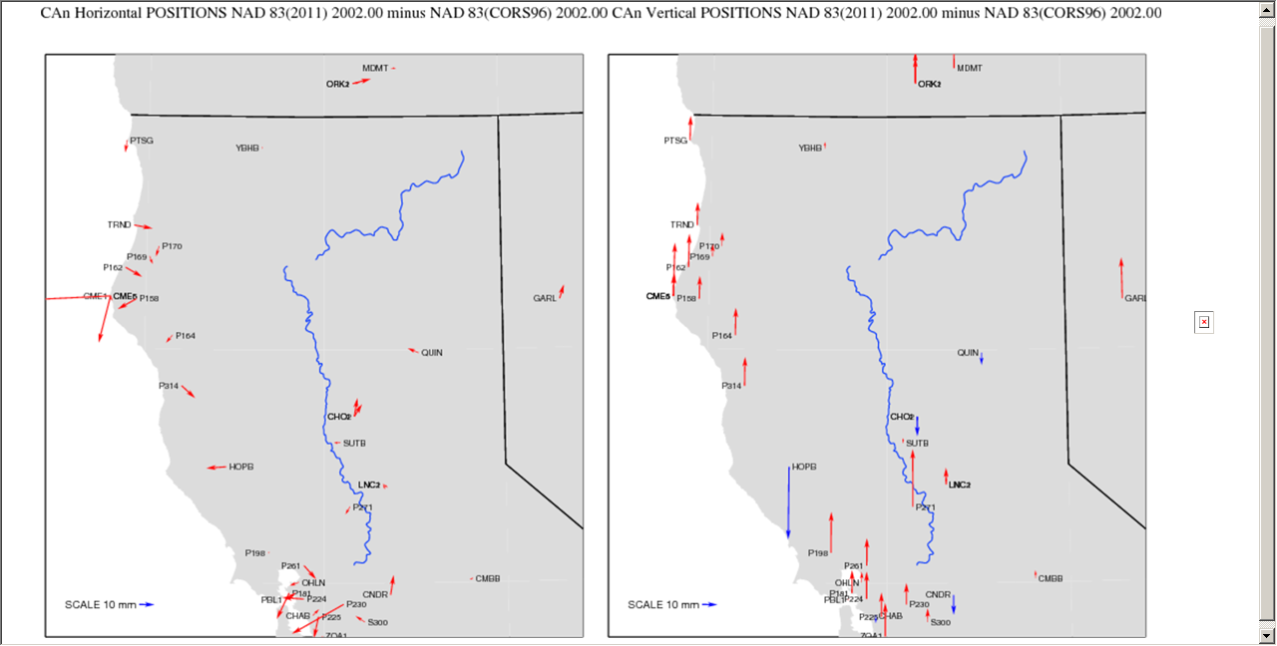
Notes:
For northern CA specific changes, these arrows illustrate the changes, at the same epoch, due to reference frame changes

Slide 5
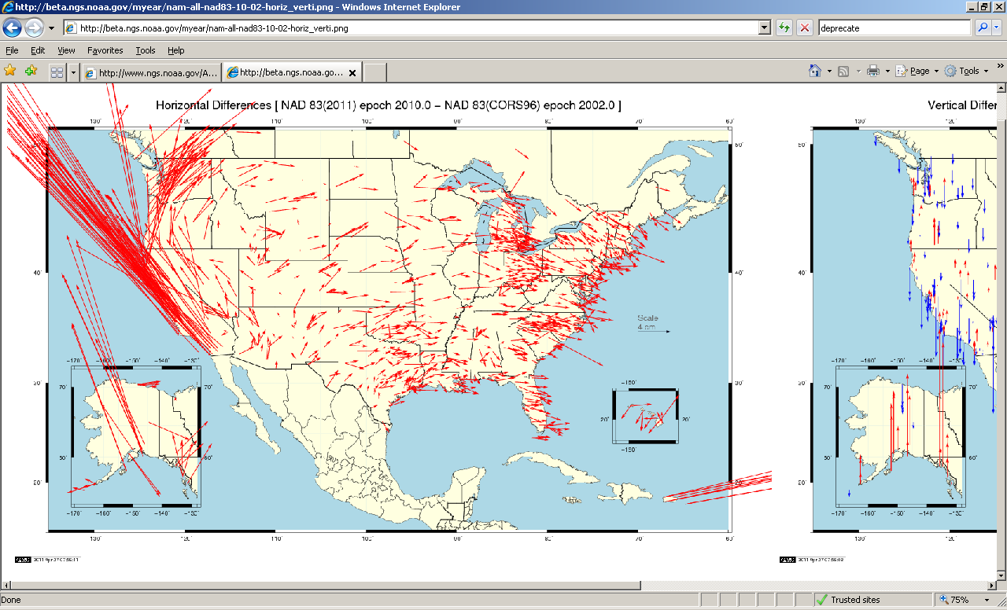

Slide 6
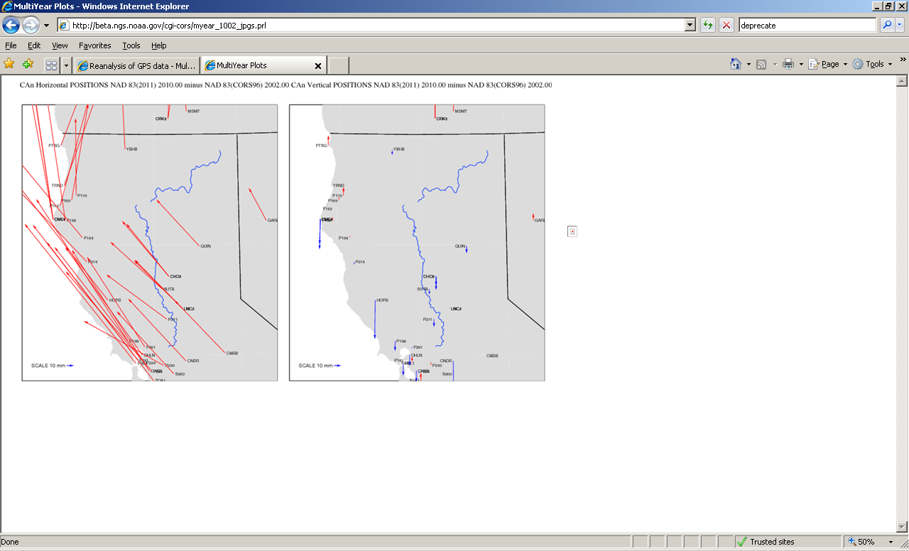

Slide 7
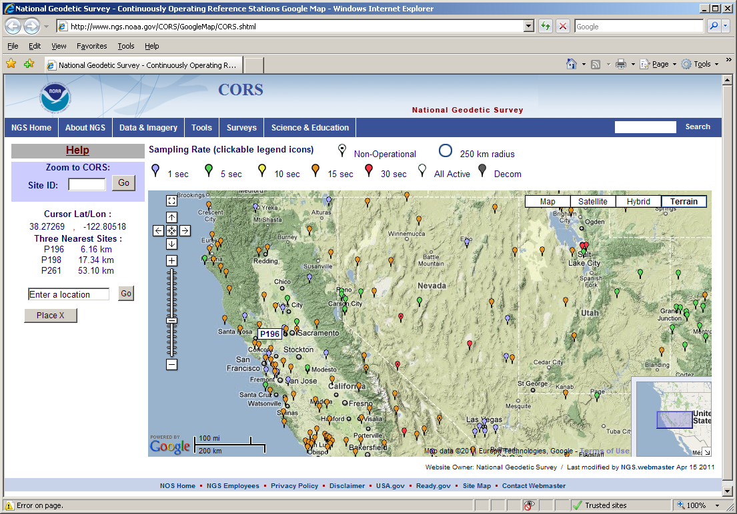
Notes:
When you hover the mouse over a location, the 4-char ID of the site pops up and the 3 nearest sites for that location show up in the left column of the page

Slide 8
Passive network update
In order for the coordinates of passive stations to maintain consistency with the CORS’ representation of the NSRS, NGS will be doing another national adjustment this year
The datum tag that will be adopted for both CORS (active) and passive is NAD83(2011)
CORS (only) will be the control for the LSA

Slide 9
What will be included?
  4127 projects --3411 projects for 2007 adjustment, 21% increase
  77,694 stations --67,693 stations , 15% increase
  398,588 vectors --313,477 vectors , 27% increase
FAQ document available on this NGS webpage: http://www.ngs.noaa.gov/web/news/NA2011_Project.shtml

Slide 10
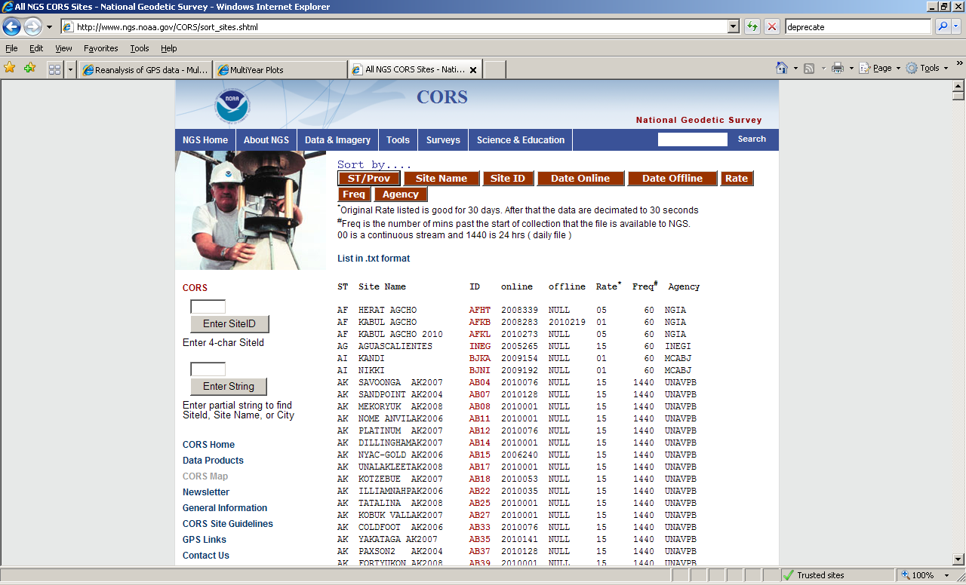

Slide 11
Sorted by Online date (online for NGS) to find recent additions
CA TOST SCGN CS1999 TOST 2011081 NULL 15 1440 UNAVPB
CA CRBT SCGN CN2001 CRBT 2011082 NULL 15 1440 UNAVPB
CA GNPS SCGN CS1999 GNPS 2011082 NULL 15 1440 UNAVPB
CA HNPS SCGN CS1999 HNPS 2011082 NULL 15 1440 UNAVPB
CA IID2 SCGN CS1998 IID2 2011082 NULL 15 1440 UNAVPB
CA IMPS SCGN CS1999 IMPS 2011082 NULL 15 1440 UNAVPB
CA LORS SCGN CS1998 LORS 2011082 NULL 15 1440 UNAVPB
CA ORES SCGN CS1999 ORES 2011082 NULL 15 1440 UNAVPB
CA POSTRANCH CN2008 P172 2011082 NULL 15 1440 UNAVPB
CA MEACHUMLFLCN2006 P196 2011082 NULL 15 1440 UNAVPB
CA HOPKINSLIGHCN2005 P270 2011082 NULL 15 1440 UNAVPB
CA BALLARAT CS2007 P463 2011082 NULL 15 1440 UNAVPB
CA MAZOURKAPKCS2006 P468 2011082 NULL 15 1440 UNAVPB
CA RAMER LAKECS2005 P506 2011082 NULL 15 1440 UNAVPB
CA MCPHERSON CS2008 P521 2011082 NULL 15 1440 UNAVPB
CA COOKEPEAK CN2007 P534 2011082 NULL 15 1440 UNAVPB
CA BUTTONWILLCS2005 P563 2011082 NULL 15 1440 UNAVPB
CA I40CORRIDOCS2007 P603 2011082 NULL 15 1440 UNAVPB
CA PAINTDRCKSCS2006 P615 2011082 NULL 15 1440 UNAVPB
CA LOGCABINRFCS2007 P636 2011082 NULL 15 1440 UNAVPB
CA SBCC SCGN CS1999 SBCC 2011082 NULL 15 1440 UNAVPB
CA POINTARENACN2006 P059 2011083 NULL 15 1440 UNAVPB
CA BURGHRANCHCN2006 P165 2011083 NULL 15 1440 UNAVPB
CA WONDERLANDCN2005 P349 2011083 NULL 15 1440 UNAVPB
CA SLATEMTN CN2006 P140 2011086 NULL 15 1440 UNAVPB

Slide 12
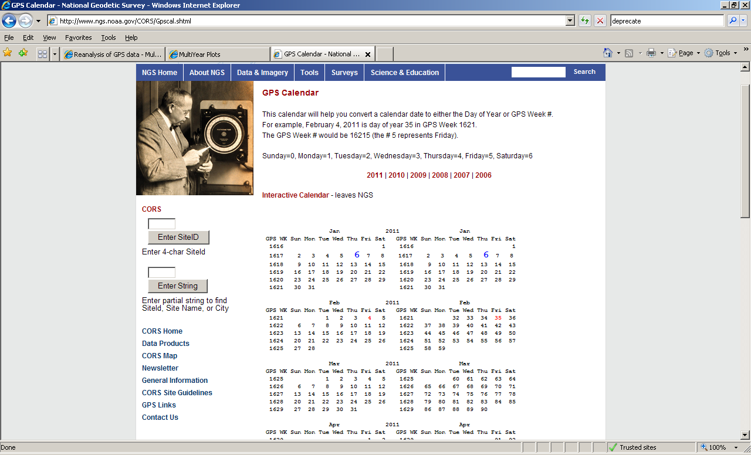
Notes:
Static GPS calendar

Slide 13
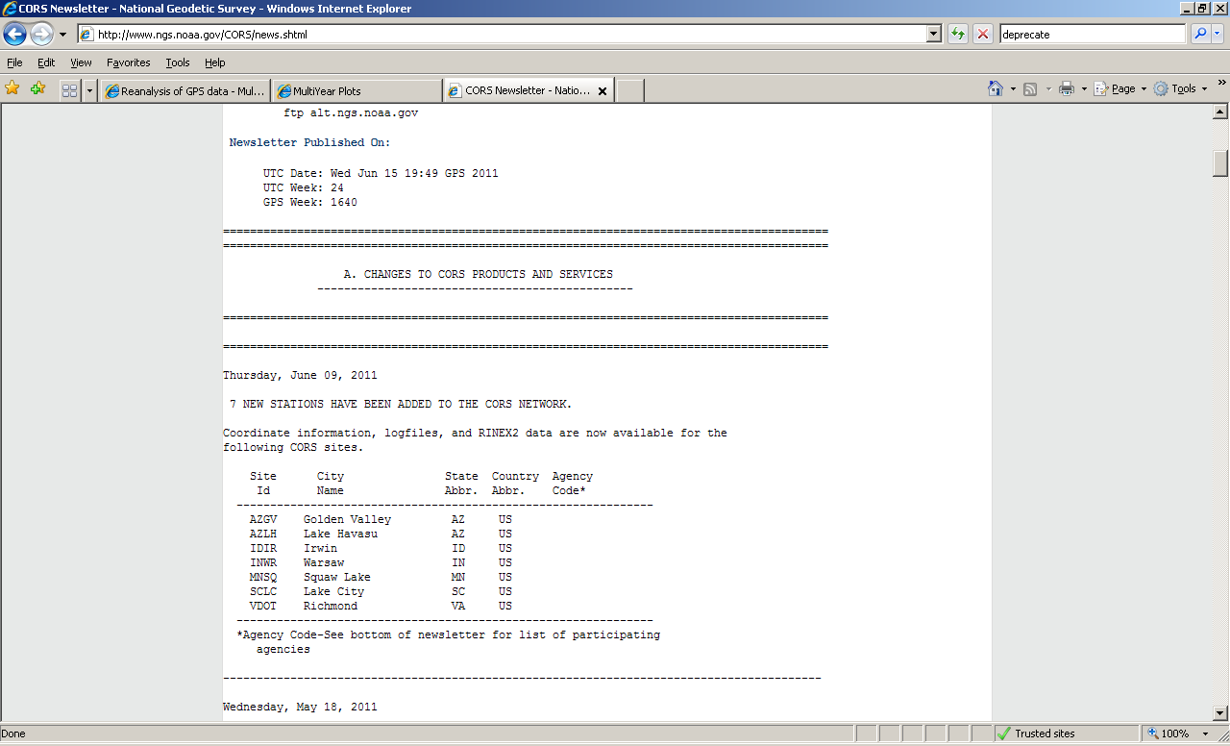

Slide 14
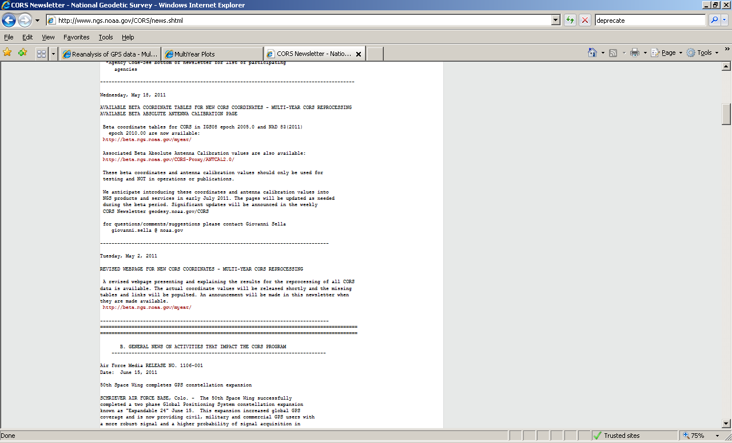
New CORS Coordinates
News that IMPACTS the CORS program, June 15, 2011 (today)

Slide 15
Updates emailed directly to you
requests@willamette.nos.noaa.gov with subject "Subscribe NGS_CORS_news“
04/20/2011 - NGS Launches Public News Subscription Service NOAA's National Geodetic Survey (NGS) now has a subscription news service to keep the public informed of NGS activities. Subscribing (and unsubscribing) is easy!...more
  subject “Subscribe NGS.news”
This story found on ‘main’ NGS page (chron order)

Slide 16
HTDP v 3.1
Interactively estimate displacements between two dates.
Individual points entered interactively or
Points on a specified grid
Select NAD83(CORS96) or NAD83(NSRS2007)
Select the dot for Deci-year format

Slide 17
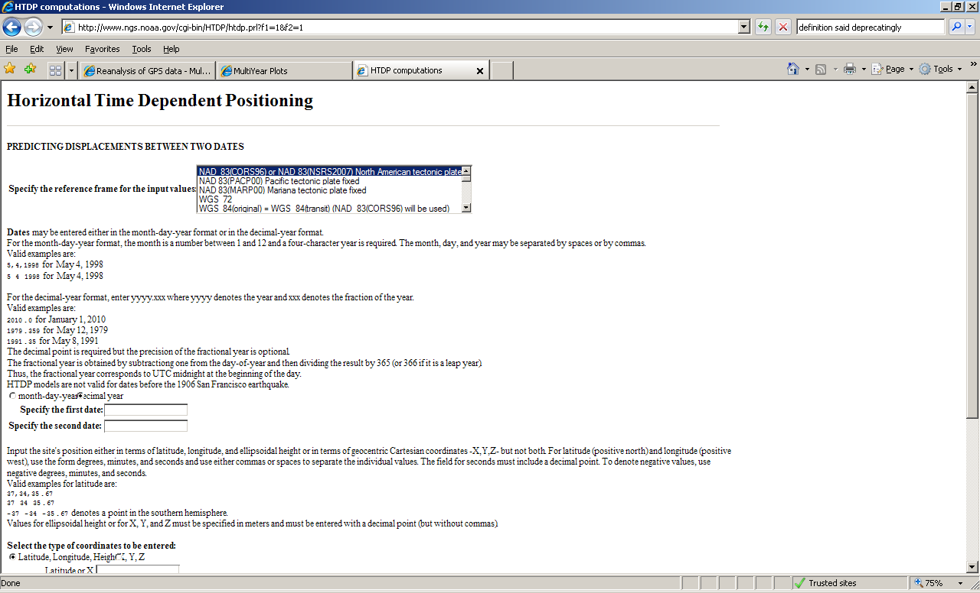

Slide 18
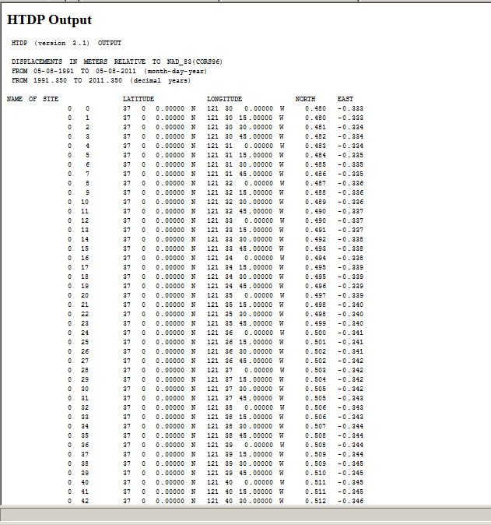
Grid output now available; Example:
15sec increment for a lat/long box, fr 1991.35 -2011.35
Velocity for N, E

Slide 19
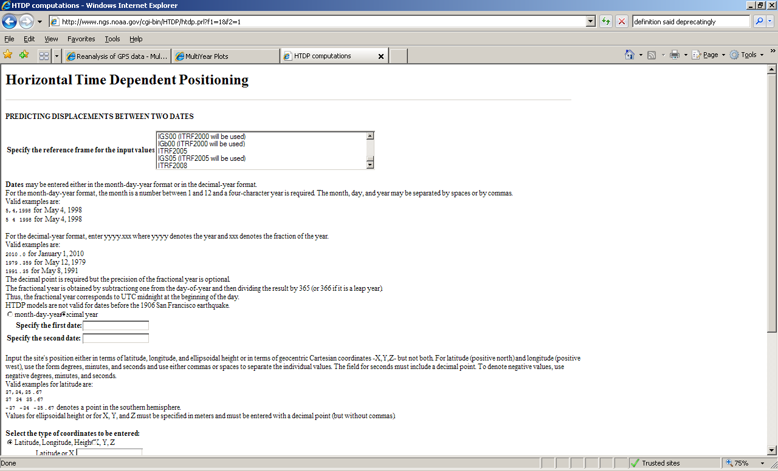

Slide 20
Guidelines for Real Time GNSS Networks - Draft Release
found via Science and Education tab, then
online Publications page under the subject GPS: Technology, Orbits, CORS. The direct link:
http://www.ngs.noaa.gov/PUBS_LIB/NGS.RTN.Public.v2.0.pdf
Comments desired now(soon); write to: william.henning@noaa.gov

Slide 21
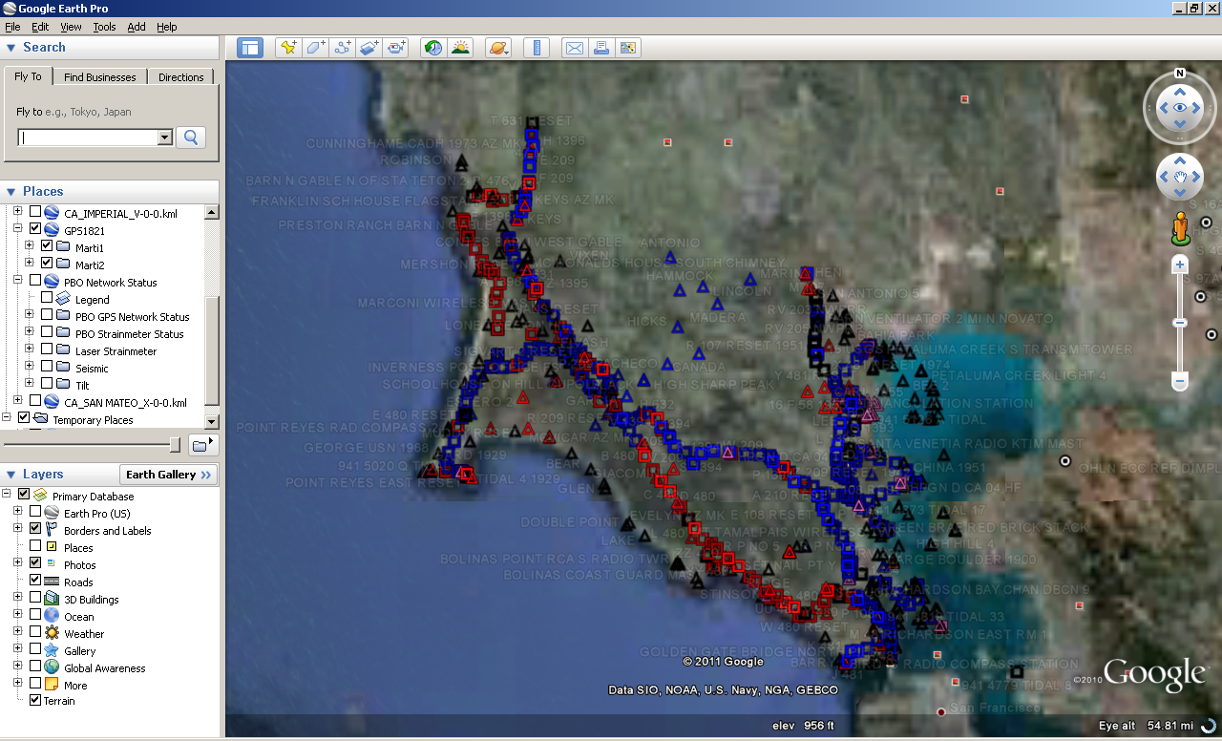
http://www.ngs.noaa.gov/PC_PROD/PARTNERS/index.shtml (DSWorld)

Slide 22
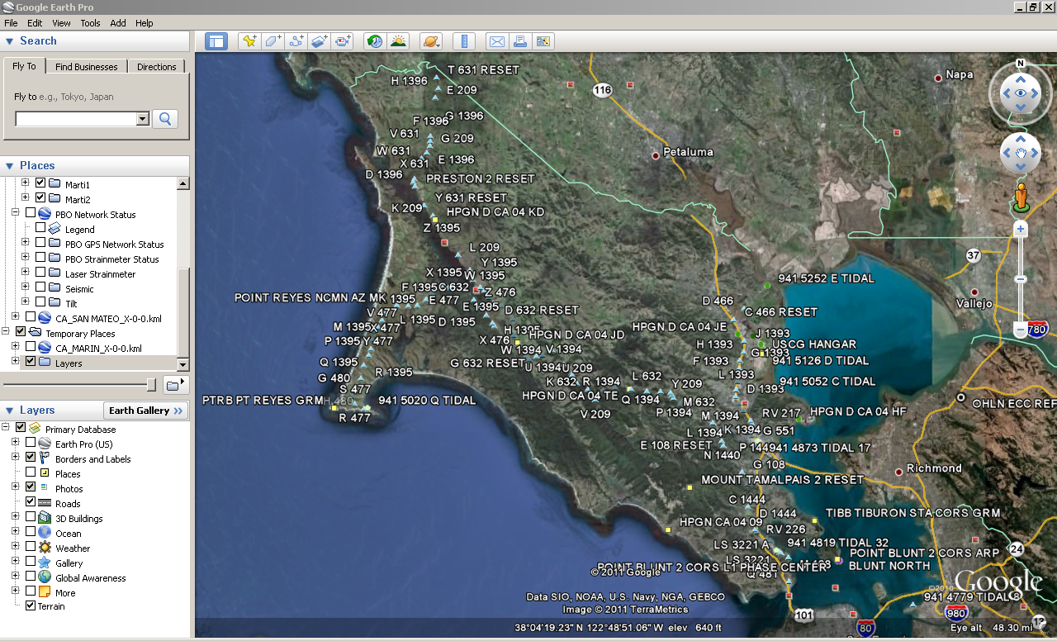

Slide 23
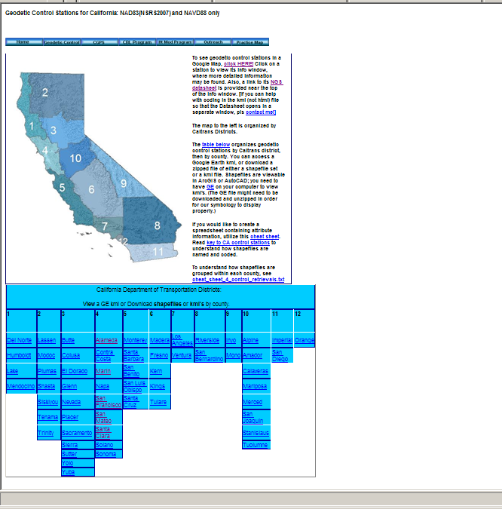
http://www.dot.ca.gov/hq/row/landsurveys/geodetic/geodetic_control.html

Slide 24
Learning Materials
Science and Education
Workshops/Training (also email notification)
Online Learning Resources (for past webinars)
Presentations Archive
  Look for (sort by) date or name or location

Slide 25
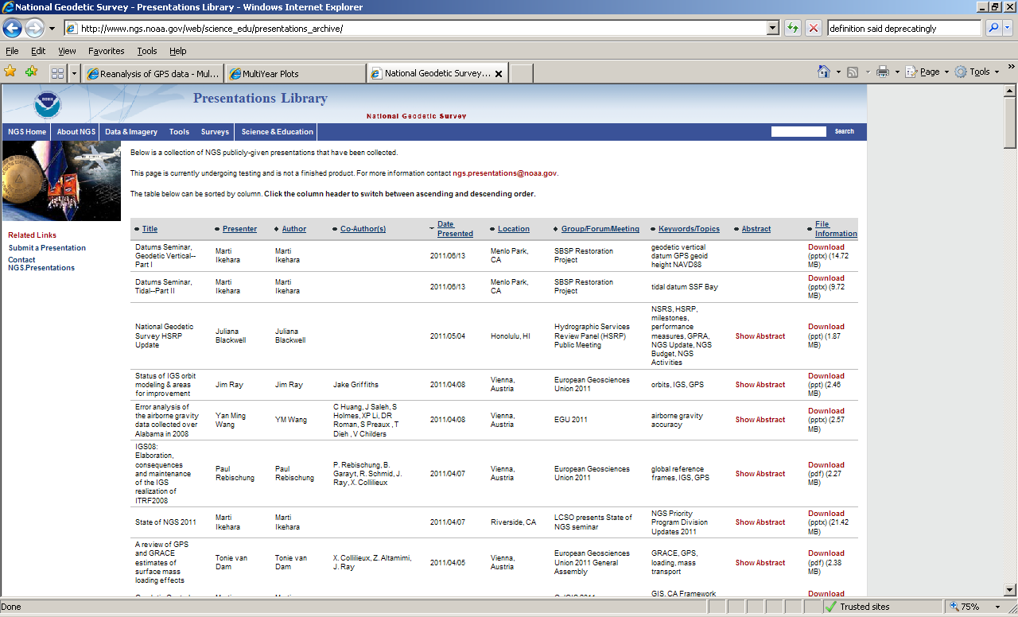
http://www.ngs.noaa.gov/web/science_edu/presentations_archive/

