Slide 1
New Developments for OPUS
Dr. Mark Schenewerk
National Geodetic Survey
Silver Spring, MD
2013 LSPS Spring Technical Session
Shreveport, LA
April 26, 2013

Slide 2
Workshop Outline
OPUS Static
OPUS Rapid-Static
BREAK
OPUS Publishing
Reference Frames
OPUS Network
BREAK
OPUS-Projects

Slide 3
Questions
I’m an informal speaker, so feel free to ask questions.
I will show examples of the web pages for completeness, but I am assuming a basic familiarity with the existing OPUS web sites. If you find any discussion about a web page too terse, ask for clarification.

Slide 4
A big subject so how to begin?
To better understand where OPUS is going, let’s begin by reviewing the who, what, when, where and why of OPUS
as it is today.

Slide 5
What is OPUS?
OPUS, the Online Positioning User Service, is a growing set of applications offering web-based access to the tools and resources provided by the NGS.
Currently, OPUS is composed of:
OPUS Static . . . . . . . static processing
OPUS Rapid-Static . . rapid-static processing
OPUS Publishing . .. . data base and publishing
Reviewing each of these individually…

Slide 6
OPUS Static
A Little OPUS Static History.
The OPUS Static Interface.
How Good Can I Do With OPUS Static?
A Quick Example.
The Standard Report.
The Extended Report.
Back To Our Quick Example.
How Does OPUS Static Work?
OPUS Uploads History.

Slide 7
A Little OPUS Static History
In the late 1990’s, a growing number of organizations were making their Continuously Operating Reference Station (CORS) data publically available with a short latency.
Supporting products such as precise ephemerides were improving and also becoming available with a short latency.
Many organizations recognized that the time seemed ripe for some sort of online, processing service.

Slide 8
A Little OPUS Static History
In the NGS, Gerry Mader started promoting the idea of a processing service.
Specifically he envisioned a web-based service that was as simple as possible without significantly sacrificing accuracy thereby creating a tool useful to the largest possible group of potential users.
The NGS recognized that such a service could also be an effective tool to disseminate the National Spatial Reference System (NSRS).

Slide 9
A Little OPUS Static History
Mader and Weston (NGS) cloistered themselves and, with the help others too numerous to be mentioned here, created OPUS, now called OPUS Static, essentially as it exists today.
After an extended trial period, OPUS was formally made available to the public in 2002.

Slide 10
The OPUS Static Interface
Beautiful in its simplicity, the user need only provide:
Their email address.
The antenna type.
The offset to the antenna reference point (ARP).
2- to 48-hours of GPS L1 + L2 data.
In turn, the user receives:
Coordinates accurate to a few centimeters.

Slide 11
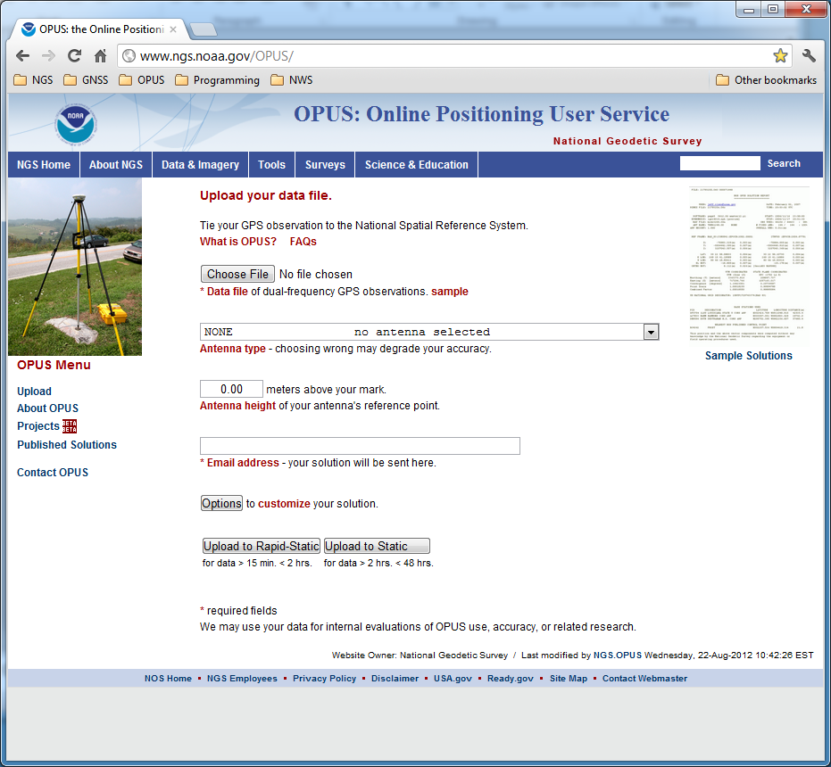
The OPUS Static Interface
This is the OPUS home page used to submit data to the processing queues.
To use OPUS Static, complete the four fields, then click the “Upload to STATIC” button. In a few minutes, an email arrives with the results.
http://geodesy.noaa.gov/OPUS/

Slide 12
How Good Can I Do With OPUS Static?
OPUS Static reliably addresses the more historically conventional requirements for GPS data processing. It typically yields accuracies of:
1 – 2 cm horizontally
2 – 4 cm vertically
However, there is no guarantee that this stated accuracy will result from any given data set. Confirming the quality of the OPUS solution remains your responsibility. That’s the “price” for automated processing.

Slide 13
How Good Can I Do With OPUS Static?
As a quality test, 2-hour data sets from more than 200 CORS were submitted to OPUS Static and the results compared to the accepted coordinates.
Mean: <0.1 cm
N-S RMS: 0.8 cm
E-W RMS: 1.4 cm
Weston, N. “OPUS: Online Positioning User Service”, CGSIC USSLS MEETING, 2008-07-08, NEW ORLEANS, LA.

Slide 14
How Good Can I Do With OPUS Static?
Same data sets, same analysis, but for the vertical. The vertical is always a little more interesting.
Mean: <0.1 cm
U-D RMS: 1.9 cm
Weston, “OPUS: Online Positioning User Service”, CGSIC USSLS MEETING,
2008-07-08, NEW ORLEANS, LA

Slide 15
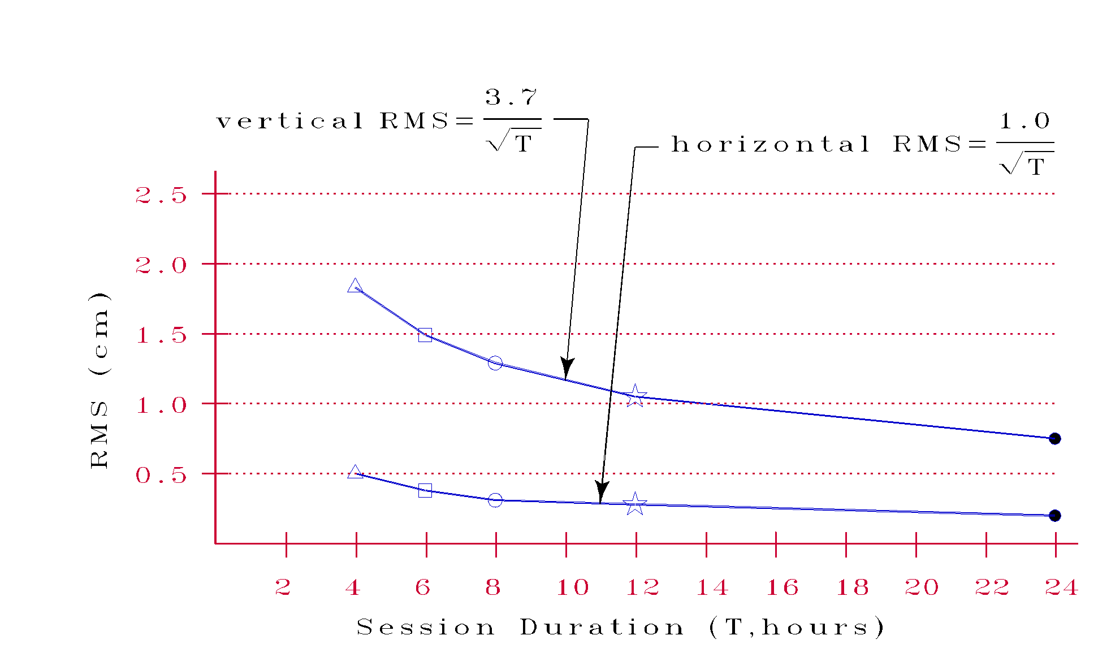
How Good Can I Do With OPUS Static?
More generally, Eckl et al. (NGS) preformed a similar but more extensive test using the same software but outside OPUS. Their results provide a good “rule of thumb”
Eckl et al., 2001, “Accuracy of GPS-derived relative positions as a function of interstation distance and observing-session duration”, J. of Geod. 75, 633-640).
for accuracy versus session duration when using OPUS Static and in many other applications.

Slide 16
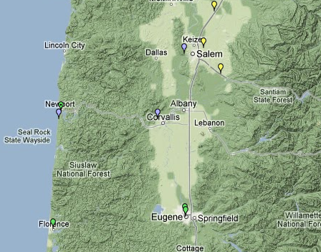
A Quick Example
As an example,
2-hours of
2009-059 data
from CORV, a PBO CORS in Oregon were submitted to OPUS Static.
CORV

Slide 17
The Standard Report
USER: mark.schenewerk@noaa.gov DATE: April 01, 2013
RINEX FILE: corv059f.09o TIME: 15:40:08 UTC
SOFTWARE: page5 1209.04 master63.pl 082112 START: 2009/02/28 05:00:00
EPHEMERIS: igs15206.eph [precise] STOP: 2009/02/28 06:59:30
NAV FILE: brdc0590.09n OBS USED: 5734 / 5906 : 97%
ANT NAME: ASH700936E_C NONE # FIXED AMB: 31 / 31 : 100%
ARP HEIGHT: 1.521 OVERALL RMS: 0.009(m)
REF FRAME: NAD_83(2011)(EPOCH:2010.0000) IGS08 (EPOCH:2009.1596)
X: -2498422.514(m) 0.003(m) -2498423.316(m) 0.003(m)
Y: -3802821.125(m) 0.003(m) -3802819.926(m) 0.003(m)
Z: 4454736.692(m) 0.004(m) 4454736.738(m) 0.004(m)
LAT: 44 35 7.91307 0.004(m) 44 35 7.92691 0.004(m)
E LON: 236 41 43.48298 0.004(m) 236 41 43.42275 0.004(m)
W LON: 123 18 16.51702 0.004(m) 123 18 16.57725 0.004(m)
EL HGT: 105.977(m) 0.002(m) 105.609(m) 0.002(m)
ORTHO HGT: 128.520(m) 0.015(m) [NAVD88 (Computed using GEOID12A)]
UTM COORDINATES STATE PLANE COORDINATES
UTM (Zone 10) SPC (3601 OR N)
Northing (Y) [meters] 4936954.985 105971.634
Easting (X) [meters] 475821.360 2277335.425
Convergence [degrees] -0.21381370 -1.98897464
Point Scale 0.99960719 0.99994603
Combined Factor 0.99959058 0.99992941
US NATIONAL GRID DESIGNATOR: 10TDQ7582136954(NAD 83)
BASE STATIONS USED
PID DESIGNATION LATITUDE LONGITUDE DISTANCE(m)
DI7529 P367 NEWPRTAIR_OR2007 CORS ARP N443506.873 W1240341.596 60113.5
DH4503 P376 EOLARESVR_OR2004 CORS ARP N445628.315 W1230608.099 42648.2
DE6236 LPSB LANE CNTY COOP CORS ARP N440304.409 W1230524.248 61789.3
Here is part of the standard report for this submission.
FYI, these results differ: 0.2 cm horizontally
0.0 cm vertically
from the accepted position projected to the epoch of the data.

Slide 18
The Standard Report
USER: mark.schenewerk@noaa.gov DATE: April 01, 2013
RINEX FILE: corv059f.09o TIME: 15:40:08 UTC
SOFTWARE: page5 1209.04 master63.pl 082112 START: 2009/02/28 05:00:00
EPHEMERIS: igs15206.eph [precise] STOP: 2009/02/28 06:59:30
NAV FILE: brdc0590.09n OBS USED: 5734 / 5906 : 97%
ANT NAME: ASH700936E_C NONE # FIXED AMB: 31 / 31 : 100%
ARP HEIGHT: 1.521 OVERALL RMS: 0.009(m)
REF FRAME: NAD_83(2011)(EPOCH:2010.0000) IGS08 (EPOCH:2009.1596)
X: -2498422.514(m) 0.003(m) -2498423.316(m) 0.003(m)
Y: -3802821.125(m) 0.003(m) -3802819.926(m) 0.003(m)
Z: 4454736.692(m) 0.004(m) 4454736.738(m) 0.004(m)
LAT: 44 35 7.91307 0.004(m) 44 35 7.92691 0.004(m)
E LON: 236 41 43.48298 0.004(m) 236 41 43.42275 0.004(m)
W LON: 123 18 16.51702 0.004(m) 123 18 16.57725 0.004(m)
EL HGT: 105.977(m) 0.002(m) 105.609(m) 0.002(m)
ORTHO HGT: 128.520(m) 0.015(m) [NAVD88 (Computed using GEOID12A)]
UTM COORDINATES STATE PLANE COORDINATES
UTM (Zone 10) SPC (3601 OR N)
Northing (Y) [meters] 4936954.985 105971.634
Easting (X) [meters] 475821.360 2277335.425
Convergence [degrees] -0.21381370 -1.98897464
Point Scale 0.99960719 0.99994603
Combined Factor 0.99959058 0.99992941
US NATIONAL GRID DESIGNATOR: 10TDQ7582136954(NAD 83)
BASE STATIONS USED
PID DESIGNATION LATITUDE LONGITUDE DISTANCE(m)
DI7529 P367 NEWPRTAIR_OR2007 CORS ARP N443506.873 W1240341.596 60113.5
DH4503 P376 EOLARESVR_OR2004 CORS ARP N445628.315 W1230608.099 42648.2
DE6236 LPSB LANE CNTY COOP CORS ARP N440304.409 W1230524.248 61789.3
At the risk of stating the obvious, there are a few items I want to draw your attention to.

Slide 19
The Standard Report
USER: mark.schenewerk@noaa.gov DATE: April 01, 2013
RINEX FILE: corv059f.09o TIME: 15:40:08 UTC
SOFTWARE: page5 1209.04 master63.pl 082112 START: 2009/02/28 05:00:00
EPHEMERIS: igs15206.eph [precise] STOP: 2009/02/28 06:59:30
NAV FILE: brdc0590.09n OBS USED: 5734 / 5906 : 97%
ANT NAME: ASH700936E_C NONE # FIXED AMB: 31 / 31 : 100%
ARP HEIGHT: 1.521 OVERALL RMS: 0.009(m)
REF FRAME: NAD_83(2011)(EPOCH:2010.0000) IGS08 (EPOCH:2009.1596)
X: -2498422.514(m) 0.003(m) -2498423.316(m) 0.003(m)
Y: -3802821.125(m) 0.003(m) -3802819.926(m) 0.003(m)
Z: 4454736.692(m) 0.004(m) 4454736.738(m) 0.004(m)
LAT: 44 35 7.91307 0.004(m) 44 35 7.92691 0.004(m)
E LON: 236 41 43.48298 0.004(m) 236 41 43.42275 0.004(m)
W LON: 123 18 16.51702 0.004(m) 123 18 16.57725 0.004(m)
EL HGT: 105.977(m) 0.002(m) 105.609(m) 0.002(m)
ORTHO HGT: 128.520(m) 0.015(m) [NAVD88 (Computed using GEOID12A)]
UTM COORDINATES STATE PLANE COORDINATES
UTM (Zone 10) SPC (3601 OR N)
Northing (Y) [meters] 4936954.985 105971.634
Easting (X) [meters] 475821.360 2277335.425
Convergence [degrees] -0.21381370 -1.98897464
Point Scale 0.99960719 0.99994603
Combined Factor 0.99959058 0.99992941
US NATIONAL GRID DESIGNATOR: 10TDQ7582136954(NAD 83)
BASE STATIONS USED
PID DESIGNATION LATITUDE LONGITUDE DISTANCE(m)
DI7529 P367 NEWPRTAIR_OR2007 CORS ARP N443506.873 W1240341.596 60113.5
DH4503 P376 EOLARESVR_OR2004 CORS ARP N445628.315 W1230608.099 42648.2
DE6236 LPSB LANE CNTY COOP CORS ARP N440304.409 W1230524.248 61789.3
RINEX FILE: corv059f.09o
START: 2009/02/28 05:00:00
STOP: 2009/02/28 06:59:30
When reviewing your OPUS solution, double check that the information you provided is correct.
ANT NAME: ASH700936C_M NONE
ARP HEIGHT: 1.521

Slide 20
The Standard Report
USER: mark.schenewerk@noaa.gov DATE: April 01, 2013
RINEX FILE: corv059f.09o TIME: 15:40:08 UTC
SOFTWARE: page5 1209.04 master63.pl 082112 START: 2009/02/28 05:00:00
EPHEMERIS: igs15206.eph [precise] STOP: 2009/02/28 06:59:30
NAV FILE: brdc0590.09n OBS USED: 5734 / 5906 : 97%
ANT NAME: ASH700936E_C NONE # FIXED AMB: 31 / 31 : 100%
ARP HEIGHT: 1.521 OVERALL RMS: 0.009(m)
REF FRAME: NAD_83(2011)(EPOCH:2010.0000) IGS08 (EPOCH:2009.1596)
X: -2498422.514(m) 0.003(m) -2498423.316(m) 0.003(m)
Y: -3802821.125(m) 0.003(m) -3802819.926(m) 0.003(m)
Z: 4454736.692(m) 0.004(m) 4454736.738(m) 0.004(m)
LAT: 44 35 7.91307 0.004(m) 44 35 7.92691 0.004(m)
E LON: 236 41 43.48298 0.004(m) 236 41 43.42275 0.004(m)
W LON: 123 18 16.51702 0.004(m) 123 18 16.57725 0.004(m)
EL HGT: 105.977(m) 0.002(m) 105.609(m) 0.002(m)
ORTHO HGT: 128.520(m) 0.015(m) [NAVD88 (Computed using GEOID12A)]
UTM COORDINATES STATE PLANE COORDINATES
UTM (Zone 10) SPC (3601 OR N)
Northing (Y) [meters] 4936954.985 105971.634
Easting (X) [meters] 475821.360 2277335.425
Convergence [degrees] -0.21381370 -1.98897464
Point Scale 0.99960719 0.99994603
Combined Factor 0.99959058 0.99992941
US NATIONAL GRID DESIGNATOR: 10TDQ7582136954(NAD 83)
BASE STATIONS USED
PID DESIGNATION LATITUDE LONGITUDE DISTANCE(m)
DI7529 P367 NEWPRTAIR_OR2007 CORS ARP N443506.873 W1240341.596 60113.5
DH4503 P376 EOLARESVR_OR2004 CORS ARP N445628.315 W1230608.099 42648.2
DE6236 LPSB LANE CNTY COOP CORS ARP N440304.409 W1230524.248 61789.3
Always check the quality control measures provided:
OBS USED > 90%
# FIXED AMB > 50%
OVERALL RMS < 3 cm
For the Obs Used:
bigger is better.
For the # Fixed Amb: bigger is better.
For the Overall RMS: smaller is better.
OBS USED: 5734 / 5906 : 97%
# FIXED AMB: 31 / 31 : 100%
OVERALL RMS: 0.009(m)

Slide 21

The Standard Report
USER: mark.schenewerk@noaa.gov DATE: April 01, 2013
RINEX FILE: corv059f.09o TIME: 15:40:08 UTC
SOFTWARE: page5 1209.04 master63.pl 082112 START: 2009/02/28 05:00:00
EPHEMERIS: igs15206.eph [precise] STOP: 2009/02/28 06:59:30
NAV FILE: brdc0590.09n OBS USED: 5734 / 5906 : 97%
ANT NAME: ASH700936E_C NONE # FIXED AMB: 31 / 31 : 100%
ARP HEIGHT: 1.521 OVERALL RMS: 0.009(m)
REF FRAME: NAD_83(2011)(EPOCH:2010.0000) IGS08 (EPOCH:2009.1596)
X: -2498422.514(m) 0.003(m) -2498423.316(m) 0.003(m)
Y: -3802821.125(m) 0.003(m) -3802819.926(m) 0.003(m)
Z: 4454736.692(m) 0.004(m) 4454736.738(m) 0.004(m)
LAT: 44 35 7.91307 0.004(m) 44 35 7.92691 0.004(m)
E LON: 236 41 43.48298 0.004(m) 236 41 43.42275 0.004(m)
W LON: 123 18 16.51702 0.004(m) 123 18 16.57725 0.004(m)
EL HGT: 105.977(m) 0.002(m) 105.609(m) 0.002(m)
ORTHO HGT: 128.520(m) 0.015(m) [NAVD88 (Computed using GEOID12A)]
UTM COORDINATES STATE PLANE COORDINATES
UTM (Zone 10) SPC (3601 OR N)
Northing (Y) [meters] 4936954.985 105971.634
Easting (X) [meters] 475821.360 2277335.425
Convergence [degrees] -0.21381370 -1.98897464
Point Scale 0.99960719 0.99994603
Combined Factor 0.99959058 0.99992941
US NATIONAL GRID DESIGNATOR: 10TDQ7582136954(NAD 83)
BASE STATIONS USED
PID DESIGNATION LATITUDE LONGITUDE DISTANCE(m)
DI7529 P367 NEWPRTAIR_OR2007 CORS ARP N443506.873 W1240341.596 60113.5
DH4503 P376 EOLARESVR_OR2004 CORS ARP N445628.315 W1230608.099 42648.2
DE6236 LPSB LANE CNTY COOP CORS ARP N440304.409 W1230524.248 61789.3
OPUS also recommends:
peak-to-peak < 5 cm
For the coordinate peak-to-peak uncertainties:
smaller is better.
In this example, we exceed all the quality control criteria so this solution gets a .
0.003(m)
0.003(m)
0.004(m)

Slide 22
The Extended Report
BASE STATION INFORMATION
STATION NAME: p367 a 3 (NewprtAir_OR2007; Newport, OR USA)
MONUMENT: NO DOMES NUMBER
XYZ -2548424.6112 -3769450.8392 4454655.8317 MON @ 2005.0000 (M)
XYZ -0.0056 0.0017 -0.0024 VEL (M/YR)
NEU -0.0000 0.0000 0.0083 MON TO ARP (M)
NEU 0.0012 0.0008 0.0860 ARP TO L1 PHASE CENTER (M)
NEU 0.0006 -0.0006 0.1183 ARP TO L2 PHASE CENTER (M)
XYZ -0.0234 0.0069 -0.0101 VEL TIMES 4.1596 YRS
XYZ -0.0033 -0.0049 0.0058 MON TO ARP
XYZ -0.0332 -0.0505 0.0612 ARP TO L1 PHASE CENTER
XYZ -2548424.6711 -3769450.8876 4454655.8886 L1 PHS CEN @ 2009.1596
XYZ 0.0000 0.0000 0.0000 + XYZ ADJUSTMENTS
XYZ -2548424.6711 -3769450.8876 4454655.8886 NEW L1 PHS CEN @ 2009.1596
XYZ -2548424.6379 -3769450.8371 4454655.8275 NEW ARP @ 2009.1596
XYZ -2548424.6346 -3769450.8322 4454655.8216 NEW MON @ 2009.1596
LLH 44 35 6.88655 235 56 18.34323 23.0166 NEW L1 PHS CEN @ 2009.1596
LLH 44 35 6.88651 235 56 18.34319 22.9306 NEW ARP @ 2009.1596
LLH 44 35 6.88651 235 56 18.34319 22.9223 NEW MON @ 2009.1596
STATION NAME: p376 a 3 (EOLARESVR_OR2004; Salem, OR United States)
MONUMENT: NO DOMES NUMBER
XYZ -2469806.8858 -3788348.5752 4482853.4285 MON @ 2005.0000 (M)
XYZ -0.0097 0.0019 -0.0037 VEL (M/YR)
NEU -0.0000 0.0000 0.0083 MON TO ARP (M)
NEU 0.0012 0.0008 0.0860 ARP TO L1 PHASE CENTER (M)
NEU 0.0006 -0.0006 0.1183 ARP TO L2 PHASE CENTER (M)
XYZ -0.0405 0.0077 -0.0154 VEL TIMES 4.1596 YRS
XYZ -0.0032 -0.0049 0.0059 MON TO ARP
XYZ -0.0322 -0.0507 0.0616 ARP TO L1 PHASE CENTER
XYZ -2469806.9617 -3788348.6231 4482853.4805 L1 PHS CEN @ 2009.1596
XYZ 0.0000 -0.0000 0.0000 + XYZ ADJUSTMENTS
XYZ -2469806.9617 -3788348.6231 4482853.4805 NEW L1 PHS CEN @ 2009.1596
XYZ -2469806.9295 -3788348.5724 4482853.4190 NEW ARP @ 2009.1596
XYZ -2469806.9263 -3788348.5675 4482853.4131 NEW MON @ 2009.1596
LLH 44 56 28.32998 236 53 51.84005 180.9555 NEW L1 PHS CEN @ 2009.1596
LLH 44 56 28.32994 236 53 51.84002 180.8695 NEW ARP @ 2009.1596
LLH 44 56 28.32994 236 53 51.84002 180.8612 NEW MON @ 2009.1596
If the extended report option was selected, additional information is appended. Scrolling past the standard report you’ll next see the BASE STATION section where the computation of the base stations’ coordinates are shown in detail.
These and the following information are expressed in the International Terrestrial Reference Frame (ITRF) currently in use.

Slide 23
The Extended Report
BASE STATION INFORMATION
STATION NAME: p367 a 3 (NewprtAir_OR2007; Newport, OR USA)
MONUMENT: NO DOMES NUMBER
XYZ -2548424.6112 -3769450.8392 4454655.8317 MON @ 2005.0000 (M)
XYZ -0.0056 0.0017 -0.0024 VEL (M/YR)
NEU -0.0000 0.0000 0.0083 MON TO ARP (M)
NEU 0.0012 0.0008 0.0860 ARP TO L1 PHASE CENTER (M)
NEU 0.0006 -0.0006 0.1183 ARP TO L2 PHASE CENTER (M)
XYZ -0.0234 0.0069 -0.0101 VEL TIMES 4.1596 YRS
XYZ -0.0033 -0.0049 0.0058 MON TO ARP
XYZ -0.0332 -0.0505 0.0612 ARP TO L1 PHASE CENTER
XYZ -2548424.6711 -3769450.8876 4454655.8886 L1 PHS CEN @ 2009.1596
XYZ 0.0000 0.0000 0.0000 + XYZ ADJUSTMENTS
XYZ -2548424.6711 -3769450.8876 4454655.8886 NEW L1 PHS CEN @ 2009.1596
XYZ -2548424.6379 -3769450.8371 4454655.8275 NEW ARP @ 2009.1596
XYZ -2548424.6346 -3769450.8322 4454655.8216 NEW MON @ 2009.1596
LLH 44 35 6.88655 235 56 18.34323 23.0166 NEW L1 PHS CEN @ 2009.1596
LLH 44 35 6.88651 235 56 18.34319 22.9306 NEW ARP @ 2009.1596
LLH 44 35 6.88651 235 56 18.34319 22.9223 NEW MON @ 2009.1596
STATION NAME: p376 a 3 (EOLARESVR_OR2004; Salem, OR United States)
MONUMENT: NO DOMES NUMBER
XYZ -2469806.8858 -3788348.5752 4482853.4285 MON @ 2005.0000 (M)
XYZ -0.0097 0.0019 -0.0037 VEL (M/YR)
NEU -0.0000 0.0000 0.0083 MON TO ARP (M)
NEU 0.0012 0.0008 0.0860 ARP TO L1 PHASE CENTER (M)
NEU 0.0006 -0.0006 0.1183 ARP TO L2 PHASE CENTER (M)
XYZ -0.0405 0.0077 -0.0154 VEL TIMES 4.1596 YRS
XYZ -0.0032 -0.0049 0.0059 MON TO ARP
XYZ -0.0322 -0.0507 0.0616 ARP TO L1 PHASE CENTER
XYZ -2469806.9617 -3788348.6231 4482853.4805 L1 PHS CEN @ 2009.1596
XYZ 0.0000 -0.0000 0.0000 + XYZ ADJUSTMENTS
XYZ -2469806.9617 -3788348.6231 4482853.4805 NEW L1 PHS CEN @ 2009.1596
XYZ -2469806.9295 -3788348.5724 4482853.4190 NEW ARP @ 2009.1596
XYZ -2469806.9263 -3788348.5675 4482853.4131 NEW MON @ 2009.1596
LLH 44 56 28.32998 236 53 51.84005 180.9555 NEW L1 PHS CEN @ 2009.1596
LLH 44 56 28.32994 236 53 51.84002 180.8695 NEW ARP @ 2009.1596
LLH 44 56 28.32994 236 53 51.84002 180.8612 NEW MON @ 2009.1596
STATION NAME: p367 a 3 (NewprtAir_OR2007; Newport, OR USA)
MONUMENT: NO DOMES NUMBER
XYZ -2548424.6112 -3769450.8392 4454655.8317 MON @ 2005.0000 (M)
XYZ -0.0056 0.0017 -0.0024 VEL (M/YR)
NEU -0.0000 0.0000 0.0083 MON TO ARP (M)
NEU 0.0012 0.0008 0.0860 ARP TO L1 PHASE CENTER (M)
NEU 0.0006 -0.0006 0.1183 ARP TO L2 PHASE CENTER (M)
This section includes
a priori information for each CORS.

Slide 24
The Extended Report
BASE STATION INFORMATION
STATION NAME: p367 a 3 (NewprtAir_OR2007; Newport, OR USA)
MONUMENT: NO DOMES NUMBER
XYZ -2548424.6112 -3769450.8392 4454655.8317 MON @ 2005.0000 (M)
XYZ -0.0056 0.0017 -0.0024 VEL (M/YR)
NEU -0.0000 0.0000 0.0083 MON TO ARP (M)
NEU 0.0012 0.0008 0.0860 ARP TO L1 PHASE CENTER (M)
NEU 0.0006 -0.0006 0.1183 ARP TO L2 PHASE CENTER (M)
XYZ -0.0234 0.0069 -0.0101 VEL TIMES 4.1596 YRS
XYZ -0.0033 -0.0049 0.0058 MON TO ARP
XYZ -0.0332 -0.0505 0.0612 ARP TO L1 PHASE CENTER
XYZ -2548424.6711 -3769450.8876 4454655.8886 L1 PHS CEN @ 2009.1596
XYZ 0.0000 0.0000 0.0000 + XYZ ADJUSTMENTS
XYZ -2548424.6711 -3769450.8876 4454655.8886 NEW L1 PHS CEN @ 2009.1596
XYZ -2548424.6379 -3769450.8371 4454655.8275 NEW ARP @ 2009.1596
XYZ -2548424.6346 -3769450.8322 4454655.8216 NEW MON @ 2009.1596
LLH 44 35 6.88655 235 56 18.34323 23.0166 NEW L1 PHS CEN @ 2009.1596
LLH 44 35 6.88651 235 56 18.34319 22.9306 NEW ARP @ 2009.1596
LLH 44 35 6.88651 235 56 18.34319 22.9223 NEW MON @ 2009.1596
STATION NAME: p376 a 3 (EOLARESVR_OR2004; Salem, OR United States)
MONUMENT: NO DOMES NUMBER
XYZ -2469806.8858 -3788348.5752 4482853.4285 MON @ 2005.0000 (M)
XYZ -0.0097 0.0019 -0.0037 VEL (M/YR)
NEU -0.0000 0.0000 0.0083 MON TO ARP (M)
NEU 0.0012 0.0008 0.0860 ARP TO L1 PHASE CENTER (M)
NEU 0.0006 -0.0006 0.1183 ARP TO L2 PHASE CENTER (M)
XYZ -0.0405 0.0077 -0.0154 VEL TIMES 4.1596 YRS
XYZ -0.0032 -0.0049 0.0059 MON TO ARP
XYZ -0.0322 -0.0507 0.0616 ARP TO L1 PHASE CENTER
XYZ -2469806.9617 -3788348.6231 4482853.4805 L1 PHS CEN @ 2009.1596
XYZ 0.0000 -0.0000 0.0000 + XYZ ADJUSTMENTS
XYZ -2469806.9617 -3788348.6231 4482853.4805 NEW L1 PHS CEN @ 2009.1596
XYZ -2469806.9295 -3788348.5724 4482853.4190 NEW ARP @ 2009.1596
XYZ -2469806.9263 -3788348.5675 4482853.4131 NEW MON @ 2009.1596
LLH 44 56 28.32998 236 53 51.84005 180.9555 NEW L1 PHS CEN @ 2009.1596
LLH 44 56 28.32994 236 53 51.84002 180.8695 NEW ARP @ 2009.1596
LLH 44 56 28.32994 236 53 51.84002 180.8612 NEW MON @ 2009.1596
XYZ -0.0234 0.0069 -0.0101 VEL TIMES 4.1596 YRS
XYZ -0.0033 -0.0049 0.0058 MON TO ARP
XYZ -0.0332 -0.0505 0.0612 ARP TO L1 PHASE CENTER
XYZ -2548424.6711 -3769450.8876 4454655.8886 L1 PHS CEN @ 2009.1596
Computation of the coordinates at the mean epoch of the data.

Slide 25
The Extended Report
BASE STATION INFORMATION
STATION NAME: p367 a 3 (NewprtAir_OR2007; Newport, OR USA)
MONUMENT: NO DOMES NUMBER
XYZ -2548424.6112 -3769450.8392 4454655.8317 MON @ 2005.0000 (M)
XYZ -0.0056 0.0017 -0.0024 VEL (M/YR)
NEU -0.0000 0.0000 0.0083 MON TO ARP (M)
NEU 0.0012 0.0008 0.0860 ARP TO L1 PHASE CENTER (M)
NEU 0.0006 -0.0006 0.1183 ARP TO L2 PHASE CENTER (M)
XYZ -0.0234 0.0069 -0.0101 VEL TIMES 4.1596 YRS
XYZ -0.0033 -0.0049 0.0058 MON TO ARP
XYZ -0.0332 -0.0505 0.0612 ARP TO L1 PHASE CENTER
XYZ -2548424.6711 -3769450.8876 4454655.8886 L1 PHS CEN @ 2009.1596
XYZ 0.0000 0.0000 0.0000 + XYZ ADJUSTMENTS
XYZ -2548424.6711 -3769450.8876 4454655.8886 NEW L1 PHS CEN @ 2009.1596
XYZ -2548424.6379 -3769450.8371 4454655.8275 NEW ARP @ 2009.1596
XYZ -2548424.6346 -3769450.8322 4454655.8216 NEW MON @ 2009.1596
LLH 44 35 6.88655 235 56 18.34323 23.0166 NEW L1 PHS CEN @ 2009.1596
LLH 44 35 6.88651 235 56 18.34319 22.9306 NEW ARP @ 2009.1596
LLH 44 35 6.88651 235 56 18.34319 22.9223 NEW MON @ 2009.1596
STATION NAME: p376 a 3 (EOLARESVR_OR2004; Salem, OR United States)
MONUMENT: NO DOMES NUMBER
XYZ -2469806.8858 -3788348.5752 4482853.4285 MON @ 2005.0000 (M)
XYZ -0.0097 0.0019 -0.0037 VEL (M/YR)
NEU -0.0000 0.0000 0.0083 MON TO ARP (M)
NEU 0.0012 0.0008 0.0860 ARP TO L1 PHASE CENTER (M)
NEU 0.0006 -0.0006 0.1183 ARP TO L2 PHASE CENTER (M)
XYZ -0.0405 0.0077 -0.0154 VEL TIMES 4.1596 YRS
XYZ -0.0032 -0.0049 0.0059 MON TO ARP
XYZ -0.0322 -0.0507 0.0616 ARP TO L1 PHASE CENTER
XYZ -2469806.9617 -3788348.6231 4482853.4805 L1 PHS CEN @ 2009.1596
XYZ 0.0000 -0.0000 0.0000 + XYZ ADJUSTMENTS
XYZ -2469806.9617 -3788348.6231 4482853.4805 NEW L1 PHS CEN @ 2009.1596
XYZ -2469806.9295 -3788348.5724 4482853.4190 NEW ARP @ 2009.1596
XYZ -2469806.9263 -3788348.5675 4482853.4131 NEW MON @ 2009.1596
LLH 44 56 28.32998 236 53 51.84005 180.9555 NEW L1 PHS CEN @ 2009.1596
LLH 44 56 28.32994 236 53 51.84002 180.8695 NEW ARP @ 2009.1596
LLH 44 56 28.32994 236 53 51.84002 180.8612 NEW MON @ 2009.1596
And the coordinates at the mean epoch of the data for the L1 phase center of the antenna, the Antenna Reference Point (ARP) and the monument.
XYZ -2469806.9782 -3788348.6366 4482853.4674 NEW L1 PHS CEN @ 2009.1596
XYZ -2469806.9381 -3788348.5733 4482853.3913 NEW ARP @ 2009.1596
XYZ -2469806.9348 -3788348.5684 4482853.3855 NEW MON @ 2009.1596
LLH 44 56 28.32921 236 53 51.83975 180.9607 NEW L1 PHS CEN @ 2009.1596
LLH 44 56 28.32918 236 53 51.83971 180.8539 NEW ARP @ 2009.1596
LLH 44 56 28.32918 236 53 51.83971 180.8456 NEW MON @ 2009.1596

Slide 26
The Extended Report
BASE STATION INFORMATION
STATION NAME: p367 a 3 (NewprtAir_OR2007; Newport, OR USA)
MONUMENT: NO DOMES NUMBER
XYZ -2548424.6112 -3769450.8392 4454655.8317 MON @ 2005.0000 (M)
XYZ -0.0056 0.0017 -0.0024 VEL (M/YR)
NEU -0.0000 0.0000 0.0083 MON TO ARP (M)
NEU 0.0012 0.0008 0.0860 ARP TO L1 PHASE CENTER (M)
NEU 0.0006 -0.0006 0.1183 ARP TO L2 PHASE CENTER (M)
XYZ -0.0234 0.0069 -0.0101 VEL TIMES 4.1596 YRS
XYZ -0.0033 -0.0049 0.0058 MON TO ARP
XYZ -0.0332 -0.0505 0.0612 ARP TO L1 PHASE CENTER
XYZ -2548424.6711 -3769450.8876 4454655.8886 L1 PHS CEN @ 2009.1596
XYZ 0.0000 0.0000 0.0000 + XYZ ADJUSTMENTS
XYZ -2548424.6711 -3769450.8876 4454655.8886 NEW L1 PHS CEN @ 2009.1596
XYZ -2548424.6379 -3769450.8371 4454655.8275 NEW ARP @ 2009.1596
XYZ -2548424.6346 -3769450.8322 4454655.8216 NEW MON @ 2009.1596
LLH 44 35 6.88655 235 56 18.34323 23.0166 NEW L1 PHS CEN @ 2009.1596
LLH 44 35 6.88651 235 56 18.34319 22.9306 NEW ARP @ 2009.1596
LLH 44 35 6.88651 235 56 18.34319 22.9223 NEW MON @ 2009.1596
STATION NAME: p376 a 3 (EOLARESVR_OR2004; Salem, OR United States)
MONUMENT: NO DOMES NUMBER
XYZ -2469806.8858 -3788348.5752 4482853.4285 MON @ 2005.0000 (M)
XYZ -0.0097 0.0019 -0.0037 VEL (M/YR)
NEU -0.0000 0.0000 0.0083 MON TO ARP (M)
NEU 0.0012 0.0008 0.0860 ARP TO L1 PHASE CENTER (M)
NEU 0.0006 -0.0006 0.1183 ARP TO L2 PHASE CENTER (M)
XYZ -0.0405 0.0077 -0.0154 VEL TIMES 4.1596 YRS
XYZ -0.0032 -0.0049 0.0059 MON TO ARP
XYZ -0.0322 -0.0507 0.0616 ARP TO L1 PHASE CENTER
XYZ -2469806.9617 -3788348.6231 4482853.4805 L1 PHS CEN @ 2009.1596
XYZ 0.0000 -0.0000 0.0000 + XYZ ADJUSTMENTS
XYZ -2469806.9617 -3788348.6231 4482853.4805 NEW L1 PHS CEN @ 2009.1596
XYZ -2469806.9295 -3788348.5724 4482853.4190 NEW ARP @ 2009.1596
XYZ -2469806.9263 -3788348.5675 4482853.4131 NEW MON @ 2009.1596
LLH 44 56 28.32998 236 53 51.84005 180.9555 NEW L1 PHS CEN @ 2009.1596
LLH 44 56 28.32994 236 53 51.84002 180.8695 NEW ARP @ 2009.1596
LLH 44 56 28.32994 236 53 51.84002 180.8612 NEW MON @ 2009.1596
So, if you add the
a priori coordinates
+ ARP TO L1,
+ MON TO ARP
+ VEL offsets,
you will get the coordinates at the mean epoch data, highlighted in yellow, used in the processing.
XYZ -2548424.6112 -3769450.8392 4454655.8317 MON @ 2005.0000 (M)
XYZ -0.0234 0.0069 -0.0101 VEL TIMES 4.1596 YRS
XYZ -0.0033 -0.0049 0.0058 MON TO ARP
XYZ -0.0332 -0.0505 0.0612 ARP TO L1 PHASE CENTER
XYZ -2548424.6711 -3769450.8876 4454655.8886 L1 PHS CEN @ 2009.1596

Slide 27
The Extended Report
REMOTE STATION INFORMATION
STATION NAME: corv 1
MONUMENT: NO DOMES NUMBER
XYZ -2498423.1731 -3802819.9848 4454736.5832 MON @ 2009.1595 (M)
NEU -0.0006 0.0004 1.5209 MON TO ARP (M)
NEU 0.0006 -0.0004 0.0919 ARP TO L1 PHASE CENTER (M)
NEU -0.0001 -0.0006 0.1204 ARP TO L2 PHASE CENTER (M)
XYZ -0.5947 -0.9059 1.0673 MON TO ARP
XYZ -0.0360 -0.0541 0.0649 ARP TO L1 PHASE CENTER
XYZ -2498423.8038 -3802820.9448 4454737.7153 L1 PHS CEN @ 2009.1596
BASELINE NAME: p367 corv
XYZ -0.1436 0.0600 0.1569 + XYZ ADJUSTMENTS
XYZ -2498423.9474 -3802820.8848 4454737.8722 NEW L1 PHS CEN @ 2009.1596
XYZ -2498423.9114 -3802820.8307 4454737.8073 NEW ARP @ 2009.1596
XYZ -2498423.3167 -3802819.9248 4454736.7401 NEW MON @ 2009.1596
LLH 44 35 7.92697 236 41 43.42270 107.2233 NEW L1 PHS CEN @ 2009.1596
LLH 44 35 7.92695 236 41 43.42271 107.1315 NEW ARP @ 2009.1596
LLH 44 35 7.92697 236 41 43.42270 105.6105 NEW MON @ 2009.1596
BASELINE NAME: p376 corv
XYZ -0.1442 0.0593 0.1557 + XYZ ADJUSTMENTS
XYZ -2498423.9480 -3802820.8855 4454737.8710 NEW L1 PHS CEN @ 2009.1596
XYZ -2498423.9120 -3802820.8314 4454737.8061 NEW ARP @ 2009.1596
XYZ -2498423.3173 -3802819.9255 4454736.7389 NEW MON @ 2009.1596
LLH 44 35 7.92692 236 41 43.42269 107.2232 NEW L1 PHS CEN @ 2009.1596
LLH 44 35 7.92690 236 41 43.42271 107.1313 NEW ARP @ 2009.1596
LLH 44 35 7.92692 236 41 43.42269 105.6104 NEW MON @ 2009.1596
BASELINE NAME: lpsb corv
XYZ -0.1409 0.0566 0.1529 + XYZ ADJUSTMENTS
XYZ -2498423.9447 -3802820.8882 4454737.8682 NEW L1 PHS CEN @ 2009.1596
XYZ -2498423.9087 -3802820.8340 4454737.8033 NEW ARP @ 2009.1596
XYZ -2498423.3140 -3802819.9282 4454736.7361 NEW MON @ 2009.1596
LLH 44 35 7.92684 236 41 43.42288 107.2215 NEW L1 PHS CEN @ 2009.1596
LLH 44 35 7.92683 236 41 43.42290 107.1296 NEW ARP @ 2009.1596
LLH 44 35 7.92684 236 41 43.42288 105.6087 NEW MON @ 2009.1596
Next are summaries of the solutions relative to each base station.
We’ll discuss this a few minutes, but, for now, simply be aware that OPUS “solves” each baseline separately, then compares and averages these results to create the report.

Slide 28
The Extended Report
REMOTE STATION INFORMATION
STATION NAME: corv 1
MONUMENT: NO DOMES NUMBER
XYZ -2498423.1731 -3802819.9848 4454736.5832 MON @ 2009.1595 (M)
NEU -0.0006 0.0004 1.5209 MON TO ARP (M)
NEU 0.0006 -0.0004 0.0919 ARP TO L1 PHASE CENTER (M)
NEU -0.0001 -0.0006 0.1204 ARP TO L2 PHASE CENTER (M)
XYZ -0.5947 -0.9059 1.0673 MON TO ARP
XYZ -0.0360 -0.0541 0.0649 ARP TO L1 PHASE CENTER
XYZ -2498423.8038 -3802820.9448 4454737.7153 L1 PHS CEN @ 2009.1596
BASELINE NAME: p367 corv
XYZ -0.1436 0.0600 0.1569 + XYZ ADJUSTMENTS
XYZ -2498423.9474 -3802820.8848 4454737.8722 NEW L1 PHS CEN @ 2009.1596
XYZ -2498423.9114 -3802820.8307 4454737.8073 NEW ARP @ 2009.1596
XYZ -2498423.3167 -3802819.9248 4454736.7401 NEW MON @ 2009.1596
LLH 44 35 7.92697 236 41 43.42270 107.2233 NEW L1 PHS CEN @ 2009.1596
LLH 44 35 7.92695 236 41 43.42271 107.1315 NEW ARP @ 2009.1596
LLH 44 35 7.92697 236 41 43.42270 105.6105 NEW MON @ 2009.1596
BASELINE NAME: p376 corv
XYZ -0.1442 0.0593 0.1557 + XYZ ADJUSTMENTS
XYZ -2498423.9480 -3802820.8855 4454737.8710 NEW L1 PHS CEN @ 2009.1596
XYZ -2498423.9120 -3802820.8314 4454737.8061 NEW ARP @ 2009.1596
XYZ -2498423.3173 -3802819.9255 4454736.7389 NEW MON @ 2009.1596
LLH 44 35 7.92692 236 41 43.42269 107.2232 NEW L1 PHS CEN @ 2009.1596
LLH 44 35 7.92690 236 41 43.42271 107.1313 NEW ARP @ 2009.1596
LLH 44 35 7.92692 236 41 43.42269 105.6104 NEW MON @ 2009.1596
BASELINE NAME: lpsb corv
XYZ -0.1409 0.0566 0.1529 + XYZ ADJUSTMENTS
XYZ -2498423.9447 -3802820.8882 4454737.8682 NEW L1 PHS CEN @ 2009.1596
XYZ -2498423.9087 -3802820.8340 4454737.8033 NEW ARP @ 2009.1596
XYZ -2498423.3140 -3802819.9282 4454736.7361 NEW MON @ 2009.1596
LLH 44 35 7.92684 236 41 43.42288 107.2215 NEW L1 PHS CEN @ 2009.1596
LLH 44 35 7.92683 236 41 43.42290 107.1296 NEW ARP @ 2009.1596
LLH 44 35 7.92684 236 41 43.42288 105.6087 NEW MON @ 2009.1596
STATION NAME: corv 1
MONUMENT: NO DOMES NUMBER
XYZ -2498423.1731 -3802819.9848 4454736.5832 MON @ 2009.1595 (M)
NEU -0.0006 0.0004 1.5209 MON TO ARP (M)
NEU 0.0006 -0.0004 0.0919 ARP TO L1 PHASE CENTER (M)
NEU -0.0001 -0.0006 0.1204 ARP TO L2 PHASE CENTER (M)
XYZ -0.5947 -0.9059 1.0673 MON TO ARP
XYZ -0.0360 -0.0541 0.0649 ARP TO L1 PHASE CENTER
XYZ -2498423.8038 -3802820.9448 4454737.7153 L1 PHS CEN @ 2009.1596
Here we see the best guess for “my” mark’s a priori information. This
includes the information I provided when I uploaded the data file to OPUS Static and a crude point position solution. Remember that these are also in the ITRF.

Slide 29
The Extended Report
REMOTE STATION INFORMATION
STATION NAME: corv 1
MONUMENT: NO DOMES NUMBER
XYZ -2498423.1731 -3802819.9848 4454736.5832 MON @ 2009.1595 (M)
NEU -0.0006 0.0004 1.5209 MON TO ARP (M)
NEU 0.0006 -0.0004 0.0919 ARP TO L1 PHASE CENTER (M)
NEU -0.0001 -0.0006 0.1204 ARP TO L2 PHASE CENTER (M)
XYZ -0.5947 -0.9059 1.0673 MON TO ARP
XYZ -0.0360 -0.0541 0.0649 ARP TO L1 PHASE CENTER
XYZ -2498423.8038 -3802820.9448 4454737.7153 L1 PHS CEN @ 2009.1596
BASELINE NAME: p367 corv
XYZ -0.1436 0.0600 0.1569 + XYZ ADJUSTMENTS
XYZ -2498423.9474 -3802820.8848 4454737.8722 NEW L1 PHS CEN @ 2009.1596
XYZ -2498423.9114 -3802820.8307 4454737.8073 NEW ARP @ 2009.1596
XYZ -2498423.3167 -3802819.9248 4454736.7401 NEW MON @ 2009.1596
LLH 44 35 7.92697 236 41 43.42270 107.2233 NEW L1 PHS CEN @ 2009.1596
LLH 44 35 7.92695 236 41 43.42271 107.1315 NEW ARP @ 2009.1596
LLH 44 35 7.92697 236 41 43.42270 105.6105 NEW MON @ 2009.1596
BASELINE NAME: p376 corv
XYZ -0.1442 0.0593 0.1557 + XYZ ADJUSTMENTS
XYZ -2498423.9480 -3802820.8855 4454737.8710 NEW L1 PHS CEN @ 2009.1596
XYZ -2498423.9120 -3802820.8314 4454737.8061 NEW ARP @ 2009.1596
XYZ -2498423.3173 -3802819.9255 4454736.7389 NEW MON @ 2009.1596
LLH 44 35 7.92692 236 41 43.42269 107.2232 NEW L1 PHS CEN @ 2009.1596
LLH 44 35 7.92690 236 41 43.42271 107.1313 NEW ARP @ 2009.1596
LLH 44 35 7.92692 236 41 43.42269 105.6104 NEW MON @ 2009.1596
BASELINE NAME: lpsb corv
XYZ -0.1409 0.0566 0.1529 + XYZ ADJUSTMENTS
XYZ -2498423.9447 -3802820.8882 4454737.8682 NEW L1 PHS CEN @ 2009.1596
XYZ -2498423.9087 -3802820.8340 4454737.8033 NEW ARP @ 2009.1596
XYZ -2498423.3140 -3802819.9282 4454736.7361 NEW MON @ 2009.1596
LLH 44 35 7.92684 236 41 43.42288 107.2215 NEW L1 PHS CEN @ 2009.1596
LLH 44 35 7.92683 236 41 43.42290 107.1296 NEW ARP @ 2009.1596
LLH 44 35 7.92684 236 41 43.42288 105.6087 NEW MON @ 2009.1596
In the associated “blocks”, the estimated adjustment and resulting coordinates for “my” mark from each baseline solution are shown.
BASELINE NAME: p367 corv
XYZ -0.1436 0.0600 0.1569 + XYZ ADJUSTMENTS
XYZ -2498423.9474 -3802820.8848 4454737.8722 NEW L1 PHS CEN @ 2009.1596
XYZ -2498423.9114 -3802820.8307 4454737.8073 NEW ARP @ 2009.1596
XYZ -2498423.3167 -3802819.9248 4454736.7401 NEW MON @ 2009.1596
LLH 44 35 7.92697 236 41 43.42270 107.2233 NEW L1 PHS CEN @ 2009.1596
LLH 44 35 7.92695 236 41 43.42271 107.1315 NEW ARP @ 2009.1596
LLH 44 35 7.92697 236 41 43.42270 105.6105 NEW MON @ 2009.1596

Slide 30
The Extended Report
REMOTE STATION INFORMATION
STATION NAME: corv 1
MONUMENT: NO DOMES NUMBER
XYZ -2498423.1731 -3802819.9848 4454736.5832 MON @ 2009.1595 (M)
NEU -0.0006 0.0004 1.5209 MON TO ARP (M)
NEU 0.0006 -0.0004 0.0919 ARP TO L1 PHASE CENTER (M)
NEU -0.0001 -0.0006 0.1204 ARP TO L2 PHASE CENTER (M)
XYZ -0.5947 -0.9059 1.0673 MON TO ARP
XYZ -0.0360 -0.0541 0.0649 ARP TO L1 PHASE CENTER
XYZ -2498423.8038 -3802820.9448 4454737.7153 L1 PHS CEN @ 2009.1596
BASELINE NAME: p367 corv
XYZ -0.1436 0.0600 0.1569 + XYZ ADJUSTMENTS
XYZ -2498423.9474 -3802820.8848 4454737.8722 NEW L1 PHS CEN @ 2009.1596
XYZ -2498423.9114 -3802820.8307 4454737.8073 NEW ARP @ 2009.1596
XYZ -2498423.3167 -3802819.9248 4454736.7401 NEW MON @ 2009.1596
LLH 44 35 7.92697 236 41 43.42270 107.2233 NEW L1 PHS CEN @ 2009.1596
LLH 44 35 7.92695 236 41 43.42271 107.1315 NEW ARP @ 2009.1596
LLH 44 35 7.92697 236 41 43.42270 105.6105 NEW MON @ 2009.1596
BASELINE NAME: p376 corv
XYZ -0.1442 0.0593 0.1557 + XYZ ADJUSTMENTS
XYZ -2498423.9480 -3802820.8855 4454737.8710 NEW L1 PHS CEN @ 2009.1596
XYZ -2498423.9120 -3802820.8314 4454737.8061 NEW ARP @ 2009.1596
XYZ -2498423.3173 -3802819.9255 4454736.7389 NEW MON @ 2009.1596
LLH 44 35 7.92692 236 41 43.42269 107.2232 NEW L1 PHS CEN @ 2009.1596
LLH 44 35 7.92690 236 41 43.42271 107.1313 NEW ARP @ 2009.1596
LLH 44 35 7.92692 236 41 43.42269 105.6104 NEW MON @ 2009.1596
BASELINE NAME: lpsb corv
XYZ -0.1409 0.0566 0.1529 + XYZ ADJUSTMENTS
XYZ -2498423.9447 -3802820.8882 4454737.8682 NEW L1 PHS CEN @ 2009.1596
XYZ -2498423.9087 -3802820.8340 4454737.8033 NEW ARP @ 2009.1596
XYZ -2498423.3140 -3802819.9282 4454736.7361 NEW MON @ 2009.1596
LLH 44 35 7.92684 236 41 43.42288 107.2215 NEW L1 PHS CEN @ 2009.1596
LLH 44 35 7.92683 236 41 43.42290 107.1296 NEW ARP @ 2009.1596
LLH 44 35 7.92684 236 41 43.42288 105.6087 NEW MON @ 2009.1596
Near the top, in light blue, you can see the pieces need to compute the estimated (NEW) L1 phase center for “my” mark.
Below, in light green, are the three estimates from the each baseline.
XYZ -2498423.8038 -3802820.9448 4454737.7153 L1 PHS CEN @ 2009.1596
XYZ -0.1436 0.0600 0.1569 + XYZ ADJUSTMENTS
XYZ -2498423.9474 -3802820.8848 4454737.8722 NEW L1 PHS CEN @ 2009.1596
XYZ -2498423.3167 -3802819.9248 4454736.7401 NEW MON @ 2009.1596
XYZ -2498423.3173 -3802819.9255 4454736.7389 NEW MON @ 2009.1596
XYZ -2498423.3140 -3802819.9282 4454736.7361 NEW MON @ 2009.1596

Slide 31
The Extended Report
G-FILES
Axx2009 228 9 228
B2009 228 5 0 9 228 659 1 page5 v1209.04IGS 126 1 2 27NGS 2013 4 1IFDDPX
IIGS08_1731 IGS 20130310
C00090001 -500013179 9 333690926 13 -809184 14 X0599ACORVX0599AP367
D 1 2 7622624 1 3 -7703796 2 3 -9121009
Axx2009 228 9 228
B2009 228 5 0 9 228 659 1 page5 v1209.04IGS 126 1 2 27NGS 2013 4 1IFDDPX
IIGS08_1731 IGS 20130310
C00090002 286163910 13 144713581 16 281166742 14 X0599ACORVX0599AP376
D 1 2 9425172 1 3 -7127185 2 3 -8313821
Axx2009 228 9 228
B2009 228 5 0 9 228 659 1 page5 v1209.04IGS 126 1 2 27NGS 2013 4 1IFDDPX
IIGS08_1731 IGS 20130310
C00090003 -83955659 14 -440873764 24 -424704606 19 X0599ACORVX0599ALPSB
D 1 2 9388094 1 3 -8598156 2 3 -8890296
Following the baseline information are some “bluebook” records…

Slide 32
The Extended Report
POST-FIT RMS BY SATELLITE VS. BASELINE
OVERALL 03 06 07 08 10 13 16 19
p367-corv| 0.008 0.010 0.012 ... 0.006 0.011 0.005 0.014 0.010
20 23 25 27 28
p367-corv| ... 0.008 0.005 ... 0.011
OVERALL 03 06 07 08 10 13 16 19
p376-corv| 0.009 0.010 0.016 ... 0.007 0.014 0.005 0.015 0.009
20 23 25 27 28
p376-corv| ... 0.007 0.005 ... 0.010
OVERALL 03 06 07 08 10 13 16 19
lpsb-corv| 0.009 0.010 0.013 ... ... 0.017 0.005 0.013 0.009
20 23 25 27 28
lpsb-corv| ... 0.009 0.004 ... 0.011
OBS BY SATELLITE VS. BASELINE
OVERALL 03 06 07 08 10 13 16 19
p367-corv| 2007 239 223 ... 239 170 239 97 198
20 23 25 27 28
p367-corv| ... 227 239 ... 136
OVERALL 03 06 07 08 10 13 16 19
p376-corv| 2002 239 238 ... 239 170 239 99 189
20 23 25 27 28
p376-corv| ... 220 239 ... 130
OVERALL 03 06 07 08 10 13 16 19
lpsb-corv| 1725 239 222 ... ... 129 239 98 194
20 23 25 27 28
lpsb-corv| ... 229 239 ... 136
Following the Bluebook information are solution statistics and observation counts in tabular form ordered by baselines (rows) and satellites (columns)…

Slide 33
The Extended Report
These tables can be a challenge to read, especially for longer data spans, because the lines wrap in the standard 80-column format. Here’s the same table without line-wrapping and with the extra header lines removed.
POST-FIT RMS BY SATELLITE VS. BASELINE
OVERALL 03 06 07 08 10 13 16 19 20 23 25 27 28
p367-corv| 0.008 0.010 0.012 ... 0.006 0.011 0.005 0.014 0.010 ... 0.008 0.005 ... 0.011
p376-corv| 0.009 0.010 0.016 ... 0.007 0.014 0.005 0.015 0.009 ... 0.007 0.005 ... 0.010
lpsb-corv| 0.009 0.010 0.013 ... ... 0.017 0.005 0.013 0.009 ... 0.009 0.004 ... 0.011
OBS BY SATELLITE VS. BASELINE
OVERALL 03 06 07 08 10 13 16 19 20 23 25 27 28 p367-corv| 2007 239 223 ... 239 170 239 97 198 ... 227 239 ... 136
p376-corv| 2002 239 238 ... 239 170 239 99 189 ... 220 239 ... 130
lpsb-corv| 1725 239 222 ... ... 129 239 98 194 ... 229 239 ... 136

Slide 34
The Extended Report
Next are covariance
matrices for the XYZ
and NEU vectors, and
the network horizontal
and vertical accuracy…
The network horizontal and vertical accuracies are a relatively new addition and will become the standard in the future.
Because of the way OPUS Static works (now), these values are derived from empirically determined relationships in the CORS network plus statistics from the individual baseline solutions.
Covariance Matrix for the xyz OPUS Position (meters^2).
0.0000009911 0.0000001335 -0.0000001012
0.0000001335 0.0000022244 -0.0000001684
-0.0000001012 -0.0000001684 0.0000016733
Covariance Matrix for the enu OPUS Position (meters^2).
0.0000012404 -0.0000003533 0.0000003721
-0.0000003533 0.0000016248 -0.0000001467
0.0000003721 -0.0000001467 0.0000020237
Horizontal network accuracy = 0.00296 meters.
Vertical network accuracy = 0.00279 meters.

Slide 35
The Extended Report
Derivation of NAD 83 vector components
Position of reference station ARP in NAD_83(2011)(EPOCH:2010.0000).
Xa(m) Ya(m) Za(m)
P367 -2548423.83050 -3769452.03475 4454655.77786 2010.00
P376 -2469806.12636 -3788349.77024 4482853.37059 2010.00
LPSB -2506818.08131 -3846908.50868 4412266.23522 2010.00
Position of reference station monument in NAD_83(2011)(EPOCH:2010.0000).
Xr(m) Yr(m) Zr(m)
P367 -2548423.82720 -3769452.02985 4454655.77206 2010.00
P376 -2469806.12316 -3788349.76534 4482853.36469 2010.00
LPSB -2506818.08131 -3846908.50868 4412266.23522 2010.00
Velocity of reference station monument in NAD_83(2011)(EPOCH:2010.0000).
Vx (m/yr) Vy (m/yr) Vz (m/yr)
P367 -0.00560 0.00170 -0.00240
P376 -0.00970 0.00190 -0.00370
LPSB -0.01070 0.00310 -0.00330
Vectors from unknown station monument to reference station monument
in NAD_83(2011)(EPOCH:2010.0000).
Xr-X= DX(m) Yr-Y= DY(m) Zr-Z= DZ(m)
P367 -50001.31320 33369.09515 -80.91994 2010.00
P376 28616.39084 14471.35966 28116.67269 2010.00
LPSB -8395.56731 -44087.38368 -42470.45678 2010.00
Additional information
related to the derivation
of NAD 83(2011)
vector components…
You’ll see four “blocks”:
the reference sites’ ARP
and MON coordinates,
The CORS velocities and the solution vector
components all expressed in the NAD 83(2011) frame.

Slide 36
The Extended Report
The state plane coordinates expressed using the international foot rather than meters …
STATE PLANE COORDINATES - International Foot
SPC (3601 OR N)
Northing (Y) [feet] 347675.965
Easting (X) [feet] 7471572.917
Convergence [degrees] -1.98897464
Point Scale 0.99994603
Combined Factor 0.99992941

Slide 37
The Extended Report
** Orthometric Heights Above Future Geopotential Datum.
Prototype orthometric heights are now being made available as a precursor to the completion
of GRAV-D and the replacement of NAVD 88 with a new geopotential reference system. The
following height reflects the current best estimate of the true orthometric height, based on
the existing gravimetric geoid model. This height is subject to change as data and modeling
for the gravimetric geoid change throughout the lifetime of the GRAV-D project, or as new
realizations of the ITRF are adopted. However, at the completion of GRAV-D, these heights will
supersede the NAVD 88 heights
APPROX ORTHO HGT: 127.492 (m) [PROTOTYPE (Computed using USGG2012,GRS80,IGS08)]
And, finally, the orthometric height derived using the best available gravimetric geoid rather than the hybrid geoid, GEOID12A in this case, defined as part of the NAVD 88.
The hybrid geoids have provided consistency throughout the existence of the NAVD 88, but are now known to be inconsistent with the physical Earth. Current and future gravimetric geoids will rectify this inconsistency.

Slide 38
Back To Our Quick Example
If you’re uncomfortable with your results (we’re not, but speaking hypothetically), check your data first.
Your hardware manufacturer may provide QC software.
  Use third-party software such as TEQC.
  Estes and Meertens, “TEQC: The Multi-Purpose Toolkit for GPS/GLONASS Data”, 1999,
  GPS Solutions, 3, 1, 42-49.
Resubmit requesting the extended report.
If you’re still uncomfortable, consider checking the CORS used in the OPUS processing. The performance of the CORS is reflected in your results.

Slide 39
Back To Our Quick Example
USER: mark.schenewerk@noaa.gov DATE: April 01, 2013
RINEX FILE: corv059f.09o TIME: 15:40:08 UTC
SOFTWARE: page5 1209.04 master63.pl 082112 START: 2009/02/28 05:00:00
EPHEMERIS: igs15206.eph [precise] STOP: 2009/02/28 06:59:30
NAV FILE: brdc0590.09n OBS USED: 5734 / 5906 : 97%
ANT NAME: ASH700936E_C NONE # FIXED AMB: 31 / 31 : 100%
ARP HEIGHT: 1.521 OVERALL RMS: 0.009(m)
REF FRAME: NAD_83(2011)(EPOCH:2010.0000) IGS08 (EPOCH:2009.1596)
X: -2498422.514(m) 0.003(m) -2498423.316(m) 0.003(m)
Y: -3802821.125(m) 0.003(m) -3802819.926(m) 0.003(m)
Z: 4454736.692(m) 0.004(m) 4454736.738(m) 0.004(m)
LAT: 44 35 7.91307 0.004(m) 44 35 7.92691 0.004(m)
E LON: 236 41 43.48298 0.004(m) 236 41 43.42275 0.004(m)
W LON: 123 18 16.51702 0.004(m) 123 18 16.57725 0.004(m)
EL HGT: 105.977(m) 0.002(m) 105.609(m) 0.002(m)
ORTHO HGT: 128.520(m) 0.015(m) [NAVD88 (Computed using GEOID12A)]
UTM COORDINATES STATE PLANE COORDINATES
UTM (Zone 10) SPC (3601 OR N)
Northing (Y) [meters] 4936954.985 105971.634
Easting (X) [meters] 475821.360 2277335.425
Convergence [degrees] -0.21381370 -1.98897464
Point Scale 0.99960719 0.99994603
Combined Factor 0.99959058 0.99992941
US NATIONAL GRID DESIGNATOR: 10TDQ7582136954(NAD 83)
BASE STATIONS USED
PID DESIGNATION LATITUDE LONGITUDE DISTANCE(m)
DI7529 P367 NEWPRTAIR_OR2007 CORS ARP N443506.873 W1240341.596 60113.5
DH4503 P376 EOLARESVR_OR2004 CORS ARP N445628.315 W1230608.099 42648.2
DE6236 LPSB LANE CNTY COOP CORS ARP N440304.409 W1230524.248 61789.3
The CORS selected as base stations are listed towards the bottom of the standard report.
OPUS examined the available sites and selected P367, P376 and LPSB.
BASE STATIONS USED
PID DESIGNATION LATITUDE LONGITUDE DISTANCE(m)
DI7529 P367 NEWPRTAIR_OR2007 CORS ARP N443506.873 W1240341.596 60113.5
DH4503 P376 EOLARESVR_OR2004 CORS ARP N445628.315 W1230608.099 42648.2
DE6236 LPSB LANE CNTY COOP CORS ARP N440304.409 W1230524.248 61789.3

Slide 40
Back To Our Quick Example
Shown are the positions of P367, P376 and LPSB relative to our “test” site, CORV.
A similar, interactive map can be found
under the CORS link
at the NGS web site.
http://geodesy.noaa.gov/CORS/
P376
P367
CORV
LPSB

Slide 41
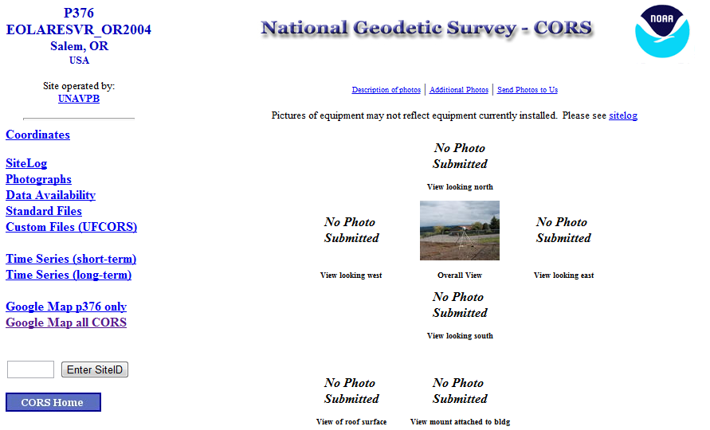
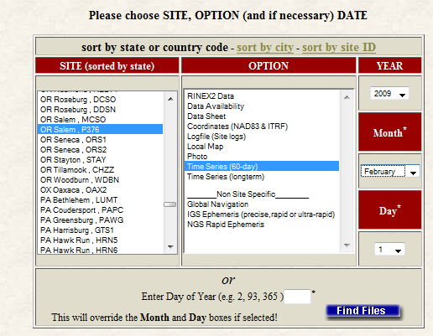
Back To Our Quick Example
The NGS monitors the CORS data daily and provides summaries of those results.
Site logs and coordinate time series for the CORS can be accessed through the CORS
Web page (http://www.ngs.noaa.gov/CORS/).
http://geodesy.noaa.gov/CORS/logfiles/

Slide 42
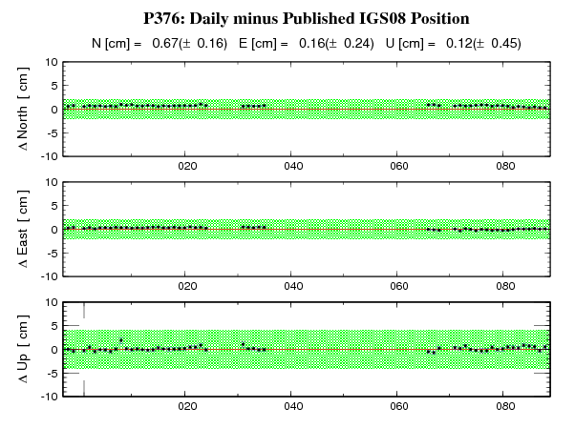
Back To Our Quick Example
This is the recent time series for P376, not from 2009-059, the epoch of our example, but this demonstrates the value of the CORS information. If we’d submitted data recently taken in this region, we might be uncomfortable with P376 because of the outages.

Slide 43
Back To Our Quick Example
This CORS and the results appear fine, but we may want to consider digging a little deeper in other circumstances.
Possible next steps in evaluating a CORS are:
Resubmit your data requesting the extended report.
Review the CORS site log.
Resubmit excluding any worrisome CORS.

Slide 44
How Does OPUS Static Work?
The primary steps of OPUS Static processing are:
Prepare and quality control the submitted data.
Estimate a crude point-position for the mark.
Compute distances to every available CORS.
Select the three “best” CORS based upon:
    Being closest to the user's mark.
    Having common satellite visibility with the user data.
    Having more than 80% of the possible data available.
    Having low multipath measures.
  Improve the point-position.
  Complete the single-baseline processing.
  Check the solution quality and replace a CORS if needed.
  Generate and email the report to the user.

Slide 45
How Does OPUS Static Work?
OPUS Static uses PAGES for data processing.
PAGES is a state-of-the-art processing engine developed by the NGS. Besides OPUS Static, PAGES is used for orbit production, reference frame definition, network monitoring and many other GPS data processing tasks.
http://geodesy.noaa.gov/GRD/GPS/DOC/toc.html
http://igscb.jpl.nasa.gov/igscb/center/analysis/noaa.acn

Slide 46
OPUS Static Modeling Highlights
Satellite coordinates from the International GNSS Service (IGS) precise ephemerides.
http://igscb.jpl.nasa.gov/components/usage.html.
CORS coordinates and hardware histories from the NGS site information data base.
Antenna phase center offsets and variations from the IGS and NGS absolute antenna model data bases.
http://geodesy.noaa.gov/ANTCAL/.
International Earth Rotation Service (IERS) 2003 solid Earth tide model.
http://www.iers.org/nn_11216/IERS/EN/Publications/TechnicalNotes/tn32.html.
Surface met from a climatological model.
Boehm et al., “Short Note: A global model of pressure and temperature for geodetic applications”,
J. Geod., 2007.

Slide 47
OPUS Static Modeling Highlights
Everything is “done” in the ITRF.
SV coordinates are held rigidly fixed.
CORS coordinates are heavily constrained.
Neutral atmosphere (tropo) dry component modeled.
Neutral atmosphere (tropo) wet component estimated.
Double-differenced, ion-free carrier phase observable.
Carrier phase ambiguities are fixed to their integer values where possible; float ambiguities are estimated otherwise.
Individual baselines are processed and the results combined generating mean coordinates and peak-to-peak uncertainties.

Slide 48
Integer Fixing
Some thoughts on phase ambiguity integer fixing.
The ambiguities, (charged and neutral) atmosphere delays and station heights strongly alias into each other.
There are really only two ways to “break” this aliasing:
Introduce more data.
Introduce additional information.

Slide 49
Integer Fixing
OPUS Static uses the former strategy.
Depending upon the circumstances, 1- to 2-hours of observations are sufficient to decorrelate the ambiguities, atmosphere and heights allowing reliable estimation of all. Thus the requirement for a minimum of 2-hours in OPUS Static.
As an aside, be aware that while simply having more data helps, it is actually the change in orientation of the satellites over the data span that forces the decorrelation.

Slide 50
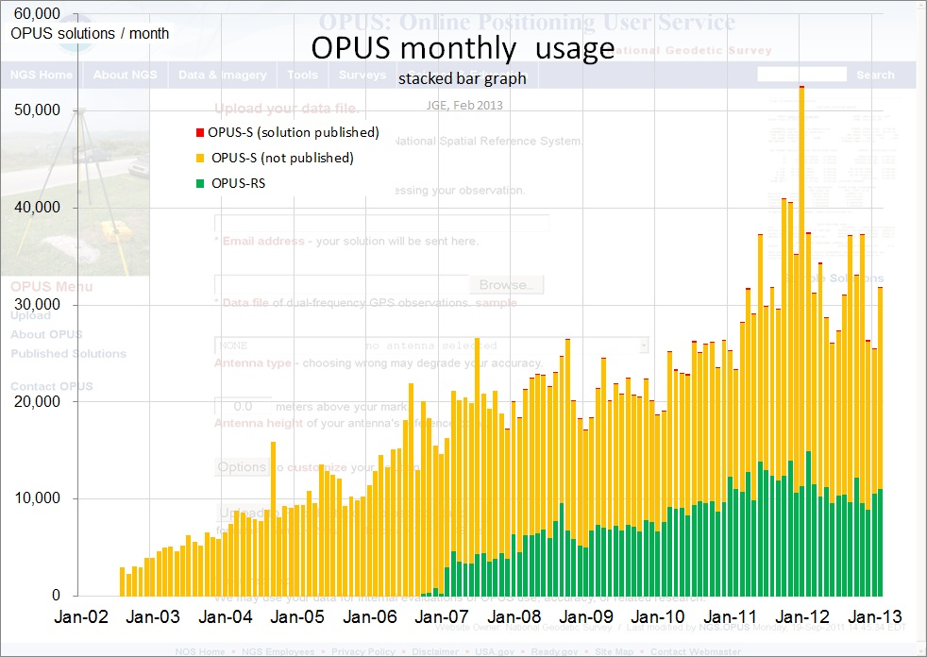
OPUS Uploads By Month
Shown here are the monthly upload counts to OPUS Static.
Submissions to OPUS Static comprise a
non-trivial percentage of all “hits” on the NGS web sites.
Valid as of April, 2013. Values before January, 2005 are approximate.

Slide 51
OPUS Rapid-Static
A Little OPUS Rapid-Static History.
The OPUS Rapid-Static Interface.
How Good Can I Do With OPUS Rapid-Static?
A Quick Example (cont.).
The Standard Report.
The Extended Report.
How Does OPUS Rapid-Static Work?
OPUS Uploads History.

Slide 52
A Little OPUS Rapid-Static History
Although successful, OPUS obviously does not satisfy the needs of all users. Discussions with the user community about future development began almost immediately after OPUS was made public.
These early discussions clearly indicated that the most desired enhancement would be the capability of producing a similar quality result from a shorter data span.

Slide 53
A Little OPUS Rapid-Static History
Work by several groups demonstrated that reliably producing results of similar quality to OPUS from shorter data spans was possible.
Collaboration between the NGS and the Satellite Positioning and Inertial Navigation (SPIN) group at The Ohio State University enabled Schwarz (DST) to implement a new processing engine capable of generating those results.
In early 2007, OPUS Rapid-Static was made publically available after its own trial period. To better delineate uses, the original OPUS processing stream was renamed OPUS Static.

Slide 54
The OPUS Rapid-Static Interface
With OPUS Rapid-Static, the beautiful simplicity remains. In fact the entry form is the same as for OPUS Static. The user provides:
Their email address.
An antenna type.
The vertical offset to the ARP.
15-minutes to 2-hours of GPS L1 + L2 data.
The user receives:
Coordinates accurate to a few centimeters.

Slide 55
The OPUS Rapid-Static Interface
The same interface is used except one clicks the “Upload to RAPID-STATIC” button instead.
http://geodesy.noaa.gov/OPUS/

Slide 56
The Standard Report
USER: mark.schenewerk@noaa.gov DATE: April 01, 2013
RINEX FILE: corv059f.09o TIME: 18:39:20 UTC
SOFTWARE: rsgps 1.37 RS74.prl 1.87 START: 2009/02/28 05:00:00
EPHEMERIS: igs15206.eph [precise] STOP: 2009/02/28 06:59:00
NAV FILE: brdc0590.09n OBS USED: 9090 / 13572 : 67%
ANT NAME: ASH700936E_C NONE QUALITY IND. 35.62/ 90.50
ARP HEIGHT: 1.521 NORMALIZED RMS: 0.289
REF FRAME: NAD_83(2011)(EPOCH:2010.0000) IGS08 (EPOCH:2009.15959)
X: -2498422.514(m) 0.008(m) -2498423.316(m) 0.008(m)
Y: -3802821.127(m) 0.012(m) -3802819.928(m) 0.012(m)
Z: 4454736.691(m) 0.010(m) 4454736.737(m) 0.010(m)
LAT: 44 35 7.91301 0.003(m) 44 35 7.92684 0.003(m)
E LON: 236 41 43.48303 0.003(m) 236 41 43.42280 0.003(m)
W LON: 123 18 16.51697 0.003(m) 123 18 16.57720 0.003(m)
EL HGT: 105.978(m) 0.017(m) 105.610(m) 0.017(m)
ORTHO HGT: 128.521(m) 0.023(m) [NAVD88 (Computed using GEOID12A)]
UTM COORDINATES STATE PLANE COORDINATES
UTM (Zone 10) SPC (3601 OR N)
Northing (Y) [meters] 4936954.983 105971.632
Easting (X) [meters] 475821.361 2277335.426
Convergence [degrees] -0.21381369 -1.98897463
Point Scale 0.99960719 0.99994603
Combined Factor 0.99959058 0.99992941
US NATIONAL GRID DESIGNATOR: 10TDQ7582136954(NAD 83)
BASE STATIONS USED
PID DESIGNATION LATITUDE LONGITUDE DISTANCE(m)
DH4503 P376 EOLARESVR_OR2004 CORS ARP N445628.315 W1230608.099 42648.2
DG5352 STAY STAYTON COOP CORS ARP N444950.532 W1224915.034 47031.0
DE6258 MCSO MARION CNTY COOP CORS ARP N445825.703 W1225720.637 51226.8
DE6433 WDBN WOODBURN COOP CORS ARP N451015.096 W1225212.130 73553.4
DG9893 NWBG ADEPAZ COOP CORS ARP N451800.172 W1225831.850 83544.6
DI0946 LFLO FLORENCE COOP CORS ARP N435900.967 W1240627.690 92644.0
Shown here is part of the OPUS Rapid-Static standard report for the same CORV data discussed earlier.
Given the number of significant figures and uncertainties, this result is identical to the OPUS Static result.

Slide 57
The Standard Report
USER: mark.schenewerk@noaa.gov DATE: April 01, 2013
RINEX FILE: corv059f.09o TIME: 18:39:20 UTC
SOFTWARE: rsgps 1.37 RS74.prl 1.87 START: 2009/02/28 05:00:00
EPHEMERIS: igs15206.eph [precise] STOP: 2009/02/28 06:59:00
NAV FILE: brdc0590.09n OBS USED: 9090 / 13572 : 67%
ANT NAME: ASH700936E_C NONE QUALITY IND. 35.62/ 90.50
ARP HEIGHT: 1.521 NORMALIZED RMS: 0.289
REF FRAME: NAD_83(2011)(EPOCH:2010.0000) IGS08 (EPOCH:2009.15959)
X: -2498422.514(m) 0.008(m) -2498423.316(m) 0.008(m)
Y: -3802821.127(m) 0.012(m) -3802819.928(m) 0.012(m)
Z: 4454736.691(m) 0.010(m) 4454736.737(m) 0.010(m)
LAT: 44 35 7.91301 0.003(m) 44 35 7.92684 0.003(m)
E LON: 236 41 43.48303 0.003(m) 236 41 43.42280 0.003(m)
W LON: 123 18 16.51697 0.003(m) 123 18 16.57720 0.003(m)
EL HGT: 105.978(m) 0.017(m) 105.610(m) 0.017(m)
ORTHO HGT: 128.521(m) 0.023(m) [NAVD88 (Computed using GEOID12A)]
UTM COORDINATES STATE PLANE COORDINATES
UTM (Zone 10) SPC (3601 OR N)
Northing (Y) [meters] 4936954.983 105971.632
Easting (X) [meters] 475821.361 2277335.426
Convergence [degrees] -0.21381369 -1.98897463
Point Scale 0.99960719 0.99994603
Combined Factor 0.99959058 0.99992941
US NATIONAL GRID DESIGNATOR: 10TDQ7582136954(NAD 83)
BASE STATIONS USED
PID DESIGNATION LATITUDE LONGITUDE DISTANCE(m)
DH4503 P376 EOLARESVR_OR2004 CORS ARP N445628.315 W1230608.099 42648.2
DG5352 STAY STAYTON COOP CORS ARP N444950.532 W1224915.034 47031.0
DE6258 MCSO MARION CNTY COOP CORS ARP N445825.703 W1225720.637 51226.8
DE6433 WDBN WOODBURN COOP CORS ARP N451015.096 W1225212.130 73553.4
DG9893 NWBG ADEPAZ COOP CORS ARP N451800.172 W1225831.850 83544.6
DI0946 LFLO FLORENCE COOP CORS ARP N435900.967 W1240627.690 92644.0
⁞
The solution quality measures are slightly different.
OBS USED > 50%
QUALITY IND. > 3
NORM. RMS ≈ 1
For the Obs Used:
bigger is better.
For the Quality Ind.: bigger is better.
The Normalized RMS should be about 1.
OBS USED: 9090 / 13572 : 67%
QUALITY IND. 35.62/ 60.50
NORMALIZED RMS: 0.289

Slide 58
The Standard Report
USER: mark.schenewerk@noaa.gov DATE: April 01, 2013
RINEX FILE: corv059f.09o TIME: 18:39:20 UTC
SOFTWARE: rsgps 1.37 RS74.prl 1.87 START: 2009/02/28 05:00:00
EPHEMERIS: igs15206.eph [precise] STOP: 2009/02/28 06:59:00
NAV FILE: brdc0590.09n OBS USED: 9090 / 13572 : 67%
ANT NAME: ASH700936E_C NONE QUALITY IND. 35.62/ 90.50
ARP HEIGHT: 1.521 NORMALIZED RMS: 0.289
REF FRAME: NAD_83(2011)(EPOCH:2010.0000) IGS08 (EPOCH:2009.15959)
X: -2498422.514(m) 0.008(m) -2498423.316(m) 0.008(m)
Y: -3802821.127(m) 0.012(m) -3802819.928(m) 0.012(m)
Z: 4454736.691(m) 0.010(m) 4454736.737(m) 0.010(m)
LAT: 44 35 7.91301 0.003(m) 44 35 7.92684 0.003(m)
E LON: 236 41 43.48303 0.003(m) 236 41 43.42280 0.003(m)
W LON: 123 18 16.51697 0.003(m) 123 18 16.57720 0.003(m)
EL HGT: 105.978(m) 0.017(m) 105.610(m) 0.017(m)
ORTHO HGT: 128.521(m) 0.023(m) [NAVD88 (Computed using GEOID12A)]
UTM COORDINATES STATE PLANE COORDINATES
UTM (Zone 10) SPC (3601 OR N)
Northing (Y) [meters] 4936954.983 105971.632
Easting (X) [meters] 475821.361 2277335.426
Convergence [degrees] -0.21381369 -1.98897463
Point Scale 0.99960719 0.99994603
Combined Factor 0.99959058 0.99992941
US NATIONAL GRID DESIGNATOR: 10TDQ7582136954(NAD 83)
BASE STATIONS USED
PID DESIGNATION LATITUDE LONGITUDE DISTANCE(m)
DH4503 P376 EOLARESVR_OR2004 CORS ARP N445628.315 W1230608.099 42648.2
DG5352 STAY STAYTON COOP CORS ARP N444950.532 W1224915.034 47031.0
DE6258 MCSO MARION CNTY COOP CORS ARP N445825.703 W1225720.637 51226.8
DE6433 WDBN WOODBURN COOP CORS ARP N451015.096 W1225212.130 73553.4
DG9893 NWBG ADEPAZ COOP CORS ARP N451800.172 W1225831.850 83544.6
DI0946 LFLO FLORENCE COOP CORS ARP N435900.967 W1240627.690 92644.0
⁞
You might be thinking, “Hey! He just said the Normalized RMS should be about 1 but I see 0.3.”
This is okay.
Look for “order of magnitude” differences. Start to worry if you see a Normalized RMS
less than 0.1 or greater than 2 or 3.
OBS USED: 9090 / 13572 : 67%
QUALITY IND. 35.62/ 60.50
NORMALIZED RMS: 0.289

Slide 59
The Standard Report
USER: mark.schenewerk@noaa.gov DATE: April 01, 2013
RINEX FILE: corv059f.09o TIME: 18:39:20 UTC
SOFTWARE: rsgps 1.37 RS74.prl 1.87 START: 2009/02/28 05:00:00
EPHEMERIS: igs15206.eph [precise] STOP: 2009/02/28 06:59:00
NAV FILE: brdc0590.09n OBS USED: 9090 / 13572 : 67%
ANT NAME: ASH700936E_C NONE QUALITY IND. 35.62/ 90.50
ARP HEIGHT: 1.521 NORMALIZED RMS: 0.289
REF FRAME: NAD_83(2011)(EPOCH:2010.0000) IGS08 (EPOCH:2009.15959)
X: -2498422.514(m) 0.008(m) -2498423.316(m) 0.008(m)
Y: -3802821.127(m) 0.012(m) -3802819.928(m) 0.012(m)
Z: 4454736.691(m) 0.010(m) 4454736.737(m) 0.010(m)
LAT: 44 35 7.91301 0.003(m) 44 35 7.92684 0.003(m)
E LON: 236 41 43.48303 0.003(m) 236 41 43.42280 0.003(m)
W LON: 123 18 16.51697 0.003(m) 123 18 16.57720 0.003(m)
EL HGT: 105.978(m) 0.017(m) 105.610(m) 0.017(m)
ORTHO HGT: 128.521(m) 0.023(m) [NAVD88 (Computed using GEOID12A)]
UTM COORDINATES STATE PLANE COORDINATES
UTM (Zone 10) SPC (3601 OR N)
Northing (Y) [meters] 4936954.983 105971.632
Easting (X) [meters] 475821.361 2277335.426
Convergence [degrees] -0.21381369 -1.98897463
Point Scale 0.99960719 0.99994603
Combined Factor 0.99959058 0.99992941
US NATIONAL GRID DESIGNATOR: 10TDQ7582136954(NAD 83)
BASE STATIONS USED
PID DESIGNATION LATITUDE LONGITUDE DISTANCE(m)
DH4503 P376 EOLARESVR_OR2004 CORS ARP N445628.315 W1230608.099 42648.2
DG5352 STAY STAYTON COOP CORS ARP N444950.532 W1224915.034 47031.0
DE6258 MCSO MARION CNTY COOP CORS ARP N445825.703 W1225720.637 51226.8
DE6433 WDBN WOODBURN COOP CORS ARP N451015.096 W1225212.130 73553.4
DG9893 NWBG ADEPAZ COOP CORS ARP N451800.172 W1225831.850 83544.6
DI0946 LFLO FLORENCE COOP CORS ARP N435900.967 W1240627.690 92644.0
⁞
For the coordinate uncertainties:
Uncertainties < 5 cm
and smaller is better.
Note that the uncertainties are 1σ standard deviations
from the solution, not
the peak-to-peak values from individual baseline solutions as is reported by OPUS Static.
0.008(m)
0.012(m)
0.010(m)

Slide 60

The Standard Report
USER: mark.schenewerk@noaa.gov DATE: April 01, 2013
RINEX FILE: corv059f.09o TIME: 18:39:20 UTC
SOFTWARE: rsgps 1.37 RS74.prl 1.87 START: 2009/02/28 05:00:00
EPHEMERIS: igs15206.eph [precise] STOP: 2009/02/28 06:59:00
NAV FILE: brdc0590.09n OBS USED: 9090 / 13572 : 67%
ANT NAME: ASH700936E_C NONE QUALITY IND. 35.62/ 90.50
ARP HEIGHT: 1.521 NORMALIZED RMS: 0.289
REF FRAME: NAD_83(2011)(EPOCH:2010.0000) IGS08 (EPOCH:2009.15959)
X: -2498422.514(m) 0.008(m) -2498423.316(m) 0.008(m)
Y: -3802821.127(m) 0.012(m) -3802819.928(m) 0.012(m)
Z: 4454736.691(m) 0.010(m) 4454736.737(m) 0.010(m)
LAT: 44 35 7.91301 0.003(m) 44 35 7.92684 0.003(m)
E LON: 236 41 43.48303 0.003(m) 236 41 43.42280 0.003(m)
W LON: 123 18 16.51697 0.003(m) 123 18 16.57720 0.003(m)
EL HGT: 105.978(m) 0.017(m) 105.610(m) 0.017(m)
ORTHO HGT: 128.521(m) 0.023(m) [NAVD88 (Computed using GEOID12A)]
UTM COORDINATES STATE PLANE COORDINATES
UTM (Zone 10) SPC (3601 OR N)
Northing (Y) [meters] 4936954.983 105971.632
Easting (X) [meters] 475821.361 2277335.426
Convergence [degrees] -0.21381369 -1.98897463
Point Scale 0.99960719 0.99994603
Combined Factor 0.99959058 0.99992941
US NATIONAL GRID DESIGNATOR: 10TDQ7582136954(NAD 83)
BASE STATIONS USED
PID DESIGNATION LATITUDE LONGITUDE DISTANCE(m)
DH4503 P376 EOLARESVR_OR2004 CORS ARP N445628.315 W1230608.099 42648.2
DG5352 STAY STAYTON COOP CORS ARP N444950.532 W1224915.034 47031.0
DE6258 MCSO MARION CNTY COOP CORS ARP N445825.703 W1225720.637 51226.8
DE6433 WDBN WOODBURN COOP CORS ARP N451015.096 W1225212.130 73553.4
DG9893 NWBG ADEPAZ COOP CORS ARP N451800.172 W1225831.850 83544.6
DI0946 LFLO FLORENCE COOP CORS ARP N435900.967 W1240627.690 92644.0
⁞
Although the quality indices and uncertainties exceed the recommendations, the percentage of Obs Used causes me to give this solution a . It’s okay, but I’d prefer a higher percentage used.

Slide 61
The Extended Report
Of necessity, the OPUS Rapid-Static extended report is larger than the corresponding OPUS Static solution. Too large to be conveniently shown here. But while seemingly intimidating, the OPUS Rapid-Static extended report sections are basically the same as those in the OPUS Static extended report.
Some additional sections include:
A covariance matrix for the reference-station-only solution.
A correlation as well as a covariance matrix.
Various Dilutions Of Precision (DOPs).

Slide 62
How Good Can I Do With OPUS Rapid-Static?
Typical estimated and empirical accuracies from OPUS Rapid-Static within the continental U.S. are comparable to OPUS Static.
Although OPUS Rapid-Static can produce quality results from more challenging “short” data sets, it is slightly more restrictive in the data sets allowed. Because of these restrictions, the NGS created the “OPUS Rapid-Static Accuracy and Availability” tool (Choi, NGS).
Always remember, the estimated accuracies suggested by this tool are just that - estimates. Confirming the quality of the OPUS solution remains your responsibility.

Slide 63
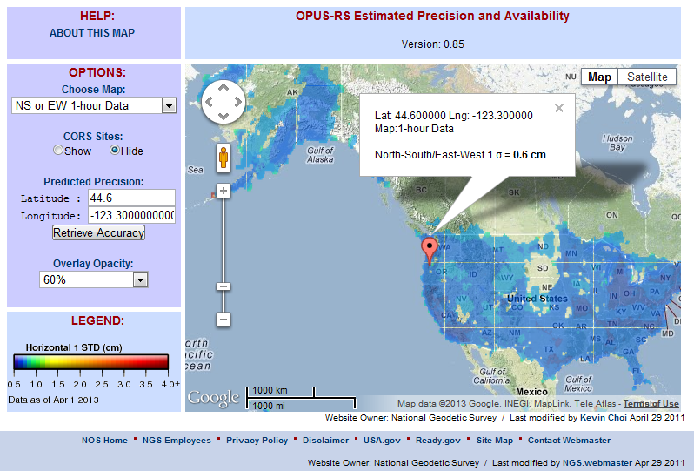
The OPUS Rapid-Static Accuracy and Availability Tool
http://geodesy.noaa.gov/OPUSI/Plots/Gmap/OPUSRS_sigmap.shtml

Slide 64
The OPUS Rapid-Static Accuracy and Availability Tool
1 σ for each 0.2 degree grid.
Horizontal and vertical standard
errors for 15 minutes and
1-hour length data.
Inverse Distance Weighting
method to interpolate the sigmas.
Areas outside the color overlay
are where there are less than
three active CORS sites within
250 km range. OPUS Rapid-Static
will usually fail at these locations.
Automated Weekly updates to account for the availability of CORS.
Global coverage including non-US territories.

Slide 65
How Does OPUS Rapid-Static Work?
OPUS Rapid-Static uses the RSGPS program which was developed specifically for this purpose.
Like OPUS Static, OPUS Rapid-Static uses state-of-the-art models, but the strategy to fix phase ambiguities to their integer values differs. To fix integers, OPUS Rapid-Static introduces more information:
Pseudorange and carrier phase.
More reference stations if possible.

Slide 66
How Does OPUS Rapid-Static Work?
OPUS Rapid-Static selects three to nine “best” CORS based upon:
    Having common satellite visibility with the user data.
    Having distances <250 km from the user's mark.
    Orientation relative to the user's mark.
This is shown here graphically.
The star represents the user’s
mark; the triangles are CORS.
No CORS farther than 250 km
from the user's mark will be
included. A minimum of three, and
no more than nine CORS are used.
s
>250km
250km
Choi, 2010, personal communication.

Slide 67
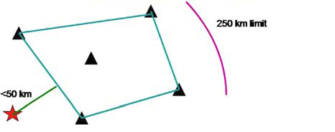
How Does OPUS Rapid-Static Work?
In addition, user's mark must be no more than 50 km from the (convex) polygon created by the selected CORS.
In this example, five CORS and their resulting polygon are shown. If the user’s mark is more than 50 km outside this
polygon, alternate CORS will be considered. If none can be found, the processing will abort.
Schwarz et al., “Accuracy assessment of the National Geodetic Survey's OPUS Rapid-Static utility”, 2009, GPS Solutions, 13(2), 119-132.

Slide 68
How Does OPUS Rapid-Static Work?
OPUS Rapid-Static uses no less than 1-hour of CORS data and no more than the submitted data’s span plus 15-minutes before and after.
A solution using only CORS data is completed to estimate the atmospheric delays at each CORS and predict them at the user's mark. This is the reason for limiting results to marks near or inside the convex polygon: interpolation (inside the polygon) is much more reliable than extrapolation (outside the polygon). The first Quality Ind. characterizes this solution.
Schwarz et al., “Accuracy assessment of the National Geodetic Survey's OPUS Rapid-Static utility”, 2009, GPS Solutions, 13(2), 119-132.

Slide 69
How Does OPUS Rapid-Static Work?
OPUS Rapid-Static then processes each baseline to the user's mark individually to produce an improved a priori position.
With an improved position and good atmospheric corrections, reliable integer-fixing can be done.
Switching modes, the previously determined values and all data are used in an “integer-fixed” solution for the user's mark. The second Quality Ind. characterizes this solution.
Schwarz et al., “Accuracy assessment of the National Geodetic Survey's OPUS Rapid-Static utility”, 2009, GPS Solutions, 13(2), 119-132.

Slide 70
OPUS Uploads By Month
Although there is considerable variation, the OPUS Static and Rapid-Static upload rates appear to have leveled off at about 17,000 and 8,000 per month.
Valid as of 2010-03-30.

Slide 71
OPUS Publishing
A Little OPUS Publishing History.
The OPUS Publishing Interface.
How Does OPUS Publishing Work?
OPUS Uploads By Month.

Slide 72
A Little OPUS Publishing History
With the release of OPUS Rapid-Static, the comments about OPUS began to focus on a new issue. Users wanted an equally simple way to share their OPUS results with the community.

Slide 73
A Little OPUS Publishing History
Historically, when in collaboration with or publishing through the NGS, one submitted results to the Integrated Data Base (IDB) and, in this manner, contributed to the NSRS.
Before submitted results could be entered into the IDB, the submissions had to meet a well-defined set of requirements and quality controls.
Reconciling the “open” submission philosophy represented by OPUS with the “controlled” philosophy represented by IDB is a tremendous challenge.

Slide 74
A Little OPUS Publishing History
A significant step in reconciliation came in 2009 with the release of OPUS Publishing.
OPUS Publishing allows users to publish their OPUS result in an online data base if minimum requirements for quality are met and the necessary associated meta-data, such as photos and descriptions, are provided.

Slide 75
A Little OPUS Publishing History
For now, OPUS Publishing and the IDB exist as two separate tools. As the NGS more fully understands the characteristics of OPUS Publishing, the OPUS data base and the IDB will be reconciled. In fact, such discussions have already begun.
In the meantime, always be aware that a submission to OPUS Publishing may be eligible for, but is not guaranteed to be included in the IDB.

Slide 76
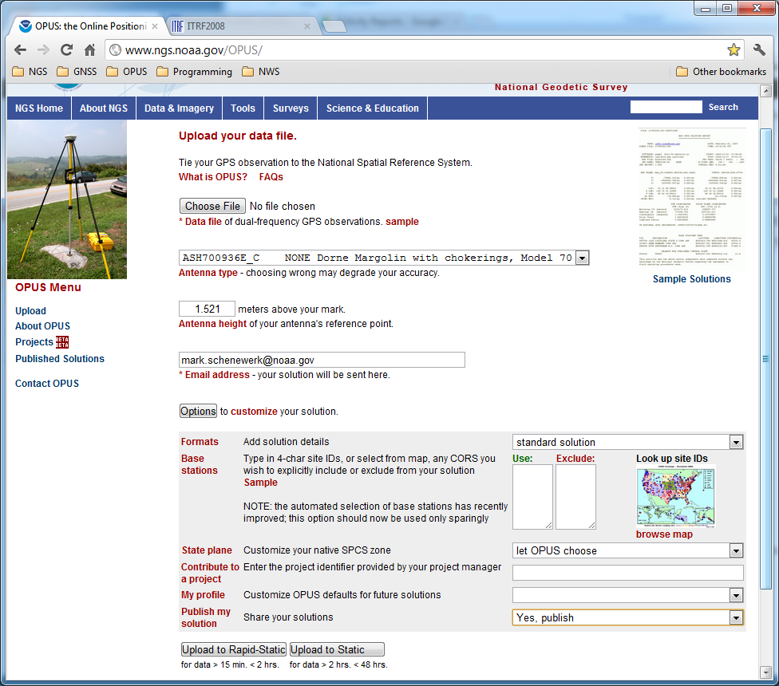
OPUS Publishing Interface
The first step in OPUS Publishing is to upload suitable data to OPUS. At that time, you must explicitly designate that your results should be published. This is done through the Options. The “Publish my solution” option is near the bottom of the Options list.

Slide 77
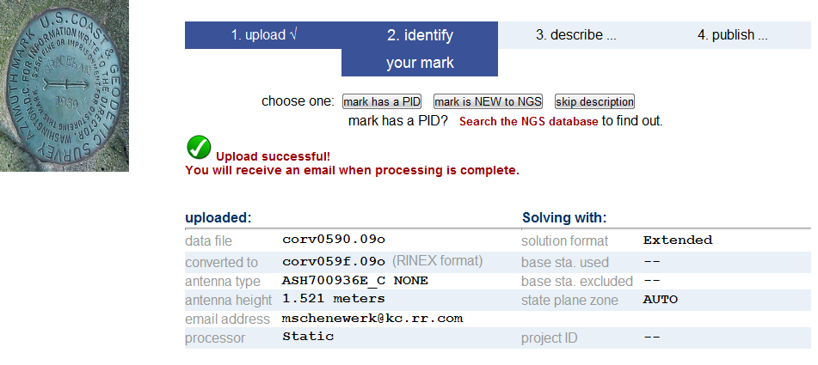
OPUS Publishing Interface
Once the upload is complete, an extended upload confirmation page is displayed. Here, the user specifies that the mark “has a PID” (recovered) or is new to the NGS.

Slide 78
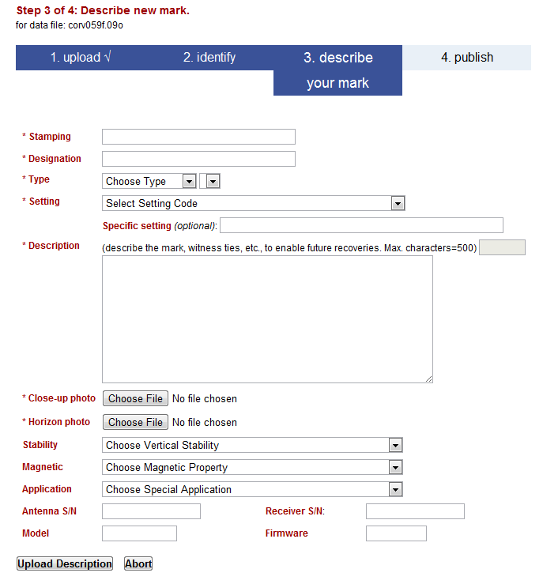
OPUS Publishing Interface
After choosing whether this is a new or recovered mark, an appropriate form for entering the meta-data appears.
In this example, we’re following the steps for a new mark.

Slide 79
OPUS Publishing Interface
The stamping, designation and type of mark are required, as are a description of how to find the mark again and photos.
Other characteristics like the estimated stability are optional, but worth recording.

Slide 80
OPUS Publishing Interface
Many of you will recognize these fields as a subset of the information required to “bluebook” a mark, but this is not blue booking per se because the process is streamlined.
This is possible, in part, because some information is provided by the data processing itself.

Slide 81
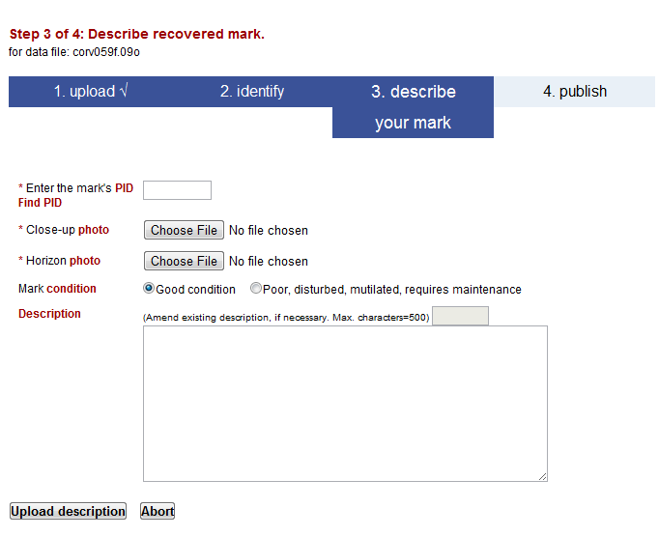
OPUS Publishing Interface
Recovering a mark is simpler:
the PID and photos clearly showing the mark and its condition are required.
specification of the mark’s good condition and descriptive updates are optional.

Slide 82
OPUS Publishing Interface
As a last step, the users receive an email given them a chance to review the submission. This is in the form of a link to a mock-up of the datasheet for their submission.
If the meta-data is complete, the quality control restrictions are met and the user gives the “OK”, the submission is entered into the data base after review by NGS.

Slide 83
OPUS Publishing Interface
To publish or not to publish?
The NGS wants you to publish and the intent of publishing through OPUS is to make this task as easy as possible. The requirements are minimal:
4 or more hours of data.
A quality, “GPS-able” mark.
Good field practices.
Good data.
Good description.
http://geodesy.noaa.gov/OPUS/about.jsp#publishing
Give it a try. There is an option to abort publishing at each step. You’ll receive your solution regardless of whether you choose to publish or not.

Slide 84
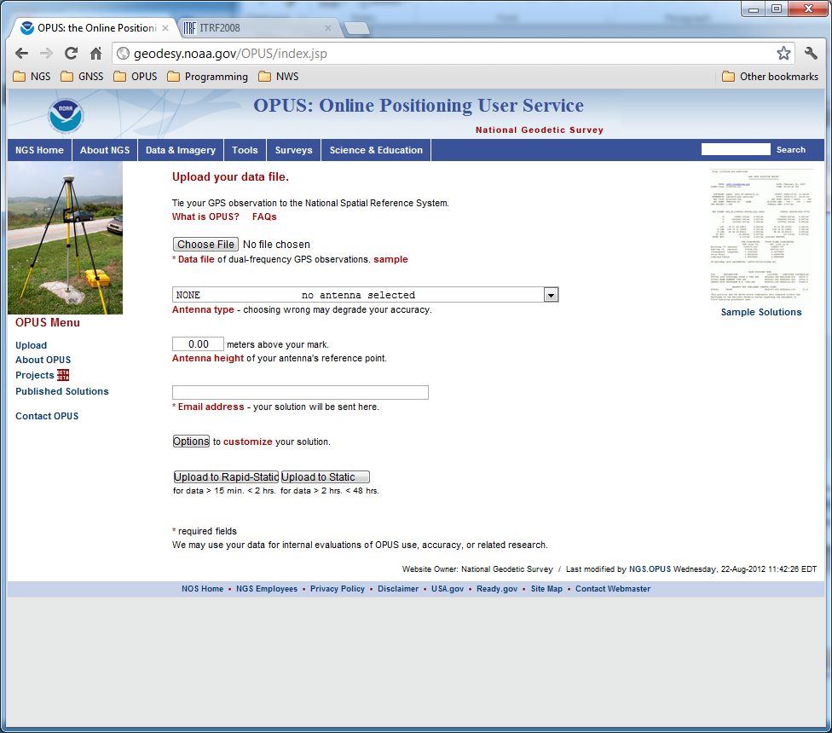
Viewing Published Solutions
To a view published solution, use the Published Solutions link in the menu on the left of the OPUS upload page.

Slide 85
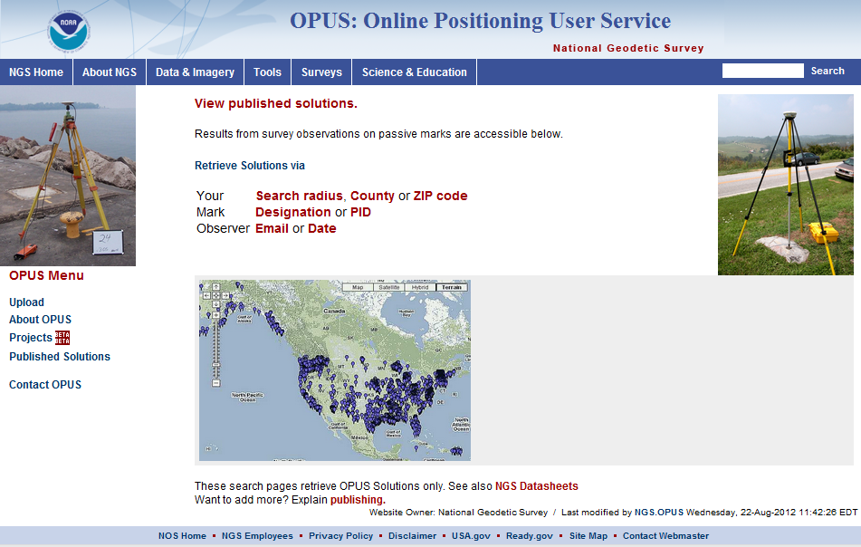
Viewing Published Solutions
You’ll immediately be taken to the form to retrieve the desired solution. Note that you can search for a solution by location, mark designation or by information about the person or group that published the solution. Alternately, the map icon reveals an interactive map from which you can select a mark.
http://geodesy.noaa.gov/OPUS/view.jsp

Slide 86
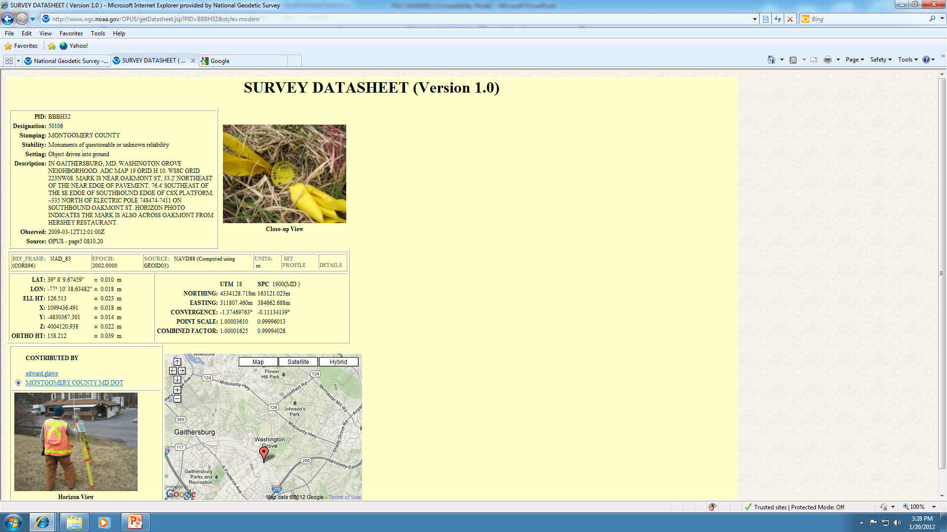
Viewing Published Solutions
Here’s a randomly selected datasheet published through OPUS.

Slide 87
Viewing Published Solutions
At the top is the mark description and close-up photograph.

Slide 88
Viewing Published Solutions
In the middle are the coordinates from the solution.

Slide 89
Viewing Published Solutions
At the bottom are another photograph giving a impression of the mark’s surroundings and a map showing the mark’s approximate location.

Slide 90
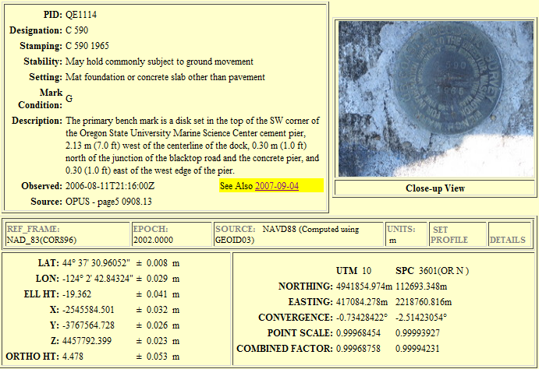
Viewing Published Solutions
Here’s another example.
Notice the “See Also” highlight. This provides access to other data base and IDB entries for this mark.

Slide 91
How Does OPUS Publishing Work?
OPUS Publishing is a data base in the sense that we think of electronic, software-driven data bases today.
This implies that entries in the data base can be sorted and sampled by any of the individual data elements provided with each submission.
As you’ve seen, users can search the data base by PID, descriptor or location, county or zip code.

Slide 92
How Does OPUS Publishing Work?
The OPUS Publishing has started as a simplification of the process for publishing to the IDB. In turn, the datasheets look like the traditional datasheets.
But OPUS Publishing remains something of a “blank sheet”. Given a fully functional data base with graphical user interface, it’s not clear how publishing through OPUS will evolve.
There are links on each page giving you a chance to offer your thoughts. Please take advantage of these.

Slide 93
OPUS Uploads By Month
Publishing through OPUS has shown steady growth in both the number of users and published marks. But it is still a tiny fraction of all OPUS uploads.

Slide 94
New Developments for OPUS
Lots of things were recently added or are in the works for OPUS. Here is a sample.
ITRF2008 and IGS08.
NAD 83(2011) and GEOID12A.
OPUS-Net.
OPUS-Projects.

Slide 95
ITRF2008 and IGS08

Slide 96
ITRF2008
For the geodesy, geophysics and surveying communities, the International Terrestrial Reference System is the “gold standard.” It includes guidelines, physical constants, standard models, and celestial and terrestrial reference frames defined and used by all space geodesy techniques.
The most concrete expression of this system is the terrestrial reference frame: the coordinates and velocities of a set of marks at a specific epoch.
This system is designed to evolve with the technology and included networks. In 2011, the global community adopted an updated system and terrestrial reference frame: the ITRF2008.
http://www.iers.org

Slide 97
Densification
Other organizations can take that information, add additional marks, perform their own adjustment and align their results to the ITRF2008. This is known as densification.
The CORS network’s coordinates and velocities are an example of densification.
These variants are as consistent with the ITRF2008 as possible, but in the most formal sense, they are unique from the ITRF2008.

Slide 98
The IGS08
The IGS contributes a “core” network of GNSS tracking sites to the International Terrestrial Reference System and Frame.
In turn, the IGS produces a densified reference frame with a superset of GNSS tracking sites thereby creating a GNSS-only expression of the ITRF2008 called the IGS08.
All IGS products were updated to be consistent with the IGS08 and, therefore, consistent are with the ITRF2008. Information about the IGS08 can be found at the IGS web sites: igscb.jpl.nasa.gov. I would suggest starting with IGSMAIL‐6354, ‐6355 and ‐6356, all dated 2011‐03‐07.
http://igscb.jpl.nasa.gov/

Slide 99
The IGb08
Some of you may have noticed that the IGS ephemerides list the IGb08 as the reference frame used rather than the IGS08.
The IGS occasionally updates its densified reference frame if needed (for example, earthquakes and other natural events can affect entire regions and the tracking sites therein). These updates also offer the opportunity to incorporate new tracking sites.
The update is still consistent with the current ITRF, but it is distinct from the original version. Thus, it is given a new designation. The IGb08 is the second variant of the IGS08.

Slide 100
NAD 83(2011) and GEOID12A

Slide 101
NAD 83 (2011)
As mentioned earlier, the NGS used its contribution to the IGS08 plus the CORS to produce improved IGS08 coordinates and velocities for the CORS network. From this, improved CORS coordinates and velocities in the NAD 83 frame were defined at epoch 2010.0. To distinguish this from earlier realizations, it is called the NAD 83 (2011).
This is not a new datum: the origin, scale and orientation are the same as in the previous realization of the NAD 83.
In September 2011, NGS formally released IGS08 and NAD 83 (2011) coordinates and velocities for the CORS. Information about the IGS08 and NAD 83 (2011) can be found at http://geodesy.noaa.gov/CORS/coords.shtml.

Slide 102
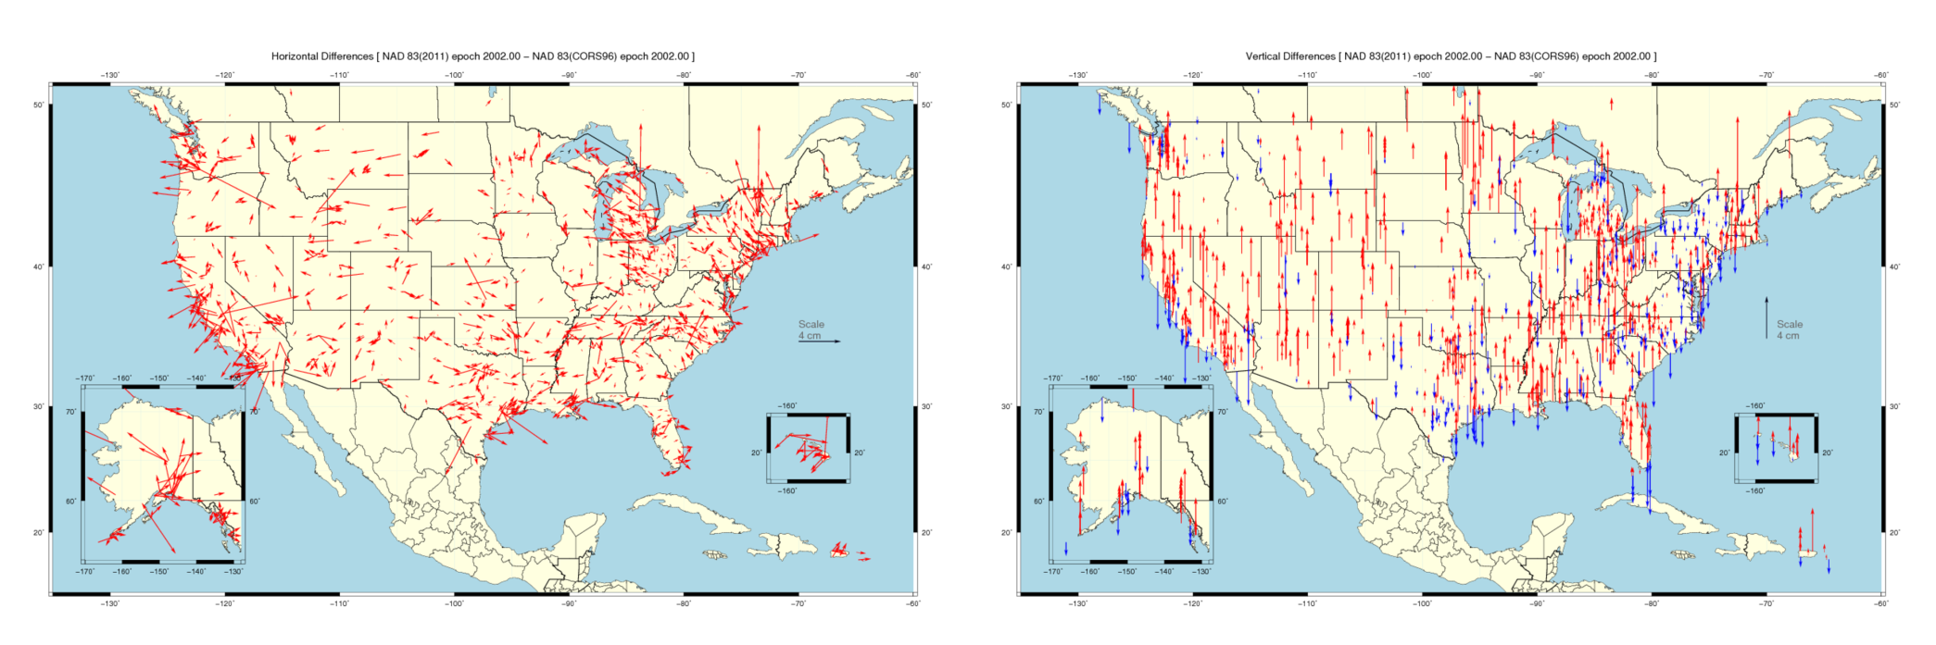
Horizontal Differences In CORS Positions
Horizontal difference in positions of NAD 83(2011) epoch 2002.00 minus NAD 83(CORS96) epoch 2002.00.
2013 LSPS Shreveport, LA
102

Slide 103
Vertical Differences In CORS Positions
Vertical difference in positions of NAD 83(2011) epoch 2002.00 minus NAD 83(CORS96) epoch 2002.00.
2013 LSPS Shreveport, LA
103

Slide 104
NAD 83 (2011) And OPUS
The OPUS also began offering results in the IGS08 and NAD 83(2011) reference frames in September 2011.
The CORS coordinates, antenna models and ephemerides used by OPUS are improved; therefore, OPUS results are improved.
So, although the NAD 83 (2011) is not a new datum, there are cases which behoove you to reprocess older results through OPUS to gain the advantages of the new reference system.
Similarly, if you process data outside of OPUS, there are cases for which you should consider reprocessing for the same reasons.

Slide 105
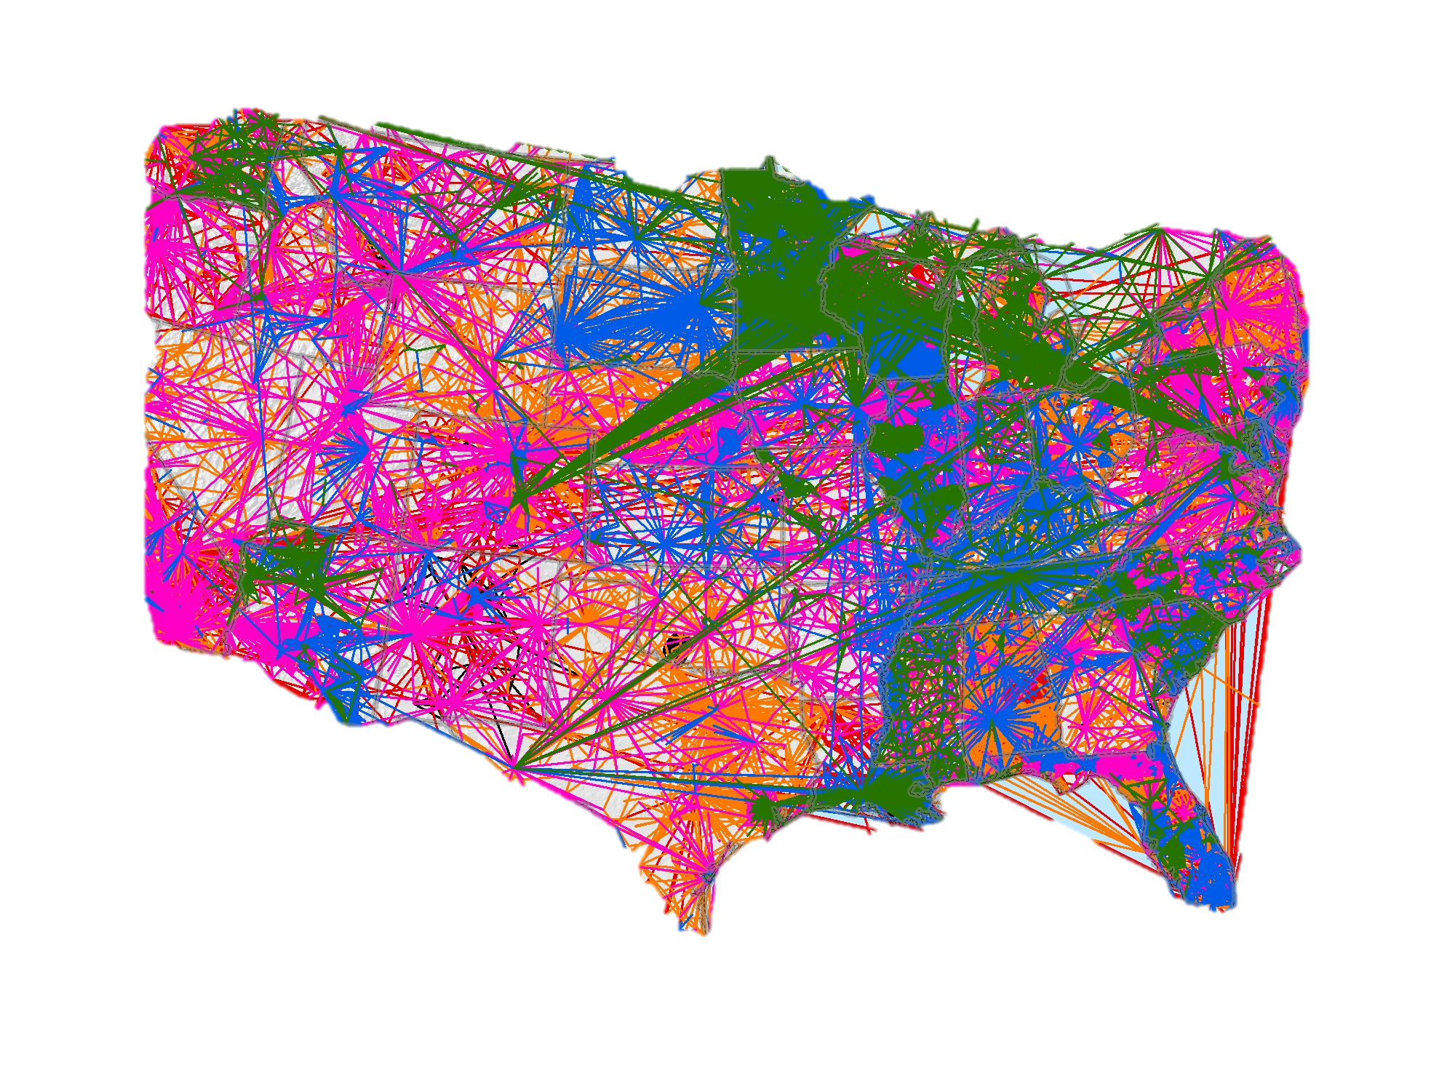
NAD 83 (2011) And
Passive Control Marks
In addition, approximately 80,000 passive control marks were readjusted to provide the best possible consistency with the improved CORS coordinates and velocities.
Known as the National Adjustment of 2011 (NA2011), these results were released in June 2012 and are now available through the datasheets.
For more information, visit
geodesy.noaa.gov/web/news/NA2011_Project.shtml
geodesy.noaa.gov/web/surveys/NA2011/NA2011_FAQ.shtml

Slide 106
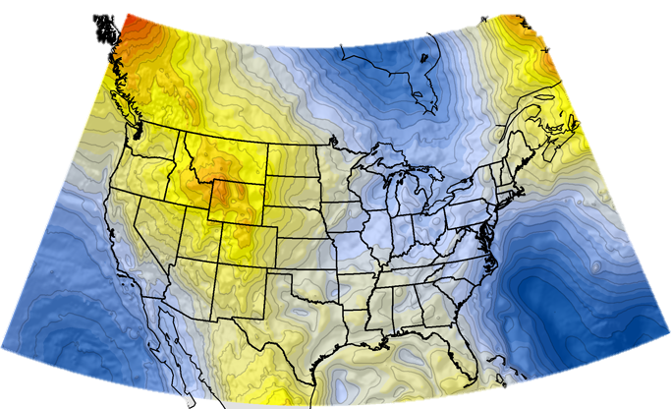
GEOID12A And OPUS
A few months after the release of the NA2011, the associated hybrid geoid model, GEOID12A, was released. This model is applicable in the Conterminous U.S., Alaska, Hawaii, and U.S. territories and protectorates.
OPUS began reporting orthometric heights using the GEOID12A almost immediately.
For more information, visit http://geodesy.noaa.gov/GEOID/GEOID12A/

Slide 107
OPUS-Net

Slide 108
OPUS-Net
Weston and Ray (NGS) have found that by more fully implementing the available processing models in conjunction with changing the CORS selection criteria, at a minimum the scatter in the north and east components can be significantly reduced with no degradation in the scatter in the height produced by OPUS Static.
Moreover, the resulting coordinates agree better with other sources such as the IGS weekly combinations.
Weston and Ray, “Test of the Use of Regional Networks for OPUS Processing”, 2010, EGU General Assembly 2010, Geophysical Research Abstracts.

Slide 109
OPUS-Net
This processing strategy was implemented in an OPUS-like application, called OPUS-Net during its testing phase. It includes:
Absolute antenna models.
An ocean-tide loading (OTL) model.
A combination of near-by and more-distant CORS.
Let’s look at these individually.

Slide 110
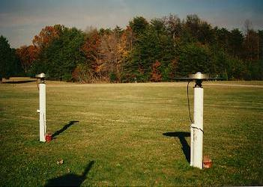
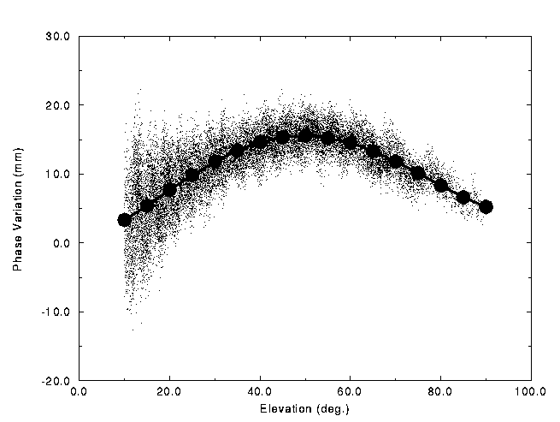
OPUS-Net
What are absolute antenna phase
correction models?
No antenna is physically or electro-
magnetically perfect.
For about two decades, some sort
of antenna correction has been
applied as part of processing.
Historically, these corrections
have been relative to a specific
antenna type.
The NGS antenna test range and a sample relative correction
pattern are shown. http://geodesy.noaa.gov/ANTCAL/

Slide 111
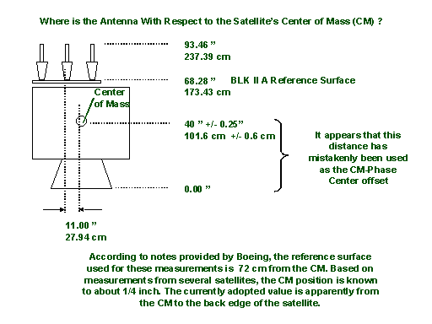
OPUS-Net
The “relative” antenna
corrections work well,
particularly if the
antennas are close
together.
But, as data processing
has improved, the
limitations of relative
antenna corrections
have become increas-
ingly evident. One example: satellite antenna corrections can not be fully applied when using a relative model.
http://geodesy.noaa.gov/ANTCAL/

Slide 112
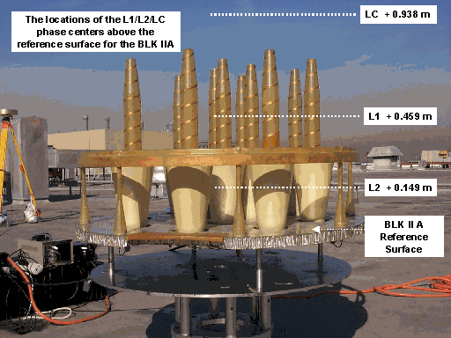
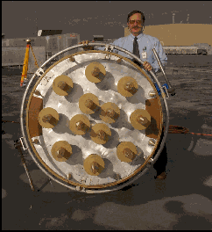
OPUS-Net
Calibrating the BLK 2A GPS antenna

Slide 113
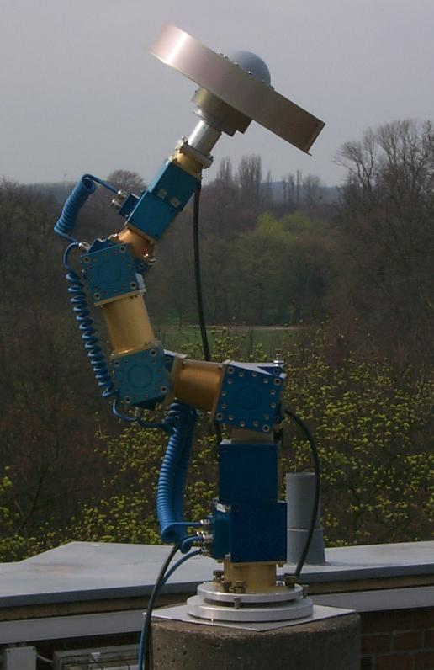
OPUS-Net
By using data from a spatially large network
with diverse equipment, and by including data
from new tools such as robotic arms which
shift the orientation of the antenna being
tested on demand, “absolute” antenna phase
patterns can be produced.
Absolute antenna corrections:
More fully implement the corrections.
Help minimize the effects of baseline lengths.
Help minimize hardware changes.
http://www.geopp.de/

Slide 114
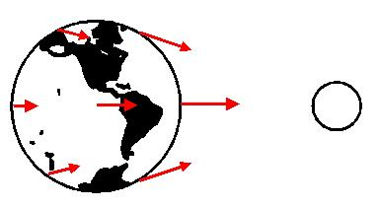
OPUS-Net
What is OTL?
Subtle differences in the gravitational force of the Moon and Sun cause the Earth to deform. Most commonly seen as ocean tides, it also affects the solid Earth and atmosphere.
Schenewerk, “Physical Models Used (and Not Used) in the PAGES Software Suite”, 2008, private communication.
2011-11-03
114

Slide 115
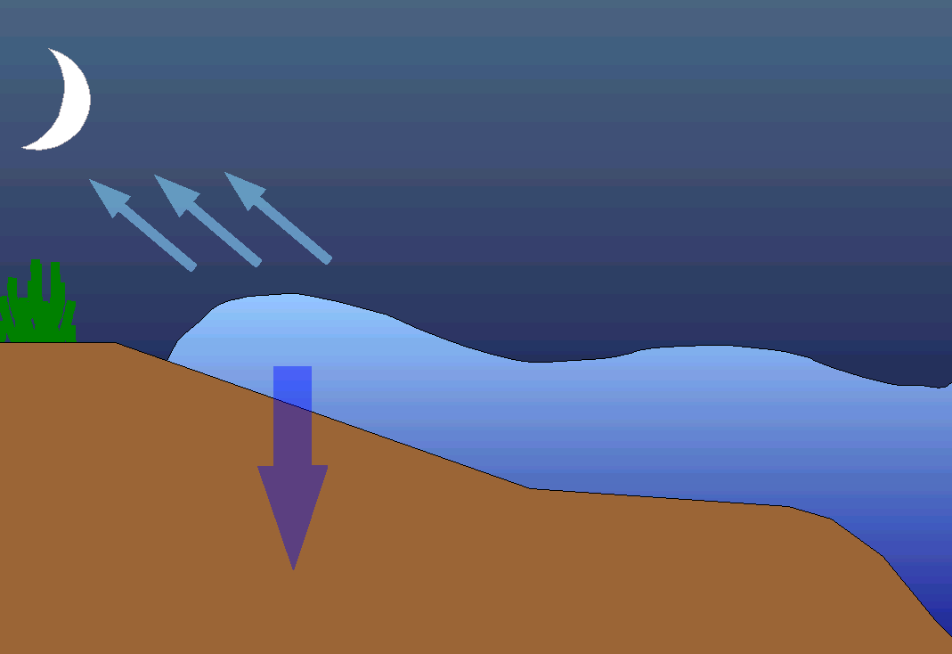
OPUS-Net
Focusing on ocean tides, as the tide swells and ebbs, the changing weight of water presses on the Earth’s crust causing it to deform with the same period as the tide.
2011-11-03
115

Slide 116
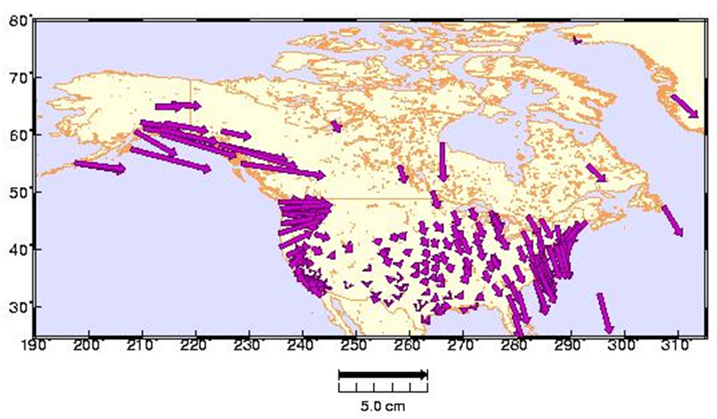
OPUS-Net
The magnitude of the deformation depends upon the shape of the coastline and topography of the ocean floor. 1 – 3 cm vertical deformation is common along the continental U.S. coasts; larger deformations on the Gulf of Alaska.
Schenewerk et al., "Vertical Ocean Loading Deformations Derived from a Global GPS Network", 2001, J. of the Geod. Soc. Of Japan, 47, 1, 237-242.
2011-11-03
116

Slide 117
OPUS-Net
Why use near-by and more-distant CORS?
Although it may seem counter-intuitive, using a combination
of near and distant CORS has a number of advantages.
CORS “quality” can be emphasized as well as data quantity.
Longer baselines enable better atmosphere corrections.
More CORS minimizes the effects of missing data and changes.

Slide 118
OPUS-Projects

Slide 119
OPUS-Projects
A Little OPUS-Projects History.
What Is OPUS-Projects?
The OPUS-Projects Interface.
How Good Can I Do With OPUS-Projects?

Slide 120
A Little OPUS-Projects History
The success of OPUS clearly demonstrated the value of web-based tools for some activities. This begged the question, could a web-based utility be made for a more complex task such as an airport or height modernization survey?
In these cases, one or more survey crews would be occupying one or more marks over several hours or days in a manner consistent with predefined project specifications.

Slide 121
A Little OPUS-Projects History
The “wish list” for such a web-based utility included:
Visualize and organize multiple, related data submissions.
Process all or subsets of the data according to user specifications.
Offer the results in useful forms and formats.
Do all this as simply as possible.

Slide 122
A Little OPUS-Projects History
But do we really need another OPUS flavor?
The practical answer is probably yes.
The NGS and other groups have a history of project’s whose specifications can’t be entirely supported by OPUS.
The academic answer is probably yes.
As good as OPUS does, and that is very good, sacrificing simplicity for flexibility can improve results - at least in some cases.

Slide 123
A Little OPUS-Projects History
In 2005, Weston and Gwinn began initial development on OPUS-Projects.
In 2006, several “proof of concept” tests were completed including one that involved hundreds of occupations spanning several weeks. Many “pros and cons” resulted, but the overall impression was positive.

Slide 124
A Little OPUS-Projects History
After a hiatus, Schenewerk began development again in 2007.
Prusky and Schenewerk oversaw a second, more focus test in 2009. Again, many “pros and cons” in the original design were revealed, but a better defined set of desirable capabilities resulted.
A beta version was released via training workshops in December, 2010.
Tentative date for a production release is July, 2013.

Slide 125
What Is OPUS-Projects?
OPUS-Projects gives users web-based access to simple visualization, management and processing tools for multiple marks and multiple occupations.
These tools include:
The advantages of data uploading through OPUS.
Data visualization and management aids.
Enhanced data processing using the PAGES suite.
Solution visualization aids.
A simplified means for producing some “bluebook” files.

Slide 126
What Is OPUS-Projects?
OPUS-Projects exists in a hierarchical structure
Create . . . . . . . . creates a project.
Upload . . . . . . . . data submission.
Session . . . . . . . session review & processing.
Manage . . . . . . . network adjustments.
OPUS-Projects czar for general support.

Slide 127
What Is OPUS-Projects?
Bluebook
Or
Publish
Your OPUS Project
OPUS Solution
Data &
Metadata
Session
Solution
OPUS Solution
Processor or Manager
Session
Solution
Manager
Network
Solution
Session
Solution
Session
Solution
OPUS Solution
Copy
To User
Copy
To User
Copy
To User

Slide 128
The OPUS-Projects Interface
It’s probably easier to show the interface than describe it, so let’s walk through some of the basic steps in creating and reviewing a project.
Please be aware …
OPUS-Projects is actively being developed. The information shown here reflects many, but not all of the recent and pending changes.

Slide 129
The OPUS upload page is the access point for all things OPUS.
Notes:
The OPUS gateway page is found at http://geodesy.noaa.gov/OPUS/.

Slide 130
Note the “Projects” link on the left. This will take you to the OPUS-Projects gateway page.

Slide 131
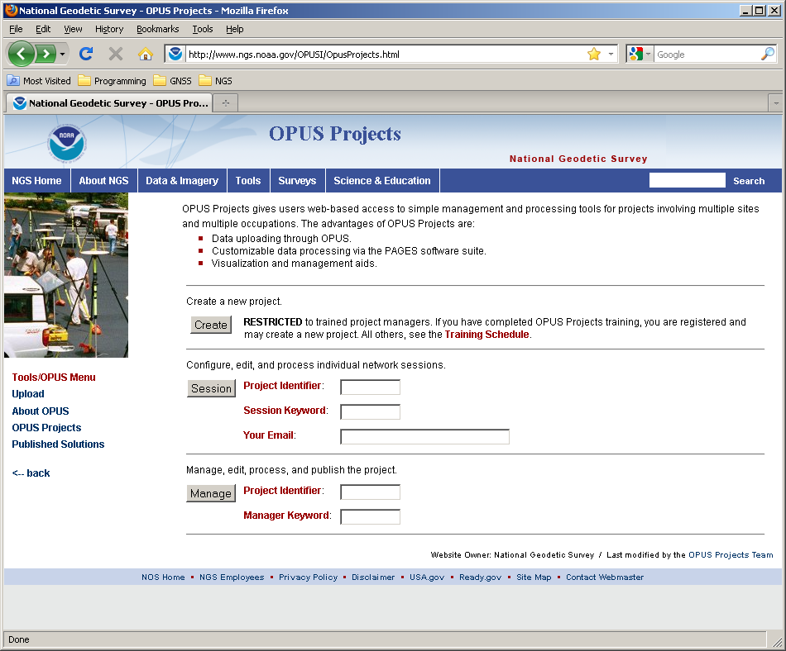
This is the OPUS-Projects gateway page.
Notes:
Informally, one can access the OPUS-Projects gateway page directly at http://geodesy.noaa.gov/OPUSI/OpusProjects.html

Slide 132
The first step is to create a project. This allocates online storage for the project’s data and generates project keywords. Start by clicking the “Create” button.

Slide 133
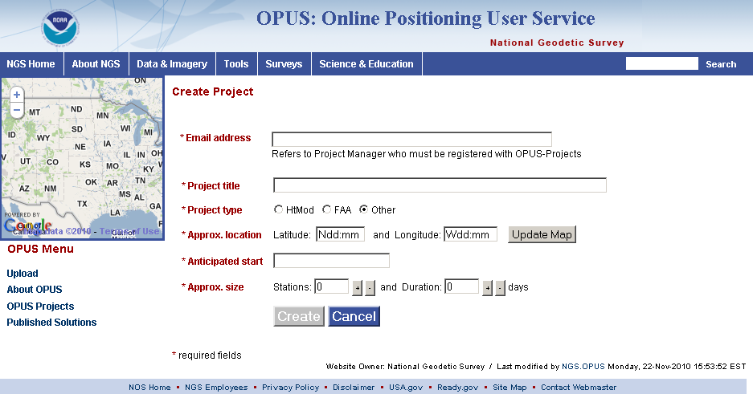
You’ll be taken to the project creation and registration page where you’ll enter your email, a title for, the type of, the approximate location of, start date for and size of your project.
2013 LSPS Shreveport, LA
133

Slide 134
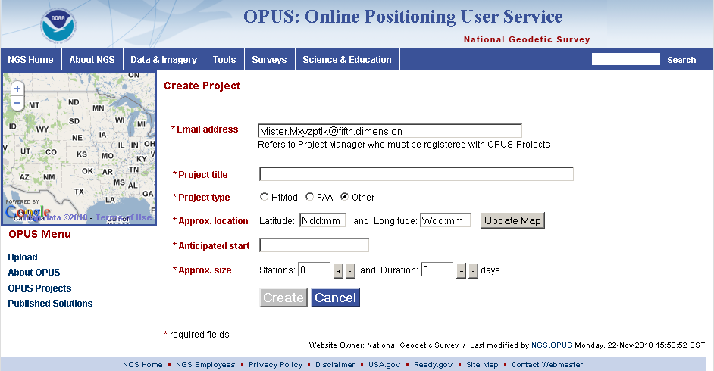
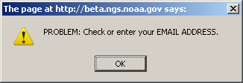
If you haven’t completed this training, you’ll be notified. Information about future training classes can be found at
http://geodesy.noaa.gov/corbin/calendar.shtml.
2013 LSPS Shreveport, LA
134

Slide 135
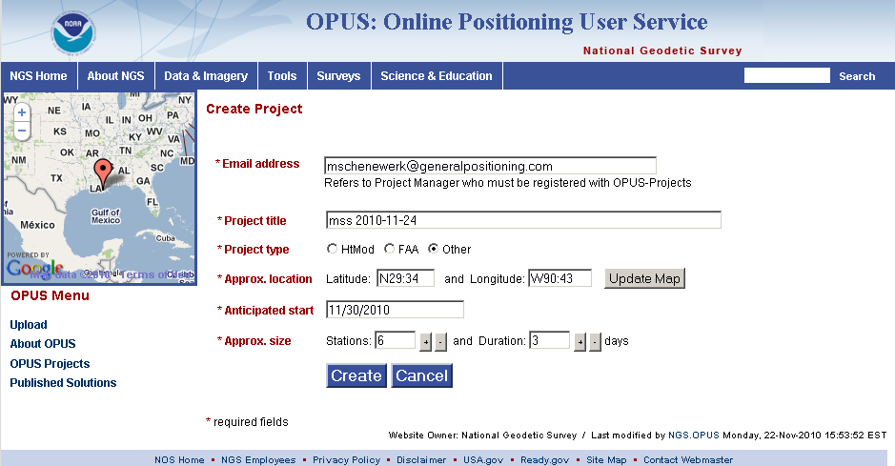
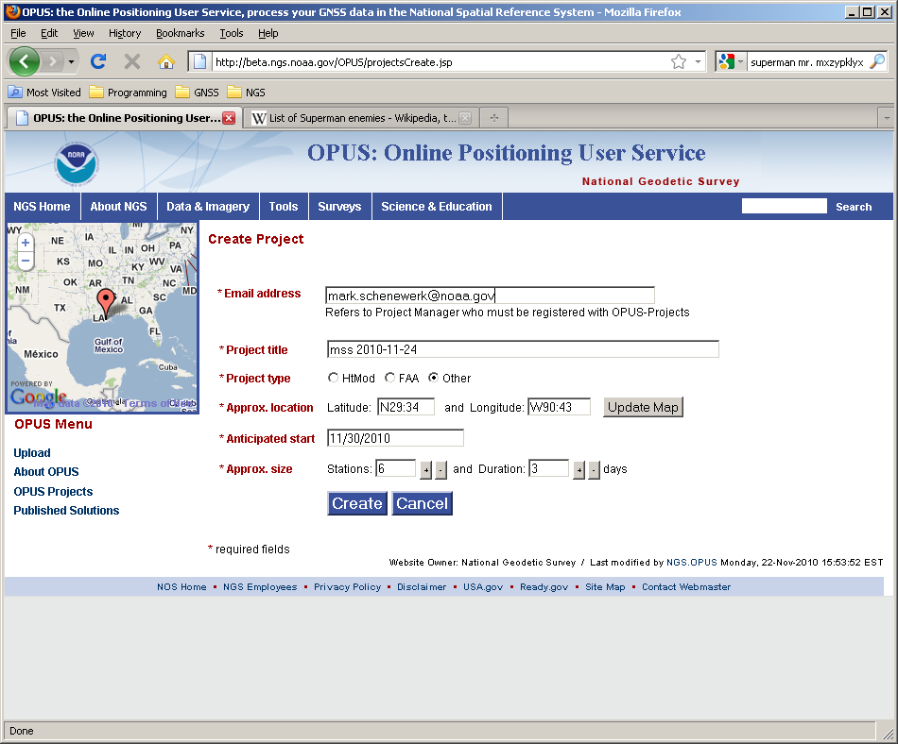
If you are registered, you can complete the form and click the (now enabled) Create button.
2013 LSPS Shreveport, LA
135

Slide 136
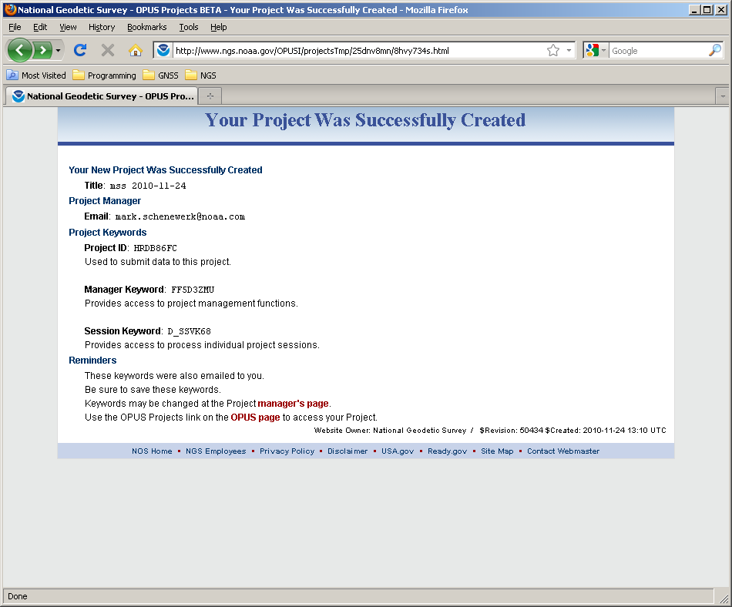
After a moment, the introduction to your newly created project is displayed. You’ll also receive an email with this information.
2013 LSPS Shreveport, LA
136

Slide 137
Let’s take a few moments to highlight a few of the critical items.
2013 LSPS Shreveport, LA
137

Slide 138
The Project Identifier, and the Manager and Session Keywords enable all other access to your project.
2013 LSPS Shreveport, LA
138

Slide 139
Some find these randomly generated strings challenging, so they can be modified from the manager’s page.
2013 LSPS Shreveport, LA
139

Slide 140
Your Project Identifier can be shared thereby permitting others to contribute data to your project.
2013 LSPS Shreveport, LA
140

Slide 141
Uploading Data To Your Project
The second step is to “Upload” data files to your project.
At this time, this is done through OPUS Static implying the same restrictions:
Your data must be dual frequency pseudorange and phase P1 (or C1), P2, L1 and L2.
Two or more hours data for each submission.
A collection rate of 1, 2, 3, 5, 10, 15 or 30 seconds.

Slide 142
Returning to the OPUS Upload page and clicking on the Options button ...
Notes:
The OPUS gateway page is found at http://geodesy.noaa.gov/OPUS/.

Slide 143
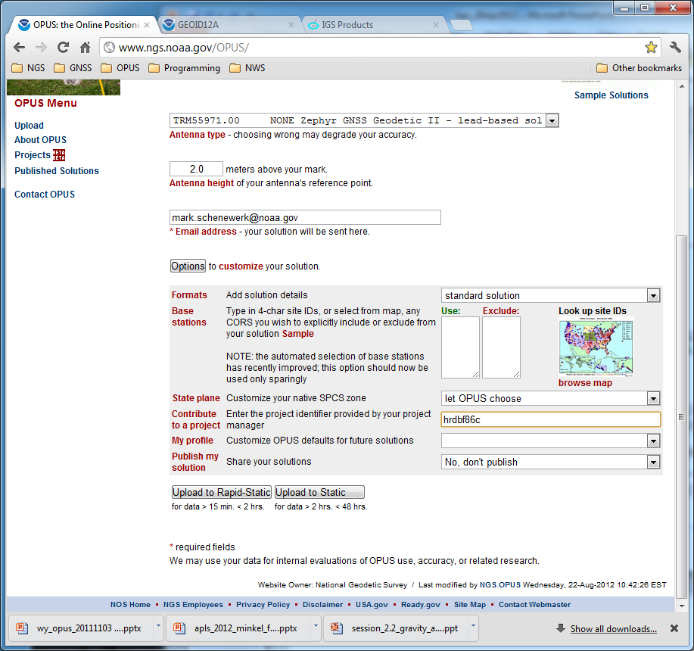
… the options accordion into view ...

Slide 144
… and we can specify that this upload is destined for a project.

Slide 145
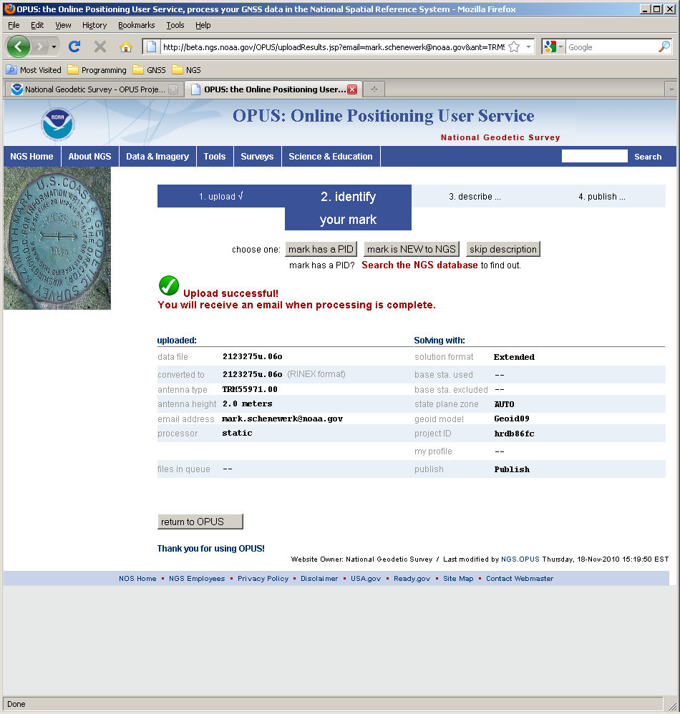
Once the upload is complete, the confirmation pages appears.
2013 LSPS Shreveport, LA
145
Notes:
The OPUS “upload complete” page.

Slide 146
But if this is the first data set uploaded for a mark, the mark description buttons appear offering the possibility to include a mark description.
2013 LSPS Shreveport, LA
146
Notes:
Mark 2126 has not been uploaded to the project before so the options to describe appear after upload.

Slide 147
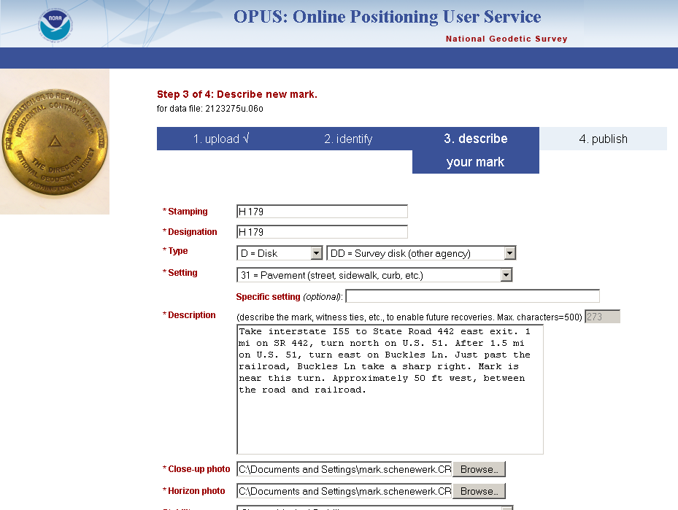
Although it is not required, we recommend you take advantage of this option – especially if you plan to publish your project.
2013 LSPS Shreveport, LA
147
Notes:
The Mark 2126 metadata page (top).

Slide 148
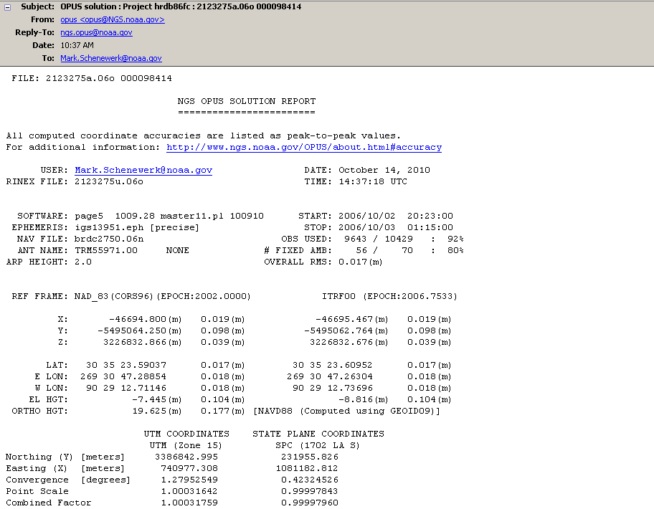
You’ll get your OPUS solution report, as you normally would, but the data and report will be copied into your project too.
2013 LSPS Shreveport, LA
148
Notes:
OPUS solution report for 2126275a.06o.

Slide 149
Uploading Data To Your Project
When data are uploaded to a project, the OPUS Static results are “quality controlled” using thresholds specified by the project manager.
If the results from a data file exceed any of the thresholds, a warning message is sent to the email address entered when the data were submitted, and the mark is flagged for easy identification by the project.
Receiving a warning message does not mean the data will be excluded from your project. That is the project’s decision.

Slide 150
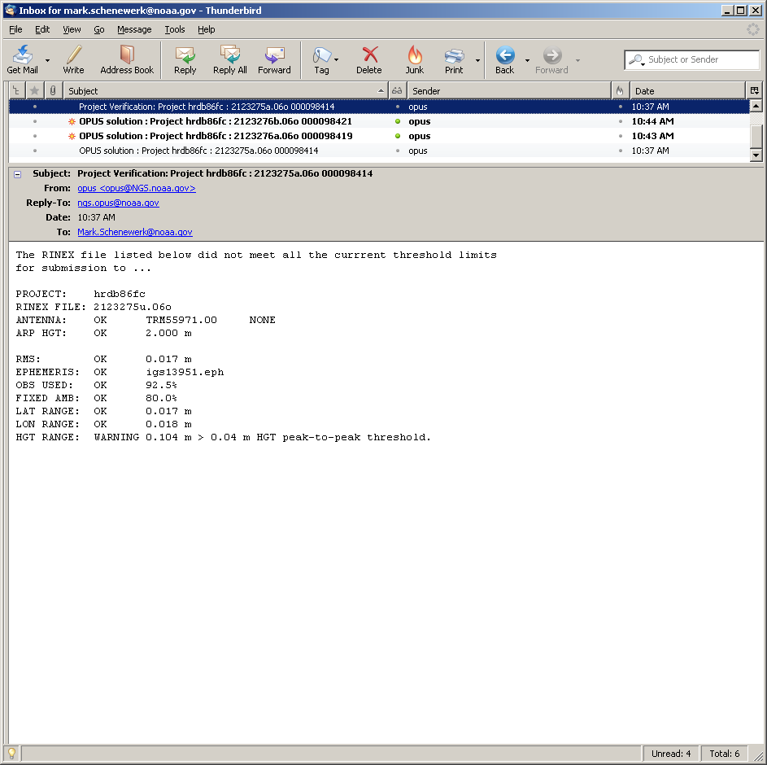
Uploading Data To Your Project
The highlight is mine.
Here you see a sample email indicating one criteria did not meet the project’s thresholds. These thresholds are set by the project manager.

Slide 151
Uploading Data To Your Project
Again, receiving a warning does not mean that the uploaded file is rejected. It only means the file will be flagged. It is still copied to the project and is available for processing.

Slide 152
View And Process A Session
OPUS-Projects groups the data into sessions.
Sessions are groups of mark occupations that overlap significantly in time. Note that
a mark may appear in more than one session.
as new data are submitted, the definitions of the sessions may change.
Now that some data has been submitted to the project, processing can begin.

Slide 153
View And Process A Session
Let’s switch to a project already loaded with data.
The project title is:
“Training data set 1”
The project keywords are:
PROJECT : hrdb86fc
MANAGER : ff5d3zmu
PROCESS : d_ssvk68
Please note that this is a project used for testing and, so, may not always be in this exact state. Nevertheless, feel free to visit and look around.

Slide 154

This time we’ll enter through the Session login on the OPUS-Projects gateway page.
2013 LSPS Shreveport, LA
154

Slide 155
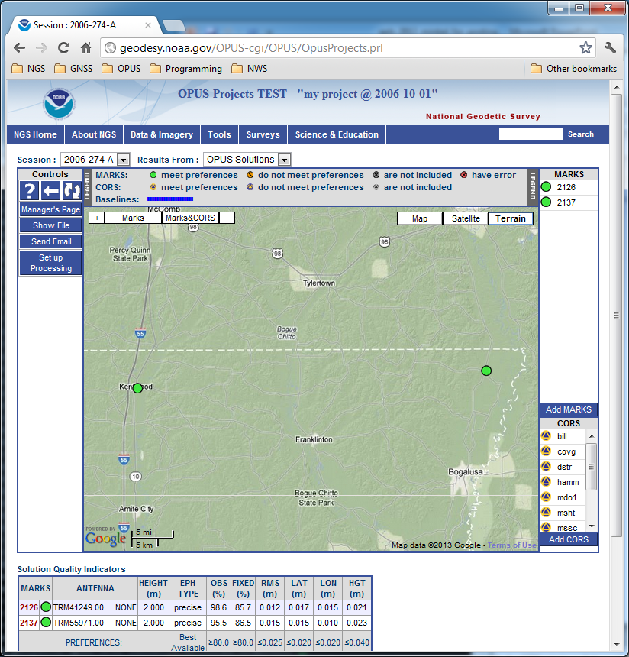
This is the page specifically for the session 2006-274-A.
2013 LSPS Shreveport, LA
155
Notes:
This is the page for session 2006-274-A of “Training data set 1”. The components of this page are:

Slide 156
The banner shows the project’s title and session. The session pull-down menu can be used to select another session to view/work with.
2013 LSPS Shreveport, LA
156

Slide 157
The left sidebar holds the controls.
2013 LSPS Shreveport, LA
157

Slide 158
The map shows the relative location of the marks in this session or solution, and their status.
2013 LSPS Shreveport, LA
158

Slide 159
The right sidebar lists the marks.
2013 LSPS Shreveport, LA
159

Slide 160
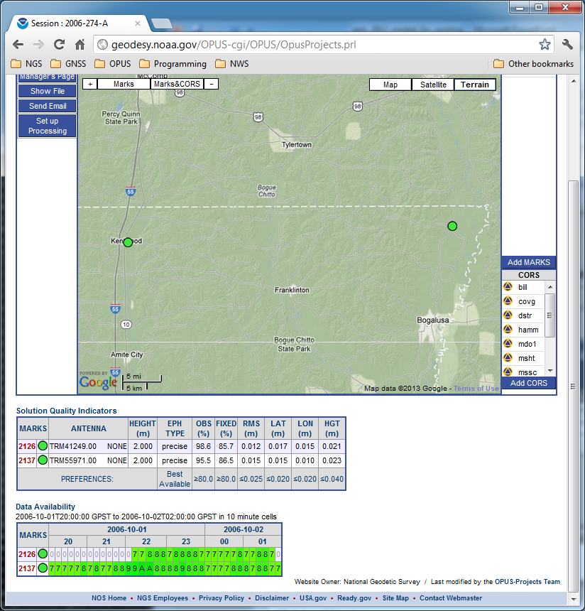
The table below the map summarizes the status for each mark.
2013 LSPS Shreveport, LA
160

Slide 161
The table below at the bottom of the page graphically represents the data availability.
2013 LSPS Shreveport, LA
161

Slide 162
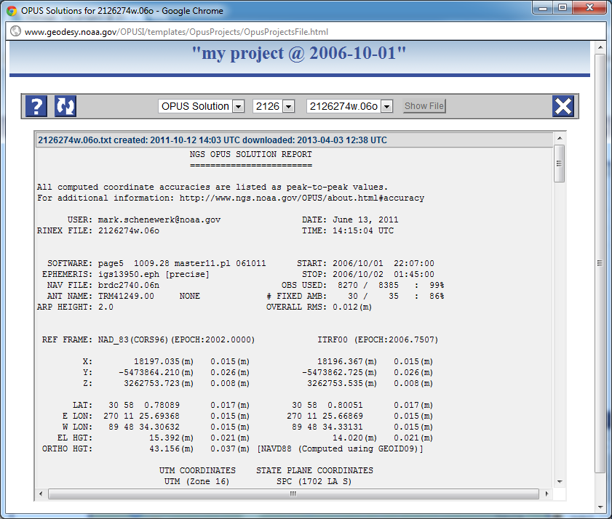
Review copies of the reports associated with the session.
2013 LSPS Shreveport, LA
162

Slide 163
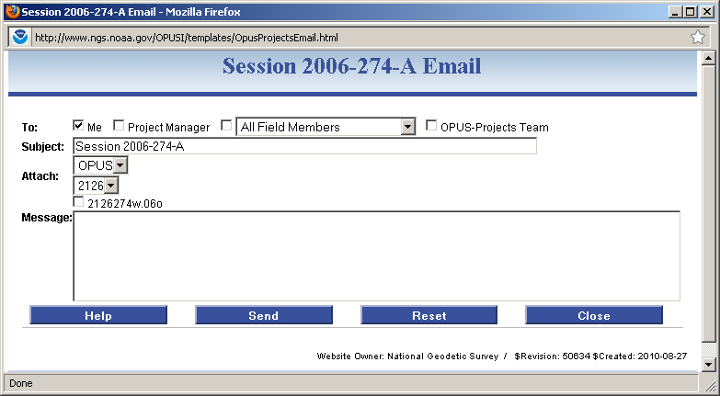
Someone working with a session can email other members of the project.
2013 LSPS Shreveport, LA
163

Slide 164
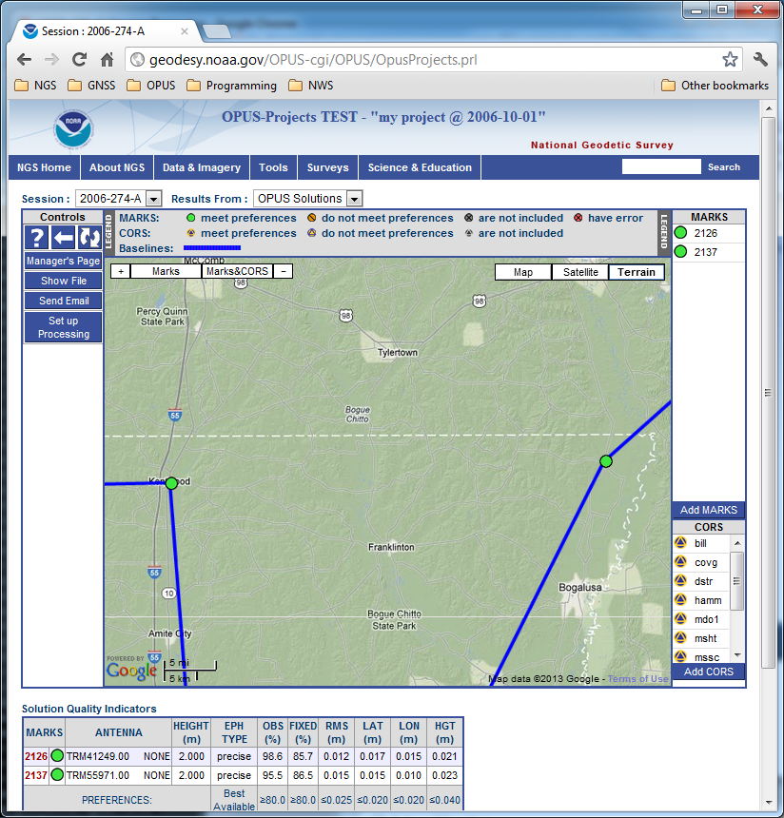
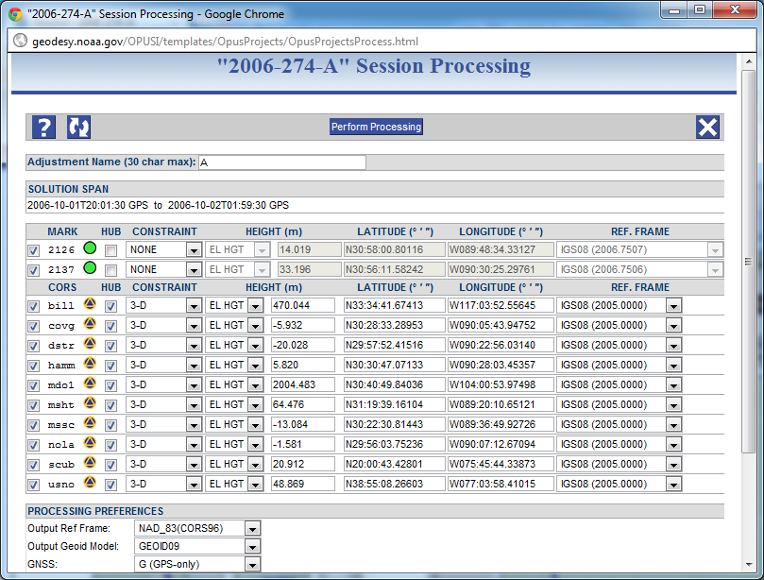
Or process the session’s data.
2013 LSPS Shreveport, LA
164

Slide 165
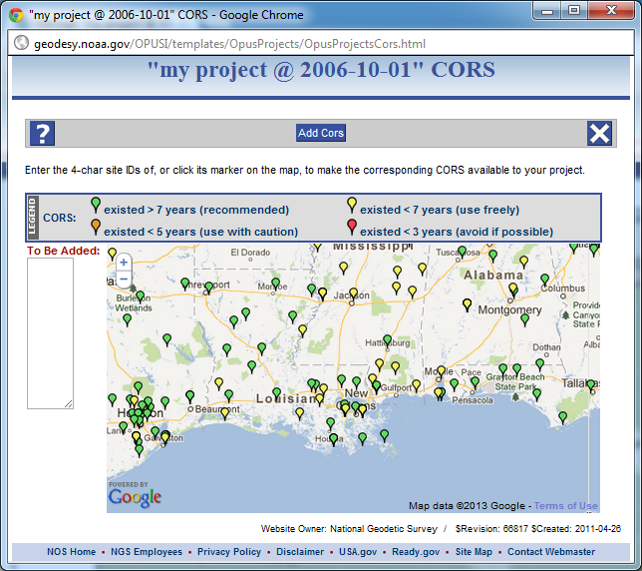
Additional CORS can be added to this session using the Add CORS button.
2013 LSPS Shreveport, LA
165

Slide 166
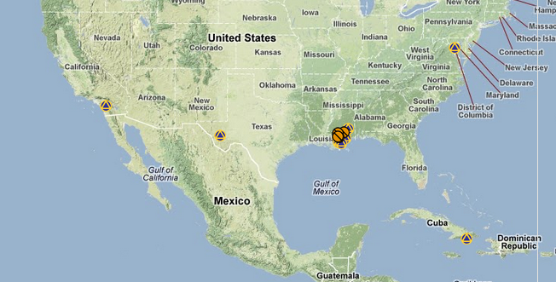
A Few Thoughts About Networks
GNSS is a
little counter
intuitive in
that including
distant CORS
can be
beneficial.
They provide a connection to the reference frame.
They help transfer the NSRS to your network.
They can improve troposphere determination which, in turn, can improve heights.

Slide 167
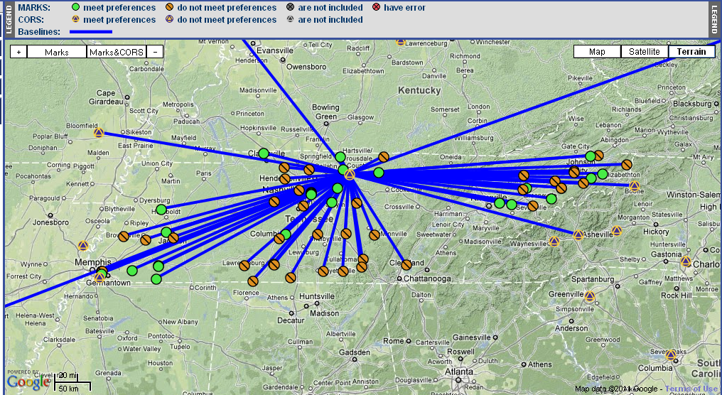
A Possible Network Design Strategy
Consider a single hub site when that mark has more than 4 hrs of data:
Include and tightly constrain CORS, loosely constrain the hub.
Connection to CORS creates a strong connection to the ITRF.
Provides a consistent reference for each project mark.
Notes:
This is just a suggestion. Generally, there is no right or wrong design. Always follow your project’s specifications.

Slide 168

A Possible Network Design Strategy
Consider multiple hubs when no mark has more than 4 hrs of data.
This keep baselines as short as possible.
Continue to include CORS where possible.
Notes:
This is just a suggestion. Generally, there is no right or wrong design. Always follow your project’s specifications.

Slide 169
Manage A Project
At any time during its lifetime, the manager can review the project’s status and modify details. Once again we’ll use the more interesting project,
“my project @ 2006-10-01”
The project keywords are:
PROJECT : hrdb86fc
MANAGER : ff5d3zmu
PROCESS : d_ssvk68
Recall that this is an active test project and, so, may not always be in this exact state

Slide 170

The manager’s tasks are sufficiently numerous and varied to warrant a separate login.
To begin, enter the project and manager keyword, then click the “Manage” button.
2013 LSPS Shreveport, LA
170

Slide 171

This is the manager’s page for project HRDB86FC.
2013 LSPS Shreveport, LA
171

Slide 172
The menu at the top of the page selects the type of solution or solutions for display.
2013 LSPS Shreveport, LA
172

Slide 173
Once Session processing has been completed, Session and OPUS solutions will be available. Network adjustments will be available too as they are completed.
2013 LSPS Shreveport, LA
173

Slide 174
The sidebar on the left contains the controls for the manager’s page.
2013 LSPS Shreveport, LA
174

Slide 175
The map shows the relative location of the project’s marks. If the Session solutions were completed, they would be shown, but the OPUS solution results can always be displayed.
2013 LSPS Shreveport, LA
175

Slide 176
The sidebar on the right lists the marks alphanumerically but segregated by project and CORS marks.
2013 LSPS Shreveport, LA
176

Slide 177

The summary table at the bottom of the page also provides convenience links to other pages for the project.
2013 LSPS Shreveport, LA
177

Slide 178
The column headers are links to individual Sessions (and later, session solutions).
2013 LSPS Shreveport, LA
178
Notes:
The column headers are links to individual Sessions (and later, solutions).

Slide 179
The row headers are links to individual marks.
2013 LSPS Shreveport, LA
179
Notes:
The row headers are links to individual marks.

Slide 180

The Preferences button opens a window with controls to change the project title and keywords, email lists and project preferences.
2013 LSPS Shreveport, LA
180

Slide 181
A future enhancements will offer tools to design a project, e.g. create hardware lists and deployment schedules, and communicate that information to other project participants.
2013 LSPS Shreveport, LA
181

Slide 182
Next are a few placeholders for future enhancements like project design and planning tools, any specialized “bluebooking” tools, and manipulation of project solutions.
2013 LSPS Shreveport, LA
182

Slide 183
The reports created during OPUS, Session or Network processing are available through the Show File controls. The selected files are display in a separate window for printing or saving locally.
2013 LSPS Shreveport, LA
183

Slide 184
A basic email tool for communicating with project participants or the OPUS-Projects staff is available, as you’ve seen previously.
2013 LSPS Shreveport, LA
184

Slide 185

Session solution matrices can be combined and solved creating an network adjustment for this project.
2013 LSPS Shreveport, LA
185

Slide 186

Using the Review and Publish button, a final network adjustment can be selected, and its results plus the associated mark metadata published to the OPUS data base.
2013 LSPS Shreveport, LA
186

Slide 187

A request to delete the project can be initiated. This begins a three step confirmation process which, if confirmed at each step, results in the project being deleted.
2013 LSPS Shreveport, LA
187

Slide 188
And, finally, additional CORS can be added to the entire project using the Add CORS button.
2013 LSPS Shreveport, LA
188

Slide 189
Let’s go to a Mark summary page and examine some results. To navigate to the 2126 page, let’s start on the project manager’s page and click on the Session & Solution table row header for Mark 2126. Similar access is possible from any session page which includes this mark.
2013 LSPS Shreveport, LA
189
Notes:
Going back to the manager’s page, now let’s go to a mark.

Slide 190

Here’s the page for mark 2126. The individual mark pages are the busiest, so let’s go through this very quickly.
2013 LSPS Shreveport, LA
190
Notes:
Mark 2126 page (top).
Note that this is the page the manager sees. Others will see a slightly different presentation.

Slide 191
At the top are controls. Several of these should be familiar to you by now, but several are new. You can change this mark’s four character ID, remove it entirely from the project.
2013 LSPS Shreveport, LA
191

Slide 192
Repeated throughout the page is a control to switch to another mark.
2013 LSPS Shreveport, LA
192

Slide 193
Note that this map can have a new icon: triangles. These indicate nearby published marks. You can click the icon to view the datasheet for a published mark or specify that this mark is the published mark.
2013 LSPS Shreveport, LA
193

Slide 194

Scrolling down the page, we find a mock-up of the datasheet for this mark. Because we accessed this mark as the project manager, we can modify this information for our own use or in preparation for publishing.
2013 LSPS Shreveport, LA
194

Slide 195

Next on the page is a summary of the occupation information for this mark. Again, because we accessed this mark as the project manager, we can modify this information for our own use or in preparation for publishing.
2013 LSPS Shreveport, LA
195

Slide 196
Next, we can review the processing results for this mark.
2013 LSPS Shreveport, LA
196

Slide 197

At the bottom are interactive plots and tables summarizing all the processing results for this mark: OPUS results from the uploads, Session Solutions and Network Adjustments. Project preferences are indicated, but, in this case, the results are all within those preferences.
2013 LSPS Shreveport, LA
197

Slide 198

OPUS-Projects Training
Because of its increased complexity, training is required to be an OPUS-Projects manager. These workshops are usually two day in length and small so that there is ample
one-on-one time with the instructor.
Check the NGS training center schedule for upcoming NGS run workshops

Slide 199
New Developments for OPUS
Dr. Mark Schenewerk
National Geodetic Survey
Silver Spring, MD
2013 LSPS Spring Technical Session
Shreveport, LA
April 26, 2013

