Slide 1
Educational and Training Opportunities Available Through the National Geodetic Survey
UESI Surveying & Geomatics Conference
June 2024
Erika Little, NGS Training Coordinator

Slide 2
Outline
Update on OPUS Projects Manager’s training
Online Videos and Lessons
Other Resources
Webinars and earning certificates on your schedule

Slide 3
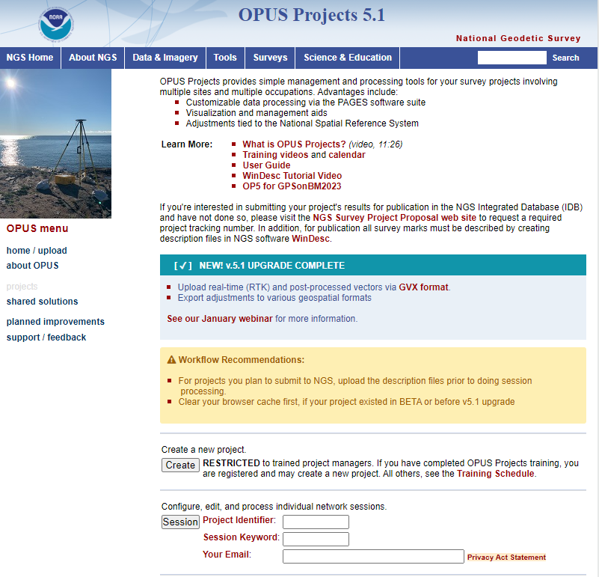
OPUS Projects
NGS has operated the Online Positioning User Service (OPUS) since March 2001, to provide end-users easy access to the National Spatial Reference System (NSRS) using GPS data.
In 2011, OPUS Projects became available to the public.
OPUS Projects is a highly integrated tool for managing GPS campaigns, including initial observation metadata and positions, session solution statistics, and network adjustments.
Provides data visualization and project management aids.

Slide 4
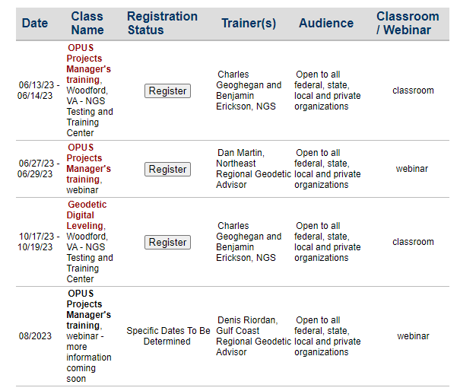
Training Requirement
NGS has required training of approximately 12 hours to access OPUS Projects
This was due to its complexity, flexibility, and ability of users to select options that would likely produce unintended outcomes.
Since 2014 when training began to be tracked, NGS has conducted training for over 4,250 participants.
Conducted by a staff of less than 15 instructors, with an average class size of approximately 20 students. These instructors are balancing OPUS Projects classes with many other responsibilities.

Slide 5
Planning to Remove the Mandatory Training Requirement
Why?
OPUS Projects has become much more intuitive and the process has been significantly streamlined. OPUS Projects now builds all of the important files for supporting data submittal, and it runs a number of quality control tests automatically, without requiring input or decisions from the user.
NGS has developed a User Guide including both a “quick start” portion and significant details on how to use the software. The User Guide explains much of the content that has previously been covered by an instructor.

Slide 6
Planning to Remove the Mandatory Training Requirement
Why?
Some organizations cannot afford the time/money for their employees to attend a 2-day course to learn how to run software, or sometimes they are not interested in all of the facets of OPUS Projects and just want basic information.
The popularity of the instructor-led training has grown. Classes frequently fill up, sometimes months in advance. It is anticipated that demand will continue to grow as OPUS Projects adds the capability to ingest RTK data. To adequately meet the demand of our constituents would require significantly more NGS staff time.
Requiring training makes NGS a gatekeeper and a barrier to the use of its own software.

Slide 7
NGS Will Stop Requiring Mandatory Training when…..
On-demand training videos are available on the NGS website. Users can view the videos at times convenient to them.
Close to completion
Update to the User Guide to include content on OPUS Projects 5 and how to work with GNSS vectors processed outside OPUS Projects is made available.
Complete!
Users have a simple way to register their email address to create a project
Close to completion

Slide 8
What’s Next?
Instructor-led training, both online and in-person, will still be offered regularly. It just will not be mandatory.
Refresh cycle established as OPUS Projects undergoes updates.

Slide 9
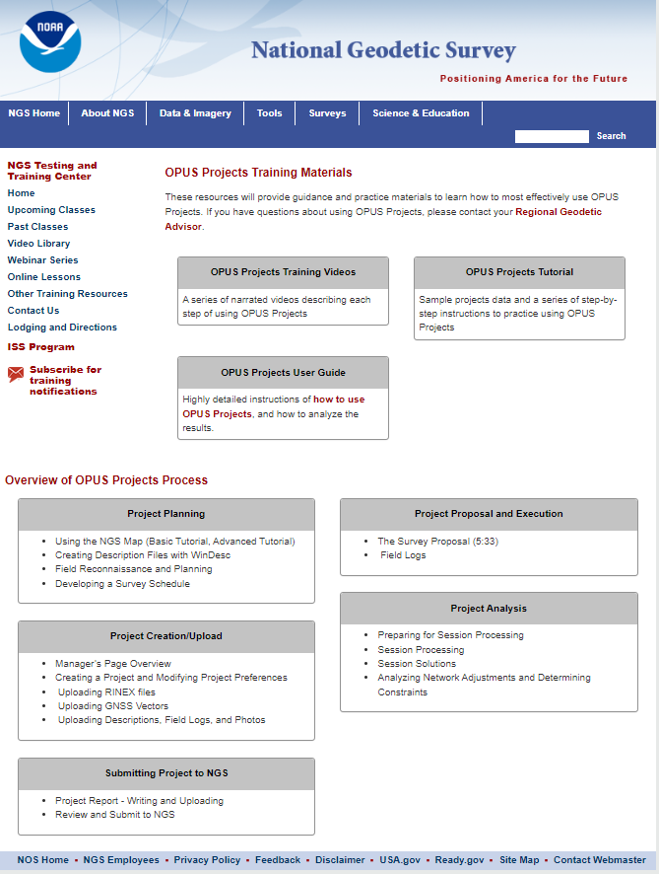
Draft Training Materials Landing Page

Slide 10
Educational Videos
Partnership with the University Corporation for Atmospheric
Research’s (UCAR) COMET Program
geodesy.noaa.gov

Slide 11
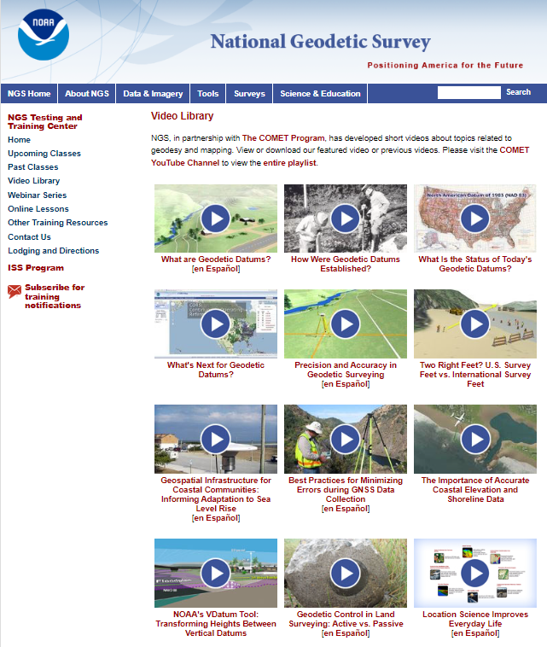
Educational Videos
Partnership with the University Corporation for Atmospheric
Research’s (UCAR) COMET Program
Most Viewed on COMET YouTube channel (through 5/2024)
What are Geodetic Datums? | 211,841
Best Practices for Minimizing Errors During GNSS Data Collection | 96,070
Precision and Accuracy in Geodetic Surveying | 76,612
These are 3 of the 6 videos now available in Spanish!

Slide 12
Online Lessons
Partnership with the University
Corporation for Atmospheric
Research’s (UCAR) COMET Program

Slide 13
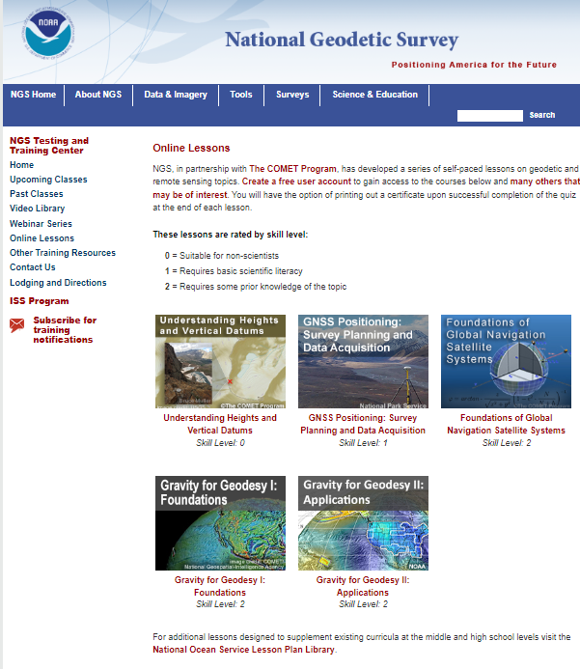
Online Lessons
Take anywhere from 45 minutes to 2 hours to complete
All lessons allow the user to receive a certificate *if* a quiz is passed
Currently 5 lessons available

Slide 14
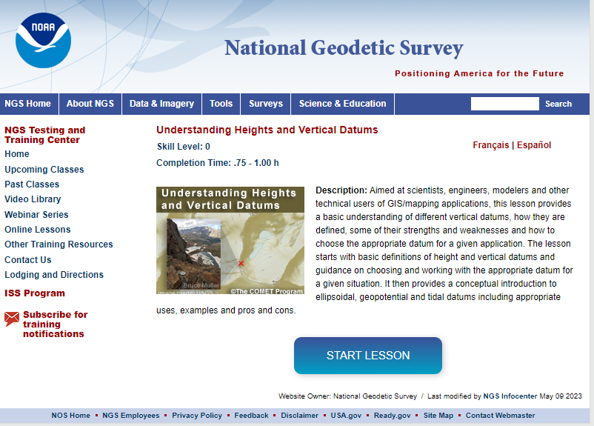
Understanding Heights and Vertical Datums lesson
Available in French and Spanish
Gravity for Geodesy I: Foundations and Gravity for Geodesy II: Applications
Available in Spanish

Slide 15
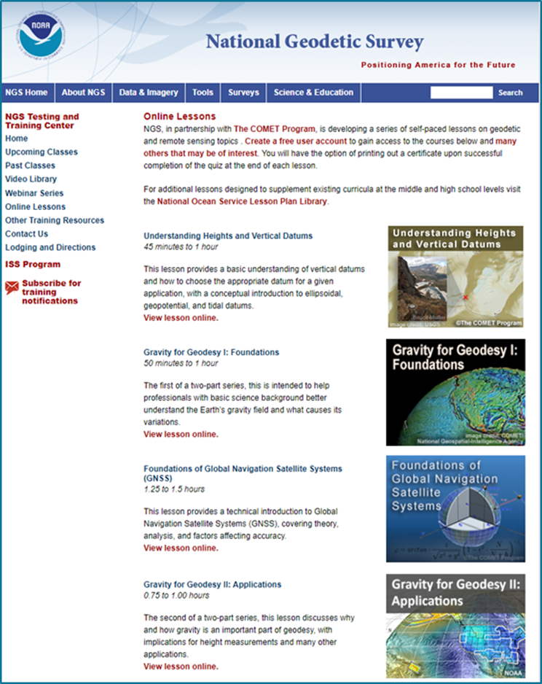
Online Lessons
Partnership with the University Corporation for Atmospheric Research’s (UCAR) COMET Program
Module completions to date by sector (through 4/2024)
Education | 4,897
Other | 1,664
Private Sector | 527
State or Local | 458
Weather Enthusiast | 208
NOAA | 205
DOD | 375
International | 75

Slide 16
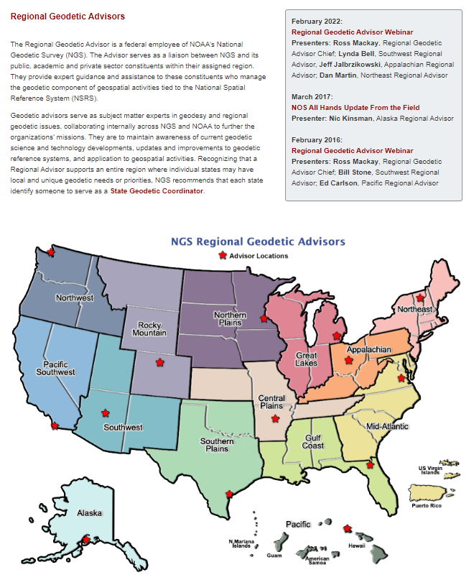
14 Regional Geodetic Advisors
Expert sources for training and education

Slide 17
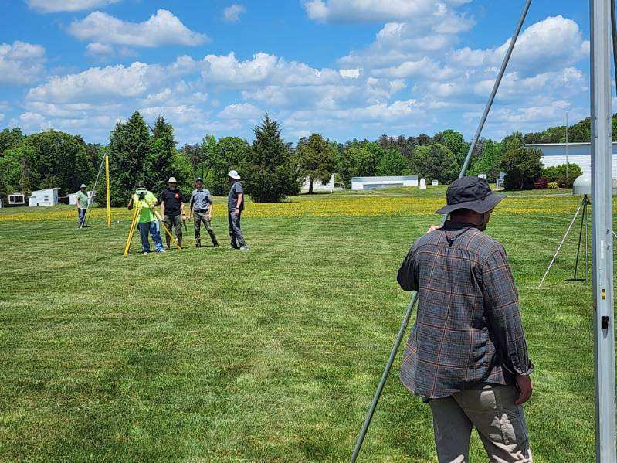
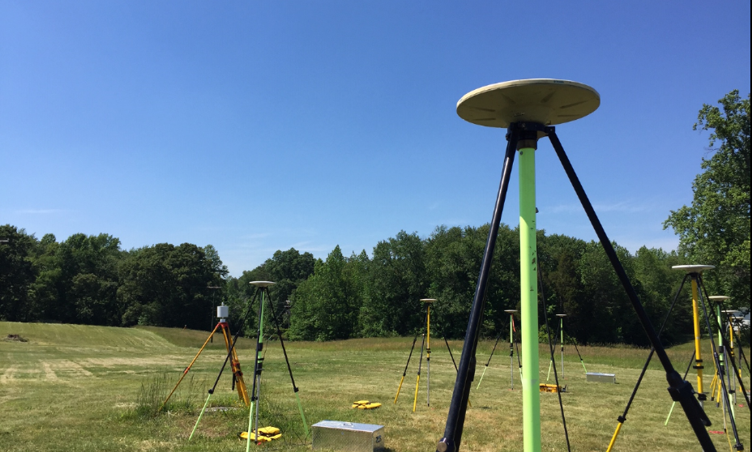
NGS Testing and Training Center
Located near Fredericksburg, VA
In-person training classes such as OPUS Projects Manager’s Training and Geodetic Digital Leveling
Many acres of land for hands-on training and equipment testing

Slide 18
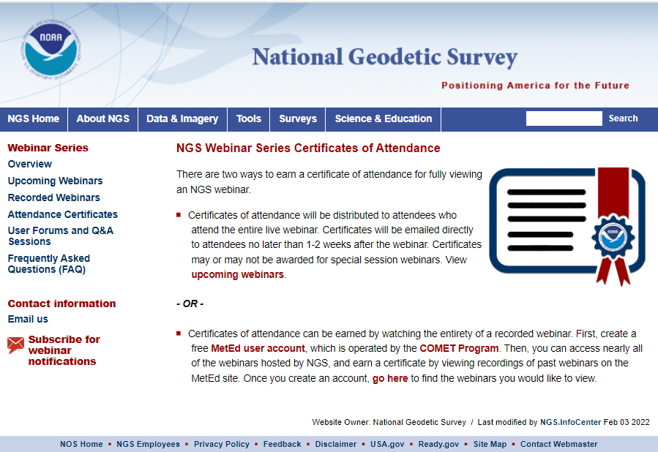
Earn Webinar Certificates on
Your Schedule
Can’t make a webinar during the scheduled time? A recorded version is always available on the NGS website.
But NOW you can earn a certificate for viewing a recorded webinar.

Slide 19
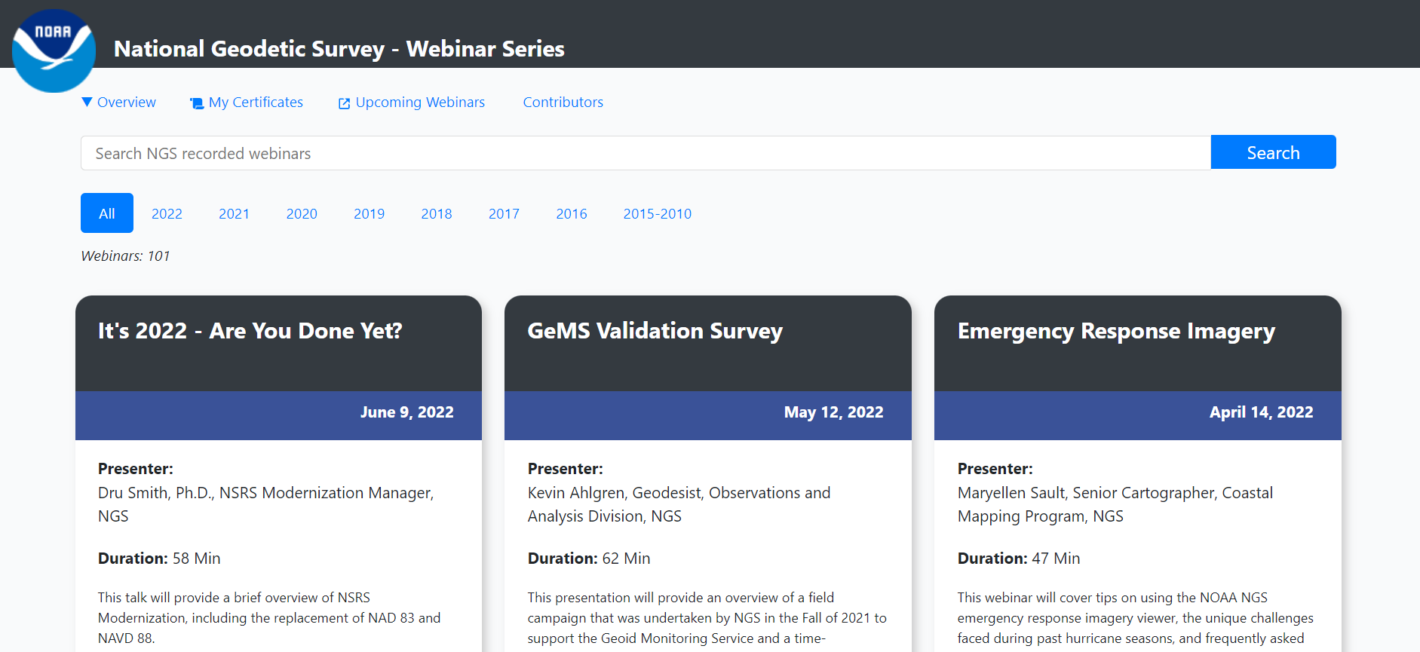
Earn Webinar Certificates on
Your Schedule
NGS again worked with the COMET MetEd program to develop a tool through which you can earn a certificate by viewing recordings of past webinars.
About 120 recorded webinars available.

Slide 20
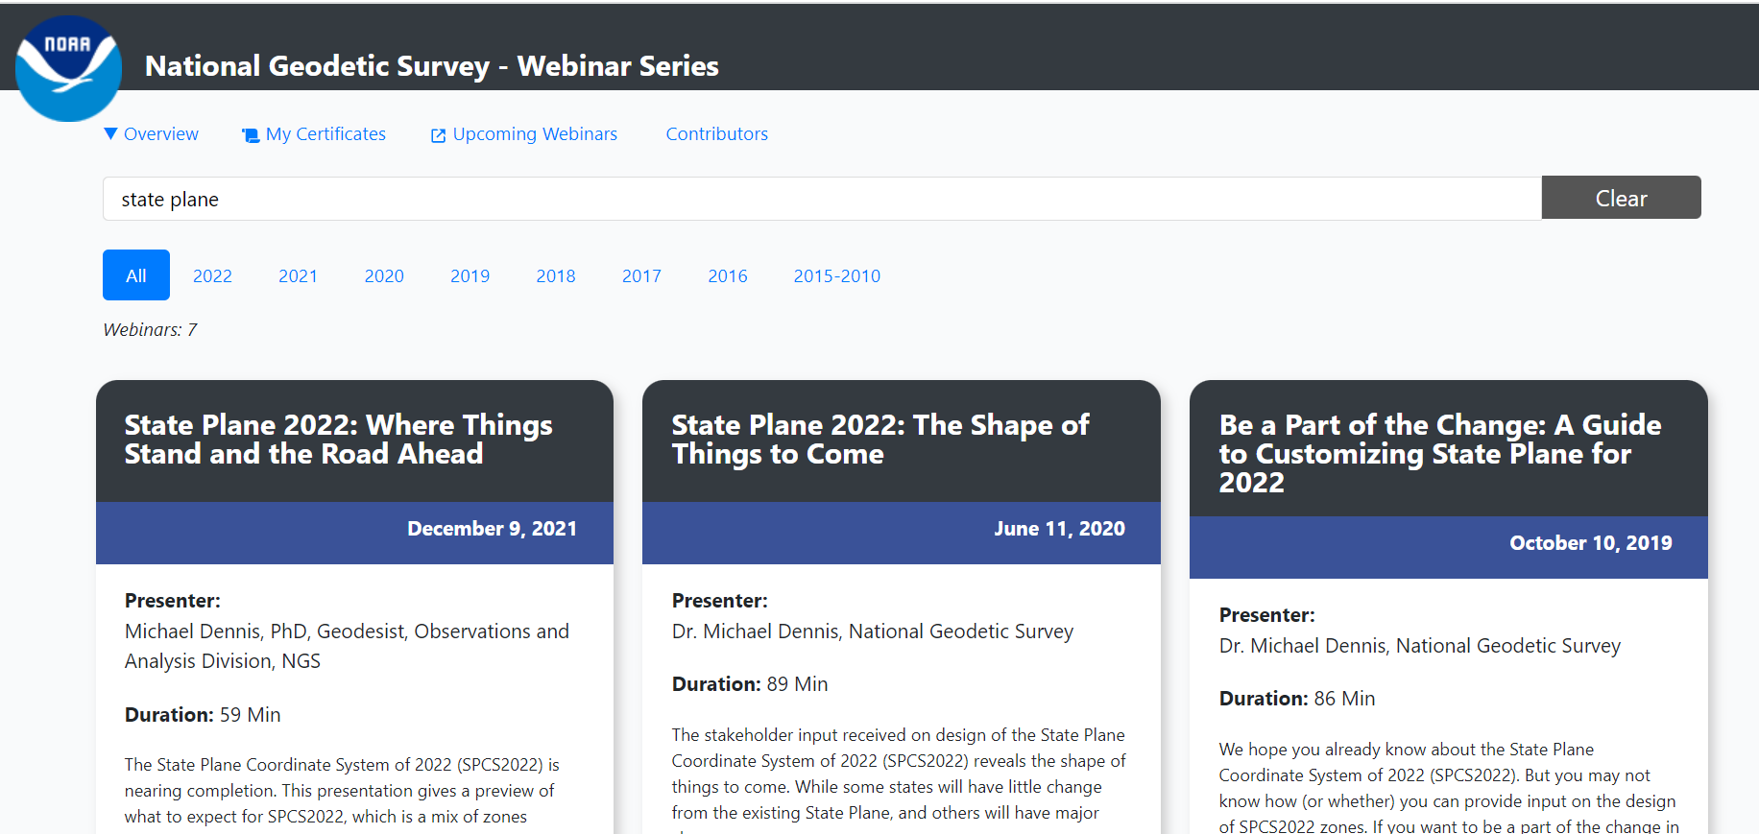
Earn Webinar Certificates on
Your Schedule
Great search function to find webinars on a certain topic.
If you are in the education field, you could assign these as pre-requisites, class work, extra credit, etc.

Slide 21
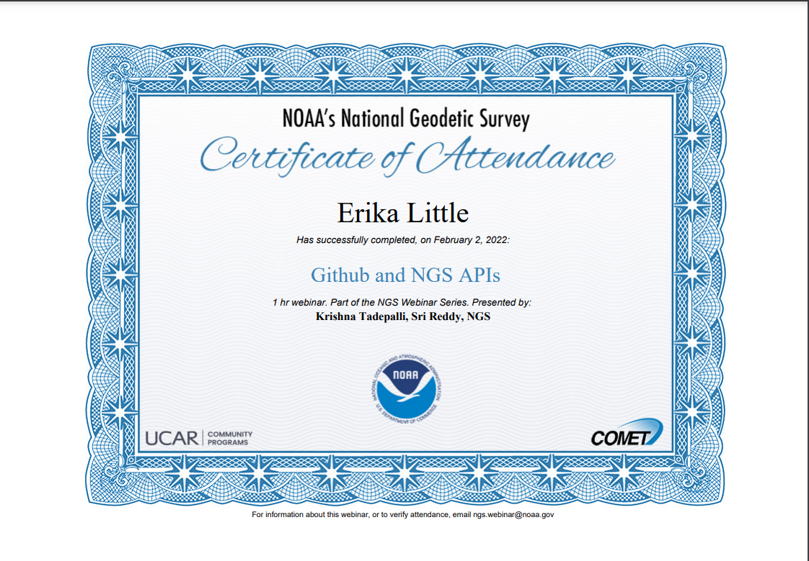
Earn Webinar Certificates on
Your Schedule
Once you watch the entirety of a webinar, you can download a Certificate of Attendance.

Slide 22
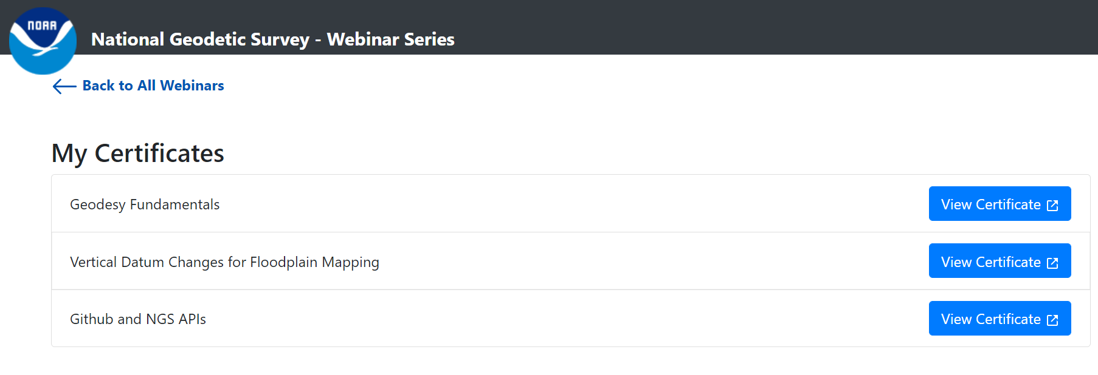
Earn Webinar Certificates on
Your Schedule
COMET MetEd will store all earned certificates.

Slide 23
Your Input is always welcome on:
Topics
Content
Delivery methods
Send to ngs.training@noaa.gov
Thank you!

