Slide 1

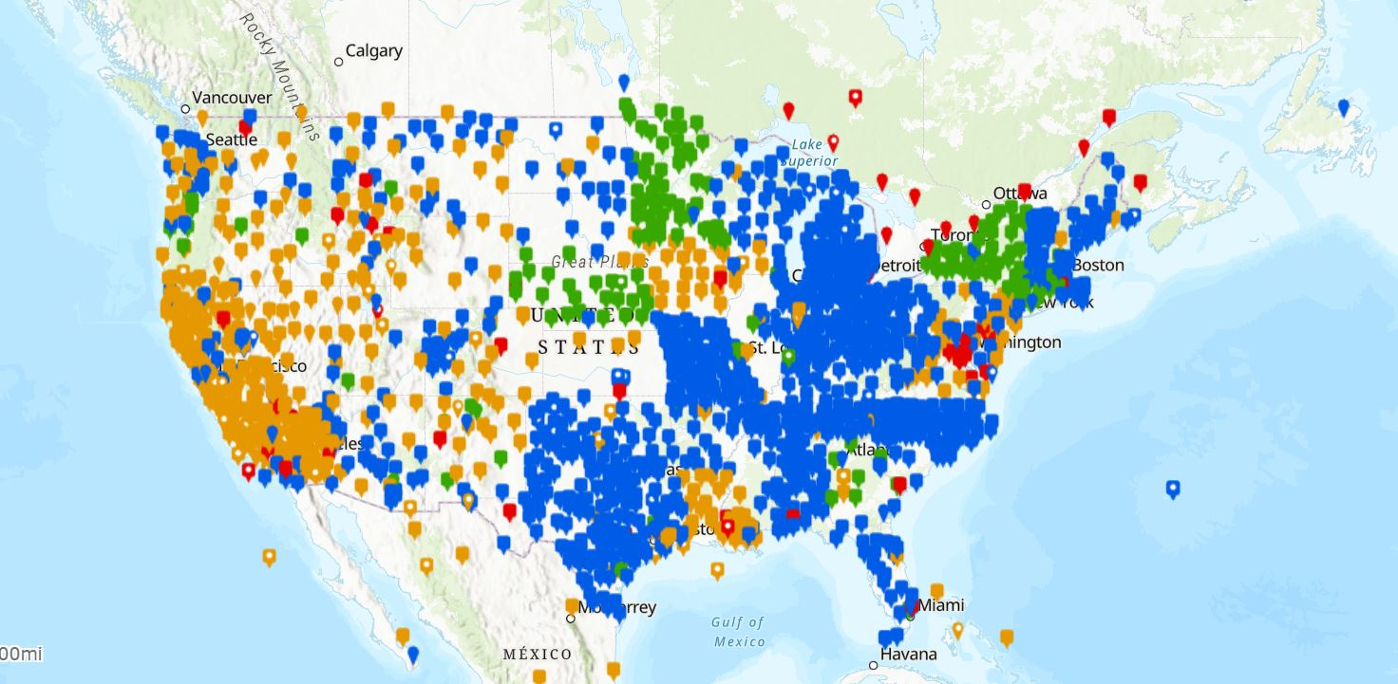
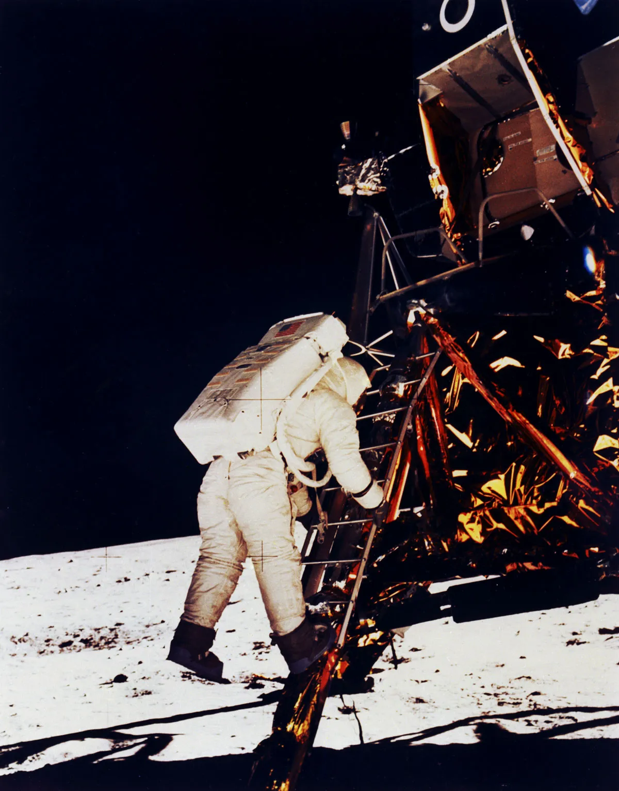
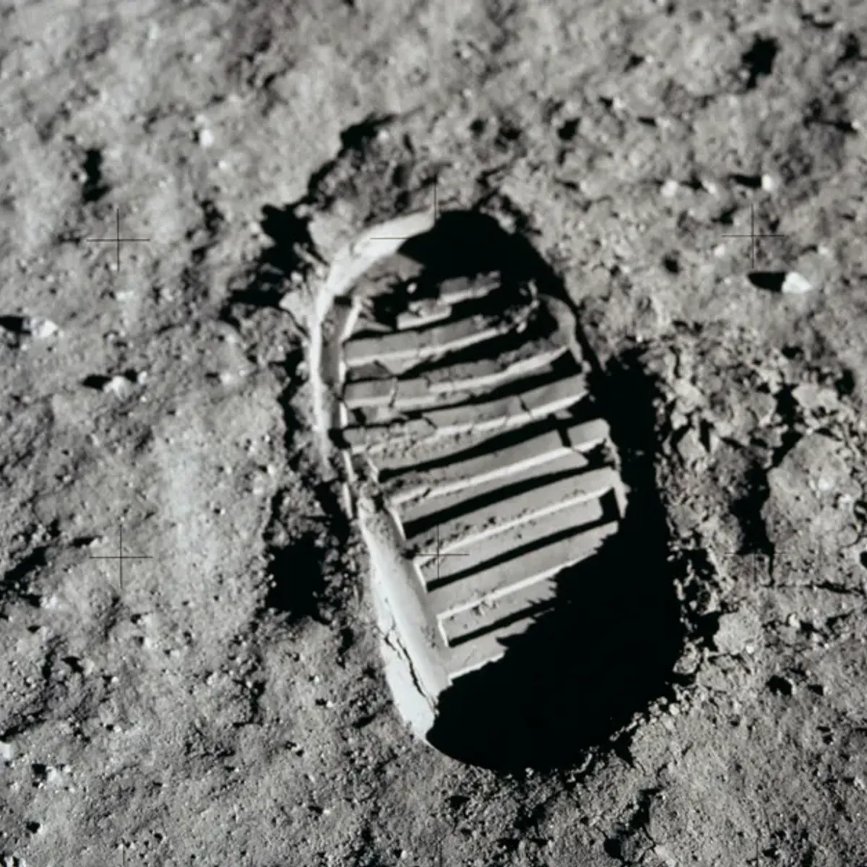
A Big Step Into the Future: NGS's Efforts to Modernize Our National Spatial Reference System
Keith Allen Kohl
NGS Regional Geodetic Advisor: Utah, Arizona, New Mexico
keith.kohl@noaa.gov
1

Slide 2

Bottom Line Up Front
If you do geospatial work in the USA…and you reference the National Spatial Reference System…
Every product you’ve ever made…
  every survey…
  every map…
  every lidar point cloud…
  every image…
  every DEM…
  WILL have outdated coordinates on it in the next few years.
  Let’s talk about what this means, why it is happening, and how it will affect things going forward

Slide 3



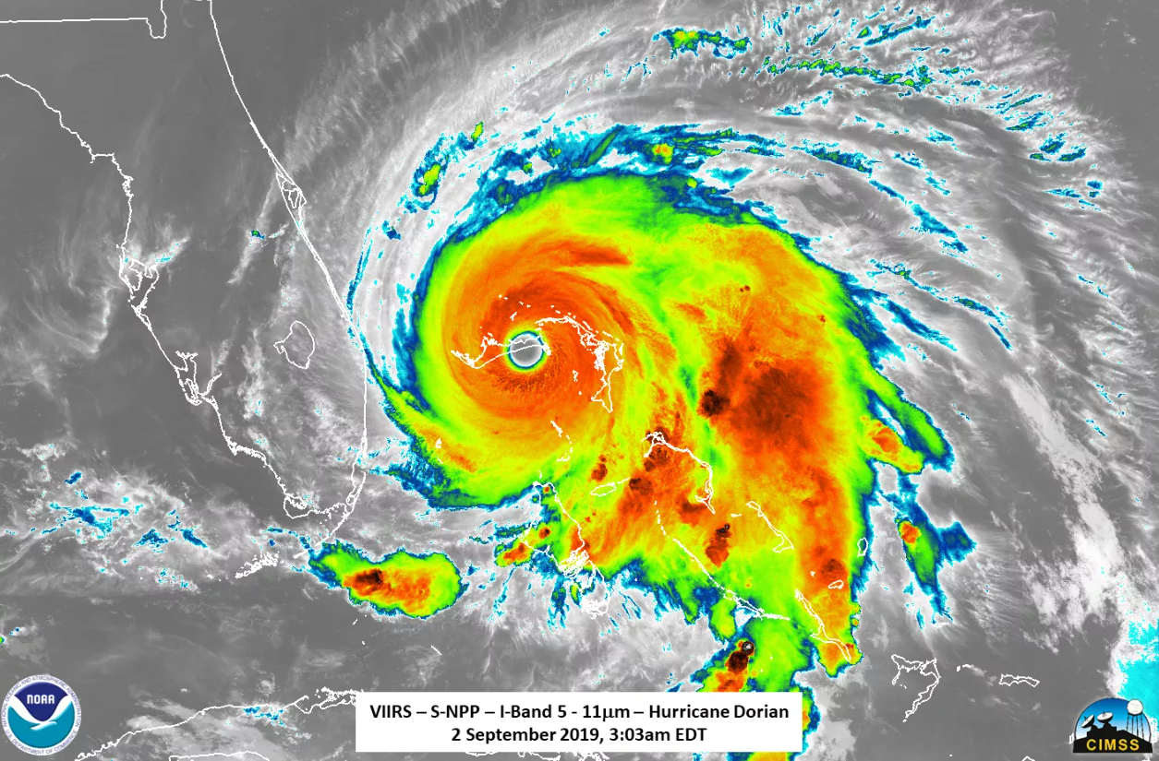
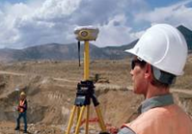
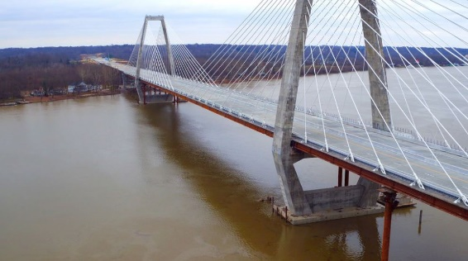
The National Spatial Reference System Benefits Our Economy
Revolutionizes professional surveying
Defined by and accessed through CORS, not suspect passive marks
Consistent alignment with National Geospatial Data Assets (NGDA) and International data themes
Vastly improves flood plain mapping
Water flows due to differences in gravity potential; This is provided by the North American- Pacific Geopotential Datum for 2022 (NAPGD2022)
Critically important in low-lying and flat communities
Fundamental support for new technologies
Consistent nationwide reference frame
Enables “Smart Highways” for autonomous vehicles, drones, etc.
Supports precision agriculture
Absolute, consistent positioning autonomously and anywhere
Impacts on infrastructure
Any application requiring precise positioning – Water conveyance, bridges, tunnels, railways, navigation -- will become more consistent

Slide 4

























Federal Partners Relying on the NSRS
4

Slide 5
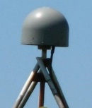
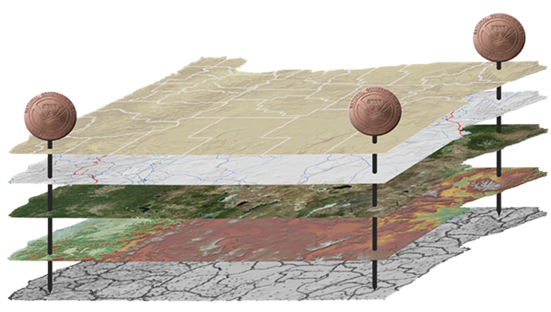
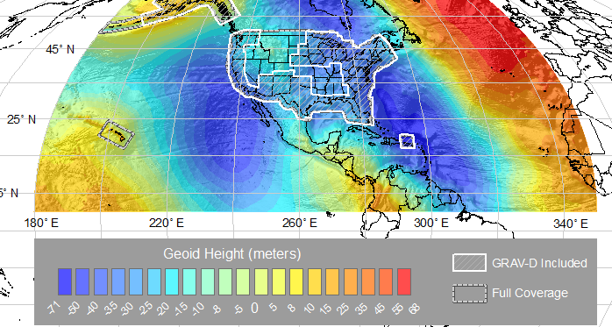
Our National Spatial Reference System
NGS defines, maintains and provides access to the NSRS to meet our Nation’s economic, social & environmental needs
Latitude • Longitude • Elevation • Gravity • Shoreline Position •
& changes over time
Our Big Step Into the Future includes:
  North American Terrestrial Reference Frame (NATRF 2022)
  Caribbean Terrestrial Reference Frame (CATRF 2022)
  Pacific Terrestrial Reference Frame (PATRF 2022)
  Marianas Terrestrial Reference Frame (MATRF 2022)
North American-Pacific Geopotential Datum (NAPGD2022)
Tomorrow’s NSRS

Slide 6
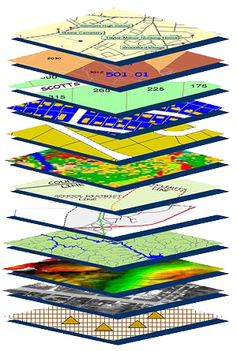
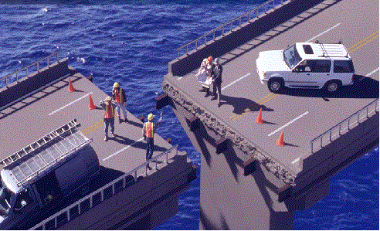
Accurate Positioning Begins
With Accurate Coordinates
The National Spatial Reference System is the foundation for all geospatial products.
Without accurate Geodetic Control as the foundation layer, GIS applications simply cannot align
Source: Zurich-American Insurance Group
07/30/2024
2024 MAPPS Conference
6

Slide 7


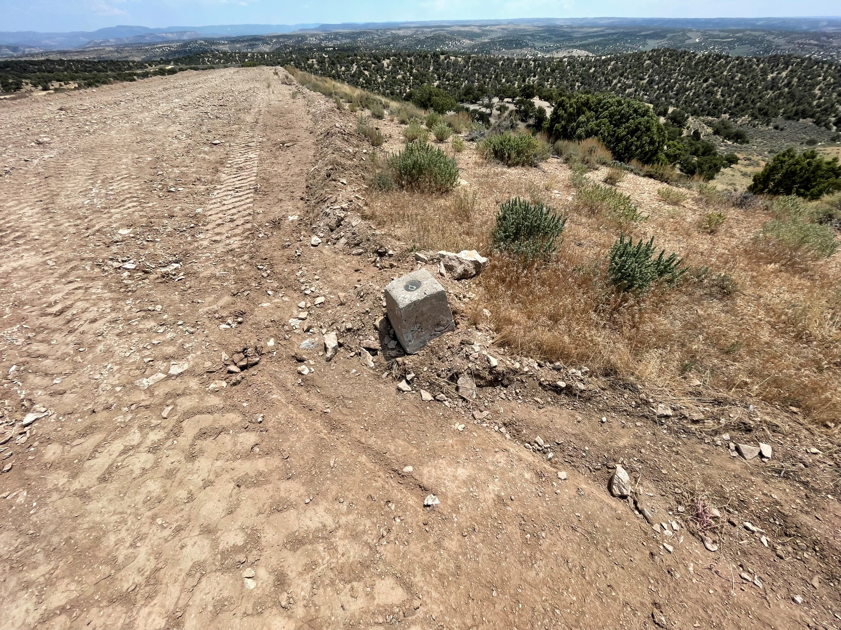
Modernizing our Reference Frames to Align with International Terrestrial Reference Frame
NAD 83 and NAVD 88 were defined during the Pre-GPS era:
  Defined by unmonitored, unstable and easily destroyed passive marks
  Defined without aid of gravity-mission satellites and airborne data
  Defined without any long-term strategy to address Earth’s dynamics or station velocities
  Global models required modifications to fit this imperfect reference frame
Systematic errors (decimeters to meters)
Origin (Earth’s Center) offset: 2.2+ meters
Zero elevation surface: 0.5 to 2+ meters
Goal: Increase Efficiency!
7

Slide 8
Improved Knowledge of Earth’s Center
Simplified concept of NAD 83 vs. “2022”
Earth’s Surface
h_{”2022”}
h_{NAD83}
φ_{NAD83} – φ_{”2022”}
λ_{NAD83} – λ_{”2022”}
h_{NAD83} – h_{”2022”}
all vary smoothly by latitude and longitude
“2022” origin
~2.24 m
NAD 83 origin

Slide 9
Modernization Increases Efficiency
  One Vertical Datum: Pole-to-Equator
    Consistent Heights Off-shore, Near-shore & On-shore
  Simplified procedures to accept geodetic data from the public
  Simplified data collection and reduction of risk of coordinate or positional inconsistencies (especially along state and international boundaries)
  Improved useability and accuracy of tools
  Consistency between ellipsoidal and orthometric heights, and between all other NSRS coordinates
Notes:
.

Slide 10
Improved Accuracy With Multi-Constellation Systems
GPS: US Global Positioning System (The Original)
GLONASS: Russian Navigation System
Galileo: European Space Agency
BeiDou: China National Space Administration
IRNSS: Indian Regional Navigation Satellite System
QZSS: Japanese Quasi-Zenith Satellite System
SBAS (Satellite-based Augmentation Systems)
  WAAS, EGNOS, MSAS, GAGAN, KASS
REAL-TIME-NETWORK GNSS Measurements ACCEPTED!

Slide 11
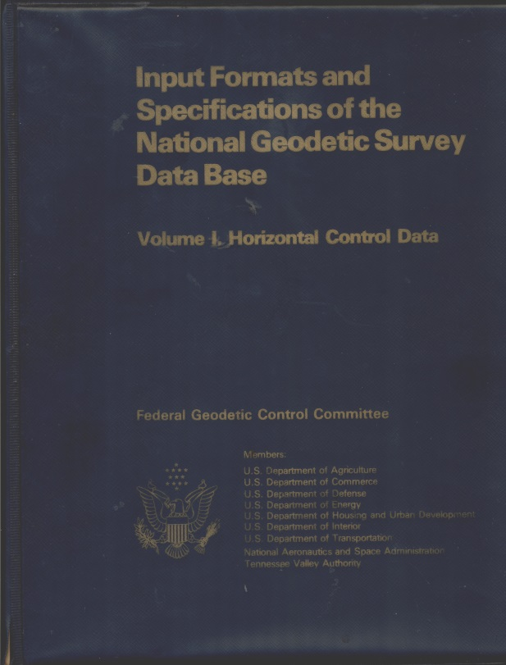
Publishing Control Becomes More Efficient
GPS surveys had been (occasionally) force-fit to less accurate measurements
NGS will continue to rely on user submitted data to densify and improve the NSRS
Bluebooking is now done ONLINE through OPUS Projects
Reference Frame is now defined by CORS rather than unmonitored passive control

Slide 12
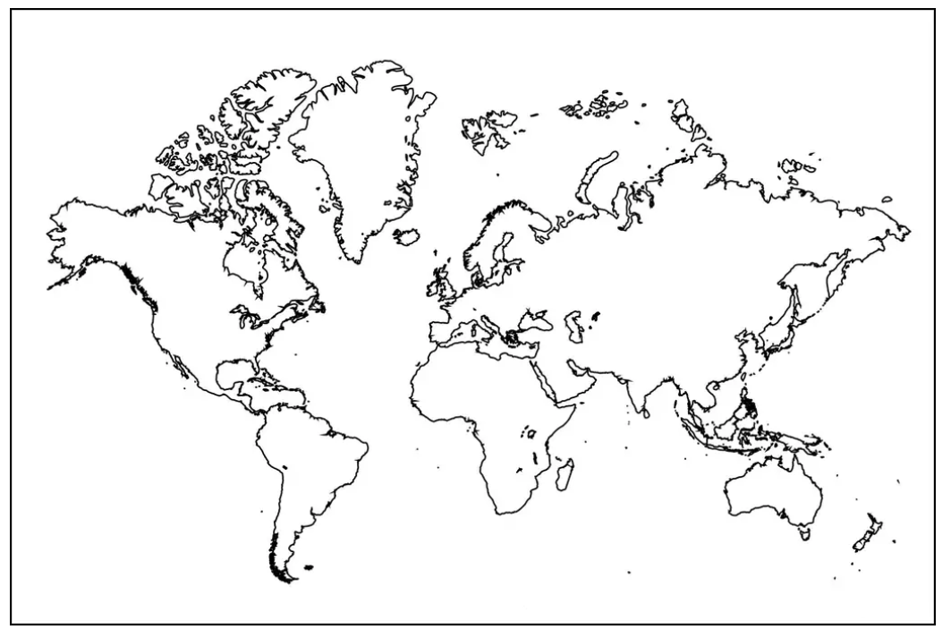
Datums In the Current NSRS
Geometric Reference Frames:
Truly global but used regionally
  NAD 83(2011)
  NAD 83(PA11)
  NAD 83(MA11)
Geoid models and Vertical Datums:
Truly Regional
  Conterminous US
    CONUS “Lower 48”
  Alaska
  Hawaii
  Puerto Rico, U.S. Virgin Islands, American Samoa, Guam
07/30/2024
2024 MAPPS Conference

Slide 13
Replacing NAD 83 with 4 Reference Frames
The Old:
NAD 83(2011)
NAD 83(PA11)
NAD 83(MA11)
The New:
The North American Terrestrial Reference Frame of 2022
(NATRF2022)
The Caribbean Terrestrial Reference Frame of 2022
(CATRF2022)
The Pacific Terrestrial Reference Frame of 2022
(PATRF2022)
The Mariana Terrestrial Reference Frame of 2022
(MATRF2022)

Slide 14
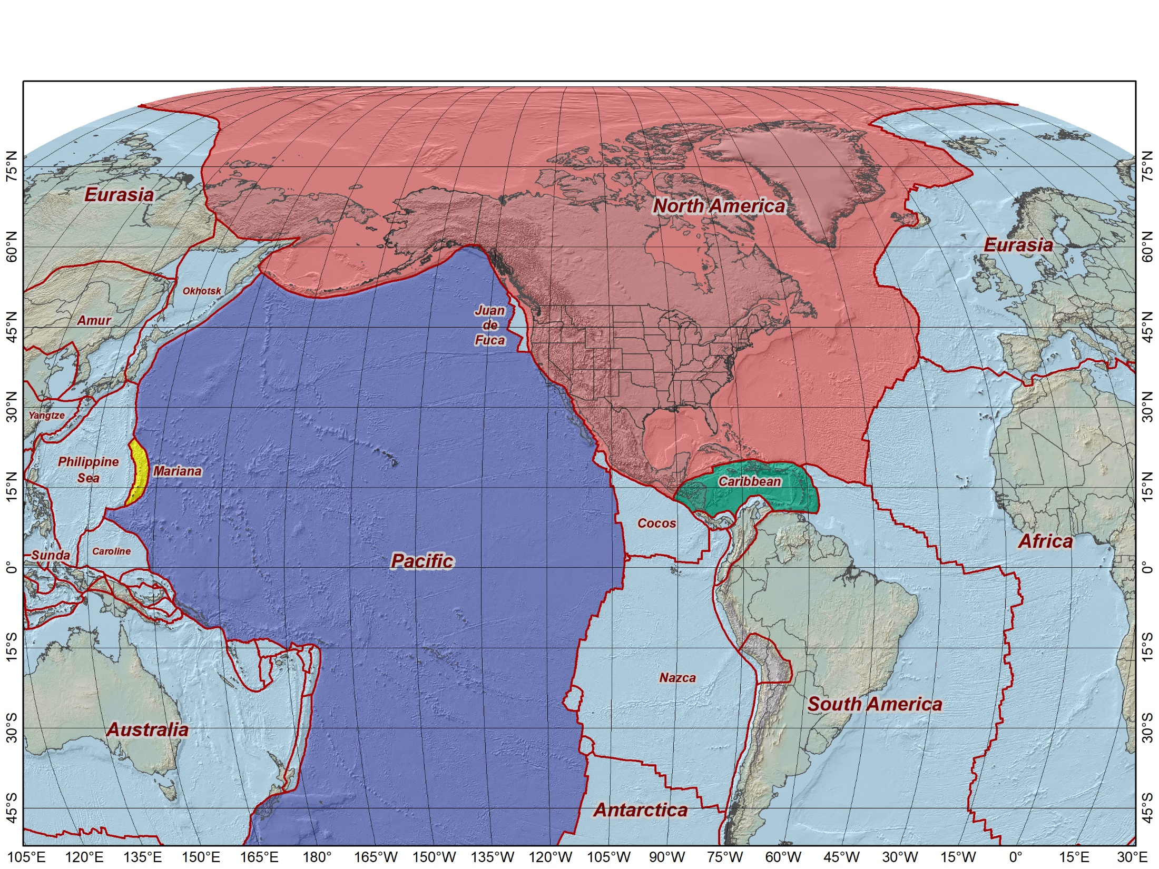
Tectonic plates “fixed” for the four 2022 Terrestrial Reference Frames
North American Terrestrial Reference Frame of 2022 (NATRF2022)
Pacific Terrestrial Reference Frame
of 2022 (PATRF2022)
Mariana Terrestrial Reference Frame
of 2022 (MATRF2022)
Caribbean Terrestrial Reference Frame
of 2022 (CATRF2022)
NATRF2022
MATRF2022
PATRF2022
CATRF2022
Initially set to epoch 2020.0 (Jan 1, 2020) and identical to ITRF2020 at that epoch

Slide 15
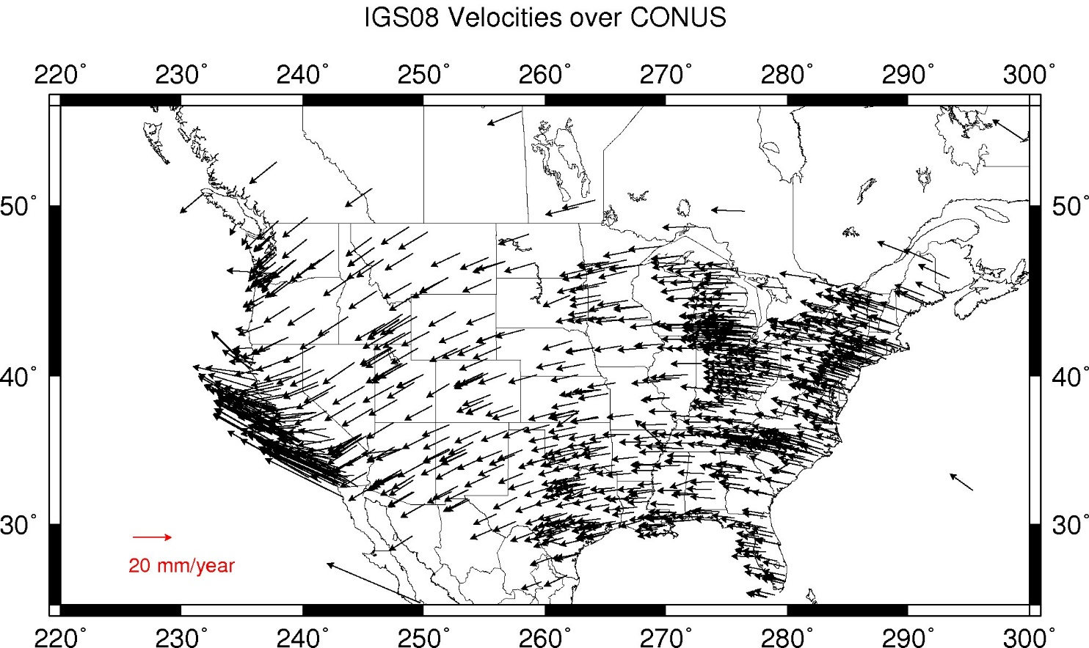
ITRF(2014) Velocities- CONUS

Slide 16
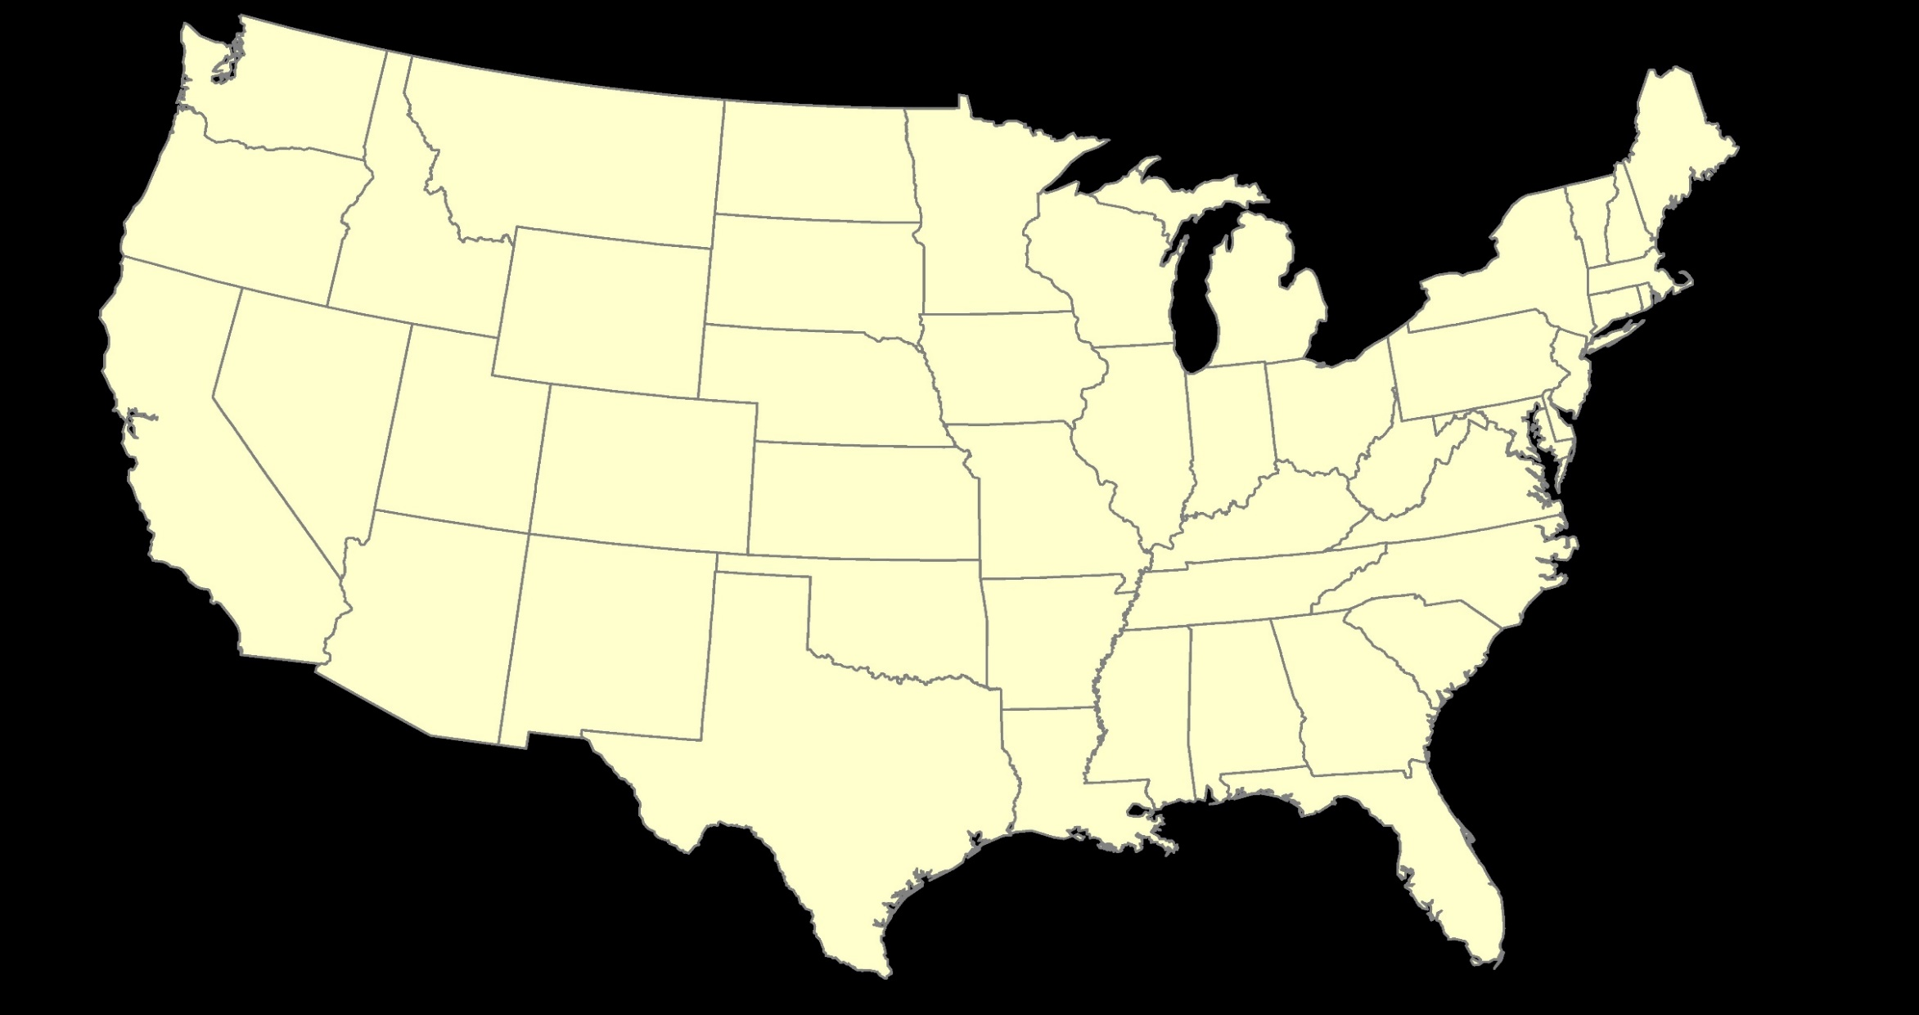
ITRF2020 or NATRF2022
07/30/2024
2024 MAPPS Conference

Slide 17
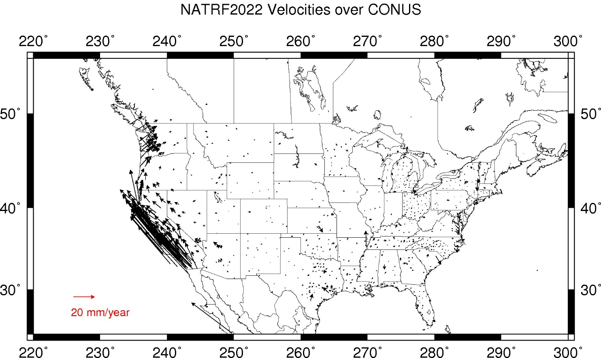
Residual Velocities – NATRF2022/CONUS

Slide 18
Why Modernize? NAVD 88 and Heights
  The Old:
  NAVD 88
  PRVD 02
  VIVD09
  ASVD02
  NMVD03
  GUVD04
  IGLD 85
  IGSN71
  GEOID18
  DEFLEC18
  The New:
  The North American-Pacific Geopotential Datum of 2022 (NAPGD2022)
Orthometric
Heights
Normal
Orthometric
Heights
  Will include:
  DEM2022
  GRAV2022
  GEOID2022
  DEFLEC2022
A HUGE component of this
effort is GRAV-D:
Gravity for the Redefinition of
the American Vertical Datum
Dynamic
Heights
Gravity
Geoid
Undulations
One Vertical Datum;
Pole-to-Equator!
Deflections of
the Vertical
07/30/2024
2024 MAPPS Conference

Slide 19
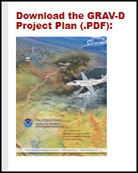
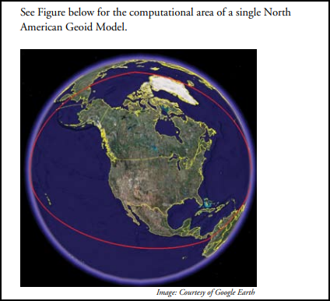
GRAV-D Improves Gravity Models
Airborne gravimeter flown at 20,000 feet.
Measured the Earth’s gravity field with sufficient density and accuracy to create a geoid model over ¼ of the Earth
  Covers the US and all its Territories.
https://www.ngs.noaa.gov/GRAV-D/pubs/GRAV-D_v2007_12_19.pdf
Notes:
.

Slide 20
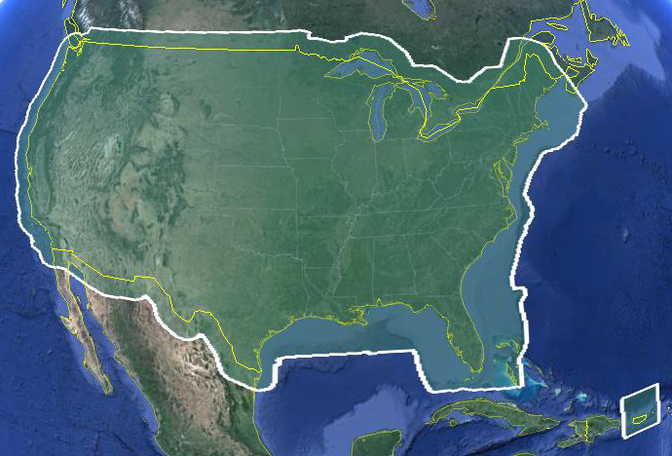
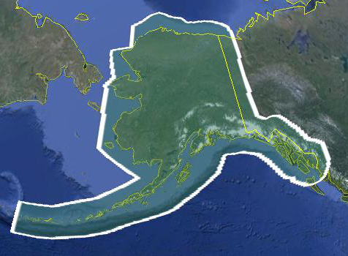
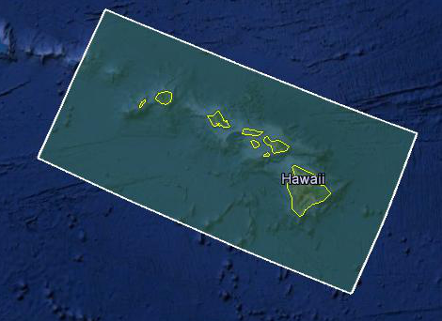
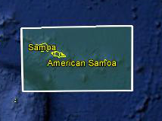
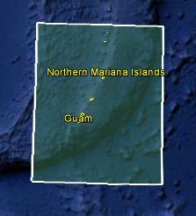
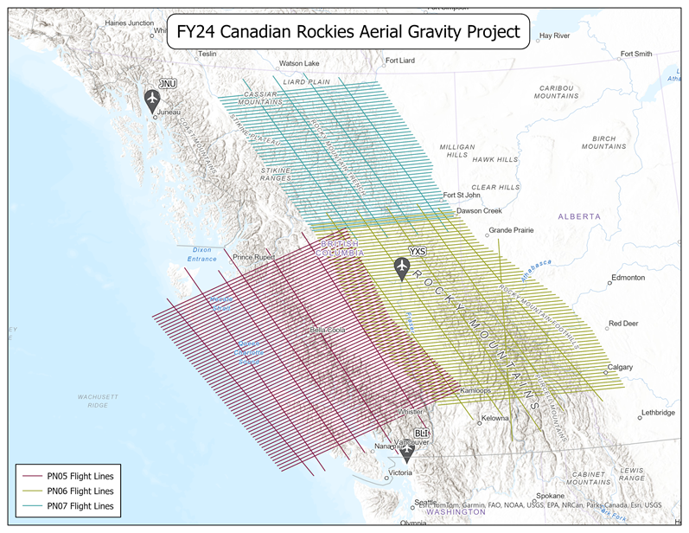
GRAV-D is Completed Throughout the US
Entire US and all its territories
  Total Square Kilometers: 15.6 million
    That’s 3,854,843,950.9 acres
  Critical for NAPGD2022 Development
  ~200 km buffer around territory or shelf break if possible
20
07/30/2024
2024 MAPPS Conference

Slide 21
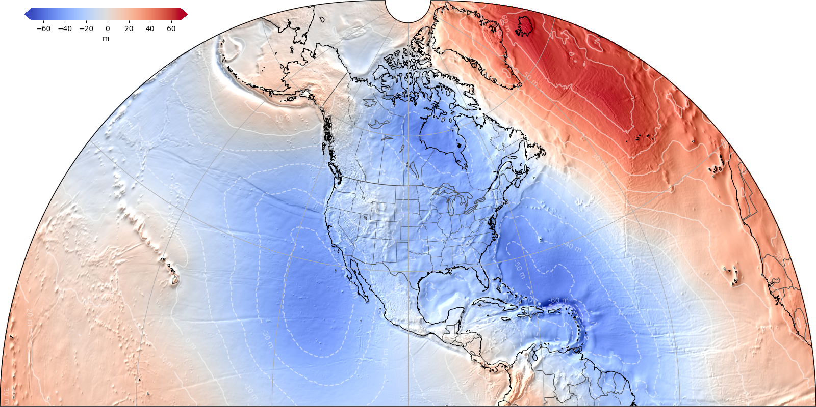
NAPGD2022 Geopotential Datum
Defined from satellite, airborne, & terrestrial gravity observations, along with satellite altimetry
Models include:
  Geopotential
  Geoid
  Deflection of Vertical
  Gravity
Primary access to datum will be via GNSS
Unified datum for off-shore, near-shore & on-shore
Consistent access to the same datum for all US and territories
Geoid undulations from the alpha GEOID2022 model
https://alpha.ngs.noaa.gov/GEOID2022/
07/30/2024
2024 MAPPS Conference

Slide 22
Geoid, Ellipsoid and Orthometric Heights
h
= H
+ N
h: ellipsoidal height
H: orthometric height
N: geoid undulation
Topography
h
H
GEOID2022
N
GRS80
ellipsoid
07/30/2024
2024 MAPPS Conference

Slide 23
GEOID2022 Available on ALPHA Site https://alpha.ngs.noaa.gov/GEOID2022/
Continuous & consistent sea level surface measurements related to sciences and modeling; including all the territories
References the Earth’s center and provides orthometric heights directly from GNSS
Doesn’t require passive mark stability for network integrity
Geometric positions and Geopotential Heights are (finally) achieved within the same reference frame!
07/30/2024
2024 MAPPS Conference

Slide 24
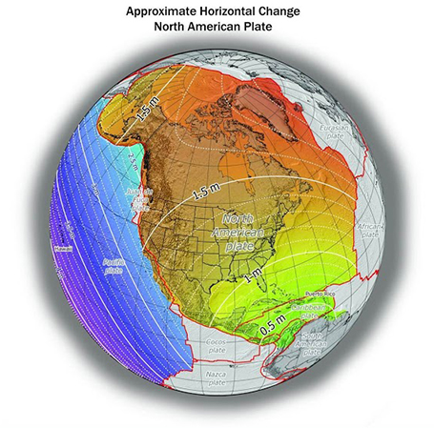
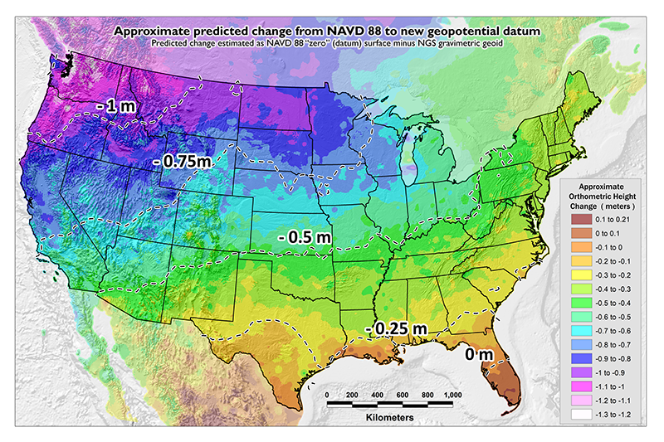
Horizontal Shift Vertical Shift
~1 to 1.5 meters North America
~2.5 to 4 meters in Pacific
0 to 1.3 meters CONUS
07/30/2024
2024 MAPPS Conference

Slide 25
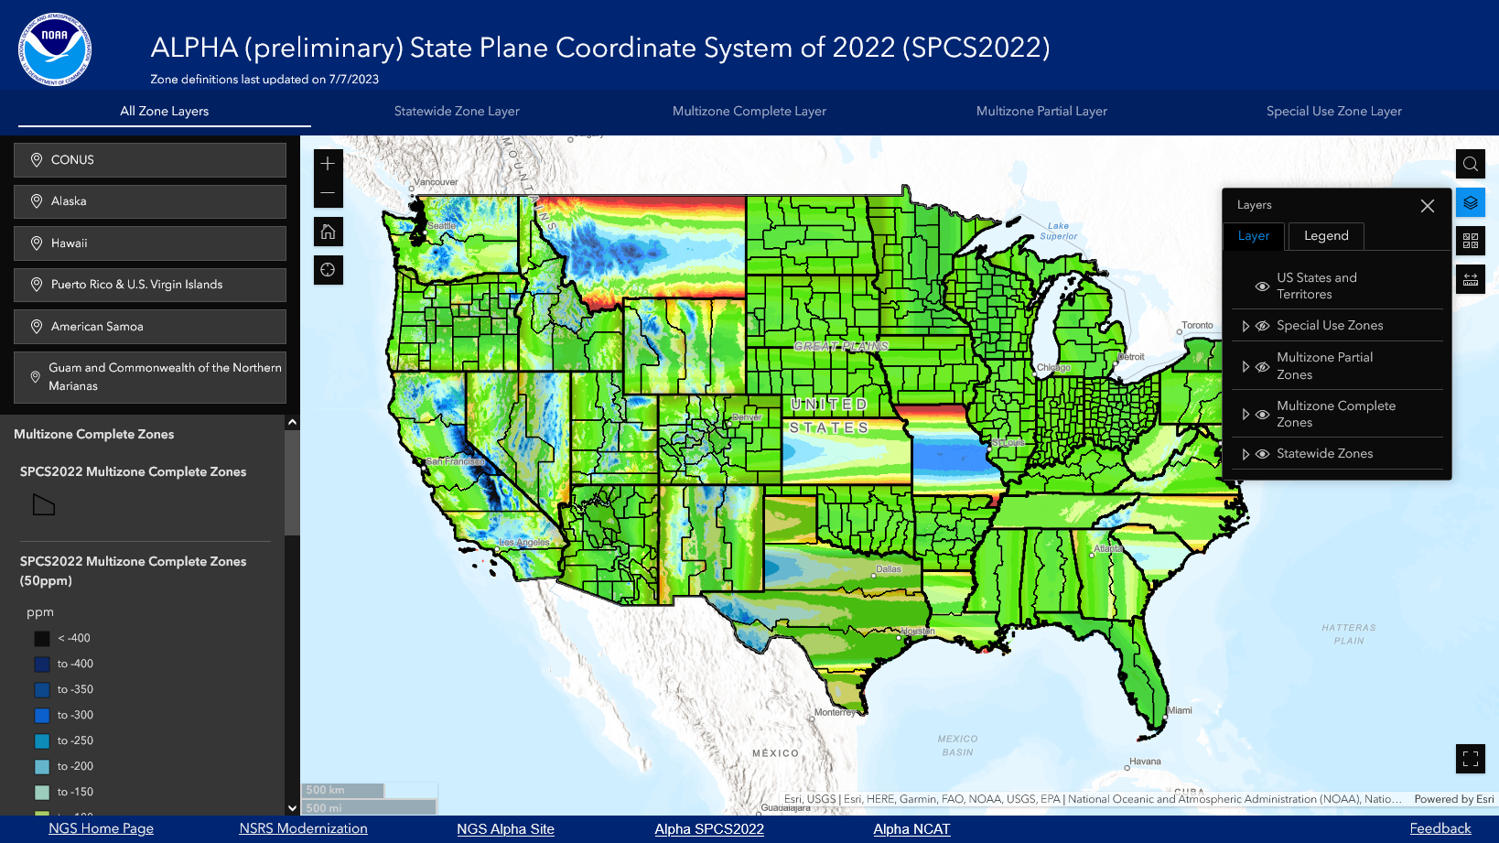
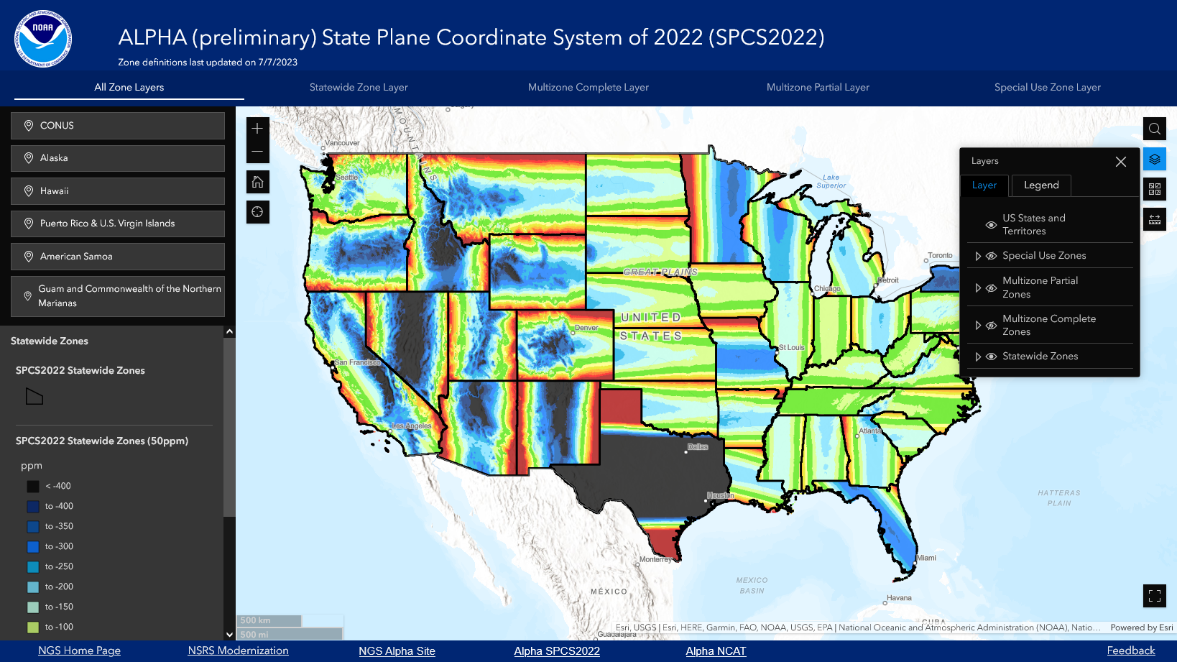
SPCS2022 Projections have been Designed By (and For) the Users
Software developers have immediate access to all projection parameters in SPSC2022 through the ALPHA site
https://alpha.ngs.noaa.gov/SPCS/index.shtml
07/30/2024
2024 MAPPS Conference

Slide 26
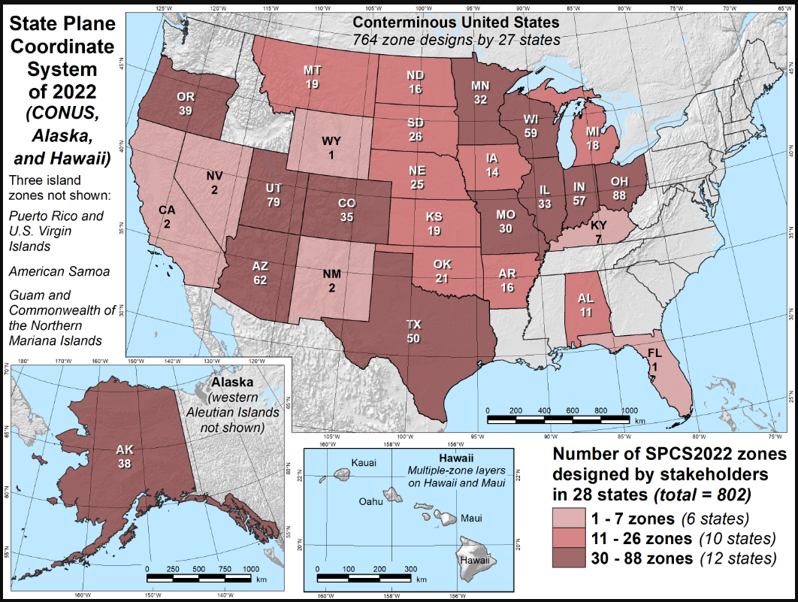
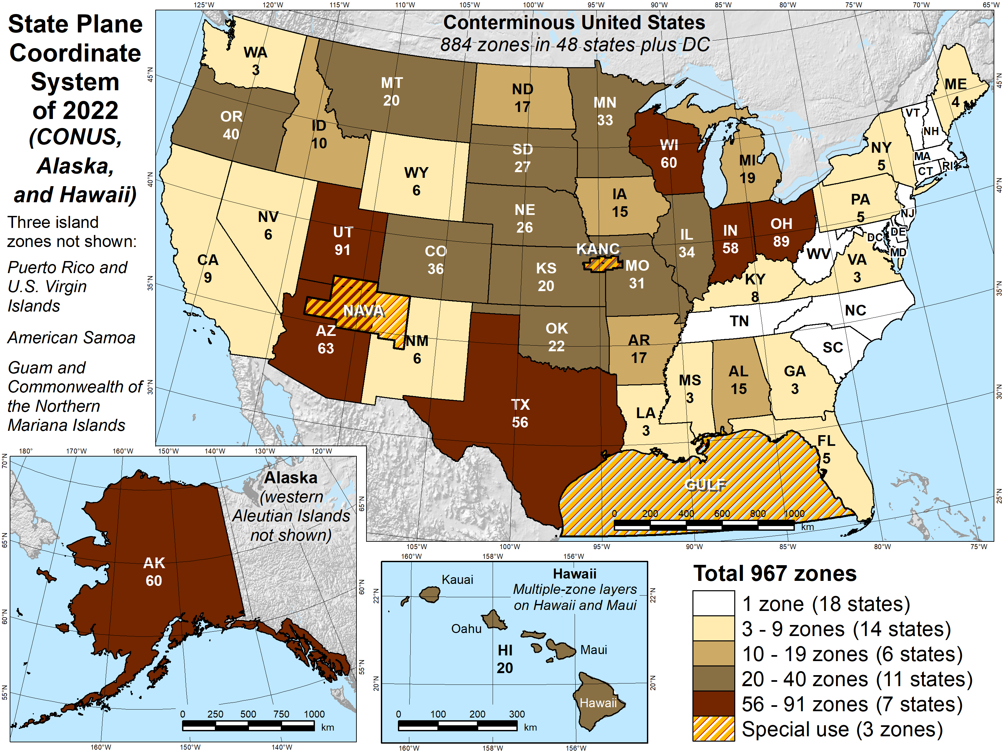
Published Projections SPCS2022
Zones Designed by States Total # of Zones

Slide 27
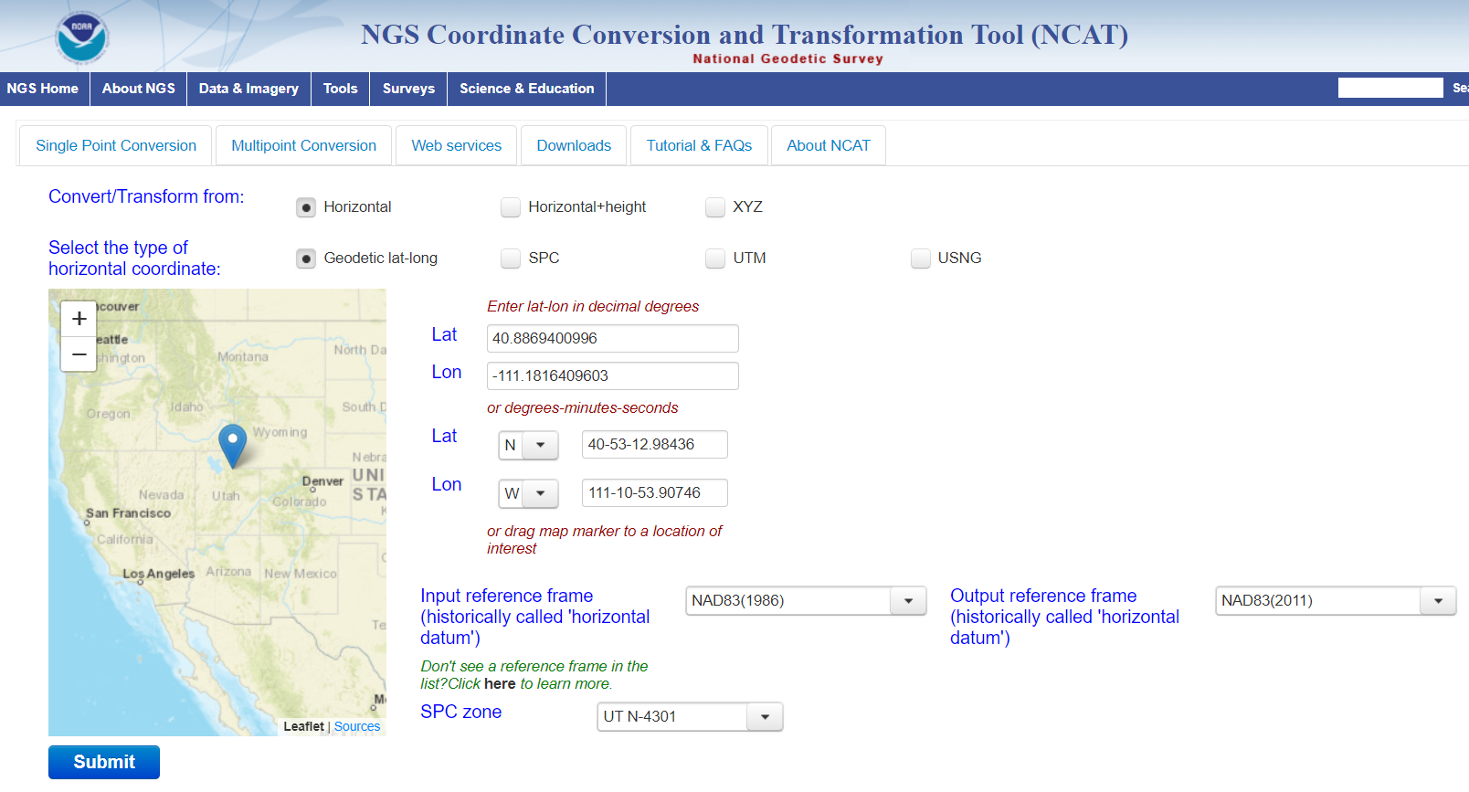
Improvement; NGS Coordinate Conversion and Transformation Tool (NCAT)
https://geodesy.noaa.gov/NCAT/
NCAT: Transforms between all realizations of NAD83 and NATRF
VERTCON will be included
Accepts entire point lists
Future will include time-dependency (An updated HTDP)
NCAT Code is available on GitHub so industry partners can prepare their software

Slide 28
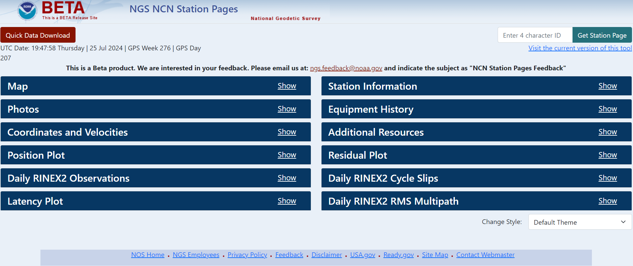
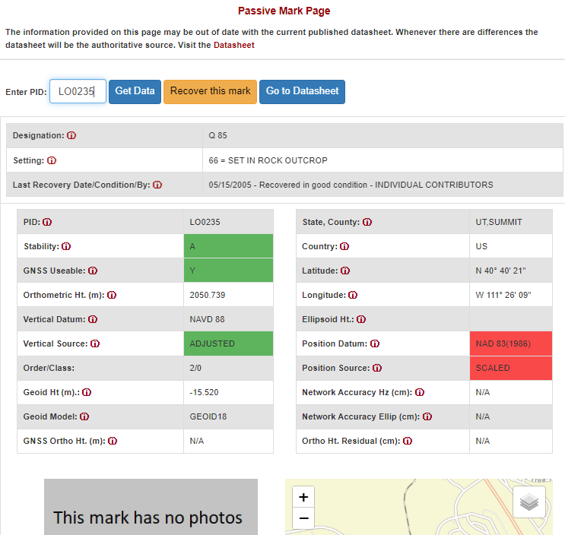
Improvement; Upgraded Data Delivery System from NGSIDB to NSRS DB
CORS
Passive Mark Page
https://beta.ngs.noaa.gov/CORS/ncn_station_pages/index.html#
https://geodesy.noaa.gov/datasheets/passive-marks/index.html

Slide 29
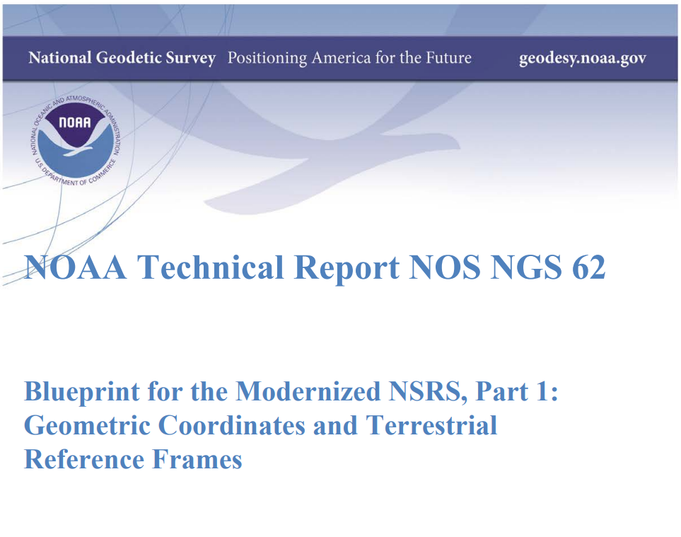
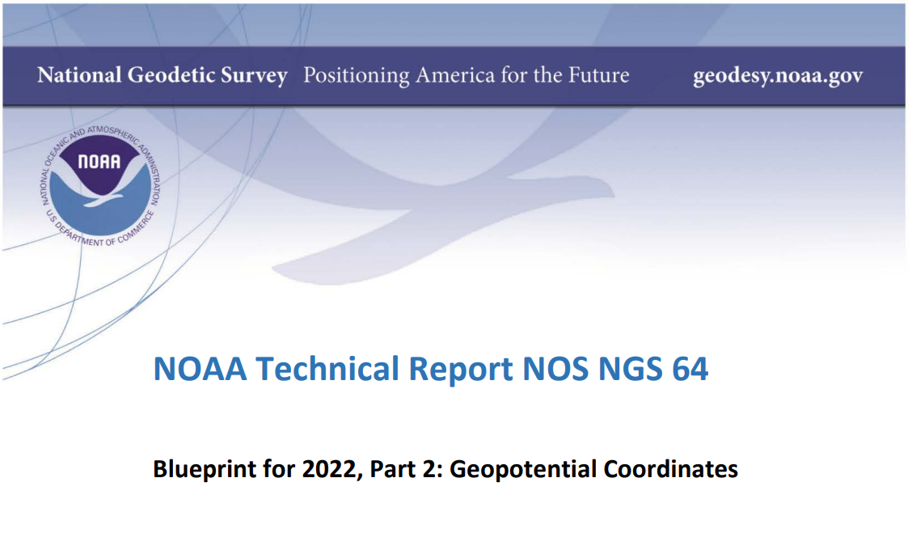
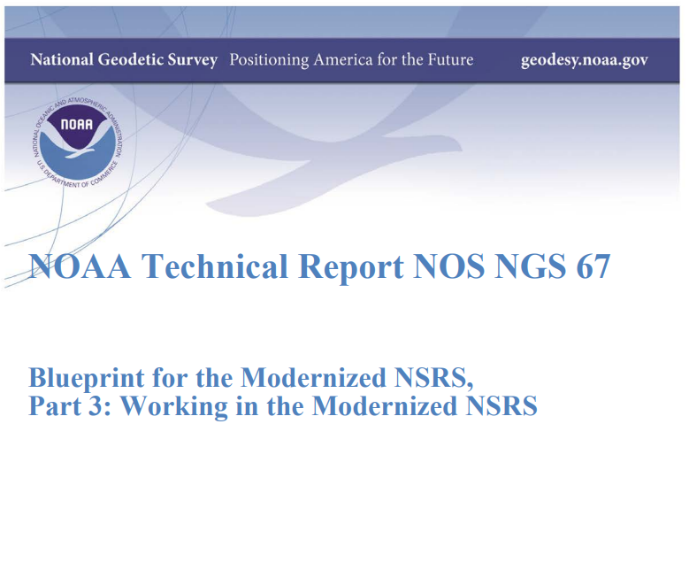
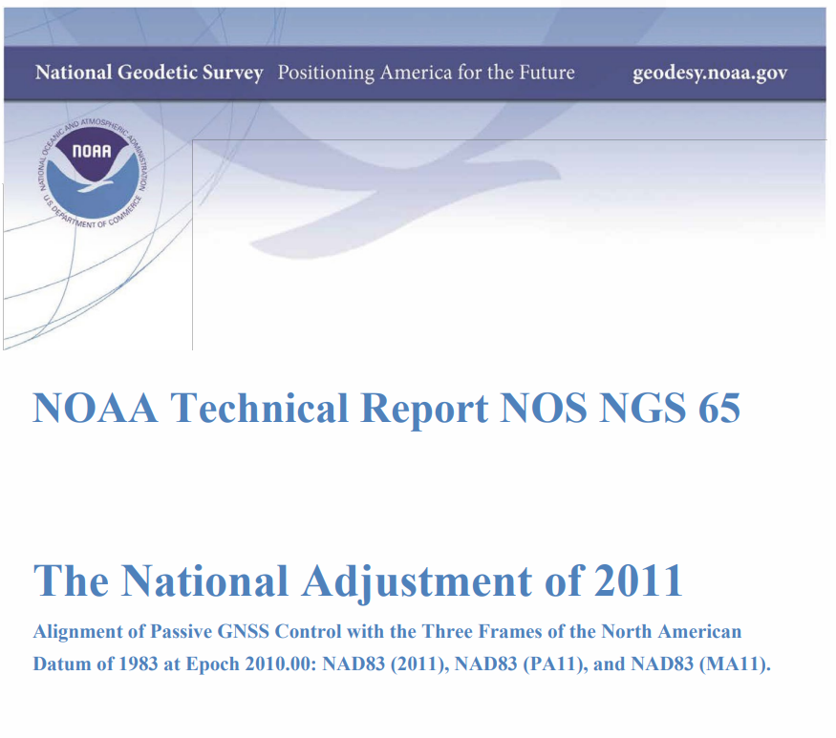
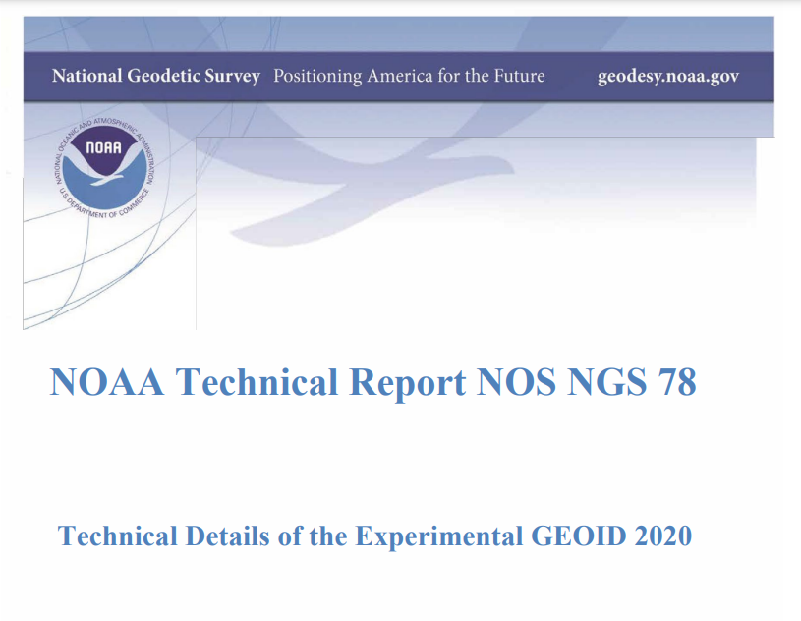
Improvement; Excellent Documentation

Slide 30
NSRS Modernization Process
Since 2022, NGS has diverted resources from tool-building to data assurance
  “Limited tools, excellent coordinates”
  Set a goal of roll-out by 2025
NGS is on-track to roll out the modernized NSRS by the middle of 2025.
Work on additional tools will continue in the out-years
Often, completing one step is a prerequisite for beginning the next
07/30/2024
2024 MAPPS Conference

Slide 31
Upcoming NSRS Modernization Tasks
Data processing for Multi-Year CORS Solution 3 (In Progress)
  Replace 3 Frames with 4; NATRF/ PATRF/ MATRF/ CATRF2022
Transition to GEOID2022 to define Zero Elevation
Compute Reference Epoch Coordinate adjustment at 2020.00
Develop transformation grids
Finalize SPCS2022 (12 States have already completed legislation)
Federal Geodetic Control Subcommittee will vote to adopt (expected 2026)
07/30/2024
2024 MAPPS Conference

Slide 32
Best Ways to (Re)determine Coordinates in the Modernized NSRS
Resurvey: Return to the field and collect new observations, relying upon geodetic control that has coordinates in the new datum. Maybe even publish them!
Readjust: Using existing observations, re-compute new coordinates based upon geodetic control that has been defined in the new datum (CORS)
Transform: Take finished products which have coordinates in the old datum and use transformation tools to attain coordinates in the new datum

Slide 33
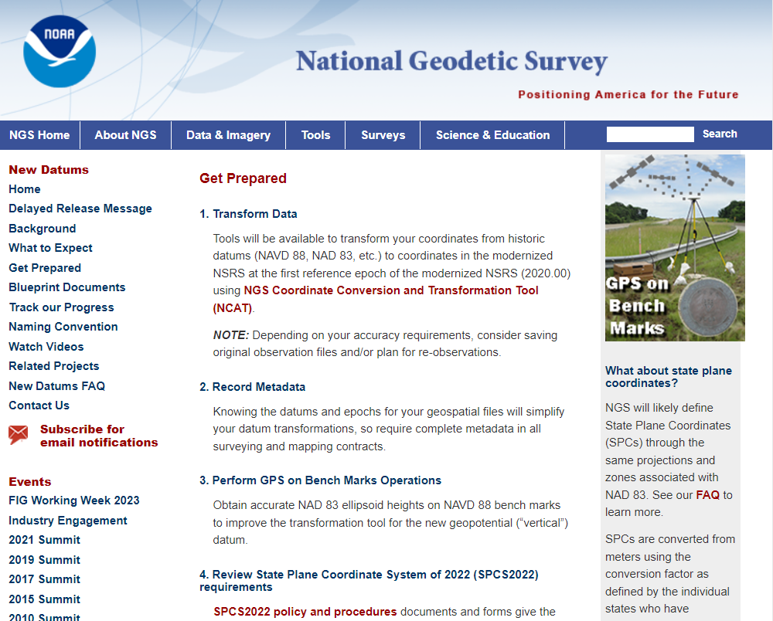
Preparing for Modernization
Read the Blueprint Documents
  We also have recorded webinars from NSRS Modernization Manager
  Consider the CASE STUDIES!
Subscribe to NGS news
Check out the New Datums web page
Reach out to NGS for answers at any time!
https://www.ngs.noaa.gov/web/news/index.shtml
https://geodesy.noaa.gov/datums/newdatums/index.shtml
https://geodesy.noaa.gov/ADVISORS/index.shtml
https://geodesy.noaa.gov/datums/newdatums/GetPrepared.shtml

Slide 34
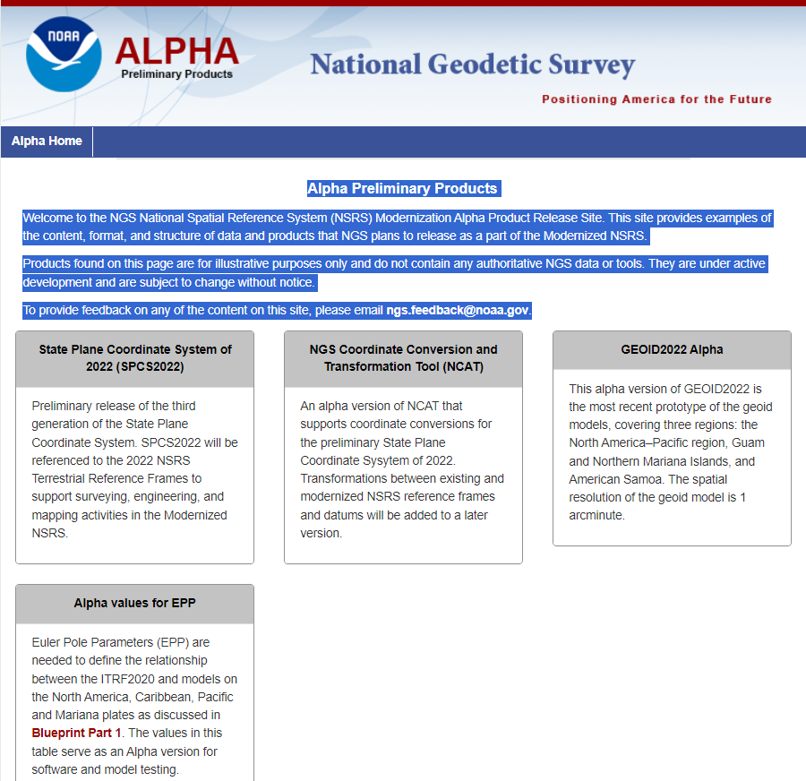
Preliminary 2022 Products on Alpha Site
Public release of preliminary Modernized NSRS products and services as a preview
For illustrative purposes only, not authoritative, but close
Under active development and subject to change without notice
Design parameters available to software vendors, States, and to the general public
https://alpha.ngs.noaa.gov/

Slide 35
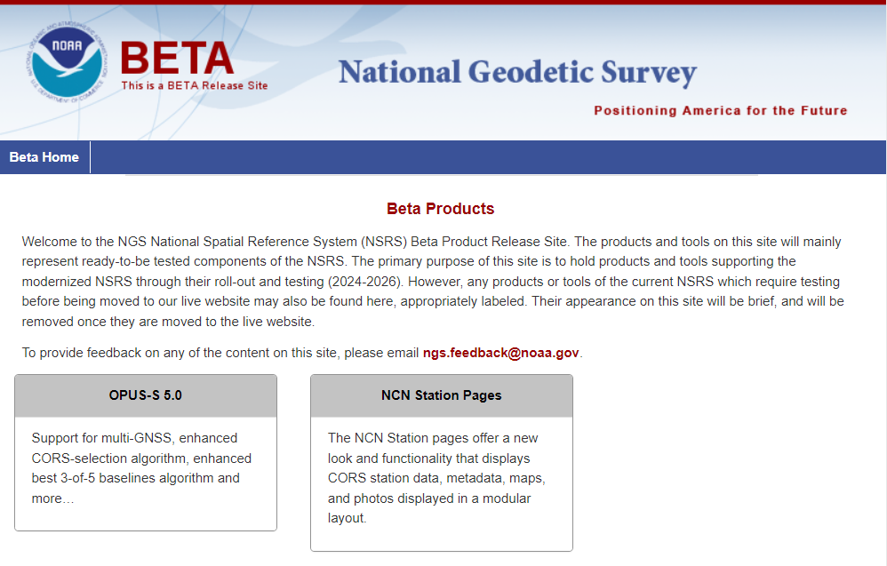

Nearly Completed Products on Beta Site
The NGS Beta website is a public-facing testing website for NGS products and services
Deserves all of our attention!
Nearly Finalized
Currently includes OPUS-S 5.0 and NCN Station Pages
Send feedback to: ngs.feedback@noaa.gov

Slide 36
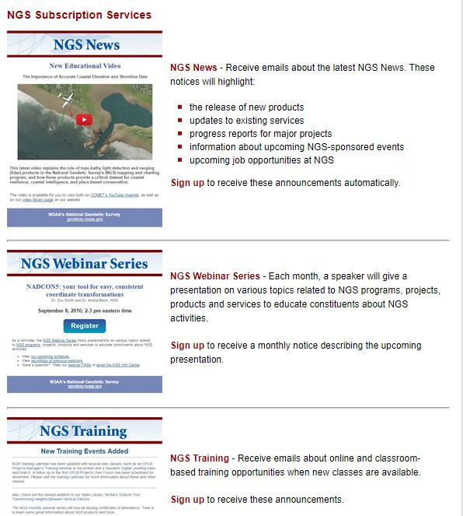

NGS Subscription Services
*Only 1-2 messages per month*
NGS News
  Includes quarterly NSRS Modernization newsletter
Webinar Series
Training
News Bulletins
Click this icon on homepage

Slide 37
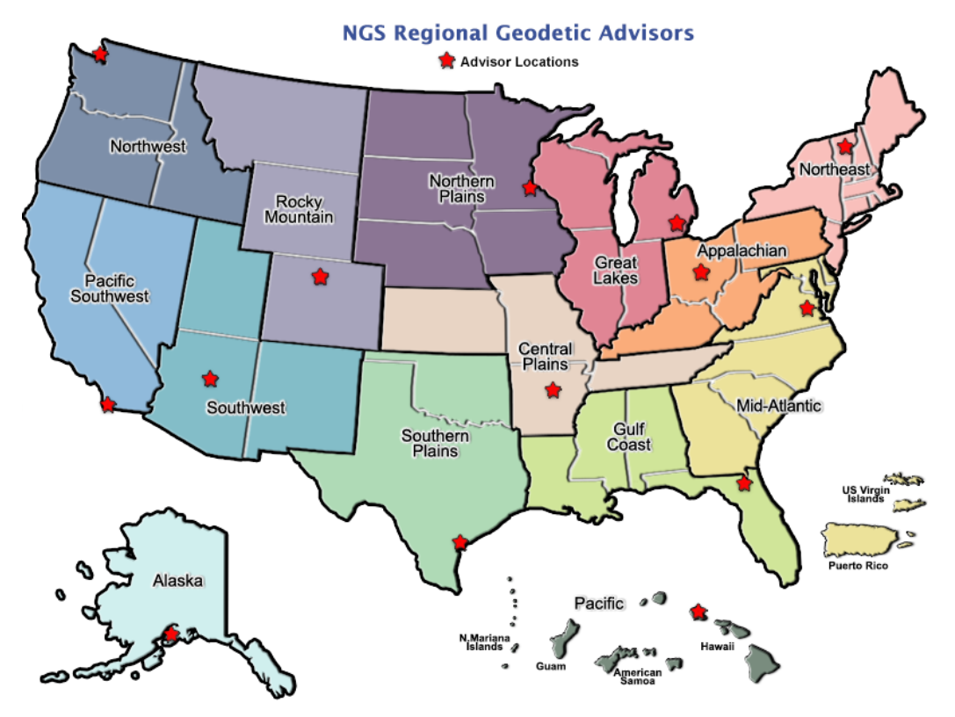
NGS Regional Geodetic Advisors
14 Advisors that support States and territories
Subject matter experts across many platforms
Vast institutional knowledge
Provide training and outreach throughout the country
Reach out! Ask!

Slide 38
Thank You!
Keith Kohl
Southwest Regional Geodetic Advisor (UT, AZ, NM)
U.S. National Geodetic Survey, NOAA
keith.kohl@noaa.gov
c/o USGS & NASA Astrogeology Science Center
2255 N. Gemini Dr.
Flagstaff, AZ 86001
For more information, visit https://geodesy.noaa.gov
Send feedback to ngs.feedback@noaa.gov

Slide 39






Today’s Panelists:
Dr. Qassim Abdullah
Brad Kearse
Dr. Dru Smith
Dr. Michael Dennis
Dr. Dan Gillins
Galen Scott

