Slide 1
NSRS Modernization Case Studies and User Perspectives Lidar Case Study - Alaska Geoid
Nicole Kinsman
Alaska Regional Geodetic Advisor
Jamie Kum and Stephen White
NGS Remote Sensing Division

Slide 2
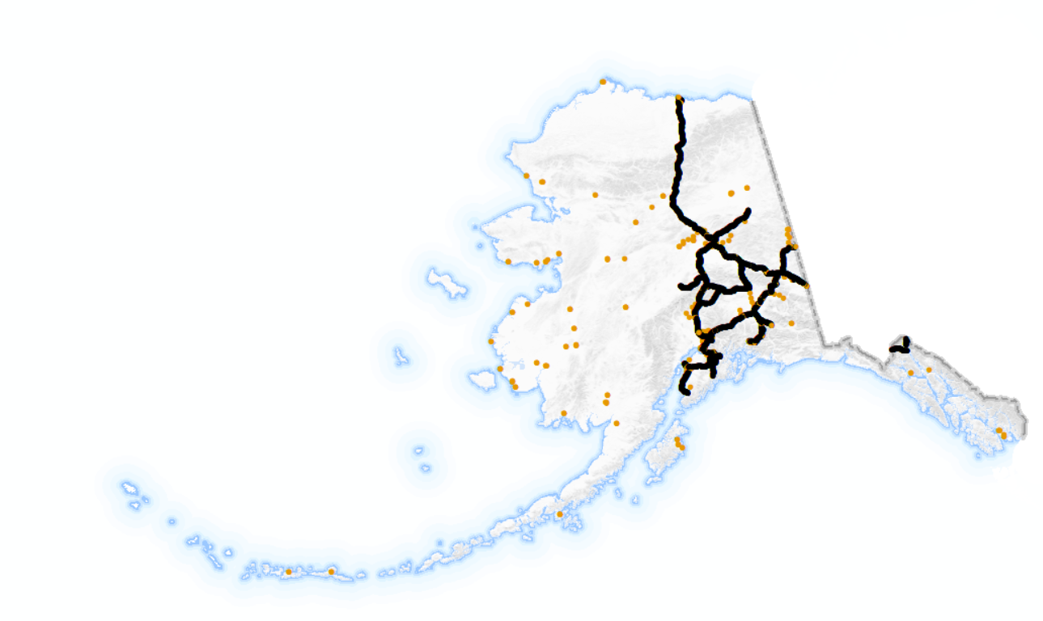
NSRS Modernization is a boon to Alaska: Access
NAVD 88 Bench Marks
Adjusted Leveling
Adjusted GPS Obs.
The NAVD 88 passive control network in Alaska is limited
GPS has already made non-local datums available to broad swaths of Alaska
Notes:
GPS-gateway opens the door to consistent NSRS access in remote and isolated parts of the United States, including offshore.
Figure illustrates limited leveling network in black (vertical NSRS control available prior to GPS in Alaska); California is shown on North slope for scale.
Published NSRS bench marks obtained from adjusted GPS observations are in orange – GPS has delivered NSRS access to parts of Alaska where it did not exist before (although with added uncertainty due to a mix of hybrid geoid models in use).

Slide 3
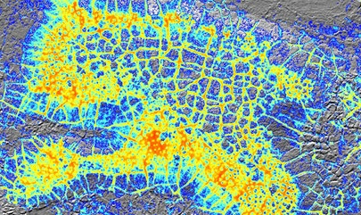
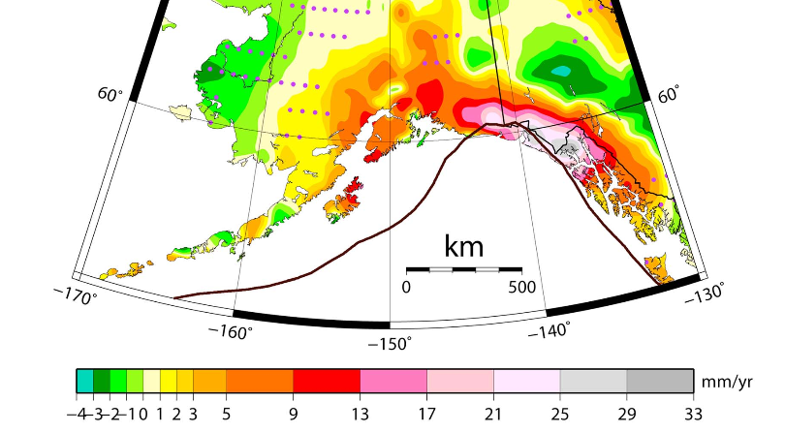
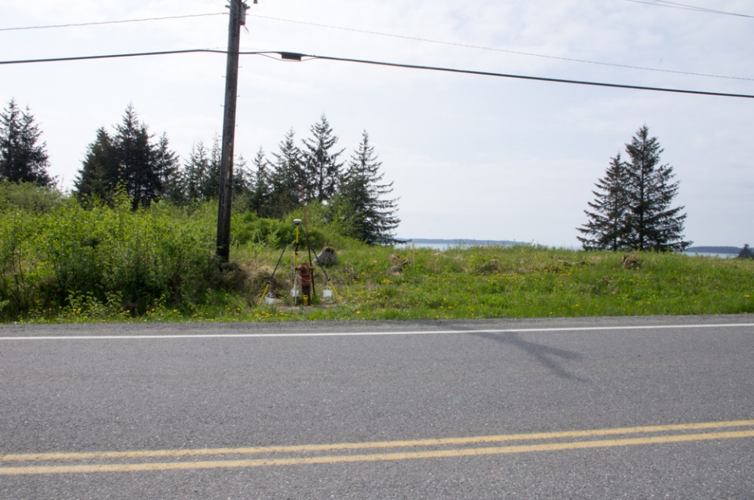
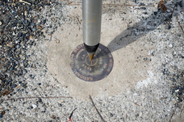
NSRS Modernization is a boon to Alaska: Reliability
Thermokarst on Alaska North Slope (see Jones et al., Nature, 2015)
Area similar to
Appearances can be deceiving…
Residual vertical velocities in Southern Alaska
(see Snay et al., JGR, 2018)
Yakutat, AK
Notes:
Time-dependency of the modernized NSRS improves access to mark stability in dynamic regions, making its easier to detect/monitor gradual change such as permafrost subsidence or tectonic motion.
Appearances can be deceiving when it comes to passive controls ability to provide alignment to the NSRS, as shown in the two examples here:
Rod monument in greased sleeve appears to the casual observer to be frost jacked; but OPUS GPS recoveries have revealed this mark to be very stable relative to the NSRS and it is the local ground around the mark that is subsiding (similar in setting and rate to the thermokarst subsidence illustrated on North Slope in figure to right)
Disk monument set in Right of Way concrete appears to the casual observer to be stable; but it is only stable relative to other local control; OPUS GPS recoveries expose the vertical uplift on this mark (within the NSRS and global frame) arising from isostatic rebound associated with glacial ice loss.
→ GPS-based alignment with the NSRS provides users with the information they need to make informed decisions about project control to achieve desired outcomes

Slide 4
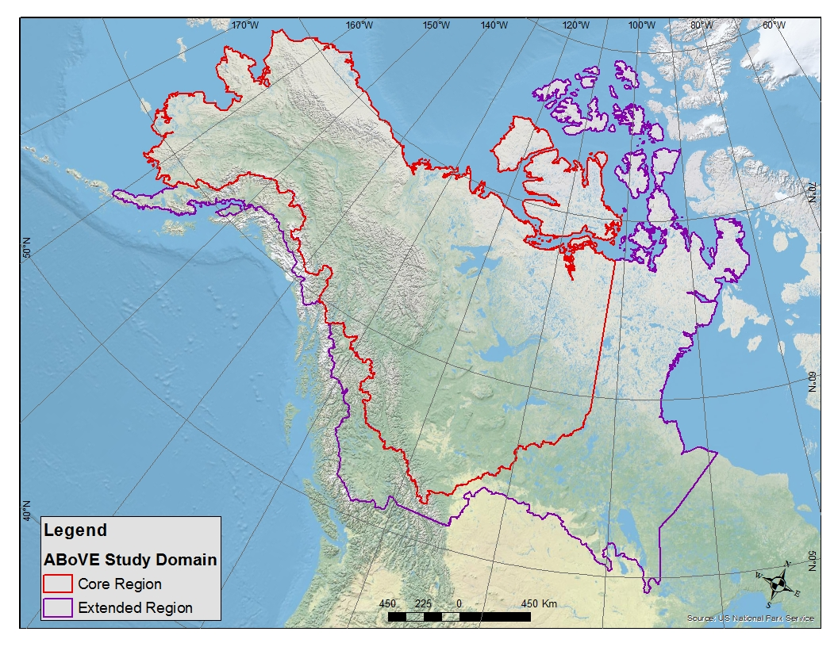
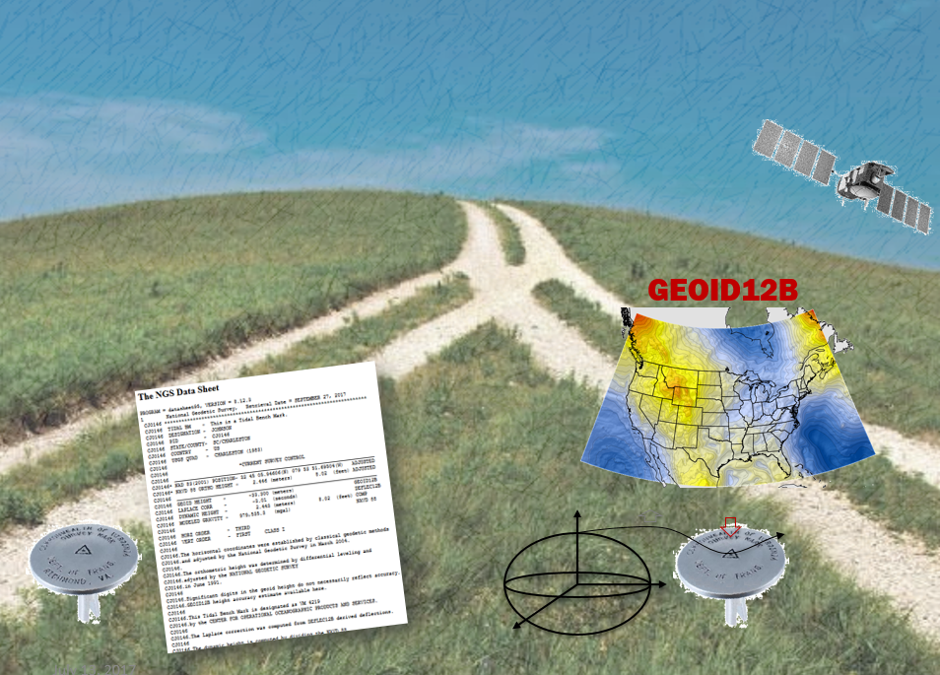
NSRS Modernization is a boon to Alaska: Consistency
Method Consistency
International Consistency
NAVD 88 v. Orthometric Heights obtained with GEOID12B (h-N)
Example:
International Projects like NASA ABoVE
Notes:
Consistency is important in different aspects of NSRS use:
In Alaska today, most IDB positions are based on dated adjustments and since the region is in motion the passive control is no longer where is was when the hybrid geoid was created so users relying on published heights obtain different results than those that are relying on contemporary GPS positions obtained from OPUS, the NGS CORS Network, and GEOID12B → modernized NSRS provides tools for different methods of NSRS access/alignment to be more consistent (also why no hybrid GEOID18 in Alaska)
The North American and Pacific Geopotential Datum of 2022 (NAPGD2022; modernized vertical datum) will align with international neighbors such as Canada, facilitating data-sharing in the Arctic (example from NASA project footprint seeking to generate a seamless DEM for ecosystem research); defined relationship between the North American Terrestrial Reference Frame of 2022 (NATRF2022) and ITRF2018 will improve also the spatial framework for UAS and precision navigation interactions with the built environment.

Slide 5
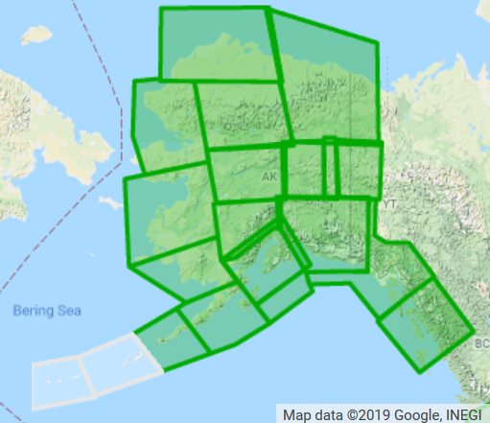
GRAV-D in Alaska
Collection over mainland Alaska completed in 2018
Aleutians possible in 2020
Contribution of GRAV-D airborne gravity to xGEOID17B
mGal
Notes:
Map on left illustrates GRAV-D collection status in Alaska as of today: green boxes are completed and white areas over the Aleutians are in planning stage.
GRAV-D data from the portions surrounded by blue are already incorporated into the most recent xGEOID models (same data over Alaska in xGEOID17B/18B, xGEOID19 on the way will include all of the airborne GRAV-D data collected in Alaska to date).

Slide 6
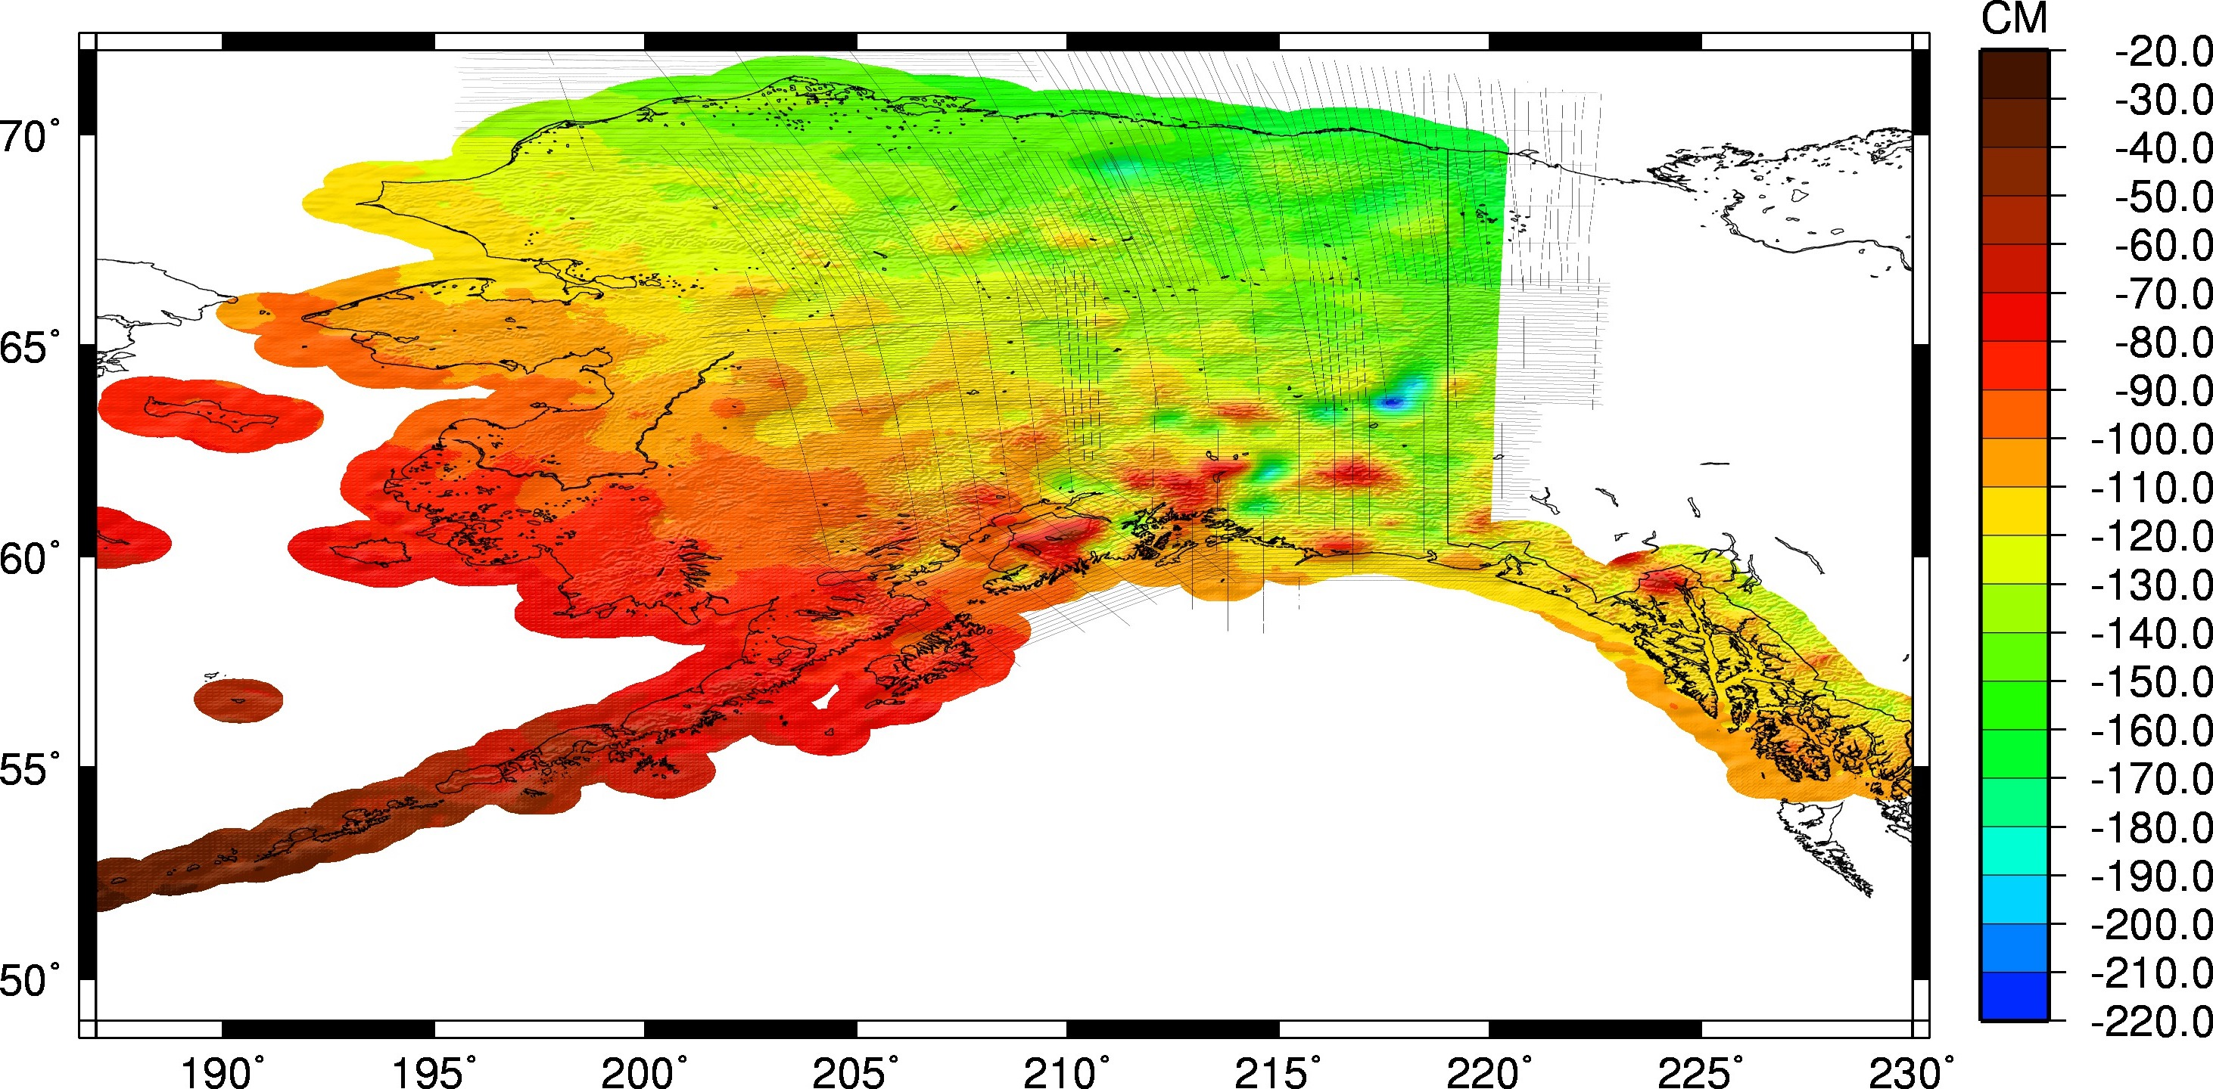
Transition to a Gravimetric Geoid in Alaska
Fairbanks, Alaska
Gravimetric xGeoid16B – Hybrid Geoid12B
Notes:
What does the move to a gravimetric geoid really look like in Alaska?
Vertical changes in the geoid model are illustrated in this difference map with the largest changes occurring in NE (<1.5 m), and smallest over the Aleutians.
Largest impact is therefore the correction of a tilt, which will also result in NAPGD2022 heights aligning more closely with local MSL values.
Case study location to look at what effects this has on the local level is in Fairbanks, Alaska

Slide 7
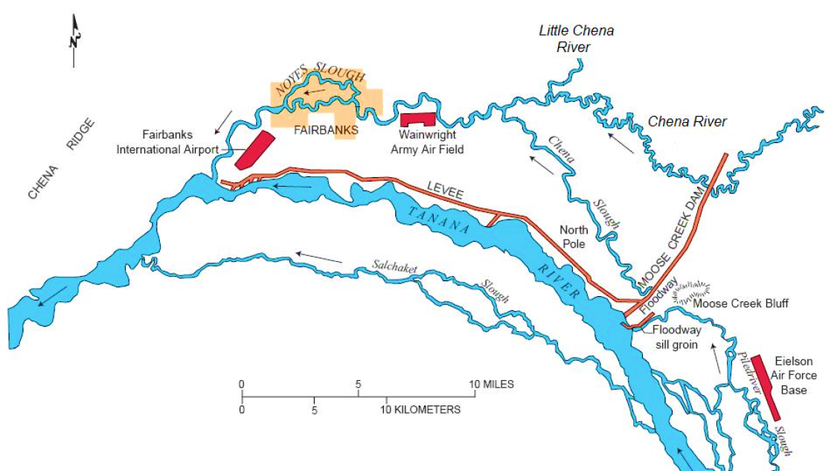
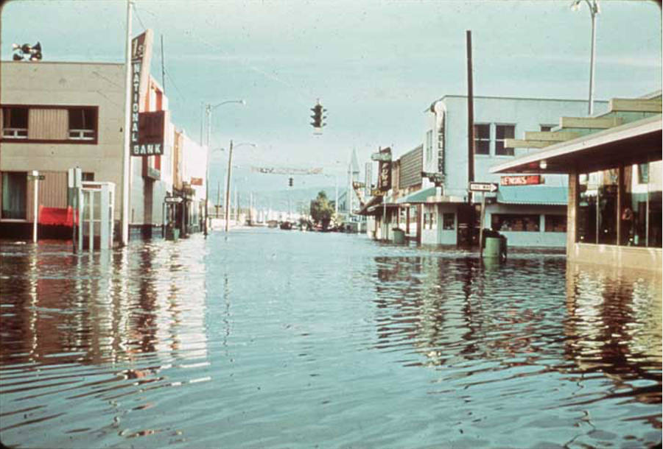
Case Study Location: Fairbanks, Alaska
Population:
14,000 1960s
31,644 today
1967 Flood
1973-79 Flood Control Project
1967
Alaska Digital Archives, Elmer E. Rasmuson Library, UAF
Chena River Lakes Project Layout. Source: US Army COE Letter Report 27, modified from USGS WRI Report 00-4227.
Notes:
Fairbanks is Alaska’s third largest city now, it is located on the banks of the Chena River, a tributary to the Tanana (Lotto River). The area experienced a severe flood that caused extensive damage in 1967 (photo of floodwaters right in downtown), resulting in a major USACE Flood Control Project that was completed in the late 70s (Moose Creek Dam & Levee).
NOAA NWS Flood Story Map: https://arcg.is/fKGvf

Slide 8
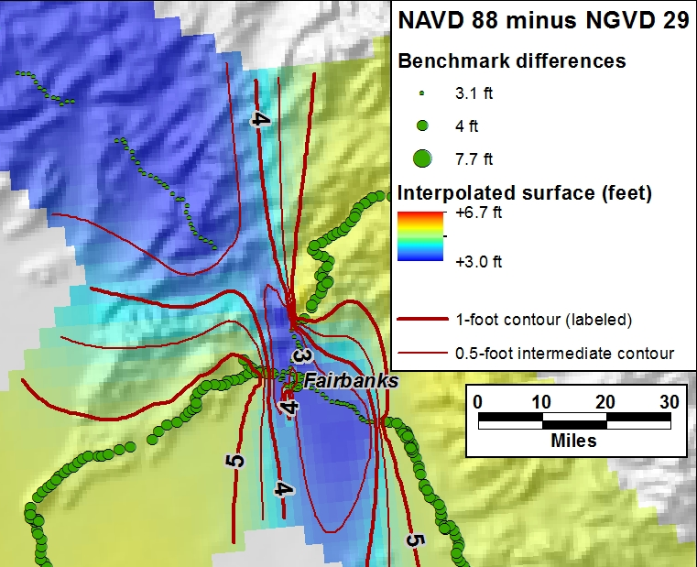
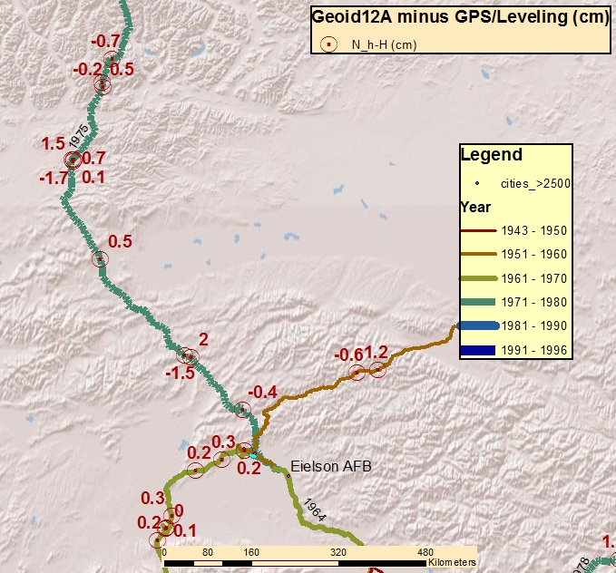
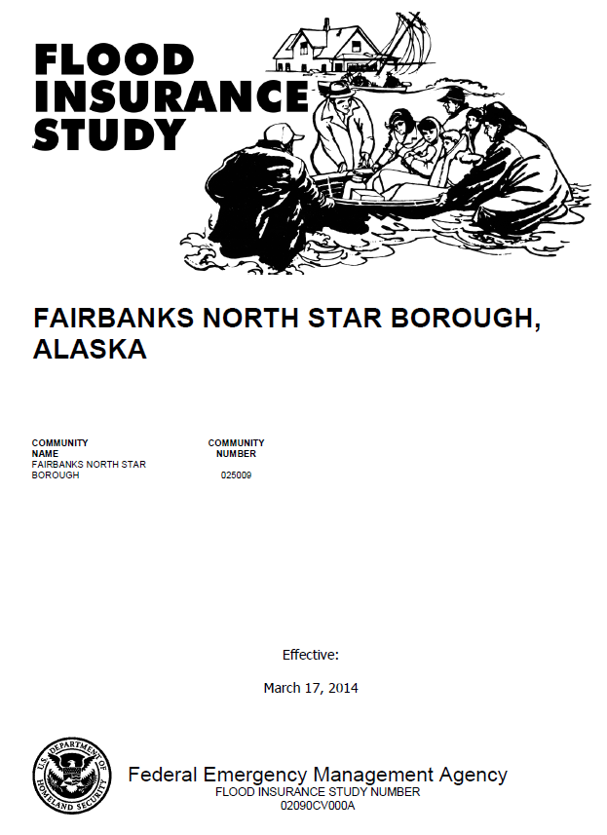
…a continuation of NSRS improvements
Pre- NAVD 88
2014 FIS Revision in NAVD 88
NSRS of Today
“ ”
M. Dennis, 2014
D. Zilkoski, 2014
1977 partial adjustment differed from 1966 adjustment by >2 feet in downtown Fairbanks
Hybrid GEOID12B w/in 2-3cm of NAVD 88 marks
Low gravimetric geoid slope (<25 ppm)
Notes:
Fairbanks is a great example of a location where ongoing NSRS improvements have only continued to enhance NSRS heights:
Prior to NAVD 88, a partial 1977 adjustment that only included about 1/3 of the first order control in the area differed from the 1966 adjustment already in the IDB by more then 2 feet in downtown Fairbanks. This two adjustments were retained in the pre-NAVD 88 height system (really linked to MSL in Gulf of Alaska, so not really NGVD29 but often called this) resulting in in significant inconsistencies in NSRS heights depending on which marks were used as the basis of vertical control. This was a big issue in the FIS of the time, and in the 2014 FIS revision, which included an update to NAVD 88, there is a long explanation abut the “datum forensics” that were necessary to determine which ‘NGVD29’ adjustment was basis of the levee project (1966).
With move to NAVD 88, this issue has been resolved but there are still vertical discrepancies between adjusted heights in the IDB and orthometric heights in the OPUS Shared DB obtained with hybrid GEOID12B.
In terms of case studies, Fairbanks is actually an end member in Alaska (and most similar to lower 48) = about as good as it gets in Alaska right now for NAVD 88 and the geoid slope is minimal; but we show here how NAPGD2022 will still yield benefits.

Slide 9
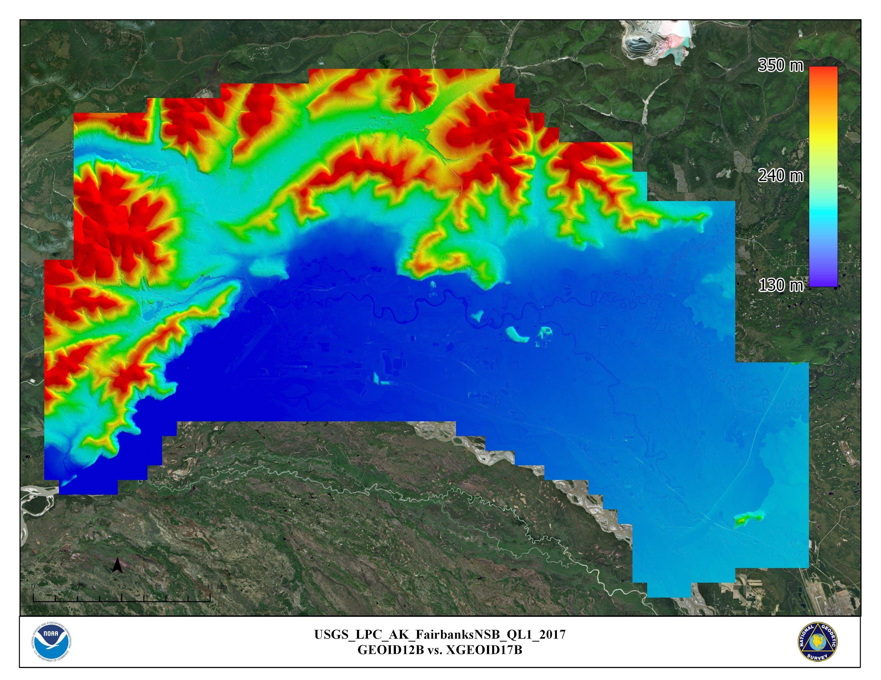
Fairbanks 2017 Lidar
350 m
240 m
2017 3DEP Project
USGS/Borough/GVEA Partnership
QL1 and QL2 lidar
Acquired to support range of applications
130 m
Notes:
Overview of 2017 lidar footprint. (mention Goldstream Valley, Domes, and highlight visibility of Moose Creek Dam in DEM)

Slide 10
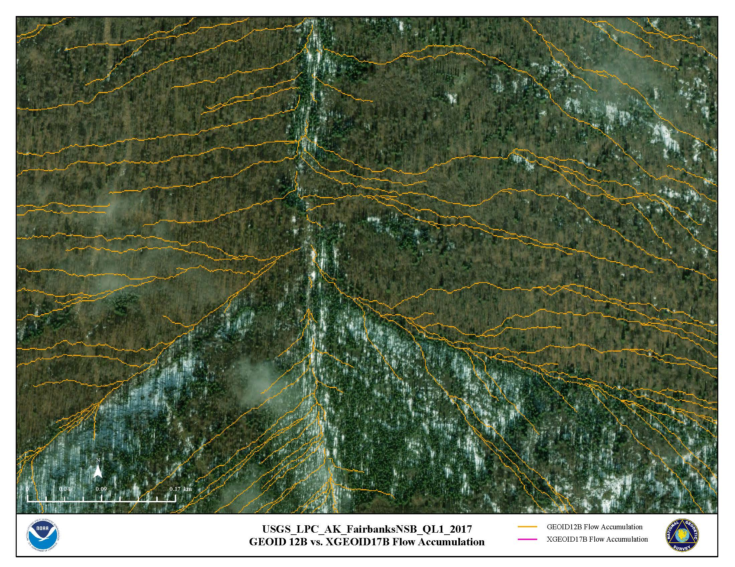
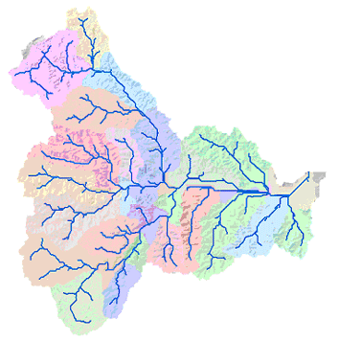
Improvements to Hydrologic Flow Models
Location Map
GIS Flow Accumulation Analysis
Example performed with ESRI ArcGIS hydrology toolset
GEOID12B Flow Accumulation
Notes:
Some of the greatest benefits from the adoption of a gravimetric geoid model are realized by a wide range of hydraulic applications.
To illustrate this we conducted a GIS Flow Accumulation Analysis on a subset of the Fairbanks lidar data
A Flow Accumulation analysis calculates accumulated flow as the function of a downslope raster analysis; cells with a high flow accumulation are areas of concentrated flow and this technique can therefore be used to efficiently identify and map stream channels. Results of the flow analysis on a DEM employing hybrid GEOID12B orthometric heights are shown here.

Slide 11
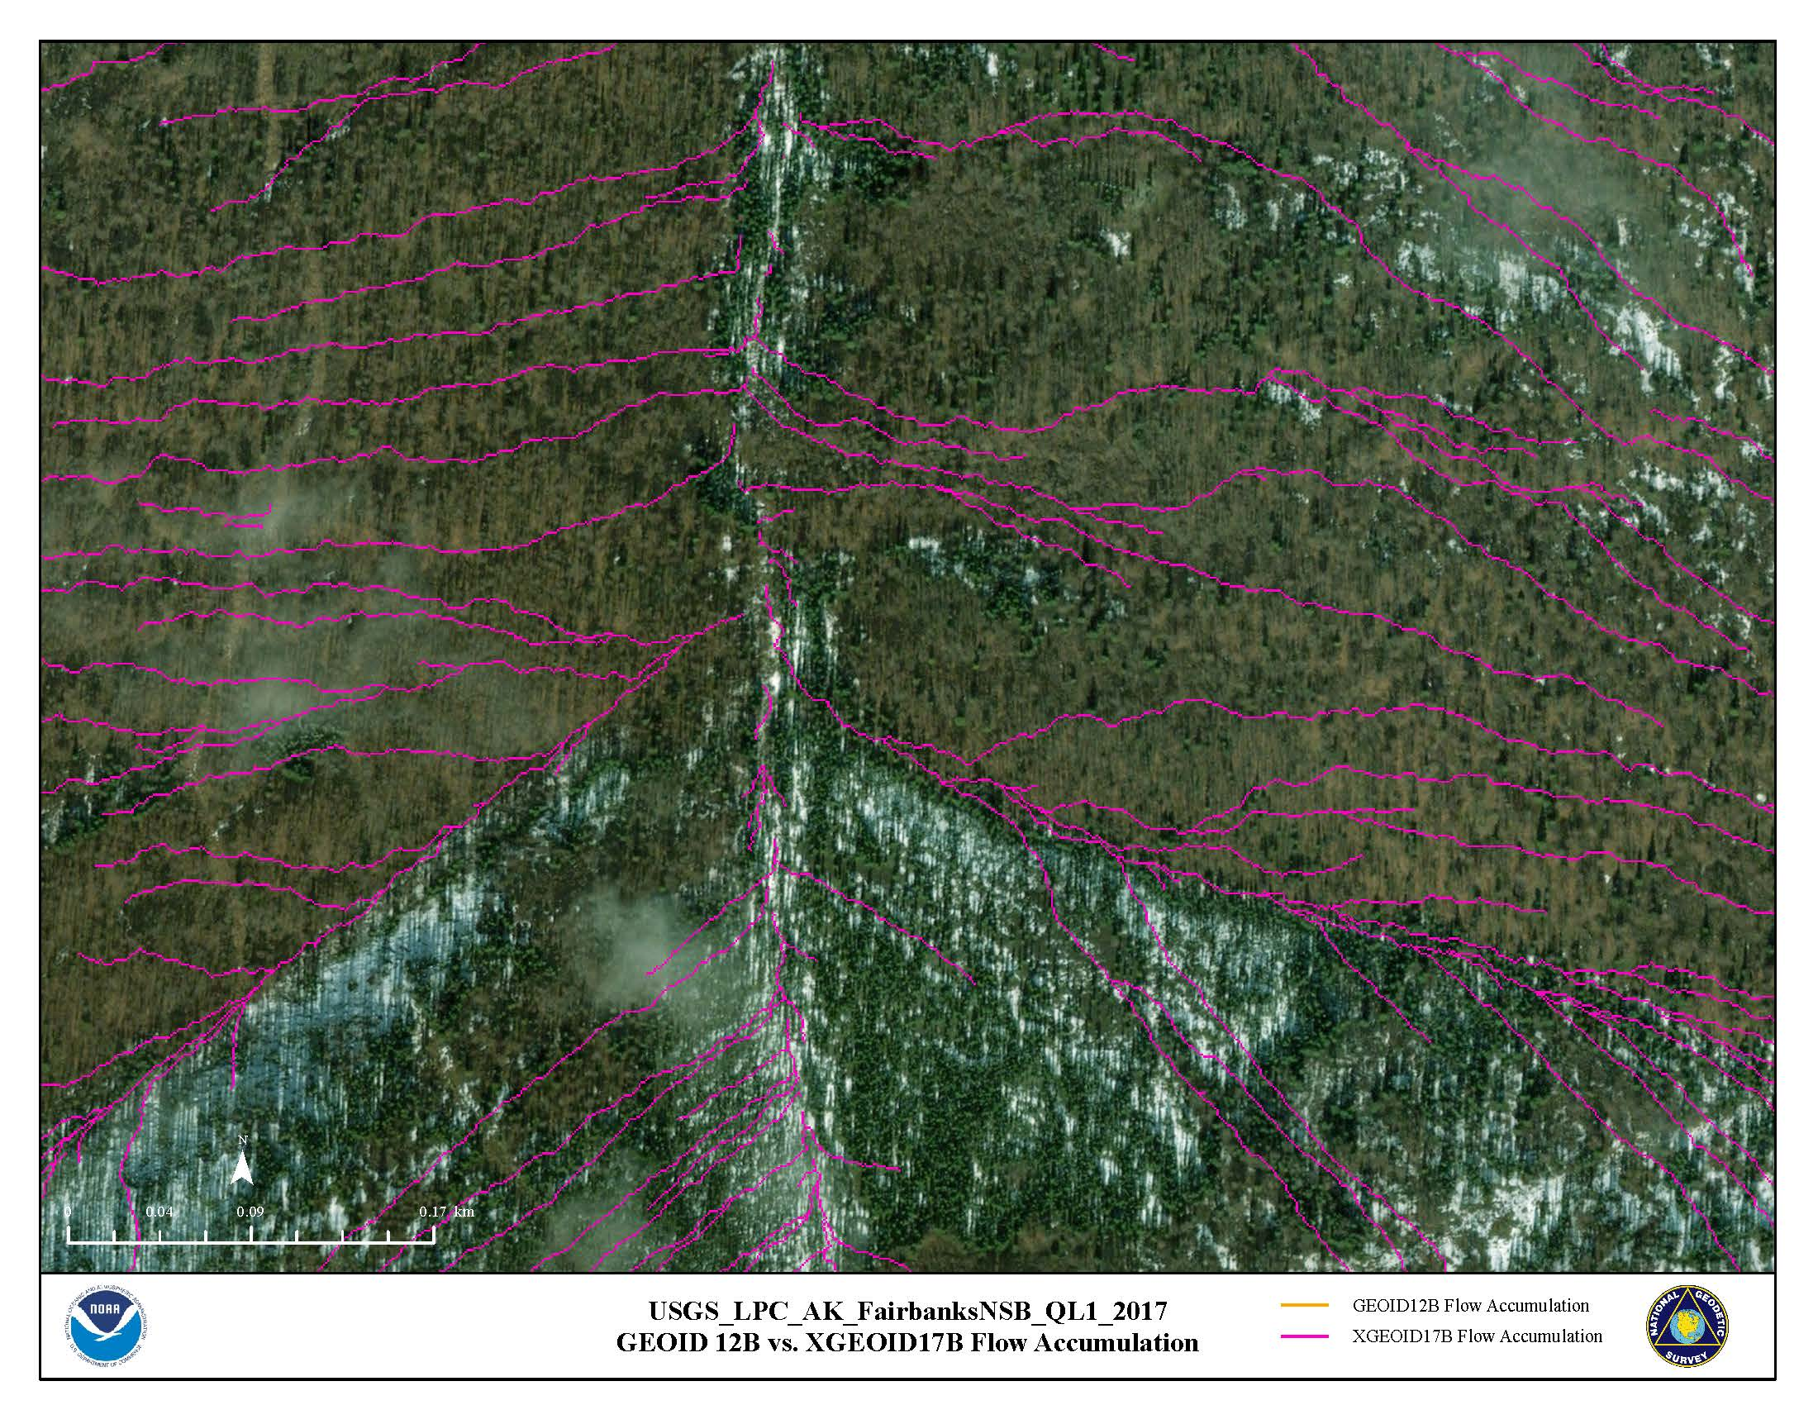
Improvements to Hydrologic Flow Models
Notes
Same lidar data
Fully gravimetric geoid model
Impacted products/activities
DEM blunder control
Automated stream mapping
Watershed determination
Contaminant flow models
Runoff management plans
Floodplain mapping
xGEOID17B Flow Accumulation
Notes:
Results of the flow analysis on a DEM employing hybrid xGEOID17B orthometric heights are shown here.

Slide 12
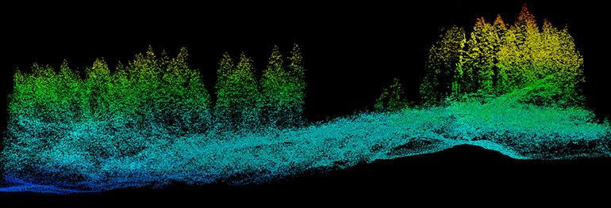
Simplified Transformation of Elevation Models
Input
Output
NAVD 88 Heights
NAPGD2022 Heights
GEOID12B
GEOID2022
NAD 83 Ellipsoid
NATRF2022 Ellipsoid
NATRF2022
NCAT transformation grids are shared by VDatum
Notes:
As a geodetic advisor, one question that I am frequently asked by those managing large geospatial datasets like lidar point clouds is “how can I explore this on my own?” and “how will I be able to take advantage of the improved geoid model and modernized NSRS when it arrives?”
Illustrated here is a very simplified diagram (graphical recipe) of the multiple steps involved in transforming an existing NAD 83(2011) NAVD88 dataset to the modernized frame
Remove geoid model (subtract in Alaska) to get ellipsoid heights
Conduct a 14-parameter transformation between reference ellipsoids
Rotate the reference ellipsoid into the preferred plate-fixed terrestrial reference frame of interest, such as the North American Terrestrial Reference Frame of 2022 (NATRF2022)
Apply the gravimetric geoid model to yield North American-Pacific Geopotential Datum of 2022 (NAPGD2022) heights
Seems complicated… but NGS provides tools (Vdatum, which runs on the same underlying pieces as NCAT) to complete all these steps behind the scenes and we are actively working with industry partners to ensure that commercial geospatial software is capable of conducting consistent transformations. VDATUM already allows users to transform LiDAR .LAS/.LAZ) files, and rasters such as GeoTIFFS using xGEOID17B. If you experiment, please share your results with NGS!

Slide 13
Preparing Geospatial Data for NSRS Modernization
Ensure metadata contain all information needed for best possible transformation:
reference frame and epoch (e.g. NAD 83 (2011) epoch 2010.0
geoid model (e.g. GEOID12B or GEOID18)
basis of project control (method and survey dates)
Retain original GPS data whenever possible
Keep apprised of, and help support, NGS transformation tool development
BETA testing and feature recommendation
GPS on Bench Marks
Notes:
Even with tools at the ready, there are still ways geospatial data managers can prepare large datasets for maximum forward compatibility with the modernized NSRS.

