Slide 1

Designing a Data Delivery
System of Future
Boris Kanazir, Geodesist, RPLS
2019 Geospatial Summit
Silver Spring, Maryland
May 06, 2019

Slide 2

What is Data Delivery System (DDS)
Short Definition:
  A replacement for the existing Datasheet
Long Definition:
  An innovative and interactive system with established protocols for data delivery/display from the NSRS Database across different platforms

Slide 3
What will go in Data Delivery System (DDS)
DDS
CORS
Passive Marks
CBL
Tidal Marks
RTN?

Slide 4
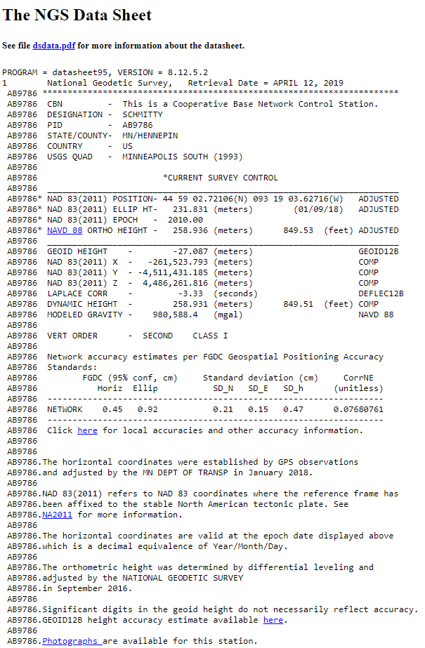

Slide 7
PID: AB9786
Surveyor: MNDT
Survey Epoch: 2012.03
LAT: 44° 59' 2.74798" ± 0.005m
LON: -93° 19' 3.66719" ± 0.005m
ELL HT: 230.942 ± 0.008m
PID: AB9786
Reference Epoch: 2020.00
LAT: 44° 59' 2.74738" ± 0.005m
LON: -93° 19' 3.67302" ± 0.005m
ELL HT: 230.942 ± 0.008m

