Slide 1

Geodetic Surveying and Map Projections
PSLS Annual Conference
January 2023
Jeff Jalbrzikowski, P.S., GISP, CFS
Appalachian Regional Geodetic Advisor
jeff.jalbrzikowski@noaa.gov
240-988-5486

Slide 2



Organizational Structure
  -Department of Commerce (DoC)
  (~47,000 employees)
  -National Oceanic and Atmospheric Administration (NOAA)
  -National Ocean Service (NOS)
  -National Geodetic Survey (NGS)
  (~175 employees)
Notes:
-We are the Federal Government’s oldest scientific agency.
-part of the Executive Branch
-I know it can seem kind of strange that NGS is part of the NOS, but the origins of NGS lie with the C&GS.
-we are a “Program Office” of the NOS
Survey of the Coast – 1807
Coast Survey – 1836
Coast and Geodetic Survey – 1878
NGS since 1970

Slide 3


Organizational Structure
We’re not USGS, we’re NGS
  -Department of Commerce (DoC)
  (~47,000 employees)
  -National Oceanic and Atmospheric Administration (NOAA)
  -National Ocean Service (NOS)
  -National Geodetic Survey (NGS)
  (~175 employees)
≠
Notes:
-as you can read my slide, I like to point that out because over my 2 years at NGS I’ve seen and heard this misunderstanding quite a bit
-don’t worry! it doesn’t offend us! and we do work closely with USGS, but we are separate agencies within totally different departments of the federal government

Slide 4
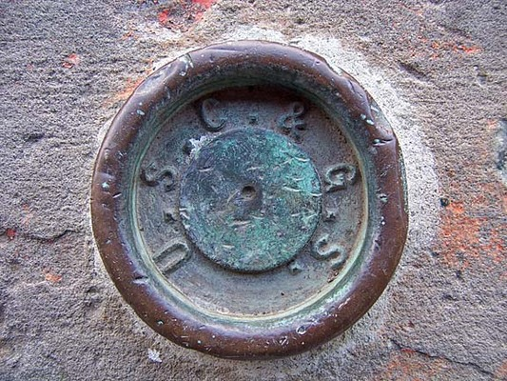
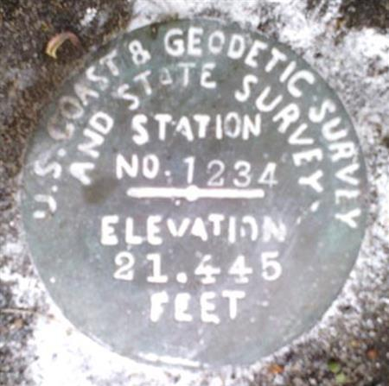
Pre-1970 USC&GS

Slide 5
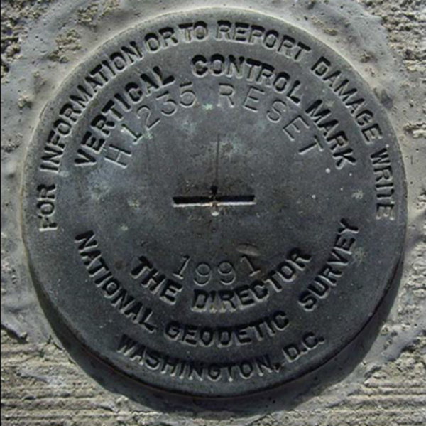
Post-1970 NGS

Slide 6
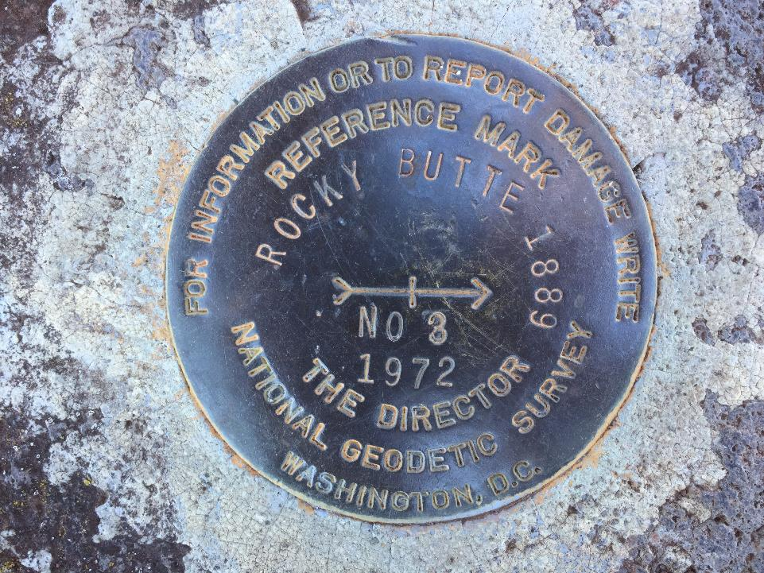
Post-1970 NGS

Slide 7
NGS Mission
To define, maintain and provide access to the National Spatial Reference System (NSRS) to meet our Nation’s economic, social, and environmental needs.
Notes:
NGS develops and maintains the National Spatial Reference System, a national coordinate system that provides the foundation for transportation, navigation, land record systems, mapping and charting efforts, and a multitude of scientific and engineering applications.
But there are many ancillary programs and products we will also discuss.

Slide 8
“Modernizing” the NSRS means:
Updating all NSRS coordinates
  Replace existing datums with new datums
  Replacing existing State Plane with new State Plane
  Accounting for coordinates changing with time
Improving NGS products and services
Simplifying customer contributions
Making the NSRS:
  More accurate
  More accessible
  More efficient
Rollout in
2025
8

Slide 9
National Spatial Reference System (NSRS)
The official system used by the civilian* federal government of the U.S.A. for determining geospatial coordinates of points.
  the DoD/Military and Intelligence Community use their own system
The phrase “NSRS” was coined in 1994.
NGS Ten Year Strategic Plan, NSRS is:
“… the official federal government reference system that allows a user to determine geodetic coordinates (for, but not limited to, latitude, longitude, height, scale, gravity, and orientation) and to know with certainty that consistency is being maintained among all federal civilian maps in the nation.”
Notes:
Note that the DoD and IC use their own system, which I will mention or callout at a few opints today.
I will also point out that it is the DoD, the US Space Force along with some NGA, who manage the GPS. Common misconception that NGS is involved, but we are not directly involved in GPS constellation functions.
Prior to an paper published by NGS in 1994 the NSRS was known as the National Geodetic Reference System (NGRS), if it was called anything at all.
According to our recent ten year plan, the NSRS was defined as … eh that’s a bit of a wordy slide there, let’s move on.

Slide 10
National Spatial Reference System (NSRS)
Geometric Geodesy
Physical Geodesy
Horizontal Datums
Geometric Reference Frames
Latitude & Longitude
Ellipsoid Height
State Plane Coordinates
Geopotential Datums
Orthometric Height
Dynamic Height
Surface Gravity
Leveling
To get to these “final products” we use a multitude of scientific methods, including Space Geodesy and Astronomical Geodesy.
And since we’re the Government… don’t forget Political Geodesy!
Notes:
All the facets of the NSRS fall into one of the two parts or fields of geodesy shown here.
CLICK
Geometric Geodesy
includes
Horizontal Datums
Geometric Reference Frames
Latitude & Longitude
Ellipsoid Height
State Plane Coordinates
or…..
CLICK
Physical Geodesy
Geopotential Datums
Orthometric Height
Dynamic Height
Surface Gravity
Leveling
And as we look at those together, it should be duly noted that to get to these final products we we use a multitude of scientific applications and methods, including Space Geodesy and Astronomical Geodesy.
CLICK
And since we’re the Government… don’t forget Political Geodesy!
We can’t accomplish what we do without funding, if the politicians see this science as a black box or have the “google earth” misconception… then

Slide 11
National Spatial Reference System (NSRS)
A consistent coordinate system that defines:
latitude
longitude
height
scale
orientation
gravity
throughout the United States.
…and their time variants
Notes:
Let’s talk about the NSRS some more before we move on to looking at all of NGS.
This system defines position (latitude, longitude, and elevation), distances and directions between points, strength and direction of gravity (no, it is not simply “straight down”), shoreline, and their “time variants”.
Or how these change over time.
Some documents will reference the National Shoreline as a component of the NSRS., we’ll briefly look at that later.

Slide 12
National Spatial Reference System (NSRS)
Aside from coordinates, other items include:
datums → USSD, NAD27, NAD83
active control → NOAA CORS Network
passive control → survey marks/disks
data models → satellite orbits, crustal motion
software → OPUS, NCAT, VERTCON, HTDP
personnel → people like our Field Operations Branch, Testing and Training Center,
…and their time variants!
Notes:
The NSRS is a collection of the science, infrastructure, mathematics, software, and people needed to implement and deliver the definition of the NSRS as contained in the 10 Year Plan.

Slide 13
National Spatial Reference System (NSRS)
These items ARE part of the NSRS
Horizontal Datums (aka Geometric Reference Frames) | Vertical Datums | Great Lakes Datums | Geoid Models | Transformations and Conversions
NAD83 | NAVD88 | IGLD85 | GEOID18 | NADCON
NAD27 | NGVD29 | IGLD55 | GEOID12B | VERTCON
USSD | VIVD09 |  | GEOID09
 | GUVD04 |  | GEOID06 | SPCS83
 | NMVD03 |  | GEOID03 | SPCS27
 | ASVD02 |  | GEOID99
 | PRVD02 |  | GEOID96
 |  |  | ALASKA94
 |  |  | GEOID93
 |  |  | GEOID90
Notes:
Note the US Standard Datum, anyone done any work in the old USSD?
Good example highlighting that the term “NSRS” is used to encompass all historic datums of NGS and its predecessors.
Saw one project during my work with the USACE, in Johnstown, PA, that had original survey records in what turned out to be US Standard Datum.
All those vertical datums below NGVD29, I greyed them out slightly because those are all Caribbean and Pacific Island datums, so in CONUS it’s just those two that you hopefully already use… and hopefully are mostly using NAVD88.

Slide 14
National Spatial Reference System (NSRS)
These items are NOT part of the NSRS
Horizontal Datums (aka Geometric Reference Frames) | Vertical Datums | Geoid Models | Transformations and Conversions
WGS84 | IHRS (by IAG) | OSU91A | CORPSCON
WGS72 |  | EGM96 | Appendix B.6 of DMA TR 8350.2 (WGS 84)
ITRF (Intl. Terrestrial Reference Frame by IERS) |  | EGM2008 | Oregon Coordinate Reference System (ORCS)
IGS (Intl. GNSS Service reference frame) |  |  | The Kansas Regional Coordinate System
Hyperlink to ITRF station map
Notes:
WGS is a DoD system. Yes, that is the system native to the Global Positioning System, but it isn’t true that you “have to” work in WGS84 to get the most accurate coordinates. I’ve heard people say that.
The Intl. Terrestrial Ref. Frame is a product of the Intl. Earth Rotation and Reference Systems Service. More on that later.
The Intl. GNSS Service Ref. Frame is, well, it’s a reference frame based on that ITRF just mentioned, but with improvements, like a more dense network of stations and is more easily accessible.
The IHRS is an International Height Reference System, which is a product that was formally adopted by the IAG (Intl. Association of Geodesy) in 2015. Not an NGS product but folks from NGS were involved.
OSU geoid, it was a research thing and I don’t know much about it.
The Earth Gravity Models are DoD products just like the WGS products, used around the world by our Nation’s military (I used EGM based height sin Iraq and Afghanistan)… but are not at all tied to NSRS geoids. Future DoD geoid models may have a closer tie to future NGS geoid models.
CorpsCon. Ah yes, Corpscon. Everyone loves Corpscon, unfortunately as convenient as it is it isn’t truly an NGS product and has not been updated in well, a long time, and there are no plans to update it in the future. (confirmed via phone call to AGC personnel on 20FEB2019)
I like Mark Huber, awesome dude, I spent some time with him surveying on some god-forsaken island in the Indian Ocean, but the USACE doesn’t seem to want to support him in funding an update to Corpscon. So it is what it is.
Those regional coordinates systems, like the ORCS in Oregon and that one in Kansas, although they have rigorously defined transformations to the NSRS (which is great, they did it right) they are not part of the NSRS.

Slide 15
NSRS … do I have to use it?
Not necessarily, but it’s a great idea!
States may mandate use of NSRS
All Federal spatial data and GIS activities financed directly or indirectly, in whole or in part, by Federal funds are required to be tied to the NSRS
If you want to get involved in contracted work with the Federal Government it’s a necessity
Notes:
-We give you efficient ways to check the accuracy of GNSS surveys, via the CORS and OPUS.
-but we’re not the datum police!
-Aerial imagery overlays, doesn’t it make you feel good when a topo lines up pretty well with statewide imagery & lidar?
- all the FEMA/USGS/NRCS 3DEP lidar, all that data will be out there in SPCS, tied to the NSRS via GPS tied to multiple CORS
CLICK
-interesting tidbit I picked up from a meeting on Friday: for anyone who’s been paying attention to the politics & bureaucracy of government geospatial efforts, the Geospatial Data Act of 2018 includes provisions for “repercussions” for agencies who do not comply with this requirement
**-important though that will not be enforced until 5 years after the GDA, so late 2023
PREPARE NOW!

Slide 16
Geodetic Control – Terminology
Conversion
    change the type of coordinate without changing the datum or frame
    NAD 83(1986) latitude and longitude to NAD 83(1986) State Plane
  Transformation
    change the datum or frame, without changing the type of coordinate
    NAD 27 latitude & longitude to an NAD 83(1986) latitude & longitude
Propagation
    this term is an ISO standard for IERS
    change the epoch of coordinate without changing the frame
    ITRF2014 epoch 2019.2675 to ITRF2014 epoch 2020.00
    NATRF2022 epoch 2020.00 to NATRF2022 epoch 2023.243
Notes:
Historically NGS has been inconsistent with these top two words.
Going forward, we will use them as:
Conversion: Meaning to change the type of coordinate without changing the datum or frame
e.g. change NAD 83(1986) latitude and longitude to NAD 83(1986) State Plane Coordinates
Transformation: Meaning to change the datum or frame, without changing the type of coordinate
e.g. changing an NAD 27 latitude & longitude to an NAD 83(1986) latitude & longitude
So, “NADCON” which transforms coordinates between datums could have been called “NADTRAN.” C’est la vie.

Slide 17
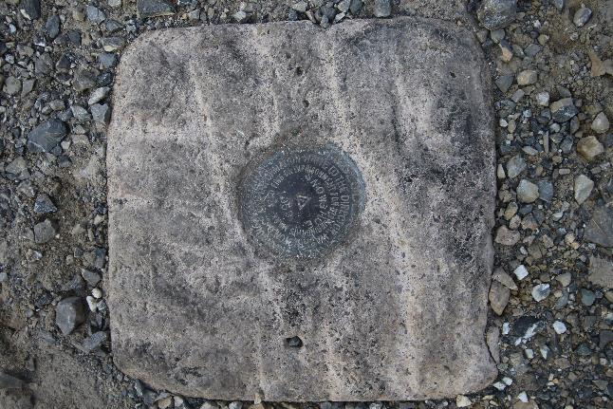
Passive Control
Geodetic Control – Terminology
All marks are passive—they sit there and hold a point
Notes:
All marks are passive!—in that they sit there doing nothing in and of themselves besides holding a point
This includes the fixed antenna mount that is a part of a CORS.
But, some marks have permanently installed equipment that enable nearly continuous observations and these are called “active” stations.

Slide 18
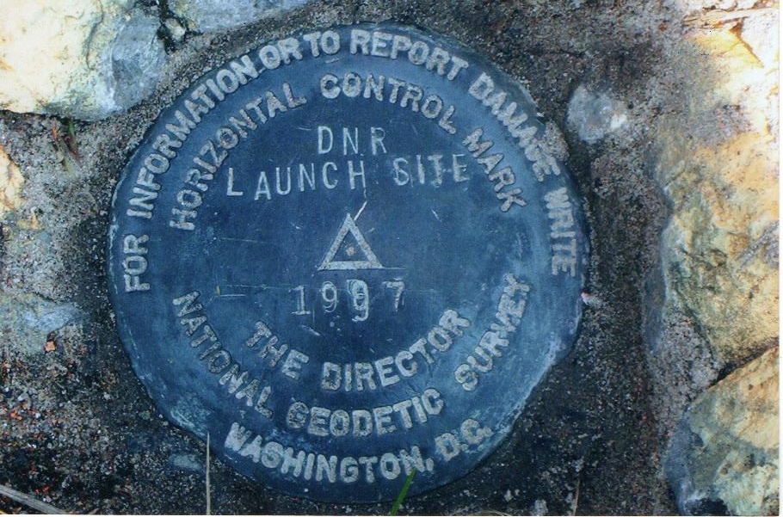
Passive Control

Slide 19
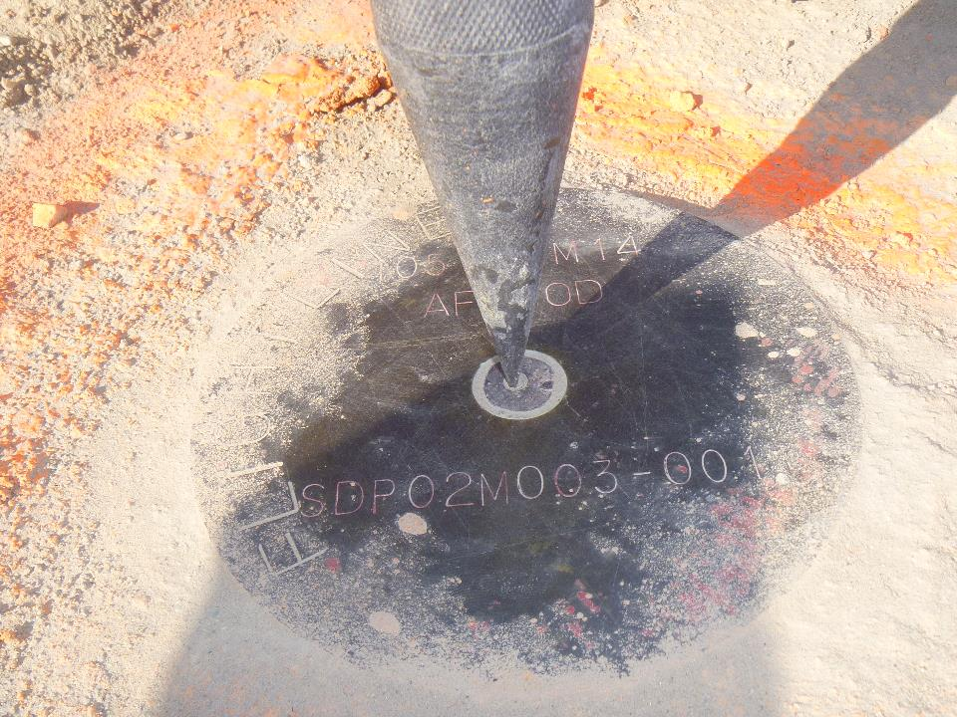
Terminology - Passive Control

Slide 20
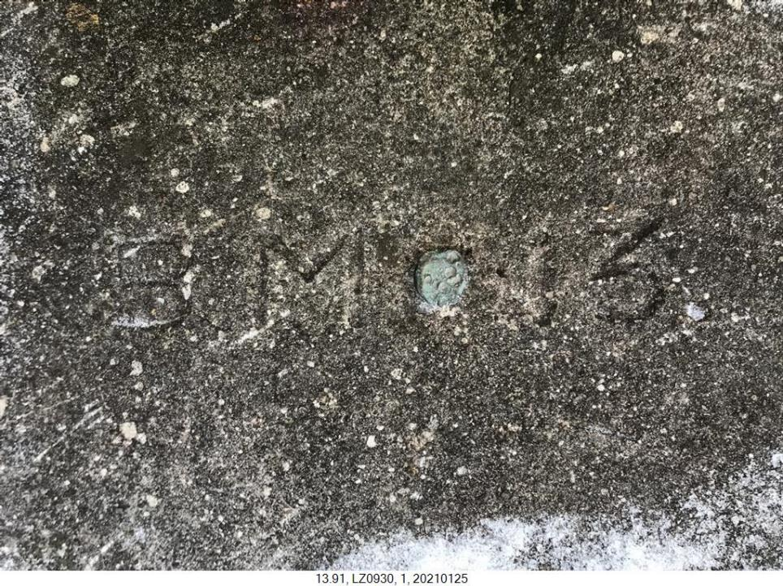
Terminology - Passive Control

Slide 21
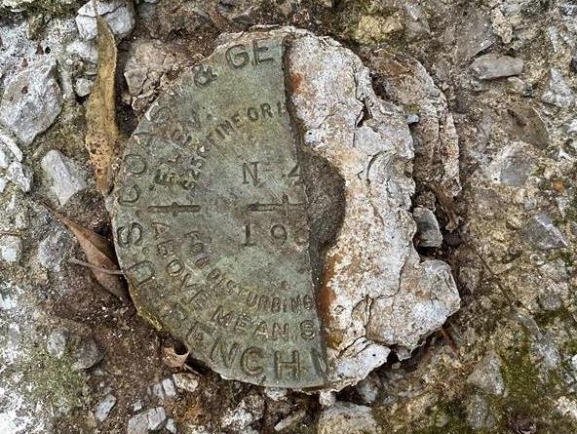
Terminology - Passive Control
Notes:
KW0392 –
https://www.ngs.noaa.gov/cgi-bin/ds_mark.prl?PidBox=KW0392
COLUMBIA COUNTY, PA, NEAR READING COMPANY REAILROAD STATION

Slide 22
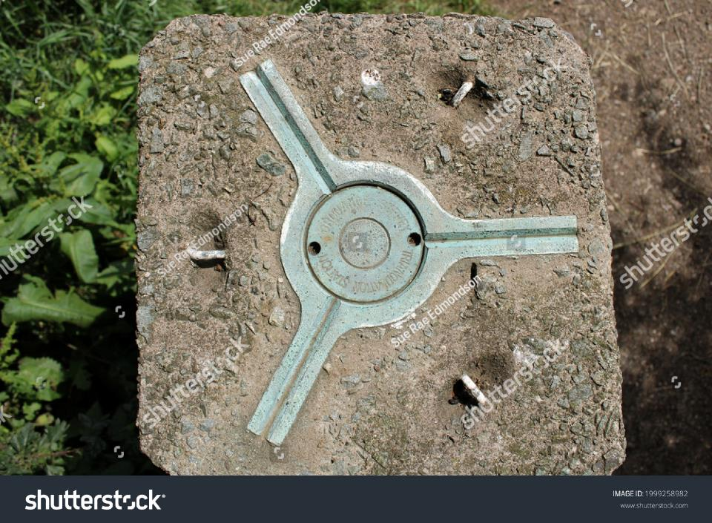
Terminology - Passive Control
Notes:
KW0392 –
https://www.ngs.noaa.gov/cgi-bin/ds_mark.prl?PidBox=KW0392
COLUMBIA COUNTY, PA, NEAR READING COMPANY REAILROAD STATION

Slide 23
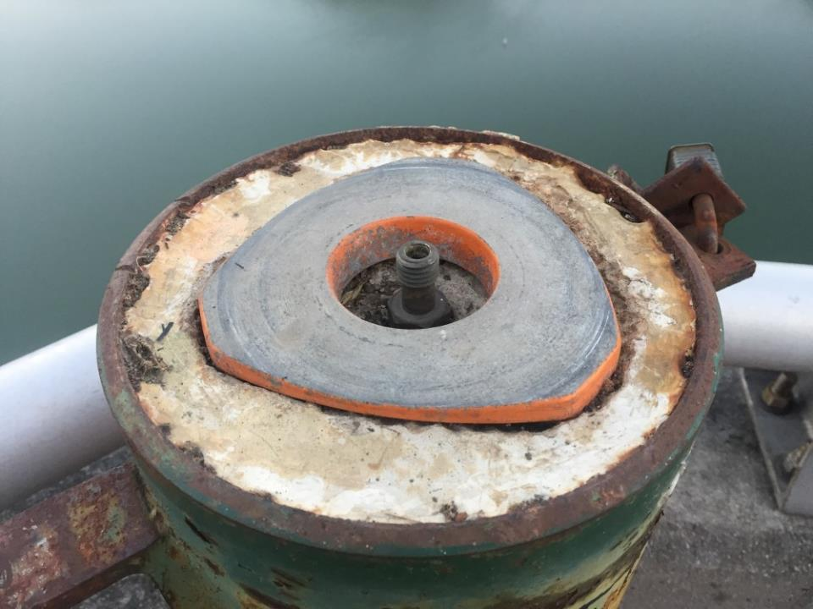
Terminology - Passive Control

Slide 24
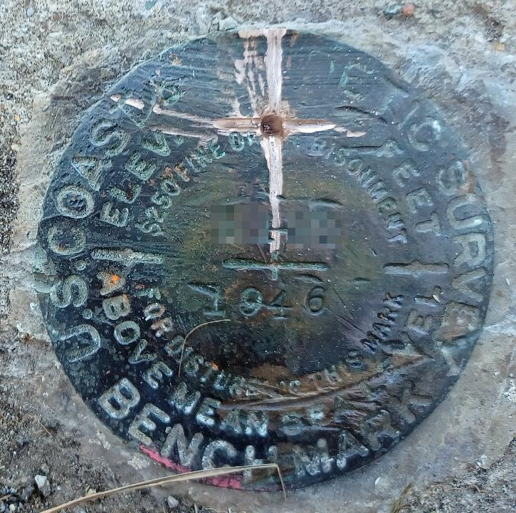
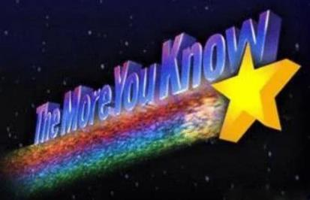
Please … do not add a new dimple

Slide 25
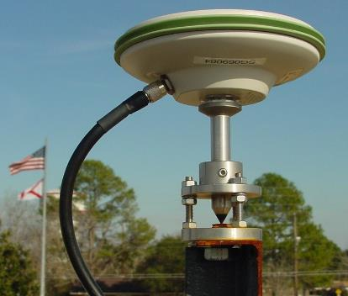
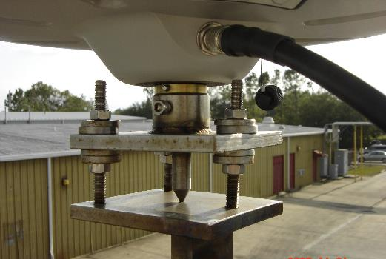
Active Control
Geodetic Control – Terminology
Some marks have permanently installed equipment that enables nearly continuous observations
(they still sit there and hold a point)
Notes:
All marks are passive!—in that they sit there doing nothing in and of themselves besides holding a point
This includes the fixed antenna mount that is a part of a CORS.
But, some marks have permanently installed equipment that enable nearly continuous observations and these are called “active” stations.

Slide 26
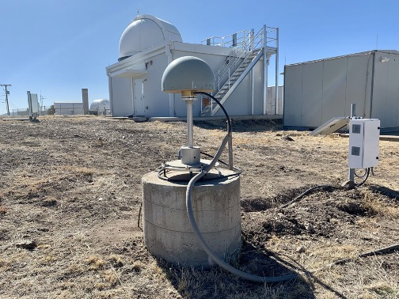
Active Control

Slide 27
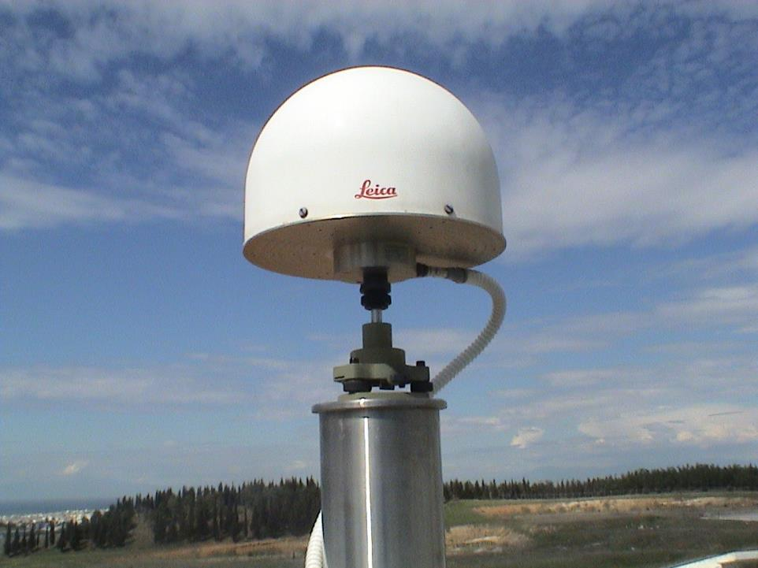
Active Control

Slide 28
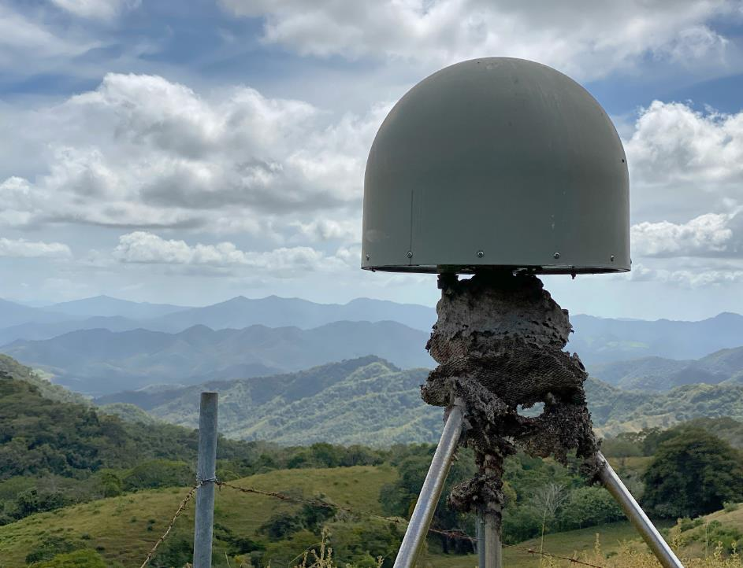
Active Control
Active Control

Slide 29
Active vs. Passive Control
Geodetic Control – Terminology
Active Control - some equipment is continuously, or at least frequently collecting observations at or near a point
  Yet those observations are used to compute coordinates of a point on a mark
My point: surveying is still surveying
Notes:
Often the term active geodetic control has been used to mean some equipment is continuously or at least frequently collecting observations at or near a point
Yet those observations are often used to compute coordinates (often time-dependent) at a point on a mark, which, by its nature is passive

Slide 30
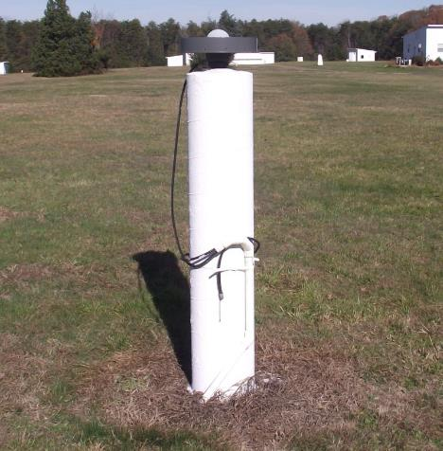
CORS
Active Control
Continuously Operating Reference Station
GNSS ANTENNA
RECEIVER
POWER
DATA STORAGE
COMMUNICATIONS
Notes:
Note that the whole pillar could be considered a type of “mark”, being a passive do-nothing structure that holds a “point”, the GRP of this CORS.
But the point, given coordinates computed from all the data collected by that antenna, is probably in here somewhere, as a part of this huge pillar which is effectively one big mark, passive as can be….

Slide 31
















NGS Overview
Modernizing the NSRS
NCN
NHMP
GRAV-D
ECO
NGS Products and Services
ASP
OPUS
VDatum
Orbit Data
National Shoreline
Geodetic Advisors
ERI
Antenna Calibrations
NCAT
CUSP
CBL
Education
Notes:
This is not an exhaustive list of NGS programs, products, and services
These are some highlights and you will se this slide repeated when we focus on some of these items

Slide 32
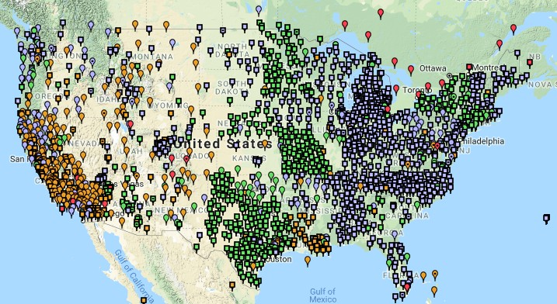
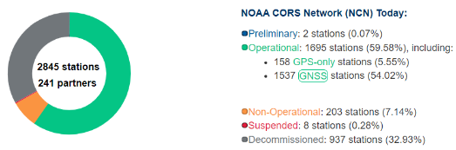
NOAA CORS Network (NCN)
1695 sites
241 organizations
Notes:
-I would like to point out we have a new, official name for the network you see represented on this map,
-The NOAA CORS Network, or NCN
CLICK
-this is neat little graphic with some stats on teh NCN you can find on our website
-below the gaphic youll find a search bar with more information

Slide 33
CORS Networks
Global: International GNSS Service (IGS) Network
  The international standard since mid-1990s
  Supported by IGS Analysis Centers (ACs) → NGS is 1 of 7
  Overall system sponsored by NASA
NSRS: NOAA CORS Network (NCN)
  NGS processes/distributes data, but few are NGS-operated
  Subset of NGS-operated CORS comprise the under construction NOAA Foundation CORS Network (NFCN)
Regional/State/Commonwealth/Local Networks
  Real-Time Networks (RTN… aka “VRS”)
  Currently semi-coupled to the NCN
Notes:
Global: International GNSS Service (IGS) Network
The international standard since mid-1990s
Supported by IGS Analysis Centers (ACs) → NGS is one AC of seven total
Overall system sponsored by NASA
NSRS: NOAA CORS Network (NCN)
NGS processes/distributes data, but few are NGS-operated
Subset of NGS-operated CORS comprise the under construction NOAA Foundation CORS Network (NFCN)
Regional/State/Commonwealth/Local Networks
Real-Time Networks (RTN… aka “VRS”)
Currently semi-coupled to the NCN
NGS sees the future as a close coupling of other networks with the NCN so users can seamlessly and confidently work in the NSRS using their favorite regional/local CORS network

Slide 34
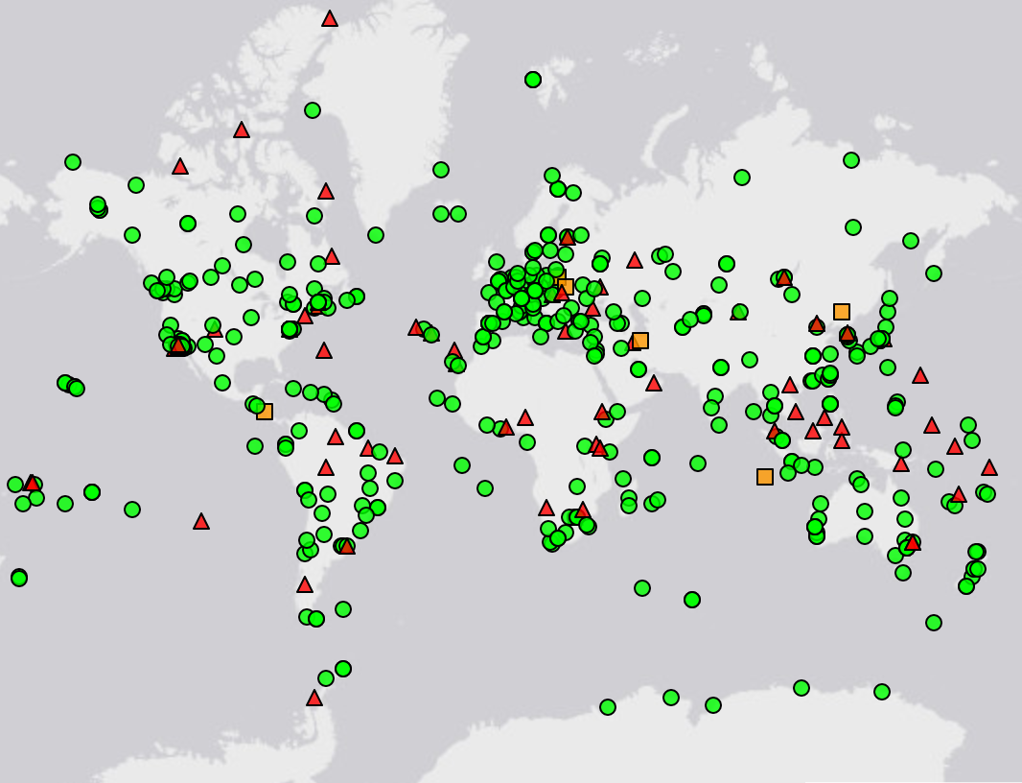

IGS Network
Source: https://www.igs.org/maps/#station-map
Notes:
There are several CORS Networks.
The Global Standard is the IGS Network
IGS = International GNSS Service
The NOAA CORS Network (NCN) which consists of:
The NOAA Foundation CORS Network (NFCN), a sub-network being installed, owned, and operated by NGS
and 2,000+ stations managed, but rarely owned by NGS
Other Regional/Local Networks (RTNs, etc.)
Currently semi-coupled to the NCN
NGS sees the future as a close coupling of these other networks with the NCN so users can seamlessly and confidently work in the NSRS using their favorite regional/local CORS network.

Slide 35
NOAA CORS Network (NCN)
Notes:
-I would like to point out we have a new, official name for the network you see represented on this map,
-The NOAA CORS Network, or NCN
CLICK
-this is neat little graphic with some stats on teh NCN you can find on our website
-below the gaphic youll find a search bar with more information

Slide 36
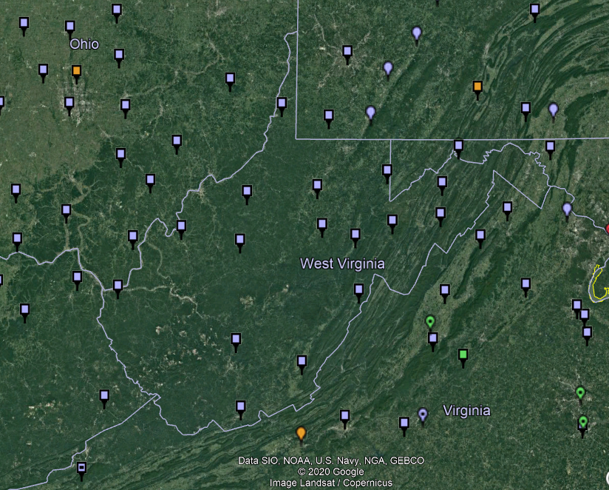
NOAA CORS Network (NCN) in WV

Slide 37
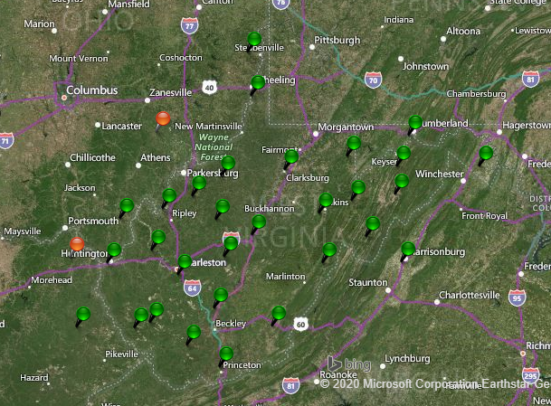
WVDOT CORS Network

Slide 38
NOAA CORS Network (NCN) in WV

Slide 39
WVDOT CORS Network
non-NCN CORS

Slide 40
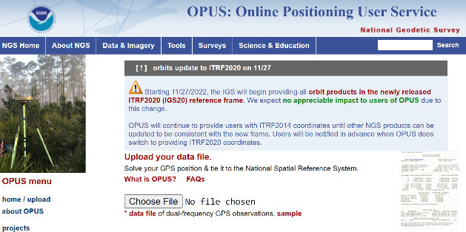
NGS Mission
To define, maintain and provide access to the National Spatial Reference System (NSRS) to meet our Nation’s economic, social, and environmental needs.
access… ? = traditionally → passive control (marks/disks/objects)
= modern and future → active control (NCN CORS)
via OPUS

Slide 41
International Terrestrial Reference Frame
(ITRF)
Is native coordinate system for NCN
Is what OPUS uses
Is what most of world uses
Is what NGS aligns WGS-84 to
Notes:
So what is that acronym, ITRF?
-it is a global reference frame, the most widely adopted one, or the “gold standard” or the “Cadillac” or what-have-you
-ITRF is the internationally recognized standard
-who realizes the ITRF? well, NGS contributes to the realization but
CLICK
-The IERS is in responsible charge of defining, realizing and promoting the ITRF
-and the ITRF was formally adopted by the…yes, more acronyms
CLICK
IUGG some years ago

Slide 42
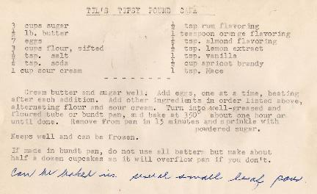
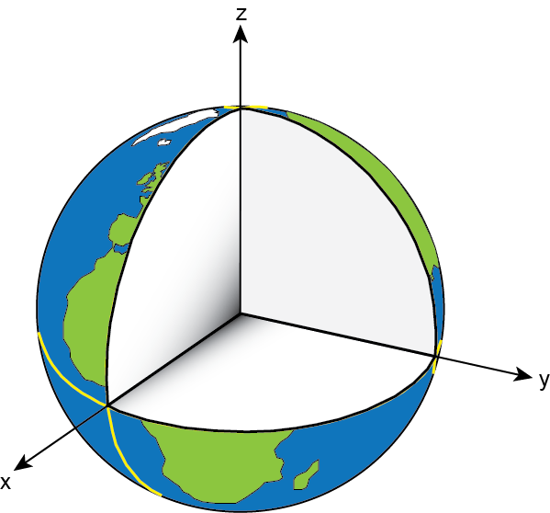
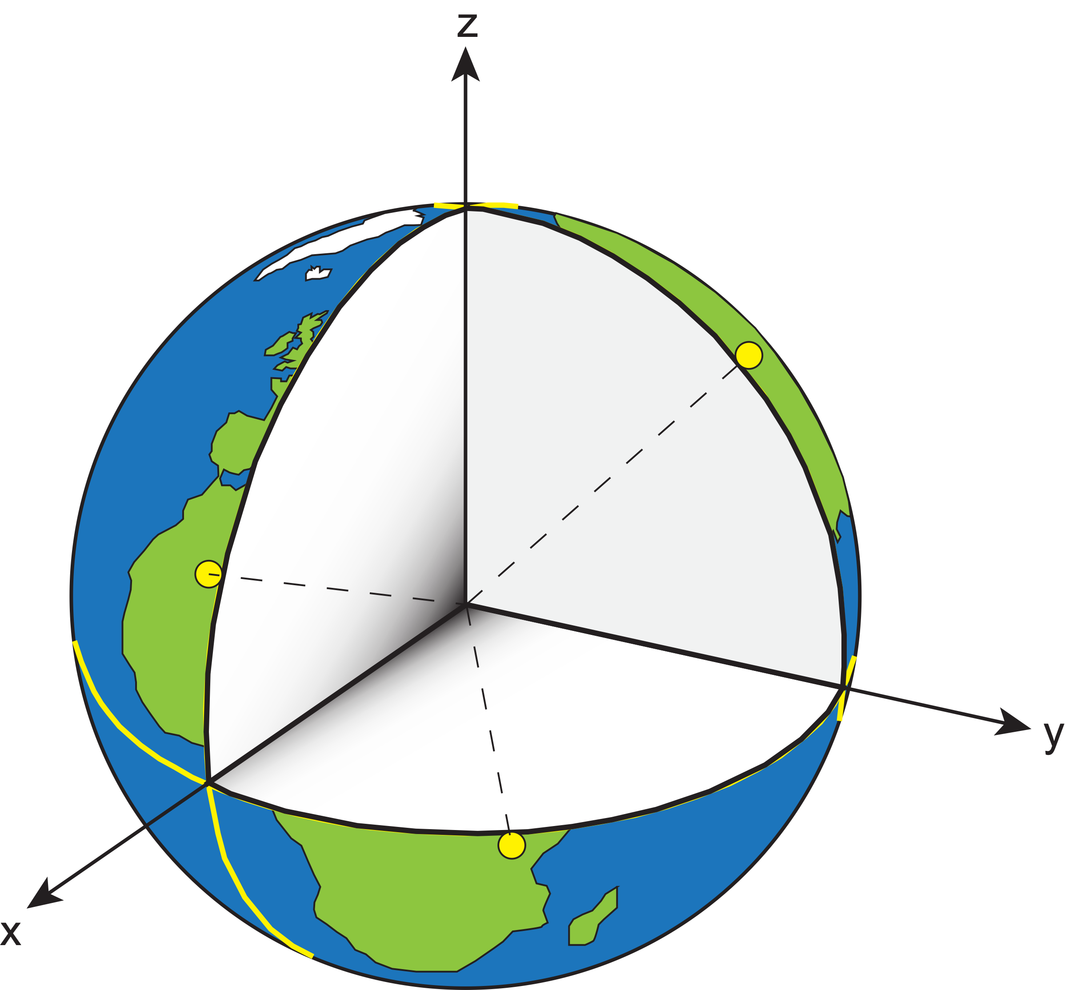

Reference System & Frame
Before you can realize a Reference Frame… you must define a Reference System
Reference System:
A set of prescriptions and conventions together with the modeling required to define a triad of coordinate axes¹
-the recipe
Reference Frame:
Realizes the system by means of coordinates of definite points that are accessible directly by occupation or observation¹
-the cake
= CORS
¹Springer Handbook of Global Navigation Satellite Systems, Ch. 2, p. 34
Notes:
An ITRS meets the following conditions: – Geocentric (origin is Earth centre of mass) – Uses the metre as the unit of length – Initial orientation given by BIH orientation at 1984 – The time evolution of the orientation is ensured by using a no-net rotation condition with regards to horizontal tectonic motions over the
whole earth.
• The ITRS is of very little use to the practitioner – we need a realisation (some coordinates)

Slide 43
Reference System & Frame
International Terrestrial Reference System (ITRS)
  IERS’s recipe
International Terrestrial Reference Frame
  Realized by the ITRF Network (the SGT stations)
True for any System and Frame
  Not just the ITRF
Notes:
Global: International GNSS Service (IGS) Network
The international standard since mid-1990s
Supported by IGS Analysis Centers (ACs) → NGS is one AC of seven total
Overall system sponsored by NASA
NSRS: NOAA CORS Network (NCN)
NGS processes/distributes data, but few are NGS-operated
Subset of NGS-operated CORS comprise the under construction NOAA Foundation CORS Network (NFCN)
Regional/State/Commonwealth/Local Networks
Real-Time Networks (RTN… aka “VRS”)
Currently semi-coupled to the NCN
NGS sees the future as a close coupling of other networks with the NCN so users can seamlessly and confidently work in the NSRS using their favorite regional/local CORS network

Slide 44
Reference System… then Frame
International Terrestrial Reference System (ITRS)
  IERS’s recipe
International Terrestrial Reference Frame
  Realized by the ITRF Network (the SGT stations)
True for any System and Frame
  Not just the ITRF
National Spatial Reference System
  NGS’s recipe
North American Terrestrial Reference Frame
  Realized by the NOAA CORS Network
  Accessible easily with GPS, by using NGS’s OPUS
Notes:
Global: International GNSS Service (IGS) Network
The international standard since mid-1990s
Supported by IGS Analysis Centers (ACs) → NGS is one AC of seven total
Overall system sponsored by NASA
NSRS: NOAA CORS Network (NCN)
NGS processes/distributes data, but few are NGS-operated
Subset of NGS-operated CORS comprise the under construction NOAA Foundation CORS Network (NFCN)
Regional/State/Commonwealth/Local Networks
Real-Time Networks (RTN… aka “VRS”)
Currently semi-coupled to the NCN
NGS sees the future as a close coupling of other networks with the NCN so users can seamlessly and confidently work in the NSRS using their favorite regional/local CORS network

Slide 45
NGS Overview
Modernizing the NSRS
CORS
NHMP
GRAV-D
ECO
NGS Products and Services
ASP
OPUS
VDatum
Orbit Data
National Shoreline
Geodetic Advisors
ERI
Antenna Calibrations
NCAT
CUSP
CBL
Education
Notes:
This is not an exhaustive list of NGS programs, products, and services
These are some highlights and you will se this slide repeated when we focus on some of these items

Slide 46
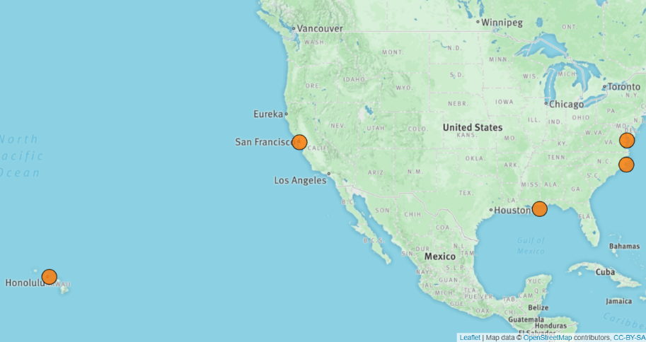
Ecosystem and Climate Operations
Notes:
-An NGS Program that adapts geodetic survey technologies, instrumentation, and procedures in support of coastal community resilience and ecological integrity, especially in responding to climate change.
-The five orange dots on this map are Sentinel Sites, or coastal sites at which various geospatial infrastructure is co-located.
*-you’re going to hear me say that again later, “co-located”
-anyway…
CLICK

Slide 47
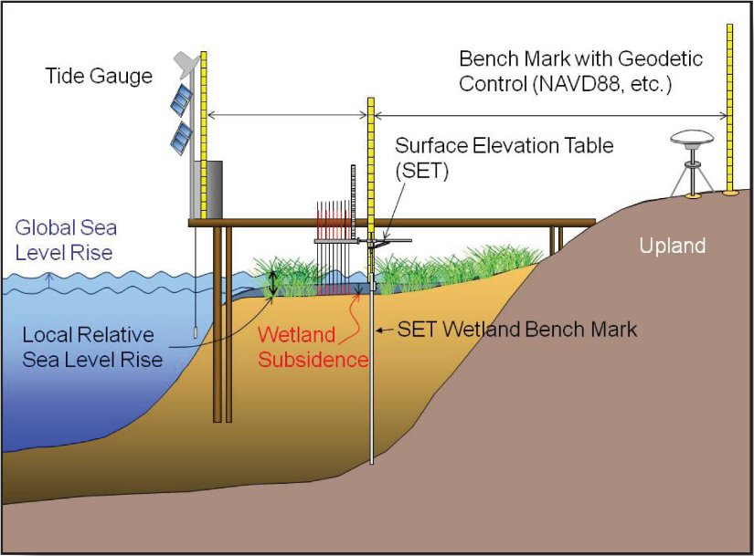

Ecosystem and Climate Operations
?
Notes:
-Here’s a decent diagram illustrating a hypothetical Sentinel Site, with BMs, tide gage, and other wetland monitoring instruments that have been leveled as a network and tied via GNSS
**-well, the image isn’t super because there’s no tie b/w GNSS and BM!
-that’s why I called it decent! LOL
-an important NGS, and NOAA overall, mission but with low visibility especially in an inland region
**-guess I tend to forget, PA being such a large state, there is the Delware River which is tidal over a 100 miles upstream, well past Philly
-anyone do any hydro work over there? show of hands?

Slide 48
NGS Overview
Modernizing the NSRS
CORS
NHMP
GRAV-D
ECO
NGS Products and Services
ASP
OPUS
VDatum
Orbit Data
National Shoreline
Geodetic Advisors
ERI
Antenna Calibrations
NCAT
CUSP
CBL
Education
Notes:
This is not an exhaustive list of NGS programs, products, and services
These are some highlights and you will se this slide repeated when we focus on some of these items

Slide 49
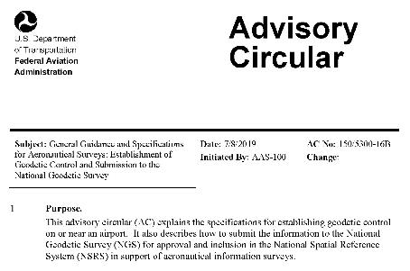
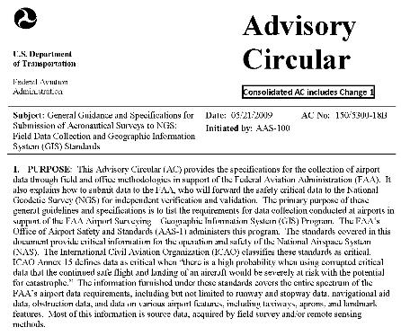
Aeronautical Survey Program
Interagency Program: FAA and NGS
  Primary Airport Control Station (PACS) and Secondary Airport Control Stations (SACS)
  Airports GIS (AGIS)
  Airport Obstruction Charts (AOC)
Primary function of NGS is to serve as QA and subject-matter expert for ASP surveys that are contracted by airports
Notes:
PACS are occupied with GNSS and tied to the NSRS via simultaneous observations to one CORS, one CBN Station, and two 1st order BMs.
SACS are then tied to the PACS with simultaneous observations.
CLICK
-and there’s the front cover of AC-16B, the requirements for establishing PACS and SACS
CLICK
-while there is AC-18B, the requirements for field data collection for “Airports GIS”
-in other words, the surveys for runway postions, NAVAIDs, and obstruction surveys

Slide 50
NGS Overview
Modernizing the NSRS
CORS
NHMP
GRAV-D
ECO
NGS Products and Services
ASP
OPUS
VDatum
Orbit Data
National Shoreline
Geodetic Advisors
ERI
Antenna Calibrations
NCAT
CUSP
CBL
Education
Notes:
This is not an exhaustive list of NGS programs, products, and services
These are some highlights and you will se this slide repeated when we focus on some of these items

Slide 51

GPS Orbit Data aka Ephemerides
NGS orbit analysis and computation is performed together with, and as a component of, the International GNSS Service (IGS)
  IGS coordinates the collection of satellite tracking data
  these orbits are what give us post-processed accuracy
Designated with this responsibility by the Civil GPS Service Interface Committee (CGSIC)
If you’re using OPUS, it’s all behind-the-curtain!
Notes:
The CGSIC is an entity of the US Dept of Transportation.
Ephemeris is a table that lists the coordinates/positions of celestial objects (natural/anthro) during a given time period.
The ephemerides (plural term) are the backbone of GNSS-based positioning; precise ephemerides lead to accurate positions.
*but if you get an OPUS error message about orbit availability, this is your issue that you’ve got satellite data but nothing to process it against.

Slide 52
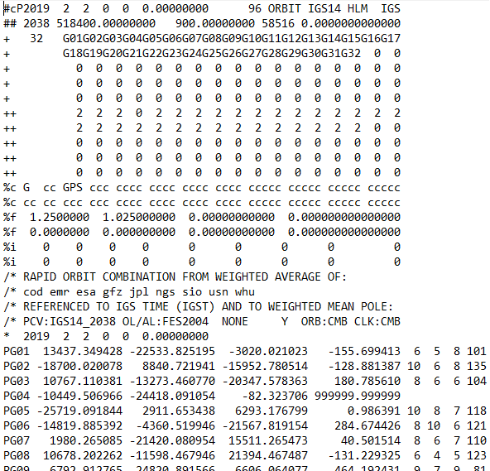
.sp3 file
Sattelite
Orbit Data
Link to NGS GPS Calendar
Notes:
-this is an example .sp3 file
-There’s our GPS Week near the top, number 2038.
-See the SV numbers? Just like a RINEX file you’ll see G## for GPS sats.
-R## for Russian, and whatever else I can’t recall.
-On down you can see this is a Rapid Orbit file, satisfactory for most work.
-Then there’s the date/time stamp followed by the positional records.
-There’s a set of those positions logged every 15 minutes, as opposed to every 15 seconds of land-based receiver logging.

Slide 53
NGS Overview
Modernizing the NSRS
CORS
NHMP
GRAV-D
ECO
NGS Products and Services
ASP
OPUS
VDatum
Orbit Data
National Shoreline
Geodetic Advisors
ERI
Antenna Calibrations
NCAT
CUSP
CBL
Education
Notes:
This is not an exhaustive list of NGS programs, products, and services
These are some highlights and you will se this slide repeated when we focus on some of these items

Slide 54
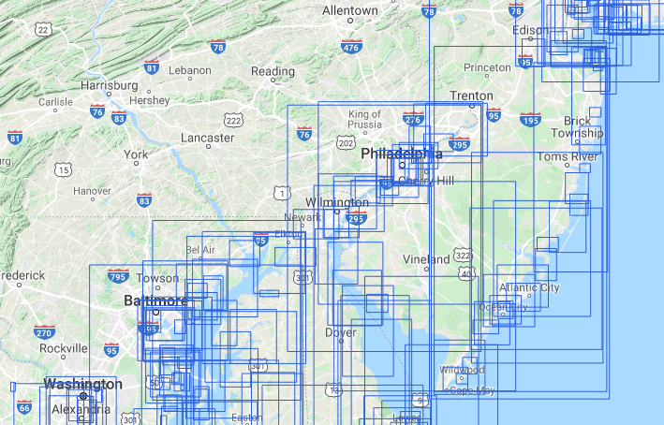
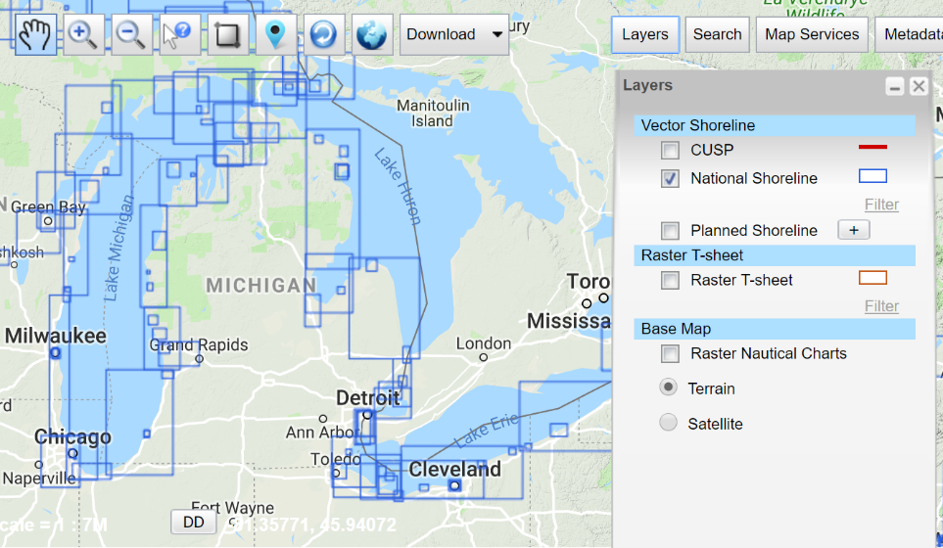
National Shoreline
The official shoreline for the Nation, in support of NOAA’s nautical charting mission
Available for download as shapefile in Mean High Water and Mean Lower Low Water datum
Organized by “Project Area” – the blue boxes
hyperlink to the National Shoreline homepage
Notes:
-This is an NGS product, highlights the origins of NGS as the Survey of the Coast, Coast & Geodetic Survey.
CLICK
-a sample screenshot of the Great Lakes area, note the Project Areas
CLICK
-And there you can see the dataset is generated up the Delaware past Philly

Slide 55
NGS Overview
Modernizing the NSRS
CORS
NHMP
GRAV-D
ECO
NGS Products and Services
ASP
OPUS
VDatum
Orbit Data
National Shoreline
Geodetic Advisors
ERI
Antenna Calibrations
NCAT
CUSP
CBL
Education
Notes:
This is not an exhaustive list of NGS programs, products, and services
These are some highlights and you will se this slide repeated when we focus on some of these items

Slide 56
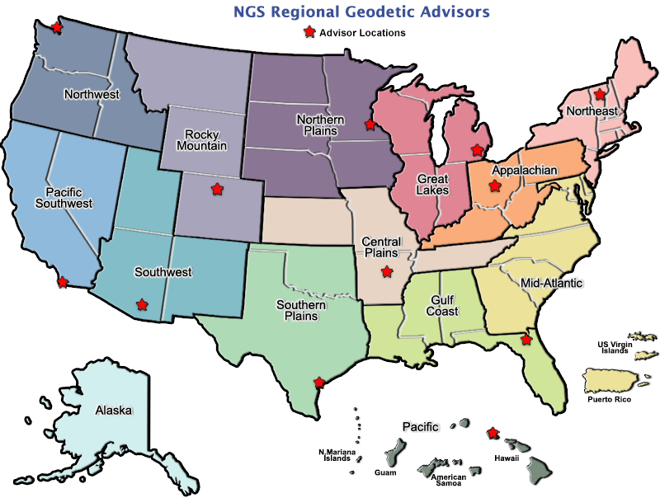
geodesy.noaa.gov/ADVISORS/
Notes:
-14 Regional Advisors, we’ve transitioned from a State-based to a Regional Program
-our advisors homepage up there at the top, also easy to find us by querying any major search engine for “ngs advisors”
-if you know Ross Mackay, he is our Chief Advisor, I report to him…
**ya know, I don’t know why they don’t make him put his photo up here
-we do have one vacant advisor position, that was recently advertised and John up there in Wisconsin is officially retired in oh… 18 days

Slide 57

Regional Geodetic Advisor Program
geodesy.noaa.gov/ADVISORS/
query any major search engine: “ngs advisors”
Notes:
Transitioned from a State to a Regional program in 2016. States no longer provide funding if they desire to have an Advisor, but NGS reorganized the personnel to support regions rather than single States.
Kentucky has appointed a State Geodetic Coordinator

Slide 58
State Geodetic Coordinators
Not an NGS employee, rather:
  State/Commonwealth government
    RTN manager
    DOT survey lead
    Geospatial Information Officer
  Academia
    Professor or Program Director
  Professional society representative
Serves as a liaison between the State’s geospatial community and the NGS
Notes:
-The State Geodetic Coordinator is not employed by NGS and is typically assigned by a state government agency or university.
-West Virginia has not requested a State Geodetic Coordinator

Slide 59
NGS Overview
Modernizing the NSRS
CORS
NHMP
GRAV-D
ECO
NGS Products and Services
ASP
OPUS
VDatum
Orbit Data
National Shoreline
Geodetic Advisors
ERI
Antenna Calibrations
NCAT
CUSP
CBL
Education
Notes:
This is not an exhaustive list of NGS programs, products, and services
These are some highlights and you will se this slide repeated when we focus on some of these items

Slide 60
Emergency Response Imagery
Mission of our Remote Sensing Division
Pre-Storm and Post-Storm photos are taken mostly along the coastal CONUS, and some other disasters natural or human
Supports Dept. of Homeland Security (DHS) and other emergency management organizations (FEMA, State, local, etc.)
Notes:
-Pre and Post photos are taken when possible
-mostly natural disasters, hurricanes
-but have also supported Midwestern Flooding and tornadic events
-notably also responded in NYC and DC on September 11, 2001

Slide 61
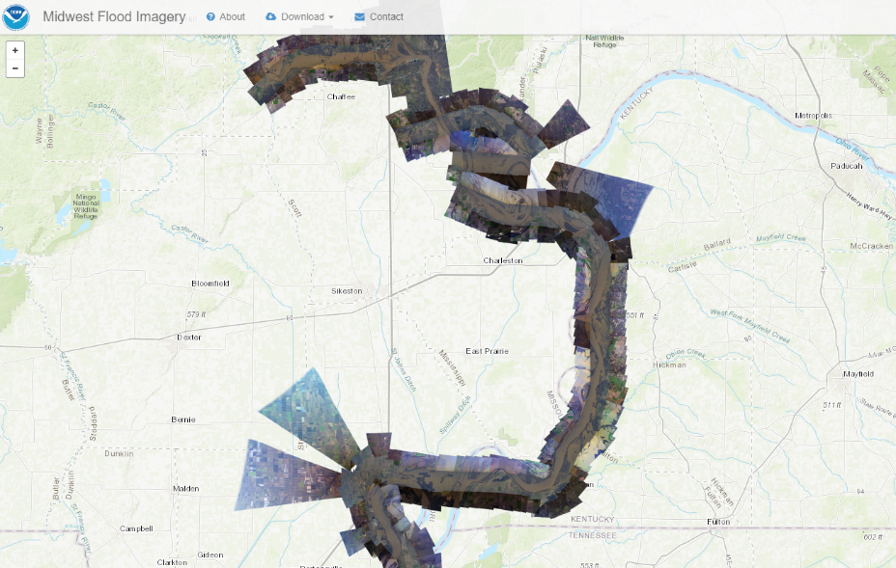
Emergency Response Imagery
Notes:
-Just a quick sample of ERI, over in Kentucky.
-dataset from 2015 flooding along the Mississippi River.
-Screenshot here is over by the Kentucky Bend, New Madrid Bend, whatever you want to call it.

Slide 62
NGS Overview
Modernizing the NSRS
CORS
NHMP
GRAV-D
ECO
NGS Products and Services
ASP
OPUS
VDatum
Orbit Data
National Shoreline
Geodetic Advisors
ERI
Antenna Calibrations
NCAT
CUSP
CBL
Education
Notes:
This is not an exhaustive list of NGS programs, products, and services
These are some highlights and you will se this slide repeated when we focus on some of these items

Slide 63
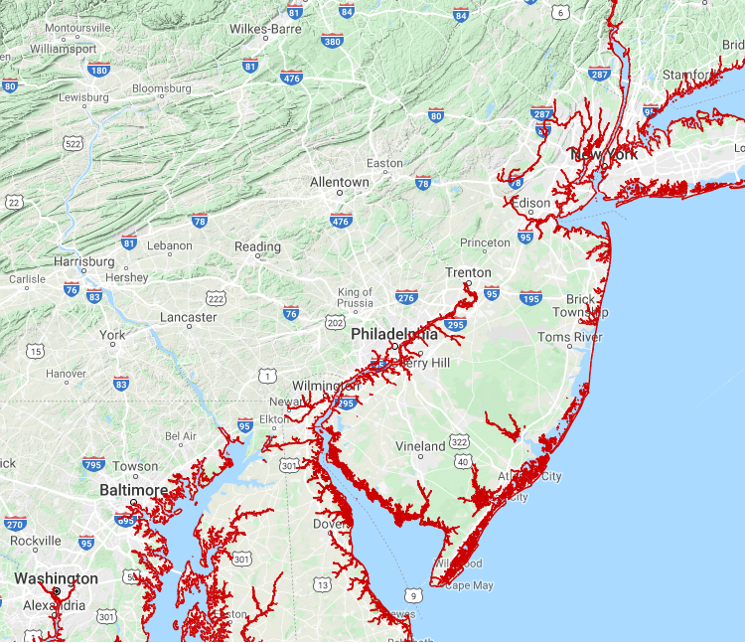
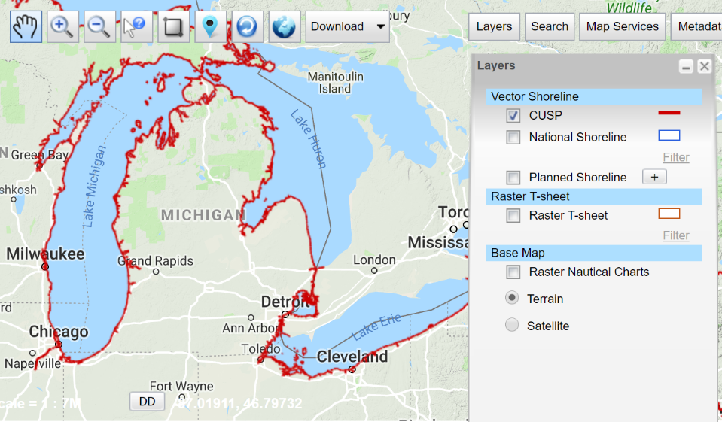
Continually Updated Shoreline Product
Just as the name says… it’s dynamic
Available for download as shapefiles
Developed by image interpretation and/or vertical modeling using water level stations (tide or lake gages)
Referenced to a computed Mean High Water
hyperlink to the CUSP homepage
Notes:
-”continually updated” equals… dynamic!
CLICK
-In typical NGS fashion, there are various ways to navigate to and locate the data, but there’s a screenshot of the NSDE, the NOAA Shoreline Data Explorer
CLICK
-and there’s a quick screenshot of the Delaware River region

Slide 64
NGS Overview
Modernizing the NSRS
CORS
NHMP
GRAV-D
ECO
NGS Products and Services
ASP
OPUS
VDatum
Orbit Data
National Shoreline
Geodetic Advisors
ERI
Antenna Calibrations
NCAT
CUSP
CBL
Education
Notes:
This is not an exhaustive list of NGS programs, products, and services
These are some highlights and you will se this slide repeated when we focus on some of these items

Slide 65
Calibration Base Lines - CBL
Three types of CBL defined by NGS
  Primary CBL (PCBL): in Woodford, VA at NGS TTC; it is open for use to constituents/professionals
  Federal CBL (FCBL): established with EDM checked at the NGS PCBL and IAW NOAA TM NGS-8
  Cooperative CBL (CCBL): established with EDM checked on an FCBL and IAW that same NGS-8 manual
Notes:
-PCBL is open for use during typical M-F duty hours. Although an appointment is not required, I would recommend calling or emailing before planning a trip.
-2 total FCBLs in WV, one in Marshall County and one at Richard C Byrd Locks & Dam.

Slide 66
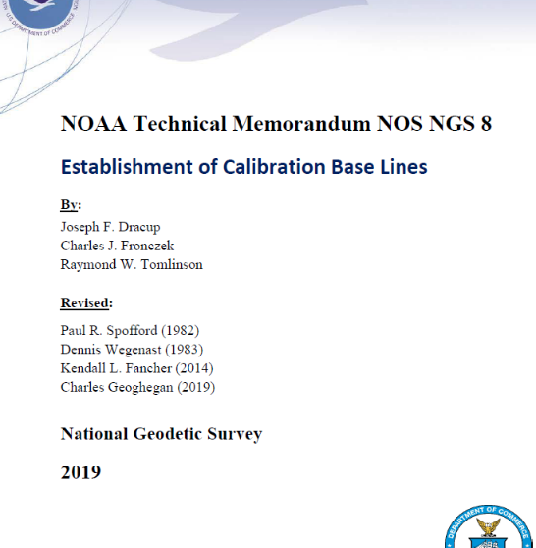
Calibration Base Lines - CBL
NGS commitment to the CBL Program:
  A minimum of one FCBL per State
  Establishment procedures document
  Public access to the CBL database
  Software to process your observations
  Verification and re-measurement data review
  Technical support (Advisors or other personnel)
https://www.ngs.noaa.gov/CBLINES/
Notes:
-we just published a new TM on establishing CBLs this past July!
-don’t ask me what’s new right now, because I can’t remember off the top of my head
-but we’re committed to the program even though some regions indicate extremely low use of the CBLs

Slide 67
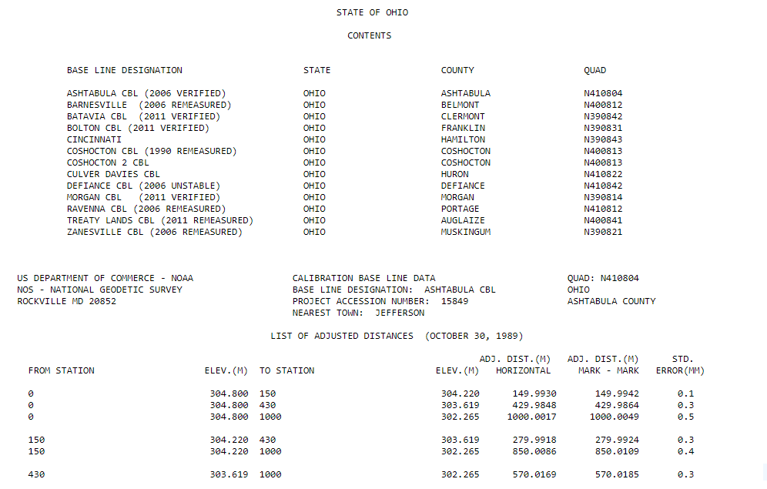
CBL Datasheets
Notes:
-these CBL datasheets, downloaded as a statewide list in ASCII format, were the longtime only way to retrieve CBL info
CLICK

Slide 68
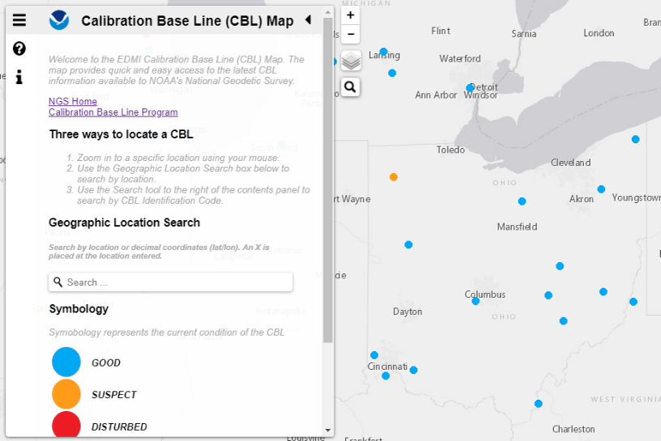
Beta CBL Map Viewer
https://www.ngs.noaa.gov/CBLINES/
Notes:
-But now we have this slick map navigation interface!
-it’s linked right now from our CBL page
-as I wrap up my discussion of CBLs: who has used a CBL in the past year?
-… 5 years?
-… ever?

Slide 69

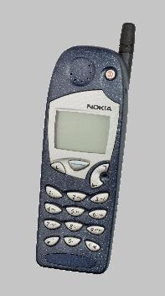
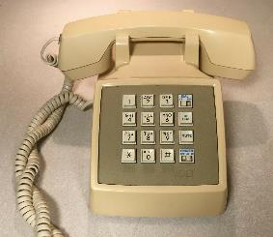
Evolution of the NSRS
NAD27
NAD83 (1986)
NAD83 (2011)
Notes:
NAD27
-like the dial of a rotary phone, you were out there spinning a theodolite around, running resections and solar shots to get a position… am I right?
-and you’d get a position, but it might not be that great, and if you set a mark then everybody wanted your data, like sharing the old party lines
NAD83(1986)
-we brought in a more accurate network, it was easier to access
-you were using an early total station and data collector, just like pushing the buttons on a touchtone phone
NAD83(2007/2011)
-the network was maturing with more CORS just like the cell towers
-just as cell phones were becoming ubiquitous, so too was the use of OPUS

Slide 70
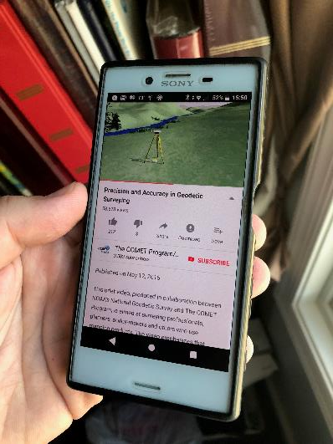
Modernized NSRS is our “smartphone”
You resisted it for a while…
It was a little cumbersome to get used to…
But soon you were hooked!
Notes:
-so if you think about the NSRS that way, then NATRF2022 is our smartphone, in more ways than one, right?
-some folks were excited to get a smartphone, but some (show of hands?) were reluctant to embrace the idea… kind of like this whole NSRS Modernization deal huh?
-some of us are excited for this development and some folks, well some are ready to retire as soon as NGS rolls this out, am I right?

Slide 71
North American Datum
of 1983
NAD83
will be replaced by

Slide 72
North American Terrestrial Reference Frame of 2022
NATRF2022
(pronounced: nat-ref)

Slide 73
Reference Frame ≈ Datum
Reference Frame is a more scientifically appropriate way of saying what we meant when we said “datum”
could be debated that “datum” was misused in NAD83(2011)
you will continue to see NGS use the phrase “New Datums” for 2022
Notes:
-for sanity and brevity’s sake…
-could be debated that “datum” was misused for many years in ellipsoidal coordinates
-even though the geometric/horizontal portion will officially be titled a “reference frame”

Slide 74
Datum Defined
“The adopted standard latitude and longitude of a given station, together with the adopted standard azimuth of a line from that station.”
e.g. NAD27
  station Meade’s Ranch and it’s azimuth mark Waldo
Source: Proceedings of the 14th General Conference of the International Geodetic Association (IAG) - ”Report on Geodetic Operations in the United States”, O.H. Tittmann, Superintendent of the USC&GS
Notes:
--Also table/podium example
-this is how things have been done historically, so let’s look closer at the example

Slide 75
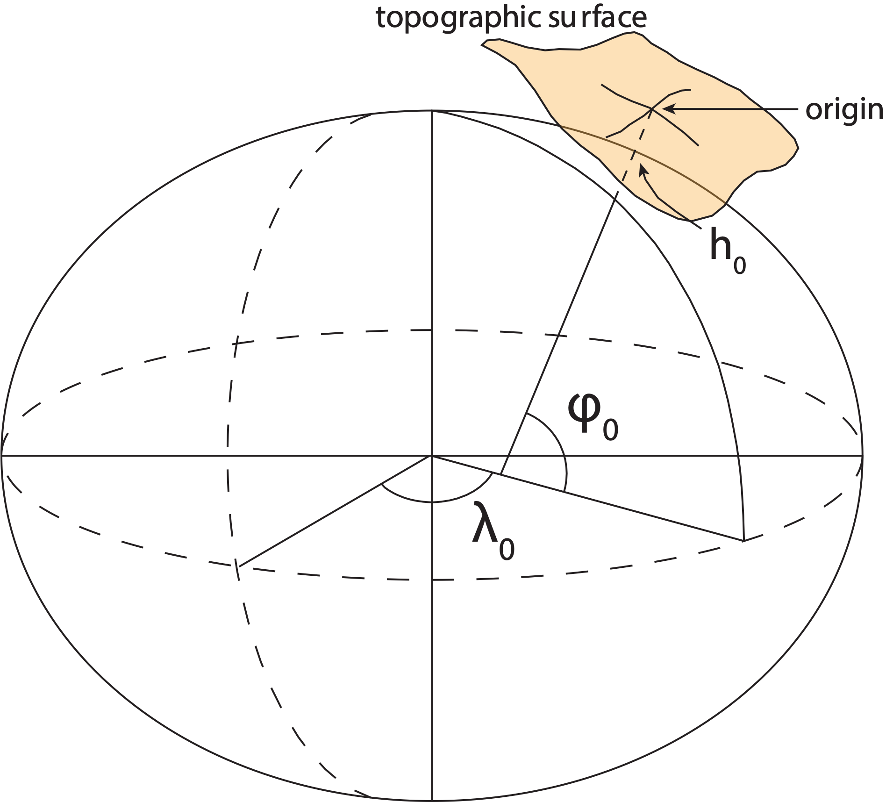
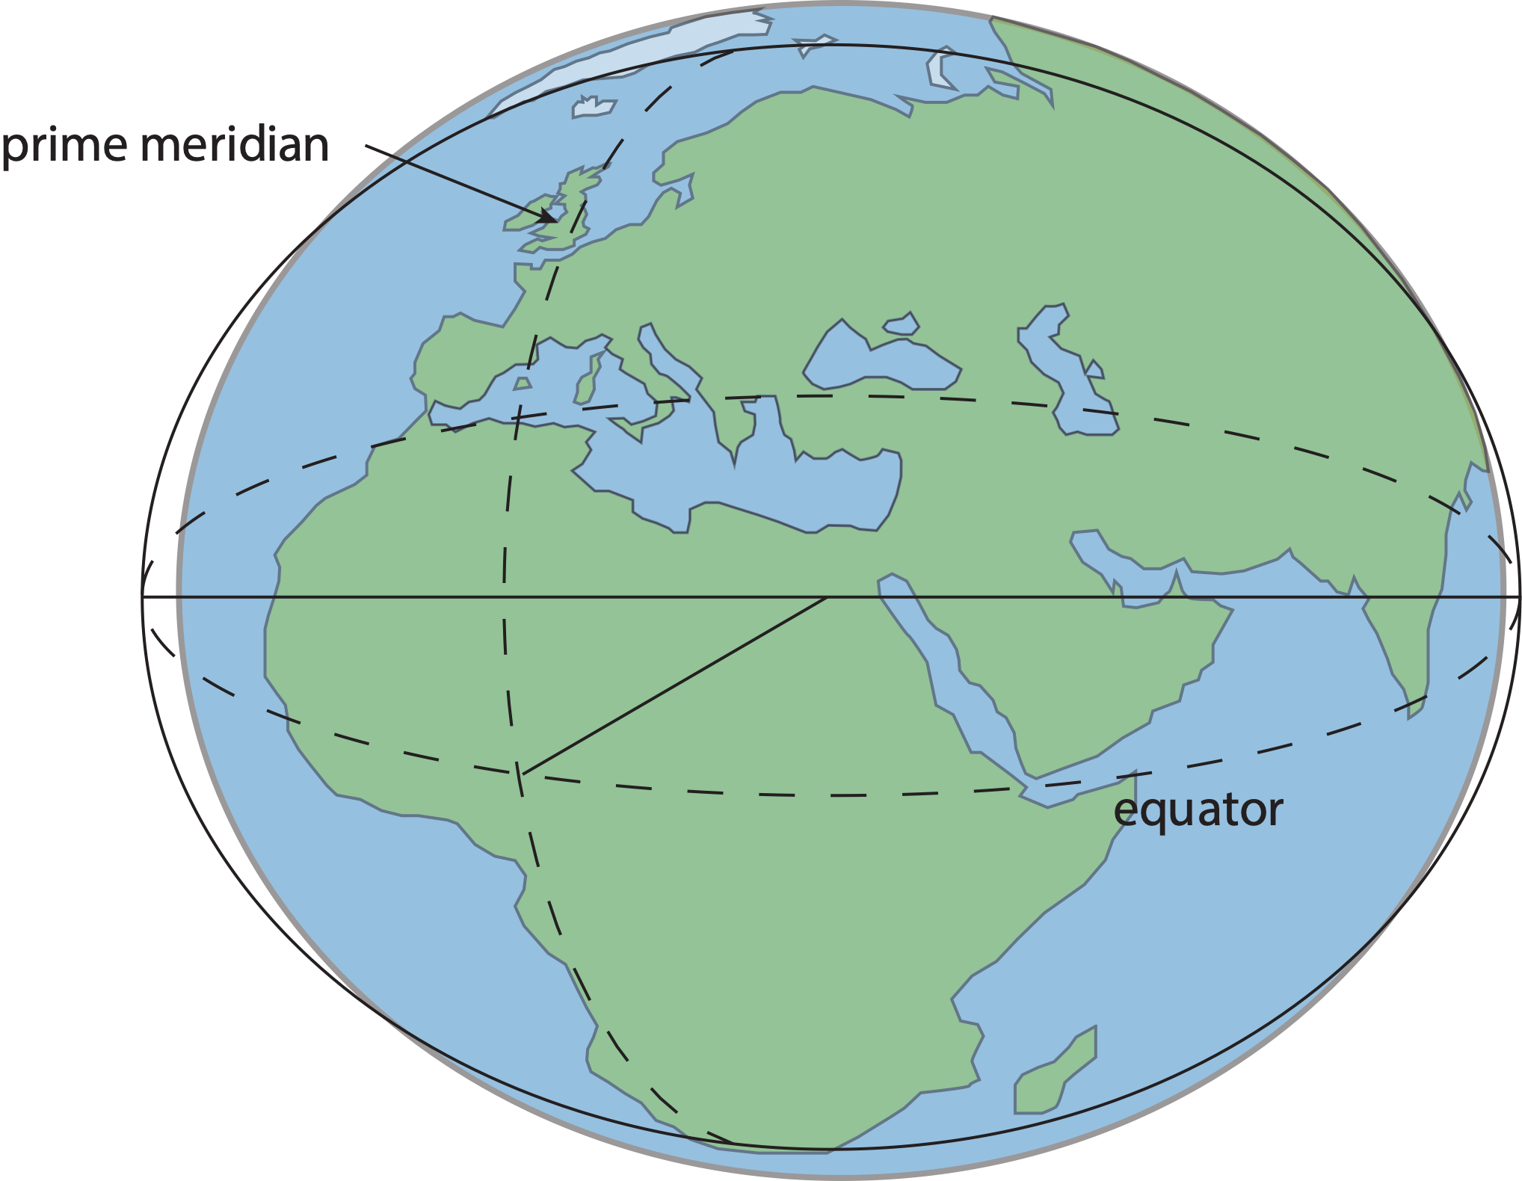
Datum – Traditional Horizontal
Positions of points on Earth’s surface are reduced to the surface of a reference ellipsoid
The reference ellipsoid roughly matches the shape of the Earth
Notes:
-to define a traditional horizontal geodetic datum, and this is specific to horizontal, we need to define a Reference Ellipsoid
-what do we do with that reference ellipsoid?
-we reduce our measurements from the surface of the earth to the reference ellipsoid
-someone selects that origin there, and all other coordinates within the datum are referenced from it

Slide 76
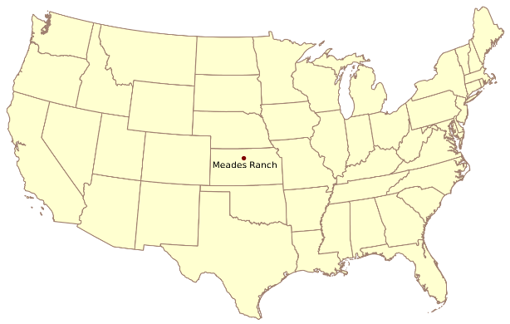
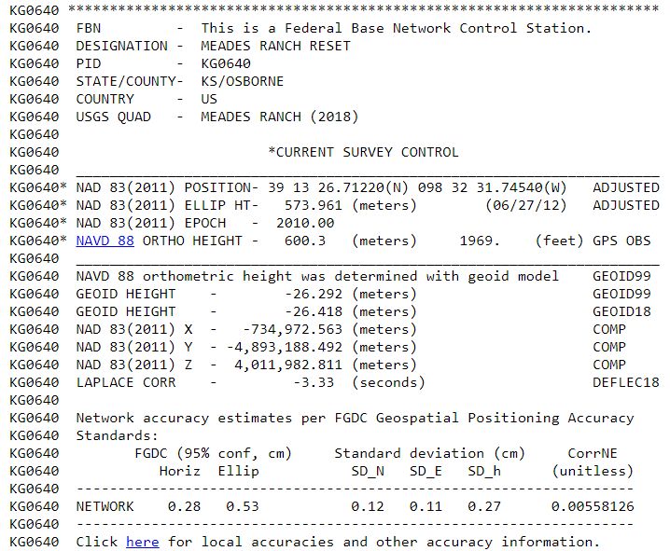
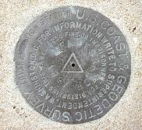
Datum – Traditional Horizontal
North American Datum of 1927 (NAD27)
Notes:
-a great example to share is the North Ameiccan Datumof 1927
-what was selected as the Origin? a specific mark, that of PID KG0640
-it’s a triangulation station now on the property of one Kyle Brant.
-his contact info is in the datasheet and do give him a call a day in advance
--STORY: was passing by once on a return trip from CO to see family
-anyway, we define that mark as the origin and…
CLICK

Slide 77

Datum – Traditional Horizontal
North American Datum of 1927 (NAD27)
Notes:
-with that mark as the origin, then we position other marks elsewhere with coordinates in relation to that origin point

Slide 78

Datum – Traditional Horizontal
North American Datum of 1927 (NAD27)

Slide 79

Datum – Traditional Horizontal
North American Datum of 1927 (NAD27)
Notes:
that’s a 129 foot wooden tower, or rather set of towers just like the Bilby.
-up in Ohio somewhere
-anyone guess what the big white tarps are for?
-wind screen, to block the inner tower where the instrument sits from heavy winds
-theres a nice shot of the instrument that these crews would have been using, a Parkhurst theodolite

Slide 80

Datum – Traditional Horizontal
Drawbacks → Reference Ellipsoid optimized for region
  not suitable for global positioning
  does not coincide with the center of mass of Earth
Source: https://www.e-education.psu.edu/geog862/node/1797
Notes:
Drawbacks
Reference Ellipsoid optimized for a region
not suitable for global positioning
does not coincide with the center of mass of Earth
Neighboring countries likely use different datums
can cause unnecessary complications in border regions
This method is static
dynamic process are unaccounted for
without international/global support they can’t be really

Slide 81
Reference Frame Defined
“A system of graduated lines symbolically attached to a body that serve to describe the position of points relative to the body.”
Source: Encyclopaedia Brittanica – Reference Frame (Physics), The Editors of the Encyclopaedia Brittanica, April 08, 2016.
Notes:
--Also table/podium example

Slide 82
Reference Frame
Before you can realize a Reference Frame… you must define a Reference System
Reference Frame:
Realizes the system by means of coordinates of definite points that are accessible directly by occupation or observation¹
-the cake
= CORS
¹Springer Handbook of Global Navigation Satellite Systems, Ch. 2, p. 34

Slide 83

Notes:
-that’s a 129 foot wooden tower, or rather set of towers just like the Bilby.
-up in Ohio somewhere
-anyone guess what the big white tarps are for?
-wind screen, to block the inner tower where the instrument sits from heavy winds
-theres a nice shot of the instrument that these crews would have been using, a Parkhurst theodolite

Slide 84
Replacing NAD83
develop four "plate-fixed" reference frames
remove non-geocentricity of NAD83
align to ITRF2020 at epoch 2020.00
remove most of tectonic plate rotation from ITRF2020 via Euler Pole Parameters
Shift and Drift…
Notes:
-four geodetic tasks to this part of modernizing the NSRS
-note that afterthought at the bottom “shift and drift”

Slide 85
Replacing NAD83
develop four "plate-fixed" reference frames
remove non-geocentricity of NAD83
align to ITRF2020 at epoch 2020.00
remove most of tectonic plate rotation from ITRF2020 via Euler Pole Parameters
Shift and Drift…

Slide 86
Four “Plate-Fixed” Reference Frames
North American Terrestrial Reference Frame of 2022
(NATRF2022)
Pacific Terrestrial Reference Frame of 2022
(PATRF2022)
Caribbean Terrestrial Reference Frame of 2022
(CATRF2022)
Mariana Terrestrial Reference Frame of 2022
(MATRF2022)
Notes:
-We refer them as “plate-fixed” because the frame moves with the plate, to minimize time-based coordinate shift. We’ll cover that in more detail, I have some slides I put together that I guarantee you’ll understand it, if not I’ll buy you a beer later. No, not really.

Slide 87


Notes:
-there’s four reference frames because there are four major tectonic plates within the NGS Area of Responsibility.
-As the National Geodetic Survey, we’re part of the DoC so we must cater to all US States and Territories
-thus we’ve got four tectonic plates in our Area of Operations, so four Ref Frames
-But…

Slide 88
Four “Plate-Fixed” Reference Frames
North American Terrestrial Reference Frame of 2022
(NATRF2022)
Pacific Terrestrial Reference Frame of 2022
(PATRF2022)
Caribbean Terrestrial Reference Frame of 2022
(CATRF2022)
Mariana Terrestrial Reference Frame of 2022
(MATRF2022)
Notes:
-… remember if you’re only working in this region, or anywhere east of the Mississippi, all you really need to be concerned with is NATRF
CLICK

Slide 89
Replacing NAD83
develop four "plate-fixed" reference frames
remove non-geocentricity of NAD83
align to ITRF2020 at epoch 2020.00
remove most of tectonic plate rotation from ITRF2020 via Euler Pole Parameters
Shift and Drift…
Notes:
-NON-geocentricity… well the goal was a geocentric NAD but it was the 80s, so they were off a little bit

Slide 90

Non-geocentricity?
Geocentric:
  relating to, measured from, or as if observed from the earth's center of mass
The goal was to accomplish that… but didn’t.
Notes:
-what does it mean to be geocentric, cute little diagram here illustrates pretty well
-why does this matter?
-Gravity
-all those satellites orbiting around the earth maintain their orbits due to gravity

Slide 91

Non-geocentricity of NAD83
ITRF2020
GRS80 ellipsoid
NAD83
GRS = Geodetic Reference System
Notes:
-we’re going to back up and get to the non-egocentricity, stay with me here
-so there’s a nice little ellipse representing the shape of the GRS80 reference ellipsoid
CLICK
-what’s GRS80? well, it’s a reference system (being a reference ellipsoid, a gravity model, and more).
-GRS80 in itself is not a datum, although you will see/hear some folks misinterpret that
CLICK
-now once you take that reference system/ellipsoid and you tie it to the origin of your choice… badabing!
-now you’ve got a datum (or reference frame)
CLICK
-in this case, we’re talking about that blue which is symbolizing an ellipsoid with it’s origin locked to the Center Mass of the earth
-which represents the ITRF2020
-you may be thinking “jeff what is the ITRF?”… don’t worry we’ll get there for now the concept is more important
CLICK
-so now let’s look at how NAD83 compares, the orange there, see it’s shape is the same GRS80 ellipsoid… but with a different origin point
-not quite aligned to CM, but close… not bad, it was the 80s maaaan, they did the best they could!
-jokes aside, a pretty amazing feet to have only “missed the mark” by a few meters, they didn’t have the satellite technology or computer power we have back in the late 70s when the calcs for NAD83 were being run
-props to those folks!
CLICK

Slide 92
Non-geocentricity of NAD83
ITRF2020
GRS80 ellipsoid
NAD83
Notes:
--zooming in to setup for next slide—
-Let’s zoom in a little to examine that situation

Slide 93
Non-geocentricity of NAD83
Earth’s
Surface
h₁₄
h₈₃
NAD83
origin
ITRF2020
origin
~2.2 meters
GRS80
ellipsoid
Notes:
-so there’s one quarter of both the NAD83 and ITRF2020 ellipsoid
CLICK
-important to note that both are using the same geometry (size, shape), the GRS80 ellipsoid, just with a different origin
CLICK
-so that dark red [maroon if you will] arrow there on the bottom left, it symbolizes and greatly exaggerates the difference between those origins
CLICK

Slide 94
Non-geocentricity of NAD83
Earth’s
Surface
h₂₂
NAD83
ITRF2020
NATRF2022
GRS80
ellipsoid
Shift…
Notes:
-and we’ll visualize the plan to remove the non-egocentricity of NAD83 with a little animation
CLICK
-our orange NAD83 ellipsoid shift over to match up with out blue ITRF ellipsoid
-and now there we see the result in red, our new NATRF2022 ellipsoid
CLICK
-what do I like to point out here?
-we’re still utilizing the GRS80 reference ellipsoid as the basis for NATRF2022
-why? because the size and shape, well the scientists nailed it on that one, like I said earlier they just didn’t quite get the CM
CLICK

Slide 95


Geometric change due to ellipsoid non-geocentricity
Horizontal (Lat, Lon)
Ellipsoidal (h)
Shift…
Notes:
-Estimate of shift from NAD83(2011) epoch 2010.00 to NATRF2022 epoch 2020.00
-so this represents the positional shift due to non-geocentricity that we’re addressing/fixing
-now remember this is the Geometric component only, so the graphic on the right illustrates a somewhat constant shift because it is representing Ellipsoidal shift, not Orthometric
-Look at the size of those arrows, based on the scale bar there we’re looking at about 1 meter-ish lat,lon shift and somewhere around the same ellipsoidally around here
-REMEMBER, this is easy to address compared to geoid/ortho heights!

Slide 96
Replacing NAD83
develop four "plate-fixed" reference frames
remove non-geocentricity of NAD83
align to ITRF2020 at epoch 2020.00
remove most of tectonic plate rotation from ITRF2020 via Euler Pole Parameters
Shift and Drift…
Notes:
We’ll talk about that ‘plate fixed’ later.
Now wait a minute Jeff, what is the IGS? You just explained the ITRF and told us about that!!
IGS Reference Frame is pretty much equivalent to the ITRF, created by the Intl. GNSS Service, of which NGS is a contributing partner.
The Intl. GNSS Service, let’s take a look at their website for a minute.
-pronounced “oiler” poles

Slide 97


Epoch
eh-puck? ee-pock? … to-may-to, to-mah-to
an instant of time
a date selected as a point of reference
Notes:
-Where do you see an Epoch right now in NGS data?
CLICK
Datasheets! there you see the epoch of 2010.0
and of course OPUS Solution Reports!
note that in blue over there on the right you’ll see another epoch, in the ITRF, which I will explain later on

Slide 98




International Terrestrial Reference Frame
(ITRF)
International Earth Rotation and Reference Systems Service (IERS)
International Union of Geodesy and Geophysics (IUGG)
Notes:
-so I mentioned global reference frames
-ITRF is the internationally recognized standard
-who realizes the ITRF? well, NGS contributes to the realization but
CLICK
-The IERS is in responsible charge of defining, realizing and promoting the ITRF
-and the ITRF was formally adopted by the…yes, more acronyms
CLICK
IUGG some years ago

Slide 99
International Terrestrial Reference Frame
The stable coordinate system that allows us to measure change over space, time and evolving technologies.
An accurate, stable set of station positions and velocities.
Network measurements interconnected by co-location of different space geodetic techniques.
“Approximately represents the motions of the tectonic plates with respect to the Earth's deep interior”… huh?
Notes:
What is the International Terrestrial Reference Frame
(ITRF)?
You’ve heard me mention the ITRF, but if you’ve been paying attention to OPUS Solution Reports you may’ve noticed the ITRF2014 coordinates over on the right hand side
Let’s try to visualize the ITRF. Last bullet,

Slide 100

ITRF concept
Watch the grid!
Drift…
Epoch:
Notes:
Ok, now ITRF mentioned a couple slides ago.
Most simplistic way to explain ITRF is to watch this animation.
This is a very loose representation/visualization of what the ITRF is, a characterization only.

Slide 101
Replacing NAD83
develop four "plate-fixed" reference frames
remove non-geocentricity of NAD83
align to ITRF2020 at epoch 2020.00
remove most of tectonic plate rotation from ITRF2020 via Euler Pole Parameters
(pronounced: “oiler”)
Shift and Drift…
Notes:
We’ll talk about that ‘plate fixed’ later.
Now wait a minute Jeff, what is the IGS? You just explained the ITRF and told us about that!!
IGS Reference Frame is pretty much equivalent to the ITRF, created by the Intl. GNSS Service, of which NGS is a contributing partner.
The Intl. GNSS Service, let’s take a look at their website for a minute.
-pronounced “oiler” poles

Slide 102
The wrong question, circa 2022:
“What’s the position of that point?”
The right question, circa 2022:
“What’s the position of that point, on some specific date?”
Drift…
Notes:
-why??
-because of that word down there: drift

Slide 103
Two types of drift
Tectonic Plate Rotation
    horizontal
Everything Else
    residual motions left after rotation
    regional linear motions
    localized subsidence or uplift
simple to model
complex
Notes:
-there’s two types of drift you’ll see

Slide 104
Tectonic Plate Rotation
    horizontal
simple to model
Notes:
-there’s two types of drift you’ll see

Slide 105
Euler Pole Parameters
of 2022
EPP2022

Slide 106

Plate Rotation visualized
Drift…
Notes:
-these are ground-level horizontal velocities
-the arrows illustrate the positions and velocities of CORS plotted in ITRF2014
-our scale is on the left there, with that arrow representing 20mm of motion per year
-so right thru Ohio it’s a little cluttered but we’re seeing arrows about that length so about 2cm/20mm per yr
-what do we notice about the direction of these arrows?
-they look rotational, don’t they?
CLICK HERE
-Note the arrows in California do not conform to the rotation… those are CORS on a different PLATE which is moving in a different direction
CLICK HERE
-so when you look at those arrows you can see the rotation, but the point of rotation is obviously off the map, way down below the screen right?
-that point is what’s known as an Euler Pole

Slide 107

Euler Poles and “Plate-Fixed”
  In the ITRF, many tectonic plates have a dominant motion: rotation
  Euler Pole - point about which a plate rotates (yellow star)
NATRF2022 Euler Pole
Notes:
We say “NATRF2022” is “fixed” to the N.A. Plate, making it a “plate fixed” frame
-the frame is constant to itself, but rotating within ITRF, and moving in a different direction than the other 3 frames

Slide 108
Euler Poles and “Plate-Fixed”
ITRF
Frame = constant
NA Plate = rotating
NATRF
Frame = rotating
NA Plate = constant
Notes:
We say “NATRF2022” is “fixed” to the N.A. Plate, making it a “plate fixed” frame
-the frame is constant to itself, but rotating within ITRF, and moving in a different direction than the other 3 frames

Slide 109
Euler Poles and “Plate-Fixed”
ITRF
Frame = constant
NA Plate = rotating
NATRF
Frame = rotating
(relative to ITRF)
NA Plate = constant
(relative to NATRF2022)
Notes:
We say “NATRF2022” is “fixed” to the N.A. Plate, making it a “plate fixed” frame
-the frame is constant to itself, but rotating within ITRF, and moving in a different direction than the other 3 frames

Slide 110

ITRF – constant frame, rotating plate

Slide 111
“Plate-Fixed”
NATRF – rotating frame, constant with plate

Slide 112
ITRF or NATRF – your choice, just use EPP

Slide 113
EPP – Euler Pole Parameters
Latitude
Longitude
Rotation Speed
yellow star off west coast of S. America
Notes:
-our EPP are that green arrow from the last slide
-the lat,lon being that ol’ yellow star

Slide 114
CORS Velocities in ITRF2014
Drift…

Slide 115

CORS Velocities in NATRF2022
Think of this map as ITRF2020 + EPP2022
Still SomeDrift…
Notes:
These velocities the motion that is left after removing Euler Pole rotation via it’s defining parameters, known simply as Euler Pole Parameters or EPP
These small bare visible arrows in our region are residual velocities leftover after modeling that Euler pole, which will then be modeled into the IFDM for NATRF2022.

Slide 116
ITRF2020 + EPP2022 = --TRF2022
Rotation of the
North American Plate
NATRF2022
CATRF2022
PATRF2022
MATRF2022
Rotation of the
Caribbean Plate
ITRF2020
Rotation of the
Pacific Plate
Rotation of the
Mariana Plate
EPP2022
Notes:
-So it all starts with ITRF
-OPUS is already running all your processing in ITRF, take a look at one of your recent solution reports and you’ll see ITRF2014 coordinates on the right hand side (or IGS/IGb08)
-Not just North America, Each plate gets a set of EPP associated with it, as each plate is rotating around a different Euler Pole

Slide 117
ITRF2020 + EPP2022 = --TRF2022
Rotation of the
North American Plate
NATRF2022
EPP2022
ITRF2020
Notes:
BUT
-if you’re only working in this region you only need to be concerned with NATRF2022

Slide 118
Two types of drift
Tectonic Plate Rotation
    horizontal
Everything Else
    residual motions left after rotation
    regional linear motions
    localized subsidence or uplift
simple to model
complex
Notes:
-there’s two types of drift you’ll see

Slide 119
Everything Else
    residual motions left after rotation
    regional linear motions
    localized subsidence or uplift
Still SomeDrift…
complex
Notes:
-there’s two types of drift you’ll see

Slide 120
Intra-Frame Deformation Model of 2022
IFDM2022

Slide 121
Concept of goal of IFDM
Longitude (Easting) History of DI4044
Trend: -1.7 mm / year
RED IS NATRF2022
COORDINATE
Still Some Drift…
Trend: -14.3 mm / year
BLUE IS ITRF COORDINATE
2004 2006 2008 2010 2012 2014 2016 2018
Notes:
First look at that blue line, that is the velocity of DI4044 if we graph it’s easting coordinate in ITRF over 10+ years.
So look at the reddish line, that’s the longitude/easting of PID DI4044 after the EPP (rotation) is modeled and factored in, but before the IFDM is applied.
This is the velocity of the point in NATRF2022
Rotation of plate removed. It is not constant because the point still suffers small “intra-frame” velocities.
Such IFVs will be captured in a model by NGS.
The intent of the IFDM is to remove even that movement to better support coordinate comparisons, etc.

Slide 122
CORS Velocities in NATRF2022
Think of this map as ITRF2020 + EPP2022
Still SomeDrift…
Notes:
These velocities the motion that is left after removing Euler Pole rotation via it’s defining parameters, known simply as Euler Pole Parameters or EPP
These small bare visible arrows in our region are residual velocities leftover after modeling that Euler pole, which will then be modeled into the IFDM for NATRF2022.

Slide 123

IFDM goal = model all velocities
Think of this map as ITRF2020 + EPP2022 + IFDM2022
Notes:
-model all velocities… within the frame

Slide 124
Still Some Drift…
  Everything in the world moves
  Coordinates will be associated with the actual date when the data was collected!
  Velocities at all marks can be estimated using this Intra-Frame Deformation Model
  IFDM goal being to move collected data thru time to Reference Epochs for coordinate comparisons/analysis

Slide 125
Intra-Frame Deformation Model
A model of all residual velocities, after removal of tectonic rotation via EPP:
  Horizontal residual motion
  Total vertical motion (ellipsoid heights)
  Replaces / Improves upon HTDP
Given t₁ and t₂, compute Δλ, Δϕ, Δh at any point, accounting for all motions
Likely be built upon CORS data, geodynamic models and InSAR, but not yet finalized
Notes:
-Model of all residual/leftover horizontal velocities after applying those EPPs
HTDP hasn’t been updated, but the IFDM will be even better than HTDP.
That bottom bullet is what the current plan is stating

Slide 126
EPP2022 – Euler Pole Parameters – Simple Rotation
  Three parameters: lat, lon, rotation speed
  Horizontal only: just latitude and longitude
  Changes the frame
  Does not change the epoch
IFDM2022 – Intra-Frame Deformation Model
  Complex set of parameters
  Residual horizontal motion: all the motion leftover after Euler Pole rotation
  All vertical motion: localized subsidence or uplift
  Changes the epoch
  Does not change the frame: “intra” = on the inside; within
  (ITRF2020 + EPP2022 = NATRF2022)

Slide 127
EPP2022
IFDM2022
Two new tools that will make time dependent geodetic control practical
They work together to account for the Drift…

Slide 128
Example of application of EPP and IFDM
It’s 2039 and you are working in San Diego using NATRF2022
Client has another set of survey data and it’s from 2028
Important: This slide only covers geometric coordinates.
…the catch is, that survey was done in PATRF2022
PATRF2022
ep. 2028.048
EPP2022
(PA)
ITRF2020
ep. 2028.048
EPP2022
(NA)
NATRF2022
ep. 2028.048
IFDM2022
(PA)
IFDM2022
(NA)
PATRF2022
ep. 2039.704
EPP2022
(PA)
ITRF2020
ep. 2039.704
EPP2022
(NA)
NATRF2022
ep. 2039.704

Slide 129

Notes:
-what’s the Magnitude of Horizontal Change?
-we will have tools online to simplify the process of estimating NAD83→NATRF2022
-see the 1.1 and 1.2m contour lines are south and just thru Northern OH, so you’ll see a northwesterly shift of less than 4 feet throughout the vast majority of Ohio, between 3.7 and 4 feet

Slide 130

What’s that going to look like?
PHOTO = NAD83
RED = NAD83 shoreline data
GREEN = shoreline transformed to NATRF2022
Notes:
RED: NAD 83 coastline against NAD 83 imagery
GREEN: Coastline shifted into NATRF2022 but the imagery remains on NAD 83

Slide 131


If you’re only working in this region…
North American Terrestrial Reference Frame of 2022
(NATRF2022)
Notes:
-remember, we covered 4 reference frames but if you’re just working in this region, you only have to be concerned with NATRF
-almost everything I’ve covered thus far is in this TR or Technical Report available on our website

Slide 132
Not just new datums…
  NSRS Modernization
Replace NAD83
Replace NAVD88
Re-invent Bluebooking
Improve Geodetic Toolkit
Better Surveying Methods
Blueprint for 2022, Part 1
Blueprint for 2022, Part 2
Blueprint for 2022, Part 3
Notes:
-so you’ve probably seen that phrase that I have front and center here, NSRS Modernization
-that’s the blanket term we use to refer to not just the new datums but other updates
-another phrase I want to mention are these “Blueprints for 2022”
-just about everything I cover today is mentioned in one of the Blueprints
-the Geodetic Toolkit, what’s that? another term that just refers to all those softwares NGS provides, like PAGES, ADJUST, etc.
-better methods – updating manuals like NGS-58 and 59 for example

Slide 133


Slide 134
State Plane Coordinate System of 1983
SPCS83

Slide 135
Pennsylvania Coordinate System Law
Act of Dec. 16, 1992, P.L. 1224, No. 161
Problems
Designates specific zones
Parameters of projections included
Restricts datum usage to 1983 or 1927
Unit of measure designated as Survey Foot
What’s the deal with the requirement to certify SPCS coordinates in recorded land records?
Notes:
-co-location and good distribution
-teamwork with other agencies like the IERS, the IUGG mentioned earlier

Slide 136
State Plane Coordinate System of 2022
SPCS2022

Slide 137


geodesy.noaa.gov
Notes:
A lot of information is available on the NGS website, including:
2022 policy changes
Supporting information (old policy and manuals, new report on SPCS history)
Maps of preliminary SPCS2022 designs available for download
Not all states yet available, but designs are in progress
Includes maps of existing SPCS 83 for comparison

Slide 138
State Plane Coordinate System of 1983
SPCS83
North and South Zones as they exist now
Notes:
We start with the SPCS83 zones as a frame of reference
NOTE that the color shading of these zones is matched to that of the Preliminary SPCS2022 Zones that follow

Slide 139

DRAFT

Slide 140

DRAFT

Slide 141
State Plane Coordinate System of 2022
SPCS2022
PA stakeholders requested 4-5 zones, which NGS designed, the following are Preliminary maps
Notes:
The following section illustrates the preliminary SPCS2022 zones
There are 4 zones in the NGS design, per request that we design “4-5 zones required to meet the minimum distortion acceptable” set by our design criteria of 50ppm
NOTE the request also included wording: “It is also requested that PennDOT districts be divded into no more than two zones”

Slide 142

Notes:
NOTE that the West Zone far surpasses the NGS design criteria of 50ppm

Slide 143

Notes:
This is the first, and likely final, draft of an Oblique Mercator projection for the Preliminary Central Zone
NOTE that even with the

Slide 144

Notes:
This is the second draft of a Preliminary North East Zone
NOTE this includes Columbia and Montour Counties, and the animation highlights the comparison between having these counties in the SE or NE Zone

Slide 145

Notes:
This is the second draft of a Preliminary South East Zone
NOTE this excludes Columbia and Montour Counties (they would fall in SE Zone)

Slide 146


Slide 147


Slide 148


Slide 149
State Plane Coordinate System of 2022
SPCS2022
NGS will create a Single Statewide Zone for every State, the following is a Preliminary map

Slide 150

Notes:
This Single Statewide Zone designed by NGS is color shaded to match the following section of slides that show UTM Zones linear distortion values
It is known that some user communities with large areas of responsibility choose to maintain geospatial data and work in UTM
This graphic as compared to the UTM serves to highlight in SPCS2022, users will see better performance (lower linear distortion) if they choose to work in the SPCS2022 Single Statewide Zone rather than one of the UTM Zones that fall within Pennsylvania

Slide 151
UTM (NAD83) Zones as
UTM
The following are maps using existing UTM zones as a Single Statewide Zone
(included to highlight the lower performance as compared to Preliminary NGS Zone)

Slide 152


Slide 153


Slide 154
Notes:
The NGS designed preliminary single statewide zone is included again here at the end for easier visual comparisons.

Slide 155

The Survey Foot is dead!
Long live the Survey Foot!
US Survey Foot was deprecated 31 December 2022… now what?!?
…or Feets Don’t Fail Me Now
Notes:
We start with the SPCS83 zones as a frame of reference
NOTE that the color shading of these zones is matched to that of the Preliminary SPCS2022 Zones that follow

Slide 156
The problem
Two versions of same unit in current use
  “New” international foot and “old” U.S. survey foot
  “New” shorter than “old” by 2 ppm (0.01 ft per mile)
  A real problem with real costs
What’s in a name?
  “U.S. survey” versus “international”
Who is using U.S. survey feet?
  Surveyors exclusively, in most (not all) states
  But it impacts everyone
Notes:
It’s likely everyone watching this webinar knows about the problem: there are two nearly identical versions of the foot in current use in the U.S.;
They differ by 2 parts per million (ppm), or only 0.01 ft per mile, or slightly more than a tenth of an inch in a mile.
Despite (or actually because of) the very small difference, it has become a REAL problem with REAL costs.
What’s in a name? That which we call a “foot” by any other word would smell as… sweet? Maybe that’s not he best analogy for the foot…
“U.S. survey foot” sounds patriotic, is surveyor-centric…
“International foot” sounds like a New World Order, UN sanctioned sort of thing, with perhaps a whiff of socialism…
Is the name really part of the problem? I hope not, but emotion does play a role. We are not entirely rational creatures after all (myself included).
Surveyors are really the only users of the U.S. survey foot (sft). They are also among the very few who even know of its existence. In schools and colleges they only teach students about the official international foot (ift). However, because people use the products created by surveyors, they end up using the sft without even knowing it.
Want to have a conversation about this, get all of us on the same page. So I will present facts to facilitate informed discussion (sprinkled with some opinions…)

Slide 157

2 parts per million (ppm)
1,000,000.00 sft = 999,998.00 ift
10,000,000.00 sft = 9,999,980.00 ift
International → 1 ft = .3048 m
US → 1 ft = .30480061 m (approx.)
  frequently calculated by $\frac{1200}{3937}$
Notes:
It’s likely everyone watching this webinar knows about the problem: there are two nearly identical versions of the foot in current use in the U.S.;
They differ by 2 parts per million (ppm), or only 0.01 ft per mile, or slightly more than a tenth of an inch in a mile.
Despite (or actually because of) the very small difference, it has become a REAL problem with REAL costs.
What’s in a name? That which we call a “foot” by any other word would smell as… sweet? Maybe that’s not he best analogy for the foot…
“U.S. survey foot” sounds patriotic, is surveyor-centric…
“International foot” sounds like a New World Order, UN sanctioned sort of thing, with perhaps a whiff of socialism…
Is the name really part of the problem? I hope not, but emotion does play a role. We are not entirely rational creatures after all (myself included).
Surveyors are really the only users of the U.S. survey foot (sft). They are also among the very few who even know of its existence. In schools and colleges they only teach students about the official international foot (ift). However, because people use the products created by surveyors, they end up using the sft without even knowing it.
Want to have a conversation about this, get all of us on the same page. So I will present facts to facilitate informed discussion (sprinkled with some opinions…)

Slide 158
What’s impacted?
When does this matter?
  Not typically in lengths/distances
  But in published planar coordinate systems
Like what?
  SPCS and UTM are very popular and both fall victim to mix-ups
Why?
  Large false eastings and northings
Notes:
It’s likely everyone watching this webinar knows about the problem: there are two nearly identical versions of the foot in current use in the U.S.;
They differ by 2 parts per million (ppm), or only 0.01 ft per mile, or slightly more than a tenth of an inch in a mile.
Despite (or actually because of) the very small difference, it has become a REAL problem with REAL costs.
What’s in a name? That which we call a “foot” by any other word would smell as… sweet? Maybe that’s not he best analogy for the foot…
“U.S. survey foot” sounds patriotic, is surveyor-centric…
“International foot” sounds like a New World Order, UN sanctioned sort of thing, with perhaps a whiff of socialism…
Is the name really part of the problem? I hope not, but emotion does play a role. We are not entirely rational creatures after all (myself included).
Surveyors are really the only users of the U.S. survey foot (sft). They are also among the very few who even know of its existence. In schools and colleges they only teach students about the official international foot (ift). However, because people use the products created by surveyors, they end up using the sft without even knowing it.
Want to have a conversation about this, get all of us on the same page. So I will present facts to facilitate informed discussion (sprinkled with some opinions…)

Slide 159




Who is responsible for standards?
National Institute of Standards and Technology
Notes:
Today, the National Institute of Standards and Technology (NIST) is responsible for defining and establishing standards. It is within their authority.
NIST is a bureau of the Department of Commerce (DOC)
The National Oceanic and Atmospheric Administration (NOAA) is also a bureau of DOC.
The National Geodetic Survey (NGS) is a program office in NOAA. It’s actually within the National Ocean Service (NOS) in NOAA.
It may seem odd to show NGS here along with NIST, but there is a reason for it, as you will soon see.

Slide 160
-use any major search engine: “NGS advisors”
Jeff Jalbrzikowski, P.S., GISP, CFS
Appalachian Regional Geodetic Advisor
jeff.jalbrzikowski@noaa.gov
240-988-5486

