Slide 1

CHECK IN CODE: AFFA
NSRS Modernization
ISPLS Annual Convention
January 2020
Jeff Jalbrzikowski, P.S., GISP, CFS
Appalachian Regional Geodetic Advisor
jeff.jalbrzikowski@noaa.gov
240-988-5486

Slide 2
My Background
Licensed Surveyor in OH, PA, and WV (PS)
Certified GIS Professional (GISP)
Certified Floodplain Surveyor (CFS)
BS in Surveying & Mapping, Univ. of Akron
Came to NGS from USACE Pittsburgh District
  primary experience is engineering surveys, including structural deformation, hydrographic/bathymetric, terrestrial lidar, GNSS control, local/legacy datum resolution
CHECK IN CODE: AFFA

Slide 3



Organizational Structure
Federal Government – Executive Branch
  -Department of Commerce (DoC)
  (~47,000 employees)
  -National Oceanic and Atmospheric Administration (NOAA)
  -National Ocean Service (NOS)
  -National Geodetic Survey (NGS)
  (~175 employees)

Slide 4
NGS Mission
CHECK IN CODE: AFFA
To define, maintain and provide access to the National Spatial Reference System (NSRS) to meet our Nation’s economic, social, and environmental needs.

Slide 5
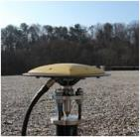
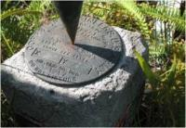

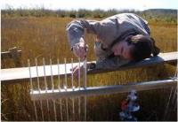
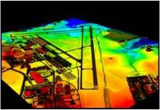
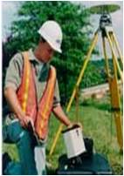
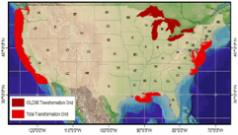
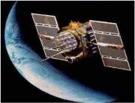
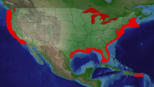
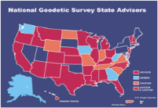
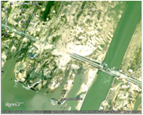
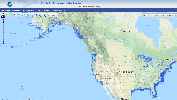
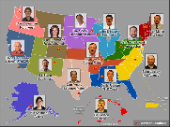
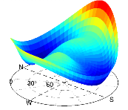
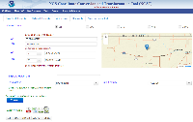
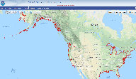
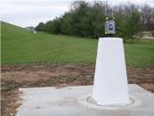
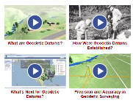
NGS Overview
CHECK IN CODE: AFFA
Modernizing the NSRS
CORS
NHMP
GRAV-D
ECO
NGS Products and Services
ASP
OPUS
VDatum
Orbit Data
National Shoreline
Geodetic Advisors
ERI
Antenna Calibrations
NCAT
CUSP
CBL
Outreach

Slide 6
NGS Overview
Modernizing the NSRS
CORS
NHMP
GRAV-D
ECO
NGS Products and Services
ASP
OPUS
VDatum
Orbit Data
National Shoreline
Geodetic Advisors
ERI
Antenna Calibrations
NCAT
CUSP
CBL
Outreach

Slide 7
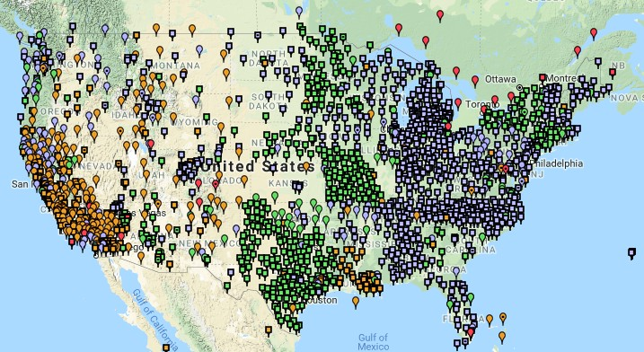
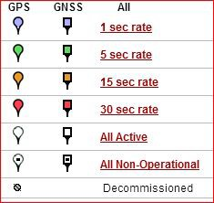
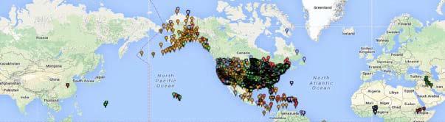
Continuously Operating Reference Station (CORS)
2000+ sites
~225 organizations

Slide 8
NOAA CORS Network (NCN)
2000+ sites
~225 organizations

Slide 9
NGS Overview
Modernizing the NSRS
CORS
NHMP
GRAV-D
ECO
NGS Products and Services
ASP
OPUS
VDatum
Orbit Data
National Shoreline
Geodetic Advisors
ERI
Antenna Calibrations
NCAT
CUSP
CBL
Outreach

Slide 10
National Height Modernization Program
…the establishment of accurate, reliable heights using GNSS technology in conjunction with traditional leveling, gravity, and modern remote sensing information…
-propagation and long-term monitoring of control thru static GPS campaigns, GPS on BMs, digital leveling
-combined with relative gravity data, lidar, etc.

Slide 11
NGS Overview
Modernizing the NSRS
CORS
NHMP
GRAV-D
ECO
NGS Products and Services
ASP
OPUS
VDatum
Orbit Data
National Shoreline
Geodetic Advisors
ERI
Antenna Calibrations
NCAT
CUSP
CBL
Outreach

Slide 12
Gravity for the Redefinition of the American Vertical Datum
Two major campaigns within GRAV-D
High-resolution snapshot of gravity
  primarily airborne observations, all relative gravity, estimated cost of ~$39 million
Low-resolution “movie” of gravity changes
  primarily terrestrial, episodic observations of absolute gravity sites

Slide 13
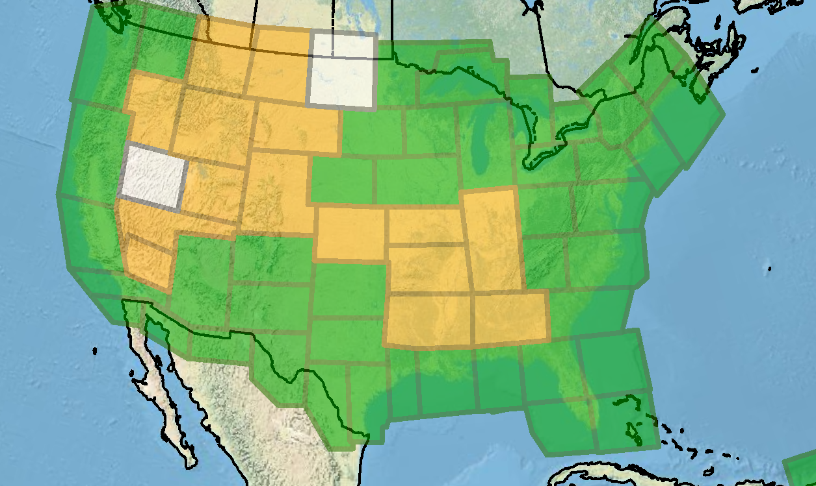
Gravity for the Redefinition of the American Vertical Datum
Green = Complete
Blue = In Processing
Yellow = Underway
White = Planned
10 km data lines
70 km cross lines
20,000 ft altitude
230 kt flight speed
As of DEC2019:
81% complete

Slide 14
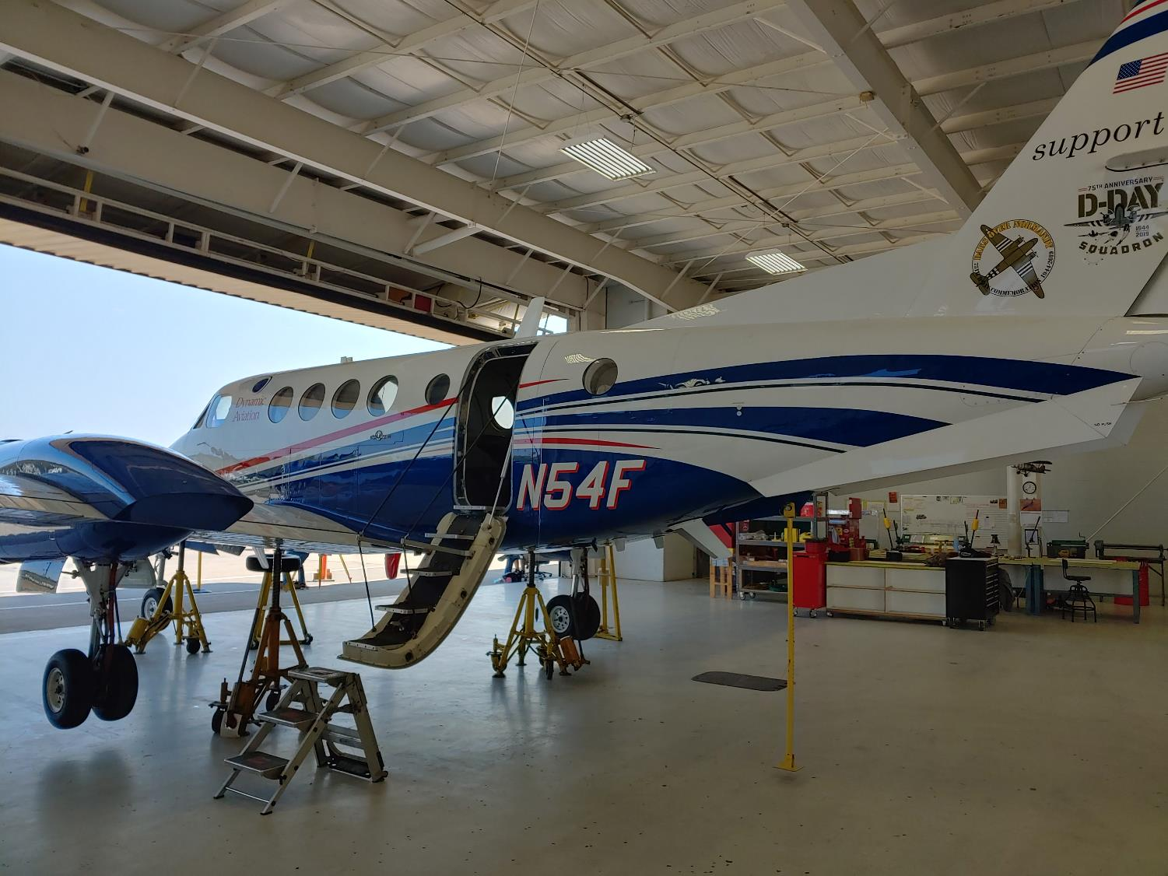
Dynamic Aviation’s King Air 200T

Slide 15

NOAA’s Gulfstream IV-SP

Slide 16
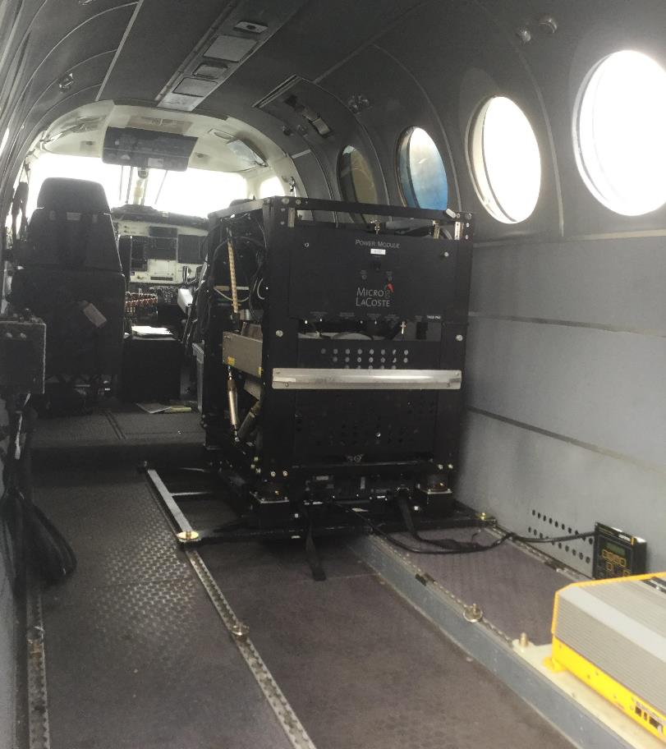
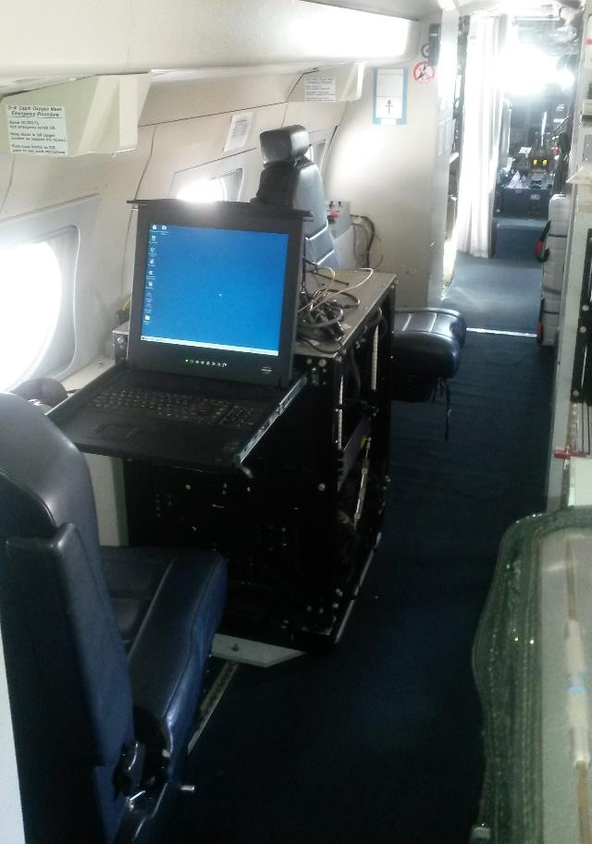
Gravimeters in the Aircraft
in the King Air
in the Gulfstream IV

Slide 17
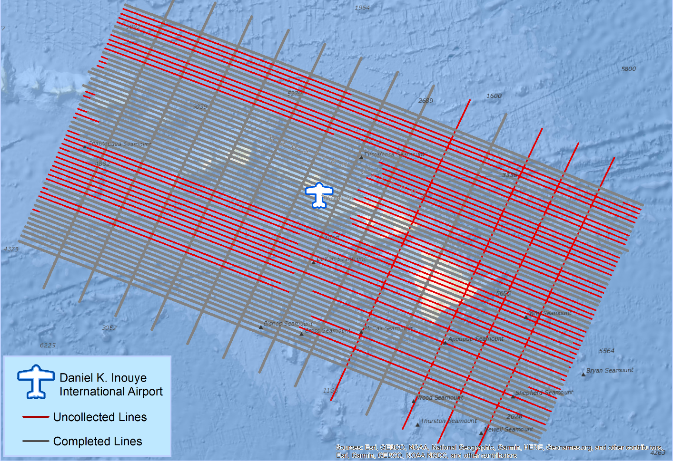
What does a flight plan look like?

Slide 18
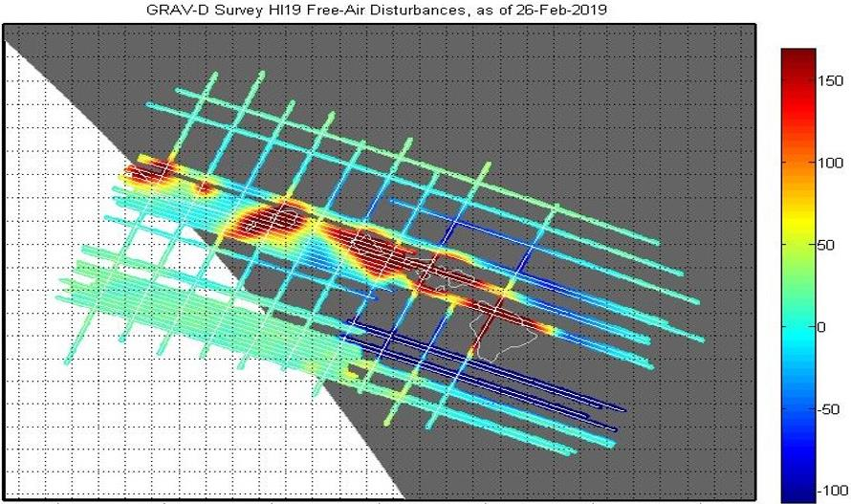
What does processed data look like?
mGal
mGal = milligal

Slide 19
NGS Overview
Modernizing the NSRS
CORS
NHMP
GRAV-D
ECO
NGS Products and Services
ASP
OPUS
VDatum
Orbit Data
National Shoreline
Geodetic Advisors
ERI
Antenna Calibrations
NCAT
CUSP
CBL
Outreach

Slide 20
Online Positioning User Service
  OPUS Rapid Static (OPUS-RS)
      dual frequency receiver data
      static sessions only
      30 seconds epoch rate (aka recording interval)
      15 minutes to 2 hours of GPS data
  OPUS Static (OPUS-S)
      same requirements as above
      2 to 48 hours of GPS data
  OPUS Projects (OP)
      adds session processing and network adjustment
      training by NGS required; typically 12 hours
      files uploaded to OPUS with a “Project ID” keyed in Options
  Beta OPUS Projects (BOP)
      enhancements and added features

Slide 21
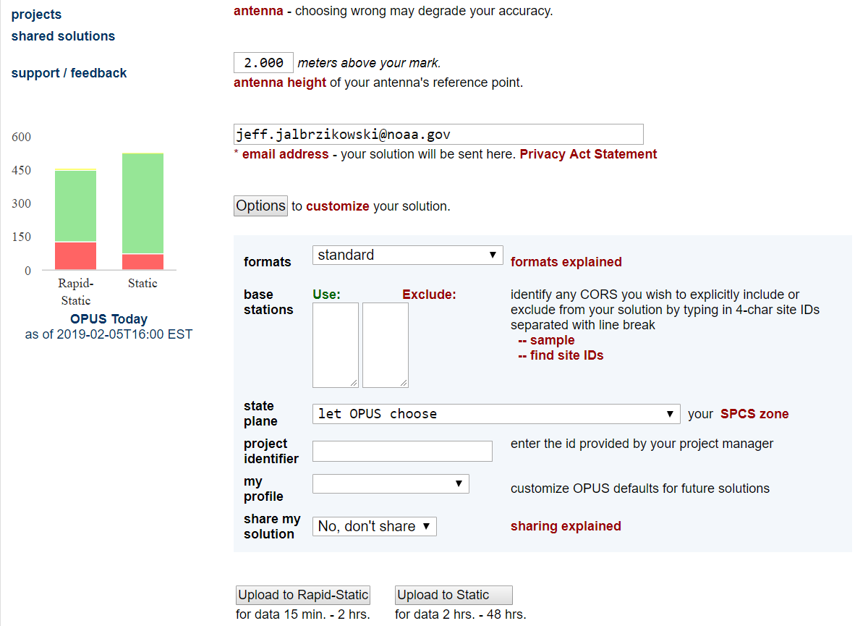
a note on OPUS “my profile”
be careful!

Slide 22
NGS Overview
Modernizing the NSRS
CORS
NHMP
GRAV-D
ECO
NGS Products and Services
ASP
OPUS
VDatum
Orbit Data
National Shoreline
Geodetic Advisors
ERI
Antenna Calibrations
NCAT
CUSP
CBL
Outreach

Slide 23
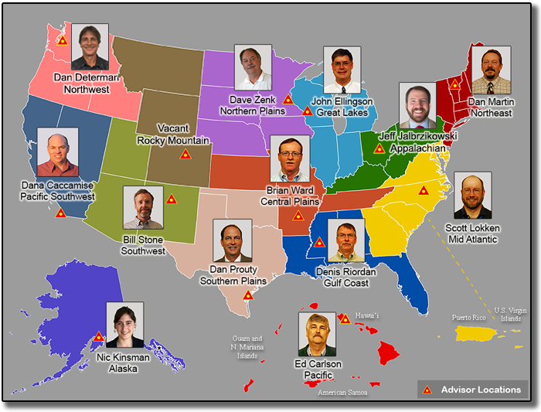
https://www.ngs.noaa.gov/ADVISORS/

Slide 24

Regional Geodetic Advisor Program
www.ngs.noaa.gov/ADVISORS/
query any major search engine: “ngs advisors”

Slide 25

State Geodetic Coordinators
Not an NGS employee
Serves as a liaison between the State’s geospatial community and the NGS
Jinha Jung over at Purdue

Slide 26
NGS Overview
Modernizing the NSRS
CORS
NHMP
GRAV-D
ECO
NGS Products and Services
ASP
OPUS
VDatum
Orbit Data
National Shoreline
Geodetic Advisors
ERI
Antenna Calibrations
NCAT
CUSP
CBL
Outreach

Slide 27
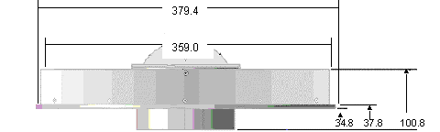
Phase Center Offset - conceptual
Orange dot = mean point of signal reception
Blue dot = Antenna Reference Point (ARP)
Red line = Phase Center Offset (PCO)

Slide 28
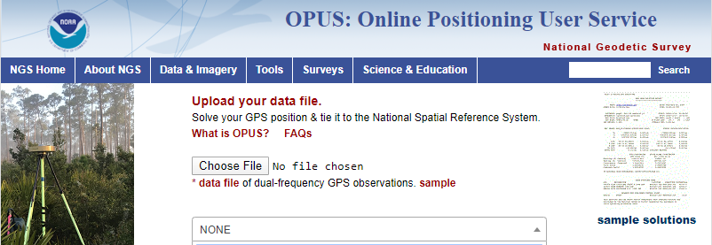
Phase Center Offset
The PCO is one reason it is important to select the correct antenna for OPUS upload!
choose
carefully!
if you have questions… drop me a line

Slide 29
NGS Overview
Modernizing the NSRS
CORS
NHMP
GRAV-D
ECO
NGS Products and Services
ASP
OPUS
VDatum
Orbit Data
National Shoreline
Geodetic Advisors
ERI
Antenna Calibrations
NCAT
CUSP
CBL
Outreach

Slide 30
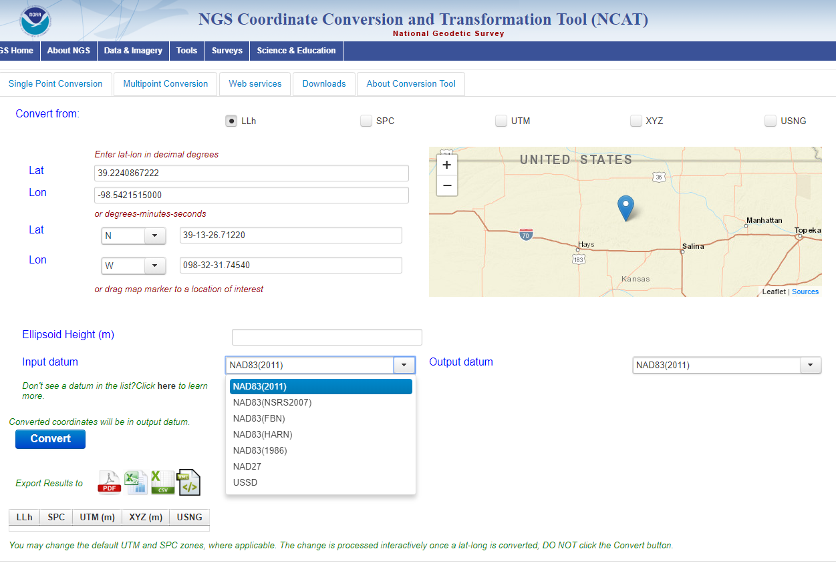
NGS Coordinate Conversion and Transformation Tool
NCAT

Slide 31
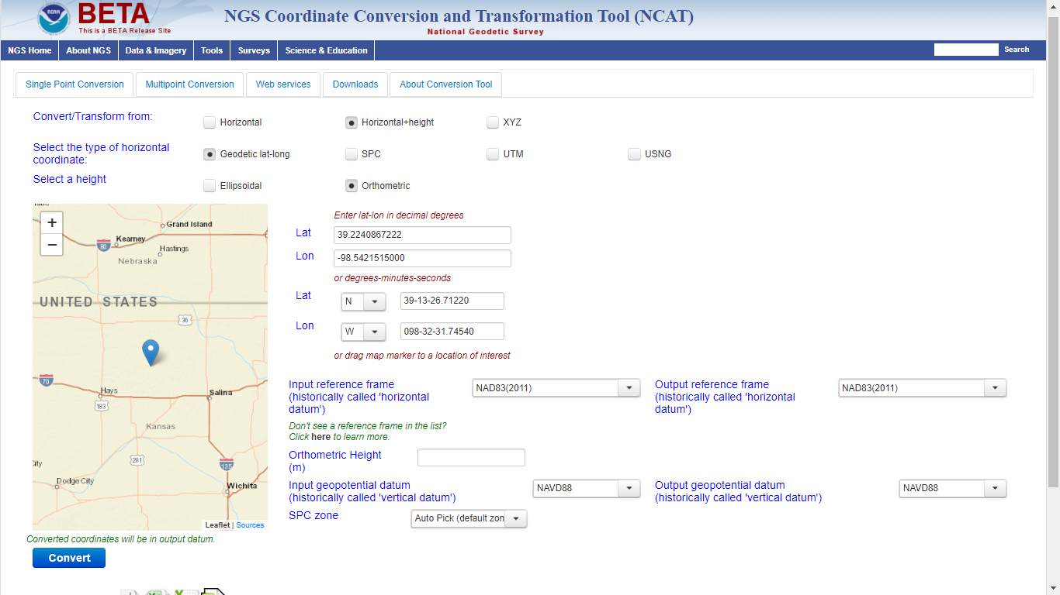
Beta NCAT – includes VERTCON 3.0 for NGVD29 to NAVD88 transformation

Slide 32
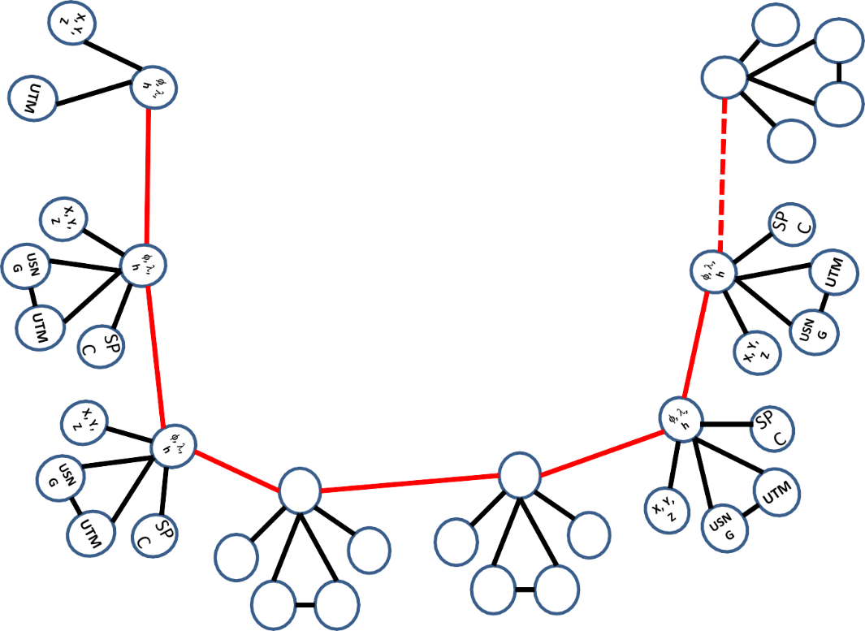
Coordinate Transformation Tool
SP
C
UTM
(NCAT / NADCON 5.0)
2022
φ, λ, h
USSD
USN
G
Relating coordinates: then & now
NAD 83 (2011)
X, Y,
Z
NAD 27
NAD 83 (NSRS2007)
NAD 83 (1986)
NAD 83 (FBN)
φ, λ, h
NAD 83 (HARN)
φ, λ, h
SP C
X, Y, Z
SP C
X, Y, Z
USN G
USN G
UTM
UTM

Slide 33
NGS Overview
Modernizing the NSRS
CORS
NHMP
GRAV-D
ECO
NGS Products and Services
ASP
OPUS
VDatum
Orbit Data
National Shoreline
Geodetic Advisors
ERI
Antenna Calibrations
NCAT
CUSP
CBL
Outreach

Slide 34
Calibration Base Lines - CBL
Three types of CBL defined by NGS
  Primary CBL (PCBL): in Woodford, VA at NGS TTC; it is open for use to organizations like the PLSO
  Federal CBL (FCBL): established with EDM checked at the NGS PCBL and IAW NOAA TM NGS-8
      2 across Indiana
  Cooperative CBL (CCBL): established with EDM checked on an FCBL and IAW that same NGS-8 manual

Slide 35
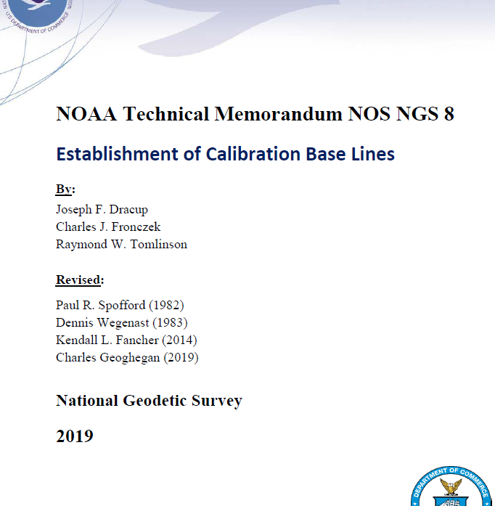
Calibration Base Lines - CBL
NGS commitment to the CBL Program:
  A minimum of one FCBL per State
  Establishment procedures document
  Public access to the CBL database
  Software to process your observations
  Verification and re-measurement data review
  Technical support (Advisors or other personnel)
https://www.ngs.noaa.gov/CBLINES/

Slide 36
NGS Overview
Modernizing the NSRS
CORS
NHMP
GRAV-D
ECO
NGS Products and Services
ASP
OPUS
VDatum
Orbit Data
National Shoreline
Geodetic Advisors
ERI
Antenna Calibrations
NCAT
CUSP
CBL
Outreach

Slide 37
Cooperative program for Operational Meteorology, Education, and Training
Meteorology… why?
The origin of the program was the National Weather Service, also a NOAA office
It expanded to various NOAA missions, including NGS

Slide 38
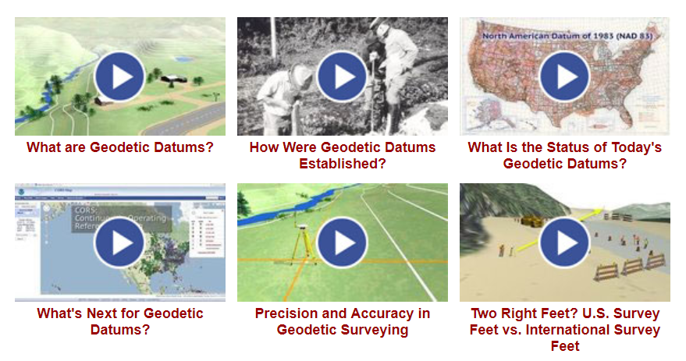
Outreach and COMET

Slide 39
NGS Mission
To define, maintain and provide access to the National Spatial Reference System (NSRS) to meet our Nation’s economic, social, and environmental needs.

Slide 40
National Spatial Reference System (NSRS)
A consistent coordinate system that defines
latitude
longitude
height
scale
orientation
gravity
throughout the United States.
…and their time variants

Slide 41
National Spatial Reference System (NSRS)
These items ARE part of the NSRS
Horizontal Datums (aka Geometric Reference Frames) | Vertical Datums | Great Lakes Datums | Geoid Models | Transformations and Conversions
NAD83 | NAVD88 | IGLD85 | GEOID12A & B | NADCON
NAD27 | NGVD29 | IGLD55 | GEOID09 | VERTCON
USSD | VIVD09 |  | GEOID06
 | GUVD04 |  | GEOID03 | SPCS83
 | NMVD03 |  | GEOID99 | SPCS27
 | ASVD02 |  | GEOID96
 | PRVD02 |  | ALASKA94
 |  |  | GEOID93
 |  |  | GEOID90

Slide 42
National Spatial Reference System (NSRS)
These items are NOT part of the NSRS
Horizontal Datums (aka Geometric Reference Frames) | Vertical Datums | Geoid Models | Transformations and Conversions
WGS84 | IHRS (by IAG) | OSU91A | CORPSCON
WGS72 |  | EGM96 | Appendix B.6 of DMA TR 8350.2 (WGS 84)
ITRF (Intl. Terrestrial Reference Frame by IERS) |  | EGM2008 | Oregon Coordinate Reference System (ORCS)
IGS (Intl. GNSS Service reference frame) |  |  | The Kansas Regional Coordinate System
Hyperlink to ITRF station map

Slide 43
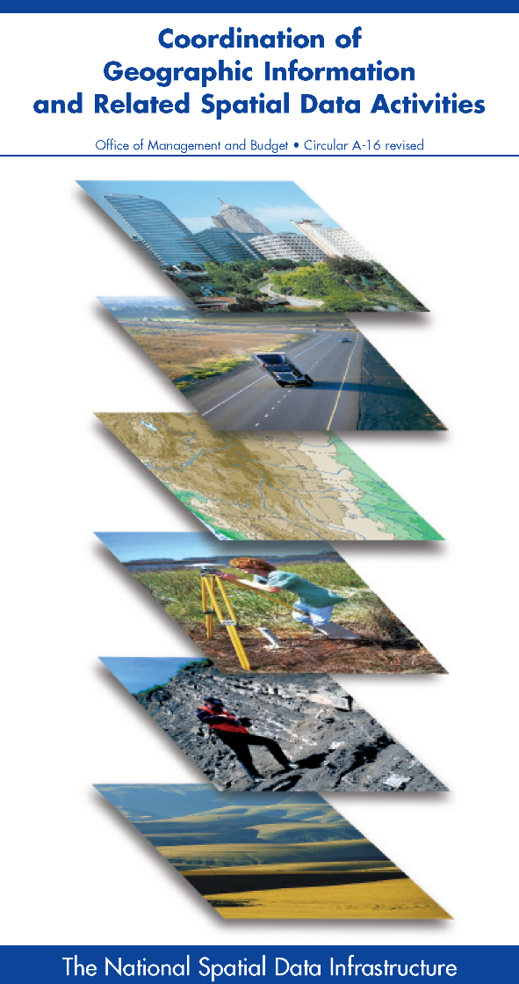



NSRS … do I have to use it?
OMB Circular A-16
  requires all Federal civilian agencies to utilize geodetic control for their geospatial activities
  places NOAA in responsible charge of that control
  NGS has defined that control as the NSRS
  FGCS has issued requirements, via FRNs, to reference data to the most recent components of the NSRS
            1989 FRN designated NAD 83
            1993 FRN designated NAVD 88
Hyperlink to NAVD88 FRN
Hyperlink to NAD83 FRN

Slide 44
NSRS … do I have to use it?
Not necessarily, but it’s a great idea!
States may mandate use
All spatial data and GIS activities financed directly or indirectly, in whole or in part, by federal funds are required to be tied to the NSRS
If you want to get involved in survey contracting with the Federal Government it’s a necessity

Slide 45
Not just new datums…
  NSRS Modernization
Replace NAD83
Replace NAVD88
Re-invent Bluebooking
Improve Geodetic Toolkit
Better Surveying Methods
Blueprint for 2022, Part 1
Blueprint for 2022, Part 2
Blueprint for 2022, Part 3

Slide 46
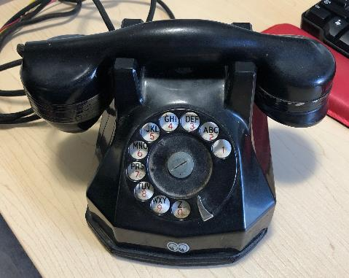
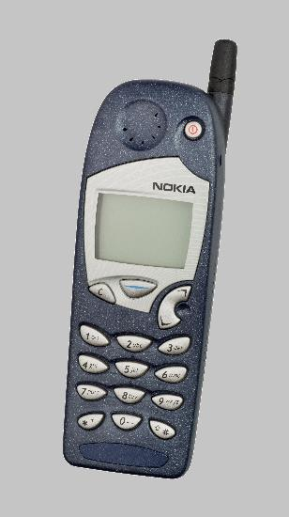
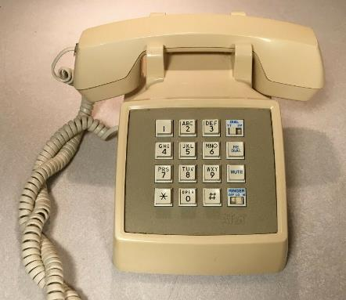
Evolution of the NSRS
NAD27
NAD83 (1986)
NAD83 (2011)

Slide 47
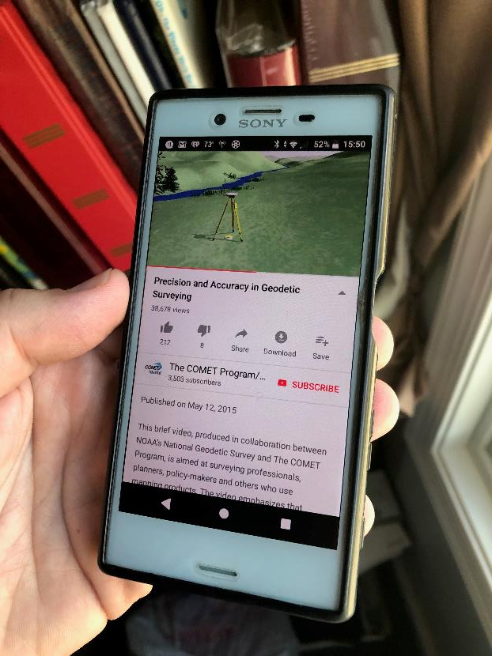
Modernized NSRS is our “smartphone”
You resisted it for a while…
It was a little cumbersome to get used to…
But soon you were hooked!

Slide 48
Two Major Components of Modernized NSRS
Geometric (LLh)
Latitude, Longitude, Ellipsoid Height
Geopotential (H)
Orthometric Height

Slide 49
North American Terrestrial Reference Frame of 2022
NATRF2022
(pronounced: nat-ref)

Slide 50
Reference Frame ≈ Datum
Reference Frame is a more scientifically appropriate way of saying “datum”
could be debated that “datum” was misused
you will continue to see NGS use the phrase “New Datums” for 2022

Slide 51
Reference Frame Defined
A point of view or a ‘frame of reference’.
If your reference frame is North America, you are standing somewhere within North America, seeing how other places move from your point of view.

Slide 52
Why replace NAD83?
Main driver: Global Navigation Satellite System (GNSS)
ACCESS
  GNSS equipment is fast, inexpensive, reliable
  Reduces reliance on physical control marks
ACCURACY
  Insensitive to distance-dependent errors
  Immune to instability; active control via CORS
CONSISTENCY
Eliminates systematic errors in current datums
Aligned with global reference frame

Slide 53
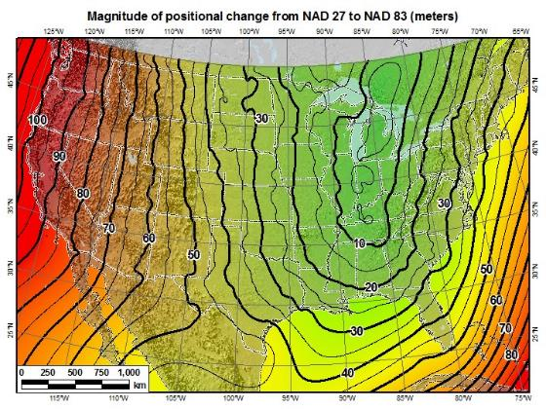
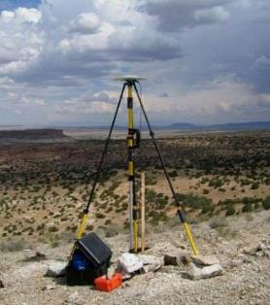
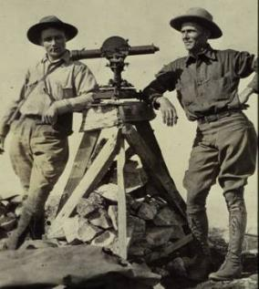
A very brief history of U.S. horizontal & geometric datums
GNSS
triangulation
NAD83(HARN/199#)
US Standard Datum
NAD83(HARN/199#)
NAD83(2007)
NATRF2022
NAD83(1986)
NAD83(2011)
NAD27
+
+
+
+
+
+
+
time
tens of meters
few 0.1m
few 0.01m
few 0.01m
<10 m
~2m
shift

Slide 54
Replacing NAD83
develop four "plate-fixed" reference frames
remove non-geocentricity of NAD83
align to ITRF2014 at epoch 2020.00
remove most of tectonic plate rotation from ITRF2014 via Euler Pole Parameters
Shift and Drift…

Slide 55
Replacing NAD83
develop four "plate-fixed" reference frames
remove non-geocentricity of NAD83
align to ITRF2014 at epoch 2020.00
remove most of tectonic plate rotation from ITRF2014 via Euler Pole Parameters
Shift and Drift…

Slide 56
Four “Plate-Fixed” Reference Frames
North American Terrestrial Reference Frame of 2022
(NATRF2022)
Pacific Terrestrial Reference Frame of 2022
(PATRF2022)
Caribbean Terrestrial Reference Frame of 2022
(CATRF2022)
Mariana Terrestrial Reference Frame of 2022
(MATRF2022)

Slide 57
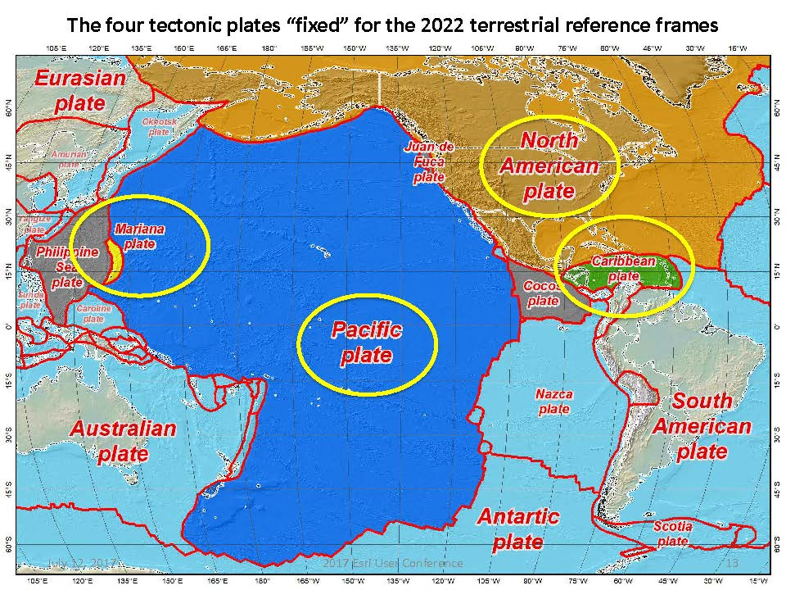


Slide 58
Four “Plate-Fixed” Reference Frames
North American Terrestrial Reference Frame of 2022
(NATRF2022)
Pacific Terrestrial Reference Frame of 2022
(PATRF2022)
Caribbean Terrestrial Reference Frame of 2022
(CATRF2022)
Mariana Terrestrial Reference Frame of 2022
(MATRF2022)

Slide 59
Replacing NAD83
develop four "plate-fixed" reference frames
remove non-geocentricity of NAD83
align to ITRF2014 at epoch 2020.00
remove most of tectonic plate rotation from ITRF2014 via Euler Pole Parameters
Shift and Drift…

Slide 60
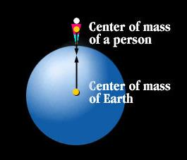
Non-geocentricity?
Geocentric:
  relating to, measured from, or as if observed from the earth's center of mass
The goal was to accomplish that… but didn’t.

Slide 61

Non-geocentricity of NAD83
ITRF2014
GRS80 ellipsoid
NAD83
GRS = Geodetic Reference System

Slide 62
Non-geocentricity of NAD83
ITRF2014
GRS80 ellipsoid
NAD83

Slide 63
Non-geocentricity of NAD83
Earth’s
Surface
h₁₄
h₈₃
NAD83
origin
ITRF2014
origin
~2.2 meters
GRS80
ellipsoid

Slide 64
Non-geocentricity of NAD83
Earth’s
Surface
h₂₂
NAD83
ITRF2014
NATRF2022
GRS80
ellipsoid
Shift…

Slide 65
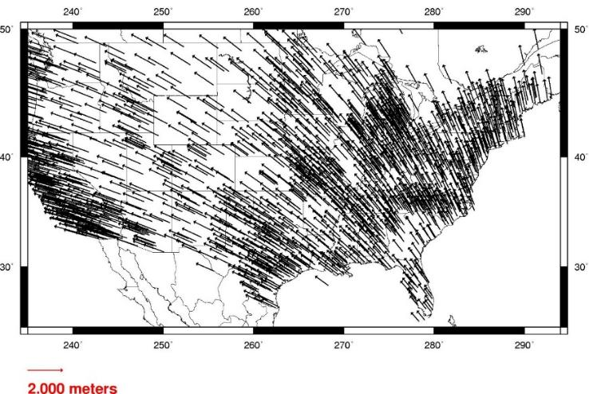
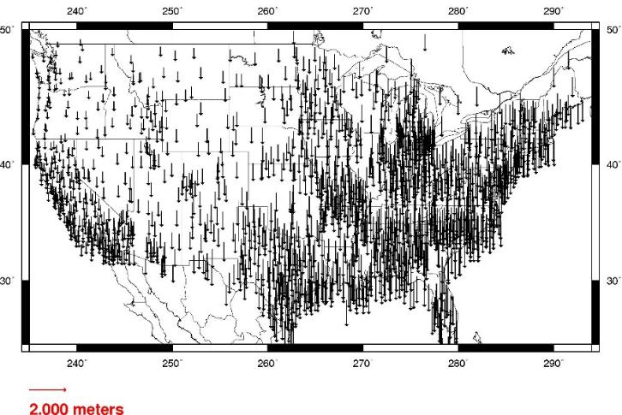
Geometric change due to ellipsoid non-geocentricity
Horizontal (Lat, Lon)
Ellipsoidal (h)
Shift…

Slide 66
Replacing NAD83
develop four "plate-fixed" reference frames
remove non-geocentricity of NAD83
align to ITRF2014 at epoch 2020.00
remove most of tectonic plate rotation from ITRF2014 via Euler Pole Parameters
Shift and Drift…

Slide 67


International Terrestrial Reference Frame
(ITRF)
International Earth Rotation and Reference Systems Service (IERS)
International Union of Geodesy and Geophysics (IUGG)

Slide 68
International Terrestrial Reference Frame
The stable coordinate system that allows us to measure change over space, time and evolving technologies.
An accurate, stable set of station positions and velocities.
Network measurements interconnected by co-location of different space geodetic techniques.
“Approximately represents the motions of the tectonic plates with respect to the Earth's deep interior”… huh?

Slide 69
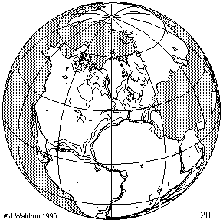
ITRF concept
Watch the grid!
Drift…

Slide 70
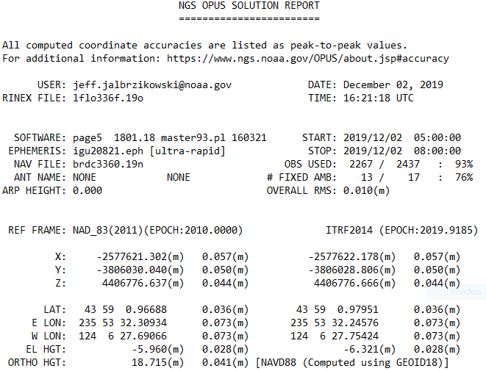
Epoch?
eh-puck? ee-pock? … to-may-to, to-mah-to
  an instant of time or a date selected as a point of reference

Slide 71
Replacing NAD83
develop four "plate-fixed" reference frames
remove non-geocentricity of NAD83
align to ITRF2014 at epoch 2020.00
remove most of tectonic plate rotation from ITRF2014 via Euler Pole Parameters
(pronounced: “oiler”)
Shift and Drift…

Slide 72
The wrong question, circa 2022:
“What’s the position of that point?”
The right question, circa 2022:
“What’s the position of that point, on some specific date?”
Drift…

Slide 73
Two types of drift
Tectonic Plate Rotation
    horizontal
Everything Else
    residual motions left after rotation
    regional linear motions
    localized subsidence or uplift
simple to model
complex

Slide 74
Tectonic Plate Rotation
    horizontal
simple to model

Slide 75
Euler Pole Parameters
of 2022
EPP2022

Slide 76
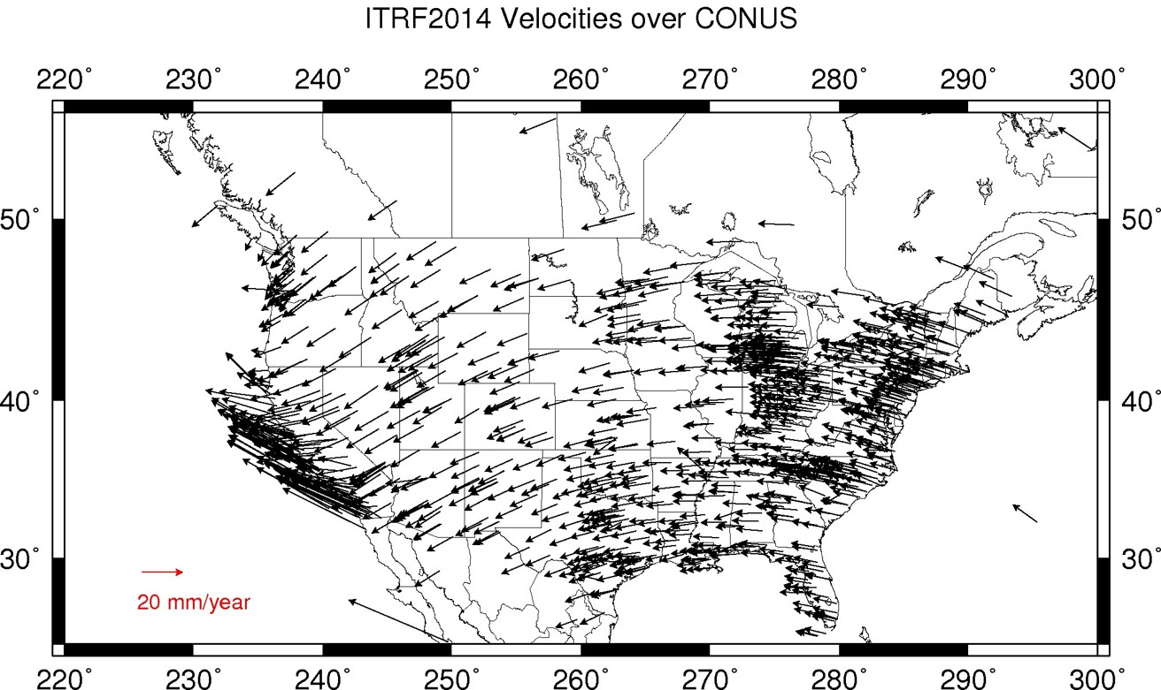
Plate Rotation visualized
Drift…

Slide 77

Euler Poles and “Plate-Fixed”
  In the ITRF, many tectonic plates have a dominant motion: rotation
  Euler Pole - point about which a plate rotates (yellow star)
NATRF2022 Euler Pole

Slide 78
Euler Poles and “Plate-Fixed”
ITRF
Frame = constant
NA Plate = rotating
NATRF
Frame = rotating
NA Plate = constant

Slide 79
Euler Poles and “Plate-Fixed”
ITRF
Frame = constant
NA Plate = rotating
NATRF
Frame = rotating
(relative to ITRF)
NA Plate = constant
(relative to NATRF2022)

Slide 80

ITRF – constant frame, rotating plate

Slide 81
“Plate-Fixed”
NATRF – rotating frame, constant with plate

Slide 82
ITRF or NATRF – your choice, just use EPP

Slide 83
EPP – Euler Pole Parameters
Latitude
Longitude
Rotation Speed
yellow star off west coast of S. America

Slide 84
CORS Velocities in ITRF2014
Drift…

Slide 85

CORS Velocities in NATRF2022
Think of this map as ITRF2014 + EPP2022
Still SomeDrift…

Slide 86
ITRF2014 + EPP2022 = --TRF2022
Rotation of the
North American Plate
NATRF2022
CATRF2022
PATRF2022
MATRF2022
Rotation of the
Caribbean Plate
ITRF2014
Rotation of the
Pacific Plate
Rotation of the
Mariana Plate
EPP2022

Slide 87
ITRF2014 + EPP2022 = --TRF2022
Rotation of the
North American Plate
NATRF2022
EPP2022
ITRF2014

Slide 88
Two types of drift
Tectonic Plate Rotation
    horizontal
Everything Else
    residual motions left after rotation
    regional linear motions
    localized subsidence or uplift
simple to model
complex

Slide 89
Everything Else
    residual motions left after rotation
    regional linear motions
    localized subsidence or uplift
Still SomeDrift…
complex

Slide 90
Intra-Frame Velocity Model of 2022
IFVM2022

Slide 91
Concept of goal of IFVM
Longitude (Easting) History of DI4044
Trend: -1.7 mm / year
RED IS NATRF2022
COORDINATE
Still Some Drift…
Trend: -14.3 mm / year
BLUE IS ITRF COORDINATE
2004 2006 2008 2010 2012 2014 2016 2018

Slide 92
CORS Velocities in NATRF2022
Think of this map as ITRF2014 + EPP2022
Still SomeDrift…

Slide 93

IFVM goal = model all velocities
Think of this map as ITRF2014 + EPP2022 + IFVM2022

Slide 94
Still Some Drift…
  Everything in the world moves
  Coordinates will be associated with the actual date when the data was collected!
  Velocities at all marks can be estimated using this Intra-Frame Velocity Model
  IFVM goal being to move collected data thru time to Reference Epochs for coordinate comparisons/analysis

Slide 95
Intra-Frame Velocity Model
A model of all residual velocities, after removal of tectonic rotation via EPP:
  Horizontal residual motion
  Total vertical motion (ellipsoid heights)
  Replaces / Improves upon HTDP
Given t₁ and t₂, compute Δλ, Δϕ, Δh at any point, accounting for all motions
Likely be built upon CORS data, geodynamic models and InSAR, but not yet finalized

Slide 96
EPP2022 – Euler Pole Parameters – Simple Rotation
  Three parameters: lat, lon, rotation speed
  Horizontal only: just latitude and longitude
  Changes the frame: ITRF2014 + EPP2022 = NATRF2022
  Does not change the epoch
IFVM2022 – Intra-Frame Velocity Model - Complex
  Complex set of parameters
  Residual horizontal motion: all the motion leftover after Euler Pole rotation
  All vertical motion: localized subsidence or uplift
  Changes the epoch
  Does not change the frame: “intra” = on the inside; within

Slide 97
EPP2022
IFVM2022
Two new tools that will make time dependent geodetic control practical
They work together to account for the Drift…

Slide 98
Example of application of EPP and IFVM
It’s 2039 and you are working in San Diego using NATRF2022
And you want to compare your work to another survey from 2028
Important: This slide only covers geometric coordinates.
…the catch is, that survey was done in PATRF2022
PATRF2022
ep. 2028.048
EPP2022
(PA)
ITRF2014
ep. 2028.048
EPP2022
(NA)
NATRF2022
ep. 2028.048
IFVM2022
(PA)
IFVM2022
(NA)
PATRF2022
ep. 2039.704
EPP2022
(PA)
ITRF2014
ep. 2039.704
EPP2022
(NA)
NATRF2022
ep. 2039.704

Slide 99
Alright Jeff... enough jibba-jabba, what’s the impact?

Slide 100


Slide 101

What’s that going to look like?
PHOTO in NAD83
RED = National Shoreline in NAD83
GREEN = National Shoreline transformed to NATRF2022

Slide 102

If you’re only working in this region…
North American Terrestrial Reference Frame of 2022
(NATRF2022)

Slide 103
North American-Pacific Geopotential Datum of 2022
NAPGD2022
(pronounced: nap-jee-dee)

Slide 104
A very brief history of (the most prevalent) U.S. vertical datums

Slide 105

NGVD29
Referenced to 26 tide gauges in the US and Canada

Slide 106

Referenced to a single tide gauge in Canada
Why one gage fixed this time?
removed local sea level variation problem of NGVD29
But it did introduce possibility of cross-continent error build-up…
Father Point Lighthouse, Quebec

Slide 107

Approximate Error in NAVD88 "zero elevation” (H=0)
Map is the H=0 surface overlaid onto satellite gravity data

Slide 108


Why Replace NAVD88?
tilt/bias in zero reference surface
subsidence, uplift, freeze/thaw of BMs
limited access, availability of undisturbed marks
Approximate Error in NAVD88 "zero elevation”

Slide 109
Known Issues with NAVD88
tilt/bias in zero reference surface
subsidence, uplift, freeze/thaw of BMs
limited access, availability of undisturbed marks
Approximate Error in NAVD88 "zero elevation”

Slide 110

Passive marks may lie still… but they still may lie! small instability x long time = large inaccuracy

Slide 111
Replacing NAVD88
primary access via GNSS and geoid (OPUS, etc.)
accurate continental gravimetric geoid (1-2 cm)
aligned with:
  NATRF2022 (or CATRF, PATRF, MATRF)
  global mean sea level (GMSL)
monitor time-varying nature of gravity (NGS Geoid Monitoring Service GeMS)

Slide 112
Two flavors of geoid models…
  Gravimetric
  Hybrid

Slide 113
Gravimetric → Hybrid
  Gravimetric geoid is created from “scratch” with various types of gravity data
      USGG2003, USGG2009, USGG2012, xGEOID19
  Hybrid geoid is simply a gravimetric geoid warped to fit some vertical datum… like NAVD88
      GEOID03, GEOID09, GEOID12B, GEOID18

Slide 114
Gravimetric → Hybrid
      USGG2003, USGG2009, USGG2012, xGEOID19
      GEOID03, GEOID09, GEOID12B, GEOID18
best fit to NAVD88
best fit to NAVD88
best fit to NAVD88
best fit to NAVD88

Slide 115
Which NAD83 with which geoid?
GEOID18
GEOID12A/B
NAD83(2011) →
NAD83(2007) →
NAD83(HARN/FBN)
NAD83(CORS96)
GEOID09
GEOID06 (AK only)
GEOID03
GEOID99
GEOID96

Slide 116


Slide 117

Obtaining N_{g} is not easy!
First you need a gravity field (data from diff. distances)
  combine satellite, airborne, terrestrial, ship track data, etc.
Next calculate gravity anomaly, or ∆g
Then, just solve Stokes’ integral!
R is the mean radius of the earth
ɣ0 is mean surface gravity on ellipsoid
S is a geometric function of position
…there’s a catch
Need to know ∆g over entire surface of the earth

Slide 118
Obtaining N_{g} is not easy!
First you need a gravity field (data from diff. distances)
  combine satellite, airborne, terrestrial, ship track data, etc.
Next calculate gravity anomaly, or ∆g
Then, just solve Stokes’ integral!
R is the mean radius of the earth
ɣ0 is mean surface gravity on ellipsoid
S is a geometric function of position
…there’s a catch
Need to know ∆g over entire surface of the earth

Slide 119







Building a Geopotential Field Model
Long Wavelengths (> 250 km)
GRACE/GOCE/Satellite Altimetry
+
Intermediate Wavelengths (20km to 300 km)
Airborne Observations
+
Short Wavelengths (< 100 km)
Terrestrial/Surface Observations and Predicted Gravity from Topography

Slide 120

GRACE - 2 Satellites measuring separation

Slide 121

GRAV-D – airborne relative gravimeters

Slide 122

Terrestrial Gravimeter - Relative

Slide 123

Terrestrial Gravimeter - Relative

Slide 124

Terrestrial Gravimeter - Absolute

Slide 125

Terrestrial Gravimeters - Absolute and Relative

Slide 126
Individual Components of NAPGD2022
Global Model of the geopotential field
  GM2022
Geoid undulation models by region
  GEOID2022 aka “0 elevation”
Deflection of the Vertical (DoV) models by region
  DEFLEC2022
Surface Gravity models by region
  GRAV2022

Slide 127


Slide 128

Sea Level Change and the Geoid

Slide 129

Sea Level Change and the Geoid

Slide 130

Sea Level Change and the Geoid

Slide 131

Estimated change in orthometric heights from NAVD88 to NAPGD2022
(NAPGD2022 approximated using xGEOID16B)

Slide 132


Estimated change in orthometric heights from NAVD88 to NAPGD2022
(NAPGD2022 approximated using xGEOID16B)
Vertical change of about -0.6 to -2.0 feet

Slide 133

North American-Pacific Geopotential Datum of 2022
(NAPGD2022)

Slide 134
How can I prepare?
Where did this all start?
How is all this possible?
What’s the benefit to me?
Well, besides learning a whole new set of terminology and methods…

Slide 135
How can surveyors prepare?
Get familiar with terms, ask now, be ready
Set/occupy RTN Validation Stations (OPUS)
Research your published control
    pre-1995 will NOT get new coordinates (GPS only)
Use OPUS Projects to re-observe/process

Slide 136

NGS Ten-Year Strategic Plan
  By 2022, reduce all definitional & access-related errors in geometric reference frame to 1 cm when using 15 min of GNSS data
  aka “Replace NAD83”
  By 2022, reduce all definitional & access-related errors in orthometric heights in geopotential datum to 2 cm when using 15 min of GNSS data
  aka “Replace NAVD88”
https://geodesy.noaa.gov/web/about_ngs/info/tenyearfinal.shtml

Slide 137

How is all this possible?
CORS
Co-location of space geodetic instruments worldwide that feed into ITRF development
Teamwork with other geodetic organizations
Research and Development
Testing
Science!

Slide 138





Co-location Site
NASA Goddard Space Flight Center, Greenbelt MD, USA
  GNSS, SLR, VLBI, DORIS

Slide 139

Co-location Site
NASA Goddard Space Flight Center, Greenbelt MD, USA
  GNSS, SLR, VLBI, DORIS

Slide 140
Co-location Site
NASA Goddard Space Flight Center, Greenbelt MD, USA
  GNSS, SLR, VLBI, DORIS

Slide 141
SLR
Satellite Laser Ranging

Slide 142


Slide 143
Co-location Site
NASA Goddard Space Flight Center, Greenbelt MD, USA
  GNSS, SLR, VLBI, DORIS

Slide 144
VLBI
Very Long Baseline Interferometry

Slide 145

VLBI

Slide 146
Co-location Site
NASA Goddard Space Flight Center, Greenbelt MD, USA
  GNSS, SLR, VLBI, DORIS

Slide 147
DORIS
Doppler Orbitography and Radiopositioning Integrated by Satellite

Slide 148

Doppler Orbitography and Radiopositioning Integrated by Satellite

Slide 149

Space Geodesy Co-location Diagram
Generic concept of “co-location survey”, typically more complex.

Slide 150


Altogether now!
All these techniques work together to create a well-defined, robust reference frame that improves positioning for users globally.

Slide 151
Not just new datums…
  NSRS Modernization
-OPUS enhancements/additions
-new types of coordinates
-new methods for establishing control
-streamlined Bluebooking
-retire the US Survey Foot

Slide 152
Online Positioning User Service
  OPUS Rapid Static (OPUS-RS)
      dual frequency receiver data
      static sessions only
      30 seconds epoch rate (aka recording interval)
      15 minutes to 2 hours of GPS data
  OPUS Static (OPUS-S)
      same requirements as above
      2 to 48 hours of GPS data
  OPUS Projects (OP)
      adds session processing and network adjustment
      training by NGS required; typically 12 hours
      files uploaded to OPUS with a “Project ID” keyed in Options
  Beta OPUS Projects (BOP)
      enhancements and added features

Slide 153
Online Positioning User Service
But wait… there’s more!
Coming soon…

Slide 154

Hybrid Control Networks = Static + RTK/RTN
OPUS for RTK/RTN-GNSS

Slide 155
“What’s the benefit?” they say…
OPUS for RTK/RTN-GNSS
Run least squares adjustment(s) of the combined Static and RTN vectors
Hold NCN CORS (and possibly other published coordinates) in adjustments
Check quality of results
Submit survey project to NGS for review and publication in national database
…you’ll be able to Bluebook RTK/RTN data!

Slide 156

Blueprint for 2022, Part 3

Slide 157
Let’s look at some new terminology

Slide 158
The NOAA CORS Network (NCN)
As of 2019, this is the official name of the network managed at NGS
  Historically referred to as “CORS” or “the CORS”

Slide 159
GPS Month
A span of four consecutive GPS weeks, where the first GPS week in the GPS month is an integer multiple of 4
  GPS Month 0 = GPS Weeks 0, 1, 2 and 3
  GPS Month 1 = GPS Weeks 4, 5, 6 and 7
  GPS Month 2 = GPS Weeks 8, 9, 10, and 11
  GPS Month 3 = GPS Weeks 12, 13, 14, and 15
  You get the idea…

Slide 160
New Types of Coordinates

Slide 161
Five types of coordinates in Modernized NSRS
Name | Generally on… | Description
Reported | Passive | “Quick and Dirty”. Smartphone accuracy. (aka HD_HELD)
Preliminary | Passive | Computed by you with OPUS using your data. Unchecked by NGS.
Final Discrete | Passive | Most accurate. Time-dependent. Computed by NGS every four weeks.
Final Running | CORS | Continuous time-dependent CORS coordinates. Checked by NGS every day.
Reference Epoch | Passive and CORS | Modeled from Final Discrete, Final Running, IFVM2022 and GeMS. Computed by NGS every five years.

Slide 162
Reported Coordinates
  These are from any source in which the coordinate is directly reported to NGS without the data necessary for NGS to replicate the coordinate.
  Compares to:
    SCALED – like on a datasheet
    HD_HELD – like on a datasheet
    Smartphone/Device GNSS
    From NCAT or VDatum
    Coordinates from and RTK/RTN rover without data files

Slide 163


Reported Coordinates

Slide 164
Preliminary Coordinates
  These are coordinates at survey epoch that have been computed from OPUS, but not yet quality checked and loaded into the National Spatial Reference System Database (NSRS DB).
  Compares to:
    OPUS Solution Report – NGS does not QC these
    OPUS-Projects results – only QC’d if submitted
  Note:
    These are the only coordinates a user will get directly from OPUS

Slide 165
Final Discrete Coordinates
  These are coordinates computed by NGS using submitted data and metadata, checked, adjusted, and referenced to a single survey epoch for loading into the NSRS DB.
    Represent the best estimates of the time-dependent coordinates at any mark
  What will the Survey Epochs be?
    GNSS: GPS Month
      Stand-alone occupations, RTK/RTN, Campaigns, etc.
    Leveling: Calendar Year; Annually
      Will be adjusted to GNSS-based orthometric heights

Slide 166
Final Running Coordinates
  These are the only type which will have a published coordinate at any epoch.
    Generally will only be available at CORSs
    Will be generated by a “fit” to daily processed data
    Another new term!
      We’ll refer to these as the Coordinate Function

Slide 167
Reference Epoch Coordinates
  These are coordinates which have been estimated by NGS based on time-dependent (final discrete and final running) coordinates, at an Official NSRS Reference Epoch (ONRE).
  Compares to:
    NAD 83(2011) epoch 2010.00 on a Datasheet
  When will NGS compute these?
    Every 5 years, on a timeline of 2-3 years post-date
    2020.00 coordinates will be computed in 2022
    2025.00 coordinates will be computed in 2027

Slide 168
Reference Epoch Coordinates from
Time-Dependent Coordinates

Slide 169
Assume “h” was determined four different times:
1990: 2.100
1994: 2.110
2002: 2.190
2009: 2.180
h
2.250
2.200
2.150
2.100
2.050
2.000
1990
‘95
‘00
‘05
‘10
‘15
‘20
‘25
‘30
time

Slide 170
All measurements have error. Shown here are the same
Values of “h”, but with their error estimates.
1990: 2.100 +/- 0.0375 (3.75 cm)
1994: 2.110 +/- 0.0250 (2.50 cm)
2002: 2.190 +/- 0.0200 (2.00 cm)
2009: 2.180 +/- 0.0250 (2.50 cm)
h
2.250
2.200
2.150
In the modernized NSRS these time-dependent
coordinates, estimated at the actual date when
the surveys took place, will be called
Final Discrete Coordinates
2.100
2.050
2.000
1990
‘95
‘00
‘05
‘10
‘15
‘20
‘25
‘30
time

Slide 171
h
In today’s NSRS, a height is held fixed until replaced. So plotting the height of these Final Discrete Coordinates as seen on a datasheet over time would look like this:
2.250
2.200
2.150
2.100
2.050
2.000
1990
‘95
‘00
‘05
‘10
‘15
‘20
‘25
‘30
time

Slide 172
In the modernized NSRS we will also have an estimate of
crustal motion from IFVM2022
h
2.250
2.200
2.150
2.100
Combining Final Discrete Coordinates
with IFVM2022 allows NGS to estimate Reference Epoch Coordinates
2.050
2.000
1990
‘95
‘00
‘05
‘10
‘15
‘20
‘25
‘30
time

Slide 173
The IFVM2022 will (statistically)
align to these Reference Epoch Coordinates but will have uncertainty.
h
2.250
2.200
2.150
2.100
2.050
In the absence of new survey data, error estimates will
grow through time.
2.000
1990
‘95
‘00
‘05
‘10
‘15
‘20
‘25
‘30
time

Slide 174
The (in)ability of current approach to
properly inform users of the height of
this mark can be seen in blue.
2.250
2.200
2.150
2.100
2.050
2.000
1990
‘95
‘00
‘05
‘10
‘15
‘20
‘25
‘30

Slide 175
State Plane Coordinate System of 2022
SPCS2022

Slide 176



geodesy.noaa.gov

Slide 177
General SPCS2022 characteristics
Distortion design requirements
  Linear distortion minimized at topographic surface
  (not at ellipsoid surface)
  Purpose: to reduce difference between projected “grid” and actual “ground” distances
Other characteristics
  Default designs (if no consensus stakeholder input)
  Statewide and “layered” zones
  Positive east longitudes
  Low-distortion projections (LDPs)
  “Special use” zones

Slide 178


Linear distortion with respect to ellipsoid
Projection axis
Projection surface (secant)
Ellipsoid distance
Grid distance > ellipsoid distance
Ellipsoid distance
Ellipsoid surface
This design approach used for SPCS 27 and 83 (minimizes distortion with respect to ellipsoid)
Grid distance < ellipsoid distance

Slide 179










Changing projection axis to reduce distortion variation
Topographic surface
Grid distance = ground distance at many points
Projection axis
Ellipsoid height of surface not constant:
h₁ ≠ h₂
h₂
h₁
Only way to reduce variation in distortion is to change projection axis location.
IMPORTANT: For large areas, there is no single defining ellipsoid height, h, for scaling the projection.
Ellipsoid surface
This design approach is being used for SPCS2022 (minimizes distortion with respect to topography)

Slide 180



“Non-intersecting” conformal map projection
Topographic surface
Grid distance = ground distance at a point
Grid distance = ground distance at a point
Projection axis
Non-intersecting
Grid distance ≈ ground distance over finite distance
Purpose is to reduce linear distortion at “ground” (topographic surface).
But distortion can vary considerably across area of interest.
Ellipsoid surface

Slide 181
Default SPCS2022 zones
To ensure all states and U.S. territories covered
  For complete system if no consensus stakeholder input
  Nearly same as SPCS 83 but with some changes
  Almost all zone projection types and extents the same
Modify existing zones to meet SPCS2022 policy
  Scale redefined with respect to topographic surface
  Use 1-parallel Lambert and local Oblique Mercator
NGS will create a statewide zone for all states

Slide 182
Zone “layers” and LDPs
Each state may have max of THREE zone “layers”
  One layer must be statewide zone (designed by NGS)
  Other layers have two or more zones (“multi-zone”)
  Only one layer can have discontinuous coverage
Multi-zone layer can consist of LDPs
  Designed by stakeholder “contributing partners”
  Minimum zone width 50 km (if height range < 250 m)
OR 10 km (if height range > 250 m)
  LDP coverage can be discontinuous

Slide 183

Alaska statewide “base” layer
Alaska zone layers
1. Statewide layer

Slide 184

Alaska complete “intermediate” layer
Alaska zone layers
1. Statewide layer
2. “Intermediate” layer (complete state coverage)
184

Slide 185


Alaska with THREE SPCS2022 layers
Alaska zone layers
1. Statewide layer
2. “Intermediate” layer (complete state coverage)
3. LDP layer (partial state coverage)
185

Slide 186
SPCS2022 deadlines
Consensus input per SPCS2022 procedures
  Requests for designs done by NGS
  Proposals for designs by contributing partners
Submittal of approved designs
  Proposal must first be approved by NGS
  Designs must be complete for NGS to review
Later requests will be for changes to SPCS2022
by March 31, 2020 for requests and proposals
by March 31, 2021 for submittal of approved designs

Slide 187
SPCS2022 in Indiana
Myself/NGS aware of InGCS and it’s use for a few years already, otherwise…
  I believe there’s a plan to submit modified design to NGS
NGS will design a single statewide Zone that covers the entire State (eliminate N-S zones)
  this will enable organizations/agencies to maintain all data within one zone

Slide 188

US Survey Foot
and
International Foot
…or Feets Don’t Fail Me Now

Slide 189
The problem
Two versions of same unit in current use
  “New” international foot and “old” U.S. survey foot
  “New” shorter than “old” by 2 ppm (0.01 ft per mile)
  A real problem with real costs
What’s in a name?
  “U.S. survey” versus “international”
Who is using U.S. survey feet?
  Surveyors exclusively, in most (not all) states
  But it impacts everyone

Slide 190

2 parts per million (ppm)
1,000,000.00 sft = 999,998.00 ift
10,000,000.00 sft = 9,999,980.00 ift
International → 1 ft = .3048 m
US → 1 ft = .30480061 m (approx.)
  frequently calculated by $\frac{1200}{3937}$

Slide 191
What’s impacted?
When does this matter?
  Not typically in lengths/distances
  But in published planar coordinate systems
Like what?
  SPCS and UTM are very popular and both fall victim to mix-ups
Why?
  Large false eastings and northings

Slide 192




Who is responsible for standards?
National Institute of Standards and Technology

Slide 193
Adopted International Foot in 1959
1 foot = 0.3048 meter exactly (1 yard = 0.9144 m)
New foot definition adopted by NASA predecessor
National Bureau of Standards created
Adopted as “new” foot for entire U.S.
1901
1933
1952
1954
1959
With one little exception…
New foot definition adopted by ANSI predecessor
International nautical mile
1,852 m exact

Slide 194
With one little exception…
“Any data expressed in feet derived from and published as a result of geodetic surveys within the United States will continue to bear the following relationship as defined in 1893: 1 foot = 1200/3937 meter
The foot unit defined by this equation shall be referred to as the U.S. Survey Foot and it shall continue to be used, for the purpose given herein, until such a time as it becomes desirable and expedient to readjust the basic geodetic survey networks in the United States, after which the ratio of a yard, equal to 0.9144 meter, shall apply.”

Slide 195
More Federal Register Notices
Surveying and mapping only (pending analysis, never resolved)
Proposed permanent use of U.S. Survey Foot
Restatement that metric used for U.S.
International vs. U.S. Survey Foot
1975
1977
1988
1989
1990
NGS goes entirely metric (for NAD 83)
NAD 83 announced
International foot used for “engineering”
U.S. survey foot used for “mapping and land measurement”
We readjusted the basic geodetic network!

Slide 196

Oops!
Problem created and perpetuated by NGS
In 1959. Then in 1986. And again in 2016…

Slide 197
What are the choices?
Do nothing (i.e., NGS stays “metric” only)
  States choose whatever foot they want
  Both feet will creep back into NGS products & services
Officially adopt U.S. survey foot for specific things
  U.S. survey foot for surveying and mapping
  International foot for engineering (and everything else)
Use international foot for everything
  Support only foot = 0.3048 meter after 2022
Use U.S. survey foot for everything (highly unlikely)
Go entirely metric (ideal situation, but also unlikely)

Slide 198
NGS proposal
Only one foot after 2022 (1 foot = 0.3048 meter)
  Make official through NIST
  NO option for U.S. survey foot in NATRF/SPCS2022
NGS will help with the transition
  Will fully support backward compatibility
  Use “correct” foot for SPCS83 and SPCS27
  Automatically done by NGS products and services
Guiding ideas
  Of all changes in 2022, this is the least significant
  About the future, not the past

Slide 199
Putting our best “foot” forward…
NGS created problem, will help fix it
  Fully support backward compatibility (NAD83, NAD27)
  Unit change minor compared to other 2022 changes
  Contact us at NGS.Feedback@noaa.gov
Federal Register Notice – 17 October 2019
  Deprecate US Survey Foot on 31 December 2022
  After, use International conversion (1 ft = 0.3048 m)
  Drop “International” refer to unit simply as “foot”
  Comment period open thru 02 December 2019
  Follow-up webinar was 12 December - recorded

Slide 200
Using the modernized NSRS
As of now, GNSS is your only entry
  Leveling and Classical/TS surveys will need some GNSS if you intend to submit your survey to NGS
  RTK- or RTN-GNSS will be acceptable
    with caveats: CORS-to-Base vectors
  No finalized decision yet on whether OPUS Projects will allow projects with no GNSS

Slide 201
Using the modernized NSRS
In regards to OPUS specifically
  Guidance from NGS such as pre-selected CORS and assistance in locating marks
  You will decide what control to hold fixed and what epochs to set for the adjustment “Preliminary Coordinates”
  Final Discrete Coordinates will be computed for your mark(s) if your raw GNSS data is submitted to NGS, like OPUS Shared Solutions

Slide 202
So much more to NSRS Modernization!
New version of PAGES
  Multi-Constellation → GPS, Galileo, GLONASS, Beidou, QZSS, etc.
  Target: 15 minute occupations
OPUS expansion plan
  RTK/RTN: 2020 rollout, already mentioned
  Leveling, Classical (Total Station), Gravity: 2020-2025
  Fully integrated (GPS projects with leveling and gravity? No problem!)
  Ease of submission to NGS for inclusion in the NSRS
New Mark Recovery Tool
  mentioned earlier, search: “NGS mark recovery” and go to Beta
Fully integrated toolkit
  NCAT and VDatum

Slide 203
What new tools are already live?
VERTCON 3.0 – functionality in Beta NCAT
Mark Recovery – mobile browser compatible
VDatum 4.0.1 – released in October
GEOID18 – latest, greatest, and last hybrid
GPSonBM – updated tracking map (AGOL)
    for NAVD88→NAPGD2022 transformation

Slide 204

Mark Recovery – mobile browser compatible
use your smartphone to submit recovery
Any major search engine:
  “NGS survey mark recovery”
beta.ngs.noaa.gov/cgi-bin/recvy_entry_www.prl
Try it out! Give us feedback!
NGS.Feedback@noaa.gov

Slide 205


Mark Recovery – mobile browser compatible

Slide 206
www.ngs.noaa.gov
beta.ngs.noaa.gov

Slide 207
CHECK OUT CODE: 8B4C
https://www.ngs.noaa.gov/ADVISORS/
-use any major search engine: “NGS advisors”
Jeff Jalbrzikowski, P.S., GISP, CFS
Appalachian Regional Geodetic Advisor
jeff.jalbrzikowski@noaa.gov
240-988-5486

