Slide 1

Geometric Reference Frames: Connecting You to the World
ISPLS Annual Convention
January 15, 2021
Jacob M. Heck, Ph.D.
Great Lakes Regional Geodetic Advisor
Notes:
Summary: The National Geodetic Survey (NGS) is in the process of modernizing the National Spatial Reference System (NSRS), which includes replacing the horizontal datum NAD 83 with a suite of terrestrial reference frames (including NATRF2022) as well as updating the State Plane Coordinate Systems. This session will focus on NGS’s efforts to replace NAD 83 with modernized geometric reference frames. We will cover a technical background on global and national reference frames (including ITRF) and how they relate with each other. We will also show how surveyors will work in the new reference frames.
3 hours

Slide 2

My Background
B.S. in Surveying Engineering at Michigan Tech
Ph.D. in Geodetic Science at The Ohio State University
NGS Headquarters (Geosciences Research Division) 2016-20
Now the Great Lakes Regional Geodetic Advisor

Slide 3
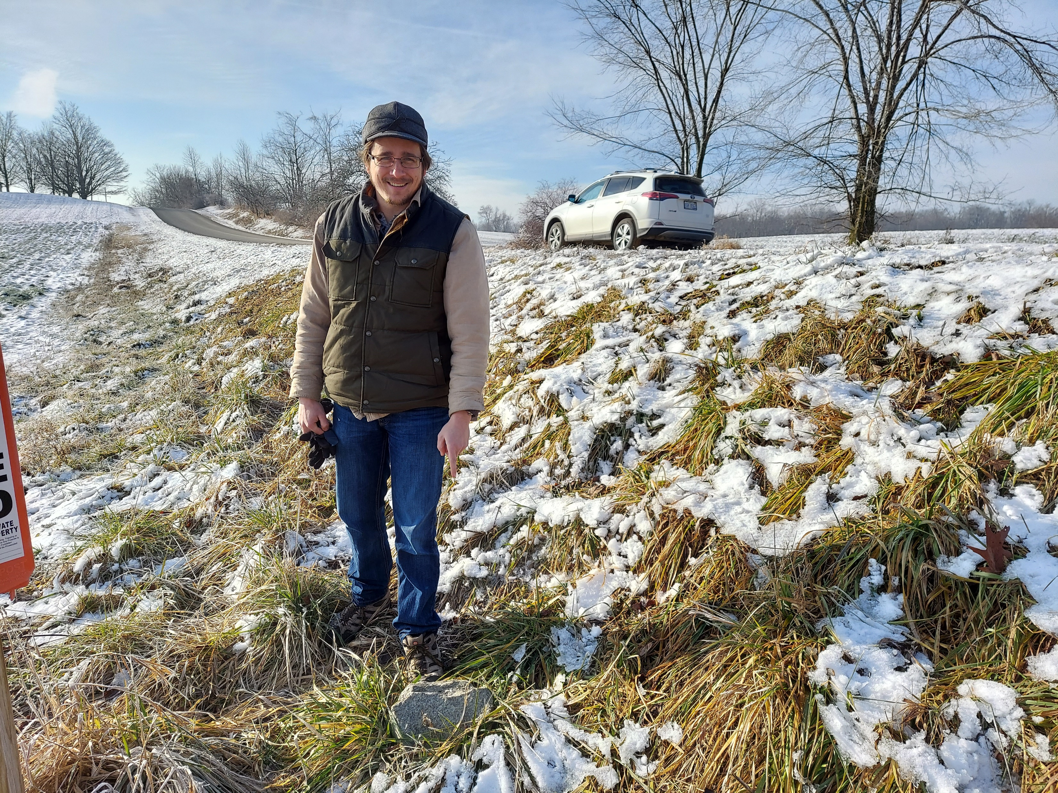
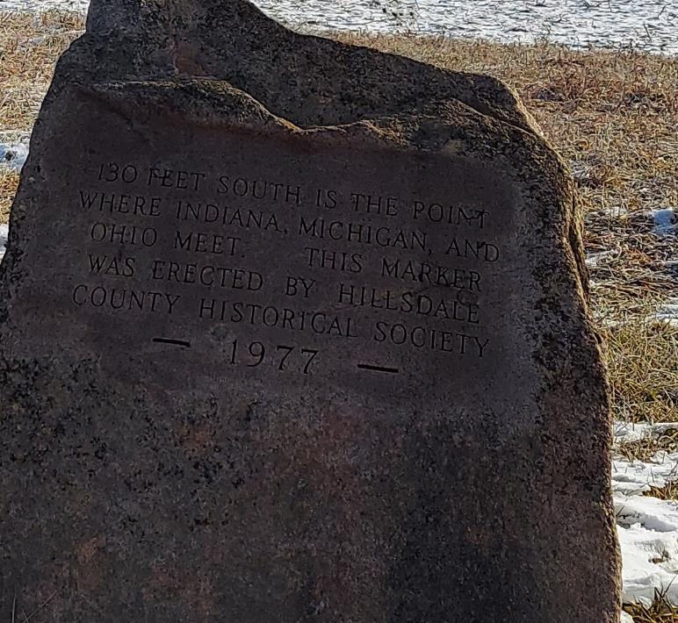

Slide 4
Outline
Background on coordinate systems
International geodetic efforts
Terrestrial reference frames
Horizontal datums of the National Spatial Reference System (NSRS)
Geometric reference frames of the Modernized NSRS
Access to the new frames
NSRS Modernization News
New types of coordinates

Slide 5
What is NGS?
The National Geodetic Survey (1970–present)
U.S. Coast and Geodetic Survey (1878–1970)
U.S. Coast Survey (1836–1878)
U.S. Survey of the Coast (1807–1836)
Nation’s Oldest Scientific Agency
Currently:
U.S. Government Executive Branch
Department of Commerce
National Oceanic and Atmospheric Administration (NOAA)
National Ocean Service (NOS)
National Geodetic Survey (NGS)
Notes:
Headquarters in Silver Spring, field office in Norfolk, VA, Testing & Training Center in Woodford, VA

Slide 6
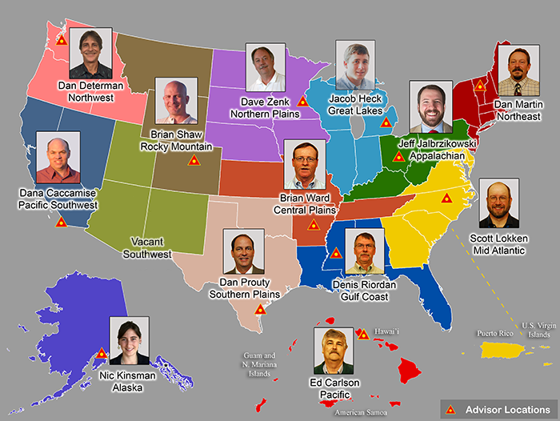
Regional Geodetic Advisor Program
www.ngs.noaa.gov/ADVISORS/
Notes:
And advisors scattered throughout the country

Slide 7
National Spatial Reference System (NSRS)
Geometric Geodesy
Physical Geodesy
Horizontal Datums/Geometric Reference Frames
Latitude
Longitude
Ellipsoid Height
State Plane Coordinates
Geopotential Datums
Orthometric Height
Dynamic Height
Surface Gravity
Leveling
Main Components: latitude, longitude, height, origin, scale, gravity, and orientation
Notes:
We like both kinds of geodesy

Slide 8
Background on coordinate systems

Slide 9
Geodetic Control Primer
Find the coordinates of point A
Somewhere on Earth…
You are presented with this problem…
Without any other information, the problem is unsolvable.
A

Slide 10
Geodetic Control Primer
Find the coordinates of point A
Wouldn’t it be fantastic if someone just provided you with a coordinate system?
Unfortunately, the Earth doesn’t come with lines of latitude and longitude just drawn all over it…
“The Earth is not a globe”
4
3
A
(x=1.8,y=2.6)
2
1
1
2
3
4

Slide 11
Geodetic Control Primer
Find the coordinates of point A
But what if someone gave you enough other points with pre-determined coordinates?
With a little measuring and trigonometry, you could certainly determine the coordinates of point A!
These “other points with pre-determined coordinates” are “geodetic control”
C (x=2.7,y=3.9)
A
B (x=3.1,y=1.4)
D (x=0.8,y=0.9)

Slide 12
Geodetic Control Primer
Find the coordinates of point A
Although the coordinate axes are not visible, their location and scale are implied by the given coordinates of the points B, C, and D.
It is often the job of surveyors, mappers and other geospatial professionals to determine the coordinates of many points on Earth.
It is the job of NGS to provide the geodetic control to the nation to make those jobs possible.
4
C (x=2.7,y=3.9)
3
2
B (x=3.1,y=1.4)
1
D (x=0.8,y=0.9)
1
2
3
4

Slide 13
Geodetic Control
Geodetic Control are a set of unique, physical, zero-dimensional points existing on or near the (rotating) Earth; with coordinates assigned to them; at a specific time determined through rigorous data collection methodologies; often involving specific types of equipment built for high-accuracy, measurement redundancy, and the proper treatment of all error sources.
While traditionally treated as unmoving and unchanging, geodetic control in the modernized NSRS will have acknowledged time-dependent movements.
Notes:
This is the definition introduced in Blueprint for 2022, Part 3: Working in the NSRS

Slide 14
Types of geodetic control
Despite their vastly different constructions and operations, all types of geodetic control always have a “unique, physical, zero-dimensional point*” as an element.
With a coordinate
Sometimes with, sometimes without, an associated time
* From Euclid’s Elements (ca ~300 BCE): “A point is that which has no part”

Slide 15
A Little Terminology…
A site is the smallest location name where station(s) are located (“McDill AFB”)
A station is a collection of equipment for one geodetic purpose (CORS “MCD1” and CORS “MCD2”)
A mark is a stable physical structure attached to the crust (PID “AJ3141” or “AJ3139”)
A mark’s job is to hold 1 point
Some Stations might share a mark
Some marks might not be part of a station, but might be on a site
+
STATIONS
SITE
+
+
+
+
MARKS
+
Notes:
A site can contain 1 or more stations.
At a CORS, the “GRP” is the “point”, not the “ARP”, despite decades of this terminology.
In the next few slides, when the words point, mark, station or site are used, they will be bolded and put in red, just to keep focus on their proper use. We will abandon that in later slides.

Slide 16
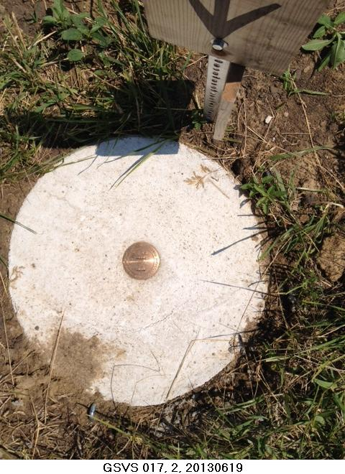
Active vs. Passive Geodetic Control
All marks are passive—in that they sit there doing nothing in and of themselves besides holding a point
Notes:
This include fixed antenna mount that is part of the monument that

Slide 17
Active vs. Passive Geodetic Control
Often the term active geodetic control has been used to mean some equipment is continuously or at least frequently collecting observations at or near a point
Yet those observations are often used to compute coordinates (often time-dependent) at a point on a mark, which, by its nature is passive

Slide 18
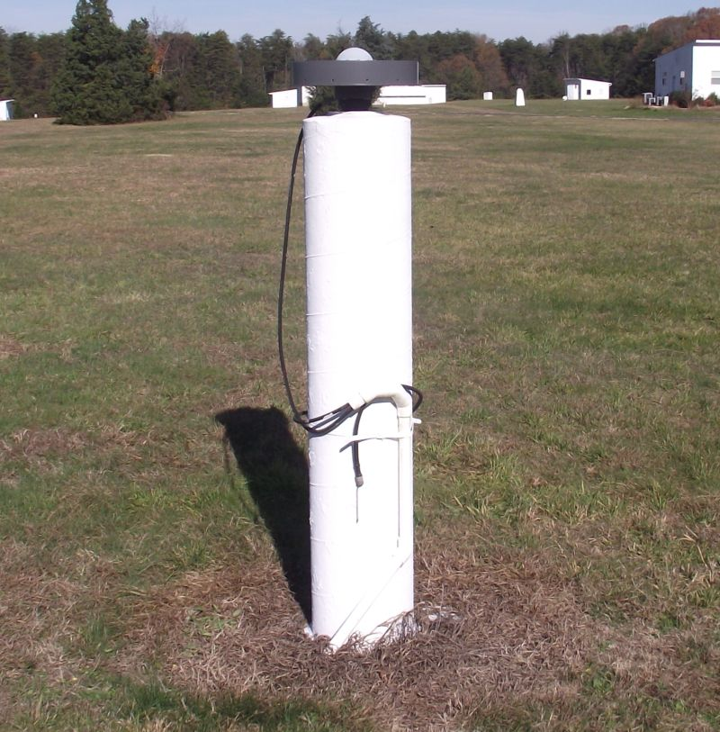
What is active control?
Continuously collecting data…
So it’s often called active…
But the point, given coordinates
computed from all the data
collected by that antenna, is probably in here somewhere, as a part of this huge pillar which is effectively one big mark, passive as can be….
Notes:
Note that the whole pillar could be considered a type of “mark”, being a passive do-nothing structure that holds a “point”, the GRP of this CORS.

Slide 19
Active vs. Passive Geodetic Control
It might be best to set aside the terms “active” and “passive” and think solely in terms of trusted geodetic control
However, sometimes this shorthand will be used for simplicity:
Passive control: Infrequently observed marks
Active control: A station with continuous GNSS

Slide 20
Geodetic Stations
The five most frequently encountered:
Continuously Operating GNSS Reference Station (CORS)
Satellite Laser Ranging (SLR) Station
Very Long Baseline Interferometry (VLBI) Station
Doppler Orbitography and Radiopositioning Integrated by Satellite (DORIS) Station
Continuously Operating Relative Gravimeter Station
All have a Geodetic Reference Point (GRP)
“Coordinates of this station” = “Coordinates of the GRP at this station”
Notes:
Note that only CORS and CORGS are continuous stations, though DORIS might also be. SLR and VLBI are actually just “frequently observed”.

Slide 21
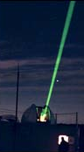
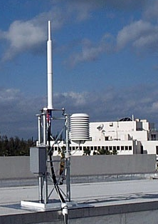
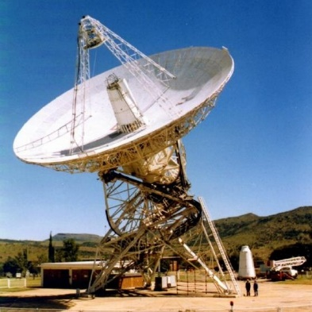
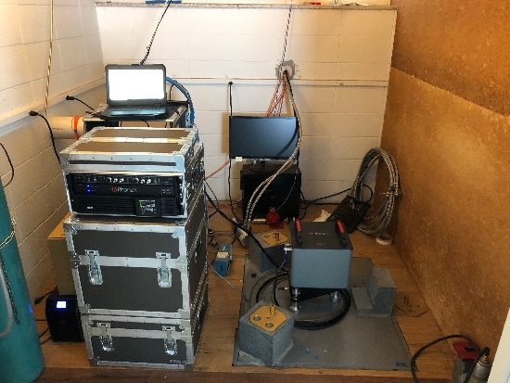
Geodetic Stations
SLR
DORIS
VLBI
Gravity
CORS

Slide 22
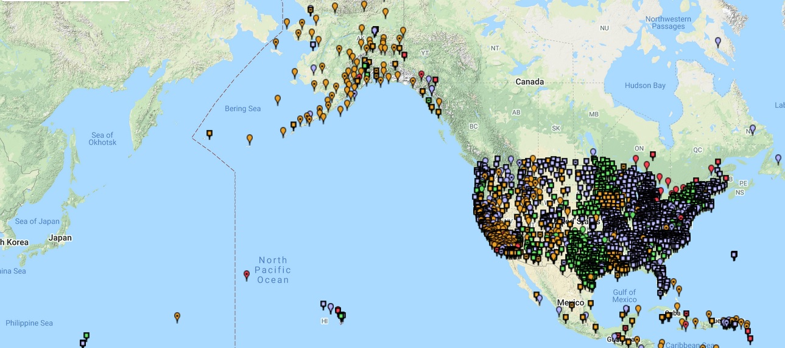
CORS Networks
Global Standard: The IGS Network
IGS = International GNSS Service
The NOAA CORS Network (NCN)
2,000+ stations managed, but rarely owned by NGS
The NOAA Foundation CORS Network (NFCN)
Sub-network being installed
Owned/operated by NGS
Other Regional/Local Networks (RTNs, etc.)
Currently semi-coupled to the NCN
NGS sees the future as a close coupling of other networks with the NCN so users can seamlessly and confidently work in the NSRS using their favorite regional/local CORS network
Notes:
*Note* CORS map appears on mouse click and disappears on click to reveal bullet points

Slide 23
Modernizing the NCN
Coordinate functions are the way to know where a CORS is at the time you are trying to position yourself relative to that CORS
They have been discontinuous, piecewise linear functions since the beginning
NGS is developing newer, faster ways to update them when any of these occur:
An earthquake
An obvious drift of the station’s daily-computed coordinates away from its own coordinate function
An obvious non-linear component to a station’s movement
Notes:
Coordinate functions are the way to know where a CORS is at the time you are trying to position yourself relative to that CORS
They have been discontinuous, piecewise linear functions since the beginning
NGS is developing newer, faster ways to update them when any of these occur:
An earthquake
An obvious drift of the station’s daily-computed coordinates away from its own coordinate function
An obvious non-linear component to a station’s movement

Slide 24
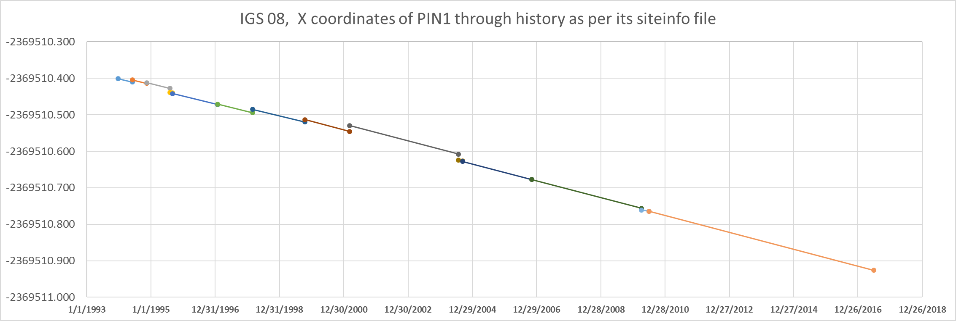
NCN Coordinate Functions
Note each piece is linear, but is offset from its neighboring piece. But at each unique time, there is one and only one “X” coordinate. This makes it a “function” by the strict mathematical definition.
Notes:
Here’s a chart of a NCN Coordinate Function
Note that each piece is linear, but is offset vertically from its neighboring piece.
But at each unique time, there is one and only one “X” coordinate.
This makes it a “function” by the strict mathematical definition.

Slide 25
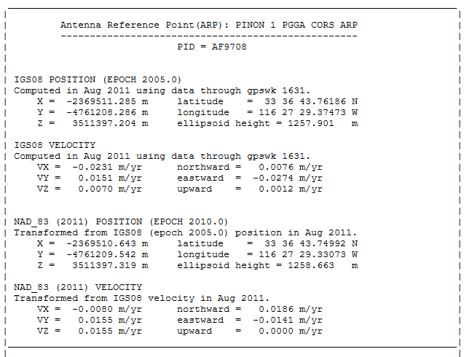
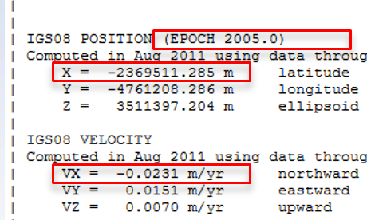
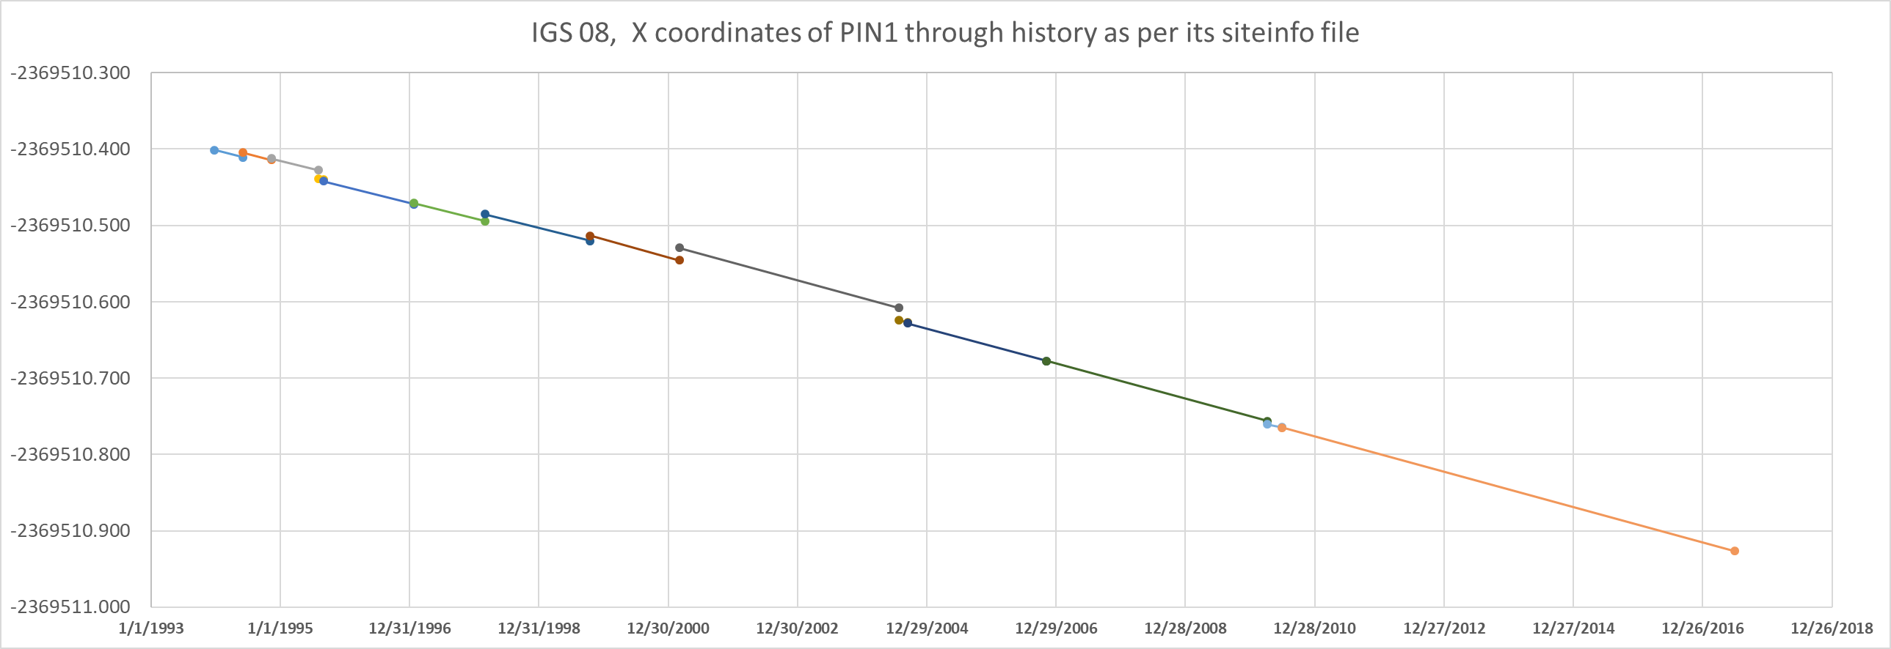
NCN Coordinate Functions
Today:
One coordinate, at one epoch, and one velocity…
Modernized NSRS:
Every discontinuity shown
Vx = -0.0231m/y
Vx = -0.0213m/y
Vx = -0.0165m/y
Notes:
CLICK CLICK CLICK
Today, NGS produces one coordinate, at one epoch, and one velocity.
CLICK CLICK
But, in the modernized NSRS, NGS will produce a more detailed coordinate function which includes coordinate velocity trends.
CLICK CLICK CLICK CLICK

Slide 26
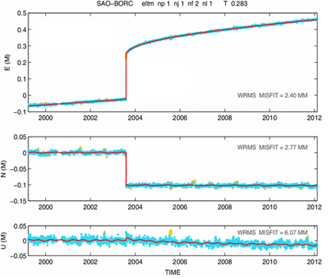
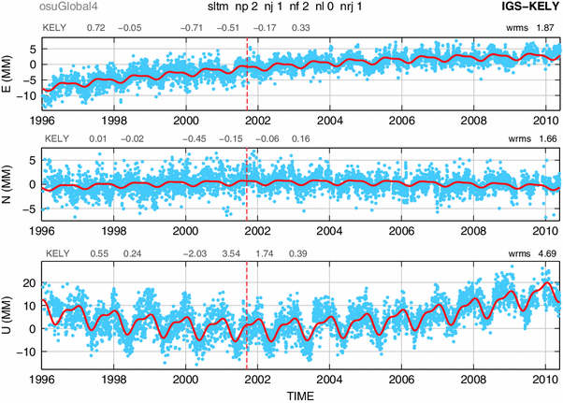
Examples of How Non-Linear CORS Coordinate Functions Might Look
Notes:
NGS is considering what non-linear coordinate functions to incorporate into the modernized NCN

Slide 27
The NCN of the Future Will…
Be the primary access to the modernized NSRS
Have a “CORS grading” system:
Quality and availability
To encourage use of “best” CORSs
Address the difference between the one GRP and the many ARPs at each station
ARP: Comes and goes with every antenna
GRP: Permanent point on the station
Notes:
Have a “CORS grading” system:
Quality and availability
To encourage use of “best” CORSs
Address the difference between the one GRP and the many ARPs at each station
ARP: Comes and goes with every antenna
GRP: Permanent point on the station

Slide 28
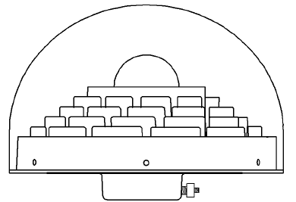

The NCN – ARP/GRP issues
The ARP is on the lowest non-removable plane of the antenna, usually coinciding with the axis of attachment
The GRP is:
a unique point that is part of a particular station
the point to which any coordinate functions of the station refer.
identified by the operator of each station
(for a CORS) part of the fixed (=non-removable) part of the antenna mount
In this example, we find it convenient to identify the GRP as the point on the axis of attachment which will coincide with the lowest non-removable plane of the antenna when the antenna is mounted.

Slide 29
The NCN – ARP/GRP issues
When the antenna goes away, so does the ARP
Leaving the GRP

Slide 30
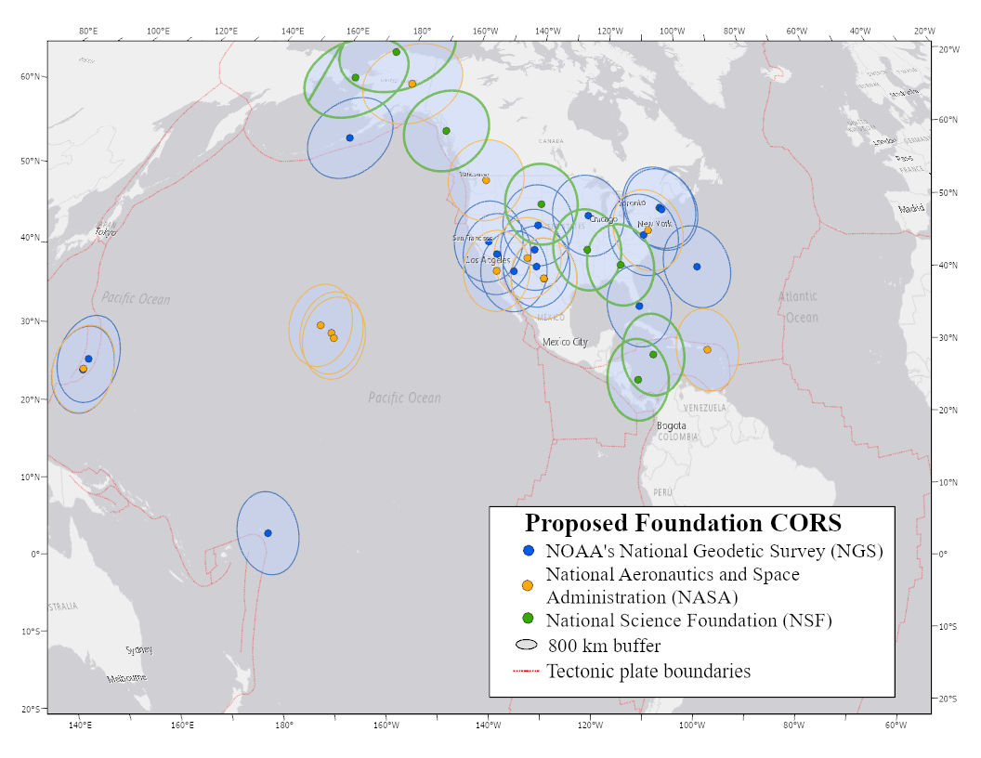
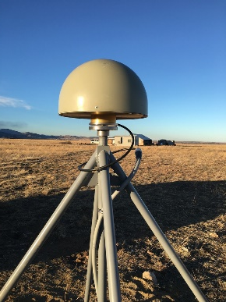
NOAA Foundation CORS Network
U.S. Federal Partners | GNSS Site ID | Location | Existing IGS or ITRF Site
National Science Foundation (NSF) Existing Sites Program: Network of the Americas (NOTA) | AB09 | Wales, AK
 | AB51 | Petersburg, AK
 | ATQK | Atqasuk, AK
 | P043 | New Castle, WY
 | P777 | Dennard, AR
 | P804 | The Rock, GA
NSF Existing Sites Program: COCONet | CN11 | Pedro Cay, Jamaica
 | SAN0 | San Andres Island, Colombia
National Aeronautics and Space Administration (NASA) Existing Sites Program: Global GNSS Network (GGN) | BREW | Brewster, WA | ITRF
 | CRO1 | St. Croix, VI | ITRF
 | FAIR/GCGO | Fairbanks, AK | IGS
 | GODE | Greenbelt, MD | IGS/ITRF
 | GUAM | Dededo, Guam | IGS
 | HAL1 | Haleakala, HI | IGS/ITRF
 | KOKB | Kauai, HI | IGS/ITRF
 | MDO1 | McDonald Observatory, TX | ITRF
 | MKEA | Mauna Kea, HI | IGS/ITRF
 | TBD | TBD California location | TBD
 | PIE1 | Pie Town, NM | IGS/ITRF
NOAA- National Geodetic Survey (NGS) Existing and New Sites Program: NOAA CORS Network | ASPA | Pago Pago, American Samoa | IGS
 | BRSG | St. George, Bermuda
 | CNMR | Saipan, Northern Mariana Islands | IGS
 | CORB | Woodford, VA
 | FLF1 | Richmond, FL | Proposed IGS/ITRF
 | GUUG | Mangilao, Guam | IGS/ITRF
 | TMG2 | Boulder, CO | Proposed IGS
 | WES2 | Westford, MA | IGS/ITRF
 | Future Station | Apache Point, NM | ITRF
 | Future Station | Fort Davis, TX | ITRF
 | Future Station | Fort Irwin, CA | ITRF
 | Future Station | Hancock, NH | ITRF
 | Future Station | Los Alamos, NM | ITRF
 | Future Station | Kitt Peak, AZ | ITRF
 | Future Station | Owens Valley, CA | ITRF
 | Future Station | Cold Bay, AK | ITRF
 | Future Station | North Liberty, IA | ITRF
26 in North America 4 in the Pacific 3 in the Caribbean 3 in the Marianas
A set of federally-operated, high quality, highly reliable stations with the longevity to guarantee citizens’ access to official National Spatial Reference System (NSRS) positions and support international positioning consistency efforts
Notes:
NGS will designate/create a superset of the NCN called the Foundation CORS Network.
It will be a set of federally-operated, high quality, highly reliable stations with the longevity to guarantee citizens’ access to official National Spatial Reference System (NSRS) positions and support international positioning consistency efforts
26 in North America,
4 in the Pacific,
3 in the Caribbean, and
3 in the Marianas
NFCN photo updated 3/25/2020, and updated again in May 2020 to current map on https://www.ngs.noaa.gov/CORS/foundation-cors.shtml
NFCN list updated 3/25/2020 – changed FAIR to FAIR/GCGO, changed “NEW” to “Future Station”
changed "New" to "Future Station"

Slide 31
International Geodetic Efforts

Slide 32

Structure of the International Association of Geodesy
International Council for Science (ICSU): 142 Countries, 31 Unions
IAU
IGU
ISPRS
IUGG
IUGS
ICA
other Unions
International Union of Geodesy and Geophysics (IUGG)
IACS
IAG
IAHS
IAGA
IAMAS
IAPSO
IASPEI
IAVCEI
International Association of Geodesy (IAG)
Commissions
1 Reference Frames
2 Gravity Field
3 Earth Rotation
and Geodynamics
4 Positioning and
Applications
Inter-Commission Committee on Theory
Scientific Services
ITRF models
IHRF models (eventually)
Geometry:
IERS
IDS
Gravity:
IGFS
BGI
Combining:
BIPM
IGS
ILRS
IVS
ICGEM
IDEMS
ISG
IGETS
PSMSL
Global Geodetic Observing System (GGOS)
Notes:
IGS: International GNSS Service
IERS: International Earth Rotatoion and reference System Service
ILRS: International Laser ranging Service
IDS: International DORIS Service
DORIS: Doppler Orbitography and Radiopositioning Intergated by Satellite
IVS: International VLBI Service
VLBI: Very Long Baseline Interferometry
ITRS: International Terrestrial Reference System
ITRF: International Terrestrial Reference Frame
IHRS: International Height Reference System
IHRF: International Height Reference Frame
SIstema de Referencia Geocéntrico para las AméricaS (SIRGAS)
Geocentric Reference System for the Americas

Slide 33
Global geodetic control
Geodetic control is inherently global.
NGS works with international groups to improve the global geodetic framework.
The UN Global Geodetic Reference Frame (UN-GGRF) was adopted by the UN Committee of Experts on Global Geospatial Information Management (UN-GGIM). The NSRS ties to the UN-GGRF.
Notes:
Geodesy comes from the Greek word meaning Earth Division, latitude and longitude are global.

Slide 34



















United Nations Committee of Experts on Global Geospatial Information Management (UN-GGIM) Structure
Environmental Statistics and Geospatial Information Management Branch
United Nations Statistical Commission
UN-GGIM Committee of Experts
Co Chairs:
Mr. Li Pengde (China)
Ms. Dorine Burmanje (Netherlands)
Rapporteur:
Mr Fernand Isseri (Cameroon)
President:
Ms. Paloma Gomez (Mexico)
Vice President:
Ms. Macarena Perez
(Chile)
Secretariat:
Ms. Gabriela Seco
(Mexico)
Data Development and Outreach Branch
United Nations
Committee of Experts on Global Geospatial Information Management
Partners
Demographic and Social Statistics Branch
Working Group on the Integration of Statistical and Geospatial
Information
PAIGH
United Nations Group of Experts on Geographical Names (UN-GEGN)
UN-GGIM Asia Pacific
UN-GGIM Arab States
UN-GGIM Africa
UN-GGIM Europe
UN-GGIM Americas
Data Innovation
Branch
SIRGAS
Economic Statistics
Branch
Working Group on Access and Use of Geospatial
Information in Disaster Risk Reduction and Climate Change
GeoSUR
Subcommittee on Geodesy
Development of Shared Principles for the Management of Geospatial Information
Geospatial Societies
Association of
Caribbean States
Trends in National Institutional Arrangements in Geospatial Information Management
Working Group on promotion and assessment of Spatial Data Infrastructure
Academic Network
University of Guyana
Reports to Statistical Commission and
UN-GGIM
Expert Group on the Integration of Statistical and Geospatial Information
Geospatial Information and Services for Disasters
Private Sector Network
AMEXCID
Denotes the participation of the United States of America
Global Fundamental Geospatial
Data Themes
UN System Network
(under formation)
CDEMA
Expert Group on Land Administration and Management
Legal and Policy Frameworks for
Geospatial Information
Management
URISA Caribbean
Reports to Statistical Commission via the Inter-Agency and
Inter-Agency and Expert Group on Sustainable Goals Indicators (IAEG- SDGs) – Working Group on
Geospatial Information
Expert Group on SDG
Indicators and
UN-GGIM
Marine Geospatial Information
Joint Group on Standards
(IHO, ISO, OGC)
Notes:
This is the official organization and reporting structure.
In English, I would say this is an “eye chart.”
I’ll break it down a bit more in the next couple of slides

Slide 35
Argentina: Diego Pinon
Canada: Calvin Klatt
Costa Rica: Álvaro Álvarez
Jamaica: Nolan Aikens
Mexico: Francisco Parra United States: Daniel Roman Uruguay: Gustavo Fabián Caubarrere Diab
SubCommittee on Geodesy (UN SCoG)
EG on Land Administration and Management
EG on the Integration of Statistical and Geospatial Information
WG on Development of a Statement of Shared Principles for the Management of Geospatial Information
WG on Trends in National Institutional Arrangements in Geospatial Information Management
WG on Geospatial Information and Services for Disasters
WG on Global Fundamental Geospatial Data Themes
WG on Legal and Policy Frameworks for Geospatial Information Management
WG on Marine Geospatial Information
United Nations
Department of Economic and Social Affairs (ECOSOC)
Statistics Division
United Nations Global Geospatial Information Management (UN-GGIM)
UN-GGIM Asia-Pacific | UN-GGIM Americas | UN-GGIM Arab States | UN-GGIM Europe | UN-GGIM Africa
UN-GGIM adopted the GGRF – that is, all Nations (including USA) have agreed to use a common reference frame based on the ITRS.
The UN-SCoG is tasked with implementing the GGRF globally.
That agreement and the obligation to adopt the GGRF was
also passed through to the Regional Committees (RCs).
Notes:
This a little easier to read and understand. The hierarchical organization is clearer.
UN-GGIM has working groups and subcommittees,
The UN-GGIM adopted the Global Geodetic Reference Frame (GGRF), which I’ll go into detail in the next few slides.
UN-GGIM tasked the UN-SCoG with implementing the GGRF at the global level.
Regional committees have to implement GGRF at the regional level.
The RC Member States collectively form the broader UN-GGIM organization, and they inherited the responsibility for implementing the GGRF in their regions.
Additionally, the RC contribute members to the UN SCoG as well as the EG’s, and WG’s. (click)
There are seven people from the Americas RC who serve on the UN SCoG. (click)
They are shown here. (click)

Slide 36
What is the UN Global Geodetic Reference Frame?
Conceptually, the GGRF encompasses all aspects of the a modernized reference frame including:
Geodetic infrastructure (GI)
Education Training and Capacity Building (ETCB)
Governance (GOV)
Outreach and Communication (OC)
Policies Standards and Conventions (PSC)
Notes:
A system is how you do things, whereas a frame is a specific realization within the system. ITRF is a scientific construct.
Except in this case the GGRF is actually more of political construct.
While the ITRS is very mature, the infrastructure behind is very mature – to the point of degradation and potential loss of functionality.
ISO – International Standards Organization
OGC – Open Geospatial Consortium
This has been one of the primary motivations for elevating the concerns of the GGRF to the UN. Scientific groups cannot continue sustain this on their own.
The IHRS is still evolving and growing.

Slide 37
What is the UN Global Geodetic Reference Frame?
Includes both International Terrestrial Reference System (ITRS) and the International Height Reference System (IHRS).
The ITRS focuses on a framework for GNSS applications in an ellipsoidal framework.
The IHRS focuses on a framework for physical heights (i.e., leveling).
Both are determined and maintained by the International Association of Geodesy (IAG).
Notes:
The ITRS is very robust and mature, while the IHRS is nascent but growing.
ITRF is a scientific application
IAG developed ITRF, UNGGIM adopted it and work to implement it, provide training, and so on.
Countries work together on infrastructure, Education, training and capacity building, and policy, standards, and conventions
UN’s role is governance, bringing it all together.
US government representatives agree to UN initiatives, and US government programs are responsible to meet the task.

Slide 38
Terrestrial reference frames

Slide 39
Reference system:
A set of prescriptions and conventions together with the modeling required to define at any time a triad of coordinate axes¹
ITRS
International Terrestrial
Reference System
Reference frame:
ITRF
International Terrestrial
Reference Frame
Realizes the system by means of coordinates of definite points that are accessible directly by occupation or observation¹
¹Springer Handbook of Global Navigation Satellite Systems, Ch. 2, p. 34

Slide 40

International Terrestrial Reference System (ITRS)
Defined and maintained by the International Earth Rotation and Reference System Service (IERS)
https://www.iers.org/IERS/EN/Home/home_node.html

Slide 41
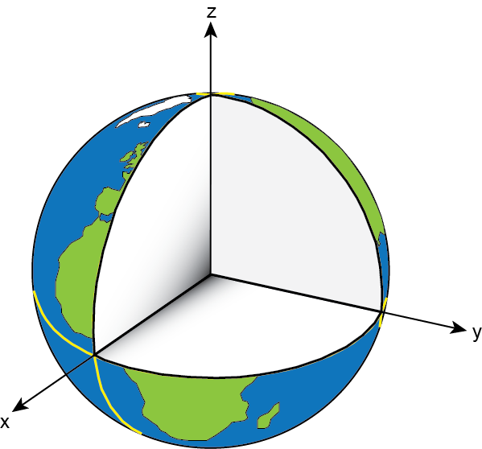
International Terrestrial Reference System (ITRS)
Need to define
conventions for:
origin – where is the zero point?
scale – what is our measure of length?
orientation – how are the axes oriented in space?

Slide 42
What is a reference frame?
Reference frames give us a means to assign self-consistent coordinates to physical locations and to describe how those coordinates change over time

Slide 43
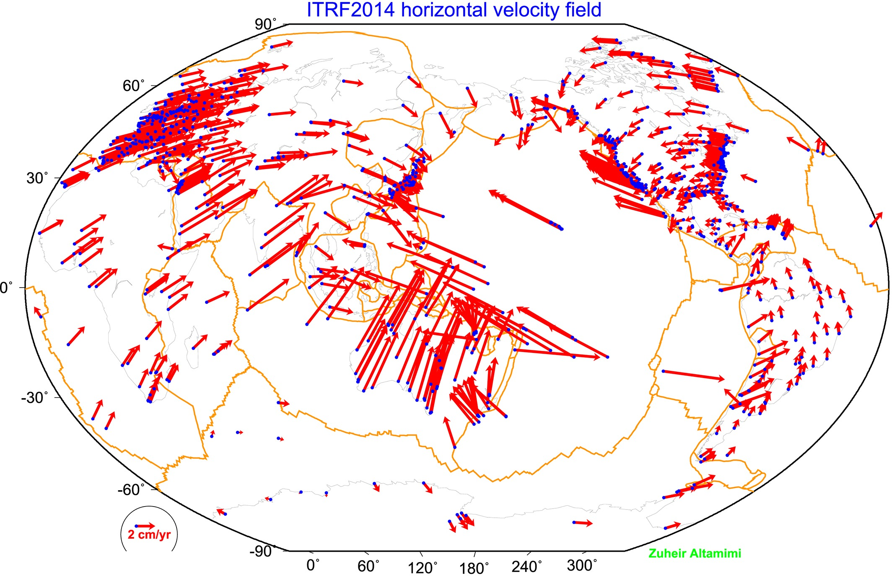
The IGS reference frame
The ITRF is defined by reference epoch coordinates AND velocities at stations
The ITRF velocity field very closely resembles absolute plate motion
The ITRF and IGS frames are both no-net-rotation frames – the sum of the angular velocities is constrained to be zero.
Altamimi et al., 2016, JGR

Slide 44
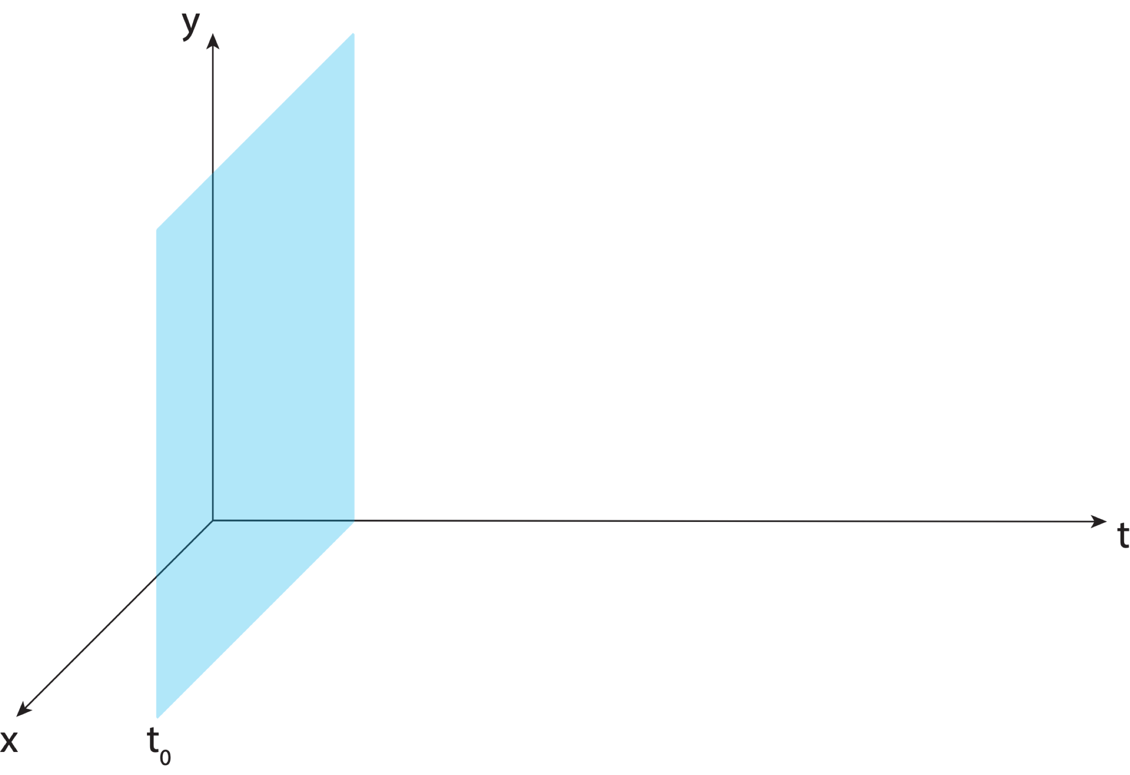
Aligning the NSRS to the IGS reference frame

Slide 45
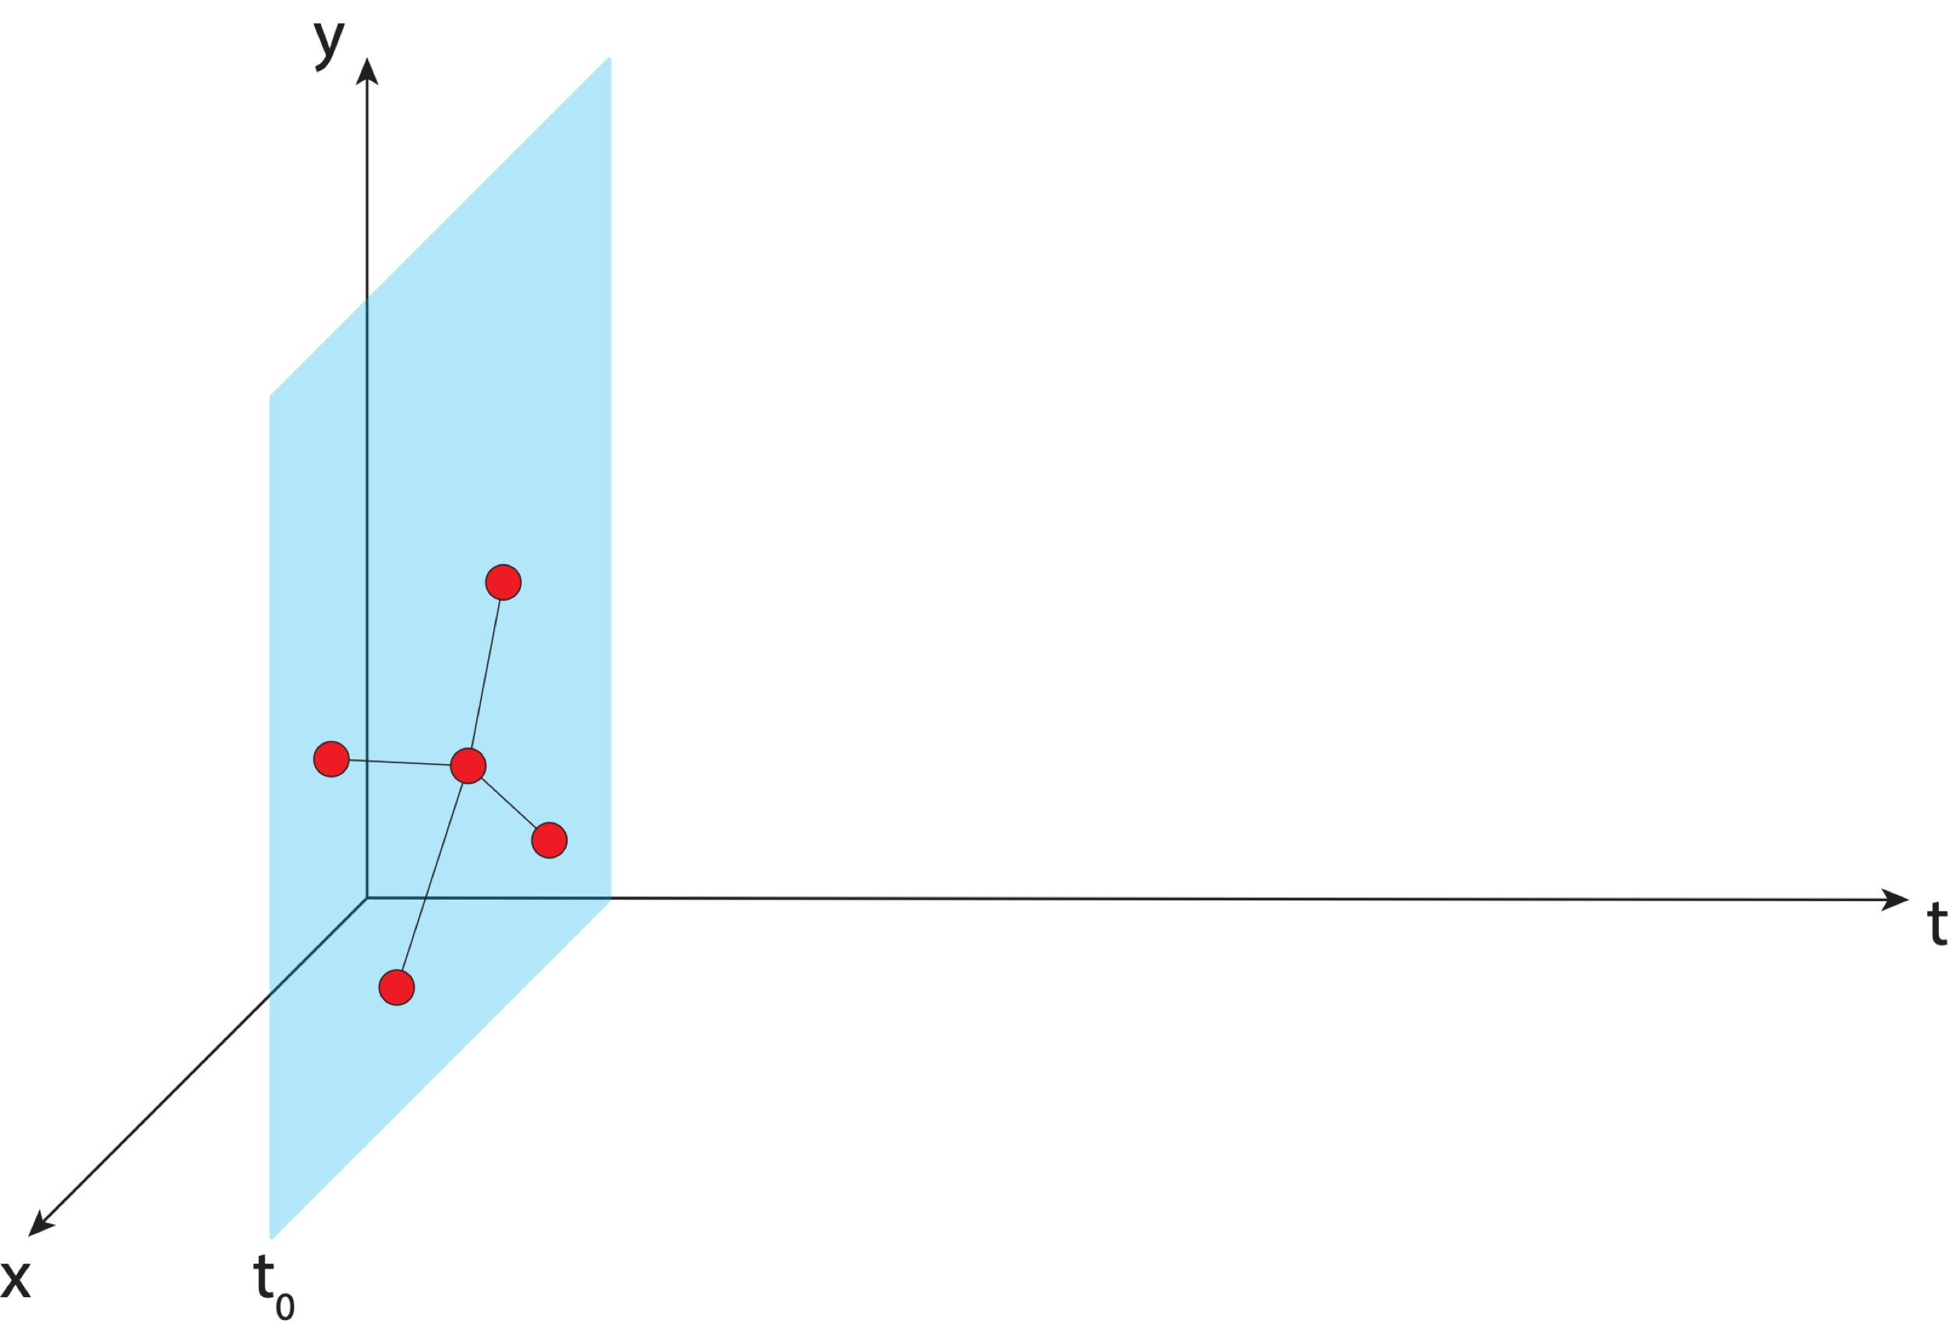
Aligning the NSRS to the IGS reference frame
IGS GNSS station
station trajectory

Slide 46
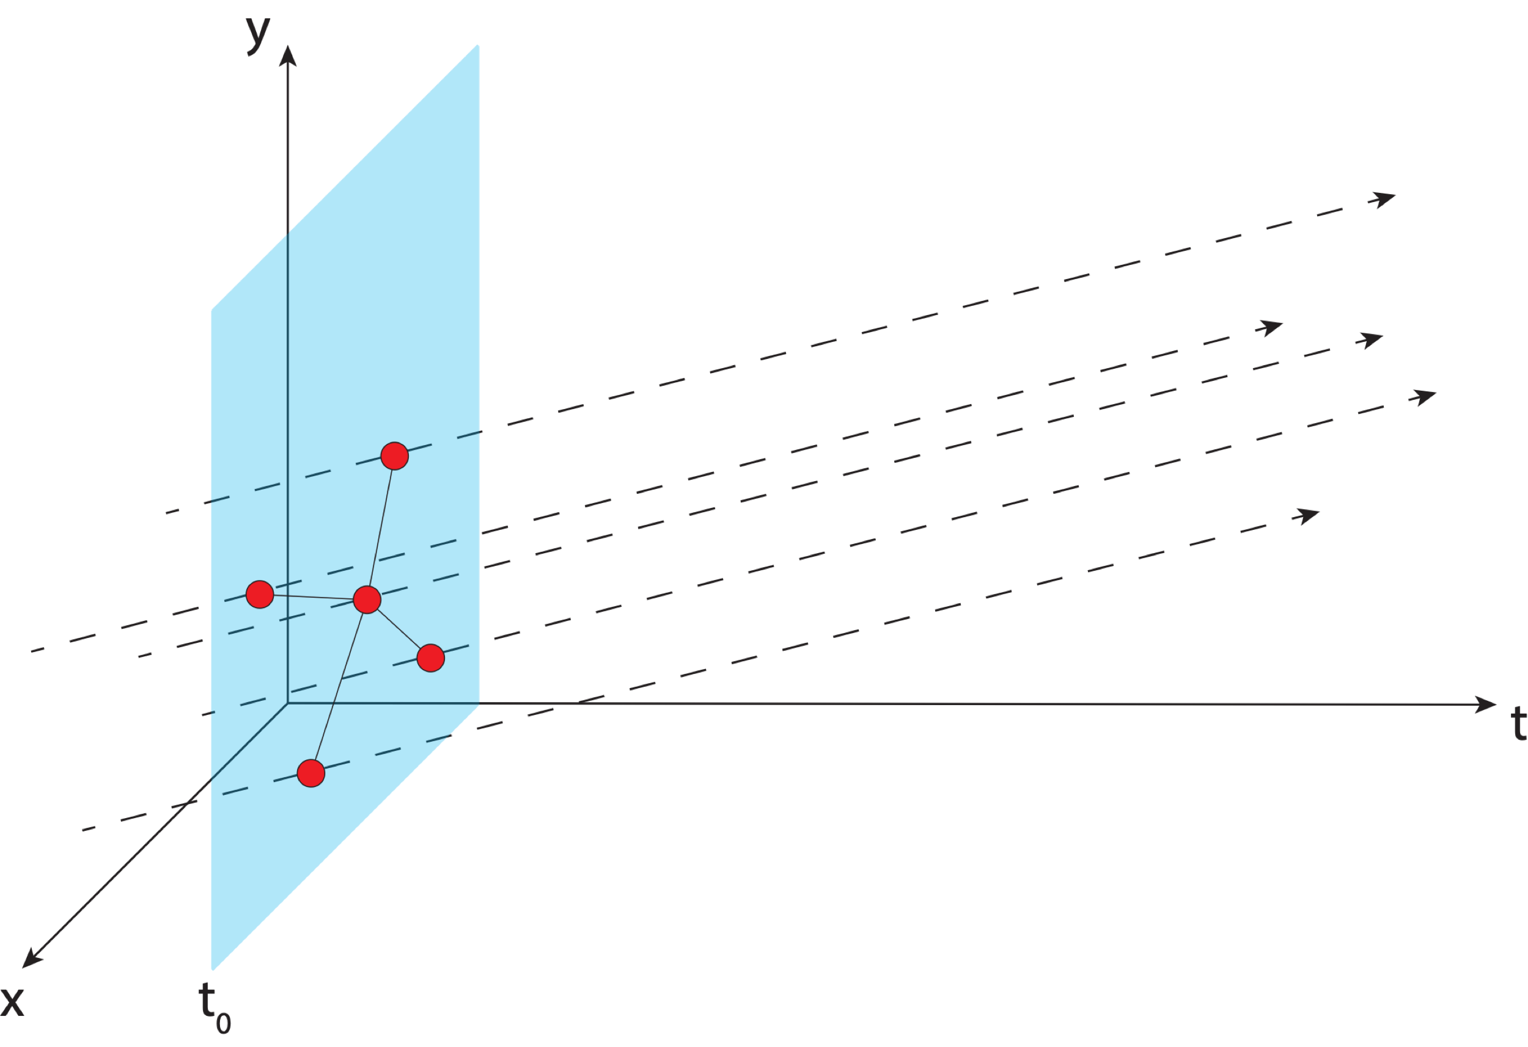
Aligning the NSRS to the IGS reference frame
IGS GNSS station
station trajectory

Slide 47
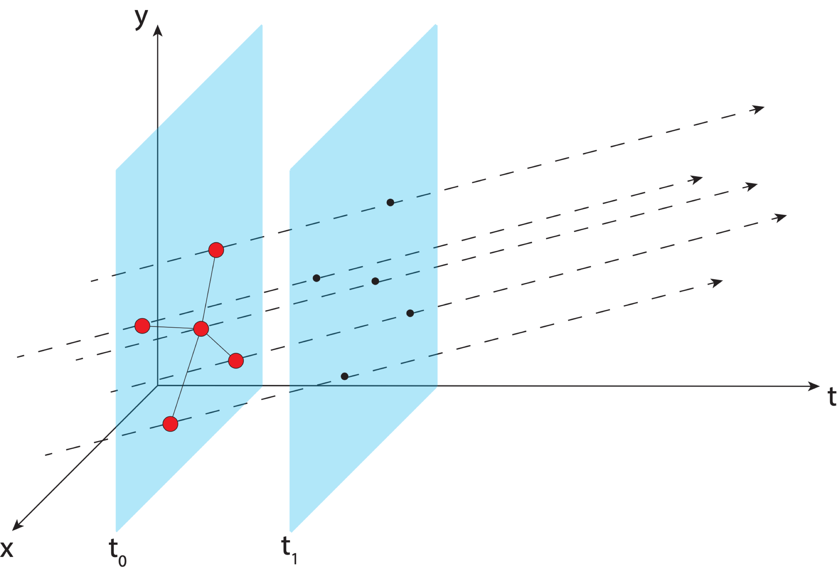
Aligning the NSRS to the IGS reference frame
IGS GNSS station
station trajectory
projected IGS station position
Notes:
Trajectory of IGS stations through time

Slide 48
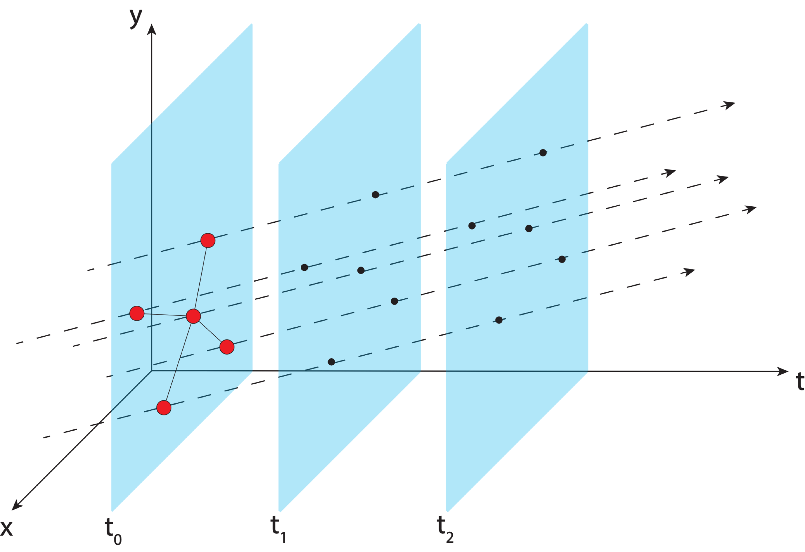
Aligning the NSRS to the IGS reference frame
IGS GNSS station
station trajectory
projected IGS station position

Slide 49
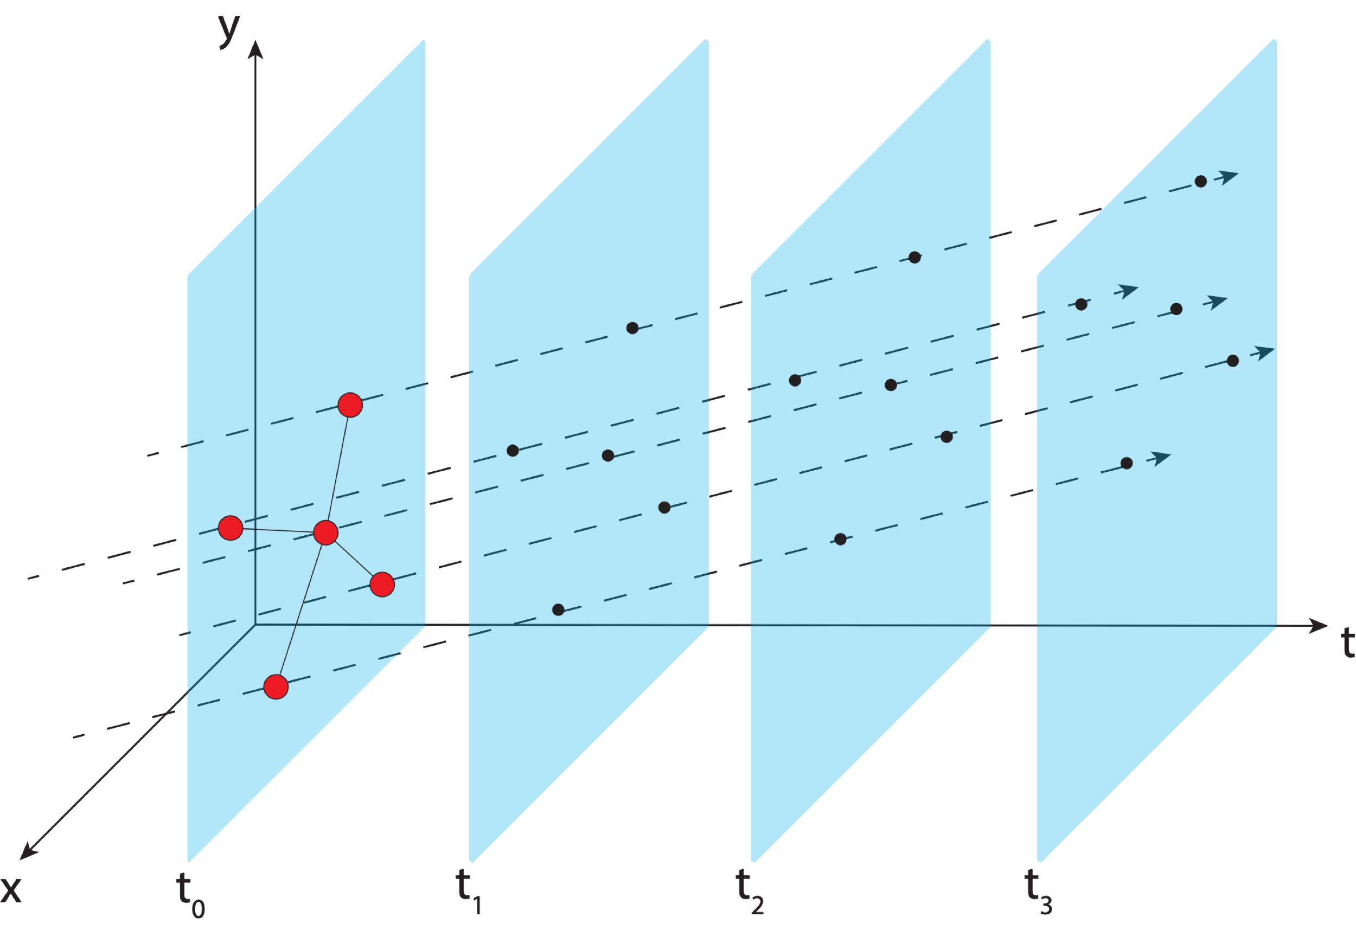
Aligning the NSRS to the IGS reference frame
IGS GNSS station
station trajectory
projected IGS station position

Slide 50
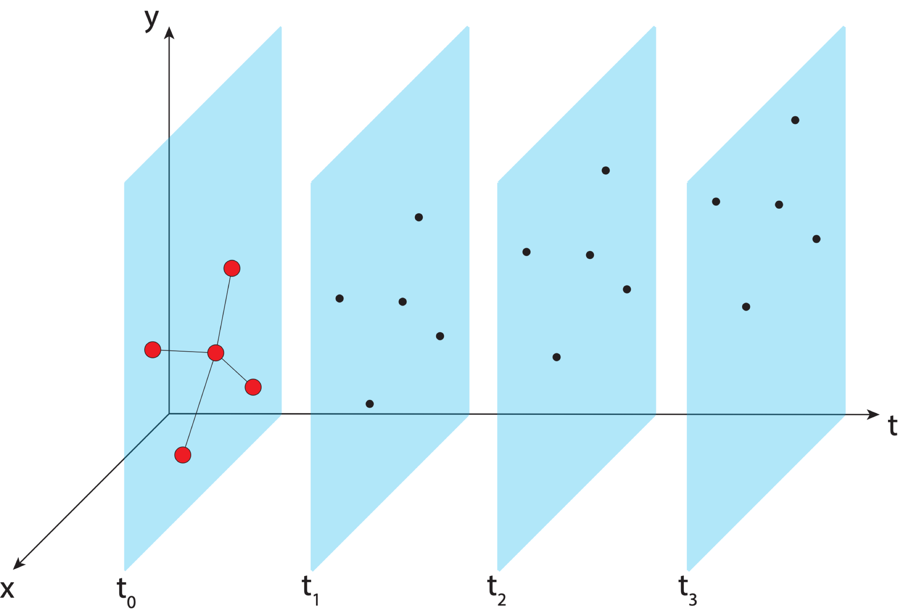
Aligning the NSRS to the IGS reference frame
IGS GNSS station
station trajectory
projected IGS station position

Slide 51
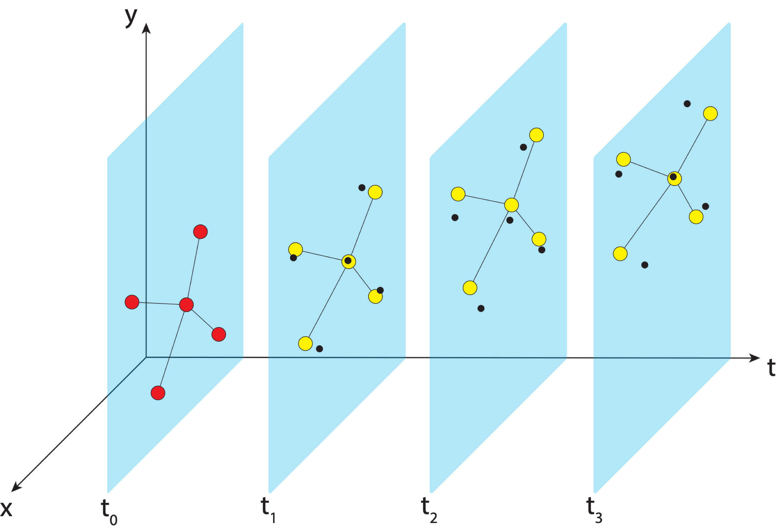
Aligning the NSRS to the IGS reference frame
IGS GNSS station
station trajectory
projected IGS station position
NGS estimate of IGS station position
Notes:
NGS estimates positions of IGS stations and compute transformation parameters to get them to align

Slide 52

Aligning the NSRS to the IGS reference frame
IGS GNSS station
station trajectory
projected IGS station position
NGS estimate of IGS station position

Slide 53
Aligning the NSRS to the IGS reference frame
IGS GNSS station
station trajectory
projected IGS station position
NGS estimate of IGS station position

Slide 54
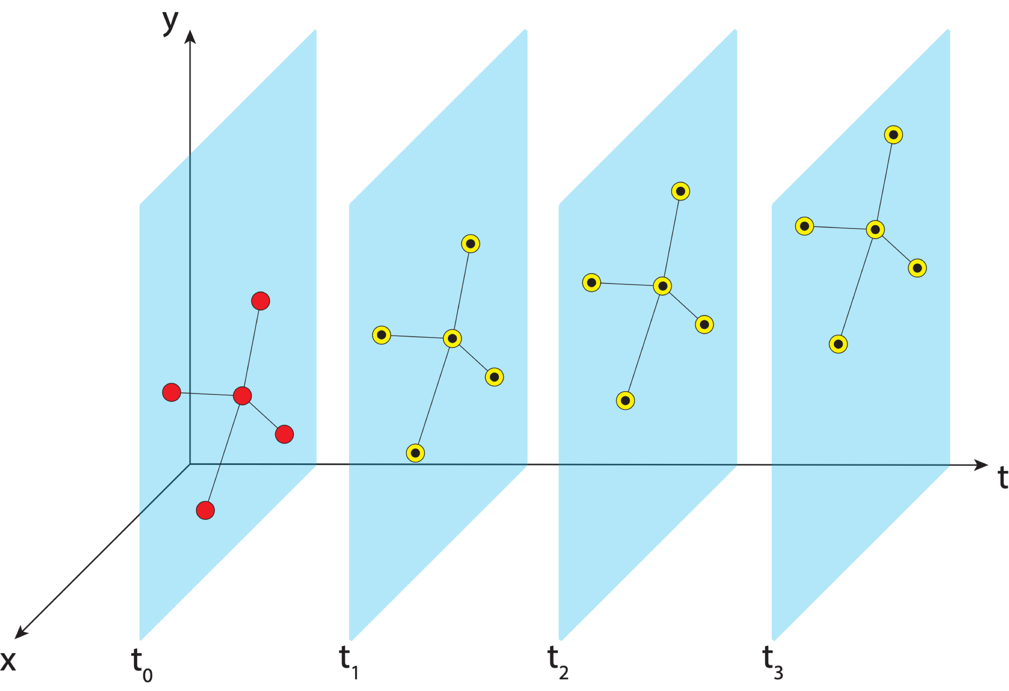
Aligning the NSRS to the IGS reference frame
IGS GNSS station
station trajectory
projected IGS station position
NGS estimate of IGS station position

Slide 55
Aligning the NSRS to the IGS reference frame
IGS GNSS station
station trajectory
projected IGS station position
NGS estimate of IGS station position
NCN GNSS station

Slide 56

Aligning the NSRS to the IGS reference frame
IGS GNSS station
station trajectory
projected IGS station position
NGS estimate of IGS station position
NCN GNSS station

Slide 57

Aligning the NSRS to the IGS reference frame
IGS GNSS station
station trajectory
projected IGS station position
NGS estimate of IGS station position
NCN GNSS station

Slide 58
Aligning the NSRS to the IGS reference frame
IGS GNSS station
station trajectory
projected IGS station position
NGS estimate of IGS station position
NCN GNSS station

Slide 59
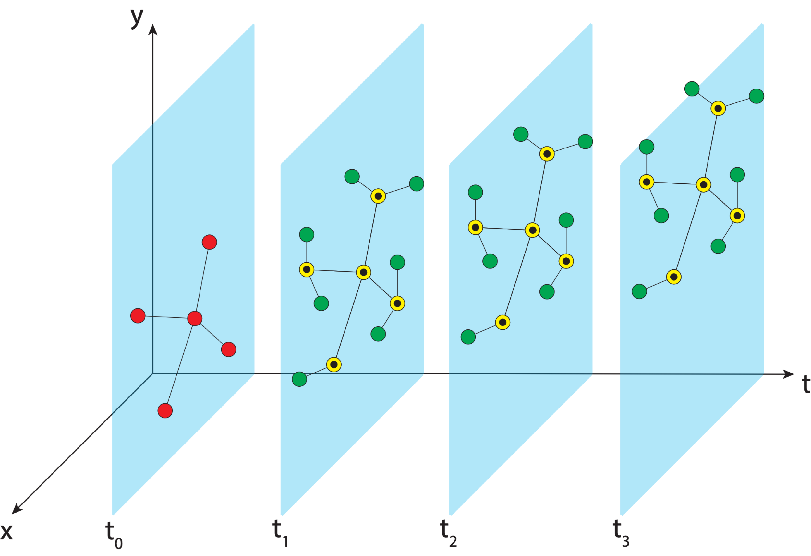
Aligning the NSRS to the IGS reference frame
IGS GNSS station
station trajectory
projected IGS station position
NGS estimate of IGS station position
NCN GNSS station
Notes:
We realize the ITRF by using the IGS realization and bringing the NOAA CORS network along with it to snap everything into a self-consistent frame

Slide 60
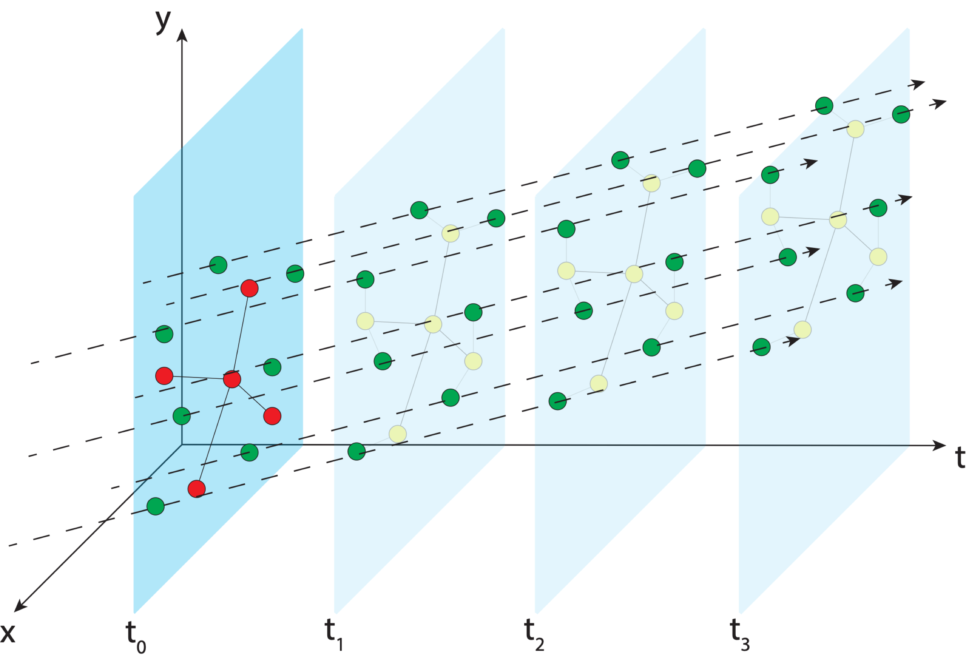
Aligning the NSRS to the IGS reference frame
IGS GNSS station
station trajectory
projected IGS station position
NGS estimate of IGS station position
NCN GNSS station
Notes:
In MYCS, we take those positions at those times and estimate the velocity (trajectory) of the stations through time

Slide 61

Aligning the NSRS to the IGS reference frame
IGS GNSS station
station trajectory
projected IGS station position
NGS estimate of IGS station position
NCN GNSS station

Slide 62
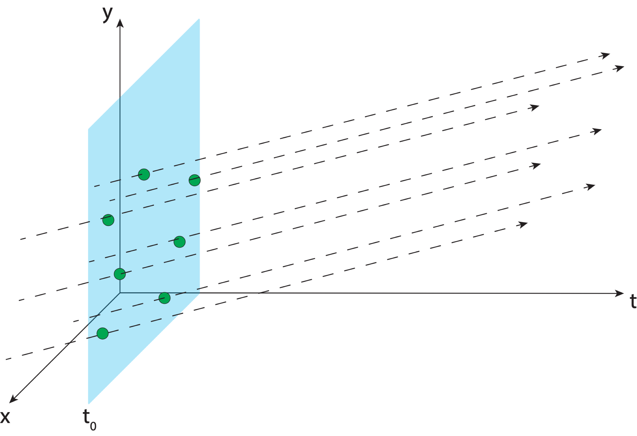
Aligning the NSRS to the IGS reference frame
IGS GNSS station
station trajectory
projected IGS station position
NGS estimate of IGS station position
NCN GNSS station
Notes:
We provide reference epoch coordinates and velocities for users to align to the NSRS

Slide 63
Aligning the NSRS to the IGS reference frame
IGS GNSS station
station trajectory
projected IGS station position
NGS provides access to the NSRS through reference epoch positions and velocities for NCN stations
When users access the NSRS through OPUS, a very similar process is performed using NCN stations as the reference
NGS estimate of IGS station position
NCN GNSS station

Slide 64
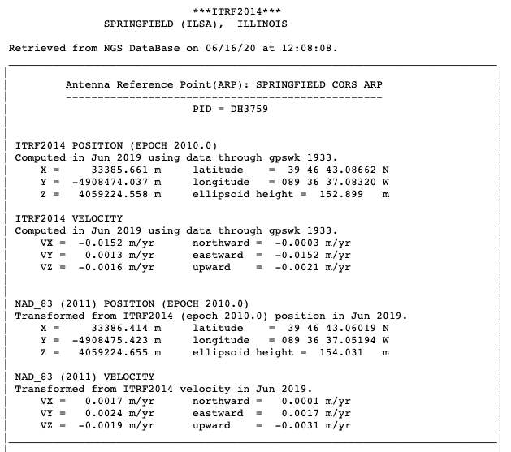
Aligning the NSRS to the IGS reference frame
IGS GNSS station
station trajectory
projected IGS station position
NGS estimate of IGS station position
NCN GNSS station

Slide 65
Aligning the NSRS to the IGS reference frame
IGS GNSS station
station trajectory
projected IGS station position
NGS estimate of IGS station position
NCN GNSS station
Notes:
And that’s what we give you. Coordinates at an epoch and a velocity

Slide 66
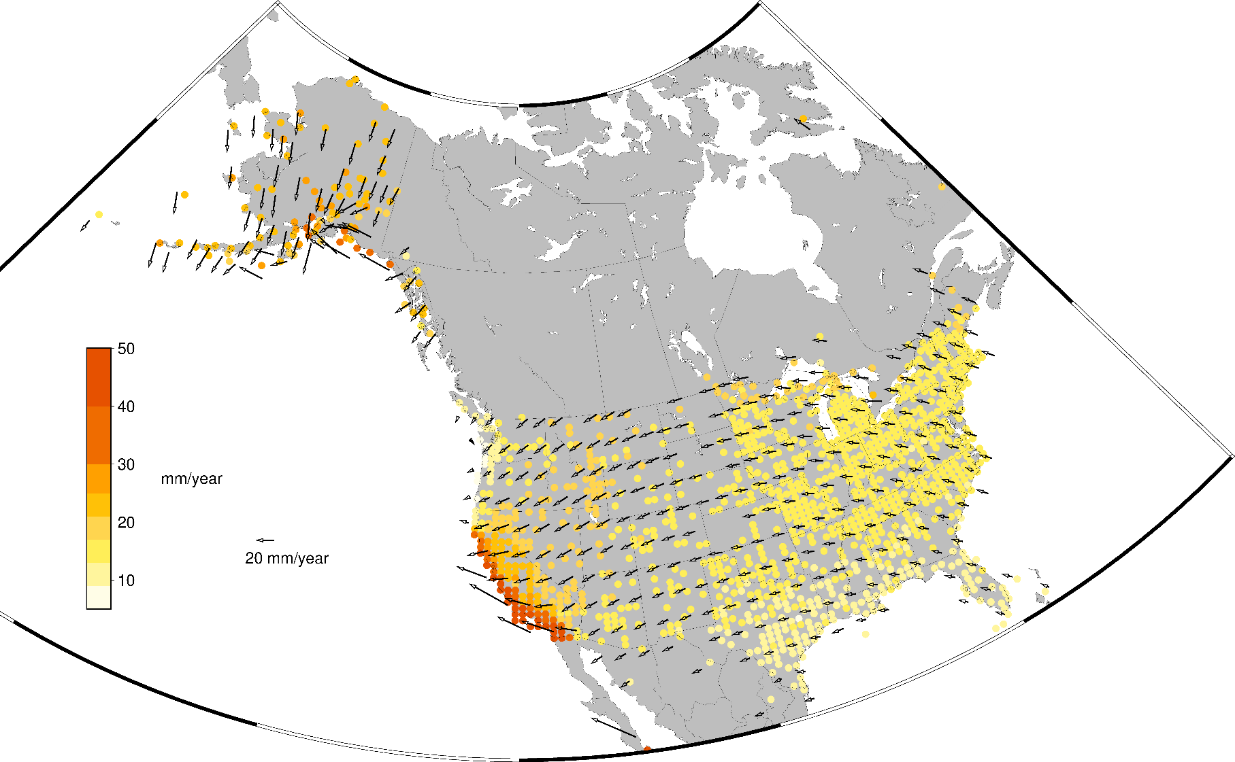
Aligning the NSRS to the IGS reference frame
MYCS2 is the most recent iteration of this process– alignment of the NSRS with ITRF2014/IGS14
Recently IGb14 was released to account for several large earthquakes since the release of ITRF2014 – the NSRS was updated to reflect these changes
ITRF2020 will be released sometime in 2021 – MYCS3 will align the NSRS with this new frame
https://www.ngs.noaa.gov/CORS/coords.shtml#2ndReprocessingCampaign
Notes:
MYCS2 recently came out, aligned to ITRF2014. Dynamic processes force updates to be made to ITRF. That’s that IGb frame

Slide 67
Historical Horizontal datums

Slide 68
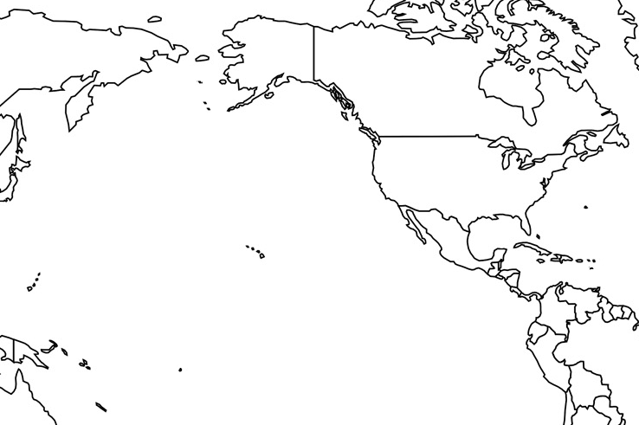
Horizontal Datums of the NSRS
St. Paul I.
St. Paul 1897
St. Paul 1952
NAD 83(1986)
NAD 83(2002:AK)
NAD 83(NSRS2007)
NAD 83(2011) epoch 2010.00
St. Lawrence I.
St. Lawrence 1952
NAD 83(1986)
NAD 83(2002:AK)
NAD 83(NSRS2007)
NAD 83(2011) epoch 2010.00
St. Matthew I.
St. Matthew 1952
Alaska
NAD 27
NAD 83(1986)
NAD 83(2002:AK)
NAD 83(NSRS2007)
NAD 83(2011) epoch 2010.00
St. George I.
St. George 1897
St. George 1952
NAD 83(1986)
NAD 83(2002:AK)
NAD 83(NSRS2007)
NAD 83(2011) epoch 2010.00
CONUS
U.S. Standard Datum
NAD 27
NAD 83(1986)
NAD 83(“HARN”)
NAD 83(“FBN”)
NAD 83(NSRS2007)
NAD 83(2011) epoch 2010.00
Hawaii
Old Hawaiian Datum
NAD 83(1986)
NAD 83(1993:HI)
NAD 83(PA11) epoch 2010.00
CNMI
Guam 1963
NAD 83(1993:GU)
NAD 83(2002:GU)
NAD 83(MA11) epoch 2010.00
Puerto Rico
Puerto Rico 1940
NAD 83(1986)
NAD 83(1993:PR)
NAD 83(1997:PR)
NAD 83(2002:PR)
NAD 83(NSRS2007)
NAD 83(2011) epoch 2010.00
U.S. Virgin Islands
Puerto Rico 1940
NAD 83(1986)
NAD 83(1993:PR)
NAD 83(1997:PR)
NAD 83(2002:PR)
NAD 83(NSRS2007)
NAD 83(2011) epoch 2010.00
Guam
Guam 1963
NAD 83(1993:GU)
NAD 83(2002:GU)
NAD 83(MA11) epoch 2010.00
American Samoa
American Samoa 1962
NAD 83(1993:AS)
NAD 83(2002:AS)
NAD 83(PA11) epoch 2010.00

Slide 69
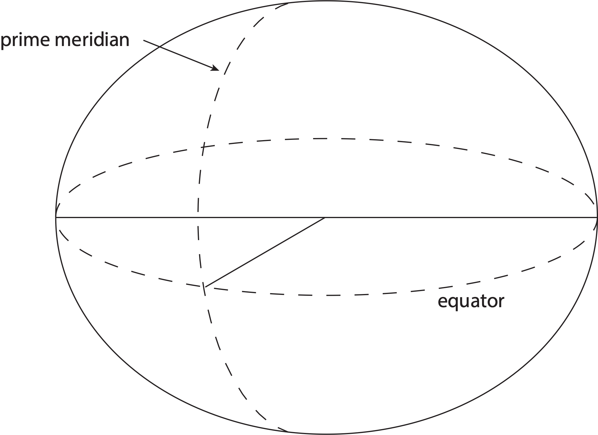
Traditional horizontal geodetic datums
Positions of points on Earth’s surface are reduced to the surface of a reference ellipsoid

Slide 70
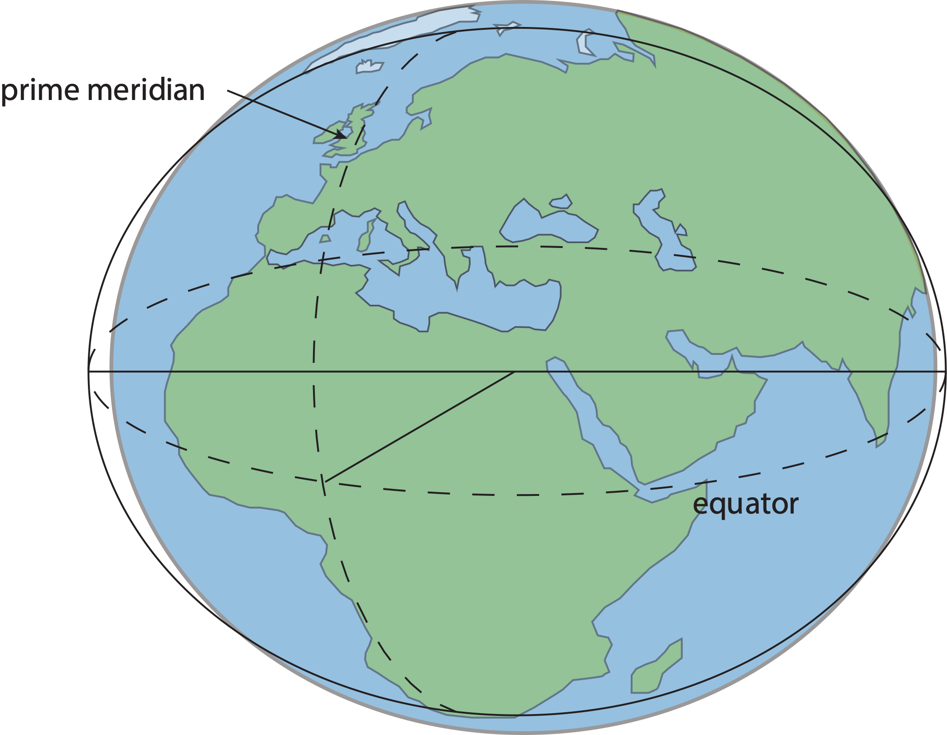
Traditional horizontal geodetic datums
Positions of points on Earth’s surface are reduced to the surface of a reference ellipsoid
The reference ellipsoid matches the shape of the Earth roughly, but not exactly

Slide 71
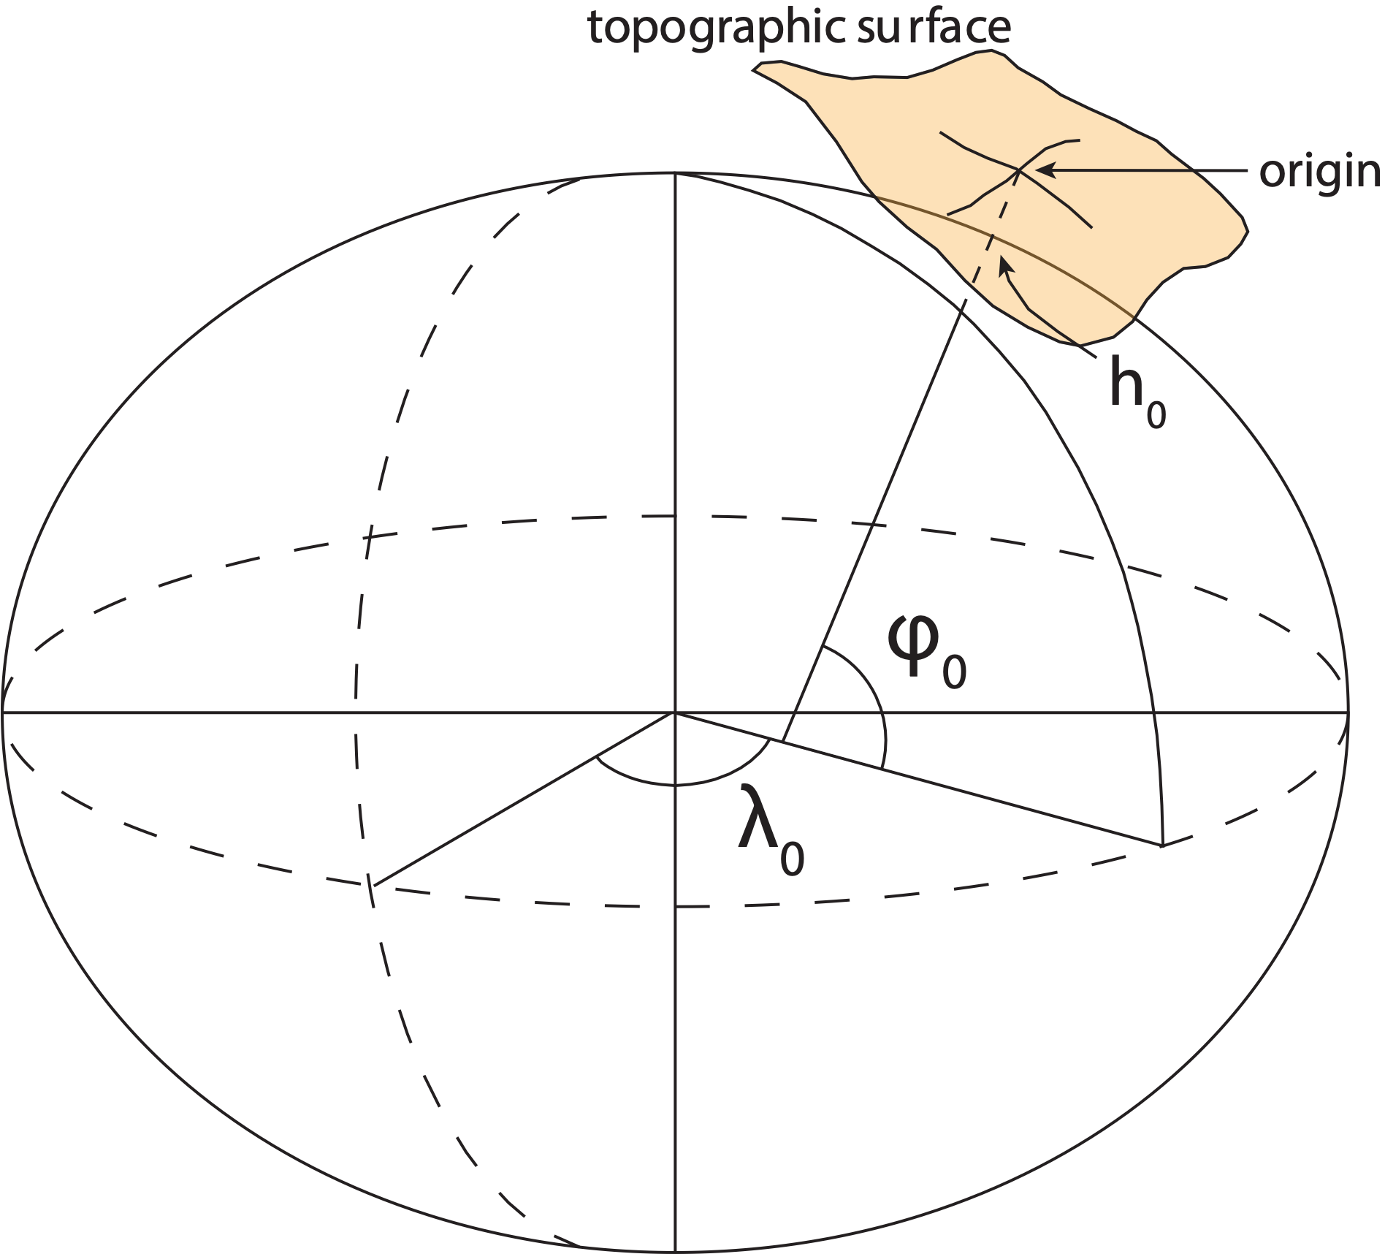
Traditional horizontal geodetic datums
Positions of points on Earth’s surface are reduced to the surface of a reference ellipsoid
The reference ellipsoid roughly matches the shape of the Earth
A reference point is selected as the origin, all other positions are given with respect to that point

Slide 72
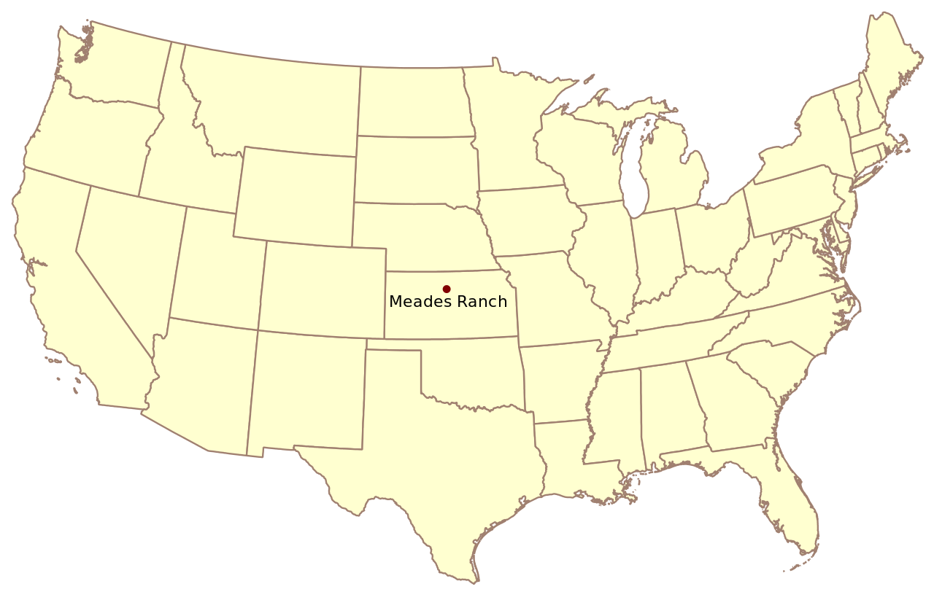
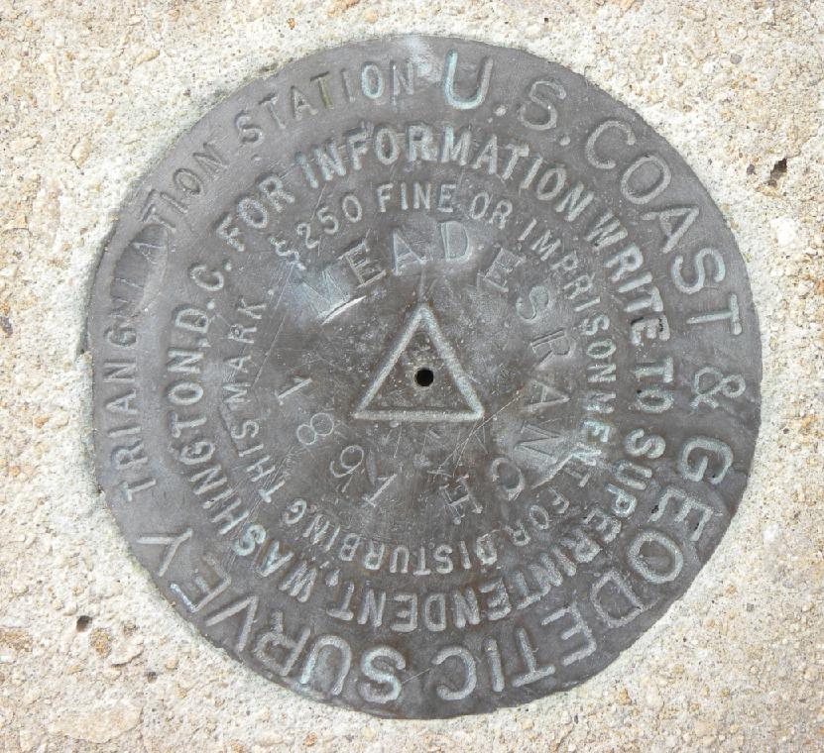
Traditional horizontal geodetic datums
North American Datum of 1927 (NAD27)

Slide 73

Traditional horizontal geodetic datums
North American Datum of 1927 (NAD27)

Slide 74

Traditional horizontal geodetic datums
North American Datum of 1927 (NAD27)

Slide 75

Traditional horizontal geodetic datums
North American Datum of 1927 (NAD27)

Slide 76
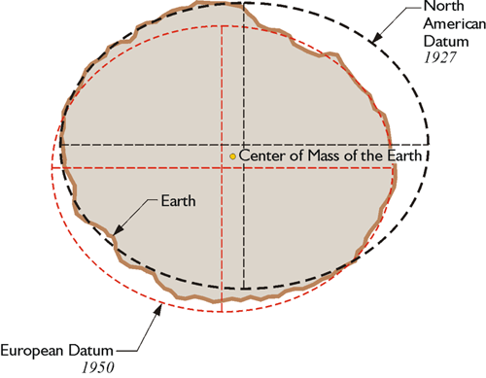
Traditional horizontal geodetic datums
Drawbacks of using this approach:
The reference ellipsoid is optimized for the region; it is not suitable for global positioning
The center of the reference ellipsoid does not coincide with the location of the center of mass of the Earth
Neighboring countries may use different datums which can cause unnecessary complications when dealing with points of interest in border regions
This method is static – dynamic process are unaccounted for
https://www.e-education.psu.edu/geog862/node/1797

Slide 77
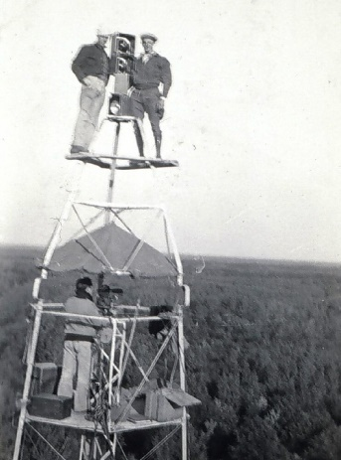
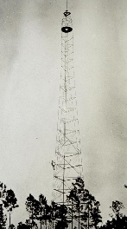
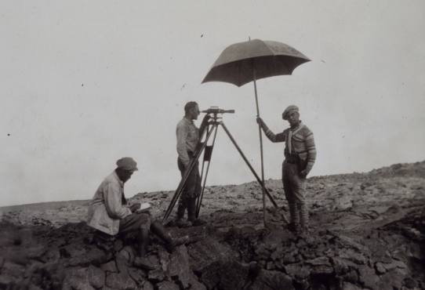
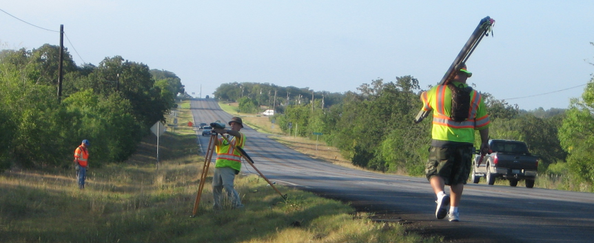
Marks – Historic Uses
Horizontal
Up high, long sights, Bilby Towers
Vertical
Low, flat (railroad ROWs), short sights
Not the highest priorities:
Convenience of access
Commonality between H & V

Slide 78
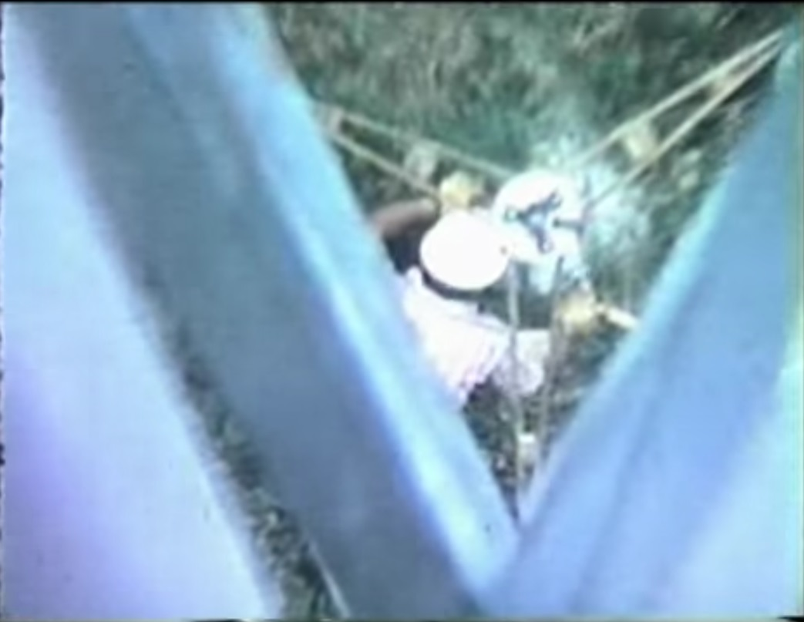
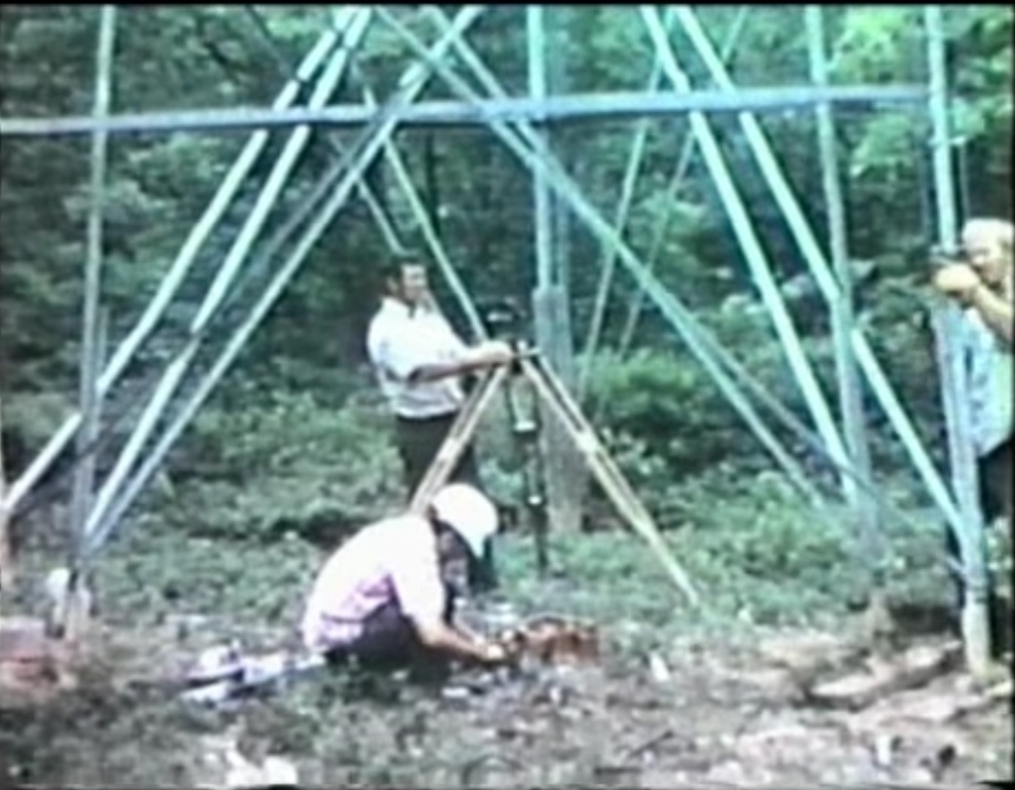
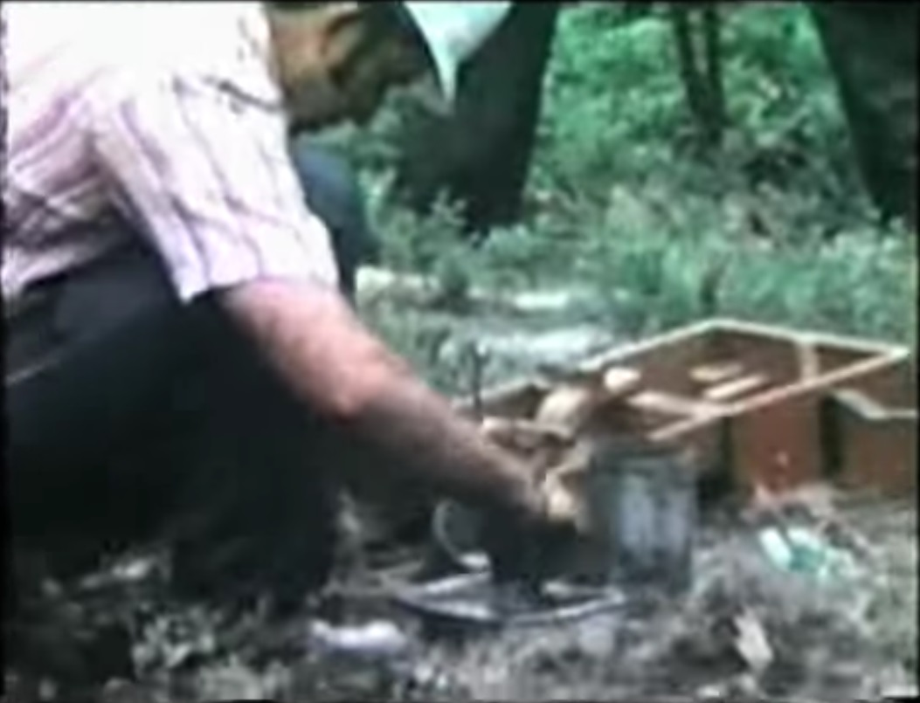
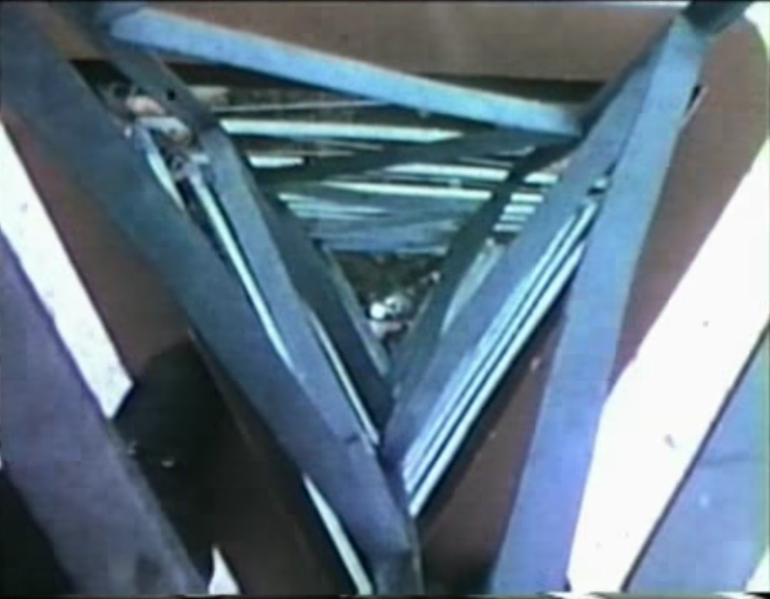

Bilby Towers: A lot of work for 1 mark…
Notes:
Use this slide to save about 20 Mb in the size of this PPT. If you have the space, insert the slide “Bilby Tower Animation” here (22 Mb by itself) for a better experience.
Note that the NAD 83 network consisted of over 270,000 such marks…it’s not clear how many of those were Bilby Tower builds (from 1927-1984), but the answer surely must be “tens of thousands” at least.
Video credit: Jim Lehman
https://www.youtube.com/watch?v=KAE2lA6mewo
https://www.youtube.com/watch?v=8cB1ygwza9w

Slide 79


…Especially when this is so easy!
PID: EZ0840

Slide 80

Marks in the NSRS 1816–2006
Watch for: 1849 CA Gold Rush 1895 Systematic Mapping of Seward’s Folly 1896 Transcontinental Arc of Triangulation (39th Parallel) 1901 Transcontinental Arc of Triangulation (98th Meridian) 1933 Public Works Administration 1950–1980 NAD 83
Project 1990s Statewide HARN and FBN Projects

Slide 81
Horizontal Datums / (Geometric) Reference Frames
What are they?
A coordinate system implied by points with coordinates
Parallels, meridians, and the geocenter are defined mathematically but don’t have a physical manifestation in the real world
Is there a difference?
Not really. It would be a waste of time and energy to debate an effectively academic question.

Slide 82
Horizontal Datums / (Geometric) Reference Frames
Realization is:
Realization is defined as the practical implementation of a concept
Coordinates assigned to points in a way that best represents the mathematically abstract definition
Coordinates come from geodetic surveys of the highest accuracy
Coordinates could stand unchanged for decades (NAD 27, NGVD 29 being the best known examples)
Piecemeal updates from re-surveys
To “personalize” is to make something personal.
To “realize” is making something real.
“Realization” is the process of making something real on the ground, in this case the concept of the datum.
There have been 4 realizations of NAD83 - 86, 96, 07, 11.
Notes:
Someone wanted “realization” to be time tagged, but that REALLY didn’t happen until the NAD 83(2011) epoch 2010.00 realization of NAD 83. All other ones were impossible to give a specific date for.
Before “global reference frames”, they were usually constrained by other locally determinable physical measurements:
Astronomic latitude/longitude

Slide 83
Horizontal Datums / (Geometric) Reference Frames
Historic Definitions and Roles
National datums were adjusted from large networks
Often fixed to one or more points in the nation
USSD and NAD 27: Meades Ranch
This meant plate rotation was effectively cancelled out
Space Age / International Efforts
BIH (Bureau international de l'heure)
IERS (International Earth Rotation [and Reference System] Service)
Service of the International Association of Geodesy (IAG)
Arbiters of the International Terrestrial Reference Frame (ITRF)

Slide 84
Horizontal Datums / (Geometric) Reference Frames
Ideal Frames
ITRF
Combination of four frames (SLR, VLBI, GNSS, DORIS)
IGS
Post-ITRF frame
Most accurate GNSS orbits are in this frame
Currently the NSRS is mathematically defined:
Three NAD 83 frames: North America, Pacific, Mariana plates
All 3 defined with respect to ITRF94 (same as ITRF96)
All other ITRFs defined with transformations between ITRFs

Slide 85

Issues
Geodetic control is usually affixed to a crust that is moving
Even so-called “plate fixed” frames are only as stable as:
The rigidity of a plate
The complete lack of subsidence or uplift

Slide 86
Addressing Issues
Abandon passive control entirely?
This would substantially(!) reduce work at NGS
Decision: Change their role and importance
Provide surveying guidance that is:
“mark free” or at least “mark-reduced”
promotes an attitude that marks are “temporary coordinate holders” and not “permanent coordinate holders”

Slide 87
Addressing Issues
Just adopt the ITRF?
Stop with the whole USA-centric, plate-fixed approach?
This would mean embracing 2cm of lat/lon change annually in CONUS (and more elsewhere!)
This would moderately reduce work at NGS that some viewed as archaic and unnecessary
Decision: Embrace the pre-eminence of the ITRF and also provide “USA specific” frames only as an after-the-fact derivative product. Lead the way toward a purely ITRF-based surveying and mapping world.

Slide 88
General Direction
Future details would come, but in 2007 the general direction was:
Replace both NAD 83 and NAVD 88, at the same time
Transition to a geoid-based vertical datum
Leverage the rise of GNSS and RTNs
Completely re-invent “bluebooking”
Reduce complexity
Retain ability to standardize geodetic survey files

Slide 89
intermission
Return at: 9:41

Slide 90
Geometric Reference Frames of the Modernized NSRS

Slide 91
Replacing the NAD 83s
The Old | The New
NAD 83 (2011) | NATRF2022 - The North American Terrestrial Reference Frame of 2022
NAD 83 (2011) | CATRF2022 - The Caribbean Terrestrial Reference Frame of 2022
NAD 83 (PA11) | PATRF2022 - The Pacific Terrestrial Reference Frame of 2022
NAD 83 (MA11) | MATRF2022 - The Mariana Terrestrial Reference Frame of 2022

Slide 92

Four Tectonic Plates
Notes:
-there’s four reference frames because there are four major tectonic plates within the NGS Area of Responsibility.
-As the National Geodetic Survey, we’re part of the DoC so we must cater to all US States and Territories
-thus we’ve got four tectonic plates in our Area of Operations, so four Ref Frames
-But…

Slide 93
The Terrestrial Reference Frames
All are global frames (no “boundary”)
This was true for the NAD 83s also, BTW
But each frame will rotate with one tectonic plate
Put another way: “The frame rotates so your coordinates don’t have to”

Slide 94

Euler Poles and “Plate-Fixed”
In the ITRF, many tectonic plates have a dominant motion: rotation
Euler Pole - point about which a plate rotates (yellow star)
NATRF2022 Euler Pole
Notes:
We say “NATRF2022” is “fixed” to the N.A. Plate, making it a “plate fixed” frame
-the frame is constant to itself, but rotating within ITRF, and moving in a different direction than the other 3 frames

Slide 95

ITRF2020: Constant Frame, Rotating Plate

Slide 96


“Plate-Fixed”
NATRF2020: Constant Frame, Rotating Plate

Slide 97

ITRF2020 or NATRF2022 — Your choice, just use EPP2022

Slide 98
The Relation of 5 Global Reference
Frames through Time
MATRF2022
NATRF2022
Rotation of North American Plate
Rotations are not to scale
PATRF2022
CATRF2022
Rotation of Pacific Plate
ITRF2020 frame
ITRF2020 frame through time
ITRF2020 frame
Rotation of Caribbean Plate
PATRF2022
Rotation of Mariana Plate
CATRF2022
NATRF2022
2020.00 : The time when
all four TRFs and
ITRF2020 are identical by definition.
MATRF2022
t = 2020.00 - Dt
(“the past”)
t = 2020.00 + Dt
(“the future”)

Slide 99
Preeminence of the ITRF
Decades as an ad-hoc international standard.
Recently adopted by the United Nations Committee of Experts on Global. Geospatial Information Management (UN-GGIM) as the Global Geodetic Reference Frame.
All geometric computations done in ITRF / XYZ.
Then transformed into the NSRS.
Notes:
U.N. (GGIM) - United Nations Commission on Global Geospatial Information Management
https://ggim.un.org/

Slide 100
Preeminence of ITRF
Rotation of the
North American Plate
North American Terrestrial Reference Frame of 2022 (NATRF2022)
Caribbean Terrestrial Reference Frame of 2022 (CATRF2022)
Pacific Terrestrial Reference Frame of 2022 (PATRF2022)
Mariana Terrestrial Reference Frame of 2022 (MATRF2022)
Rotation of the
Caribbean Plate
ITRF2020
Rotation of the
Pacific Plate
Rotation of the
Mariana Plate
EPP2022
EPP for “Euler Pole Parameters”
(a way of describing a plate’s rotation)

Slide 101
Embrace Time-Dependencies
Coordinates Change
Even in so-called “plate fixed” frames
Associate Coordinates with their Survey Epoch
Active control: daily computed coordinates
Fit a simple function to them through time
Currently linear. Non-linear in the future.
Passive Control: Coordinates only when the point was surveyed

Slide 102
Shift and Drift
When transitioning off of NAD 83, your coordinates will experience shift and drift
Shift: A one-time jump somewhere in the 0 to 4 meter range (latitude, longitude, ellipsoid height)
From fixing NAD 83’s non-geocentricity
Drift: Coordinates are now time-dependent. The shift will take you to 2020.00. Working at any other epoch means you must account for the drift (velocity) of your coordinates
As well as any other motions over time

Slide 103

Non-geocentricity of NAD83
ITRF2020
GRS80 ellipsoid
NAD83
GRS = Geodetic Reference System
Notes:
-we’re going to back up and get to the non-geocentricity, stay with me here
-so there’s a nice little ellipse representing the shape of the GRS80 reference ellipsoid
CLICK
-what’s GRS80? well, it’s a reference system (being a reference ellipsoid, a gravity model, and more).
-GRS80 in itself is not a datum, although you will see/hear some folks misinterpret that
CLICK
-now once you take that reference system/ellipsoid and you tie it to the origin of your choice… badda-bing!
-now you’ve got a datum (or reference frame)
CLICK
-in this case, we’re talking about that blue which is symbolizing an ellipsoid with it’s origin locked to the Center Mass of the earth
-which represents the ITRF2020
-you may be thinking “Jeff what is the ITRF?”… don’t worry we’ll get there for now the concept is more important
CLICK
-so now let’s look at how NAD83 compares, the orange there, see it’s shape is the same GRS80 ellipsoid… but with a different origin point
-not quite aligned to CM, but close… not bad, it was the 80s maaaan, they did the best they could!
-jokes aside, a pretty amazing feet to have only “missed the mark” by a few meters, they didn’t have the satellite technology or computer power we have back in the late 70s when the calcs for NAD83 were being run
-props to those folks!
CLICK

Slide 104
Non-geocentricity of NAD83
ITRF2020
GRS80 ellipsoid
NAD83
Notes:
--zooming in to setup for next slide—
-Let’s zoom in a little to examine that situation

Slide 105
Non-geocentricity of NAD83
Earth’s
Surface
h₂₀
h₈₃
NAD83
origin
ITRF2020
origin
GRS80
ellipsoid
~2.2 meters
Notes:
-so there’s one quarter of both the NAD83 and ITRF2020 ellipsoid
CLICK
-important to note that both are using the same geometry (size, shape), the GRS80 ellipsoid, just with a different origin
CLICK
-so that dark red [maroon if you will] arrow there on the bottom left, it symbolizes and greatly exaggerates the difference between those origins
CLICK

Slide 106
Non-geocentricity of NAD83
Earth’s
Surface
h₂₂
NAD83
ITRF2020
NATRF2022
Shift…
GRS80
ellipsoid
Notes:
-and we’ll visualize the plan to remove the non-egocentricity of NAD83 with a little animation
CLICK
-our orange NAD83 ellipsoid shift over to match up with out blue ITRF ellipsoid
-and now there we see the result in red, our new NATRF2022 ellipsoid
CLICK
-what do I like to point out here?
-we’re still utilizing the GRS80 reference ellipsoid as the basis for NATRF2022
-why? because the size and shape, well the scientists nailed it on that one, like I said earlier they just didn’t quite get the CM
CLICK

Slide 107





NAD 83(2011) epoch 2010.0 to NATRF2022 epoch 2020.00 (estimate)

Slide 108


Definitional Relationship
$${\left[\begin{matrix}X(t) \\ Y(t) \\ Z(t)\end{matrix}\right]}_{NATRF2022}=I+(t−2020.00){\left[\begin{matrix}0 & {\dot{\text{ω}}}_{X} & −{\dot{\text{ω}}}_{Y} \\ {−\dot{\text{ω}}}_{Z} & 0 & {\dot{\text{ω}}}_{X} \\ {\dot{\text{ω}}}_{Y} & {−\dot{\text{ω}}}_{X} & 0\end{matrix}\right]}_{N.A.}{\left[\begin{matrix}X(t) \\ Y(t) \\ Z(t)\end{matrix}\right]}_{ITRF2020}$$
Multiplying the 3x3 EPP2022 velocity matrix (at right) by the time since 2020.00 (when NATRF2022 and ITRF2020 were identical) and adding the identity matrix yields a 3x3 matrix which will change ITRF2020 XYZs into NATRF2022 XYZs, both at “t”
The EPP2022 model literally contains just 12 values (4 tectonic plates times 3 rotational velocities for each plate). Here we have “N.A.” for North American Plate.
The three microrotation rates, ${\dot{\text{ω}}}_{X}$, ${\dot{\text{ω}}}_{Y}$ and ${\dot{\text{ω}}}_{Z}$ are (very, very small) speeds we twist the ITRF2020’s X, Y and Z axes respectively, to simulate the rotation of the N.A. plate in the ITRF2020 frame
We end with XYZ values in NATRF2022, still at the same epoch “t” in which we started
All work is done in ITRF2020 XYZ coordinates first.
They are associated with the epoch of the data collection (survey) “t”

Slide 109

Definitional Relationship
$${\left[\begin{matrix}X(t) \\ Y(t) \\ Z(t)\end{matrix}\right]}_{NATRF2022}={R(t,t_{0})}_{N,I}{\left[\begin{matrix}X(t) \\ Y(t) \\ Z(t)\end{matrix}\right]}_{ITRF2020}$$
OPUS does everything
in ITRF2020 XYZ…
A simple 3x3 matrix from
EPP2022 (built into OPUS)…
And OPUS gives you coordinates in NATRF2022. Same epoch as ITRF2020.
Same goes for the other 3 frames.

Slide 110
Interesting factoids…
If t=2020.00, by definition, this is true: X(t)_{NATRF2022} = X(t)_{ITRF2020} Y(t)_{NATRF2022} = Y(t)_{ITRF2020} Z(t)_{NATRF2022} = Z(t)_{ITRF2020} | Which means that if t=2020.00, by definition, this is also true: φ(t)_{NATRF2022} = φ(t)_{ITRF2020} λ(t)_{NATRF2022} = λ(t)_{ITRF2020} h(t)_{NATRF2022} = h(t)_{ITRF2020}
And while, if t ≠ 2020.00, this is generally true: X(t)_{NATRF2022} ≠ X(t)_{ITRF2020} Y(t)_{NATRF2022} ≠ Y(t)_{ITRF2020} Z(t)_{NATRF2022} ≠ Z(t)_{ITRF2020} | Which means that if t ≠ 2020.00, this is generally true: φ(t)_{NATRF2022} ≠ φ(t)_{ITRF2020} λ(t)_{NATRF2022} ≠ λ(t)_{ITRF2020} But, interestingly, this is always true: h(t)_{NATRF2022} = h(t)_{ITRF2020}

Slide 111
Drift
What does it mean to provide time-dependent coordinates in 5 frames?
Let’s look at the known velocities of some active control stations in ITRF2020, NATRF2022, PATRF2022, CATRF2022 and MATRF2022

Slide 112

BSMK (North Dakota)

Slide 113

BSMK (North Dakota)
t₀=2020.0, when all five frames are identical
Note the time-dependent coordinate in latitude in NATRF2022 is stable! That means the NATRF2022 IFVM* for latitude will be ZERO for this point.
Notes:
* Intra-Frame Velocity Model: More on this later, but it is basically “all of the movement that is left over at a point after I take away the simple tectonic rotation of a plate”

Slide 114

BSMK (North Dakota)
Similarly, the time-dependent coordinate in longitude in NATRF2022 is stable! That means the NATRF2022 IFVM for longitude will be ZERO for this point.

Slide 115

BSMK (North Dakota)
However, in every frame, this point is subsiding! That will be captured in the ellipsoid height component of the IFVM for each frame.

Slide 116
ICT2 (Kansas)

Slide 117

ICT2 (Kansas)
Note the (SLIGHT) time-dependent movement of this Kansas point in latitude in NATRF2022! Such movement will be captured in the IFVM.

Slide 118

ICT2 (Kansas)
However, in longitude, this CORS is fairly stable in NATRF2022! Still, any deviation from stability would be in the IFVM.

Slide 119

ICT2 (Kansas)
All vertical motion is captured in the IFVM.

Slide 120
PIN1 (S. California)

Slide 121

PIN1 (S. California)
In latitude, S. California neither behaves like the NA plate nor the Pacific plate. These deviations from stability will be captured in IFVM2022.

Slide 122

PIN1 (S. California)
In longitude, S. California neither behaves like the NA plate nor the Pacific plate. These deviations from stability will be captured in IFVM2022.

Slide 123
What did all that mean?
Anyone can work in any frame anywhere
“Stable” time-dependent coordinates may look “constant” – don’t get complacent!
A slight drift, or one earthquake can upset that
Plate fixed frames are nice, but
Even in “stable” areas (Kansas, for instance) one cannot assume stability

Slide 124
Coordinates, Frames, Epochs, EPP2022 and IFVM2022
The next few slides will highlight the interactions between the ITRF, the four frames of the modernized NSRS, and how changing the frame and/or the epoch will be done with EPP2022, IFVM2022 or both.

Slide 125
Definitive Implementation and Interaction of EPP2022 & IFVM2022
XYZ
PATRF2022
ep. 2028.048
EPP2022
XYZ
ITRF2020
ep. 2028.048
EPP2022
XYZ
NATRF2022
ep. 2028.048
XYZ2PLH
XYZ2PLH
XYZ2PLH
φλh
PATRF2022
ep. 2028.048
φλh
ITRF2020
ep. 2028.048
φλh
NATRF2022
ep. 2028.048
Working in a common epoch (2028.048)
Notes:
This version of the slide is animated to show JUST how EPP2022 changes frames, without changing epochs. Note that XYZ2PLH is a module within NCAT and VDatum.
CLICK
Take a XYZ coordinate in ITRF2020 epoch 2028.048.
CLICK
Apply XYZ2PLH to convert it to flh coordinate in ITRF2020 epoch 2028.048
CLICK
We could also apply EPP2022 (CLICK) to convert it to XYZ coordinate in NATRF2022 epoch 2028.048 and then apply XYZ2PLH to convert it to flh coordinate in NATRF2022 epoch 2028.048
CLICK
And, we could also apply EPP2022 (CLICK to convert it to XYZ coordinate in PATRF2022 epoch 2028.048 and then apply XYZ2PLH to convert it to flh coordinate in PATRF2022 epoch 2028.048

Slide 126


Coordinates, Frames, Epochs, EPP2022 and IFVM2022
A survey done Jan 1, 2023 and reported at epoch 2020.0
New Survey (same point) done Jan 1, 2030
Position of point in NATRF2022(2030)
Position of point in NATRF2022(2020)
If IFVM = 0, then NATRF2022 (2030) = NATRF2022 (2020)
(V)
Position from 2023 survey NATRF2022 (2020.0)
ITRF2020 (2020.0)
ITRF2020 (2030.0)
IFVM 2030-2020
NATRF2022
(2020.0)
Epp2022
fframe
NATRF2022 (2030)
fEpoch
(H)
Notes:
At 2020, ITRF and NATRF are identical.
CLICK
As time goes on the North American plate moves, resulting in new ITRF coordinates at epoch (say 2030) for the same point.
CLICK
If I remove 10 years of plate motion (ITRF velocity) it puts me back where NATRF used to be....EXCEPT, there has been local motion.
That is why we call the it NATRF epoch 2030, because it is where NATRF IS in 2030.
CLICK
We now have to apply IFVM to get back to 2020, or any other date relative to NATRF.
* EPP2022 changes the FRAME
* IFVM2022 changes the EPOCH

Slide 127
Definitive Implementation and Interaction of EPP2022 & IFVM2022
Working in a common epoch (2039.704)
φλh
PATRF2022
ep. 2039.704
φλh
ITRF2020
ep. 2039.704
φλh
NATRF2022
ep. 2039.704
XYZ2PLH
XYZ2PLH
XYZ2PLH
XYZ
PATRF2022
ep. 2039.704
EPP2022
XYZ
ITRF2020
ep. 2039.704
EPP2022
XYZ
NATRF2022
ep. 2039.704
Notes:
This version of the slide is animated to show JUST how EPP2022 changes frames, without changing epochs. Note that XYZ2PLH is a module within NCAT and VDatum. Same as previous slide, but with a different epoch.

Slide 128
Definitive Implementation and Interaction of EPP2022 & IFVM2022
XYZ
ITRF2020
ep. 2028.048
Working across epochs in the ITRF2020 frame
XYZ2PLH
φλh
ITRF2020
ep. 2028.048
IFVM2022
(master model)
φλh
ITRF2020
ep. 2039.704
XYZ2PLH
XYZ
ITRF2020
ep. 2039.704
Notes:
This version of the slide is animated to show JUST how IFVM2022 will change the EPOCH of ITRF without changing the FRAME.
Since IFVM2022 works in Lat/Lon, we apply XYZ2PLH in each epoch.
CLICK
CLICK
Then apply IFVM2022 to move between EPOCHS
CLICK

Slide 129
Definitive Implementation and Interaction of EPP2022 & IFVM2022
XYZ
ITRF2020
ep. 2028.048
If “everything geometric is done in ITRF XYZ”, then why isn’t IFVM2022 built with this connection?
XYZ2PLH
Working across epochs in the ITRF2020 frame
?
φλh
ITRF2020
ep. 2028.048
IFVM2022
(master model)
Answer: Because the crustal movements in φ,λ are much different than h, and all models of crustal motion are divided that way.
φλh
ITRF2020
ep. 2039.704
?
XYZ2PLH
XYZ
ITRF2020
ep. 2039.704
Notes:
If “everything is done in ITRF XYZ, why didn’t NGS propose the IFVM be set up this way?”
CLICK
CLICK
It is a good and reasonable question. The answer is: the crust of the Earth moves in vastly different ways horizontally than vertically. Horizontally things tend to be very large, consistent horizontal motions on the scale of hundreds of square kilometers up to continental scale. On the vertical side, things can be very localized, even down to a square km or so. Every good study of crustal movement separates the signals by “horizontal” (lat, lon) and “vertical” (eht) due to their generally de-coupled nature. If we were to build the IFVM in XYZ, that decoupling (and the simplicity and accuracy which comes with it) is lost. Therefore NGS will break with their “everything geometric is done in XYZ” rule, specifically for IFVM2022.

Slide 130
Definitive Implementation and Interaction of EPP2022 & IFVM2022
XYZ
PATRF2022
ep. 2028.048
EPP2022
XYZ
ITRF2020
ep. 2028.048
EPP2022
XYZ
NATRF2022
ep. 2028.048
XYZ2PLH
XYZ2PLH
XYZ2PLH
φλh
PATRF2022
ep. 2028.048
φλh
ITRF2020
ep. 2028.048
φλh
NATRF2022
ep. 2028.048
Drats! A connection here
would be useful!
IFVM2022
(master model)
Drats! A connection here
would be useful!
φλh
PATRF2022
ep. 2039.704
φλh
ITRF2020
ep. 2039.704
φλh
NATRF2022
ep. 2039.704
XYZ2PLH
XYZ2PLH
XYZ2PLH
XYZ
PATRF2022
ep. 2039.704
XYZ
ITRF2020
ep. 2039.704
XYZ
NATRF2022
ep. 2039.704
EPP2022
EPP2022
Notes:
This version of the slide is animated to show the interaction of IFVM2022 and EPP2022, without the use of “virtual” grids.
CLICK
It takes the example of someone who prefers to work in lat/lon/eht NATRF2022, and did so in 2039.704, who then needs to compare their work against another surveyor’s work, on the same point
CLICK
where that other surveyor preferred to work in PATRF2022 and did so in 2028.048.
And, let’s say that our NATRF2022 user was given only the PATRF2022, ep. 2028.048 coordinates in lat/lon/eht, and the PATRF2022 surveyor saved no other information.
What NGS tools will allow for this comparison?
CLICK CLICK
Well, we can’t go that way!
13 CLICKS slowly
That’s a run of 7 different programs to go from NATRF2022 ep 2039.704 to PATRF2022 ep 2028.048.
Perhaps that’s to be expected, but what if it’s just a simple matter of changing epochs?...See next slide…

Slide 131
Definitive Implementation and Interaction of EPP2022 & IFVM2022
XYZ
ITRF2020
ep. 2028.048
EPP2022
XYZ
NATRF2022
ep. 2028.048
XYZ2PLH
XYZ2PLH
φλh
ITRF2020
ep. 2028.048
φλh
NATRF2022
ep. 2028.048
IFVM2022
(master model)
Drats! A connection here
would be useful!
φλh
ITRF2020
ep. 2039.704
φλh
NATRF2022
ep. 2039.704
XYZ2PLH
XYZ2PLH
XYZ
ITRF2020
ep. 2039.704
XYZ
NATRF2022
ep. 2039.704
EPP2022
Notes:
Say I just need to compare across epochs. For example: NATRF2022 lat/lon/eht given in two different survey epochs.
CLICK CLICK CLICK
We can’t go that way!
8 CLICKs slowly
That’s *7* programs to run just to change epochs.
Seems unnecessary!
Why the long path?

Slide 132
Why the long path?
Uniqueness
If there are two “paths” between input and output in our software, the potential for disagreeing answers will cause difficulties.
However, running 7 transformations solely to change the epoch, and not the frame, seems not only wasteful, but fixable without sacrificing uniqueness.
Notes:
Uniqueness!
If there are two “paths” between input and output in our software, the potential for disagreeing answers will cause difficulties.
However, running 7 transformations solely to change the epoch, and not the frame, seems not only wasteful, but fixable without sacrificing uniqueness.

Slide 133
Definitive Implementation and Interaction of EPP2022 & IFVM2022
XYZ
PATRF2022
ep. 2028.048
EPP2022
XYZ
ITRF2020
ep. 2028.048
EPP2022
XYZ
NATRF2022
ep. 2028.048
XYZ2PLH
XYZ2PLH
XYZ2PLH
φλh
PATRF2022
ep. 2028.048
φλh
ITRF2020
ep. 2028.048
φλh
NATRF2022
ep. 2028.048
IFVM2022
(“subsidiary” PATRF2022 model)
IFVM2022
(master model)
IFVM2022
(“subsidiary” NATRF2022 model)
φλh
PATRF2022
ep. 2039.704
φλh
ITRF2020
ep. 2039.704
φλh
NATRF2022
ep. 2039.704
XYZ2PLH
XYZ2PLH
XYZ2PLH
XYZ
PATRF2022
ep. 2039.704
XYZ
ITRF2020
ep. 2039.704
XYZ
NATRF2022
ep. 2039.704
EPP2022
EPP2022
Notes:
This version of the slide is animated to show JUST how EPP2022 changes frames, without changing epochs
We’d like to find a way to change EPOCHS directly within a given FRAME
CLICK
without the long path through ITRF etc.
CLICK CLICK
We need this capability in NATRF, PATRF etc.

Slide 134
“Subsidiary” IFVM2022 Models?
The master IFVM2022 model will be made in ITRF2020
But without loss of accuracy, “subsidiary” models will be made for the four NSRS frames:
-
IFVM2022
(“subsidiary” NATRF2022 model)
IFVM2022
(ITRF master model)
EPP2022
(ITRF to NATRF2022)
=
All motion in ITRF
between two epochs
Δφ,Δλ,Δh
Plate rotational motion
of North American plate
between two epochs
Δφ,Δλ
Residual motion in ITRF,
or (equivalently)
All motion in NATRF2022,
between two epochs
Δφ,Δλ,Δh
Notes:
The Master IFVM2022 model will be made in ITRF2020
But without loss of accuracy, “subsidiary” models will be made for the four NSRS frames:
CLICK First, all motion in ITRF between two epochs will be captured in the Master IFVM2022 Model.
CLICK CLICK
Second, the EPP2022 rotation model will remove the systematic horizontal motions
CLICK CLICK
Third, Leaving all the vertical motions and the residual (small) horizontal motions in the “subsidiary” model(s)

Slide 135
IFVM2022 “Regions”
On release, IFVM2022 will work in 6 regions, with these names and geographic borders:
Contrast this against NATRF2022, PATRF2022, CATRF2022 and MATRF2022 which are global frames, despite being built to minimize rotations of one particular tectonic plate.
Region | North | South | West | East
CONUS | 50° | 24° | 235° | 294°
Alaska | 73° | 50° | 172° | 232°
Hawaii | 23° | 18° | 199° | 206°
PR/VI | 19° | 17° | 291° | 296°
Guam/CNMI | 22° | 12° | 143° | 147°
Am. Samoa | -13° | -16° | 188° | 193°
Notes:
The lesson: if you’re using the modernized NSRS outside of the above 6 regions, you won’t have access to the detailed crustal motions of IFVM2022.
CLICK
You will only have access to the plate rotations embodied in EPP2022.

Slide 136
What will that look like?
Without the more complicated questions of:
Earthquakes
Velocities that change over time
Non-linear movements
Let’s look at what IFVM2022 velocities will look like in different frames and regions…
Notes:
Without discussing the more complicated questions of:
- Earthquakes
- Velocities that change over time
- Non-linear movements
Let’s look at what IFVM2022 velocities will look like in different frames and regions…

Slide 137

IFVM2022 Velocities – ITRF2020/CONUS
Notes:
This diagram of CONUS shows the IFVM2022 velocities expressed in the ITRF2020 Frame.
Note the arrows are about 20 mm/yr
It can generally be interpreted as “at what velocity are points in CONUS moving relative to the ITRF Frame?”

Slide 138

IFVM2022 Velocities – NATRF2022/CONUS
Notes:
This diagram of CONUS shows the IFVM2022 velocities expressed in the NATRF2022 Frame.
Note that even in “stable North America”, these velocities are not absolutely zero!
The IFVM2022 model will contain these tiny deviations from simple plate rotation!
It can generally be interpreted as “at what velocity are points in CONUS moving relative to the North American plate?”

Slide 139

IFVM2022 Velocities – PATRF2022/CONUS
Notes:
This diagram of CONUS shows the IFVM2022 velocities expressed in the PATRF2022 Frame.
Not of much use, except note that we MAY just have done something useful in the Southern California region…
It can generally be interpreted as “at what velocity are points in CONUS moving relative to the Pacific plate?

Slide 140

IFVM2022 Velocities – CATRF2022/CONUS
Notes:
This diagram of CONUS shows the IFVM2022 velocities expressed in the CATRF2022 Frame.
This slide is useful as a curiosity
It can generally be interpreted as “at what velocity are points in CONUS moving relative to the Caribbean plate?”

Slide 141

IFVM2022 Velocities – MATRF2022/CONUS
Notes:
This diagram of CONUS shows the IFVM2022 velocities expressed in the MATRF2022 Frame.
This slide is useful as a curiosity.
They can generally be interpreted as “at what velocity are points in CONUS moving relative to the Mariana plate?”

Slide 142

Geometric Frames
Five frames
ITRF: If you can accept annual change in latitude/longitude
N/P/C/MATRF2022 if you cannot
All geocentric
EPP2022 connects all five frames
IFVM2022 connects epochs within each frame
Ellipsoid heights will always reflect uplift/subsidence

Slide 143
Access to the New Frames

Slide 144



What “Access” to the NSRS Means
Until 1980, NGS offered “passive control”
And one definitive coordinate set for each one
1.6 M marks
More recently, NGS provides data and coordinate functions with NOAA CORS Network (most were not installed by NGS)
And one definitive coordinate function for each one
And the software (PAGES / OPUS) to differentially position your GPS receiver to each station
2000+ stations currently
Notes:
CLICK CLICK
Until 1980, NGS offered “passive control”*
* Infrequently observed marks
CLICK CLICK CLICK CLICK
And one definitive coordinate set for each one
1.6 M marks
CLICK CLICK CLICK CLICK
More recently, NGS provides data and coordinate functions with NOAA CORS Network (most were not installed by NGS)
And one definitive coordinate function for each one
CLICK
And the software (PAGES / OPUS) to differentially position your GPS receiver to each station
CLICK
2000+ stations currently

Slide 145
What “Access” to the NSRS Will Mean
Very similar philosophically:
The NSRS remains “geodetic control” for you to “access”
Geospatial information and metadata about various points
Passive control will exist…we aren’t getting out bulldozers and shovels
But gone are the days of getting “the coordinate” on a point from a “datasheet”
Notes:
CLICK
Very similar philosophically:
CLICK
The NSRS remains “geodetic control” for you to “access”
CLICK
Geospatial information and metadata about various points
CLICK
Passive control will exist…we aren’t getting out bulldozers and shovels
CLICK
But gone are the days of getting “the coordinate” on a point from a “datasheet”
Note to the audience that “OPUS” replaces everything called “OPUS-<something>” in the past.

Slide 146
What “Access” to the NSRS Will Mean
Very different practically
Information: from the Data Delivery System
Graphics (pictures, graphs, maps)
Computations: OPUS
Do-it-all (mark reporting, positioning, adjustments, etc)
Heavy emphasis on using GNSS to get to the NSRS
All constellations will be supported
Real time helpful CORS information (data availability & quality)
Use new GNSS
Or, maybe, some “trusted” passive control
Otherwise, your preliminary coordinates may say “not NSRS coordinates”
Notes:
CLICK
Very different practically
CLICK
Information: from the Data Delivery System (DDS)
CLICK
Graphics (pictures, graphs, maps)
CLICK
Computations: using OPUS – note that “OPUS” replaces everything called “OPUS-<something>” in the past.
CLICK
Do-it-all (mark reporting, positioning, adjustments, etc)
CLICK
Heavy emphasis on using GNSS to get to the NSRS
CLICK
All constellations will be supported
CLICK
Real time helpful CORS information (data availability & quality)
CLICK
Use new GNSS
CLICK
Or, maybe, some “trusted” passive control
CLICK
Otherwise, your preliminary coordinates may say “not NSRS coordinates”
Note to the audience that “OPUS” replaces everything called “OPUS-<something>” in the past.

Slide 147





Multi-GNSS
Currently, NGS only processes GPS data
Program for the Adjustment of Ephemerides (PAGES) software is being replace with multi-GNSS capable software called M-PAGES
Multi-GNSS capability expected in OPUS in 2022
US - GPS
Russia - GLONASS
EU - Galileo
China - Beidou
Japan - QZSS
Notes:
* The GNSS satellite is a “mark” of a sort, but it is NOT attached to Earth’s crust. Still, it’s a physical structure whose job is to hold a point, so we hand wave a little and jam it under the definition of “mark”
* Broadcast locations (ephemeris) and time (clocks) are good to within a few meters; rapid or final products calculated by the IGS (which NGS contributes to) are able to position the satellites to 3-4 cm about 2 weeks after the fact. Nice teaching opportunity for orbits/clocks!

Slide 148



Coming soon: RTN Vectors to OPUS-Projects
LEGEND
CORS
User Mark
Processed Vector (OPUS-Projects)
Uploaded Vector
Upload Vectors
Notes:
RTK Vector inclusion will proceed along this path.
CLICK
Upload data files for Base Stations
Upload data files for Rover Marks
CLICK
Process vectors from CORS to Base Marks, then from Base Marks to Rover Marks
CLICK
Set up Adjustment
CLICK
Review and Submit to NGS

Slide 149
Conversion? Transformation?
Historically NGS has been inconsistent with these two words. Going forward, we will use them as:
Conversion: Changing the type of coordinate without changing the datum or frame
e.g. change NAD 83(1986) latitude and longitude to NAD 83(1986) State Plane Coordinates
Transformation: Changing the datum or frame, without changing the type of coordinate
e.g. changing an NAD 27 latitude & longitude to an NAD 83(1986) latitude & longitude
So, for example, “NADCON” which transforms coordinates between datums really should have been called “NADTRAN.” C’est la vie.
Notes:
CLICK
Historically NGS has been inconsistent with these two words. Going forward, we will use them as:
Conversion: Changing the type of coordinate without changing the datum or frame
e.g. change NAD 83(1986) latitude and longitude to NAD 83(1986) State Plane Coordinates
Transformation: Changing the datum or frame, without changing the type of coordinate
e.g. changing an NAD 27 latitude & longitude to an NAD 83(1986) latitude & longitude
CLICK
So, for example, “NADCON” which transforms coordinates between datums really should have been called “NADTRAN.” C’est la vie.

Slide 150
Conversions
NGS has had many stand-alone computer programs for coordinate conversions.
All of these are now integrated together inside NCAT (NGS Coordinate Conversion and Transformation Tool) – see later slides
No datum changes are shown here
φ, λ, h
xyz2plh
SPC83
X, Y, Z
SPC
USNG
UTMS
USNG
UTM
USNG
Notes:
NGS has had many stand-alone computer programs for coordinate conversions.
All of these are now integrated together inside NCAT (NGS Coordinate Conversion and Transformation Tool) – see later slides
No datum changes are shown here

Slide 151
Region: CONUS
X, Y, Z
φ, λ, h
X, Y, Z
SPC
φ, λ, h
NATRF2022
epoch 2020.00
UTM
USSD
USNG
UTM
Conversions are BLACK lines
Transformations are RED lines
φ, λ, h
φ, λ, h
NAD 27
NAD 83 (2011)
epoch 2010.00
X, Y, Z
SPC
X, Y, Z
SPC
The NGS Coordinate Conversion and Transformation Tool (NCAT) is the NGS tool that provides conversions and transformations
USNG
UTM
Existing NADCON connections in RED
USNG
UTM
NAD 83 (NSRS2007)
φ, λ, h
NAD 83 (1986)
φ, λ, h
NAD 83 (FBN)
NAD 83 (HARN)
φ, λ, h
X, Y, Z
SPC
X, Y, Z
SPC
φ, λ, h
USNG
UTM
USNG
UTM
X, Y, Z
SPC
X, Y, Z
SPC
USNG
UTM
USNG
UTM
Notes:
9 CLICKS slowly
RED are “transformations”. Black are “conversions”. ALL are inside of NCAT.
2 CLICKS slowly
When it is released, NATRF2022 will be added to NCAT.

Slide 152
Modernization News

Slide 153
NSRS Modernization: DELAY
It’s official: we are delayed beyond 2022
On June 23, 2020, this message was rolled out via:
NGS Web Page
NSRS Modernization News Special Issue
Granicus Announcement
Notifications to NSPS, AAGS, FGDC/FGCS
Notes:
It’s official: we are delayed beyond 2022
On June 23, 2020, this message was rolled out via:
NGS Web Page
NSRS Modernization News Special Issue
Granicus Announcement
Notifications to NSPS, AAGS, FGDC/FGCS

Slide 154
NSRS Modernization: DELAY
A list of FAQs is available. Some summary highlights:
Why are we delayed?
GRAV-D issues (COVID-19, airspace, unforeseen maintenance)
Personnel issues (Losses, hiring issues)
How long is the delay?
Unknown. Years.
Will names change?
No, “GEOID2022”, “NATRF2022”, etc. will remain the same
Notes:
A list of FAQs is available. Some summary highlights:
Why are we delayed?
GRAV-D issues (COVID-19, airspace, unforeseen maintenance)
Personnel issues (Losses, hiring issues, probably some “burn out” too)
How long is the delay?
Unknown. Years.
No, “GEOID2022”, “NATRF2022”, etc. will remain the same

Slide 155



Modernizing the NSRS
The “blueprint” documents: Your best source for information
All three documents are being updated and re-released in 2021!!
Geometric:
Sep 2017
NOAA TR NOS NGS 62
32 pages
Geopotential:
Nov 2017
NOAA TR NOS NGS 64
41 pages
Working in the
Modernized NSRS:
April 2019
NOAA TR NOS NGS 67
77 pages

Slide 156
SPCS2022
Stakeholders can request and propose preferences
Proposal and request deadline was March 31, 2020
Can still change/add/remove zones after 2022
Deadline for submitting completed designs is March, 31, 2021
See SPCS2022 policy and procedures for details https://geodesy.noaa.gov/SPCS/policy.shtml
Many states requested and proposed preferences
All zone designs will be finalized in 2021
Can change/add/remove zones after official rollout
Notes:
The main difference with SPCS 83 (and SPCS 27) is that SPCS2022 zones will be designed to minimize linear distortion at the topographic surface, rather than the ellipsoid surface.
NGS will design a statewide zone for every state.
NGS will also design “default” zones for states if there is no consensus input from stakeholders requesting or proposing something different.
For nearly all states, a default zone has the same extents and projection type as SPCS 83. So they will “look” a lot like SPCS 83 zones, but with less linear distortion at the topographic surface. For states with a single SPCS 83 zone (e.g., North Carolina, Maryland, Vermont, etc.), the default zone is the same as the statewide zone.
A state can have a maximum of 3 zone “layers”, with limitations.
For all states, one layer will be the statewide zone. A state can also have 0, 1, or 2 multiple-zone layers.
About a dozen states will have only 1 layer (a statewide zone).
Most states will have 2 layers (a statewide zone plus one multiple-zone layers).
A few states will also have an additional multiple zone layer with partial state coverage. This is intended for mountainous states, so that “low distortion” coverage can be achieved in areas where needed (e.g., valleys rather than mountain tops).
Within a multiple zone layer, none of the zones can overlap.
Only one multiple-zone layer can provide complete state coverage, and only one multiple-zone layer can provide partial state coverage.
The deadline for state stakeholders to make requests and proposals is 3/31/2020 (which will likely have passed by the time this presentation is given).
However, after implementation of the 2022 NSRS Modernization (including SPCS2022), stakeholders can request or propose changes to SPCS2022
For more information on this (and other details about SPCS2022), refer to the SPCS2022 policy and procedures available on the NGS website.

Slide 157
Bye, bye, U.S. survey foot…
In modernized NSRS, NGS will support only one definition of the “foot”
Previously called the “international foot”
Now, just the “foot”
1 foot = 0.3048 meter (exact)
However
Recommend using term “international foot” when there is potential for confusion with other foot
NGS will continue to support U.S. survey foot for legacy applications (e.g., SPCS 83 and 27)
Notes:
Final Determination FRN sent out October 5, 2020
https://www.federalregister.gov/documents/2020/10/05/2020-21902/deprecation-of-the-united-states-us-survey-foot

Slide 158
New Types of Coordinates

Slide 159
New Types of Coordinates
NGS anticipates that 5 types of coordinates will be used in the NSRS. They are:
Reported
OPUS
Survey Epoch
Reference Epoch
Active
Notes:
NGS anticipates that 5 types of coordinates will be used in the NSRS.
These are
Reported
OPUS
Survey epoch
Reference Epoch
Active

Slide 160
New Types of Coordinates
Reported
“These are from any source where the coordinate is directly reported to NGS without the data necessary for NGS to replicate the coordinate.”
Scaled from a map
Transformed using NCAT or VDatum
Smartphone
Reported directly from an RTK rover without data files
Notes:
Reported
CLICK
“These are from any source where the coordinate is directly reported to NGS without the data necessary for NGS to replicate the coordinate.”
CLICK
Scaled from a map
CLICK
Transformed using NCAT or VDatum
CLICK
Smartphone
CLICK
Reported directly from an RTK rover without data files

Slide 161


Reported Coordinates
Notes:
Reported Coordinates could be captured with a smartphone, perhaps with a photo, as part of a mark recovery.
CLICK CLICK CLICK

Slide 162

Speaking of Smartphones…
NGS has a new mobile-friendly mark recovery webpage. Please try it out!
https://www.ngs.noaa.gov/cgi-bin/mark_recovery_form.prl
Notes:
NGS has a new mobile-friendly mark recovery webpage. Please try it out!

Slide 163
Buyer Beware!
Reported coordinates might be very wrong!
Reported in NAD 27 or NAD 83 or WGS 84
Systematic Error: 2–100 meters
Scaled off of a USGS topographic map
Random Error: ± 600 meters
Smartphone
Random Error: ± 10–50 meters
NGS will show you reported coordinates
But their function is to get you “in the neighborhood” of a mark, not to use as geodetic control!
Notes:
Reported coordinates might be very wrong!
Reported in NAD 27 or NAD 83 or WGS 84
Systematic Error: 2–100 meters
Scaled off of a USGS topographic map
Random Error: ± 600 meters
Smartphone
Random Error: ± 10–50 meters
NGS will show you reported coordinates
But their function is to get you “in the neighborhood” of a mark, not to use as geodetic control!

Slide 164
New Types of Coordinates
OPUS
“These are coordinates at any epoch the user wishes to use that have been computed by that user in OPUS”
User-computed values, such as they might get today from either OPUS-S or OPUS-Projects
“OPUS” coordinates are the only coordinates a user will get directly from OPUS
NGS will not evaluate your OPUS coordinates!
Notes:
NOTE: This definition disagrees with Blueprint Part 3. That is because in BP3 we didn’t consider what would happen if a user wanted to adjust everything in their survey to some epoch different from when the data were collected. This new definition takes that into account and should go into an update of BP3.
Preliminary Coordinates
CLICK
“These are coordinates at any epoch the user wishes to use that have been computed by that user in OPUS”
CLICK
User-computed values, such as they might get today from either OPUS-S or OPUS-Projects
CLICK
“Preliminary” coordinates are the only coordinates a user will get directly from OPUS

Slide 165
New Types of Coordinates
OPUS coordinates may also come with the label “tied to the NSRS”
Only if a user restricts their computations to OPUS-recommended constraints
Users who deviate from OPUS-recommended constraints can still perform computations and will get OPUS coordinates, but they will not be “tied to the NSRS”, nor have any NSRS label at all.
In neither case will OPUS coordinates be considered “part of the NSRS” however.
That moniker is restricted to NGS-computed coordinates available from the NSRS database, such as survey epoch coordinates (SECs), reference epoch coordinates (RECs) and active coordinates (ACs). See next slides.

Slide 166
New Types of Coordinates
Reference epoch coordinates (RECs)
“These are coordinates which have been estimated by NGS, from time-dependent age-limited historic survey data, CORS coordinate functions and an intra-frame velocity model, at an official NSRS reference epoch
NAD 83(2011) epoch 2010.00 (sort of) would’ve fallen under this category
These will be computed by NGS every 5 or 10 years
On a schedule 2–3 years past the reference epoch
2020.00 coordinates are computed in CY 2022, etc
Notes:
Time-limited: NGS is considering limiting how far back we reach in order to compute RECs. While horizontal motions are well known within many crustal motion models (like IFVM2022 will be), vertical motions are not. And since NGS’s intent is to put out RECs only for trusted points, and only for as long as those points ARE trusted (in all 3 dimensions), a time-limit for how far back to reach is definitely one way to keep the coordinates trusted.

Slide 167
New Types of Coordinates
Survey epoch coordinates (SECs)
“These are coordinates computed by NGS using submitted data and metadata, checked and adjusted and referenced to distinct epochs through time.”
These represent the best estimates NGS has of the time-dependent coordinates at any mark
Adjusting multiple surveys in timespans called “adjustment windows”, to a single epoch within that window.
Initial plan: 4 weeks for GNSS; 1 year for leveling
Notes:
Survey epoch
CLICK
“These are coordinates computed by NGS using submitted data and metadata, checked and adjusted and referenced to distinct epochs through time.”
CLICK
These represent the best estimates NGS has of the time-dependent coordinates at any mark

Slide 168
More on SECs and RECs
At passive control
SECs: adjusted to a midpoint epoch near the survey
(4 weeks for GNSS; 1 year for leveling; etc)
RECs: adjusted to a ref. epoch (2020.00, etc.)
REC adjustments will include:
Some age-limited span of data
If that age-limit were 10 years prior and 2 years post R.E….
Then 2020.00 RECs come from data spanning 2010.00 to 2021.99999
Exact age-limit won’t be known until we start experimenting in 2022 with the 2020.00 REC adjustments
Notes:
At passive control:
Final Discrete Coordinates or FDCs: are adjusted to a midpoint epoch near the survey
(GPS month for GNSS; 1 year for leveling; etc)
Reference Epoch Coordinates or RECs: are adjusted to a ref. epoch (2020.00, etc.)
REC adjustments will include:
Some age-limited span of data
If that age-limit were 10 years prior and 2 years post R.E….
Then 2020.00 RECs come from data spanning 2010.00 to 2021.99999
Exact age-limit won’t be known until we start experimenting in 2022 with the 2020.00 REC adjustments

Slide 169
New Types of Coordinates
Active coordinates (ACs)
Not discrete, but rather a function through time assigned to some point
At a CORS GRP*, they will be the coordinate function
Which will be generated by a “fit” to regularly computed coordinates on a TBD basis, perhaps daily, perhaps weekly
These daily or weekly coordinates will not generally be used as geodetic control by themselves
* Recall this is the physical point to which coordinates refer at a station like a CORS
Notes:
Active Coordinates
CLICK
Not discrete, but rather a function through time assigned to some point
CLICK
At a CORS GRP*, they will be the coordinate function
CLICK
* Recall this is the physical point to which coordinates refer at a station like a CORS
CLICK
The “coordinate function” be generated by a “fit” to regularly computed coordinates on a TBD basis, perhaps daily, perhaps weekly
CLICK
These daily or weekly coordinates will not generally be used as geodetic control by themselves

Slide 170

CORS Coordinate Functions… (AKA “Active coordinates”)
A typical “CORS coordinate
file” available from NGS
Just one set of coordinates
and just one set of
velocities are given…
…while this is good and useful information, it hides the true nature of the coordinate function.
Notes:
CORS Coordinate Functions
A typical “CORS coordinate file” available from NGS
CLICK CLICK
Shows just one set of coordinates and just one set of velocities.
…and while this is good and useful information, it hides the true nature of the coordinate function.

Slide 171
Coordinates
Five types:
Survey Epoch: “Time dependent coordinates”
Reference Epoch: “Estimated at 2020, 2025, 2030, …”
Reported: Good for finding a point somewhere on Earth.
Not to be used as geodetic control
OPUS: Computed by you, and as accurate or inaccurate as the choices you make
Tied to the NSRS if you follow OPUS recommendations
Active: Continuous functions at a CORS

Slide 172




Online Resources
Monthly webinar series
All webinars are recorded and available online
Online lessons
Video library
Publication library
https://geodesy.noaa.gov/

Slide 173


GPS on Bench Marks: Crowdsourcing Data for Better Models and Tools
NGS provides a prioritized list of marks where new data will most benefit the local accuracy of national scale models and tools such as GEOID18 and the 2022 Transformation Tool
Who: Federal and State government agencies, universities, and private sector firms
What: Mark Recovery Reports & Sharing GPS Observations
2022 Transformation Tool Campaign
National Coverage @ 10km spacing – ideal resolution for data to develop a national scale transformation tool
Local Densification @ 2km spacing – Allows partners to collect higher density data and increase local accuracy in areas they work
Priority Marks Web Map
Transformation Tool Campaign Progress Dashboard

Slide 174
Summary
NGS is modernizing the National Spatial Reference System, including creating 4 new plate-fixed terrestrial reference frames with connections to the International Terrestrial Reference Frame (ITRF).
Euler pole parameters (EPP) will connect the frames, an Intra-Frame Velocity Model (IFVM) will connect epochs within the frames.
NSRS Modernization has been delayed until sometime after 2022.

Slide 175
Summary
Part of the modernization includes new types of coordinates:
Active Coordinates
Survey Epoch Coordinates
Reference Epoch Coordinates
OPUS Coordinates
Reported Coordinates
The NOAA CORS Network will be the primary access to the NSRS. Passive control will be secondary access.

Slide 176


Stay tuned for another talk this afternoon!

Slide 177
Thank You!
Dr. Jacob Heck
U.S. National Geodetic Survey, NOAA
jacob.heck@noaa.gov
c/o NOAA Great Lakes Environmental Research Lab
4840 S. State Road
Ann Arbor, MI 48108
For more information, visit https://geodesy.noaa.gov

