Slide 1

Updates from NGS Part 1: Status of New Datums
Jacob Heck
NGS Great Lakes Regional Geodetic Advisor
ISPLS 2023 Convention
Notes:
NGS continues its efforts to modernize the National Spatial Reference System (NSRS), which will replace the existing datums with a suite of new datums that include NAPGD2022 and NATRF2022, which will utilize time-dependent coordinates. Part 1 of this talk will focus on the new datums themselves, including how they are being developed and how surveyors will use them. Part 2 will cover recent updates to online tools that enable access to the NSRS such as OPUS Projects, which now can be used to adjust RTN-derived GNSS vectors.

Slide 2
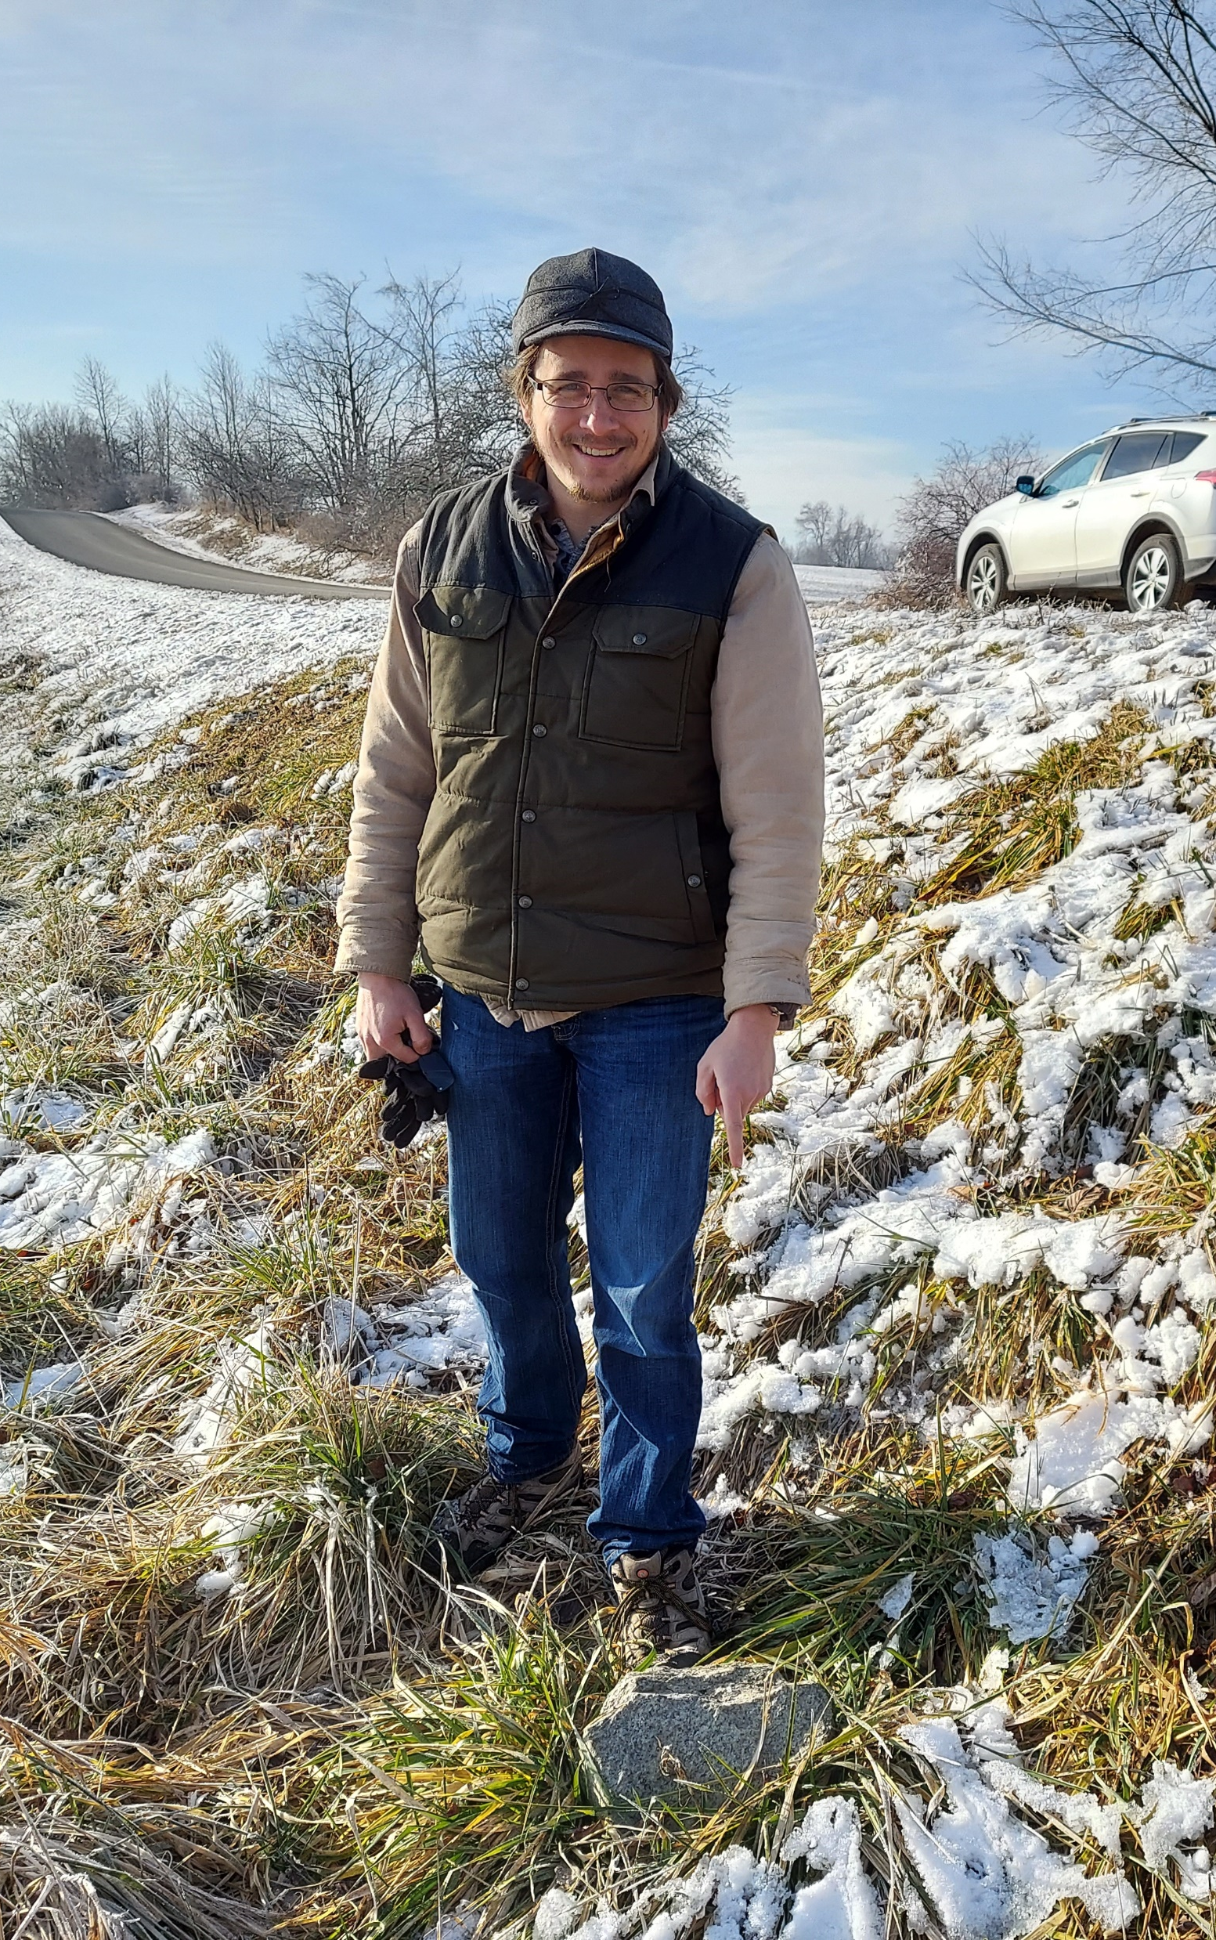
My Background
Great Lakes Regional Geodetic Advisor (IN, IL, WI, MI)
Previously at NGS Headquarters Geosciences Research Division
B.S. Surveying Engineering at Michigan Tech
Ph.D. in Geodetic Science at The Ohio State University
Professional Surveyor (MI)

Slide 3
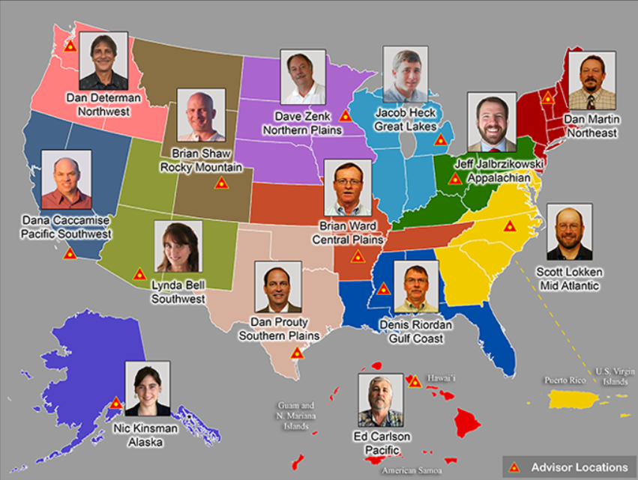
Regional Geodetic Advisor Program
www.ngs.noaa.gov/ADVISORS/
Notes:
This photo is a little out of date

Slide 4
Deprecation of the US Survey Foot
U.S. survey foot was deprecated on December 31, 2022
But use can continue for SPCS 83 (and SPCS 27)
  The 40 states that “officially” use U.S. foot for SPCS 83
  All SPCS 27 zones
  NGS will support such “legacy” use forever
  But NOT supported for ANY zones in SPCS2022
NGS will always support
U.S. survey foot for SPCS 83 and 27

Slide 5
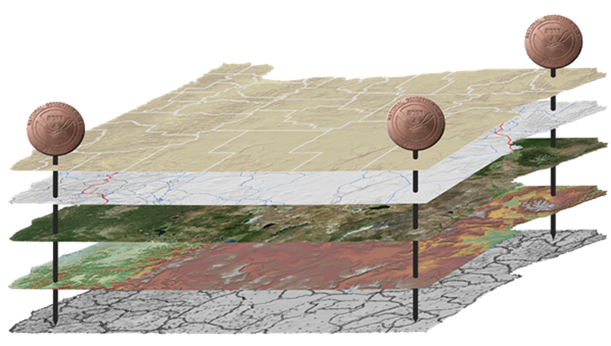
The National Spatial Reference System (NSRS)
NGS defines, maintains and provides access to the NSRS to meet our Nation’s economic, social & environmental needs
North American Datum of 1983 (NAD 83)
North American Vertical Datum of 1988 (NAVD 88)
Latitude • Longitude • Elevation • Gravity • Shoreline Position
+ changes over time
Today’s NSRS
Notes:
First of all, what is the NSRS?

Slide 6
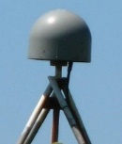
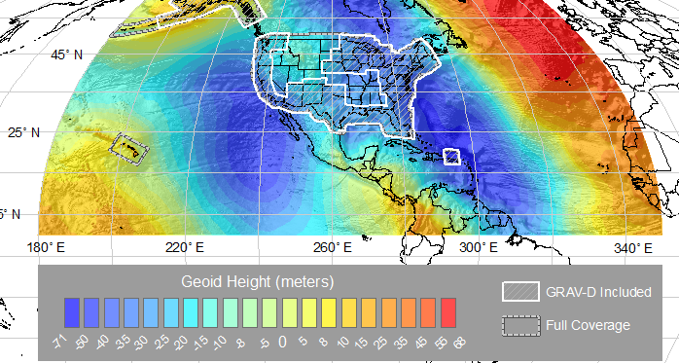
The National Spatial Reference System (NSRS)
NGS defines, maintains and provides access to the NSRS to meet our Nation’s economic, social & environmental needs
Latitude • Longitude • Elevation • Gravity • Shoreline Position
+ changes over time
North American Terrestrial Reference Frame (NATRF 2022)
Caribbean Terrestrial Reference Frame (CATRF 2022)
Pacific Terrestrial Reference Frame (PATRF 2022)
Marianas Terrestrial Reference Frame (MATRF 2022)
North America and Pacific Geopotential Datum (NAPGD2022)
Tomorrow’s NSRS

Slide 7
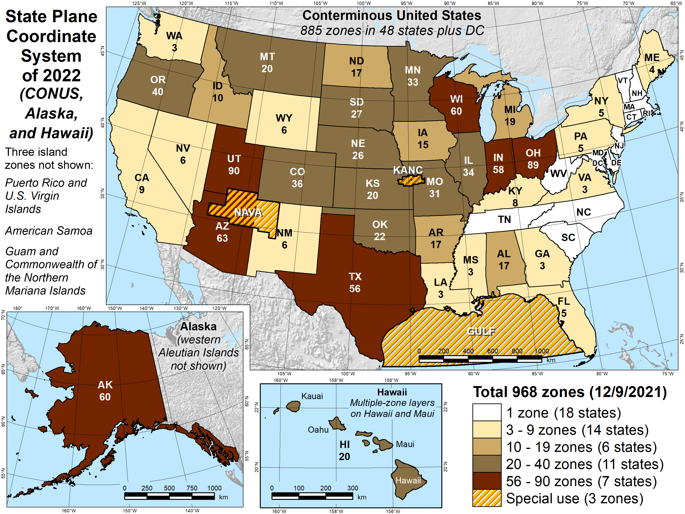
Number of SPCS2022 zones (preliminary)
968 total zones nationwide
Illinois has 2 zone layers:
  A statewide zone
  33 LDP zones

Slide 8
Getting acquainted with SPCS2022
Distortion design philosophy
  Linear distortion minimized at topographic surface (not at ellipsoid surface)
  Purpose: to reduce difference between projected “grid” and actual “ground” distances
Other things:
  Zone “layers”
  Low distortion projections (LDPs)
  Illinois designs approved by NGS in October 2022
  Will be implemented with the Modernized (2022) NSRS

Slide 9
Linear distortion magnitudes
Parts per million | Centimeters per kilometer | Feet per mile | Dimensionless ratio
20 ppm | 2 cm/km | 0.1 ft/mile | 1:50,000
50 ppm | 5 cm/km | 0.3 ft/mile | 1:20,000
100 ppm | 10 cm/km | 0.5 ft/mile | 1:10,000
400 ppm | 40 cm/km | 2.1 ft/mile | 1:2,500

Slide 10
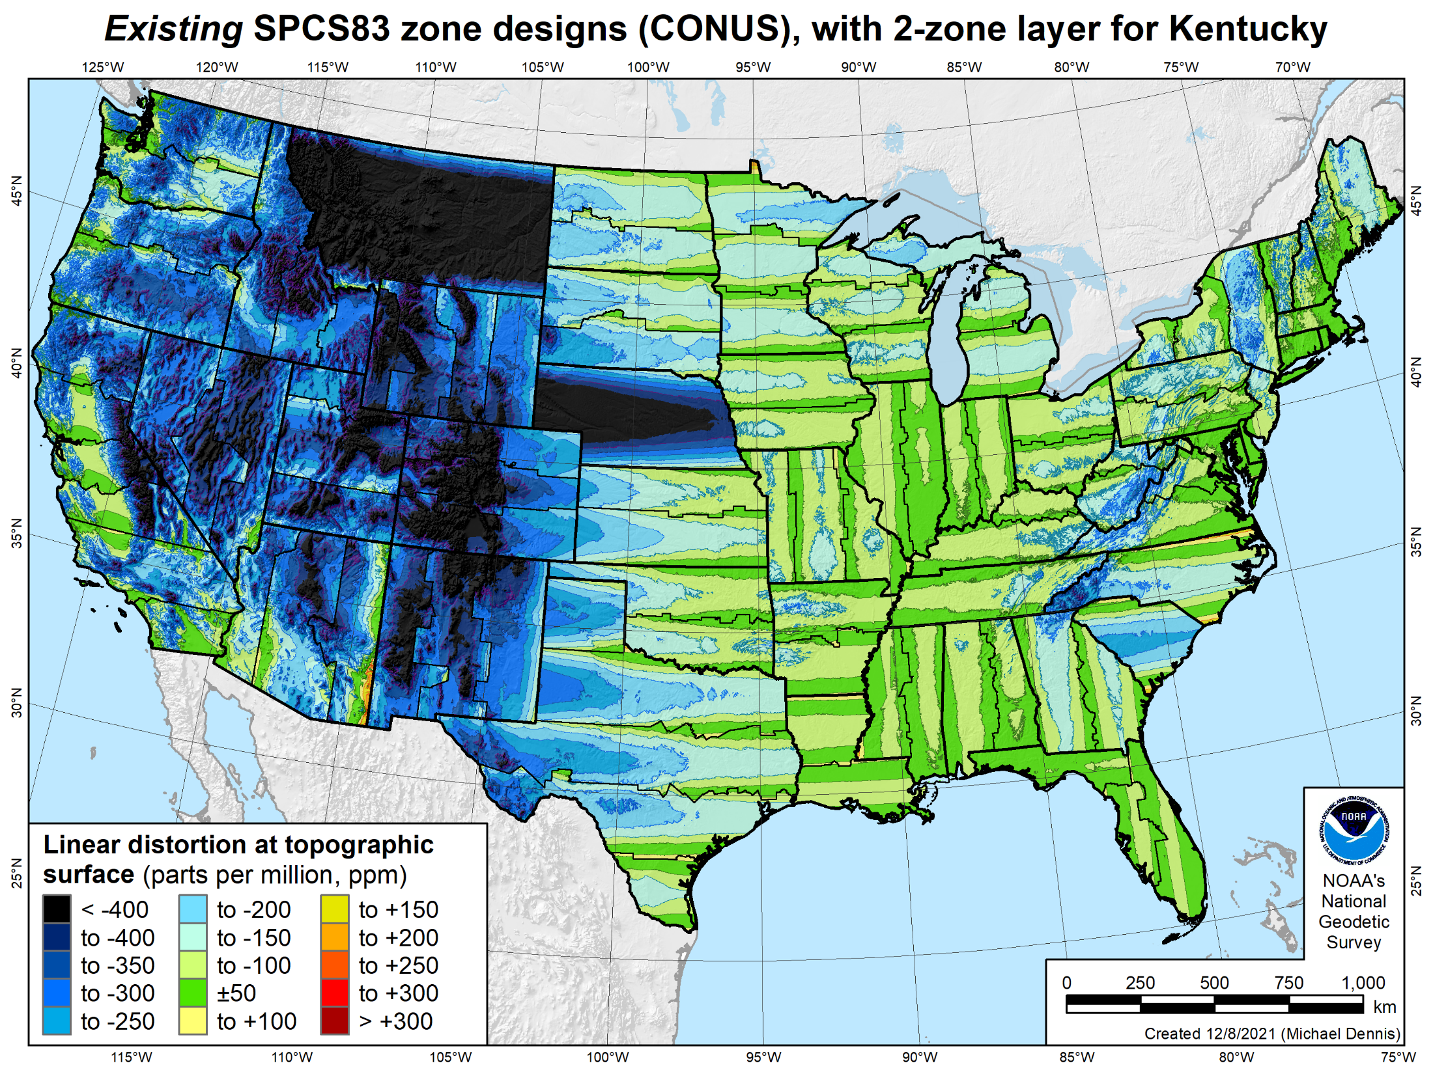
106 zones
Distortion increment 50 ppm (1:20,000 = 0.26 ft/mile)
Percent area within:
±20 ppm = 6%
±50 ppm = 17%
±100 ppm = 41%
±400 ppm = 91%

Slide 11
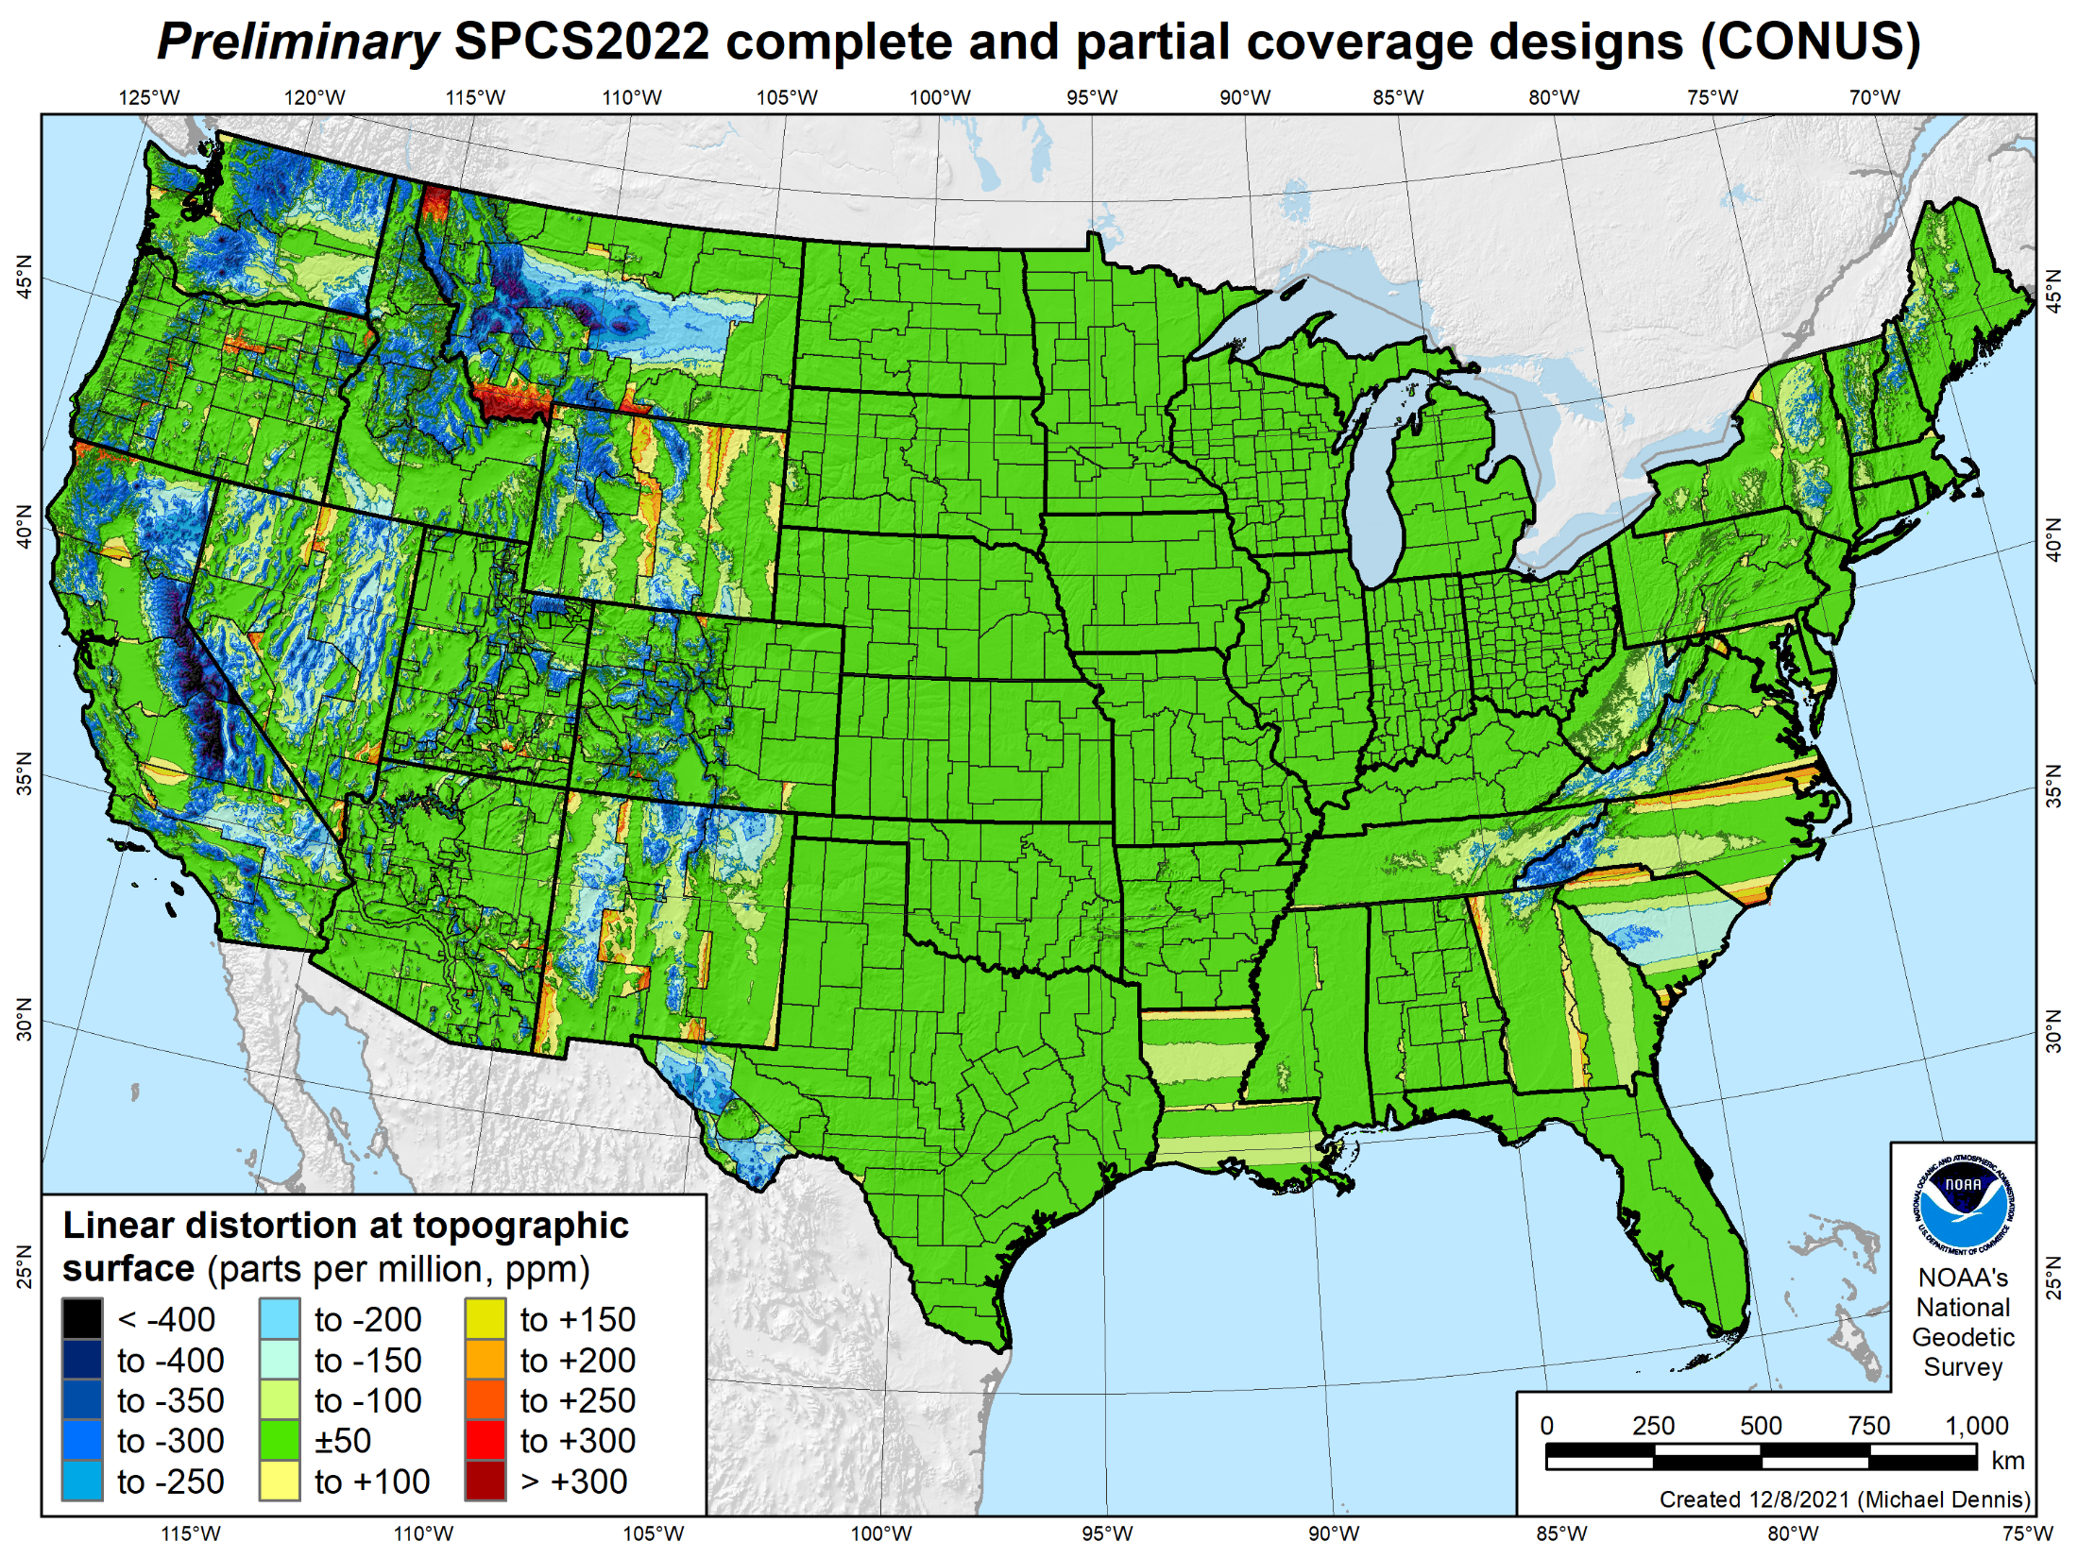
846 zones
Distortion increment 50 ppm (1:20,000 = 0.26 ft/mile)
Percent area within:
±20 ppm = 58%
±50 ppm = 76%
±100 ppm = 89%
±400 ppm = 99.9%

Slide 12
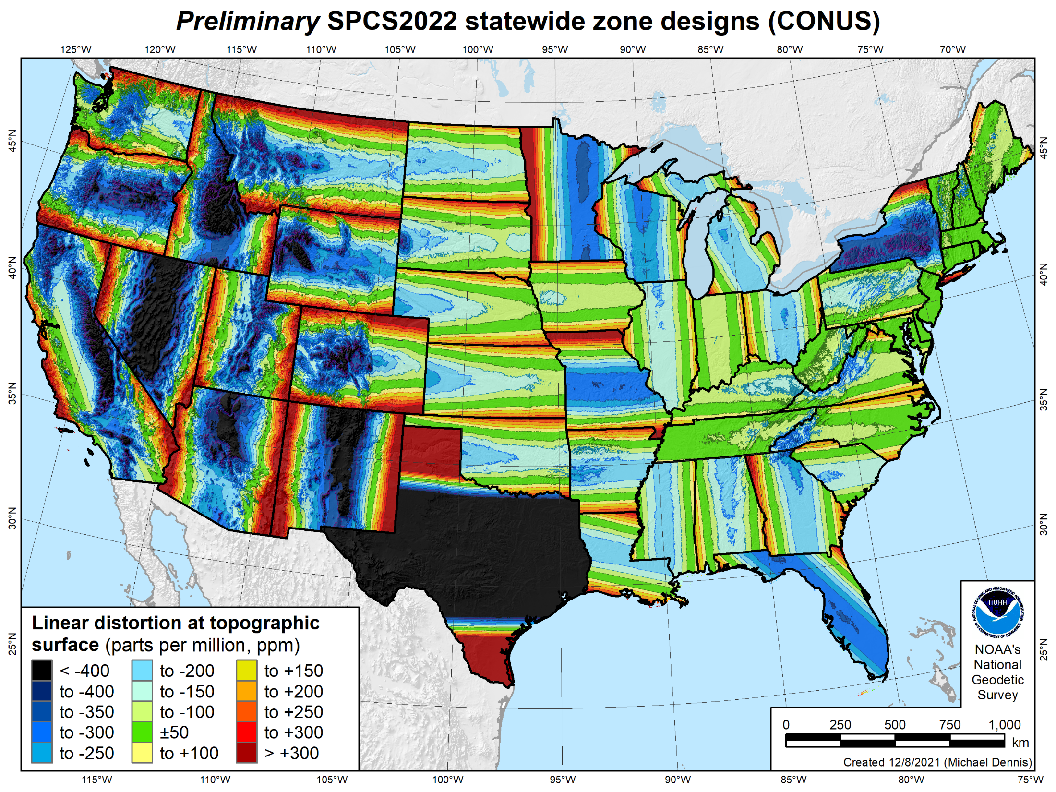
49 zones
Distortion increment 50 ppm (1:20,000 = 0.26 ft/mile)
Percent area within:
±20 ppm = 7%
±50 ppm = 18%
±100 ppm = 36%
±400 ppm = 88%

Slide 13
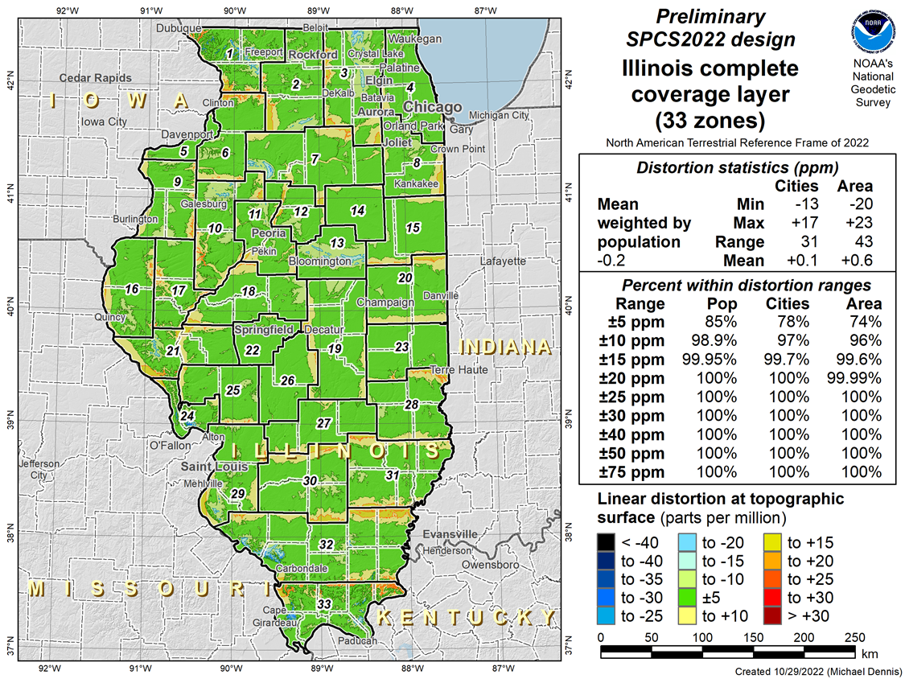
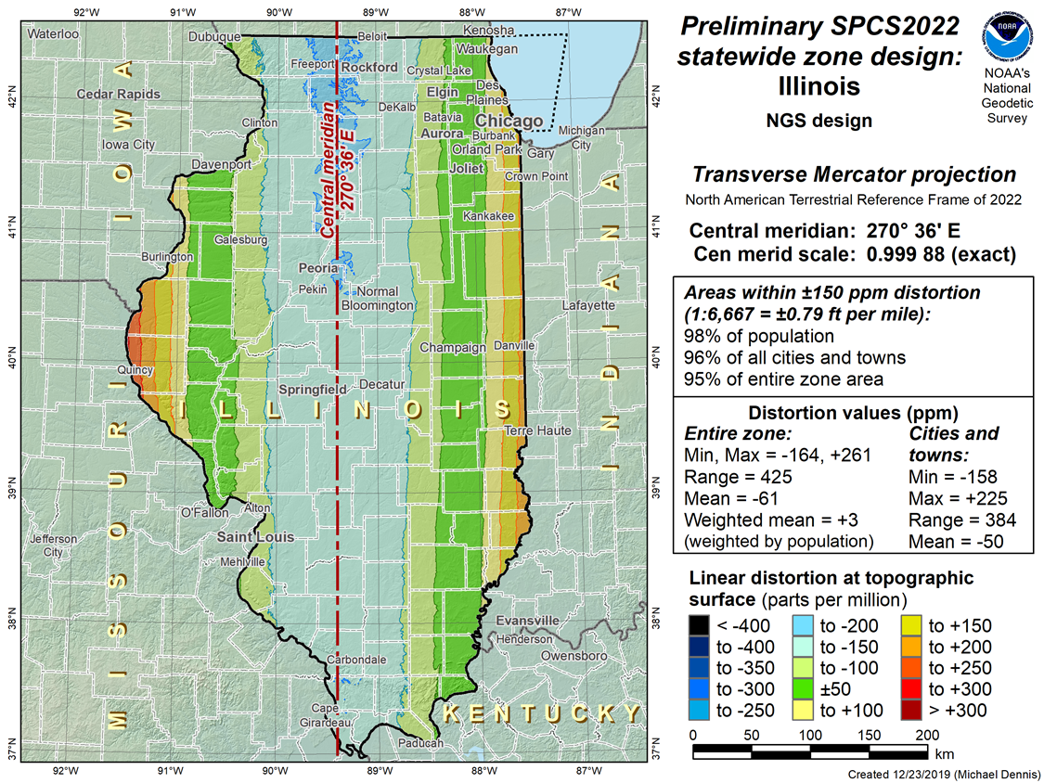
Illinois SPCS2022 Layers

Slide 14
What to expect for SPCS2022
Coordinates will change by at least 10,000 m
  Latitude and longitude change about 1-2 m
  Rest of change due to projection definition
Less difference between “grid” and “ground”
More than one zone layer in most states
  Zones will be similar to SPCS 83 in some states
  Zones will be very different in most states
Every state will have a statewide zone layer

Slide 15


Slide 16
NSRS Modernization: Delay
Will names change?
    No, “GEOID2022”, “NATRF2022”, etc. will remain the same
NGS anticipates the release of all data, and limited tools, by the middle of 2025.
  Some of this may depend on things outside of NGS control (we have already delayed beyond 2022!)
Work on additional tools will continue in the out-years

Slide 17
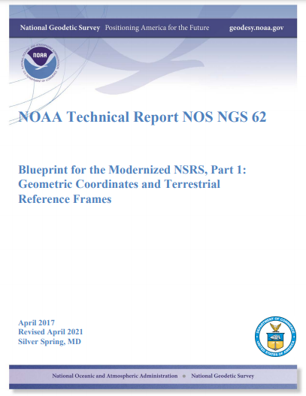
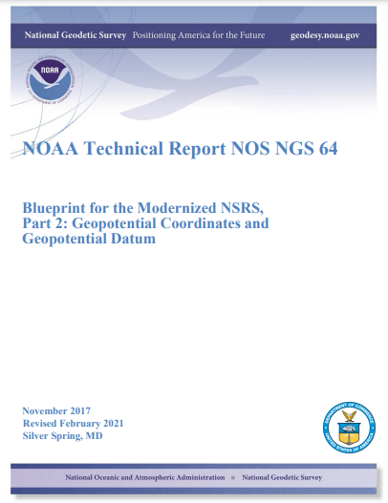
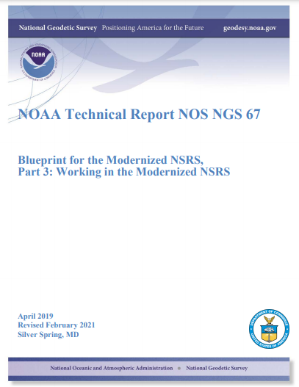
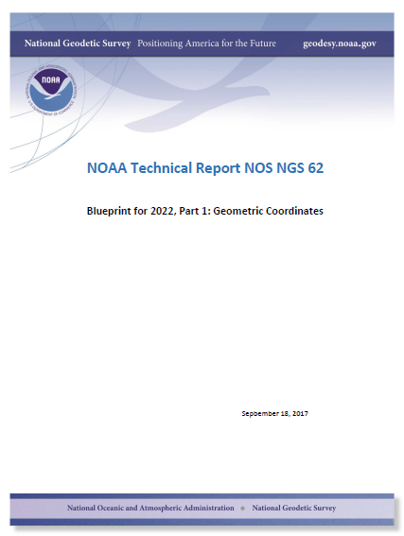
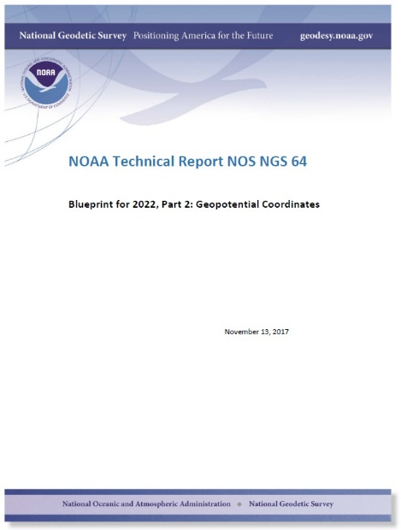
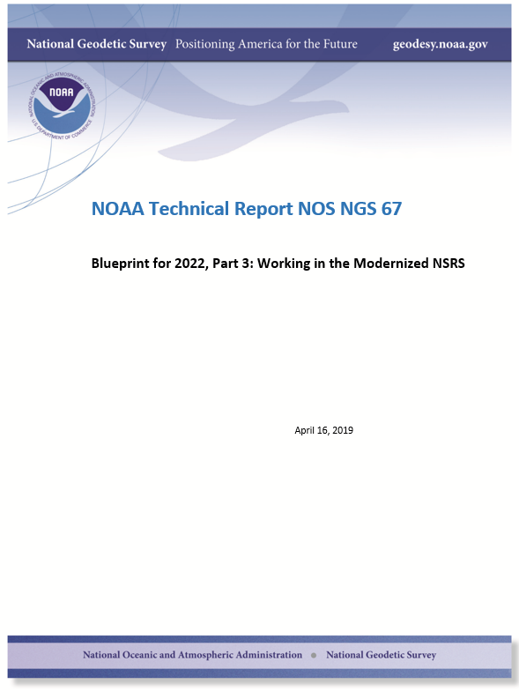
Updated blueprint documents
Available in the NGS Publications Library: https://geodesy.noaa.gov/library/
Geopotential:
Nov 2017
Revised Feb 2021
NOAA TR NOS NGS 64
53 pages
Working in the
Modernized NSRS:
April 2019
Revised Feb 2021
NOAA TR NOS NGS 67
133 pages
Geometric:
Sep 2017
Revised April 2021
NOAA TR NOS NGS 62
61 pages

Slide 18
A two-track approach to coordinates
Reference Epoch Coordinates
Survey Epoch Coordinates
An estimated “snapshot” of entire network
Every 5 or 10 years
Similar to NAD 83(2011) epoch 2010.00
Time-dependent!
Reflects coordinates at time of observation
Multiple SECs can show changes over time
Notes:
I will further cover this later in the talk.

Slide 19
Replacing the NAD 83s
The Old | The New
NAD 83 (2011) | NATRF2022 - The North American Terrestrial Reference Frame of 2022
NAD 83 (2011) | CATRF2022 - The Caribbean Terrestrial Reference Frame of 2022
NAD 83 (PA11) | PATRF2022 - The Pacific Terrestrial Reference Frame of 2022
NAD 83 (MA11) | MATRF2022 - The Mariana Terrestrial Reference Frame of 2022

Slide 20
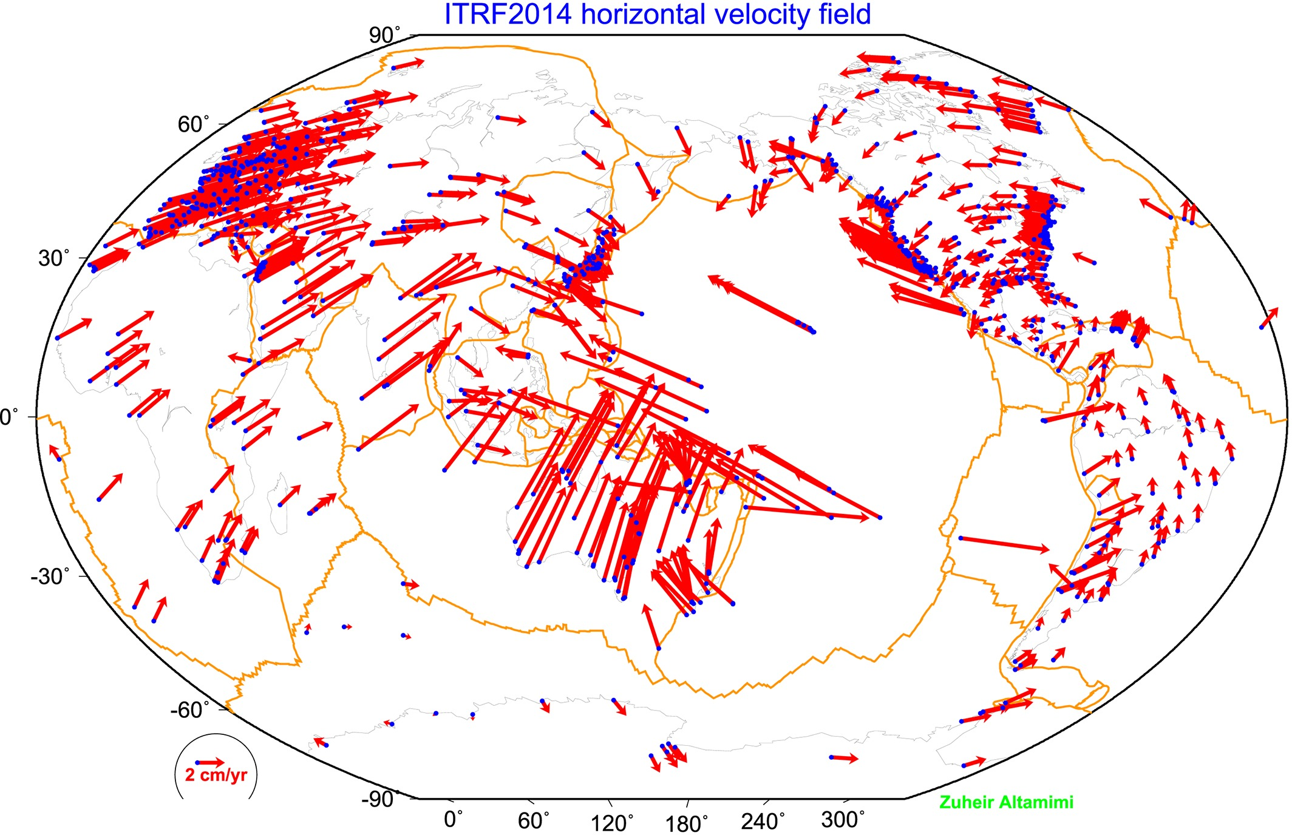
The IGS Reference Frame
The ITRF is defined by reference epoch coordinates AND velocities at stations
The ITRF velocity field very closely resembles absolute plate motion
The ITRF and IGS frames are both no-net-rotation frames – the sum of the angular velocities is constrained to be zero
The Modernized (2022) NSRS Reference Frames will tie to ITRF2020
Altamimi et al., 2016, JGR

Slide 21
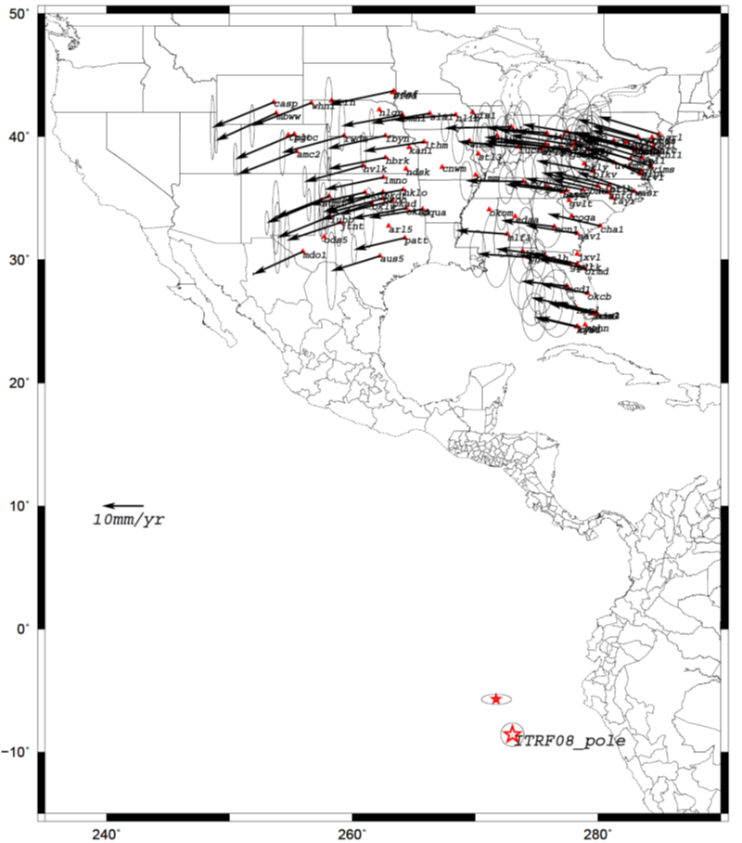
Euler Poles and “Plate-Fixed”
  In the ITRF, many tectonic plates have a dominant motion: rotation
  Euler Pole - point about which a plate rotates (yellow star)
  Euler Pole Parameters (EPP) define this rotation
  Residual motion is characterized in an Intra-Frame Deformation Model (IFDM)
NATRF2022 Euler Pole
Notes:
We say “NATRF2022” is “fixed” to the N.A. Plate, making it a “plate fixed” frame
-the frame is constant to itself, but rotating within ITRF, and moving in a different direction than the other 3 frames

Slide 22
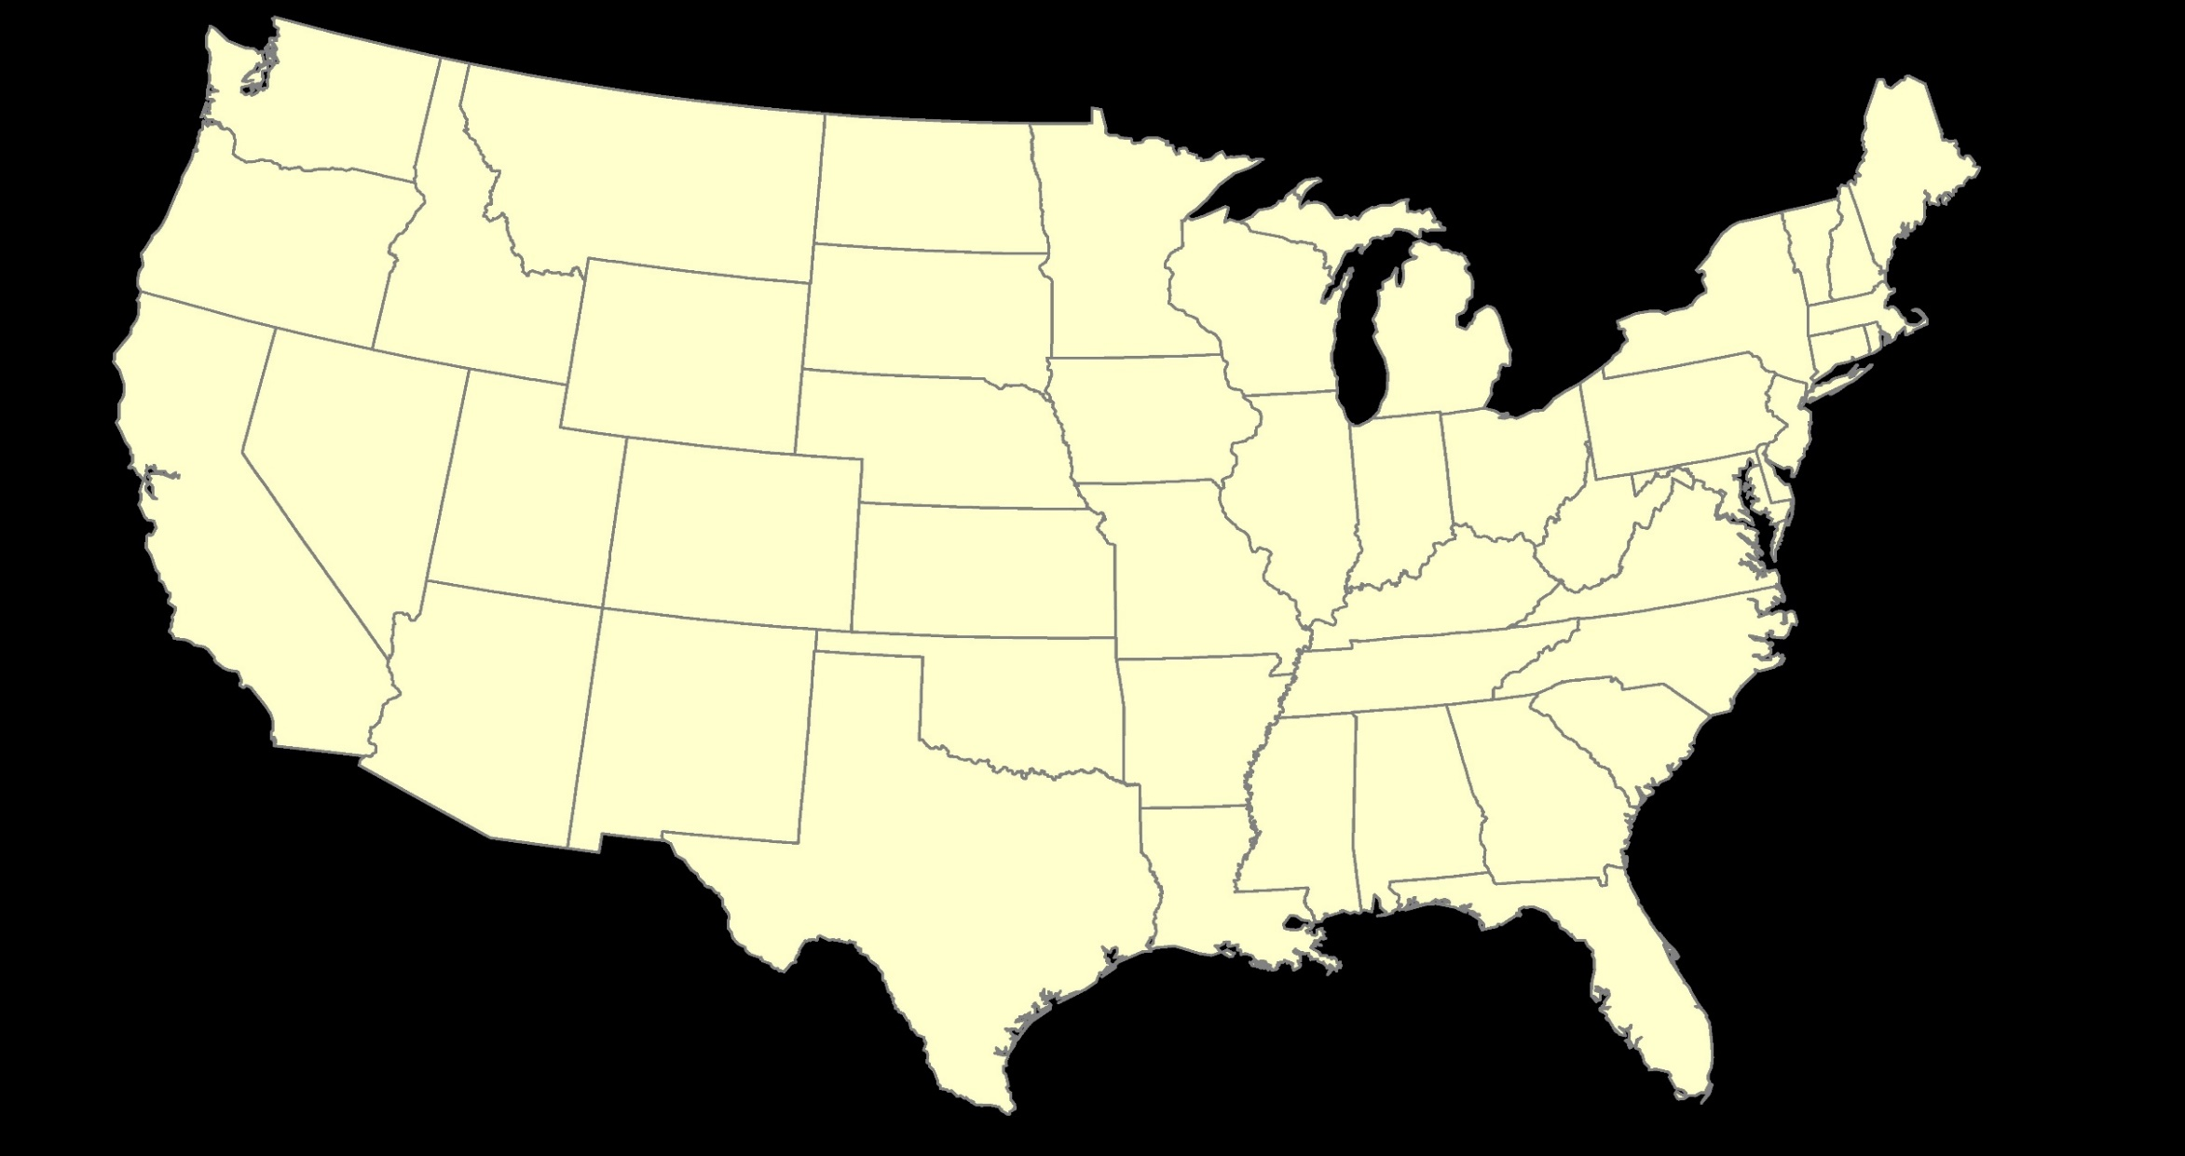
ITRF2020 or NATRF2022

Slide 23
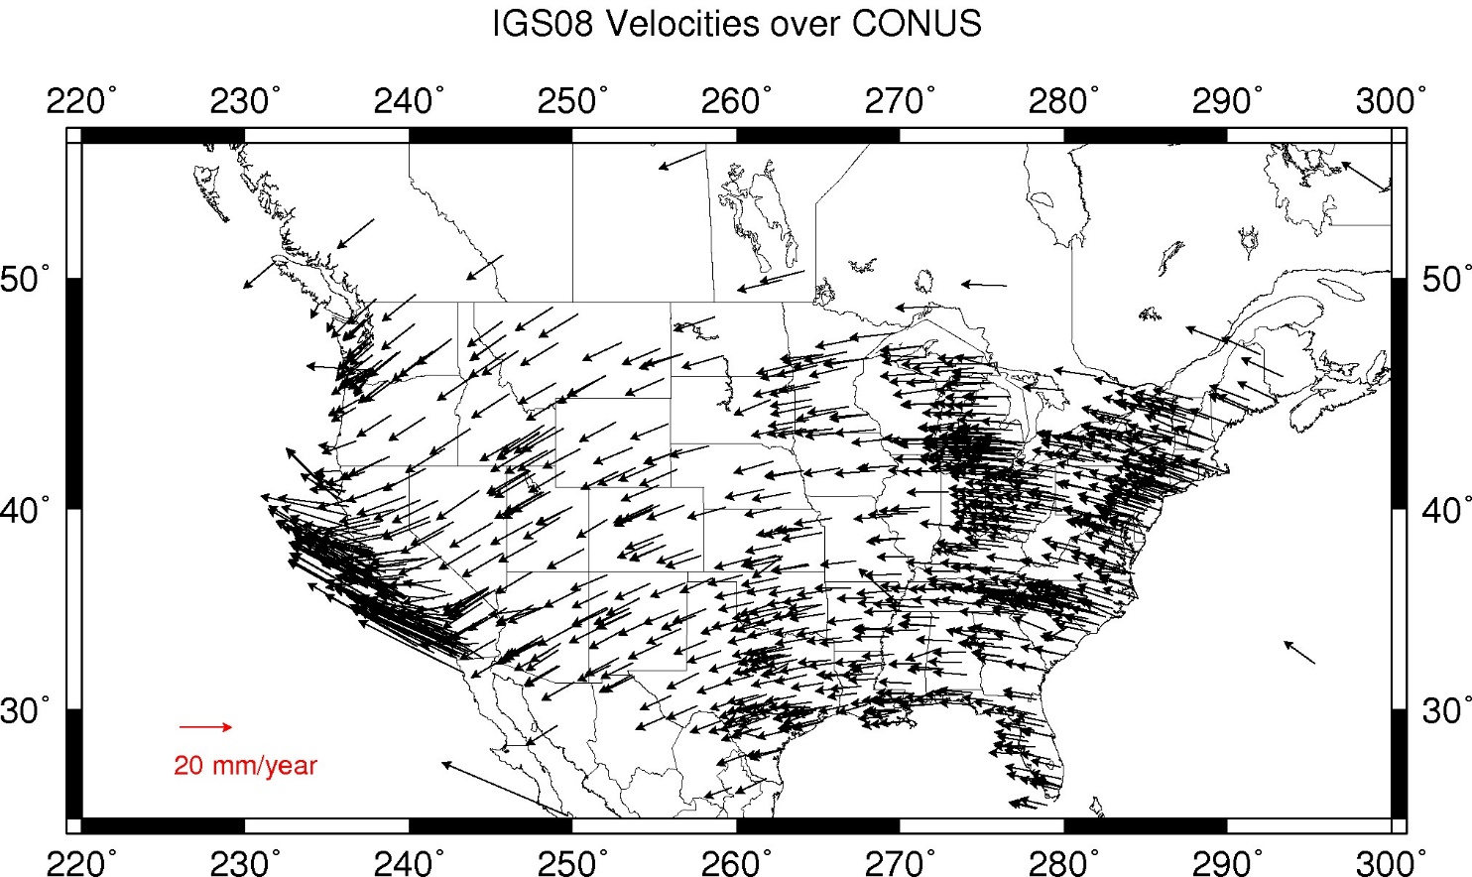
Residual Velocities – ITRF2020/CONUS
Notes:
This diagram of CONUS shows the IFVM2022 velocities expressed in the ITRF2020 Frame.
Note the arrows are about 20 mm/yr
It can generally be interpreted as “at what velocity are points in CONUS moving relative to the ITRF Frame?”

Slide 24
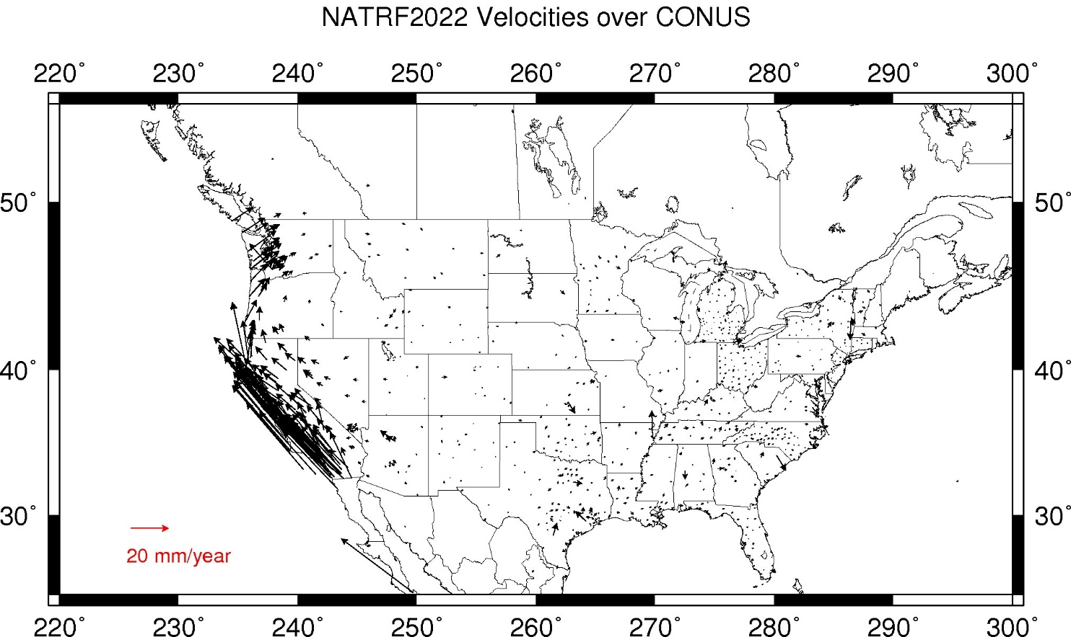
Residual Velocities – NATRF2022/CONUS
Notes:
This diagram of CONUS shows the IFVM2022 velocities expressed in the NATRF2022 Frame.
Note that even in “stable North America”, these velocities are not absolutely zero!
The IFVM2022 model will contain these tiny deviations from simple plate rotation!
It can generally be interpreted as “at what velocity are points in CONUS moving relative to the North American plate?”

Slide 25


Coordinates, Frames, Epochs, EPP2022 and IFDM2022
A survey done Jan 1, 2023 and reported at epoch 2020.0
New Survey (same point) done Jan 1, 2030
Position of point in NATRF2022(2030)
Position of point in NATRF2022(2020)
If IFDM = 0, then NATRF2022 (2030) = NATRF2022 (2020)
Position from 2023 survey NATRF2022 (2020.0)
ITRF2020 (2020.0)
(V)
ITRF2020 (2030.0)
IFDM 2030-2020
NATRF2022
(2020.0)
Epp2022
fframe
NATRF2022 (2030)
fEpoch
(H)
Notes:
At 2020, ITRF and NATRF are identical.
CLICK
As time goes on the North American plate moves, resulting in new ITRF coordinates at epoch (say 2030) for the same point.
CLICK
If I remove 10 years of plate motion (ITRF velocity) it puts me back where NATRF used to be....EXCEPT, there has been local motion.
That is why we call the it NATRF epoch 2030, because it is where NATRF IS in 2030.
CLICK
We now have to apply IFVM to get back to 2020, or any other date relative to NATRF.
* EPP2022 changes the FRAME
* IFVM2022 changes the EPOCH

Slide 26
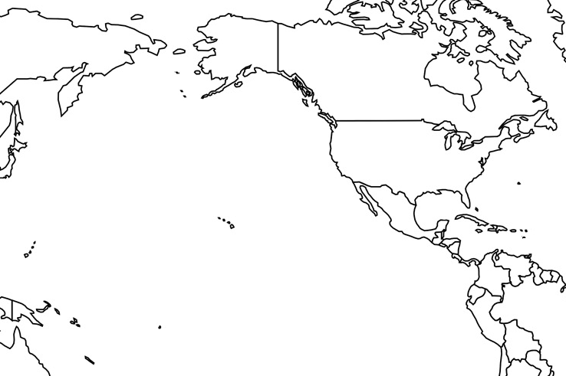
Vertical Datums of the NSRS
St. Paul I.
- None -
St. Lawrence I.
- None -
St. Matthew I.
- None -
Alaska
NGVD 29
NAVD 88
St. George I.
- None -
CONUS
NGVD 29
NAVD 88
Hawaii
- None -
CNMI
NMVD 03
Puerto Rico
PRVD 02
U.S. Virgin Islands
VIVD 09
American Samoa
ASVD 02
Guam
GVD 63
GUVD 04

Slide 27
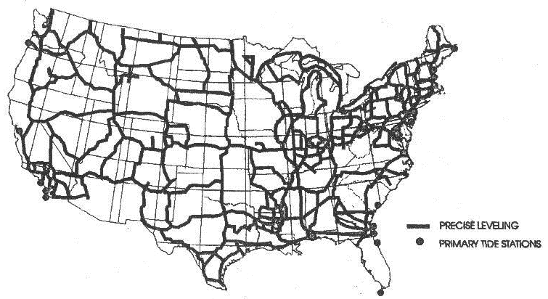
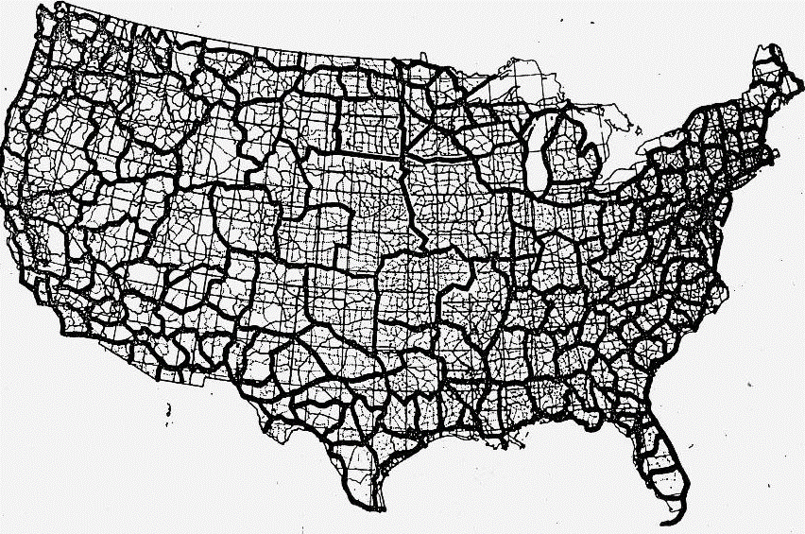
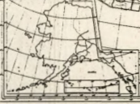
Developing the Previous Vertical Datums
NGVD 29
NAVD 88

Slide 28
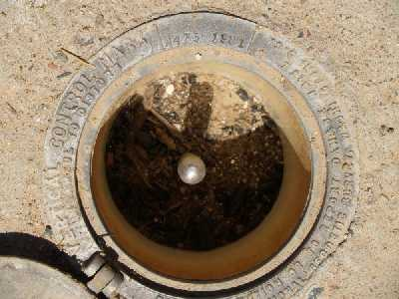
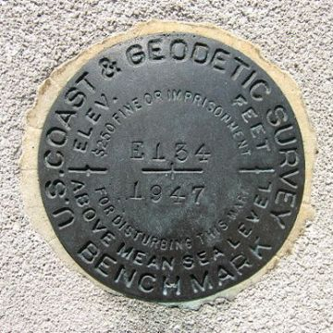
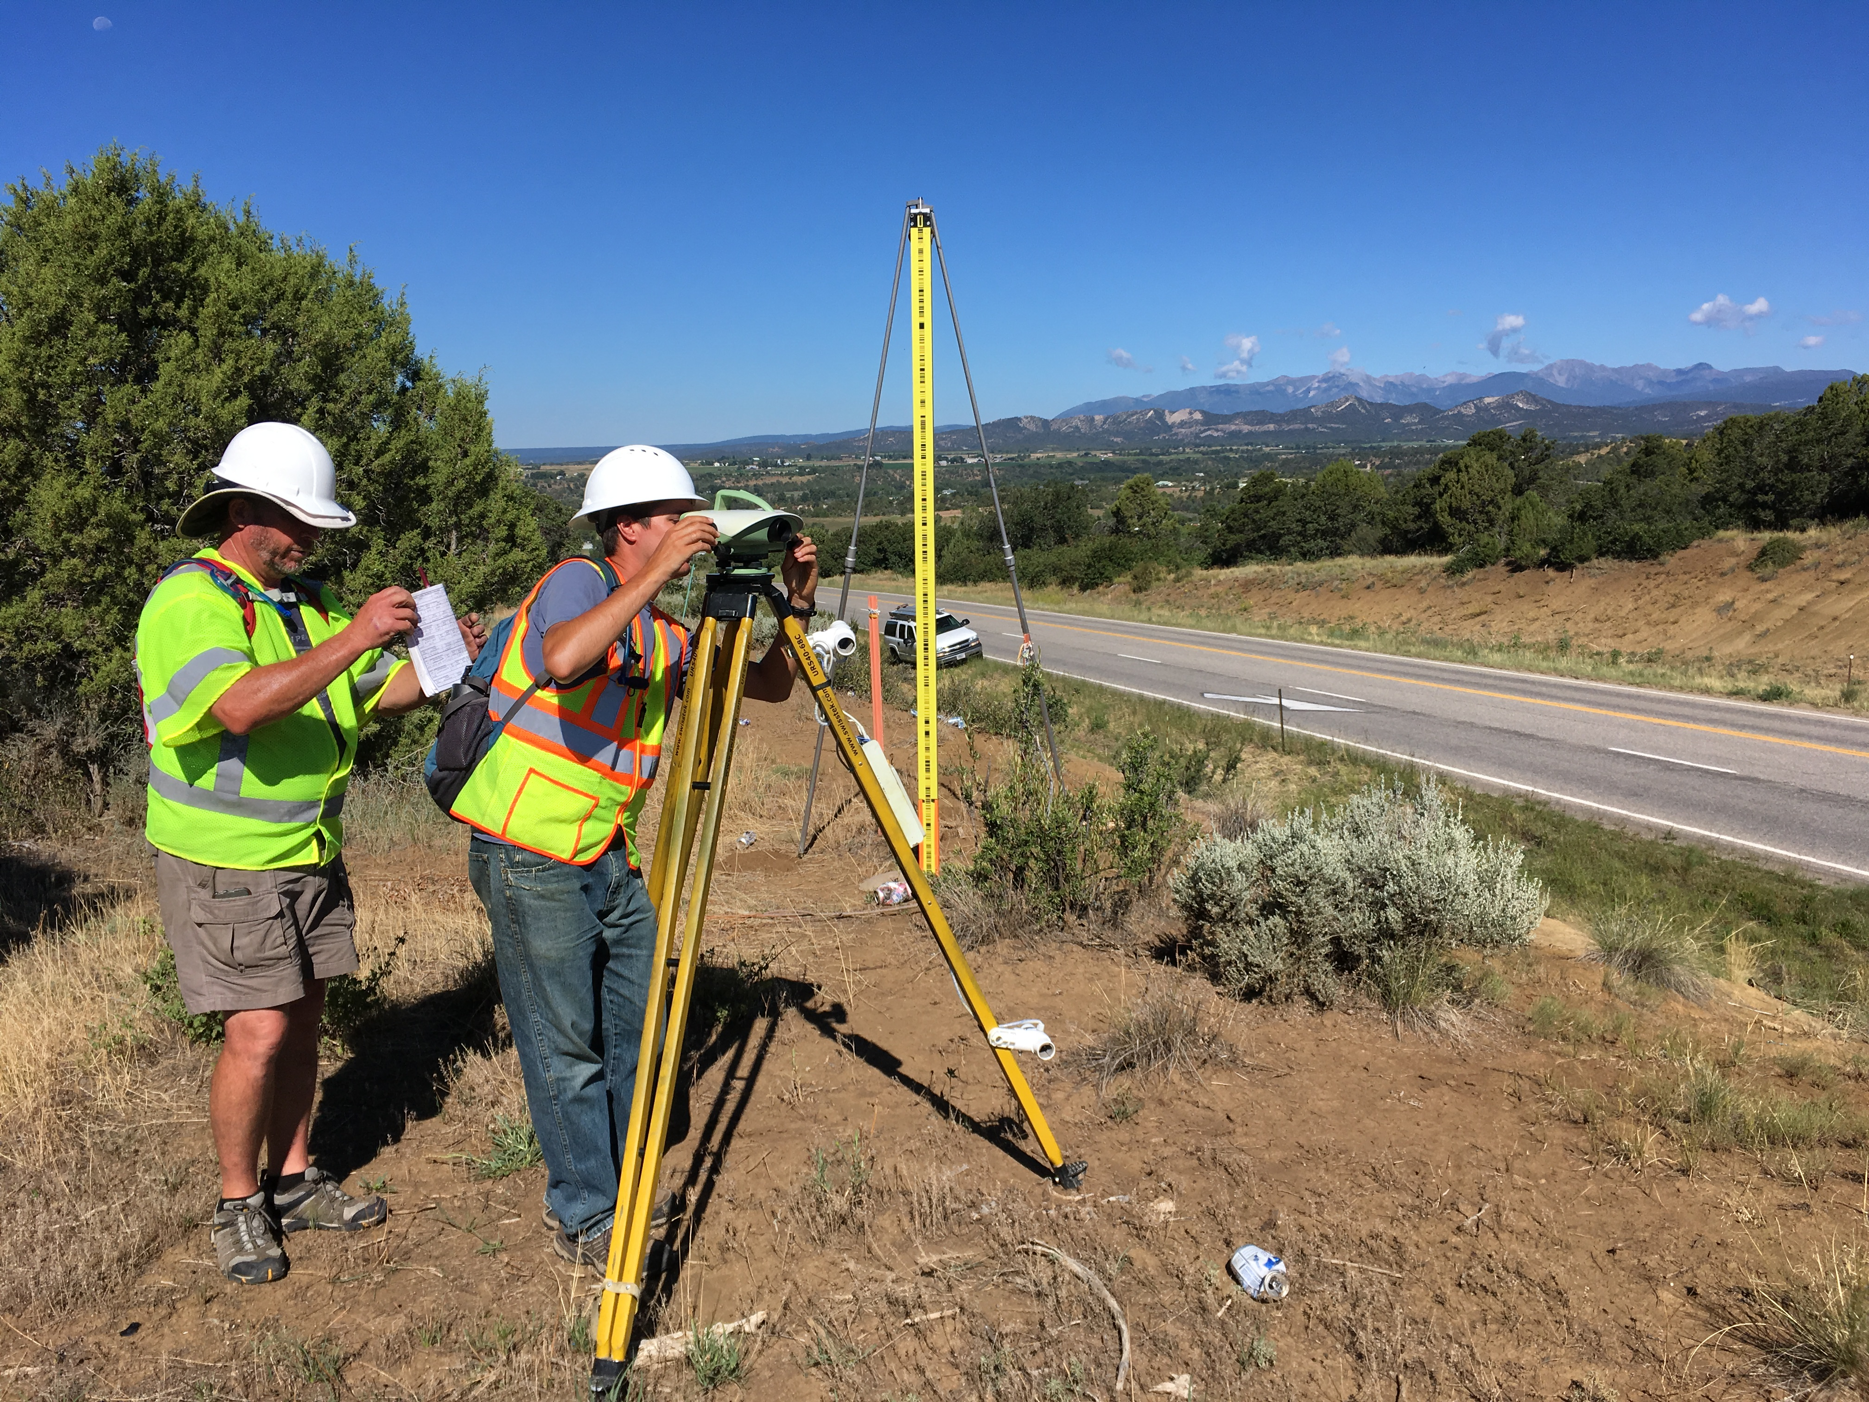
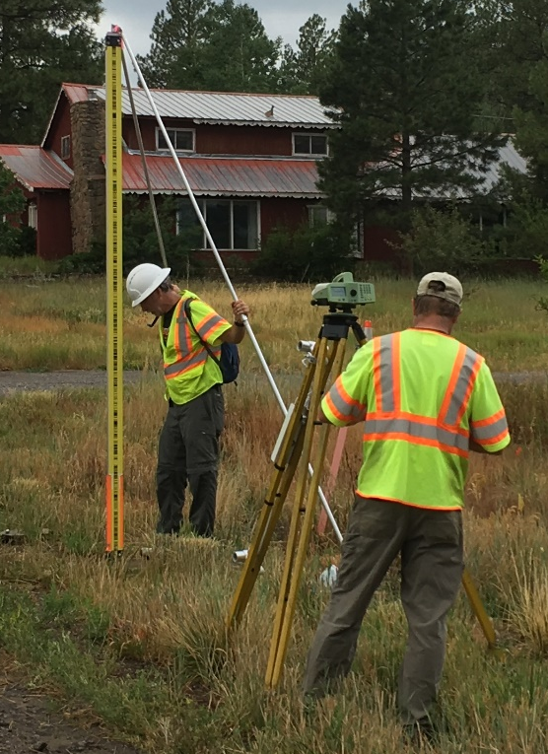
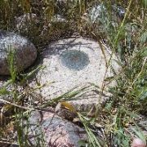
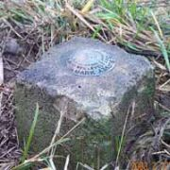
Leveling
Notes:
NAVD 88 is accessed through leveling off of marks with NAVD 88 heights on them.
Those heights were determined by leveling crews.

Slide 29
Replacing NAVD 88
  The Old:
  NAVD 88
  PRVD 02
  VIVD09
  ASVD02
  NMVD03
  GUVD04
  IGLD 85
  IGSN71
  GEOID18
  DEFLEC18
  The New:
  The North American-Pacific Geopotential Datum of 2022 (NAPGD2022)
  Will include:
  GEOID2022
  DEFLEC2022
  GRAV2022
  DEM2022
  More
Orthometric
Heights
Normal
Orthometric
Heights
A HUGE component of this
effort is GRAV-D:
Gravity for the Redefinition of
the American Vertical Datum
Dynamic
Heights
Gravity
Geoid
Undulations
Deflections of
the Vertical

Slide 30
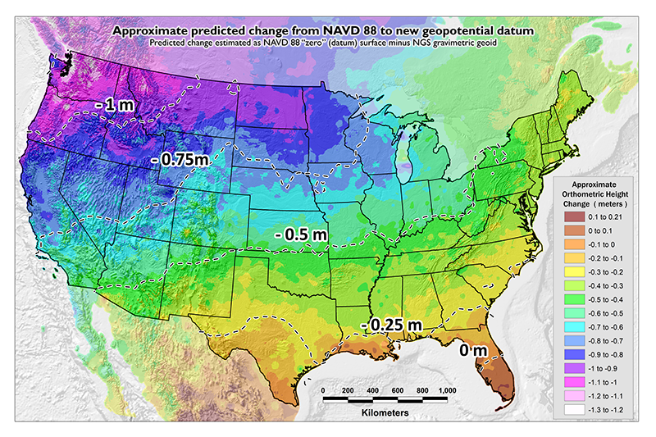
NAVD 88 (epoch ?) to
NAPGD2022 Epoch 2020.00 (estimate)

Slide 31
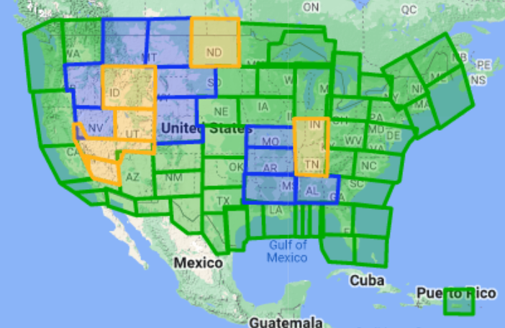

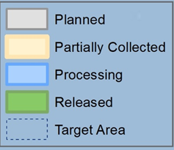
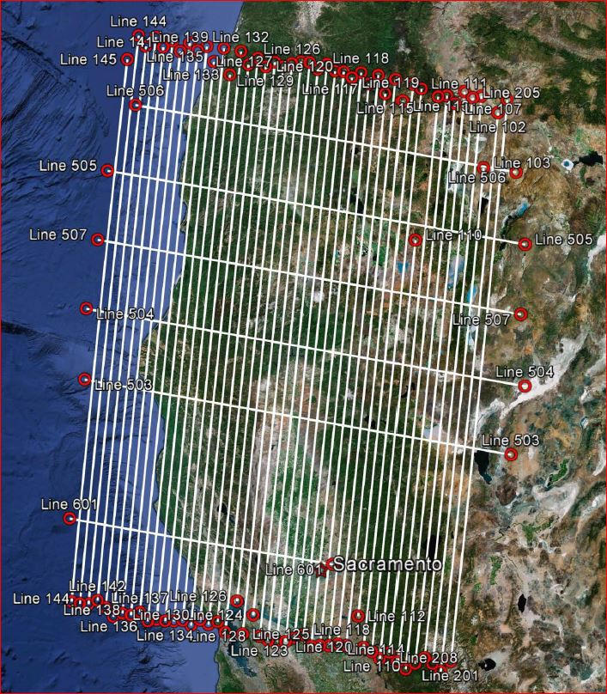
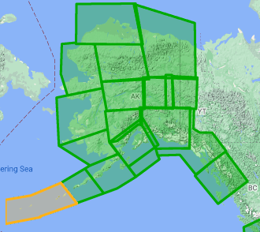
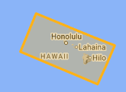
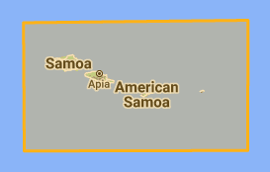

Gravity for the Redefinition of the American Vertical Datum (GRAV-D)
10 km data lines
70 km cross lines
20,000 ft altitude
230 kt flight speed
Over 96% complete
Alaska
Hawaii
American Samoa
Guam & CNMI
Notes:
96.78% complete as of 1/11/2023

Slide 32
The Geoid, and Heights
h
= H
+ N
h: ellipsoidal height
H: orthometric height
N: geoid undulation
Topography
h
H
The geoid
N
A chosen
ellipsoid
Notes:
Fundamental changes to how we access the vertical datum

Slide 33
IGLD Update

Slide 34
What is IGLD?
International Great Lakes Datum (IGLD) is a common height reference system by which water levels can be measured and meaningfully related to each other
Joint effort between the United States and Canada
Maintained by the Coordinating Committee on Great Lakes Basic Hydraulic and Hydrologic Data
Due primarily to Glacial Isostatic Adjustment, IGLD is updated every 25-35 years
The next update will be IGLD (2020)

Slide 35
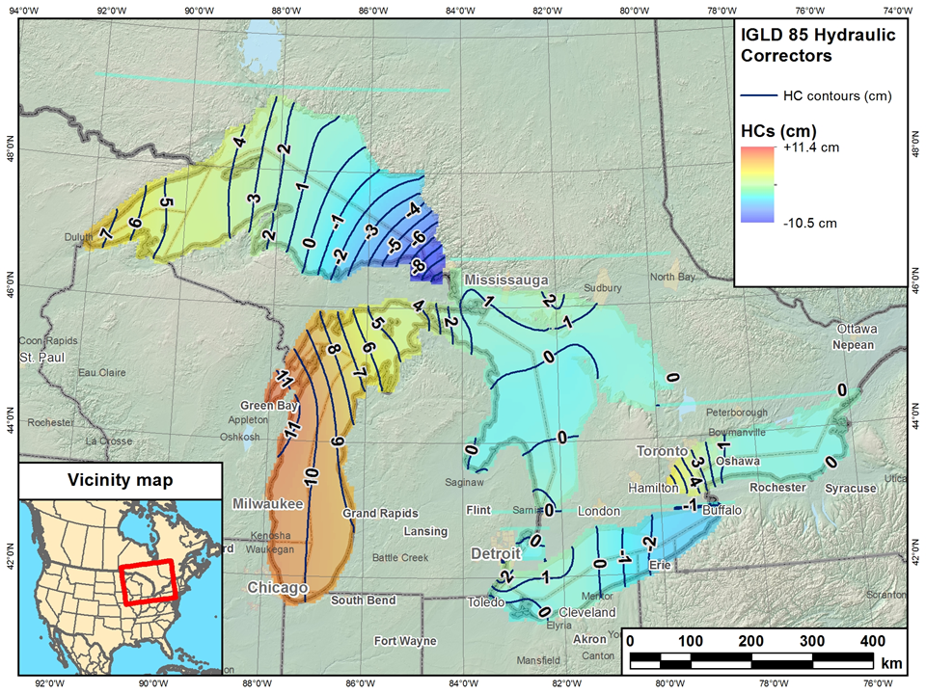
Current IGLD
IGLD (1985) replaced IGLD (1955) in 1992
Same reference zero as NAVD 88 (at Pointe au Père, Québec)
Surface determined by leveling
Dynamic heights
Hydraulic correctors

Slide 36

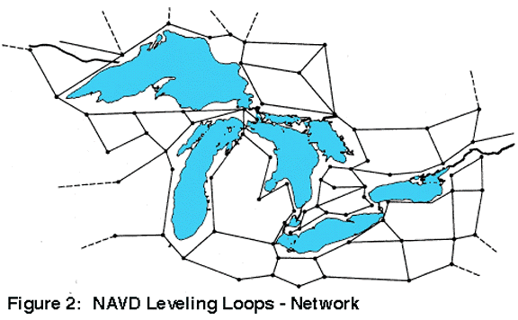
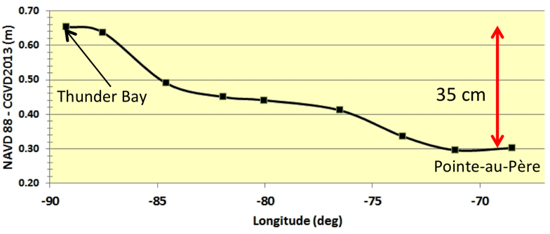
IGLD (1985) Reference Surface
Reference surface is each lake (equipotential surface) to which heights are referenced
IGLD 1955 & 1985 used 1000’s miles of geodetic leveling to indirectly define the reference surface
  Very time consuming & cost prohibitive
  Datum accessible only where leveling exists (benchmarks)
  Susceptible to accumulation of systematic errors
Extends the reference zero inland

Slide 37
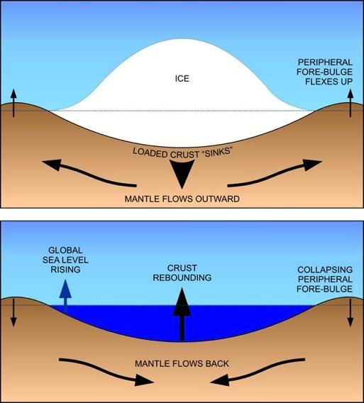
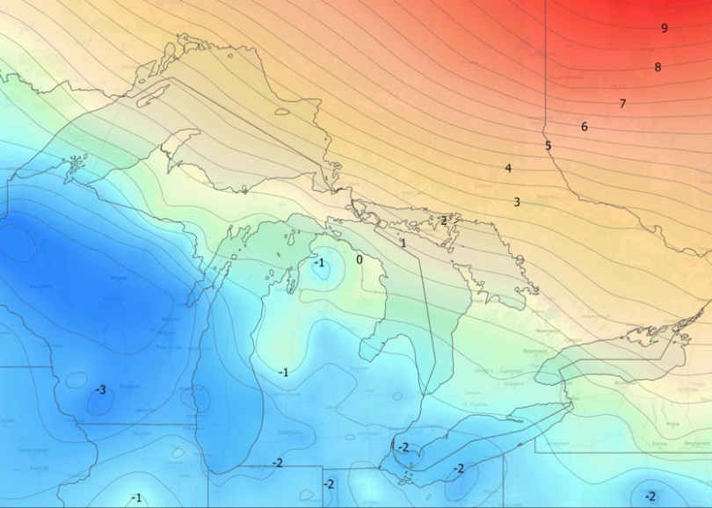
Why a new IGLD?: Glacial Isostatic Adjustment – (GIA)
Process of Glacial Isostatic Adjustment (left) and the resulting tilting of the entire Great Lakes region (right) as determined by high accuracy GPS measurements in units of mm/year. M. Craymer and C. Wisotzkey, 2021.
Entire basin is:
Uplifting in north
Subsiding in south
Overall tilting ~7 mm/year
(21cm or 0.7’ over 30 year)
Need to update IGLD
every 25-30 years

Slide 38
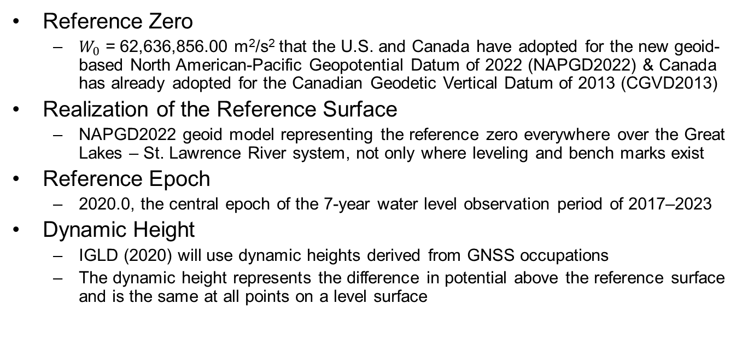
Definition of IGLD (2020)
Reference Zero
  $W_{0}$ = 62,636,856.00 m²/s² that the U.S. and Canada have adopted for the new geoid-based North American-Pacific Geopotential Datum of 2022 (NAPGD2022) & Canada has already adopted for the Canadian Geodetic Vertical Datum of 2013 (CGVD2013)
Realization of the Reference Surface
  NAPGD2022 geoid model representing the reference zero everywhere over the Great Lakes – St. Lawrence River system, not only where leveling and bench marks exist
Reference Epoch
  2020.0, the central epoch of the 7-year water level observation period of 2017–2023
Dynamic Height
  IGLD (2020) will use dynamic heights derived from GNSS occupations
  The dynamic height represents the difference in potential above the reference surface and is the same at all points on a level surface
Notes:
IGLD (2020) will be completely compatible with dynamic heights in CGVD2013

Slide 39
Status of IGLD Update
GNSS field campaign took place in 2022 – data processing continues
Seasonal gauging continues
Hydraulic corrector working group is investigating the need for HCs in IGLD (2020)
IGLD (2020) is planned for release about one year after the release of the NAPGD2022 vertical datum (around 2026)

Slide 40
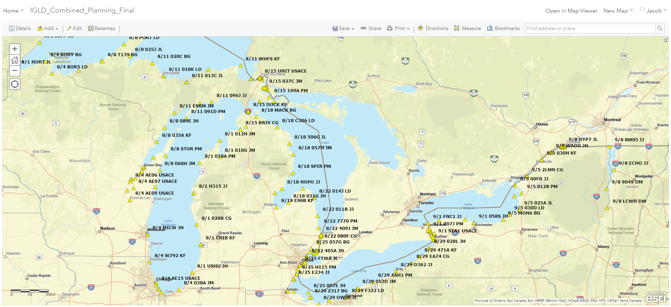
2022 IGLD GNSS Campaign

Slide 41




Save the Date! Water Level Datum Workshop
NOAA, the Canadian Hydrographic Service (CHS), and the Coordinating Committee on Great Lakes Basic Hydraulic and Hydrologic Data would like to invite you to a virtual workshop on Tidal and Water Level Datums. Participants will have the opportunity to learn more about the datums and impacts on the coastal, navigation and shipping communities and industries.
April 5: National Tidal Datum Epoch (NTDE)
April 6: International Great Lakes Datum (IGLD) and the Low Water Datum (LWD)
The workshop will feature presentations and discussions from NOAA’s Center for Operational Oceanographic Products and Services, the National Geodetic Survey, and the Office of Coast Survey, as well as U.S. Army Corps of Engineers, CHS, Natural Resources Canada, Environment and Climate Change Canada, and others.

Slide 42
Updates from NGS Part 2: Updates to Online Tools
Jacob Heck
NGS Great Lakes Regional Geodetic Advisor
IPLSA 2023 Convention
Notes:
NGS continues its efforts to modernize the National Spatial Reference System (NSRS), which will replace the existing datums with a suite of new datums that include NAPGD2022 and NATRF2022, which will utilize time-dependent coordinates. Part 1 of this talk will focus on the new datums themselves, including how they are being developed and how surveyors will use them. Part 2 will cover recent updates to online tools that enable access to the NSRS such as OPUS Projects, which now can be used to adjust RTN-derived GNSS vectors.

Slide 43
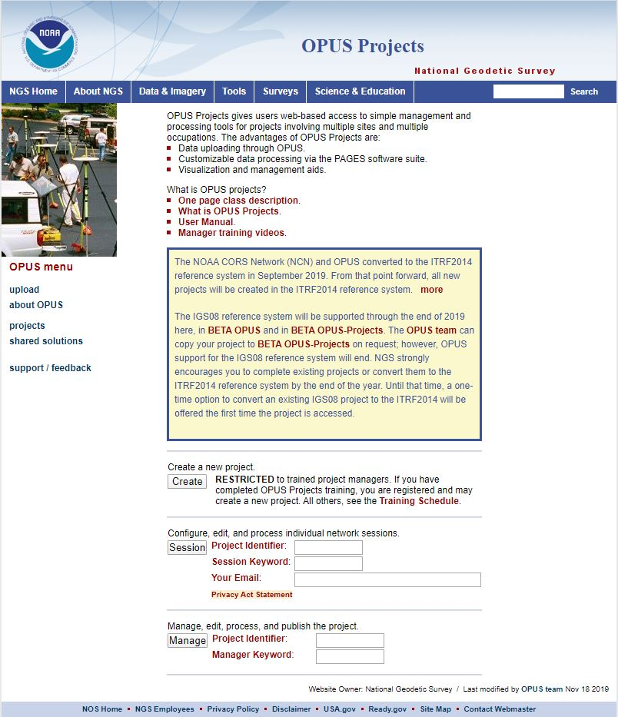
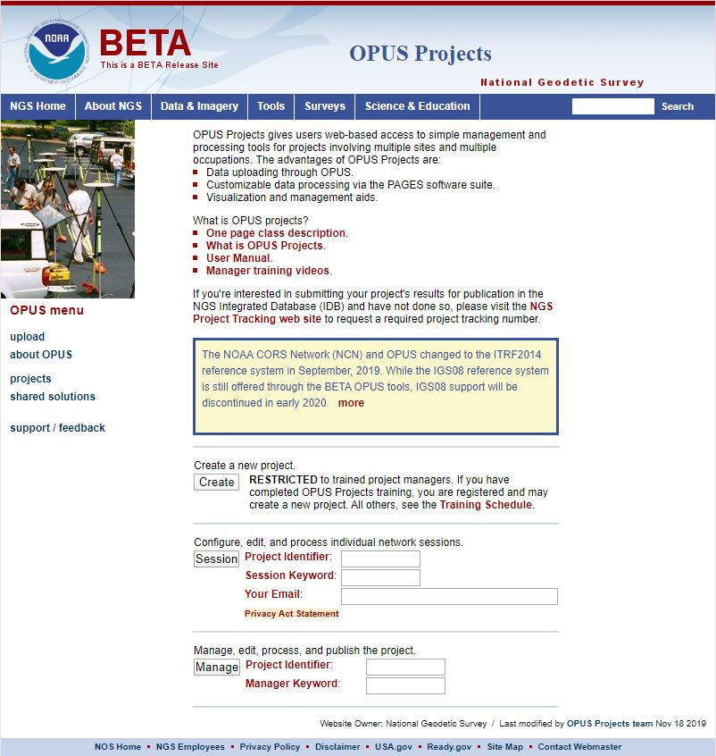
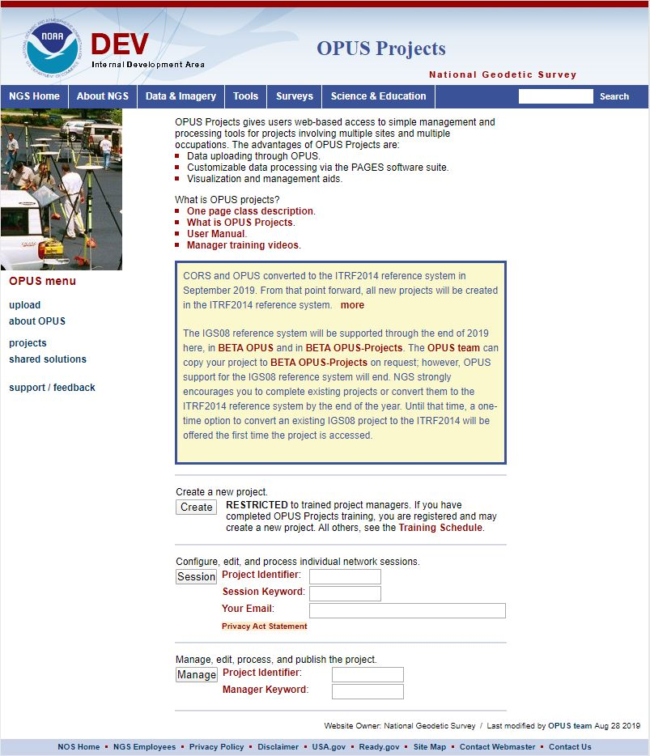
www.ngs.noaa.gov
beta.ngs.noaa.gov
Remember, you won’t see the DEV environment…
Notes:
So here we have 3 screenshots, first here showing the Production OPUS Projects gateway page
CLICK
Second is the Beta page, with the text here showing the URL for our Beta homepage
-How do you find that beta page? substitute “beta” for “www”
-or most tools that have a beta will have a link to that beta platform
CLICK
Last is the Development or DEV example, which again you will not see unless via a demo from NGS personnel

Slide 44
NGS Products and Services
Not just OPUS
All exist in three environments:
  Development (DEV) - internal testing and development
    same as when you hear a company talk about an “Alpha” product
  Beta - continued internal testing, open for public testing
    key features have already been vetted/tested
  Production - final product, open to public use
    this is what you see first when navigating our website
Notes:
I’ll be talking about OPUS today, but I need to clarify one of our processes for this to all be clear. I will also mention that this is a new-ish workflow for NGS, began in the past 8 or so years.
So all NGS Products & Services go thru this process as they are created, tested internally, open for testing by you our constituents, and then rolled out as final products.
CLICK
There’s three environments that products will exist in, listed here in the order they occur
First, a tool will be created on the “DEV” servers for internal NGS-only development, testing, and otherwise “working the bugs out”
→this is the same phase as when you hear a software company or video game maker talk about their alpha products
CLICK
Next, after some level of confidence in the product is gained, it will be migrated to the Beta servers, thereby open to the public for their own testing
→it’s important to note that when a product is available via our Beta page, when you use it you are indeed now a “beta tester”
key features will have already been tested in the Development environment, but it is still a beta, so as a beta tester please let us know if you have issues/complications/struggles or the like
CLICK
At some point, when all I’s are dotted and T’s crossed, the thing will be moved to the Production environment.
→ by then, the tool is integrated into others, has been vetted with 2 testing phases and functions as expected, but may still continue to receive version updates by repeating this process

Slide 45
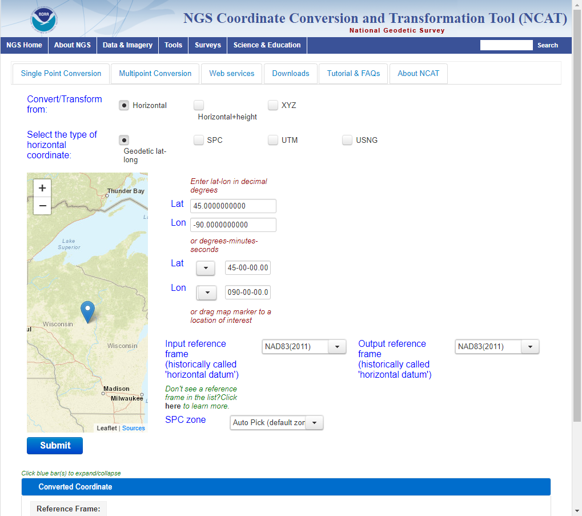
NGS Coordinate Conversion and Transformation Tool (NCAT)
Converts between types of coordinates
Transforms between datums
Works with vertical and horizontal datums in the NSRS

Slide 46
Transitioning Data into the Modernized NSRS
Most accurate, Most costly, Most complex
Resurvey
Readjust
Transform
Least accurate, Least costly, Least complex
Notes:
Listed in decreasing order of Accuracy, Cost, and Complexity, the ways for users of the NSRS to determine coordinates after modernization:
Resurvey: Return to the field and collect new observations, relying on geodetic control that has coordinates in the new datum. Useful for municipalities looking to migrate a local datum into the NSRS or for ongoing project control in areas experiencing lots of vertical motion
Readjust: Using existing observations, re-compute new coordinates based on geodetic control that has been defined in the new datum. Most appropriate for updating existing project control in stable regions
Transform: Take finished products that have coordinates in the old datum and use transformation software to estimate coordinates in the new datum. Best for updates to legacy mapping data.
Transition will be unlike past transition from NAD 27 and NGVD 29 to NAD 83 and NAVD 88:
Transformation tools will not trail release of Modernized NSRS
Resurveying/readjust still advised over transformations for most accuracy; tools to do this as well (e.g. better OPUS)
Digital data migration is far easier than the analog migrations of the past

Slide 47
NCAT https://www.ngs.noaa.gov/NCAT/
X, Y, Z
φ, λ, h
X, Y, Z
SPC
φ, λ, h
NATRF2022
epoch 2020.00
UTM
USSD
USNG
UTM
φ, λ, h
φ, λ, h
NAD 27
NAD 83 (2011)
epoch 2010.00
X, Y, Z
SPC
X, Y, Z
SPC
USNG
UTM
Transformations in RED
Conversions in BLACK
USNG
UTM
NAD 83 (NSRS2007)
φ, λ, h
NAD 83 (1986)
φ, λ, h
NAD 83 (FBN)
NAD 83 (HARN)
φ, λ, h
X, Y, Z
SPC
X, Y, Z
SPC
φ, λ, h
USNG
UTM
USNG
UTM
X, Y, Z
SPC
X, Y, Z
SPC
USNG
UTM
USNG
UTM
Notes:
9 CLICKS slowly
RED are “transformations”. Black are “conversions”. ALL are inside of NCAT.
2 CLICKS slowly
When it is released, NATRF2022 will be added to NCAT.

Slide 48
OPUS-PROJECTS Updates

Slide 49

What is OPUS?
OPUS-S (static processing, 2-48 hours)
OPUS-RS (rapid-static, 15 minutes – 2 hours)
Sharing database of solutions
OPUS Projects
  campaign style survey- processing, adjustments, publication

Slide 50

Share GPS observations through OPUS
Upload 4+hour GPS observation file
Provide antenna type, antenna height, and email address
Click “Options” & Select “Yes, Share”
Identify the Mark by PID
Write a “To Reach” description
Attach 2 photos: Close up & Horizon
Respond to confirmation email
geodesy.noaa.gov/corbin/class_description/opus-share-tutorial/

Slide 51
Why use OPUS-Projects?
Supports both static GPS and RTK GNSS surveys
Organizes data for multiple occupations on more than one mark
  Campaign-style surveys for control
Performs least squares adjustments of control survey networks
  Estimate relative accuracy between marks
Constrains NAVD 88 bench marks – check/establish NAVD 88 heights
Ensures survey is tied to the NSRS
  CORS data and published coordinates/heights
  Official models (HTDP, GEOID18)
Submits survey to NGS for review, loading in database, and publication on datasheets
  Establishment of geodetic control
  NGS will use data for making models (e.g., future transformation model for the new datums)

Slide 52
OPUS-Project 4.0
Currently on Production
What does this version add?
  Allows you to submit campaign style GPS survey to NGS for inclusion in the IDB (Integrated DataBase)
    Upload GPS data to OPUS-S
    Upload photos and mark descriptions
    Process simultaneous/overlapping sessions
    Run network adjustment (using GPSCOM and ADJUST)
    Click the “Submit” button to send to NGS!
(must be created using WinDesc)
Notes:
OP 4.0, our recent improvement allows users to submit campaign-style GPS surveys for inclusion into the NGS Integrated Database
→if you haven’t heard the phrase IDB before, that’s the database that holds the coordinates that you get on a Datasheet
So with version 4.0 you can
CLICK
Upload GPS data to OPUS-S
CLICK
Upload mark descriptions and photos … I do want to point out that descriptions and photos must be created/formatted with another tool we provide called WinDesc
CLICK
Process simultaneous/overlapping sessions
CLICK
Run least squares adjustment on the resulting network
CLICK
Then when you’re ready to submit just click the “Submit” button to send to us!
CLICK
For full details see our Webinar Series, recorded on 11 February 2021

Slide 53
OPUS-Projects 5
Available on BETA at: https://beta.ngs.noaa.gov/OP-bluebook/OpusProjects.shtml
Continues to support static GPS baseline processing and network adjustments
Continues to prepares all files according to FGCS Bluebook for submission to NGS for loading in the NGS Integrated Database and publication on Datasheets
Supports GVX → uploading of previously processed GNSS vectors
  Single-base RTK vectors
  Network RTK vectors
  Vectors post-processed in other software
Automatically “weights” uploaded vectors in a network least squares adjustment

Slide 54

Real-Time Networks
Virtual Reference Stations (VRS)
Master-Auxiliary Concept (MAC)
Vector “tails” referenced to virtual base station
Base station position is variable
Vector “tails” connected to physical base station
Base station position is fixed
RTN Base
RTN Base
VRS
Control
Center
(Landau et al. 2002)
RTN Base
(Leica 2005)
Notes:
VRS
1.) Rover sends approx. position to RTN control center
2.) Control center assigns this position as the location of an imaginary base station and interpolates corrections at this virtual location
3.) These interpolated corrections are used to generate corrected pseudo-observables that are “transmitted” from the virtual base to the rover to be processed using conventional single-base RTK algorithms to solve for precise geodetic coordinates at the rover (Wang et al. 2010)
MAC
1.) The rover transmits an uncorrected point position to the central server, and then the server searches and selects a “cell” of reference stations for generating corrections
2.) The phase ranges from all selected stations are reduced to a common ambiguity level, and dispersive and nondispersive errors for each frequency and satellite-receiver pair are computed relative to the master station
3.) The residual corrections between the auxiliary stations and the master station, as well as the full corrections and published coordinates at the master station are transmitted to the rover. The rover then interpolates the received corrections and network information to derive its precise position (Janssen 2009).

Slide 55

Empirical Evaluation of the Accuracy of RTNs
95% Confidence
± 5.0 cm, vertical
± 2.5 cm, horizontal
Or similar to accuracy of a 2-h OPUS-S solution!
Ellipsoid Height
Horizontal
[Allahyari et al. 2018]

Slide 56




GNSS Vector eXchange (GVX)
Hyperlink to GVX Info Page
Detailed documentation, Schema, and Example File available
Any major search engine: “ngs gvx file format”
Open standard for anyone to use or integrate
GVX is sort of like RINEX for RTK/RTN data

Slide 57
GVX ≈ RINEX for RTK/RTN data
RINEX
GVX
Uncorrected Observations
That’s why we post-process them
Static Observations
One observation per file
Proprietary Format → Open Standard
Export RINEX using your COTS software
Metadata
Antenna, Rx, HI, Point Name, Start Time, SVs at each epoch
Based on ASCII Text File Format
Longtime industry standard
  Way too many to list!
Corrected/Processed Positions
And the Vectors used to create them
RTN, RTK, PP Static, even PPK
Many observations, any mix of above
Proprietary Format → Open Standard
Export GVX using your COTS software
Metadata - same as RINEX, plus…
Project Info, Solution Types, PDOP, Mount Points, Correlation Matrices, QC data
Based on XML File Format
Longtime industry standard
  e.g. LandXML, JXL, MAXML, KML/KMZ

Slide 58







Status of GVX Exporters
…that we know of.
Available Now
Trimble Business Center (TBC) v5.60 - released Nov 2021
Topcon MAGNET Software v7.2 - released Nov 2021
Leica Infinity 4.0.0 - released May 2022
Developers who have expressed interest to us
iGage
Carlson
Emlid
Available, but not fully functional
JAVAD J-field - onboard Triumph-LS device
Notes:
-Please note that this information here can only reflect what we know. If you are a developer working on incorporating GVX into your software… reach out to us! We would be happy to assist you, just as we have assisted some of our other commercial partners named here.
-What would make us happiest is if the list got so long we couldn’t fit in on this slide.
-Oh, and hey, you customers out there… express your desire for GVX to your suppliers/dealers or Support team

Slide 59
GVX Flow Chart

Slide 60
Steps for Submitting a Survey to NGS
Submit a survey project proposal and obtain a project tracking ID
Create descriptions for marks in WinDesc. Tutorial video available
Upload all static data via Beta OPUS-S
Upload GVX file(s)
Upload description files from WinDesc
Perform session baseline processing
Run all 5 network adjustments
Upload 3 photos per mark (close-up of mark, horizon photo, and downward from eye-level)
Upload observation logs (as a single PDF), and a project report
Submit to NGS (button not enabled on Beta)
All but step 4 is currently explained in the OPUS-Projects User Guide!

Slide 61

Guidance for RTK Surveys

Slide 62

Equipment Setup
When using VRS, store points as vectors

Slide 63



Three Cases for RTK/RTN Bases
RTN Base = CORS
Automatically attaches GVX vectors to official coordinates for CORS
Constrain CORSs
RTK/RTN Base = Not a CORS and new to NGS
Upload static GPS data logged at the base during the days of the RTK survey
Perform session baseline processing to connect to CORSs
Constrain CORSs
3. RTK/RTN Base = Not a CORS but has a datasheet
Could constrain coordinates on datasheet
Or, upload static data at the RTN base, logged during the days of the RTK survey; perform session baseline processing; constrain CORSs

Slide 64
Future Directions
Perform Beta Testing and respond to feedback from users
  Provide your feedback! NGS.Feedback@noaa.gov
Finish OPUS-Projects 5 development and enable “submit” button
Update OPUS-Projects User Guide materials to include GVX workflow
Draft new guidelines for surveying with RTK/RTN to replace NGS-58/59

Slide 65

Datasheets
Datasheets are the current way to access the NSRS
Give information about passive marks, including coordinates

Slide 66

Beta Passive Marks page
Easier to read
Includes geospatial information
A preview of the future data delivery system
https://beta.ngs.noaa.gov/datasheets/passive-marks/index.html
Notes:
Show DE9524, a mark near Springfield

Slide 67


Beta Passive Marks page

Slide 68

Easy to use mark recovery tool
https://geodesy.noaa.gov/cgi-bin/mark_recovery_form.prl

Slide 69

NGS Map
https://geodesy.noaa.gov/datasheets/ngs_map/

Slide 70
GPS on Bench Marks

Slide 71

GPS on Bench Marks
Priority Map:
https://noaa.maps.arcgis.com/apps/webappviewer/index.html?id=6093dd81e9e94f7a9062e2fe5fb2f7f5
https://geodesy.noaa.gov/GPSonBM/

Slide 72



GPS on Bench Marks - What & Why?
GPS on Bench Marks is about preparing the country and our communities to take full advantage of the benefits of the Modernized NSRS, by collecting new GPS observations on bench marks with published NAVD 88 heights.
Primary GPSonBM Campaign Benefits:
2020.0 Reference Epoch Coordinates (REC’s)
Data for NAVD 88 – NAPGD2022 Transformation Tools
Build time series of observations in areas of motion
Added benefits:
Evaluate gravimetric geoid models
Check your RTN results
Update and maintain passive control marks
Identify marks suspected of movement
Notes:
NGS’ GPSonBM program is now requesting data to build the models that NCAT and VDatum will use to transform geospatial data from existing datums to the Modernized National Spatial Reference System.
These are the benefits that we derive that other countries could derive as well. The processes, tools, workflow, and technical specifications that we have developed can be applied in other places. We are keeping in house the definition of the NSRS, outsourcing the observations to realize the frames
Went back to marks that were set before that are no longer accessible or gpsable – so this provides ongoing maintenance. Marks were set open fields and now are developments – road widening (Chicago grew)
revisit Geodetic infrastructure regularly for maintenance

Slide 73

GPSonBM Measurements Connect
Current and Future Datums
The relationship between the old and new datums vary by location. GPSonBM data is used to measure that relationship. The accuracy of the transformations in any particular place will be directly related to the density of GPSonBM data available in that area.
  In moving from NAVD 88 to NAPGD2022, there will be a Shift: A one-time 0 to 2 meter jump in orthometric heights
  -From fixing biases and/or tilts in NAVD 88
PID: EZ0840
GPSonBM data is used to measure the Shift

Slide 74


2022 Transformation Tool Campaign
NGS will make a national scale, mapping grade transformation tool with the data we have in the NGS Database and Shared through OPUS. We must interpolate over areas with data gaps.
Uncertainties in the transformed coordinates will grow larger as the distance from a GPSonBM data point increases.

Slide 75




Data Contribution Routes
 | via OPUS option “share my solution” | via OPUS option “project ID”
WHAT DATA? | minimal one receiver, one 4+ hour observation | more; many receivers, redundant sessions, network adjusted by project manager
USE, in transformation tool | Will be used in modeling, existing BMs only (with published ortho heights) | Will be used in modeling, all marks, as projects publish new NGS datasheets with ortho heights
USE, in current generation datasheets | for all marks, results appear as ‘shared solutions’ = not published geodetic control for existing BM datasheets only, updates “SCALED”>“HD_HELD2” coordinates | for all marks, results appear as NGS datasheets = published geodetic control
USE, in next generation datasheets | will be published with 2020.00 RECs in the modernized NSRS
see also, mark recovery to update mark descriptions and add photos

Slide 76



FAQ’s #1
Q: What is the deadline to submit GPSonBM for the Transformation Tool?
A: September 30, 2023– so that observations can be used to create 2020.0 Reference Epoch Coordinates (See Blueprint 3 -Working in the Modernized NSRS)
Q: Can we submit previous observations?
A: Yes! Observations made within the past 3 years may be submitted if you have the required metadata and pictures.
Q: What do we do if we can’t find the priority mark or if it not observable with GPS?
A: 1) Submit a Mark Recovery with the new Mark Recovery Form.
2) Find and observe an secondary mark listed in the hexagon layer on the web map.

Slide 77
FAQ’s #2
Q: Can we submit offset observations for marks that are not GPS-able?
A: Not for now, unless you follow the NGS Mark Reset Procedures. In the future, OPUS 6.0 will enable you to process and adjust GPS, leveling, and total station observations together, and submit them to NGS.
Q: Can we submit less than 4 hours of data?
A: Yes, but only by using OPUS Projects to Bluebook the data.
Q: Can we submit RTK observations?
A: YES! The recently released BETA version of OPUS Projects 5.1 enables processing of Hybrid Survey Networks that include both static and real-time observations uploaded in the new GVX vector exchange file format.

Slide 78

Required Metadata for GVXonBM
WinDesc Files → 1 each of .dsc, .des, .err, .dis, .nbr
  Yes, for the foreseeable future you will need to download, install, and learn how to use WinDesc
3 photos per mark → uploaded to Marks Pages
  close-up
  downward from eye-level
  horizon/setup
Project Report (PDF)
Observation Logs (single PDF)

Slide 79
Resources
Survey Project Proposal Page
WinDesc Tutorial Video
OPUS Projects User Guide (HTML version)
OPUS Projects User Guide (PDF version)
Requirements for Using OPUS-Projects 5 in the 2023 GPSonBM Campaign

Slide 80

Save the Date! NGS day at FIG 2023
NGS will present a full day’s worth of content at the 2023 FIG Working Week in Orlando, FL on May 31, 2023
https://fig.net/fig2023/
https://geodesy.noaa.gov/datums/newdatums/fig-2023.shtml

Slide 81

NGS Webinar Series
Monthly webinars highlight geodesy and coastal mapping programs, products, and research
Each webinar features an NGS employee delving into a topic of interest, and generally includes a moderated question and answer session
Registration is free and video recordings are made available for later viewing
Certificates of attendance are available
https://geodesy.noaa.gov/web/science_edu/webinar_series/

Slide 82

https://geodesy.noaa.gov/
Notes:
Monthly webinar series
All webinars are recorded and available online
Online lessons
Video library
Publication library
NSRS Modernization News

Slide 83
Deprecation of the US Survey Foot
U.S. survey foot was deprecated on December 31, 2022
But use can continue for SPCS 83 (and SPCS 27)
  The 40 states that “officially” use U.S. foot for SPCS 83
  All SPCS 27 zones
  NGS will support such “legacy” use forever
  But NOT supported for ANY zones in SPCS2022
NGS will always support
U.S. survey foot for SPCS 83 and 27

Slide 84
NSRS Modernization: Delay
Will names change?
    No, “GEOID2022”, “NATRF2022”, etc. will remain the same
NGS anticipates the release of all data, and limited tools, by the middle of 2025.
  Some of this may depend on things outside of NGS control (we have already delayed beyond 2022!)
Work on additional tools will continue in the out-years

Slide 85
Thank You!
Jacob M. Heck, Ph.D., P.S.
Great Lakes Regional Geodetic Advisor (IL, WI, MI, IN)
U.S. National Geodetic Survey, NOAA
jacob.heck@noaa.gov
c/o NOAA Great Lakes Environmental Research Laboratory
4840 S. State Road
Ann Arbor, MI 48108
For more information, visit https://geodesy.noaa.gov

Slide 88
New types of Coordinates

Slide 89

Coordinate: One of a set of N numbers designating the location of a point in N-dimensional space. Specific to the modernized NSRS, five types of coordinates will be supported.
Notes:
All of the information in this presentation is in the NGS Blueprint Part 3
Was updated in 2021
Definitions come directly out of it

Slide 90
New Types of Coordinates
NGS anticipates that 5 types of coordinates will be used in the NSRS. They are:
Reported
OPUS
Reference Epoch
Survey Epoch
Active
Notes:
These coordinate types apply to both geopotential coordinates and geometric coordinates.

Slide 91
“Part of the NSRS”
Only coordinates computed by NGS and stored in the NSRS database are “part of the NSRS”
  Reference Epoch
  Survey Epoch
  Active
OPUS Coordinates can be “tied to the NSRS”

Slide 92

Passive Control
Any geodetic control point that is not active control. Common examples include a metal disk set in concrete or stone, or a stainless steel rod driven into the ground.

Slide 93



Active Control
A geodetic control point at a station occupied by equipment intended for and capable of continuously collecting geodetic quality data for multiple years and with active defined by or adopted by NGS.
CORS

Slide 94
Shift and Drift
When transitioning off of NAD 83, your coordinates will experience shift and drift
  Shift: A one-time jump somewhere in the 0 to 4 meter range (latitude, longitude, ellipsoid height)
  Drift: Coordinates are now time-dependent. The shift will take you to 2020.00. Working at any other epoch means you must account for the drift (velocity, as well as any other motions over time) of your coordinates

Slide 95
New Types of Coordinates
Reported
  “Coordinates directly reported to NGS without the data necessary for NGS to replicate or evaluate them. These coordinates are neither ‘part of the NSRS’ nor ‘tied to the NSRS.’”
    Scaled from a map
    Transformed using NCAT or VDatum
    Smartphone
    Reported directly from an RTK rover without data files
Notes:
These are coordinates directly reported to NGS without the data necessary for us to replicate or evaluate them.

Slide 96


Reported Coordinates

Slide 97
Buyer Beware!
Reported coordinates might be very wrong!
  Reported in NAD 27 or NAD 83 or WGS 84
    Systematic Error: 2–100 meters
  Scaled off of a USGS topographic map
    Random Error: ± 600 meters
  Smartphone
    Random Error: ± 10–50 meters
NGS will show you reported coordinates
  But their function is to get you “in the neighborhood” of a mark, not to use as geodetic control!

Slide 98
New Types of Coordinates
OPUS
  “Coordinates computed by OPUS that have not been evaluated by anyone at NGS. As these coordinates are not computed by NGS they are not considered “part of the NSRS.” However, if NGS-provided OPUS recommendations are followed, they may be ‘tied to the NSRS.’ ”
    User-computed values, such as they might get today from either OPUS-S or OPUS Projects
    “OPUS” coordinates are the only coordinates a user will get directly from OPUS
    NGS will not evaluate your OPUS coordinates!

Slide 99
New Types of Coordinates
OPUS coordinates may also come with the label “tied to the NSRS”
  Only if a user restricts their computations to OPUS-recommended constraints
  Users who deviate from OPUS-recommended constraints can still perform computations and will get OPUS coordinates, but they will not be “tied to the NSRS”, nor have any NSRS label at all.
  In neither case will OPUS coordinates be considered “part of the NSRS” however.

Slide 100
data processing
Did you follow OPUS recommendations?
Survey data
OPUS
yes
no
If you choose to deviate from the OPUS recommendations:
OPUS will warn you when you do so
You will receive an explanation why your coordinates are not tied to the NSRS
OPUS Coordinates that are
“tied to the NSRS”
OPUS Coordinates that are
“not tied to the NSRS”
Do you want to “share” your results with the world?
yes
no
Unique, public URL for this survey which you can share with anyone
Your results are shown to you on screen or via email only
Notes:
- this is the modernized NSRS
- OPUS 6.0

Slide 101
New Types of Coordinates
Reference epoch coordinates (RECs)
  “Coordinates estimated by NGS for one of the official reference epochs. As these coordinates are computed by NGS they are considered ‘part of the NSRS’”
  These will be computed by NGS every 5 or 10 years
      On a schedule 2–3 years past the reference epoch
Notes:
These are coordinates computed by NGS in an adjustment project to estimate the coordinates at one of the official (every five or ten years, as currently planned) reference epochs NGS will define
” As (generally) all such coordinates come from observations that did not take place at the reference epoch, such coordinates require the introduction of an intra-frame deformation model (IFDM) into the adjustment, and thus the coordinates so computed are subject to all uncertainties and assumptions in the IFDM. 38 See Section 2.11, and Figure 3.
Part of the NSRS
Based on “snapshot” of entire NSRS control network
Published every 5 or 10 years
Familiar to many users…NAD 83(2011) epoch 2010.00 (sort of) would’ve fallen under this category

Slide 102
New Types of Coordinates
Survey epoch coordinates (SECs)
  “Coordinates computed by NGS for one survey epoch. As these coordinates are computed by NGS they are considered ‘part of the NSRS.’”
    These represent the best estimates NGS has of the time-dependent coordinates at any mark
    Adjusting multiple surveys in timespans called “adjustment windows”, to a single epoch within that window.
      Initial plan: 4 weeks for GNSS; 1 year for leveling
Notes:
These are coordinates computed by NGS using submitted data and its metadata, then checked, adjusted and defined at one “survey epoch.” Thus, they are “part of the NSRS.” These represent the best estimates we have of the coordinates at any mark at some specific point in time

Slide 103

More on SECs and RECs
At passive control
SECs: adjusted to a midpoint epoch near the survey
  (4 weeks for GNSS; 1 year for leveling)
RECs: adjusted to a ref. epoch (2020.00, etc.)
REC adjustments will include Some age-limited span of data
  If that age-limit were 10 years prior and 2 years post R.E., Then 2020.00 RECs come from data spanning 2010.00 to 2021.99999
Notes:
SECs can be used to highlight changes over time
RECs can be used to “hide” changes over time
Exact age-limit won’t be known until we start experimenting in 2022 with the 2020.00 REC adjustments
Ellipsoidal height SECs (purple) and RECs (red) for a fictitious point. Note that RECs are computed on a regular and repeating schedule, but SECs are computed specifically for when data is collected. As such, note the growing error bars for RECs going forward in time as no new data is being collected on this point

Slide 104
New Types of Coordinates
Active coordinates (ACs)
  Coordinate functions in time, generated by NGS, and not associated with a specific epoch. As these coordinates are computed by NGS (or adopted by NGS) they are considered “part of the NSRS.”
  Which will be generated by a “fit” to regularly computed coordinates
Notes:
Unlike all other coordinates, active coordinates are actually coordinate functions in time, and not associated with a specific epoch. They will only be generated by NGS at stations with active control, such as a continuous GNSS receiver or a continuous gravimeter. Thus, they are “part of the NSRS”. At a CORS, they will be identical to the CORS coordinate function (see Terminology Guide). They will not exist on passive control
Daily or weekly CORS coordinates will be generated and the active coordinates will be a function fit to these regularly generated coordinates.

Slide 105


Examples of How Non-Linear CORS Coordinate Functions Might Look

Slide 106

Published Coordinates
RECs ‘stable’ at project scales (5-10 years)

Slide 107
Published Coordinates
RECs ‘stable’ at project scales (5-10 years)
SECs reflective of narrow window in time
ACs or Coordinate Function at CORS
height
time

Slide 108
Coordinates
Five types:
  Active: Continuous functions at a CORS
  Survey Epoch: “Time dependent coordinates”
  Reference Epoch: “Estimated at 2020, 2025, 2030, …”
  OPUS: Computed by you, and as accurate or inaccurate as the choices you make
    Tied to the NSRS if you follow OPUS recommendations
  Reported: Good for finding a point somewhere on Earth.
    Not to be used as geodetic control

