Slide 1
Uniting Global Efforts to Calibrate GNSS Antennas
Tobias Kersten², Igor Sutyagin³, Andria Bilich¹, Steffen Schön²
¹NOAA's National Geodetic Survey, United States of America
²Leibniz University Hannover, Institut für Erdmessung (IfE)
³Topcon Agriculture S.R.L.

Slide 2

GNSS Receiver Antenna Calibration
Characterization GNSS receiver and satellite antennas
No certification through standards (IEEE, ISO, etc.)
IGS - International commitment to achieve the highest quality for global products (ANTEX)
Phase Center Correction
PCC=PCO+PCV
Instant
Phase Center
Mean
Phase
Center
Phase Center Variations
(PCV)
Phase Center Offset
(PCO)
Antenna Reference Point
(ARP)
Notes:
Calibration is the act of characterizing the behavior of a GNSS antenna.
This talk concentrates on carrier phase calibrations of receiver antennas used at ground stations.
Calibration of GNSS antennas is not equivalent to certification
Thus the IGS through its Antenna Committee serves an important role in verifying the quality of antenna calibrations so that the highest quality product is achieved.
The calibration product is often referred to as IGS ANTEX, for antenna exchange format.
The ANTEX file contains models for the total phase center correction or PCC, a correction applied when processing GNSS data.
In the ANTEX format, PCC is decomposed into two components, the PCO and PCV. I will refer to PCO, PCV, and PCC throughout this talk.

Slide 3

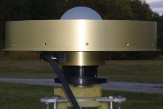
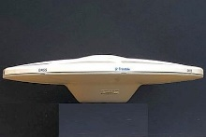
Summary of this Presentation
Overview of IGS “RingCalVal” campaign
(ring calibration and validation)
Campaign goals:
  Develop equations and software for comparing calibrations
  Compare facilities: chamber, robot, etc.
  Compare facilities contributing to IGS, now vs. future
  Understand impacts on GNSS solutions
Analysis advances: software and metrics
Results from “RingCalVal” antennas
Notes:
This talk presents early results from the IGS calibration and validation campaign, where antennas were circulated in a “ring” around the globe.
We will provide an overview of the campaign, which had multiple goals listed here
To meet those goals, the campaign organizers developed new software and equations for analyzing the results. I will share early results using the new software and metrics on data collected in this campaign.

Slide 4
Overview of IGS “RingCalVal” campaign

Slide 5
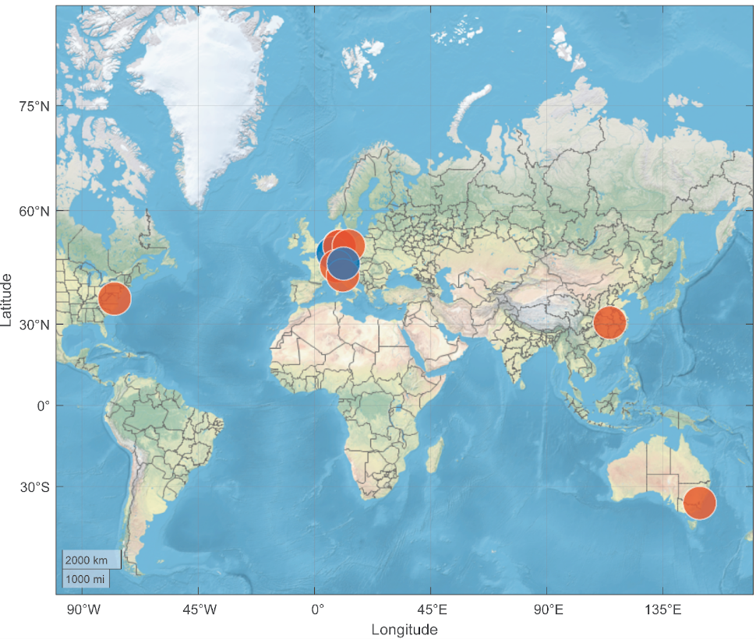
International Collaboration to Compare Calibrations
Agencies & Methods: Robot and Chamber
NGS* National Geodetic Survey (US)
TOP* Topcon Livermore (US/IT)
IFE* Institut für Erdmessung (DE)
GPP Geo++ (DE)
ETH ETH Zurich (CH)
WUH GNSS-RC Wuhan (CN)
GSA Geoscience Australia (AU)
IGG University of Bonn (DE)
DLR DLR Oberpfaffenhofen (DE)
* Coordinators
Möllers, A. (2024)
Möllers, A (2024). Multi-GNSS antenna corrections and GNSS reference stations, B.Sc. Thesis, Leibniz University Hannover
Notes:
Over the history of absolute antenna calibrations at IGS, Geo++ has been the most significant contributor to IGS ANTEX
In the previous decade, agencies such as Geoscience Australia and Uni Bonn have also contributed calibrations.
And in the last few years, several other agencies have built additional facilities and expressed interest in contributing to the IGS.
This collaboration brought together 9 agencies across the globe to compare results. My thanks to all of these groups for their efforts in calibrating antennas and freely providing results.

Slide 6
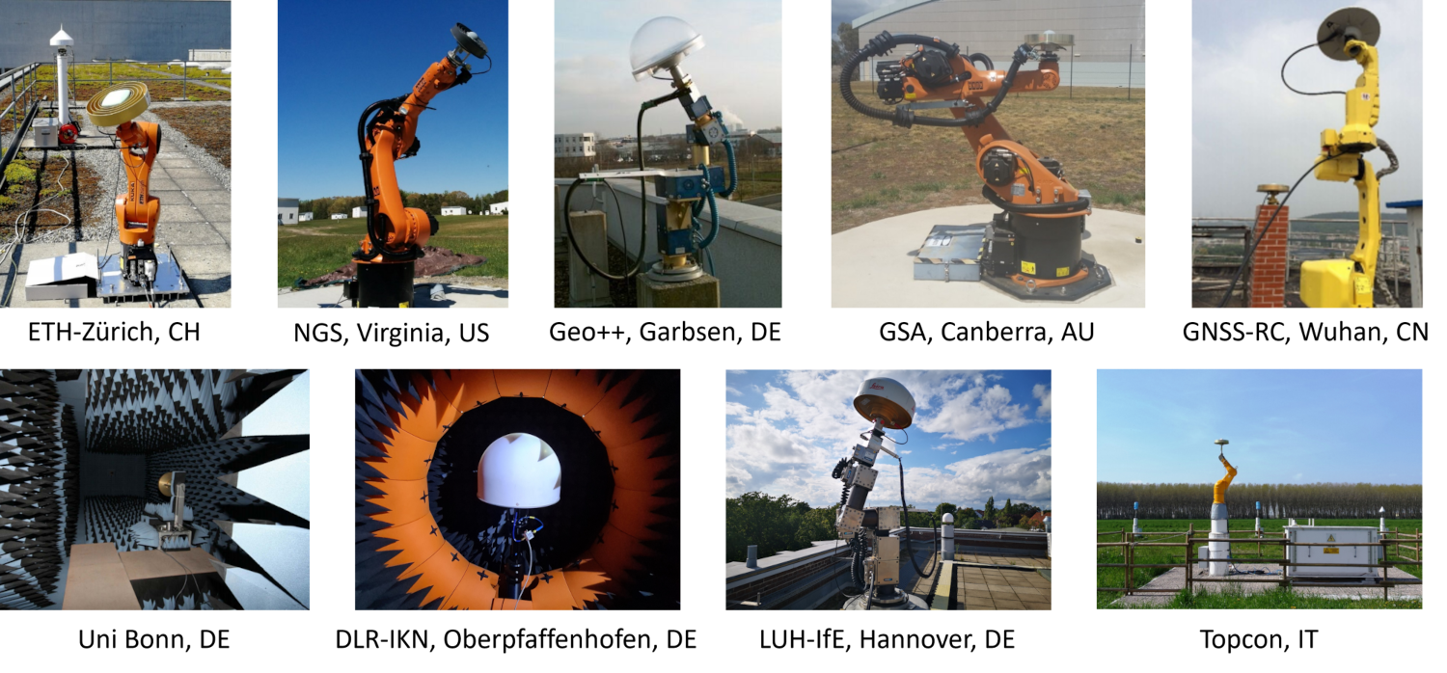
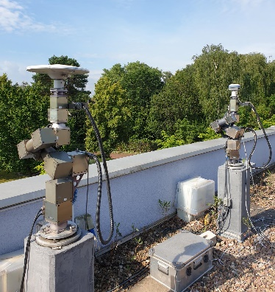
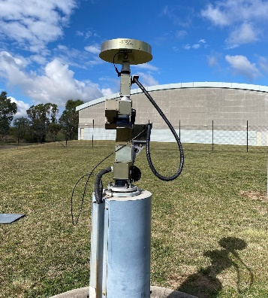
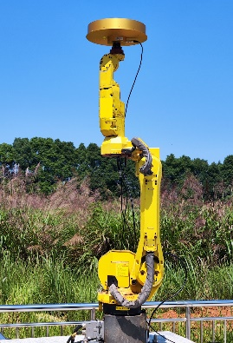
Participating Facilities
= matching equipment
Notes:
7 of the participating facilities use a variety of robots in outdoor environments, whereas 2 facilities operate anechoic chambers.
It is worth noting that several facilities operate Schunk robots and calibration software sold by Geo++
These facilities are allowed to provide calibrations to the IGS as a matter of routine due to this matching equipment.
We note that important differences exist between the facilities with this equipment, such as analysis software, GNSS receivers, and of course the field environment.

Slide 7
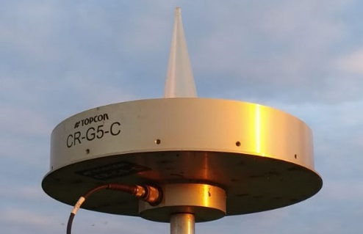

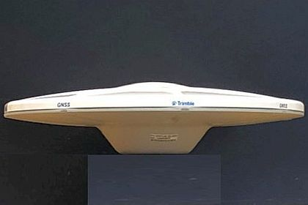
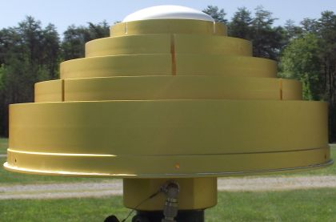
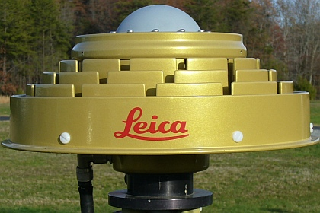
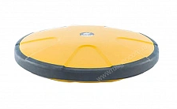
Antennas Tested (without radome)
IGS Network
as of 20 June 2024
Groundplane
11%
Flat CR
70%
TPSCR.G5C
JAVRINGANT_DM
TRM57971.00
Other
4%
Conical CR
15%
HXCCGX601A
LEIAR25.R3
TPSG5_A1
Notes:
6 individual antennas were provided by participants for calibration.
In this campaign, we calibrated all antennas without radomes, even if that model is present in the IGS network with a radome. For example, the Harxon antenna is only present in the IGS network with a radome. We decided to ignore radomes to ease the process and remove a variable that may introduce inconsistency.
The models chosen represent typical antenna models and types present in the IGS Network today.
The green shapes give the percentage of IGS stations with that category of antenna.

Slide 8
Current status as of 19 June 2024
Region | Facility | TPSCR.G5C | TPSG5.A1 | JAVRINGANT_DM | TRM57971.00 | LEIAR25.R3 | HXCCGX601A
Australia | GSA
China | WHU
Europe | DLR
 | IGG
 | GPP
 | TOP
 | ETH
 | IFE
USA | NGS
Complete
Complete, no results
Testing
Waiting
Notes:
Circulation of antennas began almost 2 years ago, and testing is nearly complete. This graphic shows data availability as of one week ago, when we compiled these initial results.
Three antennas are currently at DLR for testing, and Geosci Australia and Uni Bonn (IGG) are awaiting the last antennas in the circulation plan.
Preliminary analysis showed that DLR results must be reanalyzed, so their early results are not included in this study. All calibrations in dark green are included in our analysis.

Slide 9
Advances in Data Analysis

Slide 10
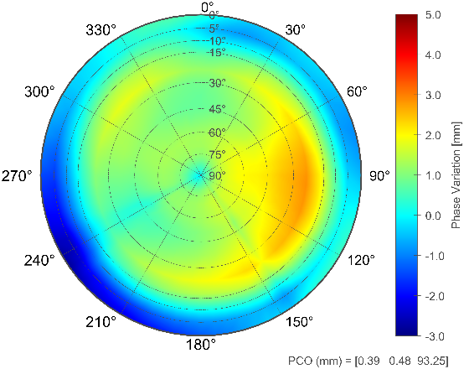
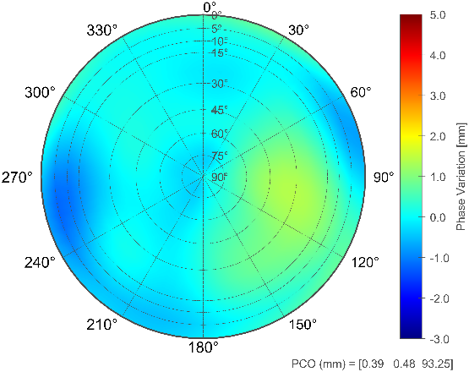
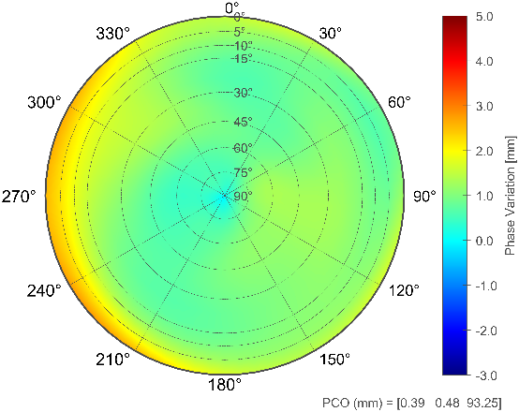
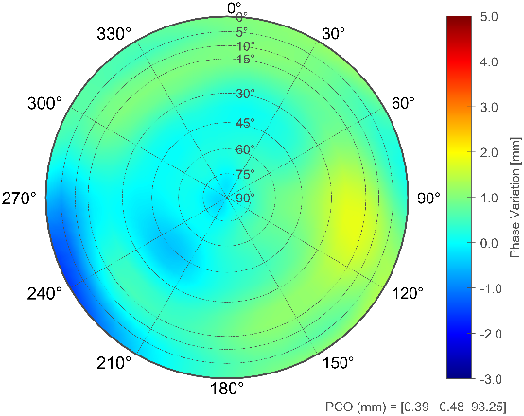
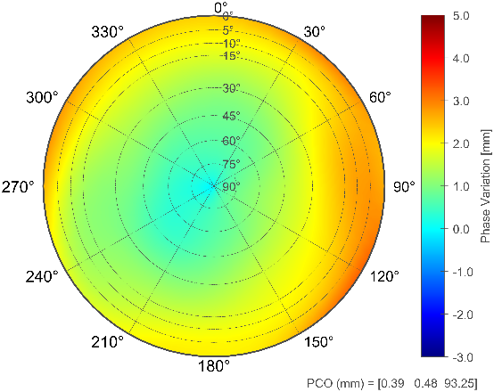
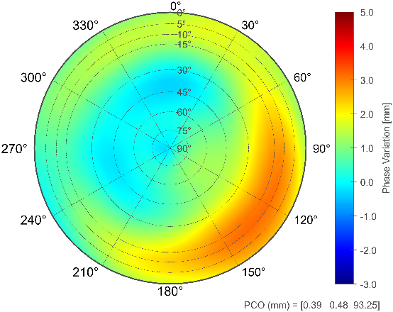
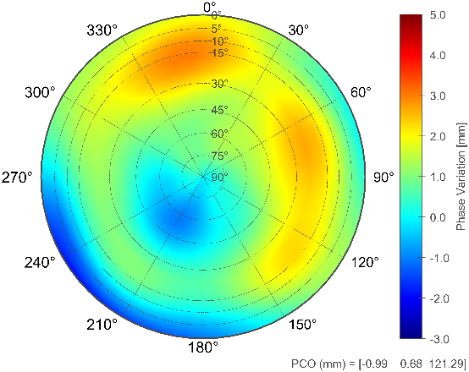
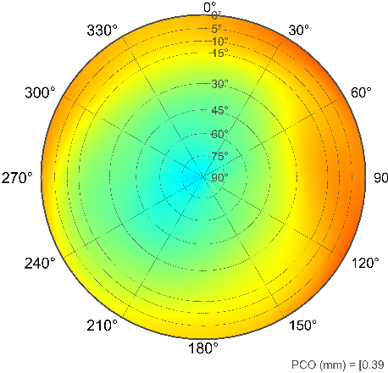
TPSCR_G5C : dPCC / GPS L1 (ref. IGS20 type mean)
ETH
IFE
TPS
GPP-MP8
IGG
WHU
NGS
GPP-MP4
Notes:
In the past, calibrations were often assessed in terms of their spatial PCC differences . As you can see with these 3-dimensional plots, it can be difficult to assess the meaning of PCC differences with this traditional approach. We have therefore devised new metrics for comparison and assessment which allow analysis in a consistent and geodetically meaningful way.

Slide 11
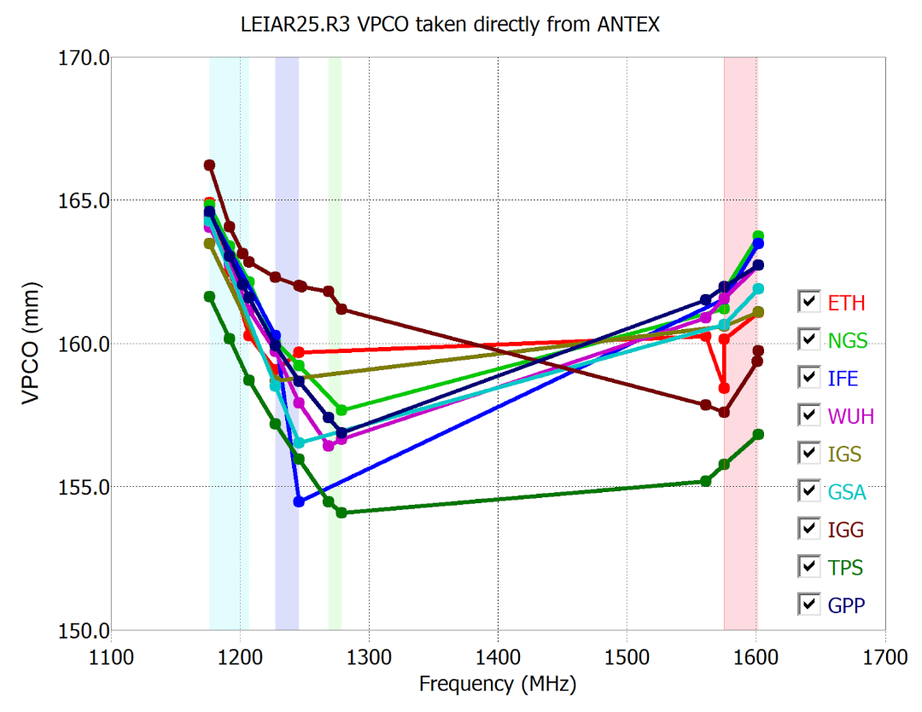
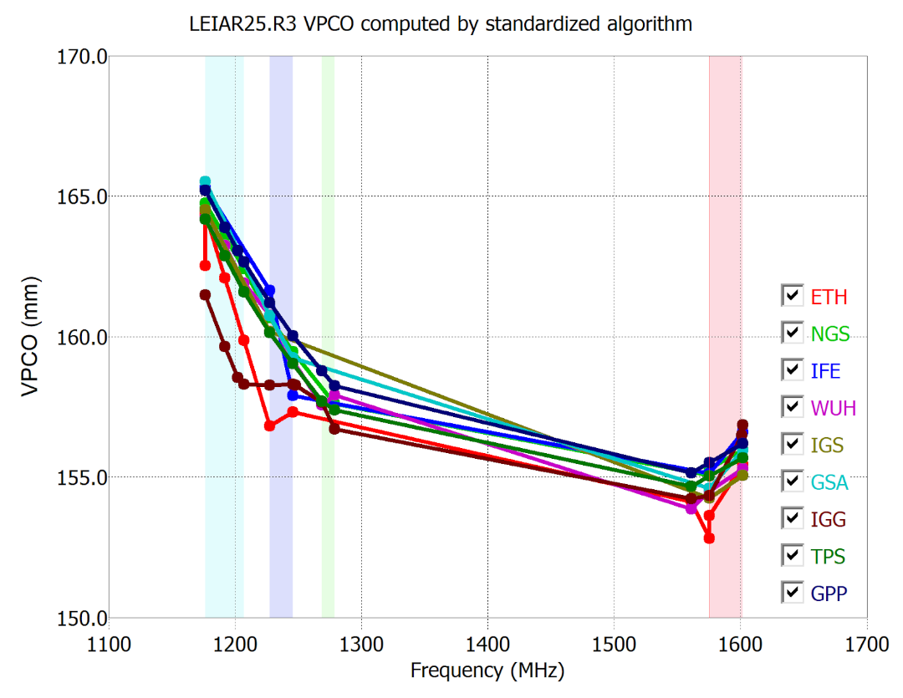
Consistent vertical PCOs (VPCO)
Facility-dependent
Consistent
Notes:
Often a comparison of PCO values is desirable, as PCO represents the mean phase center of the GNSS observation.
We note that, although it can be instructive to view calibrations as their component PCO or PCV, the separation between PCO and PCV is arbitrary, and the total PCC is what is applied in positioning software.
Thus, our study developed a robust method to separate PCO from PCC, so that PCOs can be consistently compared.
On the left, we show the PCOs from the participants’ ANTEX files for one of the antennas studied.
On the right, we show the same results after re-solving for PCO in a consistent manner. The degree of agreement is now much easier to observe.

Slide 12
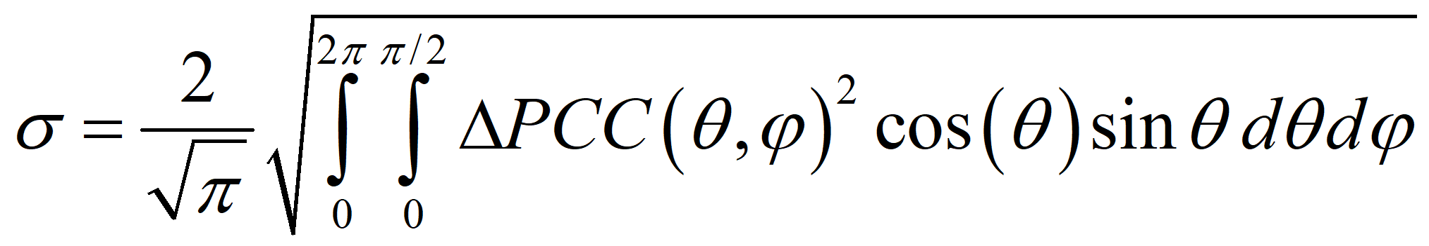
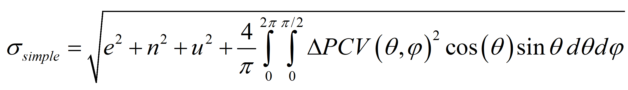
Scalar ∆PCC
Compress variability into a single scalar quantity, summarizing the distance between two PCC
Notes:
Another advance is the development of a metric which summarizes the differences between two calibrations as a single quantity. We call this the scalar delta PCC or “scalar metric”. In this formulation, the spatial variation in PCC is compressed into a single value.
When this metric is applied to two calibrations with the same phase center variations, it gives the distance between their phase centers. So, it is expressed in length units. This metric also de-weights data for low elevation angles, as is typical for GNSS.

Slide 13
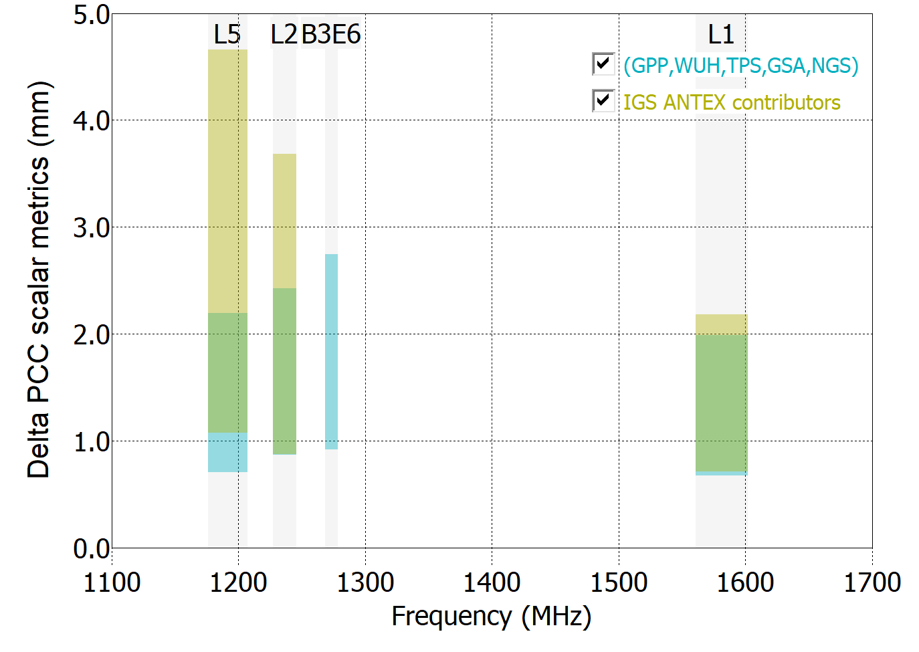
Scalar ∆PCC
min
max
Compress variability into a single scalar quantity, summarizing the distance between two PCC
Notes:
In our study, we looked at the spread of scalar values for groups of antennas.
The range is represented using the minimum and maximum values from a group of calibrations, and this spread is only calculated when 3 or more antennas are present in a group. More on groups in a bit ...

Slide 14
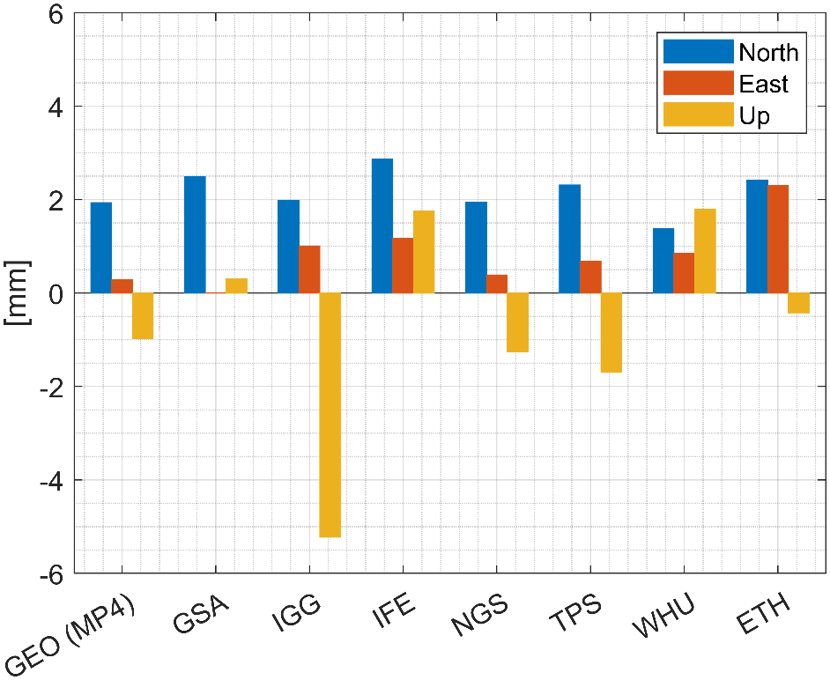
∆PCC impacts in the parameter domain
Impacts of
individual
vs.
IGS Type Mean
calibrations
in the parameter domain
Notes:
We are in a reference frame session, so I expect audience members want to know how calibration differences affect GNSS positioning. So we also simulated the impact of the dPCC on the parameter domain. The simulation uses ionosphere-free dual frequency combinations for each GNSS.
We show the expected change in north, east, and up components of position when using a specific individual calibration, relative to a solution using the IGS type mean calibration. These are not position errors, rather they are changes in position.

Slide 15
Classification into groups
Notes:
Important to our study was understanding the degree of agreement or disagreement among different techniques and facilities. For each antenna under study, we classify the facilities by two groups:
CLICK The first group are facilities that already contribute to the IGS. Those are facilities that appear in the IGS20 ANTEX file today. We will indicate this group using a tan color.
CLICK The second group are facilities which agree with each other within 2 mm VPCO on all frequencies. We indicate this group using a cyan color.
The two groups would change for each antenna and overlap to some degree, as we will show in the following slides.

Slide 16
Results:
6 antennas from “ring calibration” campaign

Slide 17
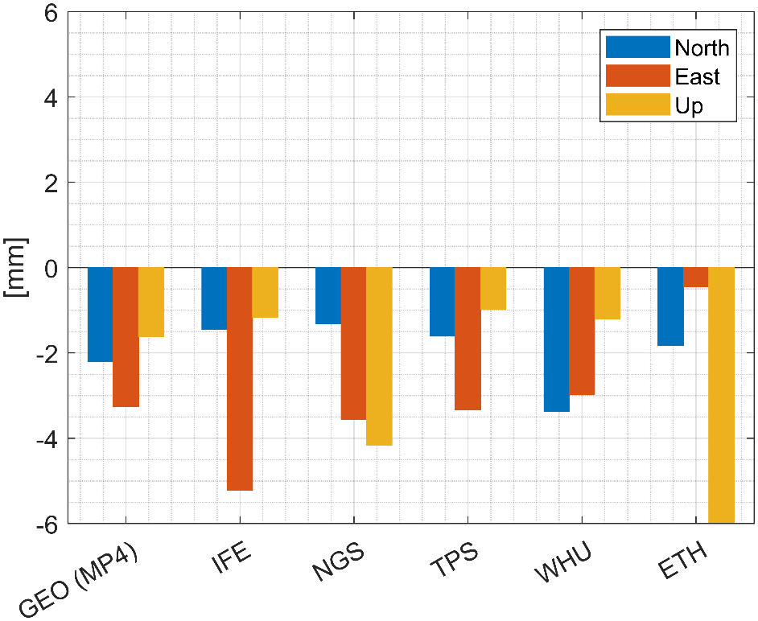

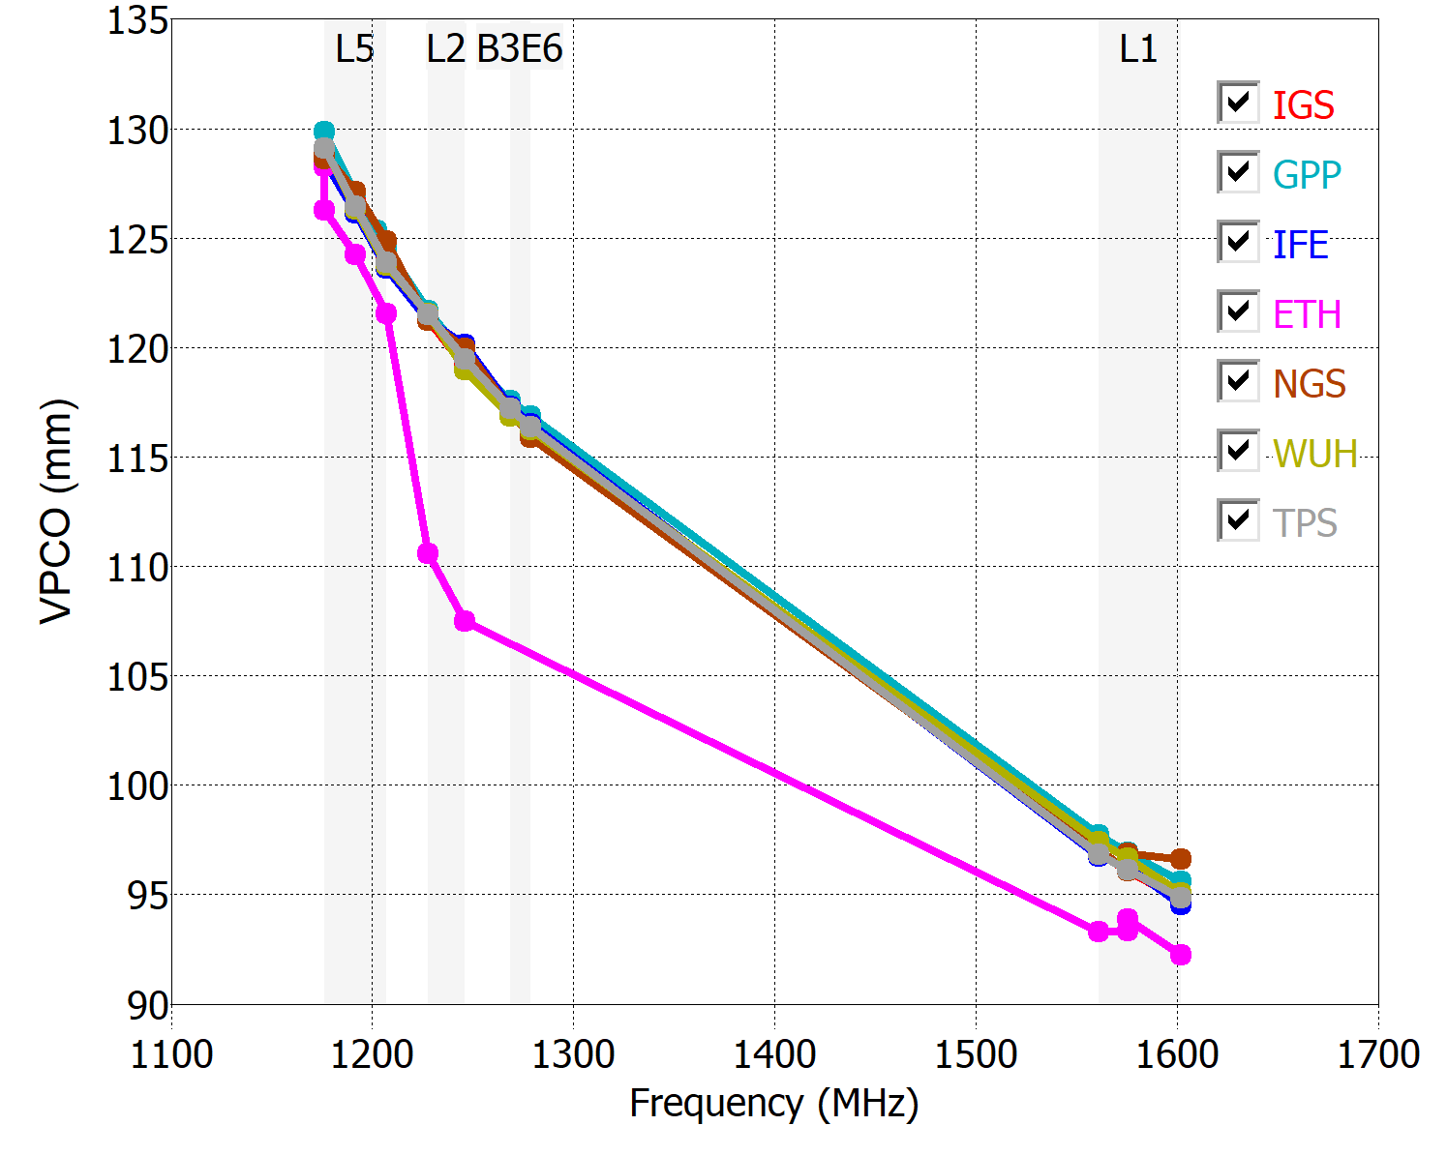
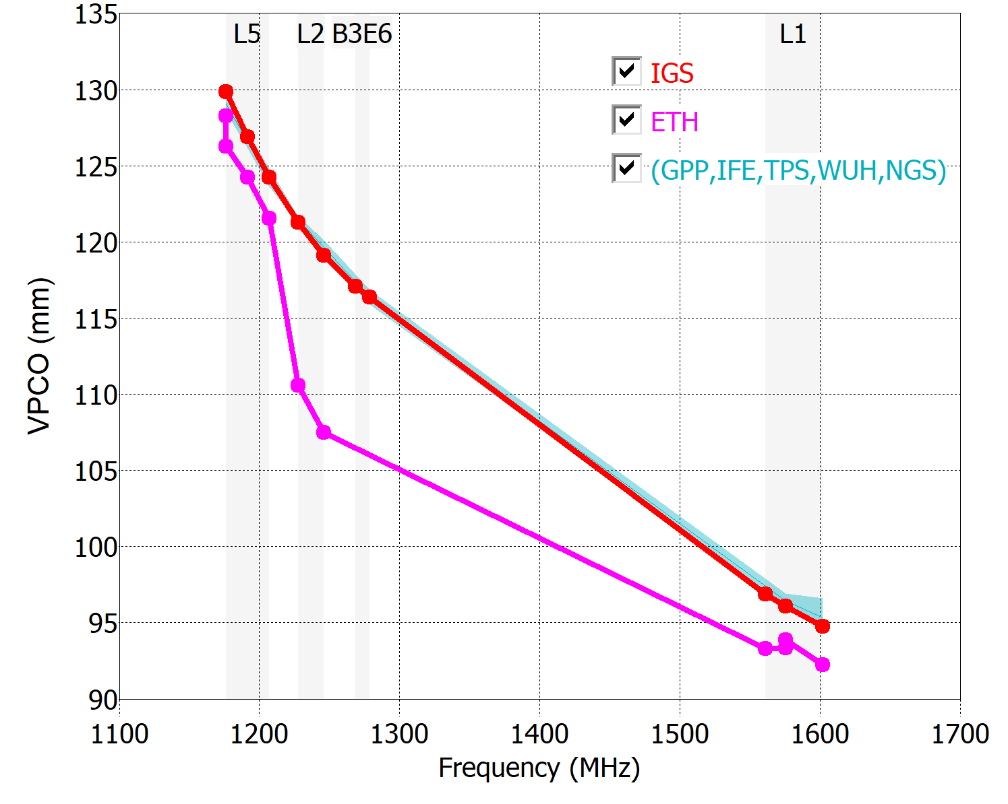
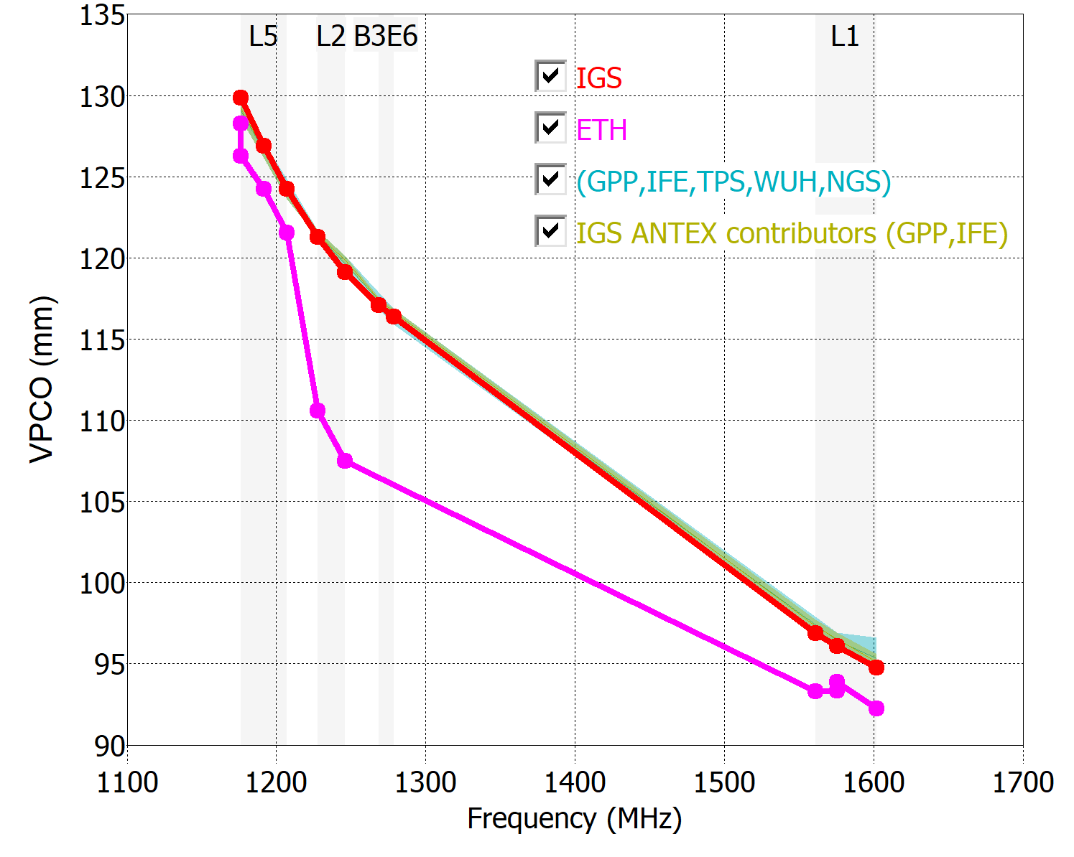
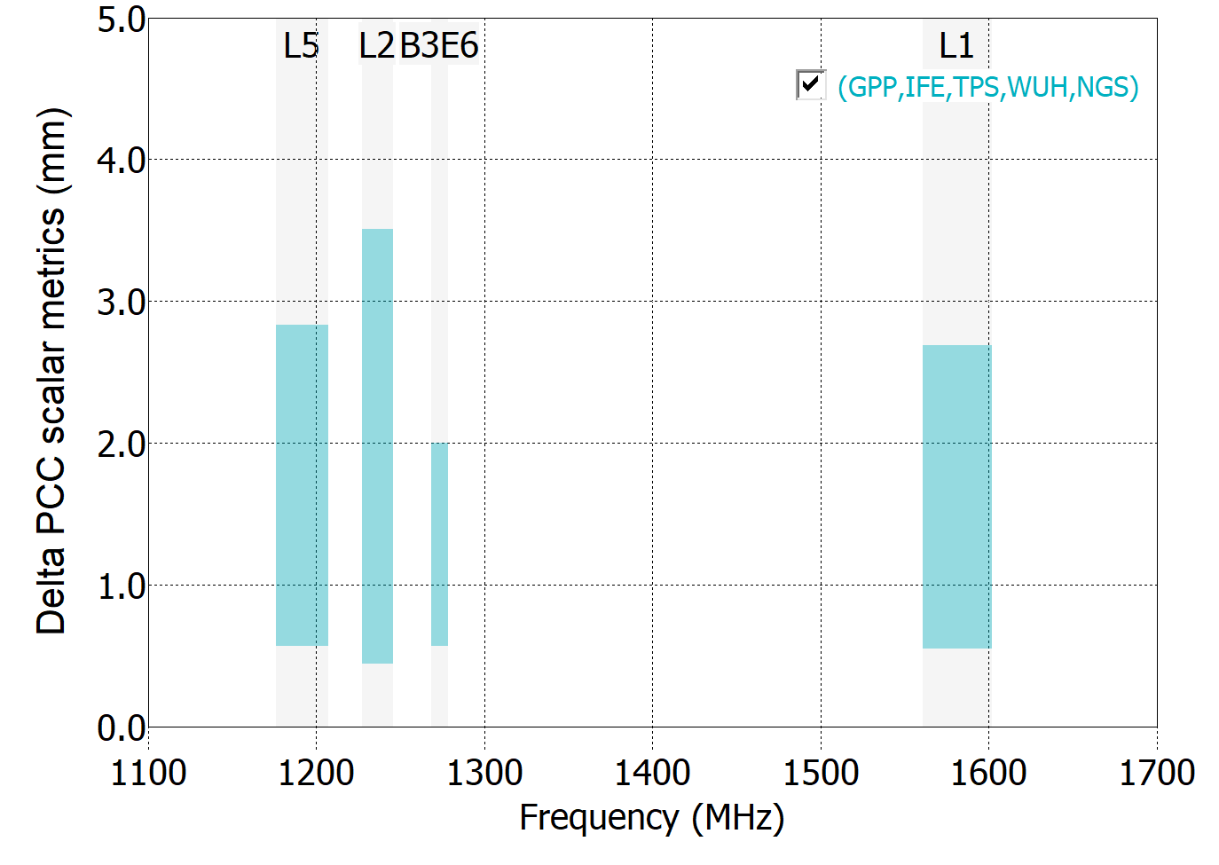
JAVRINGANT_DM
IGS
IFE
ETH
GPP
NGS
TPS
WUH
2mm VPCO agreement
IGS ANTEX contributors
Notes:
We begin the results with a JPL chokering design of antenna, a typical type in the IGS network. In all plots in this series of slides, the tan color will denote the grouping of IGS ANTEX contributors, whereas the cyan color will denote calibrations with good VPCO agreement.
For this Javad antenna, most facilities show very close match of VPCO to the IGS type mean (in red). Position deviations show that the antenna sample tested has a strong east component variation relative to the IGS type mean, which was detected and measured by nearly all the facilities. Even with the close agreement, the spread of scalar metric ranged 1-3 mm on all frequencies.

Slide 18
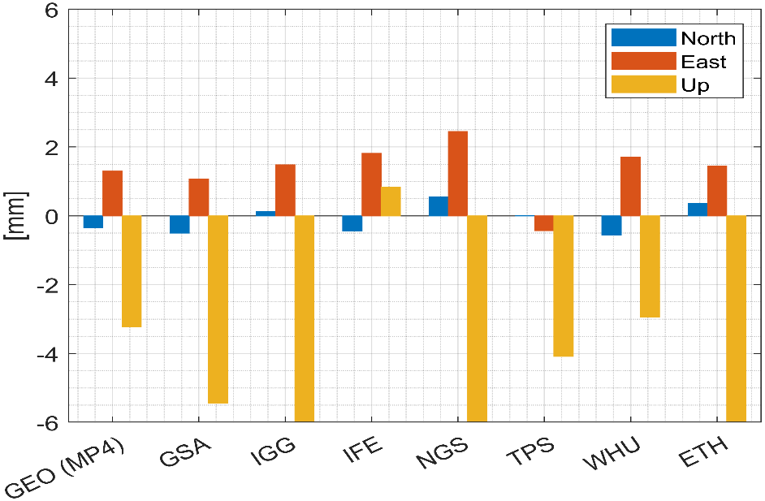
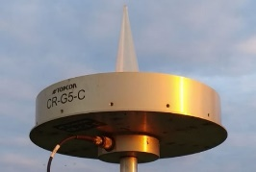
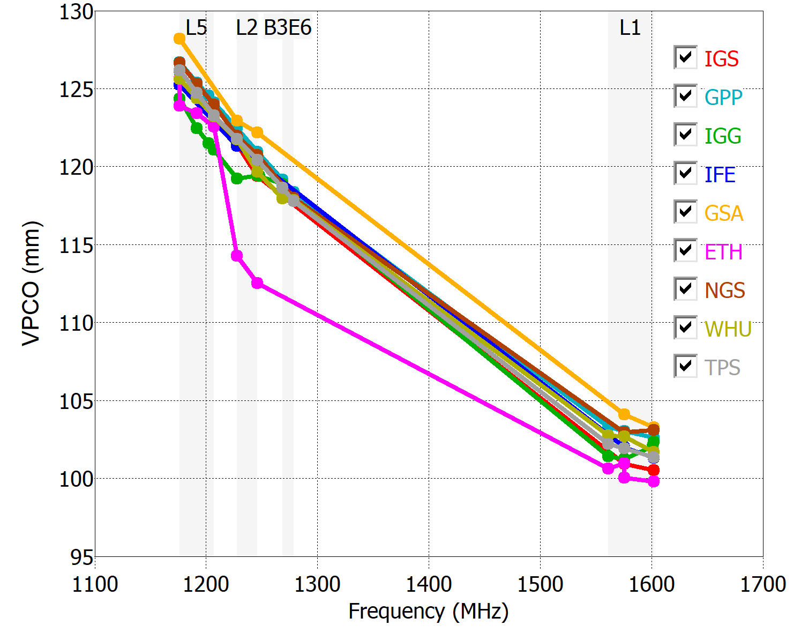
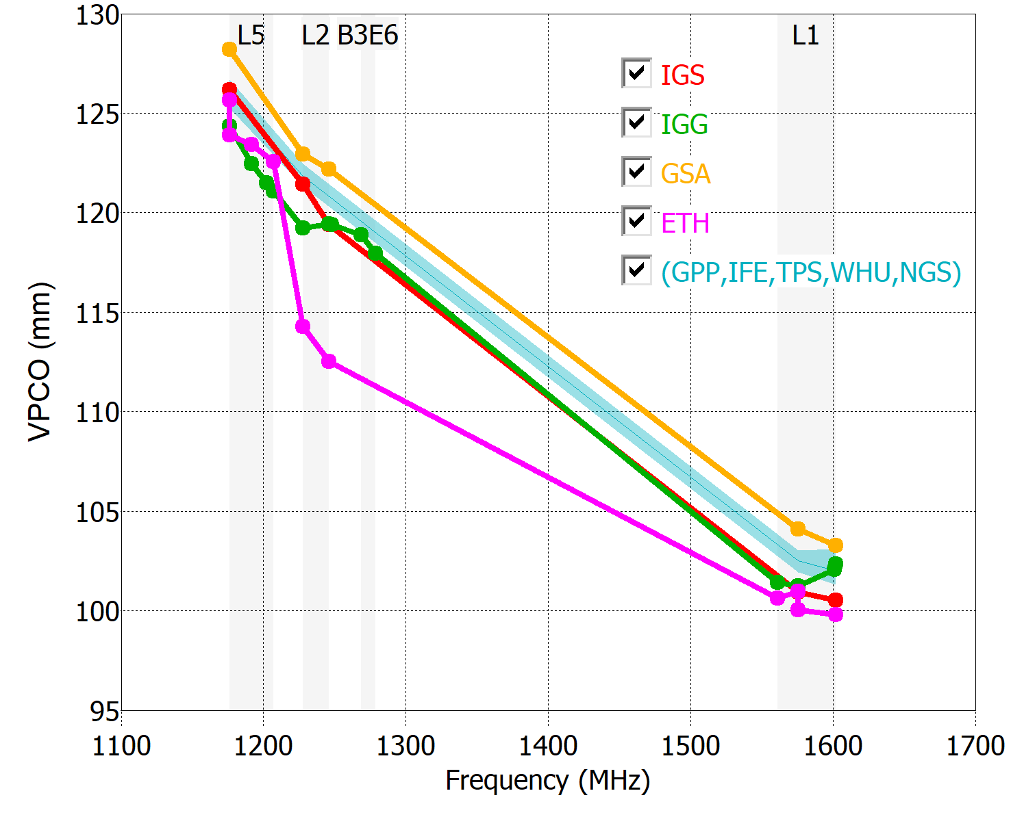
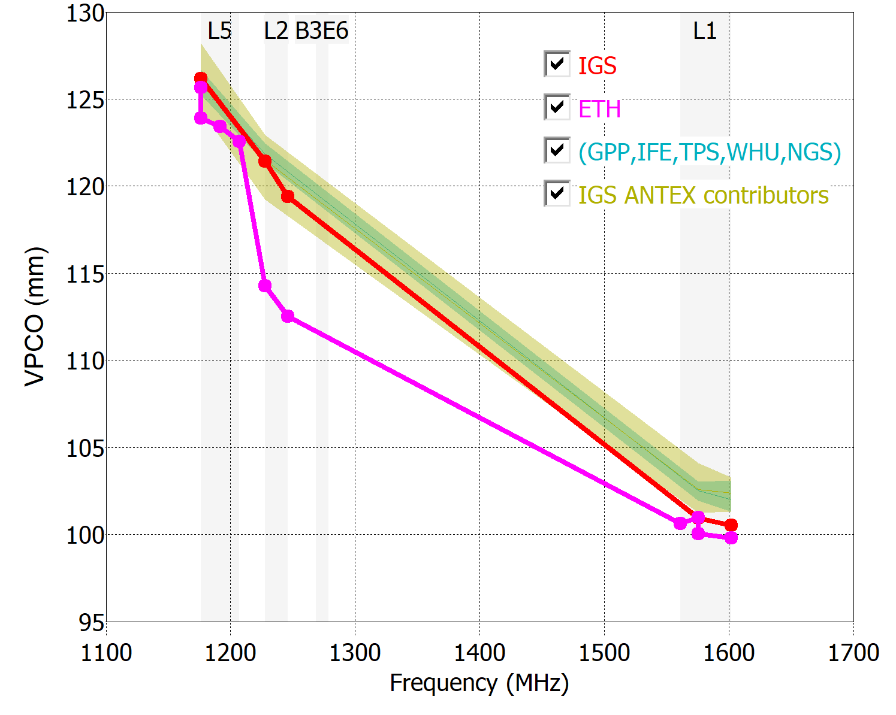
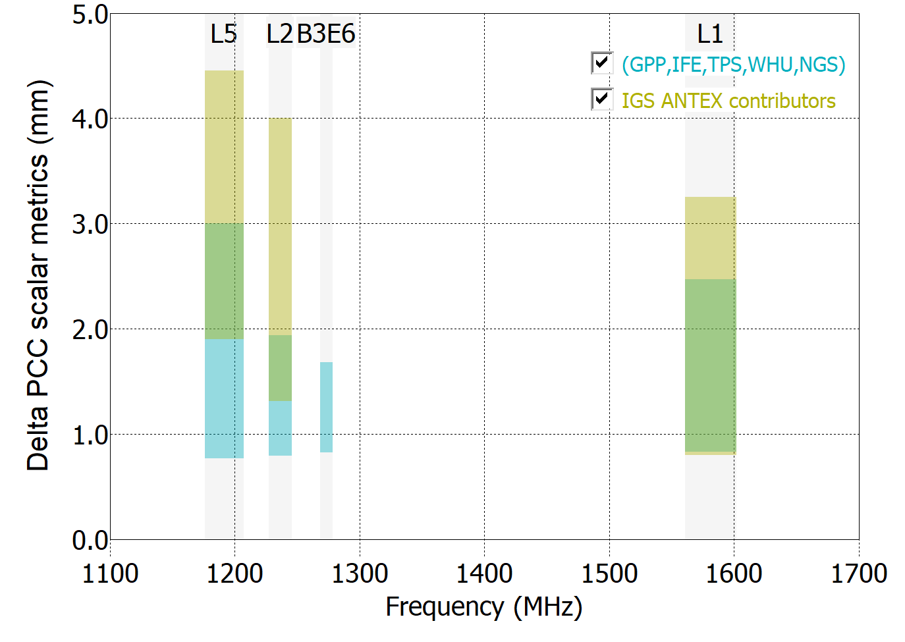
TPSCR.G5C
IGS
IGG
IFE
ETH
GPP
GSA
NGS
TPS
WUH
2mm VPCO agreement
IGS ANTEX contributors
Notes:
This JPL-style chokering antenna has been measured by 8 facilities. 5 of those facilities agree within 2 mm VPCO of each other, as shown in the cyan band. It is interesting to notice that the 5 facilities with close agreement have a 1-3 mm spread in scalar metric , whereas the 4 IGS certified facilities have a larger spread of up to 4.5 mm.

Slide 19
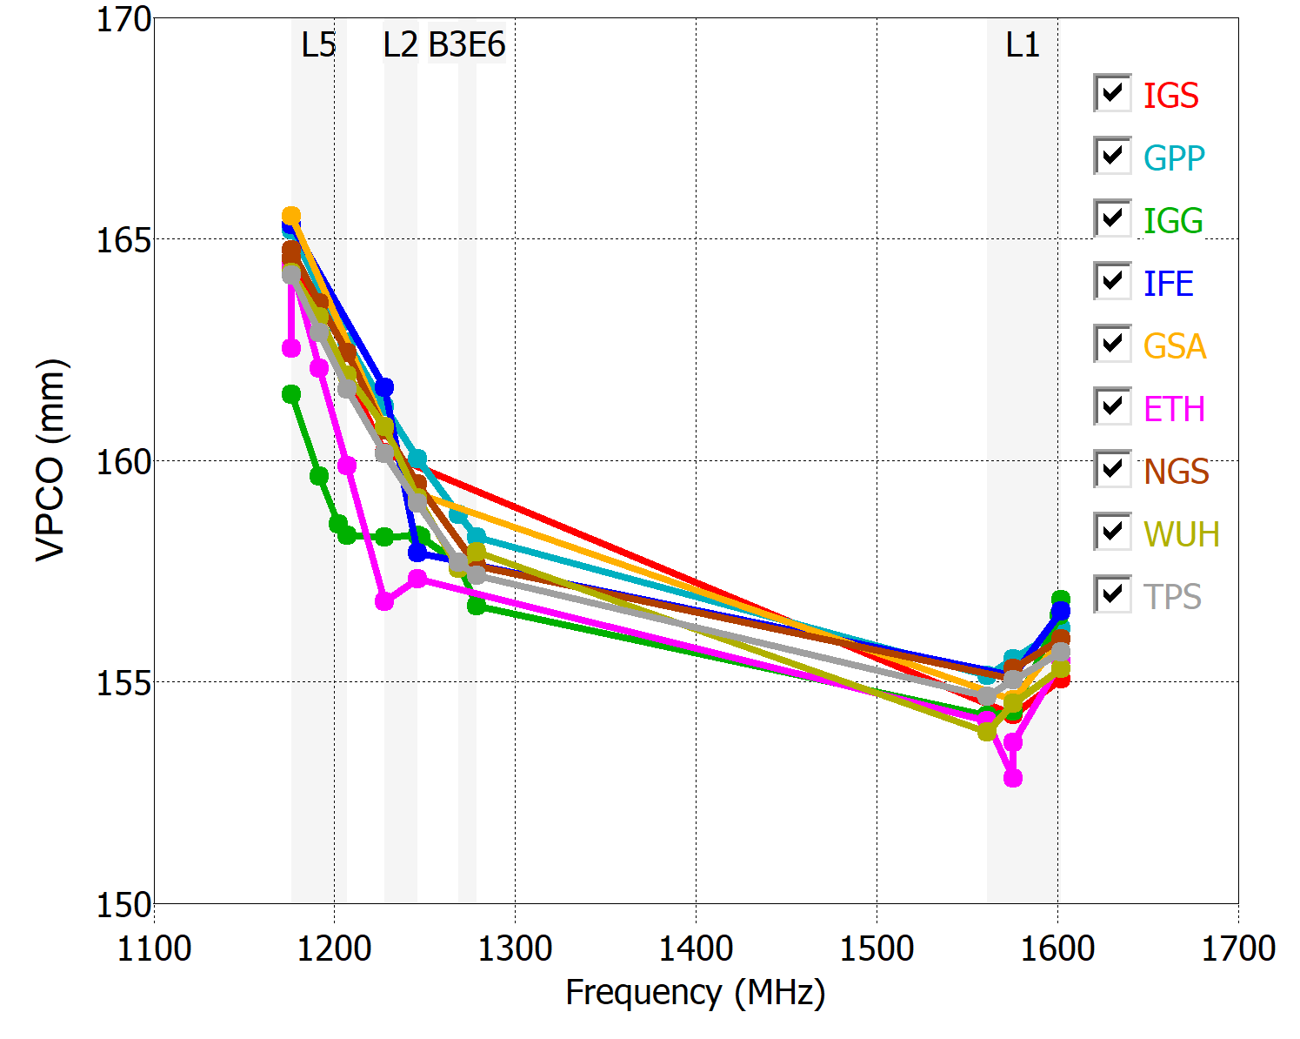
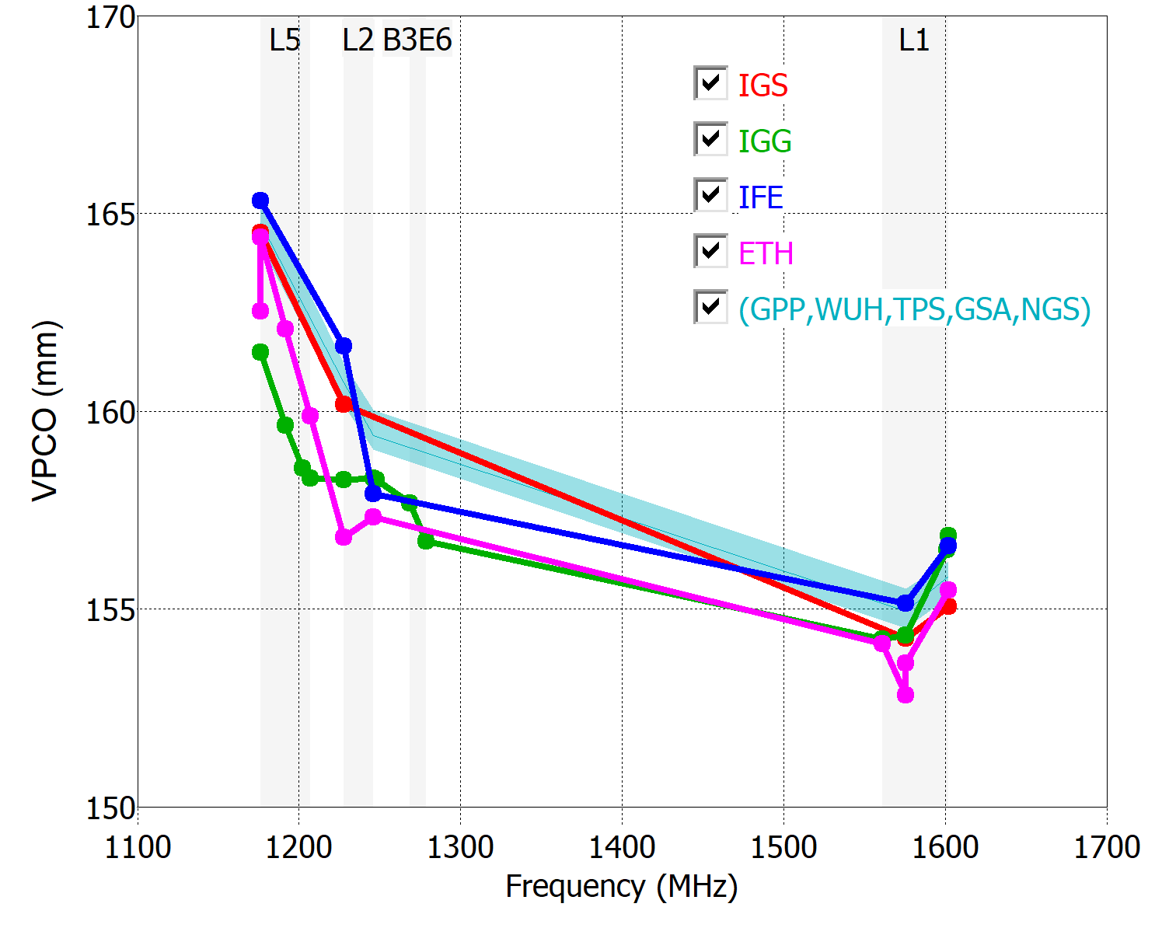
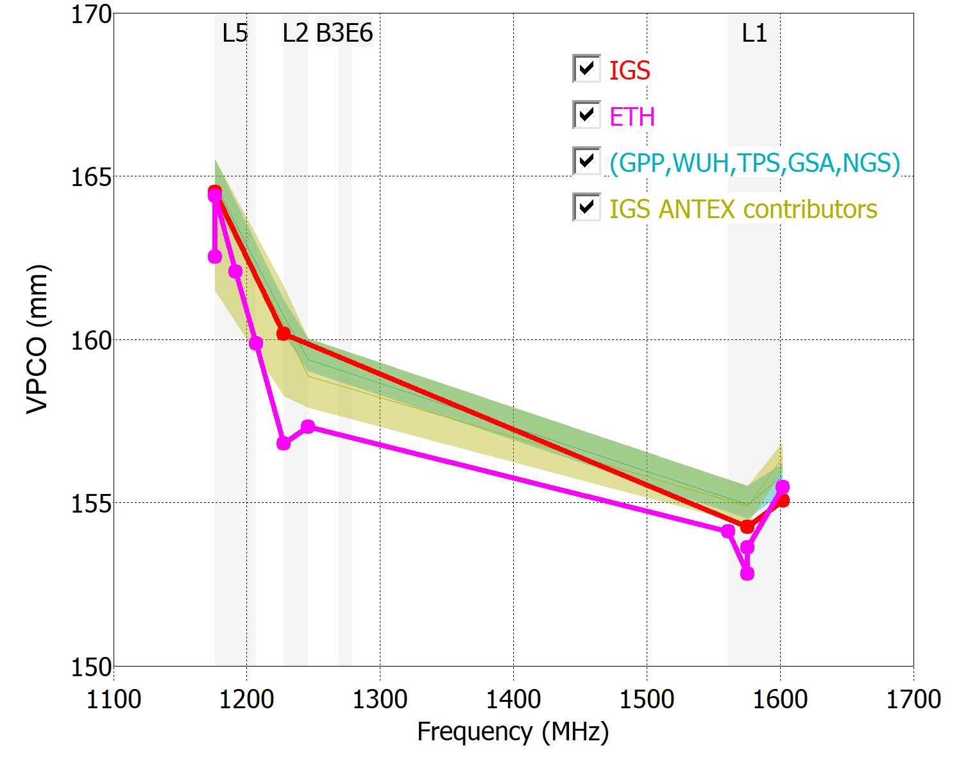
LEIAR25.R3
IGS
IGG
IFE
ETH
GPP
GSA
NGS
TPS
WUH
2mm VPCO agreement
IGS ANTEX contributors
Notes:
This conical chokering from Leica has closer VPCO agreement with the IGS type mean. Position simulations for all participants show a north shift relative to the IGS type mean, however. As was the case with the previous antenna, the spread of scalar metric is greater amongst the 4 IGS approved facilities compared to the 5 facilities with closest agreement.

Slide 20
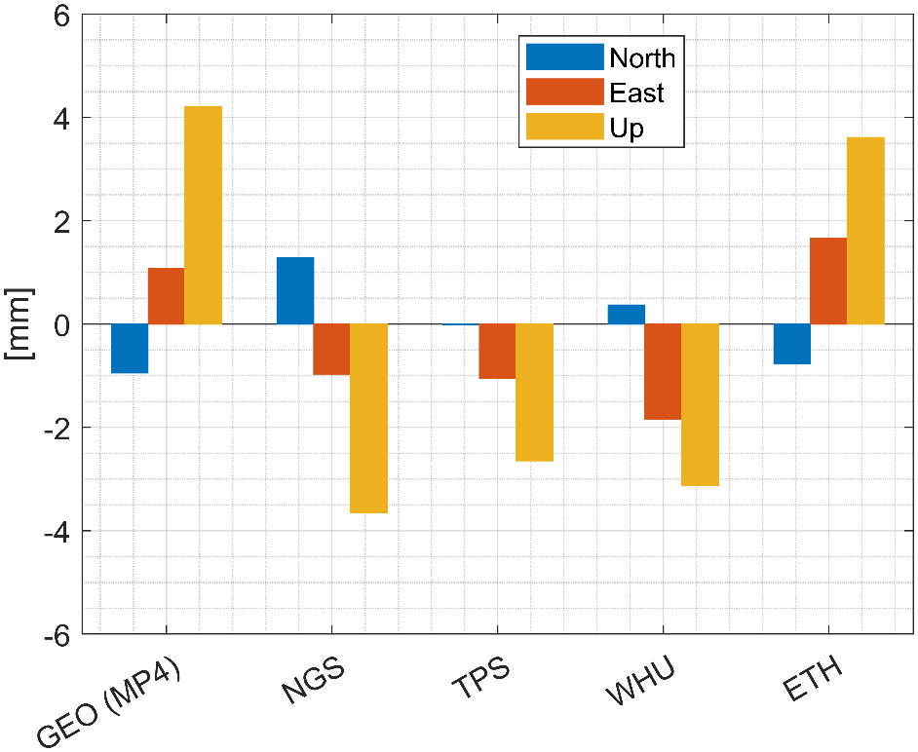
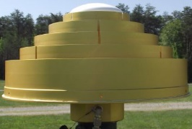
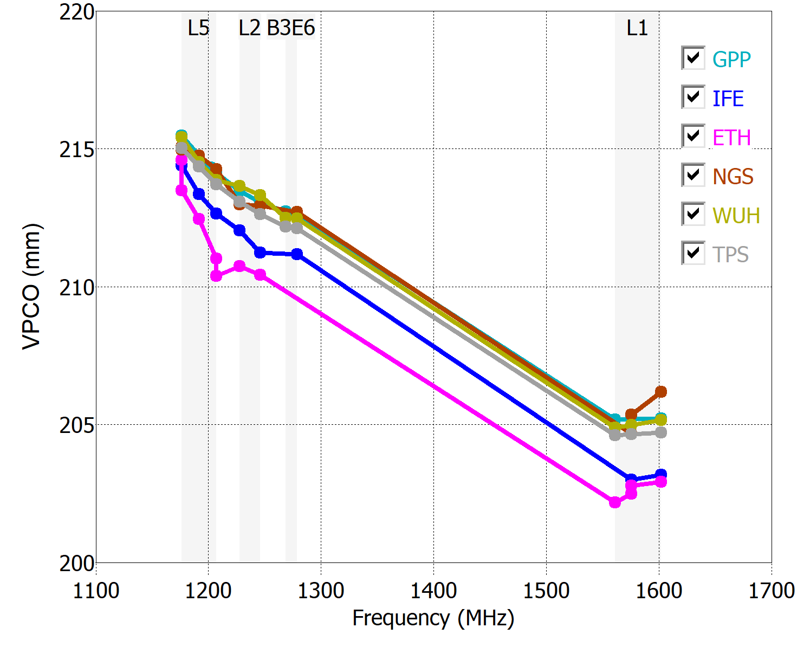
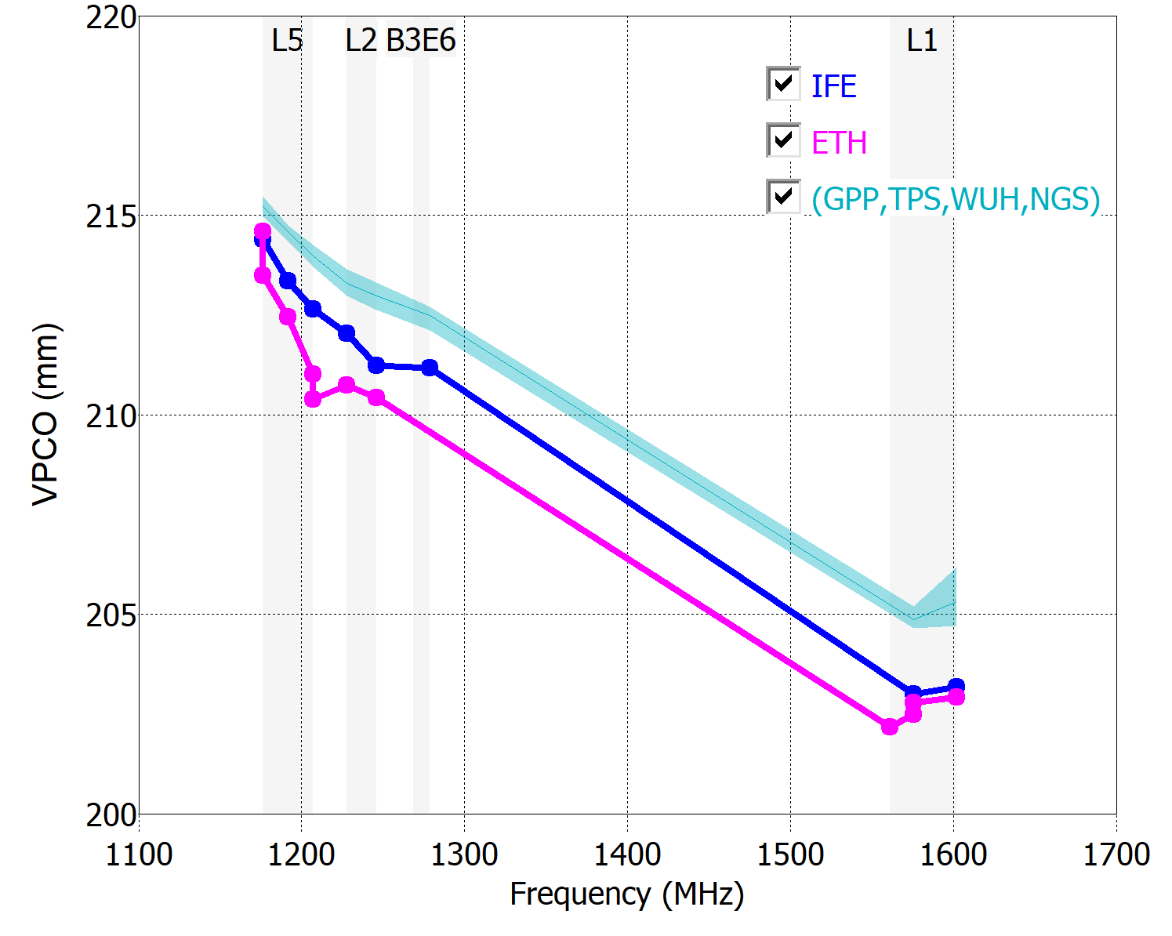
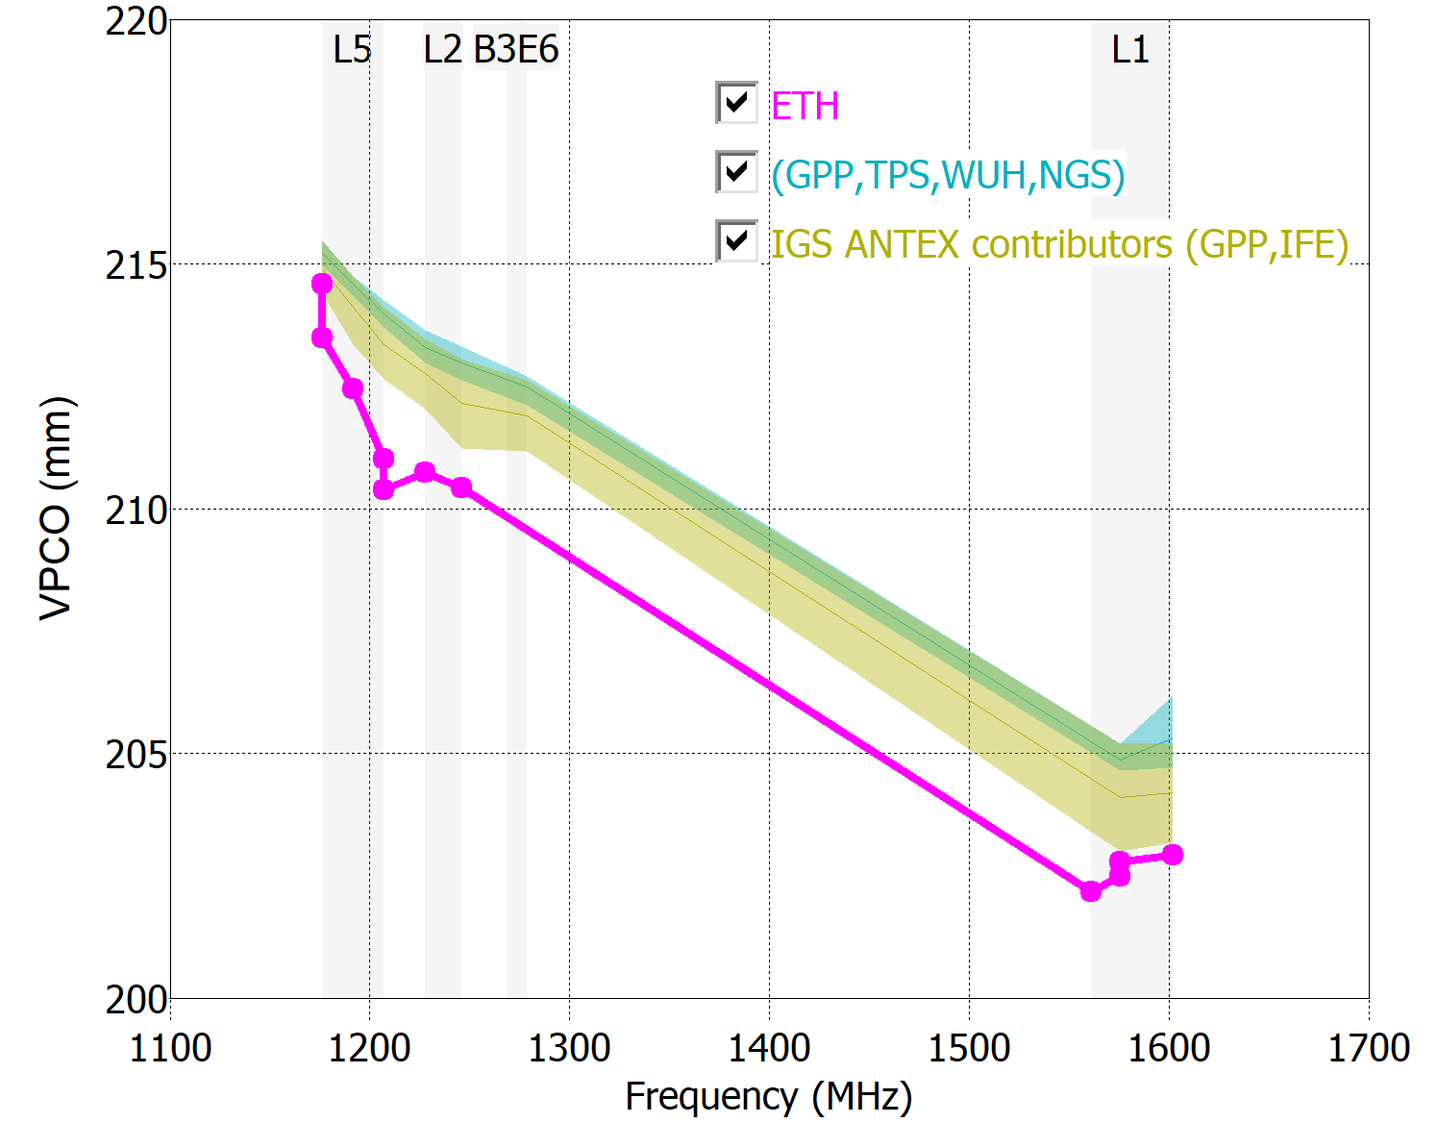
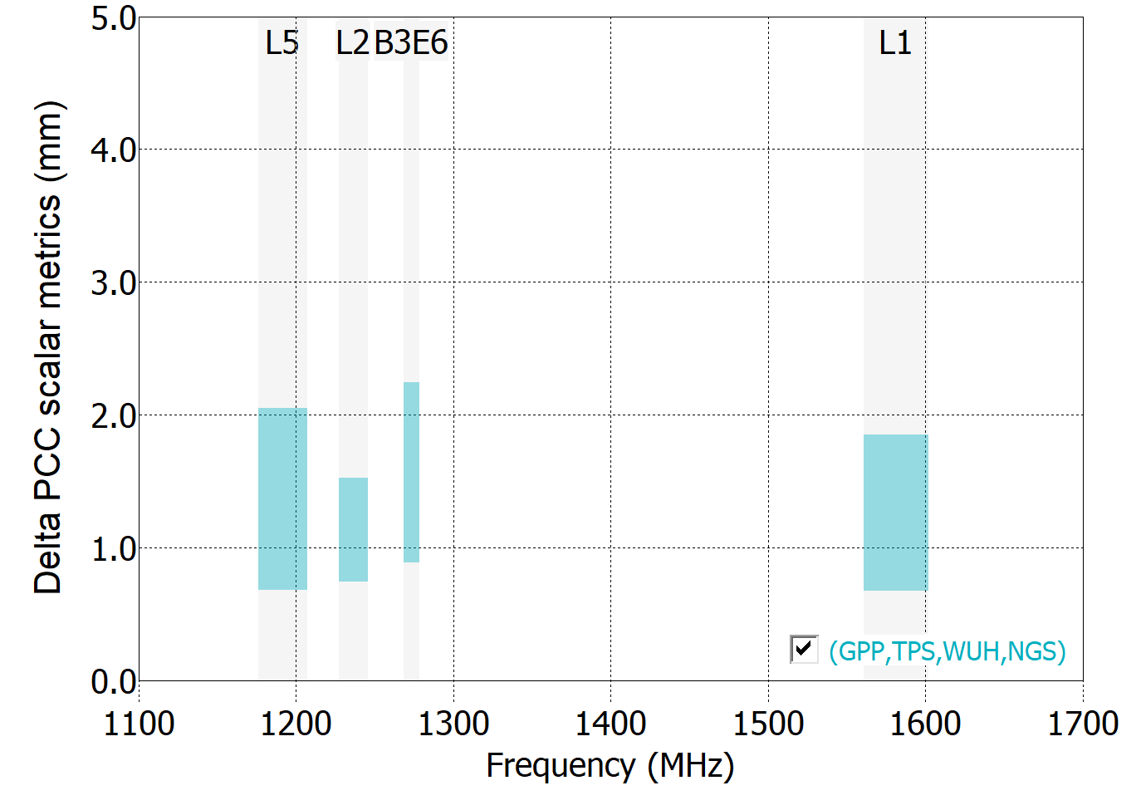
HXCCGX601A
IFE
ETH
GPP
NGS
TPS
WUH
(ref: IFE)
(ref: IFE)
2mm VPCO agreement
IGS ANTEX contributors
Notes:
Only a few facilities have tested the Harxon antenna so far.
We note this antenna does not have an IGS calibration without a radome. For this slide, the relative measurements instead use the IFE calibration as the reference. Using IFE as the reference, it is not possible to assess a range of scalar metric for IGS approved facilities, thus tan bars are missing from the scalar metric plot.

Slide 21
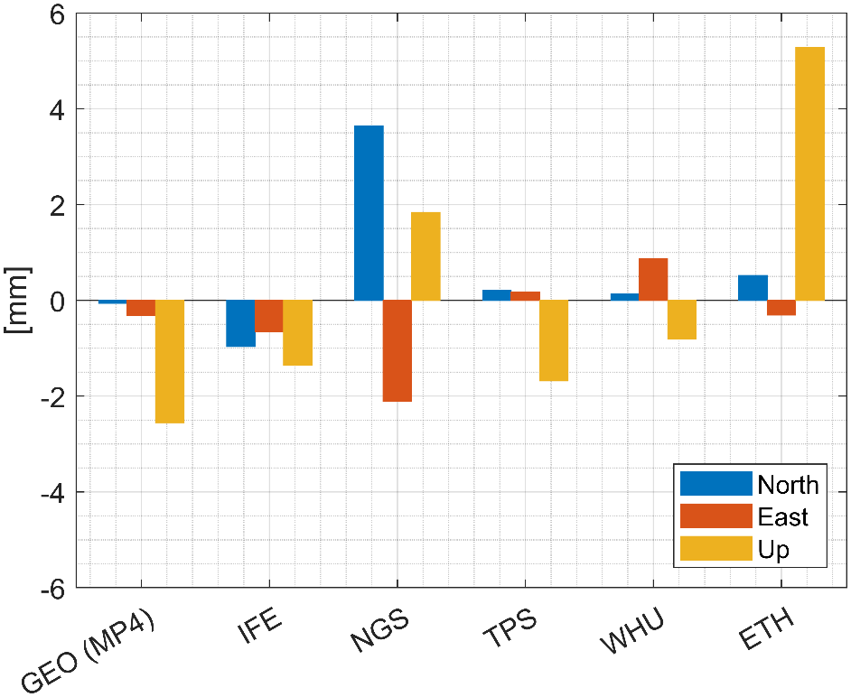

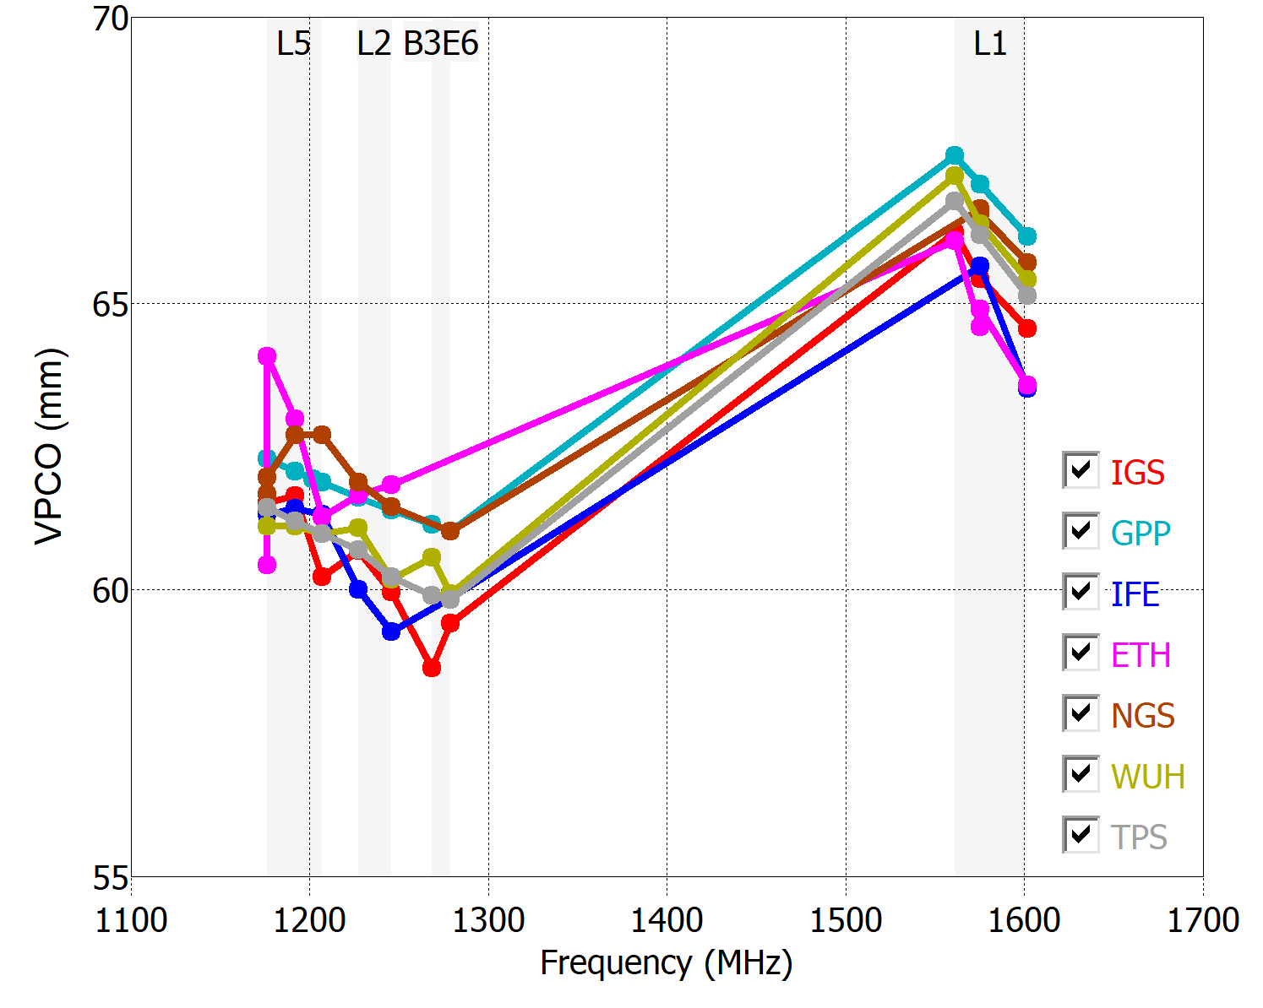
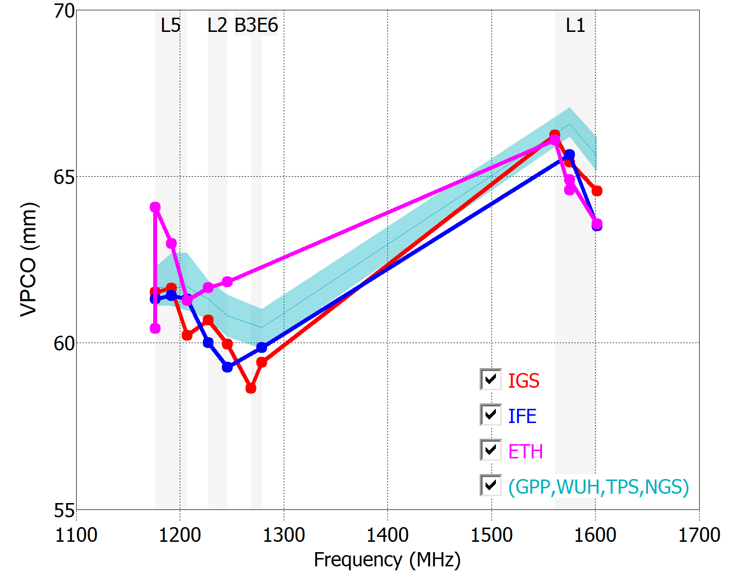
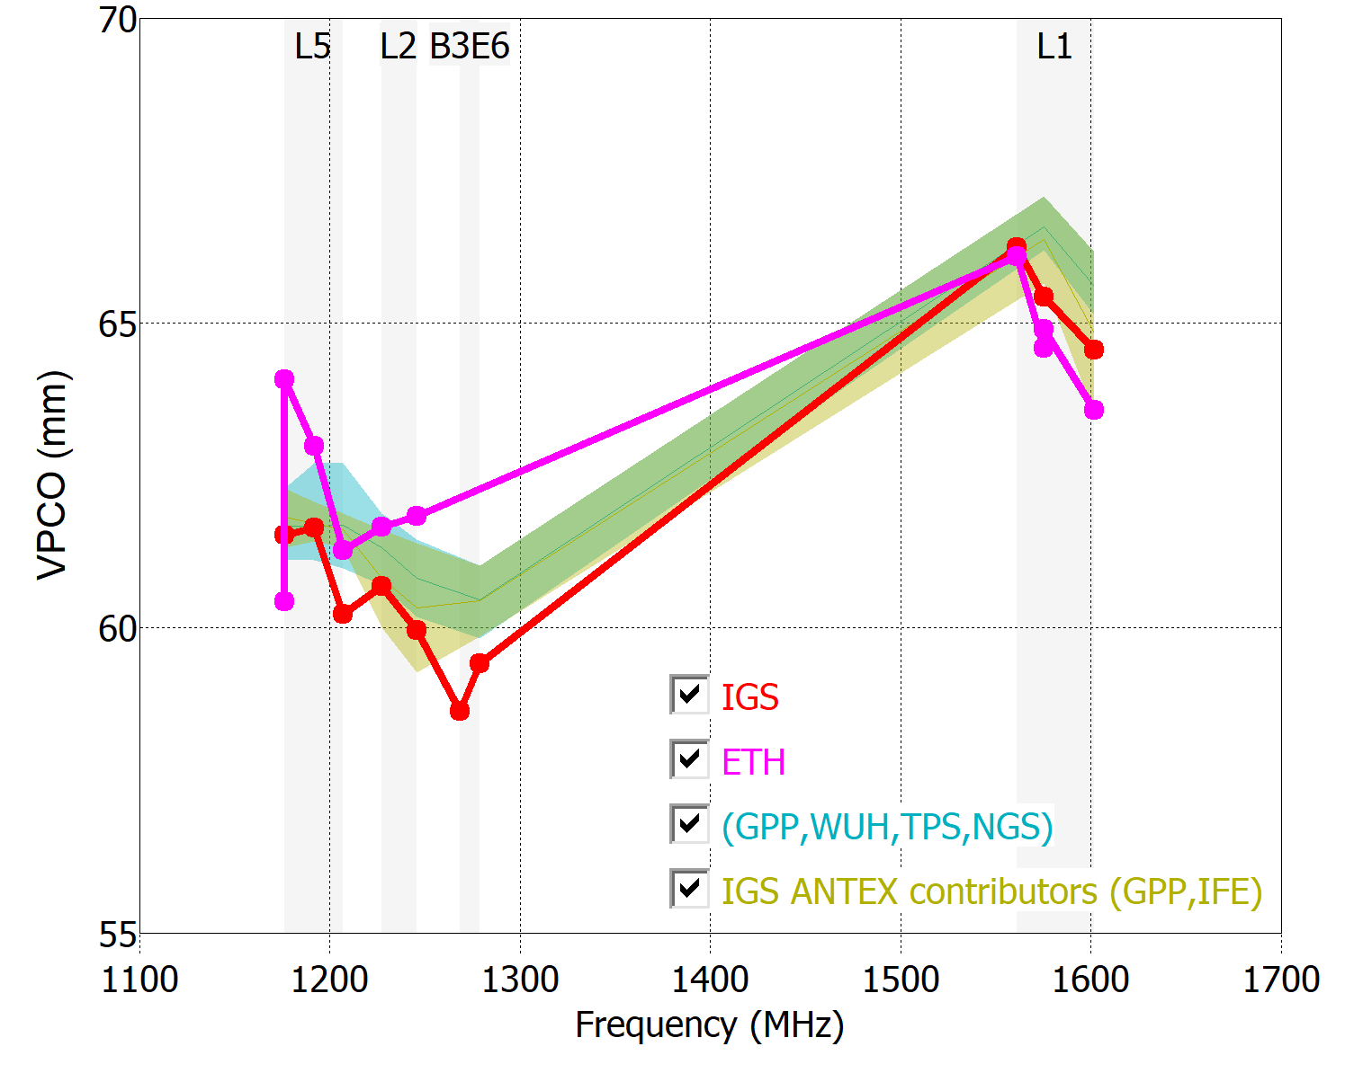

TRM57971.00
IGS
IFE
ETH
GPP
NGS
TPS
WUH
2mm VPCO agreement
IGS ANTEX contributors
Notes:
For this Trimble groundplane antenna, the frequency dependence of VPCO is quite small compared to the antennas on previous slides. In the majority of cases, the individual calibrations produce roughly the same positions as the type mean.
To date only 2 IGS approved facilities have provided calibrations for this antenna, so we are not yet able to assess the spread of the scalar metric. The 4 facilities with close agreement still have scalar measures separated by at most 1-2 mm.

Slide 22





TPSG5_A1
IGS
IGG
IFE
ETH
GPP
GSA
NGS
TPS
WUH
2mm VPCO agreement
IGS ANTEX contributors
Notes:
The majority of facilities were able to measure this antenna with similar results, to the IGS type mean and each other. The strong deviation of the GSA calibration from the rest of the participants appears to drive the statistics of the scalar measure.

Slide 23



Open-Source Software for Calibration Analysis
Notes:
The early insights from this study are only possible due to a major software development effort undertaken by the organizers of this campaign. We continue to expand the capabilities of the software with additional graphics and metrics, and develop code in multiple languages. We invite our colleagues to contribute to this open-source effort. By working together, we can continue to build additional understanding and insights on the nature of antenna calibrations.

Slide 24
Conclusions
International collaboration leads to insights
Open-source software with new metrics
Natural variability in calibrations at 1-4mm level in each frequency band.
Current contributors to IGS ANTEX have more variability that previously appreciated.
Several facilities show excellent agreement with each other, and close agreement with Geo++ (majority representation in IGS ANTEX).
Poster in session 2
  Detailed results for all antennas
Antenna Committee splinter meeting on Friday
  Open source software development
  Recommendations for IGS ANTEX contributions
Thank you to all the contributing partners:
Geo++, ETH-Zurich, GNSS-RC Wuhan, Geoscience Australia,
Univ. of Bonn, DLR Oberpfaffenhofen
Notes:
In conclusion, this international collaboration among 9 different calibration facilities, although not yet complete, is leading to insights on the nature of antenna calibrations.
We developed open-source software for calibration analysis, with standardized algorithms to account for GNSS features.
We have come to understand that the same antenna tested at different facilities will have calibrations which vary at the 1-4 mm level on each frequency.
Results to date demonstrate that groups currently contributing to the IGS ANTEX have more variability than previously appreciated.
We also observed that several facilities show excellent agreement with each other, and close agreement the results of Geo++, the facility which has been the strongest contributor to the IGS ANTEX to date.
My colleagues Igor and Steffen are also present at the workshop, and we hope you come by our poster to discuss the detailed results for all antennas in this study. We also invite you to join the Antenna Committee splinter meeting on Friday, where we will provide recommendations for new contributors to the IGS ANTEX and recruit colleagues for our open source software development efforts.

