Slide 1
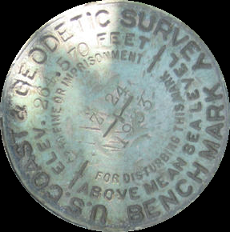
Replacing NAVD88: Effects Of Vertical Datum Modernization On Coastal Engineering
Nicole Kinsman, Alaska Geodetic Advisor, Ph.D.
NOAA National Geodetic Survey
Notes:
Who has heard of or used NAVD88? Who know it is being replaced in 2022? (MENTION HAND OUTS)
No new scientific findings/results section to share – unless it is news to you that the ocean is not flat or the earth’s lithosphere is in motion.
Today = not pulling out rug from under you, but reinforcing your subfloor →
Describe why NAVD88 is going away,
Preview what is to replace it,
Provide resources for learning more.
Sea-change = moving away from passive marks to a GNSS-based spatial reference system for the nation.
Mark shown on slide – an ‘artifact’: says MSL, which is a misnomer; stamped height assumes fixed position; and agency has changed names.

Slide 2
Allure of the Seas passes under the Store Belt Bridge, Denmark (October, 2010)
☑
Importance of Vertical Datums to Coastal Engineering
(in pictures)
☒
☑
Container barge in Bergum, Netherlands (C. Fries, 2011)
Tianjin passes under the Talmadge Bridge, Georgia (Steve Bisson, 2015)
Notes:
Reference datums matter in coastal engineering – for crest design height or bridge clearance…

Slide 3
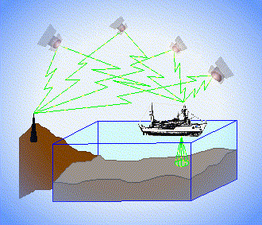
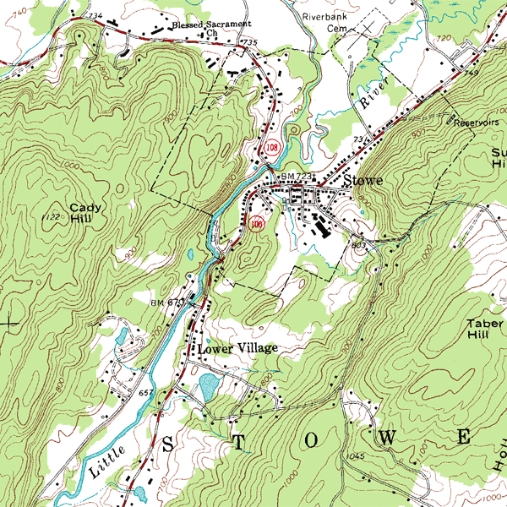
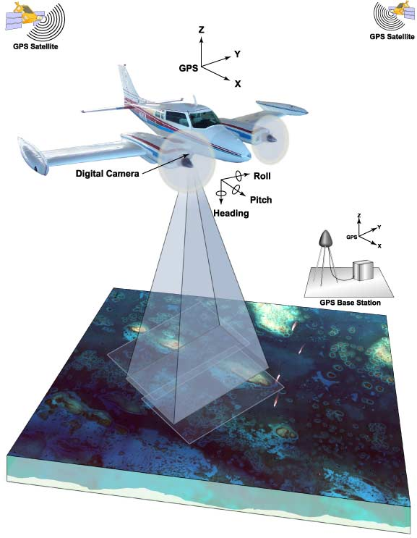
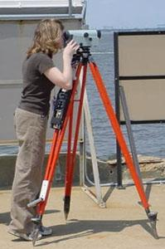
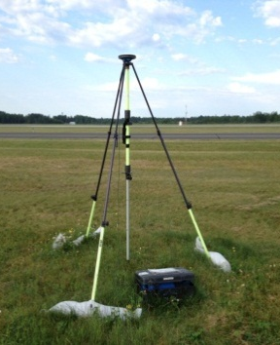
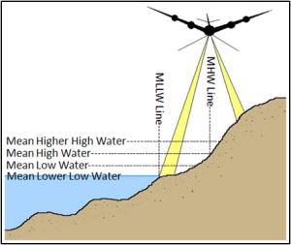
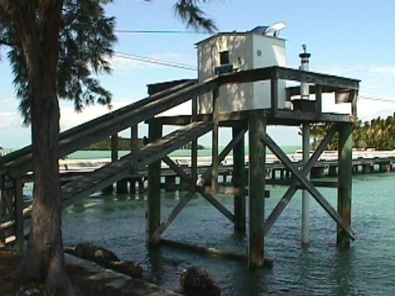
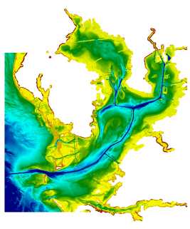
3 Categories of Vertical Datums
Ellipsoidal
Orthometric
Raw Hydrographic Surveys vertically referenced with RTK-GPS
USGS
Topography
FEMA Flood Insurance Rate Maps
Engineering and Development Site Surveys
Native GPS measurements
Raw Lidar
Tidal
NOAA Bathymetry (MLLW)
Shoreline Mapping (MHW) and Regulatory Boundaries at the Coast
Daily and Extreme Water Levels
Notes:
Slide illustrates 3 categories and examples of where each is directly used (project and application dependent).
NOAA provides tools to transform between these different height systems.

Slide 4
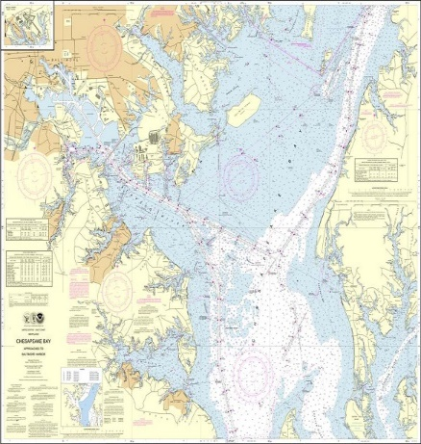
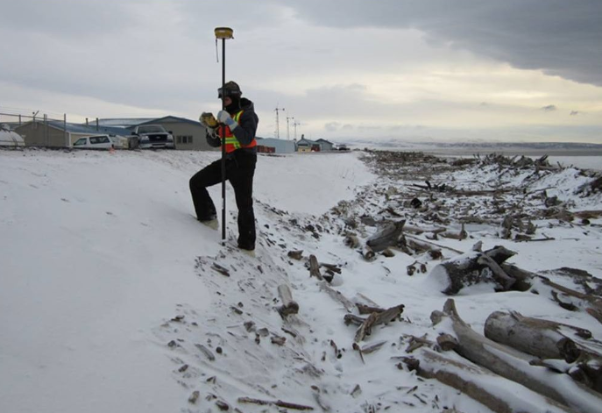
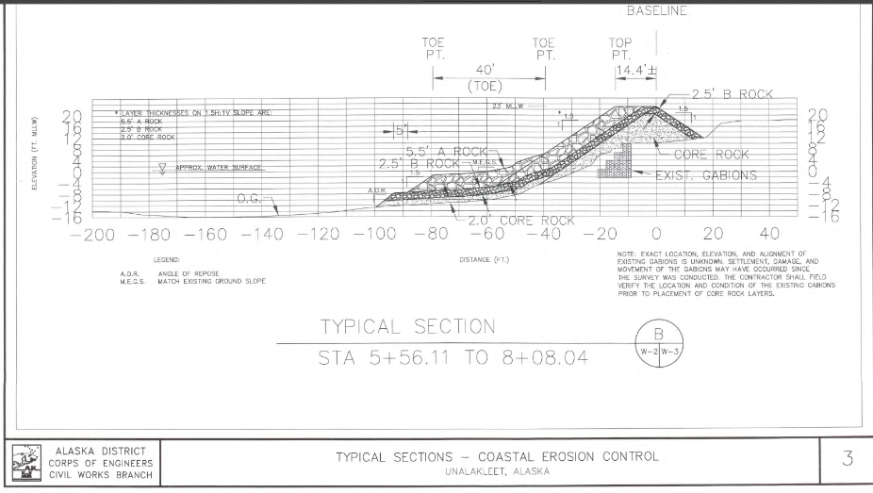
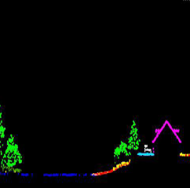
The National Spatial Reference System (NSRS)
A common and consistent geospatial framework to meet the economic, social, and environmental positioning needs of our Nation.
Foundational elements include:
Latitude • Longitude • Elevation • Gravity • Shoreline Position
+ changes over time
+
+
=
Reliable design heights require data from disparate sources and dates be consistently aligned
Notes:
NAVD88 is part of the NSRS:
NSRS is a consistent geospatial framework, common to all Federal agencies and other users
NSRS fuels informed decision-making for mapping and charting, navigation, flood risk determination, transportation, land use, and ecosystem management
Elements of NSRS include (but are not limited to): latitude, longitude, elevation, gravity, shoreline position + changes over time
Example of why we need consistent coordinates (illustrated):
Design height on an erosion control structure includes lidar, bathymetry, and high water mark measurements collected from past events…

Slide 5
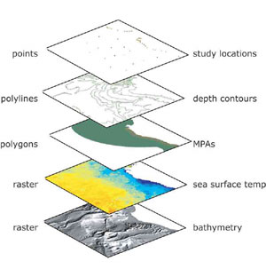
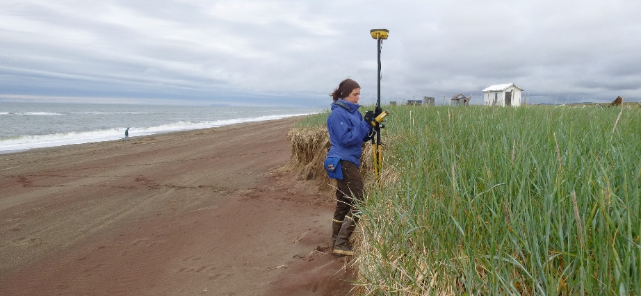
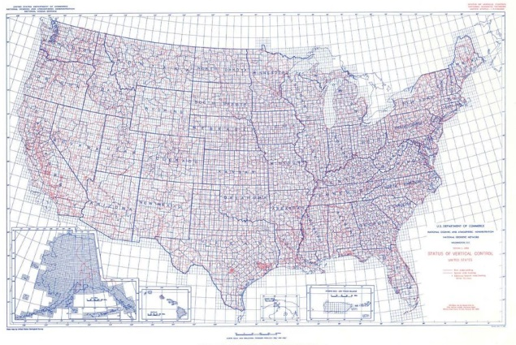
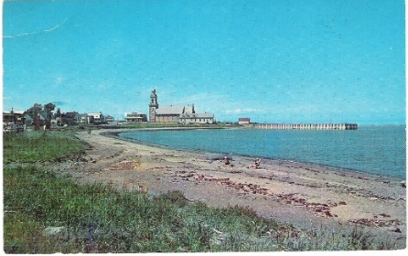
NSRS Considerations – The 4 C’s
Requirements
Expectations
CONSISTENCY
CONVENIENCE
Semi-CONSTANT Coordinates
COHERENCE with Sea Level
stamped with elevation
Notes:
For a reference system to be useful to the public it must be CONSISTENT (possess spaciotemporal reliability and repeatability) and CONVENIENT (readily accessible by users).
Additionally, (for better or worse) as a society we have also adopted an expectation that our spatial reference system is defined in a manner that provides some level of CONSTANCY (that objects considered to be stationary have fixed coordinates and/or heights). We have also come to expect that heights and depths are relative to some definition of sea level, and this COHERENCE with a natural equipotential surface also ensures that water will flow from higher to lower height values.
As NGS continues to fulfil our primary mission of defining, maintaining, and providing access to the NSRS, we have recognized the need to modernize the current NSRS in tandem with advances in geodesy, geophysics, and technology (especially GPS/GNSS); and to meet evolving requirements and expectations of the NSRS. Decisions about how to best modernize the NSRS must achieve improved consistency (especially between passive and active control) and convenience while not fully departing from expected characteristics that are part of the fabric of how our Nation uses precise positions.
Top right image shows a 1932 vertical control mark from California: https://www.ngs.noaa.gov/cgi-bin/ds_mark.prl?PidBox=HT0751 with the “permanent” elevation of 63.222 ft stamped on it, published height is now at ~65.9 ft NAVD88.
Bottom right image shows the national NAVD88 leveling network, which is held to “zero” at the level of local MSL in 1985 in Father Point in Rimouski, Quebec. The historic postcard is from Ste. Luce-Sur-Mer Beach, approximately 7km NE of Father Point.

Slide 6
The NSRS of Today (simplified)
Primary elements:
Horizontal North American Datum of 1983 - NAD 83(2011) coordinates
Vertical North American Vertical Datum of 1988 - NAVD88 orthometric heights
These elements are geodetic datums that define the shape and size of the earth to enable precise positioning
System based on connections to published passive control

Slide 7
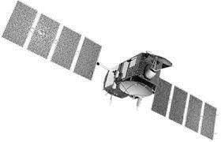
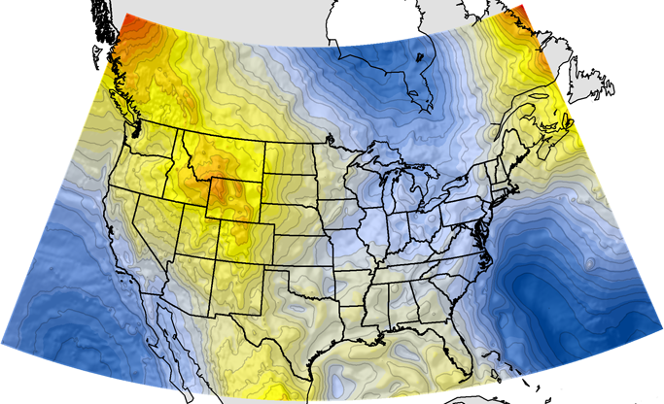
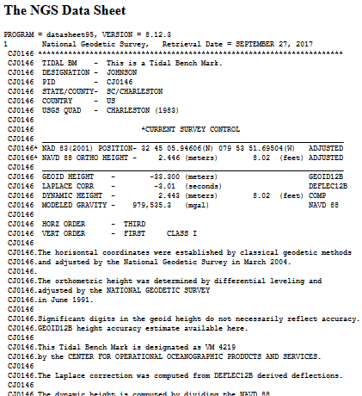
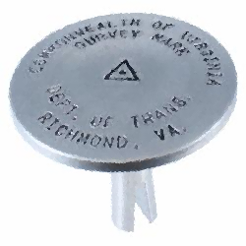
NGS Supports Access to NAVD88 Heights
GEOID12B
official path
Notes:
NGS defines, maintains, and provides access to the NSRS.
Path (1) Since the NSRS is presently defined by a network of passive control, NGS provides primary access to the NSRS at published passive control (in IDB), at preset this remains the ‘official’ gateway to NSRS position.
Path (2) In recognition of increasing use of GPS/GNSS technology for precise positioning activities, NGS also supports GPS/GNSS-enabled access to the NSRS (via OPUS).
→ In an ideal (static) world, these two pathways lead you to the same heights.
For GPS/GNSS-enabled access to NSRS heights, NGS maintains geoid models.
***Geoid models are necessary to convert GPS measurements (ellipsoid-based) into real-world elevations***
A geoid is a surface of constant gravity potential
The current geoid model (GEOID12B) that is used to access NSRS orthometric heights (NAVD88) is a hybrid geoid, a gravimetric geoid (USGG2012) that has been warped to align with published values on passive control.

Slide 8
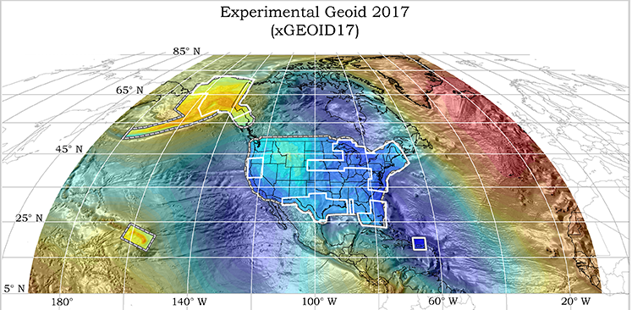
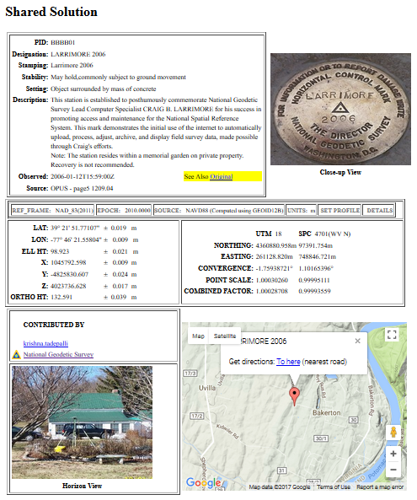
NGS Will Support Access to the NSRS of the Future
GEOID 2022
official path
Notes:
In 2022:
Active geodetic control (CORS) will replace passive geodetic control (bench marks) – includes time-dependency
GPS/GNSS will be the official gateway to the NSRS
GRAV-D project for a refined gravimetric geoid for the US that will enable access to orthometric heights w/in 2 cm accuracy using GPS/GNSS (no warp to published heights)

Slide 9
Primary elements:
The geometric North American Terrestrial Reference Frame of 2022 (NATRF2022) plus the Caribbean, Pacific, and Mariana plates
The North American-Pacific Geopotential Datum of 2022 (NAPGD2022)
New reference system is:
Time-dependent and geocentric
Defined by relationships to a global/international ideal frame
Primarily accessed via GPS technology and a newly refined semi-dynamic geoid model
Notes:
Horizontal and vertical datums will be replaced by geometric and geopotential reference systems that are time dependent
***Blueprints are available for detailed information on the proposed form of the new NSRS***
Notable Improvements (in no order):
Removes nation-wide tilt and bias in the present vertical datum
Time-dependency provides better ways to access to mark stability and use the NSRS to monitor gradual change such as subsidence or uplift
New vertical datum aligns with international neighbors such as Canada, facilitating precise positioning in border areas
GPS gateway opens consistent NSRS access to remote and isolated parts of the United States
More systematic ties between NAPGD2022 and tidal datums will significantly improve the quality of geospatial data in coastal environments with sea level trends
Direct relationships to ITRF/IGS improve the spatial framework for GNSS-based technology, such as UAS/UAVs
Image: GPS Block IIF Satellite (12 launched between 2010-2016; these platforms presently form the core of the active GPS constellation)

Slide 10
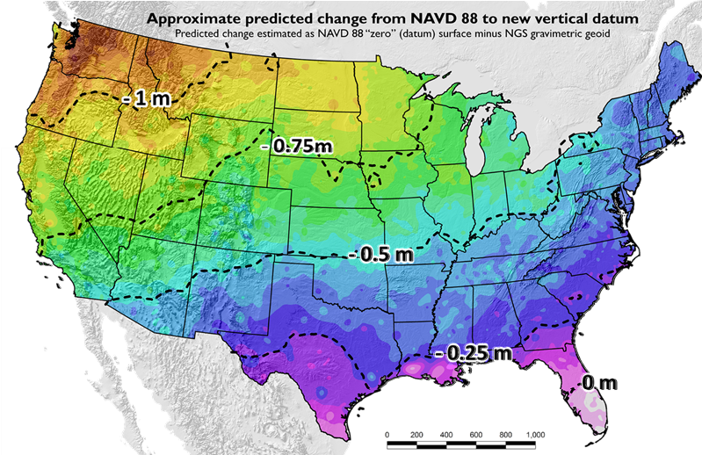
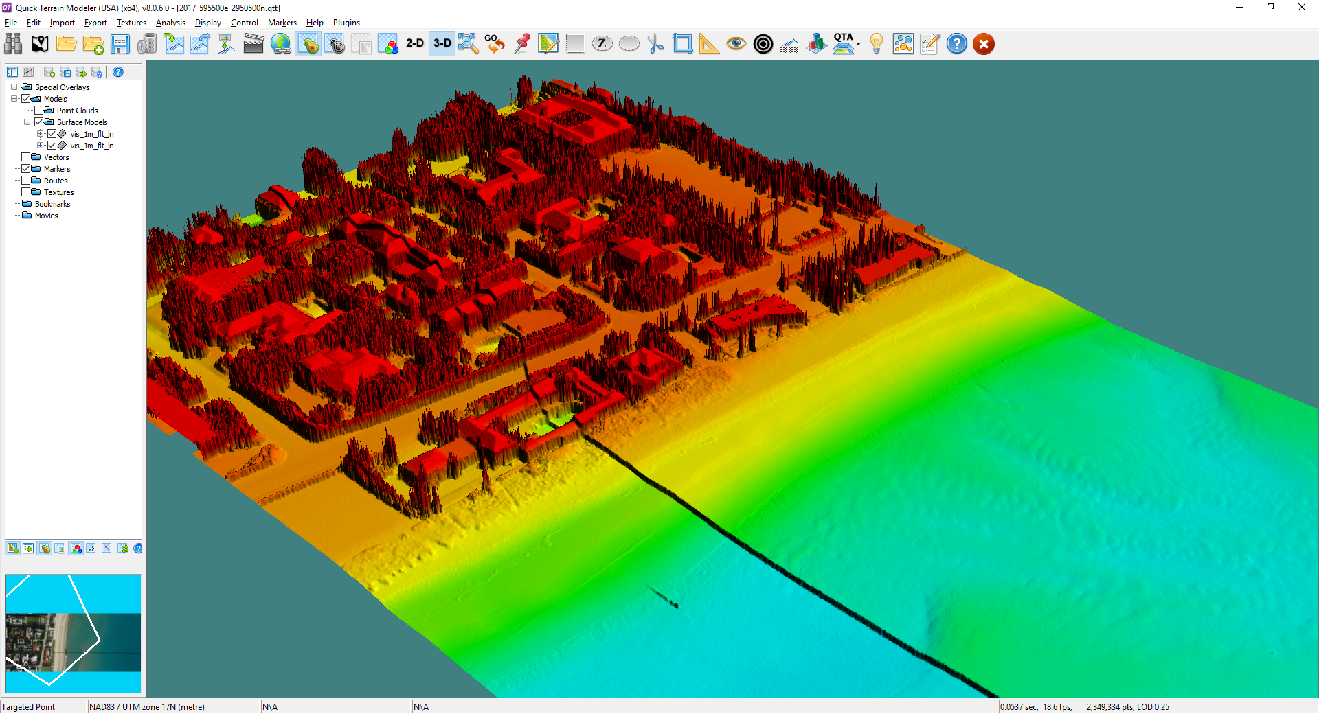
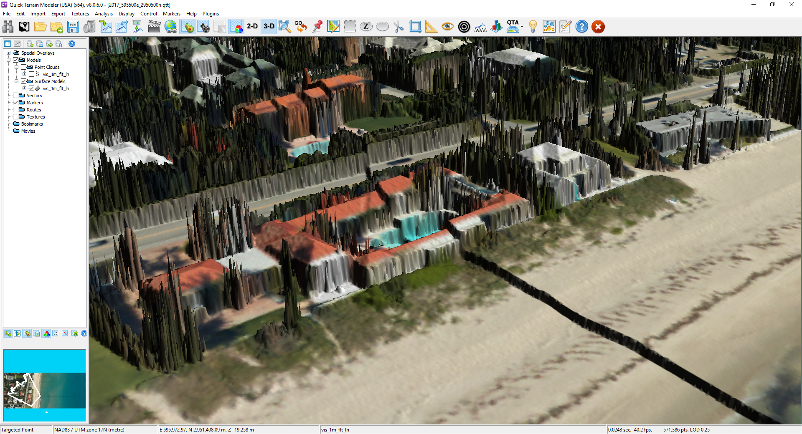
NSRS Modernization: Vertical Change
GEOID12B (NAVD88)
Updates available online from the New Datums website and Modernization News
xGEOID17
Vertical offset of more than 1 meter
https://geodesy.noaa.gov/datums/newdatums/index.shtml
Notes:
***NSRS Modernization News is available for updates on new developments and to track on progress towards the NSRS of 2022***
PREPARING FOR THE TRANSITION
Updates to the NSRS will result in a critical adjustment to orthometric heights of up to 2 meters (over 6 feet) in the vertical and have significant impact on many federal agencies → coordination with Federal partners and the Federal Geographic Data Committee (FGDC) is underway. New tools are also in development that will support users in the transition to NAPGD2022 from NAVD 88.

Slide 11
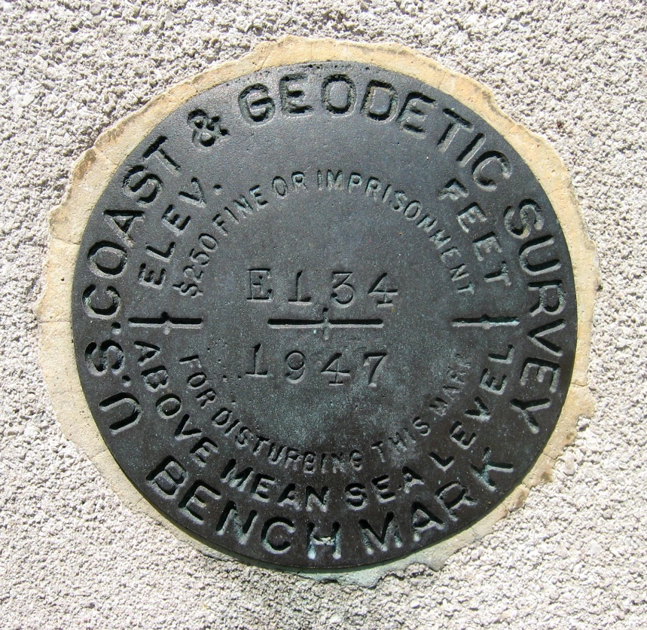
Continued Role of Passive Control
Calibration sites for GNSS technology, Real Time Network validation, and verification of datum transformation tool results.
Sites for monitoring motion to enhance velocity models (via repeat/campaign GNSS occupations)
Convenience for local project control, in areas with limited GNSS coverage (e.g. cities, forests), or in the event of GNSS failure (e.g. geomagnetic storms)
Notes:
Things are looking up! GNSS technologies simplify and improve access to and accuracy of our spatial reference system.
A common question that frequently arises is what role will passive control continue to play in the NSRS?

Slide 12
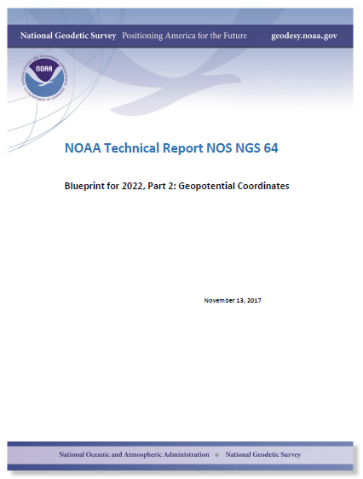
Executive Summary
An eloquent history of the role of leveling in ‘Geodetic Control’
Geoid Modeling 101
Spherical Harmonics:
Gravitation, CF, and Gravity…
Does the geoid age well?
Which comes first, the Sea Level or the GMSL W₀ value?
The many parts of the Geopotential Datum of 2022: Creation, Use, and Maintenance
… GIVE IT A GLANCE!
Notes:
Changes are still 4 years away, but users can get a sneak peak at the future in the Blueprints for 2022 Technical Report Series.
Part 2 = vertical focus. An informal summary of the contents is provided here to pique further interest.
Crack it open! Let NGS know what you think.

Slide 13
Sea Level and The Geoid
Standing definition of geoid:
The equipotential surface of the Earth’s Gravity Field which best fits, in a least squares sense, global mean sea level.
Notes:
Relevant dive into one topic of possible interest to this audience, the special geoid-definition problem…
Consider only the mechanics of sea-level change:
Mass is moving about (geopotential change)
Land ice melts and joins the ocean, re-distributing mass around the globe
Global mean sea level is rising >3 mm/yr (geometric change)
By long standing tradition, the geoid is the one equipotential surface that fits global mean sea level

Slide 14
Scenario 1: Geoid Definition remains tied to GMSL
Time Passes
H
2
H
Sea Level Rises
1
Geoid
GMSL
Geoid
GMSL
As Global Mean Sea Level rises, orthometric height gets smaller
Notes:
Violates expectation of a datum with semi-constant heights, which undermines central purpose for why we use reference datums on a on practical basis.

Slide 15
Scenario 2: Geoid Definition decoupled from GMSL
Time Passes
H
Sea Level Rises
H
1
2
GMSL
Geoid
GMSL
Geoid
As Global Mean Sea Level rises, orthometric height remains constant
Notes:
Eventually violates expectation for geoid coherence with global SL and has potential behavioral implications, especially at coast (for example if local SL is changing but building ‘heights’ remain fixed this could create a skewed perception of actual exposure to coastal flooding).

Slide 16
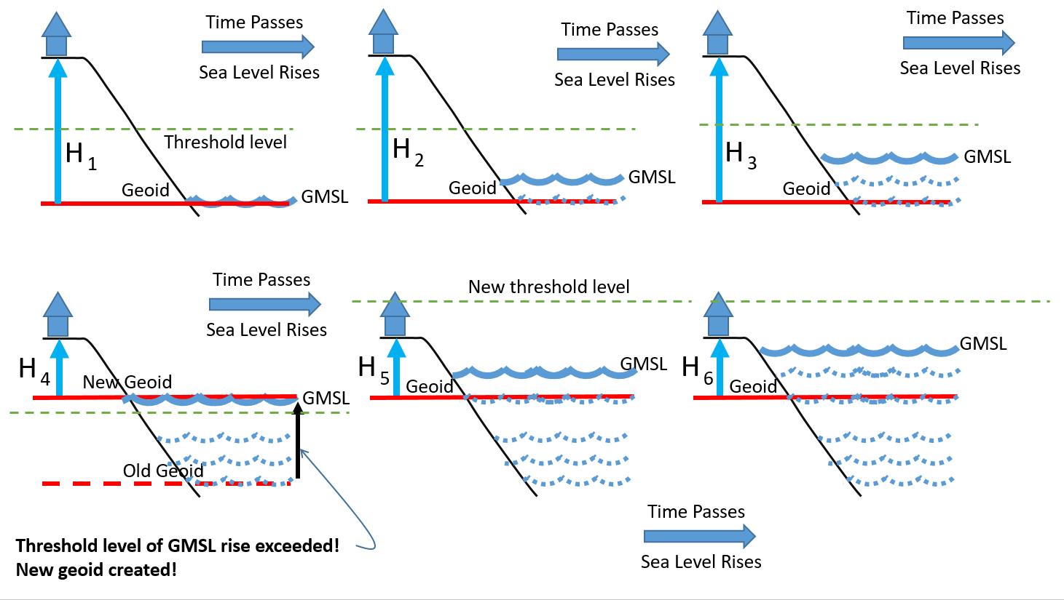
The Threshold Compromise: Choosing a new geoid as GMSL changes
(Approximately 20cm of GMSL)
Notes:
A blended approach balances NSRS requirements and expectations.

Slide 17
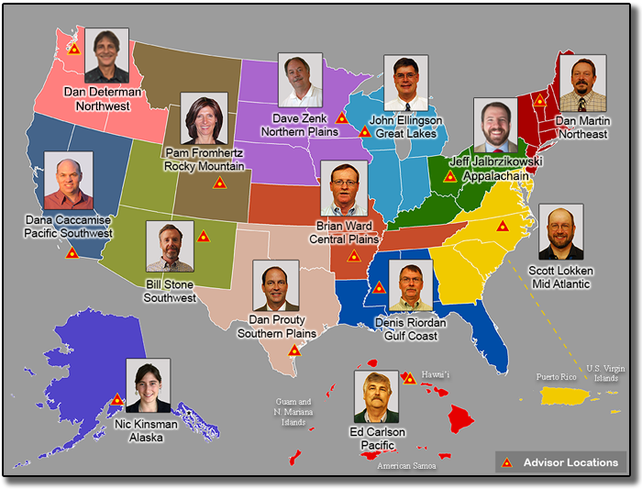
What can you do?
Coordinate
Spread the word and tell others about NSRS Modernization
Educate
Review materials and ask for support from NGS
Prepare
Lead by example and use best metadata practices
NGS Regional Advisor Program can provide customized guidance
Notes:
Reminder – don’t forget to grab a handout.

Slide 18
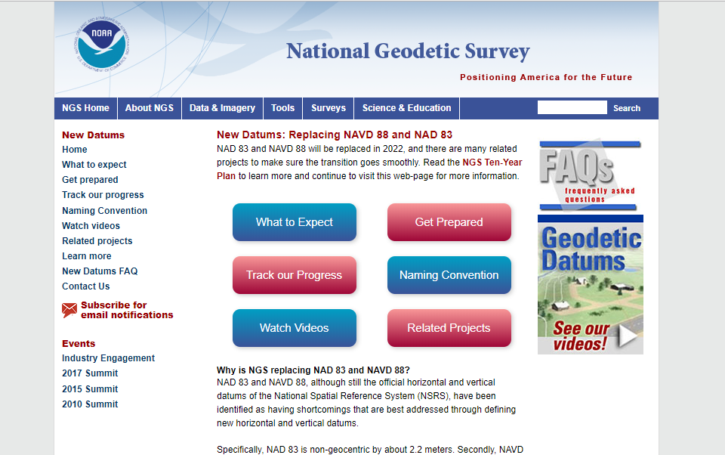
Resources from geodesy.noaa.gov
Visit geodesy.noaa.gov & click icon below
Notes:
Also: Webinars & email lists (inc. NSRS Modernization News)

Slide 19
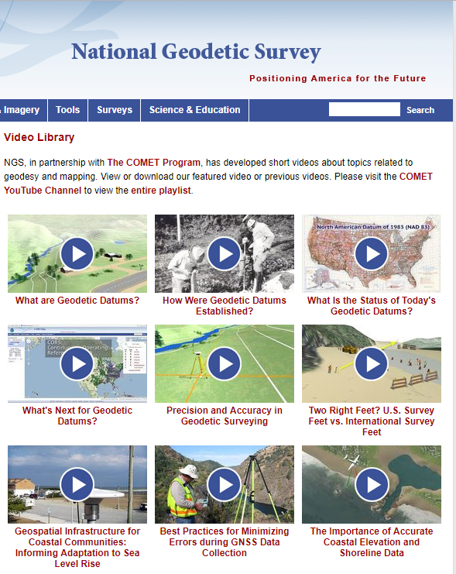
Educational Videos & Online Tutorials
Videos are
~3-5 minutes
Vertical Datums Tutorial is ~1 hour

Slide 20
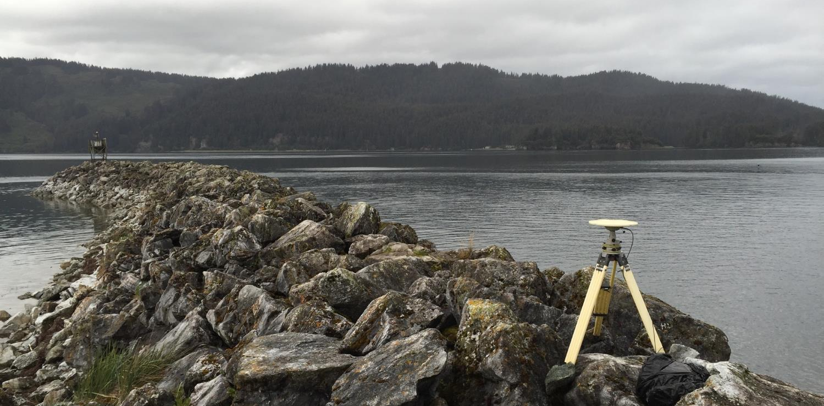
Questions?
Nic Kinsman
nicole.kinsman@noaa.gov
www.ngs.noaa.gov/datums/newdatums
Notes:
Special thanks to Monica Youngman, Dru Smith, fellow NGS Regional Advisors, and rest of NGS colleagues working to make this happen.

