Slide 1
Enhancing Access to GPS-based Heights in Alaska
Juliana Blackwell
Director, National Geodetic Survey
August 29, 2018
Juneau, AK

Slide 2
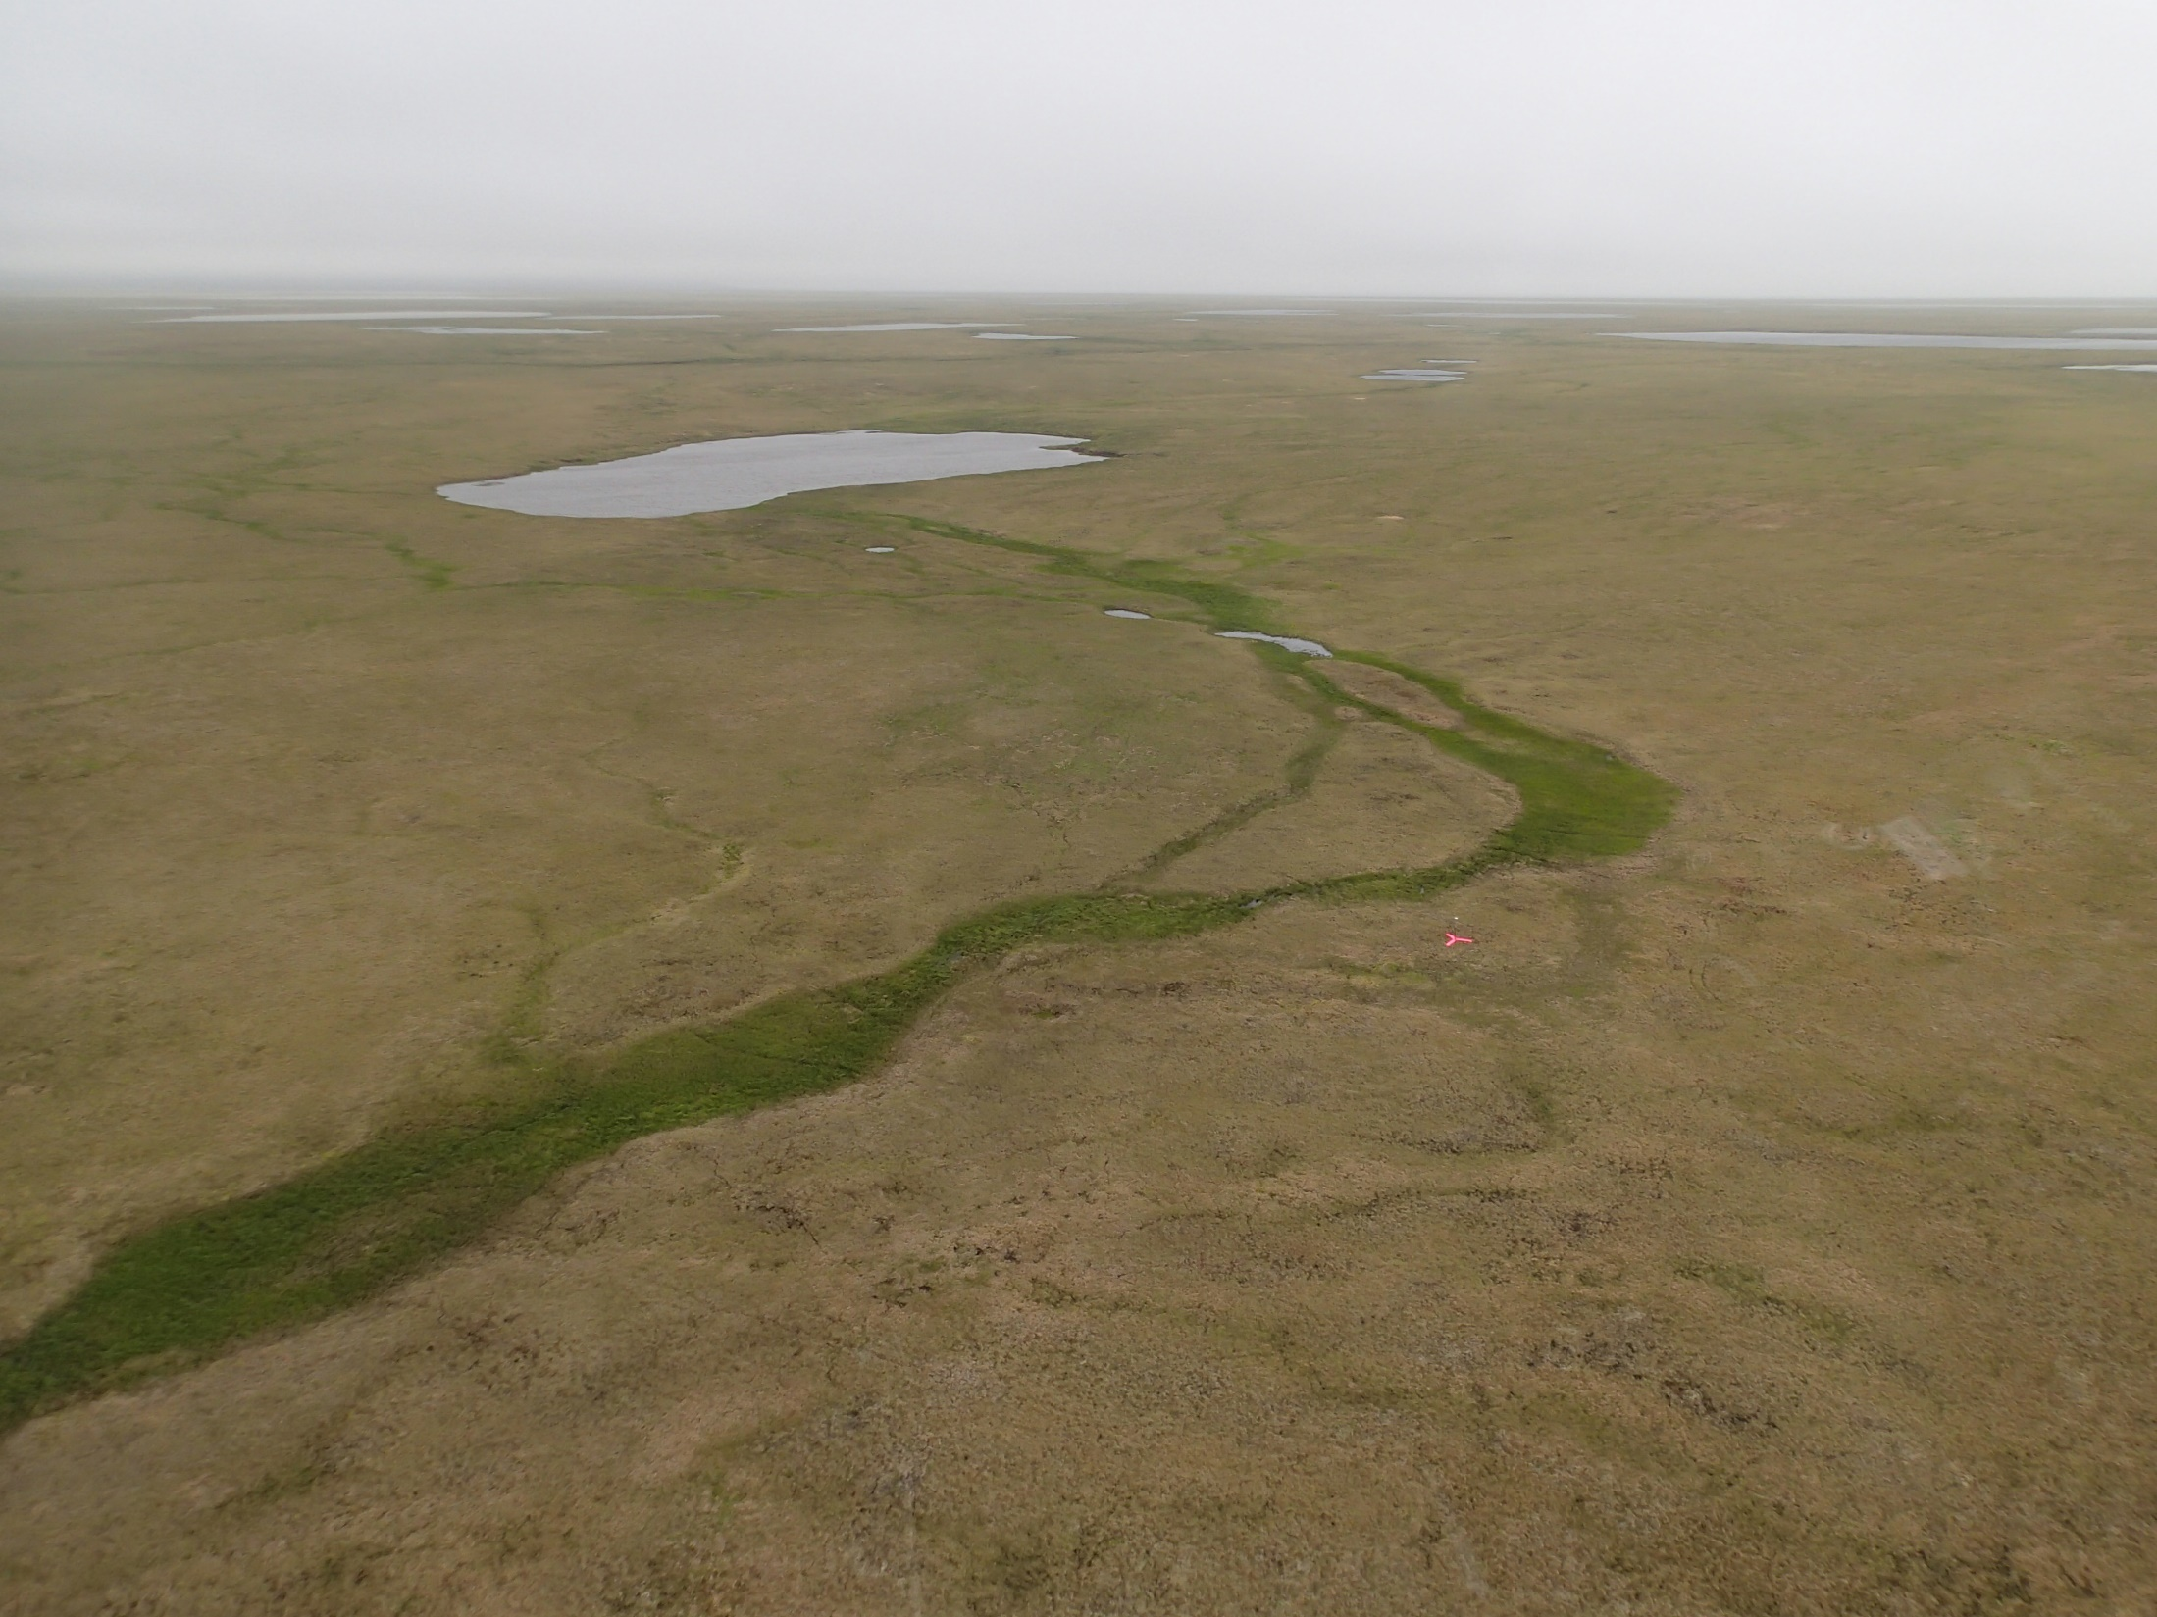
The mission of the National Geodetic Survey (NGS) is to define, maintain and provide access to the National Spatial Reference System (NSRS)
Notes:
As NGS continues to fulfill our primary mission, we have recognized the need to modernize the current NSRS in tandem with advances in geodesy, geophysics, and technology to meet evolving requirements and expectations of the NSRS. Decisions about how to best modernize the NSRS must achieve improved consistency (especially between passive and active control) and convenience while not fully departing from expected characteristics that are part of the fabric of how our Nation uses precise positions.
This presentation provides some updates on this mission in Alaska by working backwards through these three key mission areas, beginning with a topic of great importance to Alaska – NSRS access.

Slide 3
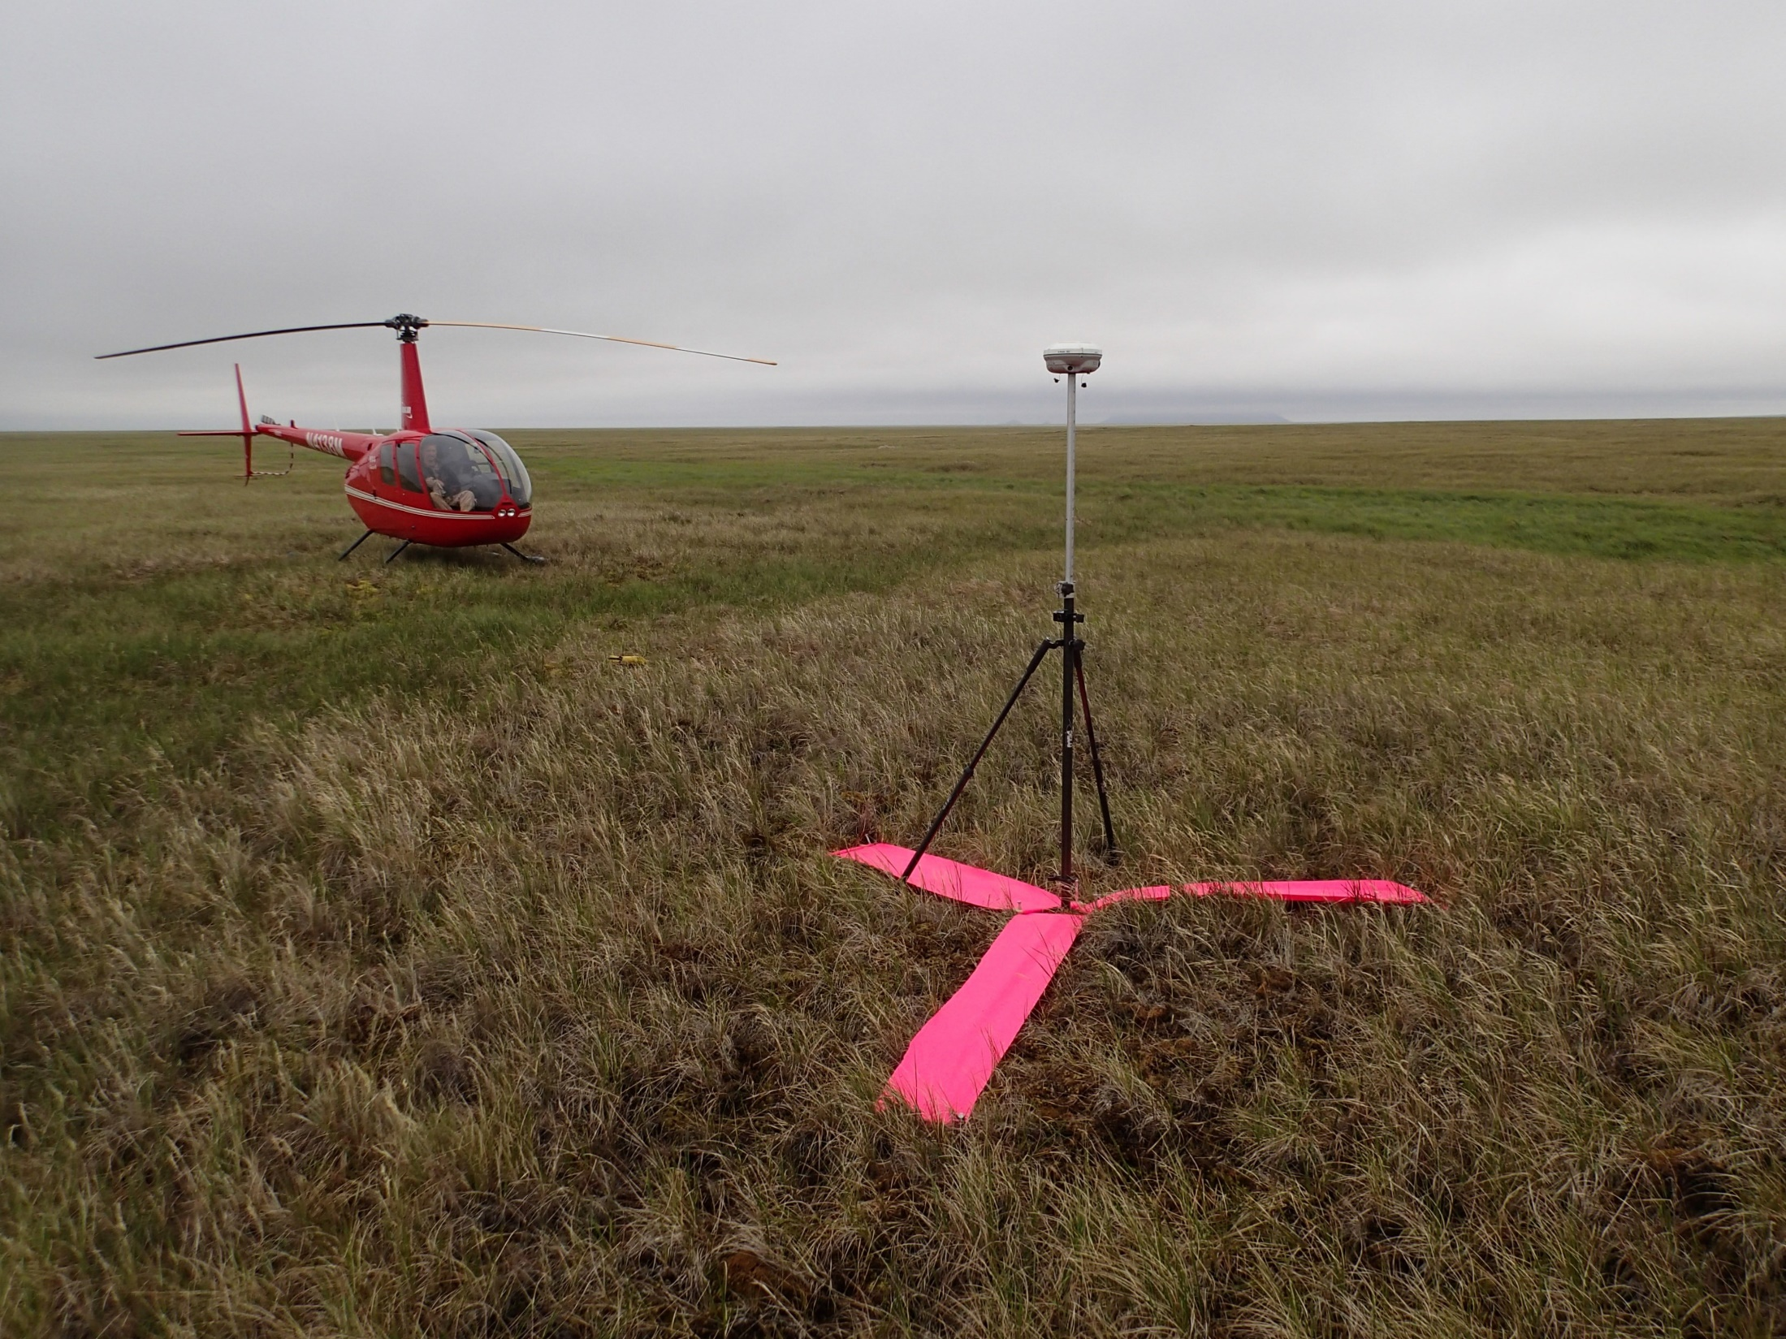
Alaska project areas can be remote, unstable, and difficult to access…
Notes:
Ground control point for an aerial survey project in western Alaska – accessible by helicopter only

Slide 4
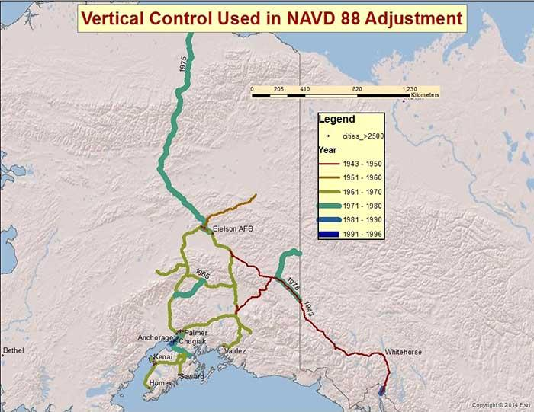
Access to Heights in Alaska – Before GPS

Slide 5
The National Geodetic Survey provides access to the NSRS through data, models, and tools:
Foundation CORS
GRAV-D
Geoid models
VDatum tool

Slide 6
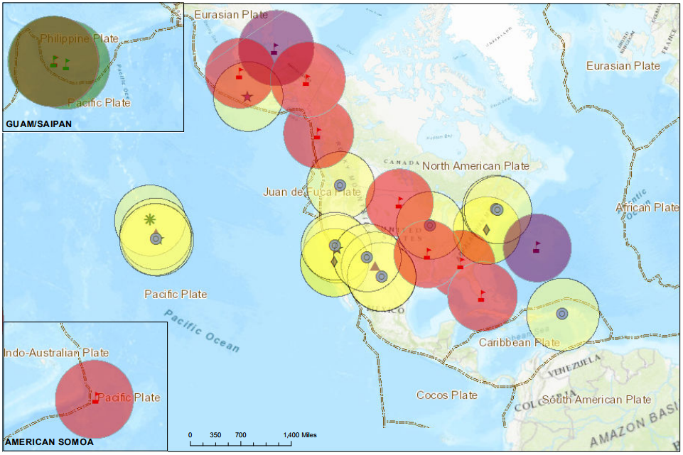
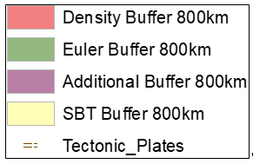
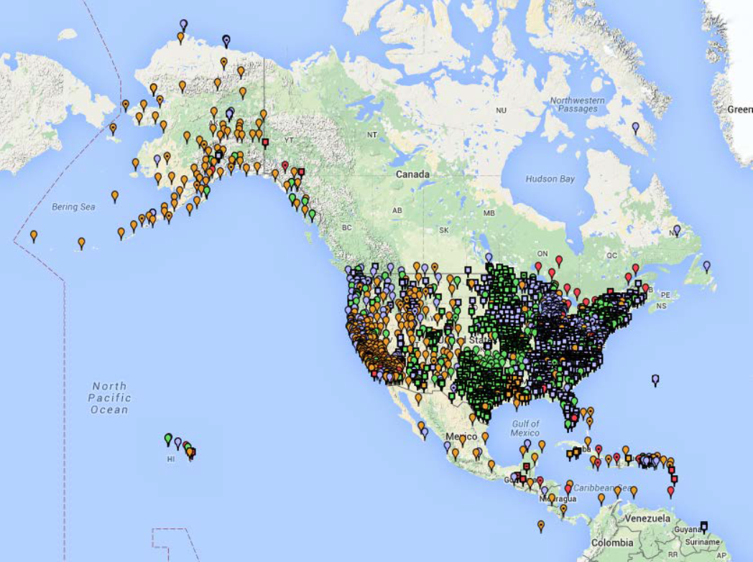
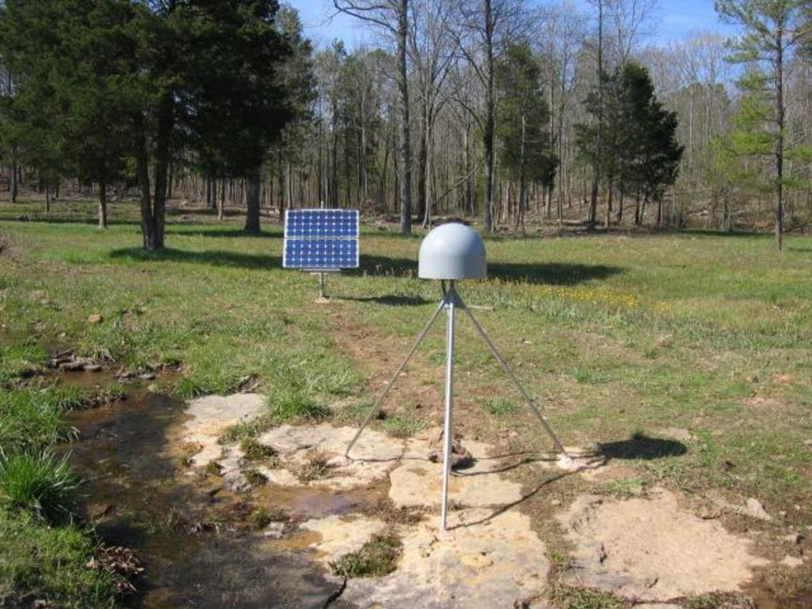
Foundation CORS - The Backbone of the NSRS
~2000 existing partner-operated CORS
A set of federally-operated, ultra-stable, high-reliability stations to guarantee citizens access to official NSRS positions and support UN-mandated international efforts.
Notes:
2000 existing CORS run by more than 200 organizations (various government, academic, and private organizations) and have varying quality, with no mandate for availability of data. It is a volunteer/crowd-sourced network where we collect, store, and make publicly-available their data in a central location.
To secure sustained access to NSRS, NGS is establishing the Foundation CORS network – an ultra-stable subset of the larger CORS network. Foundation CORS will meet strict International GNSS Service station guidelines. Principle Foundation CORS partners include the National Science Foundation, NASA, and the FAA.
Site selection based on: Collocated + Density + Euler + Additional
Phase 1 – Incorporation of Existing GNSS into Foundation CORS
28 Existing GNSS across 6 external Organizations and NGS
Phase 2 – Rehabilitation of GNSS systems to meet Foundation CORS requirements and Conduct Local Tie Surveys
7 GNSS to Rehabilitate
10 Existing GNSS require Local Tie Surveys
Phase 3 – Construction of new foundation CORS and 2 re-monuments, all with Local Tie Surveys
Apache Point, NM (new)
Boulder, CO (new)
Fort Irwin, CA (new)
Hancock, NH (new)
Fort Davis, TX (new)
Cold Bay, AK (remon)
North Liberty, IA (remon)
Eventually = 5 stations in AK:
AB09 – Wales, AK (EarthScope, PBO)
AB51 – Petersburg, AK (EarthScope, PBO)
ATQK – Atqasuk, AK (EarthScope, PBO)
FAIR – Fairbanks, AK (NASA, JPL)
CDB8 – Cold Bay, AK (FAA)

Slide 7
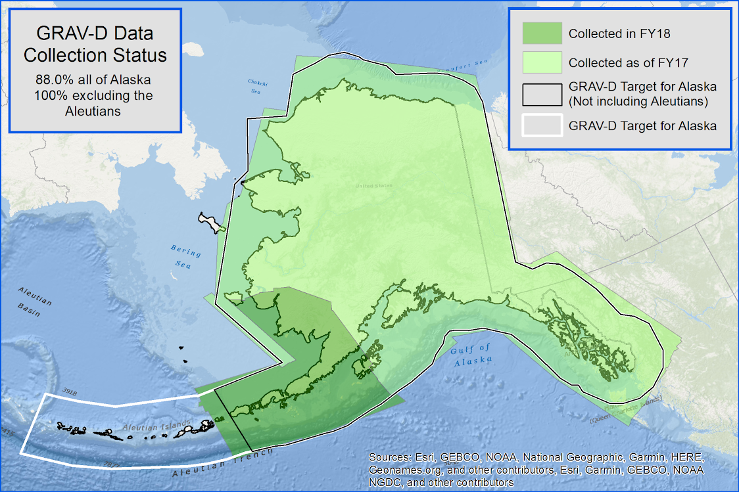
Gravity for the Redefinition of the American Vertical Datum (GRAV-D) Airborne Survey
Notes:
GRAV-D consists of two parts – the initial airborne survey component has been the focus of progress updates at previous AMEC meetings b/c of importance of accurate heights in AMEC elevation collections (e.g. to support NHD updates, etc.)
As of July 2018, airborne gravity surveys are on schedule at 100% complete over the GRAV-D target area for mainland Alaska
All of mainland Alaska GRAV-D data will be included in xGEOID19 (annual experimental geoid model); xGeoid model is recommended for use in elevation-based NHD linework updates
A key final product of complete airborne campaign is GEOID2022, which will provide GPS access to the NSRS
As scheduled, airborne surveys will pause in Alaska for several years to complete collections over other parts of US
Aleutian gravity surveys will resume at date closer to NSRS modernization in 2022 to fully leverage possible UAS approaches

Slide 8
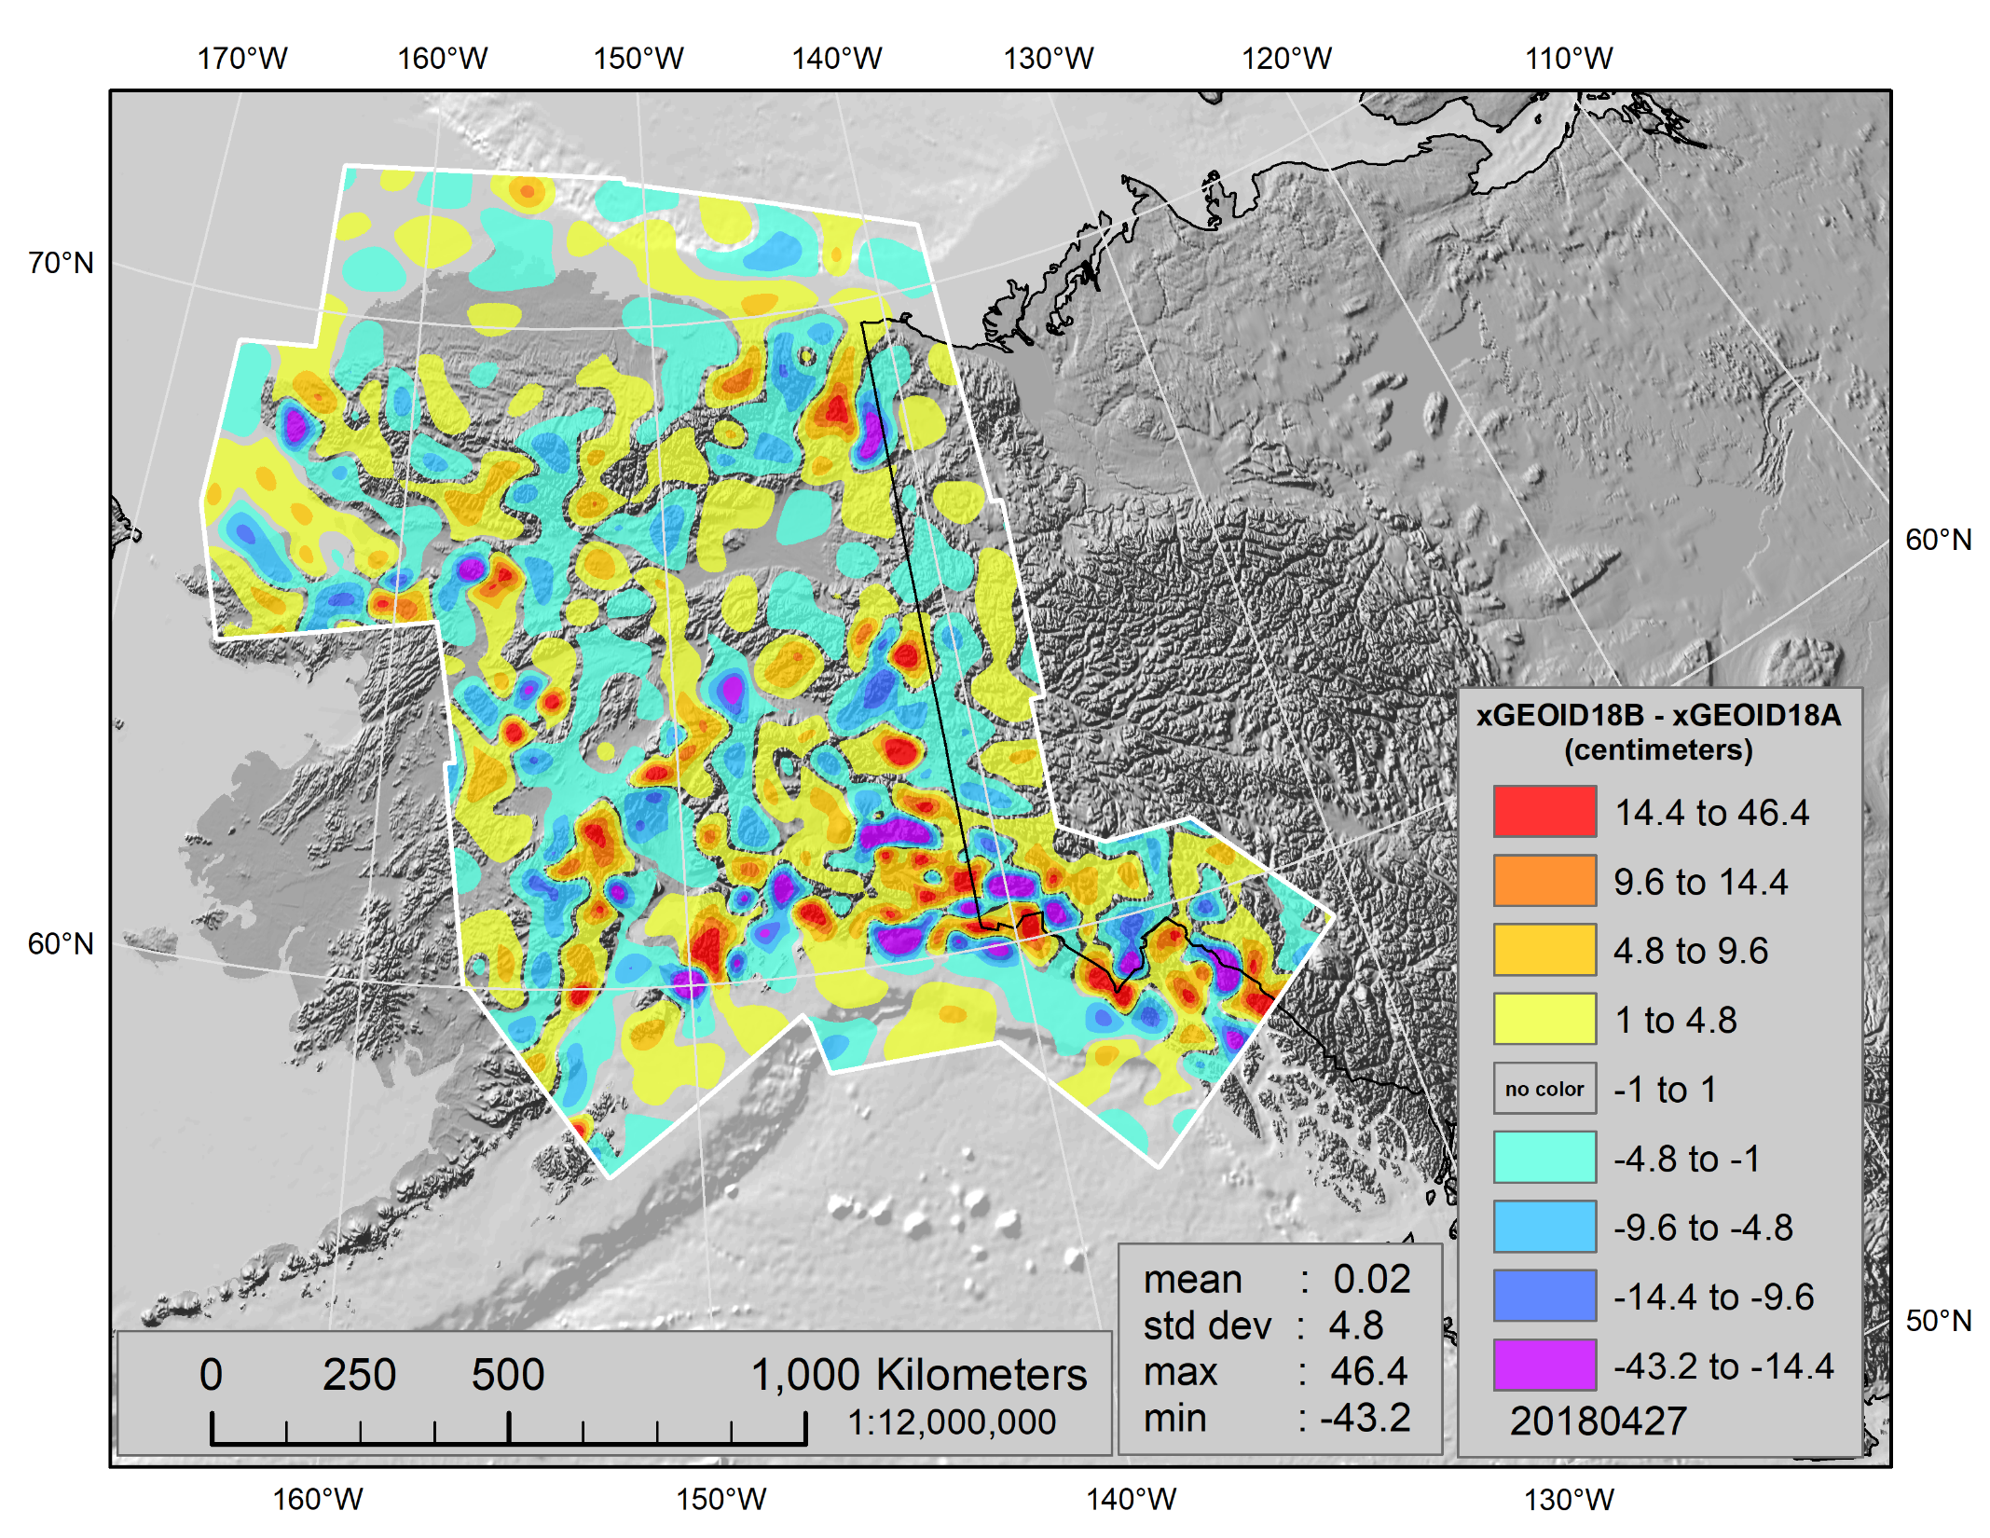
xGEOID2018
Experimental Geoid Models
Notes:
The xGeoid18A model utilizes all available data and current best computational methods, excluding GRAV-D (Gravity for the Redefinition of the American Vertical Datum) airborne gravity data, while the xGEOID18B model includes GRAV-D airborne gravity data as well. The xGEOIDs provide a preliminary, but increasingly accurate, view of the changes expected from the scheduled 2022 release of a new geopotential datum.
In FY18, for the first time an experimental Deflection of the Vertical model—xDEFLEC2018 (not shown)—was also generated. The deflection of the vertical is used to relate the orientation of a locally leveled instrument to a spatial reference system.

Slide 9

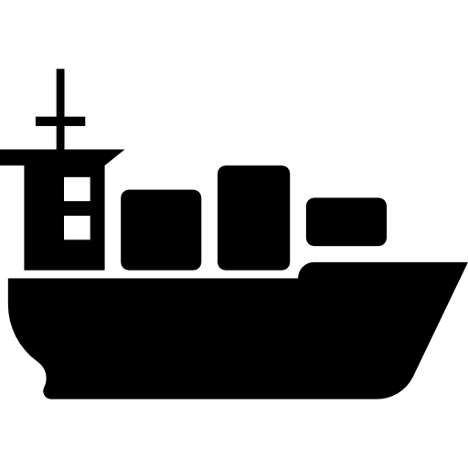
GPS-based Access to Heights in Alaska
Geoid models provide GPS-based access to orthometric heights
topography
Refined with GRAV-D
geoid model
ellipsoid
Topography of Sea Surface (TSS) models
provide GPS-based access or transformations to
heights relative to local tidal datums
ocean surface
Developed in VDatum
TSS model
ellipsoid

Slide 10
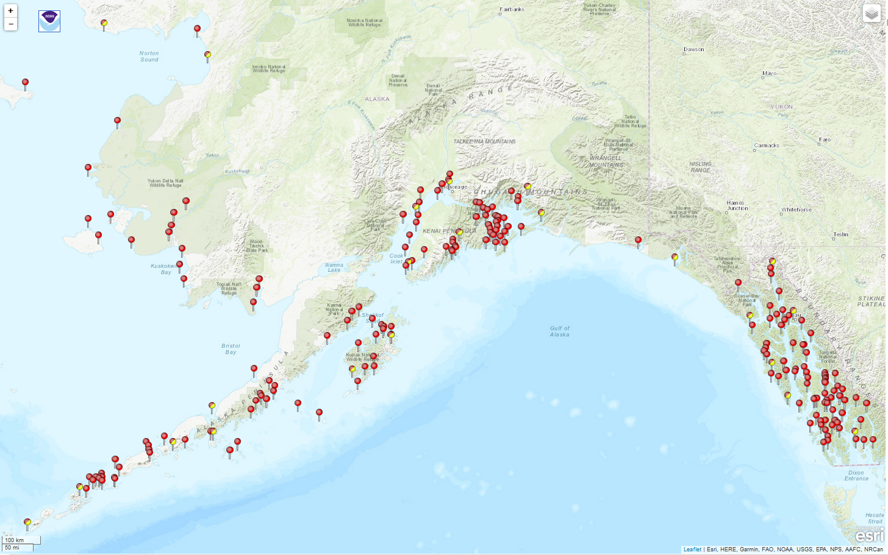
Access to (and Gaps in) Local MLLW
Notes:
Highlight VDatum development challenges – limited tidal datum establishment points and not all of those shown in map even have ties to the NSRS established. Ties have been undertaken with NGS, CO-OPS, State, and volunteer GNSS on tidal BM campaigns over last 5 years.
Note greater density in SE Alaska – allows for exploratory TSS development by VDatum program.

Slide 11
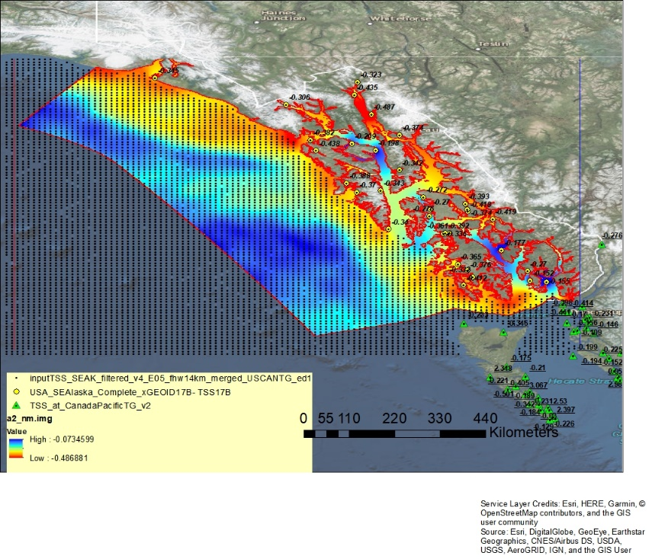
Topography of the Sea Surface (TSS) Model for Southeast Alaska VDatum
11
Notes:
The VDatum Team has been working outside of its formal production and maintenance schedule to try and make VDatum available in a portion of AK. This shows the exploratory Topography of the Sea Surface Model constructed by blending Satellite Altimetry Data with NOAA water level observations. This approach was utilized since the xGEOID availability, and has provided the opportunity to utilize a new transformation roadmap framework.

Slide 12
VDatum Transformation “Roadmap”
3D Datum
3D/Ellipsoid
Orthometric
Tidal
WGS84 (G1674)
WGS84 (….)
.
.
.
.
.
.
.
.
.
.
.
.
.
.
ITRF (…..)
IGS08
IGLD85
MHHW
MHW
MTL
DTL
MLW
MLLW
NAD83 (NSRS)
NAVD88
LMSL
HTDP
(14 Parameter + velocities)
GEOID12B
GEOID12A
GEOID….
TSS
Tidal Models
MHHW
MHW
MTL
DTL
MLW
MLLW
xGEOIDXXb
Southeast
Alaska
XGEOIDXXb (IGS08)
LMSL
TSS
Tidal Models
12
Notes:
The new VDatum Roadmap will traverse through IGS08 instead of NAD83, then utilize the experimental GEOID (xGEOID17b) in conjunction with the Next Generation TSS Version 1 to get us to local mean sea level and then onto the various tidal datums. (as shown in the SE AK red circle)
VDatum for the Arctic portion of Alaska will depend on renewed Alaska oceanographic modeling efforts in partnership with academia (presently funded by NOAA NCEP at Notre Dame, Joannes Westerink PI) and successful water level network build-out for model support and validation.

Slide 13
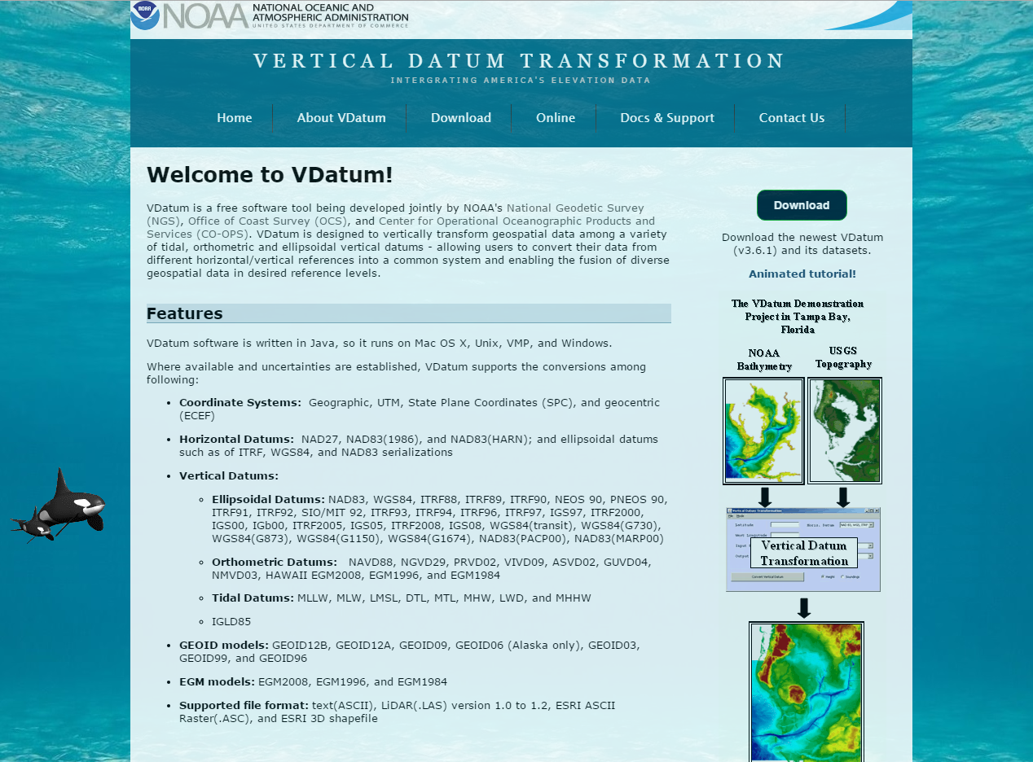
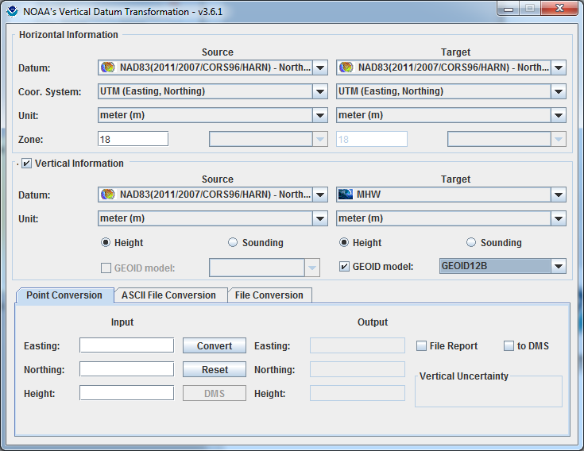
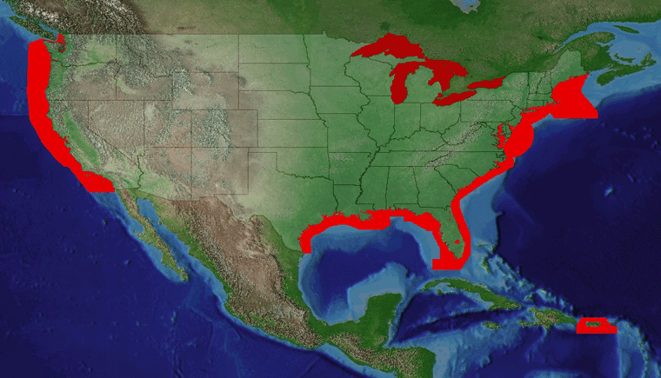
Vertical Datum Transformation (VDatum) Tool
https://www.vdatum.noaa.gov/
Version 3.9 released August 1, 2018
13
Notes:
Vdatum transformations are consistent with N-CAT tool (same innards, different interface for targeted stakeholder needs)
VDatum Software, Information, Documentation, and Training Material can be found at vdatum.noaa.gov
Current coverage for the tidal components of the tool covers CONUS, Puerto Rico and the U.S. Virgin Islands. IGLD85 is supported for the Great Lakes.
You are also able to contact the VDatum Team with support questions from the “Contact Us” tab.
Currently VDatum supports four interfaces:
1.) Downloadable Graphical User Interface (GUI): this is utilized for the processing of large data sets (i.e. lidar, multibeam, etc.)
2.) Command Line User Interface: Programmatically can call Downloadable software. Can also be used for large data sets when trying to automate processing through scripts and other software.
3.) Online Tool: Easy to use tool accessed through web browser. Has web map for enhanced user interaction and understanding of transformation capabilities (layers showing what is or is not a valid tidal transformation region and what areas are considered non-tidal)
4.) Web API: Programmatically call specific functions through web without having to download software. Limited amount of data can be transformed through this method. For example, an app on your phone could call for a point utilizing a GPS height to be transformed to another specified datum such as MLLW.

Slide 14
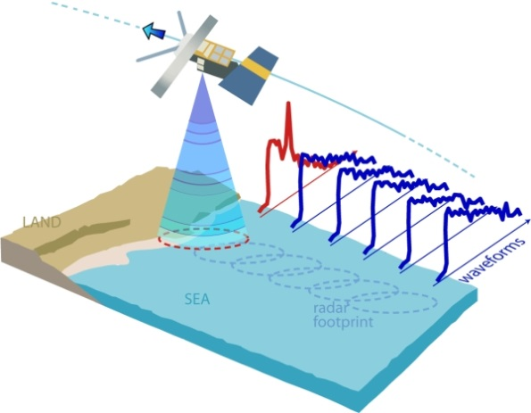
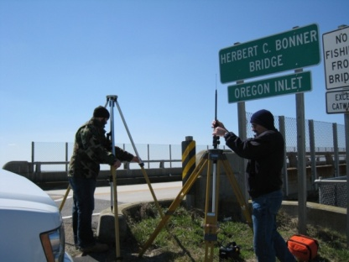
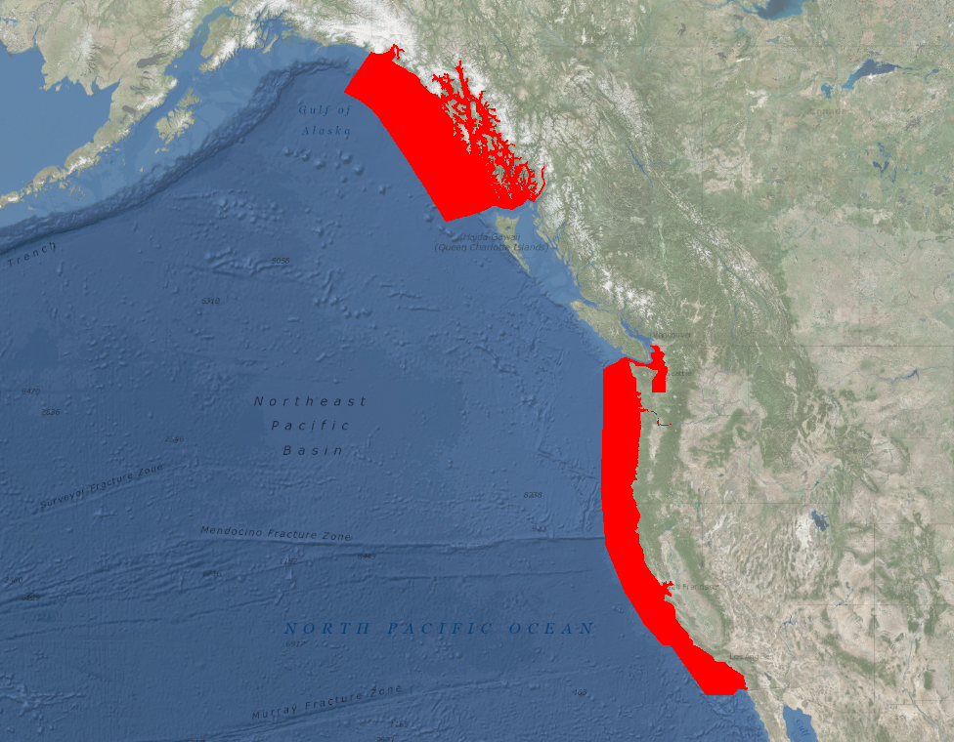
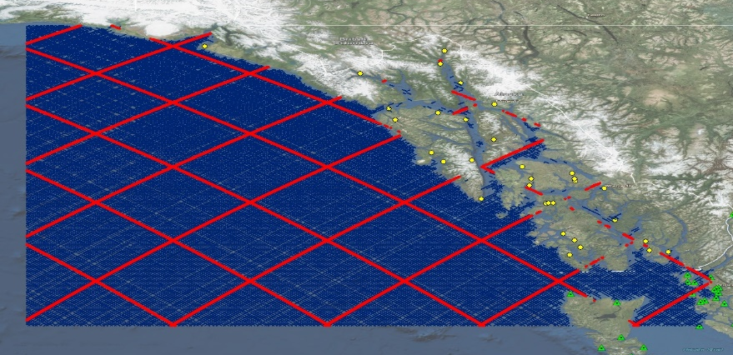
Future Enhancements to VDatum
GPS Campaign on benchmarks to determine new relationships
Incorporation of Long Wavelength Altimetry Data (Version 2)
Re-tracked coastal altimetry data to capture nearshore sea surface height signal
Longwave MSS/SSH signal and cross-over track adjustments
14
Notes:
Next Generation Topography of the Sea Surface Development Version 2
Future Enhancements will include incorporation of Longwave Mean Sea Surface/Sea Surface Height Signal and cross-over adjustments once the development of the U.S. West Coast Model is initiated to create a combined TSS field extending from SE AK to the U.S./Mexico Border.

Slide 15
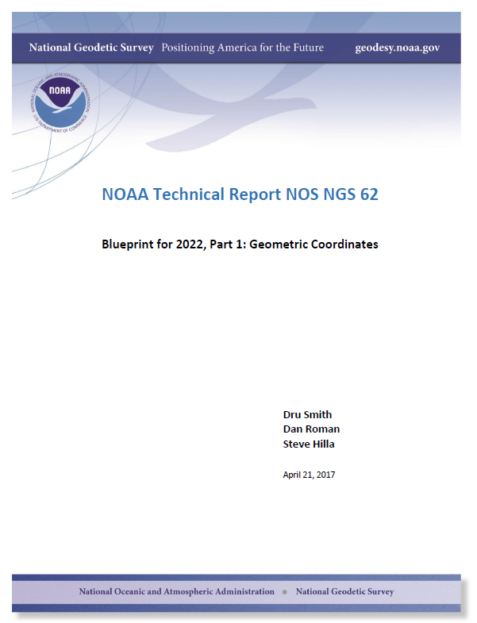
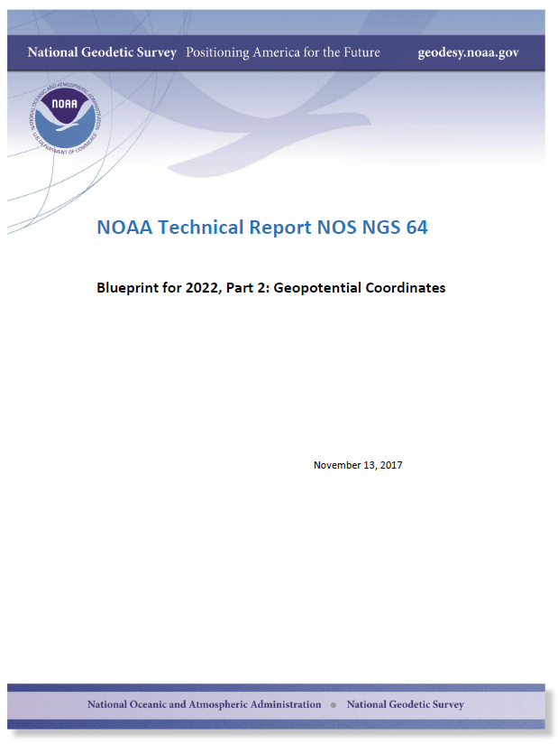
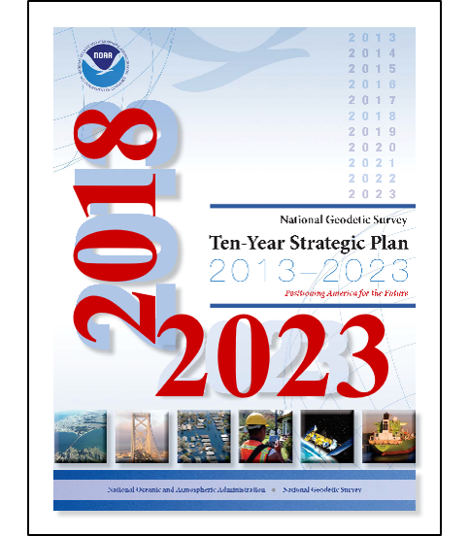
Actionable Plans at NGS
Blueprint for 2022 Technical Report Series
NGS Strategic Plan Update
Part 1: Geometric Coordinates and Part 2: Geopotential Coordinates are already released
Part 3: Working in the modernized NSRS is in preparation
Interval review underway
Editor review
Public comment
Release by end of year
15

Slide 16

Questions
Notes:
*

