Slide 1
Reference Frames and Datums: Improvements Planned for the Pacific
Dr. Daniel Roman
Chief Geodesist, National Geodetic Survey
HSRP Modeling Session 04 March 2021

Slide 2
Outline
Height relationships
GGRF and ITRS and WGS84
NSRS 2022
Western Pacific
Summary

Slide 3
Height Relationships
h: ellipsoid height
Above/below ellipsoid surface/datum
H: orthometric heights
Above geopotential datum (geoid)
Geoid ≈ Global MSL (MSL)
N: geoid height
Height from ellipsoid to geoid
Local Mean Sea Level (LMSL)
Mean Sea Surface
Topography of the Sea Surface (TSS)
Height from MSL(geoid) to LMSL(MSS)
h = H + N or H = h - N
Geoid + TSS = LMSL
ellipsoid
Tide
Gauge
N
Local MSL (MSS)
TSS/MODT
Geoid = “Global” MSL surface
?
Notes:
The surfaces in blue are datums from which heights are determined
The green values are differences between datum surfaces usually produced from models
In above example, the tide gauge is below the ellipsoid (-h) and above the geoid (+H) but at LMSL
The ship is at LMSL, but where is the bottom? How do you integrate all these for safe navigation?

Slide 4
Input for VDatum
Notes:
This information plus a whole lot more needed to adequately model VDatum for a region
Not shown here is all the bathymetric charting, shorelines flown extent and longevity of NWLON tide gauging
To do this in another region would require a heavy lift to achieve the sane level of results

Slide 5
Global Geodetic Reference Frame Roadmap
NOAA CORS Network
NWLON
Absolute Gravity sites
ISO/OGC
Standards
FGDC/FGCS
Standards
GDA
Notes:
Note that the GGRF =/ ITRS
Rather it is an overarching agreement or framework for how to align global geospatial datasets
It is, in effect, the GDA on the international scale
Note also that ISO 19161-1 is IAG’s International Terrestrial Reference System (ITRS)
GGRF essentially stipulates that all national SRS must be tied to the ITRS
The NSRS is tied to the ITRS – currently through ITRF96 but eventually through ITRF2020
Note that the UN SCoG specifically excluded use of WGS-84 as it does not meet the standards required for all users

Slide 6
WGS84 versus ITRS
Realization | Epoch, $t_{D}$ | Implementation date |  | Nominally Aligned to | Accuracy (m)
 |  | Broadcast orbits | Precise ephemeris
WGS84 | 1984.0 | 1987 | 1 Jan 1987 (1987.00) | BTS 1984 | 1-2
WGS84 (G730) | 1994.0 | 29 Jun 1994 (1994.49) | 2 Jan 1994 (1994.00) | ITRF91 | 0.10
WGS84 (G873) | 1997.0 | 20 Jan 1997 (1997.05) | 29 Sep 1996 (1996.74) | ITRF94 | 0.05
WGS84 (G1150) | 2001.0 | 20 Jan 2002 (2002.05) | 20 Jan 2002 (2002.05) | ITRF2000 | 0.01
WGS84 (G1674) | 2005.0 | 8 Feb 2012 (2012.10) | 7 May 2012 (2012.35) | ITRF2008 | < 0.01
WGS84 (G1762) | 2005.0 | 16 Oct 2013 (2013.79) | 16 Oct 2013 (2013.79) | ITRF2008 | < 0.01
Kelly and Dennis, 2021 in preparation (in review)
Notes:
WGS84 is useful for Navigation – less so for Positioning
There are no conversions available to the public between versions of WGS84
Since you must use an approximation from WGS84 versions to ITRF models to transform spatial data through time, why not just use an ITRF based system in the first place?
Also, other Nations will be adopting the ITRS – meaning that an ITRS-based solution will work better with national SRS for other countries (per the GGRF and ISO)

Slide 7
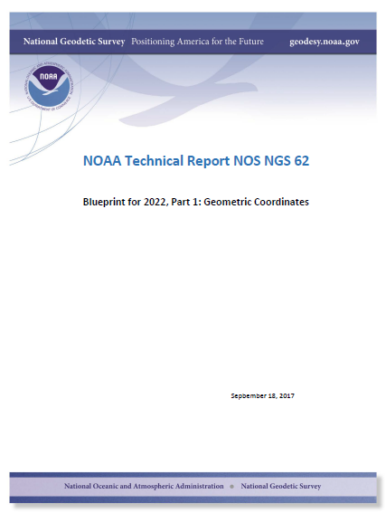
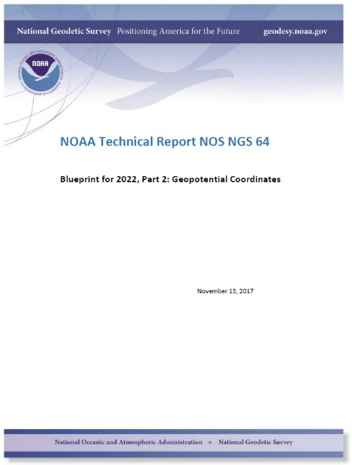
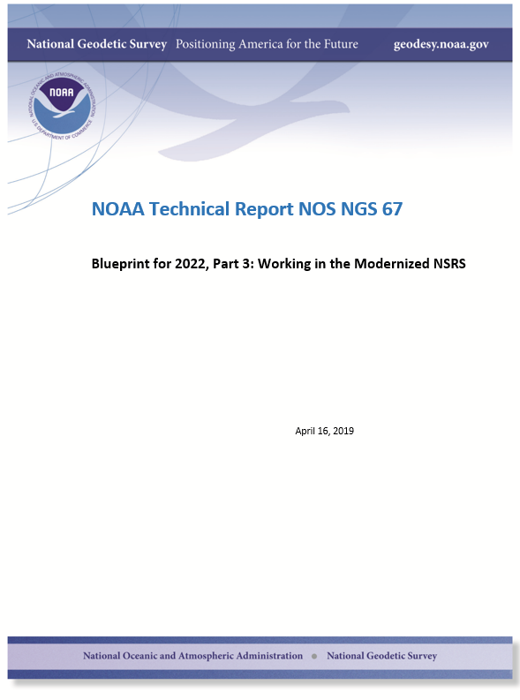
Modernizing the NSRS
The “blueprint” documents: Your best source for information
Geometric:
Sep 2017
NOAA TR NOS NGS 62
32 pages
Geopotential:
Nov 2017
NOAA TR NOS NGS 64
41 pages
Working in the
modernized NSRS:
April 2019
NOAA TR NOS NGS 67
77 pages
Notes:
All of these are currently in revisiom

Slide 8
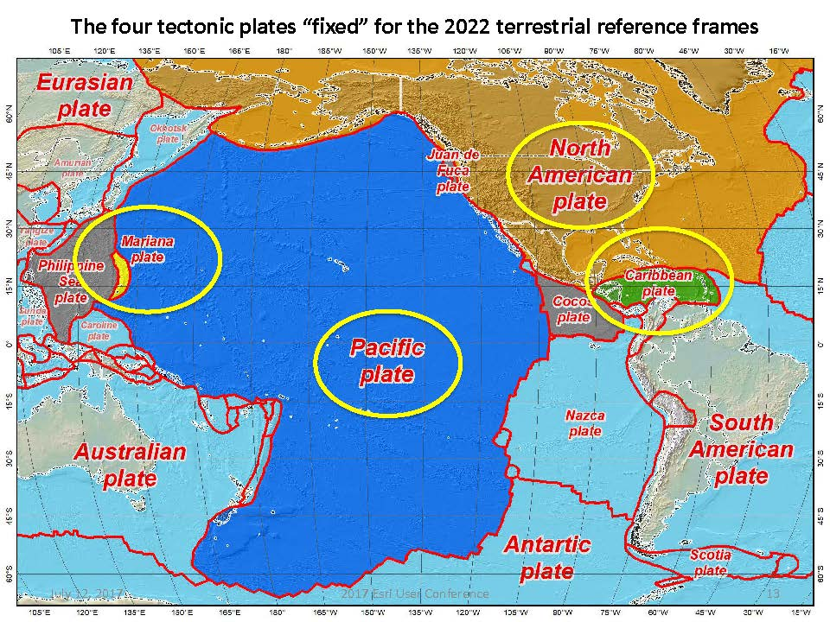
The old
NAD 83 (2011)
NAD 83 (PA11)
NAD 83 (MA11)
The new
NATRF
CATRF
PATRF
MATRF
Notes:
-there’s four reference frames because there are four major tectonic plates within the NGS Area of Responsibility.
-As the National Geodetic Survey, we’re part of the DoC so we must cater to all US States and Territories
-thus we’ve got four tectonic plates in our Area of Operations, so four Ref Frames
-But…

Slide 9
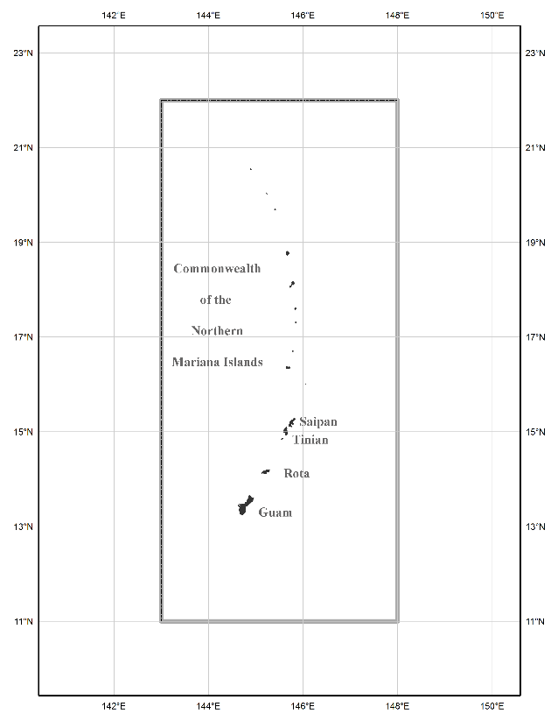
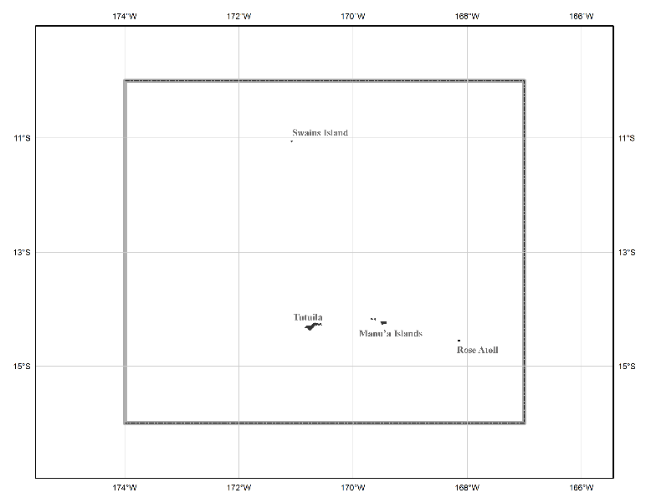
NAPGD2022 - The three gridded regions
“North American region”
¼ of the Earth
“Guam/CNMI region”
Project Area
“American Samoa region”
Notes:
Note that none of these cover Micronesia

Slide 10
Western Pacific Geodesy
Needs
Possibilities
Geometric Reference Frame
GNSS access to the Frame
Geoid model (h => H) GGM vs. regional
Terrestrial & altimetric gravity data
Tide gauges/TSS (MSL => LMSL)
ITRF2014/ITRF2020/PATRF/MATRF
NCN/APREF
ICGEM/ISG/EGM2008/EGM2020
NGA/BGI/PGSC
Academia/PGSC/PSMSL
Notes:
ICGEM

Slide 11
GNSS Access
NOAA CORS Network
Asia-Pacific Reference Frame (APREF)
Stations in APREF are being added to the NCN to boost coverage and access in the West Pacific
Notes:
There’s a lot of empty out there currently for NCN APREF has better coverage – especially in western Pacific
NGS is a member of APREF and are obtaining more stations to add to the NCN

Slide 12
Geoid Models
Global Gravity Models at ICGEM
Generally 5’ resolution or worse
10-20 km resolution – omission error
Commission errors more significant
Regional geoid models
Developed using GGM
R-C-R
Need additional terrestrial gravity
Altimetric anomalies
Still requires gravity data on islands
GGM derived from EIGEN-6c2 model
Provided on ICGEM website

Slide 13
Pacific Geospatial and Surveying Council
PGSC Core Members
Core members are national geospatial, hydrographic and surveying authorities of Pacific Island countries and territories
Maintain GNSS receivers in region
Ties: GA, LINZ, NGS, UN-GGIM, FIG, IAG
Possibilities of having local gravity data, tide information, leveling
Vision: Sustainable development in the Pacific enabled by world-class geospatial information and surveying services.
Cook Islands, Federated States of Micronesia, Fiji,
Kiribati, Nauru, Niue, Republic of the Marshall Islands,
Papua New Guinea, Palau, Samoa, Solomon Islands,
Tonga, Tuvalu, Vanuatu

Slide 14
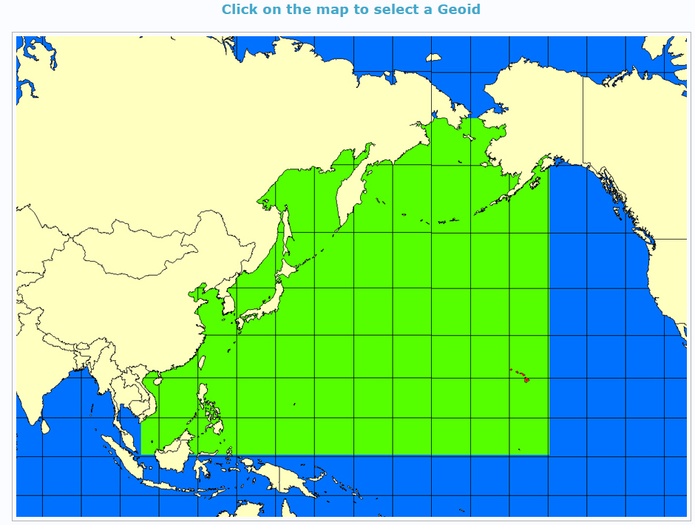
Summary
VDatum requires considerable data/care
GGRF requires all Nations to adopt ITRS
WGS-84 is not sufficient for positioning
For the West Pacific
ITRF2014 is available
NCN access limited but improving
NAPGD2022 will not cover region
EGM’s available but insufficient by themselves
Require regional geoid (R-C-R)
Altimetric anomalies available
Still lacking terrestrial gravity, TSS, tide gauge data
PGSC may be able to help with data gaps
These are the Nations in the project area
QUESTIONS?
Dan Roman
NOAA’s National Geodetic Survey
dan.roman@noaa.gov

