Slide 1
How to Submit an OPUS Share Observation
by
David Zenk
National Geodetic Survey
Advisor, Northern Plains Region
Minnesota, North Dakota, South Dakota, Iowa, and Nebraska
June 25, 2020
Notes:
Welcome to “How to Submit an OPUS Share Observation”

Slide 2
Instructor
David Zenk
dave.zenk@noaa.gov
National Geodetic Survey
Advisor, Northern Plains Region
Minnesota, North Dakota, South Dakota, Iowa, and Nebraska
Notes:
I’m David Zenk, the National Geodetic Survey Advisor for the Northern Plains Region.
I will be your instructor for this lesson.

Slide 3
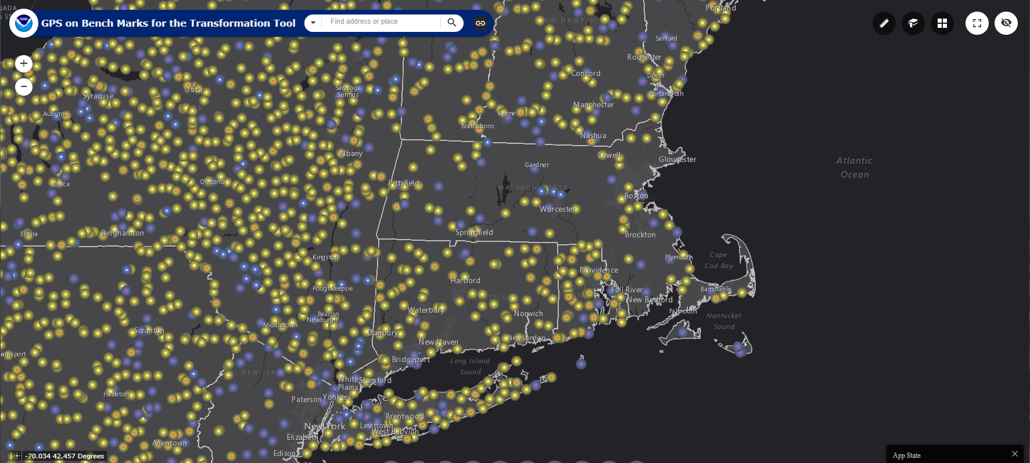
GPS on BM Campaign – OPUS SHARE
Notes:
The primary purpose of this lesson is to explain the steps needed to submit an OPUS SHARE observation in the context of supporting the GPS on BM Campaign.

Slide 4
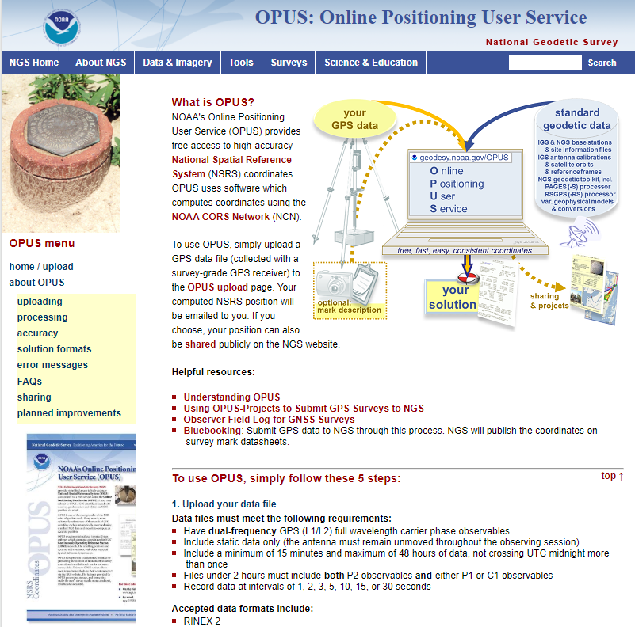
NGS Webpage - OPUS Suite
https://www.geodesy.noaa.gov/OPUS/about.jsp
Notes:
There are many sources of information on the OPUS Suite of tools.
See the NGS website at
www.geodesy.noaa.gov

Slide 5
GPS on BM Campaign – OPUS SHARE
The GPS on BM campaign has 3 goals:
Improve the NAVD88 to NAPGD2022 Transformation.
Pre-populate NATRF2022 control.
Preserve the nation’s valuable infrastructure network of legacy survey marks and to update information about those marks.
All of which benefit each of us!
Notes:
The GPS on BM campaign has 3 goals:
First, to improve the NAVD88 to NAPGD2022 Transformation.
Second, to pre-populate NATRF2022 control.
Third, to preserve the nation’s valuable infrastructure network of legacy survey marks and to update information about those marks.
All of which benefit each of us!

Slide 6
What is OPUS?
OPUS is an acronym for:
Online Positioning User Service (OPUS)
It started as a service for Static GPS users and has grown from there to serve other users.
Designed to work with minimal data input from user and be as fully automated as possible.
Only a Web Browser and Email needed to use.
Fast, easy, consistent access the National Spatial Reference System (or NSRS)
Notes:
OPUS is an acronym for:
Online Positioning User Service (OPUS)
It started as a service for Static GPS users and has grown from there to serve other users.
OPUS was designed to work with minimal data input from the user and be as fully automated as possible.
Only a Web Browser and Email are needed to use OPUS.
OPUS is a fast, easy, and consistent way to access the National Spatial Reference System (or NSRS)

Slide 7
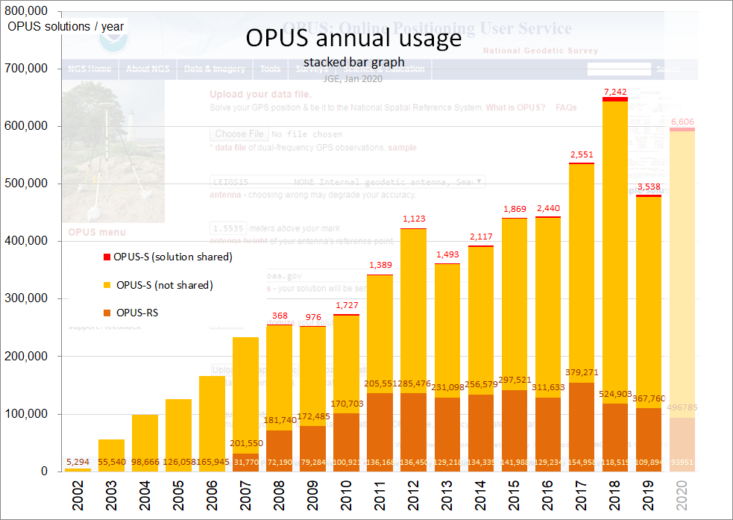
OPUS Annual Usage
2018 Results
OPUS Share = 7,242
OPUS – S = 524,903
OPUS – RS = 118,515
Total = 650,660
Notes:
OPUS has grown to be quite popular over time.
OPUS now serves over Half-a-Million data submissions per year!

Slide 8
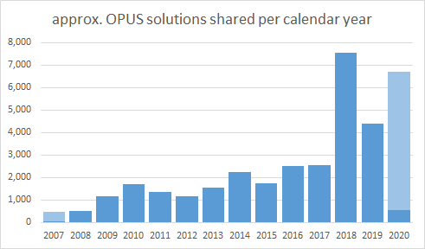
OPUS Share Annual Usage
7,242
Notes:
OPUS SHARE has become quite popular too, driven by the GPS on BM Campaign.

Slide 9
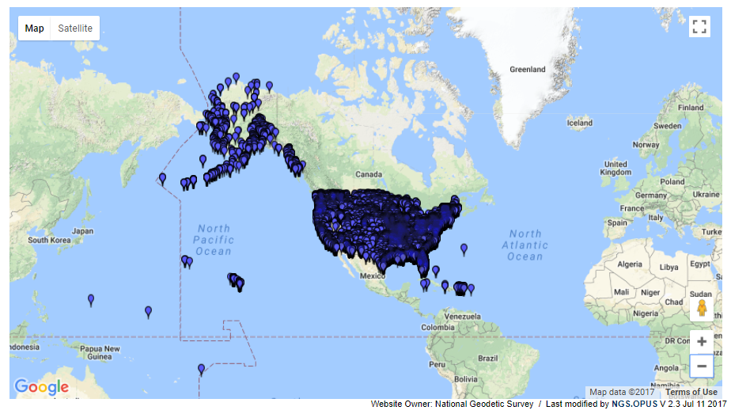
OPUS has been popular
https://www.geodesy.noaa.gov/opusmap/
OPUS Shared Solutions Map
Notes:
Browsing the OPUS Shared Solutions Map shows exactly where users have shared valuable data on permanent marks of public interest.

Slide 10
How does OPUS SHARE work?
Blueprint
Submit GPS data to OPUS Web site
Processed automatically on NGS computers
Ties to 3 CORS
Solution via email - in minutes
Fast, easy, consistent way to access the NSRS!
Notes:
The blueprint for using OPUS SHARE is:
User will submit GPS data to OPUS Web site
OPUS will automatically process it on NGS computers
With ties to 3 CORS
The solution will be returned via email - in a few minutes

Slide 11
OPUS SHARE --- 4 steps
Upload
Identify
Describe
Share
Sample Field Log Sheet
https://www.geodesy.noaa.gov/surveys/forms/obslog-OPUS.pdf
Notes:
In general, OPUS SHARE can be broken into 4 steps.
Upload
Identify
Describe
Share
The NGS Sample Field Log Sheet can be used to help organize the needed information.

Slide 12
OPUS Website
http://www.geodesy.noaa.gov/OPUS/
This is the OPUS submission page.
It is the gateway for all types of OPUS submissions, including OPUS SHARE.
Notes:
This is the OPUS submission page.
It is the gateway for all types of OPUS submissions, including OPUS SHARE.

Slide 13
OPUS Screen Layout
http://www.geodesy.noaa.gov/OPUS/
The OPUS screen shows the minimum 6 inputs. I’ll describe each one on the next slides.
GPS file
antenna type
antenna height
email
options
OPUS-S (2 hr)
Notes:
The OPUS screen shows the minimum 6 inputs.
I’ll describe each one on the next slides.

Slide 14
OPUS Inputs (REQUIRED)
GPS file – dual-frequency Rinex v.2 or v.3 (or some proprietary types) at least 4 hours duration
OPUS will compute only the GPS observations above 10⁰ mask angle.
OPUS will decimate logging interval to 30 seconds
Antenna Type – (choose from list)
Antenna Height – vertical height from mark to ARP (m)
Email – dave.zenk@noaa.gov
Options – next slide
Notes:
The 6 required inputs are:
GPS file – dual-frequency Rinex v.2 or v.3 (or some proprietary types) at least 4 hours duration
OPUS will compute only the GPS observations above 10⁰ mask angle.
OPUS will decimate logging interval to 30 seconds
Antenna Type – (choose from list)
Antenna Ht – vertical height from the mark to the ARP in meters
Email – dave.zenk@noaa.gov
Options – next slide

Slide 15
OPUS Inputs (OPTIONS)
Choose OUTPUT type
Standard or Extended
Specify CORS
Specify SPCS
OPUS-Projects Identifier
Set USER Profile
Choose “Yes, share” and then Upload to Static
Notes:
First, click on the “Options” button.
The screen will telescope open to show the options.
The user can choose from the 6 options shown.
Output Format. Most users will choose “standard” but you could also try the “extended” output and examine the useful results found there.
Users may choose to specifically “include” or “exclude” one or more specified CORS in their submission.
Most users should leave the selections blank and allow OPUS to choose.
Similarly, allow OPUS to choose the SPCS (State Plane Coordinate System)
Leave the OPUS Projects Identifier blank (if the box is shown)
And do not choose to Set a User Profile.
Choose “Yes, Share”. This choice will enable the OPUS SHARE application
And finally, press “Upload to STATIC”

Slide 16
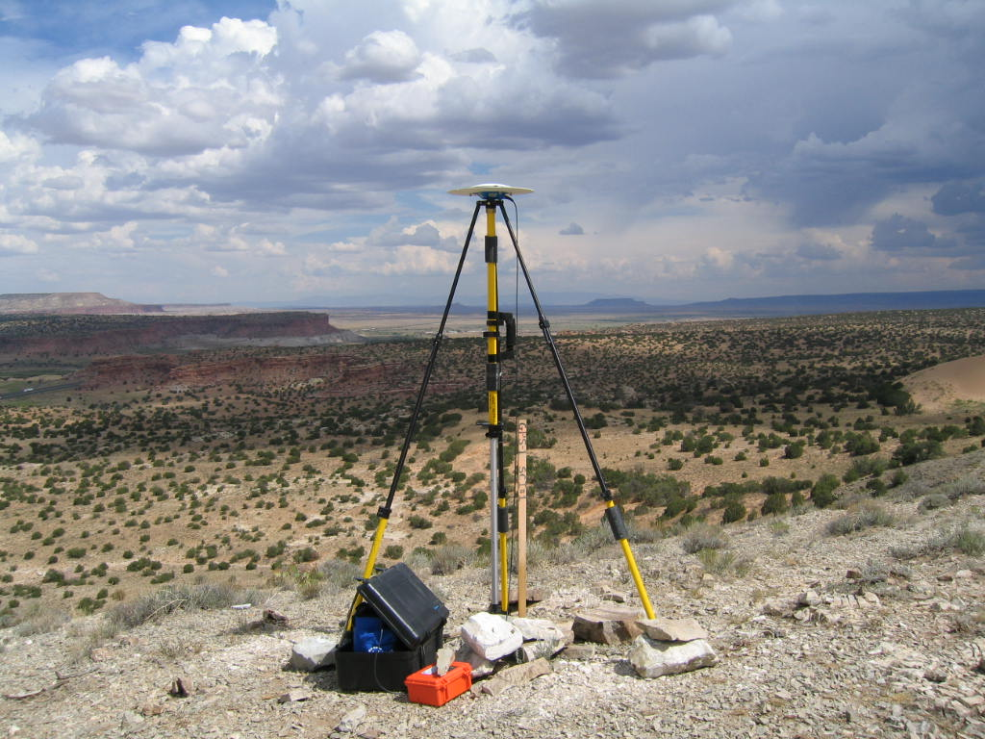
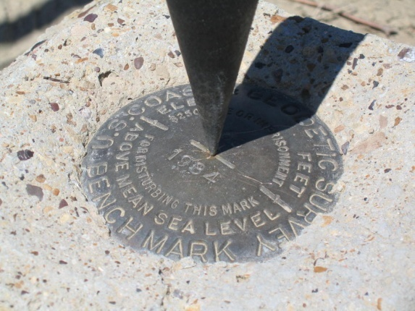
Antenna Height
true vertical distance
measured in meters
Antenna plumbed carefully over the mark
ARP
vertical
MARK
Notes:
Be careful to measure the VERTICAL Antenna Height from the Mark to the ARP.
OPUS SHARE expects the height to be entered in meters.
Make sure that the antenna is plumbed carefully over the mark.

Slide 17
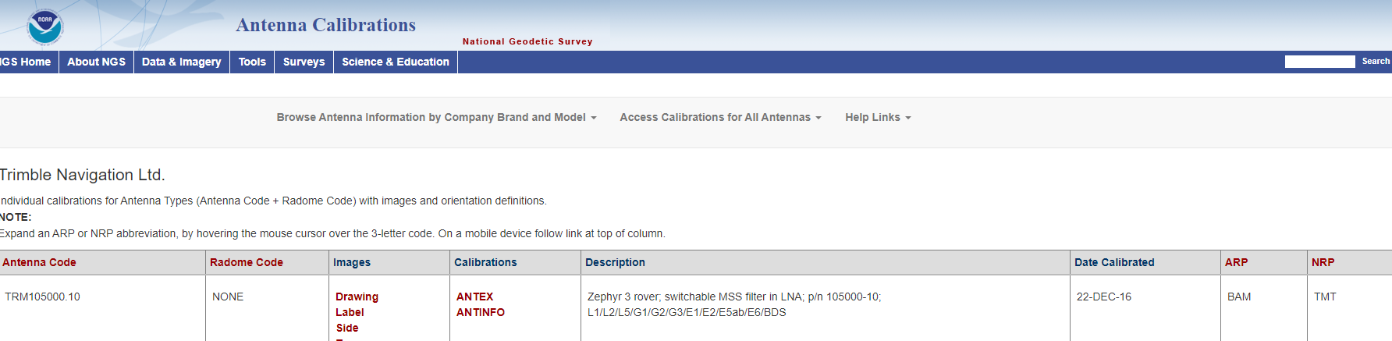
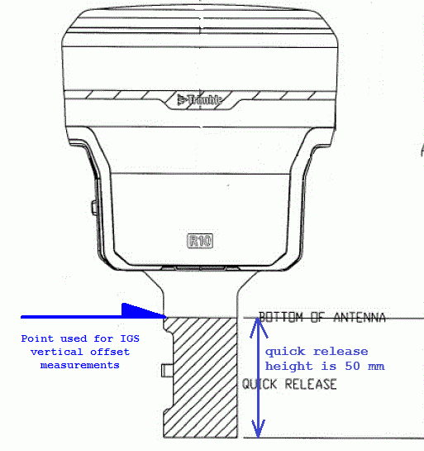
Where is the ARP?
https://www.geodesy.noaa.gov/ANTCAL/
ARP
Notes:
Exactly, where is the ARP for your antenna?
NGS supplies antenna calibrations and diagrams for most popular GPS antennae on the ANTCAL page.
In this example, the Trimble R10 diagram shows clearly that the ARP is the bottom of the antenna and is also the top of the quick release.
Be sure to measure the height to the identified ARP.

Slide 18
Where is the NRP?
https://www.geodesy.noaa.gov/ANTCAL/FAQ.xhtml#faq5
The north reference point (NRP) is a physical antenna feature which must be oriented toward the true north direction. Antenna calibration values assume that the NRP is properly oriented to true north. Please consult the antenna diagram for precise information on the NRP for your antenna model.
For TRMR10 the NRP Is MMI - meaning man-machine interface
Notes:
The tabulated NRP is the North Reference Point for the antenna.
In the case of the Trimble R10 it is listed as MMI – meaning man-machine interface.
The NGS ANTCAL FAQ page lists the abbreviations and meaning for the ARP and NRP
Your field crew should be careful to point the antenna’s NRP towards the north during observations.

Slide 19
OPUS SHARE Upload - OPTIONS
Choose “YES, Share” or “NO, Don’t Share”
The NO option reverts to normal
The YES option will bring up a Step 2 screen to identify your mark…
Choose “mark has a PID”
Or “mark is NEW to NGS”
Or “skip description”
Notes:
Once you’ve chosen “Yes, Share” and clicked “Upload to Static”, you will be given 3 options
Choose “mark has a PID”
Or “mark is NEW to NGS”
Or “skip description”

Slide 20
OPUS Share Step 2
Notes:
Here are the 3 choices of how to identify your mark.

Slide 21
OPUS Share Step 3
If you choose “mark has a PID” you need to know the mark identity (PID) and have 2 photos (small .jpg files - 1024 x 768 are adequate)
If you choose “mark is NEW to NGS”, you must fill in the required fields and have 2 photos (small .jpg files)
“Skip Description” is not an acceptable choice for OPUS SHARE
Notes:
If you choose “mark has a PID” you need to know the mark identity (the PID) and have 2 photos (small .jpg files 1024 x 768 are adequate)
If you choose “mark is NEW to NGS”, you must fill in the required fields and have 2 photos.
Skip Description is not an acceptable choice for OPUS Share

Slide 22
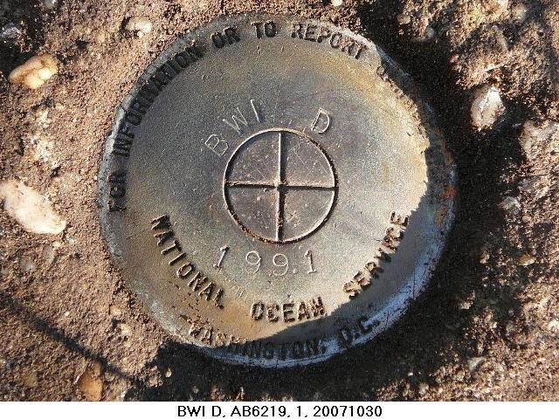
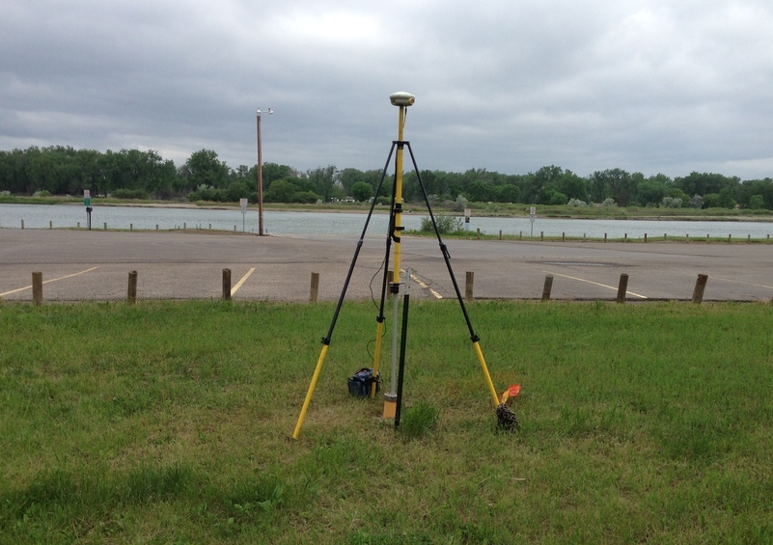
OPUS Share Step 3 - requires 2 photos
https://geodesy.noaa.gov/web/surveys/photo_submissions/
Close up photo of DISK clearly showing stamping
Horizontal photo of SETUP clearly showing equipment
JPG format, 1024 x 768 is adequate
Notes:
OPUS Share Step 3 - requires 2 photos:
A close up photo of DISK clearly showing stamping
A horizontal photo of SETUP clearly showing equipment
JPG format, 1024 x 768 is adequate

Slide 23
OPUS Share Step 3 existing mark
If you have an Existing Mark with a PID, you will need to supply the correct PID and then update each of the data fields shown.
When finished, click Upload Description
Notes:
If you have an Existing Mark with a PID, you will need to supply the correct PID and then update each of the data fields shown.
When finished, click Upload Description

Slide 24
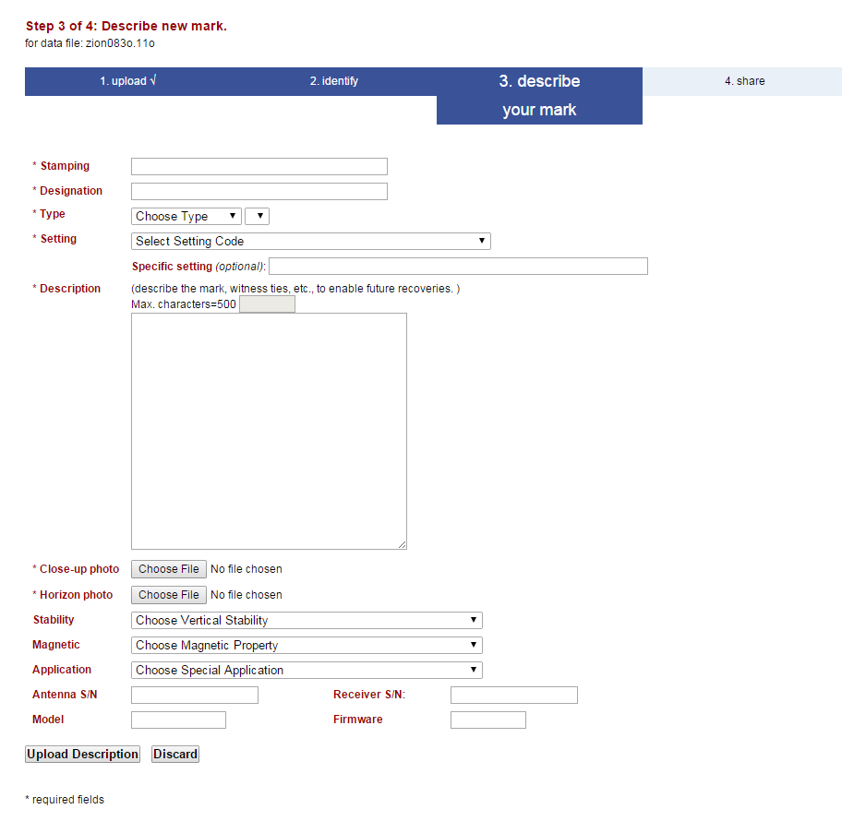
OPUS Share Step 3 new mark
If you have a New Mark, you will need to fill in each of the data fields shown.
Users who are not familiar with the contents of the fields should consult an experienced user or ask their regional NGS Advisor for assistance.
When finished, click Upload Description
Notes:
If you have a New Mark, you will need to fill in each of the data fields shown.
Users who are not familiar with the contents of the fields should consult an experienced user or ask their regional NGS Advisor for assistance.
When finished, click Upload Description

Slide 25
OPUS Share Step 4
Note that a confirming email is to come soon.
Notes:
Having entered the required data for your mark, you may Return to OPUS and submit an additional GPS observation or close the OPUS TAB.
At this time, your data file will be uploaded to OPUS SHARE and processed.
You can expect emailed results, usually within 5 minutes. Possibly longer if the OPUS servers are busy.
Note that you will also receive a second confirming email with a link to complete the process.

Slide 26
OPUS Share Confirming Email
Thank you for opting to share your OPUS solution.
The sharing status is DRAFT.
To complete sharing, please:
1) CLICK the link below to review your solution.
2) SELECT the share, edit, or discard button as appropriate.
RINEX FILE: 0186277i.16o.gz
DESIGNATION: NONE
https://www.geodesy.noaa.gov/OPUS/getFeedback.jsp?id=OP1582901444536
Notes:
In addition to the usual OPUS processing results, you will receive this second email containing notification that an OPUS contribution has been submitted.
A hyperlink will be supplied to allow you to view a mock up of the shared solution.

Slide 27
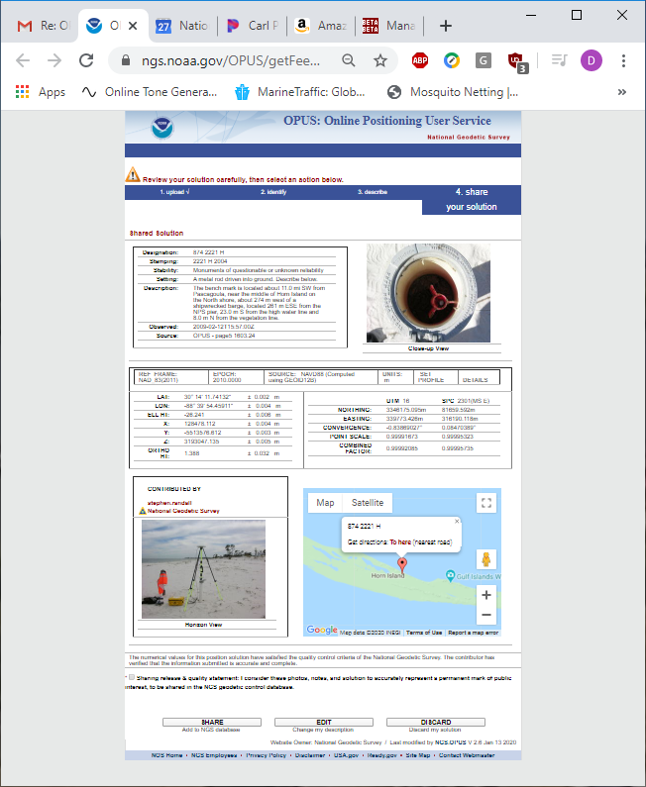
OPUS Share Final Approval and Shared Solution Mockup
SHARE, EDIT, or DISCARD
Last Chance to DISCARD
Notes:
Following the hyperlink will allow you to view a mock up of the shared solution.
Note that you have 3 choices:
Approve the shared solution as shown by clicking SHARE
Edit the description you’ve supplied by clicking EDIT
If the solution shown is not satisfactory or if you do not wish to continue for any reason, click DISCARD

Slide 28
Before we proceed to QA/QC …
New User Registration
Notes:
Before we proceed to QA/QC, we need to discuss New User Registration.

Slide 29
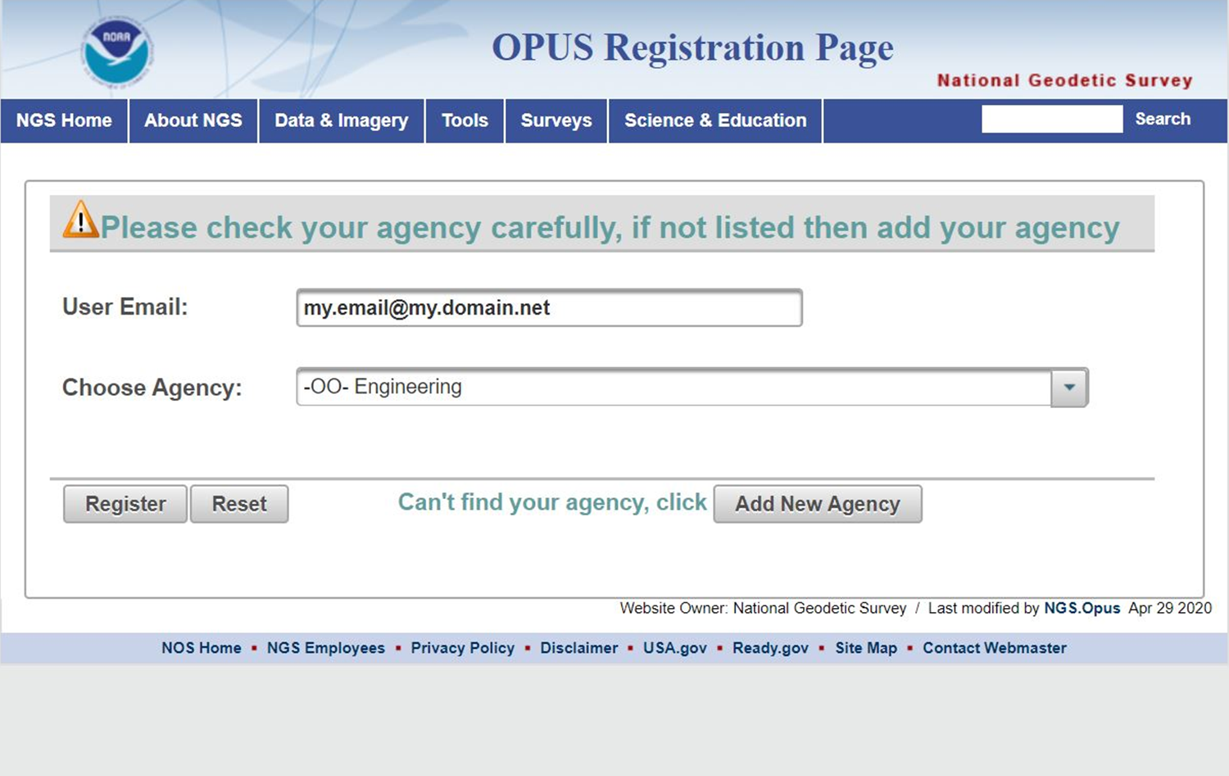
Attention New Users - Registration
If you have never submitted an OPUS Share, then your email needs to be added to the OPUS Registration list.
This is a simple one time process.
If OPUS Share does not recognize your email, you will get a pop-up window that prompts for the needed metadata.
Pop-up blockers may prevent this window from appearing.
New users should be aware of this procedure.
Notes:
If you have never submitted an OPUS Share, then your email needs to be added to the OPUS Registration list.
This is a simple one time process.
If OPUS Share does not recognize your email, you will get a pop-up window that prompts for the needed metadata.
Pop-up blockers may prevent this window from appearing.
New users should be aware of this procedure.

Slide 30
End New User Registration
Return to QA/QC Steps
Notes:
Let’s return to the QA/QC steps

Slide 31
OPUS Share Final Approval and shared solution mockup
SHARE, EDIT, or DISCARD
Last Chance to DISCARD
Notes:
Following the hyperlink will allow you to view a mock up of the OPUS SHARE shared solution.
Note that you have 3 choices:
Approve the shared solution as shown by clicking SHARE
Edit the description you’ve supplied by clicking EDIT
If the solution shown is not satisfactory or if you do not wish to continue for any reason, click DISCARD

Slide 32
OPUS Positions
NGS PAGES processing software
Ionospheric-free solution
Tropospheric scale height adjusted
Fixed ambiguities
Average of 3 unique CORS ties
ITRF & NAD83 coordinates/errors
CORS B
CORS A
₊
Average
CORS C
Notes:
OPUS SHARE, like all OPUS solutions, computes several baselines to surrounding CORS, evaluates their consistency, and then chooses the 3 best solutions.
As the diagram shows, OPUS will compute an average of the 3 best solutions and then compute a “peak-to-peak” report.

Slide 33
OPUS SHARE – Minimum Standards
OPUS shared solutions must meet the following requirements:
Your GPS data file must be 4 hours or longer.
Your mark must be a permanent mark of public interest.
- durable, have a stable setting, and good satellite visibility.
Include a description and photos to help others find your mark.
Your shared solution must be a high-quality solution:
≥ 70% observations used
≥ 70% ambiguities fixed
≤ 3 cm RMS (0.030 m)
≤ 4 cm (0.040 m) peak-to-peak error ranges for latitude and longitude
≤ 8 cm (0.080 m) peak-to-peak error range for ellipsoid height
https://www.geodesy.noaa.gov/OPUS/about.jsp#sharing
Notes:
Here are the Minimum Standards for OPUS SHARE.
Compare these to the OPUS Report to verify that it meets the minimum standards and can be submitted to OPUS SHARE

Slide 34
OPUS Report
NGS OPUS SOLUTION REPORT
========================
USER: dave.zenk@noaa.gov DATE: February 14, 2020
RINEX FILE: 5705044p.20o TIME: 18:32:03 UTC
SOFTWARE: page5 1801.18 master78.pl 160321 START: 2020/02/13 15:39:00
EPHEMERIS: igr20924.eph [rapid] STOP: 2020/02/13 21:32:00
NAV FILE: brdc0440.20n OBS USED: 10416 / 13626 : 76%
ANT NAME: SOK_RADIAN_IS NONE # FIXED AMB: 98 / 117 : 84%
ARP HEIGHT: 1.50 OVERALL RMS: 0.028(m)
REF FRAME: NAD_83(2011)(EPOCH:2010.0000) ITRF2014 (EPOCH:2020.1196)
X: -519860.102(m) 0.014(m) -519861.007(m) 0.014(m)
Y: -4844511.057(m) 0.021(m) -4844509.706(m) 0.021(m)
Z: 4102650.536(m) 0.028(m) 4102650.425(m) 0.028(m)
LAT: 40 17 17.33456 0.012(m) 40 17 17.35796 0.012(m)
E LON: 263 52 30.28771 0.013(m) 263 52 30.24350 0.013(m)
W LON: 96 7 29.71229 0.013(m) 96 7 29.75650 0.013(m)
EL HGT: 320.107(m) 0.034(m) 319.084(m) 0.034(m)
ORTHO HGT: 348.716(m) 0.046(m) [NAVD88 (Computed using GEOID18)]
UTM COORDINATES STATE PLANE COORDINATES
UTM (Zone 14) SPC (2600 NE)
Northing (Y) [meters] 4463706.581 57881.834
Easting (X) [meters] 744398.275 829363.777
Convergence [degrees] 1.86003889 2.56800278
Point Scale 1.00033534 0.99988215
Combined Factor 1.00028511 0.99983194
Notes:
Here’s a typical OPUS Report.
Let’s examine the Minimum Quality Standards for OPUS SHARE submission and compare them to the OPUS Report.

Slide 35
OPUS Report
NGS OPUS SOLUTION REPORT
========================
USER: dave.zenk@noaa.gov DATE: February 14, 2020
RINEX FILE: 5705044p.20o TIME: 18:32:03 UTC
SOFTWARE: page5 1801.18 master78.pl 160321 START: 2020/02/13 15:39:00
EPHEMERIS: igr20924.eph [rapid] STOP: 2020/02/13 21:32:00
NAV FILE: brdc0440.20n OBS USED: 10416 / 13626 : 76%
ANT NAME: SOK_RADIAN_IS NONE # FIXED AMB: 98 / 117 : 84%
ARP HEIGHT: 1.50 OVERALL RMS: 0.028(m)
REF FRAME: NAD_83(2011)(EPOCH:2010.0000) ITRF2014 (EPOCH:2020.1196)
X: -519860.102(m) 0.014(m) -519861.007(m) 0.014(m)
Y: -4844511.057(m) 0.021(m) -4844509.706(m) 0.021(m)
Z: 4102650.536(m) 0.028(m) 4102650.425(m) 0.028(m)
LAT: 40 17 17.33456 0.012(m) 40 17 17.35796 0.012(m)
E LON: 263 52 30.28771 0.013(m) 263 52 30.24350 0.013(m)
W LON: 96 7 29.71229 0.013(m) 96 7 29.75650 0.013(m)
EL HGT: 320.107(m) 0.034(m) 319.084(m) 0.034(m)
ORTHO HGT: 348.716(m) 0.046(m) [NAVD88 (Computed using GEOID18)]
UTM COORDINATES STATE PLANE COORDINATES
UTM (Zone 14) SPC (2600 NE)
Northing (Y) [meters] 4463706.581 57881.834
Easting (X) [meters] 744398.275 829363.777
Convergence [degrees] 1.86003889 2.56800278
Point Scale 1.00033534 0.99988215
Combined Factor 1.00028511 0.99983194
1
3
2
4
5
Notes:
There are 5 places to examine for quality acceptance.
First, did the solution use the PRECISE Ephemeris or something else?
NGS recommends that for best practice to wait 14 days for the Final Precise Ephemeris to become available.
Second, verify the Antenna Type and Antenna Height. Compare these to the Field Log Sheet.
Errors cannot be fixed. The file needs to be re-uploaded.
Third, Do the file Start and Stop Times show at least 4 hours duration?
Fourth,
Is the OBS USED at least 70%
Is the Number of Fixed Ambiguities at least 70%
Is the Overall RMS 3 cm or less
Fifth,
Are the peak to peak values for LAT and LON 4 cm or less
Is the peak to peak value for Ellipsoid Height 8 cm or less
In this example, all standards are met.

Slide 36
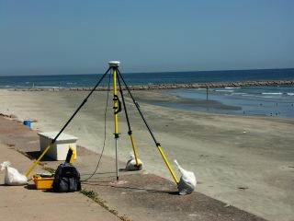
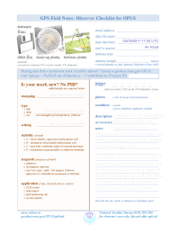
G.I.G.O.
We still need surveyors. We hope OPUS can help, but it can’t do your job for you.
Follow your project’s specifications.
Use best practices and careful field procedures.
Select permanent marks of public interest.
Good coordinates come from good data.
http://gis.larc.nasa.gov/
Notes:
Remember that you must always follow best GPS practices and make sure your equipment is in good adjustment.
G.I.G.O - means garbage in, garbage out

Slide 37
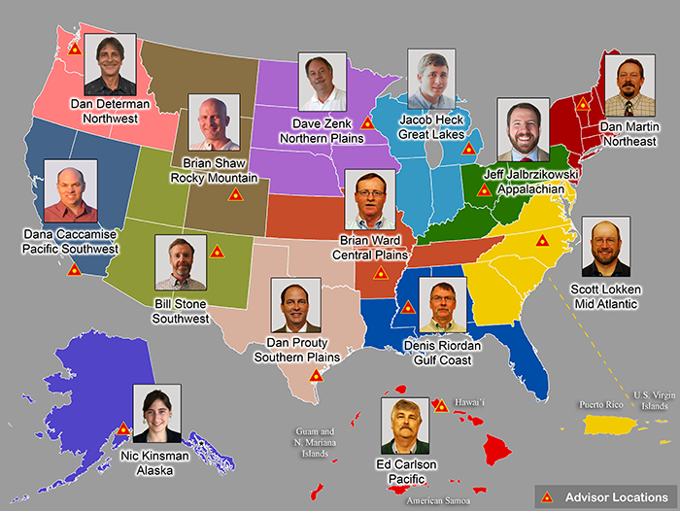
Contact
If you need assistance contact me or your regional NGS Advisor.
https://www.geodesy.noaa.gov/ADVISORS/index.shtml
Dave Zenk PE, LS
National Geodetic Survey
Northern Plains Regional Advisor dave.zenk@noaa.gov
Notes:
If you need assistance, please contact me or your regional NGS Advisor.
And good luck with your OPUS SHARE submissions.
Thank you.

Slide 38
The End

