Slide 1

Gravity for the Redefinition of the American Vertical Datum
(GRAV-D) Update
Monica Youngman
GRAV-D Project Manager
NSPS/MAPPS Conference
Silver Spring, MD
March 13, 2017

Slide 2
Agenda
  GRAV-D Project Update
    Background
    Scope and Methods
    Data Collection Status
    Data Processing
  Geoid Changes and Future Monitoring
    Experimental Geoids
    Maintenance Plans

Slide 3
Part 1: The GRAV-D Project

Slide 4

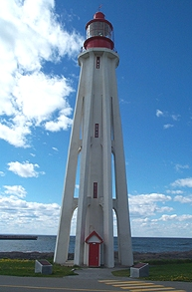
NAVD 88: Current Vertical Datum
NAVD 88: North American Vertical Datum of 1988
  The surface of equal gravity potential to which orthometric heights shall refer in the United States
How Defined:
  1980s survey campaign with leveling and gravity at >500,000 benchmarks
  Minimally constrained adjustment wit one fixed point - “Father Point/Rimouski”
Realization:
  NAVD 88 is only defined at these benchmarks.
Father Point Lighthouse Quebec, Canada
Notes:
By fixing the geopotential value at the origin point, it was possible to ensure that the origins of IGLD 85 and NAVD 88 aligned.
*It should be pointed out that while the datum was defined in such a way as to be usable on the North American continent, it was never actually adopted in Canada. It can be used there, but it’s not their official civilian datum.
Note that the designation of the vertical control point at Father Point is “1250 G=NAVD 88 DATUM POINT” for PID# TY5255 and is not available from the publicly accessible NGSIDB.

Slide 5
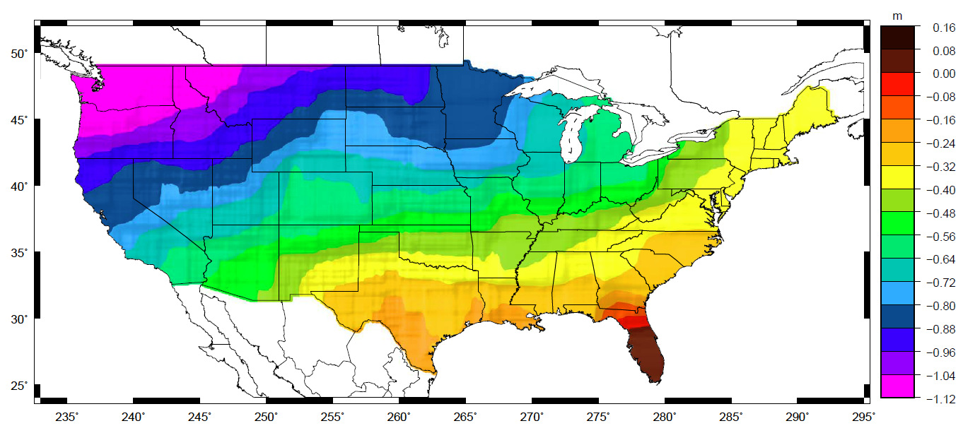
NAVD 88 Problems
Approximate mismatch between NAVD 88 (zero surface) and the global geoid (i.e. sea level)
Notes:
This map reflects the sort of height changes that users could expect if NAVD 88 were replaced with a geoid-based vertical datum.
This is only a large scale approximation and should not be used as an absolute guide. Each benchmark might have its own level
Of mismatch, say from uplift or subsidence, not captured by this broad brush.
Also, this is the difference between the zero level of NAVD 88 and the actual geoid. The difference between NAD 83 ellipsoid heights and
ITRF/GRS-80 ellipsoid heights has NO influence on this graph and should not be part of the story.
Updated October 2010

Slide 6
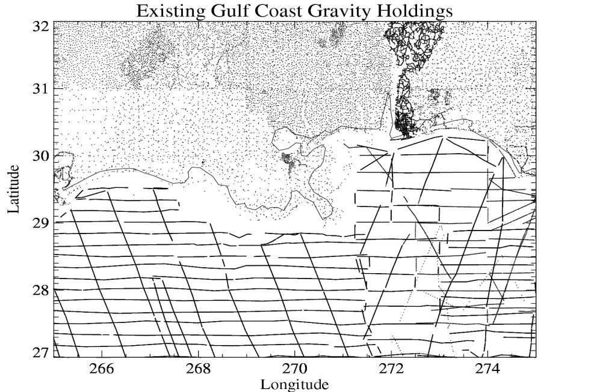
Modernizing the Datum
Goal:
  Achieve 2 cm accurate heights where possible
  Use gravity data to achieve a 1 cm accurate geoid (leaving 1 cm for GNSS uncertainty)
Problems:
  Gaps in gravity data coverage
  Inconsistent terrestrial surveys
  No medium wavelength information
Ex. Southern U.S. Coast
20-100 km gravity gaps along coast

Slide 7
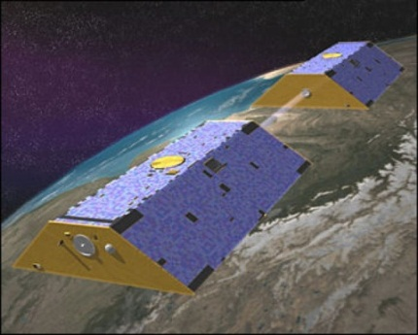
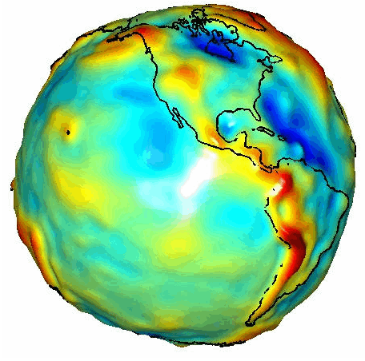
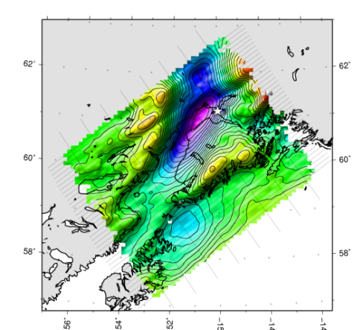

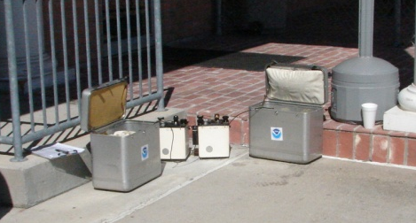
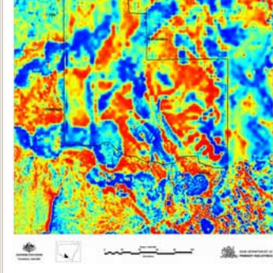
Building a Gravity Field
Long Wavelengths
(≥ 250 km)
GRACE/GOCE/Satellite Altimetry
+
Intermediate Wavelengths
(500 km to 20 km)
Airborne Measurement
+
Short Wavelengths
(< 100 km)
Surface Measurement and
Predicted Gravity from Topography

Slide 8
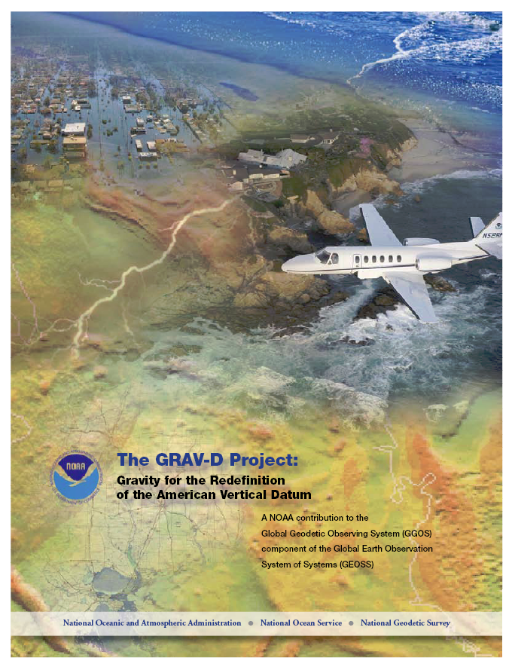
GRAV-D Project Overview
Overall Target: 2 cm accuracy orthometric heights from GNSS and a geoid model
GRAV-D Goal: Create gravimetric geoid accurate to 1 cm where possible using airborne gravity data
GRAV-D: Two thrusts of the project
  Airborne gravity survey of entire country and its holdings
  Long-term monitoring of geoid change
Leveraging partnerships to improve and validate gravity data
Notes:
Target is to be able to achieve 2 cm accuracy orthometric heights (where possible) using a GNSS receiver and a geoid model
Roughly 1 cm uncertainty from GNSS and 1 cm from the geoid model
GRAV-D
Phase 1: snapshot of the entire country to provide a consistent data set
Phase 2: long term monitoring of geoid change – in development
Work with partners to incorporate additional gravity data, particularly surface gravity data, validate existing data, and monitor change

Slide 9
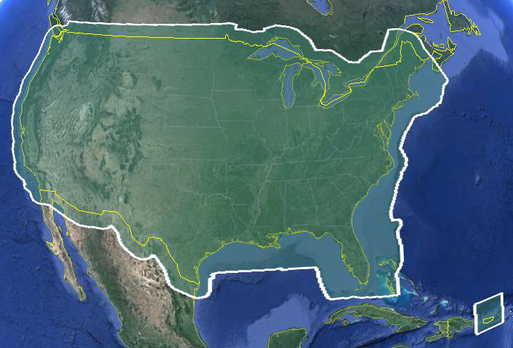
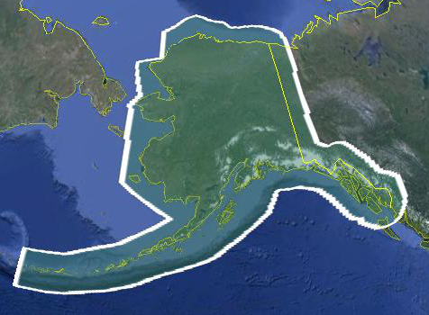
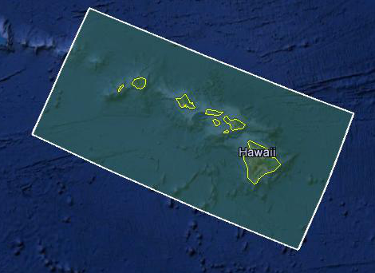
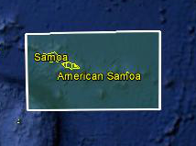
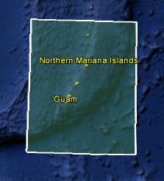
Data Collection Scope
Entire U.S. and territories
  Total Square Kilometers: 15.6 million
  Initial target area for 2022 deadline
  ~200 km buffer around territory or shelf break if possible
Notes:
Project Scope:
Scope of the project: cover roughly 15.6 million square kilometers – contiguous united states, Alaska, Hawaii, Guam, and American Samoa
In order to blend with satellite altimetry data the airborne survey is done to the continental shelf where possible or ~ 200 km beyond the shoreline or border, whichever is further
Deadline of 2022 for datum rollout, which means a target of 2021 to finish the airborne survey
Priority areas were defined as Alaska and coastal areas
Challenges:
Fixed annual budget and time → design of surveys had to fit within an annual budget of $3.5 million and meet the deadline
This was a major factor in setting altitude and line spacing

Slide 10
Priority Order for Surveys
Greatest Datum Needs
Other Variables to Consider
Alaska
Coastal US & Great Lakes
Hawaii & Pacific Islands
Aleutians
Interior CONUS
  Mountains first
Need to meet annual collection metric
Aircraft availability and capability
Appropriate season for measurement
Contract fuel availability
Notes:
NGS evaluated the US and all of its territories and established a priority order according to the where the datum is in greatest need of repair. Alaska has the biggest need, so tops the list. Next in priority are the coastal regions of the US and the Great Lakes. Then the Hawaiian and Pacific Islands, the Aleutians, and then interior CONUS. The mountainous regions have the greatest geoid errors and will get our first attention. The actual order we fly the surveys is also informed by the availability of aircraft, the appropriate seasons for measurement, the availability of government contract fuel, and the coordination of logistical constraints so as to most efficiently use our resources.

Slide 11
Annual Survey Planning
Location Priorities
Alaska
Coastal CONUS
Cost
Travel
Aircraft required
Aircraft Availability
What time of year, weather
Location requirements
Alternatives
Hawaii/Pacific
Mountains
Unforeseen weather
Opportunities to complete partial blocks
Finish started areas
Flight hours needed
Balance to Meet Annual Performance Metric

Slide 12
Performance Metric
For Airborne Surveys
FY09 Baseline | Targets vs Actual
 | FY10 | FY11 | FY12 | FY13 | FY14 | FY15 | FY16 | FY17 | FY18 | FY19 | FY20 | FY21 | FY22
6.14% | 7.5% | 12% | 20% | 28% | 36% | 45% | 53% | 62% | 70% | 79% | 87% | 96% | 100% and Implement
6.14 | 8% | 15% | 24% | 31% | 38% | 45% | 55% | 58%
Measure: Percentage of the U.S. and its territories with GRAV-D data available
to support a 1 cm geoid supporting 2 cm orthometric heights.
Notes:
We’ve set up a basic GIS GPRA monitoring in the War Room. We will report the coordinates of our survey monthly and they will calculate our percentages.

Slide 13
Long Term Planning
General plan on how to complete target area by 2022
Actual areas surveyed subject to change based on
  Actual areas completed each year
  Aircraft availability, weather, and resources
Fiscal Year | Primary Target Area
2017 | Mainland Alaska, coastal CONUS
2018 | Mainland Alaska, mountainous areas in CONUS
2019 | Hawaii, mountainous areas in CONUS
2020 | Aleutians, CONUS
2021 | Guam, American Samoa, CONUS
2022 | CONUS

Slide 14
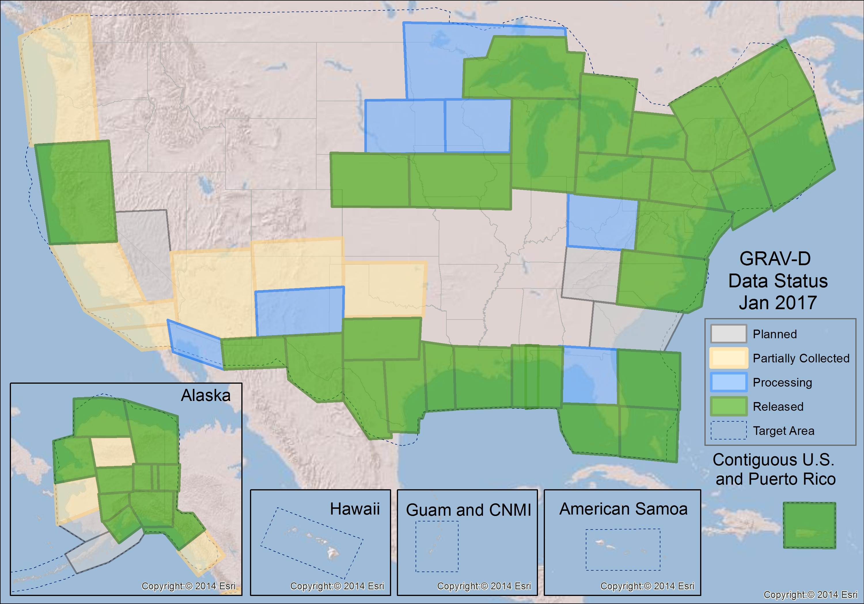
GRAV-D Status 2-28-17: 58%

Slide 15
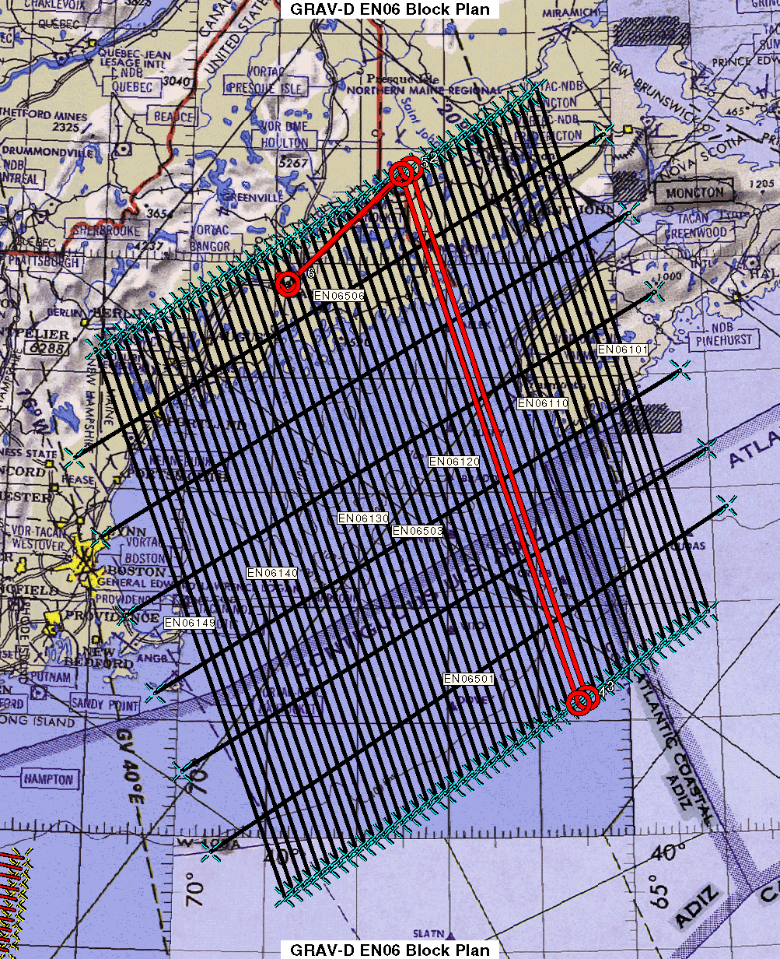
Survey and Block Plans
Blocks designed based on aircraft capabilities, available airports, and target area
Data lines spaced 10 km apart
Cross lines spaced 60-80 km apart
Flight altitude 20,000 ft
Nominal speed 220-250 kts
Notes:
Block layout based on aircraft, adjust size of block if needed

Slide 16
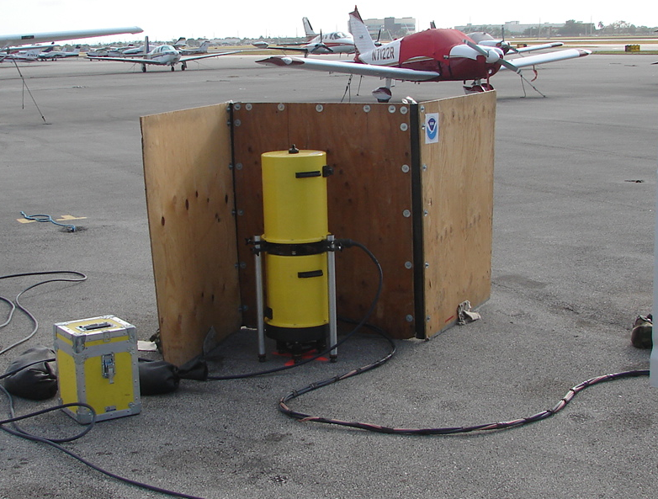
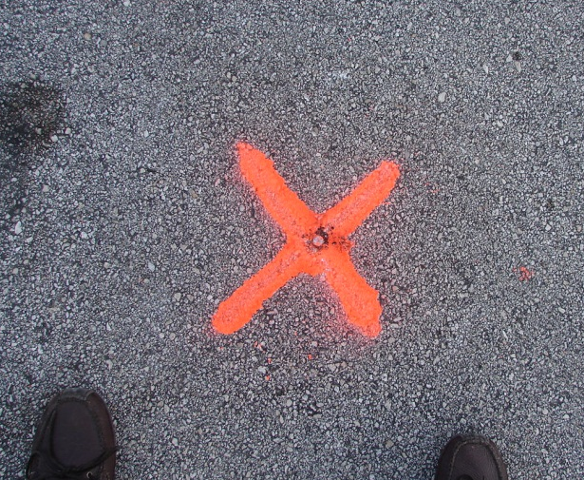
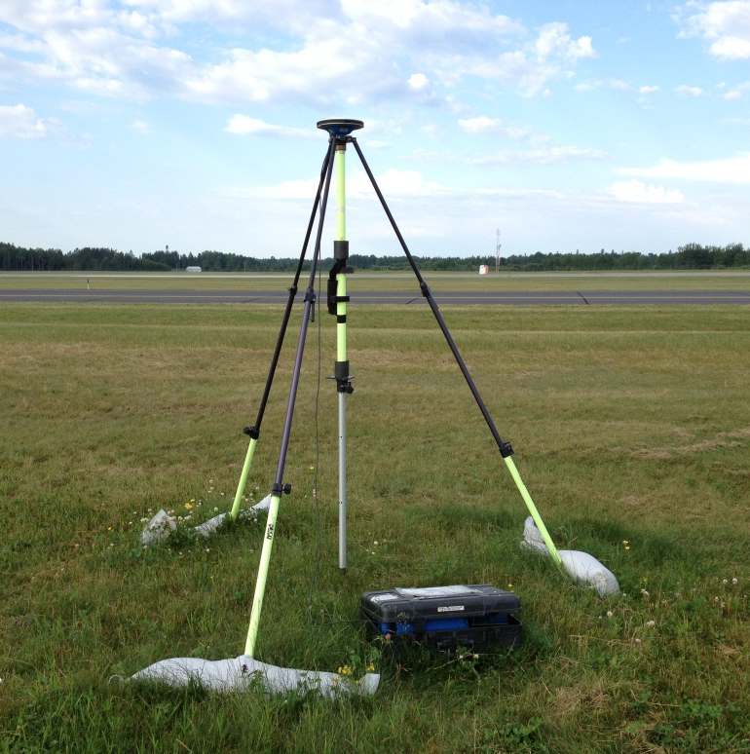
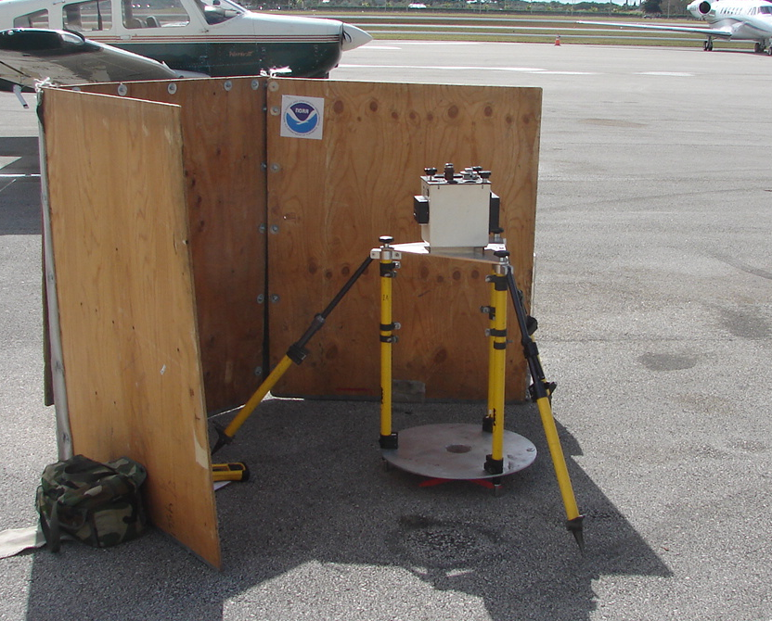
Gravity Tie and GPS Base Stations
Parking spot ID
A10 measurement
GPS Base Stations
Vertical gravity gradient

Slide 17

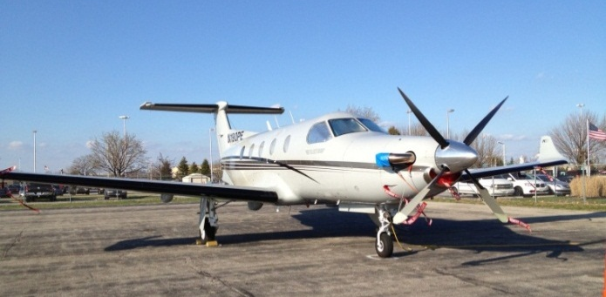
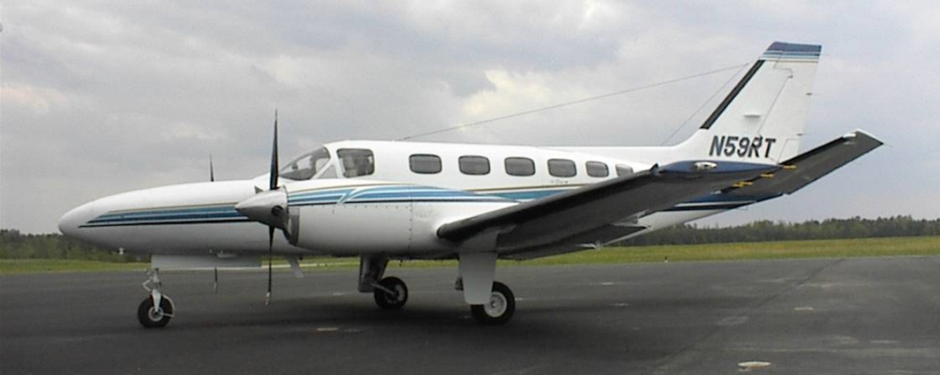

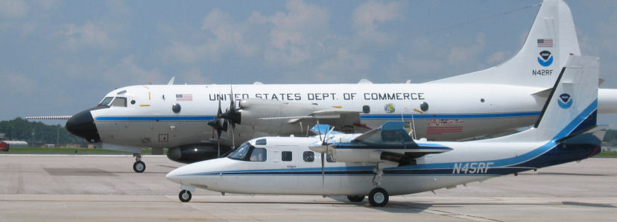
GRAV-D Aircraft
US NOAA
  Gulfstream Turbo Commander Jet Prop
  NOAA P-3 Hurricane Hunter
US Bureau of Land Management
  Pilatus PC-12
Dynamic Aviation (contractor)
  King Air 200T
Fugro (contractor)
  Cessna Conquest
  King Air E-90A
Aurora Flight Sciences (contractor)
  Centaur OPA
King Air 200T
Pilatus PC-12
Cessna Conquest
Centaur OPA
NOAA P-3 (background)
NOAA Turbo Commander (foreground)
Notes:
GRAV-D surveys have been operating on a number of aircraft. In order to accomplish our objectives within budget, we utilize a “portfolio” of aircraft of both government and contract origin. We’ve used the NOAA Jet Prop and the P-3, although little opportunity exists for further use of these aircraft. We operate about five months/year aboard the BLM Pilatus PC-12 aircraft. This aircraft is used for fire-spotting during warmer weather months in AK and the western US. This year we began working with Fugro to provide us aircraft services. We plan also to work this year with the Naval Research Lab and the VXS-1 Navy Squadron aboard their RC-12 King Air aircraft.

Slide 18
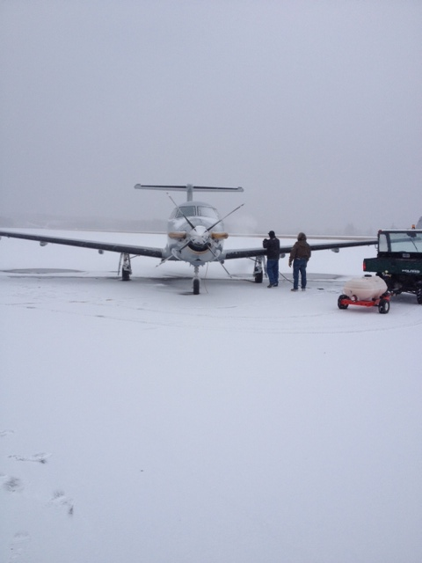
Airborne Surveying Challenges
Flight requirements:
  Weather/atmosphere is calm (meter cannot tolerate turbulence)
  Instruments and aircraft are in working order
  Good GPS geometry, no GPS jamming
  Military airspaces are not “hot”
  Operator/pilot must be within duty day limits

Slide 19
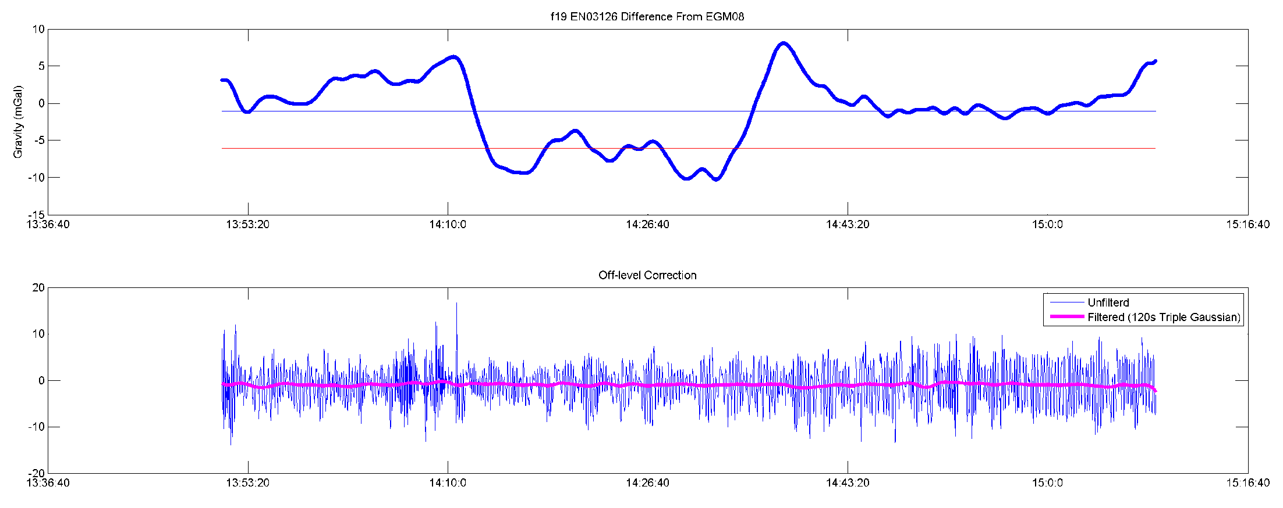
Data Processing
Field Quality Control Processing
  Determine whether lines are accepted/rejected
  Plan re-flights
Final Processing
  Perform final processing and trimming of data
  Prepare all documentation and release data publicly
Notes:
Data Processing
In the field a differential GPS-IMU solution is used to evaluate daily whether flights need to be reflown because precise ephemeris are not available
Final processing is done using Precise Point Positioning (PPP) – an analysis was done comparing differential and PPP, there was either no effect or small improvements in the gravity solutions from PPP
Gravity processing done using in-house software, Newton, which applies the absolute gravity tie, removes drift, and applies a vertical acceleration, Eotvos, and offlevel corrections and then is filtered three times with a time-domain frequency filter
End of line trimming
Data documentation produced and package released on the website
This plot is an example of part of the output. We aim for +/- 5 mGals from EGM08 – as you can see in this plot there is a significant section that deviates from that. However, part of the goal of the airborne campaign is to improve upon EGM08, so while it is a good guide, it cannot be the final determination. This line, for example, if you compare to an adjacent line it looks like this.

Slide 20
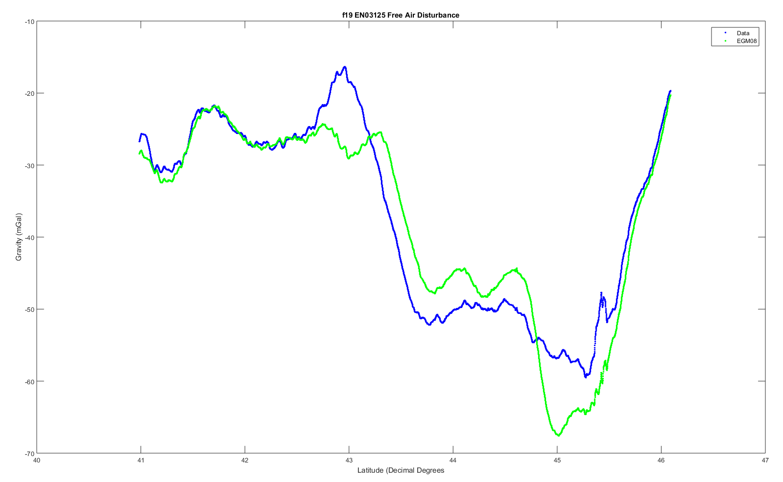
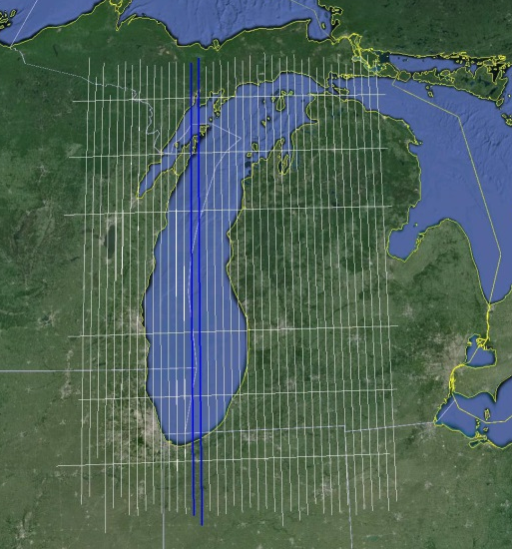
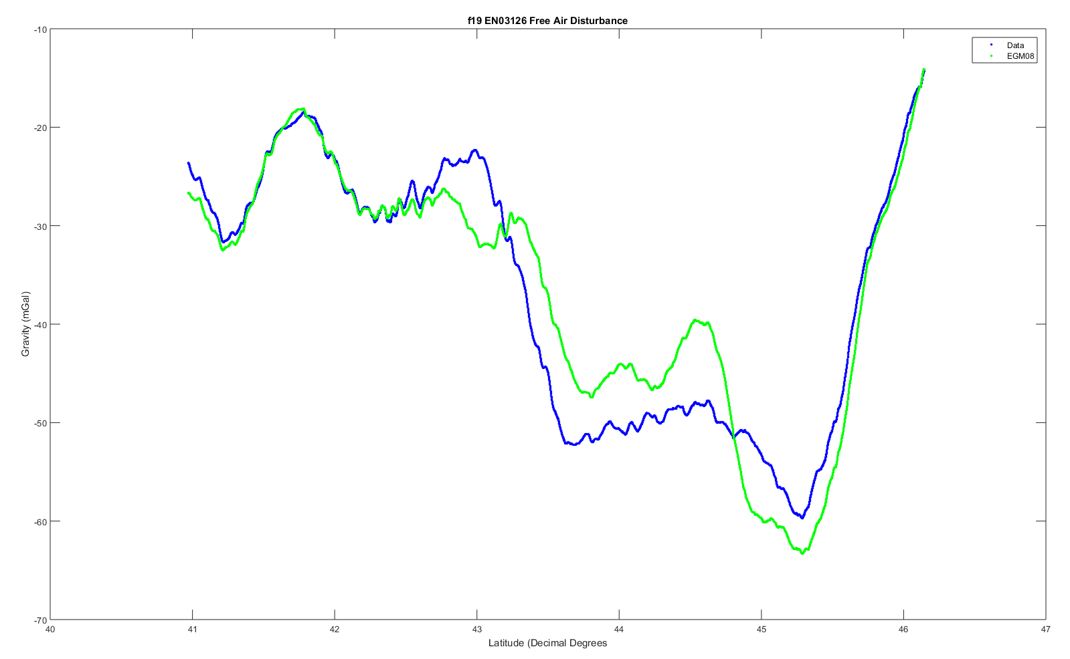
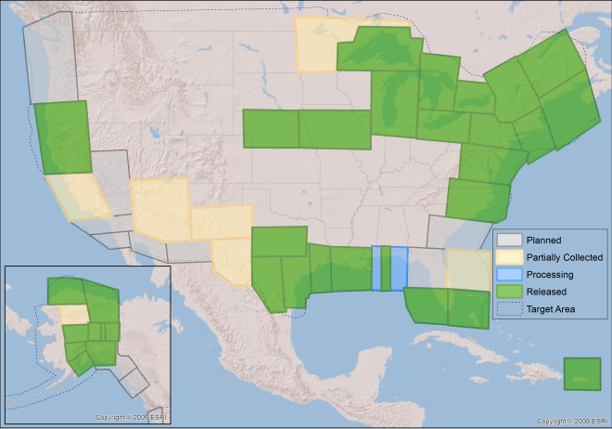
Lake Michigan
Notes:
These are two lines over Lake Michigan where the airborne data (blue) shows significant deviations from EGM08 (Green). However, the x-axis is latitude and you can see that the deviations are supported independently by both lines. This type of visual analysis is extremely useful day-to-day in the field as we determine which lines need to be reflown. In the final processing we also do line to line cross correlation to evaluate overall line agreement.

Slide 21
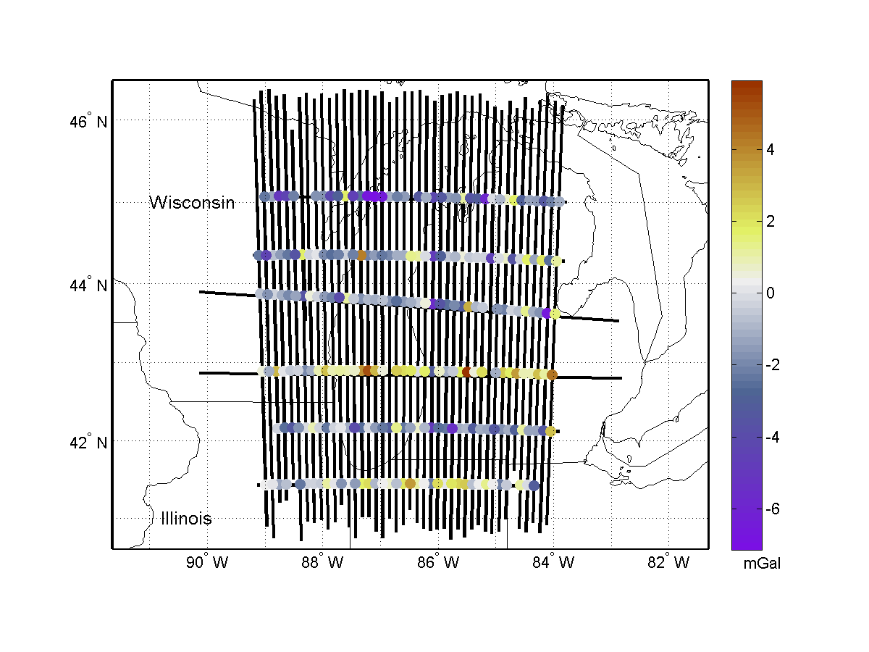
Internal Validation
Internal Validation
  Crossover analysis
  Line to line comparison
  Line reflights
These quality control measures are why partial blocks are not released
Notes:
Internal:
Start with internal comparison
Crossover analysis compares intersection points, aim for RMS of residuals of less than 5 mGals – identifies errors that may need to be removed
Line to line comparison, as was shown earlier, but look at the cross correlation of the entire block
Reflights of lines provide repeatability statistics
External:
Geoid comparison --
Compared to EGM08 the airborne data often agrees with the satellite gravity
Most updates are seen in areas of poor data coverage
Shown is Lake Michigan, the gridded airborne data, EGM2008 versus GOCE, and then adding the airborne data to EGM2008 and again comparing with GOCE
GSVS –
Three surveys: first flat and low gravity signal, second flat and high gravity signal, third rugged and high gravity signal
First is completed and published, second completed and papers in progress, third in the planning stages
2011 survey confirmed that the airborne gravity was contributing to the goal of a 1 cm accurate geoid

Slide 22
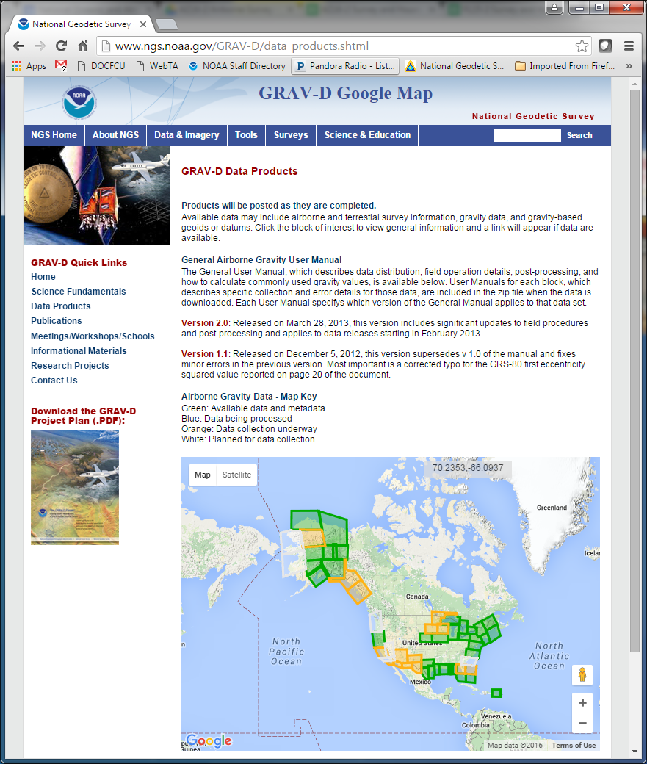
GRAV-D Website
http://www.ngs.noaa.gov/GRAV-D

Slide 23
Part 2: Geoid Changes and
Future Monitoring

Slide 24
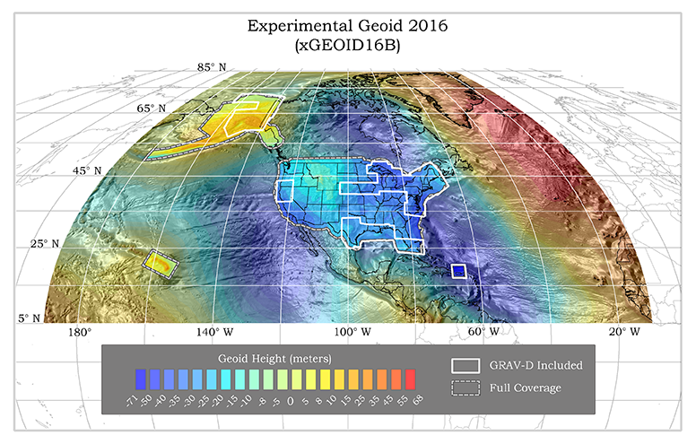
Experimental Geoids
Combining most recent satellite, airborne, and terrestrial gravity data to test methods for 2022
Published annually
  Updated with airborne gravity data
  Available on the website
Testing methods
  Blending techniques
  Density
  Terrestrial data improvements
http://beta.ngs.noaa.gov/GEOID/xGEOID/

Slide 25
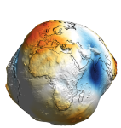

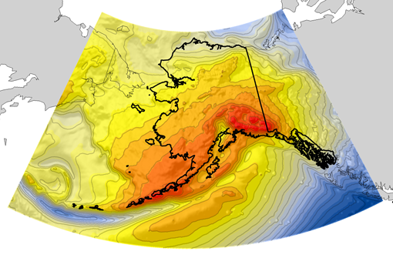
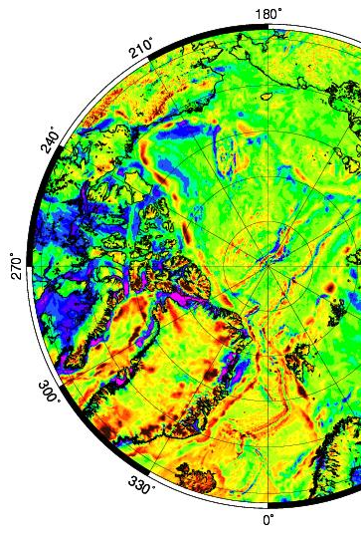
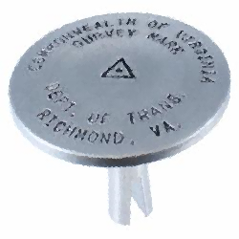
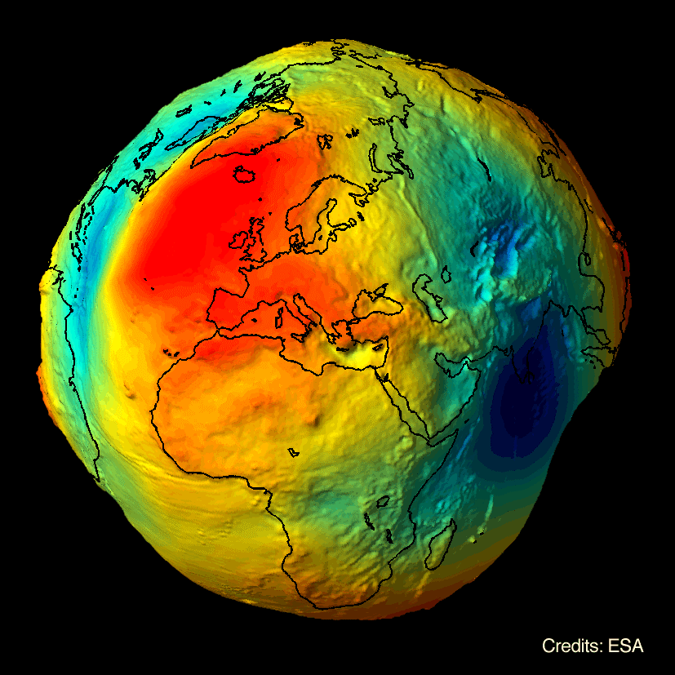

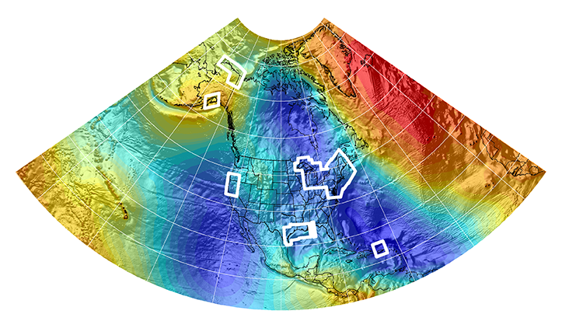
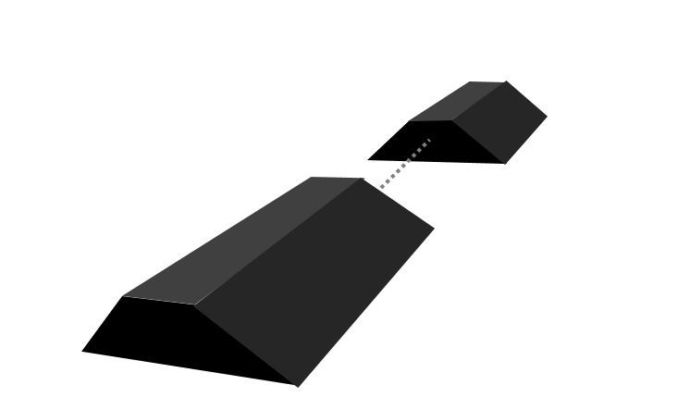

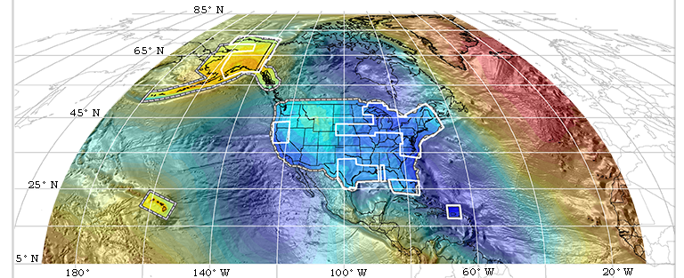

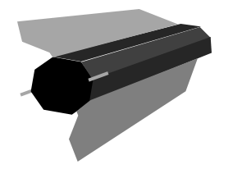

Evolution of the Geoid
EGM08
USGG2012
GEOID12A/B
NGA
ArcticGP
GRAV-D
2008
2012
2014
GOCO05S
2015
2016
xGeoid14B
GRACE
xGeoid15B
xGeoid16B
+
GOCE
Notes:
NGA Arctic Gravity Grid (2017)

Slide 26
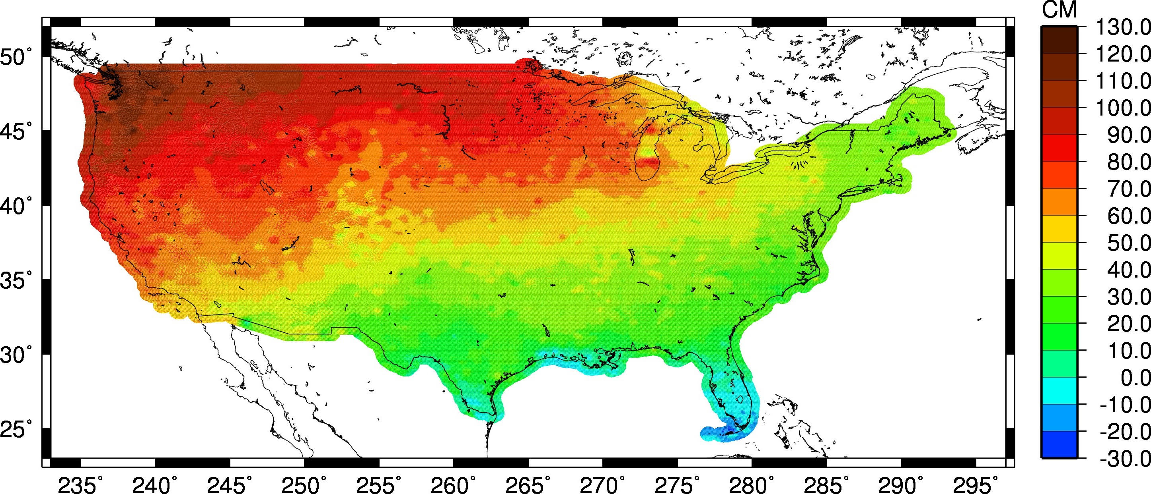
Estimate of Geoid Change
Current Experimental Geoid Compared to Hybrid Geoid: xGeoid16B – Hybrid Geoid12B
HYBRID vs. GRAVIMETRIC
Notes:
Approximately +0.1 m (Florida) to -1.3 m (Washington)
More than 2 meters of change in Alaska

Slide 27
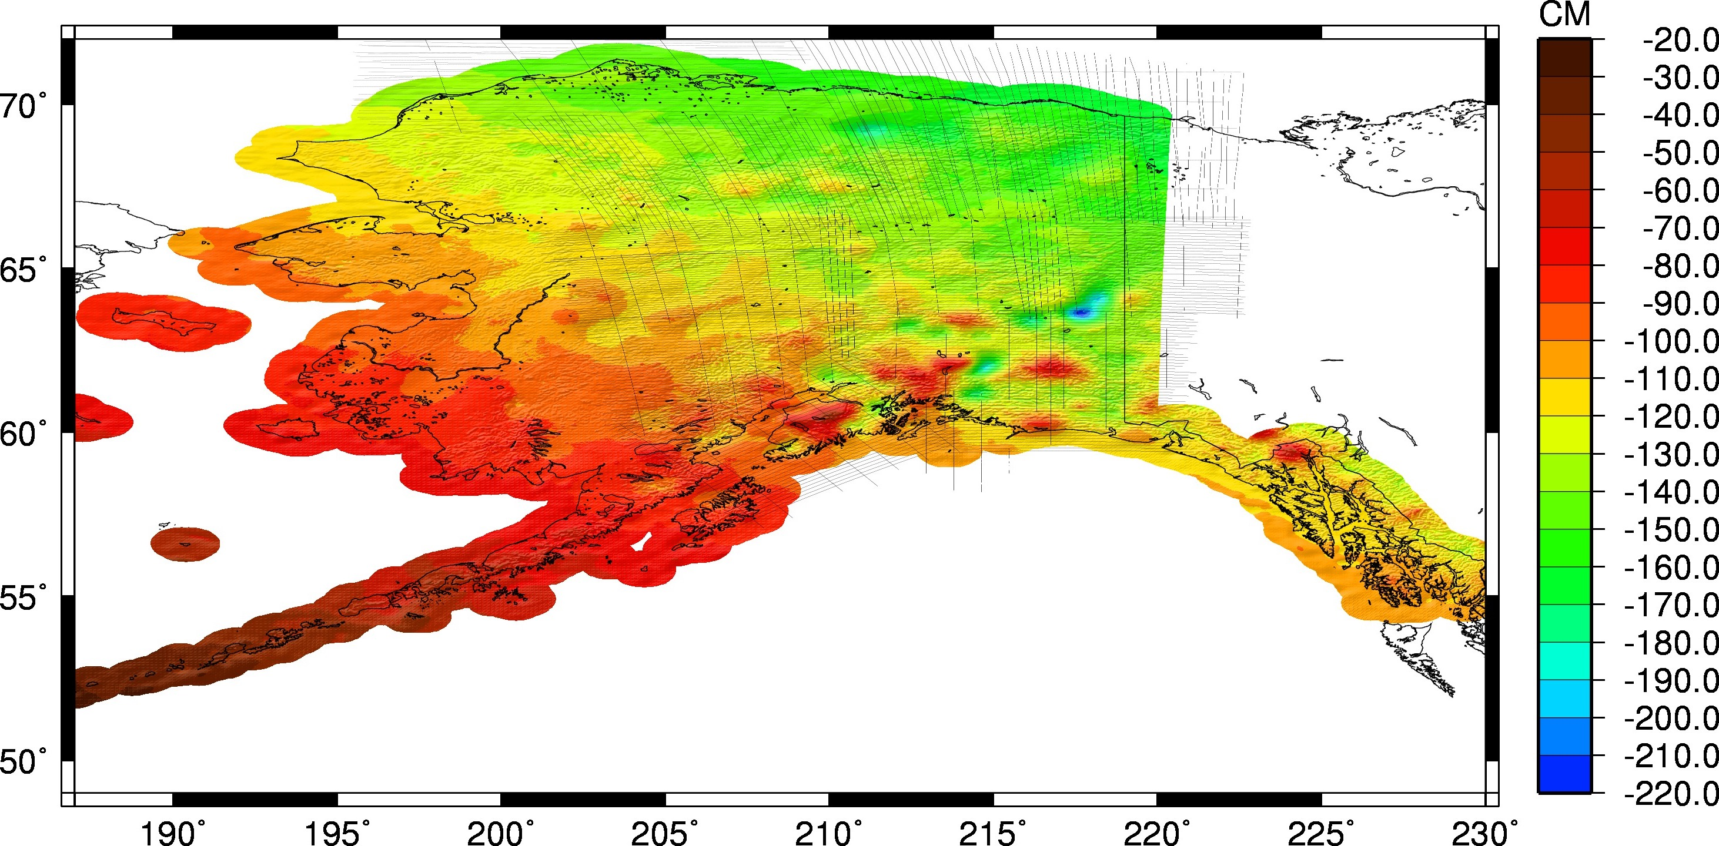
Estimate of Geoid Change
Current Experimental Geoid Compared to Hybrid Geoid: xGeoid16B – Hybrid Geoid12B
HYBRID vs. GRAVIMETRIC
Notes:
This is the big change plot!! Going from the hybrid Geoid12B to the most recent experimental geoid. Huge change, 2 meters with a lot of areas between 0.8 and 1.7 meters.

Slide 28
After 2022 – Maintaining the Datum
Continue airborne gravity surveying in adjacent areas
  Mexico, Canada, Caribbean, Alaska/Pacific Islands
Develop a long-term geoid-monitoring service (GeMS)
  Monitoring will depend on gravity signals that affect geoid change, this could include:
    Satellite data
    A tracking network
    Repeat gravity measurements, airborne or terrestrial
    Geophysical models
  Current project underway to evaluate how to monitor changes

Slide 29
Geoid Height Change Over Time
Geoid change from GRACE
Source: The Time Evolution of the Earth’s Gravity Field Since 2002.
R. Steven Nerem and Ryan A. Hardy, December 14, 2015

Slide 30
Summary
GRAV-D currently at 58% complete and on track to finish data collection in 2022
Expected height changes between
  CONUS: 30 to 130 cm
  Alaska: 20 to 220 cm
After 2022 additional gravity measurements will support improving and maintaining the geoid over time
Thank you for your attention!

