Slide 1
Gravity for the Redefinition
of the American Vertical Datum (GRAV-D) Update
Jeff Johnson, Gravity Section Chief/GRAV-D Project Manager
Additional NGS Gravity Science Team Members
Derek van Westrum, Gravity Program Manager
Kevin Ahlgren, Geoid Modeler and GeMS Project Manager
Jeff Kanney, Gravity Scientist
NGS Geospatial Summit
May 4, 2021

Slide 2
Agenda
GRAV-D Project Overview and Data Access
Data Collection Status/Completion Polygon
Data Collection Timeline
Newton Updates
Reprocessing Plans
Updates from the field

Slide 3
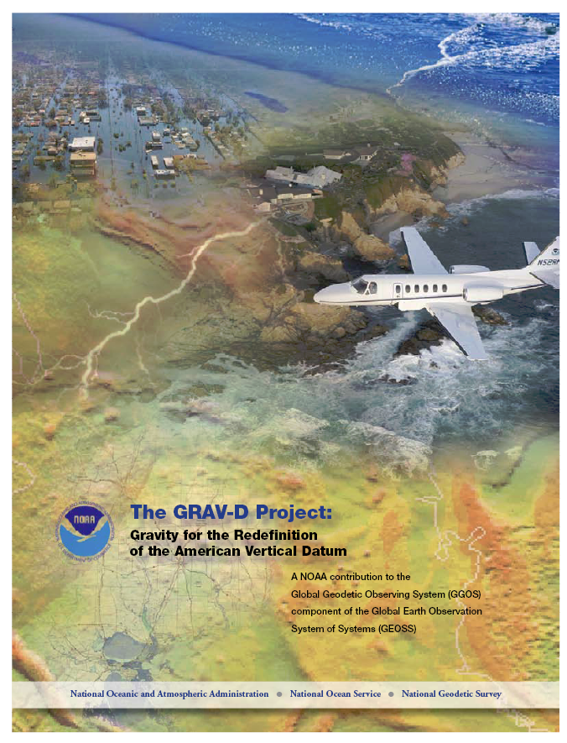
GRAV-D Project Overview
Overall Target: 2 cm accurate orthometric heights from GNSS and a geoid model
GRAV-D Goal: Create gravimetric geoid accurate to 1 cm where possible using airborne gravity data
GRAV-D: Two main goals of the project
Airborne gravity survey of entire country and its holdings
Long-term monitoring of geoid change (GeMS)
Leveraging partnerships to improve and validate gravity data
Notes:
Target is to be able to achieve 2 cm accuracy orthometric heights (where possible) using a GNSS receiver and a geoid model
Roughly 1 cm uncertainty from GNSS and 1 cm from the geoid model
GRAV-D
Phase 1: snapshot of the entire country to provide a consistent data set
Phase 2: long term monitoring of geoid change – Geoid Monitoring Service (Kevin Ahlgren) will present during this session
Work with partners to incorporate additional gravity data, particularly surface gravity data, validate existing data, and monitor change

Slide 4
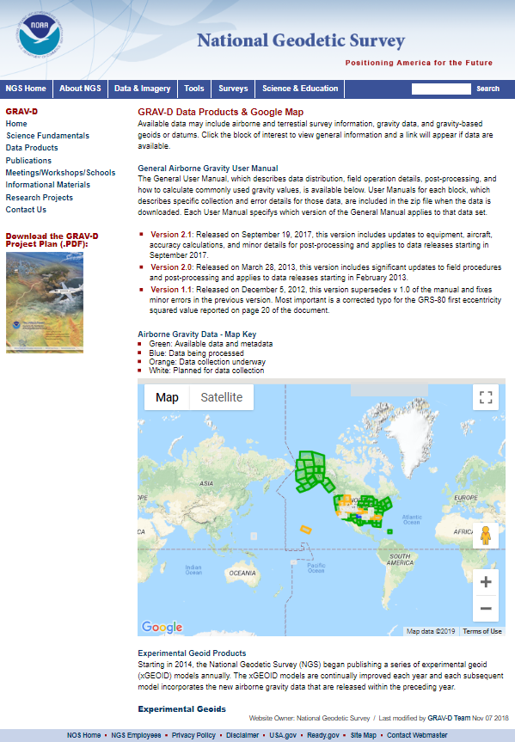
GRAV-D Website
Access GRAV-D Information and Data Products.
www.ngs.noaa.gov/GRAV-D
Notes:
All our processed block data products can be found on our website.

Slide 5
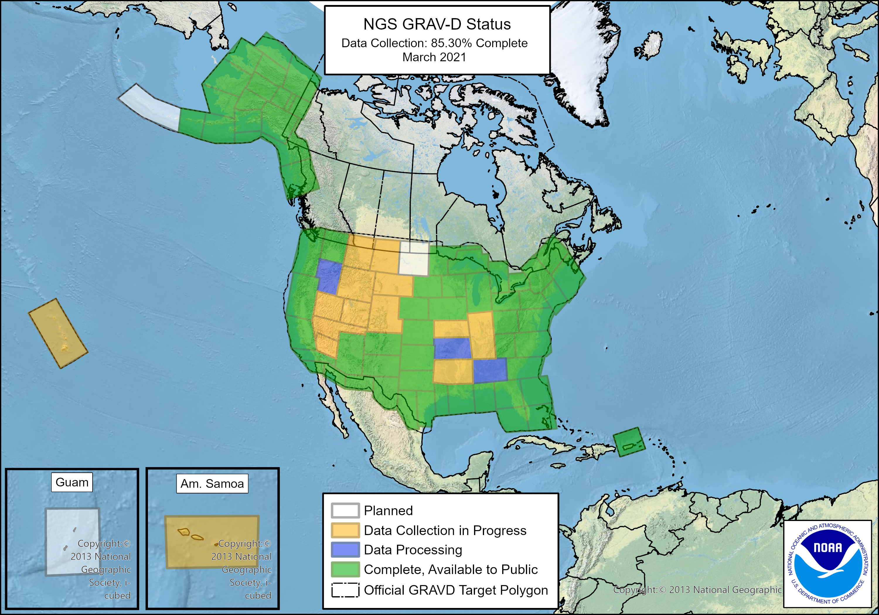
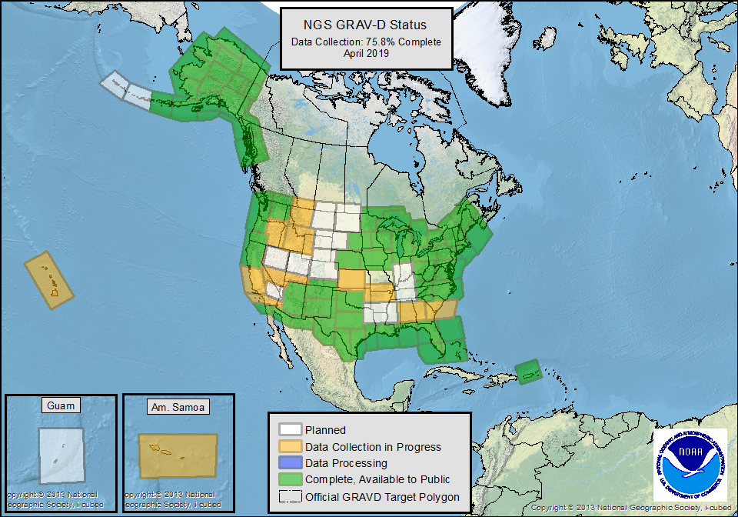
Notes:
GRAV-D Coverage
Entire Unites States and Territories
Covering ~150-200 km into neighboring countries and bodies of water
Take into account bathymetric features such as shelf breaks
Status Map
Explain Colors
White: Planned
Orange: Collection Started
Blue: Collection Complete, Processing Started
Green: Collection and Processing Complete, Released to the Public on web-page.
Milestones
GRAV-D data collection is now 85.3% complete.
Finished mainland Alaska
Started collection in the Pacific Islands (Hawaii and American Samoa)

Slide 6
GRAV-D Completion Polygon
Production flights completed during the pandemic in purple.
Notes:
This map shows the completion polygon in blue and all the data we have collected since last August when we returned to operations during the pandemic in purple.
We completed quite a bit of work in the southeast with the G-IV last fall.
Work in Western CONUS by the NOAA Turbo Commander and the DOI Pilatus
And almost completed Hawaii by piggybacking off of the SCRIPPS Atmospheric Rivers group who had the NOAA G-IV in Hawaii this winter.

Slide 7
Revised Timeline to Completion
Budget Cuts
Weather
Aircraft Access Maintenance
Airspace
Etc.
Disclaimer: This Forecast is only accurate until it is not.
As of April 2021
Goal 3rd Quarter FY24
Gov Shutdown
COVID-19
Notes:
GRAV-D Performance Metric
Total area calculated using GIS: ~15.5M sq. km.
We have collected ~13.4M sq. km.
That is 85.3% of the target area.
Explain Slide
A set of yearly goals was created to keep us on track to have 100% collection done in time for the release of the new geopotential datum in 2022 (NAPGD2022).
Historically, GRAV-D has stayed on track each year.
We’ve had some delays since the Government shutdown in 2019 (click) and a 4.5 month cessation of field work due to COVID-19 (Click)
We have re-made the yearly goals to have us done by June of 2024 (Click).
FY20 and FY21 goals are more conservative to get us past the pandemic, but then we plan to pick up the pace a bit more for the remainder of the time.
As we come to the end, we will lose flexibility of choosing locations based on best conditions and may experience some low productivity that will delay our completion.
We have several high risk locations to survey including Guam, American Samoa, Hawaii, and the Aleutian Island Chain. Inability to complete these regions could delay completion before 2024.

Slide 8
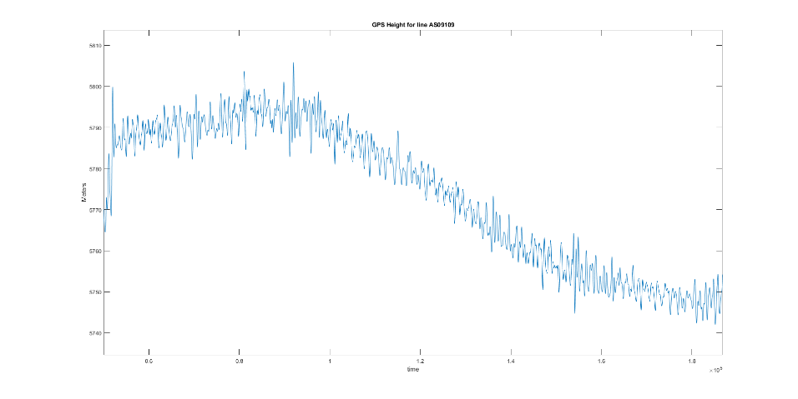
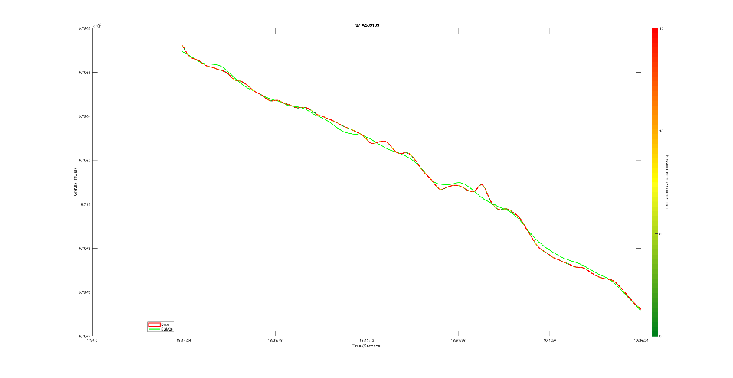
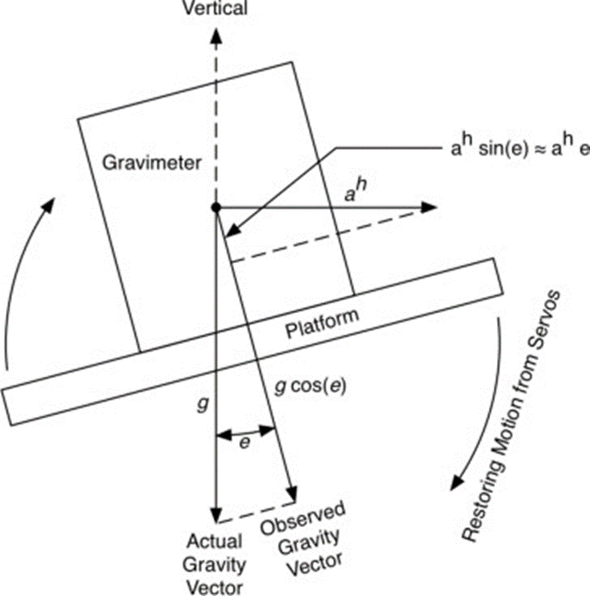
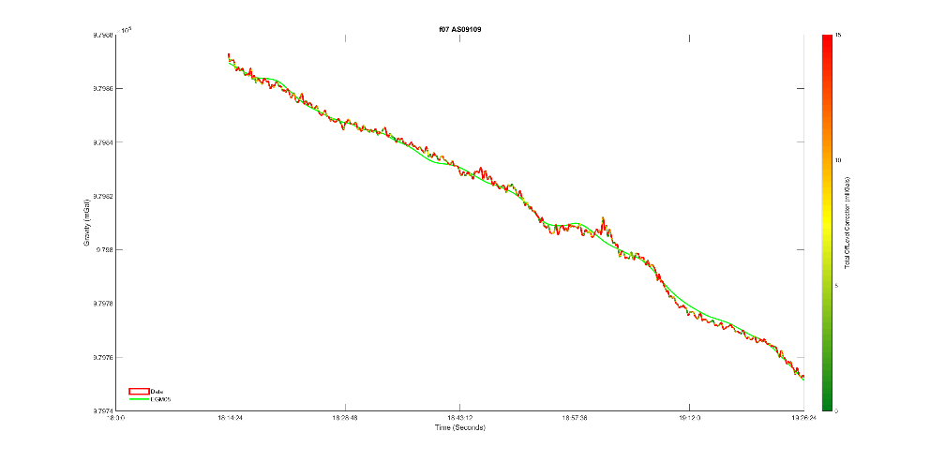
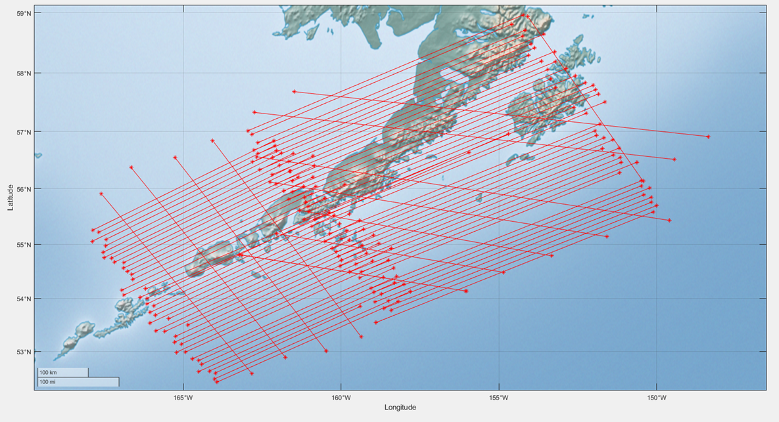
Newton Updates
Oleson vs Peter’s and Brozena Offlevel Correction.
Filtering on the disturbance rather than full field gravity
Crossover Stats
AS08 | P&B | Ol | Ol+dist filter
Mean | 2.5 | 1.7 | 1.5
Median | 2.0 | 1.4 | 1.2
Max | 9.2 | 8.1 | 6.7
AS09 | P&B | Ol | Ol+dist filter
Mean | 3.6 | 1.9 | 1.9
Median | 2.9 | 1.3 | 1.2
Max | 14.5 | 11.9 | 12.5
References:
Peters, M. F., and Brozena, J. M.(1995), Methods to improve existing shipboard gravimeters for airborne gravimetry: Internat. Symp. on Kinematic Systems in Geodesy, Geomatics, and Navigation, 39-46.
Olesen, A. V., Ph.D. Thesis (2002) Improved airborne scalar gravimetry for regional gravity field mapping and geoid determination
Willberg, M., Ahlgren, K., Zingerle, P., Pail R., Z (2021) Improvement of the GRAV-D Processing. NOAA Technical Report NOS NGS 75. (NOAA approved, but not available to the public yet)

Slide 9
GRAV-D Reprocessing Plans
Newton v2.0 Complete
Improvements
Testing/Validation
Repro Existing Data
64 Blocks need to be reprocessed
Team of 2-4 people
Process New Blocks with updated Newton v2.0 as they are completed
New blocks released with Newton v2.0
Goal: All blocks processed shortly after GRAV-D Complete
Goal: End of August 2021
4 to 6 months.
ITRF20 Transformation Parameters become available
Transformation of existing blocks to ITRF20 (2-3 months)
Data to Geoid Modelers as available
Process new blocks in ITRF20
Notes:
Newton v2.0 Complete
Newton is NGS’s airborne gravity processing software
Currently implementing updates and turning Newton into a GUI.
Need to test the software.
We hope to have it done by end of August 2021, but our staff wears lots of hats so that could be a challenge.
Repro Existing Data
Once Newton v2.0 is complete we have 64 blocks to reprocess. This will be a gravity only reprocessing and not a positioning reprocessing. Any changes from ITRF updates are well within the noise of the larger kinematic positioning error bars. We plan to use transformation tools to align the coordinates to future versions of the ITRF.
We hope to have a team of 2-4 people to reprocess all the data relatively quickly.
Hopefully we can complete this reprocessing within 4-6 months.
Moving forward we just process new blocks with updated Newton and stay on track. Goal for data collection completion is June 2024.
When ITRF20 transformation parameters are available, we will need to do a transformation on the coordinates for the entire data existing data set. This will probably take 2-3 months. Then new blocks can be released aligned to ITRF20. We can provide blocks to Geoid modelers on an ongoing basis and they could have all blocks shortly after GRAV-D data collection is complete.

Slide 10
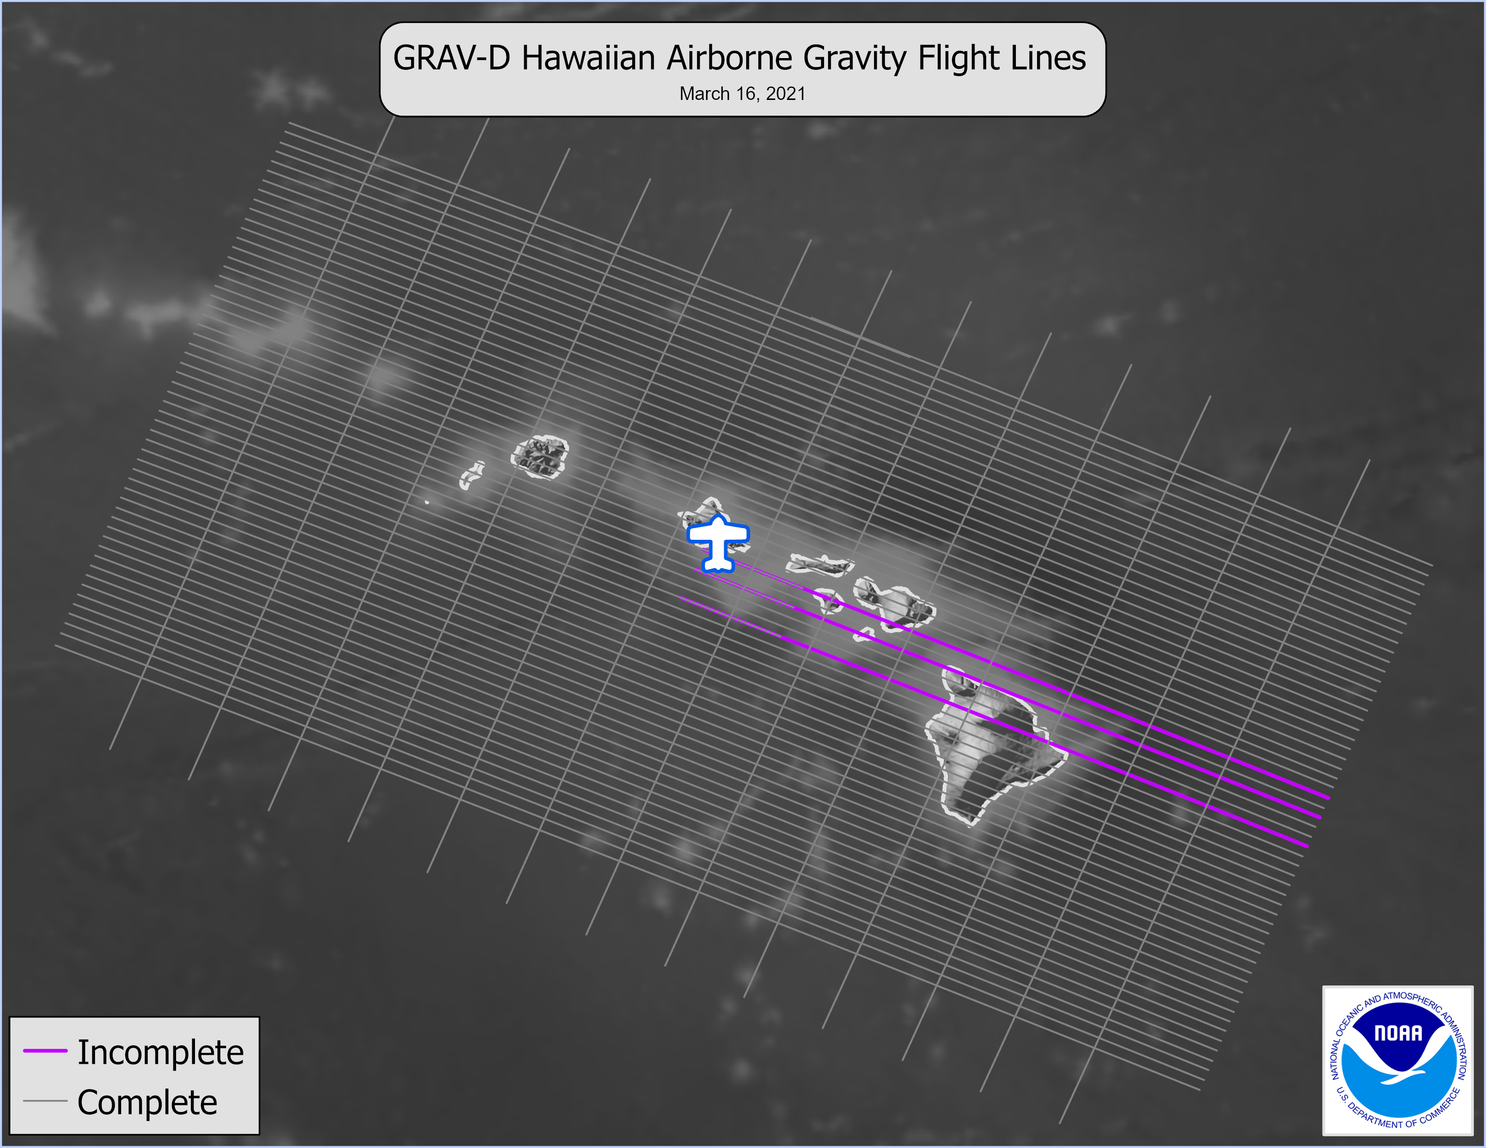
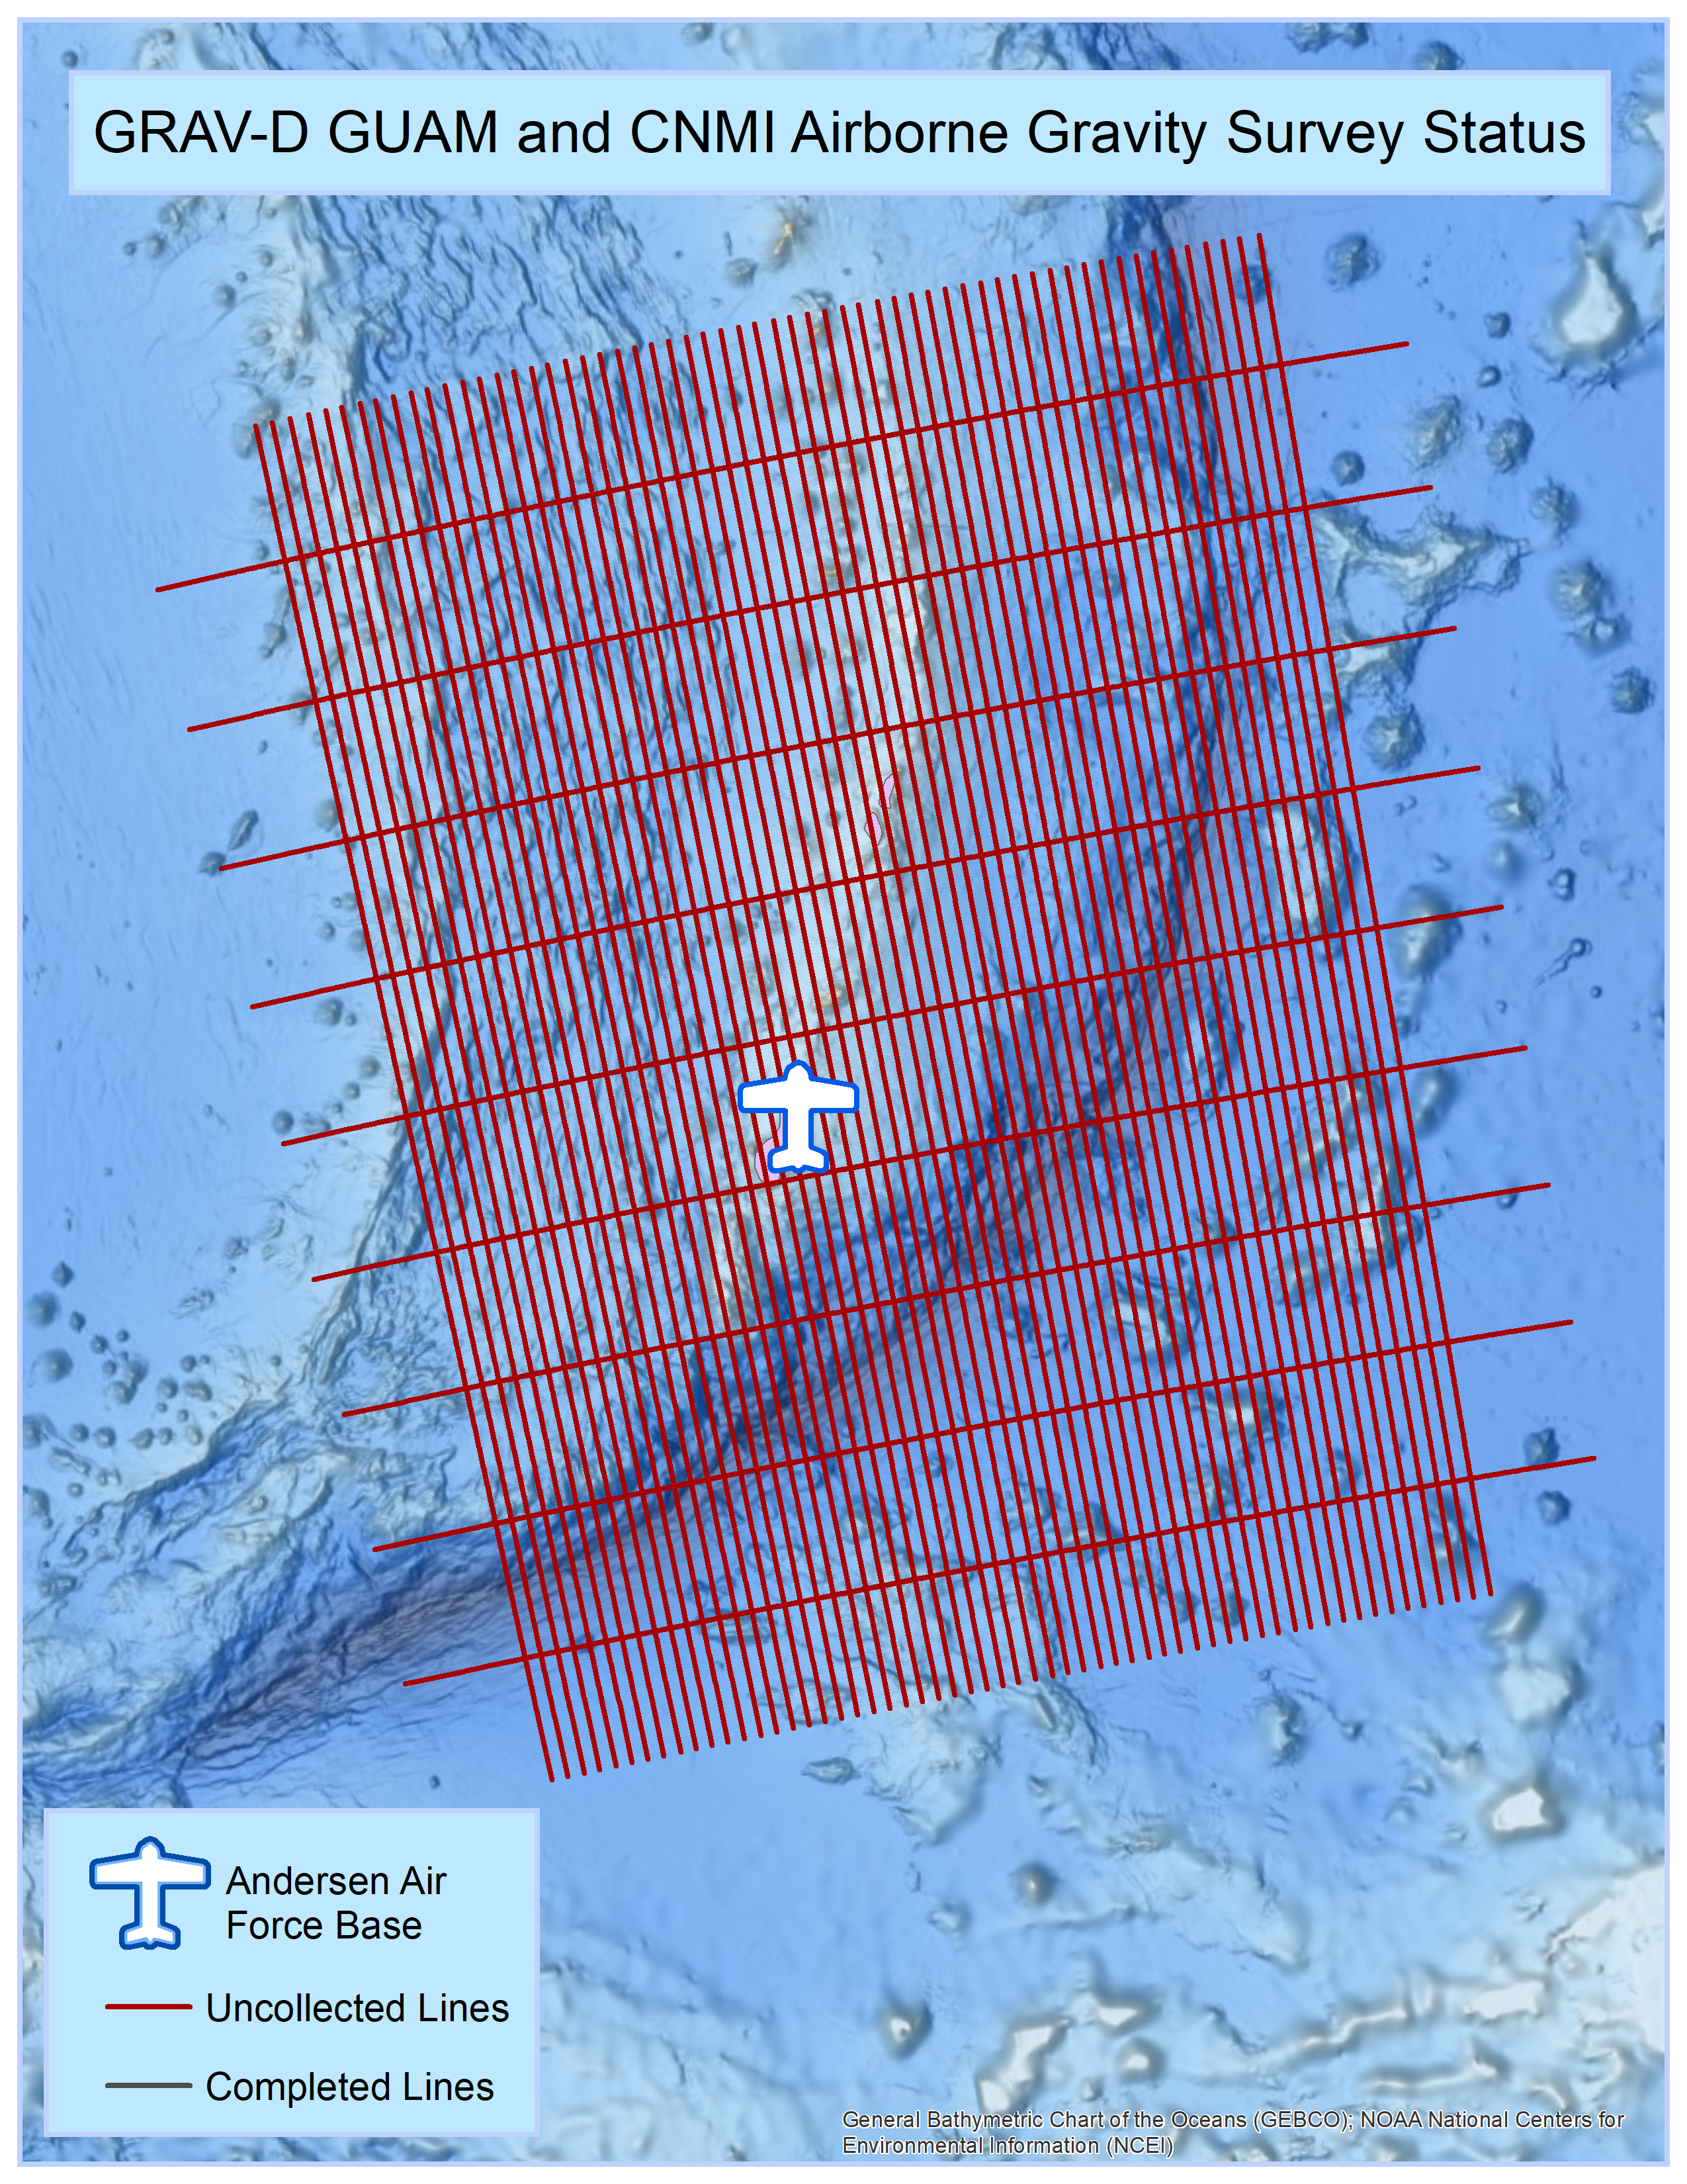
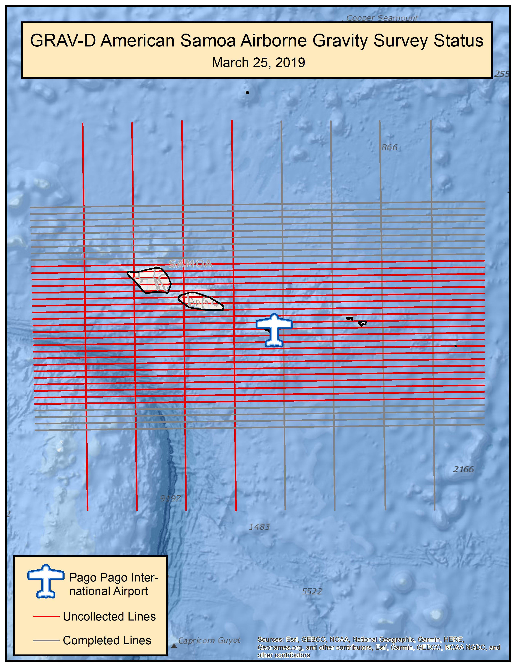
Pacific Islands Update
Jan-Mar 2021 NGS partnered with SCRIPPS Atmospheric Research Group
Hawaiian collection is ~97% Complete
Goal: Complete American Samoa (40% Complete) and Guam (0% Complete) in 2022 or 2023.
Still working out a plan for which aircraft to take to the Pacific Islands.

Slide 11
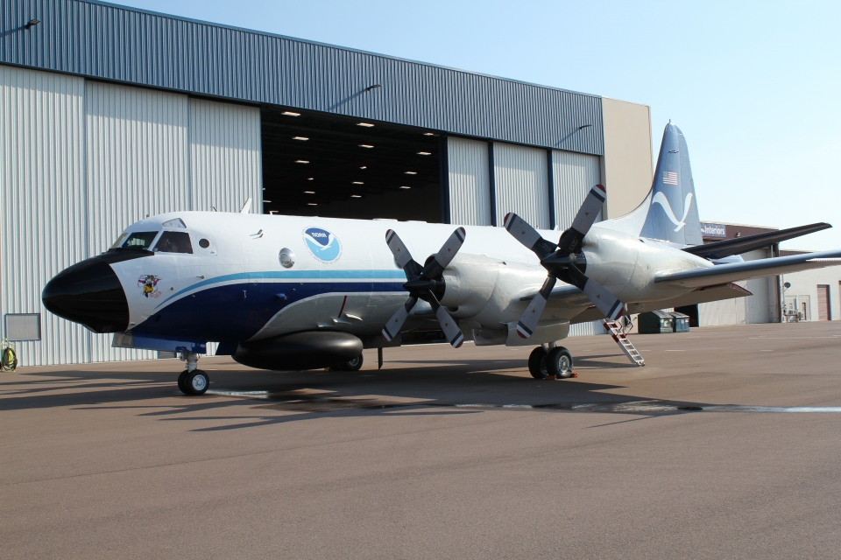
Aleutian Island Survey 2021
Schedule: May 7-June 15 based out of Anchorage, Alaska
Aircraft: NOAA WP-3D Orion
Goal: Complete as much of the high priority (red) lines as possible.
Red lines can be completed in 17 flights

Slide 12
Summary
GRAV-D has collected 85.3% of the target area.
Near-term Goals
Secure long range aircraft to continue surveying in remote locations
Continue CONUS data collection priorities
Complete Newton v2.0 and test/validate it.
Reprocess existing GRAV-D data sets
Thank you!
NGS.GRAVD@noaa.gov

