Slide 1

GPS on BM for Vertical Transformation and GEOID18 Progress
Society of Land Surveyors of Iowa
83rd Annual Meeting
Dave Zenk PE LS
NGS Northern Plains Regional Advisor
March 5-6, 2020
Ames IA

Slide 2
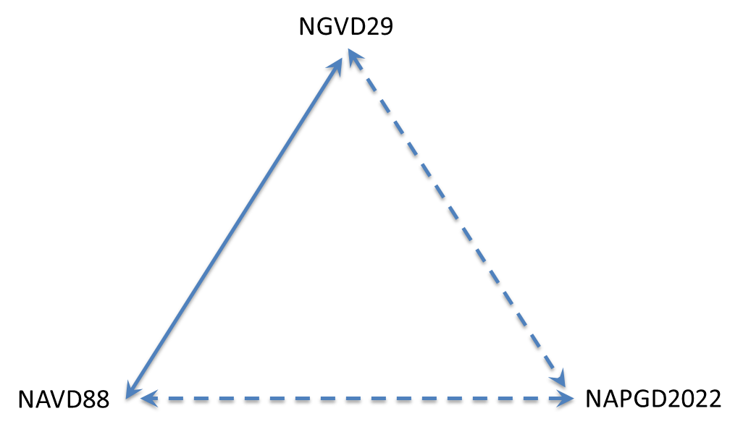
Goals for Future of Vertical Datums
GEOID 18 is FINAL
Goal 1
Improve Hybrid GEOID Model for better GPS-based access to NAVD88.
Goal 2
Improve the NCAT Vertical Transformation Model from NAVD88 to NAPGD2022.
Current Effort
H = h + N

Slide 3
First, let’s talk Hybrid Geoid

Slide 4
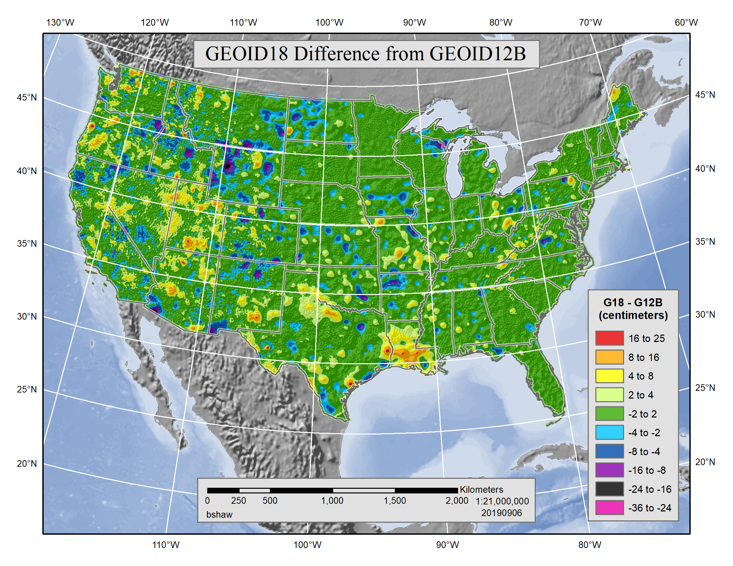
October 15, 2019

Slide 5
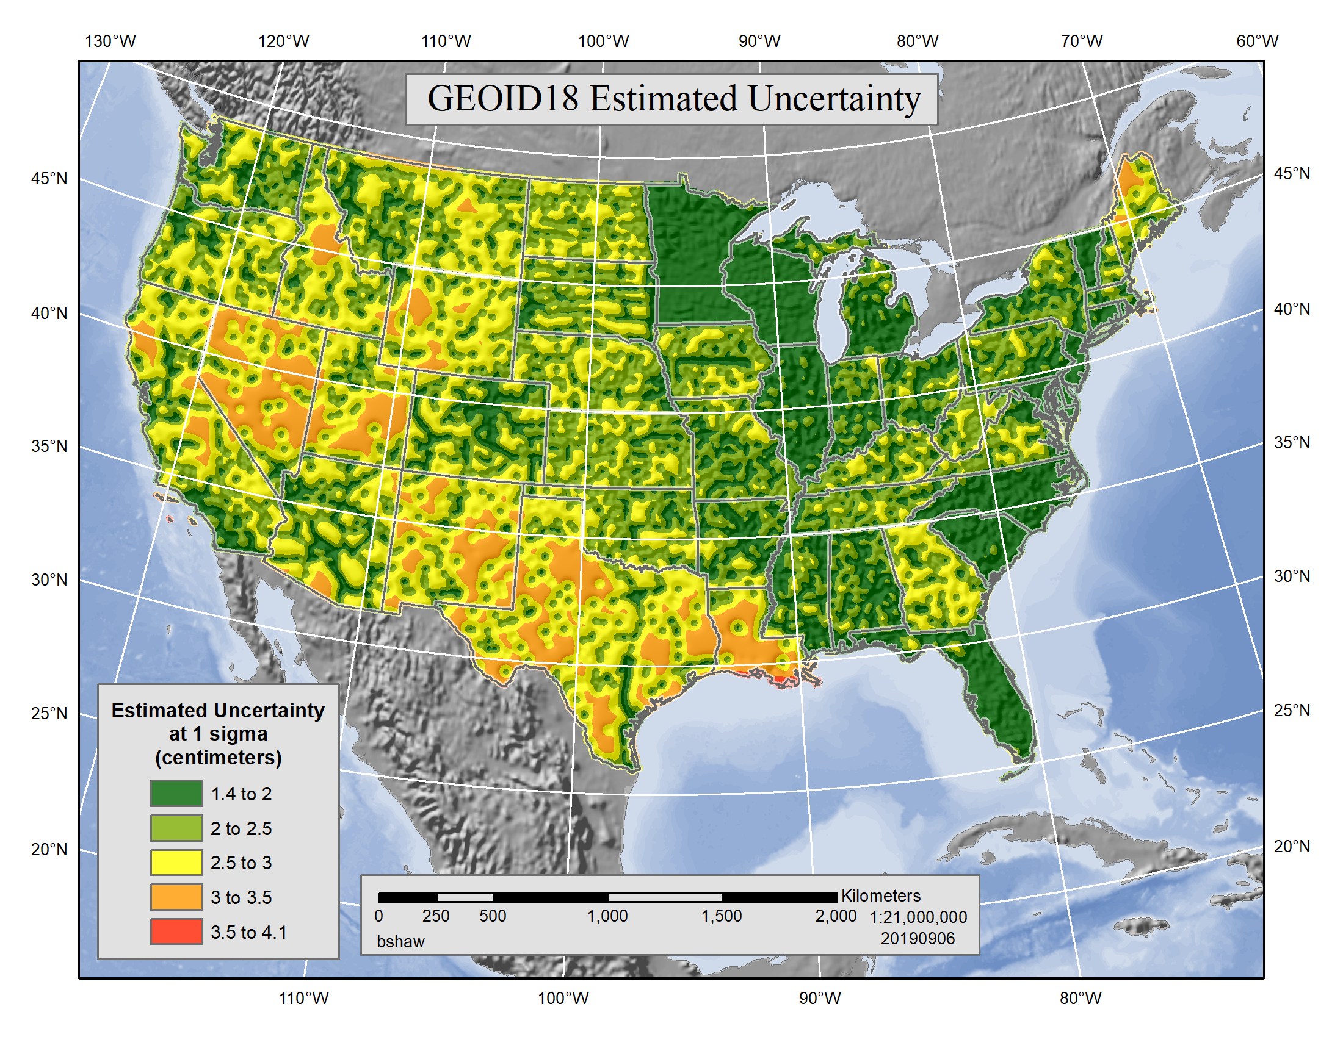
October 15, 2019

Slide 6
Hybrid GEOID Model
A hybrid geoid model includes many kinds of data.
Space-based gravity data
Airborne gravity data
Terrestrial gravity data
Analysis of “fit” between GPS, Leveling, and geoid model

Slide 7
Analysis of “fit” between GPS, Leveling, and geoid model
The success of GRAVD will provide the Future NAPGD2022 vertical datum.
But, surveyors will still need a useful tool to provide the ability to measure GPS-derived orthometric heights.
This need will continue even after NAPDG2022 is released

Slide 8
Analysis of “fit” between GPS, Leveling, and geoid model
NGS creates the tool (called a hybrid geoid model) by analyzing the “fit” between
(1) GPS-derived ellipsoid heights, h
(2) Leveling-derived orthometric heights, H
The difference is the “geoid height, N” and satisfies the need for a simple equation to compute “orthometric heights” from “ellipsoid heights”
H = h + N

Slide 9
Errors Abound
The leveling-derived orthometric heights were all part of a continental leveling network developed over 150 years.
Variable methods, tools, skills, terrain, and human errors are present in the data.
So, the geoid model must be developed by methods
Which “filter” outliers
Utilize local knowledge

Slide 10
Iterative Process
Modern hybrid geoid modeling starts with the space-based geoid, then adds in airborne data where it has become available.
This creates a reference surface
Then, NGS extracts from the IDB all marks which have BOTH ellipsoid height (from GPS) and orthometric height (from leveling).
The difference creates a second reference surface.

Slide 11
Iterative Process
By subtracting the two reference surfaces one obtains a “residual”.
By applying a “warping” function, one can gently nudge the model towards “best-fit”.
Too much nudging, includes all the underlying errors.
Too little nudging, the model does not fit the historical datums.
How to find the balance?

Slide 12
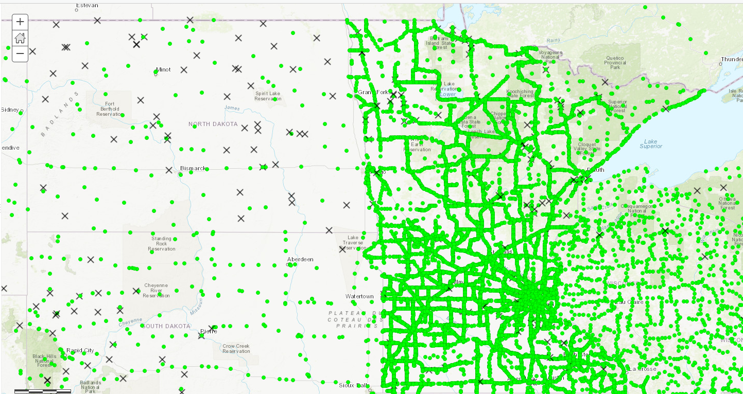
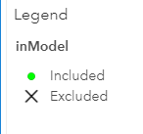
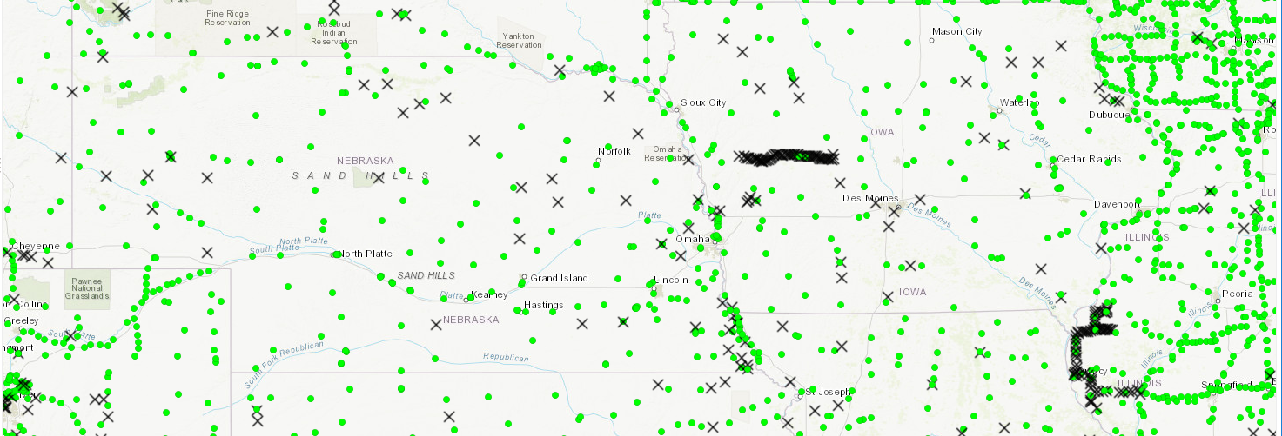
Distribution of Sample Points
ND
MN
SD
IA
NE

Slide 13
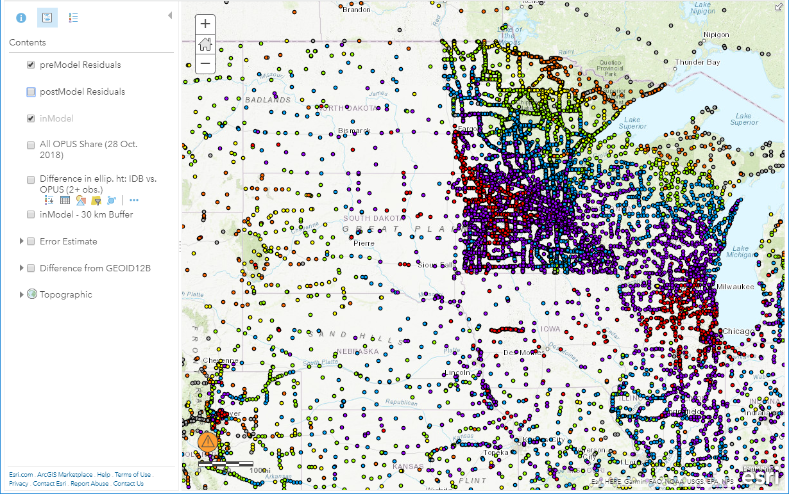
Fit of Global Geoid vs GPS on BM
Green is about +2 to -2 cm
Range about +8 to -8 cm across MN

Slide 14
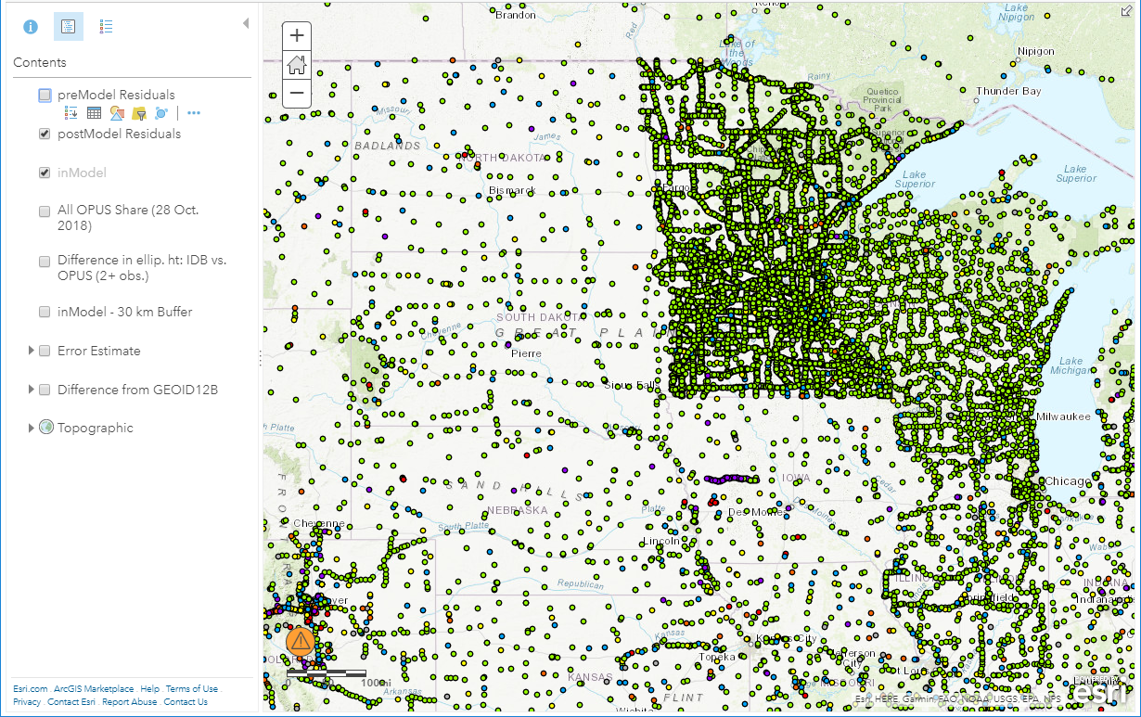
Fit of Geoid18 vs GPS on BM
Green is about +2 to -2 cm

Slide 15
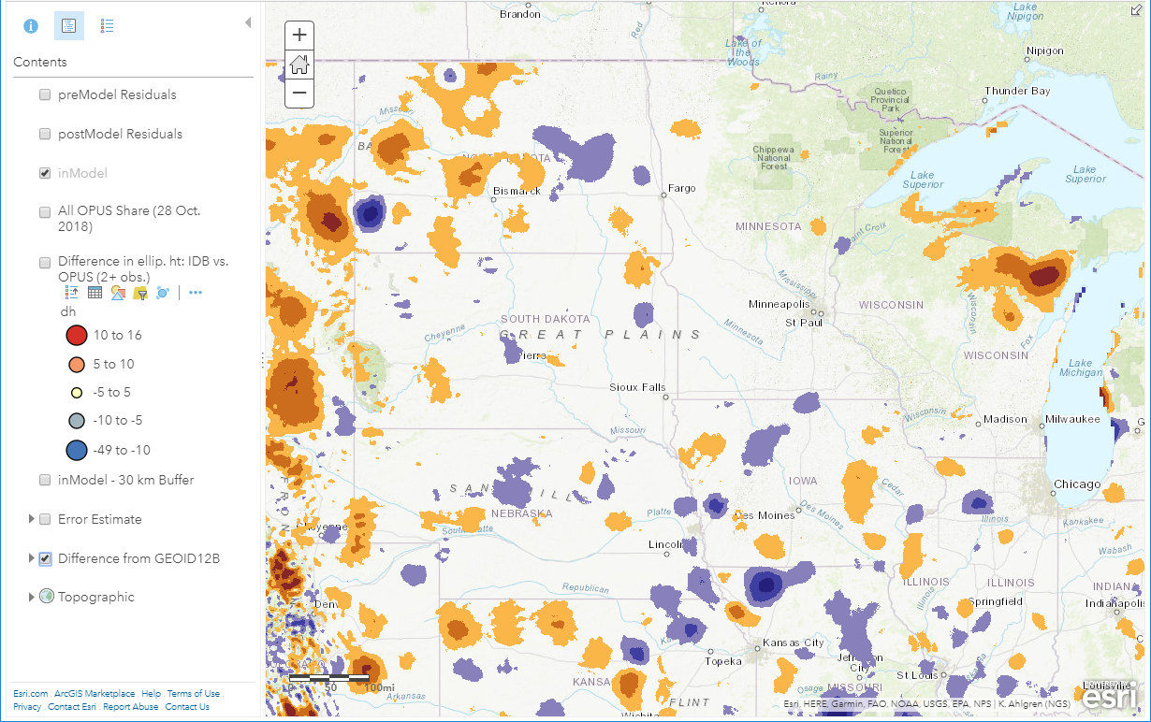
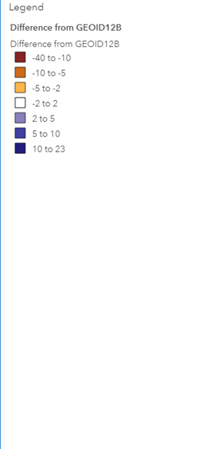
Geoid 18 Difference from Geoid 12

Slide 16
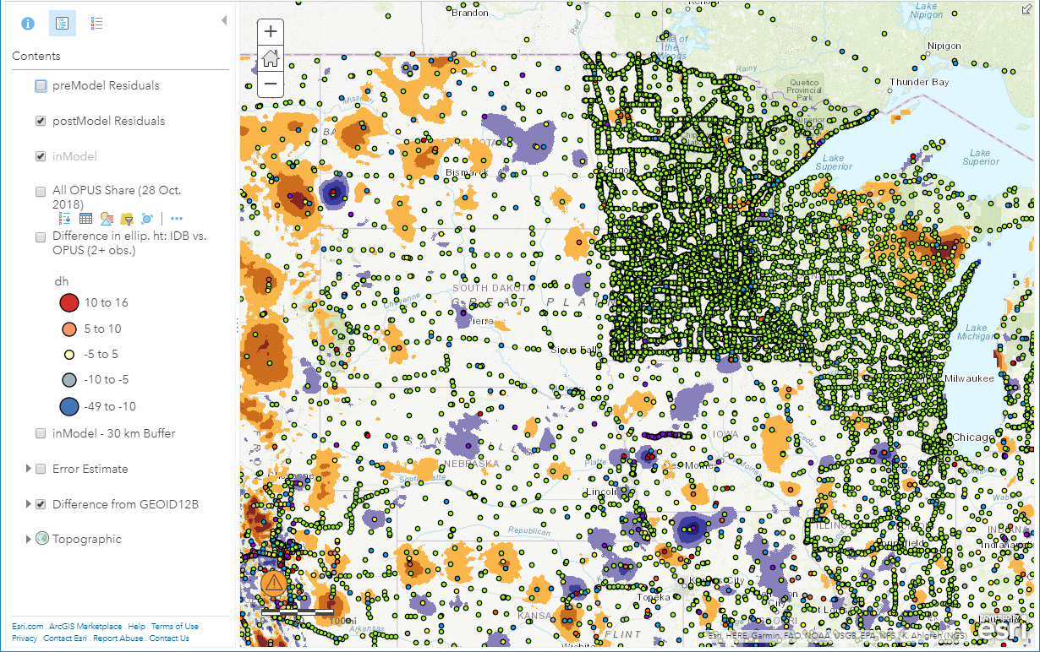
Geoid 18 Difference from Geoid 12

Slide 17
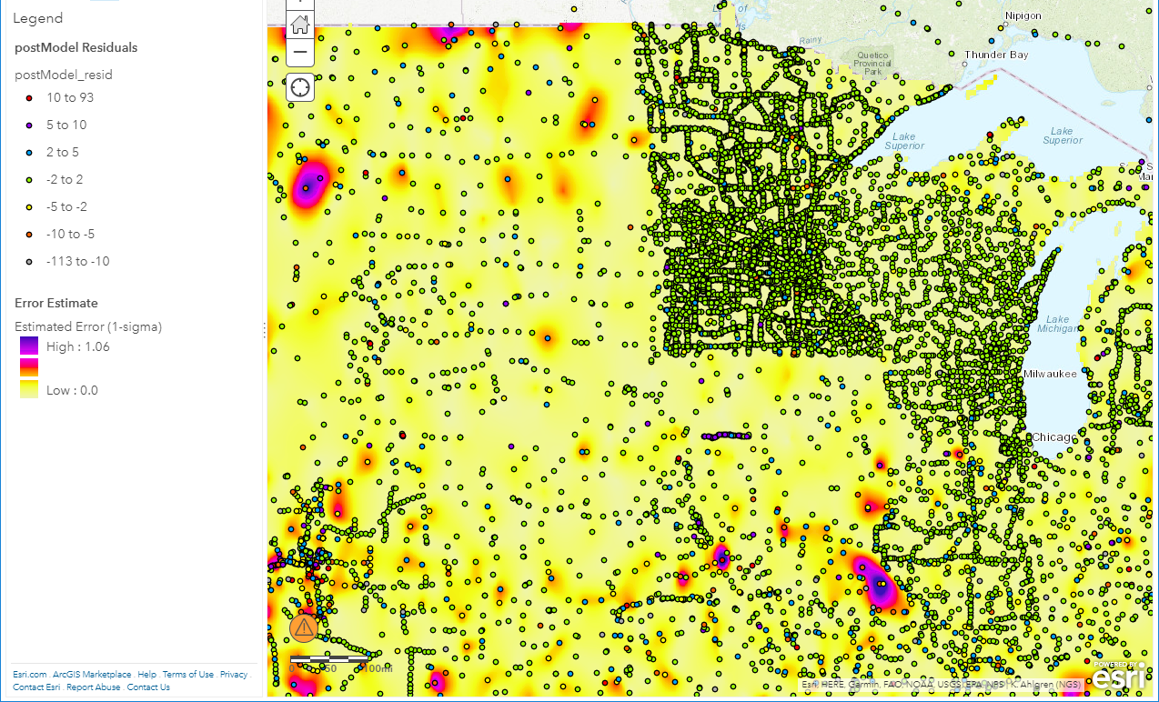
Overall “Error” Estimate
0 to 1 meter
“Error” means larger residuals in model. The underlying sample data was not rejected, so it may influence the model, but is a poor fit and leaves a high residual in the area.

Slide 18
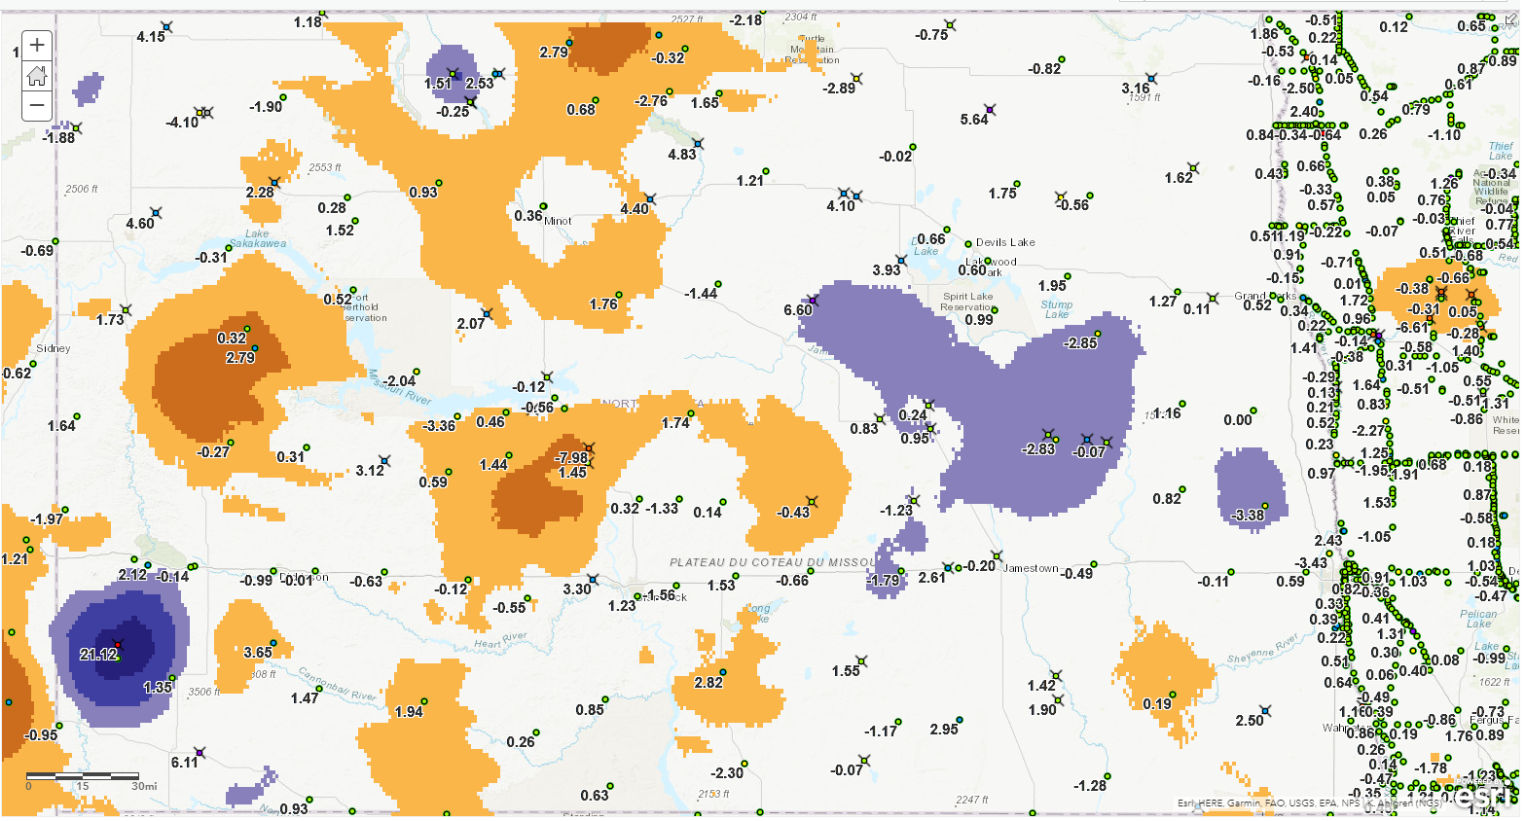
Geoid 18 Difference from Geoid 12 - ND
Devils Lake
Minot
Dickinson
Bismarck
Fargo
Bowman

Slide 19
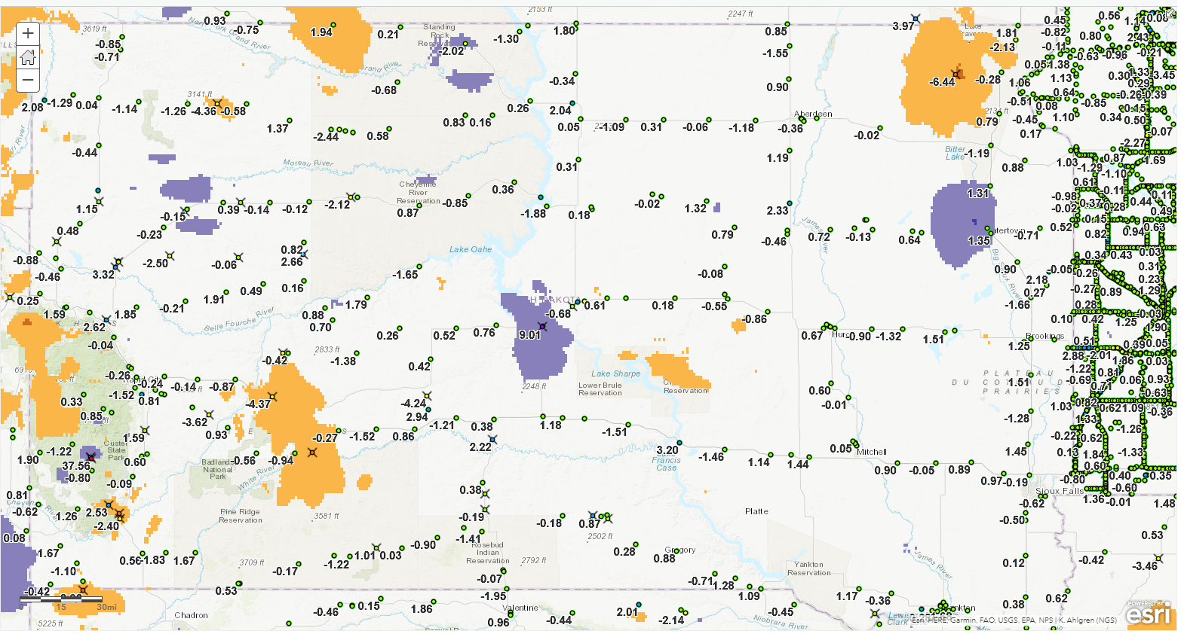
Geoid 18 Difference from Geoid 12 - SD
McLaughlin
Aberdeen
Pierre
Rapid City
Wall
Mitchell
Interior

Slide 20
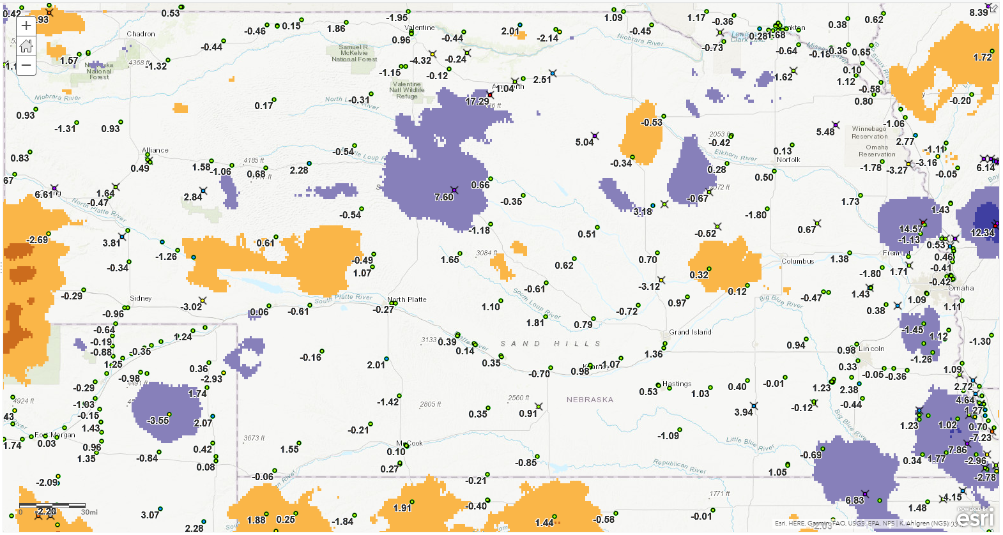
Geoid 18 Difference from Geoid 12 - NE
Valentine
Alliance
Spalding
Omaha
North Platte
Grand Island
Kearney
Rulo

Slide 21
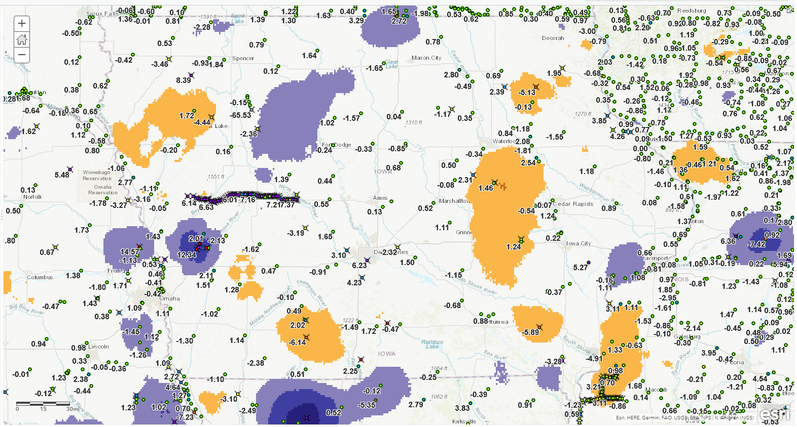
Geoid 18 Difference from Geoid 12 - IA

Slide 22
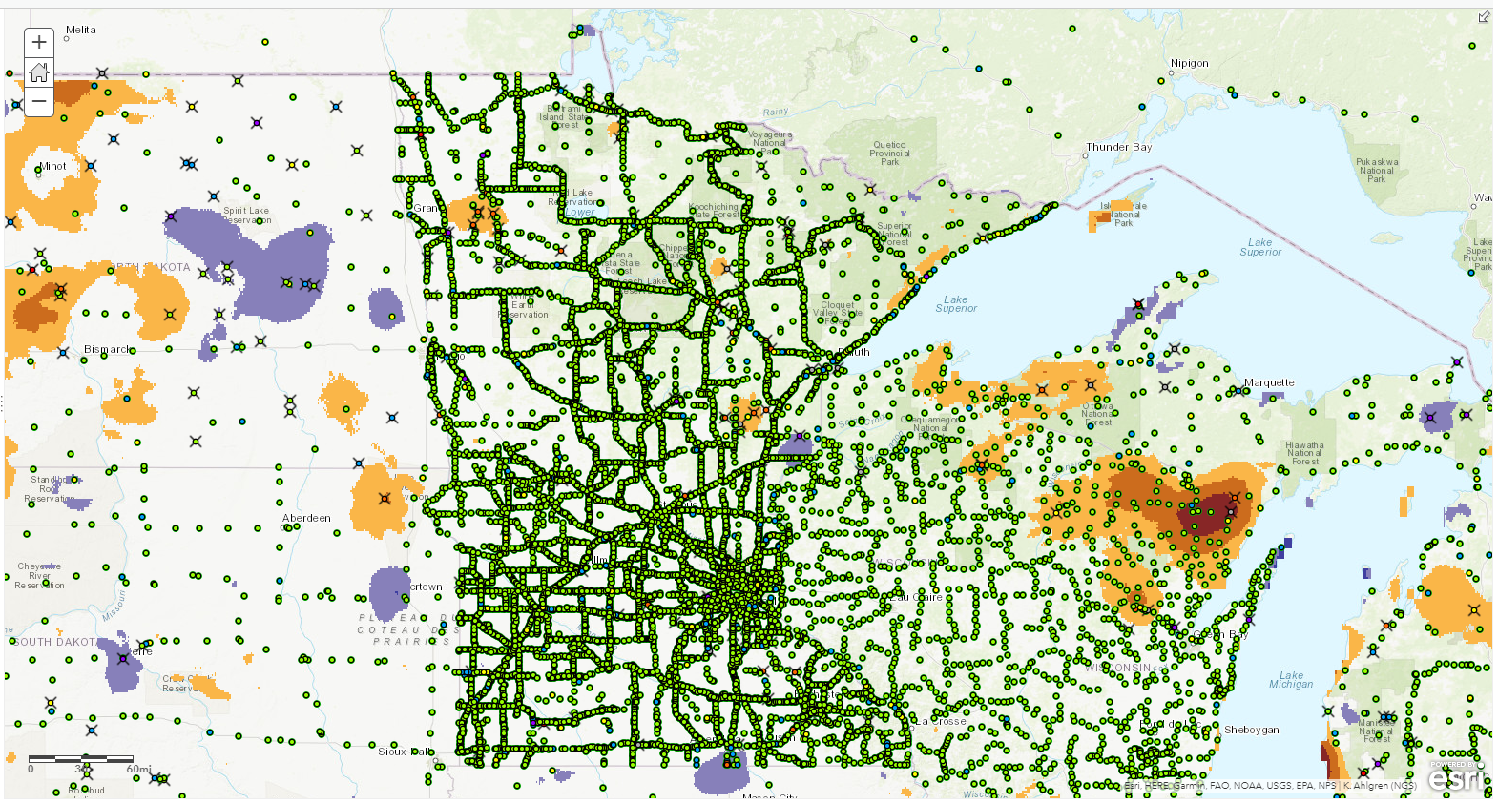
Geoid 18 Difference from Geoid 12 - MN

Slide 23
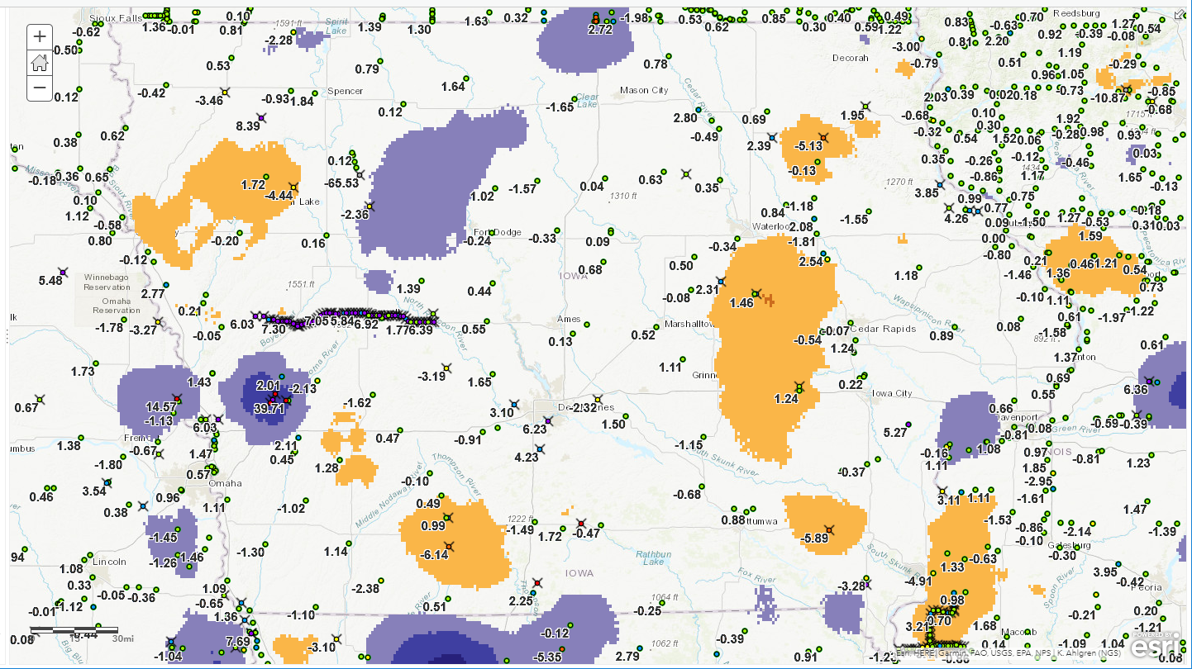
State-by-State Details - IA
Mason City
Pocahontas
Sioux City
Portsmouth
Des Moines

Slide 24
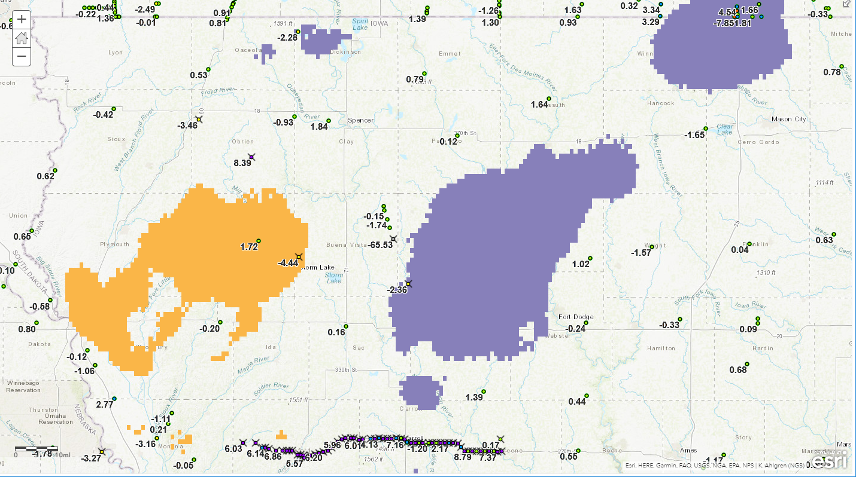
State-by-State Details - IA
-65.53 cm disagrees with all surrounding residuals, near -1 to +1.
Albert City
Pocahontas
Rejected all the GSVS14 marks

Slide 25
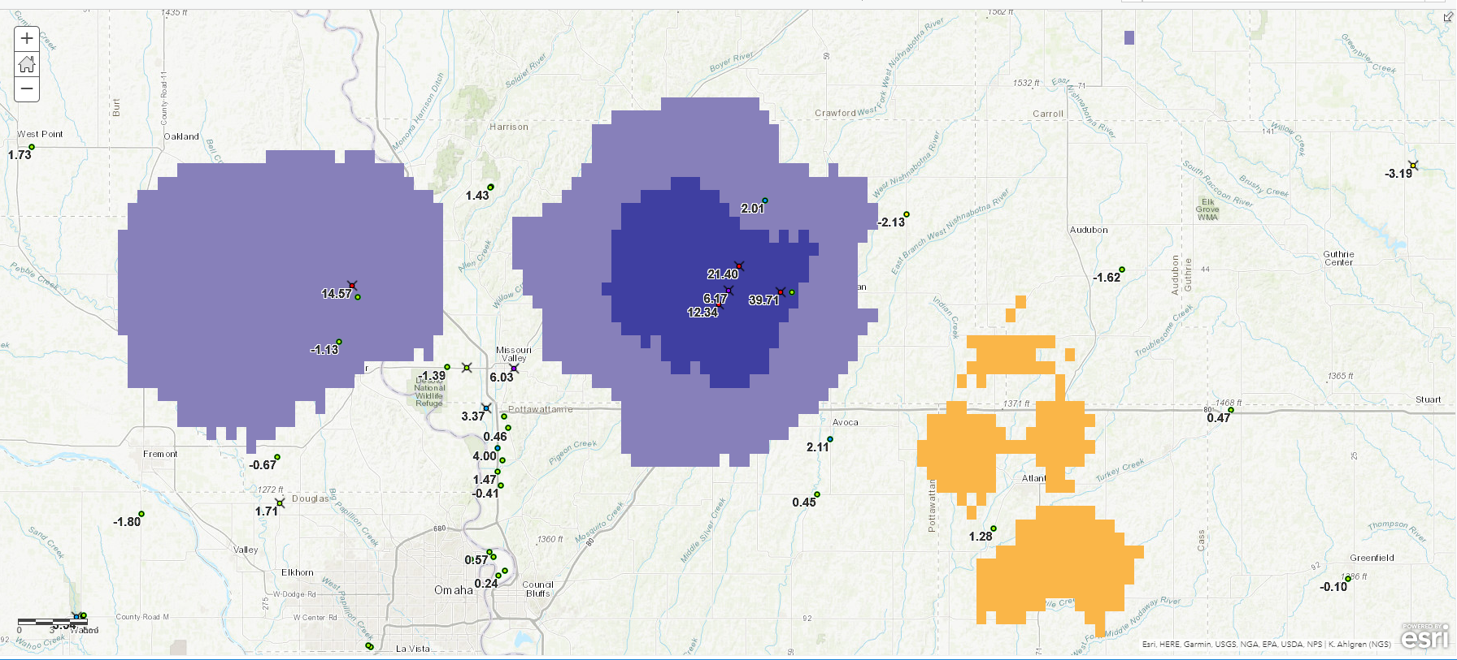
State-by-State Details - IA
39.71, 21.40, 6.17, 12.34, and 14.57 cm all disagree with nearby 0.09 cm, note surrounding residuals near -1 to +1.
OPUS SHARED solutions nearby helped confirm rejection.
0.09 cm
Portsmouth
Omaha

Slide 26
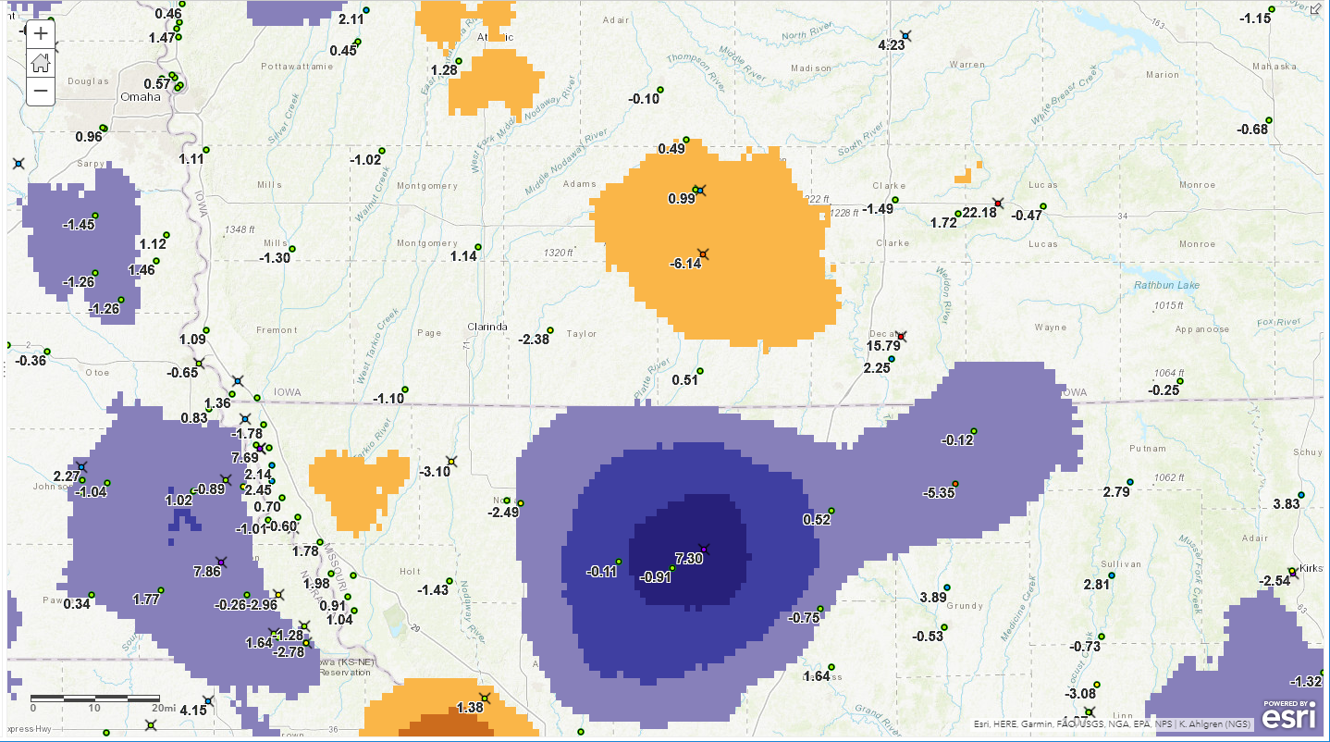
State-by-State Details - IA
-6.14, +7.30, +15.79, +22.18 cm disagrees with nearby surrounding residuals near -1 to +1.
Diagonal
Albany MO

Slide 27
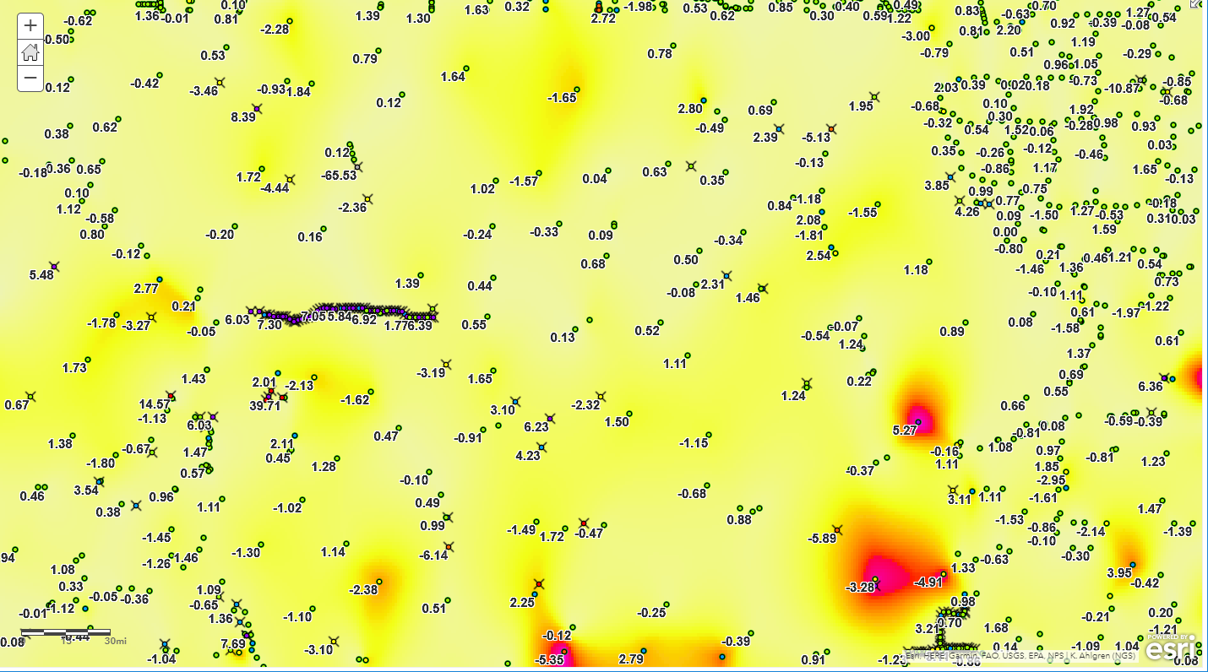
State-by-State Details - IA
Overall “ERROR ESTIMATE” for IA
Mason City
Pocahontas
Sioux City
Portsmouth
Des Moines
West Liberty
Mt Pleasant

Slide 28
Using GPS on BM for Datum Transformation

Slide 29
Let’s Talk Transformation
NAVD88 is defined by terrestrial spirit leveling across the United States.
NAPGD2022 is defined by GPS and gravity-based (not hybrid) GEOID2022.
Ellipsoid height (GPS)
This is the “difference” between NAVD88 and NAPGD2022 (~ 0.75m and varies)
NAPGD2022 height
NAVD88 height
GEOID 2022
Topo
Ellipsoid 2022
NAVD88 Datum Surface
Gravity-based Geoid 2022

Slide 30
Let’s Talk Transformation
Hybrid Geoid models do not benefit from samples closer than about 10 km to 30 km
But, Datum Transformation can be modeled as close as 2 km if data is available.
So, NGS wants a “GPS on BM” sample on as many NAVD88 benchmarks as possible.
(EllHt + GEOID2022) - (NAVD88) = Transformation
User-measured
NGS Modeled
Existing Data
Needed Amount

Slide 31
Priority
NGS can compute the NAVD88 to NAPGD2022 using the existing data that it has.
But, users can improve local areas by contributing GPS observations on existing BM’s.
First, at 10 KM spacing for general areas
Second, at 2 km spacing for critical areas

Slide 32
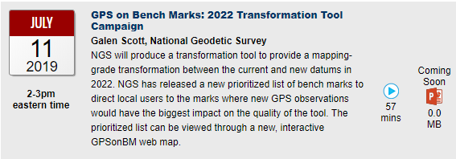
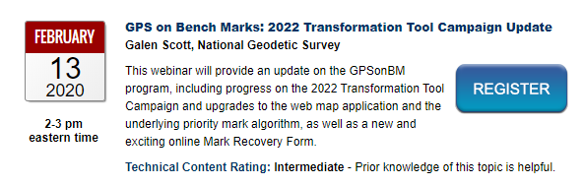
How YOU can improve NAVD88 to NAPGD2022 Conversions
You can contribute to a better conversion in NCAT by observing and sharing GPS observations of selected Benchmarks
See “GPS on Bench Marks” page at NGS
Map shows location and priority of selected bench marks.
Webinar on use of map –
https://www.ngs.noaa.gov/web/science_edu/webinar_series/2019-webinars.shtml

Slide 33
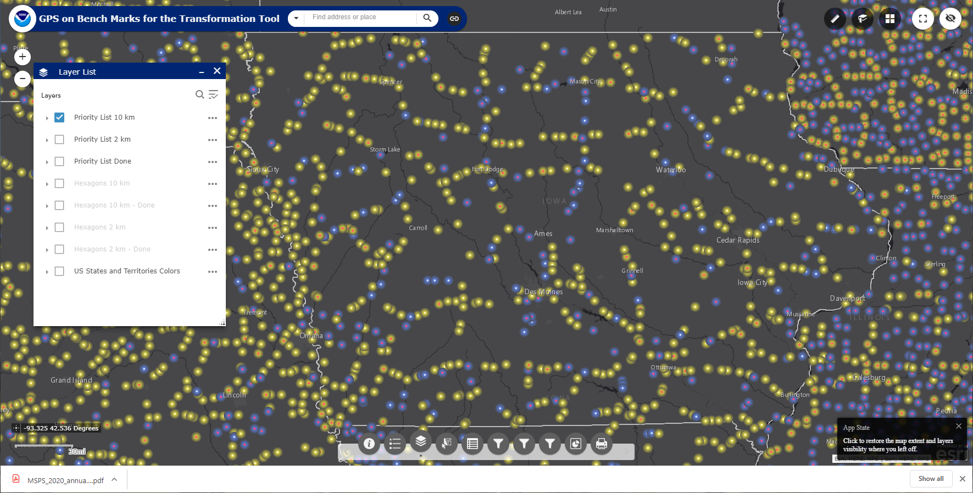
GPS on BM – Iowa
Ames

Slide 34
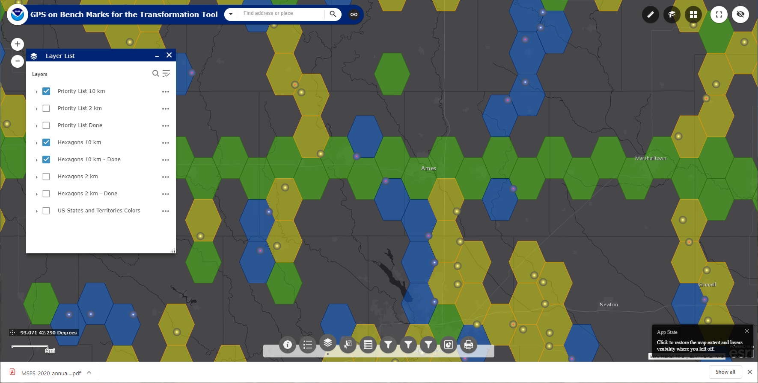
GPS on BM – Iowa
This view shows 10 km hexagons
Ames
Showing 10 km hexagons color coded by priority

Slide 35
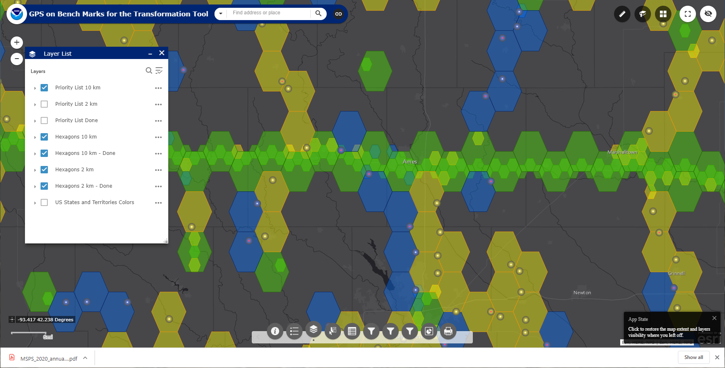
GPS on BM – Iowa
This view shows 10 km and 2 km hexagons
Ames
Showing 10 km and 2 km hexagons color coded by priority

Slide 36
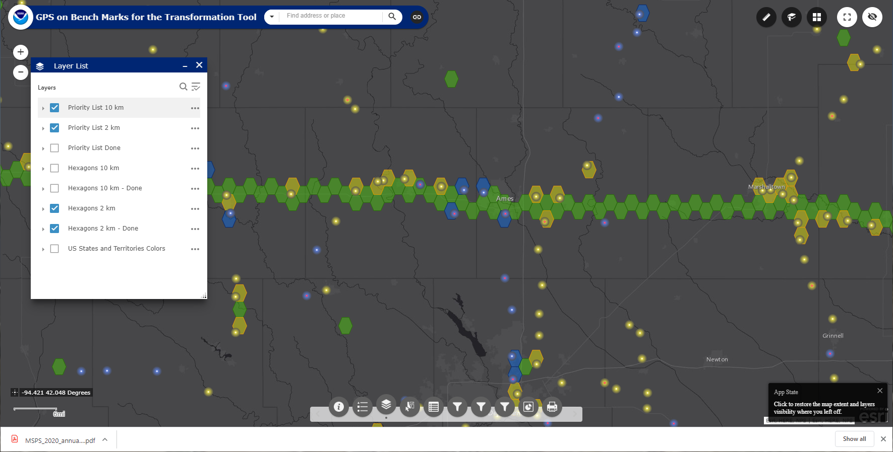
GPS on BM – Iowa
This view shows 2 km hexagons
Ames
Showing 2 km hexagons color coded by priority

Slide 37
GPS on BM – Iowa
You can observe some 10 km or 2 km hexagons near you, and submit them to NGS via OPUS Share, the map will update within a week or so.

Slide 38
Dynamic “GPS on BM” Map
The map has active controls to turn on Layers and pop-up boxes to show the details of the plotted bench marks.
Also, you can obtain lists of prioritized marks at the NGS GPS on BM pages.
Do 10 km spacing, then add 2 km spacing as needed in special areas, like towns or flood zones etc.
Benefit to USER:
NGS will have a denser sample of data with which to build a more detailed transformation from NAVD88 to NAPGD2022 in user’s area of interest.
Also, NGS will produce a NATRF2022 position and a NAPGD2022 height for the submitted marks. Thus pre-populating survey control in your area.
Map updated frequently to show progress

Slide 39
End
David Zenk PE LS Geodesist, National Geodetic Survey
Northern Plains Regional Advisor
MN, ND, SD, NE, IA
University of Minnesota, Geography Department
414A Social Sciences Building
267 19th Ave S
Minneapolis, MN 55455
763-600-6912 home office
612-414-9522 mobile
612-626-6175 U of M office (Blegen 410C)
dave.zenk@noaa.gov (federal business) zenkx002@umn.edu (personal business)

