Slide 1

GPS Seminar
Geodetic “Static” Perspective
Oroville, CA
Marti Ikehara: marti.ikehara@noaa.gov
California Geodetic Advisor
Sacramento, CA
916-227-7325

Slide 2
Table of Contents
Updating the NSRS: New CORS Reference Frame, NAD83 Realization, and Geoid Model
History of NAD83 Realizations (US, CA)
Overhaul of the NSRS
Many OPUS = OPI?
Datasheets
Data/learning resources
Demonstration of DSWorld retrievals and submissions (photos, recovery notes, etc)

Slide 3
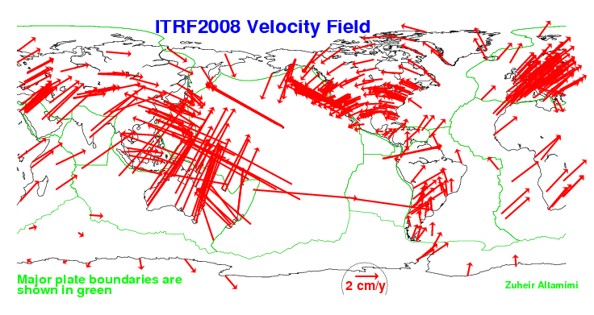
Rationale for Updating the NSRS (CORS)
Definition starts with a global RF: ITRF##
No fixed tectonic plate results in velocities

Slide 4
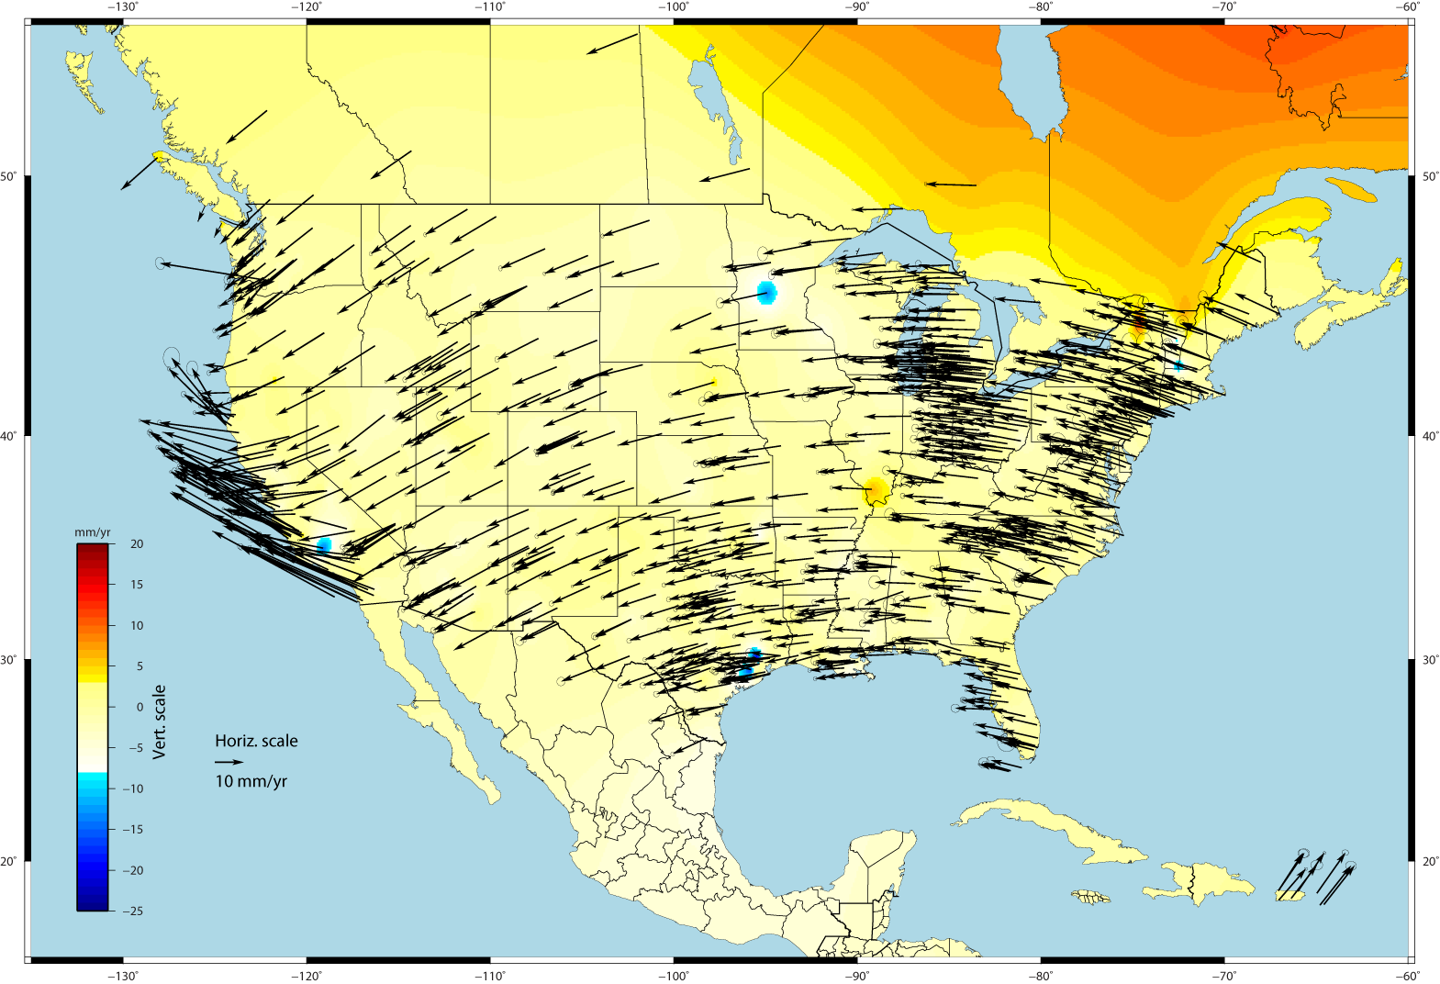
U.S. CORS Velocity Field – ITRF2008
Notes:
Color shading represents vertical velocities; Canadian shield is experiencing glacial isostatic rebound and going up.

Slide 5
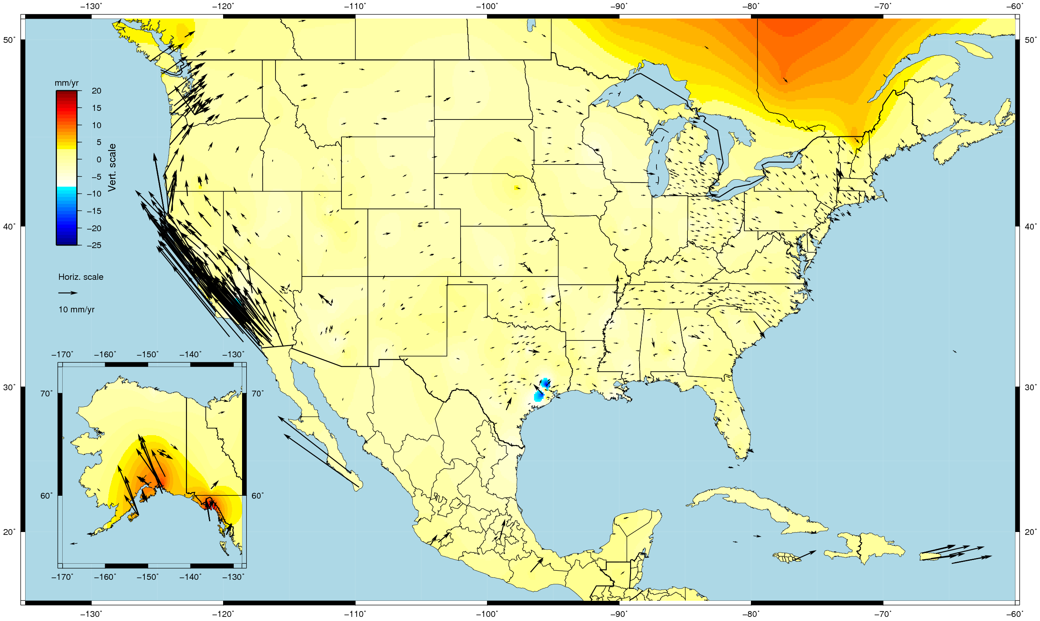
U.S. CORS Velocity Field - NAD83(2011) epoch 2010.0

Slide 6
Rationale for updating CORS RF
NSRS’s global frame was ITRF00 epoch 1997.00. Projecting 13 yrs was unrealistic because of velocities; NAD 83(CORS96) epoch 2002.00 projecting 8 yrs was becoming a problem
Coordinates and velocities were a mixture from last reprocessing (1994-2002) and adjustments using 8 to 3 IGS ref. sites
Mixture of Computed and HTDP velocities
Assumed NAD83 vertical vel. = 0 mm/yr
Change fr Relative to Absolute antenna phase center values in ITRF definition
Metadata issues, eg, discontinuities/offsets
Significant software changes since 2002
Notes:
Computed velocities from those CORS with >2.5 yrs data stored at NGS

Slide 7
Multi-year CORS Solution: MYCS
“Multiyear” effort began 7 years ago
IGS proposed re-processing all data to re-compute station coordinates, orbits, and EOPs (earth orientation parameters) fr 1994-present
NGS began with a revision of PAGES software and processing strategy driven by weak NGS orbit contributions to IGS
860 weekly (full history) CORS+ ~230 global SINEX files containing X,Y,Z positions and full variance-covariance information
Coordinates published (online) on Sept 6, 2011

Slide 8
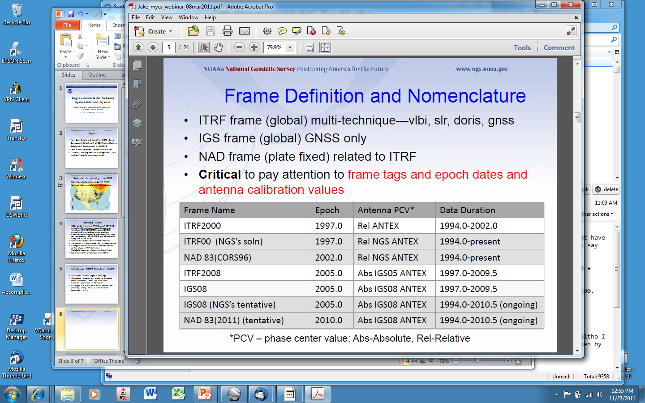
Geodetic Reference Frames past and present
xxxxxxxx
xxxxxxxxxxx

Slide 9
So, what’s different about the CORS coordinates?
Change to absolute antenna calibrations
  Use absolute cal. in your processing: DON’T MIX!
Better because 8 more years of data for:
  International CGPS sites
  CORS: about 1700 total, ~1000 w/ >2.5 yrs
  Orbits and sophistication for processing them
  CORS velocity
Better HTDP modeling for those w/ <2.5 yrs
Better processing algorithms

Slide 10
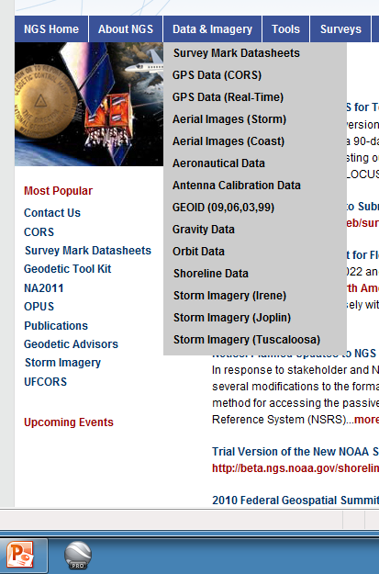
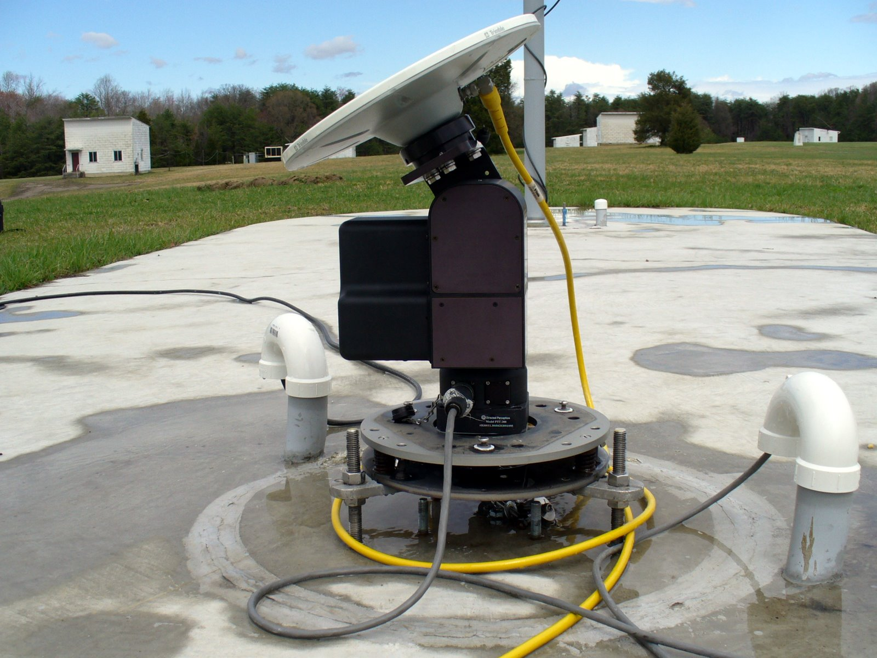

Antenna calibrations, ANTEX is new

Slide 11
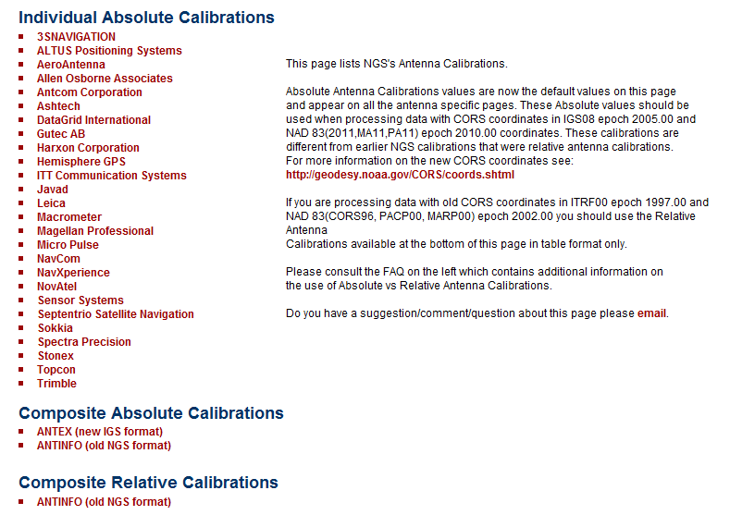
multiple Satellite Navigation Systems
>2 signal frequencies (L1, L2, L5, etc)
satellite and ground calibrations azimuthal dependencies

Slide 12
How do I find the coordinates?
Individual CORS Coordinate page, as before
On CORS page, Data Products, Coordinates Explained, Table 1, left column hotlinks
http://www.ngs.noaa.gov/CORS/coords.shtml
TWO basic divisions for the tables:
  One with COMPUTED velocities, one MODELED
TWO basic Ref Frames: IGS08, NAD83
Two types of coordinates/vel for each of those:
  X,Y,Z AND lat/long/ht (N,E,U)
Recommend using only CORS w/ computed velocities
Notes:
If you’re going to select

Slide 13
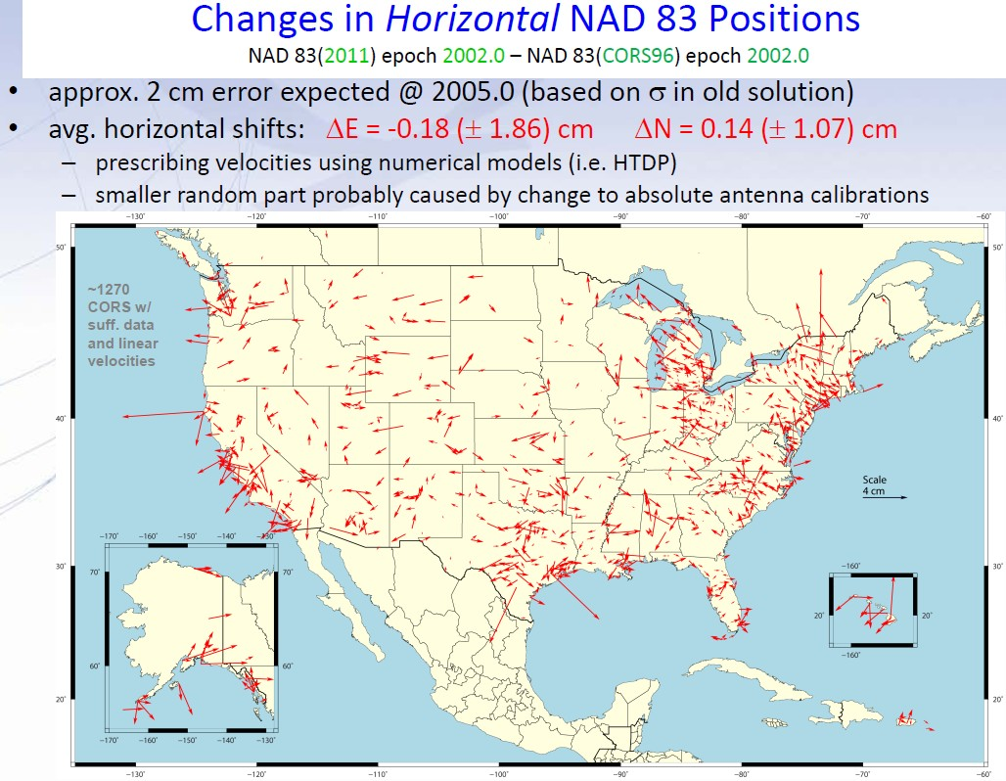

Slide 14
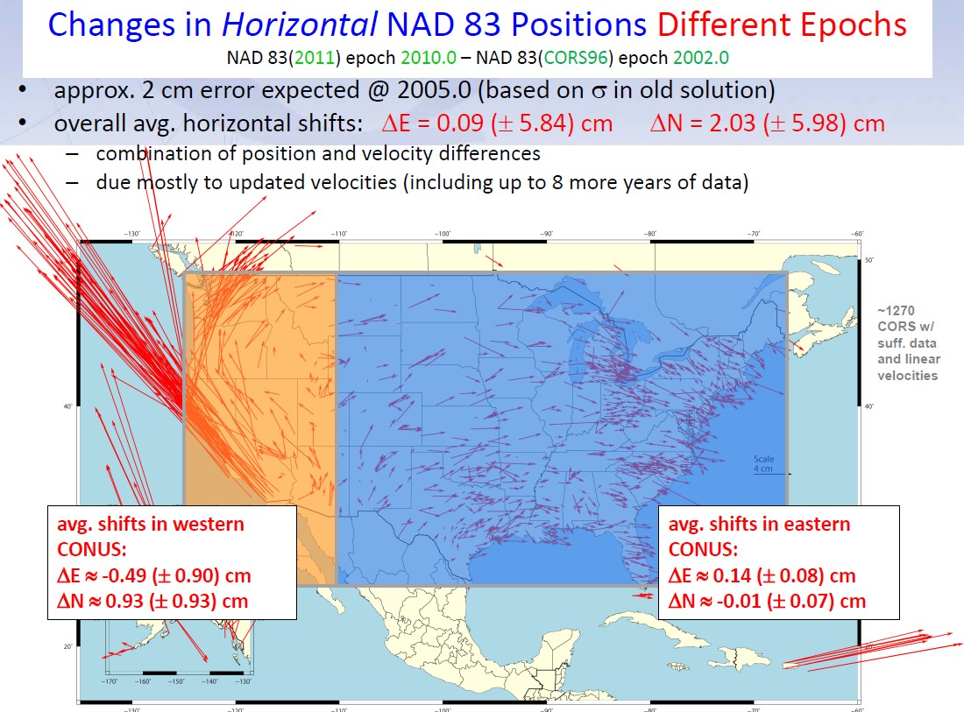
-4.9(+/-9.0)cm
9.3(+/-9.3)cm
1.4(+/-1.6)cm
0.1(+/-0.7)cm

Slide 15
Notes:
NW quadrant is CA; NE is WA/OR; E is PR

Slide 16
median values, solution quality metrics:
 | original |  | new |  | improved
peak-to-peak LAT | 0.013 m |  | 0.004 m |  | 69 %
peak-to-peak LON | 0.015 m |  | 0.004 m |  | 73 %
peak-to-peak EL_HGT | 0.024 m |  | 0.008 m |  | 67 %
% ambiguities fixed | 93 % |  | 95 % |  | 2 %
% observations used | 95 % |  | 94 % |  | -1 %
RMS | 0.014 m |  | 0.014 m |  | 0 %
Notes:
Stats for OPUS solutions much tighter with new coordinates in place

Slide 17
NEED for a new national adjustment, NA2011 project, for passive geodetic stations
Optimally align passive control with CORS
>1000 projects submitted since 2007 NatlReadj
  Number of stations increased by 1/3 in just 5 years!
  Plus Observations for Hawaii & other Pacific islands
More consistent results in tectonically active areas
  Longer time series for CORS as well as
  More current data for passive, and better tectonic modeling for applying HTDP to obs back 20+ years.

Slide 18
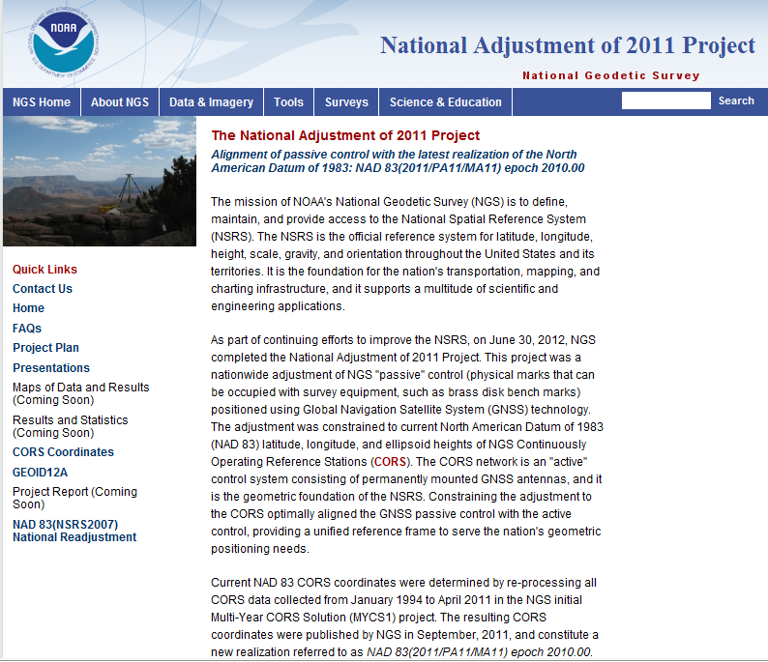

Slide 19
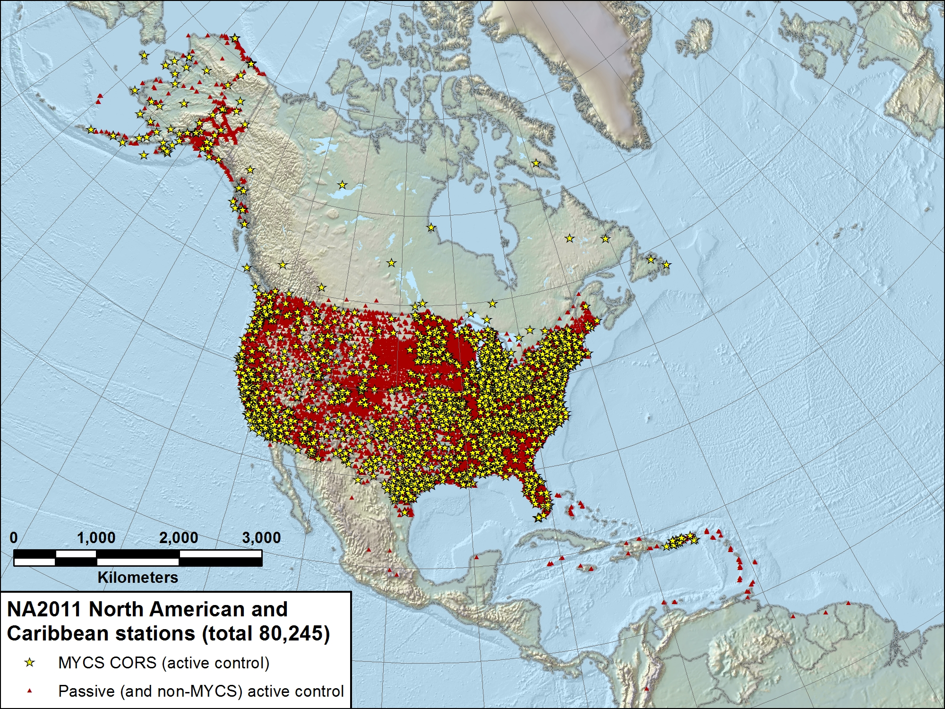

Slide 20
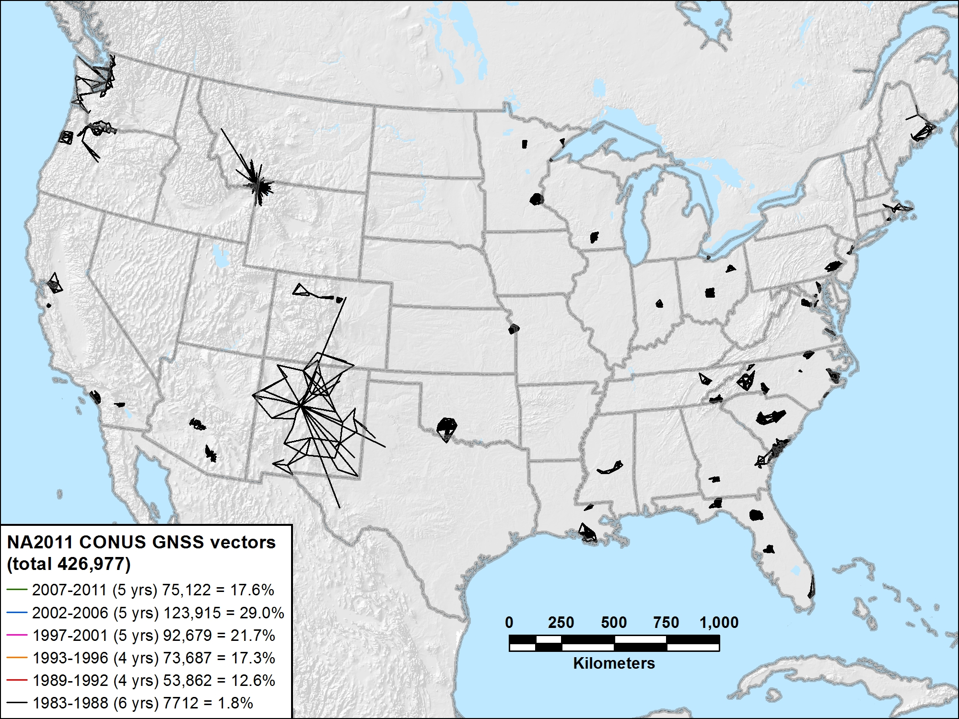
NA2011 CONUS 1983-1988 (6 yrs) 7712 vectors (1.8%)

Slide 21
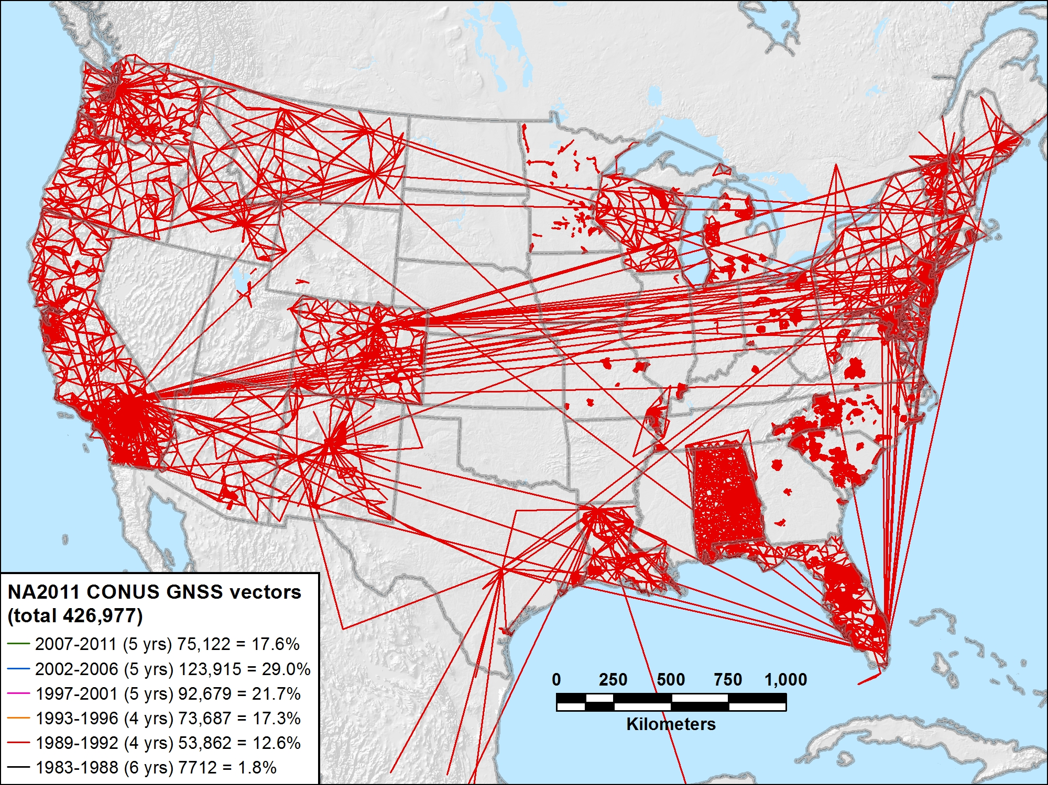
NA2011 CONUS 1989-1992 (4 yrs) 53,862 vectors (12.6%)

Slide 22
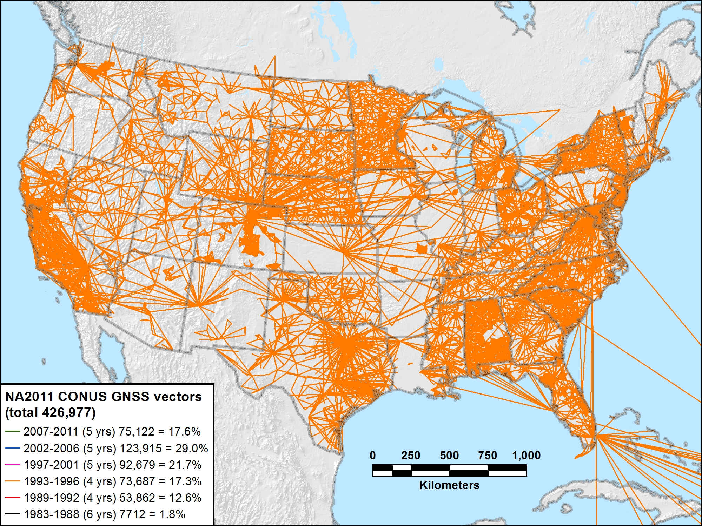
NA2011 CONUS 1993-1996 (4 yrs) 73,687 vectors (17.3%)

Slide 23
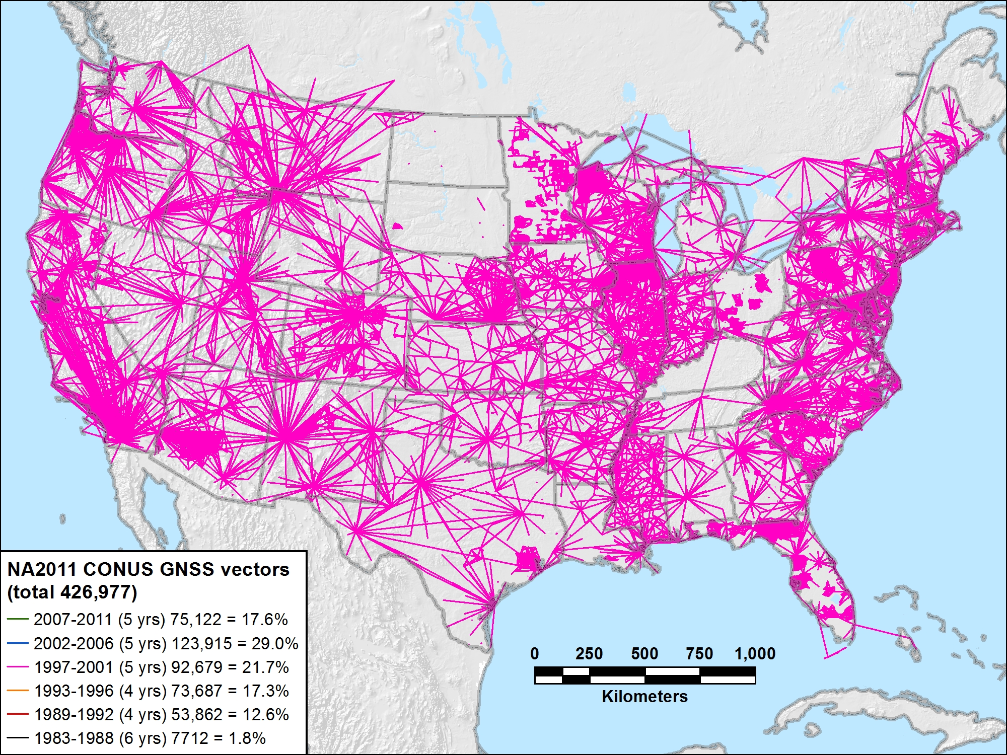
NA2011 CONUS 1997-2001 (5 yrs) 92,679 vectors (21.7%)

Slide 24
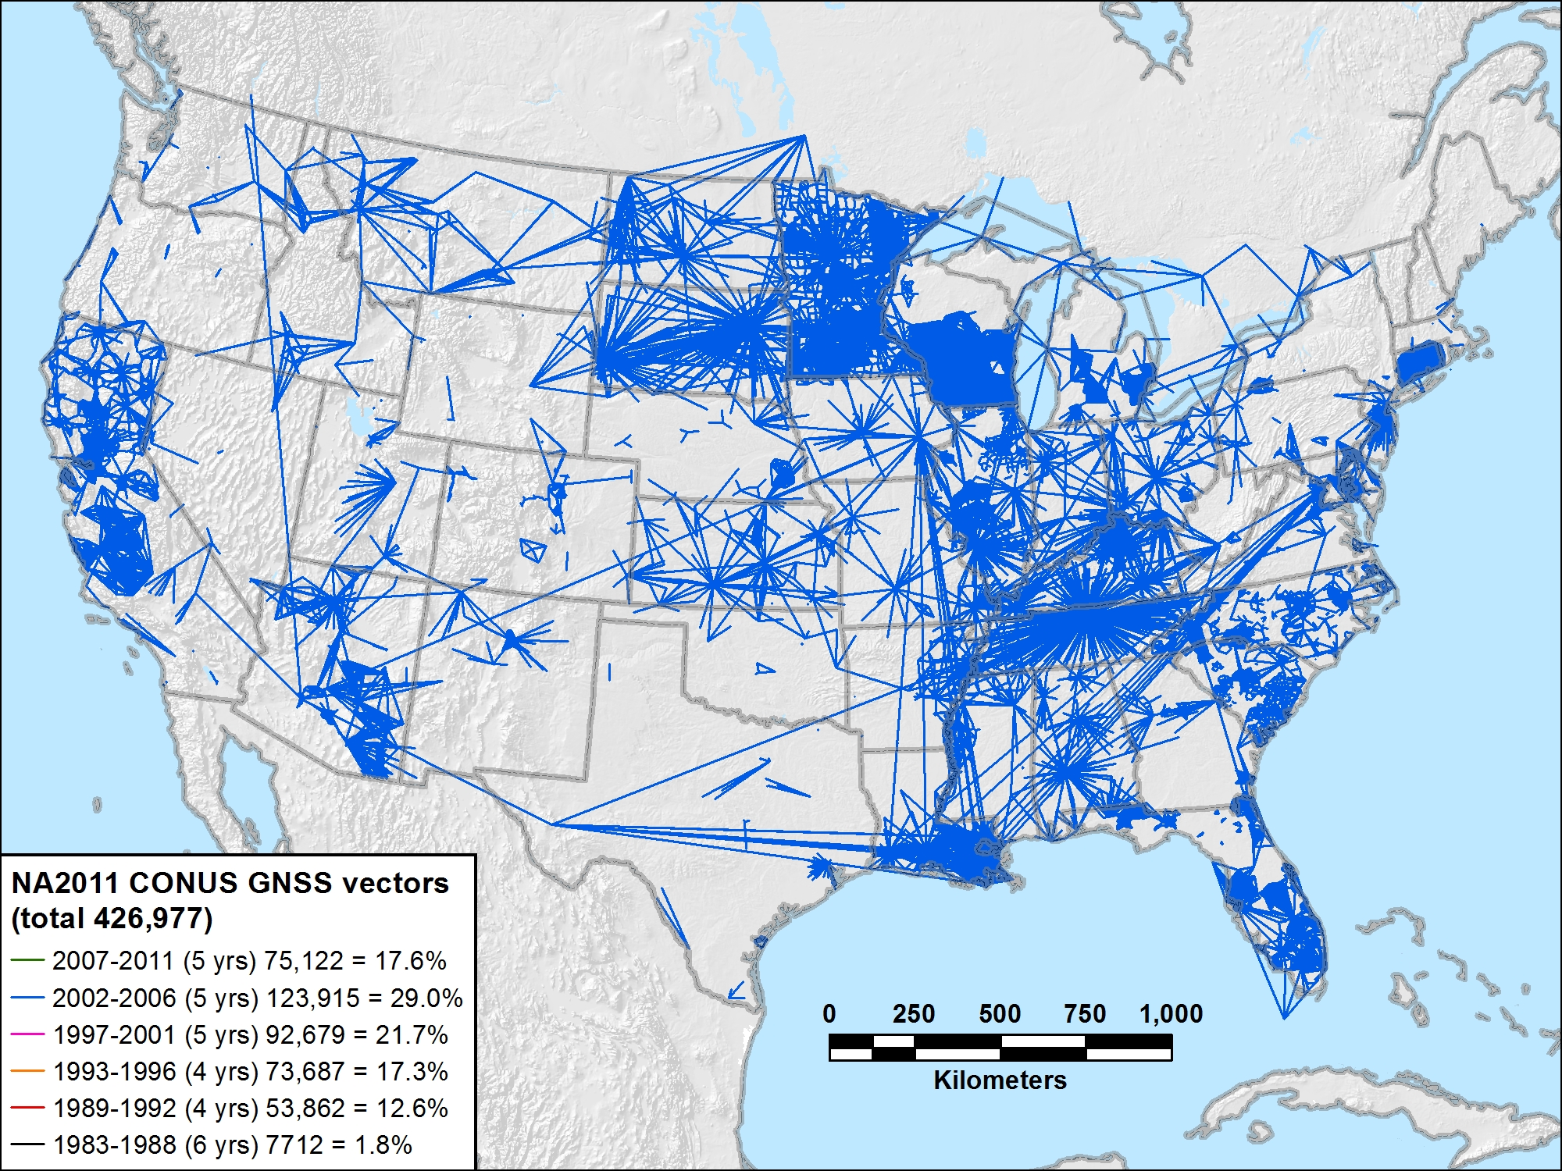
NA2011 CONUS 2002-2006 (5 yrs) 123,915 vectors (29.0%)

Slide 25
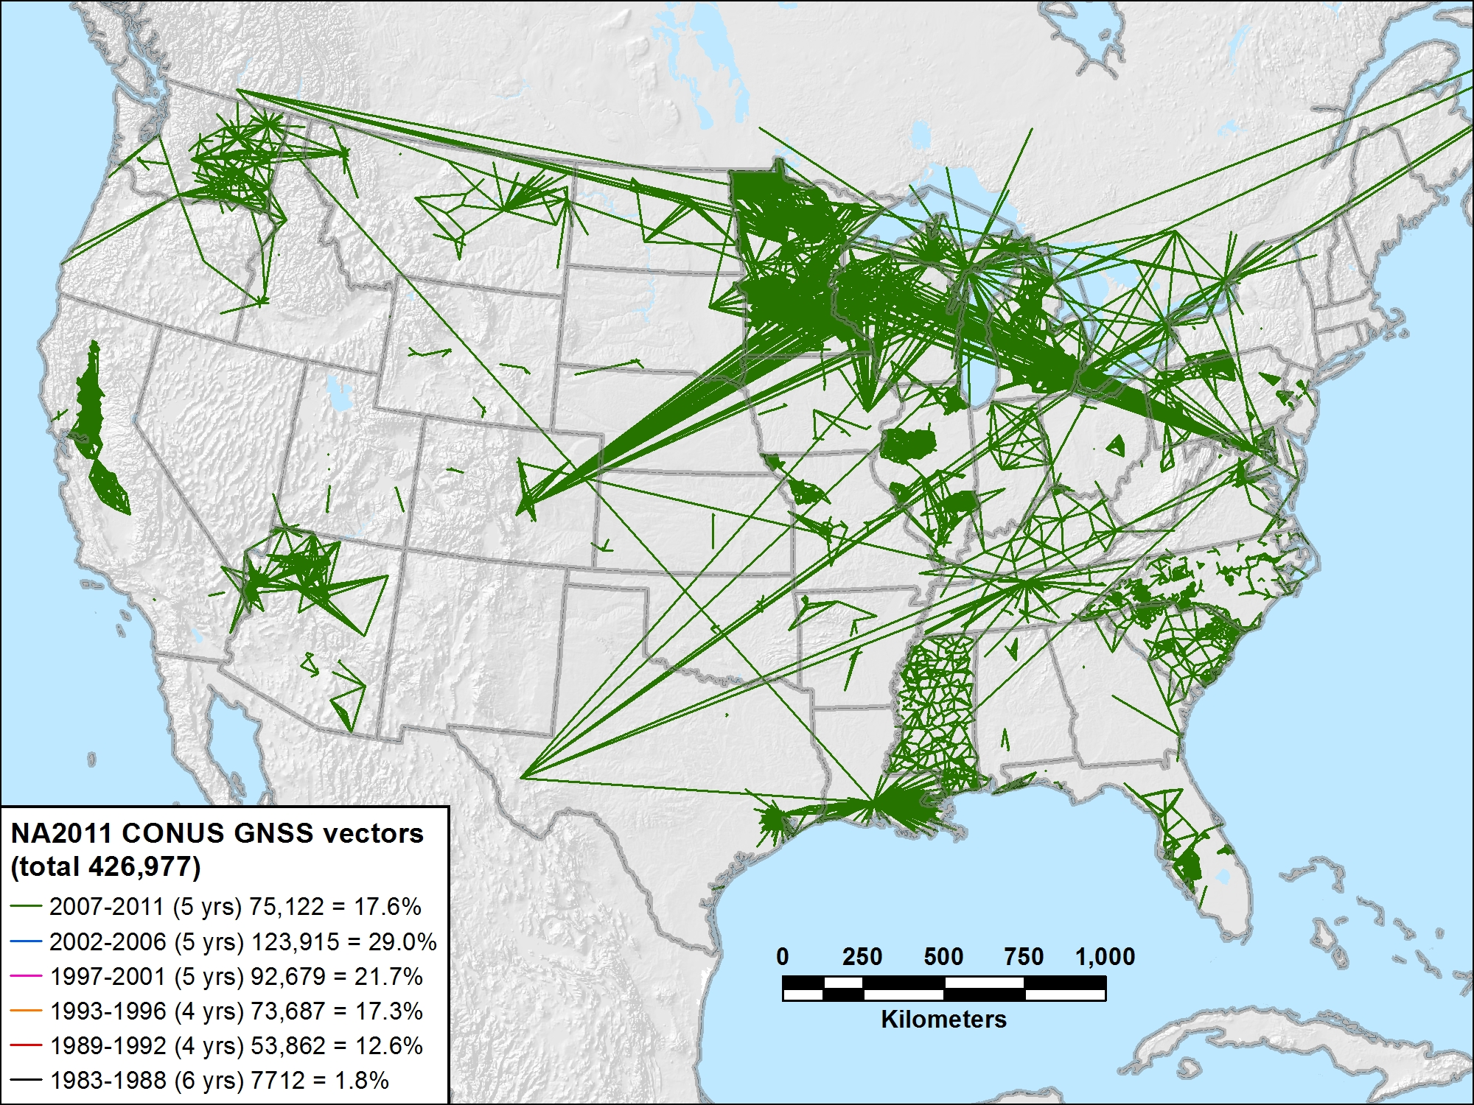
NA2011 CONUS 2007-2011 (5 yrs) 75,122 vectors (17.6%)

Slide 26
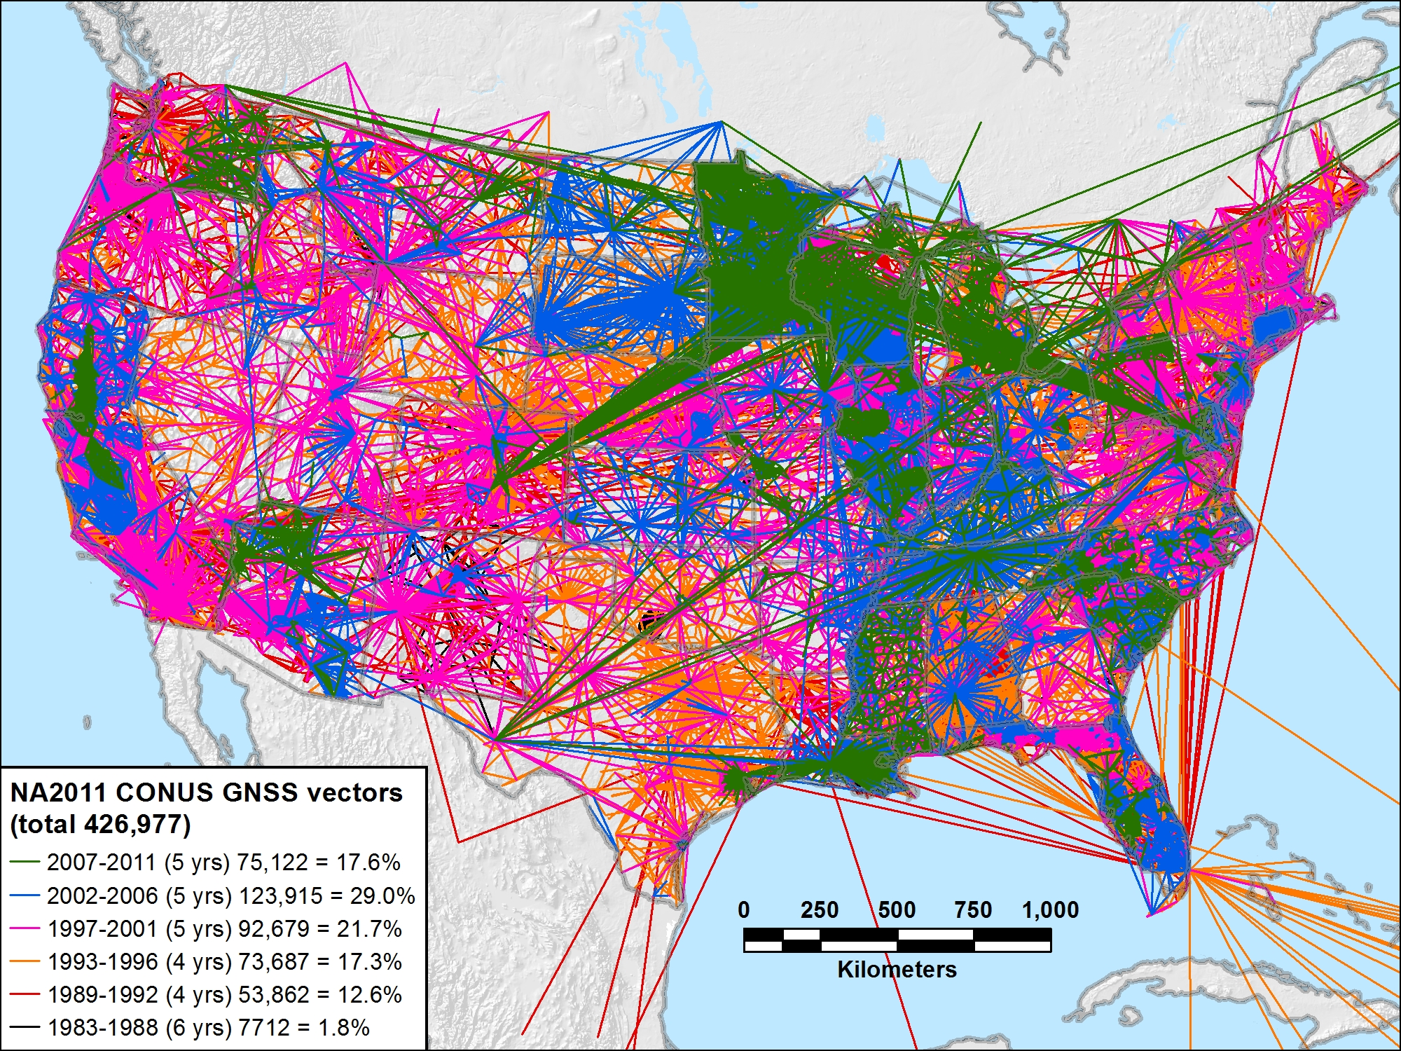
NA2011 CONUS 1983-2011 (29 yrs) 426,977 vectors (100.0%)

Slide 27
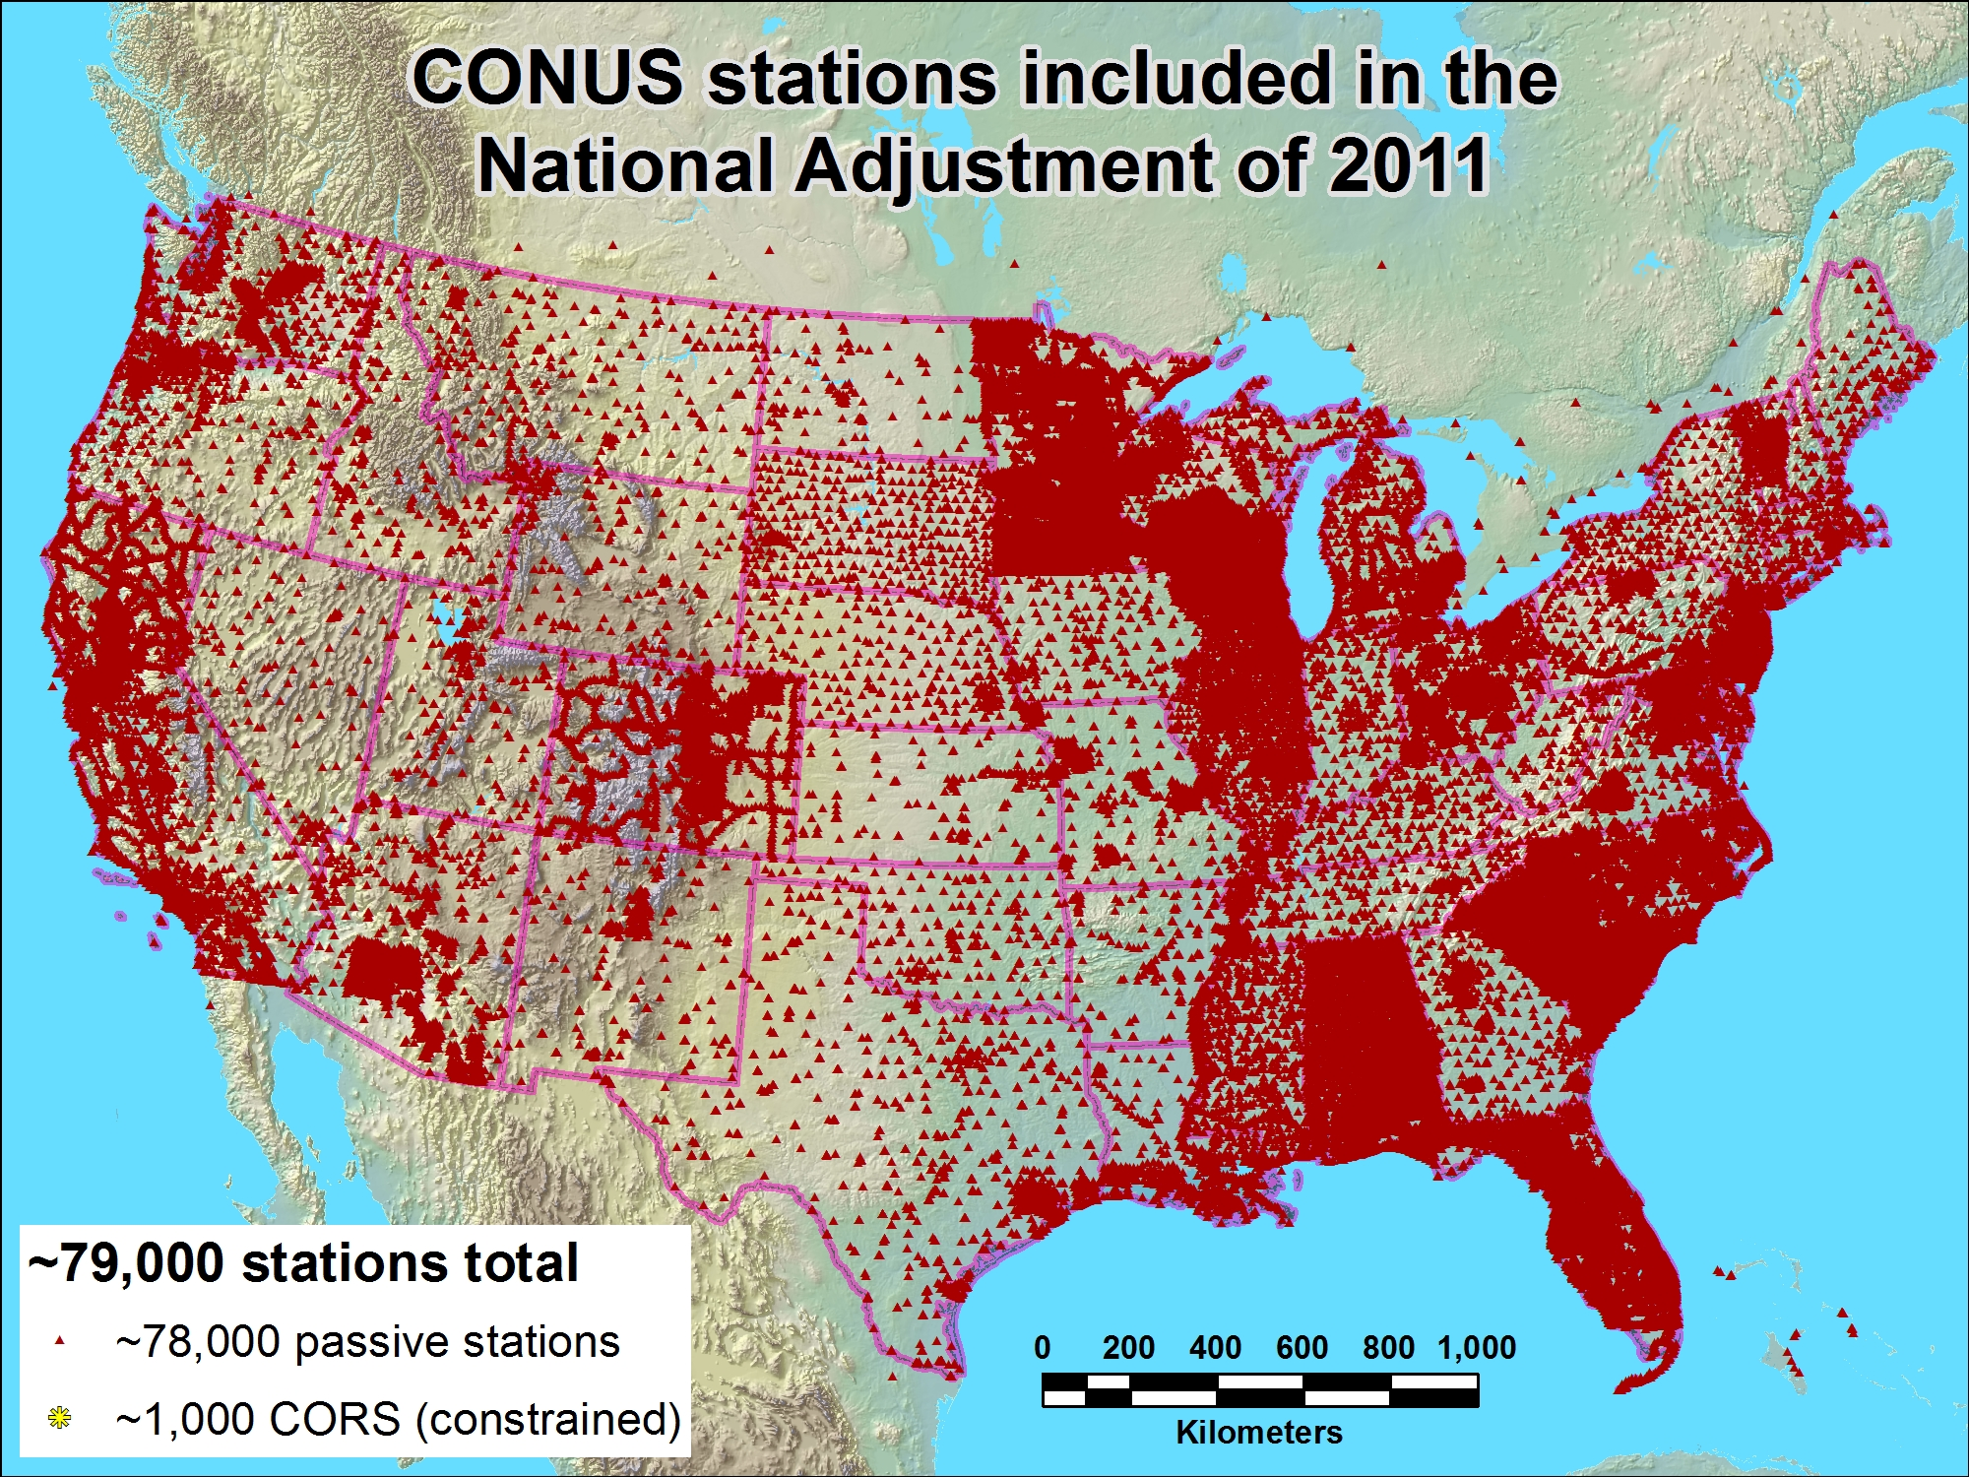
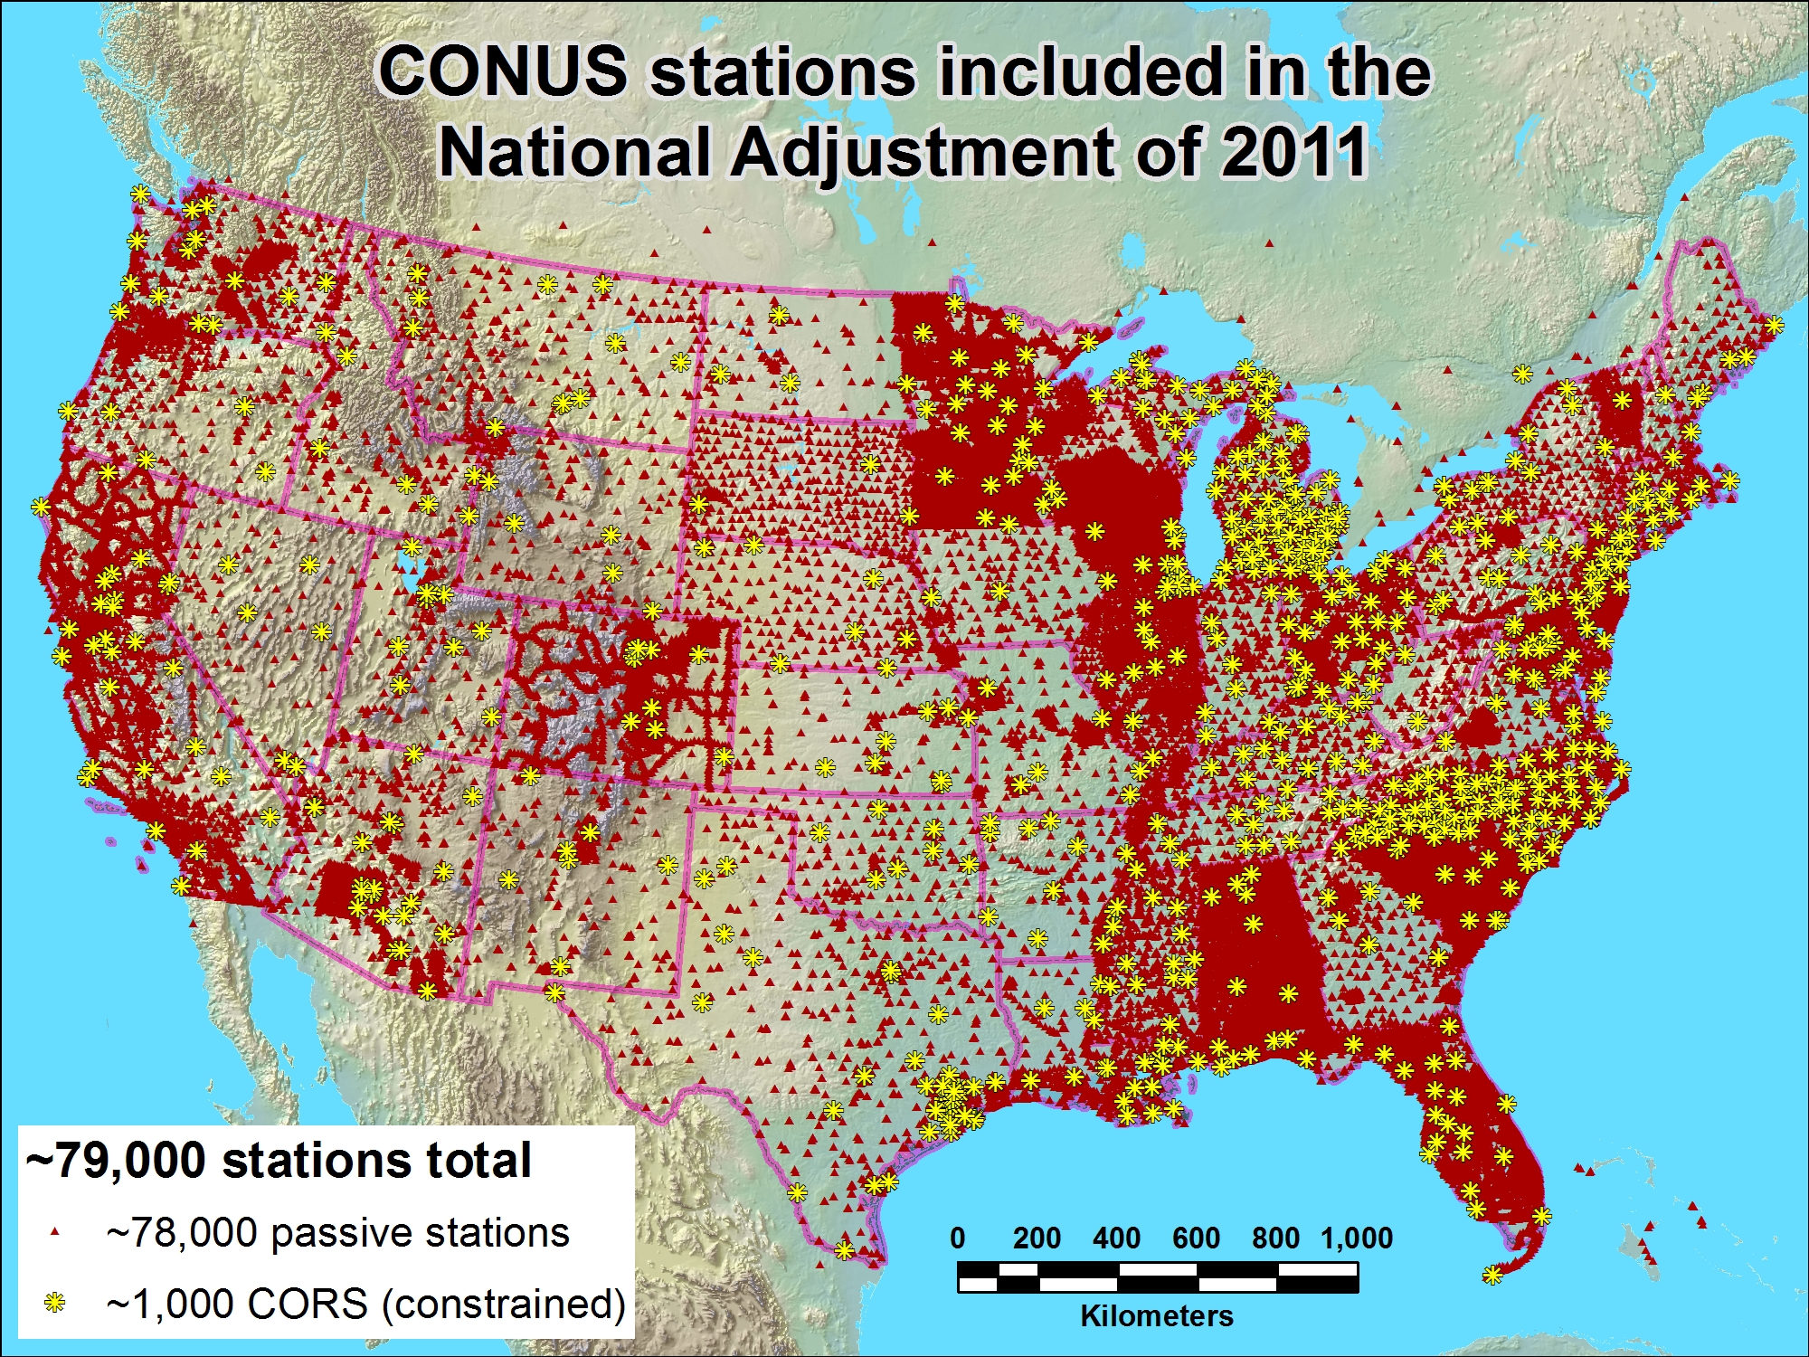
Notes:
Only about half the CORS (those with >2.5 yrs velocities) are ‘included’ ie, used as constraints. The other—newer– ones are included in adjustment but postitions determined by adjustment will not override those determined in MYCS. Many of the older observations (projects) have been excluded, as they were in the 2007 national adjustment.
Altho the newer CORS

Slide 28
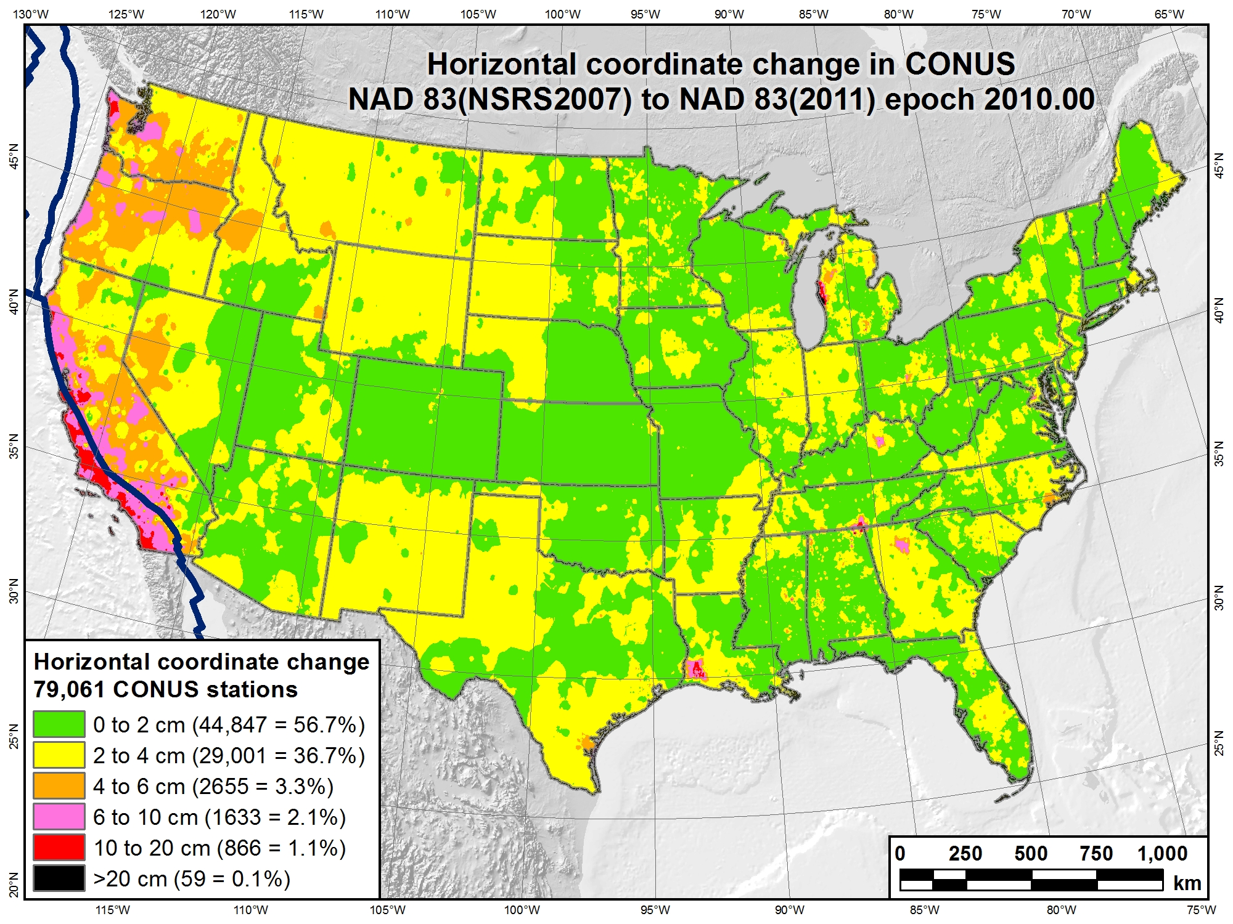
Epoch 2007.00
(only) 3 years

Slide 29
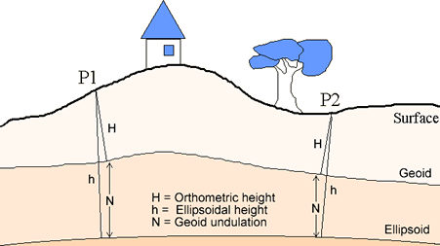


National Geodetic Survey Mission
To define, maintain and provide access to the National Spatial Reference System (NSRS)
to meet our Nation’s economic, social and environmental needs.
Latitude
Longitude
Height
Scale
Gravity
Orientation
Time Variations
GNSS reference frame

Slide 30
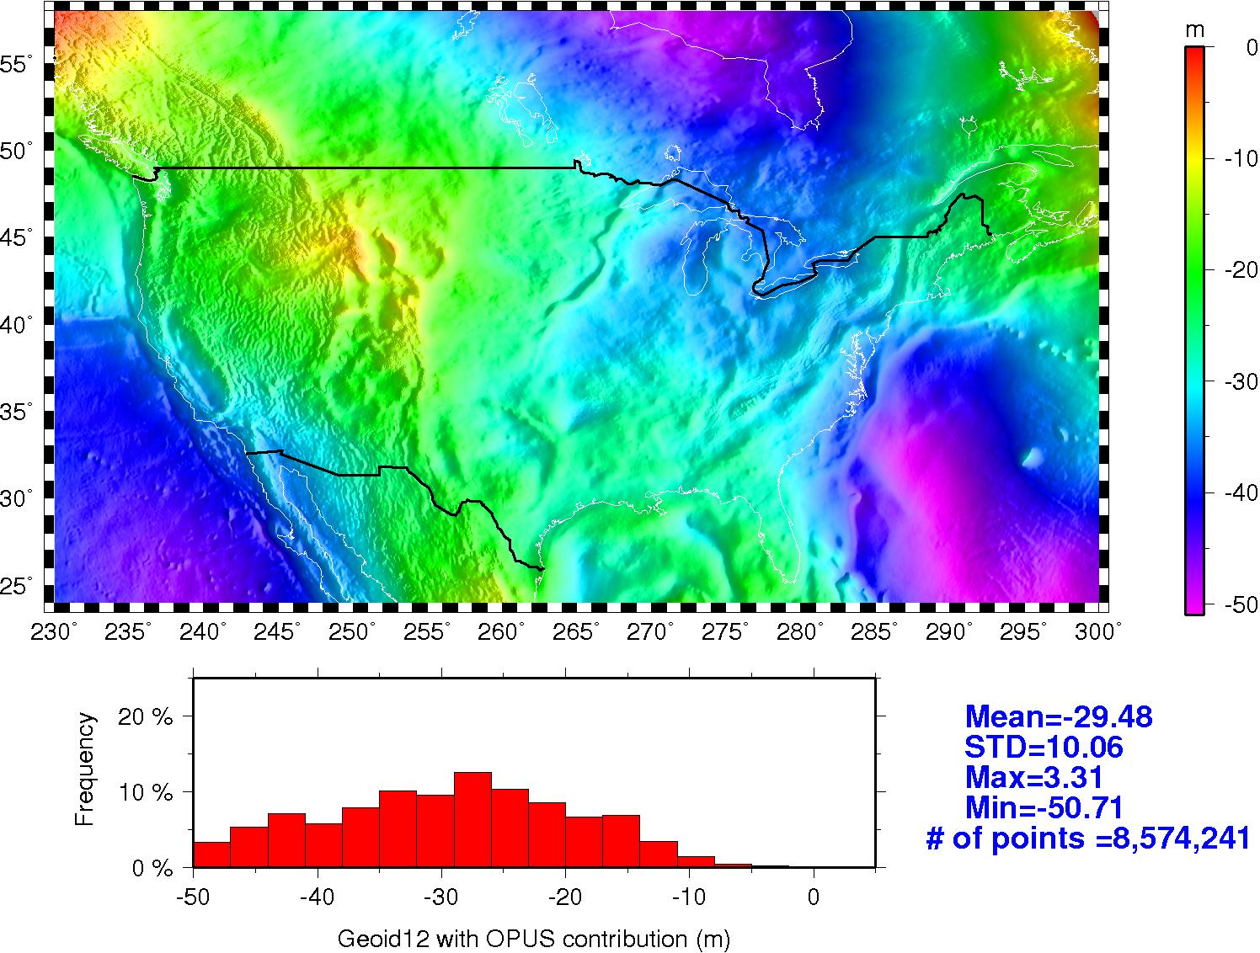
GEOID12 (with OPUS data) geoid heights

Slide 31
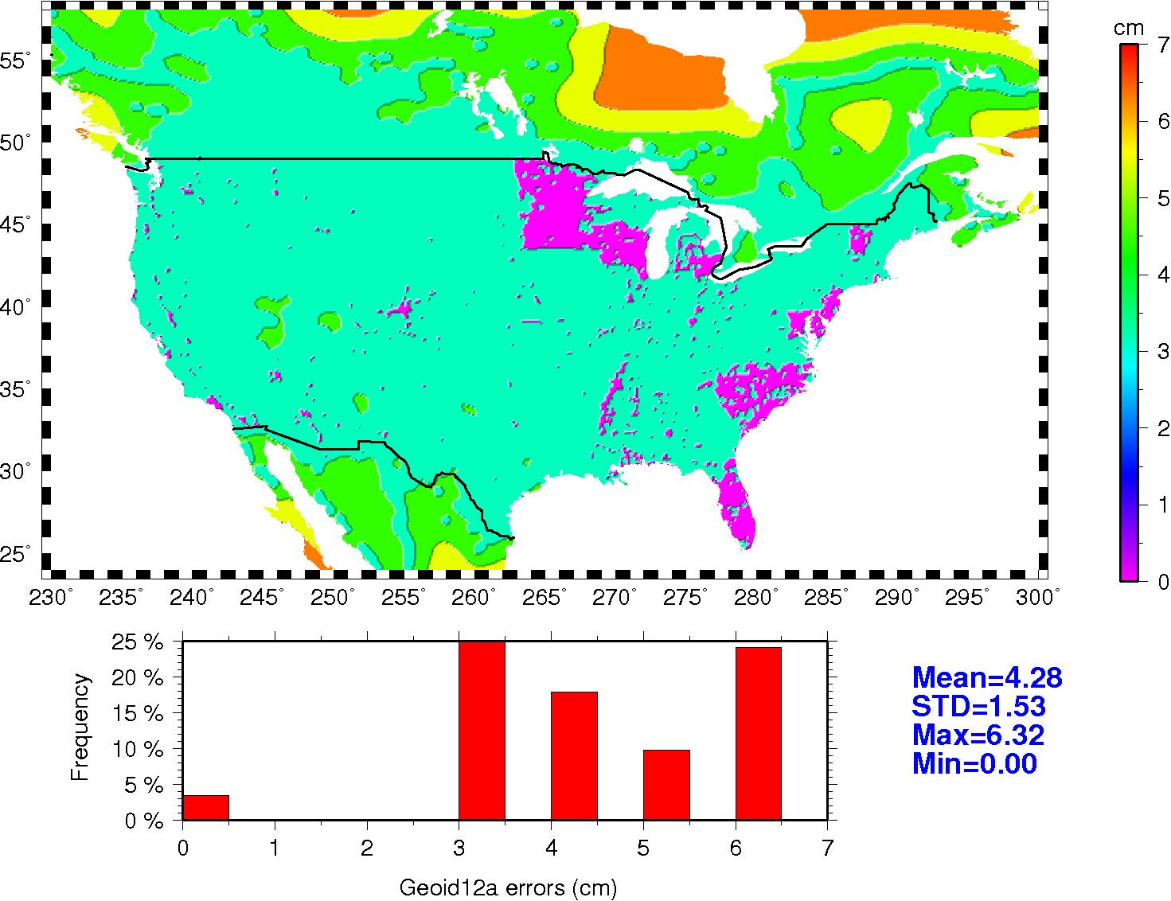
Coming Soon: Error Maps for GEOID12A
Rigorous LSC was used in GEOID12A
This ensured we had a var-cov matrix to estimate errors on a regular grid
This means errors can be provided with geoid heights

Slide 32
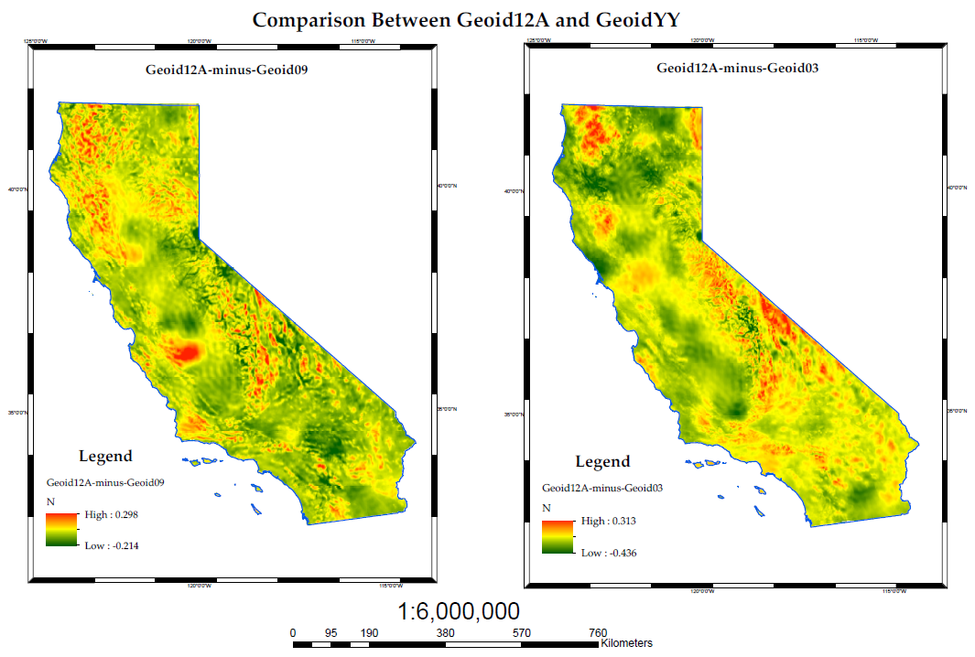
Courtesy of Kevin Kelly, ESRI

Slide 33
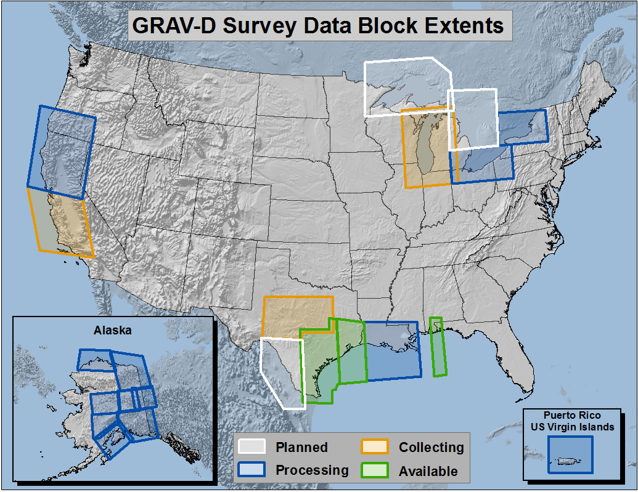
Gravity for the Redefinition of the American Vertical Datum (GRAV-D)

Slide 34
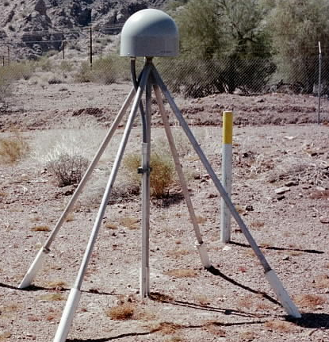
Evolution of Geodetic Datums: from NAD27/NGVD29 to NAD83/NAVD88
H + V
2 + 1
27, 29
H + V
2 + 1
83(86),88
GPS
H + V_{E} + V_{O}
2 + 1 + 1
83(92), 88
Geometric
+VELOCITIES (time)
H + H_{t} + V_{E} + V_{O}
2 + 2 + 1+ 1
83(2007)+HTDP, 88
H + H_{t} + V_{E} + V_{O}
2 + 2 + 1+ 1
83(2011)+HTDP, 88
H + H_{t} +V_{E}+ V_{Et}
2 + 2 + 1+ 1
ITRF00 (2002.00)
H + H_{t} +V_{E}+ V_{Et}
2 + 2 + 1+ 1
IGS08 (2010.00)
T O D A Y
Notes:
Conceptual: Generally, Orange represents ‘horizontal’ or NAD83 at present; yellow represents orthometric vertical.
1)moved fr non-geocentric to 2)geocentric as well as we knew at the time from early satellite technology (DOPPLER). And leveling efforts resulted in a national vertical datum with only one constraint, rather than 26 (tide gauges). 3)Static GPS exploded on the scene which 4) led to 5)the HARN networks and state-specific adjustment. With GPS surveying, we got V(E), vertical ellipsoid and V(O), vertical orthometric. 6)With the results of repeat static surveys and the advent of CGPS (Continuous CGPS), such as NGS’ National CORS, 7)the velocity of the earth’s crust relative to a reference frame, could be determined over time. 8)Using the crustal motion model HTDP for horizontal velocities on the West Coast, eg, the Pacific-North American Plates interface, NGS produced 9) a National Re-adjustment in the NAD83 (NSRS2007) datum. (No change to ortho.) However, 10)underlying the NAD83 adjustment are data and analysis referenced to ITRF00, epoch 2002.00, which does take into account both horizontal AND vertical ellipsoid velocities. (velocity=time related terms shown as italicized.) This is what we have now. 11) With better global gravity models and airborne gravity data collected by NGS, we will 12) move forward with 13) new datums BOTH referenced to an ECEF, earth-centered, earth-fixed datum which we are calling 14) Geometric, for the horizontal and ellipsoid height values, and Geopotential for the orthometric height values which will be based on a a geoid model and changes in gravity over time (G(t).

Slide 35
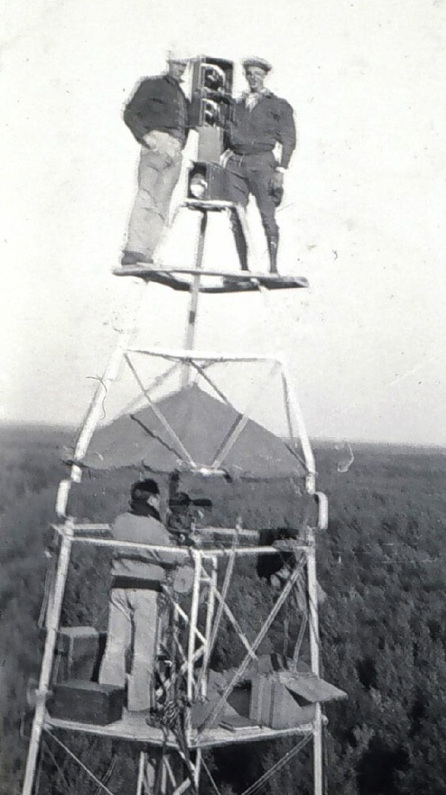
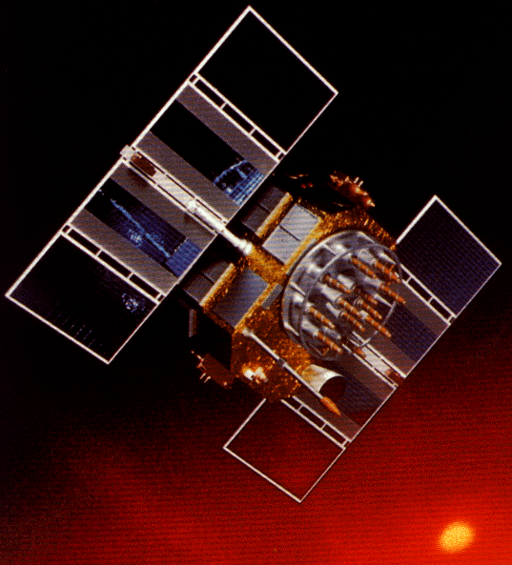
A Cryptic Evolution of NAD 83
Original realization completed in 1986
  Consisted (almost) entirely of classical (optical) observations (NADCON)
“High Precision Geodetic Network” (HPGN) and “High Accuracy Reference Network” (HARN) realizations (NADCON)
  Most done in 1990s, essentially state-by-state
  Based on GPS data but classical stations included in adjustments
  Did NOT use CORS as constraints
Partial HARN/FBN Obs, late 1990’s
  Used CORS as control, but not statewide adjustment; in CA, only ~200 stns
National Re-Adjustment of 2007
  ITRF00 and NAD 83(CORS96) basis for CORS constraints and (NSRS2007) for passive
  Simultaneous nationwide adjustment, first since 1986; no classical stations

Slide 36
Transforming among datum tags
Transform tools—beta--have become available:
NAD 83 (“HARN”)←→(NSRS2007) ←→(2011)
GEOCON and GEOCON11
However, many states have more than one statewide or large ‘’HARN”-type adjustment prior to 2007; the adjustment used was most recent prior to 2007.
Utilizes 80/86 records as input, and national grids
See “Operator’s Guide’ (not User) to get started
Linked from main page Notices, Jan 18:
http://www.ngs.noaa.gov/web/news/Beta_Release_of_GEOCON_and_GEOCON11.shtml
Feedback to ngs.geocon.development@noaa.gov

Slide 37
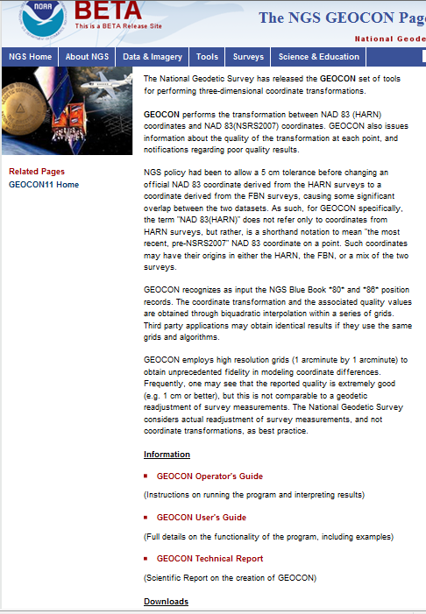

Slide 38
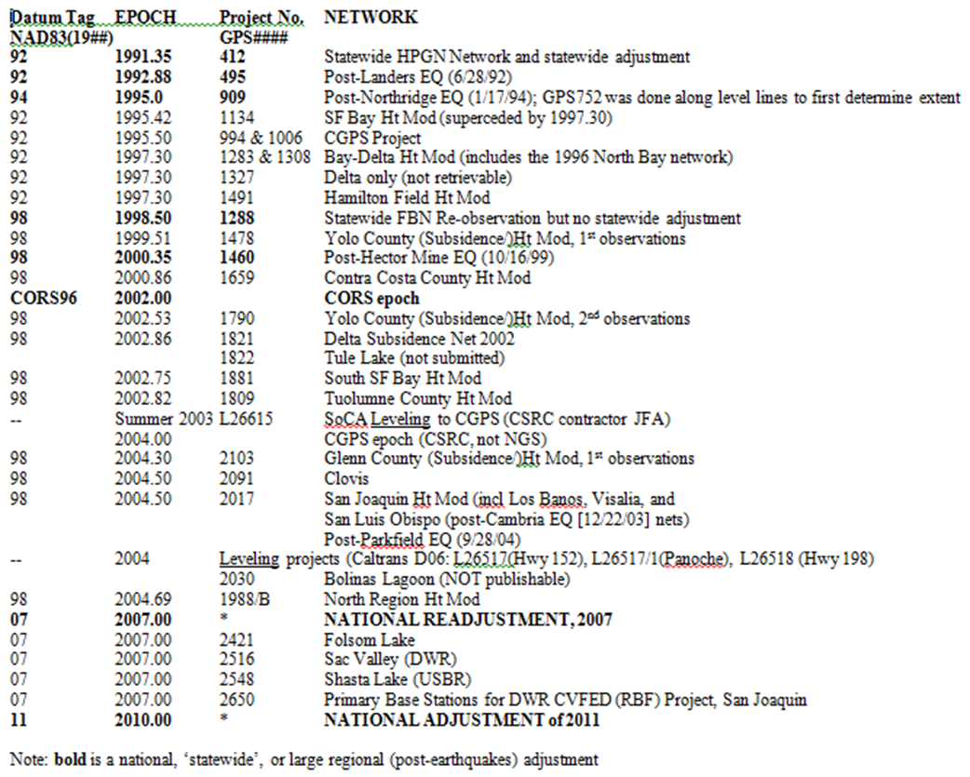
NAD83 (HARN) Datum Tags and Epochs in CA

Slide 39
BREAK

Slide 40
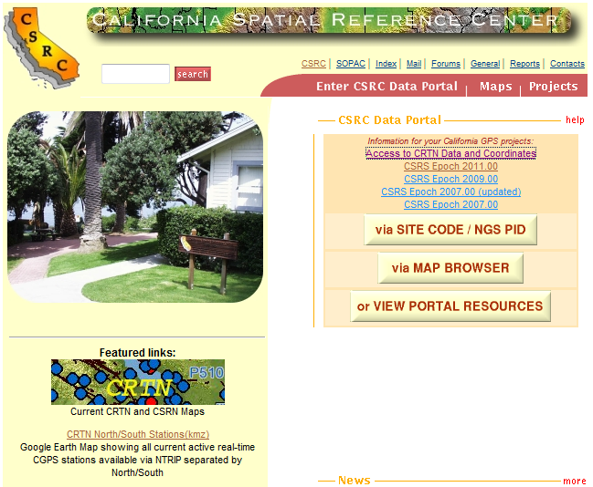
CSRC Reference Frames/Epochs for CGPS
ITRF05 (2007.00)
  NAD83 (2007) 2007.00 ** same as NGS
  NAD83 (2007) 2009.00
  El Mayor-Cucapah EQ 4/04/10
  NAD83 (2007) 2011.00

Slide 41
Rationale for new Datums
What? Terminology:
  Horizontal becomes GEOMETRIC
  Vertical becomes GEOPOTENTIAL (gravity)
When? 2022-- when GRAV-D program is complete
Why? But why?!
  Primarily needed a better vertical datum for “vertical” data(geoid, ortho ht) not obtained by traditional leveling
    Airborne gravity observations will be used to develop next geoid
  Geodetic Data collection relies upon navigation (GNSS) satellites orbiting around the mass center of the Earth
  NAD83 reference frame/datum is not geocentric
  NAD83 is not defined to include vertical velocities
  Earth is not stable in all directions; reference frame must account for this to be as geodetically accurate as possible

Slide 42
Z
A
“NAD83## disagreement with ITRF##”
Shift ≈ 2.2m +
ITRF
Earth Mass Center
GRS 80
Ellipsoid
NAD 83
Earth Mass Center
Y
X
TX = 0.9956 m
TY = –1.9013 m
TZ = –0.5215 m
RX = –25.915 mas
RY= –9.426 mas
RZ= –11.599 mas
DS = 0.62 X 10⁻⁹
ITRF00 to NAD83(CORS96)
Notes:
Translation, rotation, scale

Slide 43
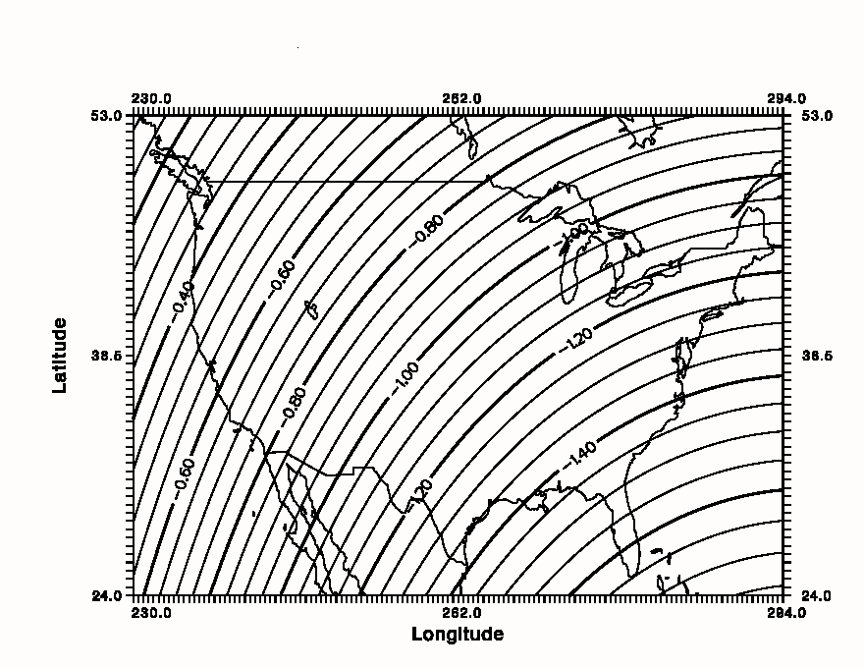
Simplified Concept of NAD 83 vs. ITRF
In California - NAD83 & ITRF
differences range from ~0.4 to ~0.9 m
h_{NAD83}
h_{ITRF}
Earth’s
Surface
ITRF 00
Origin
2.2 meters
Ellipsoid for both NAD83 and ITRF:
Geodetic Reference System 1980 (GRS80)
a = 6,378,137.000 meters (semi-major axis)
1/f = 298.25722210088 (flattening)
NAD 83
Origin
Notes:
ITRF (International Terrestrial Reference Frame) just has a different origin than NAD83; take NAD83 shaped ellipsoid centered at the ITRF origin to obtain ITRF97 ellipsoid heights. WGS84 (G1150) ~ ITRF2000; ITRFs have been updated, WGS84 has not, since
Ellipsoid heights NAD83 vs. ITRF97 - Defined origins are best estimate of the center of mass; NAD83 is not geocentric. Move origin; move ellipsoid surface as illustrated.
Ellipsoid height differences reflect the non-geocentricity of NAD83.

Slide 44
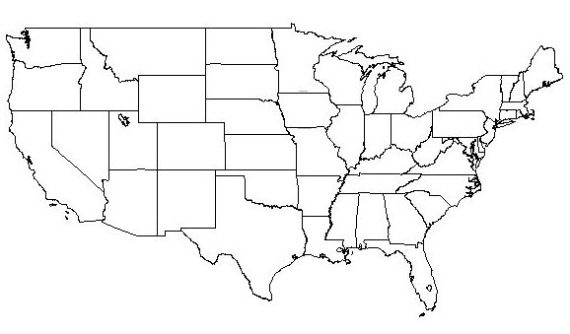
Changing the Datum
1927
“Picking the Grid”
Everything gets a
New coordinate!!
1927-1983: 100’s of meters
1983-2022: 1-2 meters
1983

Slide 45
Adjusting Coordinates within the Datum
1 cm
Modifying each point for its own ”issues”, eg, velocity:
Actual Motion
Error correction
New Information/Obs
On the order of centimeters
Done regularly: Next-- 2011
1983

Slide 46
How to Plan for the Future
Move to a contemporary realization of NAD 83
Obtain precise ellipsoid heights on NAVD 88 bench marks and publish to OPUS-DB
  Could improve hybrid geoid models and provide “hard points” to convert from old to new vertical datum
Adopt NAVD 88 for local vertical networks
  Understand the accuracy of VERTCON in your area
Move away from passive marks to active (CORS)
  Especially don’t use classical control for geodesy
Require/provide complete metadata for all mapping contracts
  How did you/they get the positions/heights?
  Always specify datum tag and epoch date, always

Slide 47
How Does OPUS-S Work?
The primary steps of OPUS-S processing are:
Prepare and quality control the submitted data.
Estimate a crude point-position using TEQC.
Compute distances to every available CORS.
Select the three “best” CORS based upon:
    Being closest to the user’s site.
    Having common satellite visibility with the user data.
    Having more than 80% of the possible data available.
    Having low multipath measures.
  Complete the single-baseline processing using PAGES.
  Check the solution quality and replace a CORS if needed.
  Generate and email the report to the user.

Slide 48
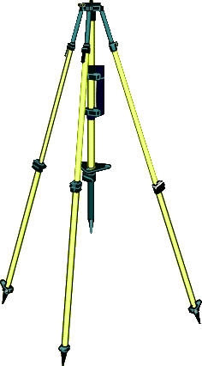
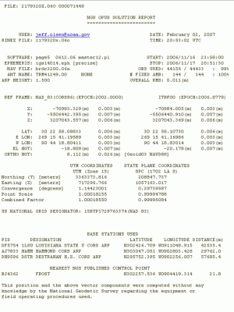
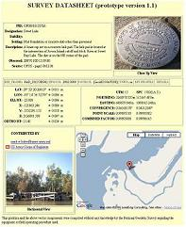

your
GPS data
IGS & NGS base stations
& site information files
IGS antenna calibrations
& satellite orbits
& reference frames
UNAVCO teqc converter
PAGES baseline processor
var. geophysical models
NGS geodetic toolkit
geodetic standard data
Online Positioning User Service
OPUS
geodesy.noaa.gov/OPUS/
free, fast, easy, consistent coordinates
JGE 2011v1
your
solution
options:
projects & publishing
mark description

Slide 49
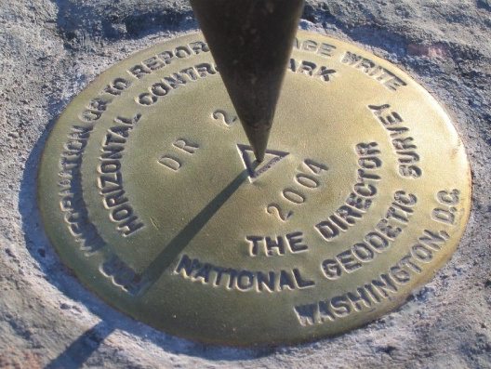
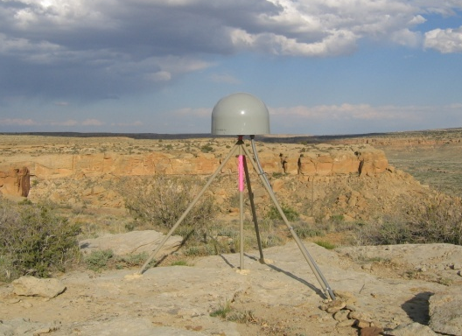
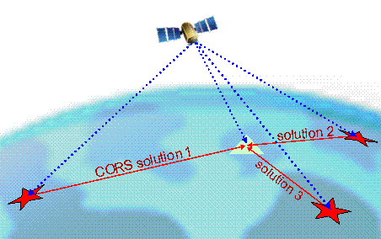
Online Positioning User Service (OPUS)
>15 min of L1/L2 GPS data >>> geodesy.noaa.gov/OPUS/
Processed automatically on NGS computers, tied to CORS
Solution via email - in minutes
Fast, easy, consistent access to NSRS

Slide 50
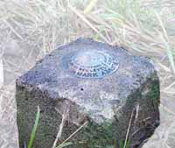
solution 2
=
h
your position:
averaged from the “best” 3 of 5 CORS solutions
φ
CORS solution #1
λ
=
=
solution 3
your peak-to-peaks:
scaled from the spread of the 3 CORS solutions
solution 5
=
=
solution 4

Slide 51
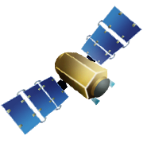


Rapid-static: OPUS first creates an atmospheric delay model from surrounding CORS data: <10 within 250km
Your position is then determined by differential GPS static solutions from up to 9 CORS.

Slide 52
OPUS static vs. rapid static
 | static | rapid static
input (dual-frequency GPS) | 2-48 hours | 15 minutes-2 hours
output | normal, extended, XML datasheet, project | normal, extended, XML
accuracy (95%confidence) | 1-2 cm horizontal 2-6 cm ellipsoidal height | 1-2 cm horizontal 4-8 cm ellipsoidal height
network geometry | 3 CORS, preferably within 1000 km of rover | 3-9 CORS, surrounding & within 250 km of rover
availability | global | 90% of CONUS (subject to CORS configuration)

Slide 53
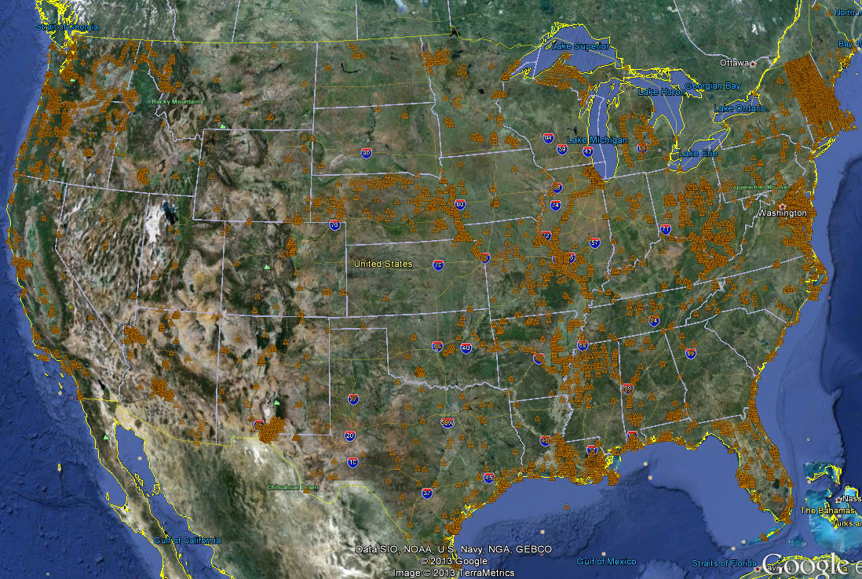
OPUS-DB Solutions, as of 2/20/13

Slide 54
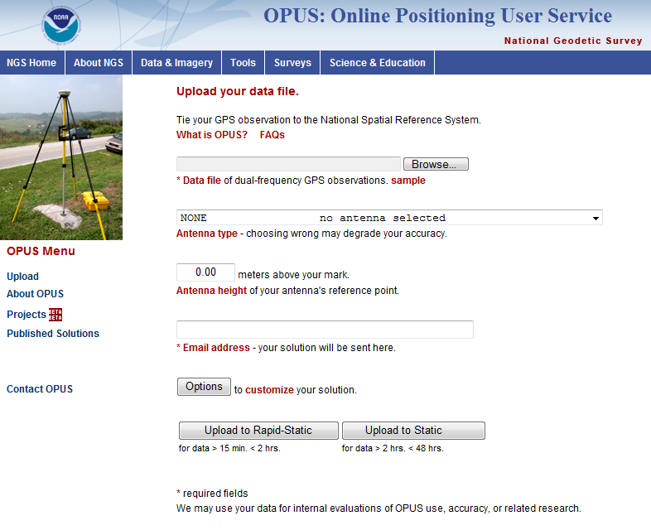
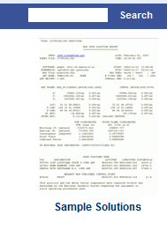

Slide 55
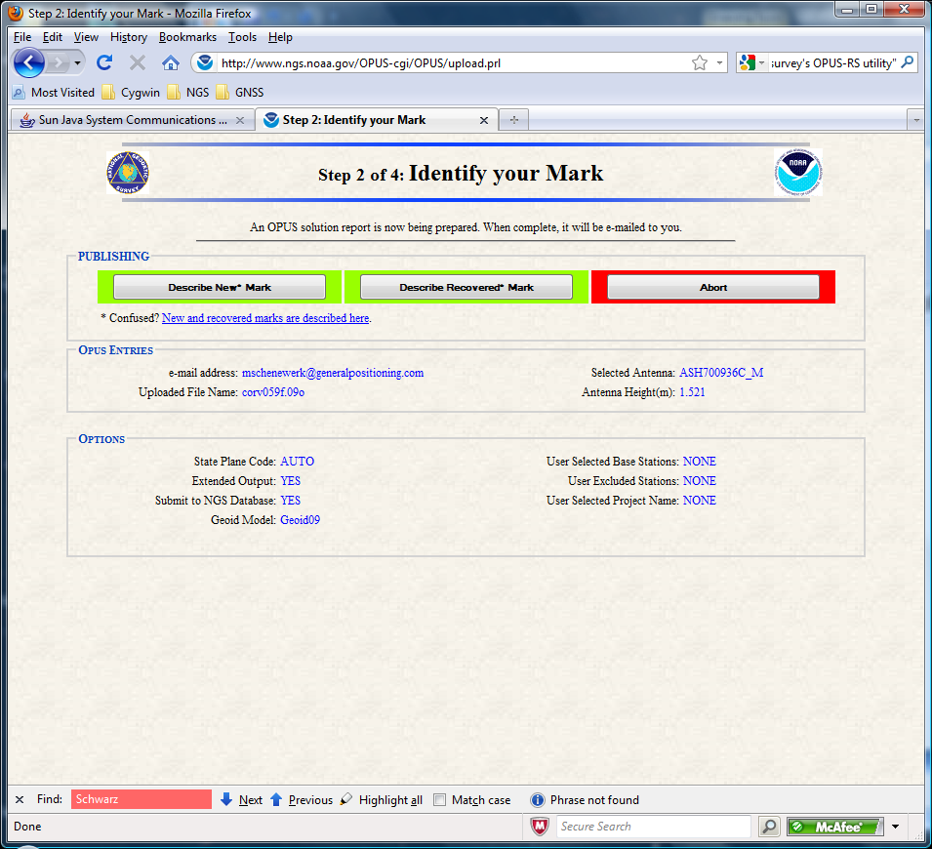
OPUS-DB Interface
The user is taken to a new page where they designate the mark associated with their data as “new” or “recovered”—new to NGS database(s), check both

Slide 56
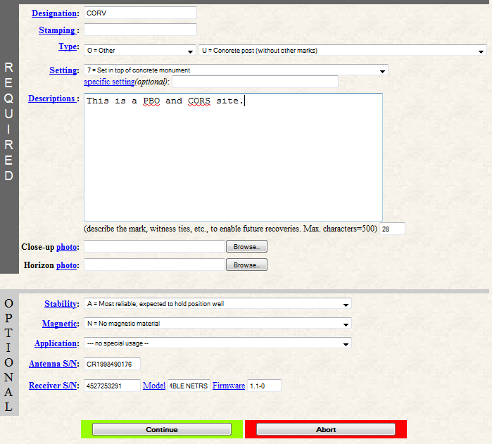
OPUS-DB Interface
After making that selection, the user is offered the appropriate form for entering the metadata.
In this example, we’re following the “new” mark designation.
56

Slide 57
What Is OPUS-Projects?
Your OPUS Project
Publish
To OPUS
OPUS Solution
Data &
Metadata
Session
Solution
OPUS Solution
Processor or Manager
Session
Solution
Manager
Network
Solution
Session
Solution
Session
Solution
OPUS Solution
Copy
To User
Copy
To User
Copy
To User

Slide 58
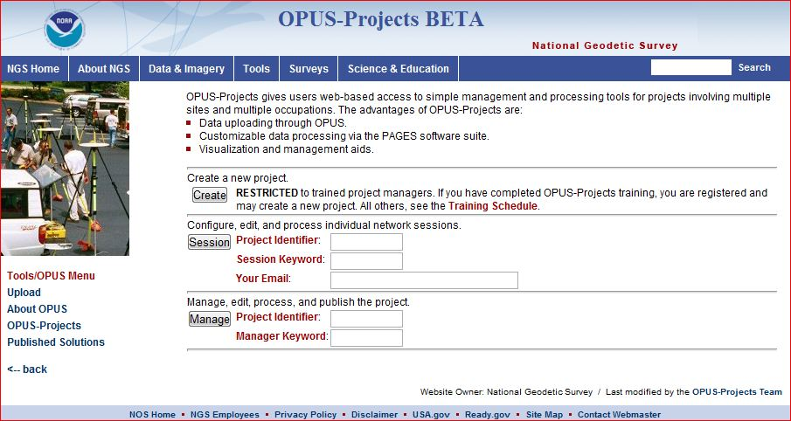

Slide 59
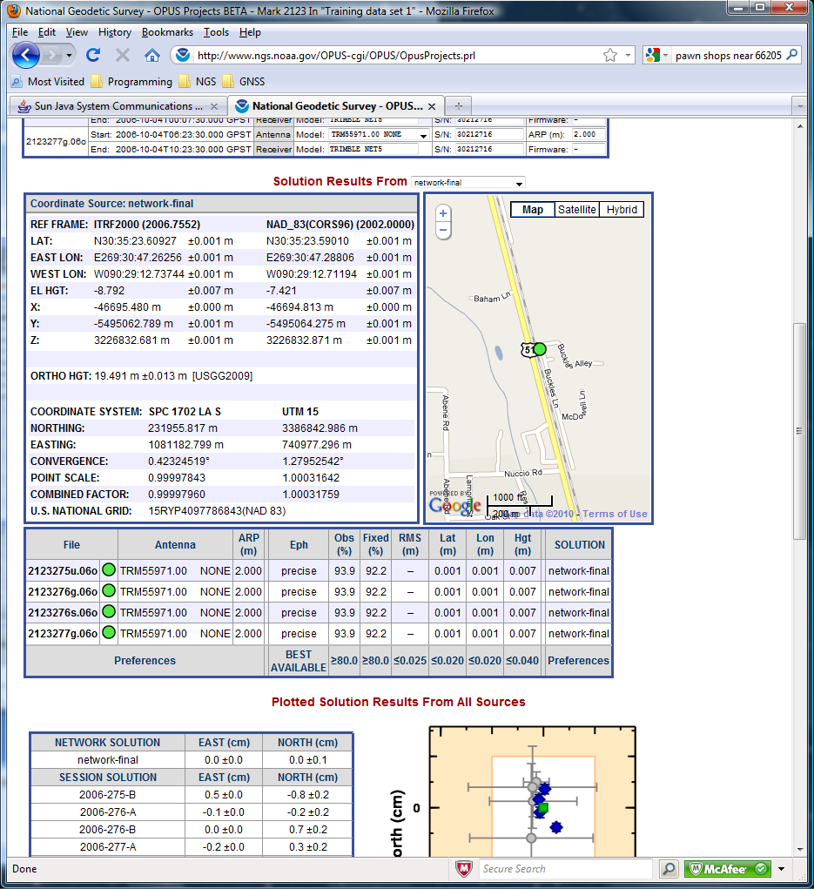
Below the summary by occupation are the coordinate and status summary tables.

Slide 60
RTN Validation by NGS
Desire to have all RTNs—public, commercial—tied to/based on the NSRS
Developing a procedure for RTNs to follow
Results submitted/reviewed
Periodic (annual?) check
ORGN RTN (OR DOT) is pilot study
RTN Symposium, May 28-29, Memphis, TN
http://www.ngs.noaa.gov/web/science_edu/rtn_symposium/index.shtml

Slide 61
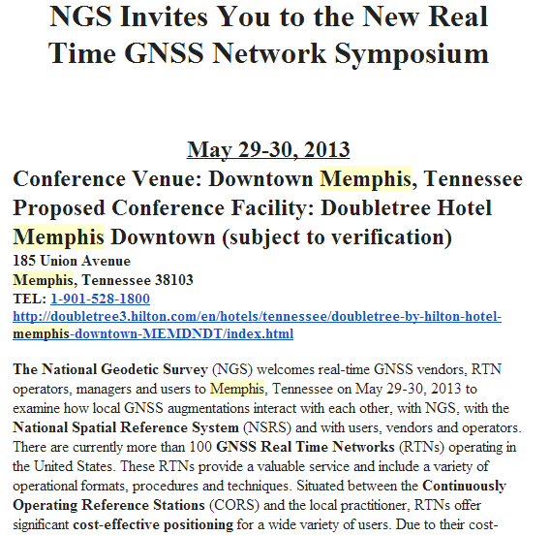
Re-scheduled from last July, RTN Symposium

Slide 62



ON-LINE VALIDATION TOOL COULD INDICATE NSRS COMPLIANCE

Slide 63

NGS’ Real-Time Kinematic Information
Surveys or S & E tab, PUBLICATIONS

Slide 64



≥107 RTN USA
≥35 DOT
MAJOR RTN IN THE USA
(MAR 2011)
ACADEMIC/SCIENTIFIC
SPATIAL REFERENCE CENTERS
VARIOUS DOTS + MACHINE GUIDANCE
COUNTY
CITY
GEODETICSURVEYS(NC,SC)
MANUFACTURERS
VENDOR NETWORKS
AGRICULTURE
MA & PA NETWORKS

Slide 65



Slide 66
Comments about DS Fields
Orders of accuracy have been superceded by linear, eg, cm; use and state the network accuracy. PRC says <2cm horizontal is CSRN (for SPC); 5cm ellipsoid height
No relation to superceded accuracies; dependent on quality of THAT survey
Observations NOT done at same time (year) of adjustment; look at superceded epoch and history

Slide 67

12 cm

Slide 68


Slide 69


Slide 70
RESOURCES
Non-NGS:
CSRC, PBO, BARD, SCIGN, NASA-JPL, IGS

Slide 71
Basis of Bearings, using CGPS
Found on CSRC website; csrc.ucsd.edu
The Basis of Bearings for this Survey is the California Coordinate System, Zone NAD 83 (Epoch ) as determined locally by a line between Continuous Global Positioning System (CGPS) Stations and/or Continuous Operating Reference Stations (CORS) Sta. Name and Sta. Name being Bearing as derived from geodetic values published by the California Spatial Reference Center (CSRC) and/or National Geodetic Survey (NGS), respectively.
Be specific about ‘derivation’ and what source

Slide 72
CSRC’s CRTN news
CSRC’s CRTN RTCM data streams available thru NTRIP protocol as of 1/5/12
To utilize: click on Access to Data spreadsheet; email ybock@ucsd.edu
To get CRTN updates, join the list serve:
http://gpsmail.ucsd.edu/mailman/listinfo/crtn-l
To be informed, read the forums:
http://sopac.ucsd.edu/ubbcgi/ultimatebb.cgi?category=6

Slide 73


Slide 74


Slide 75


Slide 76

Height Modernization Program monthly meetings, presentations

Slide 77



Slide 78


NGS Training Center

Slide 79


Slide 80

NGS 10-year Plan:
2013-2023
Support users of NSRS
Modernize and improve NSRS
Expand NSRS Stakeholder Base
Develop NGS Workforce
Marti.ikehara@noaa.gov
(916) 227-7325

Slide 81
The Changing Face of the Geodetic Advisor Program
Aging…Retiring; median age 50’s
Fewer cooperative partners (states)
can justify the financial agreement
Recommendation from some many years ago was for Fedgov to fully fund Advisor program
Advisors to be located at NOAA or Fed office
Fully implemented by FY16

Slide 82


