Slide 1
Orbit Determination:
Why? What? and How?
September 8, 2022
Josh Jones, PhD
NOAA/NOS/NGS
Notes:
Hi everyone I am happy to be here and able to present this webinar on behalf of NGS and the CORS team about Orbit Determination. As you heard in the intro my name is Josh Jones. I am a recent addition to the NGS team after spending quite some time in Blacksburg, Virginia. Go Virginia Tech. We have some exciting things to cover today as I’ll be talking about how NGS conducts orbit determination specifically touching on the Why? the What, and the How?.

Slide 2
Outline
Background
Precise Orbit determination at NGS
  Why is it done?
  What is it?
  How is it done?
Notes:
First, before we get started a quick outline so we all know where we are going.
I’ll start with some cool background on NGS and orbits; as well as a short explanation of how the Global Positioning System or (GPS) works.
Then I’ll move on to the reason we are all here and give an overview of how NGS determines GPS satellite orbits, again, trying to focus on the why, what, and how.
After that there will be a few wrap up slides and then you’re home free.
So lets gets started.

Slide 3
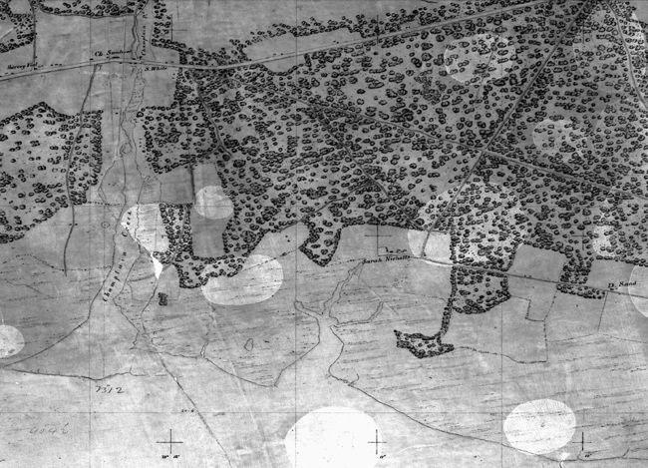
Geodesy
Geodesy is the science of accurately measuring and understanding the geometric shape, orientation, and mass of the Earth as well as the changes to those properties over time.
The National Geodetic Survey (NGS) was developed to meet U.S. surveying and navigation needs
https://geodesy.noaa.gov/INFO/history/topographic-maps.shtml
Notes:
I thought it would be good to start our background with the definition of Geodesy. After all this is an NGS webinar discussing an important aspect in the tool that is GPS.
Geodesy is the science of accurately measuring and understanding the geometric shape, orientation, and mass of the Earth as well as the changes to those properties over time.
the National Geodetic Survey or (NGS) was developed with the primary mission of surveying the U.S. coastline, and from its inception NGS and NGS employees have been uniquely involved in advancing our knowledge of geodesy.
Of course with its primary mission starting as surveying the coastline it was originally developed to primarily meet U.S. Surveying and navigation needs, but over time our mission has expanded to define, maintain, and provide access to the National Spatial Reference System. On the right you see what was the first NGS created topographic map created through field surveys.
The tools to complete this mission have changed over the life of the agency and they changed even more drastically once satellites were introduced.

Slide 4
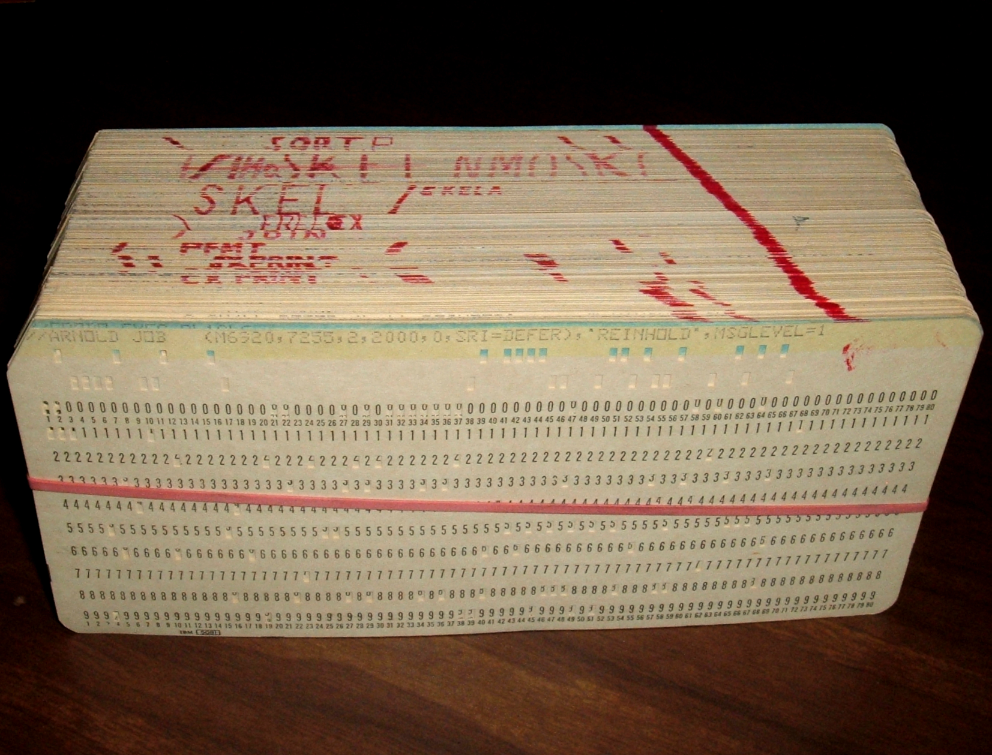
Early Orbit Determination
Using man-made satellites for Geodesy was a new idea around 1960.
However, scientists have been determining orbits for a lot longer.
Notes:
With the advent of the satellite age only around 1960’s, using man-made satellites for Geodesy is a relative new idea.
and to brag again some NGS scientists that got involved became pioneers when it came to developing and improving modern geodesy methods. The organization started to implement space based geodetic measurements as early as 1987 with the creation of simple networks.
Now even though using satellites for geodesy are relatively new the human experience, orbit determination is not.
In astronomy and other space observing disciplines, orbit determination had been used for quite some time for tracking and predicting planetary bodies.
On the right are examples of punch cards that were used to calculate and predict planetary position before the first satellite was launched, of course using computers the size of rooms.
The position data had to be filled out and hand-punched by hand.
But even way before these punch cards were invented, orbits were being determined.

Slide 5

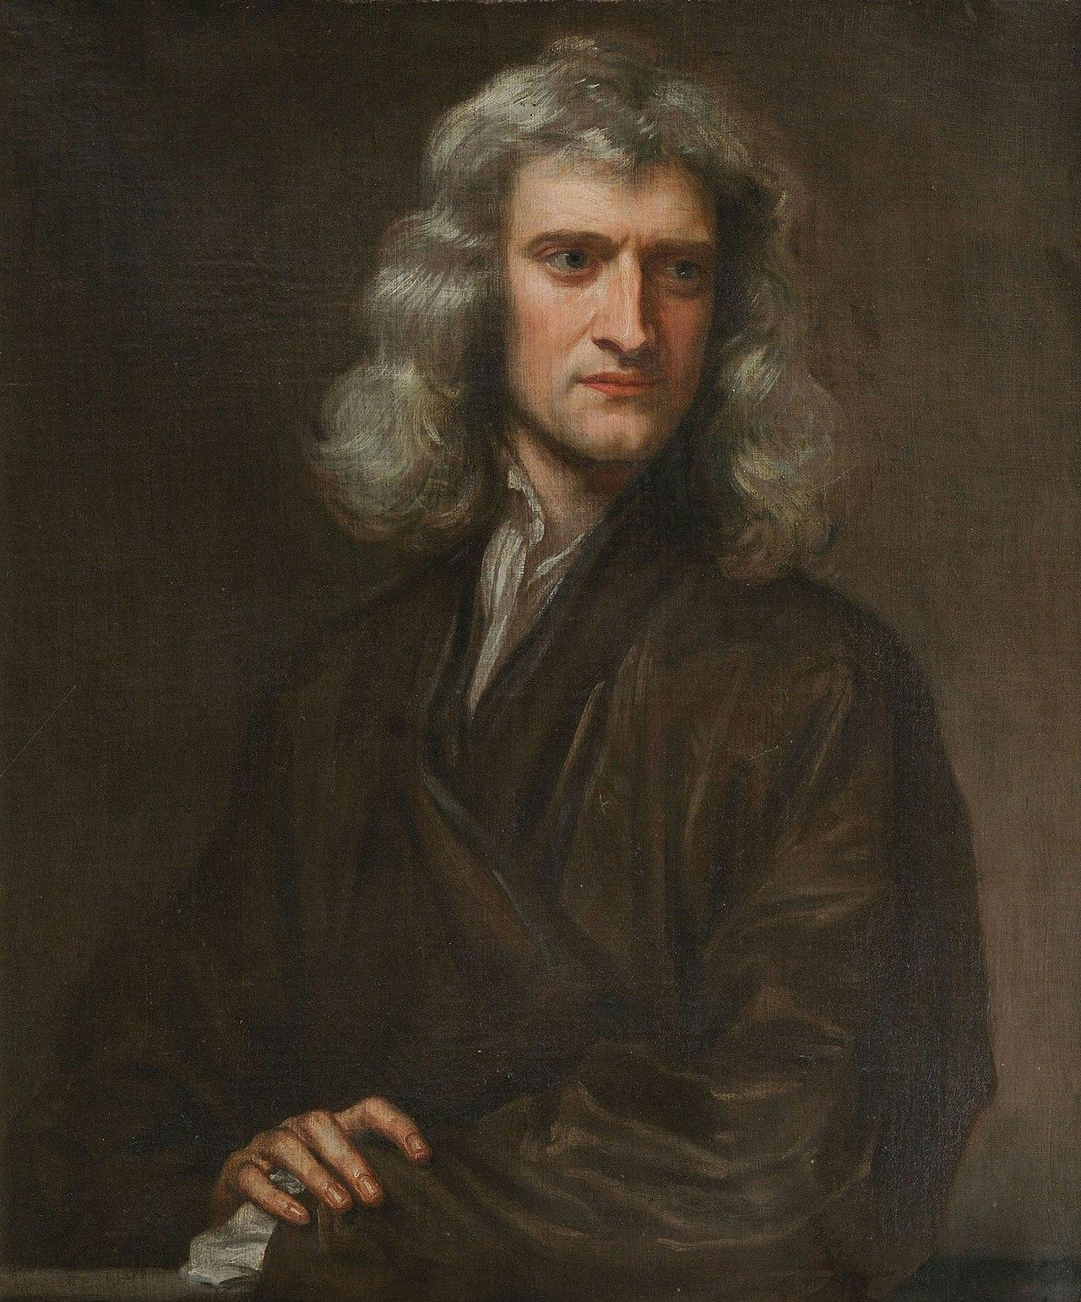
Orbit Determination is not new
Johannes Kepler (1571 - 1630)
Isaac Newton (1643 - 1727)
Notes:
We can actually go back to some familiar names in the astronomy and physics world to see where the classical understanding of orbit determination began.
Johannes Kepler in the 1600’s was able to theorize the laws of planetary motion laying the groundwork for Isaac newton to shortly incorporate his laws of motion and gravity.
The work these two completed would be the foundation of being able to predict orbits.
Even though this worked focused on planetary bodies, it worked for any mass orbiting a source so it provided a template for scientists to apply the concept of orbit determination to satellites.

Slide 6
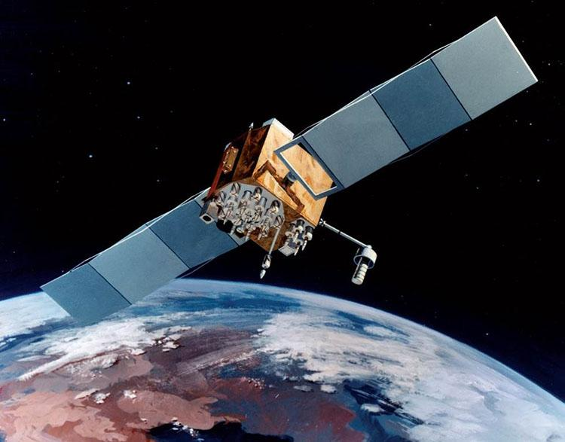
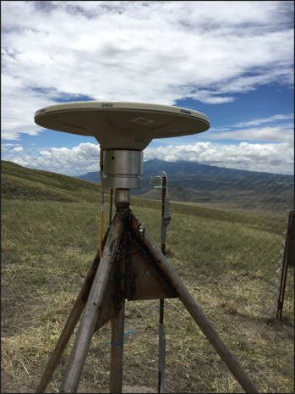

Global Positioning System (GPS)
satellite (space)
control
https://www.e-education.psu.edu/geog862/node/1773
station (User)
Notes:
But satellites are only one part of the Global Positioning System or (GPS) GPS actually consists of three separate segments. All need each other in order to properly work.
The segments are the satellites or the space segment. (on the left) we have an example of that represented by an artist rendering of a Block IIF satellite.
And a quick aside: Many of the satellite photos that I’ll be showing today are artist renditions are you can find them at the link here. The information on the page explains more about the different types of satellites which I thought was pretty cool.
Back to the GPS segments, in the center we have the station or the User segment, represented by what a modern day GPS station could look like.
This photo was taken during some of my own field work to Africa setting up these sites to collect data. Typically they consist of an antenna, that is that pancake looking object, which is connected to a receiver that stores the data.
on the right we have a representation of the control segment with a computer.
The control segment of GPS are the people with keys to the satellite.
They are in charge of maneuvering the satellite for any necessary reason as well as monitor satellite health and function.

Slide 7
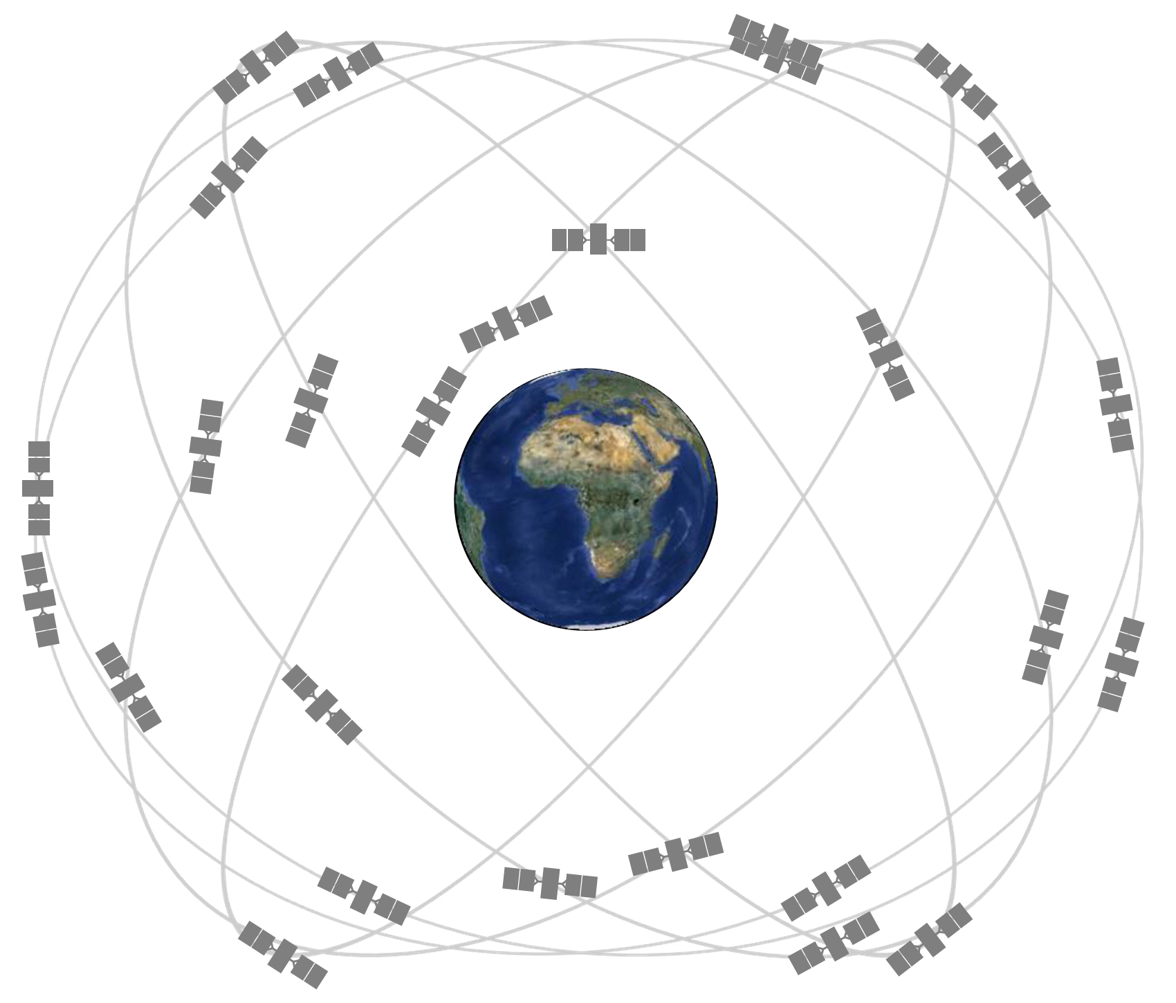
Global Positioning System (GPS)
the satellite system provide access to a global reference frame for geodetic positioning
up to 32 satellites
12-hour orbits
~20,200 km above the Earth
https://www.nasa.gov/directorates/heo/scan/communications/policy/GPS.html
Notes:
The satellite or the space segment portion of the system provides access to a global reference frame for geodetic positioning.
Not only do they provide global coverage with the design, but (thinking of orbits) we can also use the same laws of physics used for predict planetary orbits to predict where the satellites are so we were not starting from scratch.
The system consist of up to 32 active satellites. each taking 12 hours to complete an orbit at approximately 20,200 km above the Earth.
The design is also special as it has been set up so that at any time and any 1 place on Earth the goal is to have six satellites observable from that place.

Slide 8
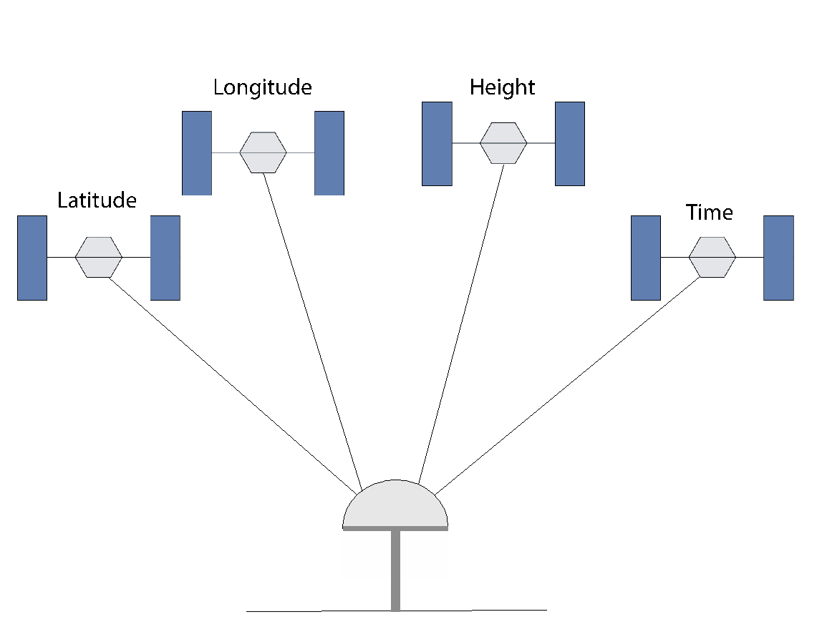
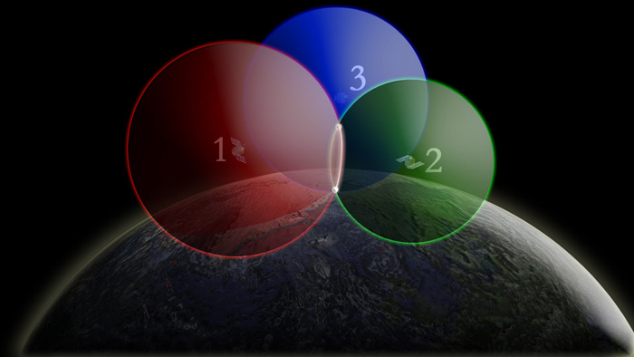
Global Positioning System (GPS)
The satellite sends its location data and with it the receiver knows how far away it is
http://oceanservice.noaa.gov/education/kits/geodesy/media/supp_geo09b3.html
Notes:
Now how this system works is relatively straightforward. The satellite is able to transmit signals containing location data to the site receiver and the site receiver is able to use that signal to tell how for away the satellite is. Then in order to fix a site’s proper location we need a certain amount of satellites to send its location data to a single station.
On the left you can see why we need at a minimum to get information from 3 satellites. Each satellite can only provide 1 distance at a time and we need to fix the station’s latitude, longitude, and height on earth. That fix however is not as accurate as it could be and in the field of geodesy and world of GPS precision and accuracy is king.
In order to get a better fix an additional satellite is used to constrain the station in time as well.

Slide 9

NGS Orbits (Why?)
Main purpose: collects, archives, and distributes GPS observation data
Notes:
So with satellites being a crucial part of using GPS for geodesy, it becomes important that we know where the satellites are, throughout their daily orbits.
Which bring us to answer the question why does NGS spend time determining orbits? and as with any good answer it begins with a story.
Over time with the increase of the use of GPS there was also in increase in data, applications, products etcetera.
It became necessary for a global collaboration that could promote international standards and to operate a common system for GPS data acquisition. To try to fill this gap the International GNSS Service or (IGS) was recognized in 1993 with the main purpose of collecting, archiving, and distributing GPS observation data and related products to support research.

Slide 10
NGS Orbits (Why?)
Types of Orbit solutions that IGS collects and shares:
IGS Orbit Solution | Accuracy | Availability
Broadcast | ~100 cm | real time
Ultra - Rapid (Predicted) | ~ 5 cm | near- real time
Ultra - Rapid (observed) | ~ 3 cm | 3 - 9 hours
Rapid | ~ 2.5 cm | 17 - 41 hours
Final | ~ 2.5 cm | 12 - 18 days
Notes:
This also included the various types of satellite orbit solutions. The first type is the Broadcast solution. it consists of raw navigation information provided directly from the satellite.
Because it is coming directly from the satellite it is available in real time, but at an accuracy of 100 cm, it is not very useful for geodetic purposes.
So reason 1 NGS produces orbits is we need to increase the accuracy of these solutions to use them for geodesy. This requires post processing the information and adding what we know about satellite orbits.
This brings us to our post processed orbit solutions starting with our Ultra-Rapid (both predicted and observed) and ending at Final solutions. Each solution undergoing additional processing and increasing accuracy. You can see however that there is a tradeoff between accuracy and processing time.
This means solutions are made available when the processing is finished. Some are able to be completed multiple times a day, others once a day or even a few times a month.
Reason 2 that NGS produces orbit solutions is that NGS and similar institutions called Analysis Centers or AC’s have accepted the responsibility of providing these post processed precise orbital data to the general public through collaboration with the IGS.
And of course these products should be at the accuracy that is necessary to use GPS for geodetic purposes.

Slide 11
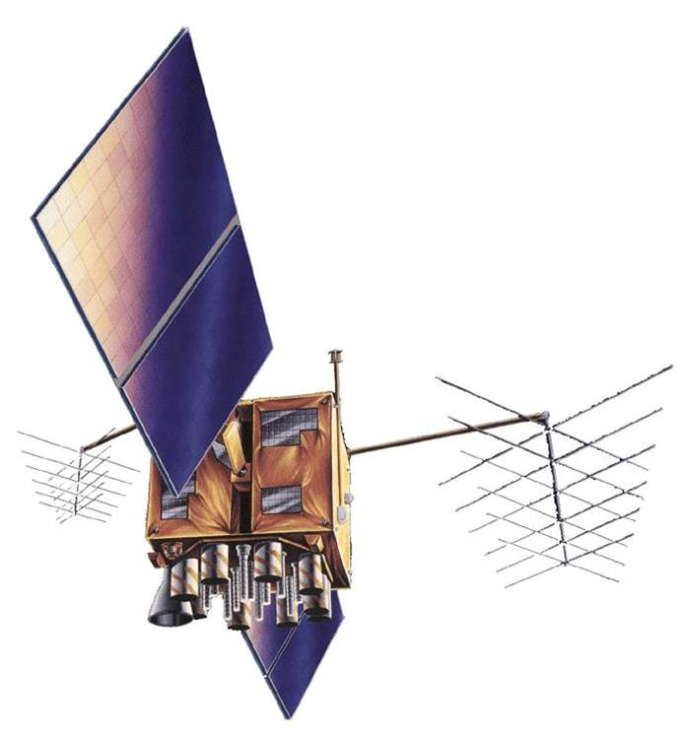
NGS Orbits (What?)
Ephemerides: set of data that provides the assigned places of a celestial body for regular intervals (including artificial satellites)
shared in specifically formatted data files
https://www.e-education.psu.edu/geog862/node/1773
Notes:
Now we have talked a little about IGS and sharing orbit solutions but What exactly is NGS sharing with the IGS?
Are our orbit solutions just Images of space with a red “satellite is here” sticker. You know, like the ones you see when youre lost in the mall? Of course not
Simply put, orbit solutions are the production and sharing of satellite ephemerides. What are Ephemerides? Well we have been talking about for a while now.
Ephemerides are a set of positional data that provides the assigned places of a celestial body for regular intervals, which now includes manmade artificial satellites
In a nutshell, they are orbit position files that are specifically formatted (typically in tables) so that anyone looking at the values knows exactly what they are looking at.
NGS currently produces all the necessary files for Rapid and Final orbit position solutions and files shared estimate the position of satellites at 15 minute intervals.
So how do we do it?

Slide 12
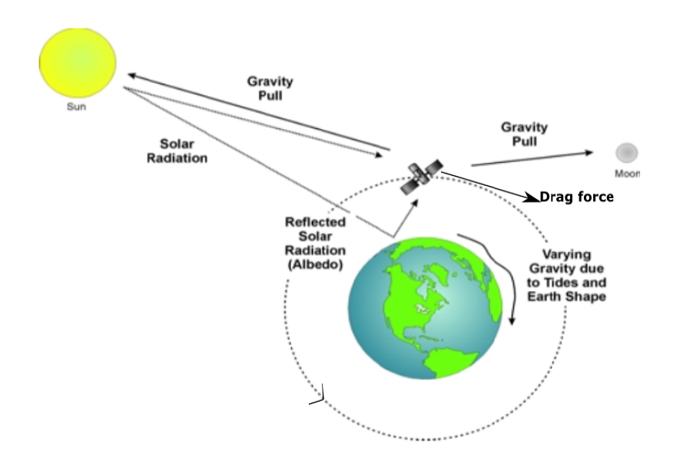
NGS Orbits (How?)
Goal: Need good modeling of orbits
Start with position data from the middle of the previous day
Orbit path is predicted through a mathematical combination of force models
Kumari and Deohans ( 2019)
Notes:
One of the initial steps in determining orbits is starting with a good base model of satellite orbits. The ideal model for a day’s orbit starts with position data from the middle of the previous day. Then we incorporate all we know about objects orbiting in space into a mathematical model that represents the satellite’s path.
This predicted path model is a combination of all the forces acting on a satellite over time.
On the left you can see a figure of just some of the forces that we take into account. including gravity, drag, and solar radiation pressure.
If we knew all of the forces acting on the satellites we would be able to have excellent predictions of the satellites future locations with high accuracy. But unfortunately a lot of models that we currently use are incomplete and the accuracy of our orbit models decrease over time. That and because all of the forces are not perfectly known to us; we need to recompute orbits daily.

Slide 13
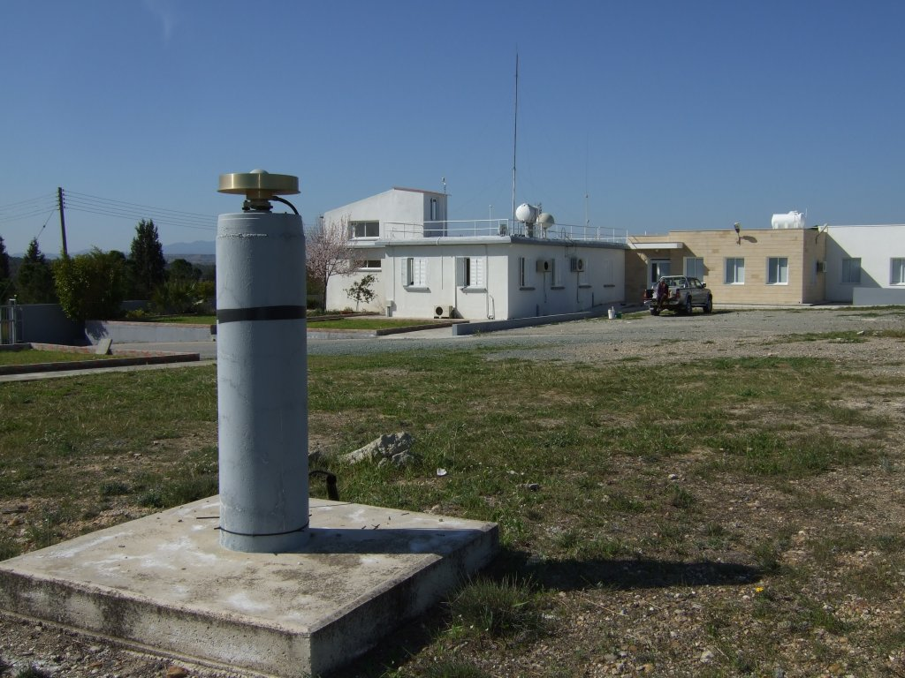
NGS Orbits (How?)
Collect observations through processing of sites
Station observations are mitigated for:
atmospheric interference (troposphere and ionosphere)
tides
https://www.igs.org/imaps/station.php?id=NICO00CYP
Notes:
Now that we have a base satellite orbit model we need to improve it through data observations.
This is done by a specific method of processing GPS stations
For the GPS data, NGS uses observations collected at 30 second intervals
During the processing station positions are accurately determined by mitigating for errors that can distort the measurement.
For example errors caused by atmospheric interference, resulting in refraction that distorts the signal can be estimated and corrected.
Since these are estimations and again (models are never perfect), we understand that there are some inherent errors that can occur. This is one reason why with accurate models and corrections involved in the post-processing the accuracy increases and error decreases.
Other interference includes radio noise that can also confuse the station receivers, but with addition hardware and software improvements these effects can be minimized.
On the right we have an example of an IGS station. This station is located on the island of Cyprus and has a little bit of a different monumentation than the station we saw earlier.
Cycle slip fixing, ambiguity resolution, SRP, basic gravity modeling.

Slide 14
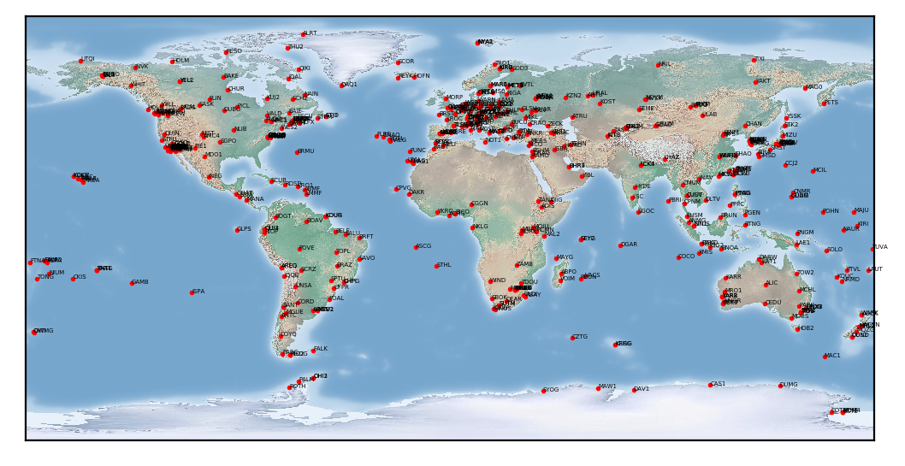
Ex. IGS Network > 400 sites
Notes:
The IGS Network consists of over 400 sites. With this number we able to take our pick of the best stations and still have global coverage.
To help speed the process along the global network is broken down into smaller regions and processed. the solution is then stored and combined at a later stage in the processing.

Slide 15
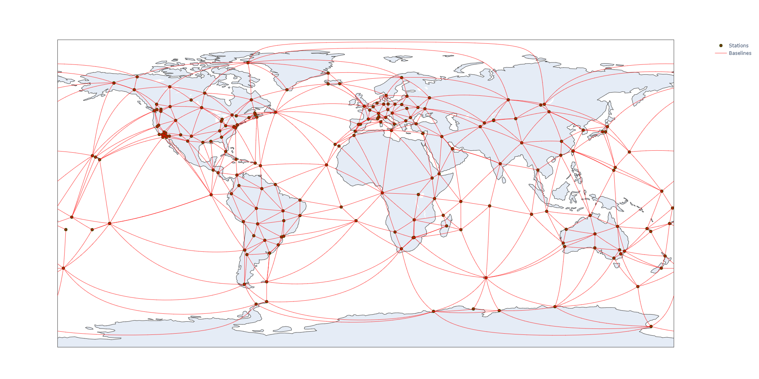
Processed stations ~ 300 sites
Notes:
This is an example from a recent solution that we processed as you can see we divide our chosen stations, (only 300), to have global coverage and then create triangles mapping the globe.
Notes:
rotation vs translation, gpscom.pdf
Delaunay triangulation algorithm that selects regions (hub and spoke model)
Least square adjustments

Slide 16
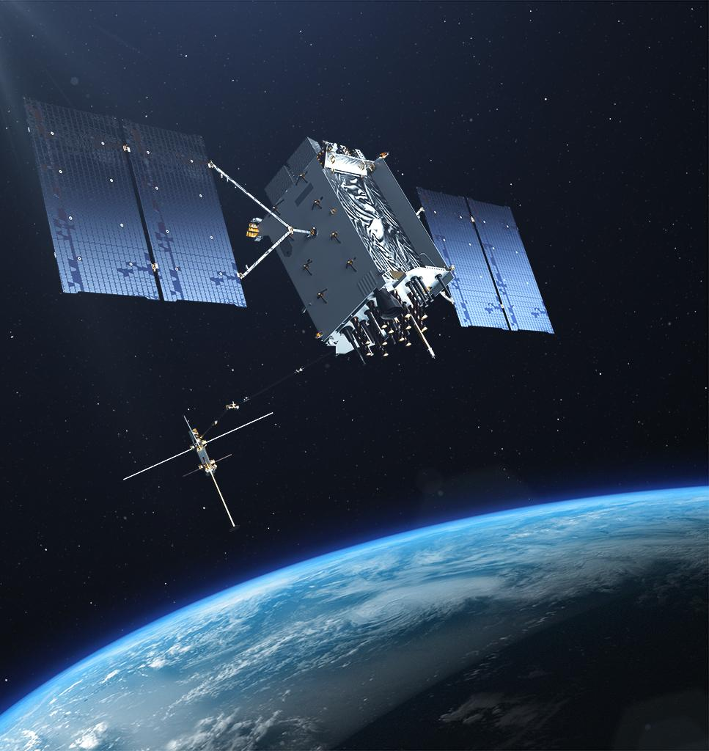
NGS Orbits (How?)
Adjust orbit models using observations
Includes more calibrations for both satellite and station antennas
We solve for orbit location by fixing well known sites at specific locations in a global frame.
https://insidegnss.com/gps-iii-the-next-big-step-in-gps-modernization/
Notes:
One of the final things that we do in orbit determination to increase the accuracy even further is we adjust our orbit models incorporation the observational data that we have processed for.
We also make some more corrections dealing with extra calibrations for both satellite and station antennas
Then one of our final steps is to finally solve for the orbit location by fixing well known sites at a specific locations in a global frame of reference.
And presto we have our final orbital positions that fit the model and the observations made by the stations.
Then we provide our orbit solution to IGS.

Slide 17
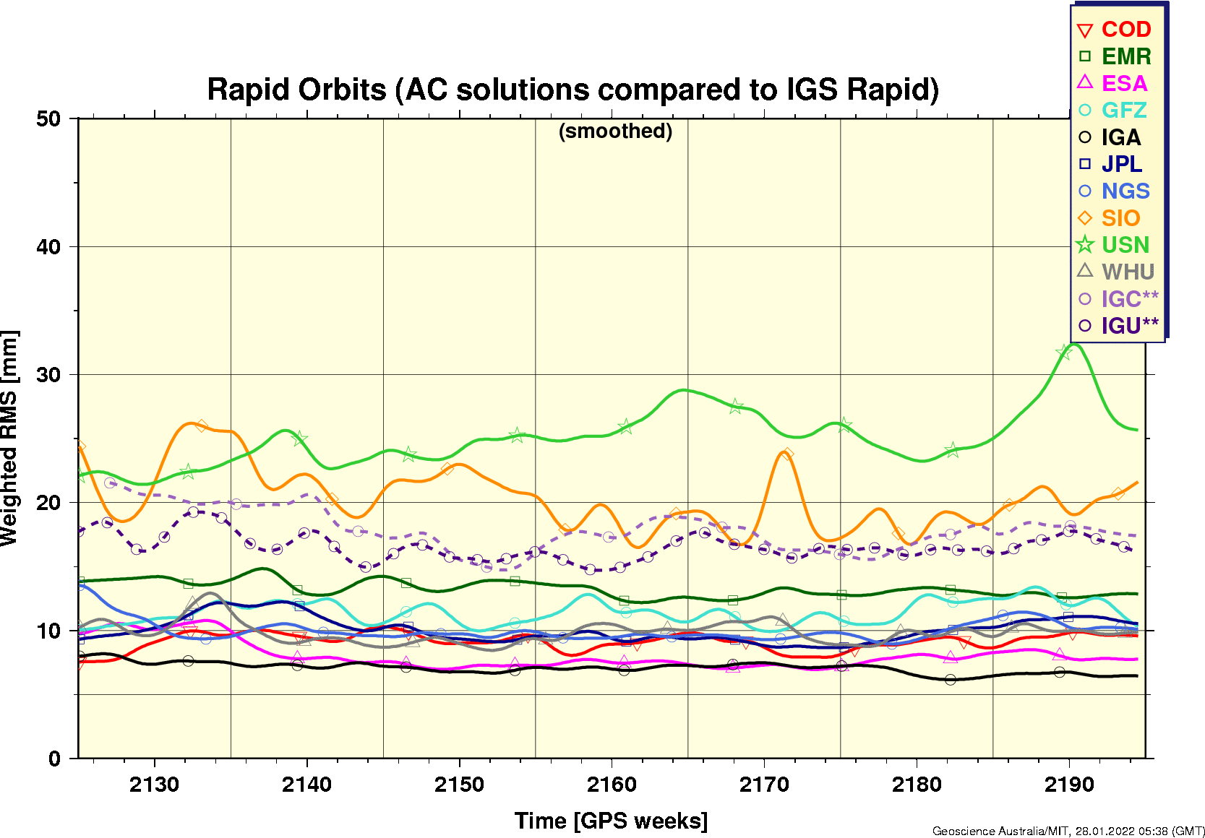
IGS Process
NGS
AC 2
Individual Solutions
IGS
Coordinator
Combined Solution
IGS Data Centers
Notes:
As I have mentioned, we are not the only ones to do this. On the right we can see rapid orbit results that have been submitted to IGS over time.
The IGS process takes into account the various models and processing steps used and for AC’s that achieve a certain standard accept the submitted solutions.
Then the IGS acts as a coordinator and combines the individual solution into smoother solutions that remove the outliers that may exist in individual solutions.
Finally IGS and other collaborating data centers provide the individual and combined solutions the the general public and scientific community.
Why does the IGS do this extra step?

Slide 18

Tools of the Trade
we use in house programs that do most of the heavy lifting.
Precise Adjustment of GPS EphemeredeS - PAGES
GPS COMbination - GPSCOM
ADJust EPHemeredes - ADJEPH
Notes:
IGS has to conduct this step because each AC is incorporating what they thing the best models are as well as using their own software that has different methods and assumptions.
For example at NGS we have our own set of inhouse programs that do most of the heavy lifting. The first set involved in orbit determination is the Precise Adjustment of GPS EphemeredeS - PAGES, responsible for station position and some corrections during processing.
GPS COMbination or GPSCOM responsible for taking the regional solutions and combining them into a global solution.
And finally ADJust EPHemeredes - ADJEPH responsible for fitting the orbit model to the observation data that was processed.

Slide 19
IGS Process
IGS combines the orbit solution to account for bias provided by AC’s software and models
http://acc.igs.org/igsacc_rapid.html
Notes:
IGS combines the orbit solution to account for bias provided by the AC’s software and modeling techniques that are chosen.

Slide 20
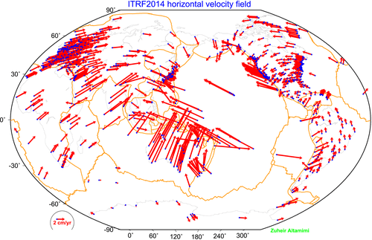
Importance of NGS Orbits
To better understand the changing shape of the US
Helping determining and build global reference frame.
Build collaborations with other experts
Helping to improve GPS infrastructure.
(Altamimi et al., 2016) ;https://ggos.org/item/station-positions-variations/
Notes:
With precise orbit determination NGS and geodesy as whole has become a lot more informative. Understanding precise positions on Earth has led to many applications like real-time monitoring, understanding plate tectonics, hazards both earthquakes and volcanoes, as well as understanding challenges like sea level rise
If we think back to a goal of NGS understanding the change shape of the Earth and US becomes a lot easier when we have cm and even mm measurements of ground motion.
Something that is only possible with well determined satellite orbits.
NGS is also working toward building updated reference frames. An example given on the right, with more precise displacement data informing the model.
Another big importance of NGS Orbits is helping to improve GPS infrastructure.
This is because GPS is now only one of many satellite systems that are currently active.

Slide 21
Helping to improve GPS infrastructure
Global Navigation Satellite Systems: GNSS
GNSS ground stations can detect, decode, and process signals from more than one satellite system
System | GLONASS | Galileo | BeiDou | Quasi-Zenith | Indian Regional
# of satellites | >24 | 28 (30 planned) | >40 | 4 (7 planned) | 8
Managed by | Russia | E.U. | China | Japan | India
Notes:
All together the multiple satellite systems in the world are referred to as the Global Navigation Satellite System or (GNSS).
GNSS ground stations can detect, decode, and process signals from more than one satellite system and are already taking advantage of the extra satellites that can provide signals.
This includes: and the India Regional Navigation Satellite System managed by India consists of eight satellites.
The development of these satellite systems will tremendously help the accuracy and precision of the sites that can connect to them. But we would still like our GPS satellites to perform at a level equivalent to these newer systems.

Slide 22
Summary
NGS has been involved in determining orbits from the onset of manmade satellites.
15 minute ephemerides (positions) are the orbit determination solutions produced at NGS and are shared with the IGS.
Orbit determination is done through modeling the orbital path of the satellites and incorporating observations from stations.
The involvement of NGS in orbit determination allows for the agency to complete its mission; as well as contribute to the broader international scientific community

Slide 23
References
William G. Kass, et al., Global GPS data analysis at the National Geodetic Survey, Journal of Geodesy, 2009
Kumari, Amisha & Deohans, Aayushi. (2019). Orbital Lifetime Analysis of GTO Objects.
https://igs.org/products/#precise_orbits
https://cddis.nasa.gov/Techniques/GNSS/GNSS_Overview.html

Slide 24
Satellite Information
https://www.glonass-iac.ru/en/
https://www.gsc-europa.eu/system-service-status/constellation-information
https://www.isro.gov.in/spacecraft/list-of-navigation-satellites
http://www.csno-tarc.cn/en/system/constellation
https://qzss.go.jp/en/technical/qzssinfo/index.html

