Slide 1
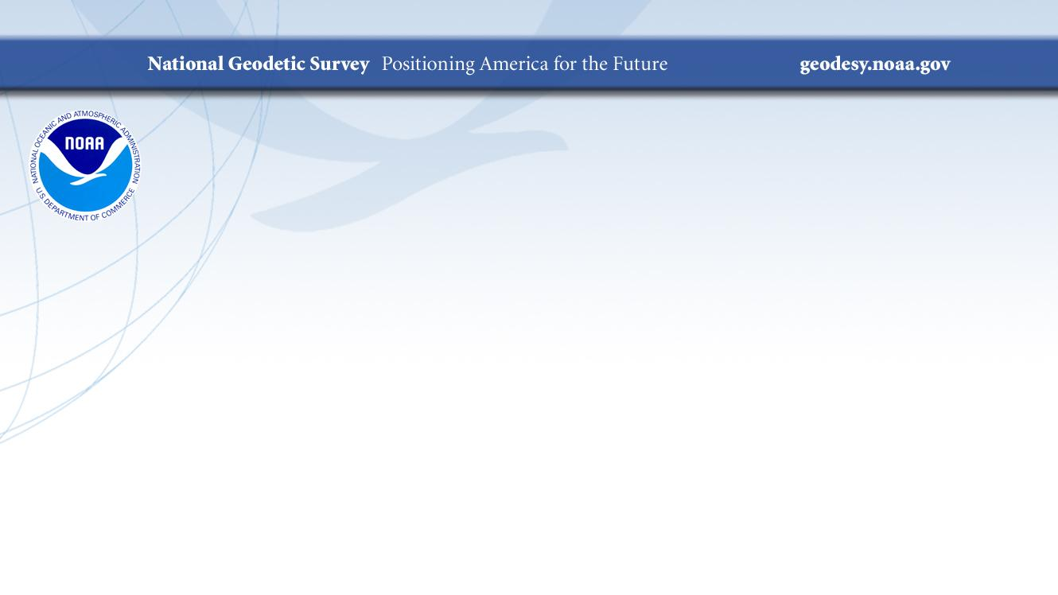
NGS Software on GitHub
Sri Reddy
Systems Development Division Chief
September 09, 2021

Slide 2
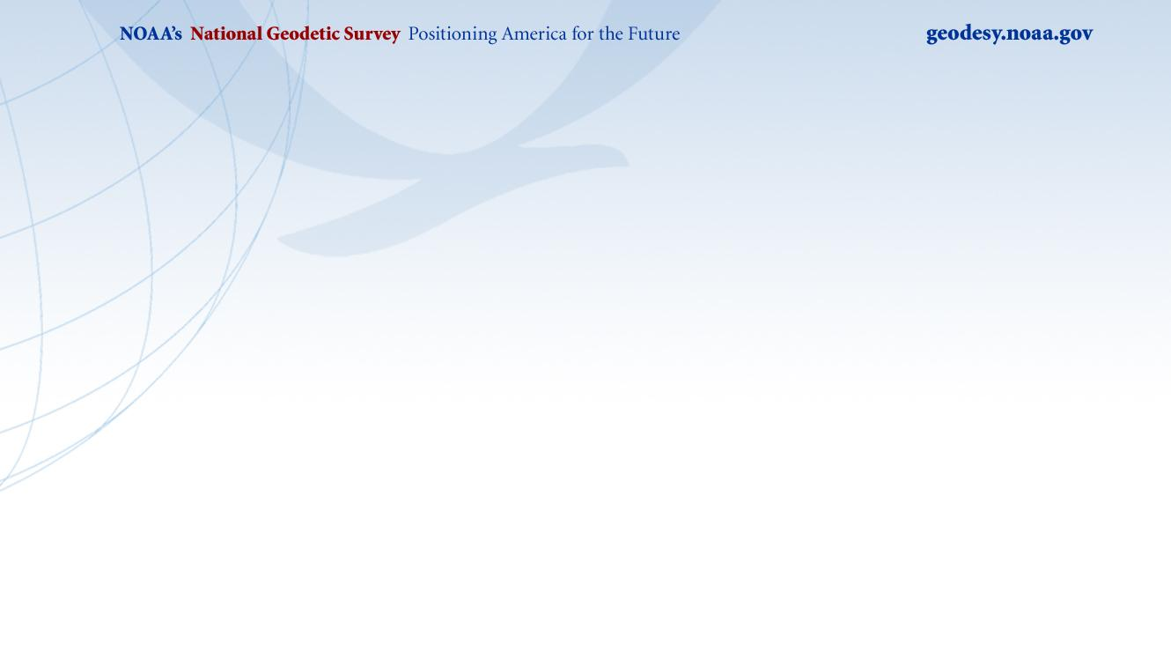
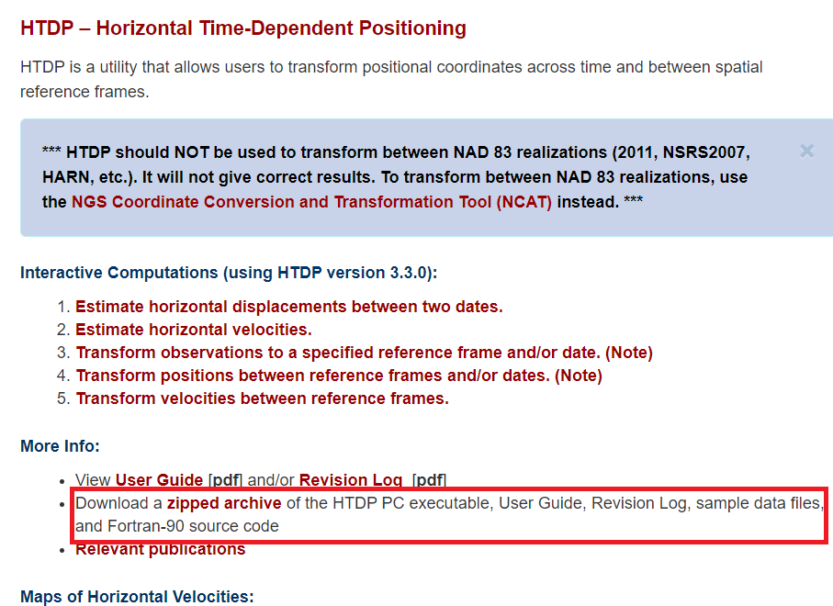
Software downloads on Geodesy.noaa.gov
NGS has been providing source code for download on the geodesy.noaa.gov site for Geodetic software and toolkits.
HTDP
NCAT
Geoid interpolation (intg)
Adjust

Slide 3
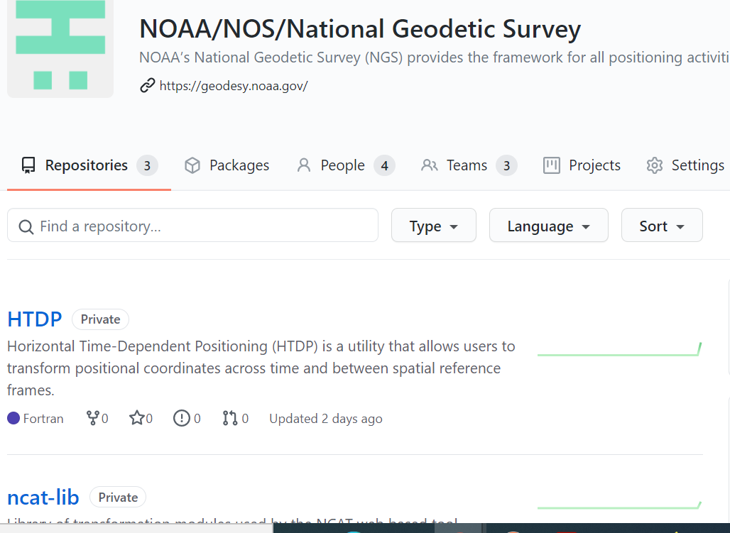
Source Code on GitHub
NGS has approval from DOC to use GitHub (Cloud Software as a Service) for collaborating with partners on software development.
NGS software code can be found under the Organization noaa-ngs on GitHub.
https://github.com/noaa-ngs/

Slide 4
Benefits of using GitHub
You can easily clone the code and integrate it into your software development process.
You can see all the revisions and previous releases on GitHub. NGS will maintain releases of the software on GitHub.
You can fork the code, modify it to extend the functionality and submit it back to NGS via pull requests. NGS will review and if approved will merge the pull requests into the master branch.
You can check GitHub for the latest release either manually or by a simple script.
You can also be a watcher on a repository which should alert you by email when there are updates.
You can report bugs/issues you find using GitHub.

Slide 5
Repositories currently on GitHub
The following repositories are currently available on GitHub
Intg (INTerpolate Geoid)
xintg (INTerpolate Experimental Geoid)
Intd (INTerpolate from Deflection files)
Adjust (Least Squares Adjustment software)
ncat-lib (transformation algorithms/modules used by the NCAT web tool)
HTDP (Horizontal Time-Dependent Positioning )

Slide 6
What to expect next?
NGS will be adding more code repositories to GitHub as we modernize and develop new tools.
NGS will provide inputs and outputs for specific use cases that you can use to test and verify the results.

Slide 7
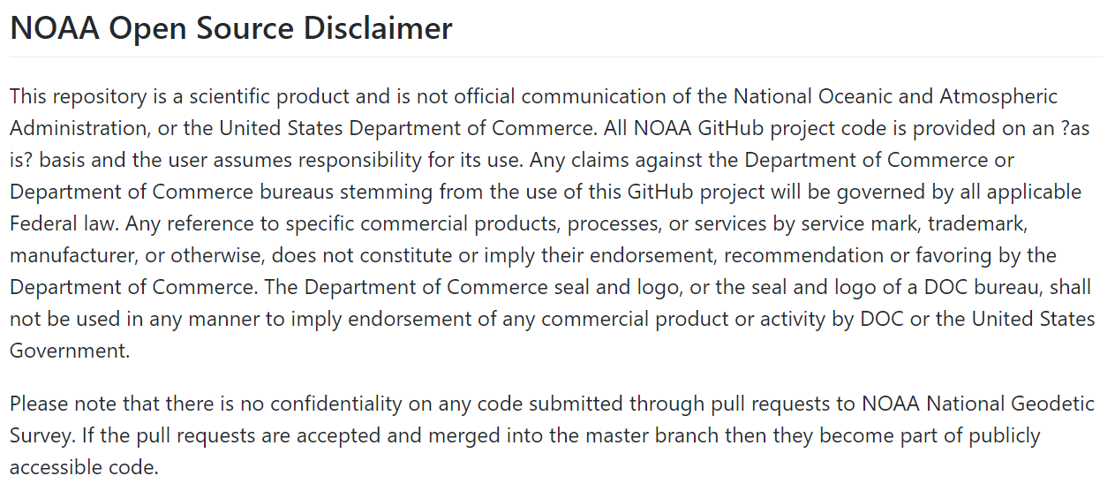
Disclaimer

Slide 8
Demo

Slide 9
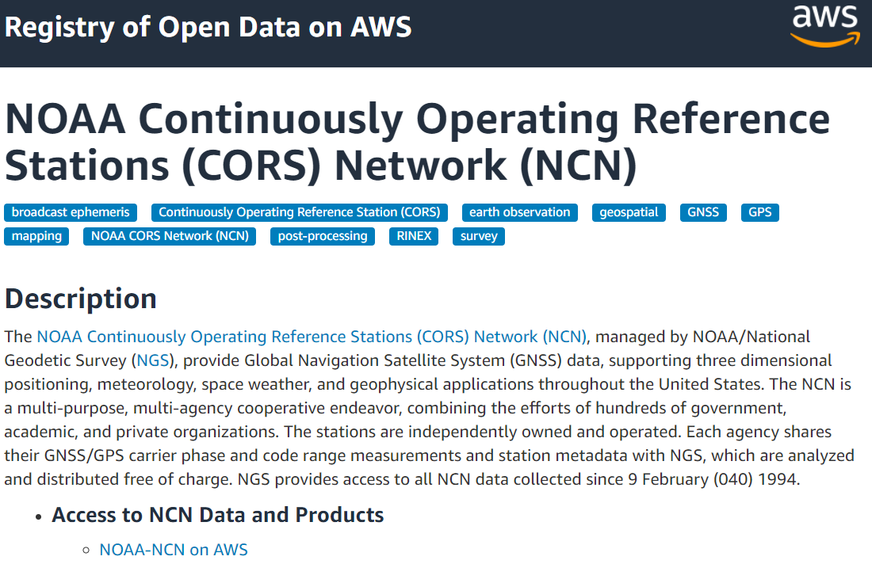
NOAA Big Data Project
NOAA has partnered with the big Cloud Service Providers (CSPs) (Amazon, Google, Microsoft and others) to provide access to large data sets to the public.
NGS is making available CORS data in a S3 bucket in Amazon Cloud. Data is refreshed hourly.
https://noaa-cors-pds.s3.amazonaws.com/index.html
Data in S3 has 99.9% availability.
Notes:
* Using AWS S3 lowers cost to NGS as the CSPs bear the cost of storage and egress.

Slide 10
Accessing the data in AWS
Any browser
https://noaa-cors-pds.s3.amazonaws.com/index.html
AWS command line interface (CLI).
aws s3 ls s3://noaa-cors-pds/rinex/2021/250/1lsu/ --no-sign-request
aws s3 cp s3://noaa-cors-pds/rinex/2021/250/1lsu/ . --recursive --exclude "*" --include "1lsu250*.gz" --no-sign-request
Cyberduck - Open-source client
Notes:
* Using AWS S3 lowers cost to NGS as the CSPs bear the cost of storage and egress.

