Slide 1

OPUS-Projects for Uploading Real-time Kinematic (RTK) GNSS Vectors
Dan Gillins, Ph.D., P.L.S.
Geodesist, National Geodetic Survey
May 7, 2019
2019 Geospatial Summit

Slide 2


Accuracy vs. Cost
Accuracy
Cost
Set a continuous GNSS reference station (i.e., CORS)
  Permanent or semi-permanent base station
Campaign-style static GNSS survey with multiple receivers
  Develop survey network for adjustment
  OPUS-Projects
Static GNSS survey session with one receiver (i.e., OPUS-S)
Rapid-static GNSS survey session with one receiver (i.e., OPUS-RS)
Real-time kinematic (RTK) observation

Slide 3
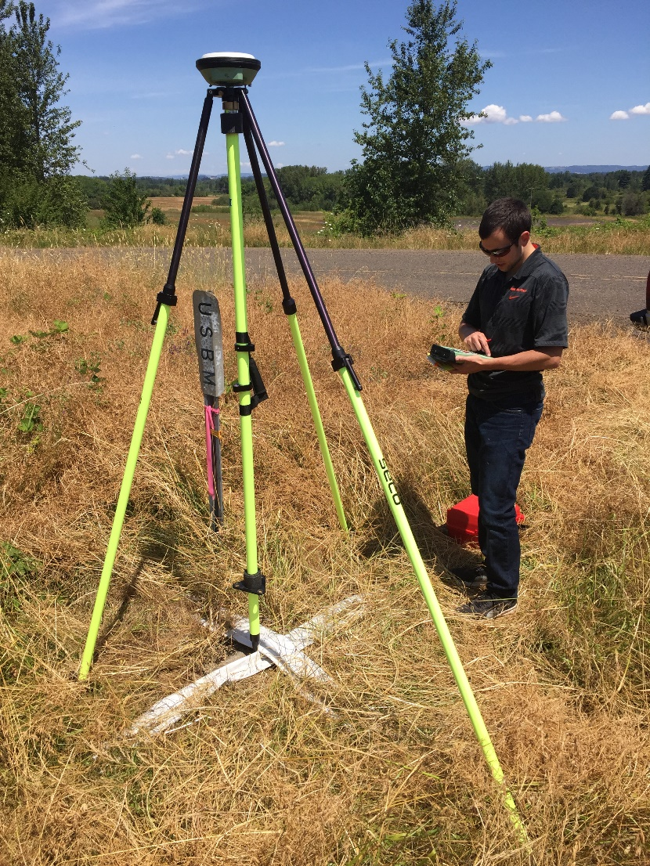
Real-time Networks (RTNs)
Network of continuously operating GNSS stations
  ~ 70 km interstation spacing
Atmospheric and orbital corrections are transmitted to rover via mobile data link
Baselines processed in real-time
Coordinates to cm-level accuracies derived in seconds to minutes

Slide 4
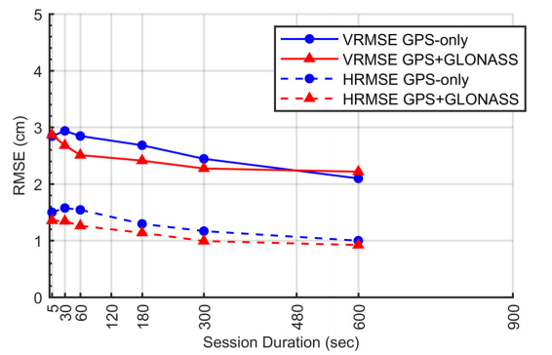
Empirical Evaluation of the Accuracy of RTNs
[Allahyari et al. 2018]

Slide 5
RTN Surveys Compared to Static Surveys
Benefits | Concerns
FAST. Could reduce field observations from several hours to just a few minutes | RTN may not be aligned with the National Spatial Reference System
Can evaluate data quality in real time | Ideally, survey should be tied to CORS Network
Easy to obtain additional observations | More prone to multipathing errors
Only a single receiver (i.e., rover) is needed during a session | Baselines must be kept short (i.e., < 40 km)

Slide 6
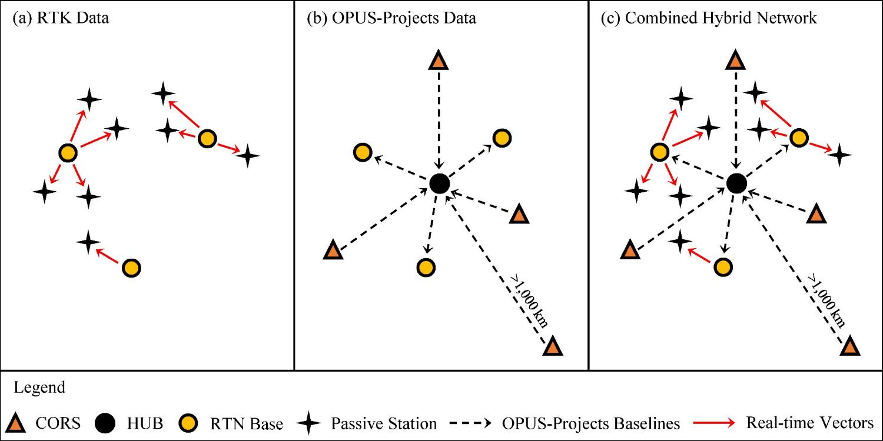
Hybrid Static + RTN Survey Networks
[Weaver et al. 2018]

Slide 7
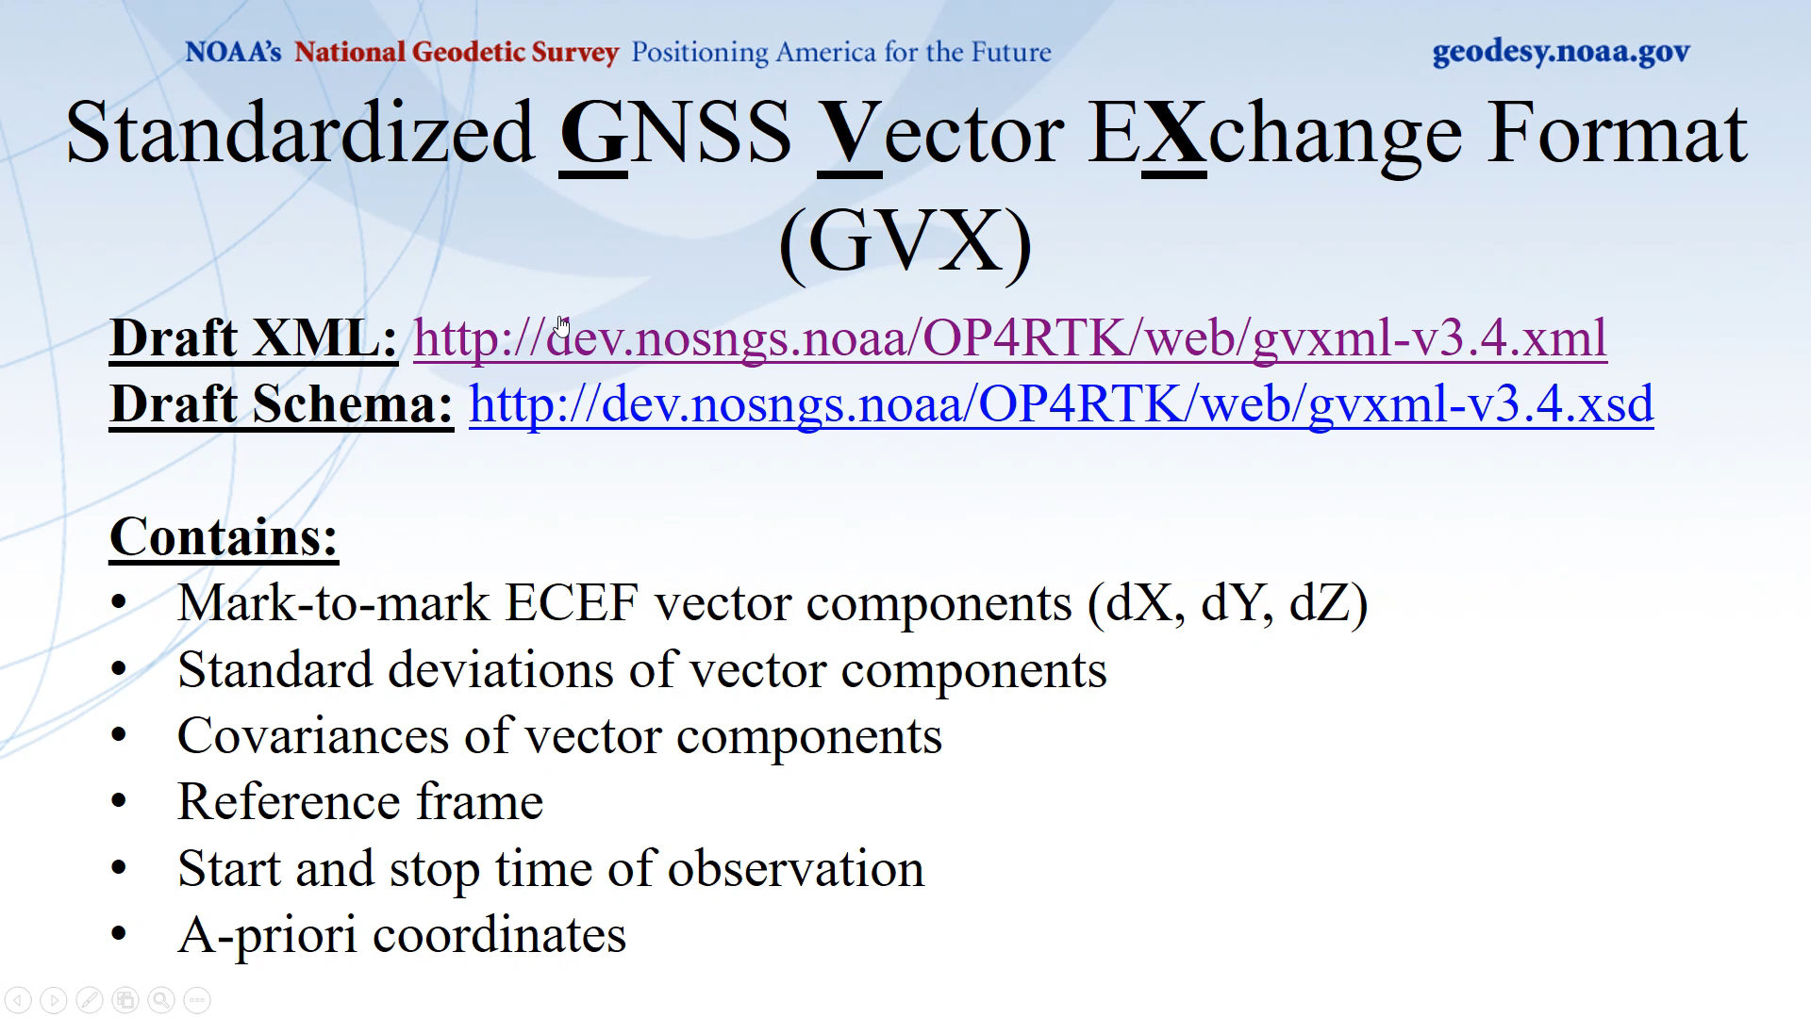
Standardized GNSS Vector EXchange Format (GVX)
Draft XML: http://dev.nosngs.noaa/OP4RTK/web/gvxml-v3.4.xml
Draft Schema: http://dev.nosngs.noaa/OP4RTK/web/gvxml-v3.4.xsd
Contains:
Mark-to-mark ECEF vector components (dX, dY, dZ)
Standard deviations of vector components
Covariances of vector components
Reference frame
Start and stop time of observation
A-priori coordinates

Slide 8
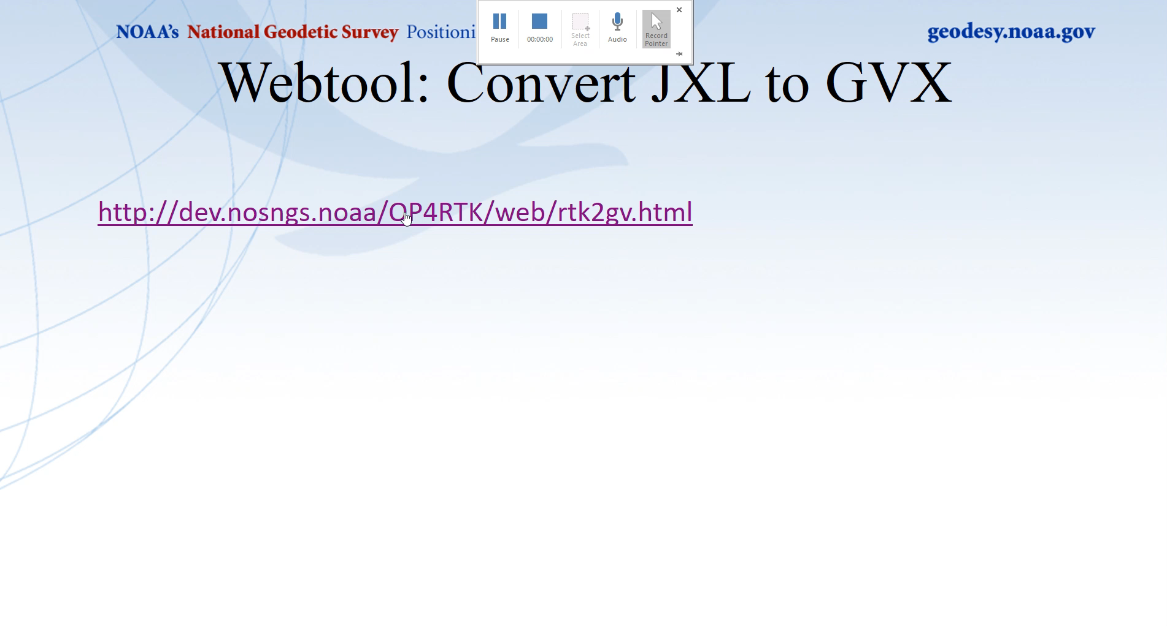
Webtool: Convert JXL to GVX
http://dev.nosngs.noaa/OP4RTK/web/rtk2gv.html
Notes:
Download RTN data from a data collector to software. Then, identify which base stations were chosen by the RTN as references during the survey. Go to an FTP or website to download the static data logged at the base stations on the day(s) of the RTN survey. Upload this static data (preferably as 24-h files) to OPUS-Projects.

Slide 9
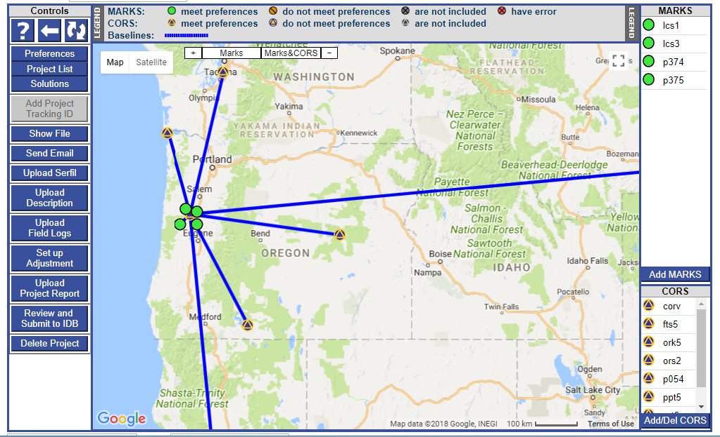
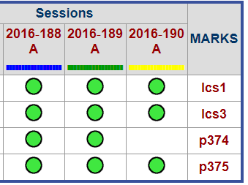
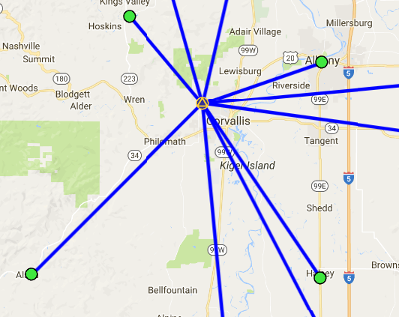
Example: Process Static Data in OPUS-Projects
Upload Vectors

Slide 10
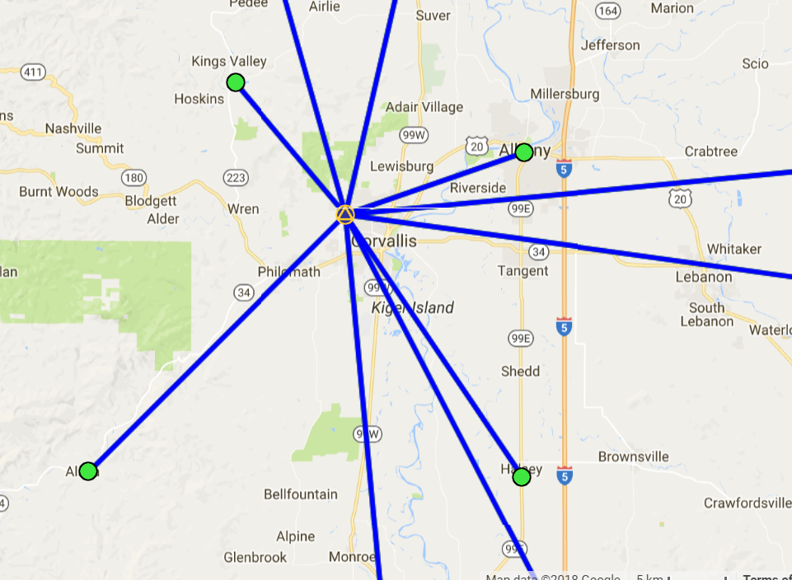
Example: Upload RTN Vectors to OPUS-Projects
LEGEND
CORS
User Mark
Processed Vector (OPUS-Projects)
Uploaded Vector
Upload Vectors

Slide 11
Example: Adjust Static + RTN Network
Run least squares adjustment(s) of the combined static data and RTN vectors in the survey network
Hold CORS (and possibly other published coordinates on passive marks) as control in network adjustments
Check quality of results
Submit survey project to NGS for review and publication in national database

Slide 12
Summary
Real-time kinematic GNSS data are sufficiently accurate for many geodetic surveying applications
  Must balance accuracy versus efficiency
Developing tools in OPUS-Projects so surveyors can upload, include, and adjust vectors from real-time GNSS surveys
  Need a standardized GNSS vector exchange format for industry; proposing the “GVX” file format
Developing new surveying guidelines and/or specifications for including real-time data in a GNSS geodetic control survey

Slide 13
Questions?
Daniel.Gillins@noaa.gov

