Slide 1
Retirement of the U.S. Survey Foot
2021 NSRS Modernization Geospatial Summit
May 5, 2021
Michael Dennis, PhD, PE, RLS
SPCS2022 Project Manager
michael.dennis@noaa.gov

Slide 2
A tale of two feet
Two versions of “foot” in current use:
“Old” U.S. survey foot
“New” international foot
‭1 ft = 0.3048006096…‬ m
1 ft = 0.3048 m exactly
differ by
2 parts per million (ppm) or ~0.01 ft/mile
A real problem with real costs
Notes:
It’s likely everyone watching this webinar knows about the problem: there are two nearly identical versions of the foot in current use in the U.S.;
They differ by 2 parts per million (ppm), or only 0.01 ft per mile, or slightly more than a tenth of an inch in a mile.
Despite (or actually because of) the very small difference, it has become a REAL problem with REAL costs.

Slide 3
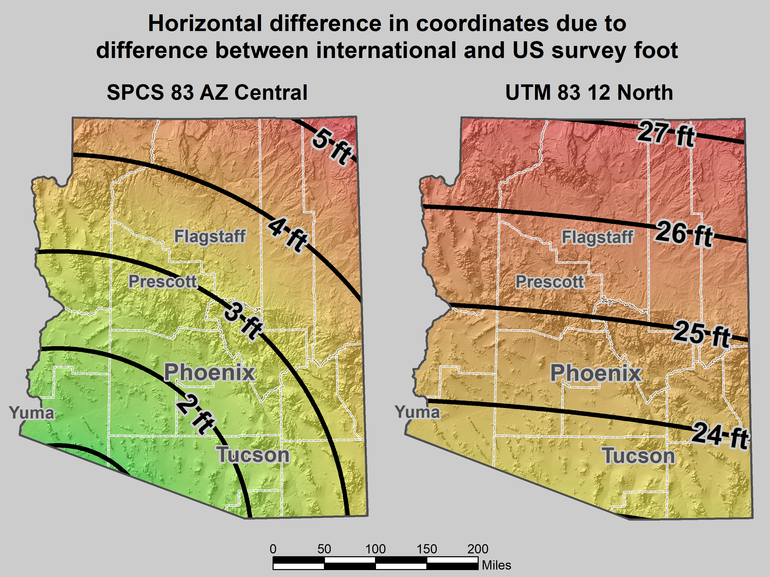
Map of error in mixing feet
Notes:
As an example of some of the problems, consider the state where I am registered, beautiful Arizona. It is an ift state, yet mix-ups with sft occur all the time:
The map on the left shows the horizontal difference in feet when ift and sft are interchanged for SPCS 83 AZ Central Zone.
I worked a lot in Flagstaff. This confusion occurred so often that whenever I saw a 3.5 ft horizontal discrepancy, I suspected it was this issue. And it usually was.
When the City of Flagstaff installed their GIS software, it defaulted to State Plane in sft (even though it’s supposed to be ift). When the City discovered this, they decided to just leave it in sft, which is part of the reason why the 3.5 ft error showed up so often in Flagstaff. But they also occur elsewhere.
I probably shouldn’t complain about ift/sft problems, because I’ve made money off of it. In one weekend I made a couple thousand dollars helping someone with a big survey near Prescott. One of the problems was a 3-ft horizontal discrepancy. Turned out it was due to an ift/sft mix-up, mainly because more than one company worked on the project.
It’s not just State Plane. I don’t know if they still do it, but a statewide electric utility (Arizona Public Service) uses UTM coordinates, in sft. This causes positional errors of 23 to more than 27 feet if ift are used, depending on location.
These problems are real. And they don’t just occur in ift states. They can (and do) occur in any state. I’ve heard more stories about such problems than I can keep track of. This is especially a problem for surveyors licensed in multiple states with different foot types. Or for projects with multiple companies (especially if from different states or countries). Or for anyone who uses software. In short, it has negatively impacted many people, but it can potentially impact anyone. Maybe it has never been a problem for you. But you won’t have to look very far to find someone who has war stories on this topic.

Slide 4
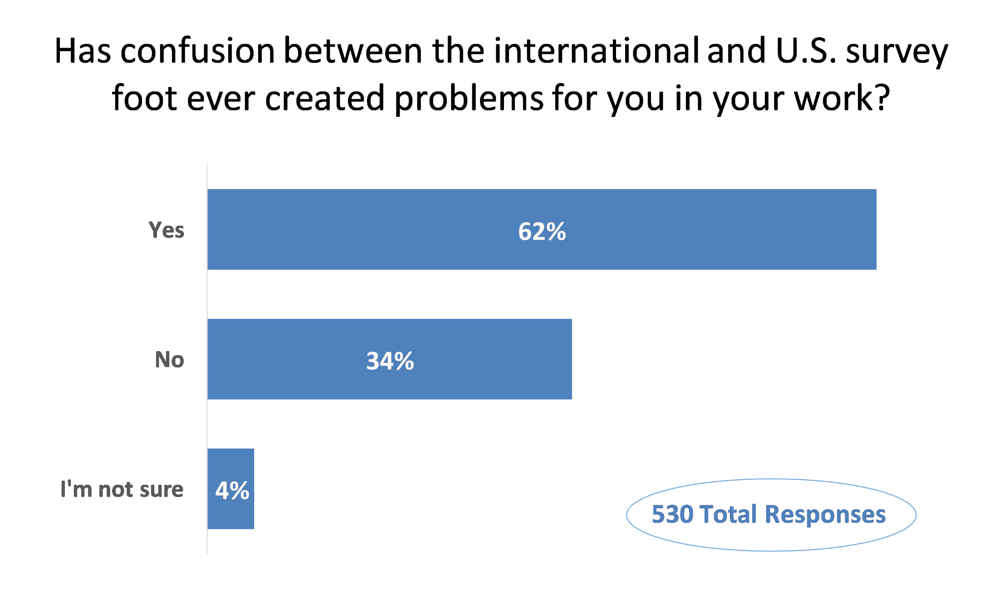
Poll question
Poll question from NGS webinar

Slide 5
How did we get in this mess, and why is NGS involved?

Slide 6
Who is responsible for standards?
Today:
National Institute of Standards and Technology
Notes:
Today, the National Institute of Standards and Technology (NIST) is responsible for defining and establishing standards. It is within their authority.
NIST is a bureau of the Department of Commerce (DOC)
The National Oceanic and Atmospheric Administration (NOAA) is also a bureau of DOC.
The National Geodetic Survey (NGS) is a program office in NOAA. It’s actually within the National Ocean Service (NOS) in NOAA.
It may seem odd to show NGS here along with NIST, but there is a reason for it, as you will soon see.

Slide 7
Who is responsible for standards?
Before 1901:
U.S. Coast and Geodetic Survey
Office of Standard Weights and Measures
Superintendent of C&GS also Superintendent of Office of Standard Weights & Measures
Notes:
Responsibility for standards was different before 1901.
In 1901, the National Bureau of Standards (NBS) was created, which later became in NIST (in 1988)
Department of Commerce was created in 1903, when NBS became part of it (initially in Department of the Treasury).
Before 1901, standards of weights and measures was handled by the U.S. Coast & Geodetic Survey (C&GS), the predecessor of NGS.
Operated under the authority of the Department of the Treasury, in the Office of Standard Weights and Measures.
Superintendent (same as “Director” today) of C&GS was also Superintendent of Weights and Measures – so that is the connection to NGS! But there is a later connection as well, which is also the reason we currently have two foot definitions.

Slide 8
Congress is the Authority
Notes:
The ultimate authority on standards of weights and measures is the U.S. Congress.

Slide 9
Congress is the Authority
Per the U.S. Constitution (Article I, Section 8, Clause 5)
“The Congress shall have Power … To coin Money … and fix the Standard of Weights and Measures”
Without uniformity, standards are useless
Notes:
The authority of Congress is given in the U.S. Constitution, Article I, Section 8, Clause 5.
Congress delegated its power to the Office of Weights and Measures in the Department of the Treasury.
NBS then got this authority as the successor to the Weights and Measures, and NBS became part of DOC.
Why was something like standards of weights and measures so important that it was specifically listed as a congressional power in the Constitution?
Because standards for weights and measures are tightly connected to commerce, including coining of money. We’re going to come back to this near the end of the presentation.
In short, it was to avoid the “toothbrush problem”…

Slide 10
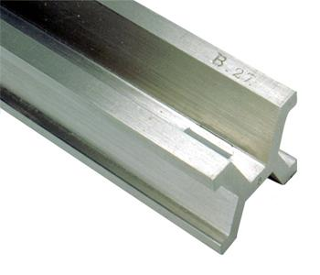
A short history of length
“Exact” copy of British Imperial Yard
Troughton Scale from England becomes U.S. standard
Congress legalizes use of metric system
Standard Meters Nos. 21 and 27 sent from France
1789
1815
1855
1866
1876
1888
1890
U.S. Constitution
New Imperial Yard sent from England
Bronze Yard No. 11 travels back to England, twice
Article I, Section 8, Clause 5 Congress to “…fix Standard of Weights and Measures”
Bronze Yard No. 11 new U.S. standard
Different length – both times!
0.022 mm shorter than Troughton Scale
Notes:
The start of the metric era:
1866. Congress legalized use of the metric system for commerce in the U.S. Included 4 conversion tables of metric to existing (nominally British Imperial).
1875. U.S. signs “Treaty of the Meter” or “Metric Convention”, along with 16 other nations, to establish an international bureau of weights and measures (ratified in 1878).
1876 and 1888. Bronze Yard No. 11 transported to England, and in both cases did not agree in length, and by different amounts. Could not be determined with the U.S. or British yards had changed in length. All were considered unstable.
1890. Copies of the international meter were made, with none being the “official” version. Bars no. 21 and 27 were randomly selected and shipped to the U.S.
Chaos: Two separate standards of length existed, one based on the British Imperial yard (as represented by Bronze Bar No. 11), the other as represented by Standard Meters Nos. 21 and 27, 90% platinum, 10% iridium, far superior in construction to the bronze bar (accurate to about 0.0001-0.0002 mm). They disagree at levels that are measurable. What can be done to remedy this problem?
As a related aside, the basis for defining the meter was later refined a few times. The last was in 1983, when it was defined as the distance light travels in a vacuum in 1/299,792,458 of a second. This basis is considered measurable to ab accuracy of 0.1 nm (0.000 0001 mm). That’s 1000-2000 times more accurate than Standard Meters Nos. 21 and 27, and this basis is unlikely to change again anytime soon.

Slide 11
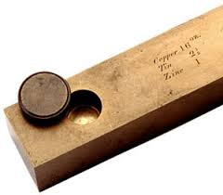
Out of chaos, order
1893
The Mendenhall Order
Thomas Mendenhall
Superintendent C&GS and Office of Weights & Measures (1889-1894)
The U.S. officially became metric
Embraced meter
Abandoned British Imperial Yard
Declared foot defined by meter: 1 foot = 1200/3937 meter
Notes:
The Mendenhall Order (1893): When the U.S. officially became metric.
Officially adopted meter as basis of length, where 1 foot = 1200/3937 meter (per 1866 act of Congress), and with meter represented by Meter Bars No. 21 and 27.
Completely abandoned British Imperial Yard as basis for length (as represented by Bronze Bar No. 11).
Declared in Appendix 6 of C&GS Bulletin No. 26, including conversion tables.
Interesting to note that conversion showed 1 Gunter’s chain = 20.1168 m
That is EXACTLY 66 ift (vs. 65.999868 sft)
This is just a coincidence due to rounding, but it shows that for the precision of the chain, the distinction between the ift and sft is immaterial…

Slide 12
A new foot for a new century
1 foot = 0.3048 meter exactly (1 yard = 0.9144 m)
New foot definition adopted by NASA predecessor
Adopted as “new” foot for entire U.S. (and world)
National Bureau of Standards created
1901
1933
1952
1959
With one little exception…
New foot definition adopted by ANSI predecessor
Notes:
With increasing measurement precision and global trade, it became necessary to adopt a more precise definition of the foot, and one that agreed with international usage.
A motivation for a new definition of the foot was in gage-block standardization for precise machine shop work used by industry. It was a practical solution to a practical problem. Note this has nothing whatsoever to do with surveying.
The new (international) foot definition was 1 ft = 0.3048 m (exact), and is the same to this day (it will not change). The adoption of the ift was a gradual process (as such things often are):
1933. Adopted by American Standards Association, now American National Standards Institute (ANSI).
1952. Adopted by National Advisory Committee for Aeronautics, now National Aeronautics and Space Administration (NASA).
1954. Adopted International Nautical Mile as exactly 1852 m. This is not related specifically to ift, but shows overall move toward adopting “exact” (non-ratio) relationships to the meter.
1959. NSB officially adopts ift for the entire U.S., with one little notable exception…

Slide 13
Federal Register temporary exception
1959
This should have happened in 1989
“Any data expressed in feet derived from and published as a result of geodetic surveys within the United States will continue to bear the following relationship as defined in 1893:
1 foot = 1200/3937 meter
The foot unit defined by this equation shall be referred to as the U.S. Survey Foot and it shall continue to be used, for the purpose given herein, until such a time as it becomes desirable and expedient to readjust the basic geodetic survey networks in the United States, after which the ratio of a yard, equal to 0.9144 meter, shall apply.”
Signed by NBS and C&GS directors, approved by Commerce Secretary, June 25, 1959
https://geodesy.noaa.gov/PUBS_LIB/FedRegister/FRdoc59-5442.pdf
Notes:
Federal Register Notice (1959) establishing ift and (temporary) sft
Official adoption of ift (1 ft = 0.3048 m) nationwide.
Temporary exception granted for geodetic surveys (including State Plane coordinates), to accommodate C&GS.
Mandates that ift shall be adopted after readjustment of U.S. geodetic network. This is not a “recommendation” or a “suggestion.” At the time this was published, “shall” was used in legal documents as mandatory (nowadays the usage of “shall” as mandatory is discouraged in legal documents).
Co-issued and signed by NBS and C&GS directors.
This FRN delayed full adoption of the ift, and promoted continued use of the sft for all surveying (not just geodetic surveys), and it is how we got into the situation we are in today.

Slide 14
Why make the change and what are the choices?
Notes:
Let’s step away from surveying and consider the Big Picture.
This is about much more than surveying. When reading about the U.S. history of weights and measures, the words “science” and “industry” are often used together. And together they mean commerce. Business. Trade. Efficiency. Money. That’s really what this is about. All of those things are facilitated by uniform standards (and compromised without standards).
As stated earlier, change is an integral part of progress. We cannot stand still.
This is also about the law, because there is a powerful legal basis for weights and measures. We did not get here by accident.

Slide 15
Why make the change?
That was original intent (over 60 years ago!)
Two “feet” is inefficient and causes confusion
Leads to errors that cost money
Absurd to have “same” unit that differs by 2 ppm
Defeats purpose of having a length standard
Only recognized in part of U.S. for some things
NGS software will support backward-compatibility
Now is the time
Many other changes will be made for modernized NSRS
Change in foot trivial compared to other changes
Otherwise U.S. survey foot problems will never go away
Notes:
Continuing with why we should make the change:
The sft is not recognized in the entire U.S. Only in parts of the U.S. And even for states where the ift or sft is specified, there are internal exceptions (a few of which I have already mentioned).
NGS can make the transition easier by automatically supporting backward-compatibility in our software. That way you would get sft for all SPCS 27 zones, and also for SPCS 83 in the 40 states that have specified the sft for SPCS 83.
To repeat: Now is the time. Otherwise this problem will never go away (unless the U.S. goes completely metric).

Slide 16
What are the choices?
Do nothing (i.e., NGS stays “metric” only)
States choose whatever foot they want
But feet will creep back into NGS products & services
Officially adopt U.S. survey foot for specific things
U.S. survey foot for surveying and mapping
International foot for engineering (and everything else)
Use international foot for everything
Only support 1 foot = 0.3048 meter, period
Use U.S. survey foot for everything (highly unlikely)
Go entirely metric (good luck with that!)
Notes:
There are five options for moving forward:
Do nothing. This one is interesting, because a number of people have recently proposed a solution where NGS just goes metric, and every state uses whatever foot they want. What they don’t seem to realize is that is exactly what we are doing now! NGS went metric in 1977. But customers wanted to get coordinates in feet, so we provided them. Which meant we had to make sure and give them the type of foot they wanted (even though some locations within sates use a different foot than other parts of states, as mentioned previously). The same thing would most definitely happen again for SPCS2022 if we tried to only give metric coordinates. So the situation would be exactly the same as now.
Officially adopt U.S. survey foot for specific things. This was what was proposed in the 1988 FRN. It would formally perpetuate a dual foot system in the U.S., making it even more entrenched. We would be stuck with a dual foot anti-standard.
Use international foot for everything. This is what NGS proposes. Only one foot after 2022, with same definition as ift. It is the only viable means of using a single foot definition for future work. Legacy work will always use appropriate units (of which there are many types).
Use U.S. survey foot for everything. As discussed previously, this is extremely unlikely, so much so that it’s safe to say it is impossible. The ift is simply too well established in a vast majority of the economy. Surveying is a tiny minority, so it is not reasonable to expect the sft to prevail, even if the sft is used for surveying in most states.
Go entirely metric. This is my personal very strong preference! This is also the preference of most (all?) people at NGS and NIST. But alas it appears much too big a lift for NGS, and even for NIST at this time. Maybe some day in the not-too-distance future (but remember what happened when we tried to go metric in the late 70s). At least SPCS2022 parameters will all be defined in meters! On a positive note, of the people who have provided feedback so far on this topic, more are in favor of going metric than are of keeping the sft (although a large majority opted for the ift).

Slide 17
Putting the “best” foot forward
U.S. survey foot will be retired
Not supported for SPCS2022 (or any part of modernized NSRS)
Only international foot will be supported
Effective December 31, 2022
Independent of NSRS modernization
But U.S. survey foot will still be supported for legacy products (e.g., “old” State Plane)
Official action has been taken…

Slide 18
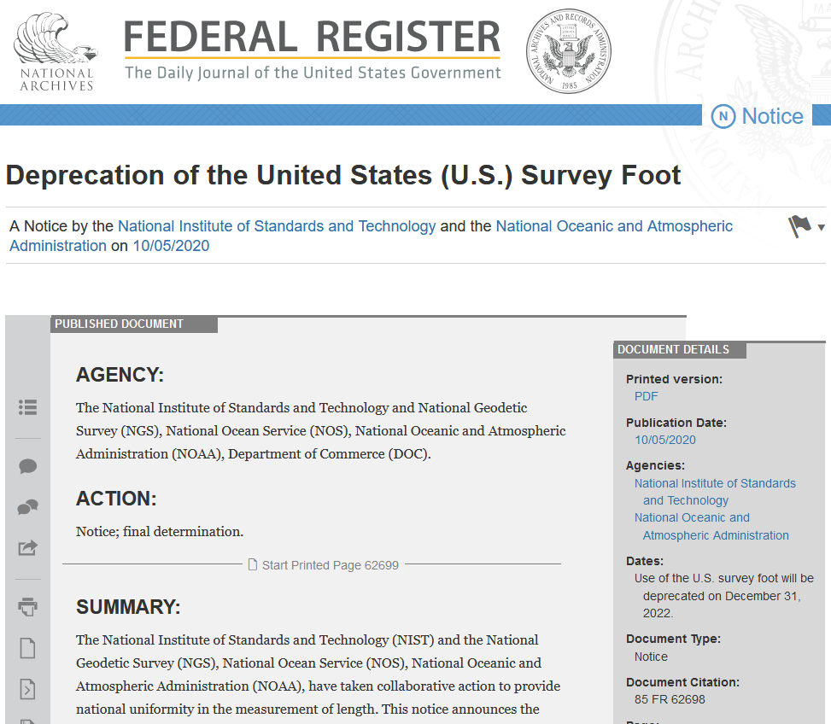
Federal Register Notice (Oct 5, 2020)
Final determination:
Describes public comments received, along with the plan, resources, training, and other information for an orderly transition
(Note: this image is hyperlinked to the Federal Register page)

Slide 19
What about NSRS Modernization?
Deprecation effective Dec 31, 2022
NSRS modernization will happen later
For users of existing NSRS:
Deprecation will have no effect
U.S. survey foot will still be supported
Difference in dates will NOT create a problem
Will give more time to make the transition
U.S. survey foot will ALWAYS be supported by NGS for State Plane Coordinate Systems of 1983 and 1927
Notes:
NGS wants you to join us in taking a stand for standards, for the reasons listed here that summarize what was discussed in this presentation.
An important point is that although it appears the federal government has the authority to mandate a single foot definition, we believe it is far better to persuade than coerce. Our hope is that you have found this presentation persuasive, and that you are at least considering the merits of a switch from the sft to the ift.

Slide 20
In closing…
The foot problem created for convenience
Intended as temporary, for geodetic work only
Keeping U.S. survey foot is an “anti-standard”
Single definition efficient, clean, and right thing to do
NGS will help fix it
Fully support backward compatibility
Will make simple and painless as possible
Foot change minor compared to other coming changes
This is about making things better for the future
Notes:
In closing, I want to reiterate that NGS essentially created this problem, and now we want to help fix it. Yes, we are coming at this some 30+ years late, but there is no better time to do this than when we are updating the entire NSRS. A change in the foot definition will be a minor part of the overall changes that will occur when we make the transition to a modernized NSRS in 2022. NGS will do everything we can to make a foot change – and all the other 2022 changes – as simple and painless as possible. Remember, the idea here is not change for its own sake, but change to make things better. And these changes will make things better.
I encourage you to provide questions and comments to NGS.Feedback@noaa.gov. If this change for the foot goes forward, there will also be opportunities for comments as part of issuing an FRN.
I remind you, again, that this is about the future, not the past. The past will always exist and will not change. But the future is something we can change, and make better. Please remember our heroes, and the incredible work they put into establishing standards for weights and measures. Their eyes were also on the future, and we are the beneficiaries of their vision.
For those of you who are surveyors (as I am), this is more than about how you practice surveying today, wherever you may work, and whatever type of surveying you do. For those who want to retain the U.S. survey foot, I implore you to please consider the larger picture, and the future. That future will be inherited by the young surveyors, GIS professionals, and all other U.S. citizens. We should strive to do well by them, and for them.

