Slide 1
State Plane Coordinate System
2021 NSRS Modernization Geospatial Summit
May 5, 2021
Michael Dennis, PhD, PE, RLS
SPCS2022 Project Manager
michael.dennis@noaa.gov

Slide 2
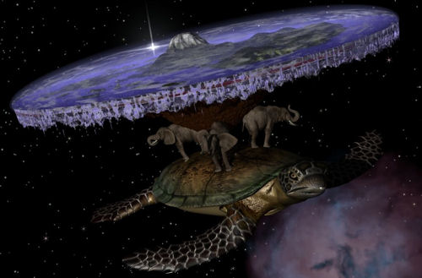
Alternative Earth models exist…

Slide 3
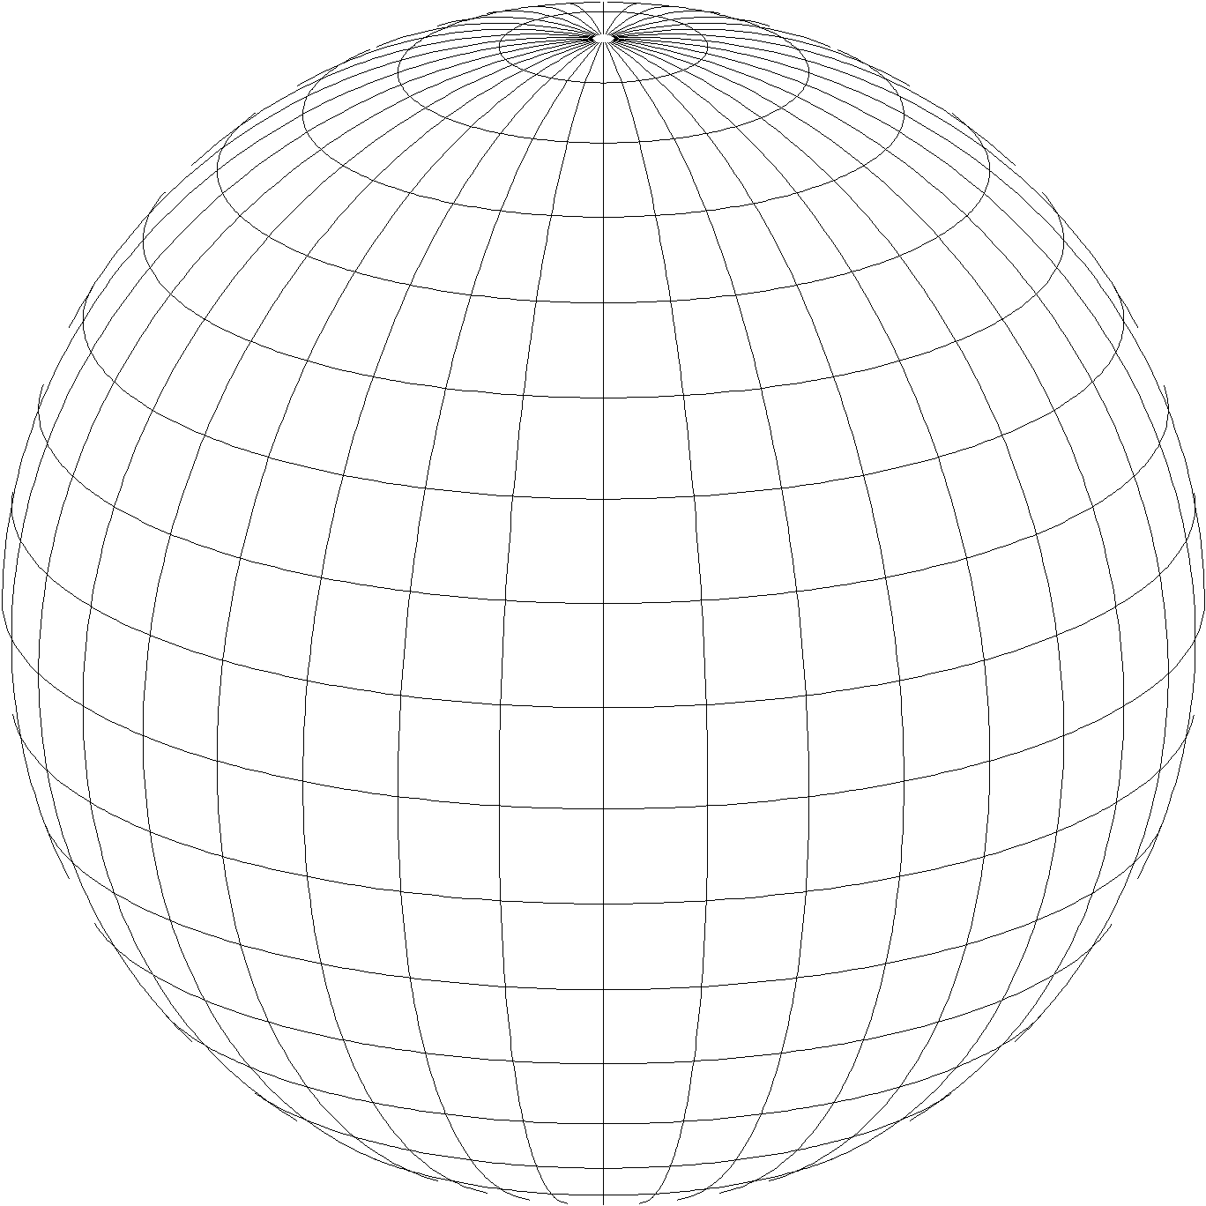
A “flat earth” for the future
State Plane Coordinate System of 2022 (SPCS2022)
Referenced to 2022 Terrestrial Reference Frames
Based on same reference ellipsoid as SPCS 83 (GRS 80)
Same 3 conformal projection types as SPCS 83 and 27:
Lambert Conformal Conic (LCC)
Transverse Mercator (TM)
Oblique Mercator (OM)

Slide 4
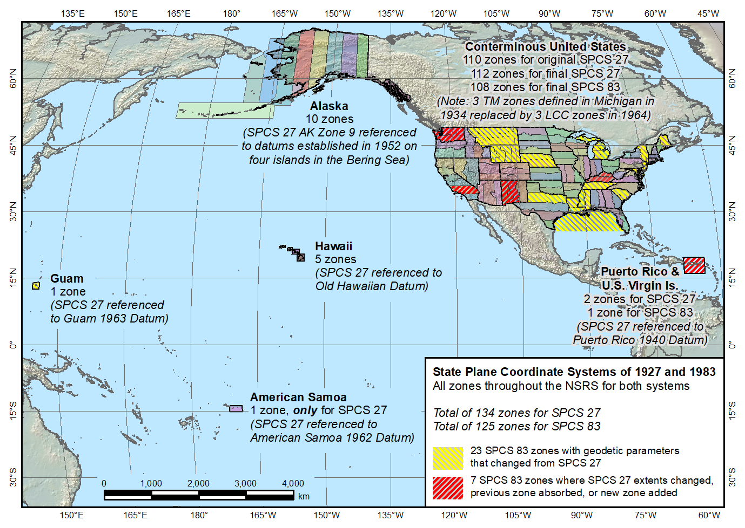
SPCS 83 and 27
State Plane Coordinate Systems of 1927 (134 zones) and 1983 (125 zones)
The shape of things to come for SPCS2022

Slide 5
Getting acquainted with SPCS2022
Distortion design philosophy
Linear distortion minimized at topographic surface (not at ellipsoid surface)
Purpose: to reduce difference between and projected “grid” and actual “ground” distances
Other things:
Zone “layers”
Status of zone designs
The timing of it all…
Notes:
Will go over main general characteristics of SPCS2022 (not enough time to go into detail)
This is based on final SPCS2022 Policy & Procedures (not yet published but most decisions have been made on content)
Final policy & procedures created based in part on public response to the FRN
A key element of SPCS2022 is linear distortion (“scale error”) design requirements
Linear distortion is the difference between a “grid” distance (between the projected coordinates of a pair of points) and the true horizontal “ground” distance (at the topographic surface of the Earth)
SPC2022 zones are designed to minimize linear distortion at the topographic surface, NOT at the ellipsoid surface (as was done for SPCS 83 and 27)
Other relevant characteristics are listed; each will be discussed in this presentation

Slide 6
Map projection linear distortion
Map projection designed to minimize linear distortion on ellipsoid (at “sea level”)
Topographic surface
Horizontal ground distance
Projection surface
Grid (“map”) distance
Grid distance < ground distance
Ellipsoid surface (~“sea level”)
This design approach used for SPCS 27 and 83 (minimizes distortion with respect to ellipsoid)

Slide 7
Map projection linear distortion
Map projection designed to minimize linear distortion at ground surface
Topographic surface
Projection surface
Grid distance ≈ ground distance
Ellipsoid surface (~“sea level”)
This design approach is being used for SPCS2022 (minimizes distortion with respect to topography)

Slide 8
SPCS2022 “layers” and designs
Max of up to 3 zone “layers” allowed
One must be statewide zone
Most states will have total of 2 layers
NGS designs:
Statewide zone for every state
Multiple zones not designed by stakeholders
Many states made requests and proposals
Requests for zones designed by NGS
Proposals for zones designed by stakeholders

Slide 9
Status of zone layout and designs
One layer (statewide): 18 states and territories
Includes combined territories sharing 1 zone
Puerto Rico and U.S. Virgin Islands
Guam and Commonwealth Northern Mariana Islands
Two zone layers: 28 states
Three zone layers: 10 states
NOTE: Zones within a layer cannot overlap

Slide 10
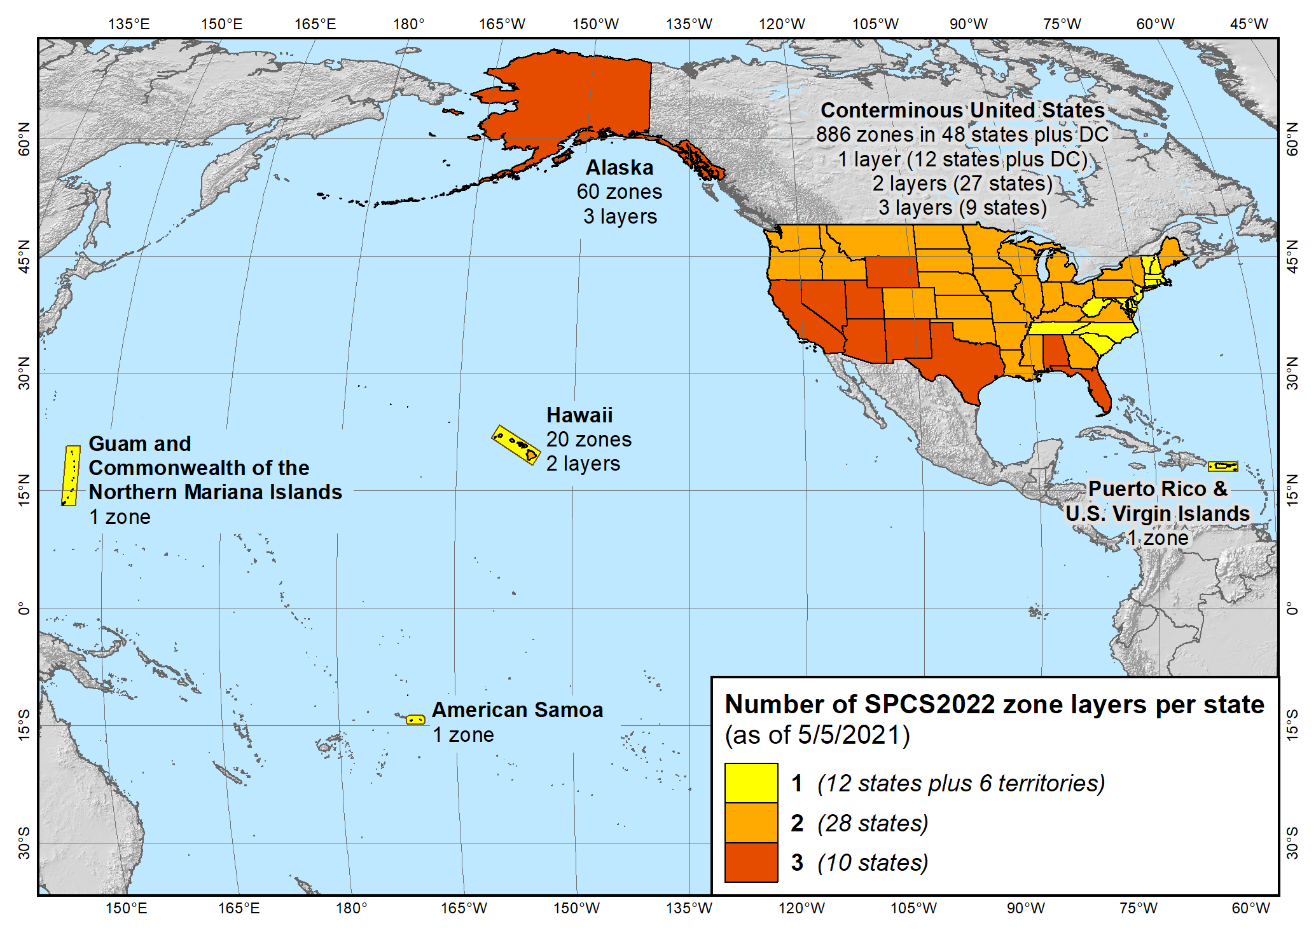
Maps of all SPCS2022 layers
State Plane Coordinate System of 2022 (940 zones in 56 states and territories)

Slide 11
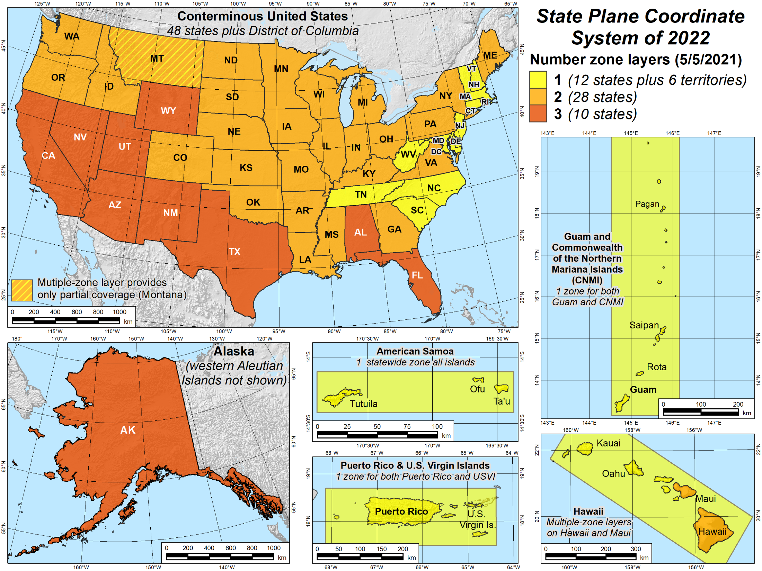
Maps of number of layers

Slide 12
Status of zone layout and designs
Designs by NGS
159 zones (including 54 statewide)
Range from 1 to 22 zones per state (max in Alaska)
Designs by state stakeholders
810 zones in 28 states
Range from 1 to 88 zones per layer (max in Ohio)
Essentially all are “low distortion projections”
Total = 969 zones for 56 states and territories
Number may decrease, but will not increase

Slide 13
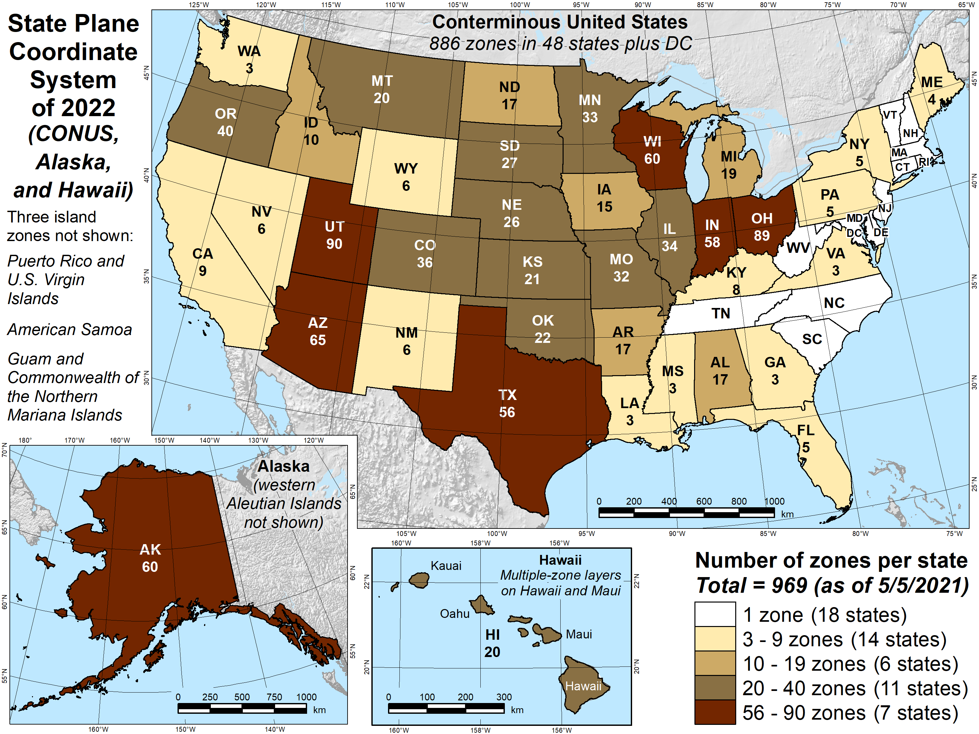
Map number of zones

Slide 14
SPCS2022 zone designs
All designs so far are PRELIMARY
Begin finalizing designs NOW
Compile and compare all designs
Ensure consistent and correct
Get stakeholder input before finalizing
Provide preliminary complete parameters
Solicit input from stakeholders 2021/2022
Finalize after stakeholder input

Slide 15
About the timing of it all…
Finalize all designs in 2022 (maybe later…)
Other things in 2022 (maybe later…)
Provide machine-readable definitions
SPCS2022 report
Modify NGS algorithms (e.g., 1-parallel Lambert)
Official release with rollout of modernized NSRS
Final definitions available in 2022 (maybe later…)
But will not release before modernized NSRS
Likely after 2025…

Slide 16
But I want to use SPCS2022 now!

Slide 17
But I want to use SPCS2022 now!
Some want to use designs with NAD 83
Same reference ellipsoid
Near identical performance
Can reference to NAD 83, however:
Will not become part of SPCS 83
Will not be supported in NGS products & services
If you use designs with NAD 83:
Change grid origins by large amount
Will help avoid confusion with SPCS2022 version

Slide 18
SPCS2022 summary
Minimize distortion at topo surface, not ellipsoid
Up to 3 zone “layers” allowed
Some layers very similar to existing SPCS 83
Some layers very different
Total 969 zone for initial rollout of SPCS2022
NGS: 159 zones (includes 54 statewide)
Stakeholders: 810 zones in 28 states
Number of zones may decrease, will not increase
Will be implemented along with Modernized NSRS
Earlier usage with NAD 83 will not be supported by NGS
Can change/add/remove zones after modernized NSRS

