Slide 1

Geodetic Vertical and Tidal Datums, focus on South SF Bay, CA
Marti Ikehara, Geodetic Advisor
NOAA’s NGS, Sacramento
Marti.ikehara@noaa.gov

Slide 2
Agenda, Part I
GEODETIC VERTICAL DATUMS
The World According to Garpodesy
-Definitions: ellipsoid, datum, reference frame, datum realization, epoch date
-Geoid model: What does it do?, Geoid data in California
Vertical datums: NGVD29, NAVD88
GPS/GNSS Technology
-How does it work? Why doesn’t it work sometimes?
-RTK versus Static methodology (Height Modernization techniques)
-Real world data example from a current Ht Mod project
Retrieving Geodetic Vertical Control data
Understanding Vertical Control info on an NGS Datasheet
-Digit significance, accuracies
-Metadata (datum tags, epoch dates)
-Superceded data

Slide 3
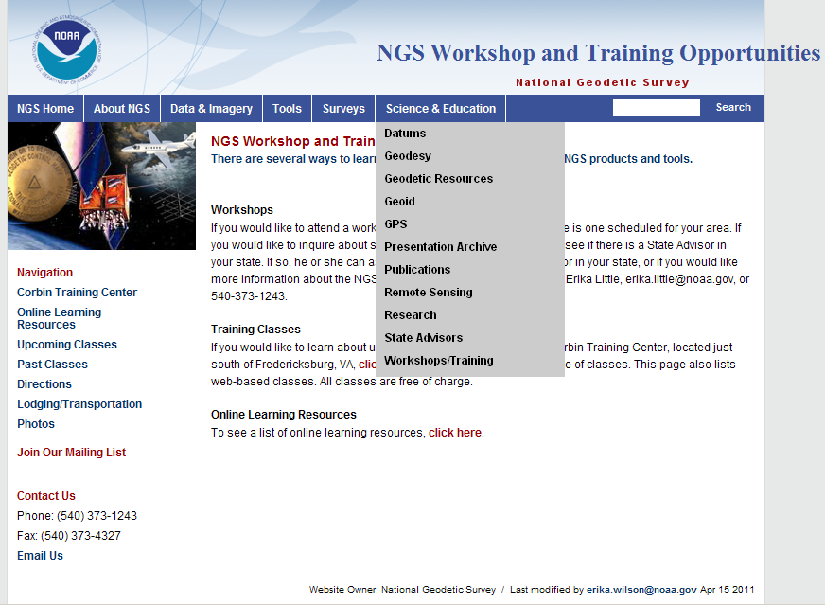

Slide 4
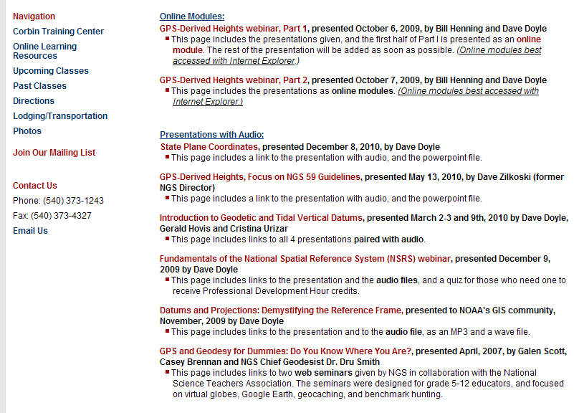

Slide 5
The World According to Garpodesy
Vertical data now measured with GPS so we must understand GPS (3-D) coordinate system
Geodesy: study of size & shape of the Earth
Earth is represented by an oblate ellipsoid; the a (axis)radius and flattening parameter 1/f
Ellipsoid utilized by many is GRS80: Geodetic Reference System of 1980
World Geodetic System of 1984 (WGS84) ellipsoid used by DOD for GPS

Slide 6
DEFINITIONS of ELLIPSOIDS USED in U.S. and the datums based on them
CLARKE 1866 (NAD 27)
a = 6,378,206.4 m 1/f = 294.97869821
GEODETIC REFERENCE SYSTEM 1980 - (NAD 83)
a = 6,378,137 m 1/f = 298.257222101
WORLD GEODETIC SYSTEM 1984 - (WGS 84)
a = 6,378,137 m 1/f = 298.257223563
Notes:
There have been several different ellipsoids used for the horizontal datums of the United States. As part of the activity to complete the North American Datum of 1983 (NAD 83), in 1979, the National Geodetic Survey decided to adopt the Geodetic Reference System 1980 (GRS 80) as recommended by the International Association of Geodesy, as it most closely reflects the size and shape of the entire globe. It should be noted that GRS80 is for all practical purposes, the same size and shape as the World Geodetic System of 1984 (WGS 84) ellipsoid used with the Global Positioning System (GPS). The small numerical differences in the flattening (1/f) amount to less than 0.1 millimeter from the most northern part of Alaska to the southern tip of Florida!!

Slide 7
WHAT IS A DATUM?
It is a geographic system for coordinates or heights, so a datum has an origin and/or ‘zero’.
“Underlying” a horizontal or geometric datum system is an ELLIPSOID, that represents the global shape of the earth; a geometric DATUM is the ‘continental’ shape as measured with physical marks (passive or active) that have been related by geodetic surveying
NAD83 was thought to be geocentric but with addition of GPS data, we found out that it is not
Notes:
While this definition pertains to a horizontal or vertical datum, the focus at the moment is horizontal or what we now call geometric, eg, 3-D, which is horizontal coordinates and ellipsoid height

Slide 8
Simplified Concept of NAD 83 vs. ITRF## (or WGS84)
h##
Earth’s
Surface
h₈₃
IDENTICALLY shaped ellipsoids (GRS80)
a = 6,378,137.000 meters (semi-major axis)
1/f = 298.25722210088 (flattening)
ITRF ##
Origin
2.2 meters
NAD 83
Origin
Notes:
8
ITRF (International Terrestrial Reference Frame)
Ellipsoid heights NAD83 vs. ITRF00/WGS84 - Defined origins were best estimate—at the time, with conventional, non-GPS geodetic data-- of the center of mass; NAD83 is not geocentric but ITRF and WGS84 are.

Slide 9
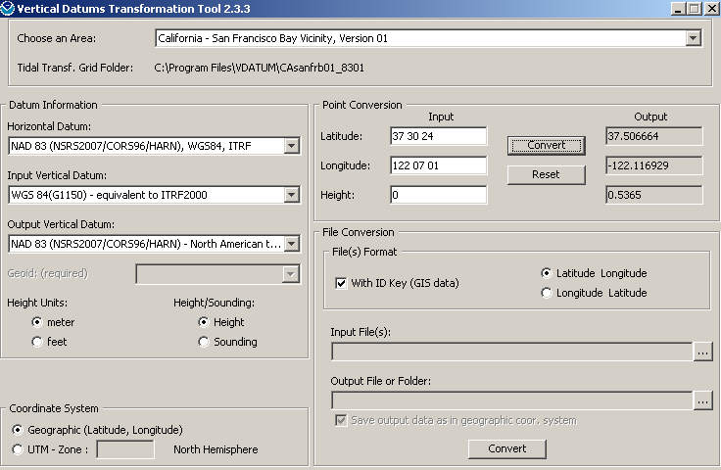
Notes:
While WGS84, NAD83, and ITRF can be considered equivalent-for the purposes of this model-, for the horizontal datum, they are NOT equivalent for the vertical datum. This example shows that there is >0.5 m difference in height between WGS84 and NAD83. So, if your bathymetric data is collected in WGS84, do not assume that it is the ‘same as’ NAD83 vertically. Note there is an option to switch to ‘Sounding’ instead of “Height’.

Slide 10
What is a reference frame?
A fundamental (the highest accuracy) geodetic 3-dimensional coordinate system that includes velocities (dynamic). It can also be a “datum”.
ITRF is a global geodetic system that is based on data from continuous GNSS stations. NAD83 datum, at the national level, is transformed from the ITRF system, and is primarily defined by CORS. The first transform was in 1996. Thus, for OPUS solutions, you will see “Refer-ence frame: NAD83 (CORS96).”

Slide 11
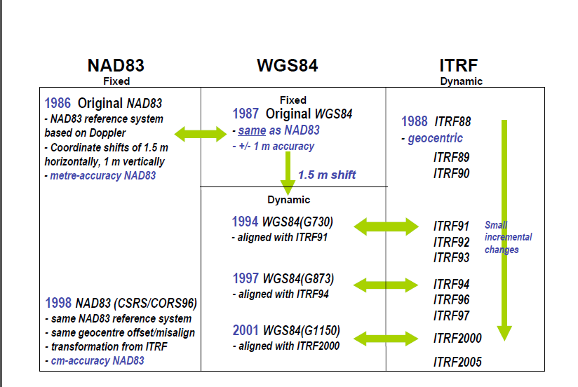
http://www.naref.org/transf/nad83_agu2007spr.pdf

Slide 12
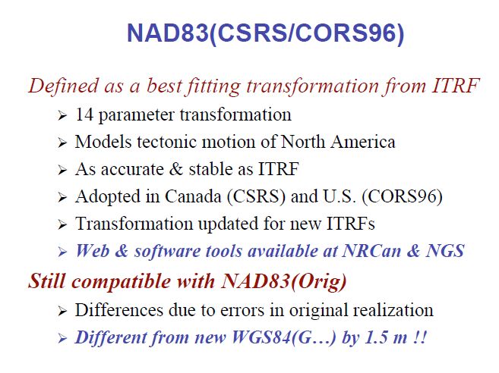
Translation, rotation, scale + TIME

Slide 13
Realizations of NAD83, epoch date
A “realization” is when a major adjustment is done by NGS of the geodetic control, either by state or nationally, resulting in new coordinates and ellipsoid heights, and is identified by a “datum tag”.
Ortho heights are NOT revised.
The realization has different stations in the dataset, and used different control/constraints, and likely different values for them because of crustal motion
There are two types of epoch dates in CA:
  Reflects the time of the field observations, eg, 2002.75, or
  Reflects the time of the recent national adjustment, eg, 2007.00, or a local adjustment constrained to the national, or a statewide (or large project) adjustment by CSRC

Slide 14
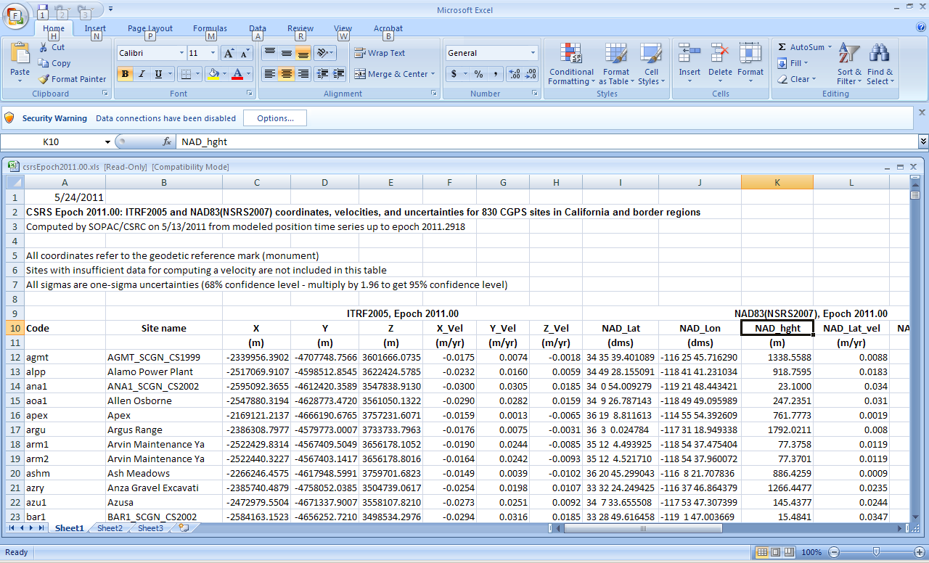
http://csrc.ucsd.edu: NAD hght, 2011.00
Notes:
So, here’s a sample of the 2011.00 epoch corodinates for 830 CGPS sites. Just published 2 weeks ago.

Slide 15
Ellipsoid, Geoid, and Orthometric Heights
H = Orthometric Height (NAVD 88)
h = Ellipsoidal Height (NAD 83)
H = h - N
N = Geoid Height (Geoid09)
H
h
TOPOGRAPHIC SURFACE
N
GEOID 09
Geoid
Ellipsoid
GRS80/NAD83
Notes:
GEOID model provides relation between ellipsoid height (mathematical surface) and orthometric height (land surface)

Slide 16
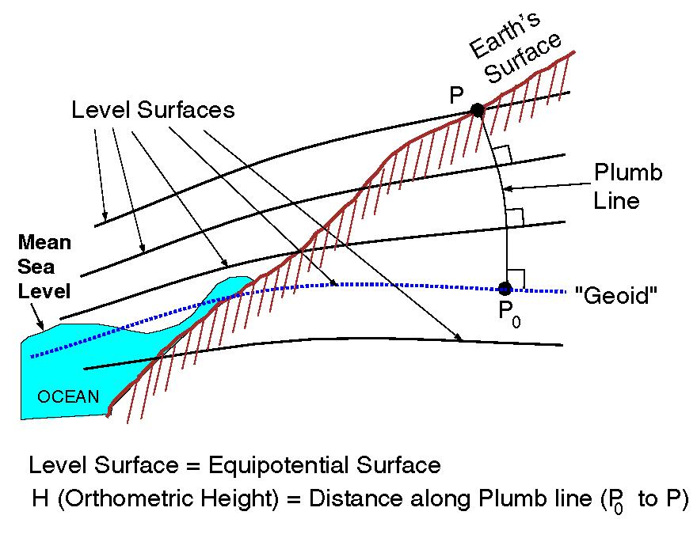
EQUIPOTENTIAL SURFACES
Notes:
A leveling measurement, using a traditional spirit level, is affected or impacted by the gravitational force at the point on the earth’s surface. Equipotential contours are where the gravity potential is the same, equal, and a ‘surface’ along which water will not flow.
It turns out that MSL is a close approximation to another surface, defined by gravity, called the geoid, which is the true zero surface for measuring elevations. Because we cannot directly see the geoid surface, we cannot actually measure the heights above or below the geoid surface. We must infer where this surface is by making gravity measurements and by modeling it mathematically. For practical purposes, we assume that at the coastline the geoid and the MSL surfaces are essentially the same. Nevertheless, as we move inland we measure heights relative to the zero height at the coast, which in effect means relative to MSL.

Slide 17
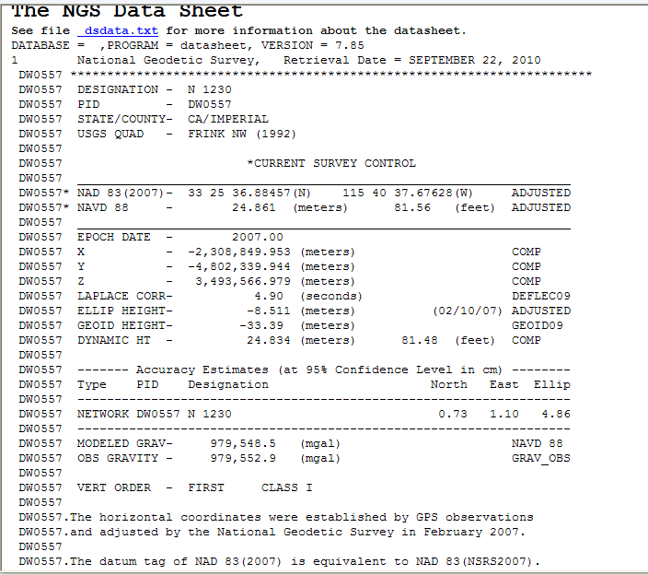
Notes:
The definition of NAVD88 did include some field gravity measurements, as seen for this bench mark in Imperial County. The reason why you adjust the leveling instrument on the tripod is so the internal plumb bob hangs perpendicular—along the plumb line-- to the gravity field experienced at that location.

Slide 18
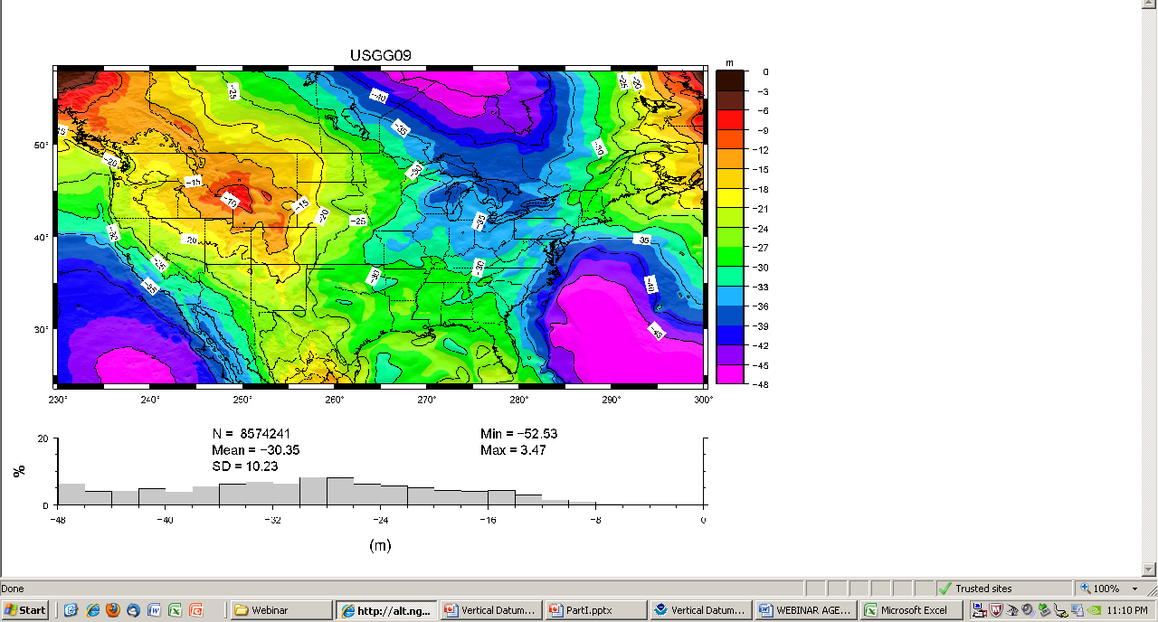
Global Geoid model, satellite data
Notes:
This illustrates the contours, in milligals, of the global geoid model, as determined by satellite data. We start with this and develop a hybrid model for the US by utilizing data points that have leveled NAVD88 heights and NAD83 ellipsoid heights and that are likely to not have moved vertically between those 2 measurements.

Slide 19
GEOID09 compared to GEOID03
09: teal, good; yellow: State advisor-rejected;
red: analysis-rejected
03 (underlying dots): dk blue, kept; orange: rejected
Notes:
New points for 09 include data from Height Modernization projects: Leveling/GPS from BMs to CGPS in southern CA;
GPS data on BMs in San Joaquin Valley and northern CA. Yellow dots represent those HPGN marks that were leveled to from NGVD29 but which were improperly coded as NAVD88 in the database. Their use in G03 probably contributed to the errors in the model in the Central Valley that were seen.

Slide 20
What vertical datums are in use?
Orthometric: NAVD88, NGVD29 (superceded)
Ellipsoid: NAD83, WGS84 (4), ITRF## (11)
Non-tidal: IGLD85
TIDAL
Island datums (HI, PR, VI, AM, GU, MAR)

Slide 21
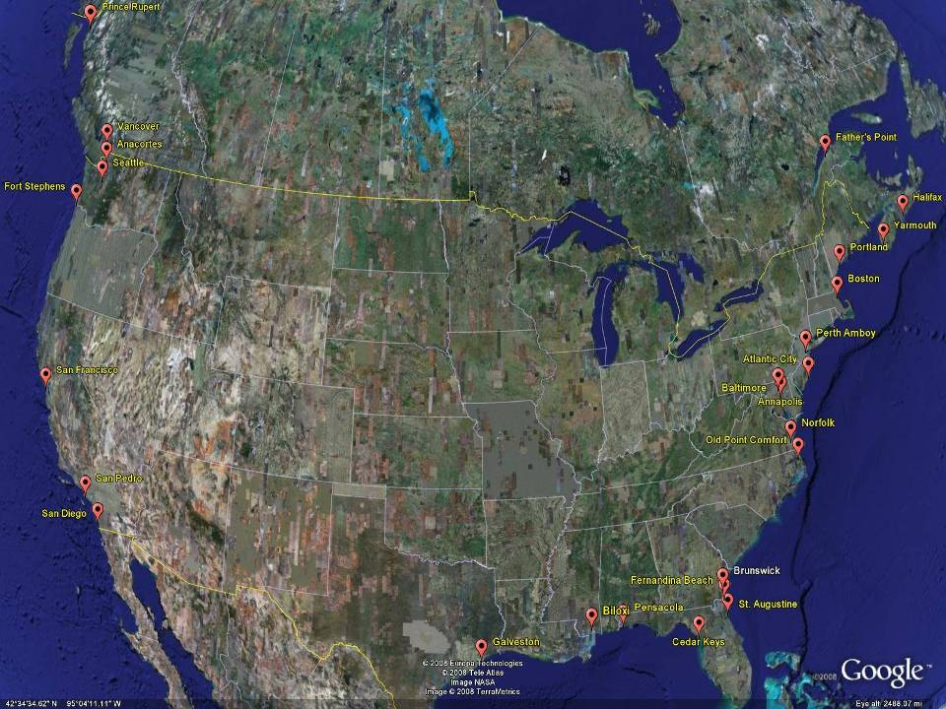
NGVD29
The National Geodetic Vertical Datum of 1929 is referenced to 26 tide gauges in the US and Canada
Notes:
It turns out that MSL is a close approximation to another surface, defined by gravity, called the geoid, which is the true zero surface for measuring elevations. Because we cannot directly see the geoid surface, we cannot actually measure the heights above or below the geoid surface. We must infer where this surface is by making gravity measurements and by modeling it mathematically. For practical purposes, we assume that at the coastline the geoid and the MSL surfaces are essentially the same. Nevertheless, as we move inland we measure heights relative to the zero height at the coast, which in effect means relative to MSL.
Definition: NGVD29 – The National Geodetic Vertical Datum of 1929…
The Sea Level Datum of 1929 was the vertical control datum established for vertical control surveying in the United States of America by the General Adjustment of 1929. The datum was used to measure elevation or altitude above, and depression or depth below, mean sea level (MSL).
Mean sea level was measured at 26 tide gauges: 21 in the United States and 5 in Canada. The datum was defined by the observed heights of mean sea level at the 26 tide gauges and by the set of elevations of all bench marks resulting from the adjustment. The adjustment required a total of 66,315 miles (106,724 km) of leveling with 246 closed circuits and 25 circuits at sea level.
Since the Sea Level Datum of 1929 was a hybrid model, it was not a pure model of mean sea level, the geoid, or any other equipotential surface. Therefore, it was renamed the National Geodetic Vertical Datum of 1929 (NGVD 29) in 1973. The NGVD 29 datum was subsequently replaced by the North American Vertical Datum of 1988 (NAVD 88) based upon the General Adjustment of the North American Datum of 1988.

Slide 22
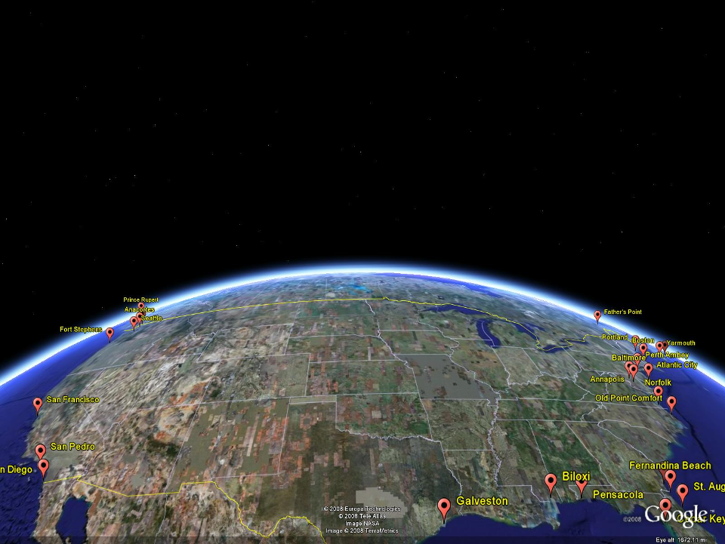
NAVD 88
Referenced to 1 Tide Gauge
(Father’s Point)
NGVD 29
Referenced to 26 Tide Gages
-11 cm
125 cm
-23 cm
85 cm
102 cm
NAVD88 minus LMSL(1960-1978)
70 cm
-11 cm
4 cm
-23 cm
Notes:
NGVD29 consisted of the national vertical network referenced to 26 tide stations along the coast of North America
Click
That network was warped or twisted to fit those tide stations. The difference between the geoid (what we run levels on) and LMSL is not the same for every tide station due to prevailing winds, ocean current, etc. It is that difference that warped the network.
Click
NAVD88 utilized additional leveling data along with gravity measurements (to measure the geoid) and was referenced to only one tide station on the St. Lawrence Seaway. As you can see in the graphic, the network was unwarped which changes those reference mark’s elevations (differences between NAVD88 and the local mean sea level shown) This is not the difference between NAVD88 and NGVD29 but it is a representation of what happened.

Slide 23
GPS Technology wrt getting Heights
GPS radio receiver does calculations to determine, for each satellite viewed, the number of integers (ambiguity) of full-phase cycles of the carrier phase of the GPS code embedded on the signal between the satellite and the receiver.
If/when that solution is correct, the calculated distance (range) is correct and triangulation is likely to be correct.

Slide 24
Why doesn’t it ‘work’ sometimes?
Triangulation works best when the knowns are well-distributed not clumped.
No signals can come from ‘below’ the unknown point so all the calcs are from above
WEAK signal coming from 24K km above
Error fr: Ground, Air, Equipment

Slide 25
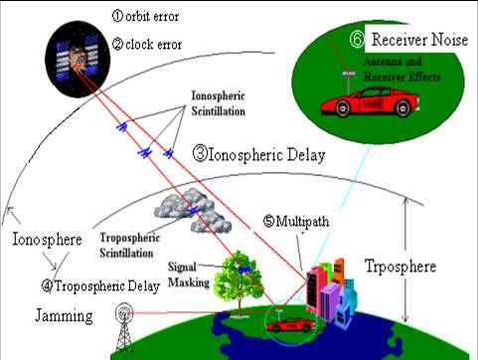
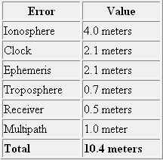
SOURCES OF ERROR in GPS SIGNAL RECEPTION

Slide 26
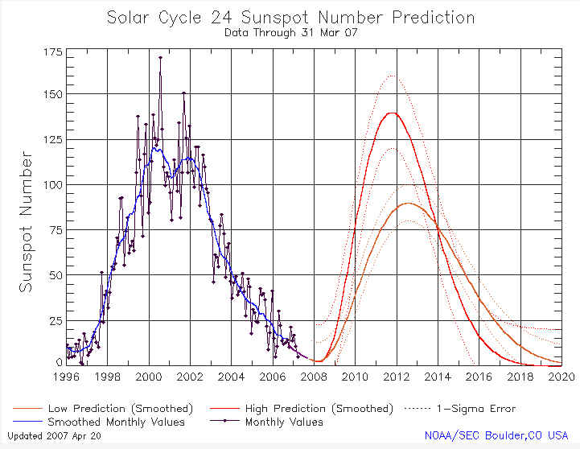
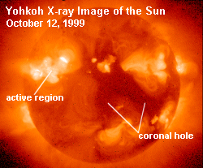
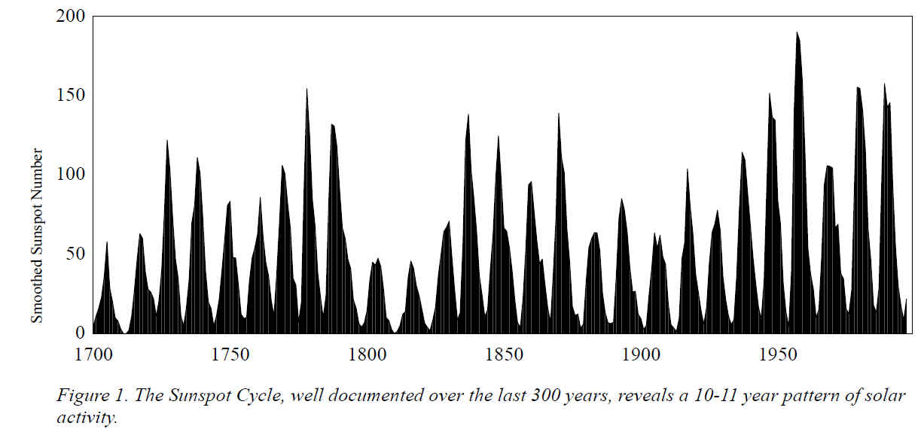
SUNSPOT CYCLE
WWW.SWPC.NOAA.GOV
Sunspots normally follow a regular 11 year cycle
We are on the rising leg of the current cycle
Sunspots increase the radiation hitting the earth's upper atmosphere and produce an active and unstable ionosphere

Slide 27
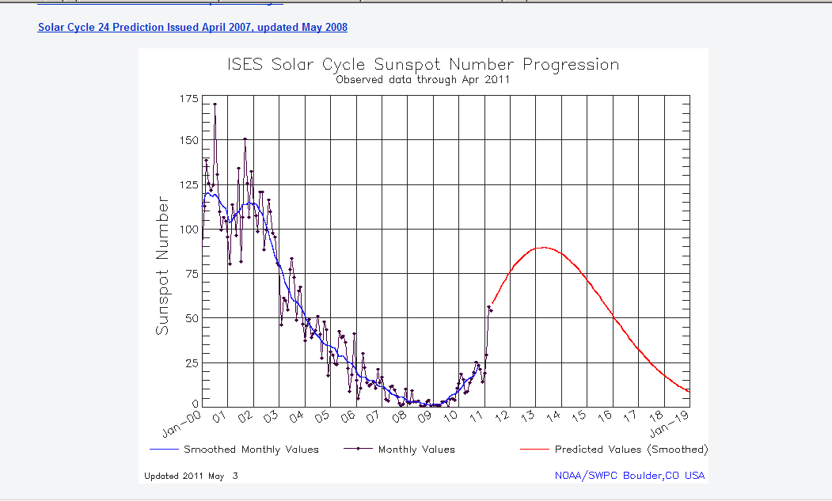
The next solar cycle will be below average in intensity, with a maximum sunspot number of 90. Given the predicted date of solar minimum and the predicted maximum intensity, solar maximum is now expected to occur in May, 2013.

Slide 28
Disruption/jamming/interference
From Sea Surveyor’s report for tide gage installation:
During collection of soundings along the eastern shoreline of South San Francisco Bay, an unknown microwave source (possibly radar from Oakland International Airport) occasionally disrupted the differential corrections being received aboard the survey vessel. The field survey crew found that placing metal shielding on the north side of the differential GPS antenna eliminated the microwave disruptions.
Military airborne or airport operations can interfere.

Slide 29
SV 20
SV 20
SV 14
SV 14
Different
Phase Patterns
Note that SV elevation and varying phase patterns affect signal interpretation differently
Antenna
Type A
Antenna
Type B

Slide 30
RTK technology/methodology
Limited to 10-20 km because ionosphere changes enough that correction may be wrong
Horizontal calcs from triangulation are/can be good but vertical is much harder
3 signals at risk: each GPS unit, and correction
PRECISION can be very good, but ACCURACY not as likely
  Darts clustered in triangle 1, but aiming for 20
  Darts scattered but evenly distributed fr bullseye
Redundancy is always key; for vertical, it is crucial
Repeat measurement with a different satellite constellation

Slide 31
Height Modernization procedures, “Long Static”
Dual-frequency rx, fixed height poles
Redundancy: EVERY baseline observed twice
DIFFERENT TIME OF DAY, >3 hours difference
  This assures accuracy not just precision because it uses a new set of satellites (an independent obs)
45 (minimum)-60 (preferred) minutes--not 30
Local stn spacing average 7km, <10km
Difference in B1 and B2 <2 cm (25mm)
3 sessions of 5 hours on stns at 40km spacing

Slide 32
Real world data, Delta Ht Mod project
A baseline has an ellipsoid height difference between two stations
A comparison is made between two (at least) observations made on dif days at dif time of day
They should agree to within 2cm (<26mm)

Slide 33
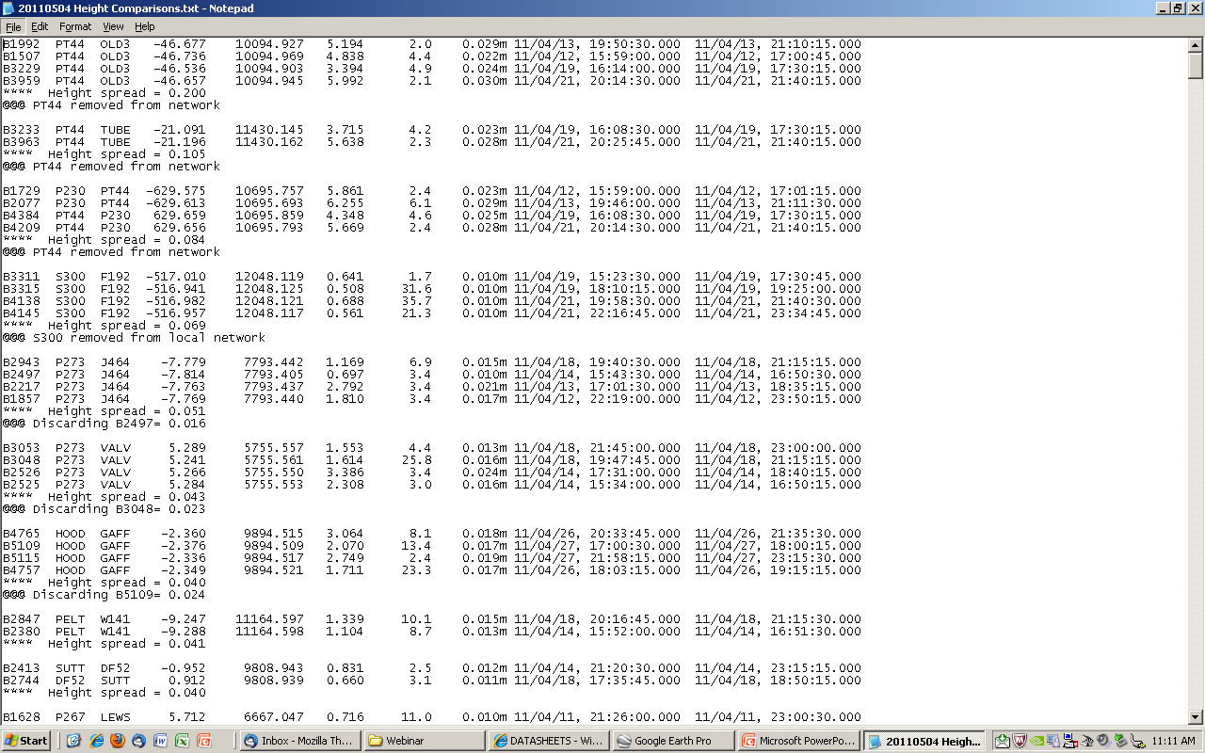
20 cm
10.5
8.4
Why SO bad?
6.9
5.1, 1.6
4.3, 2.3
4.0, 2.4
Notes:
The 3 worst vector groups involve the same station, PT44, so clearly something is wrong. Using Google Earth to look at it, we can see that there are tall evergreen trees very close, so the site is no longer GPS-friendly.
S300 is a CGPS and being on the edge is not necessarily to include in the local network.

Slide 34
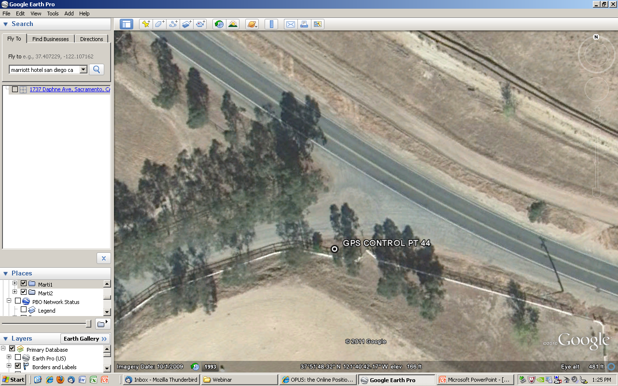

Slide 35
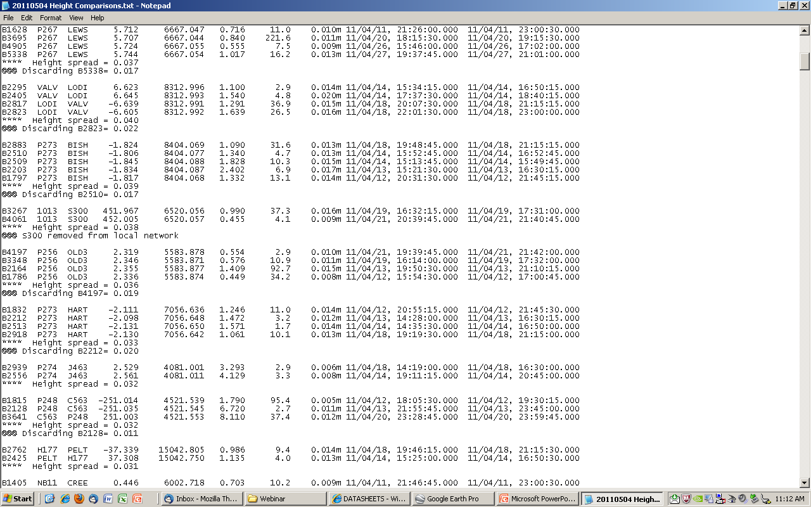
Notes:
After editing/removing outlier baselines when there are more than 2, the worst that can not be fixed starts at 3.1 cm. Which is really quite good. About 5%, which is the norm, of the baselines, eg, 2 stations simultaneously, of this project—both sessions because it is simpler than guessing at which was the bad observation period-- had to be reobserved to meet the 2cm criteria.

Slide 36
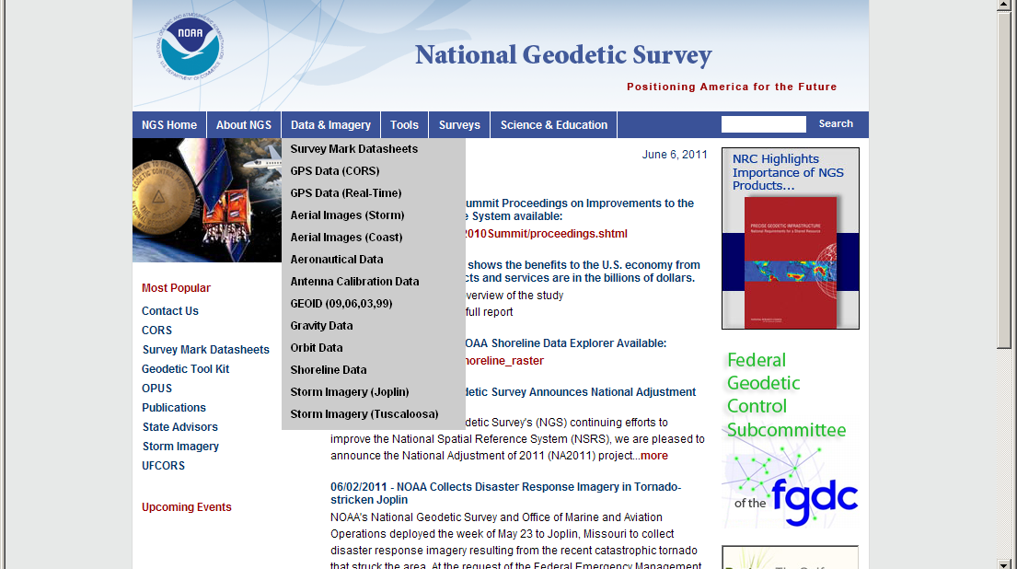
NGS Vertical Geodetic Control

Slide 37
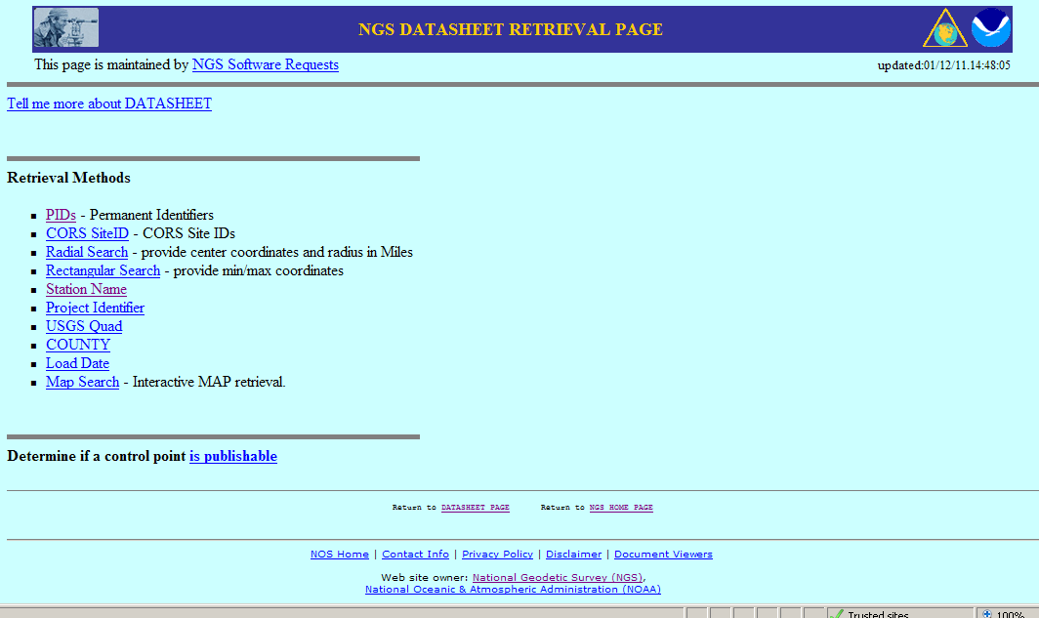
Retrieval options, ASCII text (or shapefiles)

Slide 38
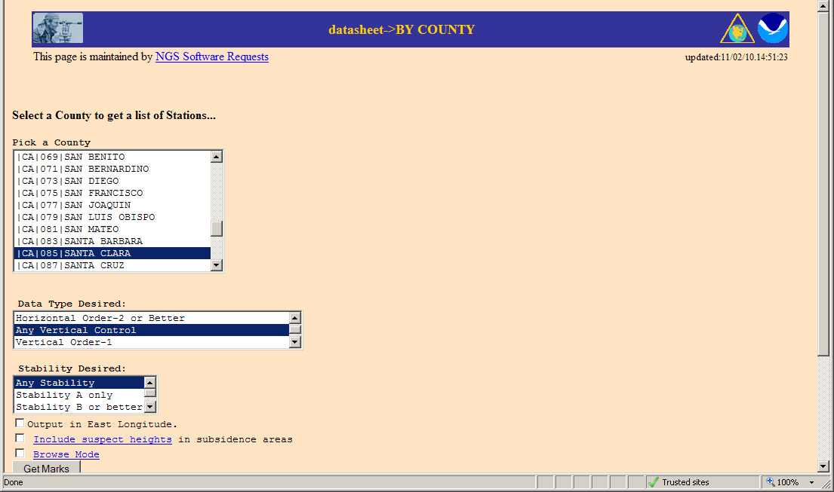

Slide 39
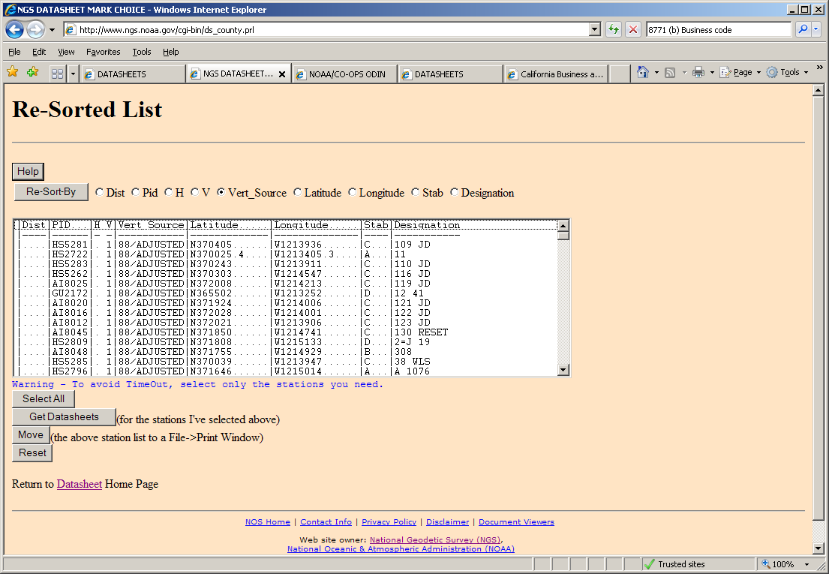

Slide 40
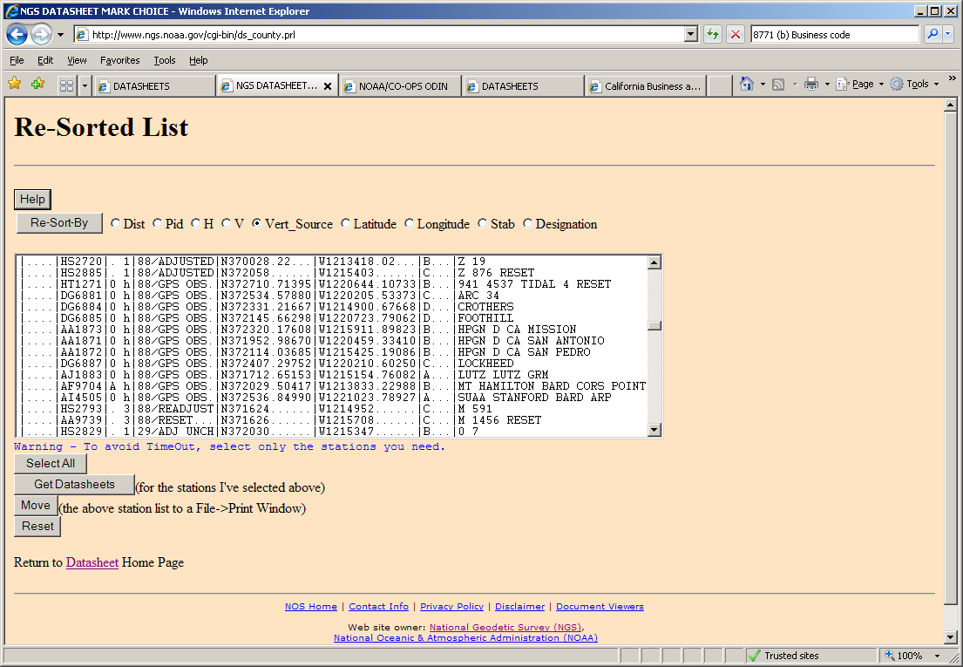

Slide 41
Visualization of NGS Geodetic Control
CA Geodetic Advisor Resources (CGAR) website, hosted by CT Office of Land Surveys webpage
http://www.dot.ca.gov/hq/row/landsurveys/geodetic
  Google Earth kmls
  Google Maps online
  Shapefiles
DSWorld, NGS partner software (shows ALL control; doesn’t symbolize VERTCON differently)

Slide 42
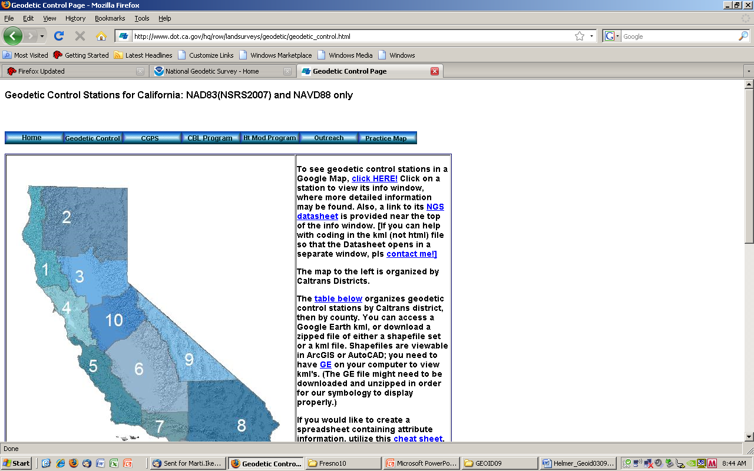
http://www.dot.ca.gov/hq/row/landsurveys/geodetic/geodetic_control.html
Notes:
Shown on the state are the 12 Caltrans districts; the counties are arranged by which CT District they are in.

Slide 43
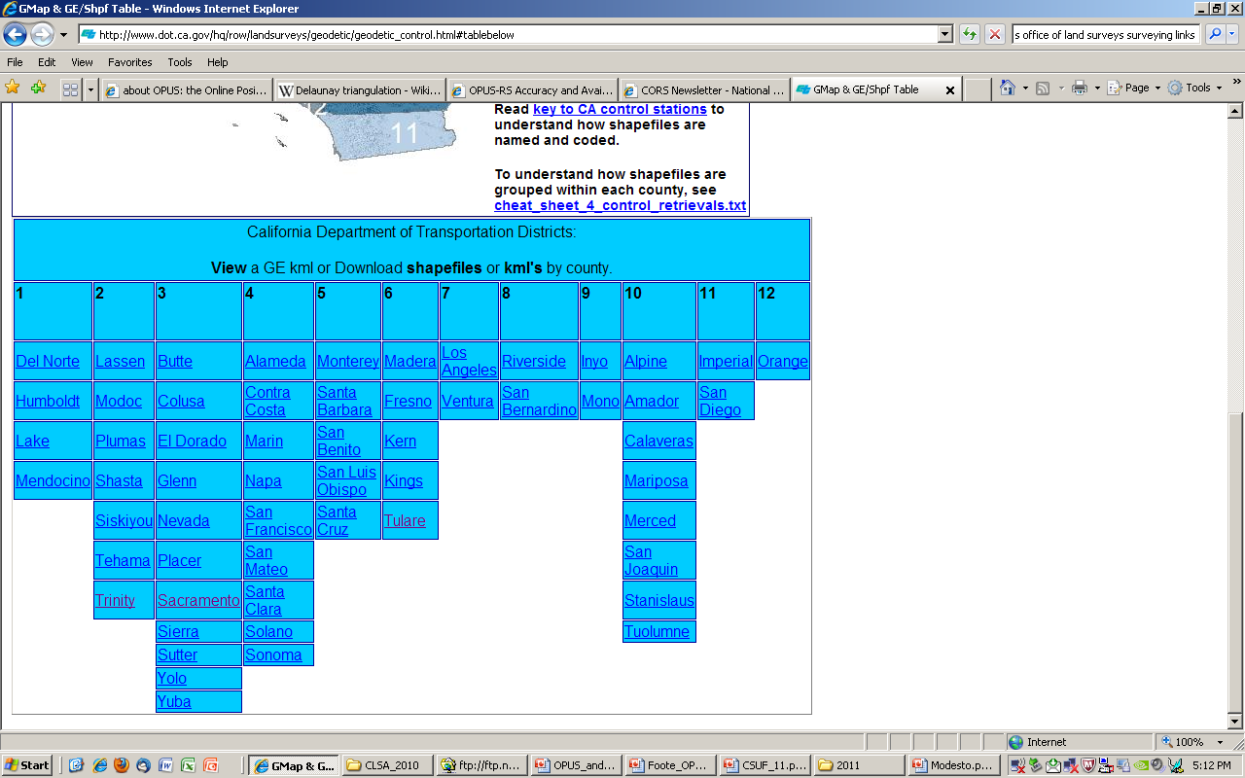

Slide 44
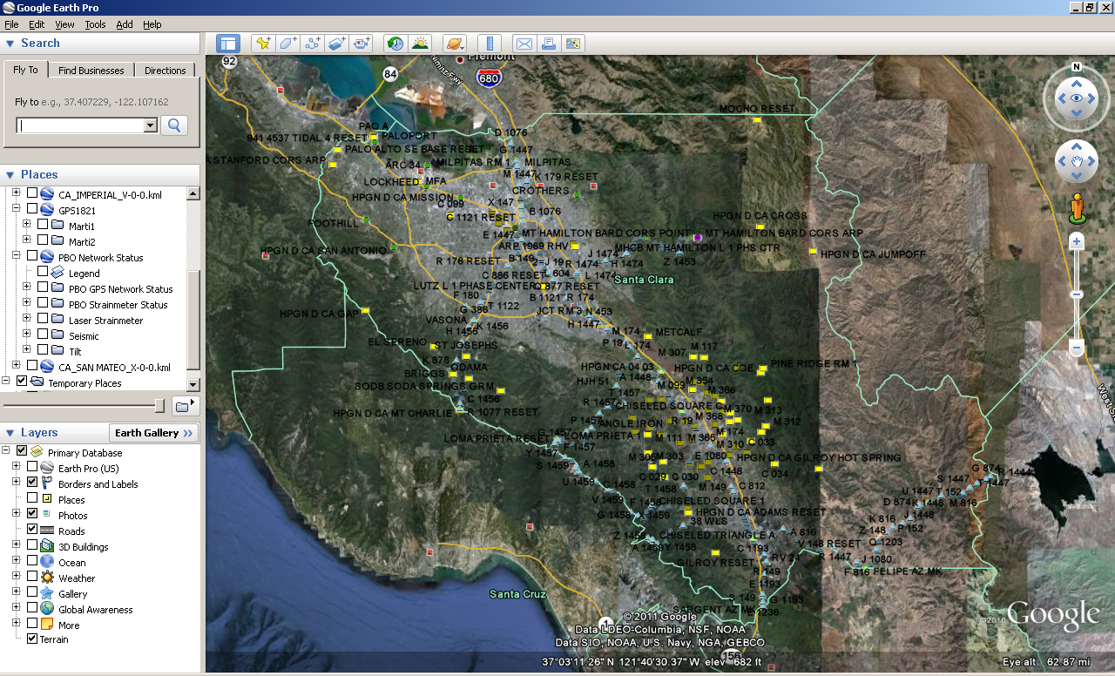

Slide 45
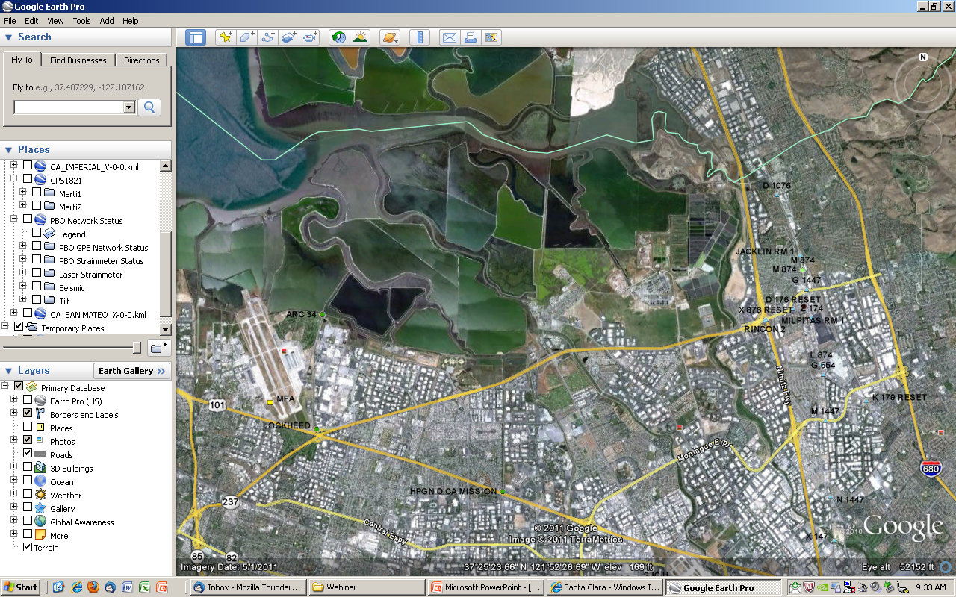

Slide 46
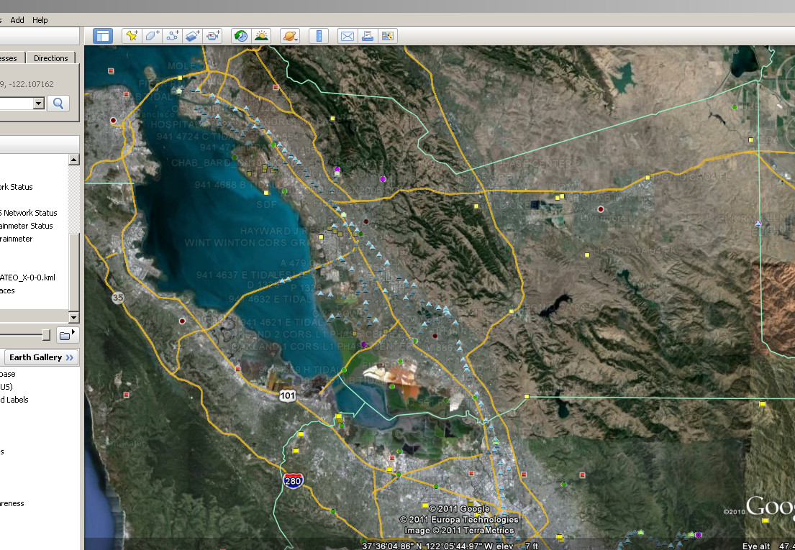
Notes:
Alameda County

Slide 47
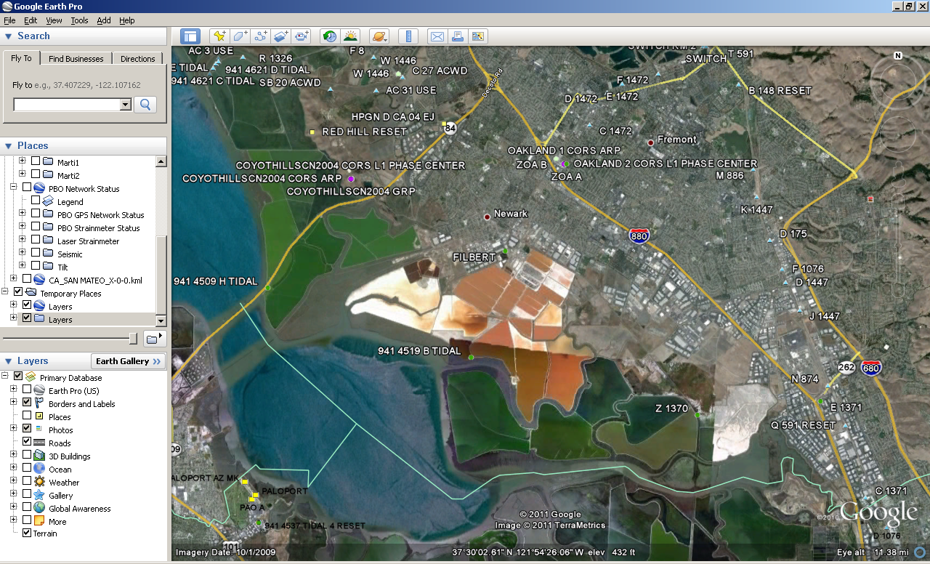
Notes:
Several tidal BMs,

Slide 48
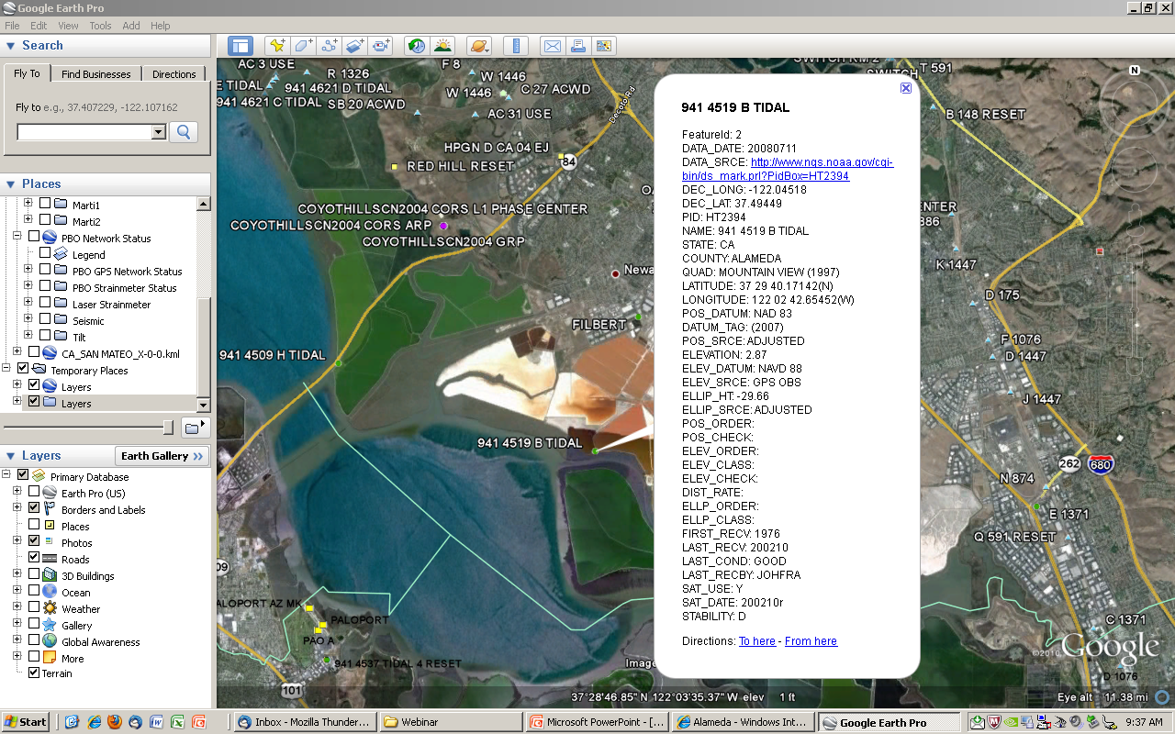

Slide 49
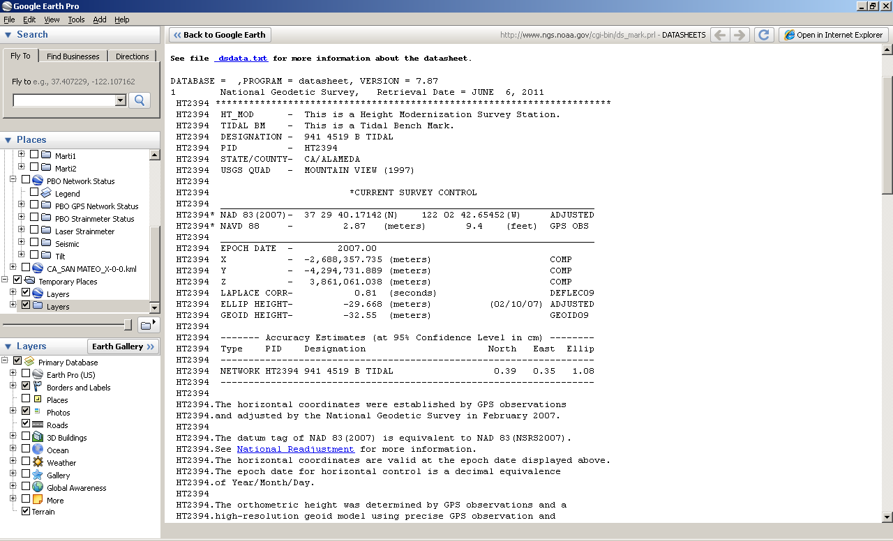
PROTECT this mark at all costs or transfer elevation to something (else) “permanent” or both!
Notes:
With a network accuracy of just over 1cm, this represents the best quality GPS-derived ellipsoid height one can get; it IS part of a Ht Mod survey.

Slide 50
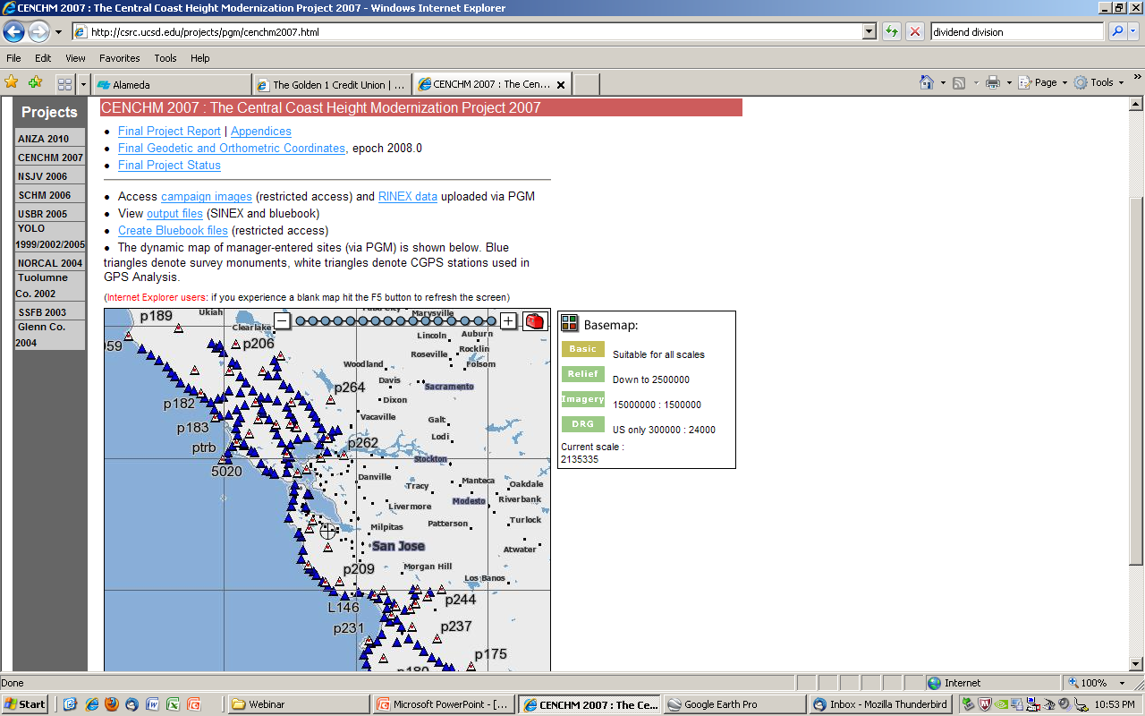
http://csrc.ucsd.edu http://csrc.ucsd.edu/projects/pgm/cenchm2007.html
Notes:
Central Coast Ht Mod project is another source of Ht Mod elevations.

Slide 51
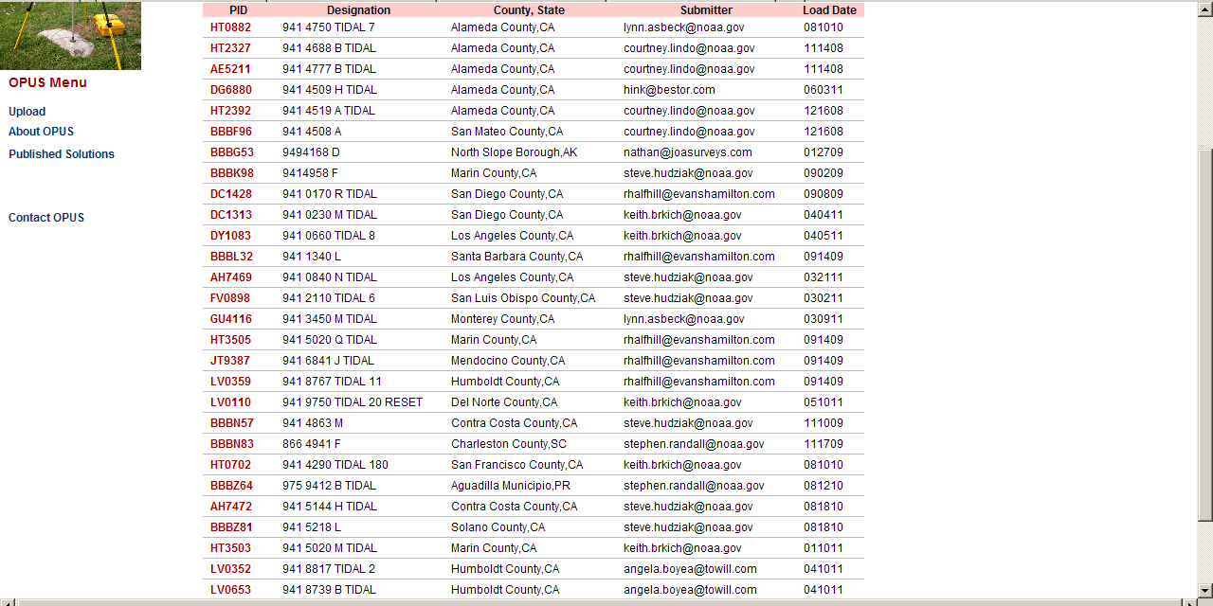
Search option: Name includes ‘941’
PID format:
AA####: HAS leveled ht; may be NGVD29
AAAA##: NOT in old NGS database, so no geodetic ht

Slide 52
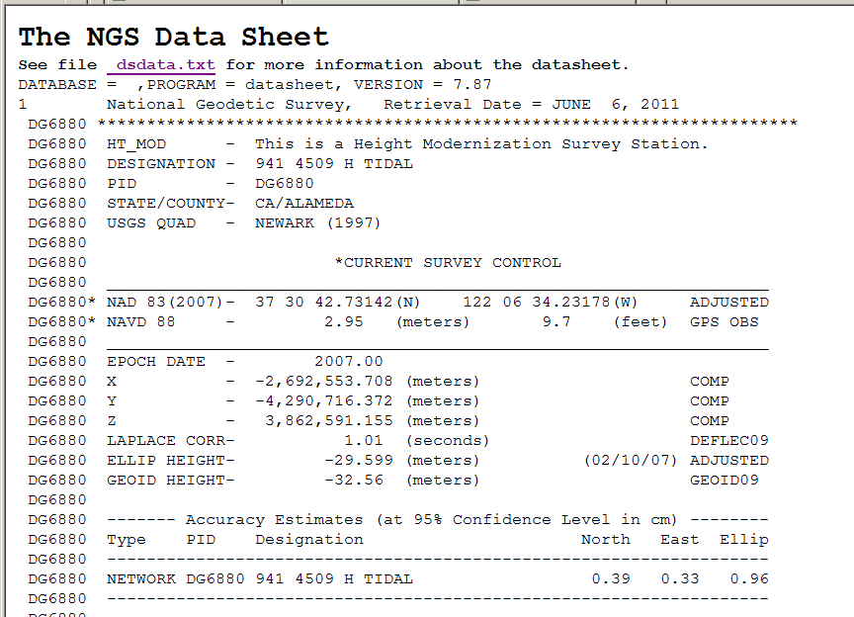
Notes:
1. First, let me explain digit significance, because I’ve seen our published heights misused in some documents for work done around here. The NAVD88 height is NOT 2.950 meters; it is 2.95 meters; for feet, it is NOT 9.70 feet or 2.95 divided by the quotient of (1200/3937)-- which is the official conversion factor for U.S. Survey foot-- which would result in 9.68 feet. It is 9.7 feet. Do NOT add to the significant digits just because you want to, unless you are looking strictly at relative differences in height in a local sense.
2. Next, the unshown error bars for the ortho height. For ellipsoid height, we give the network accuracy, relative to the NAD83 datum; in this case, it is 0.96 cm, which is about the best you can get, which is because the observations were performed to Ht Mod specs. The uncertainty for the ortho height, although published to cm, is not + or – 1cm; it is + or – 5 (five) cm. Easily. The error for geoid models, in California, has been in the 5-10 cm range. And the uncertainty for the ellipsoid height is added on. So, we publish to cm, but the best one can say is that the elevation relative to the NAVD88 datum is +/- 5cm, and +/- 10cm would be more conservative. Now, the LOCAL ACCURACY, which is the relative accuracy of the height compared with the heights of adjacent geodetic control marks, is generally between 1 and 5 cm. We plan to start publishing those accuracies later this year; the table will show what neighboring stations were observed simultaneously in all projects in the database.

Slide 53
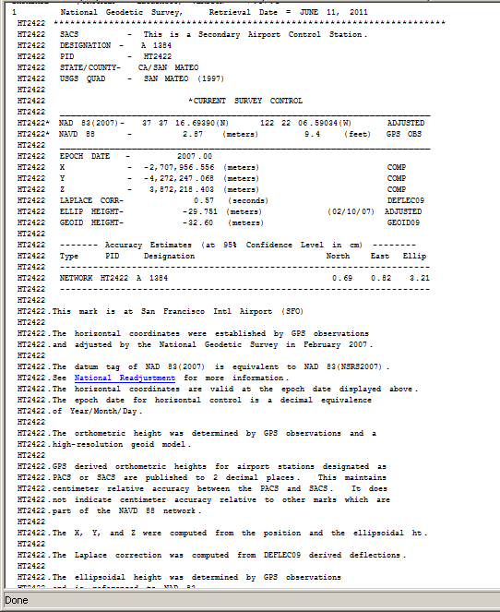
Shown to cm
No HtMod note at top
METADATA is to be read!

Slide 54
GPS derived orthometric heights for airport stations designated as PACS or SACS are published to 2 decimal places. This maintains centimeter relative accuracy between the PACS and SACS. It does not indicate centimeter accuracy relative to other marks which are part of the NAVD 88 network.

Slide 55
Notes:
3) Now, let’s read this datasheet for info about datum tag, epoch date, adjustment date
The 2007.00 epoch date with adj date of 2/10/07 was National Readjustment, NOT fieldwork epoch. Datum tag is (2007). Now go down and look at superceded data

Slide 56
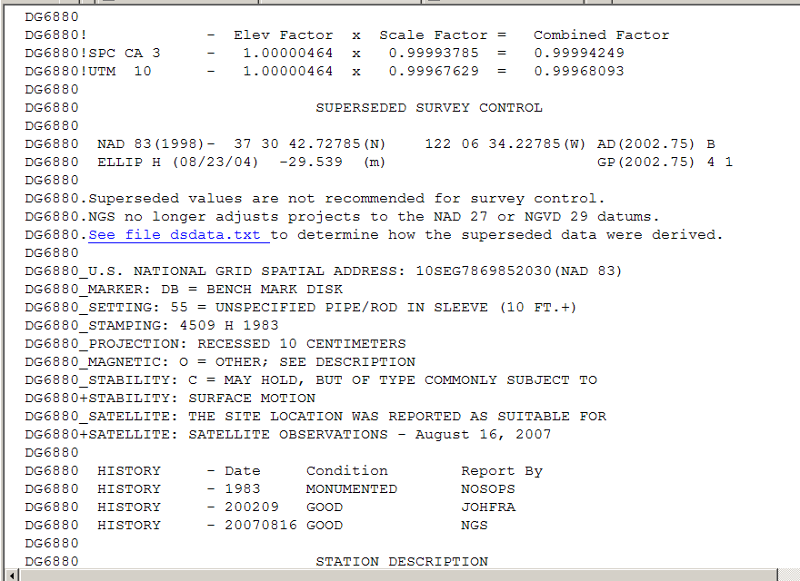
Notes:
Datum tag is (1998); epoch is 2002.75; this IS when field work was done. “Verified’ by history entry of Sept 2002 by surveyor. Because tag is different, ellipsoid heights NOT exactly comparable; this shows -29.539; current is .599, -6cm lower. FYI, the difference in ellipsoid heights of the Cargill mark—same datum tags as this example-- was also about 6cm. But again, do NOT compare for the purpose of determining subsidence, say.
Note adjustment date of 8/23/04; even tho field work done in Sept 02, the processing and adjustment and submittal took awhile, I think because it was decided to wait for GEOID03 to be published, which came out 12/30/03, I believe. Note last history entry of 8/16/07; might be tempting to think that epoch date of 2007.00 is because of that visit, but it is not. The 2007.00 epoch and the 2/10/07 date are special. However, the 2007 field visit did result in an OPUS-DB entry, shown next.

Slide 57
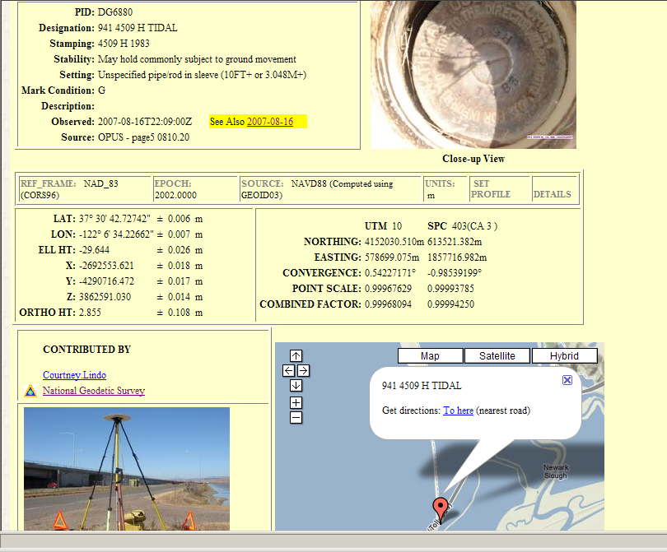
OPUS-DB, 8/16/07: eh: -29.644 +/-2.6cm; oH: 2.855 +/-10.8cm
GEOID03
Notes:
Using the stats provided on the OPUS-DB solution, the range of oH is 2.75 – 2.96.

Slide 58
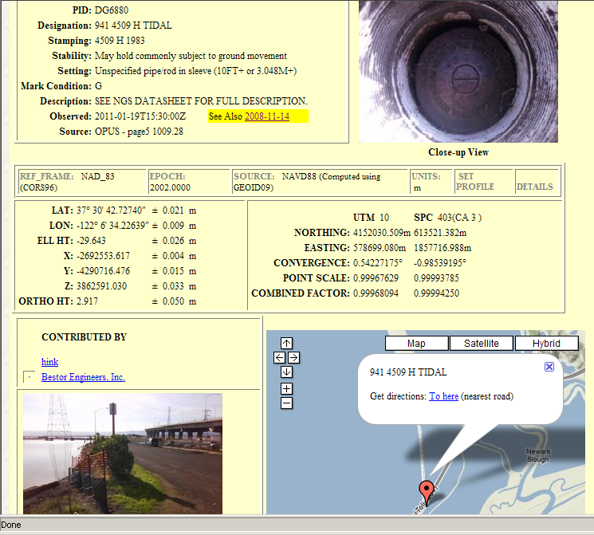
OPUS-DB, 1/19/11: eh: -29.643 +/-2.6cm; oH: 2.917 +/- 5cm
GEOID09
Notes:
This OPUS-DB solution oH range is 2.87 – 2.97. The heights from each solution ARE in the overlapping ranges. I would use the Ht Mod published height of 2.95 +/- 5cm. Note that we publish the ortho ht to mm—we’ve had some vigorous discussions at NGS about doing that or not!; but the important thing to always keep in mind and report as you do your work is the uncertainty.

Slide 59
-29.599 +/-.96cm; 2.95=
-29.539 + GEOID03 (LSA)
Notes:
Even though the ellipsoid height (and horizontal coordinates) were adjusted in 2007, the orthometric height, ref to NAVD88 was NOT. The ellipsoid height that was a component of this calculation is found under superceded control.
The other component is the geoid height and I already said that it used GEOID03, but NOTE that “GEOID09” is shown on the Datasheet. This does NOT mean that GEOID09 was used; we are in the process (a year out) of documenting what geoid model WAS used, and transferring that data to superceded when/if the ortho height gets superceded. We just—5 weeks ago--started showing superceded GPS-derived ortho heights.

Slide 60
ORTHO HEIGHT COMPARISONS
Eht datum tag: 1)NAD83(1998); 1a)NAD83(2007);
2 and 3)NAD83(CORS96)
1.Published Datasheet, 2002.75 epoch(superceded) for the orthometric ht adjustment
-29.539 – (-32.499) ≈[2.96]: 2.95±5cm
1a. [-29.599 ± 0.96cm --current eht]
2.OPUS-DB, 8/16/07
-29.644 ±2.6cm -32.499 [G03] 2.855 ±10.8cm
3.OPUS-DB, 1/19/11
-29.643 ±2.6cm -32.56 [cur ght] 2.917 ±5cm
Notes:
Now, let’s compare heights from 3 solutions, this one from a least squares adjustment of a HtMod project using G03, the next from an OPUS-DB solution from 2007 using G03, and the 3rd fr an OPUS-DB solution using G09, fr Jan of this year, done in conjunction with the tide gage installation. The 2.95m was computed using the .539 eht, which is now superceded. It doesn’t say it, but remember that the generic error for ortho hts of a Ht Mod project is +/- 5cm, so 2.90 to 3.00 is the range.

Slide 61
SUMMARIZE
Geodesy: representing the Earth and defining a system for coordinates and heights
GPS Technology: difficult to get heights
Real-world data, errors up to 20 cm!
Where to get NGS vertical control
Interpreting quality, age of data reading metadata on NGS Datasheets
BREAK!

Slide 62
Utilization of ‘heights’ from NGS
NGS adopting new reference frame for CORS, the active component of NSRS, this July: IGS08 (2011), epoch 2005.00
National adjustment of passive component of NSRS by year end (we hope): NAD83 (2011), epoch 2010.00
Ellipsoid hts will change again, but NOT ortho
Because GEOID models keep changing, can I just look at and compare ellipsoid heights over the years? They are not directly comparable because of the different datum tags and different scope and constraints (fixed stations) in each project.
Notes:
I should make you aware of two developments this year. NGS will adopt IGS08 for the CORS reference frame or datum and publish new coordinates, at epoch 2005.00, which is the official epoch associated with that ref frame. Thereafter we will be doing another national adjustment
of the passive component of the NSRS, which will have an epoch date of 2010.00 for the NAD83 datum, so OPUS results will change from 2002.00 to 2010.00 epoch.

Slide 63
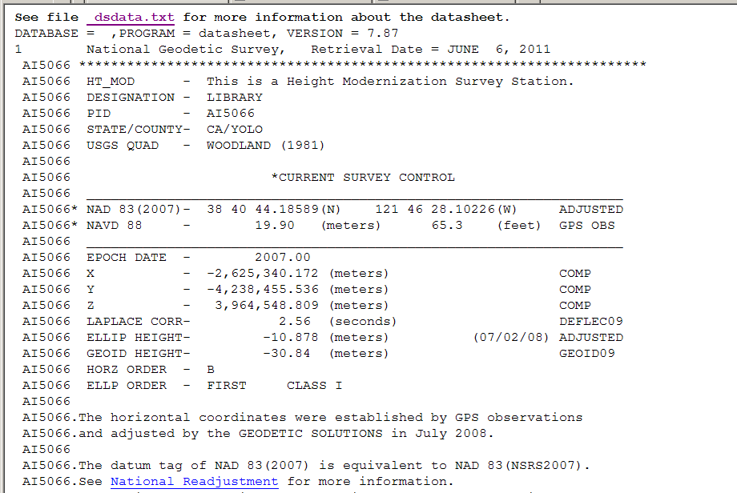
Notes:
Altho epoch date is 2007.00, adjustment date– in ( )– is not 2/10/07. So, this is not part of national re-adjustment, and the missing network accuracies are also a clue. So in this case, the 2007.00 represents a local survey that used the previously published 2007.00 values as a constraint for this adjustment, which was done in July 2008. History shows fieldwork was 1/1 2008, which indicates that just the year was put in; in looking at other stations in this project (and personal knowledge), I ascertained that the fieldwork was done in April and May.
Showing GEOID09 model does not mean that it was used. Because the adjustment date is 7/2/08, we know it was NOT used; the model was made available in the 3rd week of Sept/09.

Slide 64
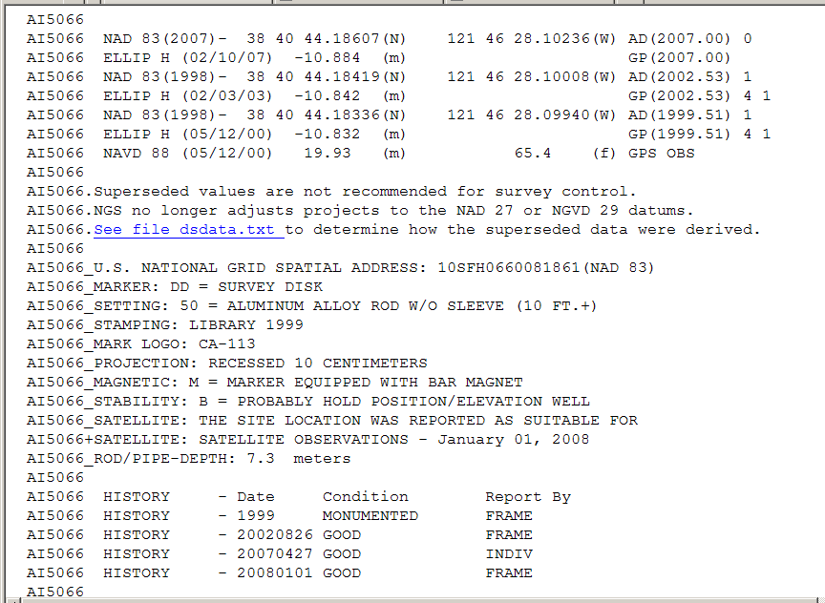
Notes:
First adj was on 5/00, with the midpoint of the field work done in 1991, July; tag was (1998).; 2nd adj was in 2/03 with fieldwork done in July 2002; tag was also (1998). So ellipsoid heights could be compared, remembering that the specific network constraints were likely to not be exactly the same—dif was 1cm lower in 2nd adj. Then 2007.00 national adjustment, so tag of 2007; ht was -10.884; current control, also tag of 2007, shows it to be 6mm higher, which actually makes some sense because this survey was done in the Spring when ground had rebounded, in contrast to all the other surveys which were done in July. Still, remember that all values are within the error bars of 5cm. In subsidence area, so new ortho ht was computed for the 2008; used G03 model, whereas 2000 adj likely used G99. New value is 3cm lower, which is not greater than the error bars but residuals during the least squares adjustment indicate when previously published values should be unconstrained and new heights allowed to be computed. The April 27 2007 visit in the History area was from “just” an interested Individual, and is not connected with any of the data collection efforts.

Slide 65
Agenda, Part II
TIDAL DATUMS in the South SF Bay
Computing Tidal Datums
-Basic tidal computations
-Common tidal datums
VDATUM
-Sources of error
-Sample values
Bathymetry mapping effort (2005)
-Tidal zonation in South SF Bay for MLLW datum
Preliminary data from new (2011) tide gages
-Dumbarton (9414509)
-Coyote Ck/Alviso Sl (9414575)
Notes:
You’ll be able to tell that I took most of the slides in this next section from CO-OPS webinar. As my last slide, I’ll show you where to find several webinars on Geodetic Vertical and Tidal Datums on NGS webpages.

