Slide 1

Geodetic Control in Texas
Boris Kanazir, Geodesist, RPLS
boris.kanazir@noaa.gov
Virtual TxDOT Survey Conference
December 08, 2020

Slide 2

Outline
Modernized NSRS
Texas Control Issues
Heights Suppression
Tools to Densify Geodetic Control Network
  OPUS Projects
  OPUS Projects for RTK
Modernized NSRS
TX Control Issues
Heights Suppression
Tools to Densify

Slide 3
Decision to Modernize
In 2007 NGS announced its decision to completely change how it approached its mission.
In a word, they chose to modernize the NSRS
Let’s look at the issues that drove that decision, and the direction they decided to go
Modernized NSRS
TX Control Issues
Heights Suppression
Tools to Densify

Slide 4
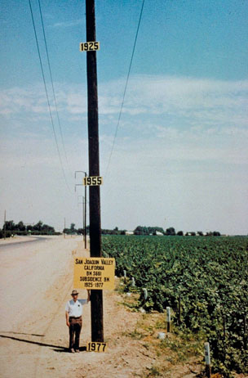
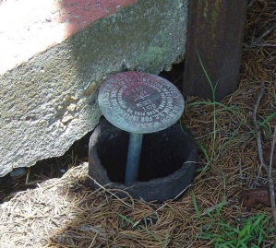
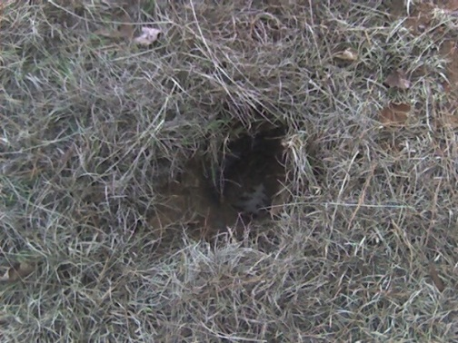
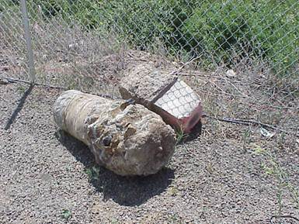
Issues
NAVD 88 suffers from use of passive control that:
Is almost never re-checked for movement
Disappears by the thousands every year
Is not funded for replacement
Is not necessarily in convenient places
Doesn’t exist in most of Alaska
Wasn’t adopted in Canada
Was determined by leveling from a single point, allowing the build up of cross-country error
PID: EZ0840
Modernized NSRS
TX Control Issues
Heights Suppression
Tools to Densify

Slide 5
Issues
NAVD 88 suffers from unknown movements before, during and after its original adjustment
By way of example…
1954: Leveling Performed to bench mark
House
House
House
BM
BM
BM
1991: Original 1954 leveling data is used to compute the NAVD 88 height which is then published for this BM
1954-1991: Subsidence
H₈₈(published)
H₈₈(true)
NAVD 88 zero height surface
Obviously the true height relative to the NAVD 88
zero surface is not the published NAVD 88 height
Modernized NSRS
TX Control Issues
Heights Suppression
Tools to Densify

Slide 6
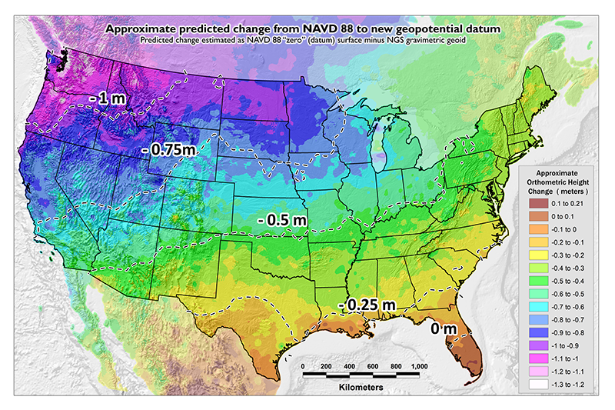
Issues
NAVD 88 suffers from a known bias (50 cm) and tilt (about 1 meter across CONUS) relative to the gravimetric geoid
Approximate level of geoid mismatch known to exist in the NAVD 88 zero surface
PID: EZ0840
Modernized NSRS
TX Control Issues
Heights Suppression
Tools to Densify

Slide 7
Issues
NAD 83 suffers from a 2+ meter non-geocentricity (which misaligns it with ITRF and all GNSS orbits)
Earth’s Surface
h_{ITRF}
h_{NAD83}
ITRF origin
~2.24 m
NAD 83 origin
Modernized NSRS
TX Control Issues
Heights Suppression
Tools to Densify

Slide 8
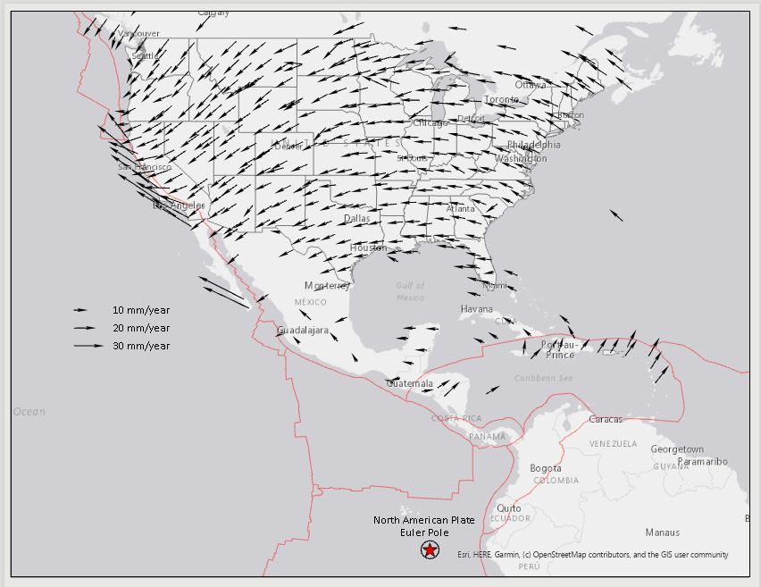
Issues
Geodetic control is usually affixed to a crust that is moving
  Even so-called “plate fixed” frames are only as stable as:
    The rigidity of a plate
    The complete lack of subsidence or uplift
Modernized NSRS
TX Control Issues
Heights Suppression
Tools to Densify

Slide 9
General Direction
Future details would come, but in 2007 the general direction was:
  Replace both NAD 83 and NAVD 88, at the same time
  Transition to a geoid-based vertical datum
  Leverage the rise of GNSS and RTNs
  Completely re-invent “bluebooking”
    Reduce complexity
    Retain ability to standardize geodetic survey files
Modernized NSRS
TX Control Issues
Heights Suppression
Tools to Densify

Slide 10

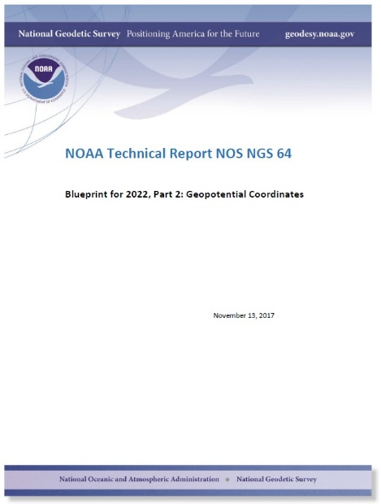

Modernizing the NSRS
The “blueprint” documents: Your best source for information
All three documents are being updated and re-released in 2020!!
Geometric:
Sep 2017
NOAA TR NOS NGS 62
32 pages
Geopotential:
Nov 2017
NOAA TR NOS NGS 64
41 pages
Working in the
Modernized NSRS:
April 2019
NOAA TR NOS NGS 67
77 pages
Modernized NSRS
TX Control Issues
Heights Suppression
Tools to Densify

Slide 11
Replacing the NAD 83s
The Old | The New
NAD 83 (2011) | NATRF2022 - The North American Terrestrial Reference Frame of 2022
NAD 83 (2011) | CATRF2022 - The Caribbean Terrestrial Reference Frame of 2022
NAD 83 (PA11) | PATRF2022 - The Pacific Terrestrial Reference Frame of 2022
NAD 83 (MA11) | MATRF2022 - The Mariana Terrestrial Reference Frame of 2022
Modernized NSRS
TX Control Issues
Heights Suppression
Tools to Densify

Slide 12
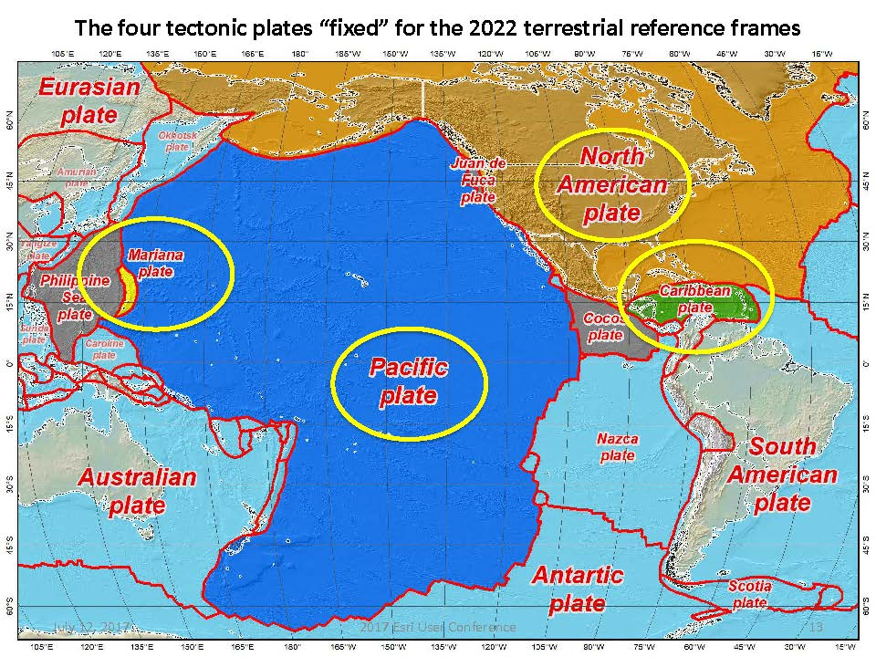
Four Tectonic Plates
Modernized NSRS
TX Control Issues
Heights Suppression
Tools to Densify

Slide 13
The TRFs
All are global frames (no “boundary”)
  This was true for the NAD 83s also, BTW
  But each frame will rotate with one tectonic plate
    Put another way: “The frame rotates so your coordinates don’t have to”
Modernized NSRS
TX Control Issues
Heights Suppression
Tools to Densify

Slide 14
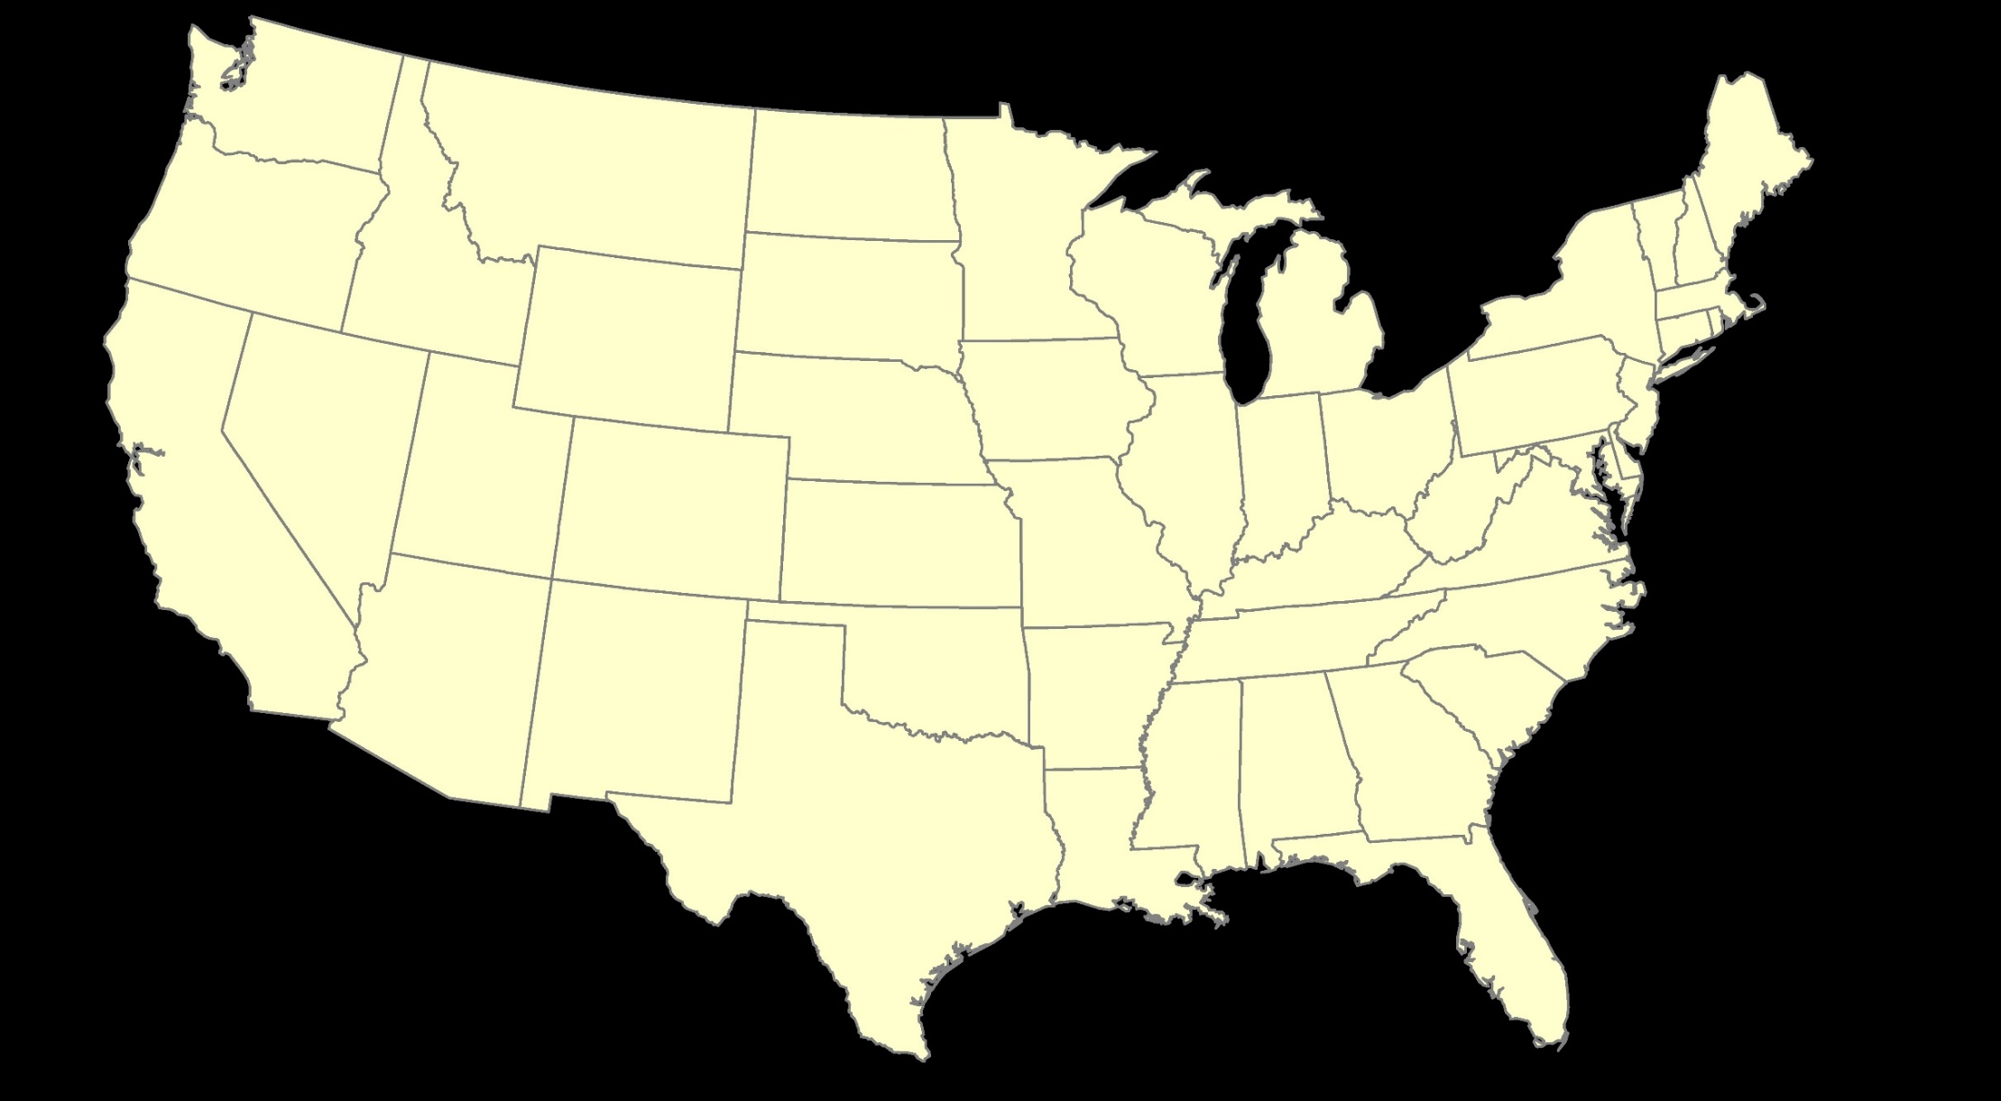
ITRF2020: Constant Frame, Rotating Plate
Modernized NSRS
TX Control Issues
Heights Suppression
Tools to Densify

Slide 15


“Plate-Fixed”
NATRF2020: Constant Frame, Rotating Plate
Modernized NSRS
TX Control Issues
Heights Suppression
Tools to Densify

Slide 16

ITRF2020 or NATRF2022 — Your choice, just use EPP2022
Modernized NSRS
TX Control Issues
Heights Suppression
Tools to Densify

Slide 17
Shift and Drift
When transitioning off of NAD 83, your coordinates will experience shift and drift
  Shift: A one-time jump somewhere in the 0 to 4 meter range (latitude, longitude, ellipsoid height)
    From fixing NAD 83’s non-geocentricity
  Drift: Coordinates are now time-dependent. The shift will take you to 2020.00. Working at any other epoch means you must account for the drift (velocity) of your coordinates
    As well as any other motions over time
Modernized NSRS
TX Control Issues
Heights Suppression
Tools to Densify

Slide 18
Replacing NAVD 88
  The New:
  The North American-Pacific
  Geopotential Datum of 2022
  (NAPGD2022)
  - Will include GEOID2022
  The Old:
  NAVD 88
  PRVD 02
  VIVD09
  ASVD02
  NMVD03
  GUVD04
  IGLD 85
  IGSN71
  GEOID12B
  DEFLEC12B
Orthometric
Heights
Normal
Orthometric
Heights
Dynamic
Heights
Gravity
Geoid
Undulations
Deflections of
the Vertical
Modernized NSRS
TX Control Issues
Heights Suppression
Tools to Densify

Slide 19
Shift and Drift
When transitioning from NAVD 88 or another vertical datum, your coordinates will shift
and drift:
  Shift: A one-time jump somewhere in the 0 to 2 meter range (orthometric height)
    From fixing biases and/or tilts in NAVD 88 and others
  Drift: Coordinates are now time-dependent. The shift will take you to 2020.00. Working at any other epoch means you must account for the drift (velocity) of your coordinates
    As well as any other motions over time
Modernized NSRS
TX Control Issues
Heights Suppression
Tools to Densify

Slide 20
NAVD 88 (epoch ?) to
NAPGD2022 Epoch 2020.00 (estimate)
Modernized NSRS
TX Control Issues
Heights Suppression
Tools to Densify

Slide 21
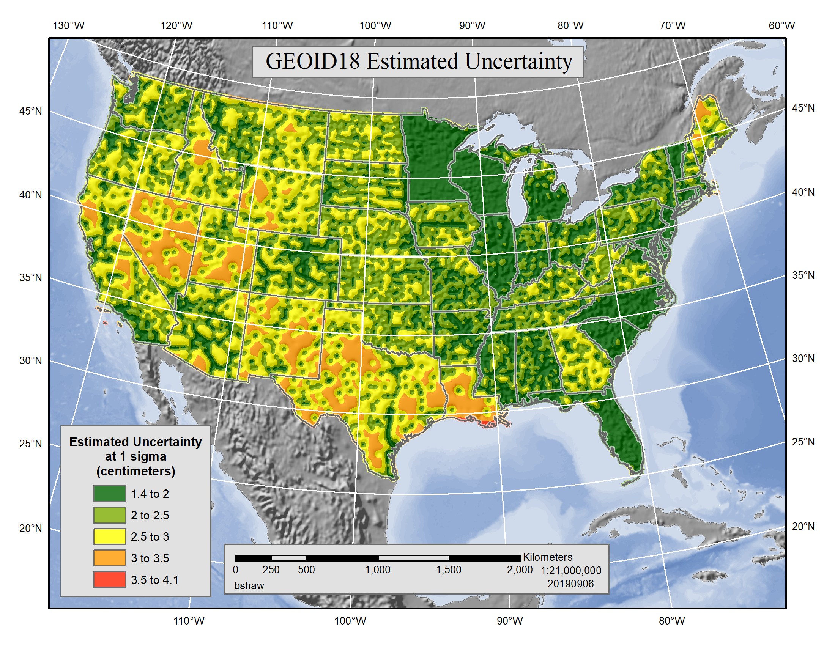
GEOID18 Estimated Uncertainty
Modernized NSRS
TX Control Issues
Heights Suppression
Tools to Densify

Slide 22
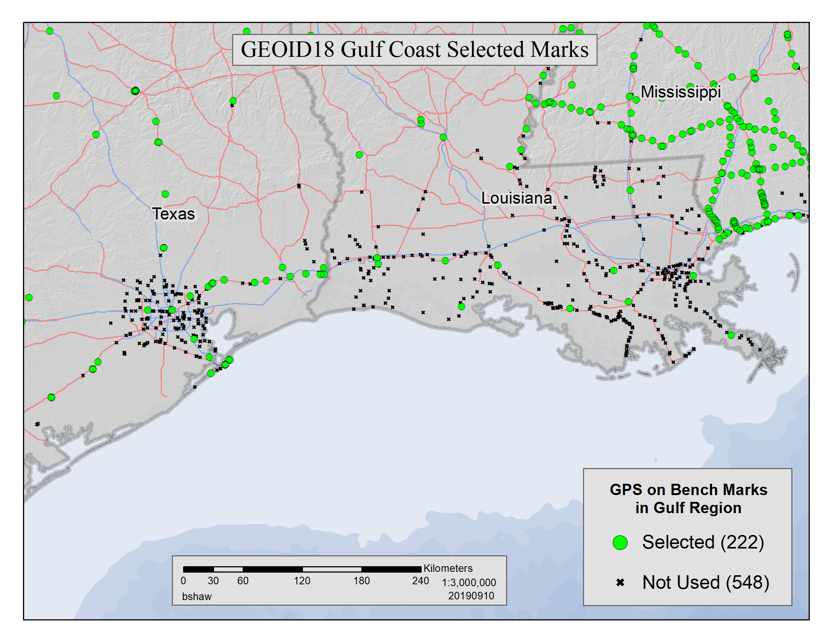
GEOID18 Gulf Coast Selected Marks
Modernized NSRS
TX Control Issues
Heights Suppression
Tools to Densify

Slide 23
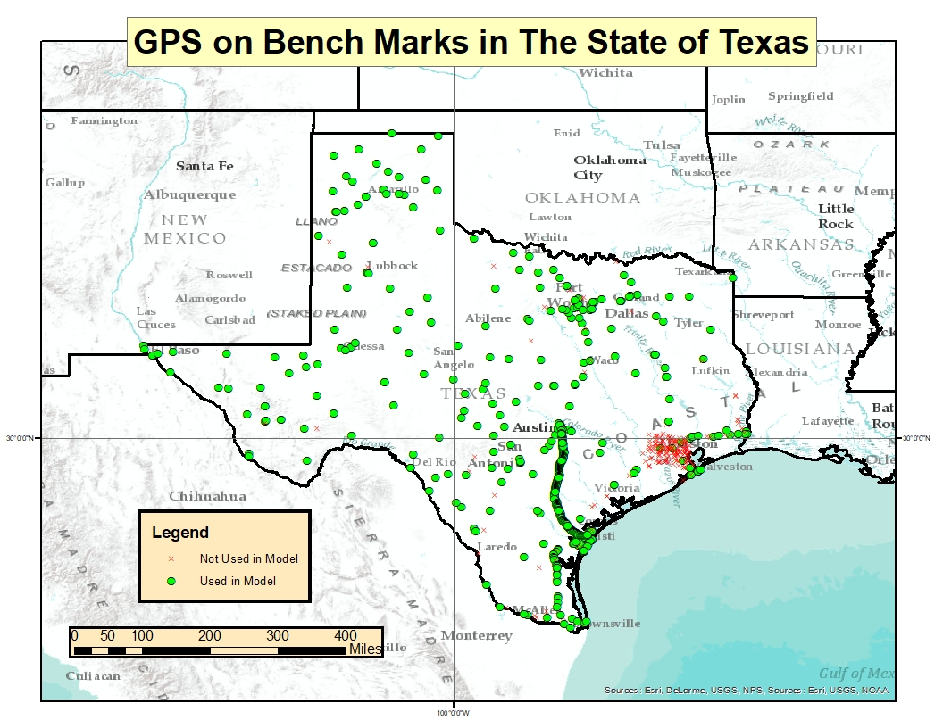
GPS on BM in Texas
Modernized NSRS
TX Control Issues
Heights Suppression
Tools to Densify

Slide 24
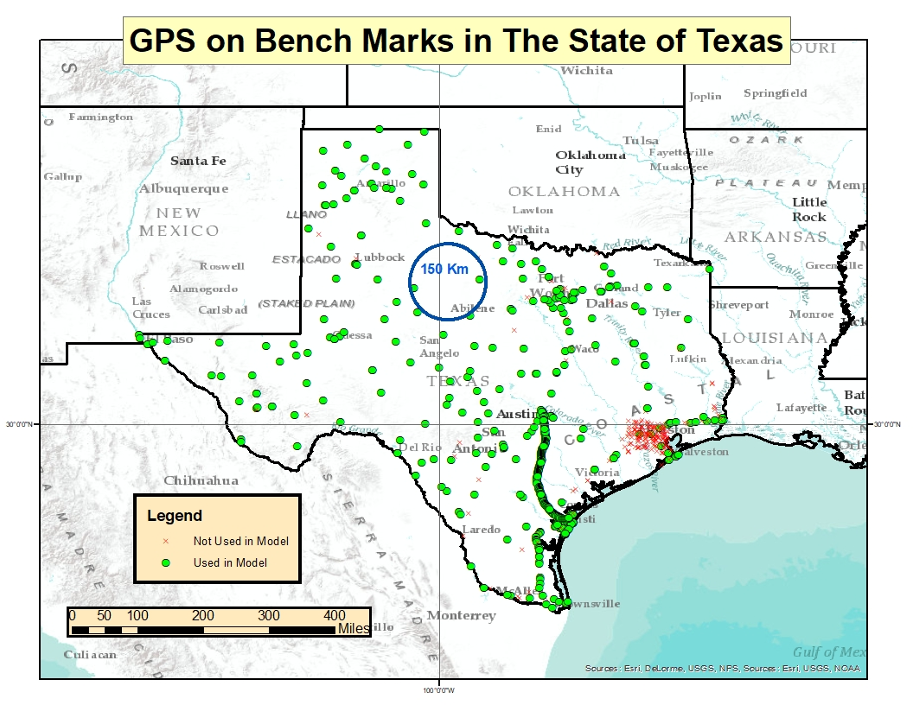
GPS on BM in Texas
Modernized NSRS
TX Control Issues
Heights Suppression
Tools to Densify

Slide 25
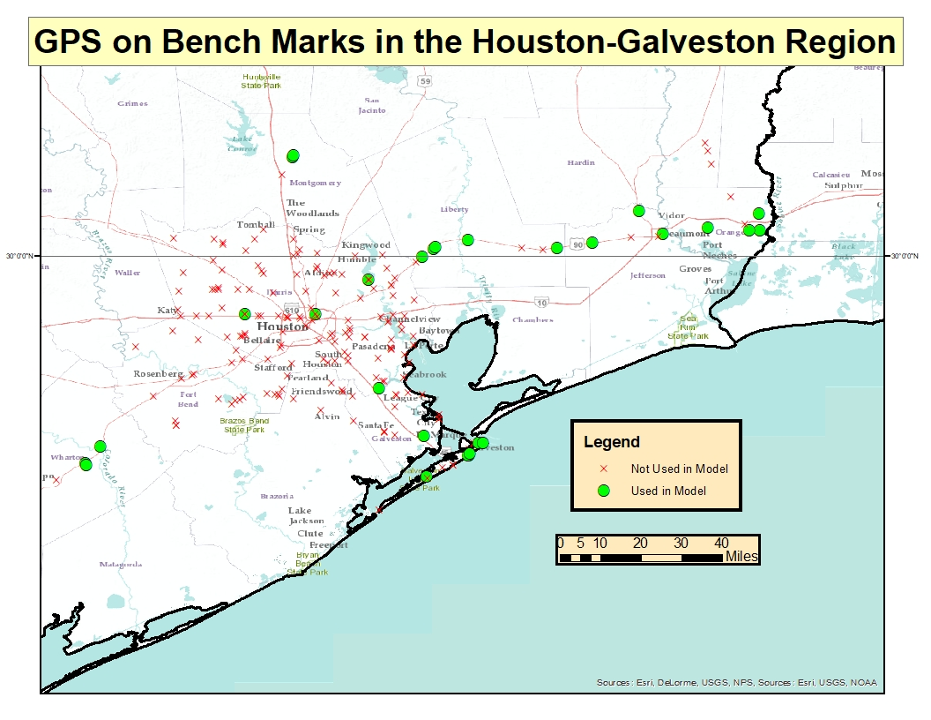
GPS on BM in Houston-Galveston
Modernized NSRS
TX Control Issues
Heights Suppression
Tools to Densify

Slide 26
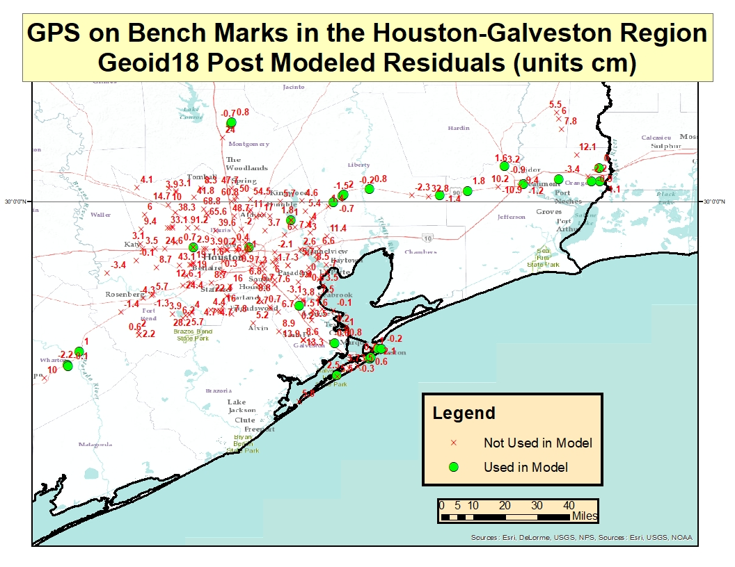
GEOID18 Post Modeled Residuals
Modernized NSRS
TX Control Issues
Heights Suppression
Tools to Densify

Slide 27
Houston Case
Harris County Floodplain Reference Marks and Flood Insurance Rate Maps (FIRMs) are referenced to locally defined NAVD88 2001 elevations (not published by NGS)
Elevation errors and outdated maps could have a major effect on flood zones determination and flood risk assessment
This highlights the reasons for and the importance of NGS’ shift to time-dependent positioning in the NSRS Modernization in 2022
Modernized NSRS
TX Control Issues
Heights Suppression
Tools to Densify

Slide 28
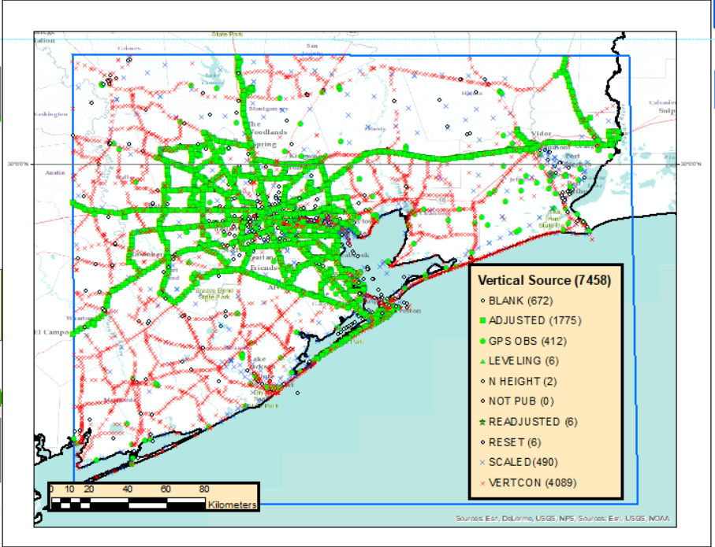
Good published heights in the SE Texas
The box includes approximately 7,500 marks in the NGS database
More than 4,000 heights created by VERTCON (Vertical Datum Conversion) = suspect heights!
Only 28 marks out of 7,500 in this box are considered to have good heights!
Modernized NSRS
TX Control Issues
Heights Suppression
Tools to Densify

Slide 29
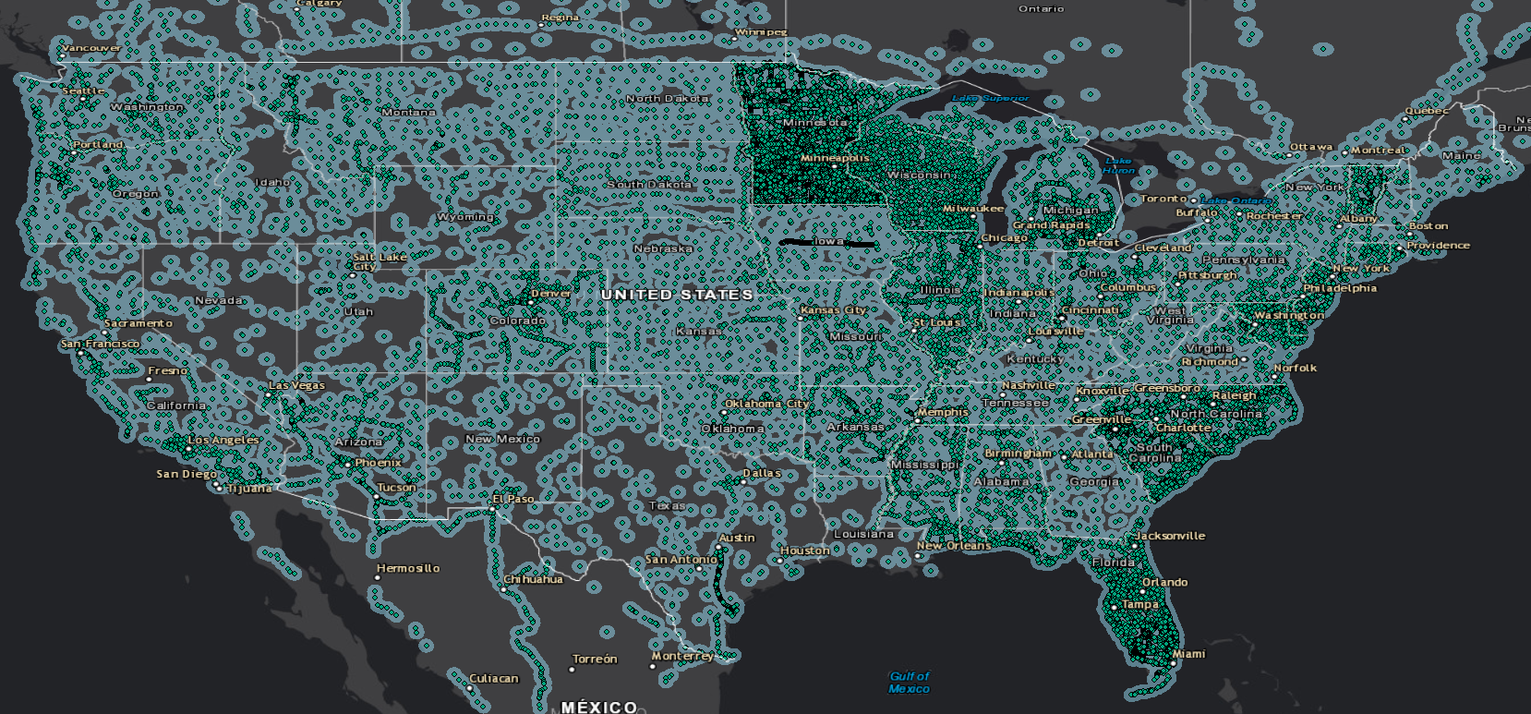
Good heights in the US - 30 km buffer
Modernized NSRS
TX Control Issues
Heights Suppression
Tools to Densify

Slide 30
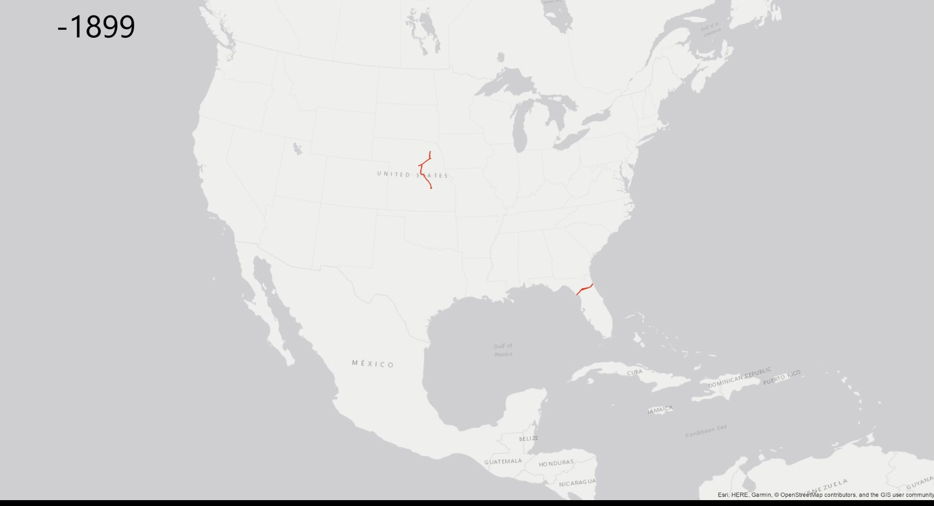
History of Leveling in the U.S.
Modernized NSRS
TX Control Issues
Heights Suppression
Tools to Densify

Slide 31
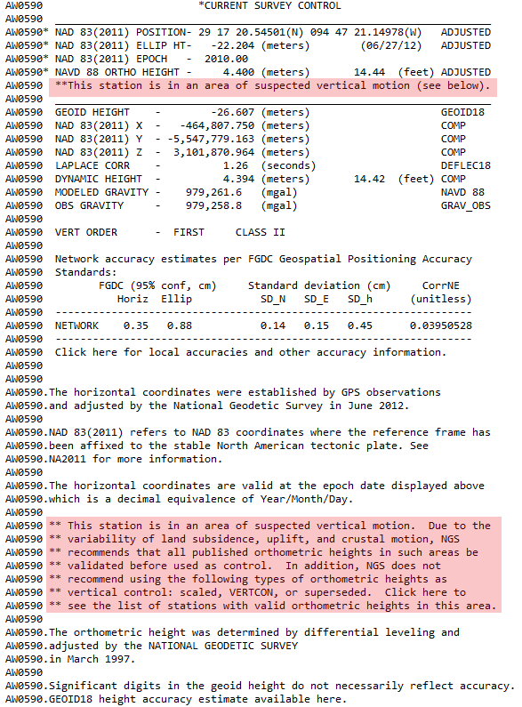
What NGS did about it
Modernized NSRS
TX Control Issues
Heights Suppression
Tools to Densify

Slide 32
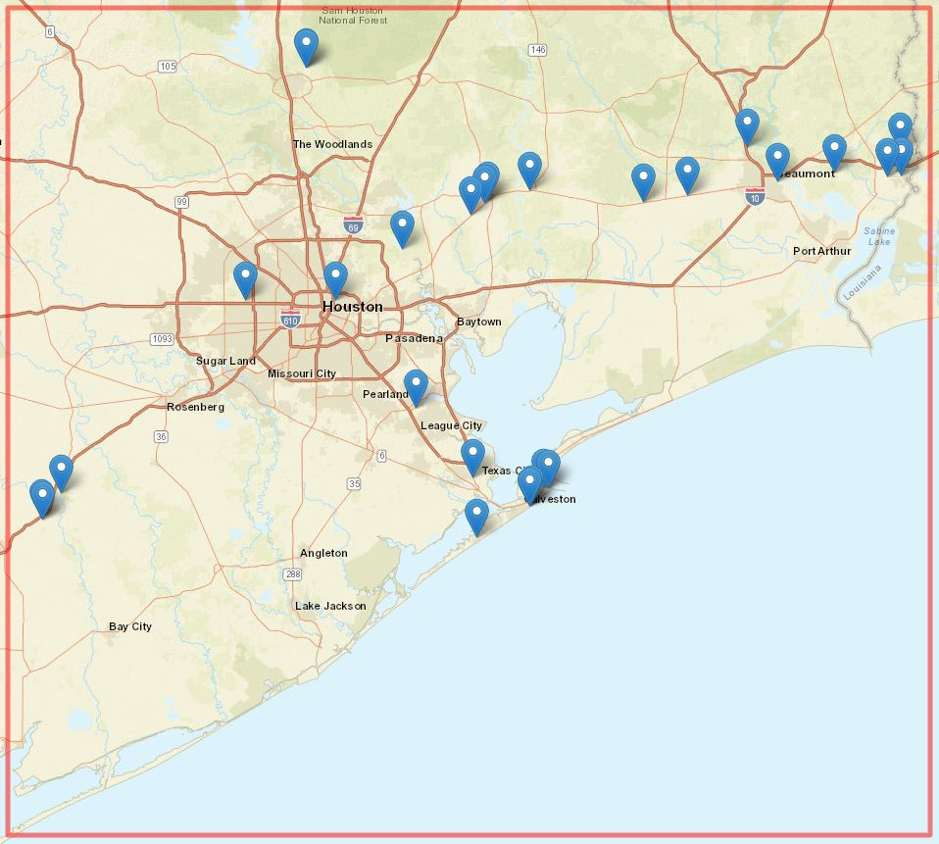
What NGS did about it
Modernized NSRS
TX Control Issues
Heights Suppression
Tools to Densify

Slide 33
What NGS is doing about it now
Plan by end of January 2021:
  Valid NAVD 88 heights will be published
    only 28 marks (until new surveys are completed) will remain published in Current Survey Control section
  Suspect NAVD 88 heights will get suppressed
    Current Survey Control will not show NAVD 88 height
    If requested, NAVD 88 height will be shown in Superseded Survey Control section
Modernized NSRS
TX Control Issues
Heights Suppression
Tools to Densify

Slide 34
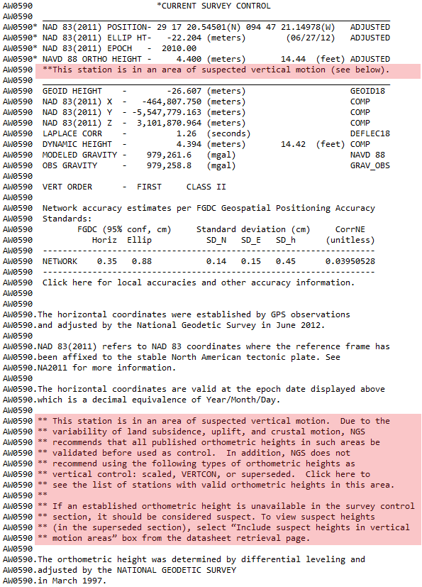
Valid NAVD 88 Heights
Modernized NSRS
TX Control Issues
Heights Suppression
Tools to Densify

Slide 35
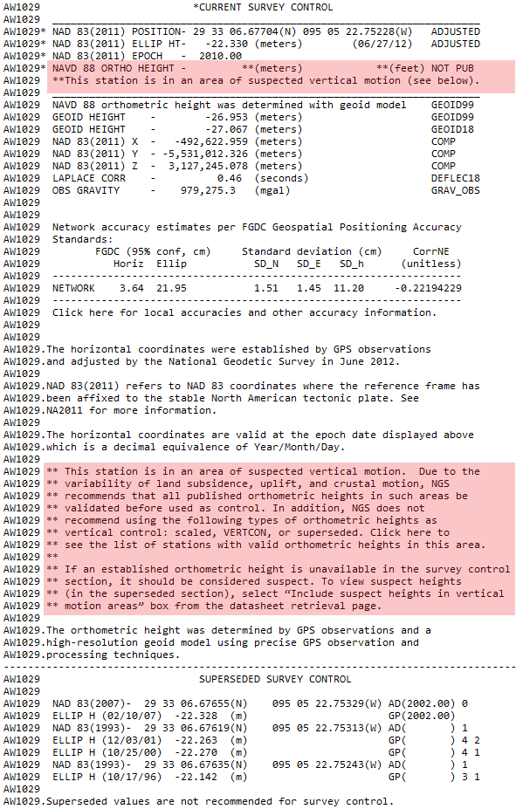
Suspect NAVD 88 heights (not requested)
Modernized NSRS
TX Control Issues
Heights Suppression
Tools to Densify

Slide 36
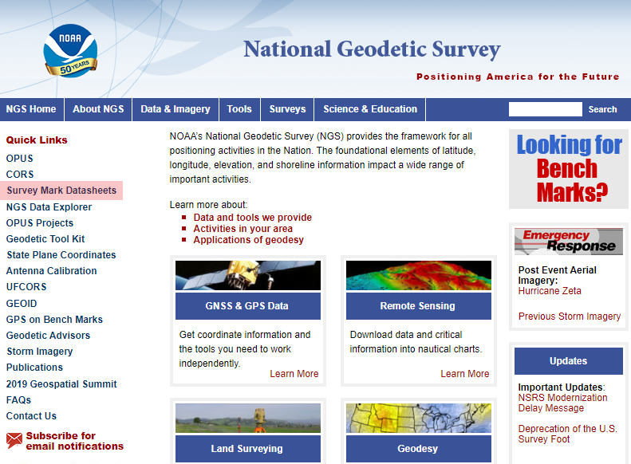
Suspect NAVD 88 heights (requested)
Modernized NSRS
TX Control Issues
Heights Suppression
Tools to Densify

Slide 37
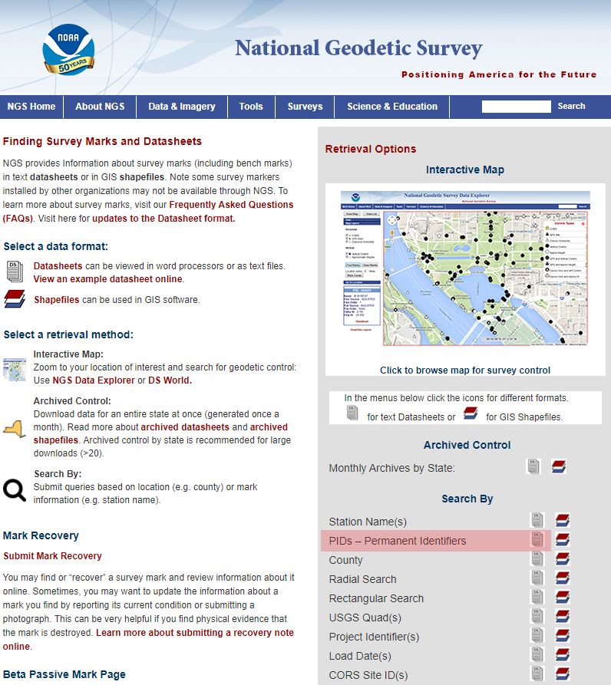
Suspect NAVD 88 heights (requested)
Modernized NSRS
TX Control Issues
Heights Suppression
Tools to Densify

Slide 38
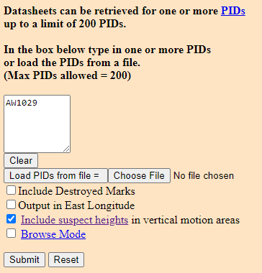
Suspect NAVD 88 heights (requested)
Modernized NSRS
TX Control Issues
Heights Suppression
Tools to Densify

Slide 39
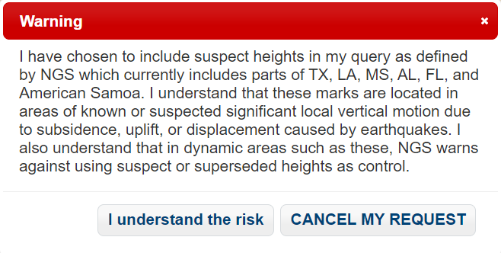
Suspect NAVD 88 heights (requested)
Modernized NSRS
TX Control Issues
Heights Suppression
Tools to Densify

Slide 40
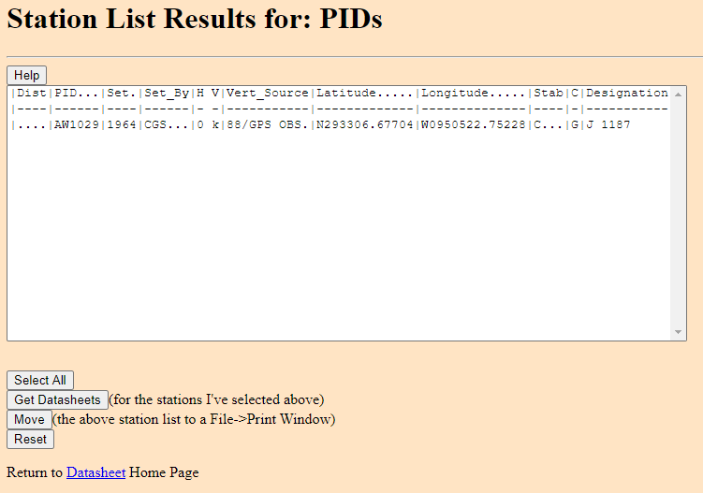
Suspect NAVD 88 heights (requested)
Modernized NSRS
TX Control Issues
Heights Suppression
Tools to Densify

Slide 41
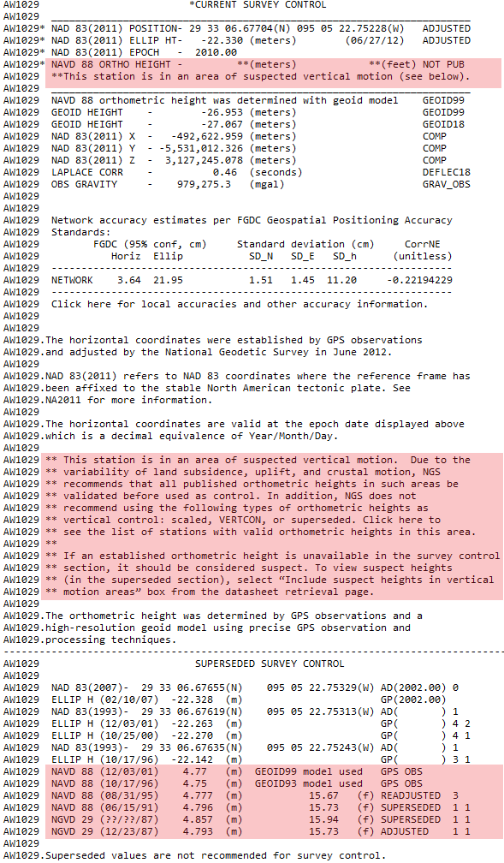
Suspect NAVD 88 heights (requested)
Modernized NSRS
TX Control Issues
Heights Suppression
Tools to Densify

Slide 42
What can Texas do about it?
Densify geodetic control (with good heights) by conducting new Leveling & GPS projects
  Submit data for inclusion into the NSRS (FCGS Bluebook)
  Update elevations on a select set of marks (where good heights don’t exist)
  Improved survey network will provide enhancements for rebuilding and improvement of infrastructure in the area
  It will help with flood plain management, flood hazard identification and risk assessment, elevation certificates…
Modernized NSRS
TX Control Issues
Heights Suppression
Tools to Densify

Slide 43
How can NGS support these efforts?
NGS can provide:
  Trainings
  Technical support
  Projects QA/QC
  Analyzing, ingesting and storing new data
  Online tools to access the NSRS
NGS cannot conduct field work for you!
Modernized NSRS
TX Control Issues
Heights Suppression
Tools to Densify

Slide 44
What tools can Texas use?
BETA OPUS Projects - New way of Bluebooking!
  Makes bluebooking process easier and less intimidating
  Provides an interactive visual interface
  Automates the processing and creation of complex files
  Provides improved QA/QC process and better display & visualization of statistics
Modernized NSRS
TX Control Issues
Heights Suppression
Tools to Densify

Slide 45
What tools can Texas use?
BETA OPUS Projects
  It requires minimum of two 2-hours sessions for your stations
  It is used for submitting static, campaign-style GNSS surveys resulting in network survey solution intended for inclusion in the NGS database
  New stations will have published adjusted position on a datasheet
Modernized NSRS
TX Control Issues
Heights Suppression
Tools to Densify

Slide 46
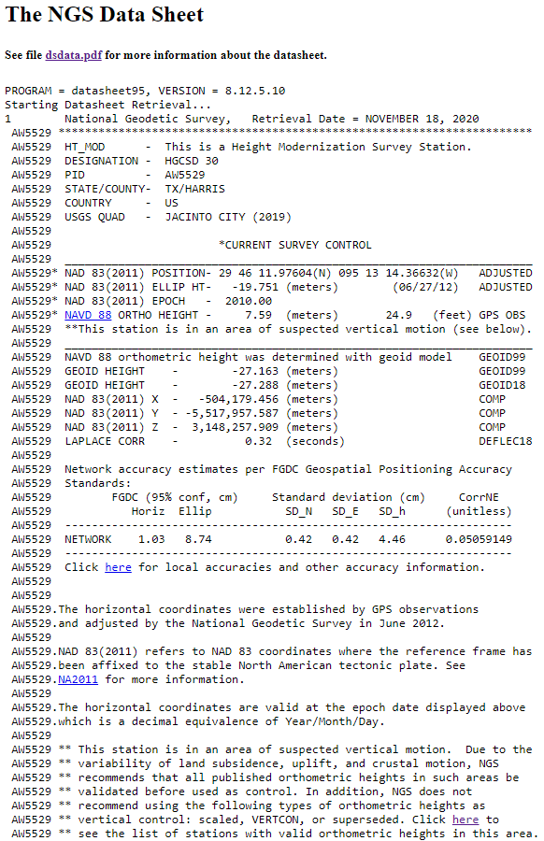
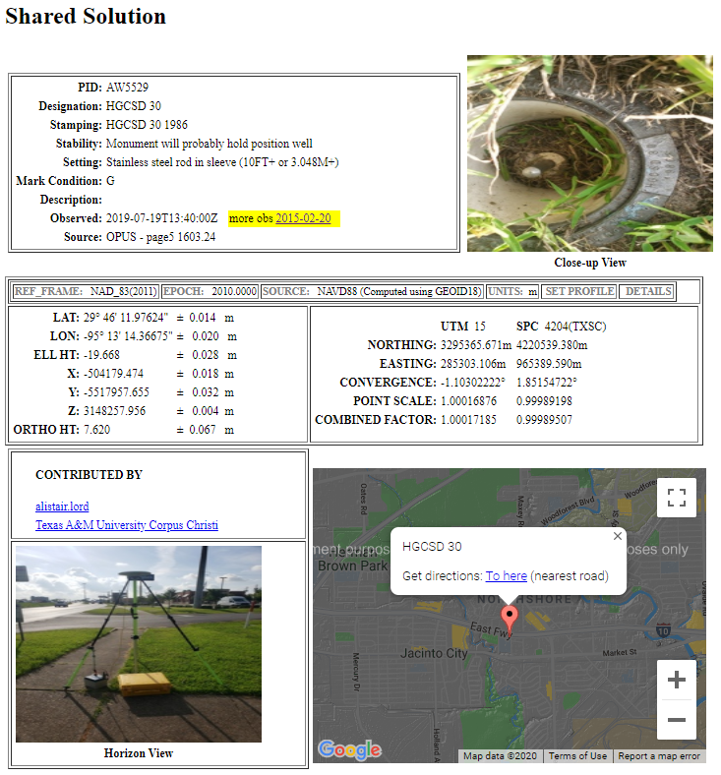
Datasheet and Shared Solution
Geodetic Control
Not Geodetic Control
Modernized NSRS
TX Control Issues
Heights Suppression
Tools to Densify

Slide 47

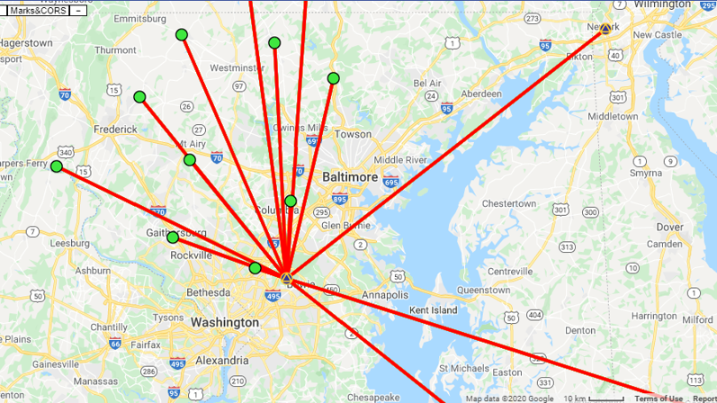
Project Objectives
What are your objectives?
Accurate lat/lon/Eh on new “passive marks”
Accurate GNSS-derived NAVD 88 heights on passive marks
Accurate positions on active GNSS stations (not CORS; e.g. RTN stations)
Modernized NSRS
TX Control Issues
Heights Suppression
Tools to Densify

Slide 48
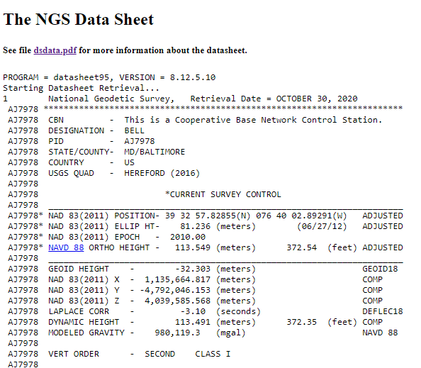
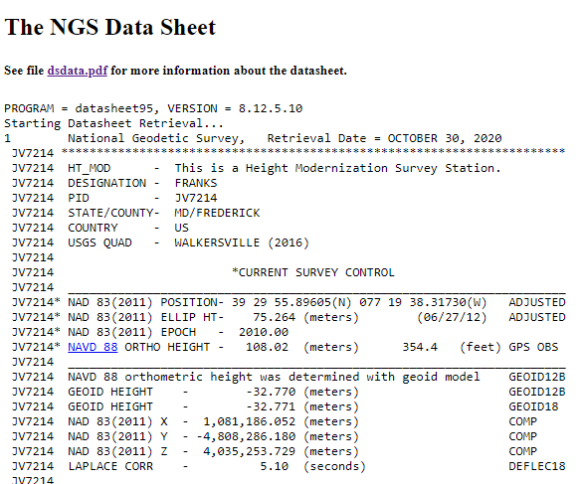
Project Control
Leveled heights (Adjusted and Reset, Orders One - Three)
Height Mod Heights
“HT_MOD”
Height accurate to 2 decimal places
Modernized NSRS
TX Control Issues
Heights Suppression
Tools to Densify

Slide 49
Planning Your Project
Orthometric Height Accuracy Requirements
Number of occupations
Length of occupations
Spacing of valid control
Recommended/Permitted
Minimum of 2 NAVD 88 control marks per new mark observed
OPUS is currently restricted to a minimum of 2-hour occupations
Maximum distance between new marks and NAVD 88 control is between 30-50 km, based on occupation length
Not Permitted*
*Future developments of OP will permit real-time vectors from shorter occupations
Modernized NSRS
TX Control Issues
Heights Suppression
Tools to Densify

Slide 50
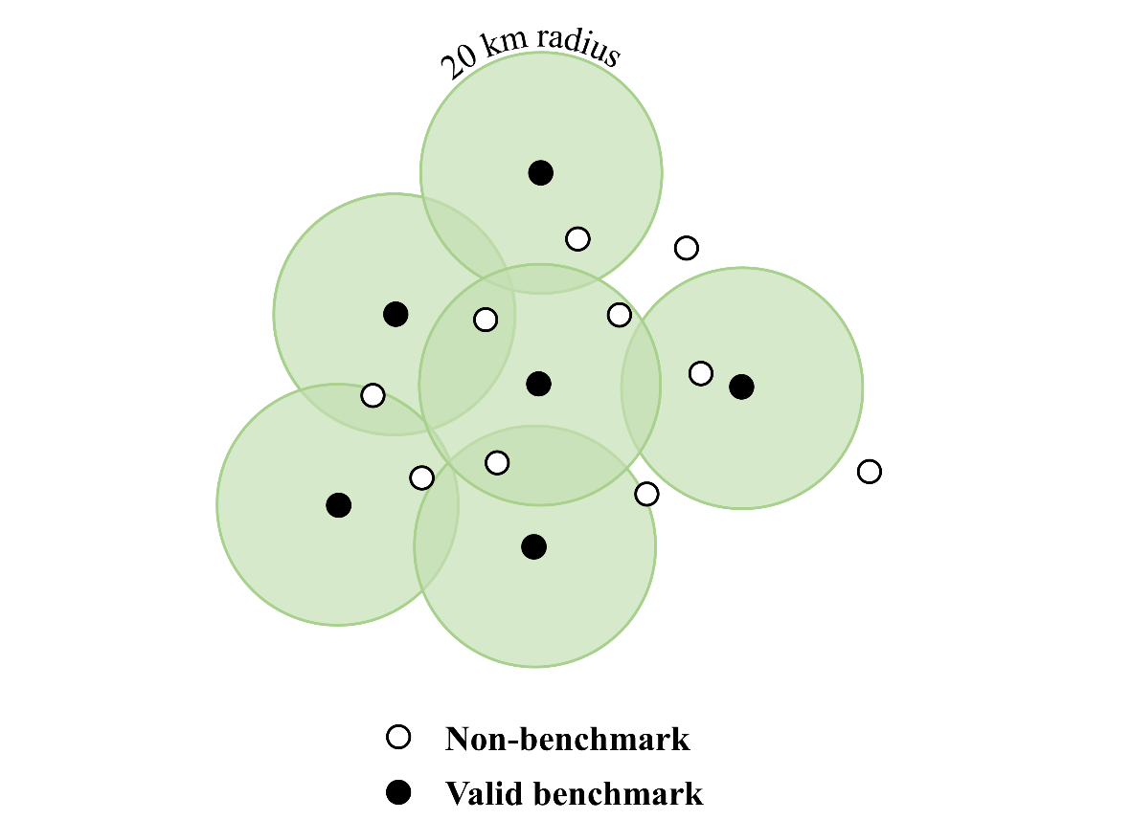
Planning Your Project
Orthometric Height Accuracy Requirements: a look at control mark spacing
Occupy bench marks with “valid” NAVD 88 orthometric heights
  Distributed every ~30-50 km
  Two (2) valid control marks per new mark
  Adhere to distance-occupation requirement
Use latest hybrid geoid model (i.e., GEOID18)
Perform constrained vertical least squares adjustments of the GNSS network holding the bench marks as control
30
Modernized NSRS
TX Control Issues
Heights Suppression
Tools to Densify

Slide 51
Planning Your Project
How many valid NAVD 88 bench marks would you need at a 30 km spacing?
30
Modernized NSRS
TX Control Issues
Heights Suppression
Tools to Densify

Slide 52
Planning Your Project
How many valid NAVD 88 bench marks would you need at a 30 km spacing?
30
6 valid NAVD 88 control marks within 30 km would cover requirements for only three new marks!
30 km spacing require a minimum of only 2-hr occupations
Modernized NSRS
TX Control Issues
Heights Suppression
Tools to Densify

Slide 53
Planning Your Project
Increasing your spacing to 50 km would require only 4 valid NAVD 88 control marks to cover 9 new marks.
Only one mark would require additional control
However, minimum occupation time would increase from 2 to 6 hours
50 km radius
30
Modernized NSRS
TX Control Issues
Heights Suppression
Tools to Densify

Slide 54
Planning Your Project
Now that we’ve discussed distance (X-axis), let’s talk Occupation Length (Y-axis)
Recommended/Permitted
Two important considerations:
Redundancy (how many reps)
Duration (how long an observation)
Not Permitted*
*Future developments of OP will permit real-time vectors from shorter occupations
Modernized NSRS
TX Control Issues
Heights Suppression
Tools to Densify

Slide 55
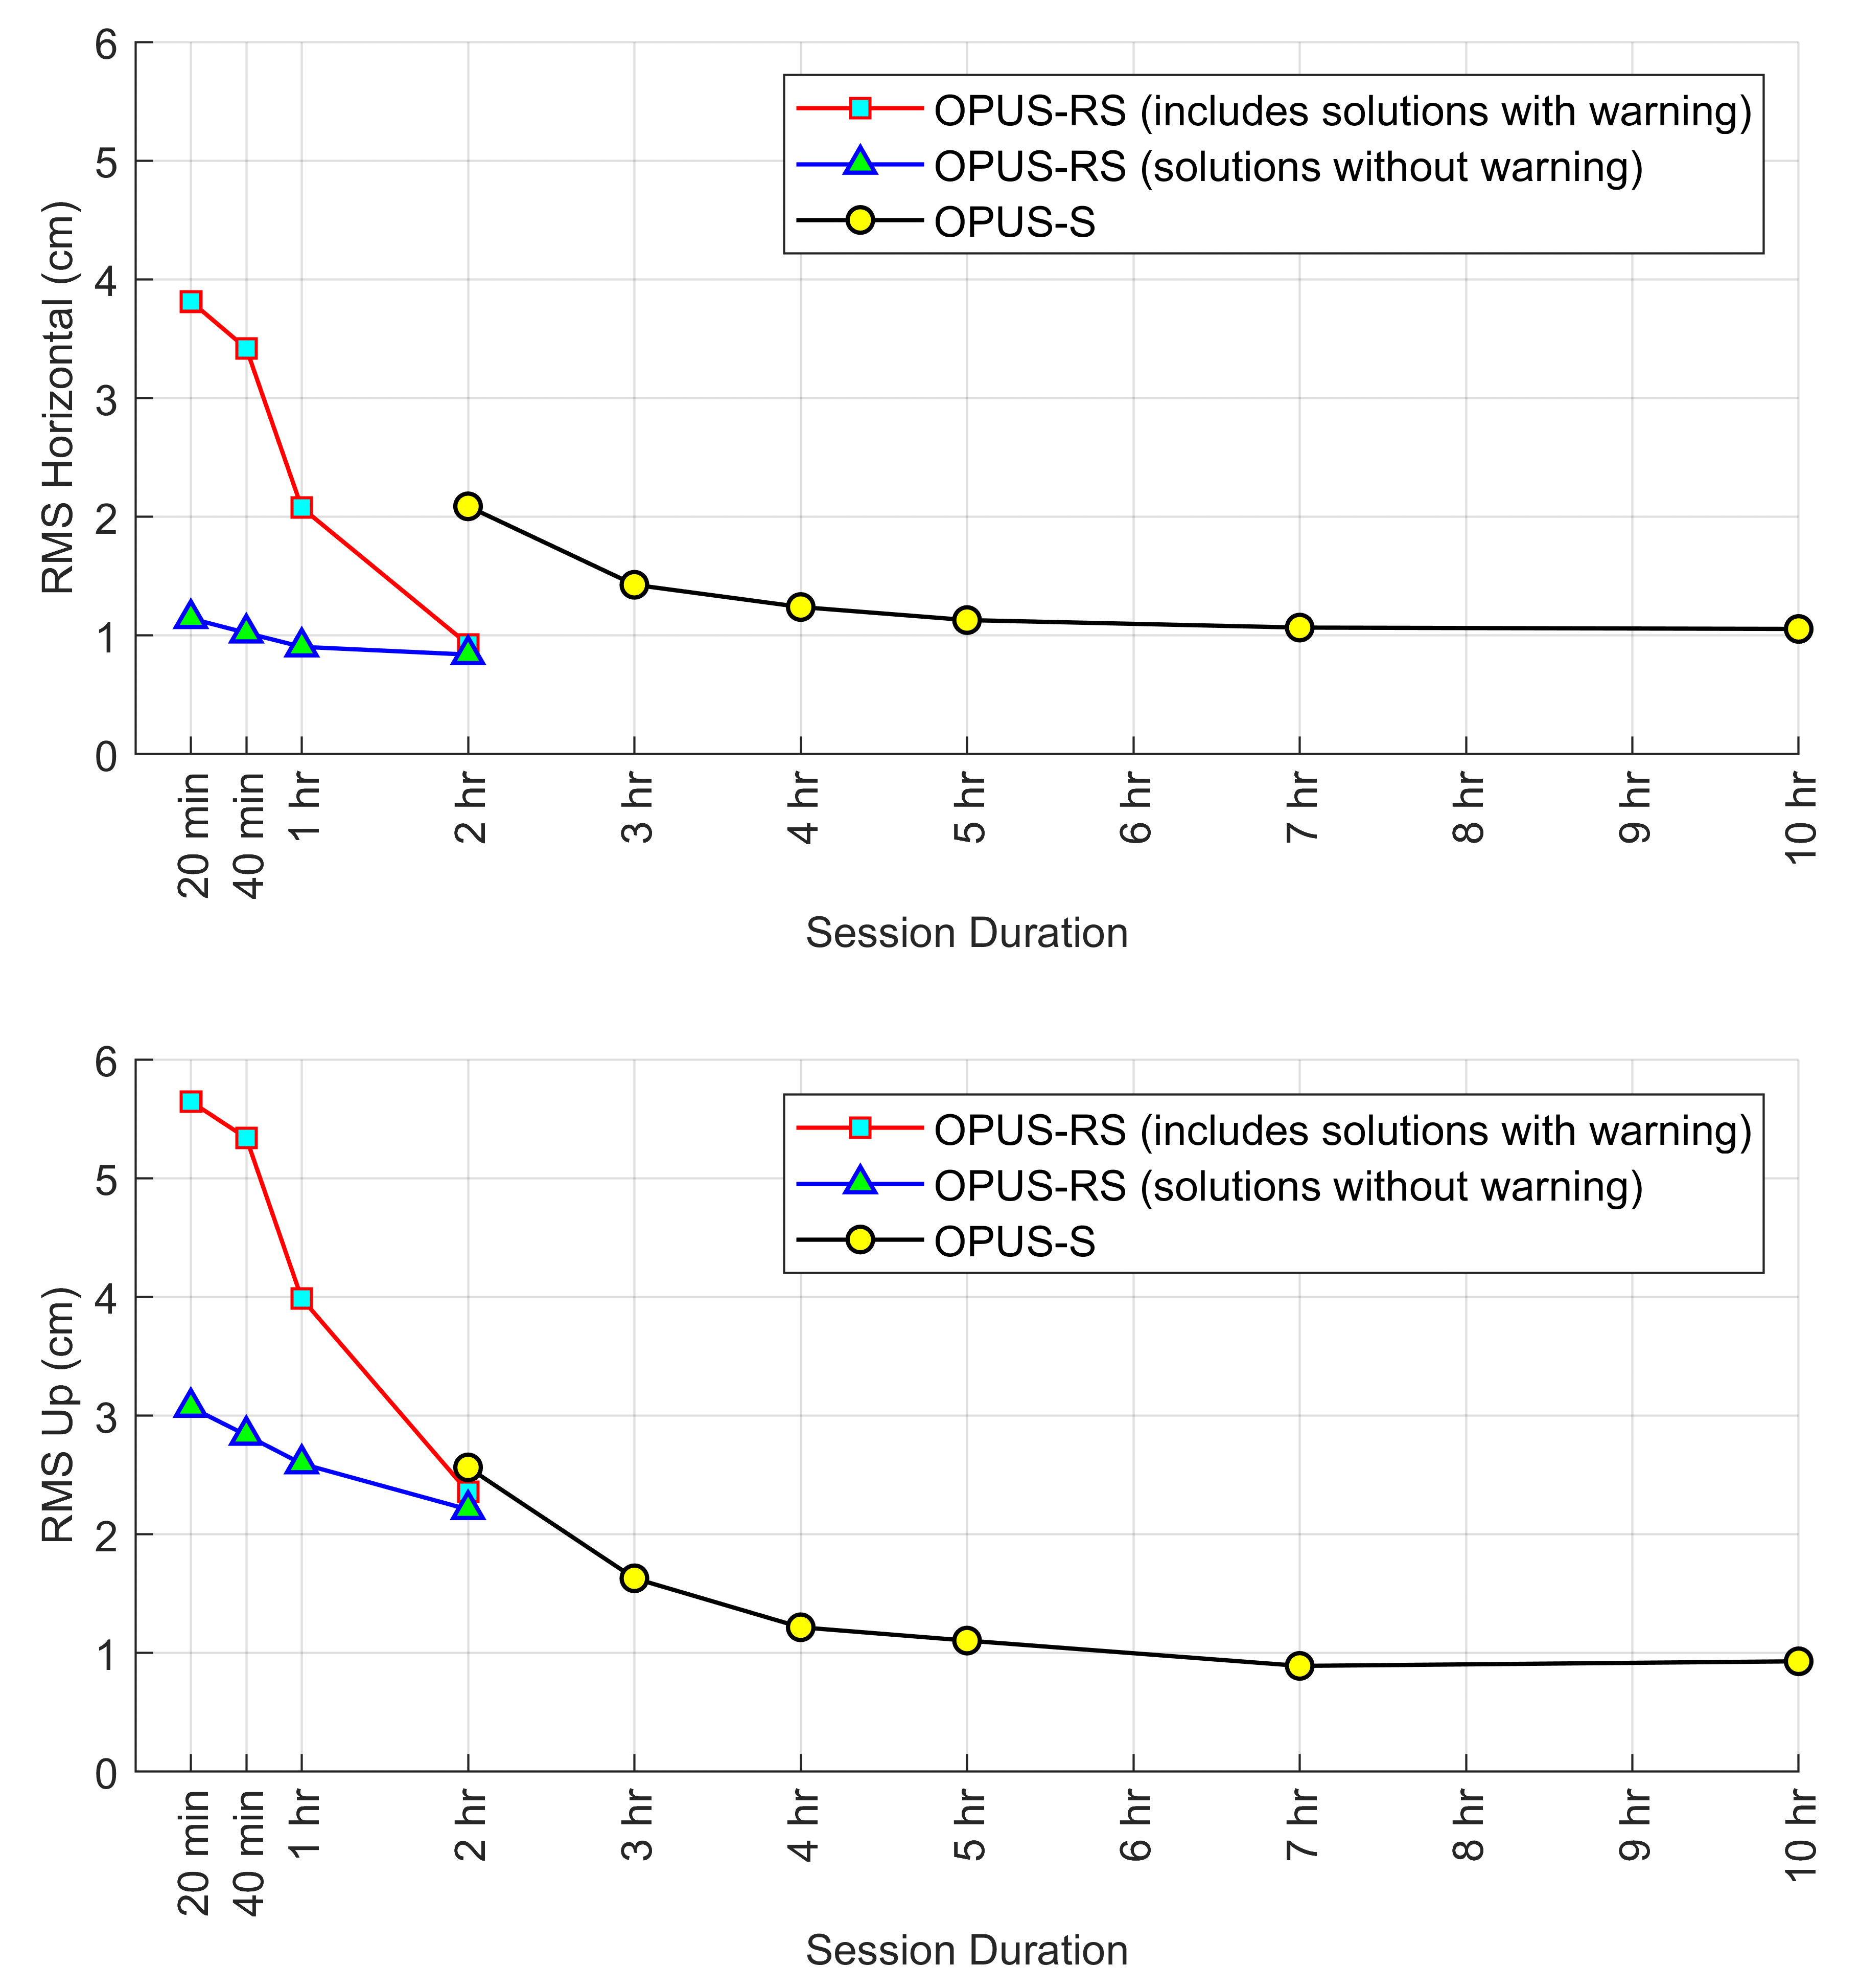
OPUS Accuracies
How long should each occupation be?
-A look at OPUS Accuracies
RMS at 1σ
Modernized NSRS
TX Control Issues
Heights Suppression
Tools to Densify

Slide 56
Occupation Time
Vertical Network Accuracies, OPUS Projects
95% CI values shown
TOTAL time on mark
Modernized NSRS
TX Control Issues
Heights Suppression
Tools to Densify

Slide 57
Project Recommendation
Summary of Vertical Accuracy of OPUS Projects
Vertical Standard | Total Time on Mark (h) | Recommended Sessions and duration
3.0 cm | 4 | (2) 2-h
2.5 cm | 8 | (2) 4-h or (3) 3-h
2.0 cm | 22 | (2) 10-h or (3) 7-h
1.7 cm | 48 | (2) 24-h
Modernized NSRS
TX Control Issues
Heights Suppression
Tools to Densify

Slide 58
OPUS Projects for RTK
Builds upon OPUS Projects
It supports all types of GNSS vectors (real-time and post-processed):
  Single-base RTK vectors
  Network RTK vectors
  Vectors processed in other software
Modernized NSRS
TX Control Issues
Heights Suppression
Tools to Densify

Slide 59
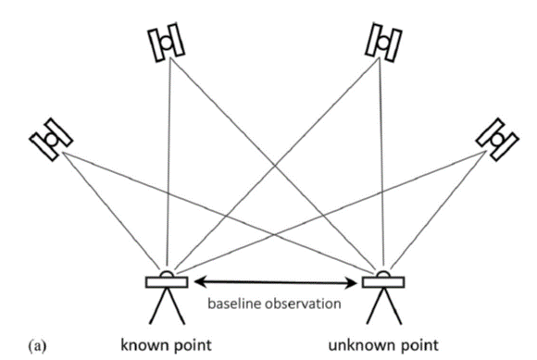
Baseline and Vector
Baseline: the line connecting two GNSS marks
Vector: a mathematical representation of a measurement of the baseline, expressed in delta X,Y,Z components (along with error estimates)
So, one baseline measured repetitively five times will have five vectors
Modernized NSRS
TX Control Issues
Heights Suppression
Tools to Densify

Slide 60
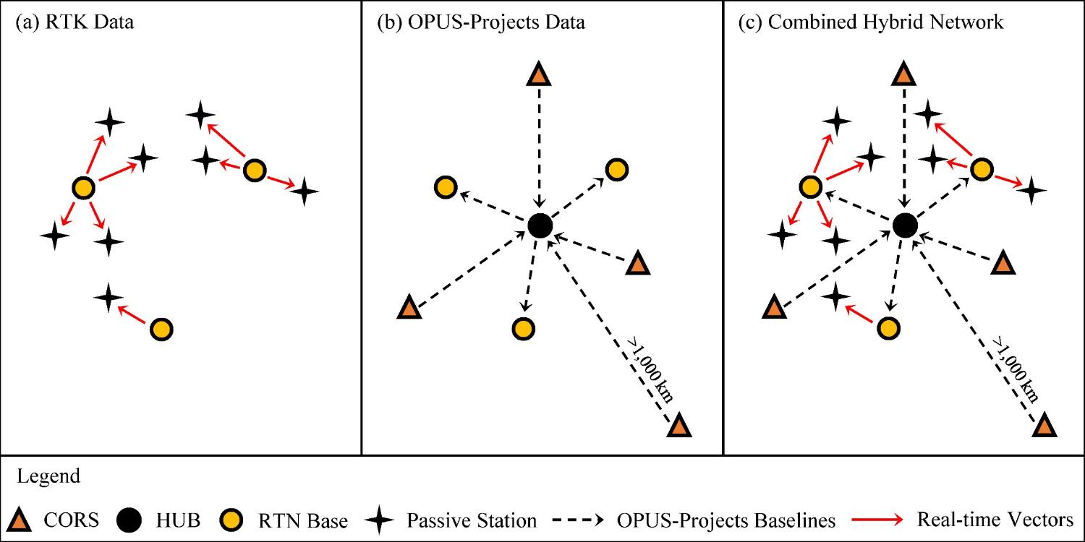
Design for OPUS-Projects and GVX
GVX file (from RTK survey or baseline processing in other software)
OPUS-Projects (from static GNSS session processing)
RTK Base or “From” Mark
RTK Rover or “To” Mark
Vector
Vector in GVX File
Modernized NSRS
TX Control Issues
Heights Suppression
Tools to Densify

Slide 61
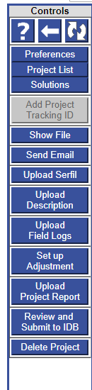
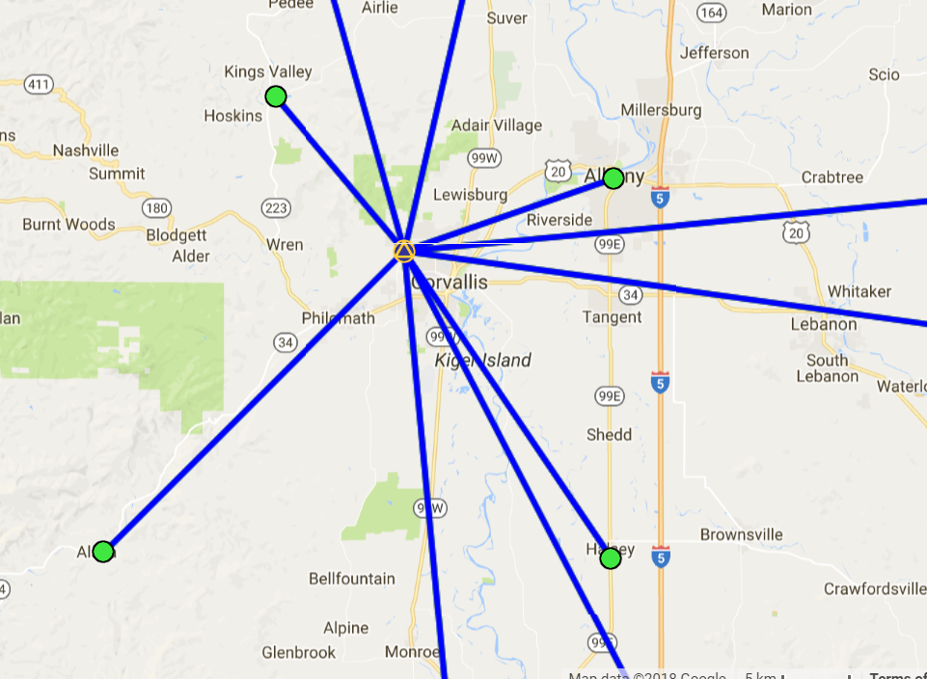
Example: Upload RTN Vectors to
OPUS-Projects
LEGEND
CORS
User Mark
Processed Vector (OPUS-Projects)
Uploaded Vector
Upload Vectors
Modernized NSRS
TX Control Issues
Heights Suppression
Tools to Densify

Slide 62
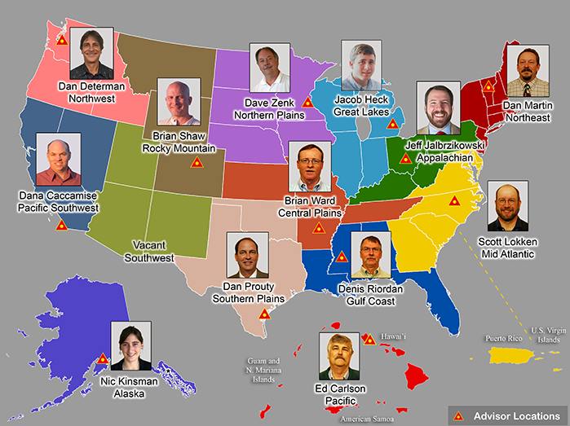

Contact your NGS Regional Geodetic Advisor

