Slide 1
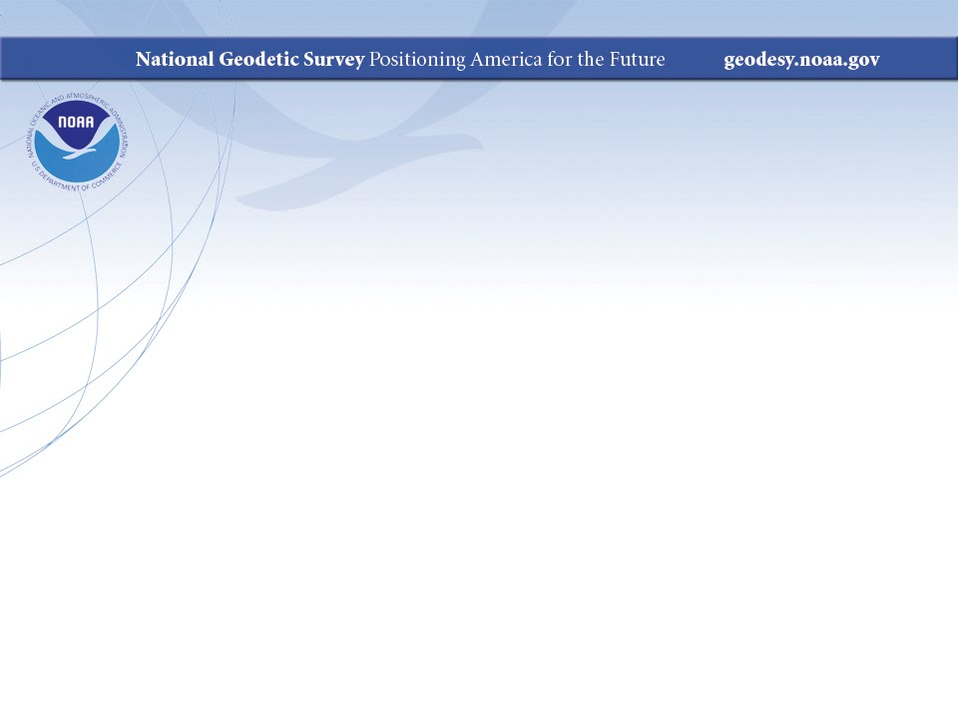
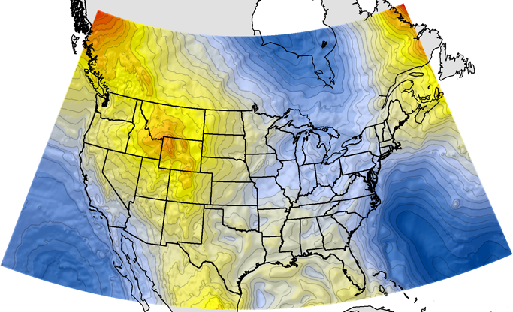
Geodesy Fundamentals
Professional Surveyors Association of Nebraska
Winter Seminar
Dave Zenk
NGS Advisor
February 9, 2018
Kearney, NE
February 9, 2018
Professional Surveyors Association of Nebraska
1

Slide 2
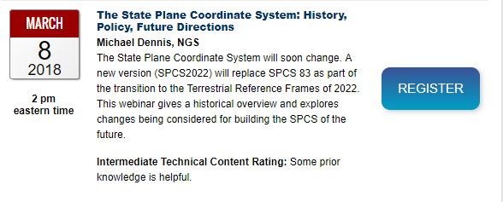
SPCS2022 Webinar
Webinar on State Plane Coordinates on March 8, 2018 by Michael Dennis
https://geodesy.noaa.gov/web/science_edu/webinar_series/Webinars.shtml
February 9, 2018
Professional Surveyors Association of Nebraska
2

Slide 3
Class Outline
Review the basics
  Astronomy
  Geodetic Systems
  Datums
  Map Projections
  GPS
February 9, 2018
Professional Surveyors Association of Nebraska
3

Slide 4
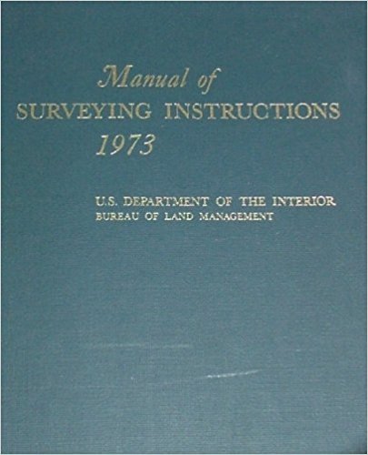
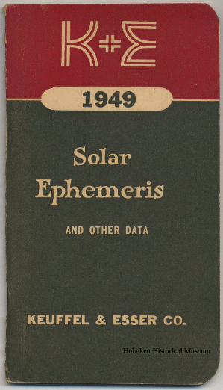
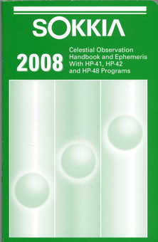
Astronomy
https://www.blm.gov/cadastral/Manual/73man/id34.htm
Sections 2-53 to 73
Earth, Sun, Stars System
  Earth Orbit around Sun
  Geometry and Vocabulary
Practical Astronomy and Celestial Coordinates
  Altitude-Azimuth System
  Right Ascension-Declination System
  Sidereal Hour Angle – Local Hour Angle System
  PZS Triangle
  Methods for finding latitude, longitude, and azimuth.
Elgin, Knowles & Senne, Inc. (Archer-Elgin)
310 E. 6th St., Rolla, MO 65401
http://www.rollanet.org/~eksi/2008EPHEM.pdf
February 9, 2018
Professional Surveyors Association of Nebraska
4

Slide 5
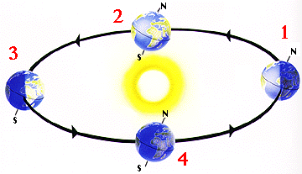
Astronomy
Earth’s Elliptical Orbit Around the Sun (Northern Hemisphere)
  1) Winter Solstice (December 21)
    Perihelion (January 3)
  2) Spring Equinox (March 21)
  3) Summer Solstice (June 21)
    Aphelion (July 3)
  4) Autumn Equinox (September 21)
Perihelion = closest to sun on January 3 (147 M km)
Semi-dia = 0-16’-15.9”
23.5 degree axis tilt from ecliptic plane
closer to sun
further from sun
Aphelion = furthest from sun on July 3 (152 M km)
Semi-dia = 0-15’-43.9”
Image by NASA
February 9, 2018
Professional Surveyors Association of Nebraska
5

Slide 6
Astronomy
Intersection of Orbital Plane and Equatorial Plane forms a line which points to First Point of Aries, γ (vernal equinox) and First Point of Libra, Ω (autumnal equinox)
Astronomers prefer the vernal equinox and so it is the reference point in the sky.
γ
2 planes intersect to form a line which points to γ
γ
γ
γ
Image by NASA
February 9, 2018
Professional Surveyors Association of Nebraska
6

Slide 7
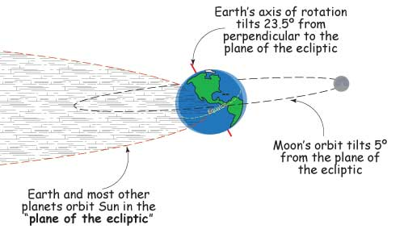
Astronomy
Moon’s orbit is tilted 5 degrees from ecliptic plane
Image by NOAA/NASA SciJinks
February 9, 2018
Professional Surveyors Association of Nebraska
7

Slide 8
Astronomy
Celestial Sphere (infinite radius)
Rotates east-to-west
Pole
Which direction is Earth rotating?
Sun or Star
Itty-Bitty Earth
Autumnal Equinox
(first point of Libra)
γ
Vernal Equinox
(first point of Aries)
Celestial Equator
February 9, 2018
Professional Surveyors Association of Nebraska
8

Slide 9
Astronomy
Right Ascension - Declination (Sidereal Hour Angle) System
Pole
Sun or Star
Declination Angle
Right Ascension (RA)
γ
Vernal Equinox
Celestial Equator
Sidereal Hour Angle (SHA)
February 9, 2018
Professional Surveyors Association of Nebraska
9

Slide 10
Astronomy
Altitude-Azimuth System (based on local horizon of observer)
Zenith
Sun or Star
Altitude Angle
West
South
North
East
Horizon
Azimuth Angle
Nadir
February 9, 2018
Professional Surveyors Association of Nebraska
10

Slide 11
Astronomy
PZS Triangle
Pole
P
Sun or Star
S
Z
Zenith
Vernal Equinox
Celestial Equator
February 9, 2018
Professional Surveyors Association of Nebraska
11

Slide 12
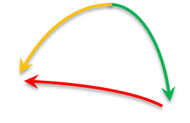
Astronomy
P
Pole
PZS Triangle
90⁰ - Declination
LHA
90⁰ - Latitude
Parallactic Angle
S
Sun or Star
“Azimuth”
90⁰ - Altitude
Z
Zenith
February 9, 2018
Professional Surveyors Association of Nebraska
12

Slide 13
Astronomy
Spherical Trigonometry
  3 sides and 3 angles – all are expressed in angular units of measure!
  If one knows any 3 of the 6 parts, one can solve for the other 3 parts.
Spherical Law of Sines
Spherical Law of Cosines
A
c
b
sin A sin B sin C
----- = ----- = -----
sin a sin b sin c
B
a
C
cos a – cos b cos c
cos A = -------------------
sin b sin c
February 9, 2018
Professional Surveyors Association of Nebraska
13

Slide 14
Astronomy
What do we know and what do we measure?
  Latitude
  Altitude
  Declination
  Azimuth
  Local Hour Angle (LHA)
  Parallactic Angle
Choice and circumstance dictate!
Traditionally know: Latitude, Longitude, & Declination
  Measure altitude, then use “Altitude Method” to solve for azimuth
  Measure time, then use “Hour Angle Method” to solve for azimuth
February 9, 2018
Professional Surveyors Association of Nebraska
14

Slide 15
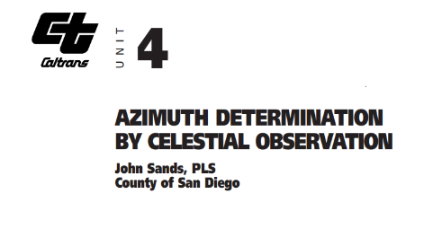
Astronomy
Derive practical equations for both methods (Caltrans)
  http://www.dot.ca.gov/hq/row/landsurveys/LSITWorkbook/04.pdf
  See Unit 4, page 4
Altitude Method
  Uses Latitude, Declination, and Altitude
Hour Angle Method
  Uses Latitude and Declination, then Longitude, Time, and Right Ascension (to compute LHA)
sin DEC – sin LAT sin ALT
Z = cos⁻¹ -------------------------
cos LAT cos ALT
sin LHA
Z = tan⁻¹ ---------------------------------
sin LAT cos LHA – cos LAT tan DEC
February 9, 2018
Professional Surveyors Association of Nebraska
15

Slide 16
Astronomy
Refraction Correction – Altitude Method
  One of the difficulties of the Altitude Method is refraction due to the atmosphere.
February 9, 2018
Professional Surveyors Association of Nebraska
16

Slide 17
Astronomy
Altitude angle error due to refraction by atmosphere
Apparent Sun
Actual Sun
February 9, 2018
Professional Surveyors Association of Nebraska
17

Slide 18
Astronomy
Refraction Correction – Altitude Method
  Angular refraction error is a function of altitude
  Also semi-diameter correction
Altitude | Approximate Correction
90⁰ | 0⁰
70⁰ | - 0⁰00’18”
50⁰ | - 0⁰00’48”
30⁰ | - 0⁰01’36”
10⁰ | - 0⁰05’18”
Date | Semi-diameter
January 3 | 0-16’-15.9”
July 3 | 0-15’-43.9”
Affected by atmospheric temperature and pressure, which can only be measured at position of observer.
February 9, 2018
Professional Surveyors Association of Nebraska
18

Slide 19
Astronomy
The dynamic relationships of Earth, Sun, & Stars are important concepts and so is the vocabulary and geometry to describe it.
The best way to master practical astronomy is to go outside and do the observations.
Learn to cast solar shadows of the telescope’s crosshair on a white card – do not look through telescope!
You can see why measurements are usually made to the tangent trailing edge of the moving SUN
SUN
February 9, 2018
Professional Surveyors Association of Nebraska
19

Slide 20
Astronomy
NGS datasheets often contain a BOX SCORE showing the measured AZIMUTH to nearby objects.
These can be a good resource for a field exercise.
1 National Geodetic Survey, Retrieval Date = OCTOBER 4, 2016
LH1243 ***********************************************************************
LH1243 DESIGNATION - 80 3
LH1243 PID - LH1243
LH1243 STATE/COUNTY- NE/HALL
LH1243 COUNTRY - US
LH1243 USGS QUAD - WOOD RIVER (1993)
LH1243
LH1243 *CURRENT SURVEY CONTROL
LH1243 ______________________________________________________________________
LH1243* NAD 83(1995) POSITION- 40 46 28.66144(N) 098 32 59.95328(W) ADJUSTED
LH1243* NAVD 88 ORTHO HEIGHT - 592.0 (meters) 1942. (feet) VERTCON
LH1243 ______________________________________________________________________
LH1243 GEOID HEIGHT - -24.911 (meters) GEOID12B
LH1243 LAPLACE CORR - -2.14 (seconds) DEFLEC12B
LH1243 HORZ ORDER - SECOND
LH1243|---------------------------------------------------------------------|
LH1243| PID Reference Object Distance Geod. Az |
LH1243| dddmmss.s |
LH1243| CN8485 80 3 RM 1 10.898 METERS 13358 |
LH1243| CN8486 80 3 RM 2 19.983 METERS 23512 |
LH1243| CN8484 80 3 AZ MK 2493549.5 |
LH1243| LH1239 WOOD RIVER MUNICIPAL TANK APPROX. 6.7 KM 3175921.5 |
LH1243|---------------------------------------------------------------------|
February 9, 2018
Professional Surveyors Association of Nebraska
20

Slide 21
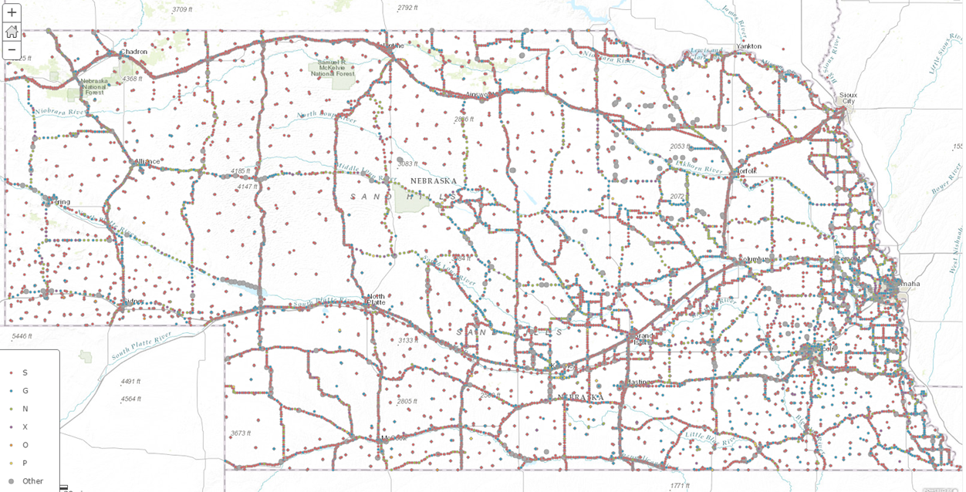
Astronomy
Q. Why Is Astronomy Important in Geodesy?
Because it is the FOUNDATION of all geodetic observations.
The entire United States was surveyed by astronomic observations to set out the passive control marks we have today.
State of Nebraska
February 9, 2018
Professional Surveyors Association of Nebraska
21

Slide 22
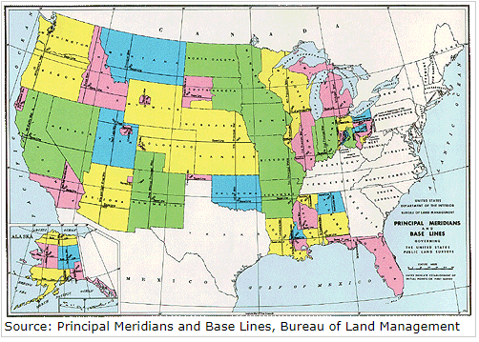
Astronomy
Q. Why Is Astronomy Important in Geodesy?
Sometimes in retracing an old description, it will reference TRUE NORTH.
That was determined by astronomy – or by magnetic bearing corrected for magnetic declination, which was itself measured by astronomy.
A good surveyor knows how it was done then and could still retrace it by the same methods.
February 9, 2018
Professional Surveyors Association of Nebraska
22

Slide 23
Geodesy
How does Geodesy differ from Astronomy?
  Geodesy seeks to describe the size, shape, and other physical characteristics of the Earth.
  Deeply related to gravity, geology, geometry, and physics.
  Astronomical observations are all conducted relative to the vertical defined by the direction of local gravity
  Geodetic calculations are all computed on the surface of an ellipsoid chosen to represent the Earth
  On a perfect Earth with a perfect choice of ellipsoid there’d be no differences.
  Unfortunately, nothing’s perfect.
February 9, 2018
Professional Surveyors Association of Nebraska
23

Slide 24
We Must Choose a Reference Surface
We need a reference surface from which to base measurements.
NGS has chosen the equipotential surface that most closely matches the mean sea surface on a global basis as the reference surface.
This surface is called the GEOID.
Then selected an ellipsoid that is a “best fit” to the geoid and whose center is located at Earth’s center of mass.
Compared to a smooth mathematical surface, the GEOID is lumpy.
February 9, 2018
Professional Surveyors Association of Nebraska
24

Slide 25
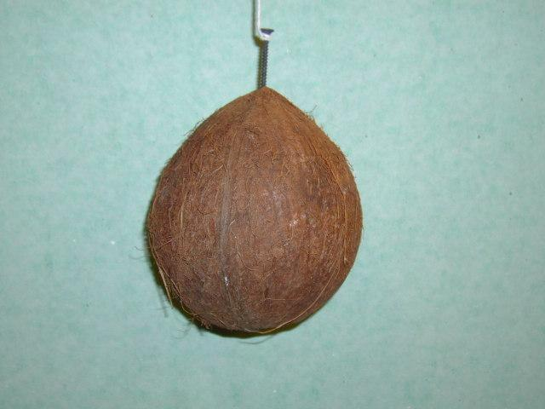
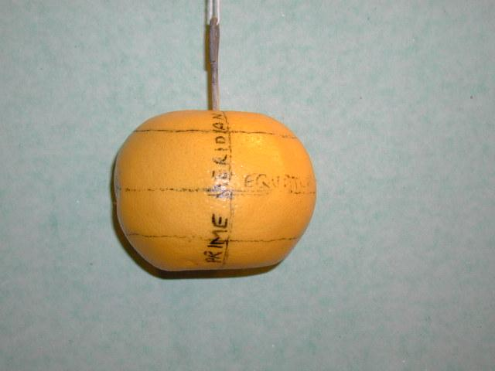
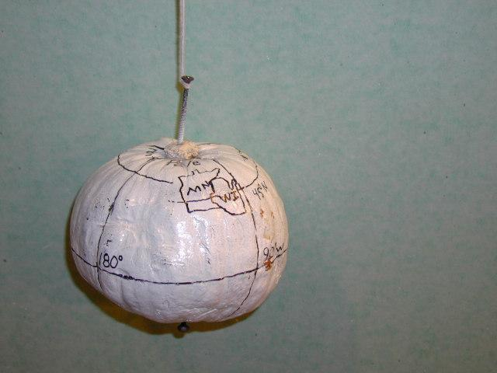
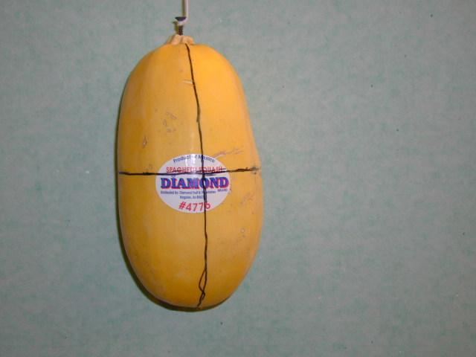
Some Trial Geoid Shapes to Consider
least bad choice
February 9, 2018
Professional Surveyors Association of Nebraska
25

Slide 26
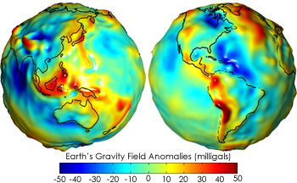
What the Geoid Looks Like
The “geoid” represents the equipotential (level) surface that best approximates the mean sea surface (which is NOT a level surface)
https://earthobservatory.nasa.gov/Features/GRACE/page3.php
February 9, 2018
Professional Surveyors Association of Nebraska
26

Slide 27
Geodesy
Many astronomic and geodetic concepts are related, but need to be modified and refined for the reality of the Earth.
  Astronomic vs Geodetic
    Vertical
    North
    Azimuth
    Latitude
    Longitude
    Other terms
February 9, 2018
Professional Surveyors Association of Nebraska
27

Slide 28
Geodesy
Vertical
deflection of the vertical
perpendicular to geoid = direction of gravity
geoid
perpendicular to ellipsoid
ellipsoid
Angular difference is a few arc-seconds and leads to Laplace correction:
geodetic azimuth = astronomic azimuth + Laplace correction
February 9, 2018
Professional Surveyors Association of Nebraska
28

Slide 29
Geodesy
Laplace Correction
Pole
Astronomic North
Horizon
Setup perpendicular to gravity
February 9, 2018
Professional Surveyors Association of Nebraska
29

Slide 30
Geodesy
Laplace Correction
Pole
Astronomic North
Geodetic North
Horizon
Setup perpendicular to ellipsoid
Laplace correction = angular difference in azimuth
geodetic azimuth = astronomic azimuth + Laplace correction
February 9, 2018
Professional Surveyors Association of Nebraska
30

Slide 31
Geodesy
Laplace Correction is listed on appropriate NGS datasheets
1 National Geodetic Survey, Retrieval Date = OCTOBER 4, 2016
LH1243 ***********************************************************************
LH1243 DESIGNATION - 80 3
LH1243 PID - LH1243
LH1243 STATE/COUNTY- NE/HALL
LH1243 COUNTRY - US
LH1243 USGS QUAD - WOOD RIVER (1993)
LH1243
LH1243 *CURRENT SURVEY CONTROL
LH1243 ______________________________________________________________________
LH1243* NAD 83(1995) POSITION- 40 46 28.66144(N) 098 32 59.95328(W) ADJUSTED
LH1243* NAVD 88 ORTHO HEIGHT - 592.0 (meters) 1942. (feet) VERTCON
LH1243 ______________________________________________________________________
LH1243 GEOID HEIGHT - -24.911 (meters) GEOID12B
LH1243 LAPLACE CORR - -2.14 (seconds) DEFLEC12B
LH1243 HORZ ORDER - SECOND
LH1243|---------------------------------------------------------------------|
LH1243| PID Reference Object Distance Geod. Az |
LH1243| dddmmss.s |
LH1243| CN8485 80 3 RM 1 10.898 METERS 13358 |
LH1243| CN8486 80 3 RM 2 19.983 METERS 23512 |
LH1243| CN8484 80 3 AZ MK 2493549.5 |
LH1243| LH1239 WOOD RIVER MUNICIPAL TANK APPROX. 6.7 KM 3175921.5 |
LH1243|---------------------------------------------------------------------|
February 9, 2018
Professional Surveyors Association of Nebraska
31

Slide 32
Geodesy
The Prime Vertical is a great circle passing through the geodetic zenith from east-to-west.
The prime vertical component of deflection of the vertical leads to Laplace correction.
Meridional component does not.
Pole
Prime Vertical
Zenith
East
West
Celestial Equator
February 9, 2018
Professional Surveyors Association of Nebraska
32

Slide 33
Geodesy
Astronomic Latitude is the angle from the equator up to the observer’s astronomic zenith.
Geodetic Latitude is the angle from the equator up to the observer’s geodetic zenith.
Affected by meridional component of deflection of the vertical
Pole
Zenith
Celestial Equator
February 9, 2018
Professional Surveyors Association of Nebraska
33

Slide 34
Geodesy
Latitude affected by Meridional component of deflection of the vertical
meridional component of deflection of the vertical
Geodetic Latitude
Astronomic Latitude
perpendicular to ellipsoid
opposite of gravity
geoid
ellipsoid
Equator
February 9, 2018
Professional Surveyors Association of Nebraska
34

Slide 35
Geodesy
Longitude affected by Prime Vertical component of deflection of the vertical
Prime Vertical component of deflection of the vertical
Pole
Zenith
Reference Meridian
Zero
Equator
Geodetic Longitude
Astronomic Longitude
February 9, 2018
Professional Surveyors Association of Nebraska
35

Slide 36
Geodesy
Datums
  Horizontal (NAD27, NAD83)
  Vertical (NGVD29, NAVD88)
Types
  Geometric
  Geopotential
  3D (NATRF2022 – which includes NAPGD2022)
February 9, 2018
Professional Surveyors Association of Nebraska
36

Slide 37
Geodesy
8 Horizontal Datum Definition Requirements
  Size and Shape of Reference Ellipsoid (2 elements)
  3 Translations (relative to a chosen point on or in the Earth)
  3 Rotations (relative to a chosen point on or in the Earth)
Specifically, the 8 Defining Elements of Horizontal Datum include:
    Semi-major Axis length
    Flattening Ratio
    Latitude of Initial Point
    Longitude of Initial Point
    Ellipsoid Height of Initial Point
    Prime Meridian Deflection of the Vertical at Initial Point
    Meridional Deflection of the Vertical at Initial Point
    Geodetic Azimuth of a Line at Initial Point
February 9, 2018
Professional Surveyors Association of Nebraska
37

Slide 38
Geodesy
Among the infinite choices for Reference Ellipsoid are the following commonly used ellipsoids with their names:
Ellipsoid Name | Semi-major Axis | Flattening Ratio (approx.)
Airy | 6377563.396 | 299.32
Australian National | 6378160.000 | 298.25
Bessel 1841 | 6377397.155 | 299.15
Clarke 1866 | 6378206.400 | 294.9786982
Clarke 1880 | 6378249.145 | 293.47
Everest | 6377276.345 | 300.80
Fischer 1960 (Mercury) | 6378166.000 | 298.30
Fischer 1968 | 6378150.000 | 298.30
GRS 1967 | 6378160.000 | 298.25
GRS 1980 | 6378137.000 | 298.257222101
Helmert 1906 | 6378200.000 | 298.30
Hough | 6378270.000 | 297.00
International | 6378388.000 | 297.00
Krassovsky | 6378245.000 | 298.30
WGS 60 | 6378165.000 | 298.30
WGS 66 | 6378145.000 | 298.25
WGS-72 | 6378135.000 | 298.26
WGS-84 | 6378137.000 | 298.257223563
February 9, 2018
Professional Surveyors Association of Nebraska
38

Slide 39
Geodesy
NAD27
  used Clarke 1866 ellipsoid and oriented at Meades Ranch and Waldo.
NAD83
  used GRS80 ellipsoid and tried to orient at mass center of Earth
WGS84
  used WGS84 ellipsoid and tried to orient at mass center of Earth
February 9, 2018
Professional Surveyors Association of Nebraska
39

Slide 40
Geodesy
Datum-to-Datum Conversion Methods are needed to convert coordinates to-from-between datums.
Several Methods with often confusing names
  3 parameter (NADCON)
  7 parameter (Helmert)
  7 parameter (Bursa-Wolfe)
  7 parameter (Molodensky)
  10 parameter (Molodensky-Badekas)
  14 parameter (scientific community)
Exactness of geometry is often sacrificed for simplicity
February 9, 2018
Professional Surveyors Association of Nebraska
40

Slide 41
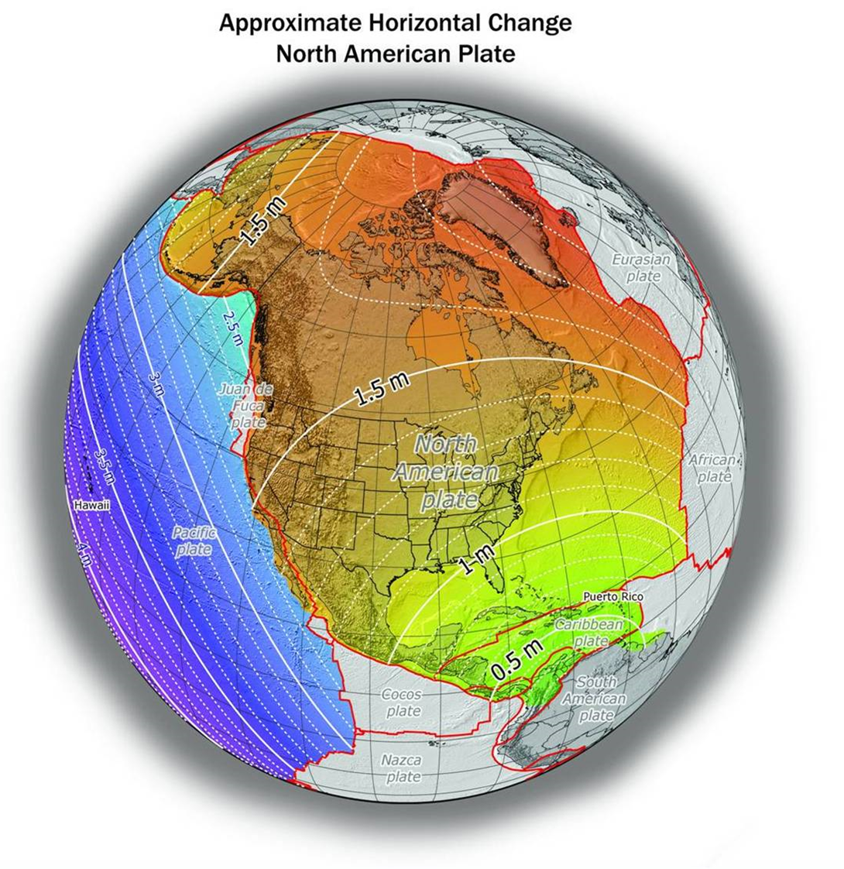
Geodesy
3 parameter (NADCON) cannot model more than a limited patch on the Earth.
DX,DY, DZ here not same as there
NADCON used a 15’ x 15’ grid in CONUS. (About 15 miles x 10 miles). See page 10, NOAA Technical Memorandum NOS NGS-50, 1990.
February 9, 2018
Professional Surveyors Association of Nebraska
41

Slide 42
Geodesy
7 & 10 parameter are more rigorous and cover a larger area.
14 parameter also includes velocities for the 7-parameters.
Note that in the long-term, the velocities are also changing, so maybe we should consider a 21 parameter solution someday!
February 9, 2018
Professional Surveyors Association of Nebraska
42

Slide 43
Geodesy
Datum Conversion “mileage chart problem”
Any datum should be convertible to any other datum.
Since large numbers of datums (N) exist, there are (N²) conversions needed.
So, a common datum is used as an intermediary datum.
Scientific community cooperates by creating International Terrestrial Reference Frame (ITRF).
Only need 2N conversions: X>ITRF and ITRF>Y
  But, only need to tabulate N conversions - (then treat as to or from)
Also makes it easier to add a new datum if needed.
February 9, 2018
Professional Surveyors Association of Nebraska
43

Slide 44
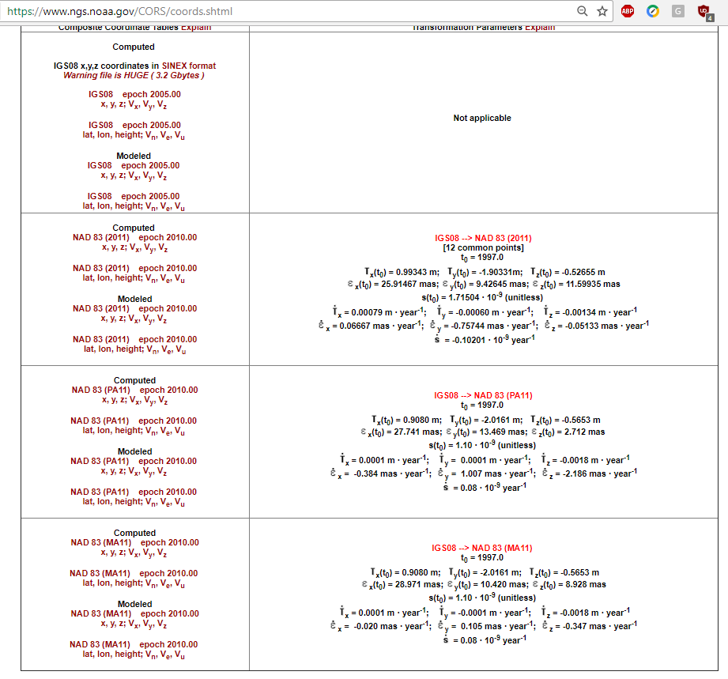
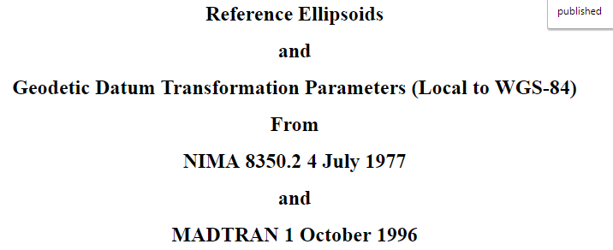
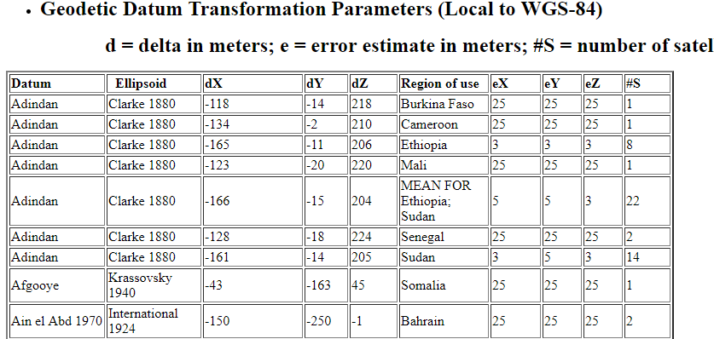
Geodesy
Datum Conversion Table and Parameters
  (https://www.ngs.noaa.gov/CORS/coords.shtml#Col1Exp)
14 parameters
February 9, 2018
Professional Surveyors Association of Nebraska
44

Slide 45
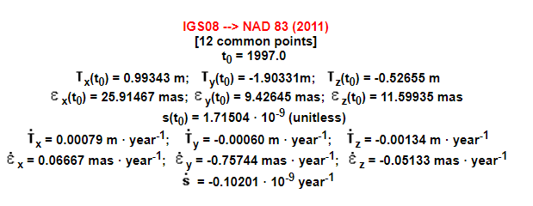
Geodesy
14 Parameters from NGS
  3 translations, 3 rotations, 1 scale factor
  and 7 Velocities
February 9, 2018
Professional Surveyors Association of Nebraska
45

Slide 46
Geodesy
Datum Conversion Chart for direct conversions
DATUM NAME | NAD27 | NAD83 | NATRF2022 | AGD84
NAD27 | Null | s dx, dy, dz, ω, φ ,κ | s dx, dy, dz, ω, φ ,κ | s dx, dy, dz, ω, φ ,κ
NAD83 | s dx, dy, dz, ω, φ ,κ | Null | s dx, dy, dz, ω, φ ,κ | s dx, dy, dz, ω, φ ,κ
NATRF2022 | s dx, dy, dz, ω, φ ,κ | s dx, dy, dz, ω, φ ,κ | Null | s dx, dy, dz, ω, φ ,κ
AGD84 | s dx, dy, dz, ω, φ ,κ | s dx, dy, dz, ω, φ ,κ | s dx, dy, dz, ω, φ ,κ | Null
N² entries
½ (N² – N) entries
Not needed – these are negatives of the others
AGD84 = Australian Geodetic Datum 1984
February 9, 2018
Professional Surveyors Association of Nebraska
46

Slide 47
Geodesy
Datum Conversion Chart using intermediary conversions
DATUM NAME | ITRF
NAD27 | s dx, dy, dz, ω, φ ,κ
NAD83 | s dx, dy, dz, ω, φ ,κ
NATRF2022 | s dx, dy, dz, ω, φ ,κ
AGD84 | s dx, dy, dz, ω, φ ,κ
Only N entries
Chart is even simpler using intermediary datum
February 9, 2018
Professional Surveyors Association of Nebraska
47

Slide 48
HEIGHTS
February 9, 2018
Professional Surveyors Association of Nebraska
48

Slide 49
Geodesy
Heights above or below a reference surface
  Mean Sea Level Heights
  Ellipsoid Heights
  Orthometric Heights
  Geoid Heights
  Vertical Datums
    1912
    NGVD29
    NAVD88
  Dynamic Heights
February 9, 2018
Professional Surveyors Association of Nebraska
49

Slide 50
Geodesy
Height above Mean Sea Level
terrain
mean sea level
Positive is UP, negative is down
February 9, 2018
Professional Surveyors Association of Nebraska
50

Slide 51
Geodesy
Height above Ellipsoid
terrain
h
ellipsoid
Positive is UP, negative is down
February 9, 2018
Professional Surveyors Association of Nebraska
51

Slide 52
Geodesy
Height above Geoid (Orthometric)
terrain
H
geoid
Positive is UP, negative is down
February 9, 2018
Professional Surveyors Association of Nebraska
52

Slide 53
Geodesy
Geoid Height above ellipsoid
ellipsoid
N
geoid
Positive is UP, negative is down
February 9, 2018
Professional Surveyors Association of Nebraska
53

Slide 54
Geodesy
Height above Mean Sea Level
Height above Ellipsoid
Height above Geoid (Orthometric)
Geoid Height
terrain
ellipsoid
geoid
mean sea level
Positive is UP, negative is down
February 9, 2018
Professional Surveyors Association of Nebraska
54

Slide 55
Geodesy
Height above Mean Sea Level
Height above Ellipsoid
Height above Geoid (Orthometric)
Geoid Height
terrain
h
ellipsoid
H
N
geoid
mean sea level
Positive is UP, negative is down
H = h - N
Note that N is negative in most of CONUS.
Note that h may be negative near coastlines.
Could H be negative?
February 9, 2018
Professional Surveyors Association of Nebraska
55

Slide 56
Geodesy
Vertical Datums in the United States
  There have been several vertical datums in use across the United States. The earliest ones were “local”, since the leveling did not form an interconnected network.
  The earliest unified datums were the 1912 Datum (4th General Adjustment).
  Followed by the NGVD29 adjustment.
  Followed by the NAVD88 adjustment.
February 9, 2018
Professional Surveyors Association of Nebraska
56

Slide 57
Geodesy
NGVD29 consists of a leveling network across the United States.
  Leveling was adjusted to fit tide gauges which forced the NGVD29 datum surface to be an approximation of the mean sea surface.
  Unfortunately, the sea surface is NOT level (fails to conform to gravitational potential energy due to salinity, temperature, and currents.
  It seemed like a good idea at the time.
  Resulted in the severely misleading term “Mean Sea Level”.
    Preferred term “mean sea surface”.
February 9, 2018
Professional Surveyors Association of Nebraska
57

Slide 58
Geodesy
NAVD88 consists of a leveling network on the North American Continent, ranging from Alaska, through Canada, across the United States, affixed to a single origin point on the continent.
  Leveling was adjusted “internally” and tied to only 1 point – Pointe au Pere (Father’s Point) in Quebec
    Tide Station & Location = Pointe-au-Pere, Rimouski, Quebec, Canada
    Located in corner of a school building at Rue St Germaine and Goulet Avenue
    PID = TY5255
    Bench Mark = 1250 G
    Height above LMSL = 6.271 meters
February 9, 2018
Professional Surveyors Association of Nebraska
58

Slide 59
Geodesy
Height above Mean Sea Level
As if we weren’t confused already, let’s add the datum surfaces to the diagram.
Height above Ellipsoid
Height above Geoid (Orthometric)
Geoid Height
terrain
ellipsoid
NAVD88
geoid
v
1912
v
NGVD29
mean sea level
The datums are NOT parallel, nor smooth.
February 9, 2018
Professional Surveyors Association of Nebraska
59

Slide 60
Geodesy
Vertical Datum Conversions
  There is NO SINGLE VALUED conversion between 1912, NGVD29, nor NAVD88.
    Datums are not parallel.
    Datums are not smooth.
    Underlying leveling is not error-free.
Must research the relationship among the known published datum heights for specific passive marks in the area of interest.
Devise a diagram for your local area.
  See “Digging for Datums” by David Zenk (2012)
  Sample next slide - - - >
February 9, 2018
Professional Surveyors Association of Nebraska
60

Slide 61
Draw a DATUM PROFILE
St. Paul, MN
(PBM 67)
Dresbach, MN
(PBM 182)
Elevation above datum = Depth to datum
NGVD29
NAVD88
0.046 m
0.013 m
NAVD88
NGVD29
0.098 m
0.071 m
Mean Gulf
Mean Gulf
1912
0.003 m
0.078 m
2.222 m
2.148 m
1912
Memphis
Memphis
February 9, 2018
Professional Surveyors Association of Nebraska
61

Slide 62

Geodesy
Dynamic Heights
  A dynamic height is directly related to the amount of potential energy at a given point.
  As an object is raised it acquires gravitational potential energy.
  Potential energy = Work Done in raising a weight through a Distance
  PE = D x F
D = Distance (m)
D = 1 m
F = Weight
F = Mass x Gravity
F = 1 kg x 9.8 m/sec²
PE = 1 m x 1 kg x 9.8 m/sec²
PE = 9.8 kg m²/sec²
February 9, 2018
Professional Surveyors Association of Nebraska
62

Slide 63
Geodesy
Note that gravity varies over distances, so equal potential energy surfaces are not parallel.
stronger gravity zone
weaker gravity zone
D = Distance (m)
D = 1 m
D = Distance (m)
D = 1.01 m
F = Weight
F = Mass x Gravity
F = 1 kg x 9.8 m/sec²
F = Weight
F = Mass x Gravity
F = 1 kg x 9.7 m/sec²
PE = 1 m x 1 kg x 9.8 m/sec²
PE = 9.8 kg m²/sec²
PE = 1.01 m x 1 kg x 9.7 m/sec²
PE = 9.8 kg m²/sec²
February 9, 2018
Professional Surveyors Association of Nebraska
63

Slide 64
Geodesy
Equal PE but not equal distances.
Geopotential surfaces are not parallel, but ARE level.
PE = 9.8 kg m²/sec²
PE = 9.8 kg m²/sec²
D = 1 m
D = 1.01 m
PE = 0 kg m²/sec²
PE = 0 kg m²/sec²
February 9, 2018
Professional Surveyors Association of Nebraska
64

Slide 65
Geodesy
Every geopotential surface could be computed and labeled with its Geopotential Number.
All such geopotential surfaces directly denote level surfaces.
Water does not flow along these level surfaces.
A set of Geopotential Numbers can be divided by a constant amount and all resulting numbers are still in proportion and still represent a series of level surfaces.
So choose to divide by normal gravity at 45⁰ latitude (9.806199 m/sec²) and by 1 kg.
Result is a Dynamic Height whose unit is meters, but is not an actual height – it is merely a label for a level surface.
February 9, 2018
Professional Surveyors Association of Nebraska
65

Slide 66
Geodesy
Here’s what NGS has to say about DYNAMIC HEIGHTS near the Great Lakes
Special Note on IGLD 85 Heights
Dynamic heights are relevant near large bodies of water such as reservoirs or very large lakes, so the Great Lakes are an ideal candidate for dynamic heights. However, the Great Lakes are referenced to the International Great Lakes Datum of 1985 (IGLD 85) dynamic heights. The difference between IGLD 85 dynamic heights and NAVD 88 dynamic heights is known as a hydraulic corrector. An application which includes these hydraulic correctors is available for users who wish to compute IGLD 85 heights directly.
February 9, 2018
Professional Surveyors Association of Nebraska
66

Slide 67
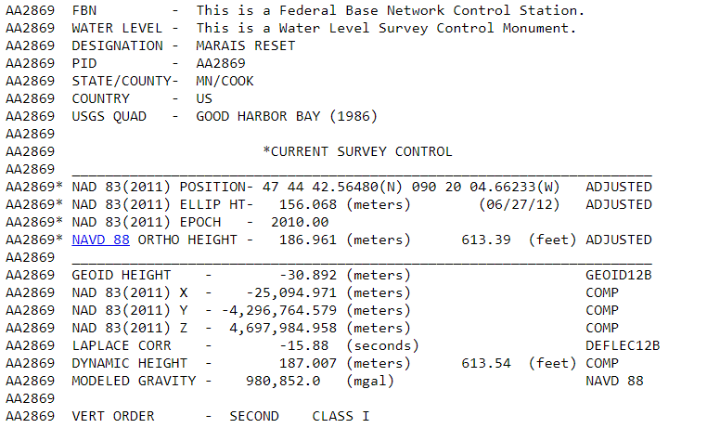
Geodesy
February 9, 2018
Professional Surveyors Association of Nebraska
67

Slide 68
End
Dave Zenk PE, LS
National Geodetic Survey
Northern Plains Regional Advisor
1735 Lake Drive West
Chanhassen, MN 55317-8581
763-600-6912 home office
952-368-2548 office
612-414-9522 mobile
dave.zenk@noaa.gov (federal business)
zenkx002@umn.edu (personal business)
February 9, 2018
Professional Surveyors Association of Nebraska
68

