Slide 1
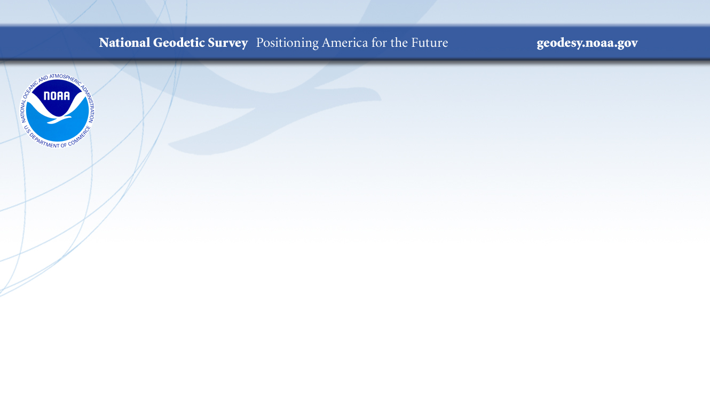
NGS’s Geoid Monitoring Service (GeMS)
Ahlgren, Kevin M. – GeMS Project Manager
 | NGS Webinar Series | 9/12/2019

Slide 2
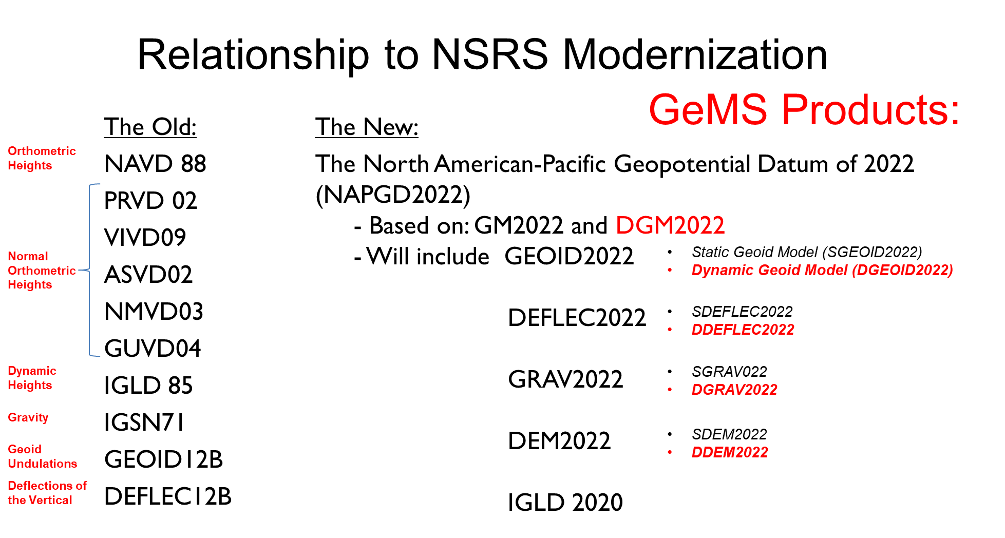
Outline
Overview of Geoid Monitoring Service (GeMS) Project at NGS
Current status → xDGEOID19
Geoid change and new terminology related to GeMS
Options in Near-term Outlook (2019 - 2022)
  Modeling & Validation
Extended Outlook (10+ year)
Questions

Slide 3
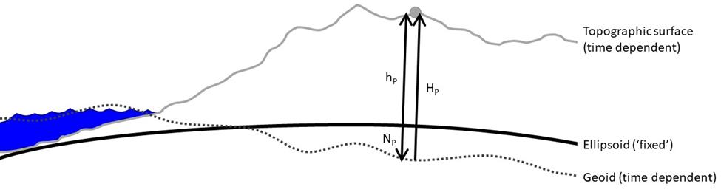
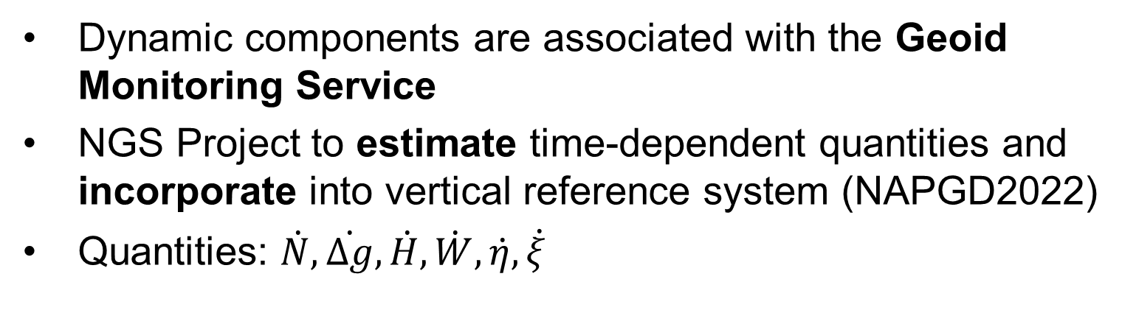
GeMS
Project
Dynamic components are associated with the Geoid Monitoring Service
NGS Project to estimate time-dependent quantities and incorporate into vertical reference system (NAPGD2022)
Quantities: $\dot{N},\dot{∆g},\dot{H},\dot{W},\dot{η},\dot{ξ}$
Notes:
Stress: Need a lot of mass and (gravity) change over large areas to get ‘significant’ geoid change. It is not just a surface deformation event. There actually has to be mass redistribution causing gravity change.
Need to validate how well this changes reflect what is happening on the ground.

Slide 4
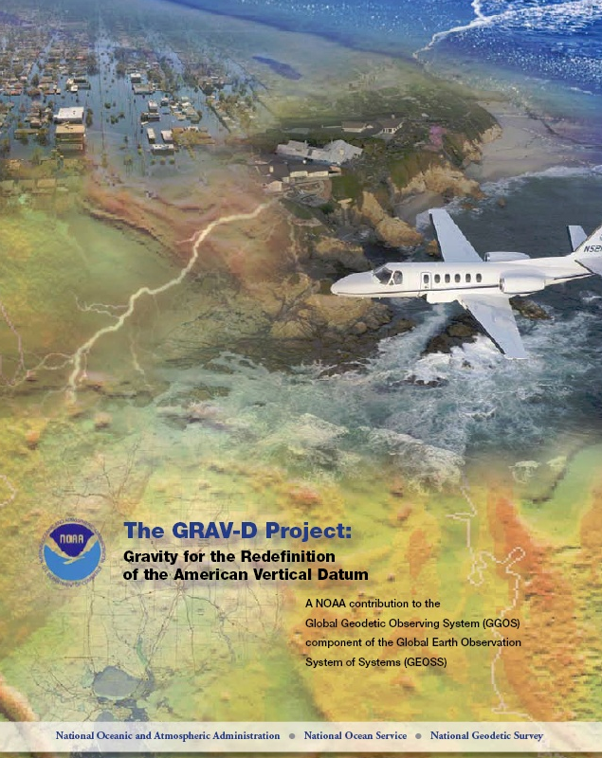
GeMS
Motivation
Initially proposed as the 2nd component of Gravity for the Re-definition of the American Vertical Datum (GRAV-D)
  “low-resolution movie to track the temporal changes to the gravity field on a broad scale—a re-occurring survey with very coarse spatial coverage and a long temporal span”
Specified in NGS Strategic Plan 2019-2023: Objective 2-2: “Replace NAVD 88”
  Define and provide access to a geocentric, time-dependent, geopotential datum by year 2022.
Notes:
GeMS is not a ‘new’ project as it was originally proposed as the 2nd component of the GRAV-D project.

Slide 5
GeMS Project
Status
Research and Development
  Scope:
    What can NGS do? What can NGS not do?
    What are the costs, benefits, and risks of doing or not doing a particular element within GeMS?
  Status:
    Nearly completed (95% done).
  Deliverables:
    NOS NGS Technical Report 69: A Preliminary Investigation of the NGS’s Geoid Monitoring Service (GeMS)
    Alpha Products: xDGEOID19 – a dynamic geoid model will be available for testing with xGEOID19.
    Supporting Tools: Software, documentation, and details.
    Recommendations that will drive subsequent GeMS stages.
Operations and Development (TBD)
Refinement and Improvement (TBD)

Slide 6
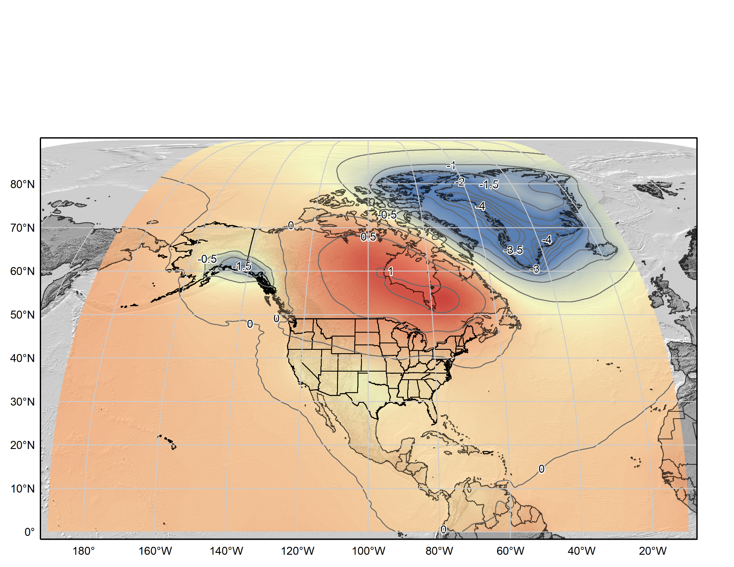
xDGEOID19
Alpha model based on secular trend from GRACE (NASA GSFC mascon v02.4, Luthcke, et al. 2013)).
Units: mm/yr.
Contour Interval: 0.5 mm/yr
Notes:
Stress: Need a lot of mass change over large areas to get ‘significant’ geoid change
Need to validate how well this changes reflect what is happening on the ground.

Slide 7

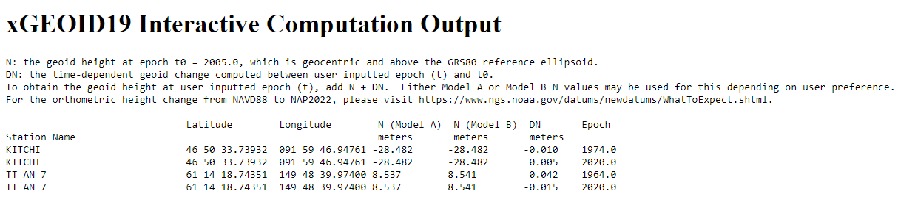
xGEOID19 BETA Model
Sample Output:
Static Geoid Model Output (same as previous xGEOIDs): value from Model A and B
xDGEOID19 Component:
DN = geoid rate * (t-t₀)
User Inputted Coordinates
User Inputted Epoch

Slide 8
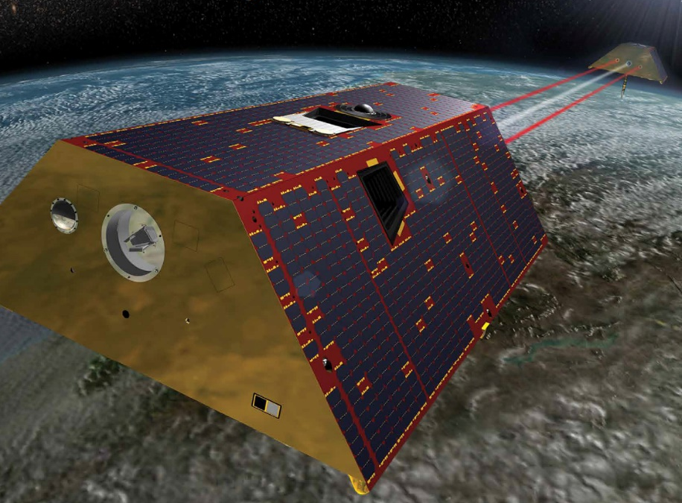
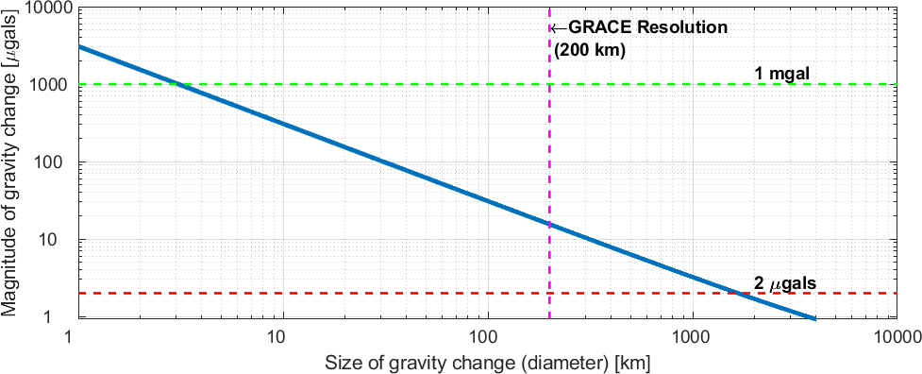
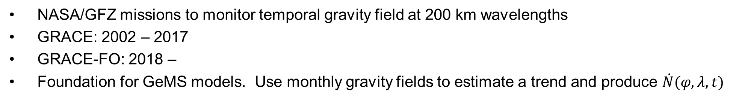
GRACE/GRACE-Follow-on
NASA/GFZ missions to monitor temporal gravity field at 200 km wavelengths
GRACE: 2002 – 2017
GRACE-FO: 2018 –
Foundation for GeMS models. Use monthly gravity fields to estimate a trend and produce $\dot{N}(φ,λ,t)$
GRACE/GRACE-FO – Twin satellites that measure distance between one another at few μm (a tenth of the thickness of a human hair). (Image courtesy of NASA)
Relationship between gravity change, geographic size of change, and geoid change. Combinations to the right of the blue line will cause a 1 cm geoid change. Shaded area is specifically needed through non-GRACE techniques.

Slide 9
Types of
Geoid Change
Shape Change - most common and most of what GeMS will capture
  change in the shape of the geoid (W=W₀) without changing W₀
  Analogy: Squeezing a balloon – depressions and bulges occur but volume is maintained
Size Change – quite rare with limited amount of change
  Change in the size of the geoid (W=W₀) without changing W₀.
  Increasing or decreasing the volume contain by the geoid or geopotential field
  Analogy: Adding or removing air to a balloon – increased or decreased volume or size
W₀ Change
  Any long term sea level change (up or down).
  This would result in a new datum definition…
Not to Scale:
Size change
Shape change
Notes:
Stress: Need a lot of mass change over large areas to get ‘significant’ geoid change

Slide 10
Terminology
Water Equivalent Height:
  the amount of mass (change) converted into a layer of water over the region in question.
  Typically interested in the change
  +1 cm W.E. is consistent with an additional 1 cm high layer of water over a specified geographic area.
  Units allow multiple user groups to work with mass change (geodesy, hydrology)
Mascon:
  Mass concentration
  A discrete cell that has its own gravity / mass change
  Used to break up the Earth into specific geographic areas.
1 cm
Single mascon at two time epochs (t₁ and t₂). Water equivalent height has increased by 1 cm from t₁ to t₂
Notes:
1 m w.e ≈ 0.04 mGal
Since we know the density of water (1000 kg/m3) and the area that the mass/water was added to, we also can determine the gravity change, the geoid change, etc.

Slide 11
Terminology
Water Equivalent Height:
  the amount of mass (change) converted into a layer of water over the region in question.
  Typically interested in the change
  +1 cm W.E. is consistent with an additional 1 cm high layer of water over a specified geographic area.
  Units allow multiple user groups to work with mass change (geodesy, hydrology)
Mascon:
  Mass concentration
  A discrete cell that has its own gravity / mass change
  Used to break up the Earth into specific geographic areas.
Mass concentrations with equivalent water heights at some initial time epoch, t₁.
Notes:
1 m w.e ≈ 0.04 mGal
Since we know the density of water (1000 kg/m3) and the area that the mass/water was added to, we also can determine the gravity change, the geoid change, etc.

Slide 12
Terminology
Water Equivalent Height:
  the amount of mass (change) converted into a layer of water over the region in question.
  Typically interested in the change
  +1 cm W.E. is consistent with an additional 1 cm high layer of water over a specified geographic area.
  Units allow multiple user groups to work with mass change (geodesy, hydrology)
Mascon:
  Mass concentration
  A discrete cell that has its own gravity / mass change
  Used to break up the Earth into specific geographic areas.
Mass concentrations with equivalent water heights at some later time epoch, t₂. Mascons in red have lost mass from t₁ to t₂ and mascons in blue have gained mass from t₁ to t₂.
Notes:
1 m w.e ≈ 0.04 mGal
Since we know the density of water (1000 kg/m3) and the area that the mass/water was added to, we also can determine the gravity change, the geoid change, etc.

Slide 13
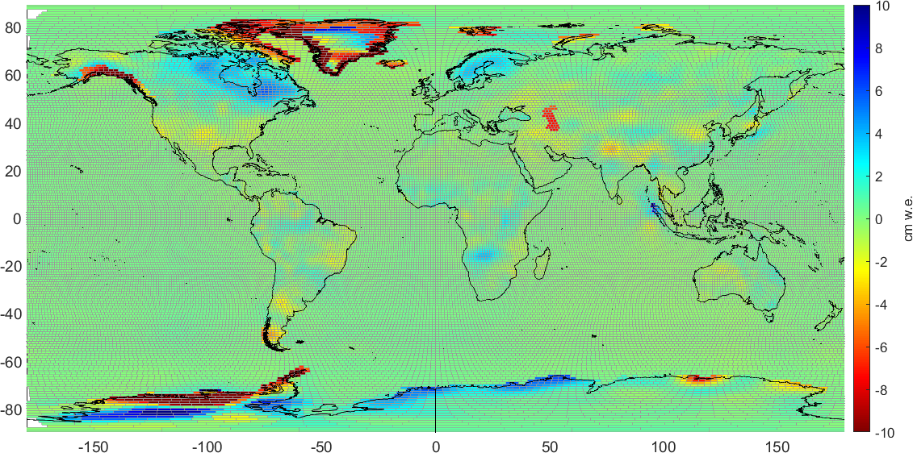
Terminology
Water Equivalent Height:
  the amount of mass (change) converted into a layer of water over the region in question.
  Typically interested in the change
  +1 cm W.E. is consistent with an additional 1 cm high layer of water over a specified geographic area.
  Units allow multiple user groups to work with mass change (geodesy, hydrology)
Mascon:
  Mass concentration
  A discrete cell that has its own gravity / mass change
  Used to break up the Earth into specific geographic areas.
Mass Change in cm water equivalent (cm w.e./yr) – secular trend from GRACE (NASA GSFC mascon v02.4, Luthcke, et al. 2013))
Notes:
1 m w.e ≈ 0.04 mGal
Since we know the density of water (1000 kg/m3) and the area that the mass/water was added to, we also can determine the gravity change, the geoid change, etc.

Slide 14
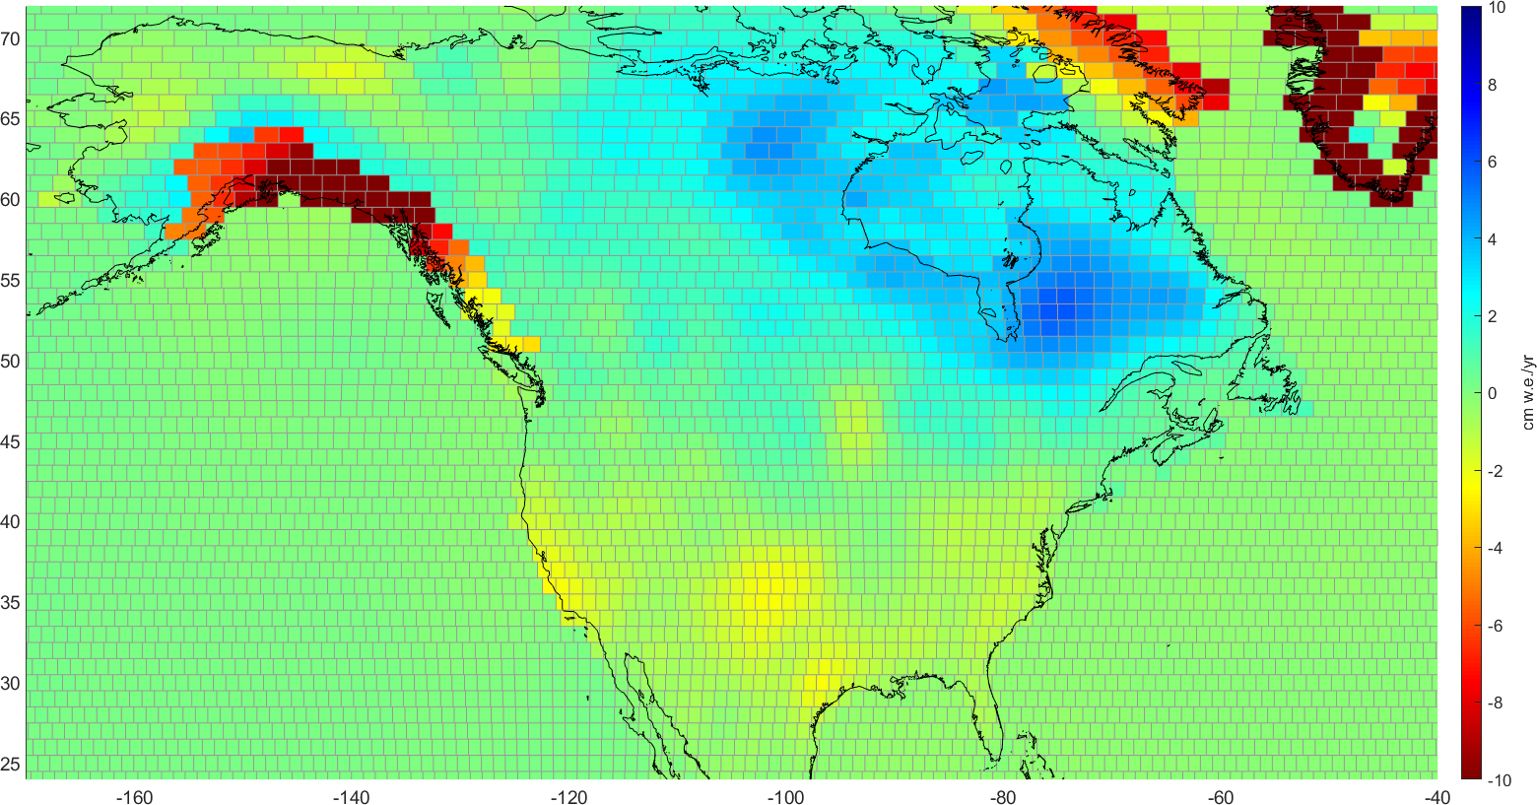
Terminology
Water Equivalent Height:
  the amount of mass (change) converted into a layer of water over the region in question.
  Typically interested in the change
  +1 cm W.E. is consistent with an additional 1 cm high layer of water over a specified geographic area.
  Units allow multiple user groups to work with mass change (geodesy, hydrology)
Mascon:
  Mass concentration
  A discrete cell that has its own gravity / mass change
  Used to break up the Earth into specific geographic areas.
Mass Change in cm water equivalent (cm w.e./yr) – secular trend from GRACE (NASA GSFC mascon v02.4, Luthcke, et al. 2013))
Notes:
1 m w.e ≈ 0.04 mGal
Since we know the density of water (1000 kg/m3) and the area that the mass/water was added to, we also can determine the gravity change, the geoid change, etc.

Slide 15
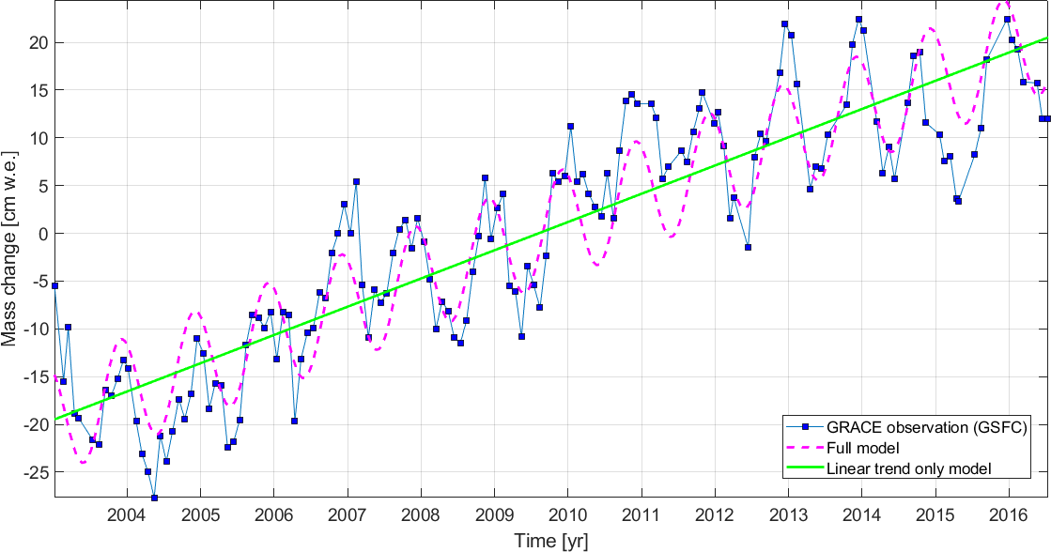
Looking at one of the mascons….
Monthly time series from GRACE/GRACE-FO
Temporal signatures: trend, sinusoids, instantaneous jump, (& residual)
Mass change [cm water equivalent height]
Notes:
Not interested in 1 month to the next month like in the previous cartoons but in the long term history or time series of all the global mascons. If you are familiar with a GNSS CORS time series plot of latitude, longitude, or height, this is pretty similar BUT we are observing the water equivalent height or mass change in time …. The variable height of water in that mascon with respect to some reference amount.
There are many signatures or components are are evident in this time series that NGS could possibly incorporate into a GeMS DGEOID model: secular trend, annual signals, seasonal, seasonal signals, and instantaneous jumps. We will look at each of these in later slides but before we get there, let’s look at what types of thresholds and targets have been proposed.
For each mascon, we can then estimate 1) a trend (or secular) in the water equivalent height, 2) the annual amplitude (the size of the seasonal signal), 3) more high frequency temporal signals (1/2, 1/3, ¼, …. Year)

Slide 16
GeMS target rate and implications
Less than 1 cm geoid error at 10 years
  Implied Rate = 1 mm / yr (geoid rate)
  Target Rate = 0.5 mm / yr (geoid rate)
Implications for geophysical signals to monitor:
  GIA in CONUS just at target
  Ice-mass changes in Alaska, Canada, Greenland
  Very large earthquakes (M8+)
  Hydrology model
Mass Change in cm water equivalent (cm w.e./yr) – secular trend from GRACE (NASA GSFC mascon v02.4, Luthcke, et al. 2013))
Notes:
NGS as a scientific agency wants to produce the most scientifically rigourous products and results. However, we also want to balance practicality here also.

Slide 17

Modeling: Secular Component ($\dot{N}$)
Rely on GRACE / GRACE-FO
Foundation for GeMS models.
Full time series (15+ years) used
Alpha Product: xDGEOID19 which uses GSFC v02.4 model (Luthcke, et al. 2013)
GRACE-FO satellite conception (courtesy: NASA)
xDGEOID19 – Alpha product for evaluation purposes. Units: mm/yr. Contour interval: 0.5 mm/yr.

Slide 18
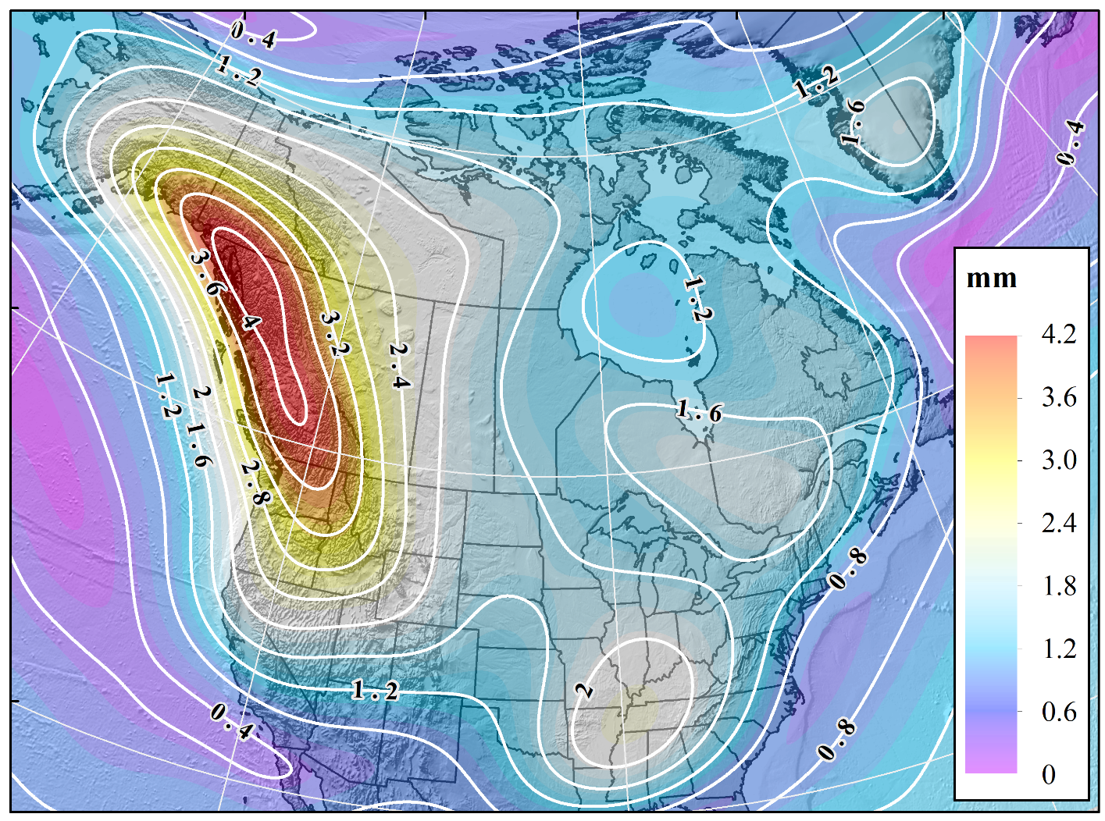
Modeling: Annual Amplitude
Currently, not included in GeMS products
GRACE Annual amplitude reaches ~4 mm in North America
Other regions like South America (w/10+ mm) may need to consider incorporating
Annual amplitude from GRACE (CSR RL06 n_{max} = 96)

Slide 19
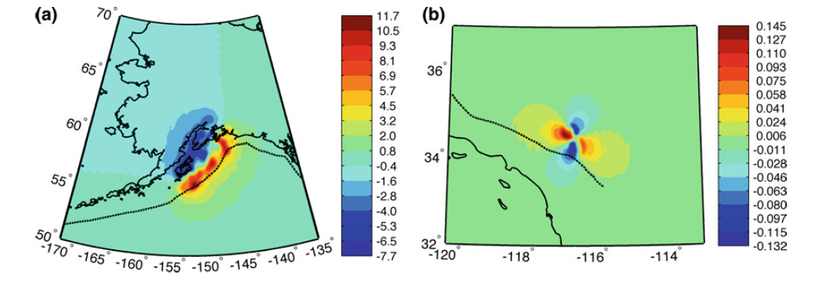
Modeling:
Episodic Events
Earthquakes, Volcanoes, Landslides…
Handled on a case by case basis…
Possibly warrant a geodetic response
Very rarely occur at levels of significance
  1992 Landers M7.3 Earthquake produced ~0.1 mm
  1964 Alaska M9.2 had ~10 mm
  Mount St. Helens Eruption:
    Flank collapse: 10+ cm geoid change
    Material redistribution: 2 cm geoid change
Modeled geoid change in mm for (a) the 1964 Alaska earthquake and (b) the 1992 Landers earthquake. (from Jacob, et al., 2012)

Slide 20
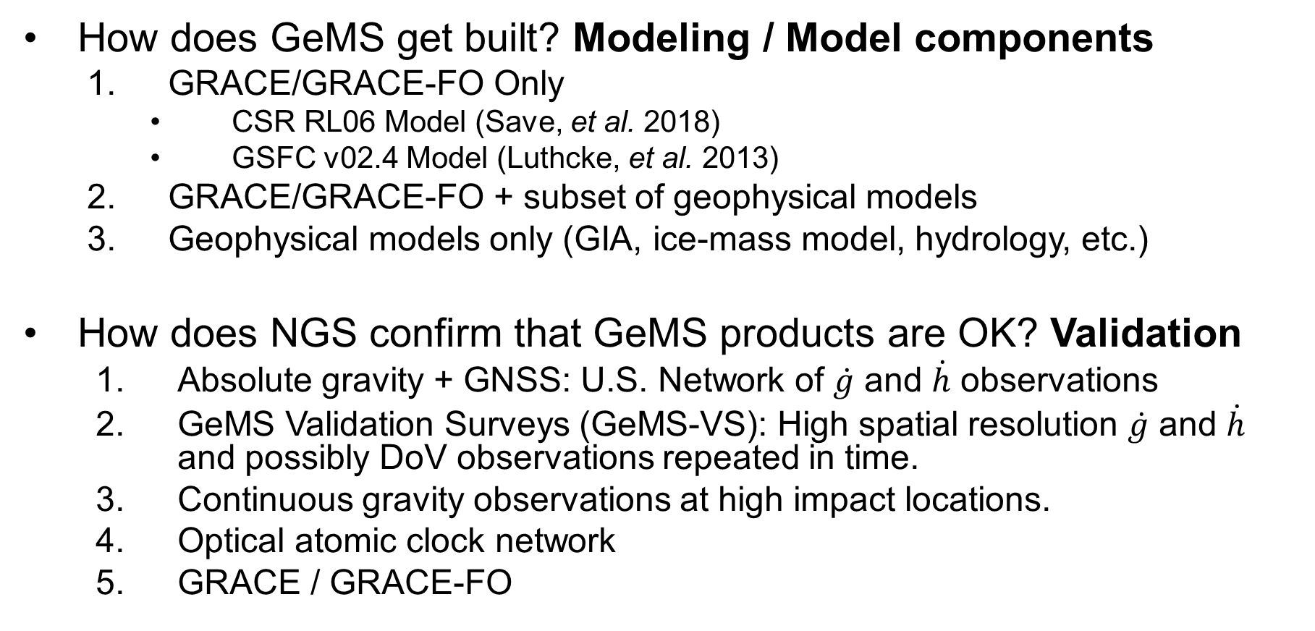
GeMS Options in Near-Term
How does GeMS get built? Modeling / Model components
  GRACE/GRACE-FO Only
    CSR RL06 Model (Save, et al. 2018)
    GSFC v02.4 Model (Luthcke, et al. 2013)
  GRACE/GRACE-FO + subset of geophysical models
  Geophysical models only (GIA, ice-mass model, hydrology, etc.)
How does NGS confirm that GeMS products are OK? Validation
  Absolute gravity + GNSS: U.S. Network of $\dot{g}$ and $\dot{h}$ observations
  GeMS Validation Surveys (GeMS-VS): High spatial resolution $\dot{g}$ and $\dot{h}$ and possibly DoV observations repeated in time.
  Continuous gravity observations at high impact locations.
  Optical atomic clock network
  GRACE / GRACE-FO
Notes:
Two simple questions that have very complicated answers:
How does NGS build GeMS?
How does NGS have any confidence in GeMS products?
These are complicated answers because there are no ‘slam-dunks’. These are all complicated elements that haven’t been done operationally by NGS or other geodetic agencies around the world.

Slide 21
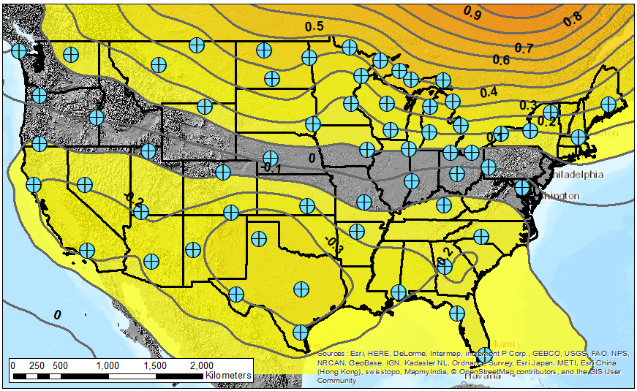
Validation: Proposed Absolute Gravity Network
Proposed Network
~60 locations
Observe every 1-3 years
Build off existing NOAA FCORS Network
Densify in areas with most geoid change (Great Lakes and Alaska)
Additional benefits:
  Supports relative gravity efforts nationwide
Proposed, preliminary absolute gravity network with geoid rates from GRACE in mm/yr (contour interval = 0.1 mm/yr)

Slide 22
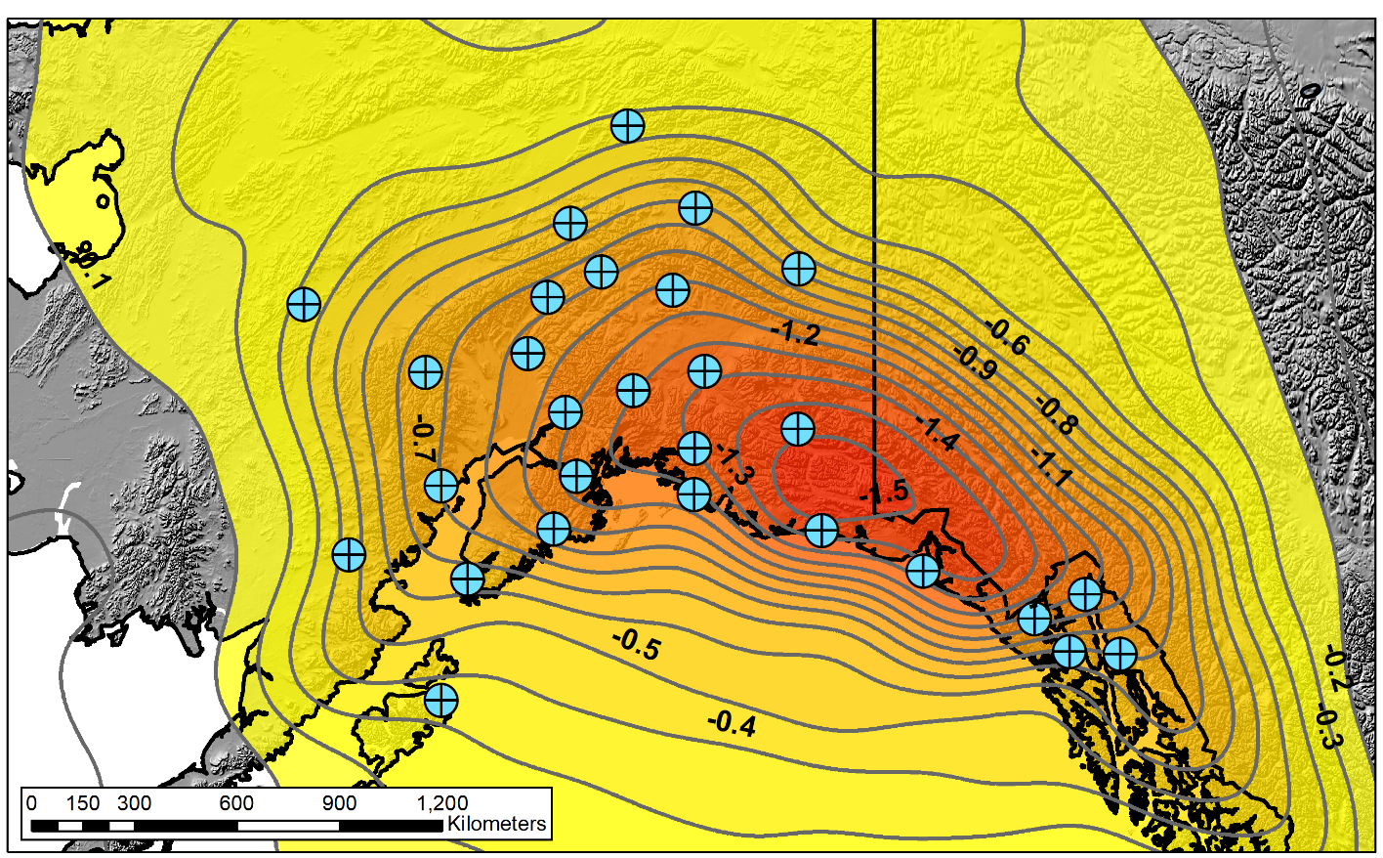
Validation: Proposed Absolute Gravity Network
Proposed Network
~30 locations
Observe every 1-3 years
Build off existing NOAA FCORS Network
Densify in areas with most geoid change (Great Lakes and Alaska)
Additional benefits:
  Supports relative gravity efforts nationwide
Proposed, preliminary absolute gravity network with geoid rates from GRACE in mm/yr (contour interval = 0.1 mm/yr)

Slide 23
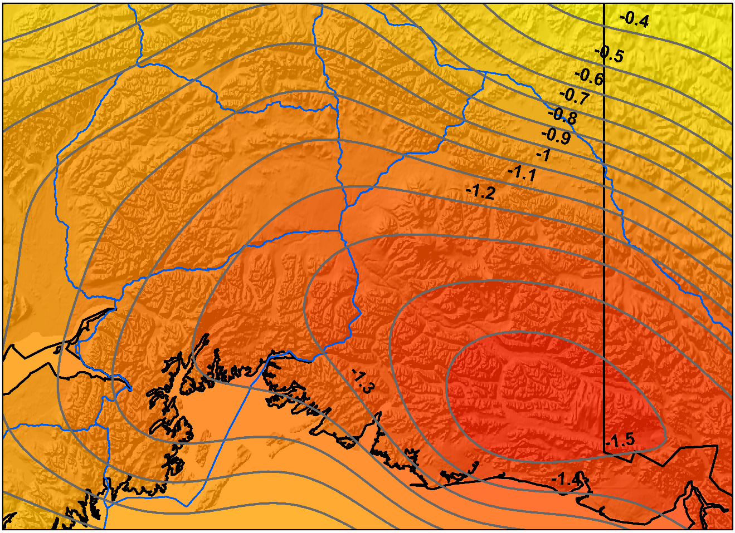
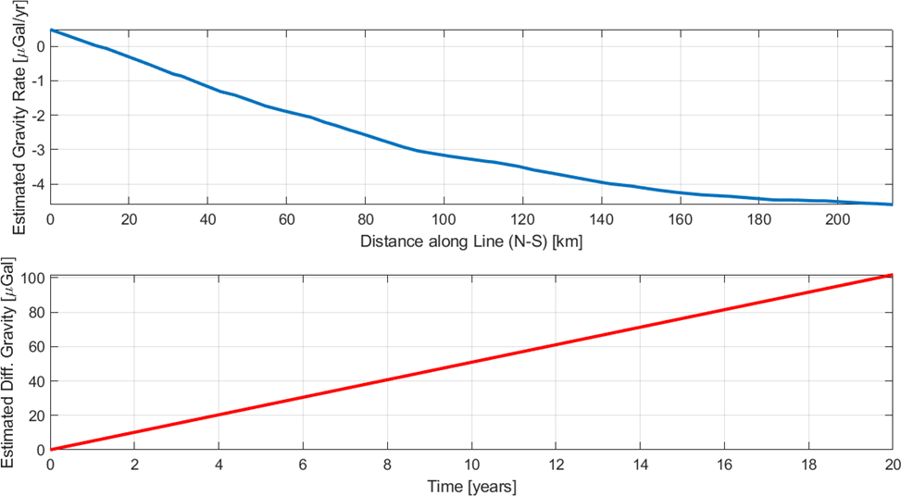
Proposed GeMS
Validation Survey
Tok
Glennallen
Anchorage
Alaska Geoid Rate from GRACE in mm/yr. Roads shown in blue.
Notes:
Single example of a GeMS Validation Survey (GeMS-VS) could be done with repeat gravity, GNSS, DOV. Slight modification on GSVS lines as only 1 cm of geoid change builds up over 18 years. This would be difficult to remedy with GPS\L PLUS don’t have the absolute height change (0 degree part). With gravity, only need about 4-6 years to resolve 20 uGals along this 220 km line. Mixture of FG5 absolute w/ relative and static GNSS.

Slide 24
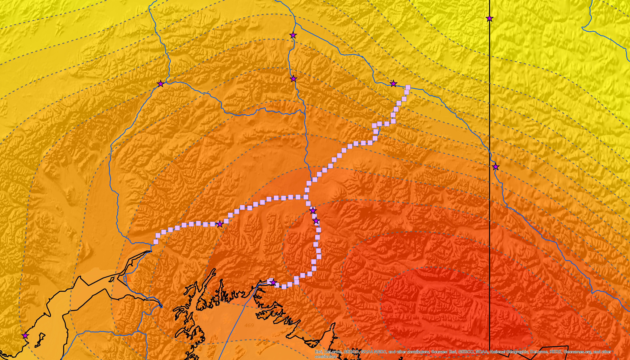

Proposed GeMS-VS
Historical DoV measurements
(pre 1912 and pre 1950s)
Tok
GeMS-VS
20 km spacing
Repeat relative gravity w/ CG-6 to get relative $\dot{g}$ (change within line)
Repeat GNSS w/static surveys
Repeat FG-5 at Glennallen to get absolute $\dot{g}$
Value will be gained after the initial observations as 50+ year baselines exist with IDB gravity and IDB/UNAVCO data for h
Proposed Profiles from Glennallen:
Glennallen to Palmer – ~23 pts
Glennallen to Valdez – ~23 pts
Glennallen to Tok – ~25 pts
Repeat Historical DoV
8-10 single repeats around Glennallen
Glennallen
Anchorage
Valdez
Alaska Geoid Rate from GRACE in mm/yr. Roads shown in blue.
Notes:
GeMS Validation Survey (GeMS-VS) could be done with repeat gravity, GNSS, DOV. Slight modification on GSVS lines as only 1 cm of geoid change builds up over 18 years. This would be difficult to remedy with GPS\L PLUS don’t have the absolute height change (0 degree part). With gravity, only need about 4-6 years to resolve 20 uGals along this 220 km line. Mixture of FG5 absolute w/ relative and static GNSS.

Slide 25

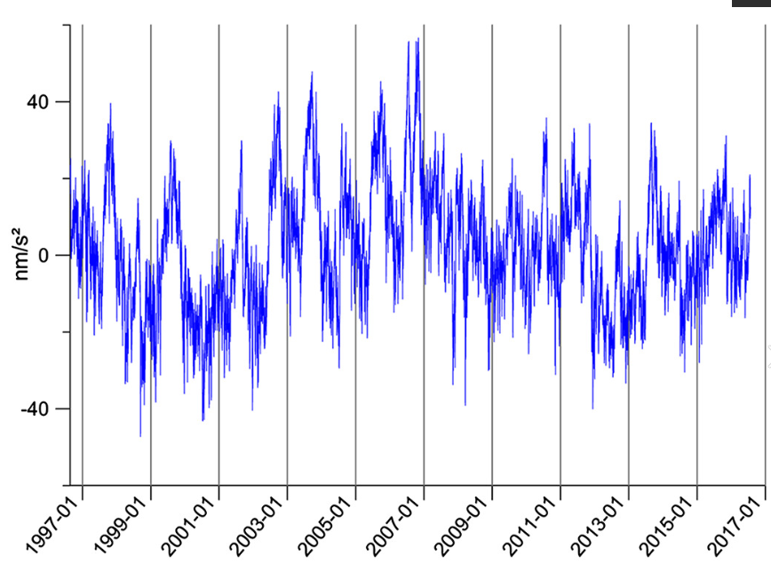
Validation: Continuous gravity observations
High temporal resolution (trade off in spatial resolution)
Capture temporal gravity at less than annual time spans
Provide information about geoid change at high temporal resolutions
Numerous instruments designed for this
Temporal gravity at a location in Belgium (from Van Camp, et al. 2017).
Annual amplitude from GRACE (CSR RL06 n_{max} = 96)
Notes:
10 nms-2 = 1 micro-Gals

Slide 26
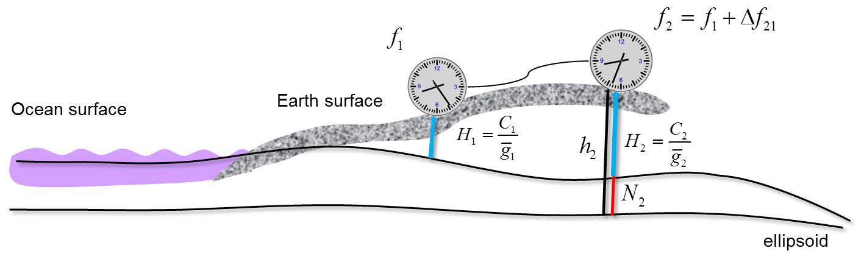
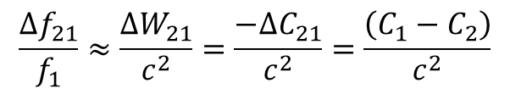
Optical Atomic
Clock Observations
Tok
Glennallen
$$\frac{{∆f}_{21}}{f_{1}}≈\frac{{∆W}_{21}}{c^{2}}=\frac{−{∆C}_{21}}{c^{2}}=\frac{\left(C_{1}−C_{2}\right)}{c^{2}}$$
Anchorage
Alaska Geoid Rate from GRACE in mm/yr. Roads shown in blue.
Optical clock network (from Müller, et al., 2018)

Slide 27
Conclusions
Currently working to finalize:
  ALPHA model xDGEOID19
  NOAA NOS NGS Technical Report 69: A preliminary investigation of the NGS’s Geoid Monitoring Service (GeMS)
  NGS Recommendations for upcoming components of GeMS
Near-term Outlook (2019 – 2022):
  Finalize modeling (GRACE/GRACE-FO only, augment with ice-mass models, or more) for official NAPGD2022 products.
  Incorporate additional geopotential components into NGS tools, websites, workflows.
  Decision on Proposed Validation Scheme(s) and begin implementation:
    Absolute gravity network collocated w/ NOAA FCORS Network and NOAA CORS Network
    GeMS-VS: Repeat surveys in areas with most significant change (e.g. Alaska)
    Continuous gravity observations in high impact locations
Extended Outlook (2022 - beyond) - TBD
  Operational Validation Schemes
  Optical atomic clock network
  Episodic events handled on case-by-case situation.
  Re-evaluation

Slide 28
Further Information
NGS Blueprint for 2022, Part 2: Geopotential Coordinates
https://geodesy.noaa.gov/PUBS_LIB/NOAA_TR_NOS_NGS_0064.pdf
Soon to be available:
NOAA Technical Report NOS NGS 69 – A preliminary investigation of the NGS’s Geoid Monitoring Service (GeMS).

Slide 29
Questions / Feedback
Kevin M. Ahlgren, PhD
kevin.ahlgren@noaa.gov
 | NGS Webinar Series | 9/12/19

Slide 30
References
Jacob, T., Wahr, J., Gross, R., Swenson, S., & Geruo, A. (2012). Estimating geoid height change in North America: past, present and future. Journal of Geodesy, 86(5), 337-358.
Luthcke, S.B., T.J. Sabaka, B.D. Loomis, et al. (2013), Antarctica, Greenland and Gulf of Alaska land ice evolution from an iterated GRACE global mascon solution. J. Glac.; 59(216), 613-631, doi:10.3189/2013JoG12J147
Müller, J., Dirkx, D., Kopeikin, S. M., Lion, G., Panet, I., Petit, G., & Visser, P. N. A. M. (2018). High performance clocks and gravity field determination. Space Science Reviews, 214(1), 5.
Save, H. and the CSR Level-2 Team, "GRACE RL06 Reprocessing and Results from CSR," EGU2018-10697, EGU General Assembly 2018.
Van Camp, M., Viron, O., Watlet, A., Meurers, B., Francis, O. & Caudron, C. ( 2017). Geophysics from terrestrial time‐variable gravity measurements. Reviews of Geophysics, 55, 938– 992. https://doi.org/10.1002/2017RG000566

