Slide 1

Evaluating Mean Ocean Dynamic Topography at NWLON Tide Gauges
Daniel Roman and Xiaopeng Li

Slide 2
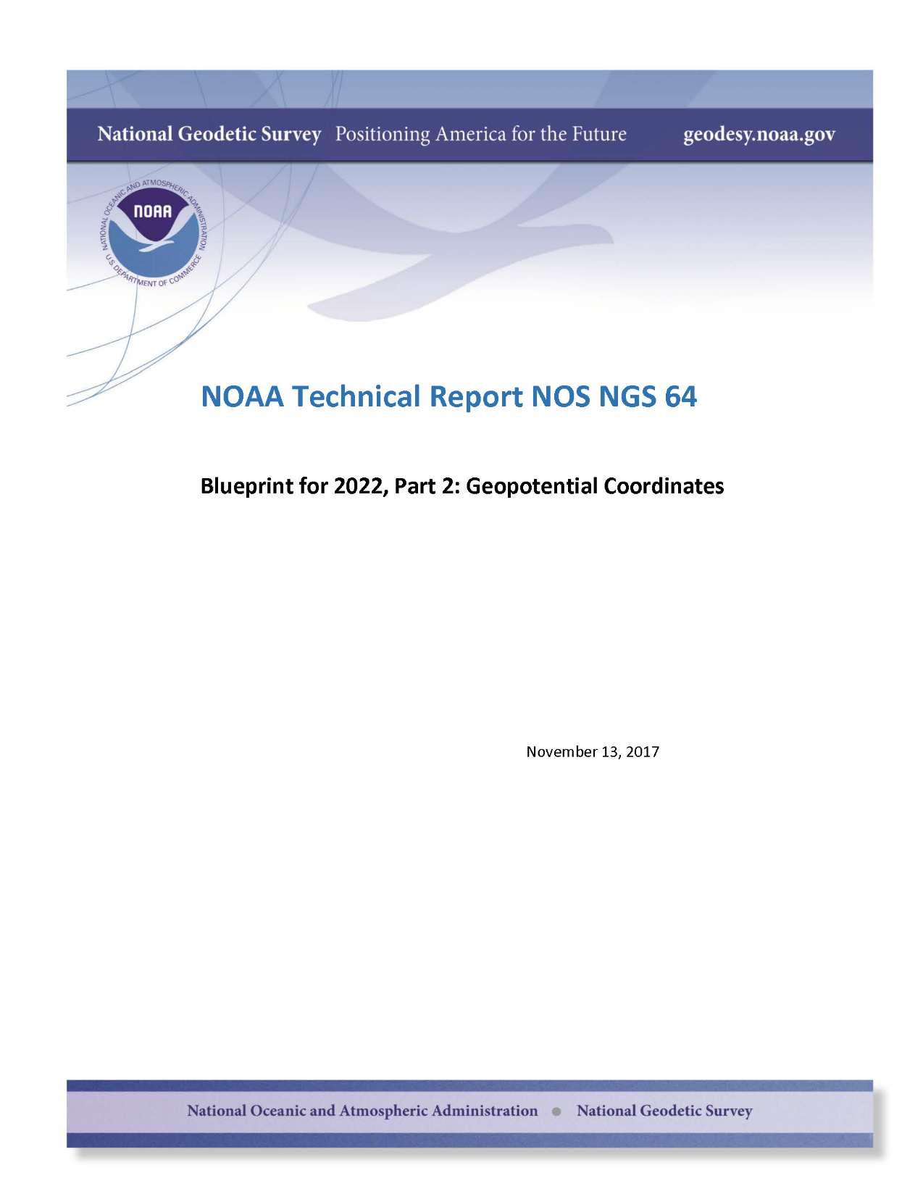

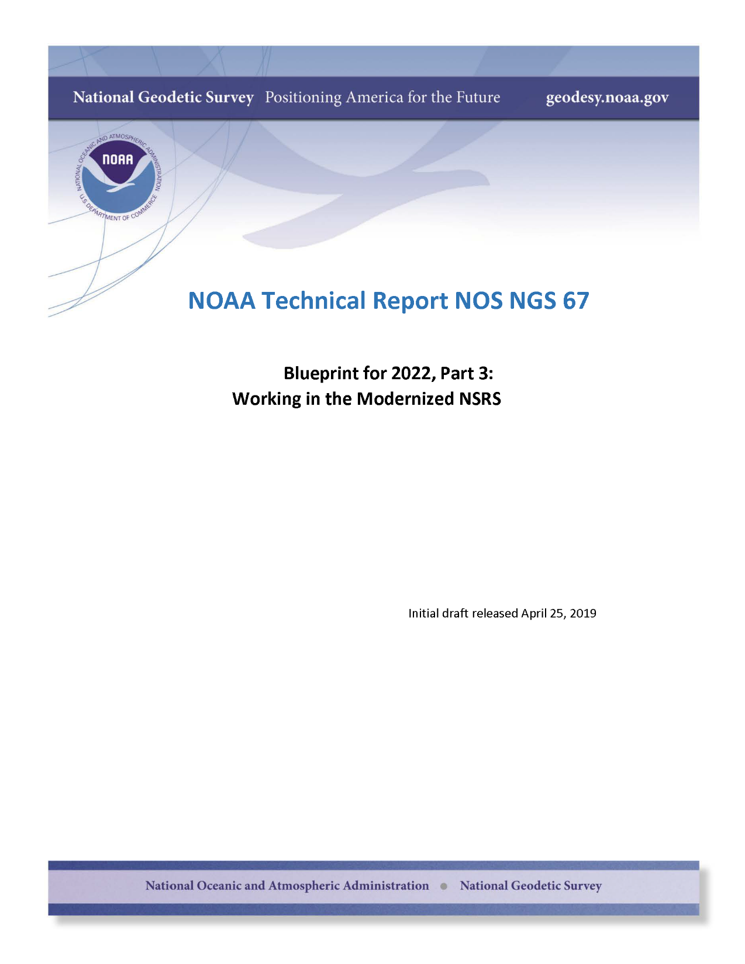
Modernizing the NSRS in 2022
Notes:
The US will be updating the NSRS in 2022 as highlighted in three blueprint documents provided on our website.
<click> This includes definition of a geopotential datum for determining vertical positions.
To that

Slide 3
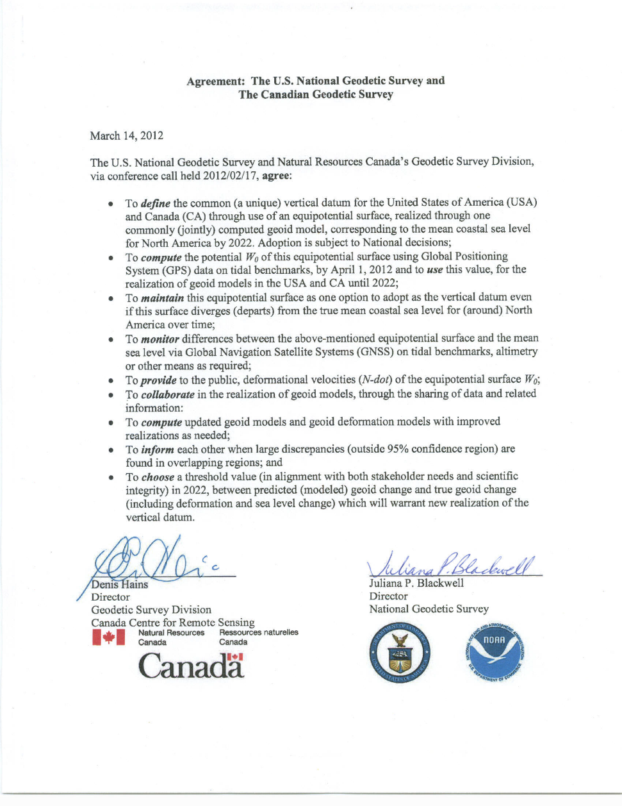
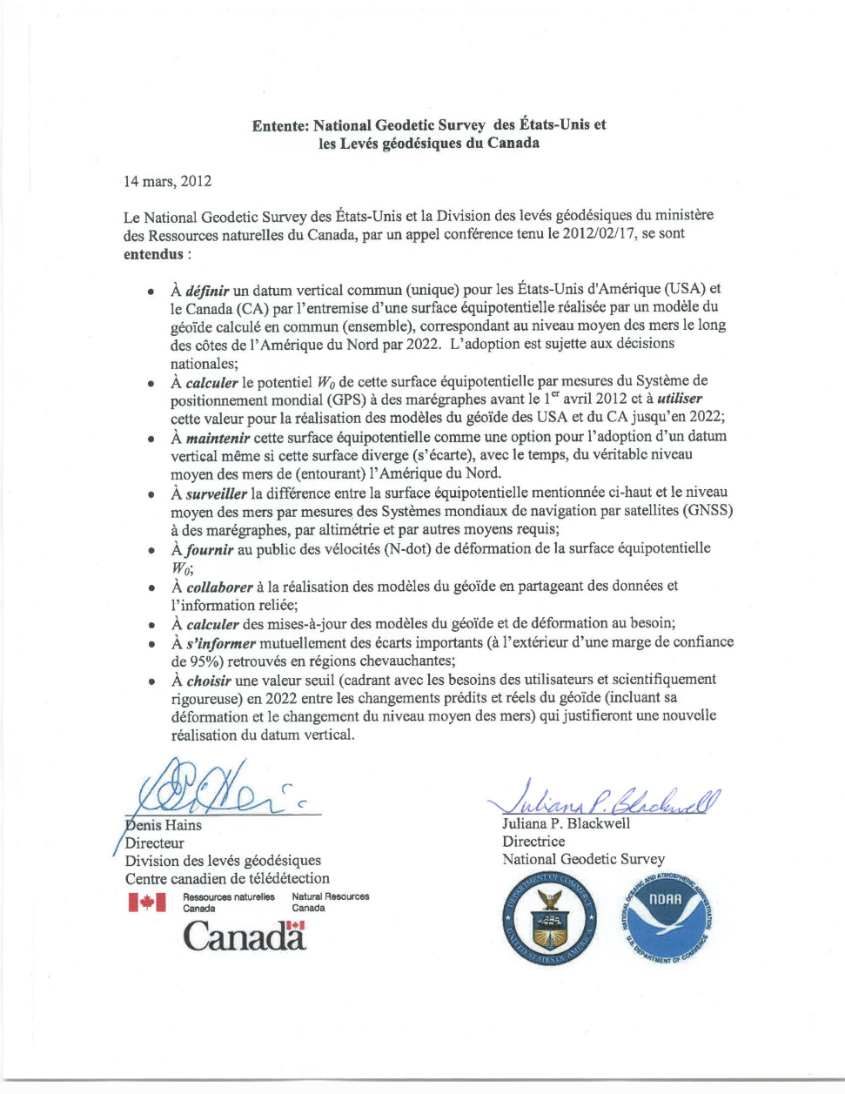
US-Canada – Agreement of Datum
W₀ = 62,636,856.00 m²/s²
Notes:
The datum we have selected will be joint with others including Canada.
Mexico and other neighboring countries have likewise expressed an interest in adopting a common datum with the US.
The intent here is to follow through with a true North American Vertical Datum.
After an analysis that I’ll cover next, the geopotential value determined for the is datum was 62,636,856.00 m2/s2
This value was determined in 2012 and is consistent with that adopted by the IERS and IAU. It is not consistent with the value later adopted by IAG.
However, the value was determined not based on any such considerations but rather from a c comparison at tide gauges throughout the US and Canada.

Slide 4
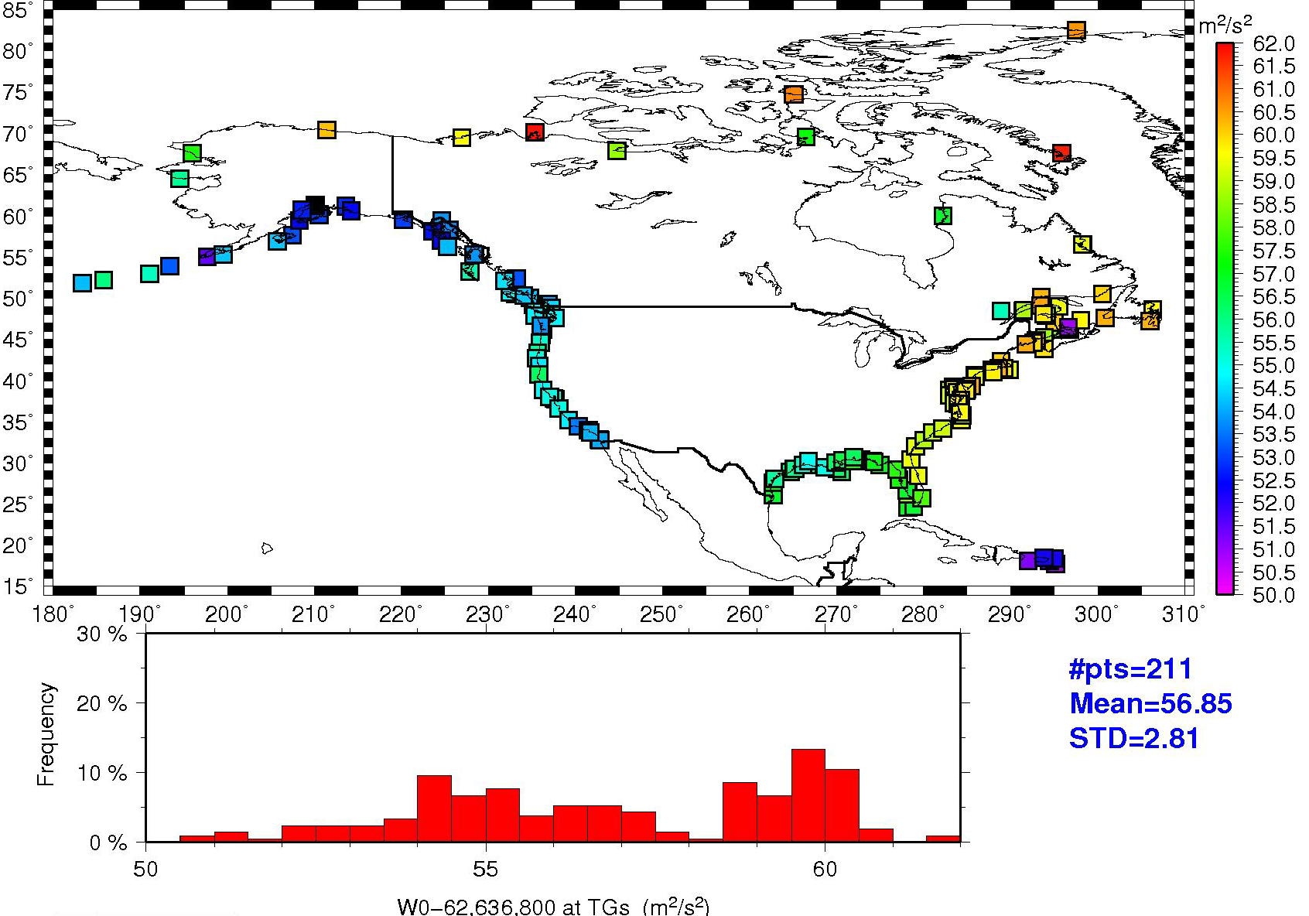
Available Tide Gauges in the US and Canada
NTDE 1983-2001
Notes:
The following few slides were taken from a 2012 FIG presentation where the determination of the W0 value was explained.
There 211 tide gauges available for comparison. However, some were newer and scattered around the Arctic.
None were then available then from Mexico, because Mexico joined this effort later on.
These values are all determined on the NTDE of 1983-2001 – so they represent the mean tide values at these locations for an older tidal epoch.
The next tidal epoch will range from 2002-2020 and should be out at about the same time as the NSRS update.
The values shown are determined from the EGM2008 model at the geometric coordinates determined by GPS occupations.
Note that there is considerable variation around the shorelines – upwards of 9 m2/s2 => roughly 90 cm.
This is not surprising given the variations in local MSL caused by P-T-S variations. Hence, these must first be taken into account.

Slide 5
SST (MODT), TBM’s and the Geoid
P,T,S ≠ constant/uniform
Geoid + SST = LMSL (as observed at tide gauge)
Local MSL
SST/MODT
Geoid = “Global” MSL surface

Slide 6
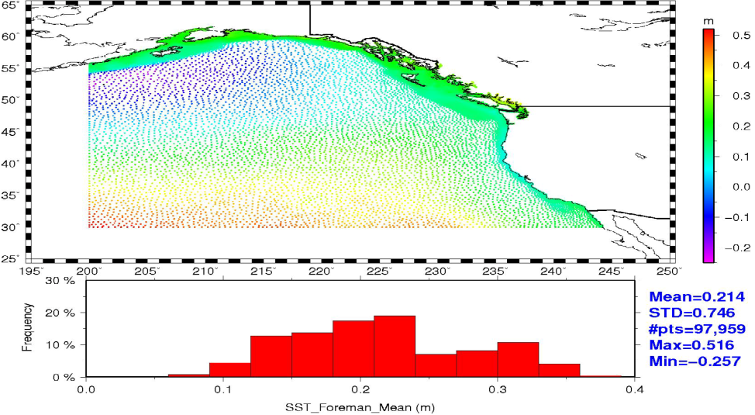
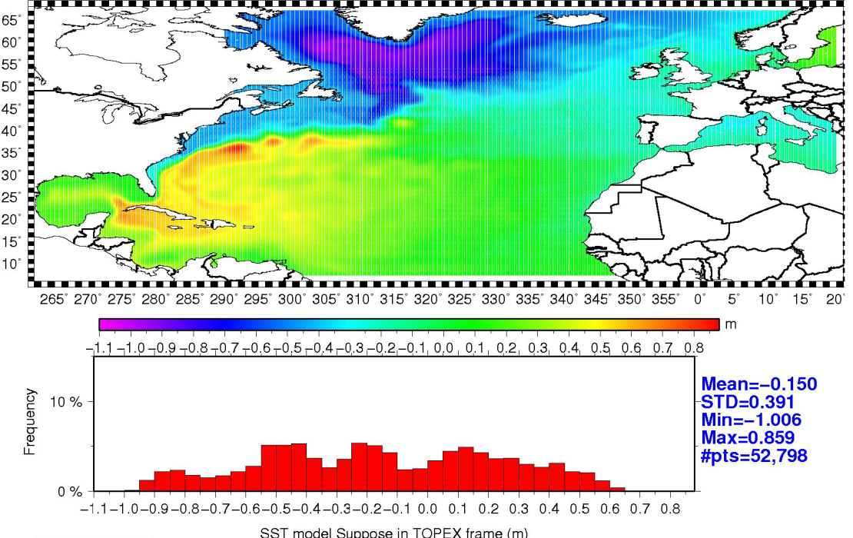
SST (MODT) Models
Foreman et al. 2004
Thompson-Demirov 2006
Notes:
Foreman, M. & Bell, Rob & Cherniawsky, Josef & Beckley, B.. (2004). Tides and sea‐level variability in the south‐west Pacific from TOPEX/Poseidon. New Zealand Journal of Marine and Freshwater Research - N Z J MAR FRESHWATER RES. 38. 649-669. 10.1080/00288330.2004.9517268.
Thompson, Keith & Demirov, E.. (2006). Skewness of sea level variability of the world's oceans. Journal of Geophysical Research. 111. 10.1029/2004JC002839.
While these two models are older, they were available in 2012 for this analysis – and quite helpful.

Slide 7
Evaluation Process
LMSL = MSL (geoid) + MODT
  LMSL: NWLON tide gauges (and Canadian equivalent)
  MSL (geoid): SHM
  MODT: Foreman and Thomson/Demirov
Remove MODT height from ellipsoid height at tide gauges
Use Lat-Lon-Height in SHM synthesis software to generate W_{i}
Average W_{i} to find best estimate of MSL from tide gauges (W₀)

Slide 8
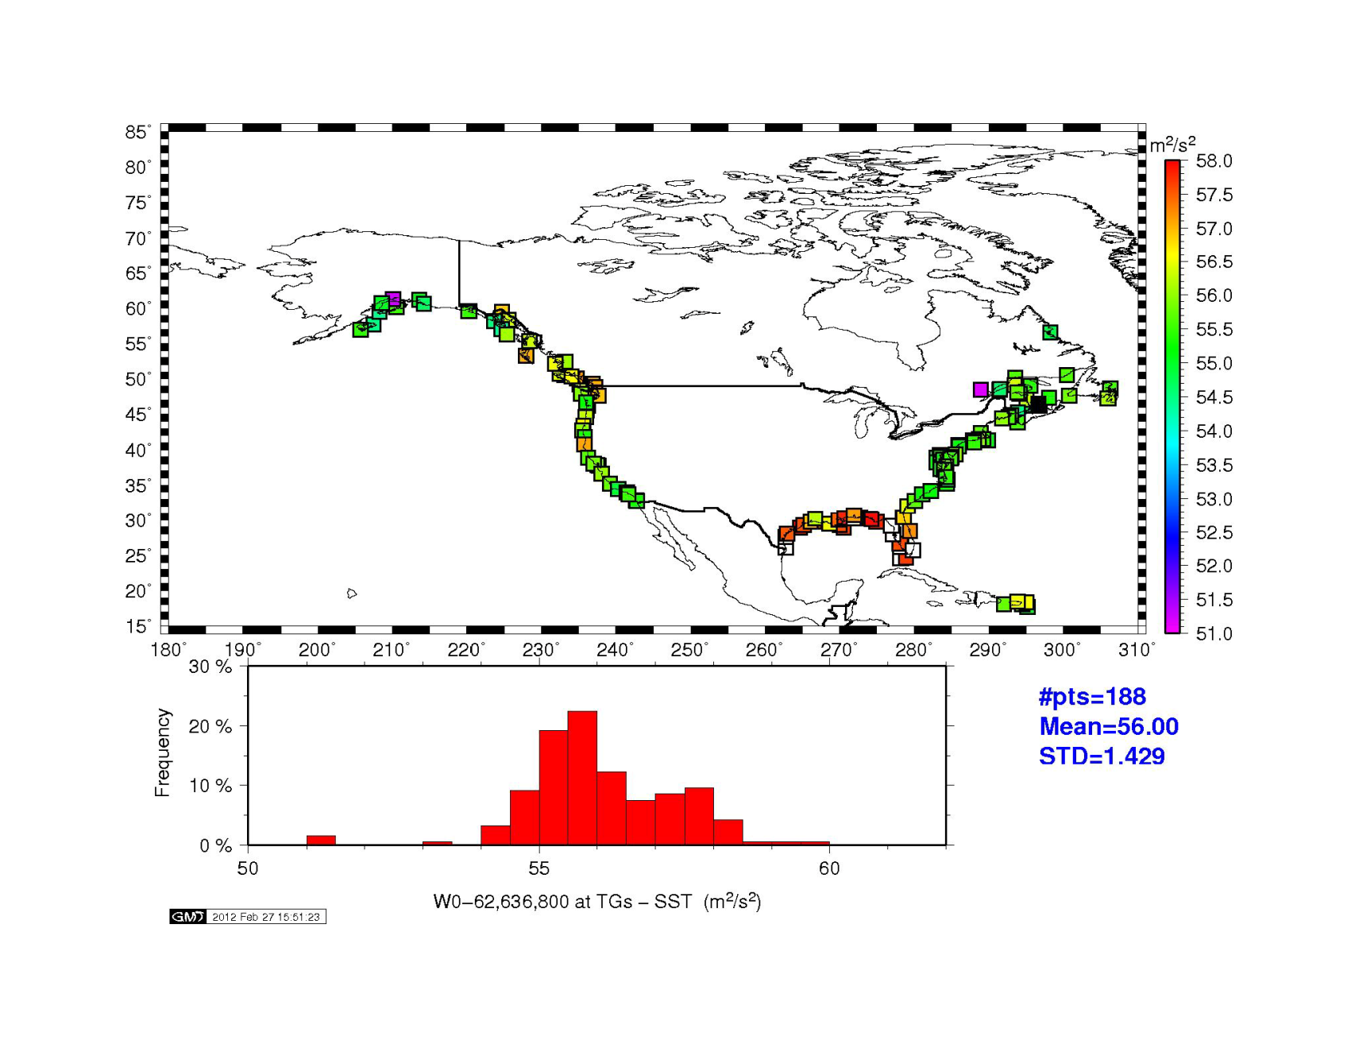
Tide Gauge comparisons w.r.t EGM2008
(limited to where SST models exist)
62,636,856.00 m²/s²
Notes:
Hence, we ended up with this value after comparisons at tide gauges using EGM2008 at five arcminutes.

Slide 9
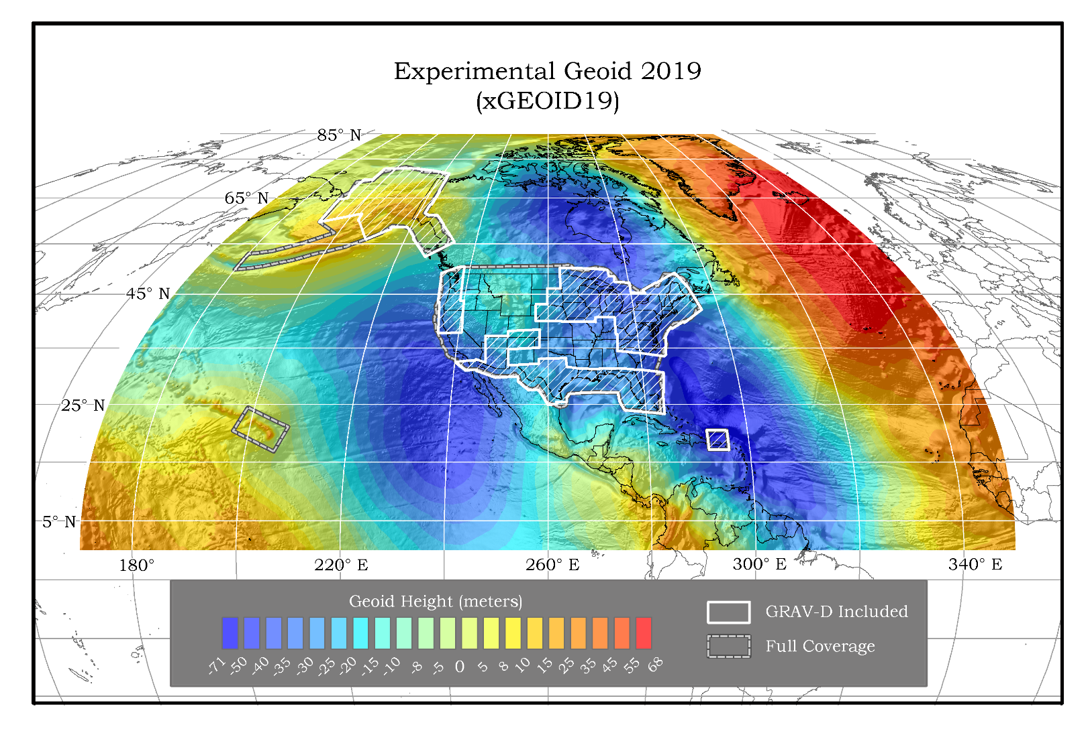
Notes:
Since then NGS has developed a series of experimental geoid models built on improved EGM’s and satellite gravity models.
xGEOID19 represents the latest such model. It was built upon five arcminute reference field models that have also been updated for more recent satellite gravity data.

Slide 10
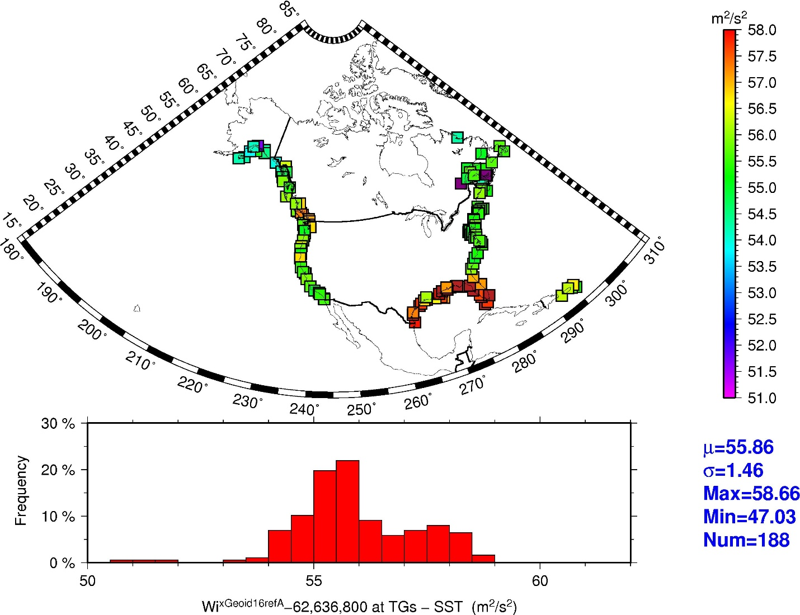
Geopotential numbers based on xGEOID16A_Ref
Mean = 55.86
Notes:
xGEOID16A_Ref is the last model developed without any airborne gravity data in it. It is produced to exemplify the models built with airborne gravity.
Note that there has been a slight drop in the mean value (56.00 => 55.86). Variability stays about the same with the Gulf Coast have a systematic difference as before.

Slide 11
Geopotential numbers based on xGEOID19B_Ref
Mean = 55.86
Notes:
xGEOID19B_Ref is the latest model using airborne gravity data. Statiustically this almost the same as xGEOID16A_Ref

Slide 12
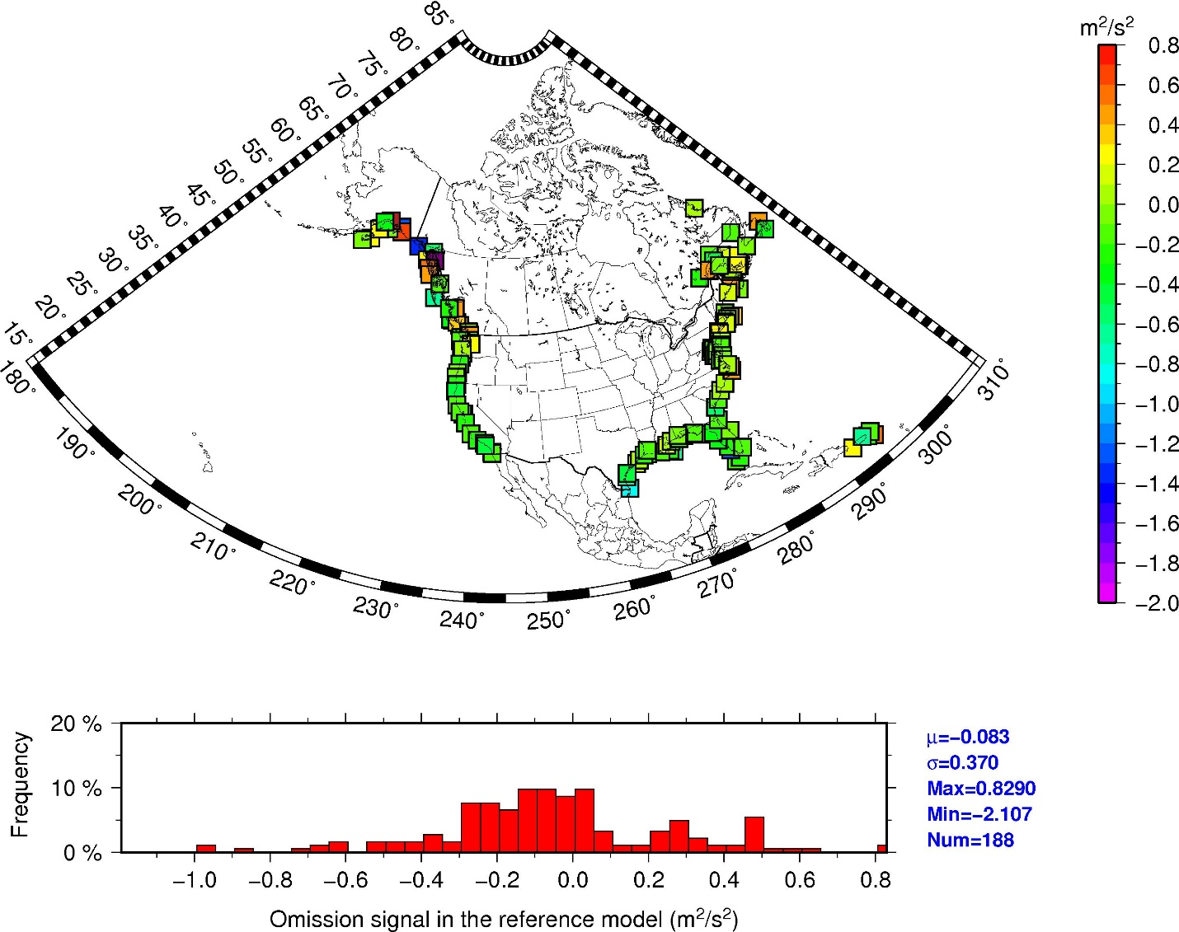
Geopotential numbers calculated from residual geoid heights
Mean = 0.083
Notes:
Finally, the impact of omission of the 1’ to 5’ signal is examined. Following procedures developed for the Great Lakes, residual geoid heights are formed by subtracting xGEOID19B_Ref values from the regional xGEOID19B model. These values are manipulated to generate residual geopotential numbers shown here.
Since these represent the addative signal of the omitted signal, the mean value shown here should be added to that in the previous plots to provide a more complete geopotential estimate.
In fact that would then make the mean value again close to the value currently adopted.

Slide 13
Summary
NA W₀ determination process in 2012 based on EGM2008 (5’)
Re-evaluated process for xGEOID16A_Ref and xGEOID19B_Ref
  Updates for satellite data (A&B models) & aerogravity (B model only)
  Still only looking at 5’ SHM to easily determine geopotential W_{i}
SST(MODT) determined from same models as before
  Foreman et al. 2004 and Thmpson-Demirov 2006
Slight change in mean value – down about 1.5 cm – for both
However, 62,636,856.00 m2/s2 still best fits most tide gauges

Slide 14
Future Work
Will revaluate after next NTDE updates LMSL at tide gauges
  Current NTDE 1983-2001
  Next NTDE 2002-2020 likely out in 2023
  Impacts comparison points
Will look for updated MODT models
  Especially for Gulf of Mexico an Caribbean
  Likewise needs to reflect MODT for 2002-2020 timeframe
  Impacts change from LMSL to global MSL

